Slide 1
Some aspects of simulation of complex many-body systems on quantum computers
Nuclear Physics Team - Theory Pole
Supervisor: Denis Lacroix
2nd year PhD
Edgar Andres Ruiz Guzman
31 May 2022

Slide 2
1. Introduction

Slide 3
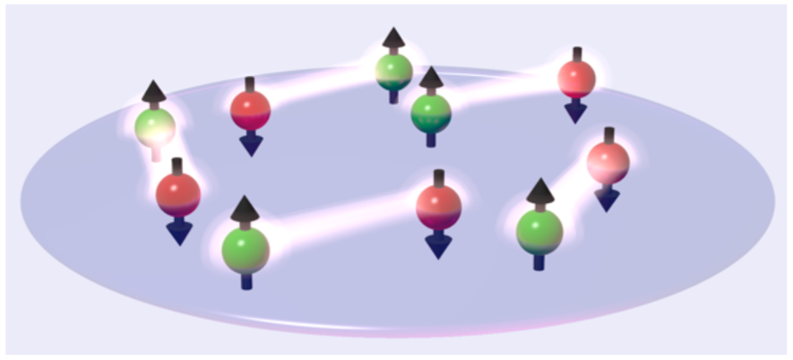
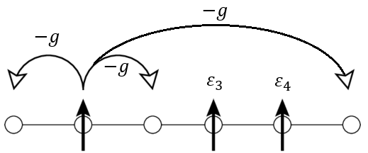
What does a many-body problem look like?
Many-body problem → Many quantum particles in interaction.
Pairing model:
https://www.uni-heidelberg.de/presse/news2016/pm20160128_what-are-the-special-properties-of-an-atomic-gas.html
$${\hat{H}}_{p}=\sum_{i}{ε_{i}}{\hat{a}}_{i}^{†}{\hat{a}}_{i}−g\sum_{i,j}{{\hat{a}}_{i}^{†}{\hat{a}}_{j}}$$

Slide 4
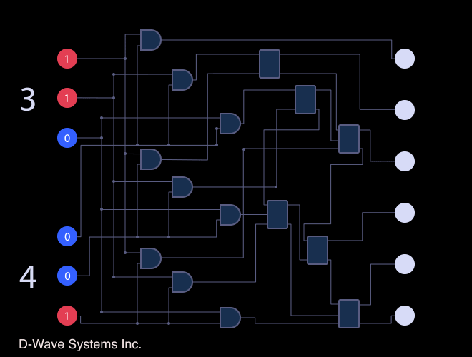
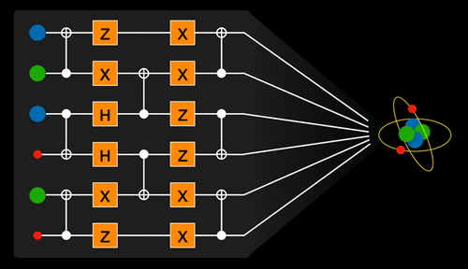
Why solve many-body problems with quantum computers?
Resources for the description of
the configuration space $\left(2^{n_{qubits}}\right)$:
Classical computer → exponential scaling.
Quantum computer → polynomial scaling.
Various quantum algorithms that have up to an exponential speed-up over their classical counterparts.
Dynamical quantum computing ecosystem with real devices available for the public (e.g., IBM experience).
https://www.engadget.com/2018-10-04-d-wave-takes-quantum-computers-mainstream-with-leap.html
https://pubs.acs.org/doi/10.1021/acs.chemrev.8b00803

Slide 5
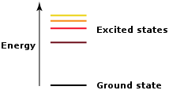
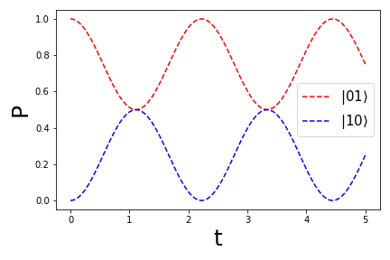
Problematics
Create ansatzes that can reproduce the eigenstates of a Hamiltonian.
Ansatz: Circuit that creates a variational quantum state $|Ψ\left(\left\{θ\right\}\right)⟩$ in a quantum register.
Find the spectrum of a many-body Hamiltonian.
Obtain the quantum state evolution/dynamics.
Notes:
Applications made on schematic Pairing or Hubbard Hamiltonian.
Hamiltonians encoded on qubits using the Jordan-Wigner transformation.
$$e^{−itH}\left|ψ_{0}\right\rangle →$$

Slide 6
2. Ansatzes

Slide 7
Bardeen–Cooper–Schrieffer(BCS) ansatz
BCS theory $→$first microscopic theory of superconductivity.
Equation:
$\left|BCS\left(\{θ_{p}\}\right) \right\rangle =⨂_{p=0}^{N−1}{\left[sin\left(θ_{p}\right){\left|0\right\rangle }_{p}+cos\left(θ_{p}\right){\left|1\right\rangle }_{p}\right]}=\prod_{p=0}^{N−1}{R_{Y}\left({π−2θ}_{p}\right){\left|0\right\rangle }_{p}}$
Superposition of states with different number of pairs.
Circuit:

Slide 8
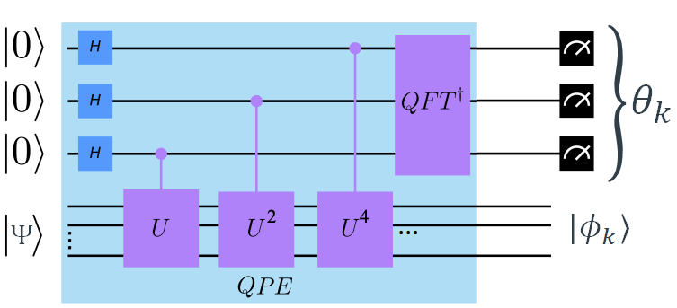
Projection on a fixed number of particles
Quantum Phase Estimation (QPE) → eigenvalues $\left\{θ_{k}\right\}$ and eigenstates $\{φ_{k}\}$:
$M\vec{x}=λ\vec{x}$
$M→U, λ→e^{2πiθ_{k}}, \vec{x}→|φ_{k}⟩$
$U\left|φ_{k}\right\rangle =e^{2πiθ_{k}}\left|φ_{k}\right\rangle$
Projection:
$$\left|Ψ\left(n_{1}, n_{2},…\right)\right\rangle →QPE\left(\hat{N}\right)→n_{k},|Ψ\left(n_{k}\right)⟩$$
fd
https://www.swissquantumhub.com/quantum-supremacy-quantum-hybrid-hhl-algorithm-for-solving-a-system-of-linear-equation/

Slide 9
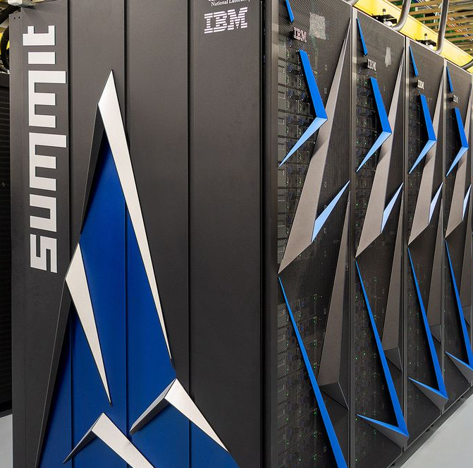
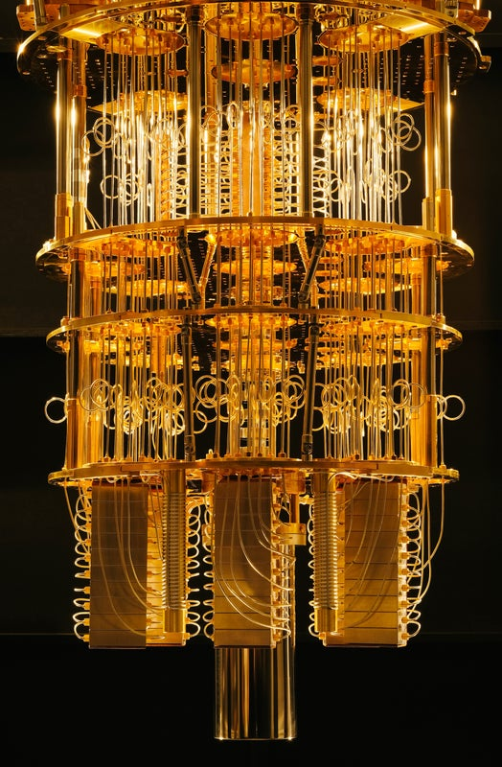
Variational Quantum Eigensolver (VQE)
Hamiltonian decomposition $→H=H_{1}+H_{2}+…$.
VQE:
$$\{θ\}$$
$$|Ψ\left(\left\{θ\right\}\right)⟩$$
$$\left\{∇θ\right\}$$
$$\left\langle Ψ|H_{1}|Ψ\right\rangle$$
$$\left\langle Ψ|H_{2}|Ψ\right\rangle$$
$…$
$$\left\langle H\right\rangle =\left\langle H_{1}\right\rangle +\left\langle H_{2}\right\rangle +…$$
https://www.theverge.com/circuitbreaker/2018/6/12/17453918/ibm-summit-worlds-fastest-supercomputer-america-department-of-energy
https://pulsenews.co.kr/view.php?year=2019&no=321975

Slide 10
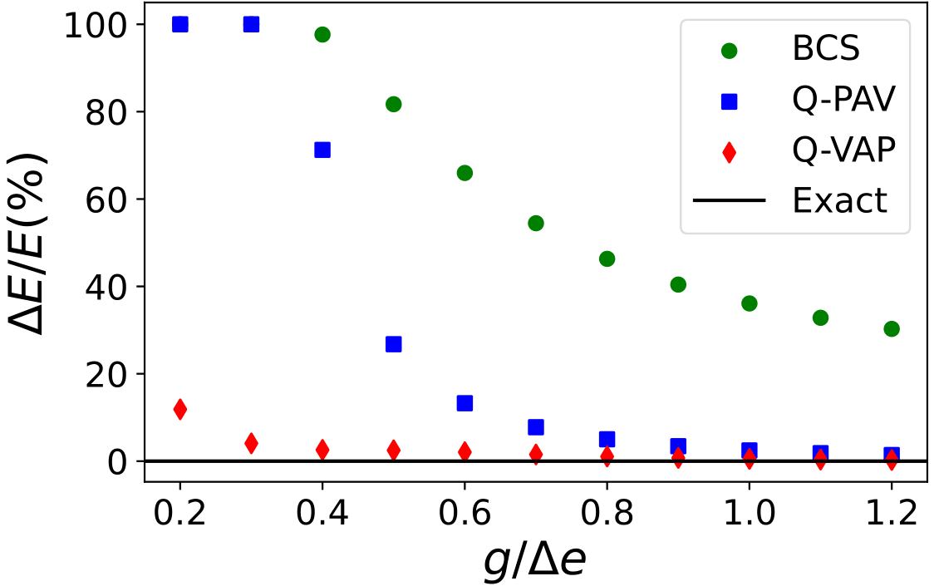
Quantum-Projection After Variation (Q-PAV) and Quantum-Variation After Projection (Q-VAP)
fd
Q-PAV:
$\left|Ψ\left(n_{1},n_{2},…\right)\left\{θ\right\}\right\rangle \underset{→}{VQE}min\left(\left\langle Ψ\left|H\right|Ψ\right\rangle \right)\underset{→}{QPE(\hat{N})}n_{k},|Ψ\left(n_{k}\right)⟩$
Q-VAP:
$\left|Ψ\left(n_{1},n_{2},…\right)\left\{θ\right\}\right\rangle \underset{→}{QPE(\hat{N})}n_{k},|Ψ\left(n_{k}\right)⟩\underset{→}{VQE}min\left(\left\langle Ψ\left(n_{k}\right)\left|H\right|Ψ\left(n_{k}\right)\right\rangle \right)$
8 levels, 4 particles.
$ΔE/E\left(\%\right)→$ Percentage distance
to the ground state.

Slide 11
3. Post-processing

Slide 12
Quantum Phase Estimation(QPE) for Hamiltonians Hamiltonian Phase Estimation
$$\left.\begin{matrix}H\left|φ_{k}\right\rangle =E_{k}|φ_{k}⟩ \\ \left|Ψ\right\rangle =\sum_{k}{c_{k}}|φ_{k}⟩ \end{matrix}\right\}→ QPE\left(H,|Ψ⟩\right)→\left\{{\left|c_{k}\right|}^{2},E_{k}\right\}$$
E.g. 8 levels,
4 particles
https://www.swissquantumhub.com/quantum-supremacy-quantum-hybrid-hhl-algorithm-for-solving-a-system-of-linear-equation/
4 ancilla
6 ancilla
8 ancilla

Slide 13
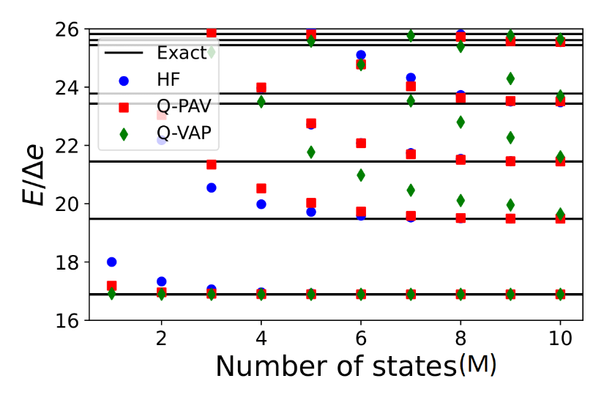
Quantum Krylov
Change of basis → Krylov basis of size M:
$$\left\{Φ_{j}\right\}=\left\{\left|Ψ\right\rangle \right.,e^{−iτ_{1}H}\left|Ψ\right\rangle ,…, \left.e^{−iτ_{M−1}H}\left|Ψ\right\rangle \right\}$$
Hadamard Test → $\left\langle Φ_{i}\left|H\right|Φ_{j}\right\rangle =⟨Ψ|He^{−i\left(τ_{j}−τ_{i}\right)H}|Ψ⟩$
Diagonalization of $⟨Φ_{i}\left|H\right|Φ_{j}⟩$ → Approximated $E_{k}$
E.g. 8 levels, 4 particles. $τ_{p}=p∗0.3$

Slide 14
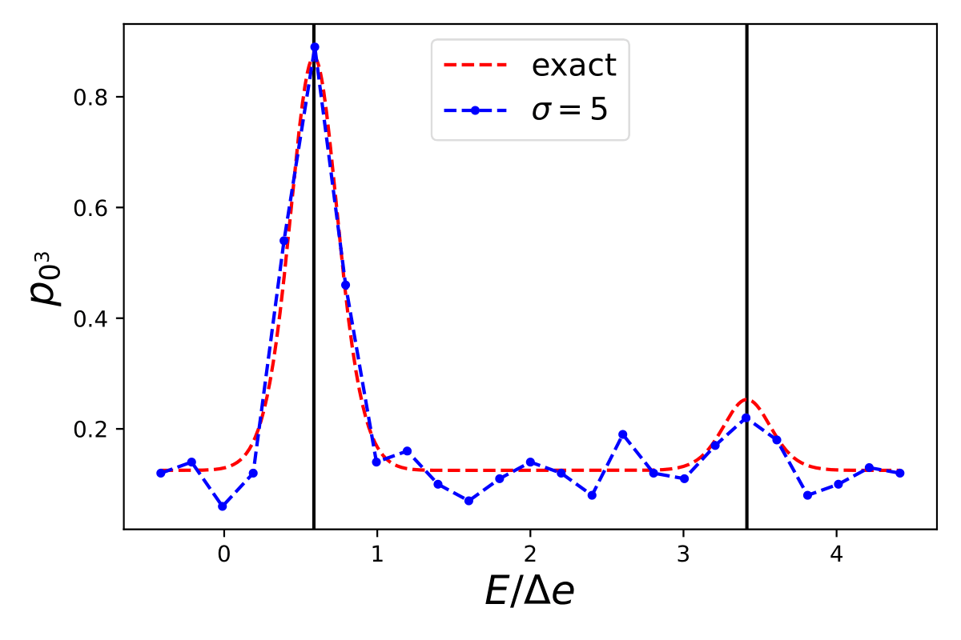
Rodeo algorithm
$τ$ → Random Gaussian distribution with standard deviation $σ$.
$p_{0^{N}}$ has Gaussian distributions around eigenvalues $E_{k}$
$$p_{0^{N}}\left(λ\right)=\sum_{k}{{\left|c_{k}\right|}^{2}}{\left[\frac{1+e^{−{\left(E_{k}−λ\right)}^{2}σ^{2}/2}}{2}\right]}^{N}$$

Slide 15
Conclusions
We have implemented the Quantum Projection After Variation (Q-PAV) method and the Quantum Variation After Projection (Q-VAP) method. Both processes can be applied to any ansatz.
Several post-processing methods have been explored to recover approximations of the ground and excited states energies of a Hamiltonian.
Information about the initial state $|ψ⟩$ can be retrieved in some of the post-processing methods (QPE, Rodeo). An approximation of its evolution can also be obtained (Quantum Krylov).

Slide 16
Questions ?

Slide 17
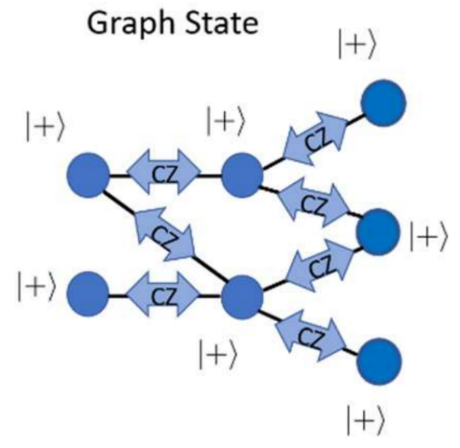
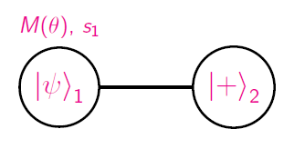
Measurement-Based Quantum Computing(MBQC)
Graph states -> Entangled qubits in the state $\left|+\right\rangle =\frac{1}{\sqrt{2}}\left(\left|0\right\rangle +|1⟩\right)$:
Gates -> Measurement over qubits on a rotated basis $\left\{\left|+_{θ}\right\rangle ,|−_{θ}⟩\right\}$:
${\left(X_{2}\right)}^{s_{1}}HP\left(−θ\right){\left|ψ\right\rangle }_{2}$

