Slide 1
Off-shell Higgs into 4 leptons & electron tracking in ATLAS
Arnaud Maury
PhD supervised by David Rousseau
Séminaire du CAT des doctorants de 2ème année - 2022
Laboratoire des 2 Infinis Irène Joliot-Curie Orsay

Slide 2
Off-shell Higgs into 4 leptons
EFT Monte-Carlo generation of off-shell Higgs:
Higgs: a bit of history
H4l: the golden channel
Off-shell Higgs
What is SMEFT?
Basics of Monte-Carlo generation for HEP
Validation plots
Simulation-based inference (with ML)

Slide 3
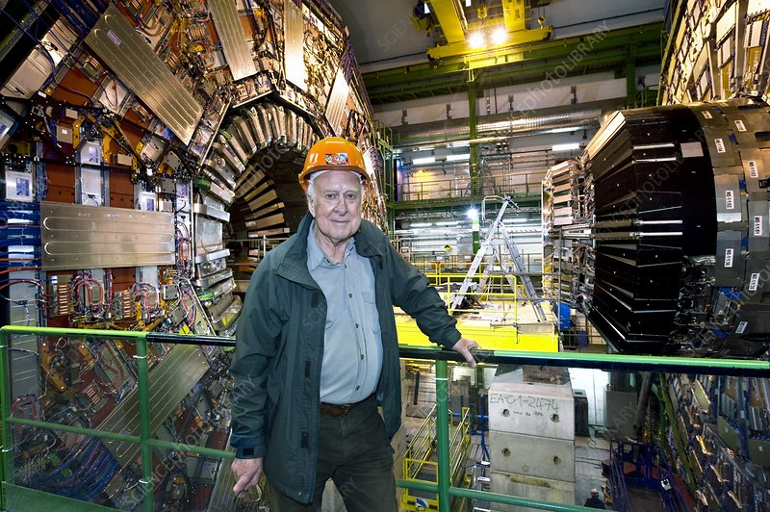
Higgs: a bit of history
Discovered at CERN in 2012!

Slide 4
H4l decay mode
H -> ZZ* -> l⁺l⁻ l⁺l⁻ (/!\ : l = e or μ)
Called the “golden channel”
yields a very clean signal
is one of the Higgs decay modes with the best resolution
Downside: low number of events
BR(H -> ZZ) = 2.6% (in comparison, BR(H -> bb) = 58%, BR(H -> W⁺W⁻) = 21%)
BR(Z -> l⁺l⁻ ) = 6.7%
(at m_{H} = 125 GeV)

Slide 5
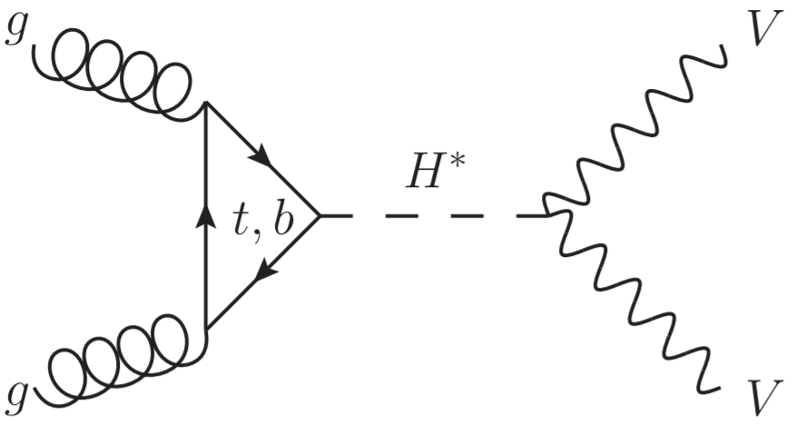
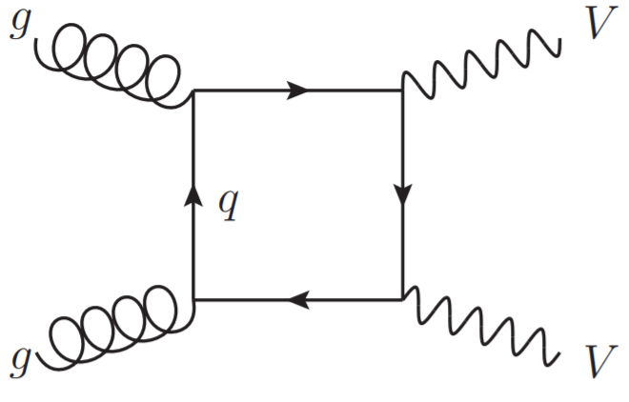
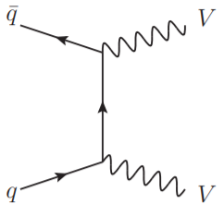
Interference and background(s)
Gluon-gluon fusion (ggF)
Signal S :
Background B:
+
Total signal SBI (negative interference)
+
Background qqZZ:

Slide 6
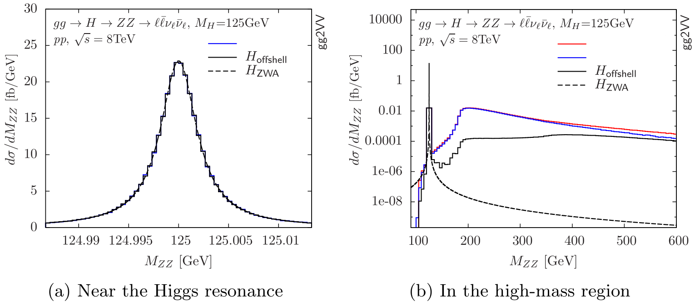
Off-shell Higgs
High-Mass (HM) region: m_{4l} > 220 GeV
Off-shell Higgs production is not negligible (kinematics: on-shell ZZ at 180 GeV, tt threshold at ~350 GeV).
But still, m_{H} = 125 GeV while Γ_{H} = 4.1 MeV…
Zero-Width Approximation works well around 125 GeV, but not in the High-Mass region
SBI
S + B
SBI
negative interference
on-shell ZZ
tt threshold
Inadequacy of zero-width approximation for a light Higgs boson signal, N. Kauer, G. Passarino, arXiv:1206.4803 [hep-ph]

Slide 7
SMEFT: an Effective Field Theory for the SM
L_SMEFT = L_SM + L_5 + L_6 + L_7 + L_8 + …
c_{i} : Wilson coefficients O_{i} : Wilson operators
We treat the SM as an effective theory.
We only consider dimension-6 operators.
Considered operators :
O_pg, O_pt, O_tp

Slide 8
Monte-Carlo generation 101
Parton level process (hard scattering) : MadGraph
Parton shower (Pythia)

Slide 9
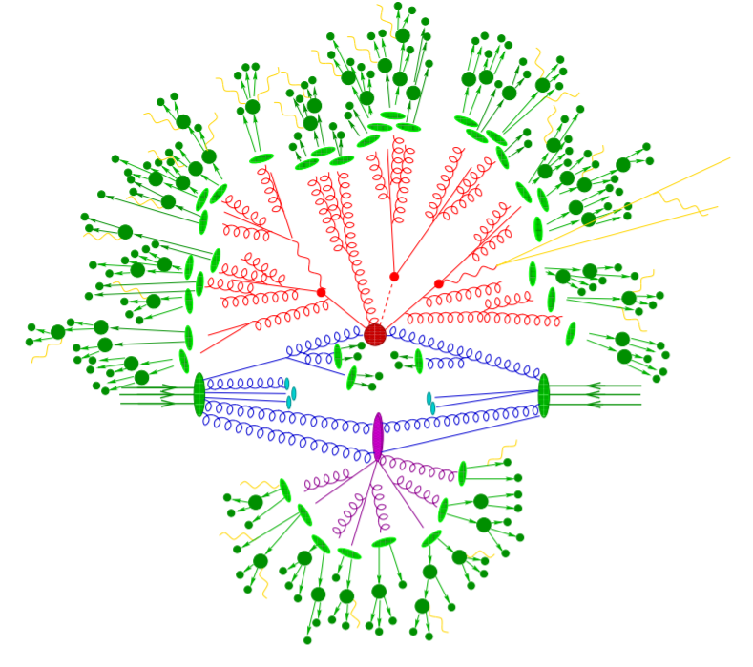
Monte-Carlo generation 101
Introduction to parton-shower event generators, Stefan Höche, arXiv:1411.4085 [hep-ph]

Slide 10
Validation plots
The main goal: compare two versions of the « SMEFTatNLO » model (v0.1 vs v1.0).
Two versions of MadGraph were finally used: MGv2.7.3 and MGv2.9.3
Plots for these observables: |cos θ*|, |y_{4l}|, cos(θ₁), cos(θ₂), m_{4l}, p_{T}(4l), Φ
Relevant EFT operators: Opt, Otp, OpG
Notes:
|cos θ*| seems to be the most interesting and practical observable to compare runs, as it keeps a sufficient cross-section in each bin (e.g. this is not the case for m_{4l}), while having different-looking profiles for each operators.

Slide 11
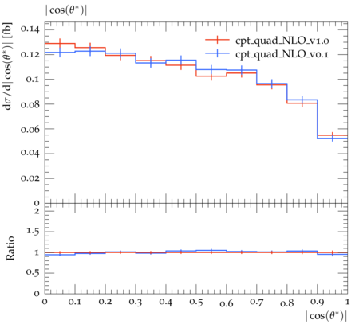
SMEFTatNLO v1.0 vs v0.1
Same observable
With MadGraph v2.9.3 (release 21.6.71)
Observable: |cos θ*| Operator: cpt Quadratic contribution
Notes:
_un opérateur, tous les variables
_une variable, tous les opérateurs

Slide 12
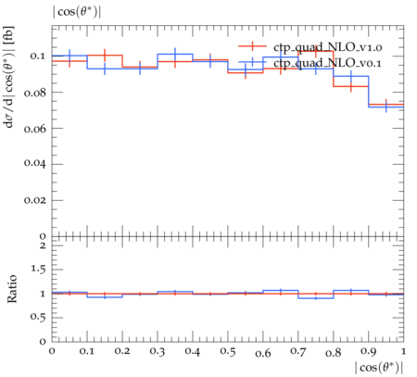
SMEFTatNLO v1.0 vs v0.1
Same observable
With MadGraph v2.9.3 (release 21.6.71)
Observable: |cos θ*| Operator: ctp Quadratic contribution
Notes:
_un opérateur, tous les variables
_une variable, tous les opérateurs

Slide 13
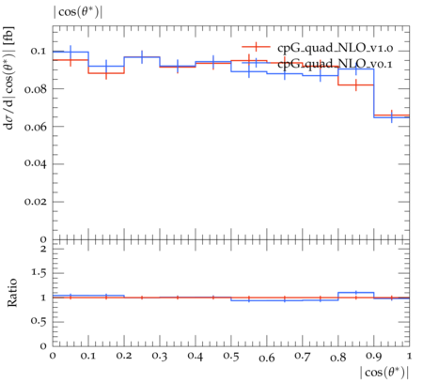
SMEFTatNLO v1.0 vs v0.1
Same observable
With MadGraph v2.9.3 (release 21.6.71)
Observable: |cos θ*| Operator: cpG Quadratic contribution
Notes:
_un opérateur, tous les variables
_une variable, tous les opérateurs

Slide 14
What we are trying to achieve:
Simulation-based inference
Theory parameters:
Signal strength μ
Couplings of the Higgs with other particles
EFTs: Wilson coefficients
…
Physical observables:
Fireworks

Slide 15
What we are trying to achieve:
Simulation-based inference
Theory parameters:
Signal strength μ
Couplings of the Higgs with other particles
EFTs: Wilson coefficients
…
Physical observables:
Fireworks
Mass, energy, trajectories of particles (interaction with the detector)

Slide 16
What we are trying to achieve:
Simulation-based inference
Theory parameters:
Signal strength μ
Couplings of the Higgs with other particles
EFTs: Wilson coefficients
…
Simulation
Physical observables:
Fireworks
Mass, energy, trajectories of particles (interaction with the detector)

Slide 17
What we are trying to achieve:
Simulation-based inference
Theory parameters:
Signal strength μ
Couplings of the Higgs with other particles
EFTs: Wilson coefficients
…
Simulation
Physical observables:
Fireworks
Mass, energy, trajectories of particles (interaction with the detector)
Likelihood

Slide 18
Simulation-based inference
Intractable problem (like in thermodynamics, epidemiology, meteorology, etc)
Here, the likelihood function is not tractable, because of the high dimension of the problem (dimensionality curse), non-analytical processes (e.g. parton shower), incomplete computation (only upto NLO diagrams), experimental effects…
Main idea: train DNNs to estimate several probability ratios
Notes:
Dimensionality curse: coined by Richard Bellman

Slide 19
Mixture Model (1/2)
“Mixture model” idea: train 3 different DNNs to estimate 3 probability ratios:
SBI vs S: $\frac{p(x|SBI)}{p(x|S)}$
B vs S: $\frac{p(x|B)}{p(x|S)}$
qqZZ vs S: $\frac{p(x|qqZZ)}{p(x|S)}$ .
Reminder: There are 4 processes studied here: S, B, SBI and qqZZ.

Slide 20
Mixture Model (2/2)
“Mixture model” idea: re-express the likelihood ratio into those 3 probability ratios.
3 ratios: $\frac{p(x|SBI)}{p(x|S)}$, $\frac{p(x|B)}{p(x|S)}$ and $\frac{p(x|qqZZ)}{p(x|S)}$ .

Slide 21
Simulation-based inference applied to off-shell H4l to find 1 parameter (signal strength θ): work by Jay Sandesara
3 ratios: $\frac{p(x|SBI)}{p(x|S)}$, $\frac{p(x|B)}{p(x|S)}$ and $\frac{p(x|qqZZ)}{p(x|S)}$ .
$\frac{p(x|θ)}{p(x|1)}$ is our main goal: the likelihood ratio for the parameter strength. This is what we can and will use to analyse experimental data
(one day).

Slide 22
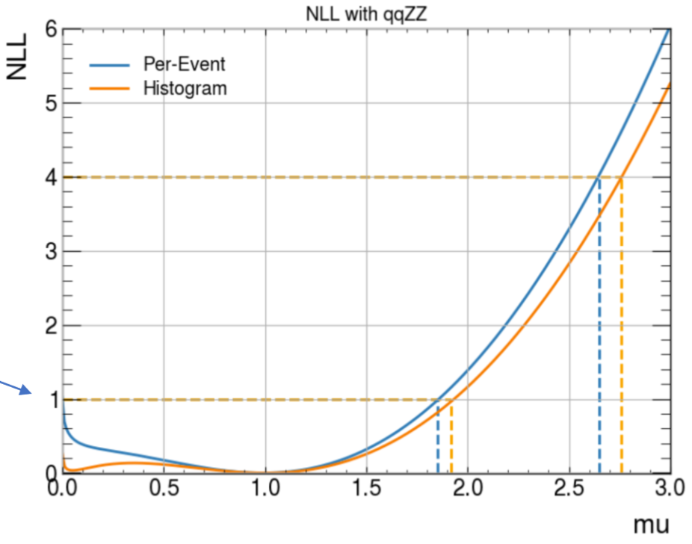
Comparison between “conventional” histogram method and this NN/statistics method:
Work by Jay Sandesara

Slide 23
Comparison between “conventional” histogram method and this NN/statistics method:
Need to take into account systematics
NN training: the problem of negative weights
This method still is not very stable: either too much bias or too much variance…
WORK IN PROGRESS
Work by Jay Sandesara

Slide 24
Electron tracking in ATLAS (ITk)
ITk, a new all-silicon tracker for ATLAS:
Tracking: what is a track?
How to find tracks
The problem of electrons (spoiler alert, it’s because of bremsstrahlung)
The ACTS software
Adaptation to ITK and integration to Athena
Integration of a new track fitting algorithm (GSF)
Pull plots, a useful diagnostic tool

Slide 25
The ACTS software
A Common Tracking Software
Originates from the indigenous tracking software developed at ATLAS.
Was then restarted from scratch as an experiment-independent software
The project now:
integrate to ACTS a new track fitting algorithm (GSF);
integrate it back to ATLAS (for ITk);
Validation: Physics must be accurate, execution should be efficient.

Slide 26
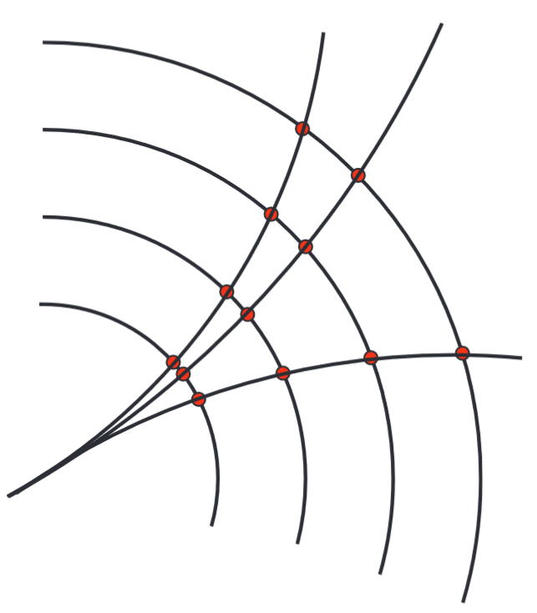
What is a track?
Trajectory of the particle: a track
We can only measure points, at the intersection of the track and the detectors !
Detector layer
Figure from Andreas Salzburger (Track and Vertex Reconstruction - HCPSS Aug 11-22, 2014)

Slide 27
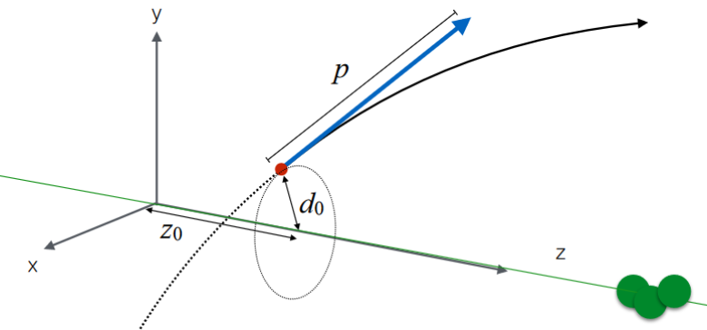
What is a track?
Each track is (uniquely) defined by 5 parameters:
d0
z0
θ : angle with the beam axis
φ : angle in the normal plan of the beam axis
q/p : electric charge over momentum
Figure from Andreas Salzburger (Track and Vertex Reconstruction - HCPSS Aug 11-22, 2014)

Slide 28
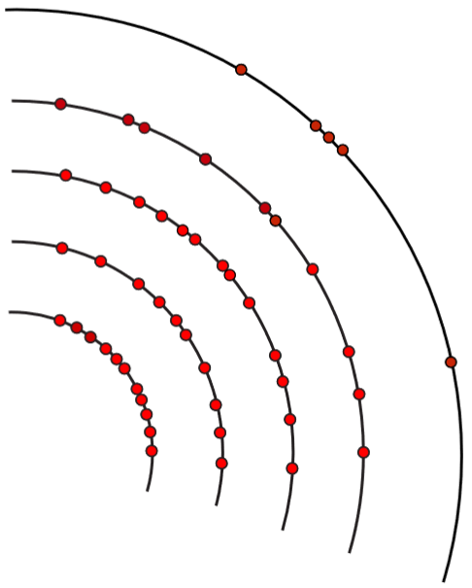
How to find tracks
From those points, we must find a track. But this is not always trivial…
Basic idea:
Find a seed (a crude first guess)
Refine this “idea” by propagation (B field map, magnetic force, Runge-Kutta…)
Fitting: do a chi-square minimization
Current default method: Combinatorial Kalman Filter (CKF)
Figure from Andreas Salzburger (Track and Vertex Reconstruction - HCPSS Aug 11-22, 2014)

Slide 29
The problem of (low energy) electrons
At “low” energies (in the order of 5 to 10 GeV), electrons radiate and lose a lot of energy by bremsstrahlung.
Reminder: the curvature is inversely proportional to the momentum.
Consequence: the trajectory gets more curved than expected.
Solution: use a fitting algorithm that can take this phenomenon into account and better fit electron tracks: Gaussian Sum Filtering (GSF)
Notes:
And this will need to be tested, validated and benchmarked.

Slide 30
Pull plots
Pull defined as: (true_value – fitted_value) / error_value
For each track, for each parameter (one of 6), we have a pull value.
Plot the histogram. Must be ideally:
a gaussian
centred
a standard deviation of 1.

Slide 31
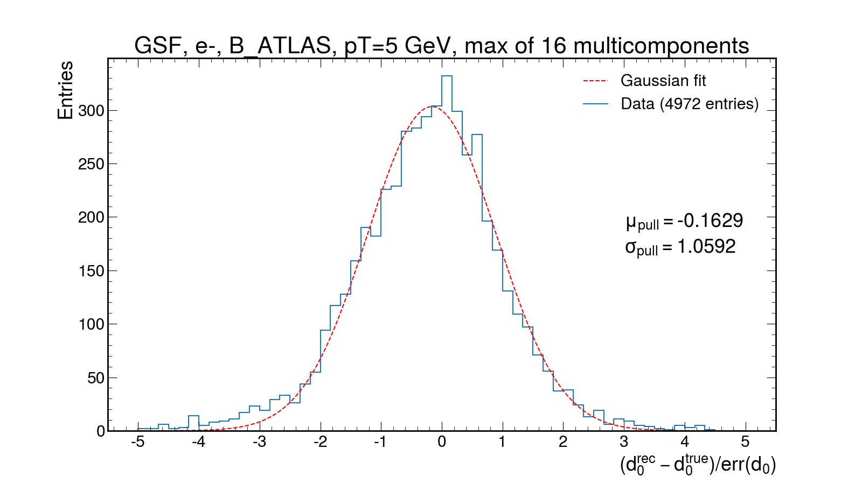
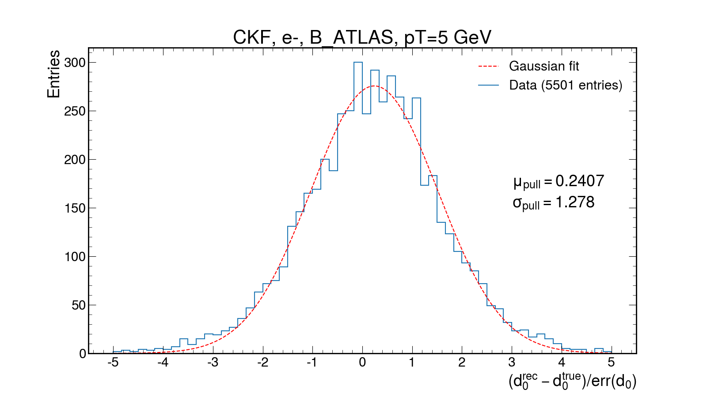
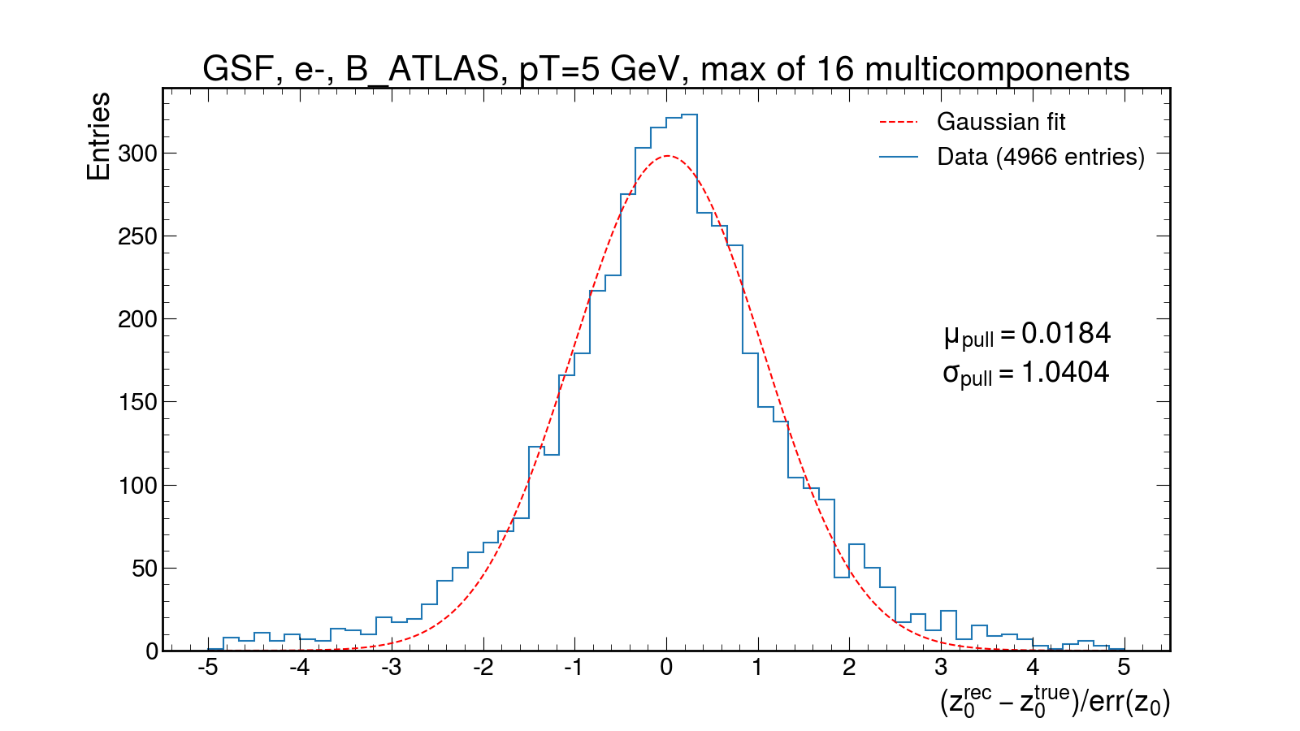
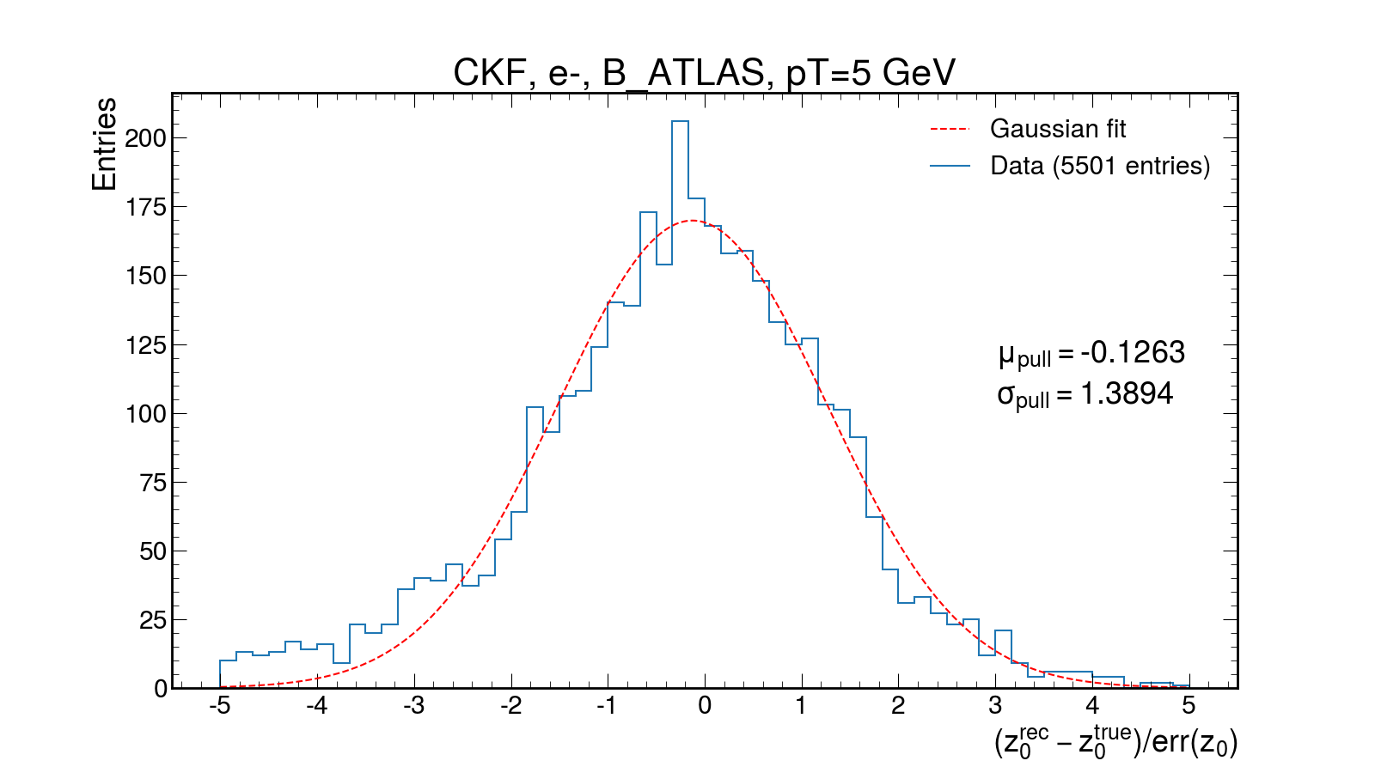
Electrons: GSF vs CKF, p_{T}=5 GeV
Work in progress
Work in progress
Work in progress
Work in progress
Better performance from the GSF (left)

Slide 32
Conclusion
There are interesting new studies to be done in the off-shell Higgs’ study!
Monte-Carlo generation is challenging especially for EFT samples.
But MC is our main source of data when developing new stat/ML techniques or tracking algorithms.
With HL-LHC coming up, aggressive R&D is a must. Computational progress will not be able to keep up.
Run 3 and the ITk upgrade are coming up soon.
Work to integrate a new track fitting algorithm (GSF) to ACTS.
Work to make ACTS work for ITk.
In progress: validate ACTS GSF vs the existing ATLAS GSF in Athena, the software versioning framework of ATLAS.
Thank you for your attention

Slide 33
Backup

Slide 34
Interference and background(s)
Gluon-gluon fusion (ggF)
Background B:
Signal S :
+
Total signal SBI (negative interference)
Note that I can be negative (here, it is the case).
+
Background B2:

Slide 35
Simulation-based inference
Constraining Effective Field Theories with Machine Learning,
J. Brehmer, K. Cranmer, G. Louppe and J. Pavez
arXiv:1805.00013 [hep-ph]

