Slide 1
Particle Physics and the FCC
Ursula Bassler
Scientific Director IN2P3

Slide 2
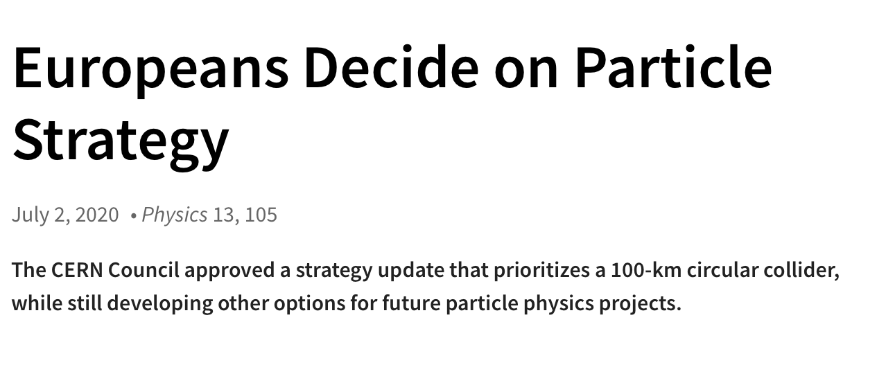
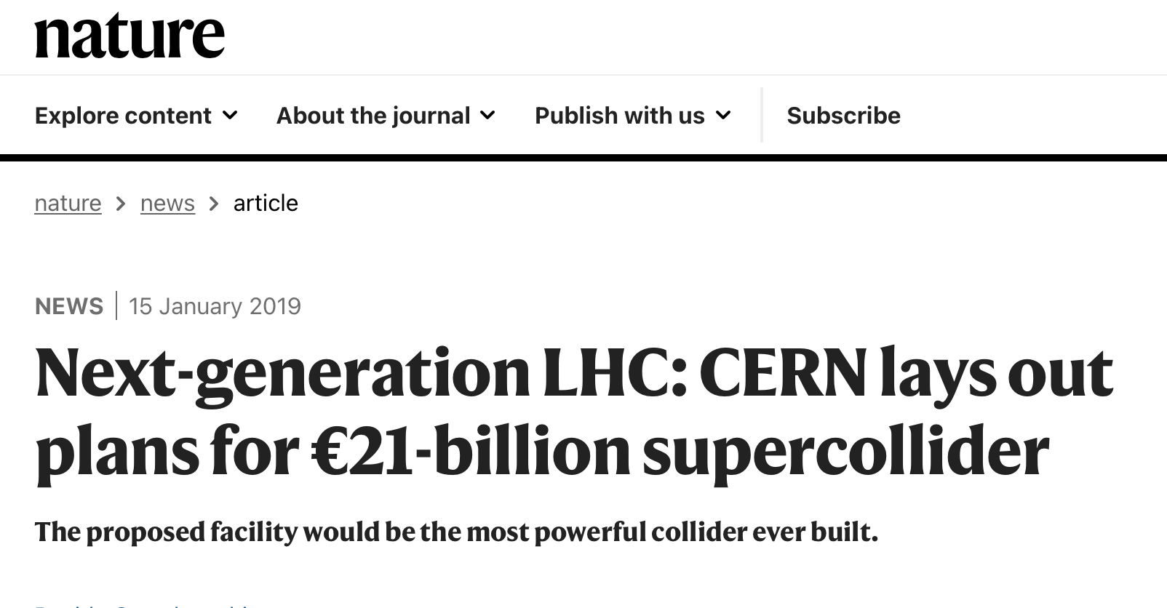

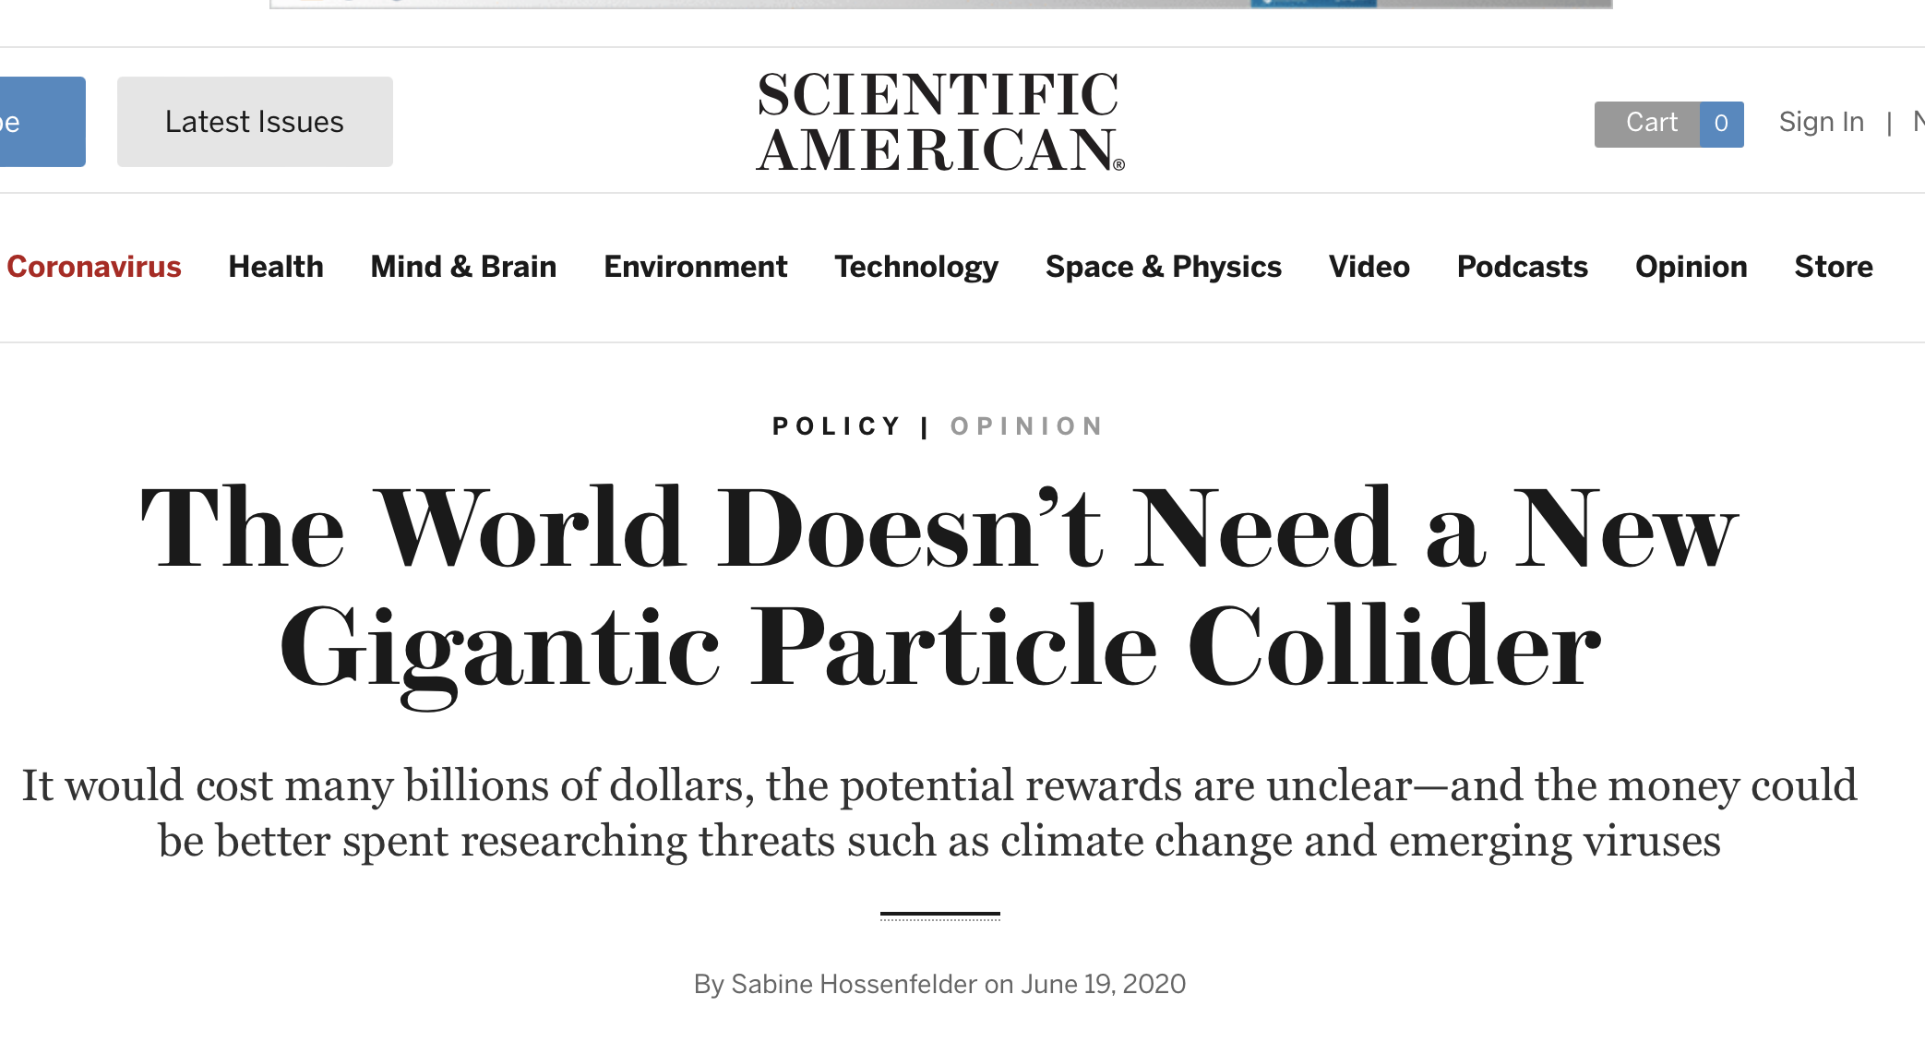
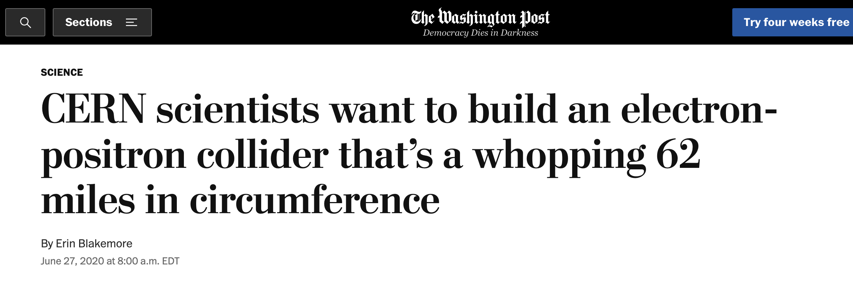
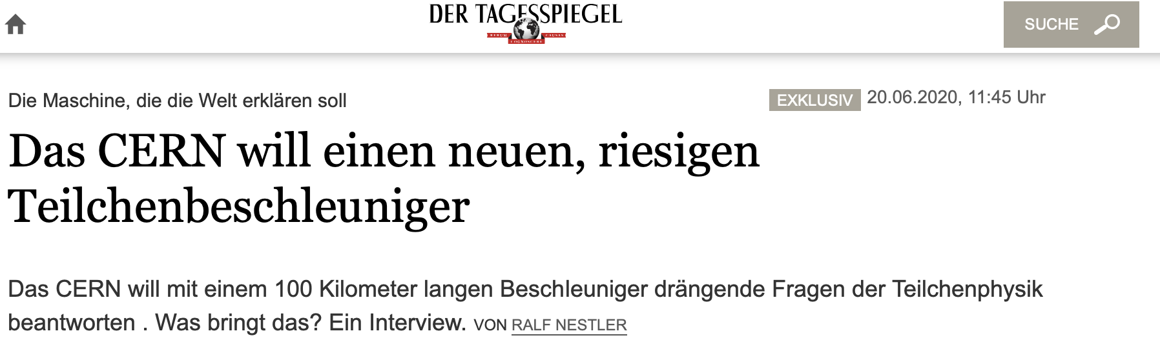


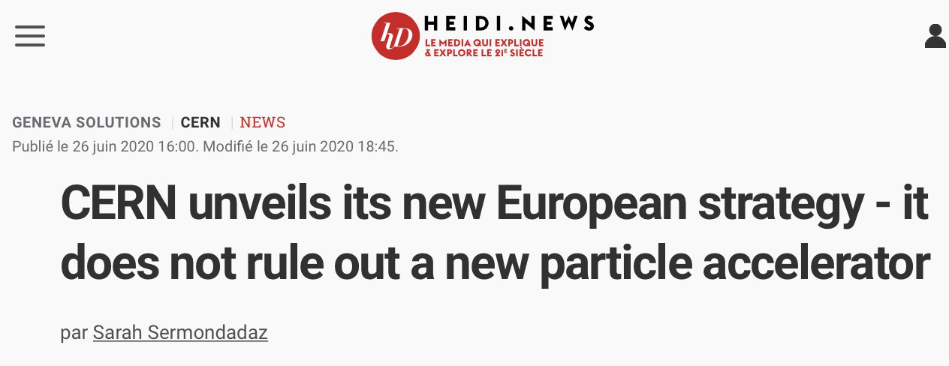

Slide 3

2020 European Strategy for Particle Physics
est. 2005: updated every 5-7 years by the CERN Council:
bottom-up process with about 160 contributions received and discussed during an Open Symposium
Produced a 200 page briefing book
“topish-down”: delegates from all European Member States of CERN formulate the strategy
An electron-positron Higgs factory is the highest-priority next collider. For the longer term, the European particle physics community has the ambition to operate a proton- proton collider at the highest achievable energy. Accomplishing these compelling goals will require innovation and cutting-edge technology.
Europe, together with its international partners, should investigate the technical and financial feasibility of a future hadron collider at CERN with a centre-of-mass energy of at least 100 TeV and with an electron-positron Higgs and electroweak factory as a possible first stage. Such a feasibility study of the colliders and related infrastructure should be established as a global endeavour and be completed on the timescale of the next Strategy update.

Slide 4
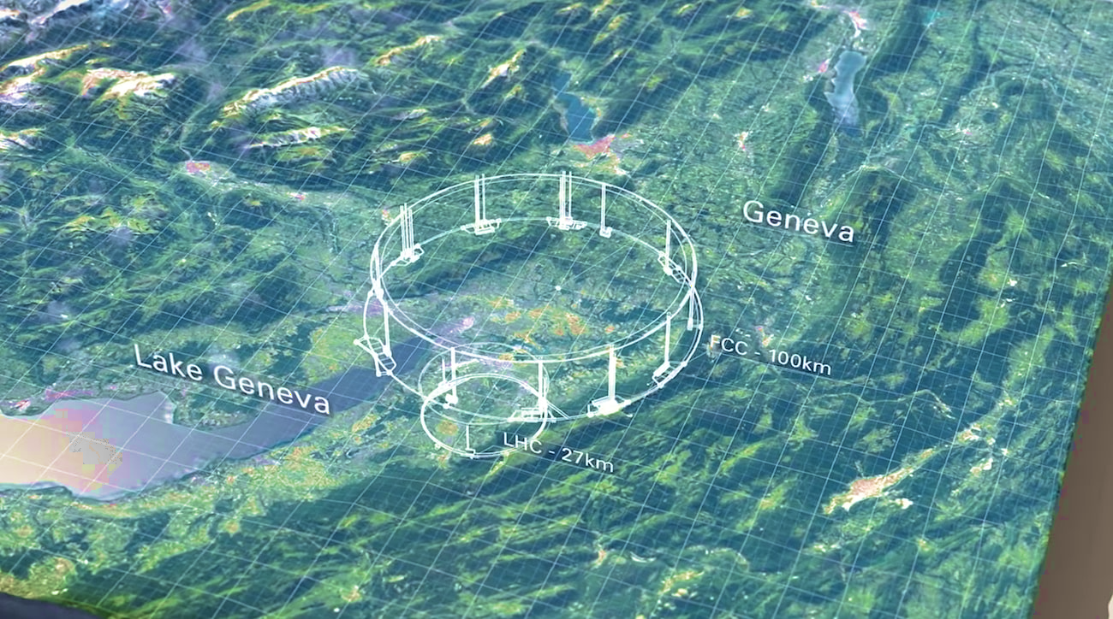
Annecy

Slide 5
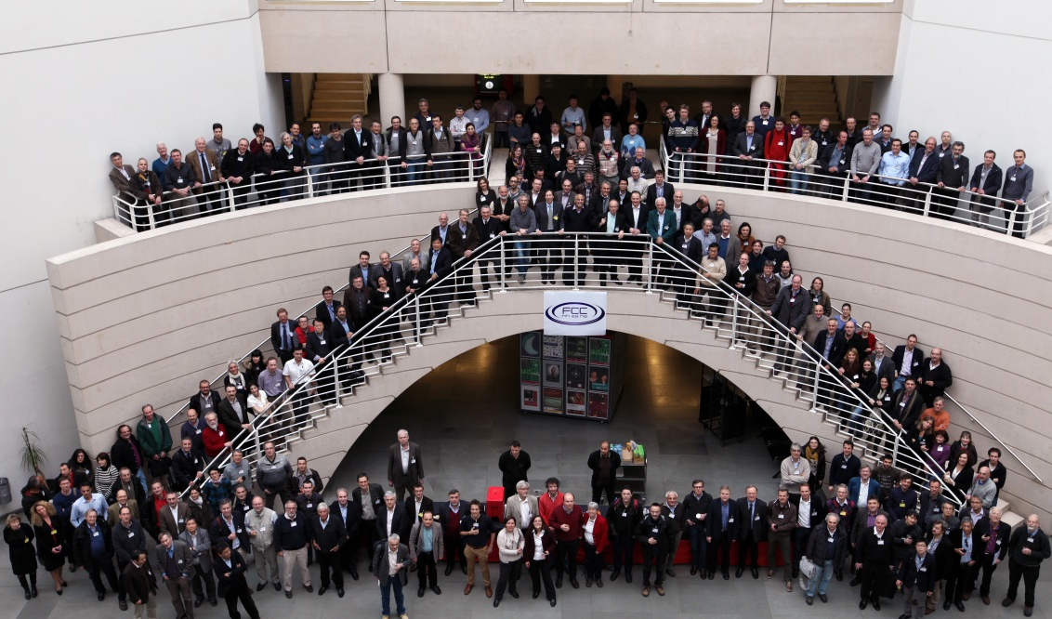
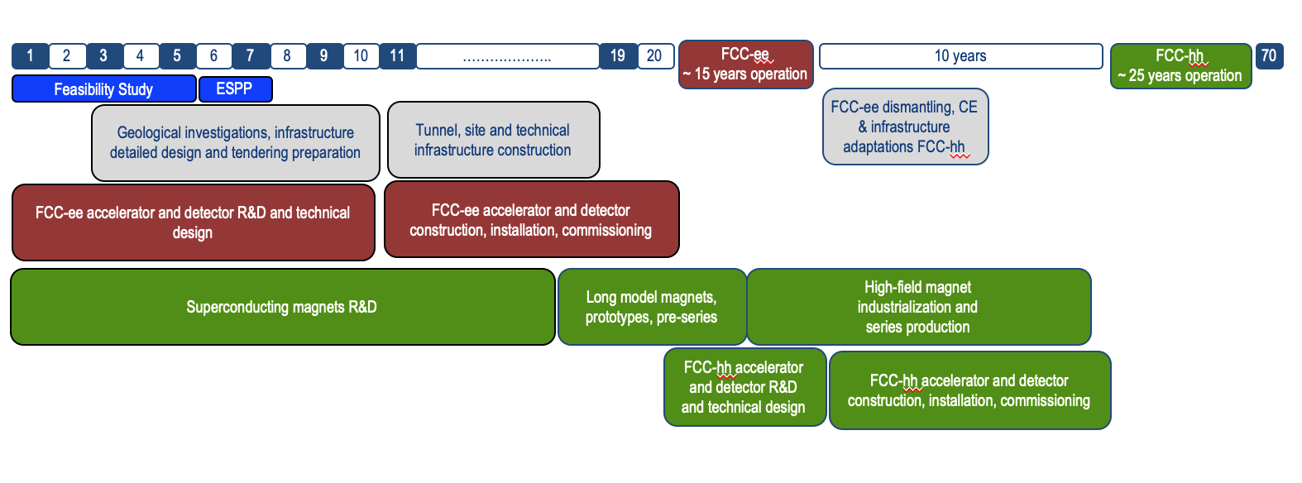
FCC studies
Design study started in 2014
Feasibility study 2021-2025
Concept : 100km tunnel hosts successively different colliders (LEP/LHC)
→ optimal use of tunnel investment
Location in Geneva area → 1/3 Swiss, 2/3 France
→ cooperation with regional authorities
→ assessment of geological conditions
→ cost estimation

Slide 6


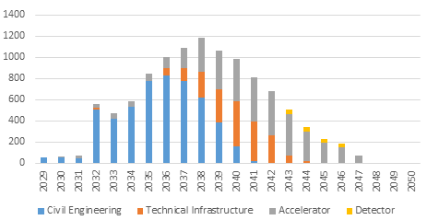
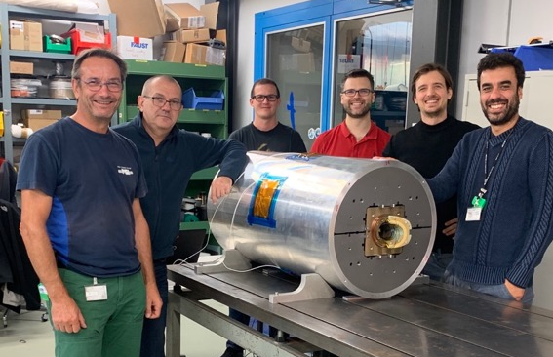
FCC project
Increase in energy and luminosity similar to Tevatron to LHC
FCC-ee
Z peak 90 GeV 4 years
WW 160 GeV 2 years
H 240 GeV 3 years
Top ≈365 GeV 5 years
FCC-hh
pp 100 TeV 25 years
PbPb 39 TeV 1 month/year
LEP data accumulated in the first 3’!
Today
2030
2040
2055
2065
2090
FCC-hh: one of the cost-drivers:
4,700 16 T magnets →
high field magnets in development
Preliminary cost estimation for FCC-ee: ≈ 11 Md CHF
including
≈ 5 Md CHF civil engineering

Slide 7
What is so interesting about the Higgs Boson?
and can FCC help answer “the big questions”?

Slide 8
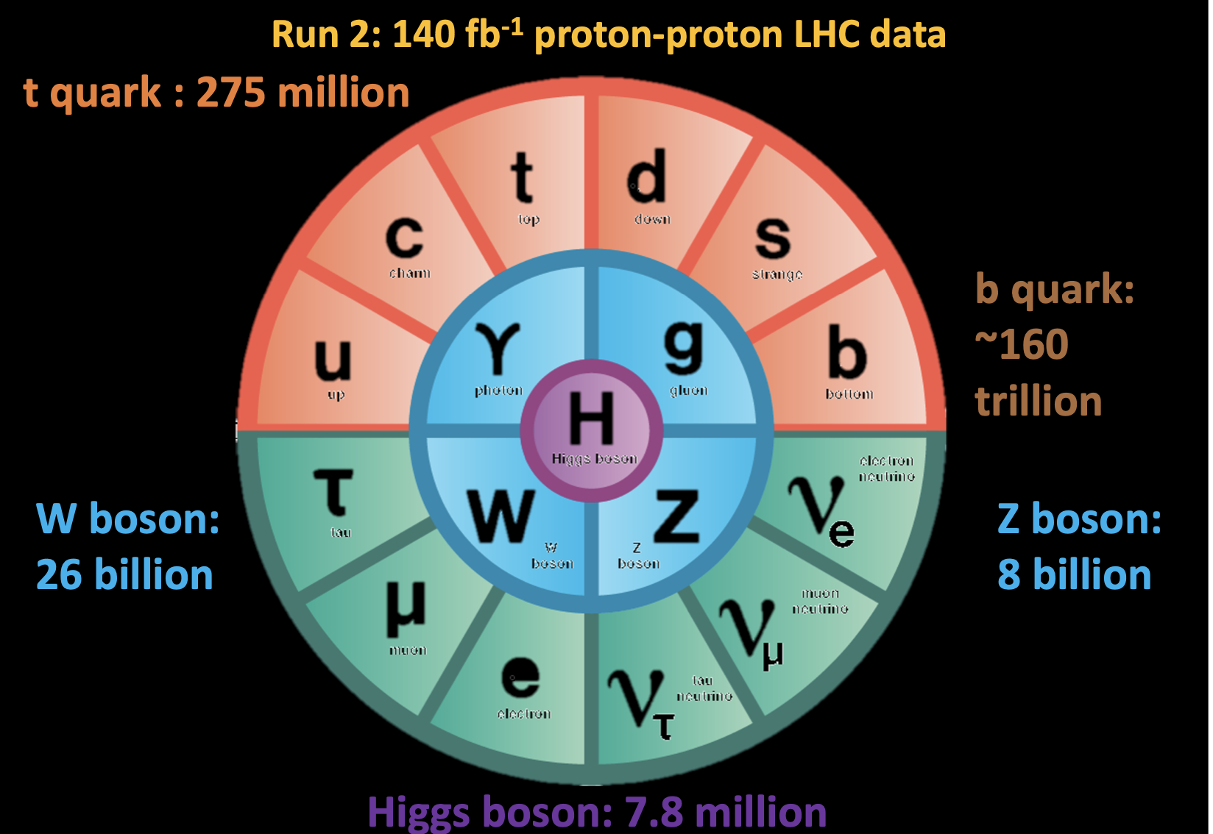
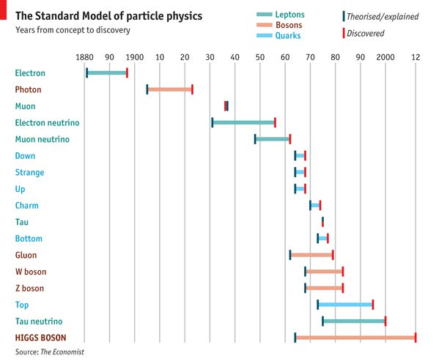
The Standard Model of Particle Physics
Nearly 120 years ago, the first particle of the Standard Model was discovered: the electron
About 50 years ago, the theory concepts behind the standard model have been established
10 years ago the Higgs boson was the last particle of the standard model to be discovered
For comparison:
Gravitational waves

Slide 9
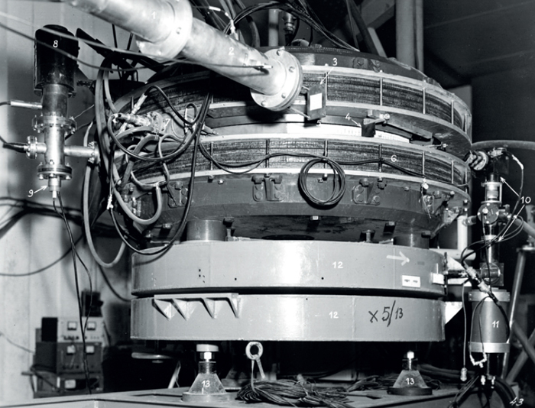
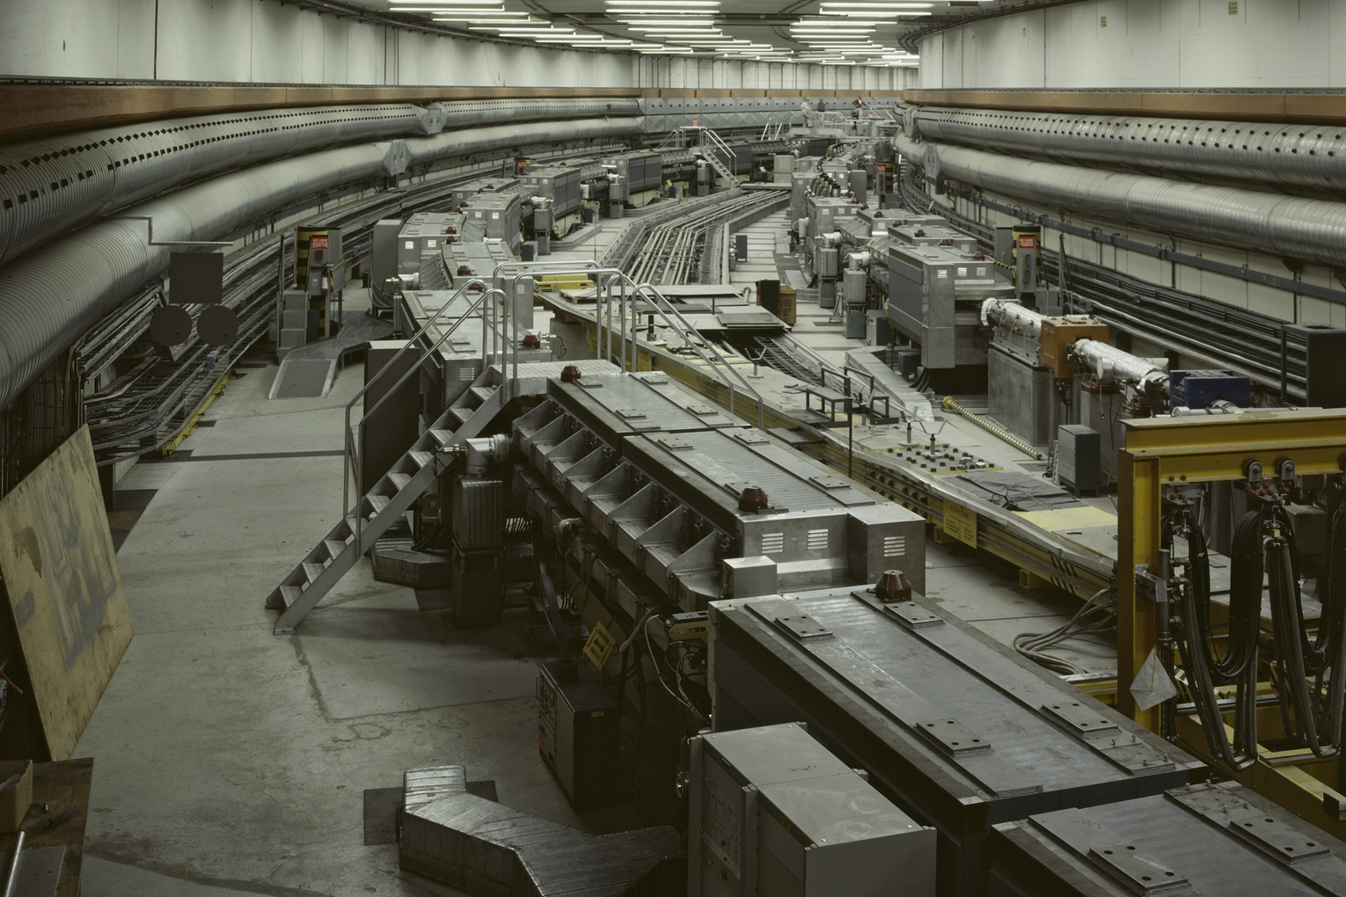
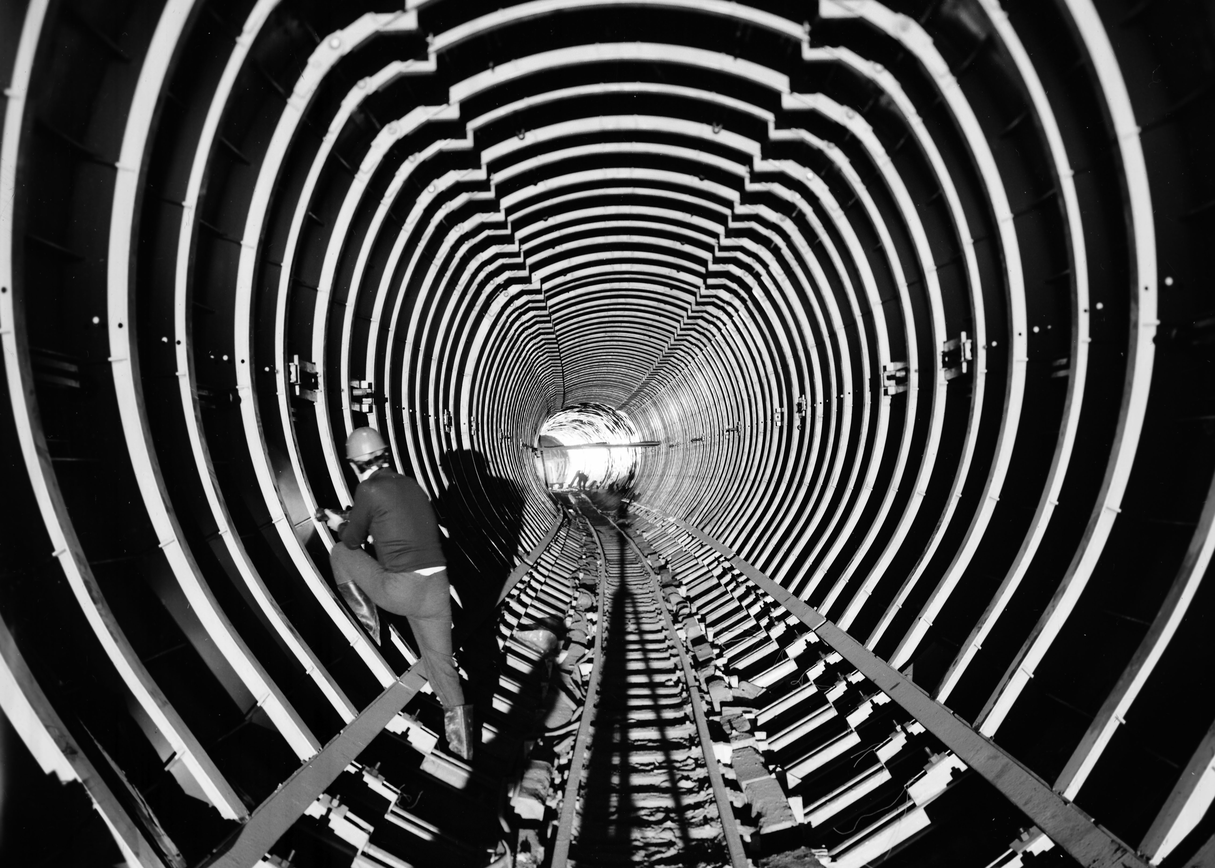
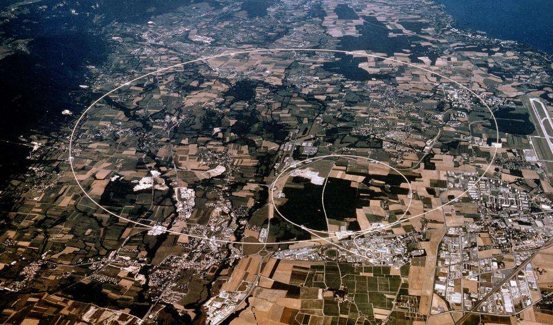
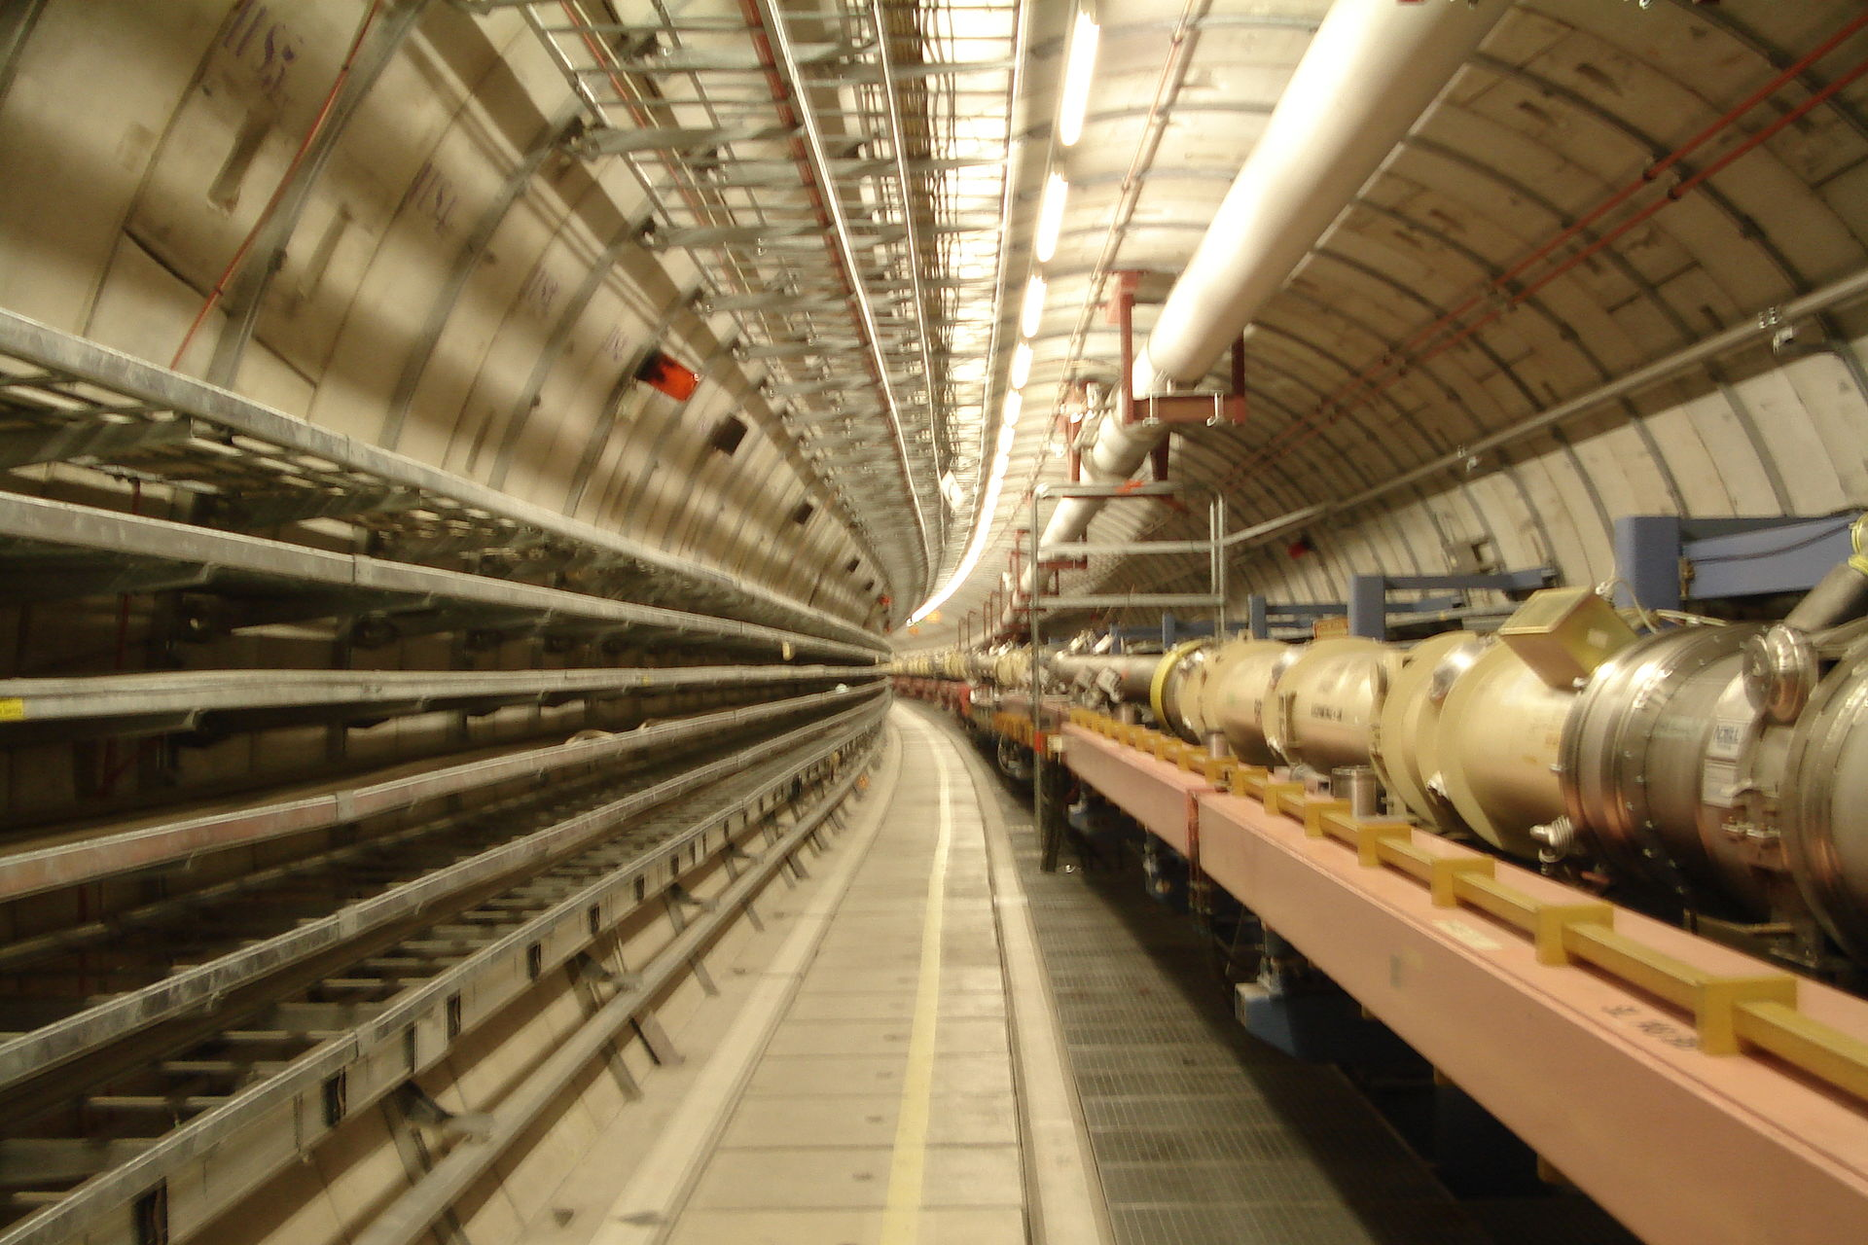
Workhorse of modern particle physics: Colliders
1963: The first electron-positron collider AdA was constructed in Frascati and the first collisions observed in Orsay
1971: First proton-proton collisions at the ISR at CERN
1981: First proton-antiproton collisions at the SppS at CERN
LEP/LHC at CERN:
electron-positron collider (1989-2000) and proton-proton collider (since 2009) using the same tunnel
1991: First proton-electron collisions at HERA in DESY
→ Talk by Pierre Vedrine

Slide 10

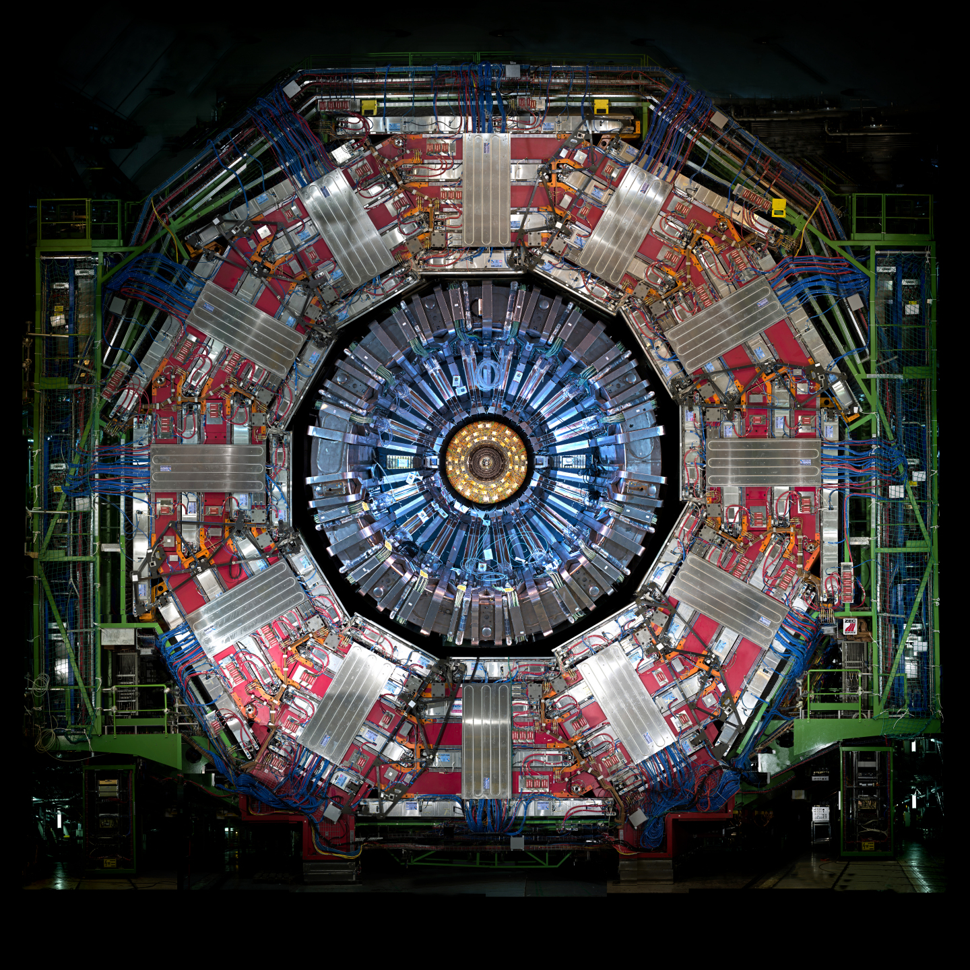
…and marvellous detectors
→ Talk by Didier Contardo

Slide 11
LHC: what has been done so far
Higgs boson: 8 million
Florencia Canelli

Slide 12
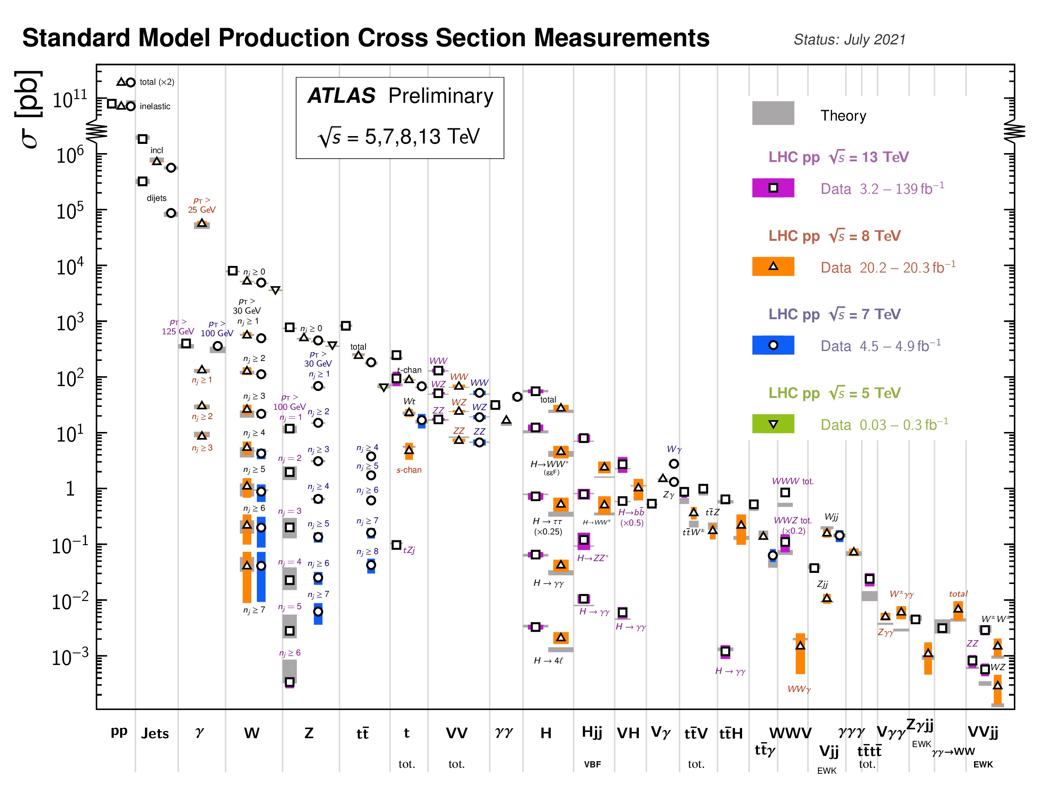
LHC cross-section measurements
Measurement of production rates over 10 orders of magnitude:
From jet-production to multi-boson processes
high precision measurements with inclusive production
measurements of different production modes
examine differential distributions
Test high order QCD and EW calculations,
check for deviations from SM

Slide 13
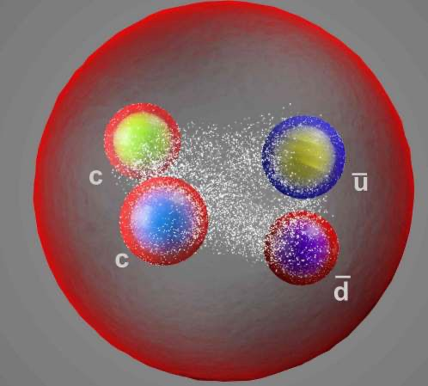
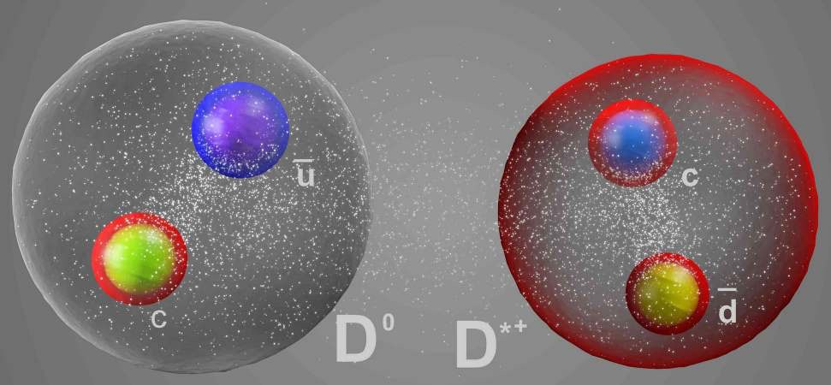
Discoveries at the LHC: Exotic hadrons
LHC: More than 60 hadrons discovered !
Catching hadrons:
50 mesons possible : 1 undiscovered
75 baryons possible: ≈ 50 seen so far
→exotic hadrons @ LHC:
13 tetraquarks : 3 cqqq, 8 ccqq, 1 cccc
5 pentaquarks: ccqqq
Do hexaquarks exist?
Structure of the tetraquarks?
compact tetraquarks:
all 4 quarks see the colour of the others
hadronic molecules:
2 colour-neutral di-quarks coupled through light meson-exchange

Slide 14
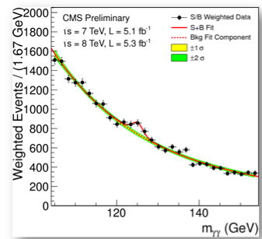
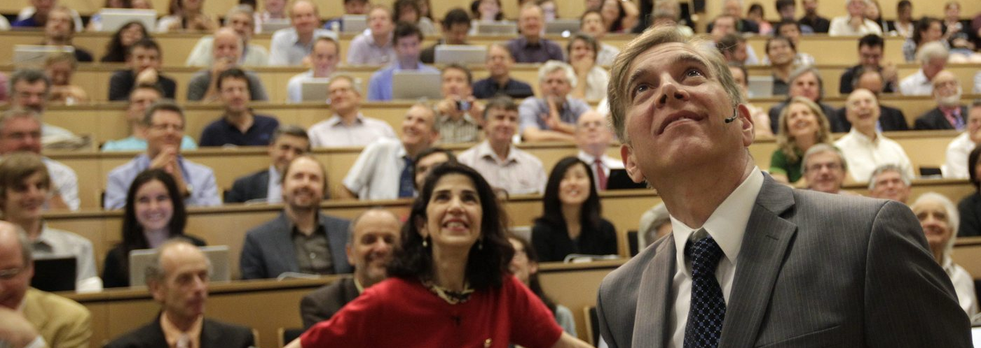
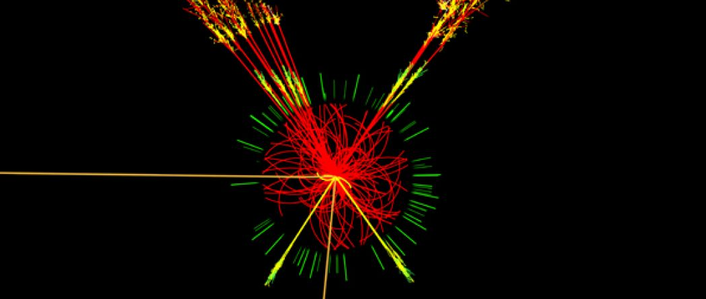
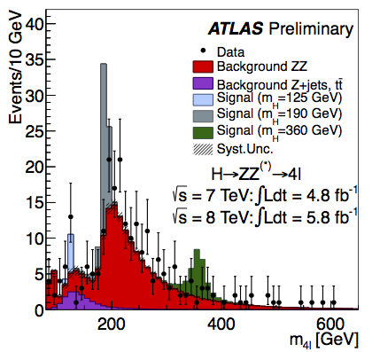
The ”discovery” at the LHC: Higgs boson !

Slide 15
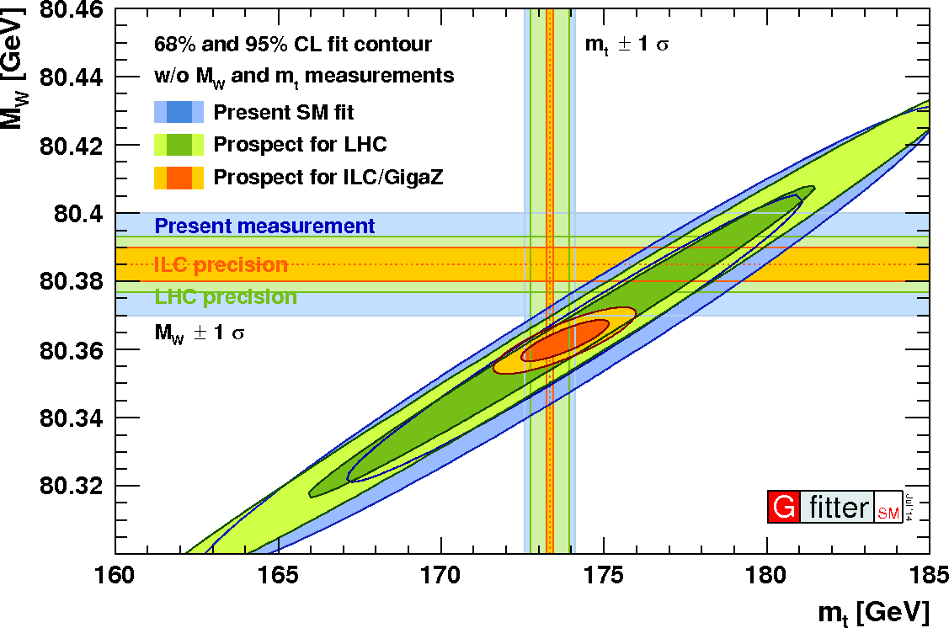
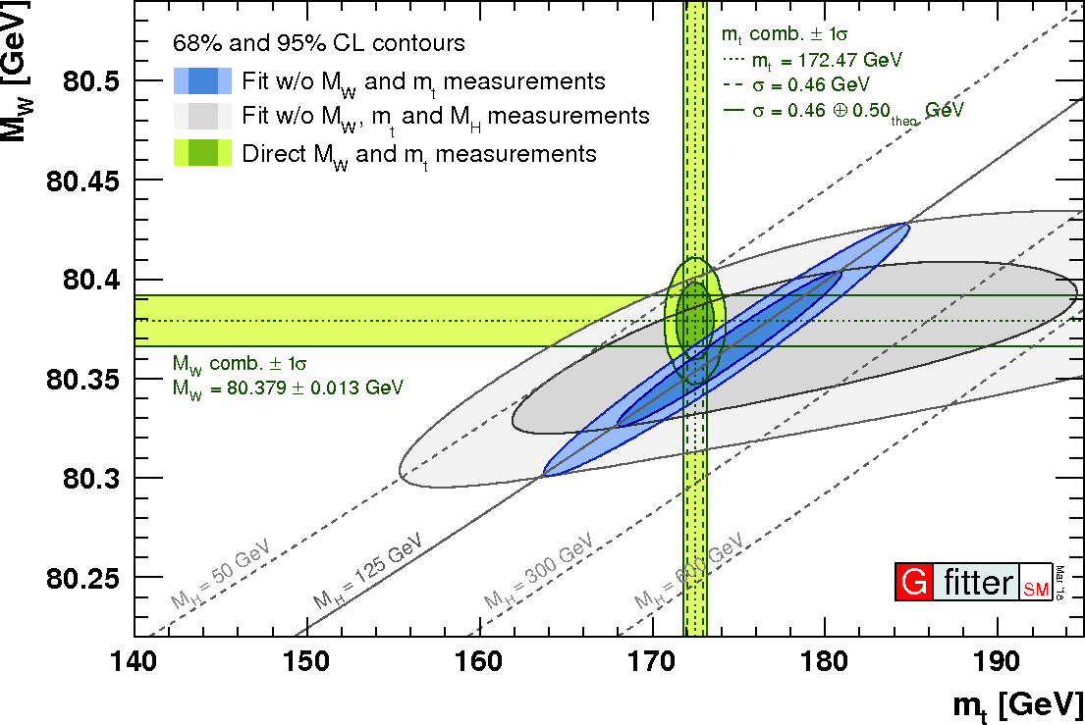
Higgs mass: coherence of the SM
Measurement of the Higgs mass at the 1 ‰ level !
Top, W and Higgs mass → consistency check
Increased precision from future colliders - FCC-ee should produce :
10 million WW events for precision W-mass measurements → precision 0.5 MeV
1 million top anti-top events for the first model independent top-mass measurement
→ precision 16MeV
Projected FCC-ee precision

Slide 16
Higgs mass: coherence of the SM
Measurement of the Higgs mass at the 1 ‰ level !
Top, W and Higgs mass → consistency check
Recent mass measurement from CDF : 80,433.5 ± 6.4 (stat) ± 6.9 (syst) MeV to be investigated!
Increased precision from future colliders - FCC-ee should produce :
10 million WW events for precision W-mass measurements → precision 0.5 MeV
1 million top anti-top events for the first model independent top-mass measurement
→ precision 16MeV
Projected FCC-ee precision
≈M_{W} CDF

Slide 17
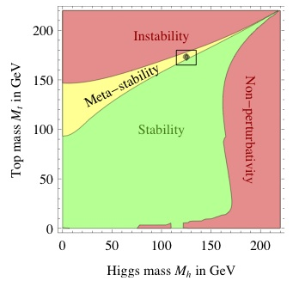
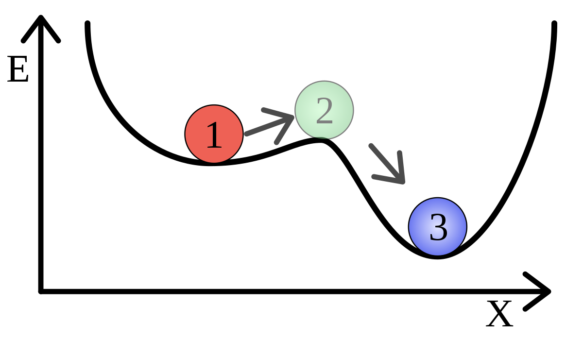
Higgs mass: stability of the Universe
Is the vacuum state of the Universe stable?
Evolution of the vacuum up to the Planck scale: Current analysis indicate meta stability at 1.3-2.8σ
Or Universe may transit to another vacuum state sometime… but maybe we have other problems before
New physics?
Calculation based on the Higgs mass and the top pole-mass
ee-collider at tt-bar threshold: model independent top mass measurement!
FCC-ee: improvement on top and Higgs mass by at least a factor 10!
unstable
metastable
stable
Shaposhnikov

Slide 18
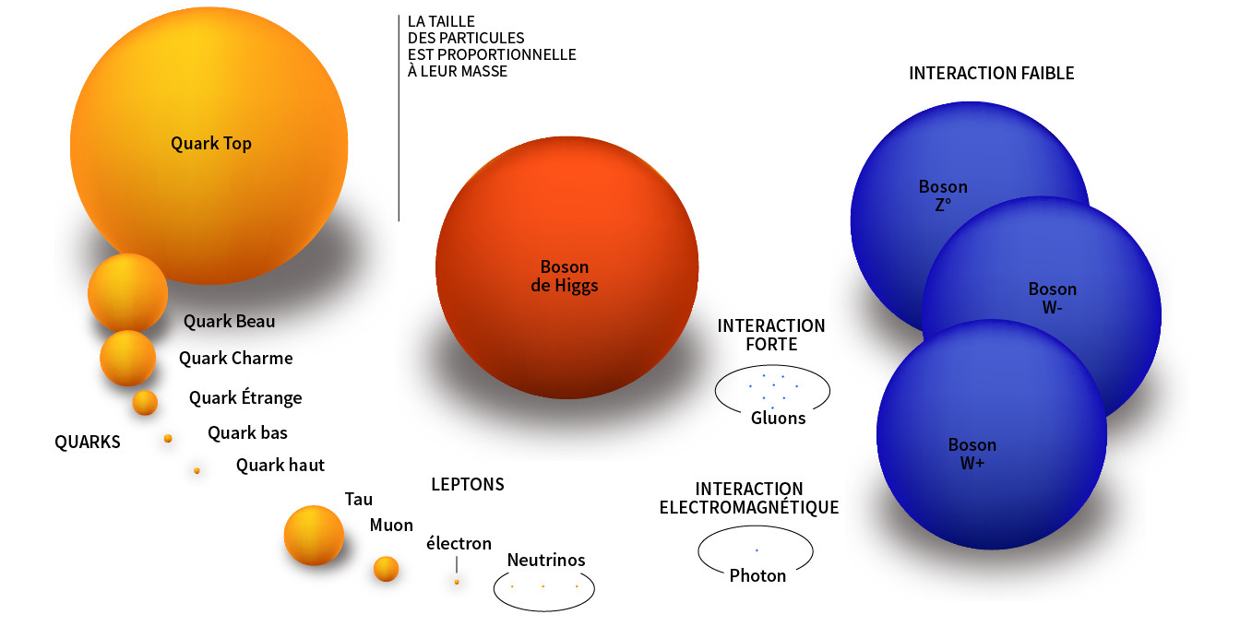
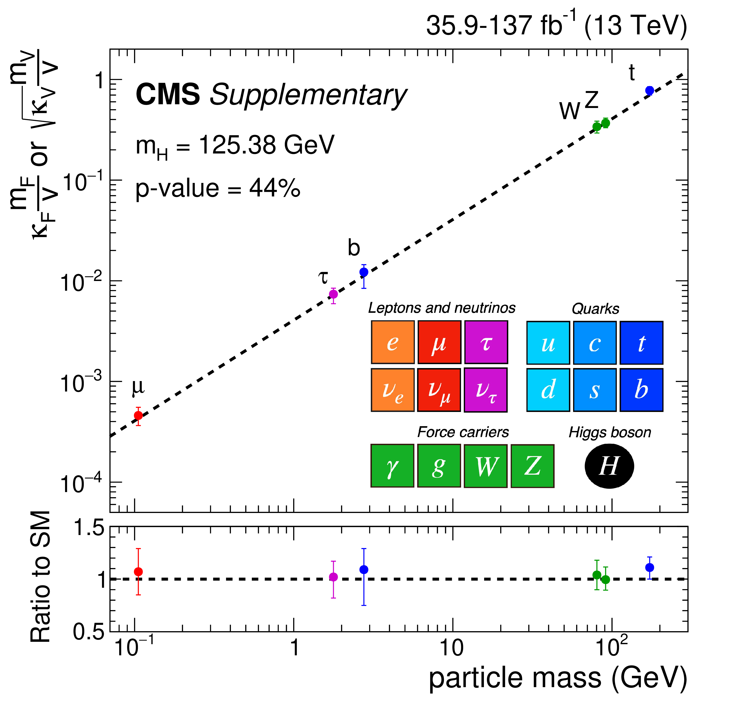
Higgs Couplings
The size of the symbols is proportional to the particle mass
-Couplings of the Higgs boson to elementary particles (quarks, leptons, bosons) proportional to their mass
- The interaction with the Higgs field is the only interaction that distinguishes fermion families !
→ the higher the mass, the easier to verify !
Verification down to the 2nd generation
1st generation: too small to be measured ~O(10⁻⁹)
except through Higgs production in monochromatic ee collisions under study !
Physics beyond the Standard Model : deviations at < 1% can be reached at FCC-ee !
Projections for HL-LHC: ≈ 5% range

Slide 19
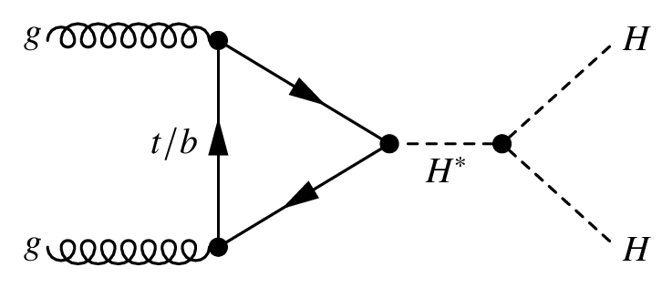
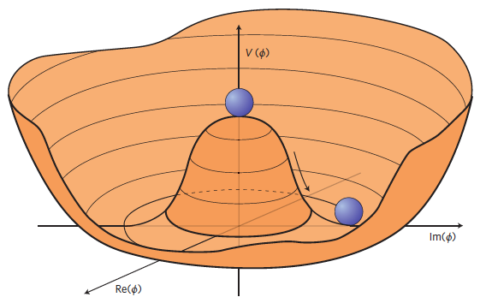
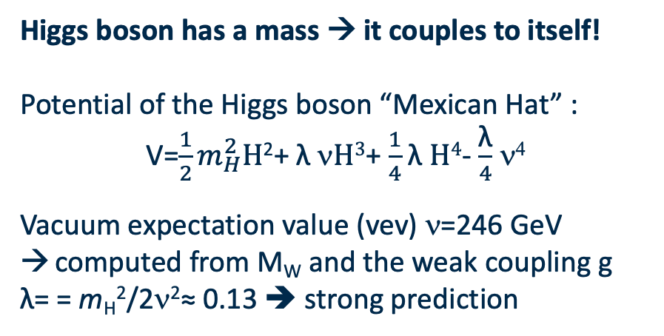
Higgs self-coupling
Higgs boson has a mass → it couples to itself!
Potential of the Higgs boson “Mexican Hat” :
V=$\frac{1}{2}m_{H}^{2}H$²+ λ ν$H3$+ $\frac{1}{4}$ λ $H4$- $\frac{\text{λ}}{4}$ ν⁴
Vacuum expectation value (vev) ν=246 GeV
computed from M_{W} and the weak coupling g
λ= = m_{H}²/2ν²≈ 0.13 ➔ strong prediction
Higgs potential
vev
➔ HHH measurements give direct access to λ
But: small cross section: experimentally challenging
HL-LHC: about ~ 100k HH produced, but very difficult to identify
➔ determine if self-coupling exists
ee-colliders: directly measurement ZHH channel with √s ≳ 400 GeV
FCC-ee indirect measurements : NLO effects in single H production

Slide 20
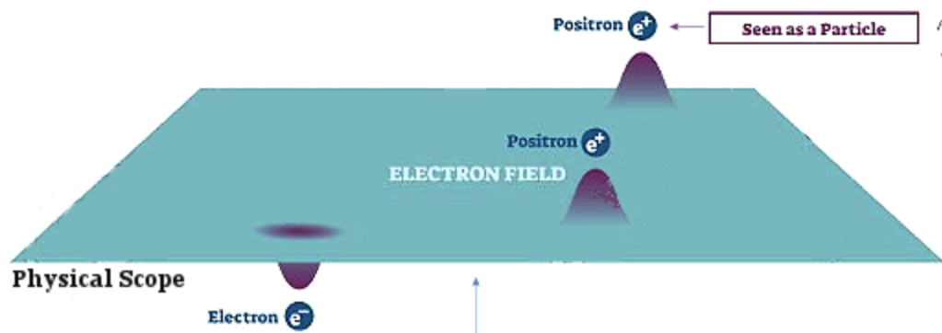
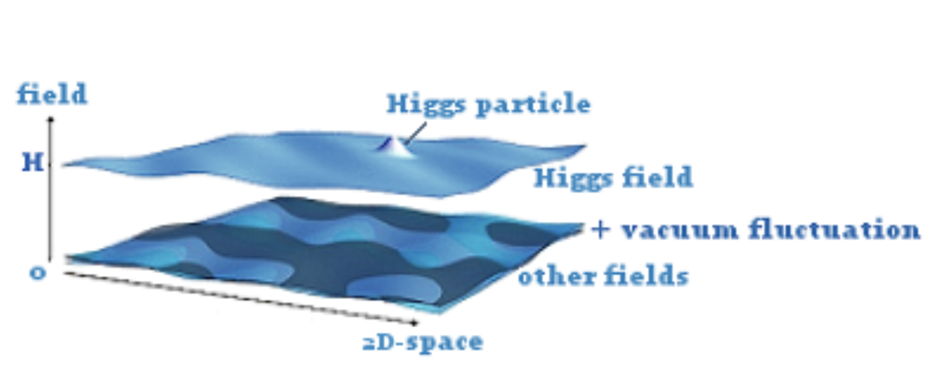
Higgs Field
In Quantum Field Theory:
All particles are considered as excitations of the underlying field
→ Every electron is an excitation of the same electron-field filling up the whole Universe
©shutterstock
→ allows to compute the probability, to find a given particle at a given time at a certain position
→ field contains all the quantum information associated to a type of particle
→ mean “ground state energy”, the vacuum expectation value (vev) contained in a field is 0, except…
…for the Higgs field:
scaler field
symmetry can be broken
vacuum expectation value can be ≠ 0
Notes:
Besseren übergang von Teilchen zu Feld erklären und erklären was die Quanteninformationen sind

Slide 21

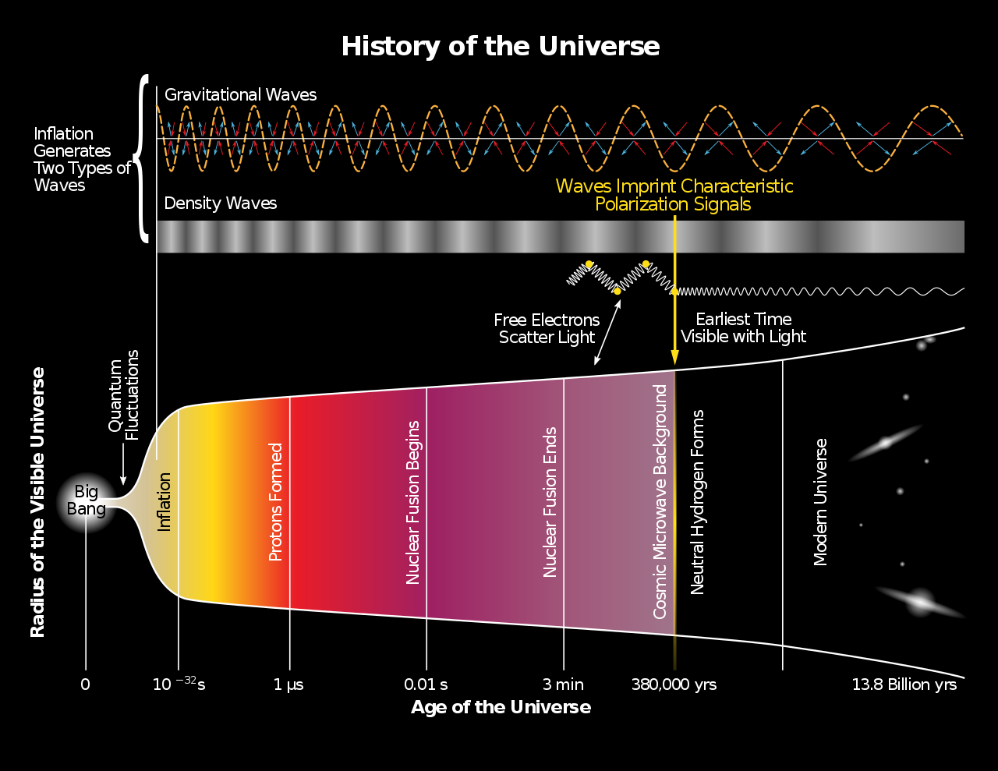
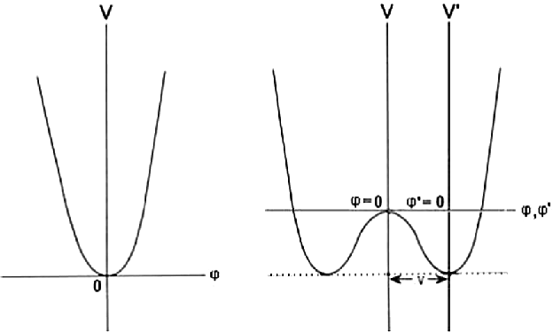
Higgs boson in the primordial Univers
≈ 10⁻¹² after the Big Bang, the Higgs boson underwent a phase transition:
the potential energy of the Higgs field became minimal at a non-zero vacuum expectation value
symmetry breaking :
massive Z and W± + a H boson
- matter particles interact with the Higgs field and appear massive
… the Universe as we know it!
vev
vev

Slide 22
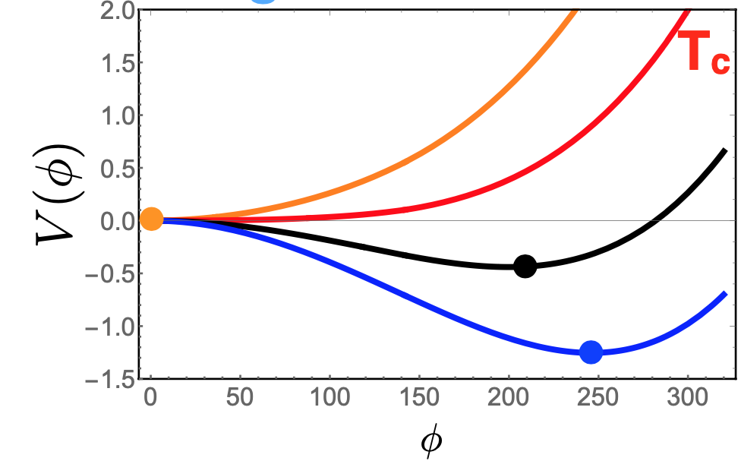
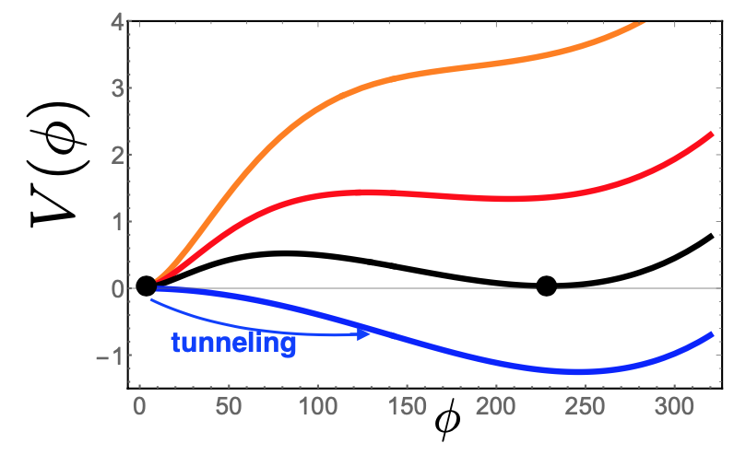
Higgs phase transition
Higgs potential must have evolved during the cool-down of the Universe : How?
2nd order phase transition: Universe stays in thermic equilibrium → favoured by the Higgs mass measurement (m_{H}>70 GeV): matter creation?
1st order phase transition:
No thermic equilibrium → formation of “bubbles” and tunnelling effects : required for baryogenesis, but physics beyond the Standard Model necessary i.e. additional scaler fields
Primordial gravitational waves may help understand!
LISA satellite ?

Slide 23
Higgs and cosmic inflation?
The Observation of a homogeneous Universe led to assumption that Cosmic Inflation could describe the very early expansion:
→ in the very first 10⁻³⁴s the Universe expanded by a factor 10²⁶
Expansion would be due to the scaler inflaton-field
- the potential of the inflaton-field would decrease over time
→ generation of matter-antimatter particles creates negative pression
Good news: scaler fields exist !
Bad news: doesn’t look to be the Higgs field : Higgs is to heavy and the expansion rate by a factor 10¹¹⁸x too fast!
But: Search for Higgs-inflaton oscillations in B meson decays
➔ not observation disfavours existence of light inflaton
Future investigations on inflation:
Inflation should have produced primordial gravitational wave
Polarised CMB, LISA satellite
or observation of cosmic gravitational wave background

Slide 24
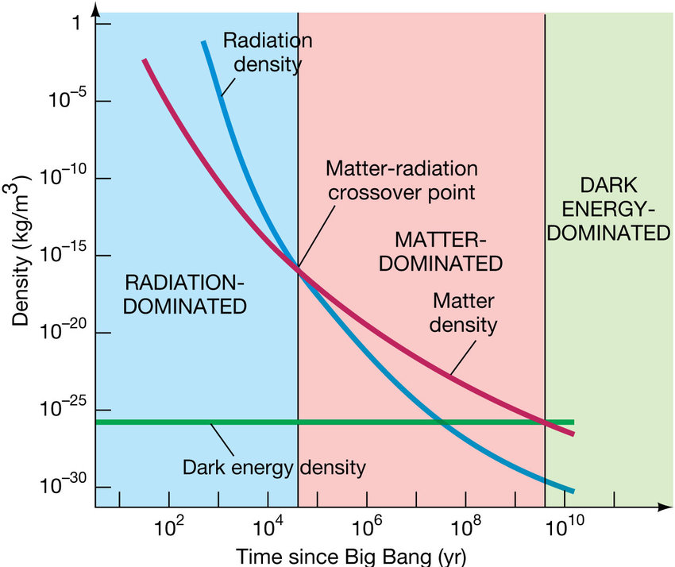
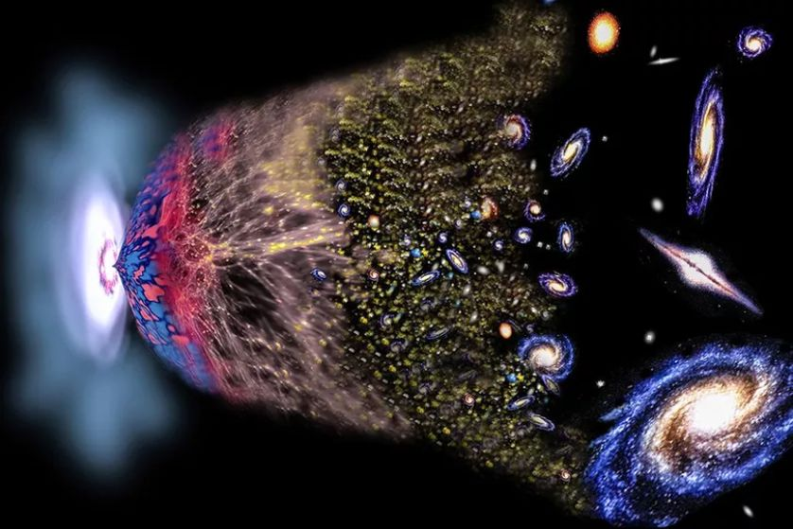
Higgs and dark energy?
The expansion of the Universe has different phases:
Rapid expansion dominated by the negative pressure of photons and relativistic particles
Slowed down by matter and its gravitational attraction
Current acceleration due to a constant “dark energy“
Not much is know about Dark Energy:
« could be a property of spacetime itself, or just a huge misunderstanding of how gravity works on a cosmic scale. »
at colliders?
Hmm « trying to determine the nature of a weak long range interaction through its interactions on the smallest possible length scales involving the highest possible terrestrial energies… »
➔models builders are looking for possible links to the Higgs boson and first searches at LHC started !

Slide 25
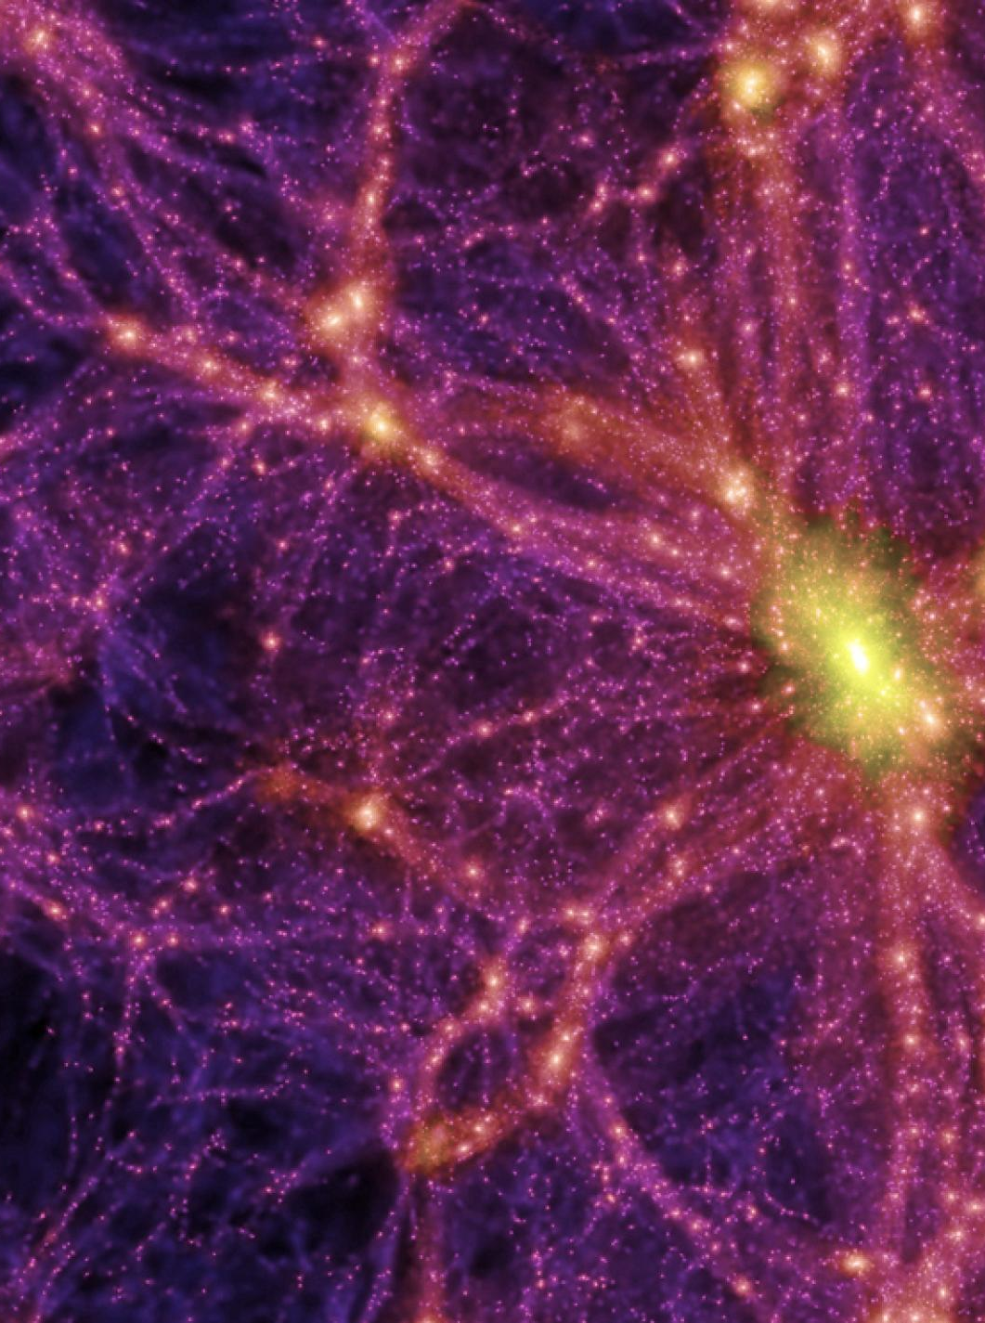
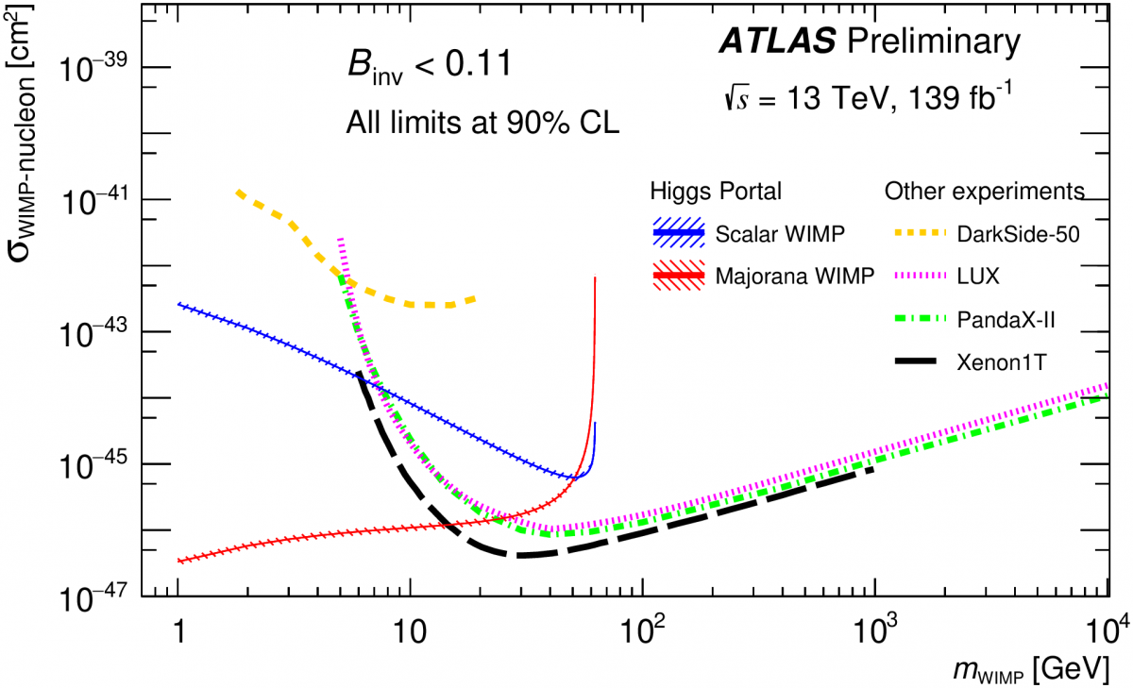
Higgs: portal to Dark Matter?
Since the 1930’s astrophysical observations point to the existence of Dark Matter
The Standard Model of Cosmology ΛCDM based on the existence of Dark Matter and Dark Energy
Direct Dark Matter searches have reached an impressive sensitivity
in the high energy range through nucleon recoils
In the low energy range through electron recoil
VOLKER SPRINGEL, MAX PLANCK INSTITUTE FOR ASTROPHYSICS, ET AL
All massive particles should couple to the Higgs boson:
Could we see Dark Matter particles through the Higgs boson?
Higgs as Dark Matter mediator:
  Direct searches as for H → XX
  Exclude B(H → Z_{d} Z_{d}) as low as 2-8 x 10⁻⁵
  Higgs boson coupling to Dark Matter:
  B(H→inv) < 11% at 90% CL
➔ FCC-ee: discovery potential to decays of 0.5%

Slide 26
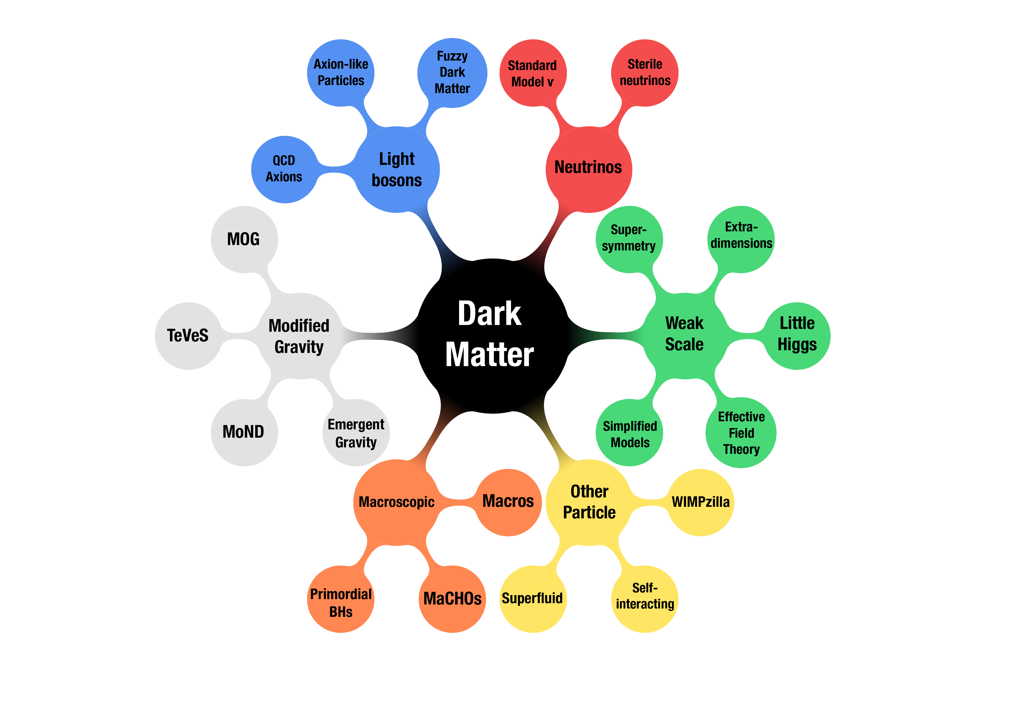

Slide 27
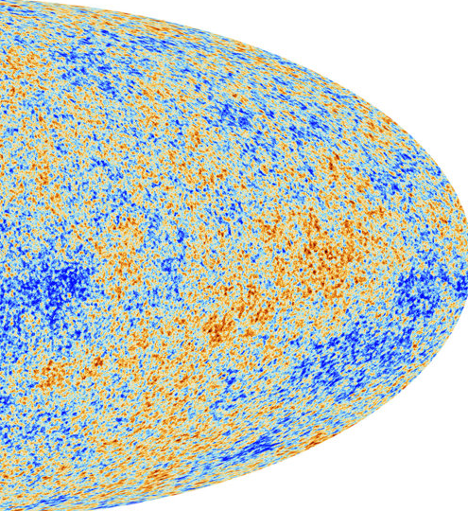
Where is the antimatter?
In the current Universe: 10⁹ photons, 1 proton - 0 antiprotons
Yet, matter and antimatter should have been created in equal amounts!
1 μs after the Big Bang:
500 000 001 quarks and 500 000 000 antiquarks annihilate!
Why does matter exist ?
3 Sakharov conditions for baryogenesis:
1) No thermal equilibrium:
  reaction and backwards reaction not in equilibrium
  1st order phase transition
  measurement of Higgs potential

Slide 28
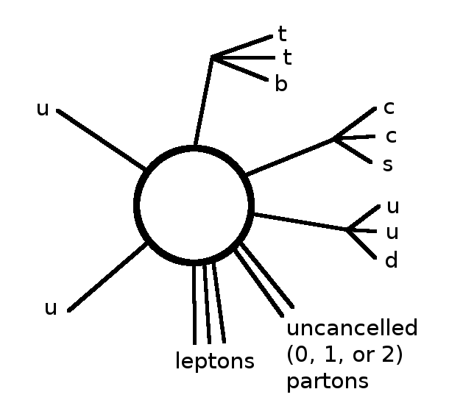
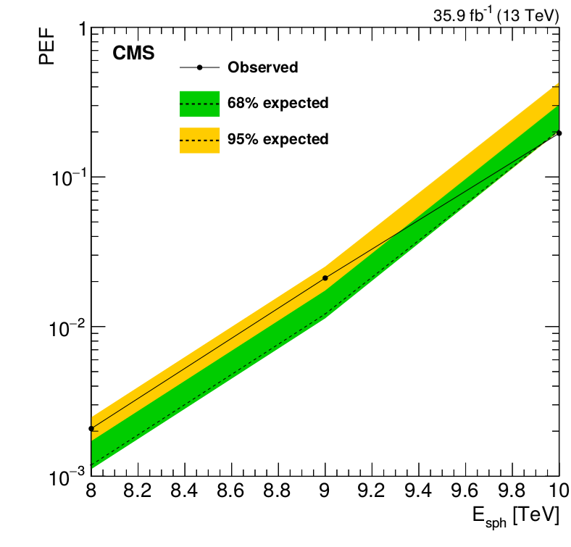
Baryogenesis
2) Non-conservation of the baryon number:
  stability of the proton measured to 10³¹: limit to be reached 10³⁹
  Sphaleron: non-perturbative process at high energy
  in the Standard Model → predicted by d’Hooft in 1976
  - transformation of 3 baryons into 3 anti-leptons
  → first searches at the LHC: BaryoGen generator
  Production should occur above ≈9 TeV
  Higgs mass last missing piece for prediction
  Event signature:
  “Fireball” final states: around twelve 0.8 TeV particles
  → High energy hadron collider ideal for searches

Slide 29

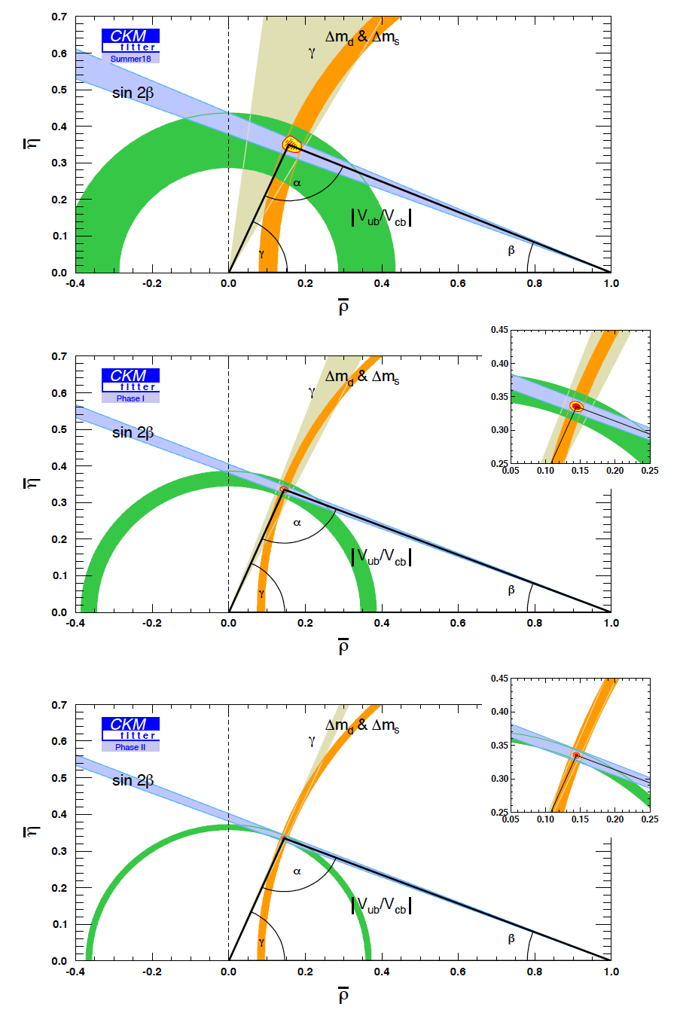

CP-violation: Anti-matter in the mirror
3) CP violation:
Charge-Parity symmetry is not conserved : matter and anti-matter behaves differently
Baryogenesis: CP violation from weak interactions in the quark sector too small x 10⁹
Precision increase in the determination of the CKM parameters with HL-LHC statistics and upgraded detectors
Complementary measurements from Belle-2 in ee collisions
Coherence tests of SM
2018
LHC
FCC-ee: boosted b-production at the Z-peak
→ at least 5 10¹² Z decays needed
~15 times Belle II anticipated statistics
• All species of b-hadrons are produced
➔ Constraints on limits on new Physics up to 20 TeV
HL-LHC
S. Monteil

Slide 30


Lepton-Flavour Universality
- In the Standard Model all three lepton families should behave the same in electroweak decays, but…
Measurements from LHCb confirms deviations observed!
Lepton-flavour universality measurement through the ratio
R_{K} = BR(B(ub)⁺→K(us)⁺μ⁺μ–)/BR(B⁺→K⁺e⁺e–)
= 0.846^{+0.042}_{-0.039} (stat.) ^{+0.013}_{-0.012} (syst.)
SM prediction: R_{K}=1± O(10⁻⁴)[QCD] ± O(10⁻²)[QED]
3.1 σ evidence for LFV
➔ Measurement with upgraded detector and higher statistics to come in new LHC Run and Belle-II
Lepton flavour Universality from τ decays:
Branching-faction into electrons depend on the τ-mass
Current measurement show tensions
→ FCC-ee increases precision by a factor 10
Lepton flavour violation in Z-decays typically < 10⁻⁵⁰ in the Standard Model
→ Z-statistics at FCCee pushes sensitivity by 3 orders of magnitude

Slide 31




Neutrinos
Standard Model:
no right handed neutrinos !
1998 discovery of Neutrino oscillations → neutrinos have a mass
if neutrinos acquire mass through the Higgs mechanism, right handed neutrinos should exist
“See-saw’” mechanism: right-handed neutrinos could be very heavy
Could explain Matter-Antimatter Asymmetry through “leptogenesis”
If mass > 140 MeV: for matter anti-matter asymmetry
Constraint:
mass = 1-50 keV
Search through: N → νγ ongoing
→Pairs of left- and right-handed neutrinos can be produced at FCC-ee!
Sensitivity FCC‐ee :
8 orders of magnitude higher than LEP!

Slide 32

FCC : looking backwards
Dark Energy, CP-violation in the B-sector, Neutrino oscillations, Higgs boson, Gravitational waves
1950: π⁰ discovery
1954: CERN creation
1962: 2 types of neutrinos
1968: proton substructure
1983: W/Z discovery
1995: top discovery
2020

Slide 33
FCC : looking forwards
2040: I’ll turn 75
2055: hopefully I‘lI get 90!
2065: not very optimistic to get 100
Today
2032: I will retire

Slide 34

FCC : looking forwards
« Je voudrais revenir sur terre, un instant, dans mille ans, juste le temps de voir ce que trente générations de savants auront su découvrir, et entendre ce que les hommes (et femmes) de science seront alors en humeur de dire. »
Hubert Curien
Ministre délégué à la Recherche
DG CNRS
Président du CNES
Président de l’ESA
Président du conseil du CERN
…
2040: I’ll turn 75
2055: hopefully I‘lI get 90!
2065: not very optimistic to get 100
Today
2032: I will retire

