Slide 1
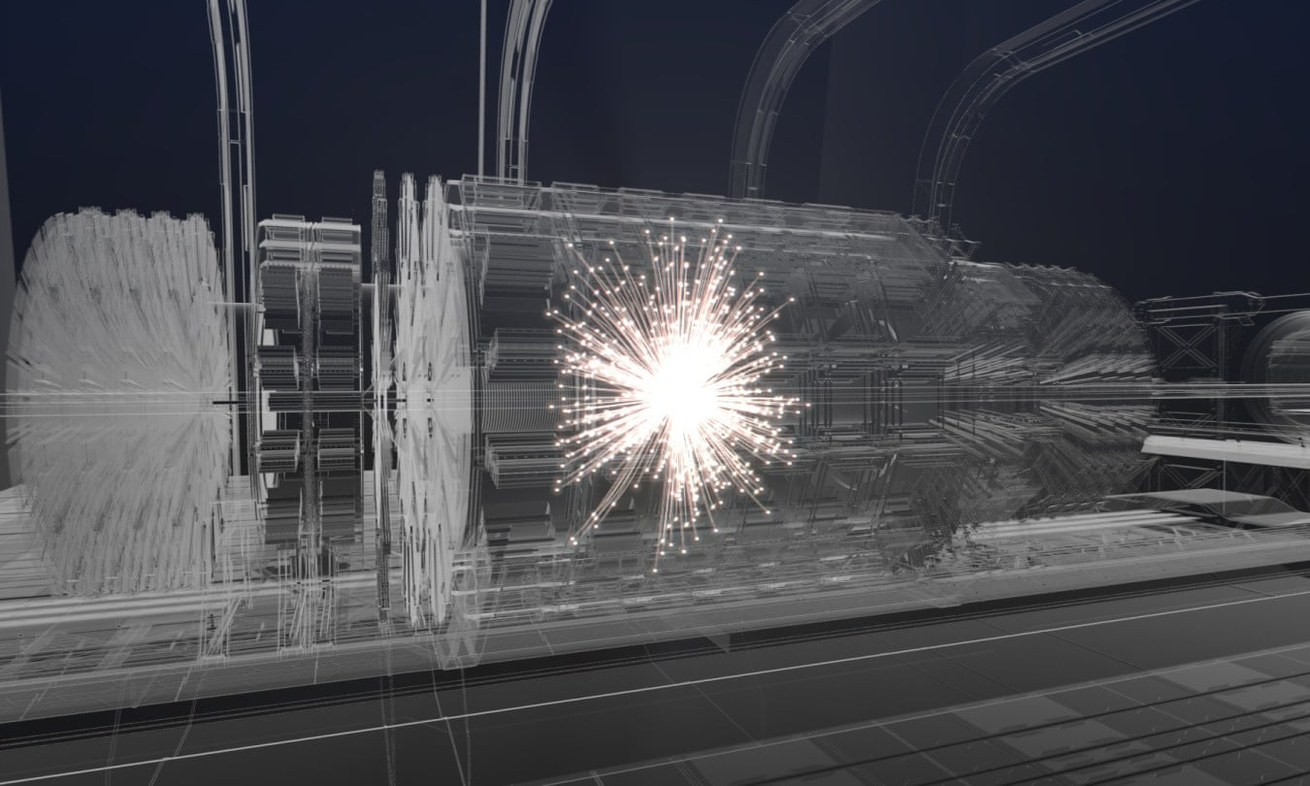
Challenges for detectors at FCC experiments
credit Polar Media
FCC-week public event, June 3/2022 D. Contardo, CNRS-IN2P3 IP2I

Slide 2
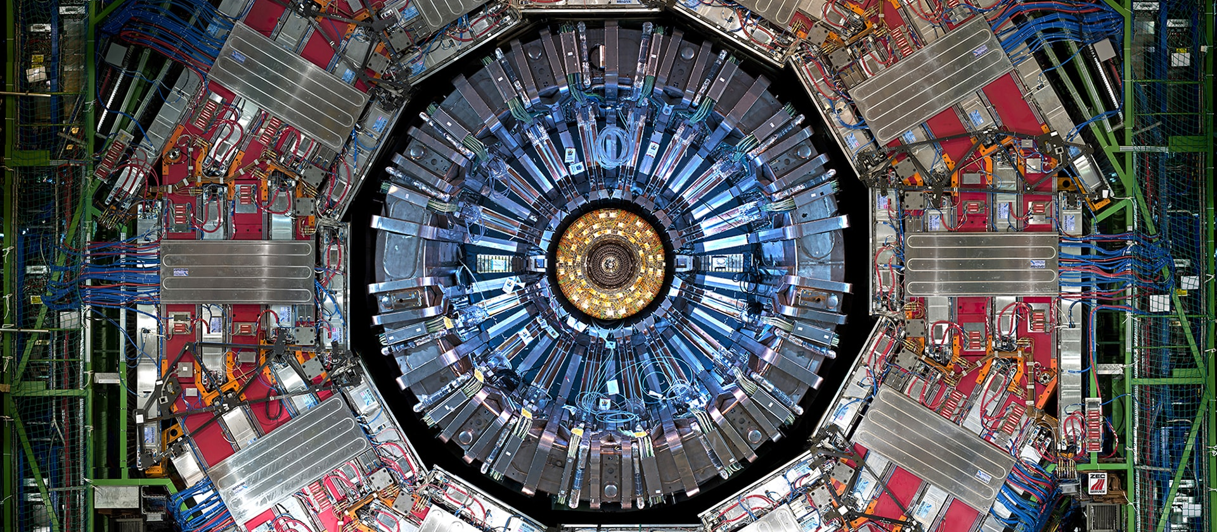
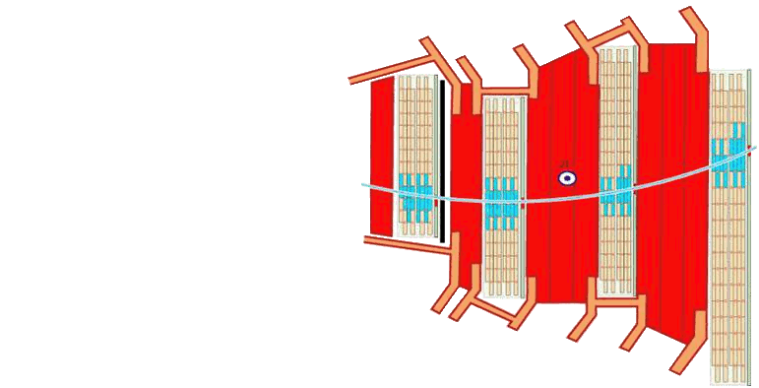
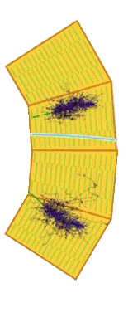
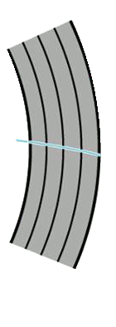
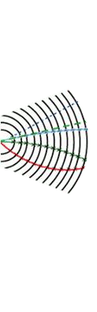
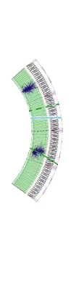
Ideally the detector measures all particles produced in each beam collision
Front view of the CMS detector barrel part
γ
h⁰
μ
Muon Chambers
Solenoid
Hadronic Calorimeter
Tracker
Electromagnetic Calorimeter
e±
h±
Hermeticity allows to assess missing energy carried by non-interacting particles 𝜈, Dark Matter
2

Slide 3
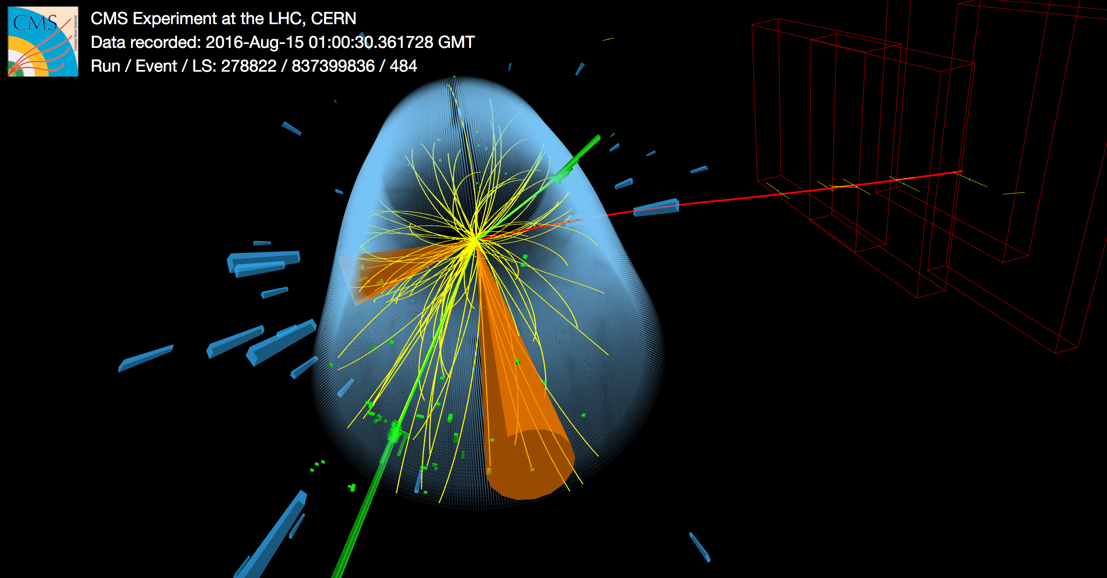
Ideally data are reduced to sought signals and background
of known physics process leading to a same final state
event reconstruction is a local and global complex process*
selection is based on energy content and event topologies**
apparatus efficiencies are corrected in analyses of datasets
ex. tZq candidate event
jet
e⁺e⁻
W + b-jet
μ + 𝜈
* Forming 1) particle hits in layers: channel calibration and clustering, and 2) physics objects: all hits combined to form trajectories of identified particles associated to a same collision with calibrated parameters
** a fast pre-selection can be performed at data taking (online), full precision is eventually used for final physics analysis selection (offline)
3

Slide 4
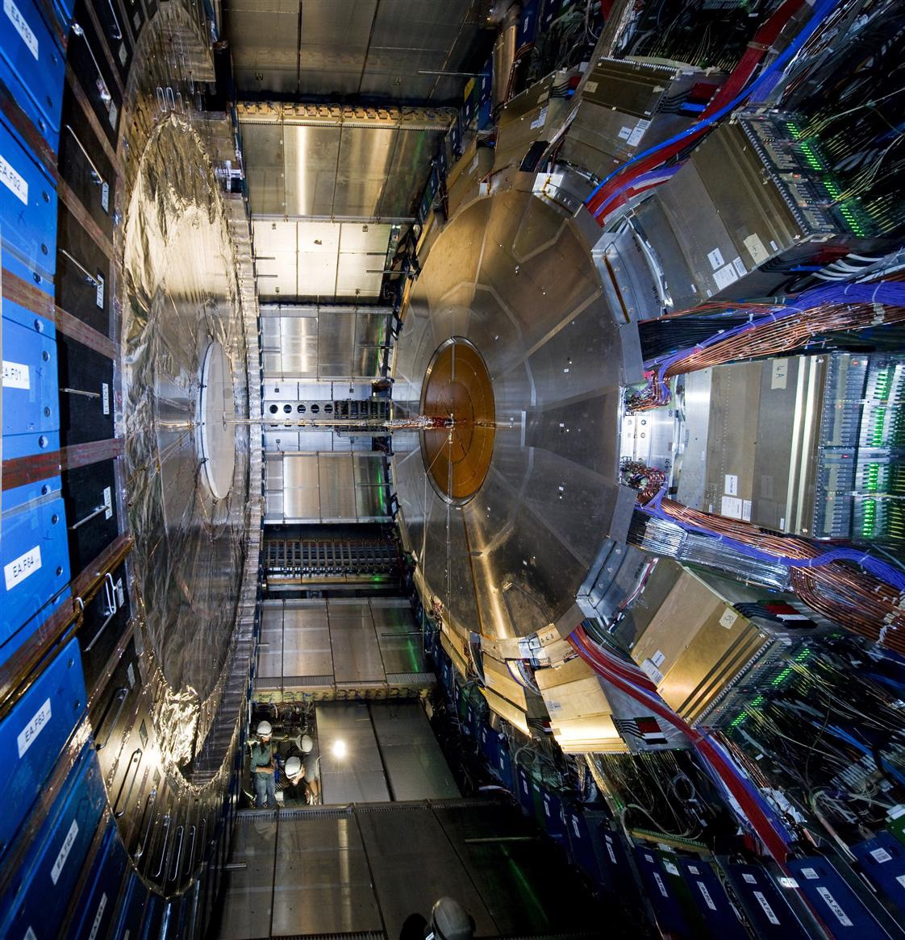
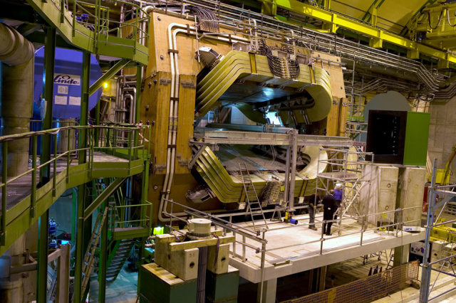
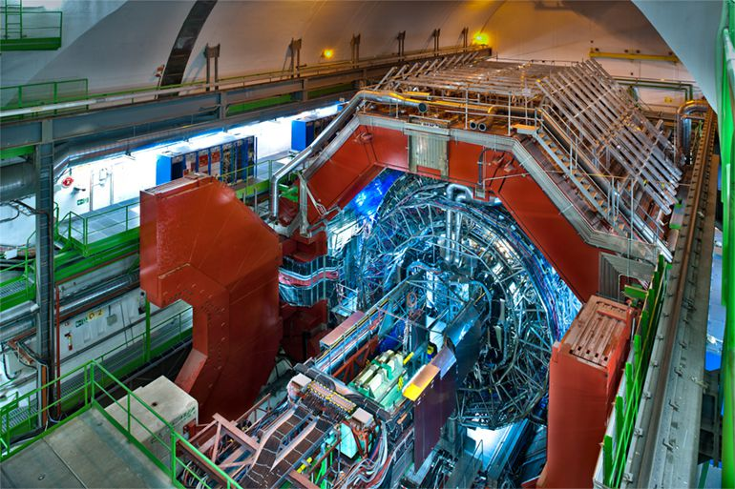
LHC detectors can be visited at CERN
here in open configurations
ATLAS
CMS
LHCb
ALICE
Illustrations in the following are mostly taken from these detectors
or State of the Art developments
4

Slide 5
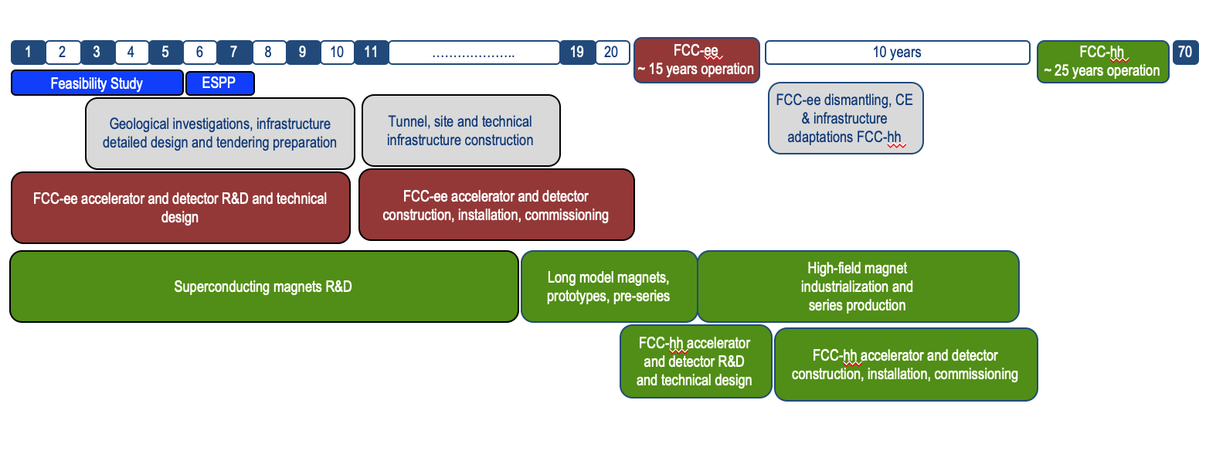
Timeline of the FCC program
technologies R&D
conceptual design
final system
engineering
FCC-ee detector preparation
production
Instal.
2021
2026-27
2032
2035
18
2043-45
Experiment upgrades for the High Luminosity LHC are stepping stones toward FCC detectors*
Technology progress over > 20 years of R&D by FCC-hh are hardly predictable
* During long shutdowns of the accelerator: in 2026-28 and 2033-34
5

Slide 6
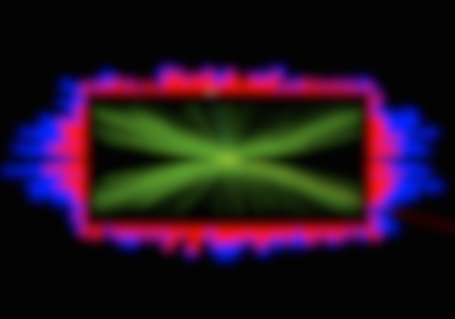
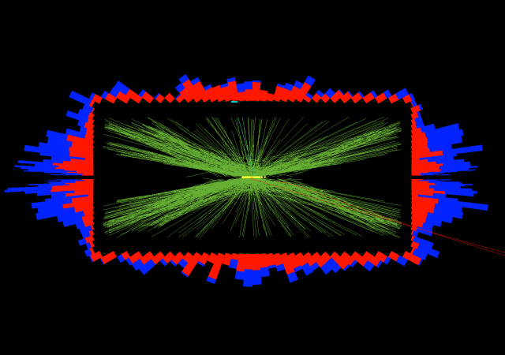
FCC-ee detectors uncertainties should be brought to the statistical level
This requires unprecedented measurement precision
in all components of each system, altogether, and in metrology
beam energy O(10⁻⁶), luminosity O(10⁻⁴), detector acceptance O(10⁻⁵), B-field to O(10⁶)
FCC-hh detectors will have to cope with unprecedented collision rate
30 GHz - <1000>/ bunch crossing every 25 ns, and O(10²) x LHC irradiation levels
It will require similar features as for precision in FCC-ee detectors
plus new paradigm of 4D measurements with time precision < 10 ps to separate collisions
It will demand on-detector processing for data reduction and new range of transfer bandwidths
New materials will be needed in several systems for radiation tolerance
3D tracking
4D tracking
FCC-hh collisions are separated by <170> μm and <0.5> ps
6

Slide 7
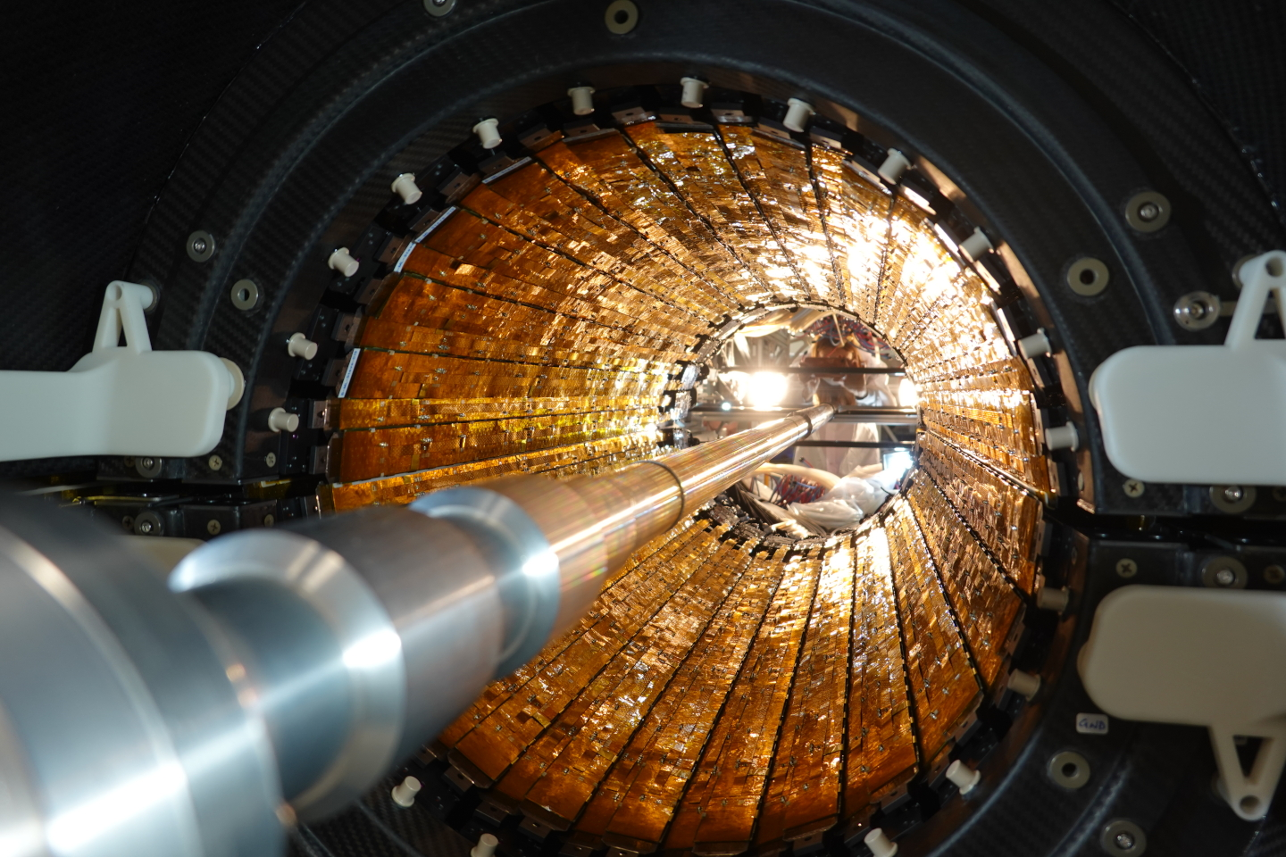
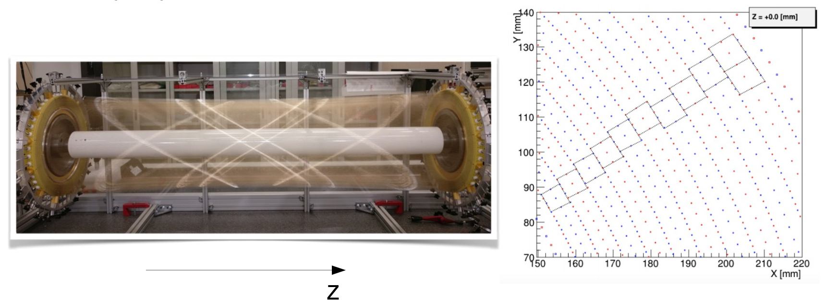
FCC-ee tracking must measure particle origin (Vertex Detector) with
O(1) μm precision & transverse momenta (Central Tracker) to O(10⁻⁵⁾ /GeV
A challenge for hit position precision and for transparency of the overall system*
Two conceptual designs and 3 technology options can be considered
Solid State Detectors surrounding Central Gas Detector: Drift or Time Projection Chamber
O(100) points at O(100) μm, best transparency
Solid State Devices tracker, O(10) layers
best accuracy < 10 μm, not most tansparent
ALICE inner tracker
ALICE TPC
Vertex detector
Meg-II DC
7
* To minimize multiple scattering energy loss and interactions in crossed materials

Slide 8
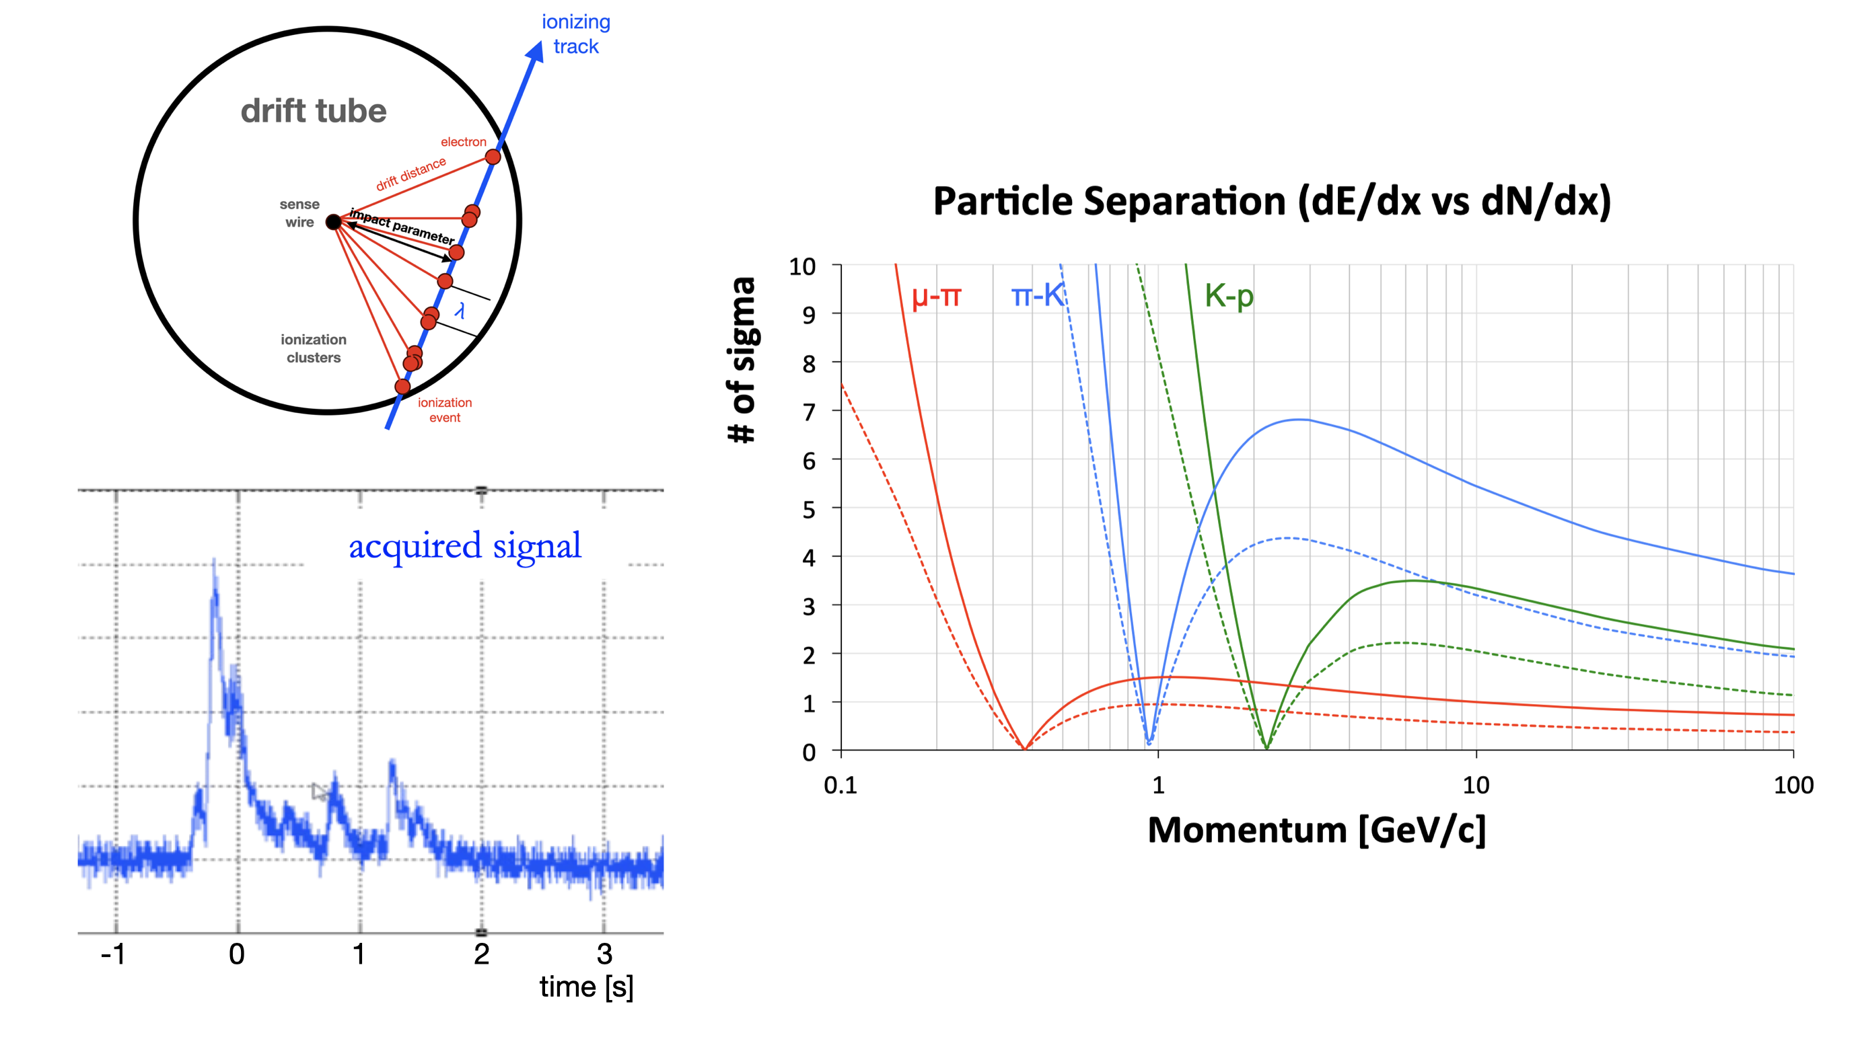
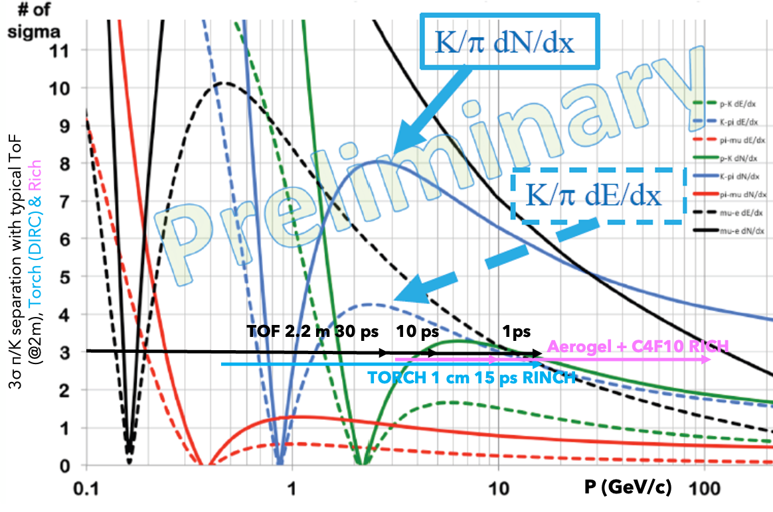
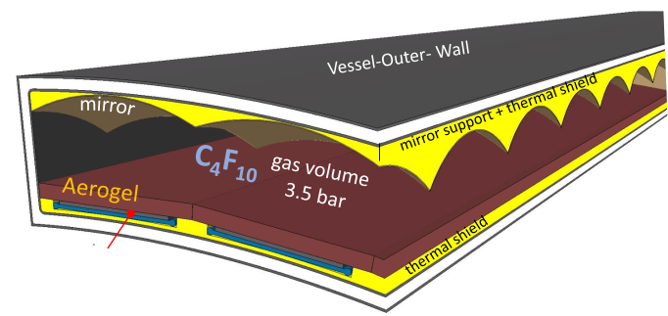
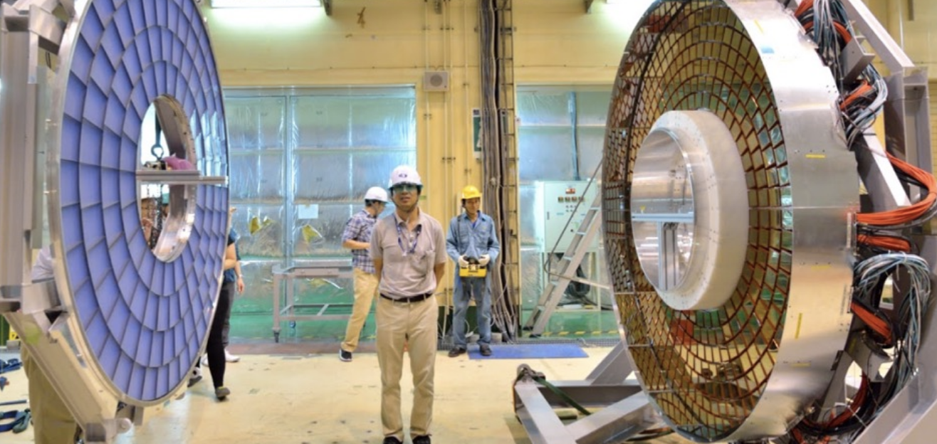
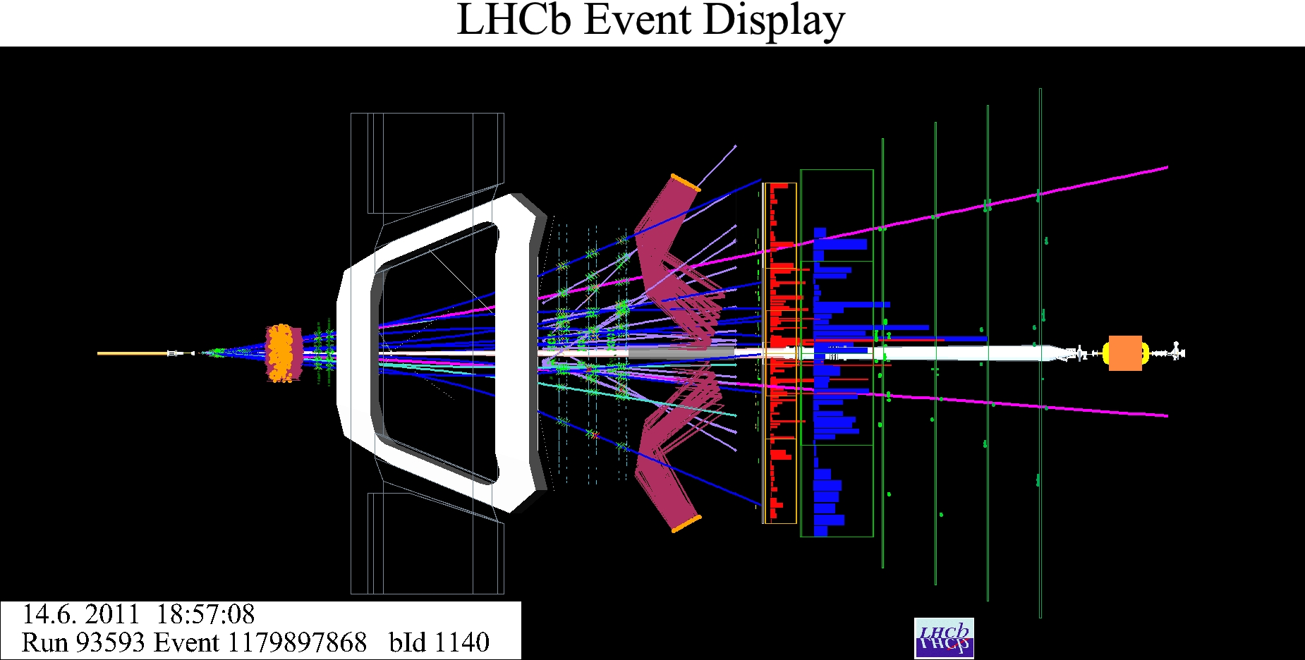
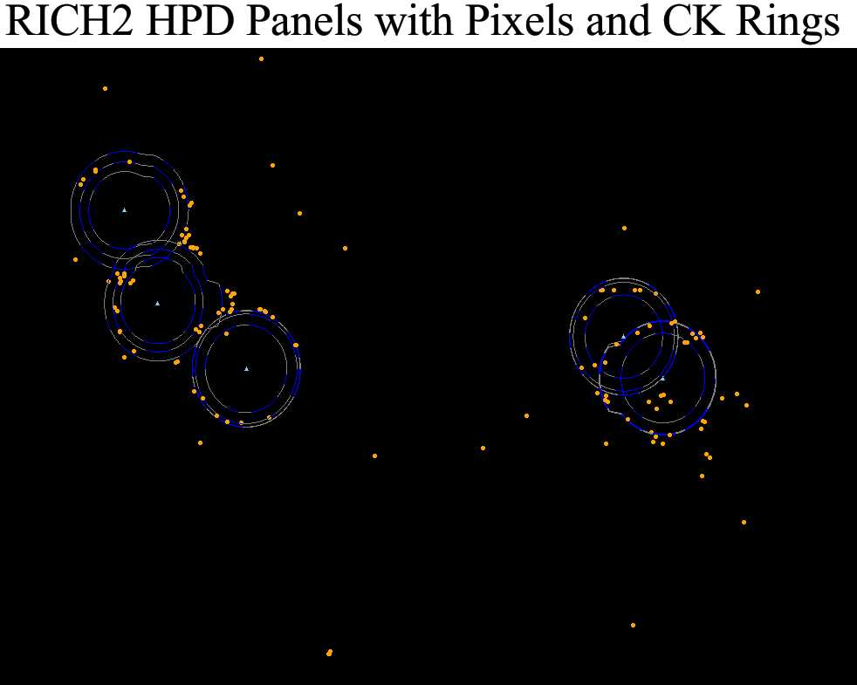
FCC-ee e/π/K/p identification must cover O[1,>50] GeV/c
not yet achieved in a single system, the range reached depends on measurement precision
3 complementary methods with different technology
Tracker Drift / Time Projection Chamber
Up to >50 GeV, ineffic. at dE/dX crossing
requires new dN/dx technique
Time of Flight layer(s) (≲ 10 ps)
O[0.1-5] GeV/c
Integrated with tracker
Solid State/Scintillator/Gas
Ring Image Cherenkov
O[5, >50] GeV/c
light, thin outside tracker, new design
coupling aerogel + gas radiators
20 cm
SiPM
ALICE TPC
Meg-II DC
Belle-2 aerogel RICH
LHCb gas RICH
8

Slide 9
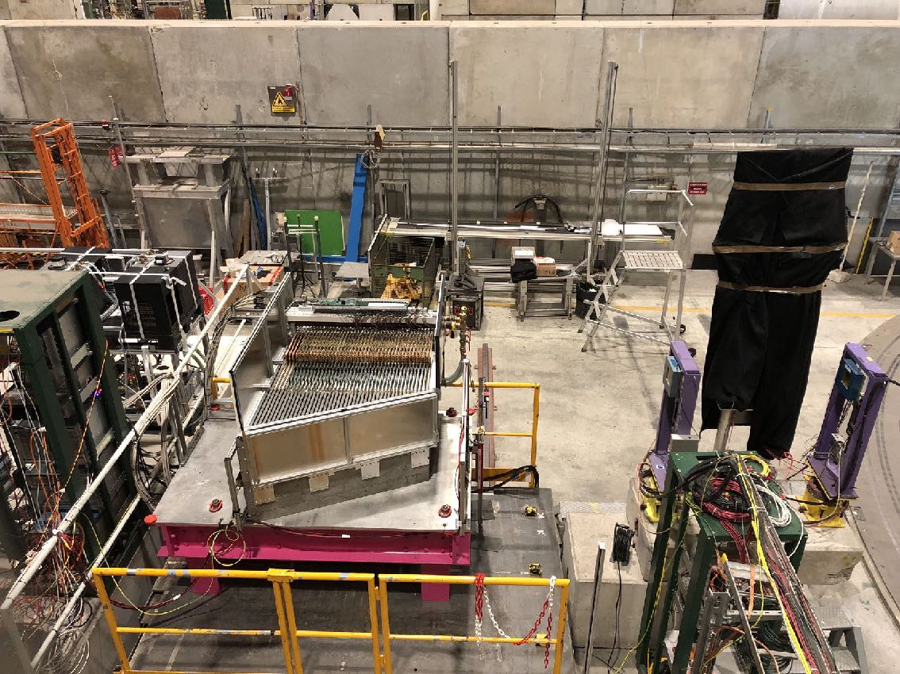
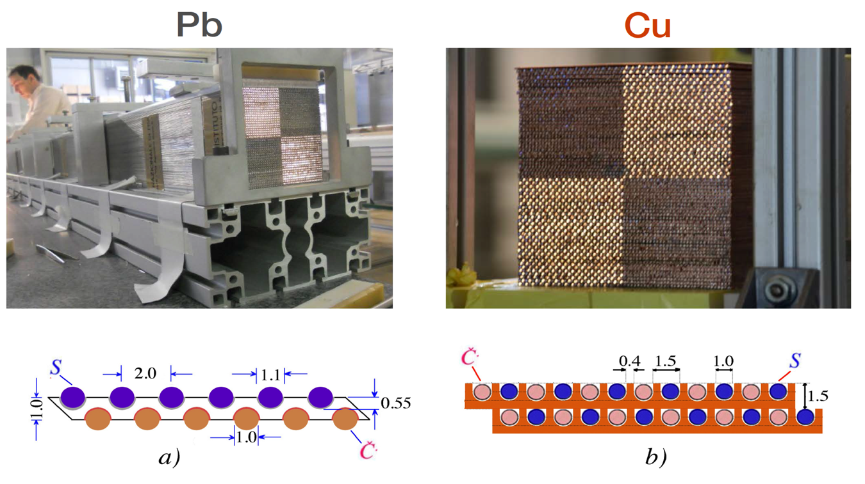
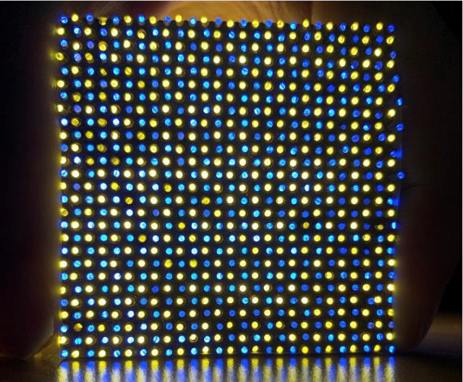
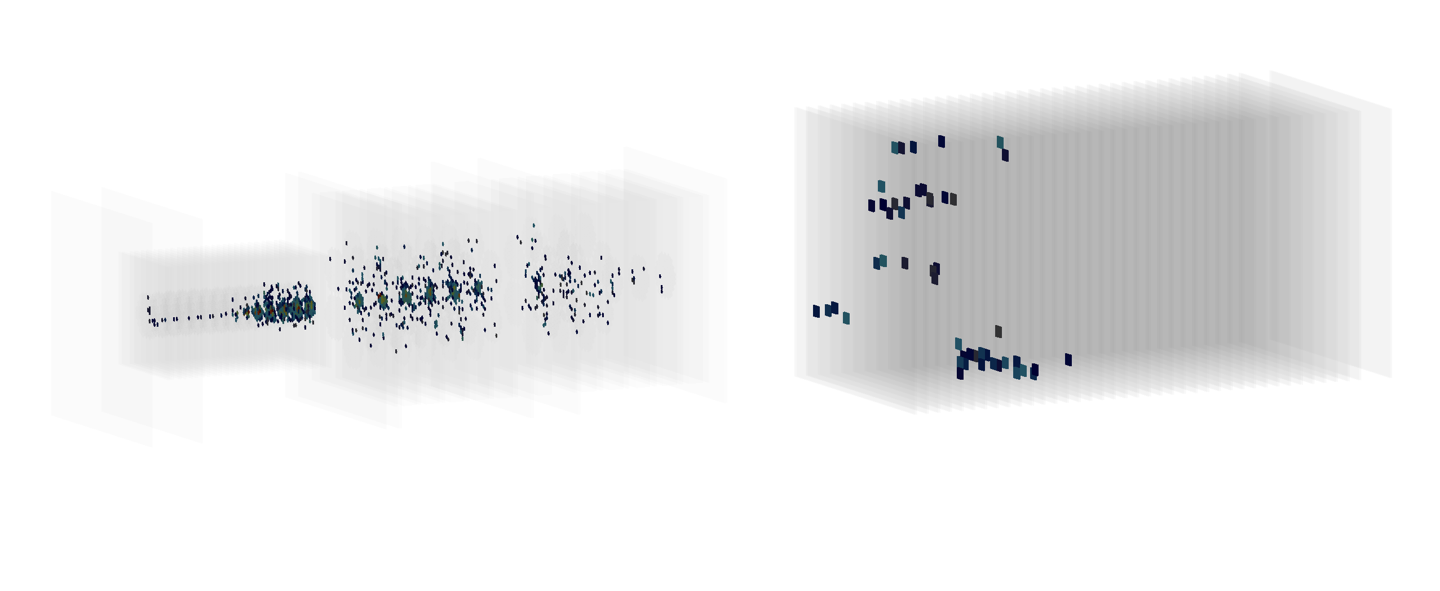
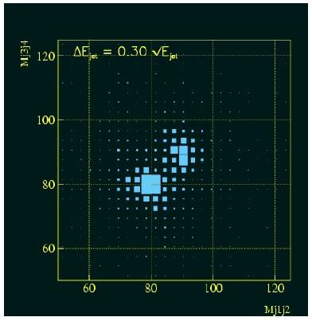
FCC-ee calorimetry high energy resolutions is needed for e/𝛾/h and jets
Best performance for all objects is not yet achieved in a single calorimeter or detector concept
Several possible combinations of configurations and technologies can be considered
below two options with single concept for electromagnetic and hadronic segments
High Granularity Calorimeter
sandwich of several absorber & sensitive layers: solid state device/scintillator/gas
3D shower topology provide very good particle ID, pointing, matching to tracks for jet resolution
CMS at HL-LHC
CALICE
CALICE*
French flagship pioneering development for ILC
IDEA FCC-ee
Dual Readout Calorimeter
longitudinal Scintillating & Cerenkov fibres in absorber
best hadron energy resolution, 2D showers so far
H→ ZZ →4j
H→WW→4j
hadron shower
9

Slide 10
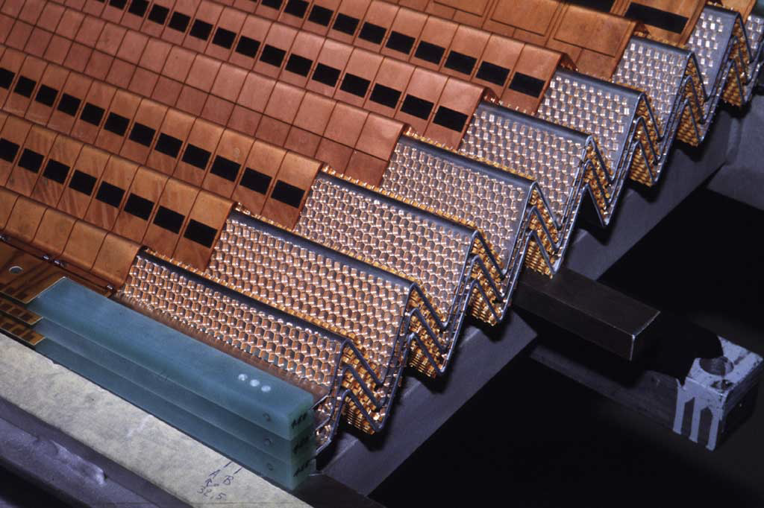
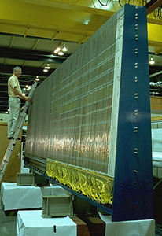
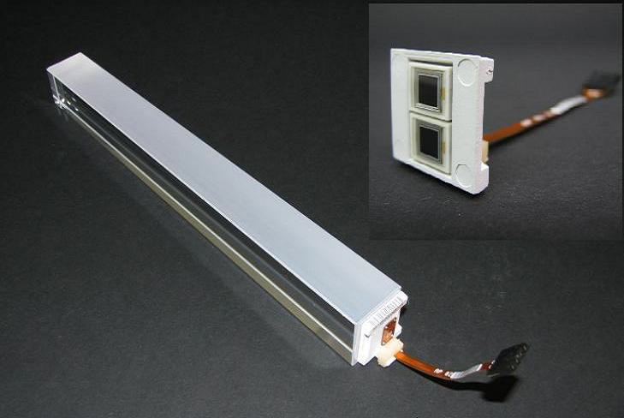
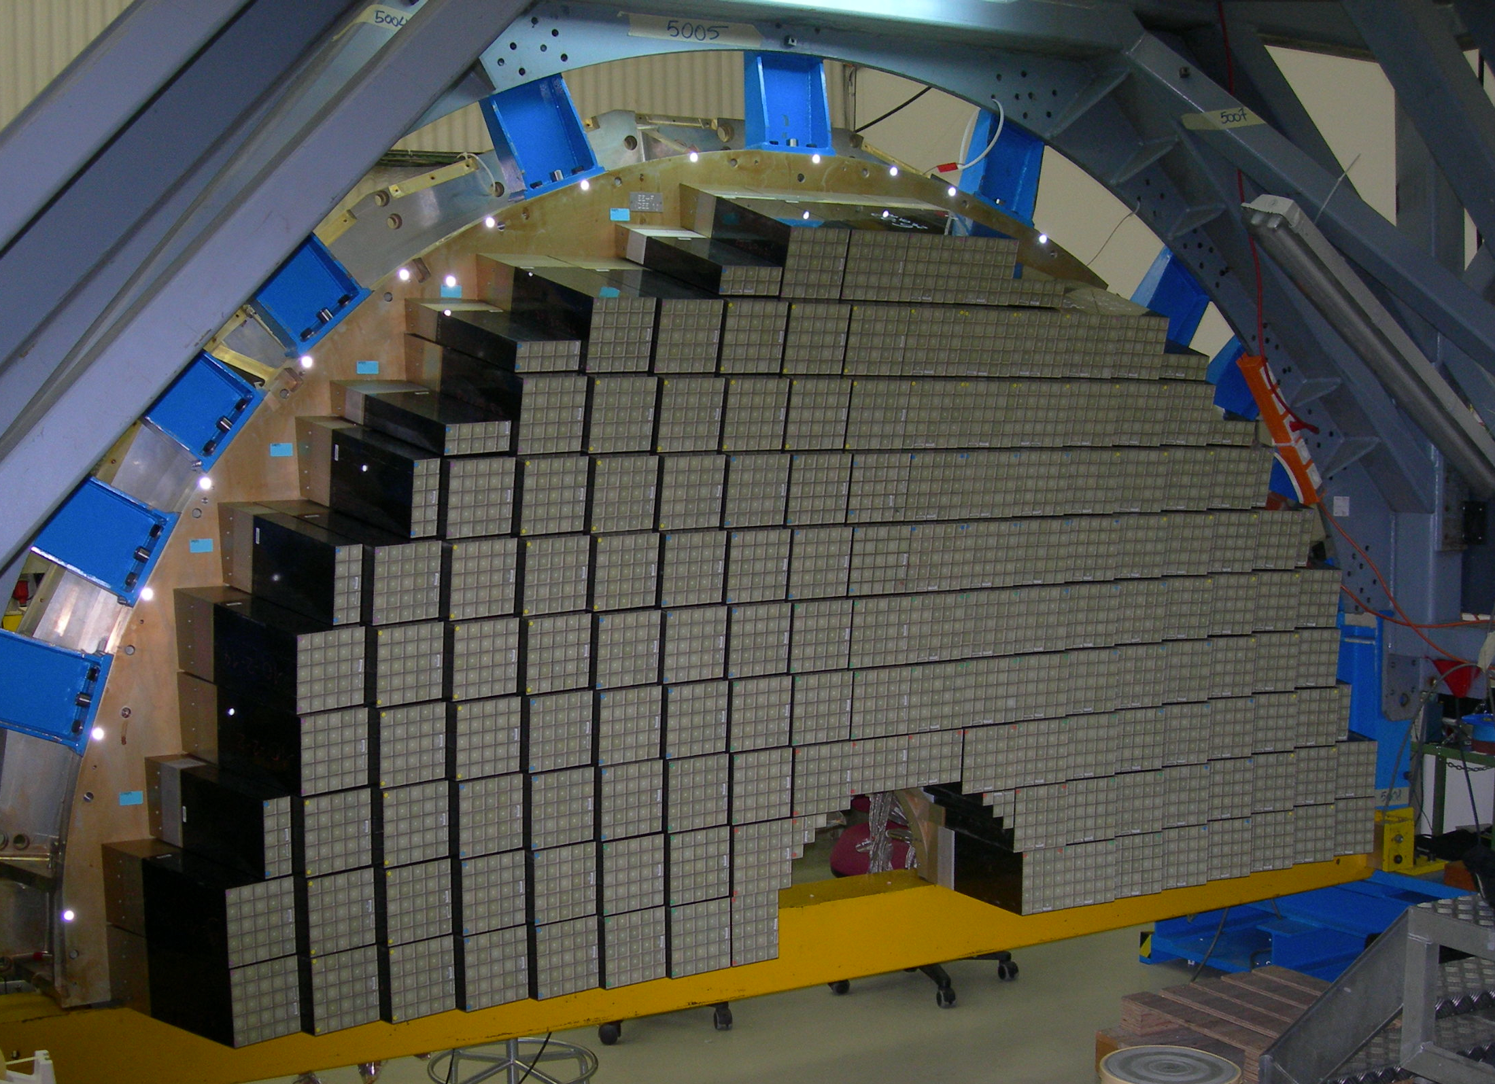
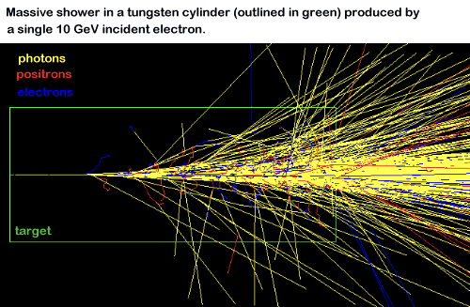
FCC-ee calorimetry high energy resolutions is needed for e/𝛾/h and jets
Best performance for all objects is not yet achieved in a single calorimeter or detector concept
Several possible combinations of configurations and technologies can be considered
below two options with different concepts for electromagnetic and hadronic segments
Noble Liquid Gas (Ar/Kr/Xe) electromagnetic segment
Followed by scintillating tiles hadronic segment
good energy compromise, high stability, most radiation tolerant
ATLAS LAr concept
ATLAS Scint.tiles
APD
CMS endcap
Electromagnetic calo.
CMS PbWO₃ crystal
Homogenous Crystal electromagnetic segment
best e/𝛾 resolution
Followed by Dual Readout or Scintillating tiles
hadronic segment
e/𝛾 shower
electromagnetic segment
e/𝛾 shower
electromagnetic segment
10
** French flagship accordion concept development

Slide 11
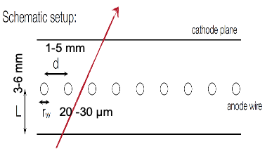
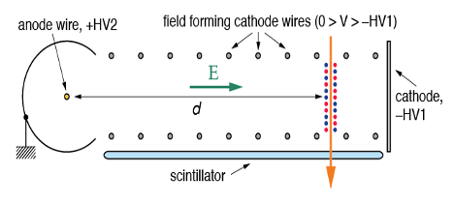
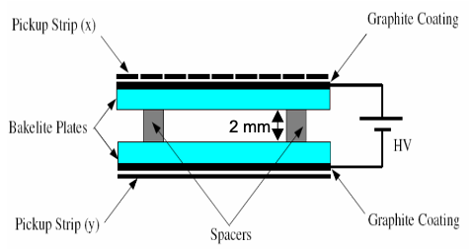
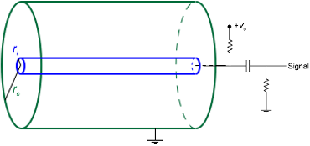
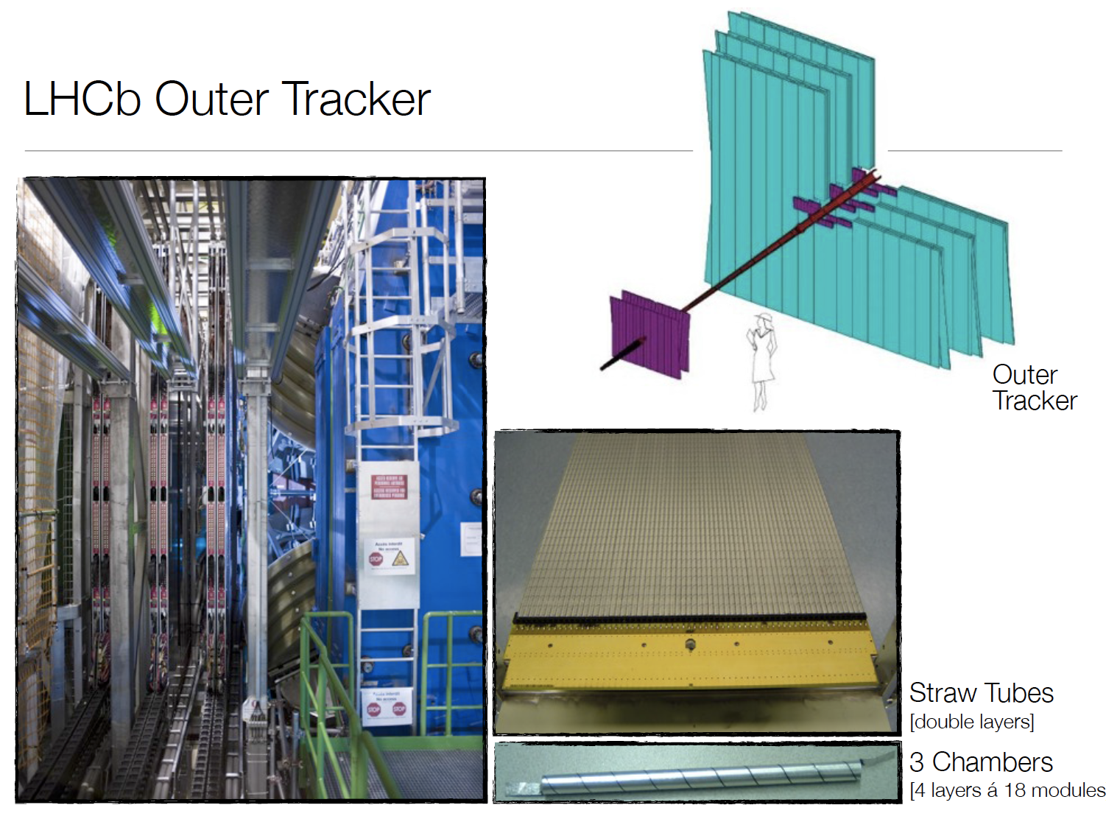
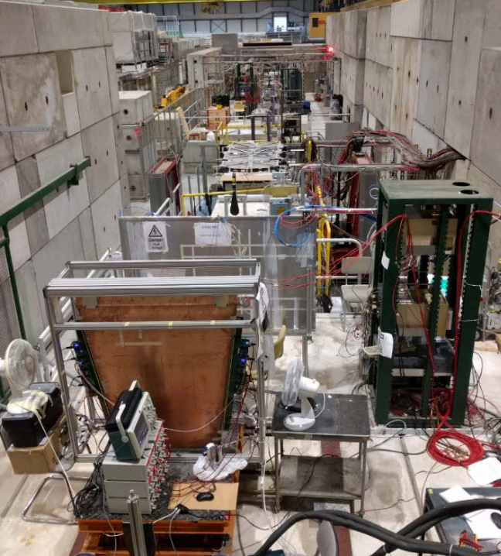
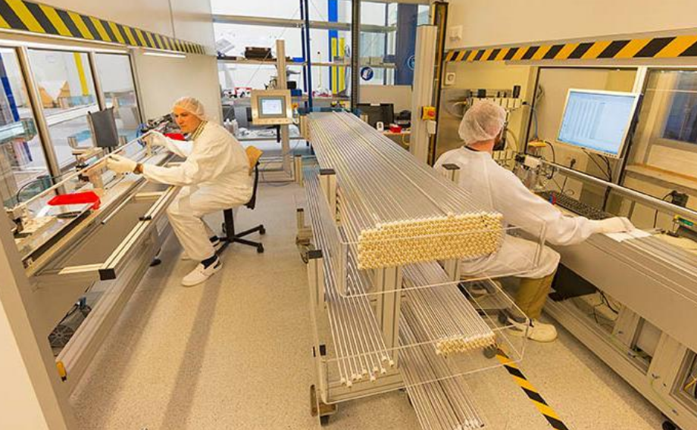
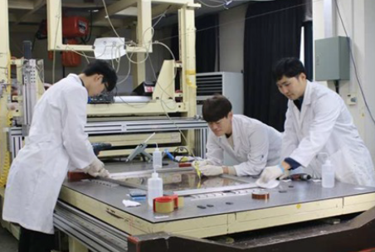
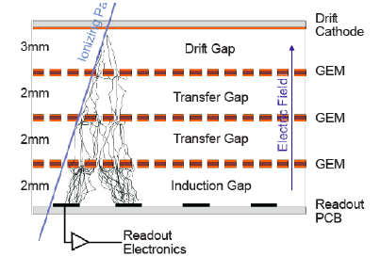
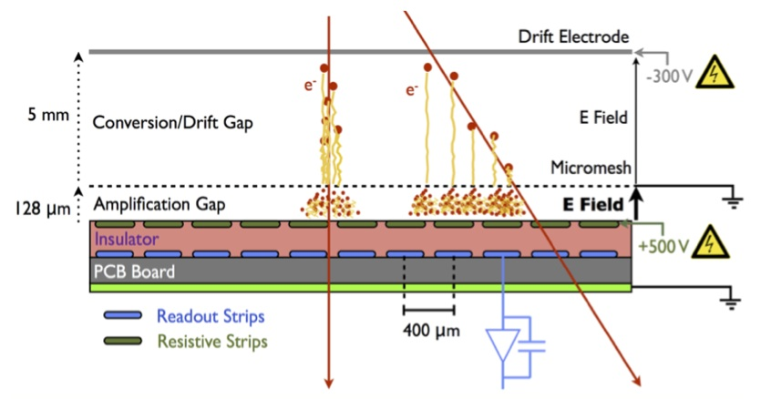
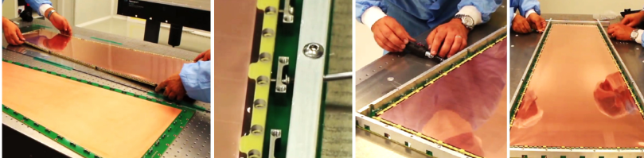
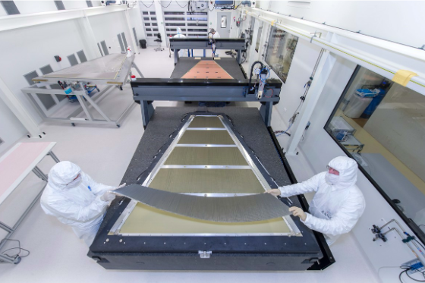
FCC-ee Muon system, existing Gas Detectors achieve performance needs
Several configurations of signal collection can be tailored to requirements
simplified devices for easier production assembly will be highly welcomed
Wires/strips/pads electrodes, precision O(0.1 – 1) mm and rates ≲ 10 kHz/cm²
Straw Tube
Cathode Strip Cham.
Drift Tubes (x = vt)
Resistive Plate Cham.
ATLAS
ATLAS
CMS
LHCb
MicroPattern Gas Detectors precision O(0.05) mm and rates O(1) MHz/cm²
Gaz Electron Multiplier (GEM)
MicroMegas** (MM)
CMS
ATLAS
** CEA/IRFU flagship development
11

Slide 12
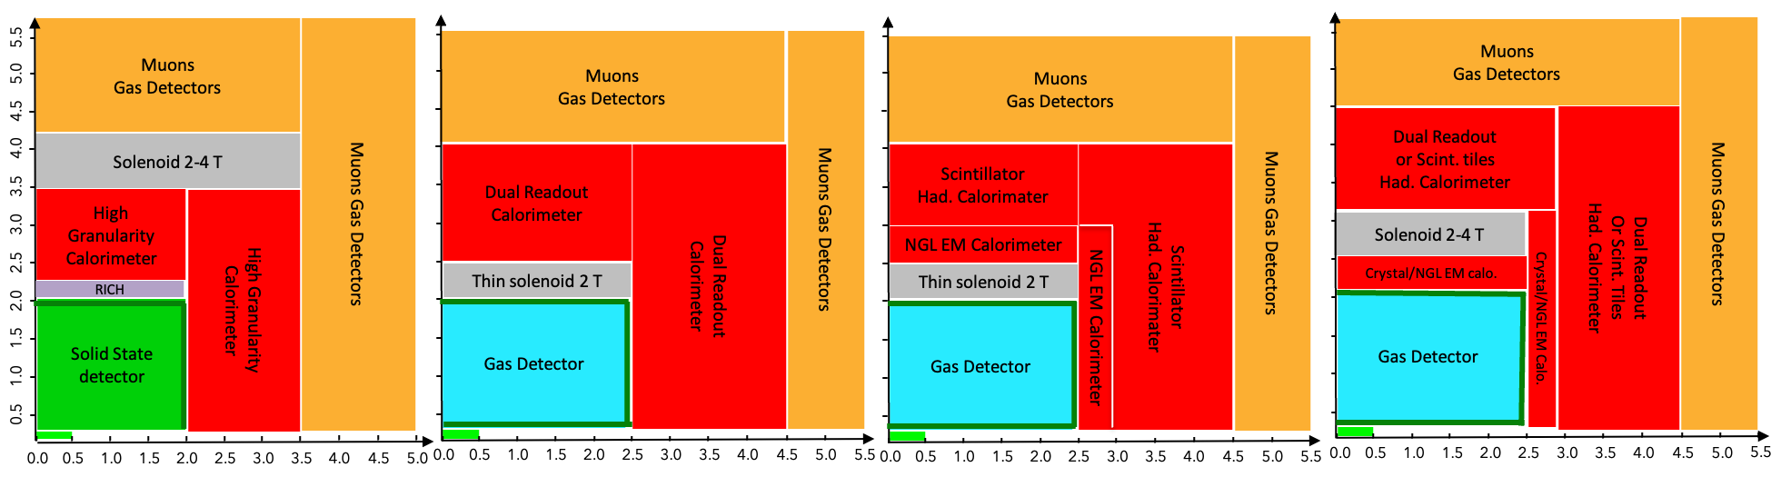
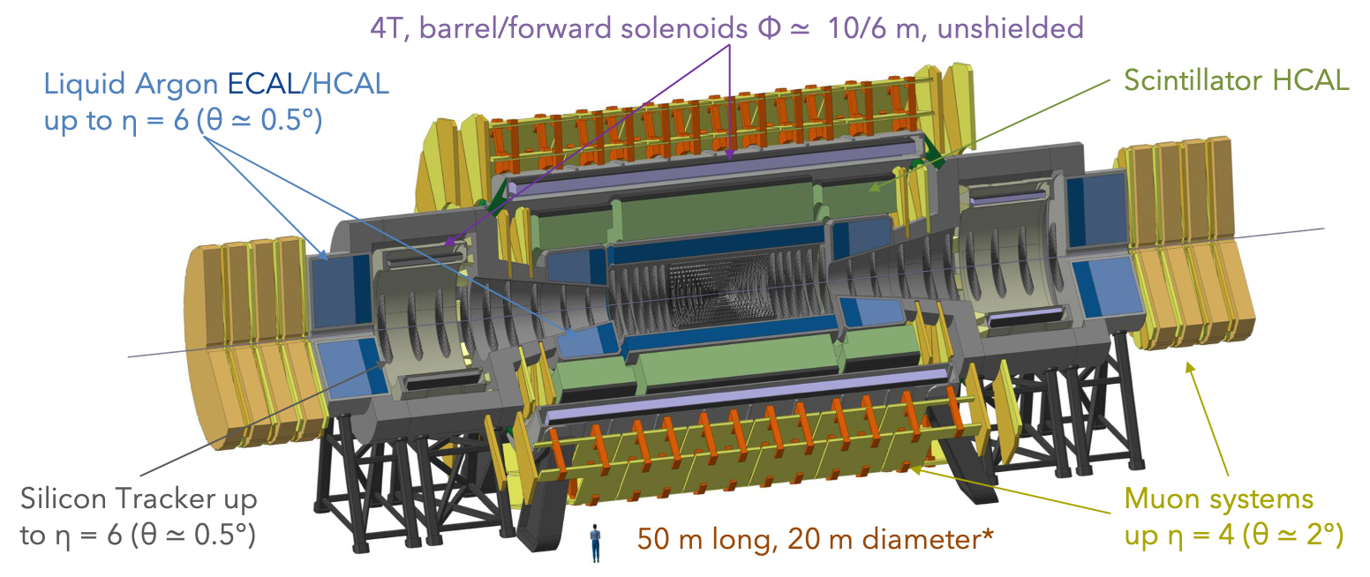
Detector Conceptual Designs
FCC-ee with 4 detectors is cost effective to increase statistics against operation time
Also allowing different perf. optimizations, technical risk mitigation, below 4 ex. based on options presented
FCC-hh, one feasibility conceptual design (at this stage)
Size and coverage in forward regions increase due to the particle boost
12

Slide 13
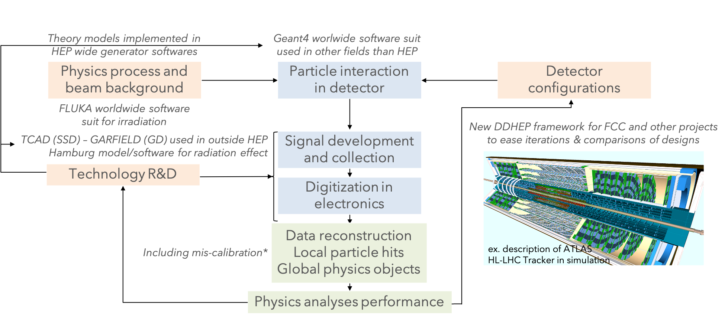
Detector design optimization is complex in itself
It must anticipate the experiment from end to end in simulation
FCC-ee building on common software framework developments to facilitate comparison of design scenarios
First attempt at Machine Learning made to link detector design parameters to physics reach (versus cost)*
by FCC-hh this may be how experiments will be optimized
* mode project of Joint ECFA-NuPPEC-APPEC Activities)
13

Slide 14
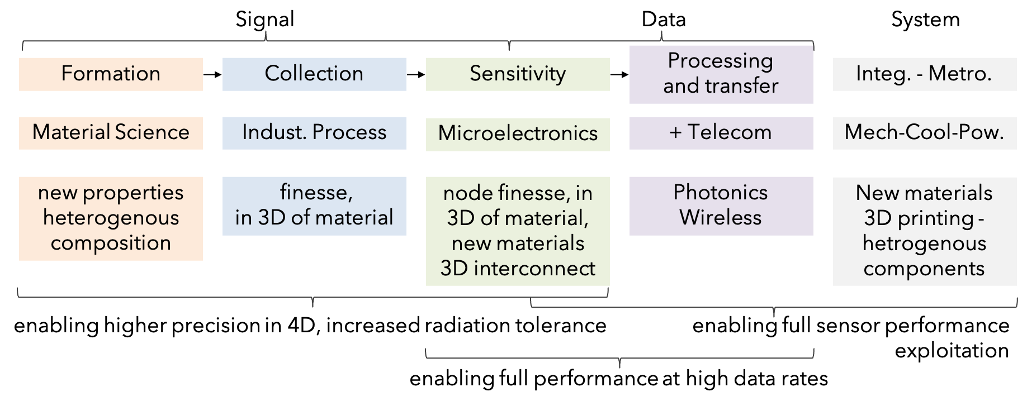
Schematic of common problematic and trends in R&D for all systems
Typical R&D path (not exclusive)
Develop sensor material and fabrication process with university, national research foundations, startups,
then transfer to medium size companies with commercial interest and production capabilities
For microelectronics access to large companies needed, requiring frame contracts (managed by CERN…)
Also facilitating EU programs ex. Europractice (multi-project runs), ATTRACT for industrial partners
14

Slide 15
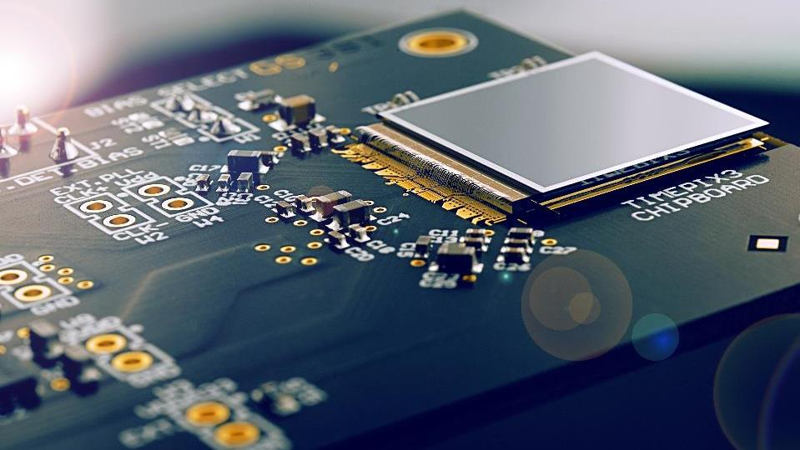
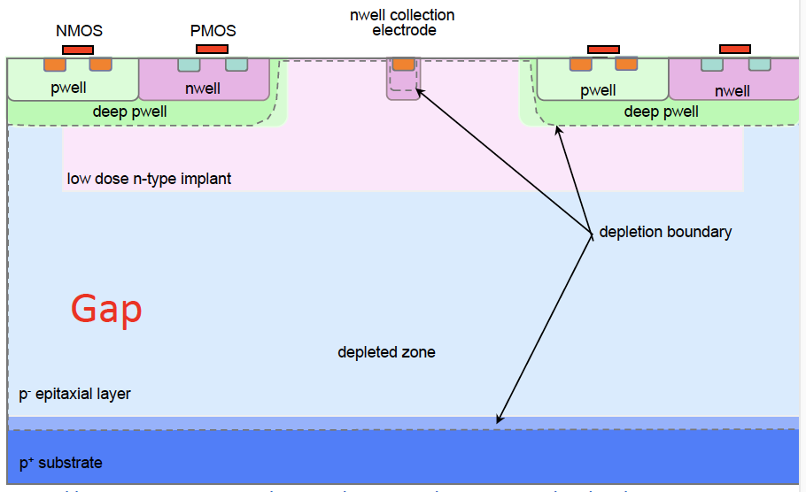




Solid State Devices
Semi-conductor materials (mostly Silicon as in microelectronics), provide highest granularity
and fast signal development for high precision, rate and radiation tolerance
Monolithic Active (CMOS) Pixels Sensors
with electronic built on sensitive element
(French flagship pioneering development)
Hybrid design, electronics bump bonded
to planar sensor, highest radiation tolerance
Timepix
Highest granularity & transparency
Technology Transfer (medipix CERN program)
ADVACAM single photon X-ray color camera
Use of ALPIDE ALICE sensors in
iMPACT
hadron therapy
CSES-Limadou 2
ESA/NASA
radiation monitoring
MARS Bio:
X ray in color
InsightArt: goods analysis
pCT scanner
15
Note: several design variants exist, also for connection to electronics, in different process, technologies (ex. SoI, Bi-CMOS for MAPS)

Slide 16






Solid State Devices, precision and transparency priority at FCC-ee
≲ 3 μm - large area sensors - low power dissipation O(20) mW/cm²
best candidate is the CMOS Imaging Sensor commercial process
Specific feature are being developed in the limit of tolerable adjustment of foundry process
Modified process for full depletion
faster, more radiation tolerant
Mask stitching on 12’’ wafers
system transparency
Electronics architecture, fast
with low noise & power at high rate
O(100) MHz/cm² & precision <100 ps
critical to transparency for gas flow cooling
Carbon foam
MAPS 180 nm MicroSemi/Intel
ALICE MAPS 180 nm MicroSemi/Intel
Being ported to 65nm for pitch< 20 µm
Developments for ALICE inner tracker upgrade in 2026-28, paving the path toward FCC-ee
16

Slide 17






Solid State Devices, time precision
≲10 ps target will require new designs and electronics
challenging to reconcile with real estate at small pixel pitch and with low power requirements
Designs without gain
Designs with gain
3D electrodes
O(30) ps today
SIGe BiCMOS – CMOS planar large electrodes O(50) ps expected
Low Gain Avalanche Diode
O(30) ps today
Single Photon Avalanche Diode O(20) ps today
Strong interest in health care for Time of Flight PET and dose distribution in X-ray and hadron therapy
It is a photosensors for light devices problematic is similar to other SSD with specific issue of Dark Current and UV sensitivity
ex. Of development
path from national research
labs to industry
17

Slide 18



Solid State Devices further prospect
In High Granularity Calorimeter MAPs of large size, 3D electronics integration
Can improve compactness, homogeneity and reduce dead materials for energy resolution
Vertex Detector type MAPS
counting particles with time precision O(<10) ps could provide ultimate shower measurement
Heterogenous FOrwardCALorimeter ALICE project
CMOS imaging technology can offer more, lower nodes and 3D integration of electronics functions
may naturally bring ultimate hit & time precision, at lower power consumption & higher radiation tolerance
Commercial imagers
Left: Sony(left) 3D layer thinned to 3 µm, DRAM for 960 fps Right: Samsung (right) 1.2 µm pixel pitch,
2.5 µm TSV 6.3 µm pitch, 20 nm DRAM, 28 nm logic
18

Slide 19


Solid State Devices, radiation tolerance at FCC-hh
Most radiation tolerant design today would not survive below a radius of O(30) cm
Non Ionizing Energy Loss affect sensors (signal), tolerance needs to increase from O(10¹⁶) to O(10¹⁸) neq/cm²
  3D sensors may still work al lowest radii with O(year) replacement*
Total Integrated Dose affects electronics, tolerance needs to increase from O(1) GRad to O(30) GRad
Finer nodes than those explored so far (< 65 nm) could provide improvements, to be evaluated
New materials / 3D process are likely to provide more radiation tolerance
Wide Band Gap semi-conductors expected to be more radiation tolerant (ex Diamond already used in HEP)
SiC/Graphene technologies are now used in microelectronics industry**, driven by energy efficiency/photonic
higher dielectric oxide and multiple gates designs in 3D are also being implemented in deep node technologies ≲ 5nm
ex. CVD-diamond 3D pixel sensors
ex. microelectronics 3D FinFET
* qualification above 10¹⁷ neq/cm² not easy, but recent tests indicate an unexpected saturation of leakage current and smaller charge trapping
** Starting to be accessible through europractice Multi Project Wafers (ex Franhaufer IISB)
19

Slide 20









Light devices for Dual Readout calorimetry
Several new materials investigated for high light yields & sub-ns precision integrated in single medium
Basis is doping of crystals/glass, embedding quantum/nanomaterial for fast signals, in fibers, cubes…
New fabrication techniques, square fibers, 3D printing both for sensitive material and absorber
Allow new designs with: higher ⊥ granularity, // segmentation physical or from time precision
ex. low cost dopped glass for homogenous hadron calorimeter
ex. Quantum dots allow tuning of wavelength, opening new idea for // segmentation
Sapphire:Ti
Cerenkov
Scintillation
ex. perovskite in polymere
BaSiO₂
SiO₂:Ce fibers
Attract/Preciosa
Large interest in materials developments for PETs with
synergies in fast electronics development
Pulse sampling for precise time and to discriminate Scint. & Cerenkov components
ClearPET small animals
ClearPEM breast
endo TOFPET
CMS calorimeter
CMS LYSO timing detector
Crystal module 2 cm²
CMS APDs
20

Slide 21










Front-End ASICs
Will require smaller nodes, this is driven by microelectronics industry
Time consuming to train and get expertise, specific design rules to develop for radiation tolerance
work is started on 28 nm, technologies for FCC-hh not yet predictable
Developments needed for NBL calorimeters for higher ⊥ & // segmentation with low power & cold electronics
New design for 12 depth segmentation with multiple layers PCB
Synergies with DUNE TPC full cold chain
40 cm
multiple layers PCB
FE ASIC
ADC
barrel
Expertise and specific property of custom designs are of interest for exploitation outside HEP
ex. Omega (IN2P3/CNRS) Weeroc startup (parternship MICROCHIP – ATMEL – AIRBUS – CNES)
PET IRM Trimage
ASTRI CTA telescope
Ariane 5 et satellites
21

Slide 22







Gas Detectors, approaching performance of Solid State Devices
Exploit Printed Board Circuit technology with new single amplification stage design
Implement in CMOS process on ASIC, with conversion stage for time precision
Also important goal to minimize/recuperate/drop GHG
New idea with Graphene
Cerenkov radiator +
Photocathode
+
Micromegas
ex. InGrid CMOS MM
grid on pixel ASIC chip
μ-RWell
Picosec: 24 ps precision
Versatile, relatively easy systems to use and to adjust to several needs at low cost
X-rays, hadrons (medical applications), neutrons (ESS, ITER, reactors…) and other radiation monitoring
Exploiting cosmic Muons to analyze large structures for homeland security, geophysics, infrastructures…
Fukushima reactor imaging
Khufu pyramid at Giza
ex. La Soufriere Guadeloupe
22
Notes:
O(4000)m2 for muon system in simplification for technology transfer for production
Graphene matériau bidimensionnel cristallin tres bonne conductivite electrique et thermique, resistance mecanique souplesse transparence optique impermeabilite moleculaire

Slide 23






Data acquisition and selection scheme, a challenge at FCC-hh
ASICs in 3D integration
with AI for data reduction (ex. Dynamic Sensor Vision)
+ wireless communication between layers for further data reduction
plus photonics for high bandwidth transfer
Full readout
O(300) TB/s muon – calo.
O(3) PB/s tracker likely to require partial transfer to contain #links
LHCb generic DAQ board
Cots optical links
custom BackEnd boards
& commercial network
CPPM
1st selection O(10) μs, requiring efficient pile-up rejection
2nd selection O(100 ) ms
O(500kHz) physics output
Event building & data selection, custom FPGA boards, GPU & CPU
continuous progress already at LHC, AI algorithms ported in FPGA
LHCb demonstrated GPUs data selection at 5TB/s, ALICE performs full reconstruction on-line with GPUs, CMS achieved 25% off-loaded of selection to GPUs
Wireless: WADAPT 60 GHz RFIC and HR SoI antenna
Integrated ASIC and plasmonic modulator
ex. IEF ETH Zurich
IRFU/CEA & LETI
23

Slide 24


Off-line computing and software
FCC–ee requirements will be similar to those of HL-LHC
benefiting from further progress in continuous process to minimize resources
At FCC-hh a factor O(x50) in data scale will need a new technical leap to contain costs
Microprocessor clock frequency limits throughput of serial codes
K. Rupp
Growth is now through:
Parallel processing
  GPU well suited for ML, high throughput, less for data movements
  Opportunities FPGA, specialized proc. (ex. Tensor Processing Units for NN)
Multiple centers, with opportunistic computing at HPC
and Cloud data management
> 10% of computing reached today at LHC with test of GPUs on-going
Jean Zay GENCI-IDRIS HPC 109th world rank academic & industrial research for HPC associated to IA, 1st photonic co-processor
Migration has started with challenges to orchestrate use of different resources, automatize flows, adapt codes & train users
Other efforts, minimize number of data reconstruction,
reduce event size, improve algorithms performance
Other considerations, sustainability, minimize GHG emission
24

Slide 25
Open data and analyses
Data are becoming pubic through the Data European Open Science Cloud (EOSC)
providing seamless access to individual researchers and citizens
The European Science Cluster of Astronomy & Particle Physics ESFRI (ESCAPE)
establishes infrastructure and data management in relation with EOSC
Boosted Decision tree, Neural Network are used since beginning of LHC analyses O(10) years
enabled gain of 50% to 100% for evidence of signals observed much earlier than anticipated
Deep NN now outperform NN, on-going work on ML (systematic uncertainties, parametrized…)
ML developments are entering all stages of data treatment exploring several versions of NN
ex. Generative Adversarial Network to generate set of shower patterns
ex. Recurrent/Convolution/Graph NN specific to physics object reconstruction
Implementation in FPGA for fast first level data selection
Ideas emerge to to implement ML in custom ASICs
ML experts can provide very efficient contributions
already experienced in Hackathons
25

Slide 26

Detector R&D organization
Following approval of European Strategy for Particle Physics by the CERN Council in June 2020
ECFA prepared a detector roadmap approved by the CC in Dec. 2021
Wide consultation of the community, in 8 domains with working groups led to RD programs for future facilities
ECFA is now developing implementation building on previous RD collaboration’s model
Coordination framework recognized by institutions
Working Groups in all R&D aspects with worldwide expertise (including outside HEP)
Relation/access to technology research foundation and industrial partners
Training and knowledge dissemination
Relation to EU supported programs, AIDAInnova, ATTRACT… and to other regions
26

Slide 27
The FCC program is a unique opportunity to unveil mysteries of the universe
Necessary instrumentation and data treatment progress are multi-disciplinary,
well in line with society needs
We are calling on and contributing to the technical developments
in other science and at industrial companies
Looking forward to new ideas and collaborators
we can offer an inspiring framework for young people, to bring
or gain expertise in their preferred area, they can make a difference
Thank you for your interest
27

