Slide 1


Slide 2
FUTUR CIRCULAR COLLIDER
FCC
2 juin 2022 / Public event
Pierre Védrine
a new large collider for the 21st century

Slide 3
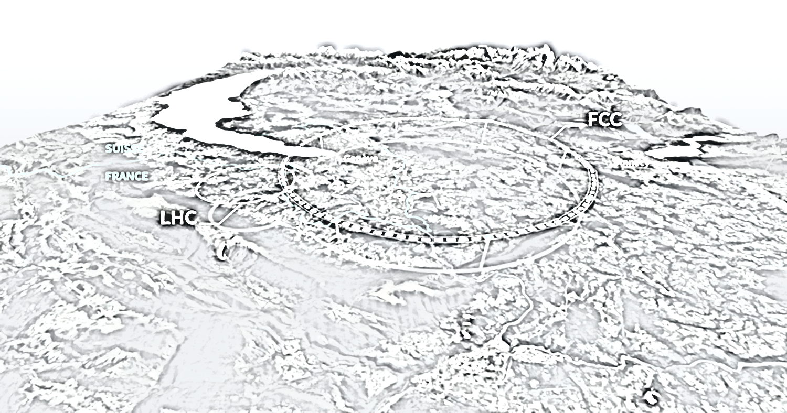
FCC
collider
What it is and how it works ?

Slide 4
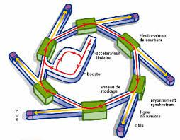
Particle Accelerators what it is ?
User community
Study the matter -> collisions
Particle physicists
Nuclear physicists
Synchrotron radiation production
Physicists
Chemists
Biologists
Engineers
Industrialists
Historians
Artists
Irradiation
Physicists
Chemists
Physicians
Industrialists

Slide 5
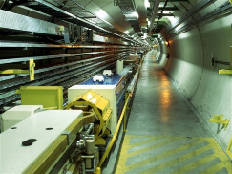
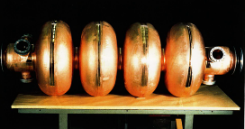
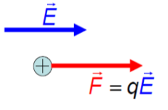
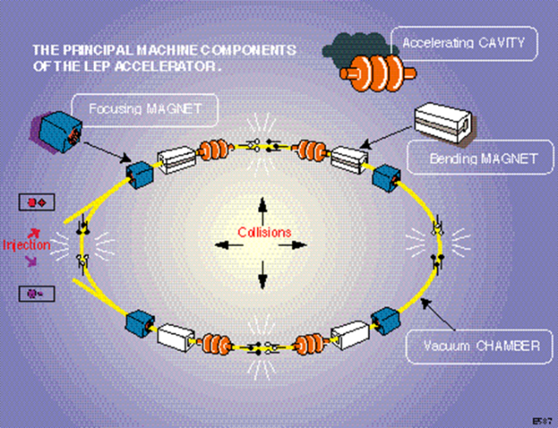
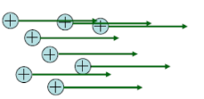
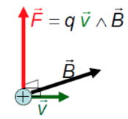
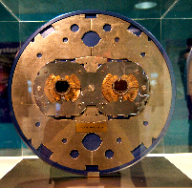
Particle Accelerators how it works ?
E
Beam: a set of charged particles with an overall velocity
Force parallel to speed: acceleration, energy increases
B
Force perpendicular to speed: deflection, energy remains constant

Slide 6
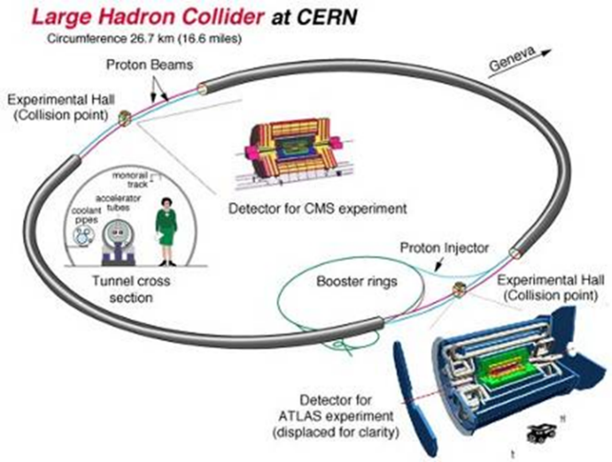
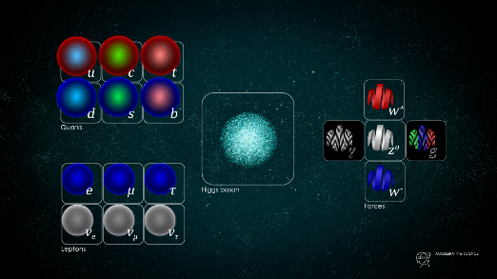
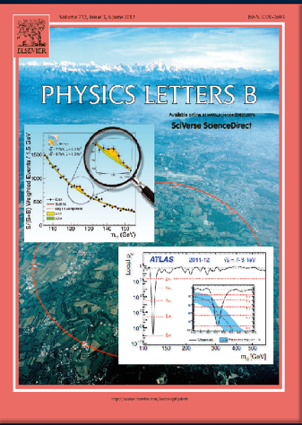

Large Hadron Collider @ CERN
14 TeV proton-proton 27-km collider with 8.3 T superconducting magnets:
Installed in a 27 km tunnel, to produce the events needed to study the "Standard Model" of particles to understand "mass", the Higgs boson and more...
Higgs boson discovery 2012

Slide 7
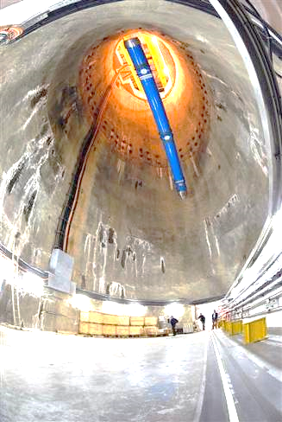
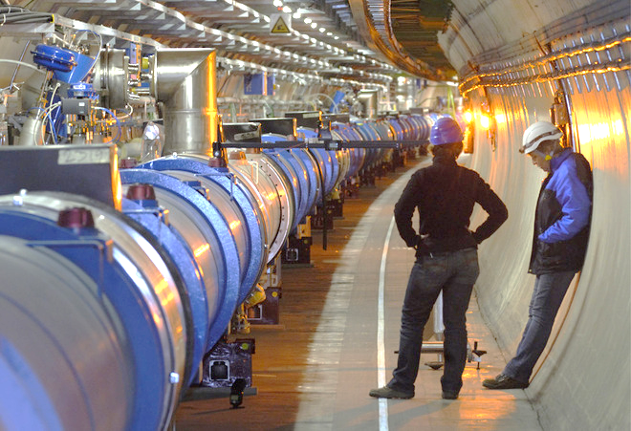
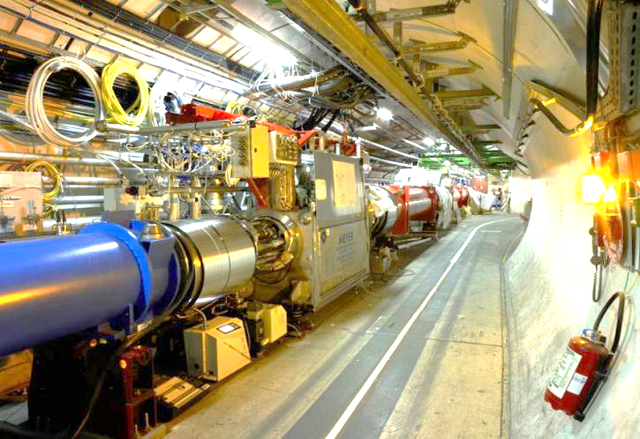
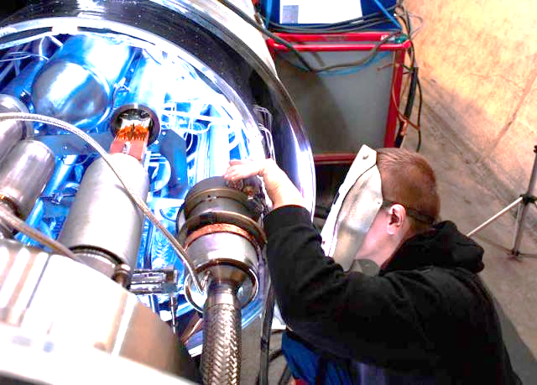
LHC Superconducting Magnets

Slide 8
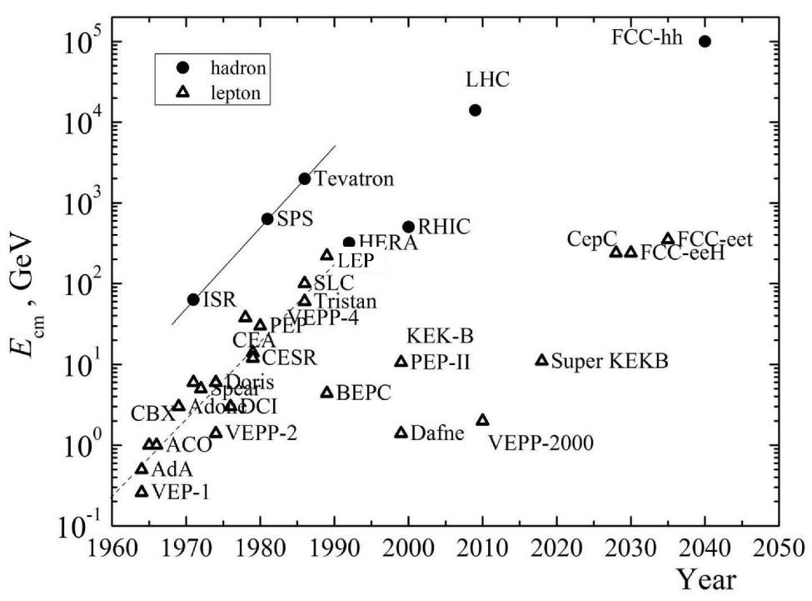


What’s next after the LHC…
pp
E_{cm} $∝$Bρ
hadron-lepton
factor 10 every
20-30 years
ep
factor 10 every
10 years
FCC-he
LHeC
e⁺e⁻
factor 10⁵-10⁷ in e⁺e⁻
luminosity
Courtesy V. Shiltsev

Slide 9
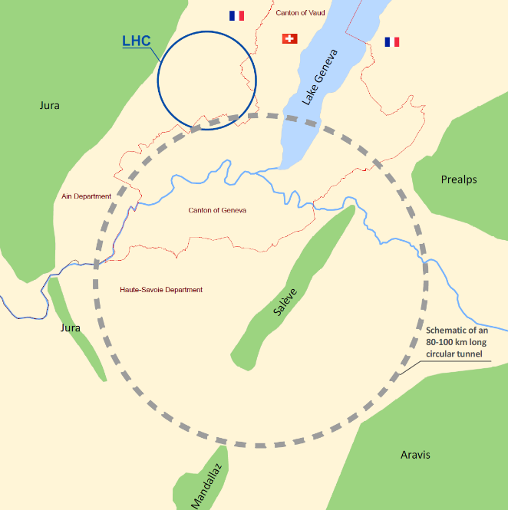
Introduction to the Future Circular Collider (FCC)
e+ e- collider
Collision energy 90 to 350 GeV
~600 cavities ~ 7000 NC magnets
Higgs Factory
Very high luminosity
2045-2060
International FCC collaboration for the study of Future Circular Colliders in a quasi-circular tunnel of 91-km perimeter
Complementary physics
Common civil engineering and technical infrastructures,
building on and reusing CERN’s existing infrastructure
Hadron collider
16 T ⇒ 100 TeV for 91 km
~17 000 SC magnets 48 cavities
16 T bending dipole magnet
Energy Frontier
2070-2090++

Slide 10
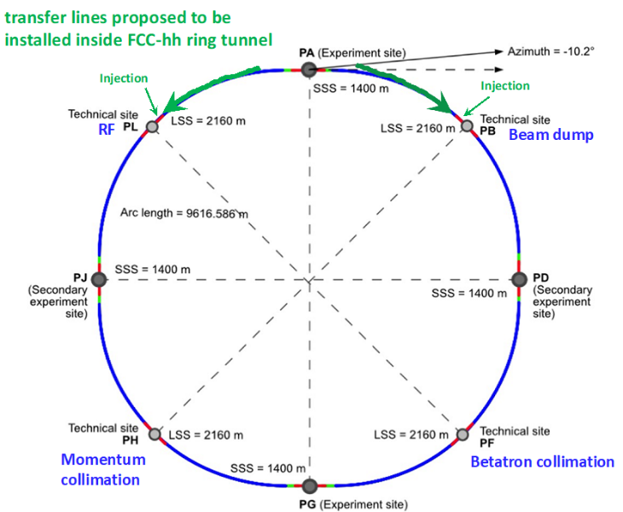
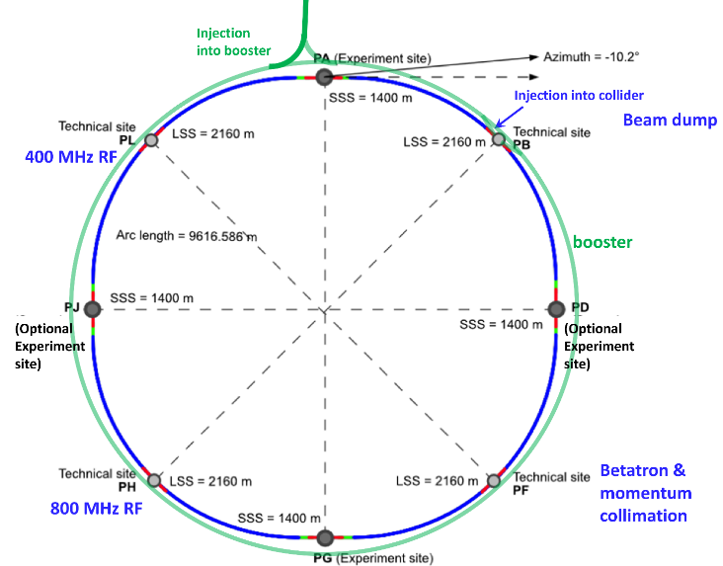
FCC–ee FCC-hh
Double ring e+e- collider Common footprint Two in one magnets
One ring booster 20 GeV -> 182 GeV

Slide 11
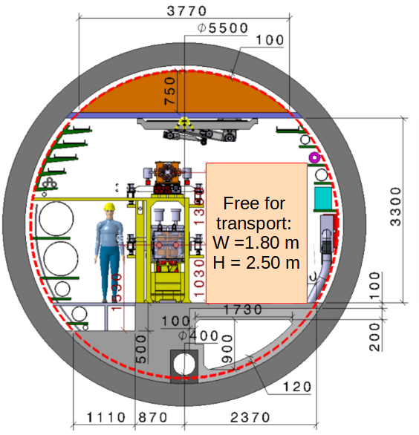
Tunnel Cross-section
FCC–ee FCC-hh
.
See next Presentation by Oriol Rios

Slide 12
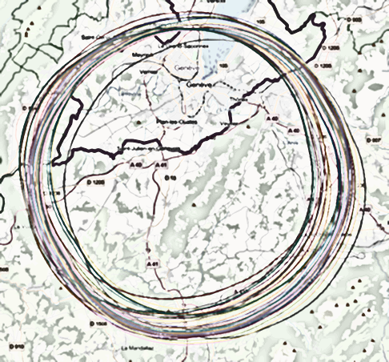
The tunnel challenge waste management and environmental impact.

Slide 13
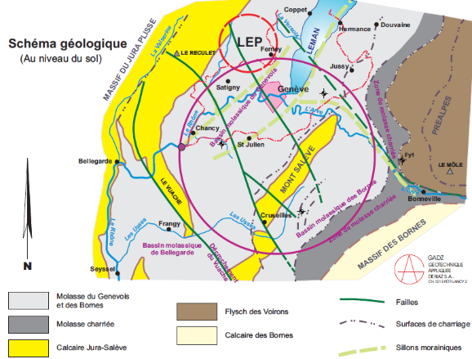
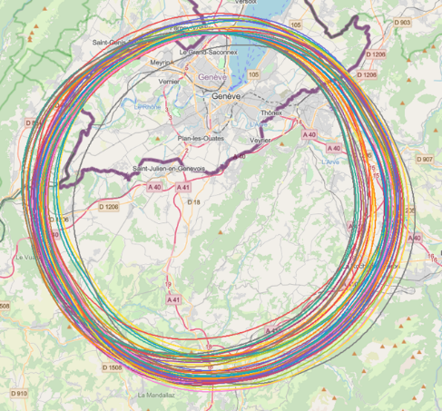
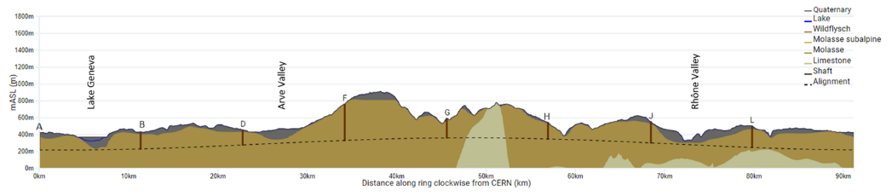
Geology constrains
Implementation studies
Based on geology and surface (land, availability, acess, etc..) environment (protected zone), infrastructure (water, electricity, transport, etc)
50 initial variants

Slide 14
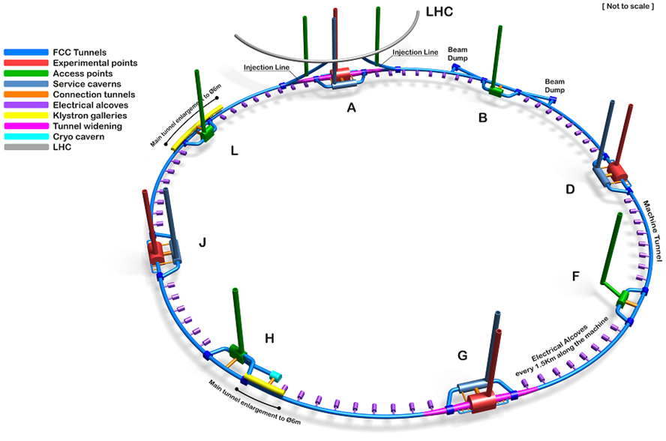
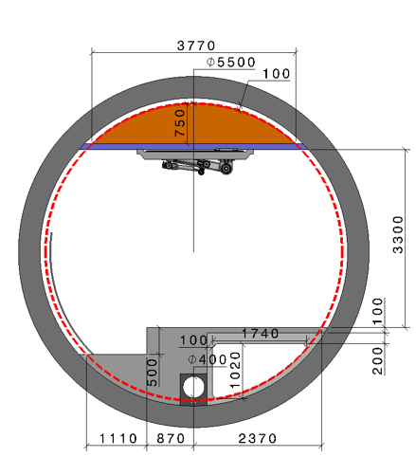
Tunnel Layout and Cross Section
8 sites –use of land <40 ha
Possibility for 4 experiment sites
All sites close to road infrastructures
(< 5 km of new road constructions )
Vicinity of several sites to 400 kV electrical grid lines
Total construction duration 7 years
First sectors ready after 4.5 years
150 m to 400 m deep underground

Slide 15
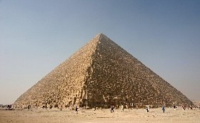
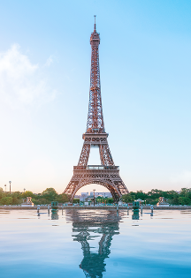
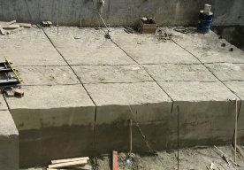

Waste Management and Environmental Impact
Long-term environmental sustainability
“Éviter, Réduire, Compenser” (Avoid, Reduce, Compensate) principle.
One example : Underground structure (tunnel, alcoves at regular intervals, large caverns and access shafts)
-> 9 million m³ of excavated materials with a large quantity of molasses.
“Mining the future” competition : identify credible solutions for innovative reuse and sustainable management of the estimated large quantities of excavated materials.

Slide 16
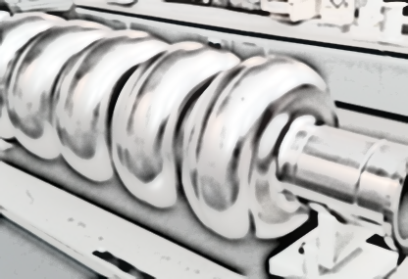
technological challenges and their possible societal impact

Slide 17
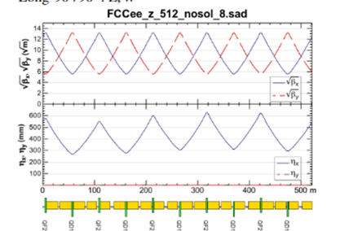
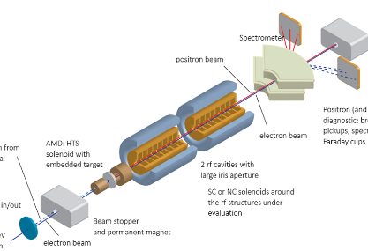
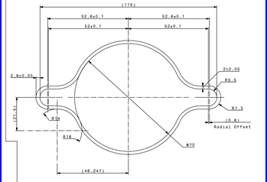
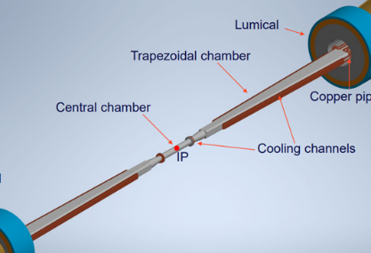
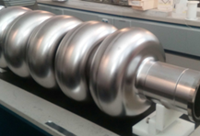
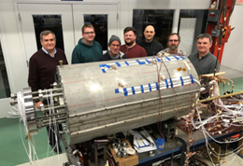
Technological Challenges
FCC optics
Positron source
Vacuum system
Interaction region
RF Accelerating System
Magnets

Slide 18

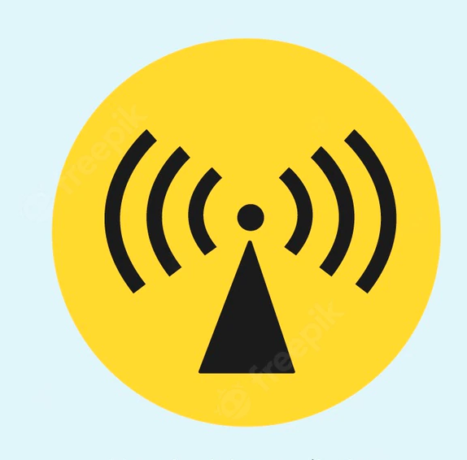

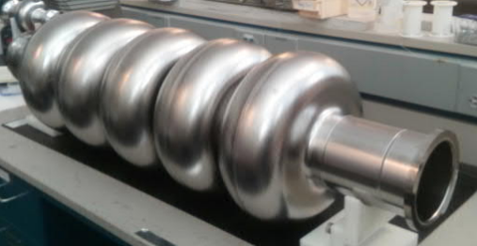
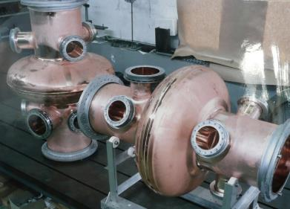
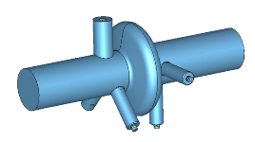
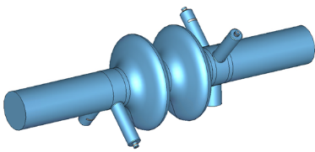
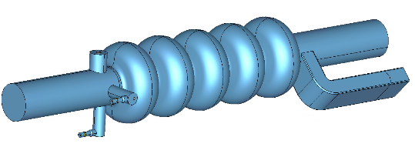
FCC-ee SRF Technology :
Efficient superconducting cavities
-271/-269 °C
E_{acc} = 5.7 MV/m, Q₀ = 3e9,
P_{RF} = 900 kW
E_{acc} = 12 MV/m, Q₀ = 3e9
P_{RF} = 450 kW
    E_{acc} = 25 MV/m, Q0 = 2e10
    P_{RF} = 200 kW
LHC
New
JLAB
LEP
Z
ttb
W, H
400 MHz 1-cell cavities Nb/Cu
400 MHz 2-cell cavities Nb/Cu
800 MHz 5-cell cavities Bulk Nb

Slide 19
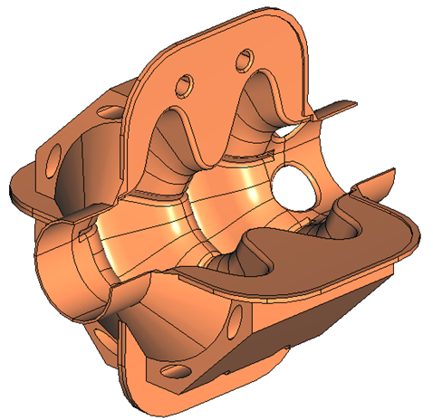
2-cell 600 MHz cavity for Z, W, H
Alternative cavity option to cover the three machines
E_{acc} = 12.5 MV/m, P_{RF} = 600 kW
Robust against vibrations and electromagnetic force deformations
Innovative concept compatible with Nb/Cu technology
I. Syratchev
F. Peauger
O. Brunner
S. Gorgi Zadeh
CERN

Slide 20
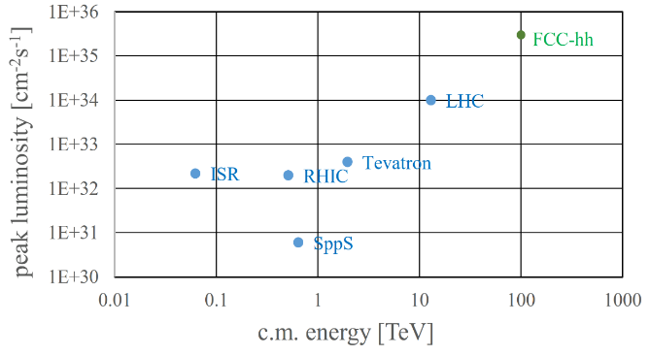
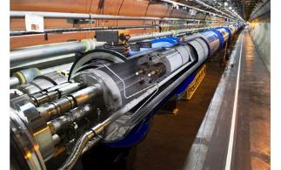
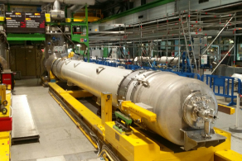
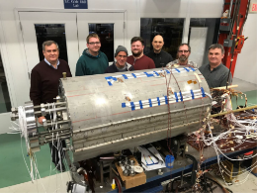
FCC-hh: highest collision energies
order of magnitude performance increase in both energy & luminosity
100 TeV cm collision energy (vs 14 TeV for LHC)
similar performance increase as from Tevatron to LHC
key technology: high-field magnets
from
LHC technology
8.3 T NbTi dipole
via
HL-LHC technology
12 T Nb3Sn quadrupole
FNAL dipole demonstrator
14.5 T Nb3Sn

Slide 21

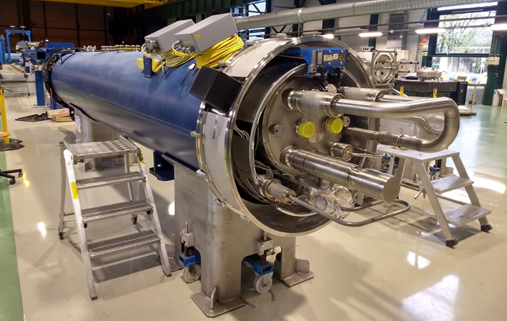
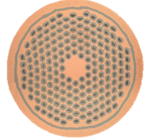


High-field magnets R&D towards FCC-hh
-271°C
Nb₃Sn

Slide 22








Main Conceptual Design Highlights:
Variants for the FCC hh Dipoles
Dia = 600 mm
50 mm aperture
B_{ultimate} = 16 T

Slide 23






Societal Impact
NMR
High Field Magnets
Fusion
Power applications
MRI
Ion Therapy

Slide 24

the energy challenge

Slide 25


Electrical Power Estimate
FCC ee
FCC hh
~Half unit of an electrical power plant

Slide 26


Connection to the Electrical Network

Slide 27
Motivation for Efficient Accelerator
~0.9% of France's annual electricity production

Slide 28






Reducing - Efficiency Challenges
High-efficiency RF klystron, target 80%
High efficiency large-scale cryogenics infrastructure
Low-loss magnet design
Low static losses of RF cavities
Economic mode for accelerator systems
Heat Recycling

Slide 29



Powerflow in Accelerator Facilities
rare: direct application:
p-therapy
isotope production
public GRID
Accelerator
Radio Frequency
Magnets
Vacuum etc.
beam
conversion to secondary radiation (beam collisions, targets, undulators …)
secondary radiation
exotic particles, e.g. Higgs, B-mesons
synchrotron radiation
neutrons
muons
Auxiliary systems
cryogenics
conv. cooling, AC etc.
Instruments
e.g. particle detectors
finally ~ 90 % converted to waste heat !

Slide 30

Heat Recycling
Hot water collected and diverted to parallel circuits
to supply the heating system of a new areas currently under construction.

Slide 31

FCC … a new large collider for the 21st century …
Future Circular Collider
… for new discoveries in physics!

Slide 32
Merci pour votre attention
Thank you for your attention
.
32

