Slide 1
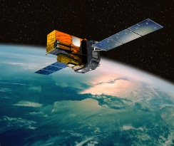
20 years of observation of the transient sky with INTEGRAL P. Laurent (IRFU/Dap)
November 15th, 2022
Astroparticle symposium 2022

Slide 2
INTEGRAL : ESA M mission
Launched on October 17th 2002
by a PROTON rocket
Eccentric Orbit :
Apogée: 13 000 km
Périgée : 152 000 km
Inclinaison : 51°
Durée : 72h
Mission extended up to mid-2023
Desorbitation : 2029

Slide 3
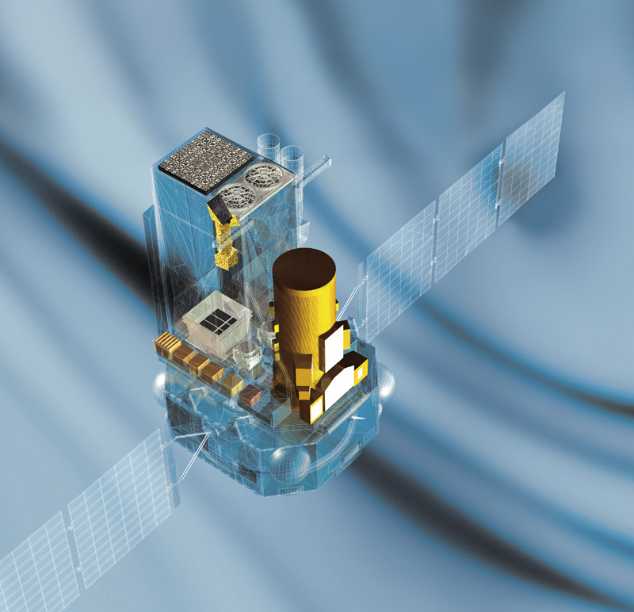
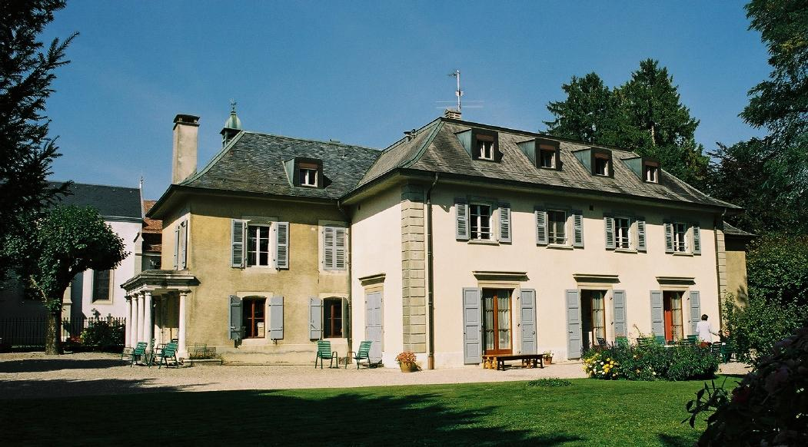
Satellite
4.1 tons
5 m height
3.7 m diameter
16 m solar panels
INTEGRAL Scientific payload
OMC (optical)
IBIS
15 keV – 10 MeV
12’ FWHM imaging
<1’ source location
19°x19° FOV
ISDC
JEM-X
SPI
20 keV – 8 MeV
2 keV FWHM
26° Ø FOV
ACS ∼ 4π FOV

Slide 4
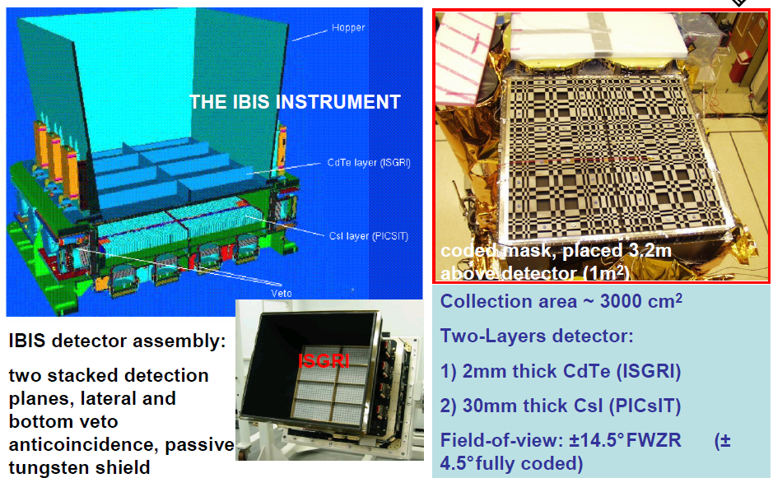
The IBIS telescope
November 15th, 2022
Astroparticle symposium 2022

Slide 5
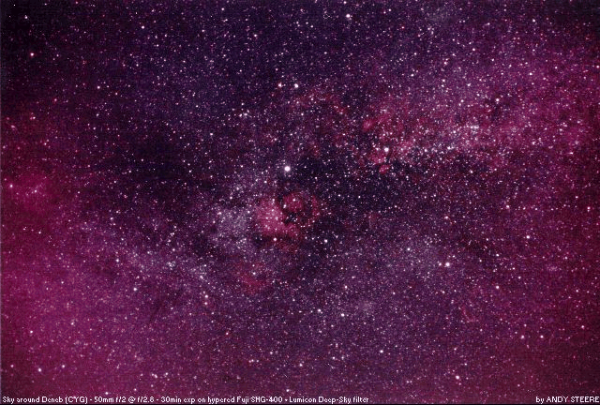
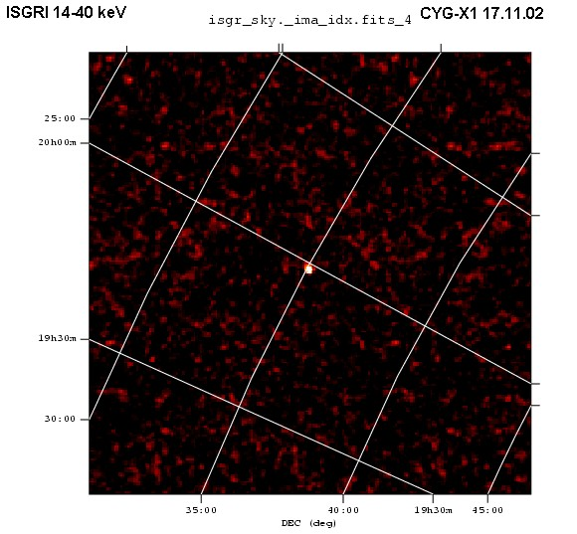
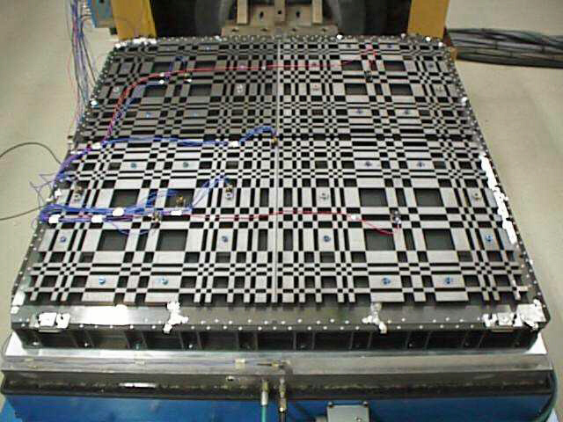
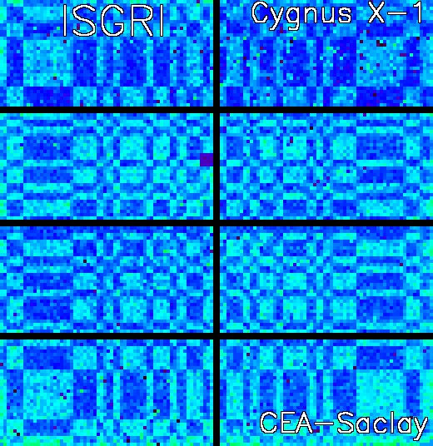
INTEGRAL image analysis
FCFOV : 9°
PCFOV : 29°
Res. : 12’
observation
decoding
transmission
November 15th, 2022
Astroparticle symposium 2022

Slide 6
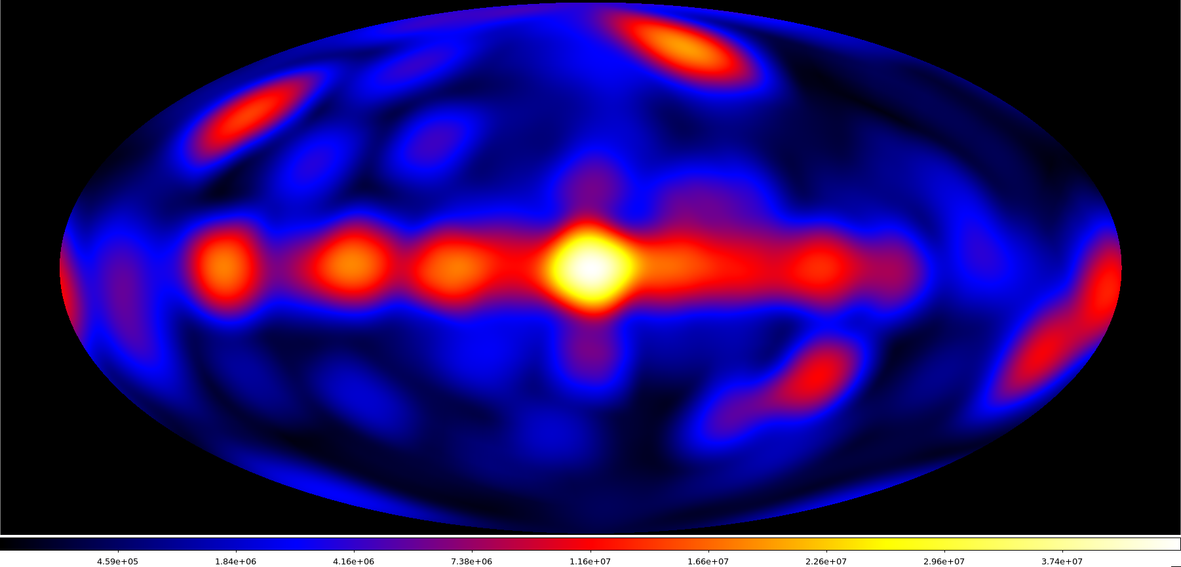
INTEGRAL sky coverage in galactic coordinates
(17 years, max 5 10⁷ s)
November 15th, 2022
Astroparticle symposium 2022

Slide 7
INTEGRAL main outcomes
INTEGRAL has enabled to:
Study in details the spectral and timing behaviour of high energy sources (few keV – few MeV) and over a very long time (spectral states, fast variabilities, Hardness/Intensity diagram).
Look for possible polarization emission (vs energy band, spectral state, …).
Look for fast transients (GRB, FRB, GW and neutrinos counterparts, …) with a rapid repointing strategy.
November 15th, 2022
Astroparticle symposium 2022

Slide 8
IBIS as a Compton polarimeter
The IBIS telescope is a coded mask telescope which could be used as a Compton telescope.
The Compton mode events are ISGRI and PICSIT events in temporal coincidence, within a window τ_{W} ≈ 3.8 μs.
Incident photon
ISGRI
e
PICsIT
Scattered photon
November 15th, 2022
Astroparticle symposium 2022

Slide 9
Compton polarimetry principles
Klein-Nishina cross section is maximum for photons scattered at right angle to the direction of the incident electric vector
⇒ non-uniformity of the azimuthal profile S of scattered events (π-periodic modulation).
November 15th, 2022
Astroparticle symposium 2022

Slide 10
INTEGRAL “polarigrams”
So, Compton events show in PiCsiT a π-periodic modulation in their azimuthal angle, that we fit afterward with the predicted modulation :
a = modulation factor
PF = a/a₁₀₀ with a₁₀₀, the modulation for a 100 % polarized source.
a₁₀₀ between 0.2 and 0.3 for IBIS.
polar. angle = PA = ϕ₀ - π/2 + nπ
November 15th, 2022
Astroparticle symposium 2022

Slide 11
Integral 15+ YEARS REVIEW
15 papers on INTEGRAL science published in New Astronomy Review
November 15th, 2022
Astroparticle symposium 2022

Slide 12
Multi-messenger astronomy with INTEGRAL
Ferrigno C. et al.,
New Astronomy Review
92, 101595,
2021
November 15th, 2022
Astroparticle symposium 2022

Slide 13
INTEGRAL results on GRB
Götz D. et al.,
New Astronomy Review
87, 101537,
2019
November 15th, 2022
Astroparticle symposium 2022

Slide 14
Main results on GW/ Neutrinos
November 15th, 2022
Astroparticle symposium 2022

Slide 15
INTEGRAL all-sky sensitivity and LVT151012
+ eccentric orbit
⇒ 85% useful observation time each orbit.
November 15th, 2022
Astroparticle symposium 2022

Slide 16
The GW 170807/GRB 170807A event
INTEGRAL results :
Savchenko V. et al.,
ApJ, 848, L15, 2017
November 15th, 2022
Astroparticle symposium 2022

Slide 17
Neutrinos event
IceCube-170922A /TXS 0506+056
Neutrino – gamma-ray (Fermi/MAGIC) possible association from a blazar.
INTEGRAL made a follow-up observation (32 ks) ⇒ upper limit of 10⁻¹⁰ erg/cm²/s.
Not strong but unique constraint on the blazar SED between 80 keV and 1 MeV.
November 15th, 2022
Astroparticle symposium 2022

Slide 18
FRB and magnetar
November 15th, 2022
Astroparticle symposium 2022

Slide 19
FRB200428/SGR 1935+2154
Two of the subpeaks occurred just 6.5 ms after the radio pulses.
They are separated by 30 ms, exactly as the radio pulses.
FRB radio bursts superimposed to the magnetar light curve
INTEGRAL results :
Mereghetti S. et al.,
ApJ, 898, L29, 2020
November 15th, 2022
Astroparticle symposium 2022

Slide 20
GRB studies
November 15th, 2022
Astroparticle symposium 2022

Slide 21
IBIS GRB spatial distribution
Distribution of the 127 GRBs detected in the IBIS FOV in galactic coordinates.
November 15th, 2022
Astroparticle symposium 2022

Slide 22
IBIS GRB timing and flux distribution
Distribution of T0 and F_{peak} for the IBIS GRB, compared to Swift BAT⇒ INTEGRAL catches fainter bursts
November 15th, 2022
Astroparticle symposium 2022

Slide 23
GRB polarization : the example of GRB041219A
Götz D. et al.,
MNRAS, 413, 2173, 2011
Variable polarization angles
during the GRB duration.
November 15th, 2022
Astroparticle symposium 2022

Slide 24
IBAS online catalog
(http://ibas.iasf-milano.inaf.it/IBAS_Results.html)
November 15th, 2022
Astroparticle symposium 2022

Slide 25
The last October monster (GRB 221009A)
November 15th, 2022
Astroparticle symposium 2022

Slide 26
Thank you !
November 15th, 2022
Astroparticle symposium 2022

