Slide 1
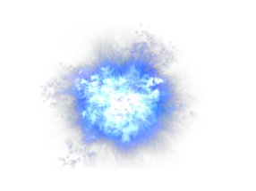
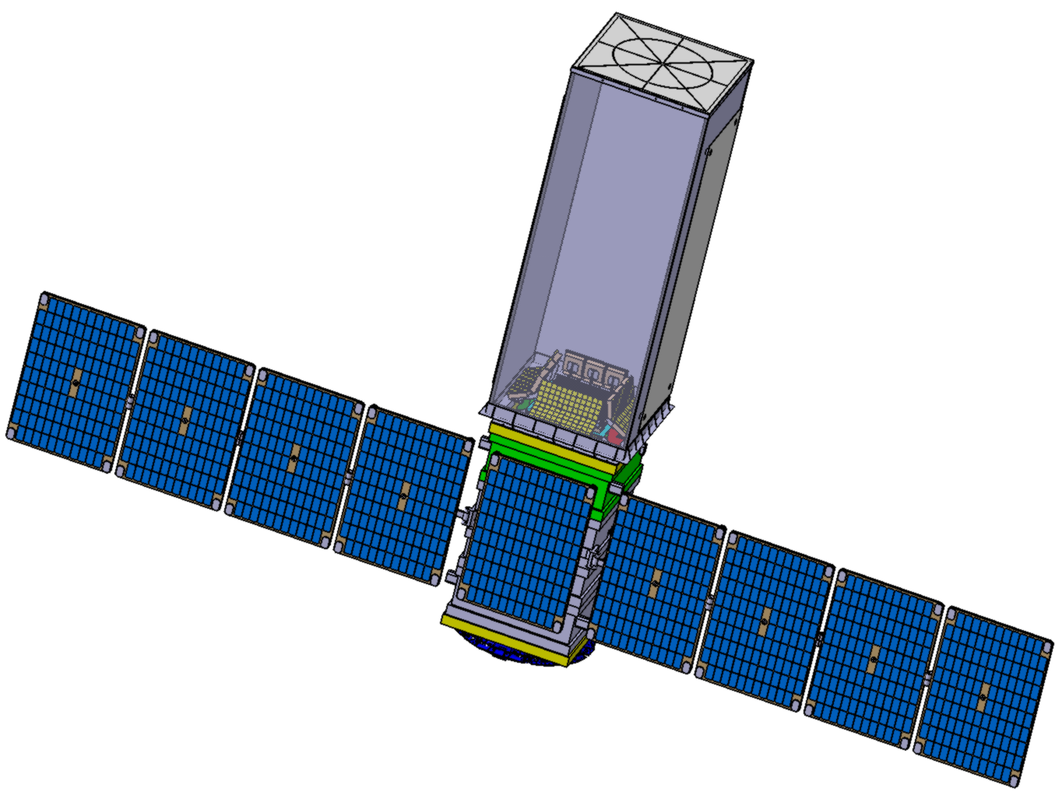
GRINTA
An explorer of the multimessenger and transient sky
Lorenzo Natalucci, Philippe Laurent on behalf of the GRINTA Consortium Astroparticle Symposium, Institut Pascal, Saclay, November 2022

Slide 2
The Consortium
17 European research laboratories, 47 researchers, 8 countries

Slide 3
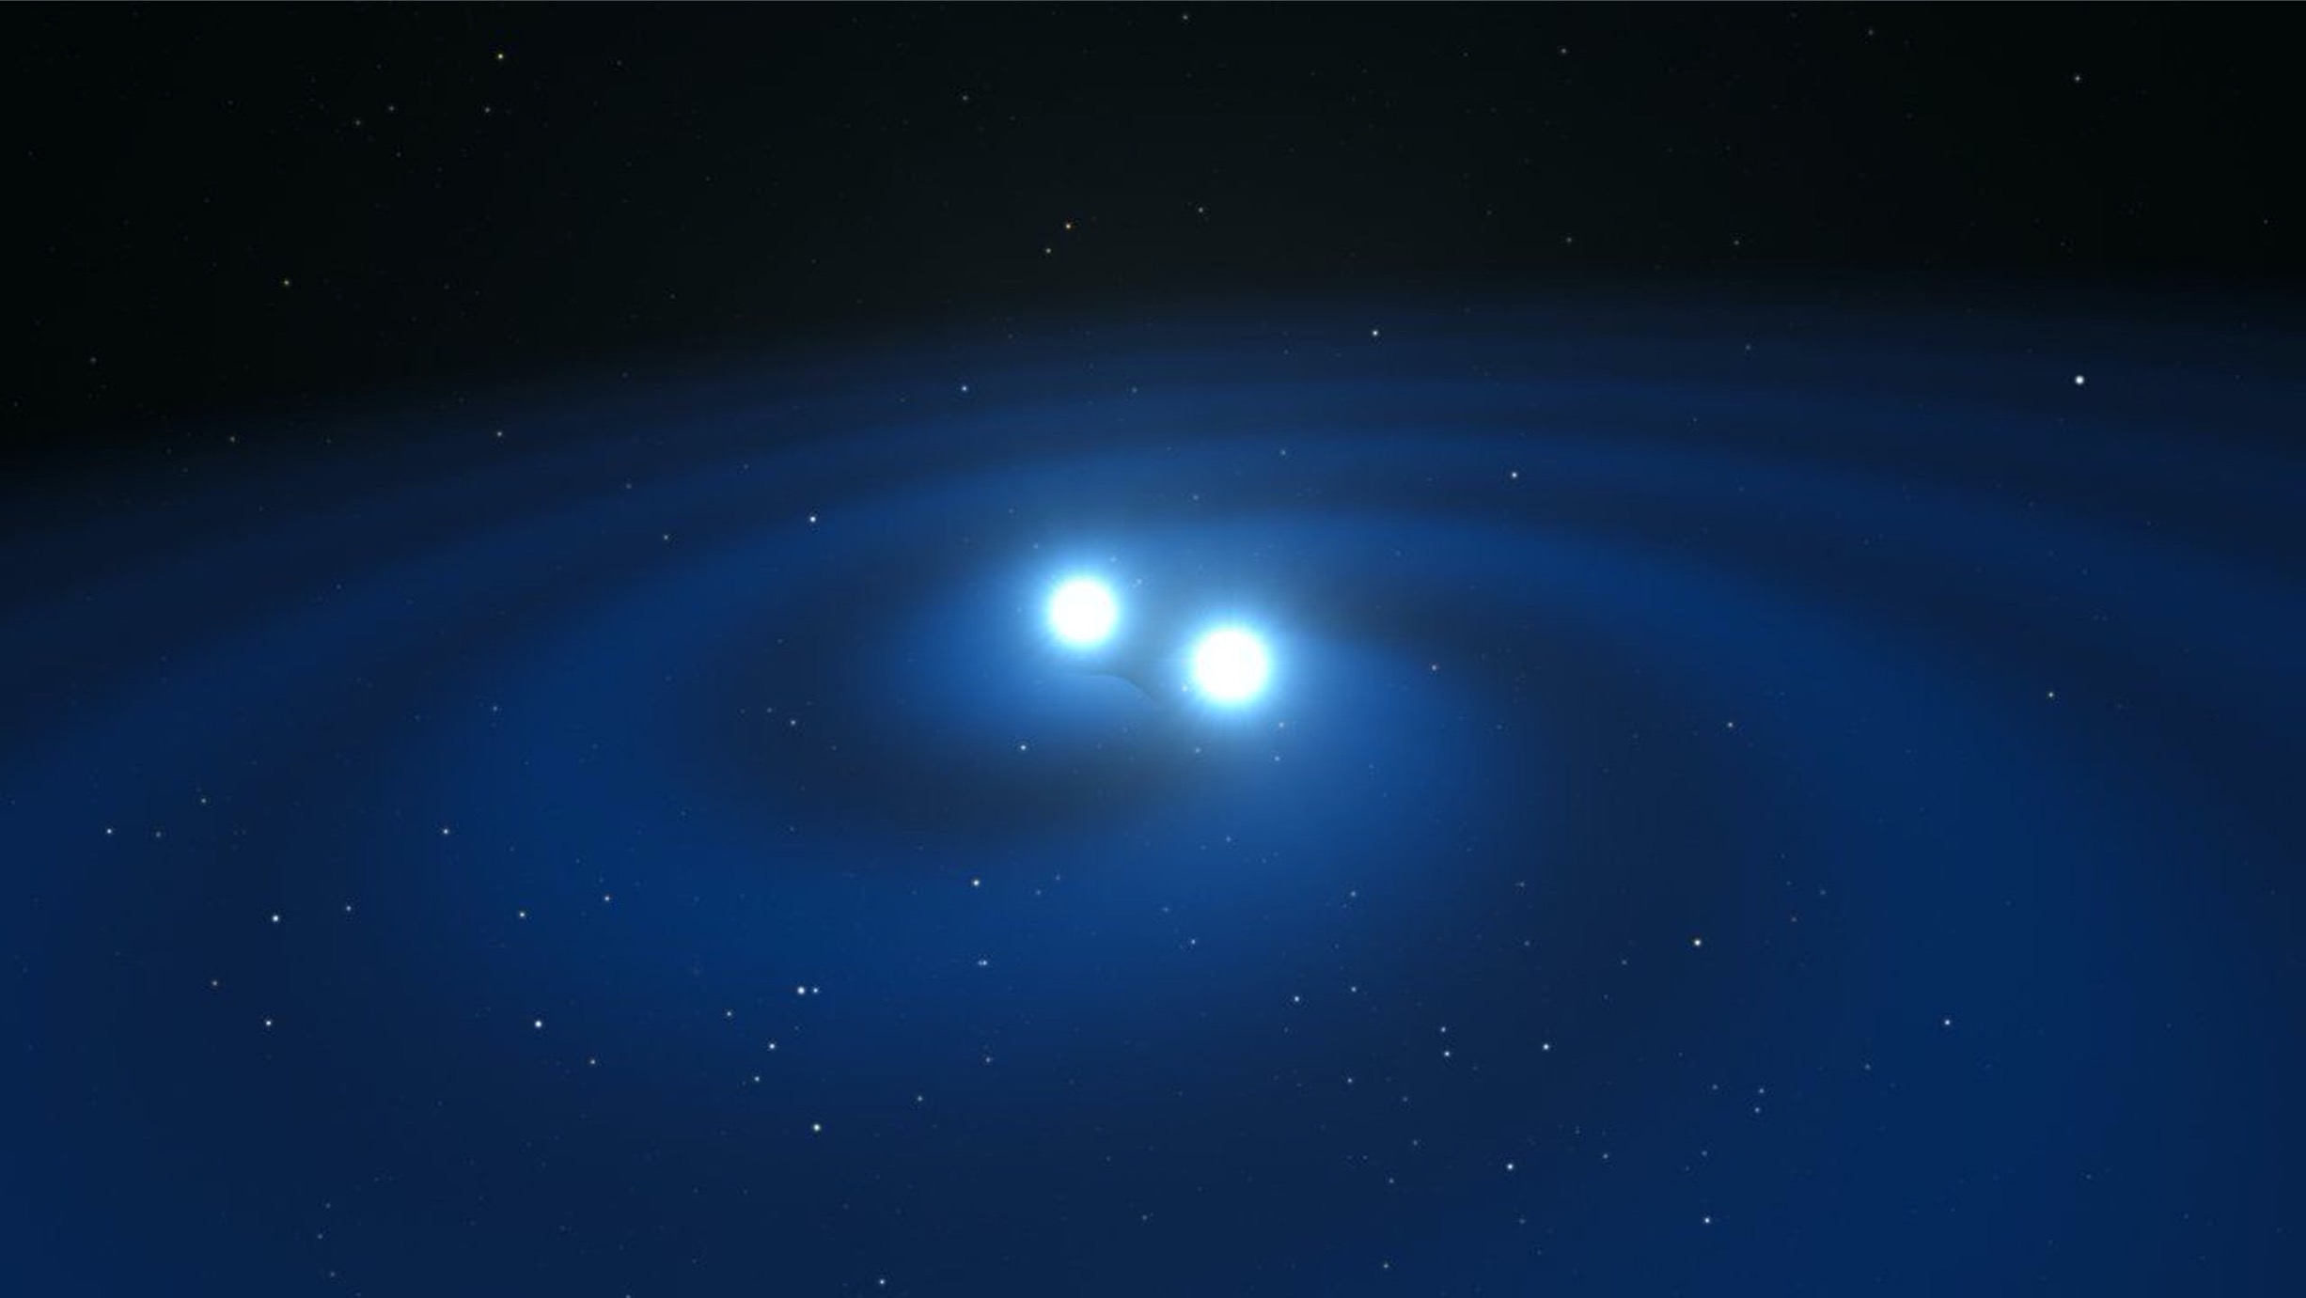
GRINTA in a nutshell
Main goals: GRB & multimessenger, Surveys
Launch: 2030/2031
Orbit: LEO equatorial (<5deg)
Rapid repointing, light S/C
GRB detection:
Coverage ~8 sr FoV (0.02-10 MeV)
Followup:
Coverage 400deg² FoV (5-200 keV)
#GRBs: ~570/yr (of which ~90 SGRBs/yr)
Localization:
<10 deg @90% confidence at first detection,
30” after followup

Slide 4
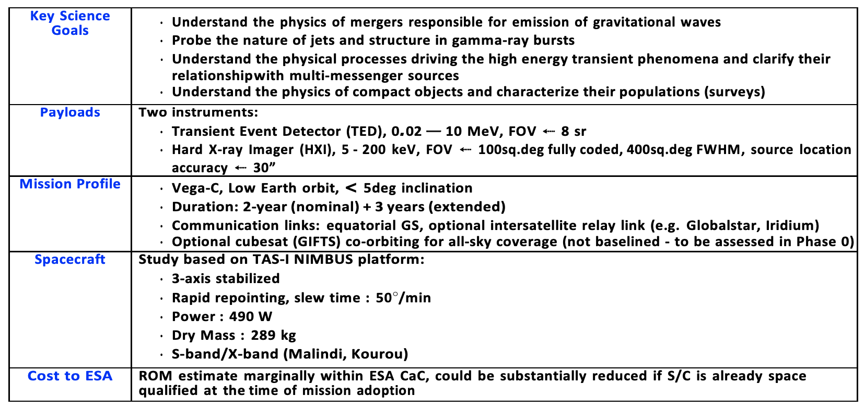
GRINTA fact sheet

Slide 5
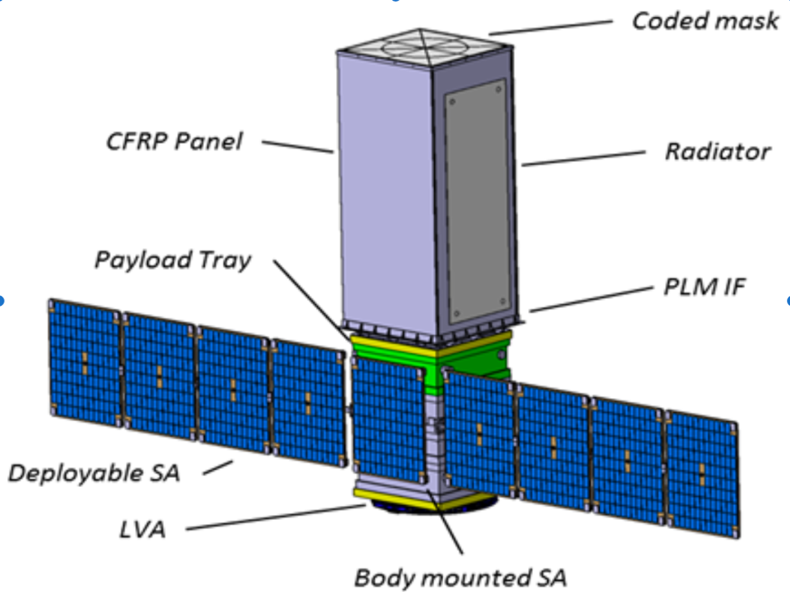
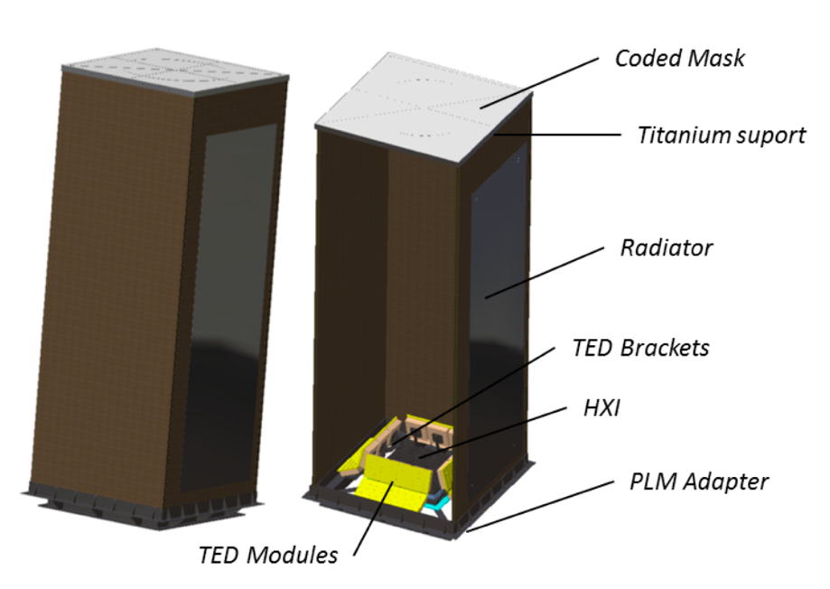
The S/C and payload module
S/C study based on TAS-I Nimbus S/C

Slide 6
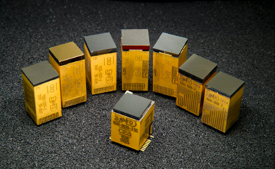
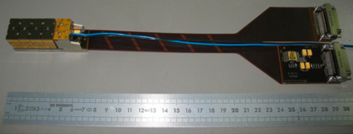
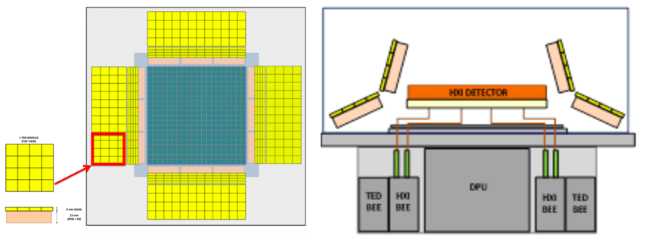
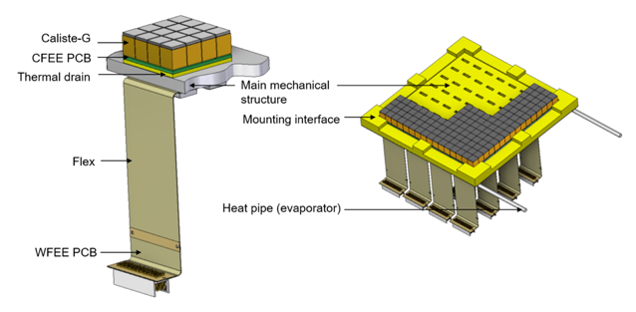
The GRINTA payload
Hard X-ray Imager (HXI)
Transient Event detector (TED)
Coded mask instrument
(400 deg² FoV)
Detection units based on Caliste modules (CdTe Schottky, already flight proven)
Focal plane assembly has 16x16 modules, 850cm² detection area. Imaging pixel size = 1mm.
24 modules, each of 100cm² geometric area
They are used on board to detect GRBs and other transients and send alerts to the DPU
They also act as active AC system for the HXI detector plane
Technology already used in space, mainly on smallsats (e.g. GECAM, GRID, …)
Sensitivity ~1.5-2x better than Fermi/GBM (directions<60º)
A set of Caliste modules. A version of them has been launched on Solar-Orbiter(TRL-9)

Slide 7
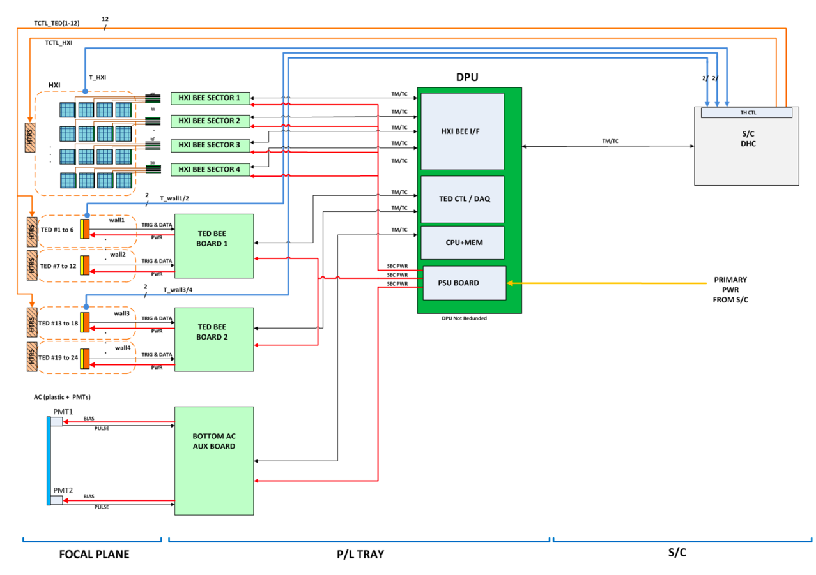
GRINTA Block diagram

Slide 8
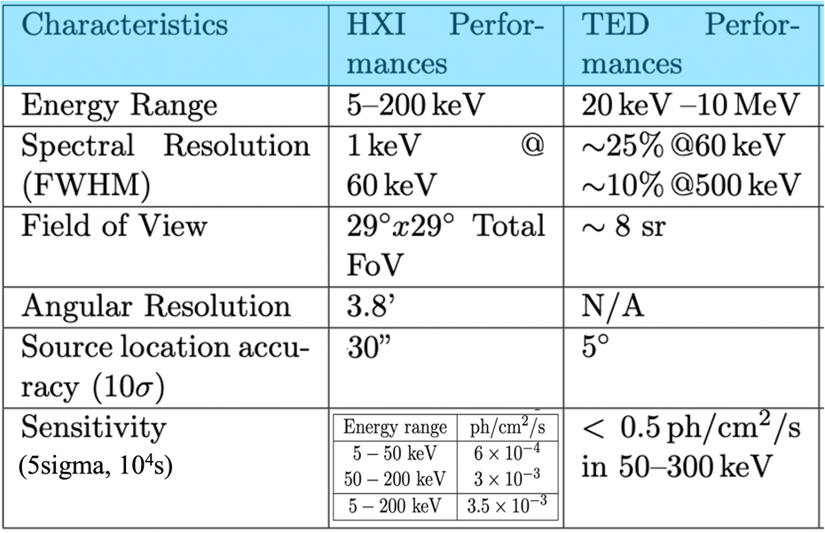
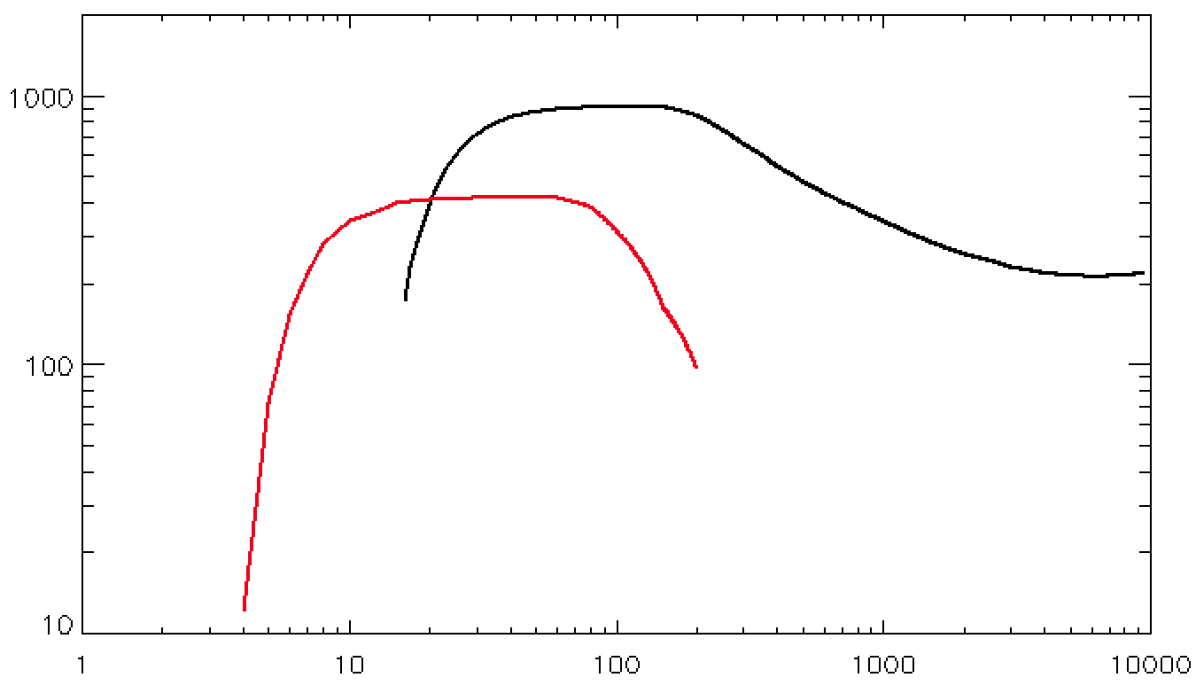
GRINTA performance summary
Effective area
TED
HXI
A (cm²)
E (keV)
Effective areas of HXI (on axis) and TED (30deg)

Slide 9
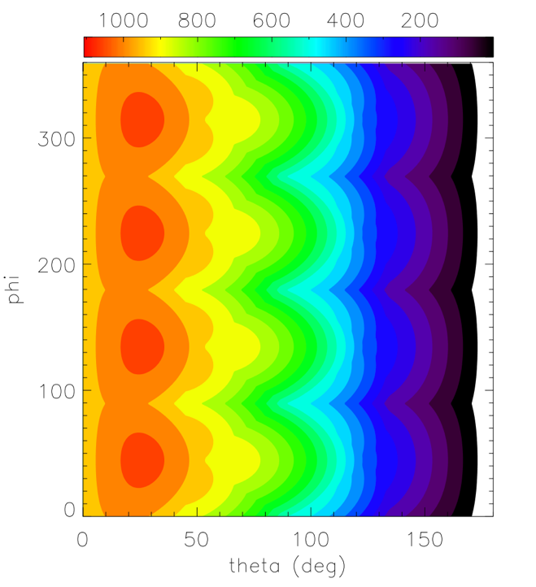
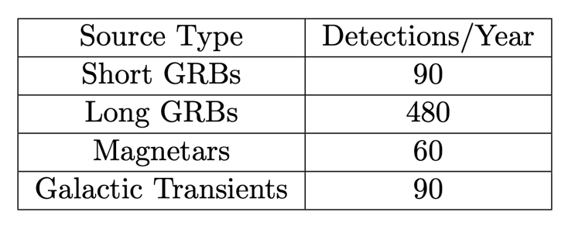
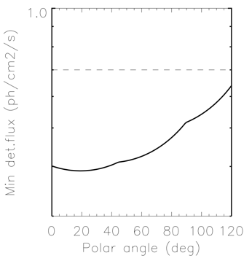
TED sky monitoring
Azimuth
Zenith
Projected area as a function of arrival direction
TED sensitivity compared to Fermi/GBM

Slide 10
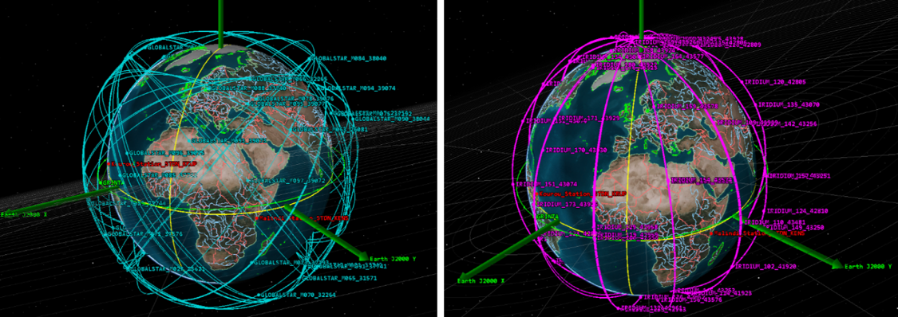
Operational Concept
Basic operational modes:
(a) Safe mode (b) Survey (c) Follow-up
Fast slew towards the target (50º in < 60’’)
Follow-up triggered by TED localisation of an event or by external (ground or satellite) alert
Re-orientable solar panels
S/C communication via both GS and satellite constellations (necessary to reduce delays down to ~min timescale)

Slide 11
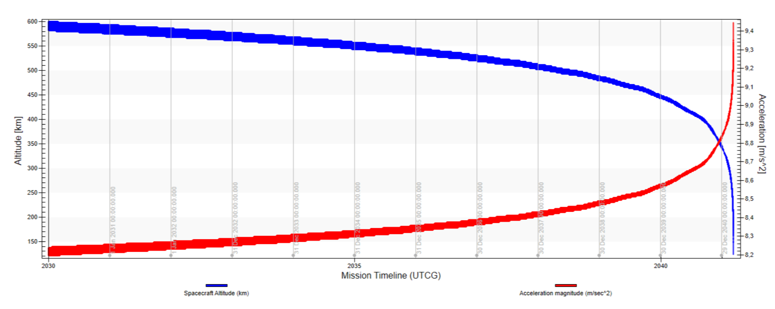
Orbit evolution
Credit: TAS-I

Slide 12
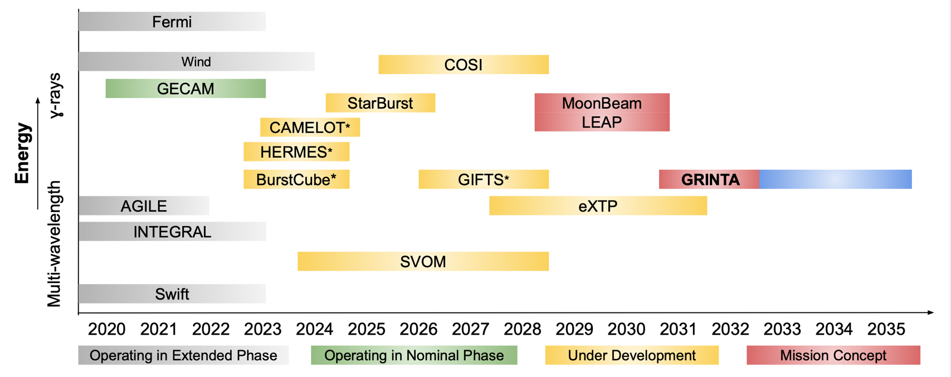
HE missions scenario
No hard X-ray missions with imaging capabilities like Swift and INTEGRAL in the 2030s

Slide 13
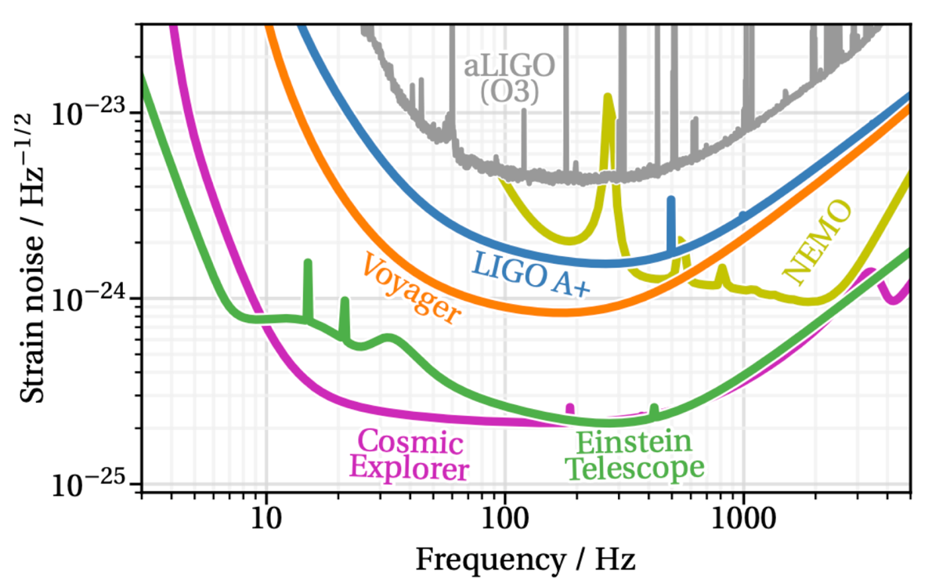
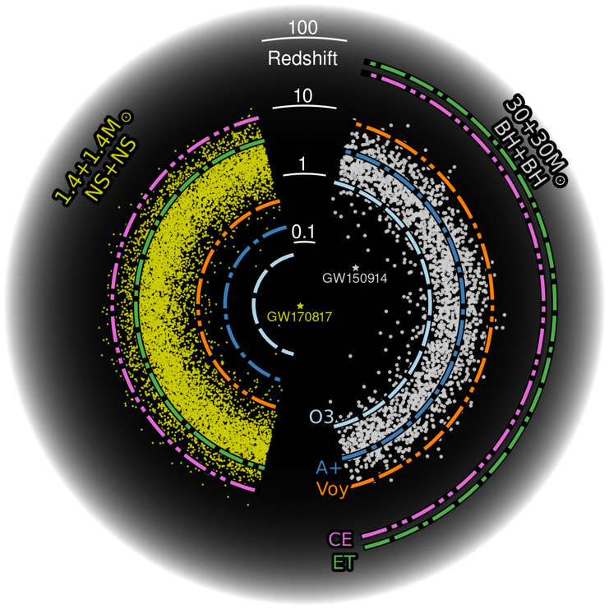
Planned GW detectors
~2025
~2030
~late 2030’s
Credits: https://cosmicexplorer.org/

Slide 14
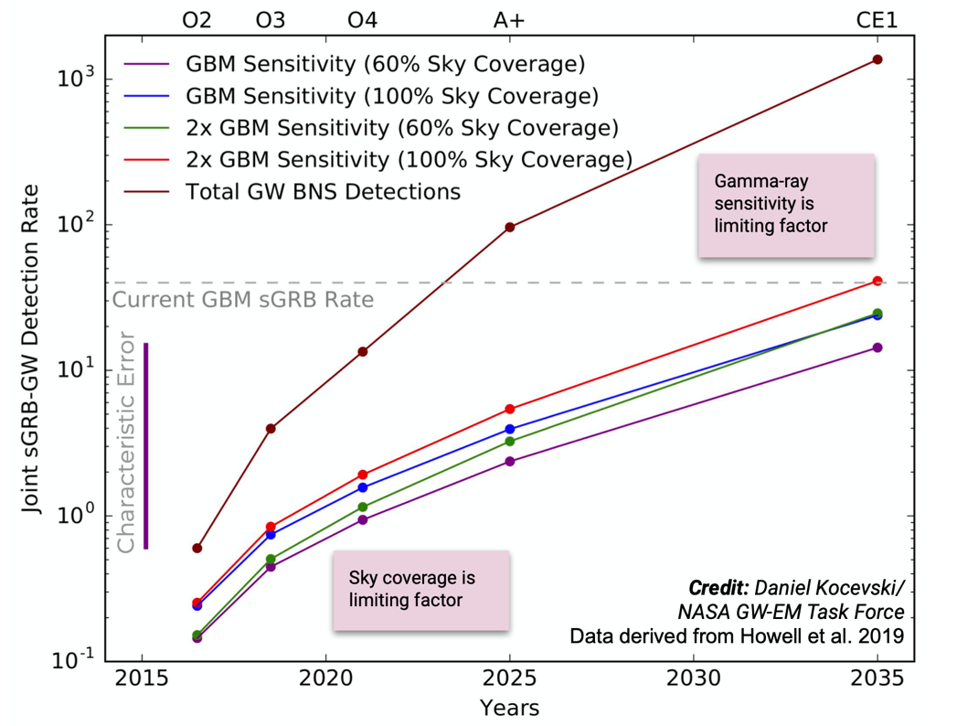
Scenarios for SGRB detection, post-O5
Voyager?
> 2030 (post-O5): Several hundreds (thousands?) of GW BNS detection per year up to z ~1
Limit distance expected to increase to ~1 Gpc for NS/NS
For most events, prompt follow-up by optical/UV telescopes will not be feasible
Hard X-rays are needed! For both detection and localisation
GRINTA expected sGRB rate

Slide 15
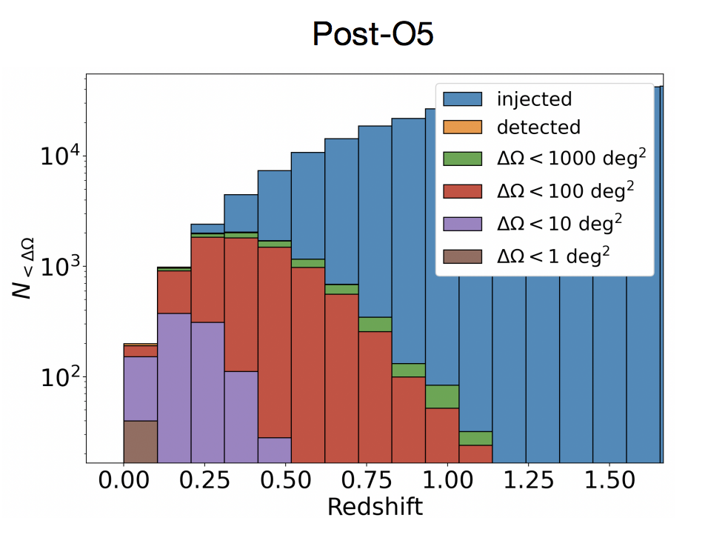
Most GW detected events in the post-O5 scenario will have localization error < 100 deg² (ref. Ronchini+22)

Slide 16
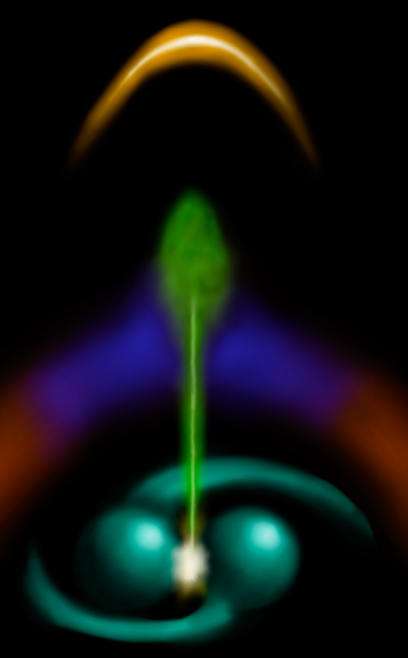
GRINTA contribution to GRB science in the GWs era
TED will detect about 90 short GRBs per year
Almost half will be detected by HXI in 𝛄/X-ray (down to
~5 keV)
Among all short GRBs observed by TED, 55% (32%) will be detected by HXI considering a slew time of deltaT = 60s (tdel = 5 min).
These numbers include an evaluation of the accessibility of the target position for HXI.
→ measure the source spectra probing the
emission mechanims
HXI sub-arcmin sky-localization will drive the multi-wavelenght follow-up by ground and identification of the host galaxy
→ complete picture of the relativistic jet and interaction
with the environment
Credits: Ronchini

Slide 17
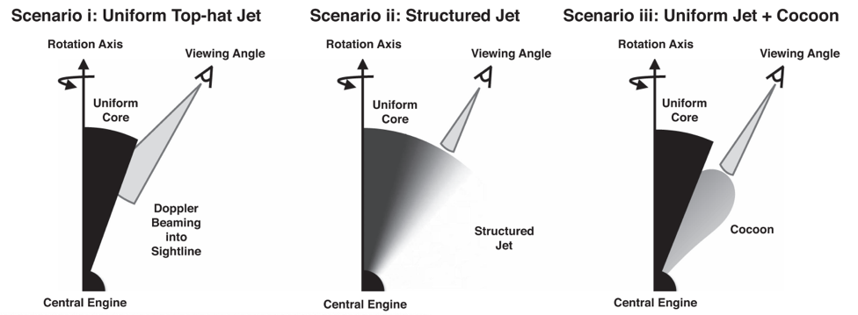
GRINTA contribution to GRB science in the GWs era
GW/GRB: post O5, ~10 detection per year in survey mode and another tens by follow-up of GW signals
Evaluate the fraction of BNS able to produce a jet
Jet structure by detecting off-axis GRBs (pointing GWs)
Detect X-ray signature to identify the nature of the merger remnant
Understand the role of NS-BH mergers as short GRB progenitor
With 2+3 years mission → cosmology with H₀ at 1 percent level and test of modified gravity
Abbott+2017

Slide 18
What GRINTA can do jointly with other facilities
Provide accurate locations of the events to follow-up with IR/optical/UV telescopes. Measurements of redshifts by IR/optical followup of SGRBs will have impact on cosmology (H₀ measurements) and fundamental physics (e.g. theories of modified gravity)
Followup with optical/UV to investigate the relative contribution of mergers and core-collapse SNae to the r-process (connection to cosmic-ray science, origin of heavy elements).
Investigation of alerts generated by radio, optical and VHE (e.g. SKA, Vera Rubin, CTA), including subthreshold searches. Events from GRBs, TDEs, FRBs,…
Search for HE neutrino counterparts in the error regions of neutrino telescopes: IceCube Gen2, KM3NET…
Perform joint studies of the hard X-ray and TeV emission (e.g. blazar flares) with GRINTA and CTA
Follow-up and localization of many astrophysical transients
Investigation of HE unidentified sources for thousands of objects (e.g. sources already detected by INTEGRAL, Swift, Fermi, eRosita, …)
Localization is the key!

Slide 19
Summary
GRINTA represents an outstanding opportunity to complement the GW post-O5 and neutrino 2nd generation detectors with EM measurements in the 2030’s.
It will provide wide sky coverage in hard X-rays, currently the most effective choice for the detection and prompt localization of short GRBs from binary mergers at large distances
The detection of tenths/hundreds of joint EM/GW events will provide breakthrough discoveries in fundamental physics, cosmology, relativistic jet formation and structure, gravity theories, etc.
GRINTA will detect a very large sample (~500/year) of long GRBs to provide deeper insights into the progenitors, central engines and jet structures associated with massive stellar collapses.
It will provide broad band coverage to study accretion and ejection phenomena in compact sources, covering an important gap in the decade
It will work in synergy with other ground and space facilities, spanning from radio to UHE gamma-rays to study the most energetic phenomena

Slide 20
Prospects
The GRINTA mission concept is a natural evolution of the successful, currently operational missions: Fermi, INTEGRAL, Swift, with an innovative operational approach.
It has recently proposed to ESA as the F2 mission.
Among the final three missions considered for selection, GRINTA was not selected due to claimed programmatic risks (funding, SiPM rad hardness, & unclear scenario of GW event rates).
In the absence of GRINTA, the impossibility of monitoring prompt and afterglow emissions due to the lack of high-energy observatories in 2030 will significantly limit our ability to maximize the scientific return of a GW signal by detecting a counterpart.
The Consortium is strongly motivated to search for other flight opportunities

Slide 21
Backup slides

Slide 22
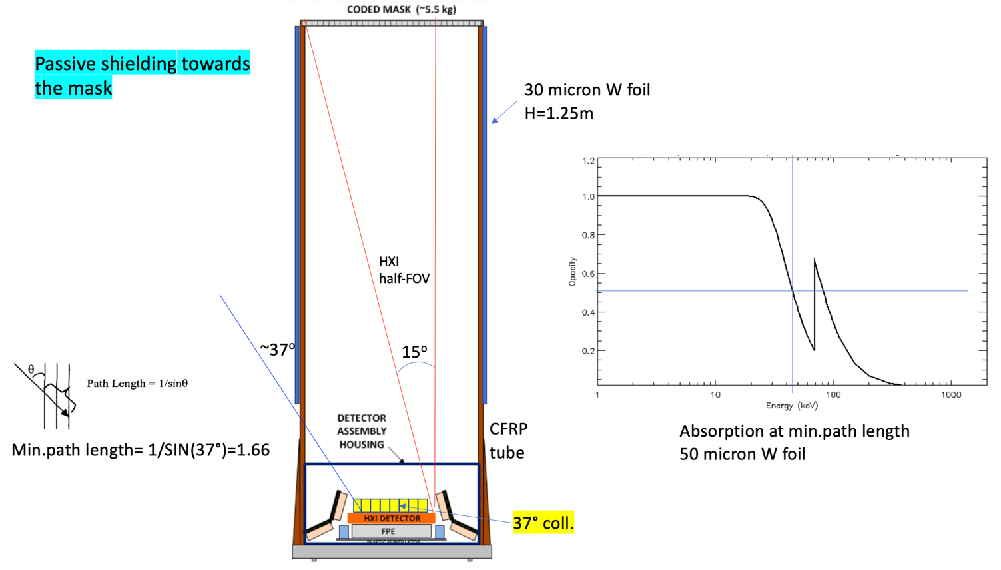
HXI shielding concept

Slide 23
Ground coverage time

Slide 24
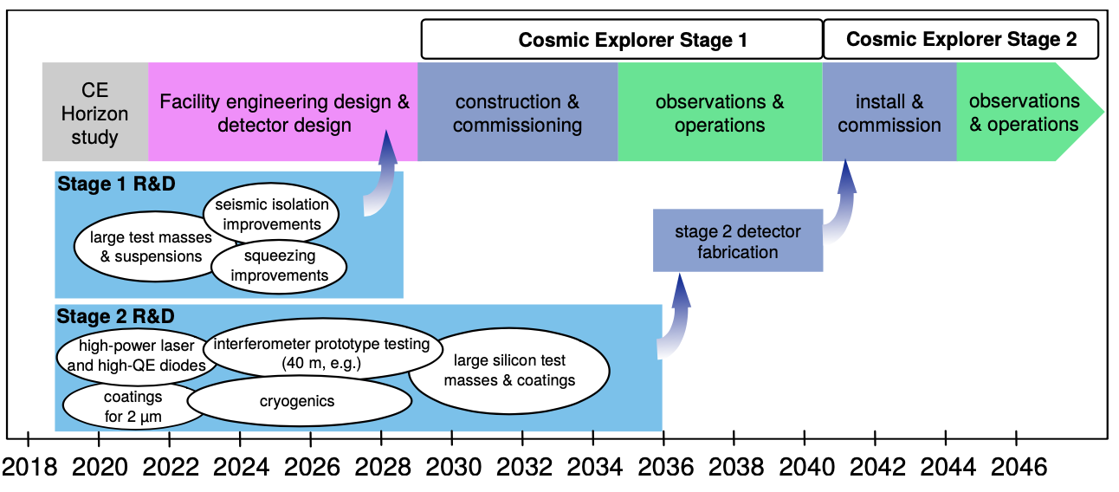
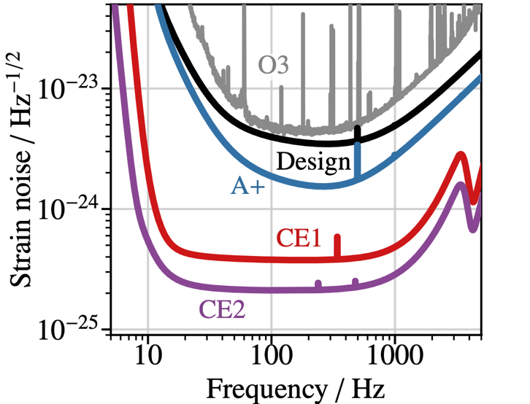
COSMIC
EXPLORER
Credit: Reitze

Slide 25
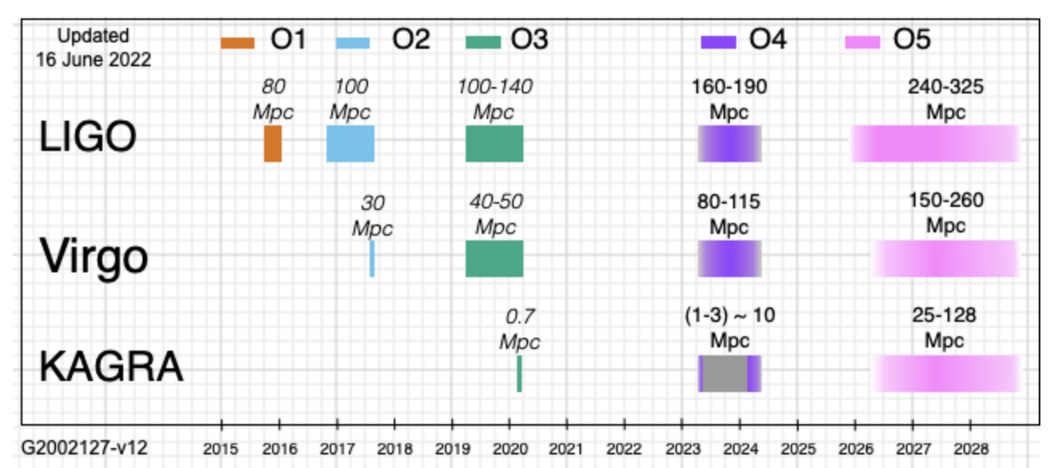

Slide 26
Motivation for joint GW/EM observations
GRINTA will localize bursts by detecting the lightcurves and spectra from a range of GRBs including short events. Analysis of these data alone and in combination with GW coincidences will lead to better understanding of short GRBs progenitors by searching for coincidences and comparing events with/without GW counterparts.
The GW observations can constrain the mass, spin, distance, and inclination, and the time of the merger. The gamma-ray observations constrain the EM energetics and outflow characteristics and connect the merger classification to the burst population, and support interpretation of the afterglow or kilonova if one is detected. Therefore, combining the two messengers can address the question of SGRB progenitors, and structures of relativistic jets and outflows. Without GRINTA, the connection to the GRB population cannot be addressed.
The detection of a gamma-ray signal from a NSBH system could shed light on the progenitor types of SGRBs and provide confirmation of the NSBH classification when the nature of the secondary component is ambiguous

Slide 27
MoonBeam & LEAP vs GRINTA
 | GRINTA | LEAP | MoonBEAM
Orbit | LEO | ISS | Earth-Moon L3
FoV | ~8 str | 1.5 str | All-sky
E range | TED: 20 keV – 10 MeV HXI: 5 – 200 keV | 10 keV – 5 MeV | 20 keV – 5 MeV
Area | Geo: ~1500 cm² on-axis Eff at 300 keV: 400-600 cm² < 100 deg on-axis | Geo: 3000 cm² | Eff at 300 keV:400-700 cm²
# of GRBs | ~570/yr (~90 SGRBs/yr) | ~400 GRBs in 2.5 yrs ~80 SGRBs in 2.5 yrs | ~70 SGRBs/yr
Localisation | TED: <10 deg @ 90% confidence at first detection HXI:<1 arcmin | 2-3 deg | ~70% of GRBs within 1 sig radius of 10 deg
Sci Goal | GRBs & MM events / surveys | Measure GRB polarization | GRBs & MM events

Slide 28
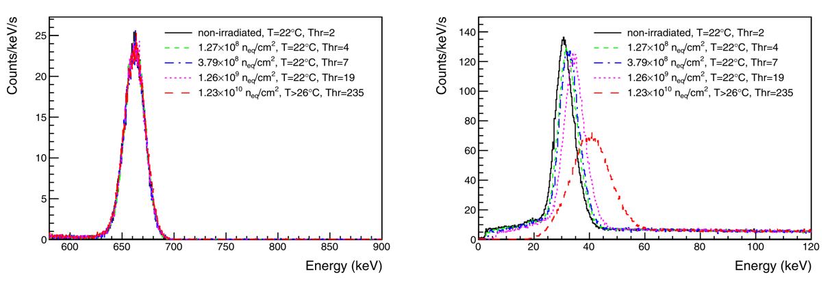
SiPM performance vs irradiation/aging
SIPM devices are sensitive to the radiation dose received in orbit. Their dark current is expected to increase along the mission life.
Noise level (sigma) increases ~3.5 keV/yr after 5 years
Low threshold: 20 keV → ~40 keV after 5 years
~99% of GRBs triggered GBM in 50-300 keV range, so minimal impact
May impact galactic source triggers in TED
7W/year increase in power. No effect on veto function for HXI
Cs137 – 662 and 32 keV lines
Ulyanov et al. (2020)

Slide 29
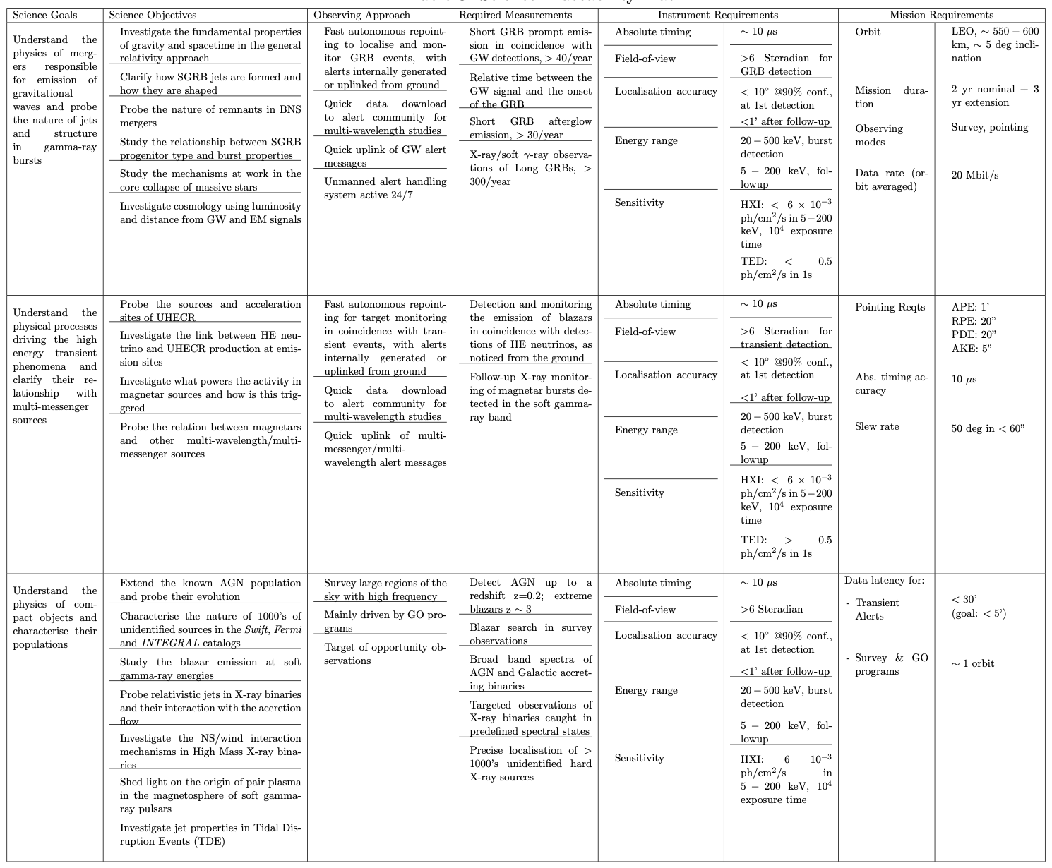

Slide 30
