Slide 1
Teiresias Radiative Transfer: Modelling the Kilonova Afterglow with Relativistic Hydrodynamics
Ethan van Woerkom
Gravitational and Astroparticle Physics Institute (GRAPPA),
API Institute for Astronomy,
University of Amsterdam

Slide 2
Ethan van Woerkom
BSc in Mathematical Physics at University of Edinburgh (2016-2020)
MSc Theoretical Physics at University of Amsterdam (2020-2022)
Member of Samaya Nissanke MMA Group in GRAPPA Institute.
Collaborated with Kenta Hotokezaka (UTokyo) on this work.
Interests: BNS/NSBH mergers, kilonova (afterglow), radio precursor emission, everything related to radiative transfer.
Looking for PhD in astronomy/astrophysics starting 2022 or 2023.

Slide 3
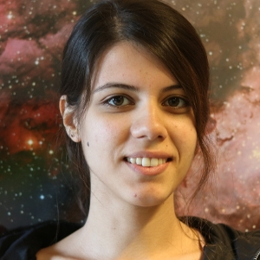
Nissanke MMA Group
(PI) Samaya Nissanke
(PD) Pablo Bosch
Numerical Relativity
(PD) Pippa Cole
LISA, PBH
(PI) Tana Joseph
XBs, E&D
(PhD) Geert Raaijmakers
EM/KN - GEMMA
(PhD) Banafsheh Shiralou
BBH w/ modified GR
(PhD) Uddipta Bhardwaj
GW NN inference, EM
(PhD) Ekaterina Leonova
Research Assistant: Alexandra Wernersson, MSc: Hidde Boersma, Ioannis Bousdokos, Marta Stentella, Joshua Yu-Wing, Ethan van Woerkom
Notes:
Nissanke group: focus on MM / EM counterparts in GW astronomy / GW physics.

Slide 4
BNS/NSBH Merger EM Counterparts
GW170817:
GW (~2 min)
sGRB (~2 s)
Kilonova (~10 days)
GRB Afterglow (~years)
Kilonova Afterglow (decades-100 years)
+Metzger & Berger (2013)

Slide 5
What is a Kilonova Afterglow?
Also known as:
“KN Radio Remnant”
“Radio flare”
“Long-term radio transient”
e.g. Piran & Nakar (2013), Hotokezaka & Piran (2015), Hotokezaka et al. (2018), Kathirgamaraju (2019)
Notes:
Last ~0.1/2s before merger: tidal ejecta thrown out, dominates, GRB jet is launched soon after; due to its small mass it is ignored
Radioactive decay produces heat, from 1~30 d kilonova transient.
Continuing adiabatic expansion
E ~ t^3(gamma-1)
Kilonova energy peaks at ~30d , thus after 1y, ~100x cooling – relativistically hot ejecta do not cool necessarily as much? (10x). The internal energy is converted into kinetic energy. Thus reasonable to consider ejecta as completely cold.
Expanding ejecta sweep up ISM into FS. Since the FS has the greatest velocity difference & largest pressure, it has the greatest energy density, and thus dominates in synchrotron emission.
As FS slows, increasingly more ejecta collect in RS, until the RS travels back to the center, and the ‘impulsive’ phase ends, going in to a phase of adiabatic expansion. After a short relaxation period, the remnant begins to expand according to the Sedov-Taylor solution: R ~ t^2/5
This continues for 100s of years, until pressure becomes comparable to ISM, and remnant is absorbed into surrounding medium.

Slide 6
Inspiration: Afterglowpy
Primarily for GRB / cocoon models, no self-absorption, no velocity profile

Slide 7
A Public KN Afterglow Code
Goal: publicly available model for after O4 / GW170817
Possible several-10s BNS / NSBH mergers expected
No straightforward recipe
Piran, Nakar & Rosswog (2013)
Notes:
Make a publicly available model f/ afterglow
No straightforward recipe
Had to trawl through literature to figure out synchrotron physics, underlying assumptions, etc.
Realised afterglow models contain many systematic uncertainties, unsure what to do with them.
In particular, blastwave evolution prescriptions interesting
Sought to produce 1D simulations to test these. Eventually produced full-scale RT model
Lists energetics of kilonova, grb and kilonova afterglow
Afterglowpy, PyBlastafterglow

Slide 8
Self absorption, blastwave evolution, thermal+power-law electrons, velocity profile, but private and not hydrodynamic

Slide 9
Assumptions in modelling – are they satisfied?
Hydro:
Perfect fluid: no conductivity or viscosity. This requires electrons to diffuse on very small distances due to magnetic fields.
Shock is colliiosnless
Initial conditions well-defined: kilonova does not affect ejecta profile from simulations & ejecta are cold.
No Rayleigh-Taylor instability
Shock is not radiative
Equation of state only dependent on baryons
Mono-atomic EOS of single type
RS/FS Same composition
1D Spherically Symmetric Blastwave
Electrons:
Electron population solely power-law
Electrons distributed randomly with respect to magnetic fields.
Accelerated electrons exist locally at every point of the fluid.
Microphysical parameters e_b, e_e (f,p) stay constant throughout space and time.
RT:
Optically thin (e.g. afterglowpy)
Equal time surfaces difficult due to intermediate regime
Notes:
It worries me!

Slide 10
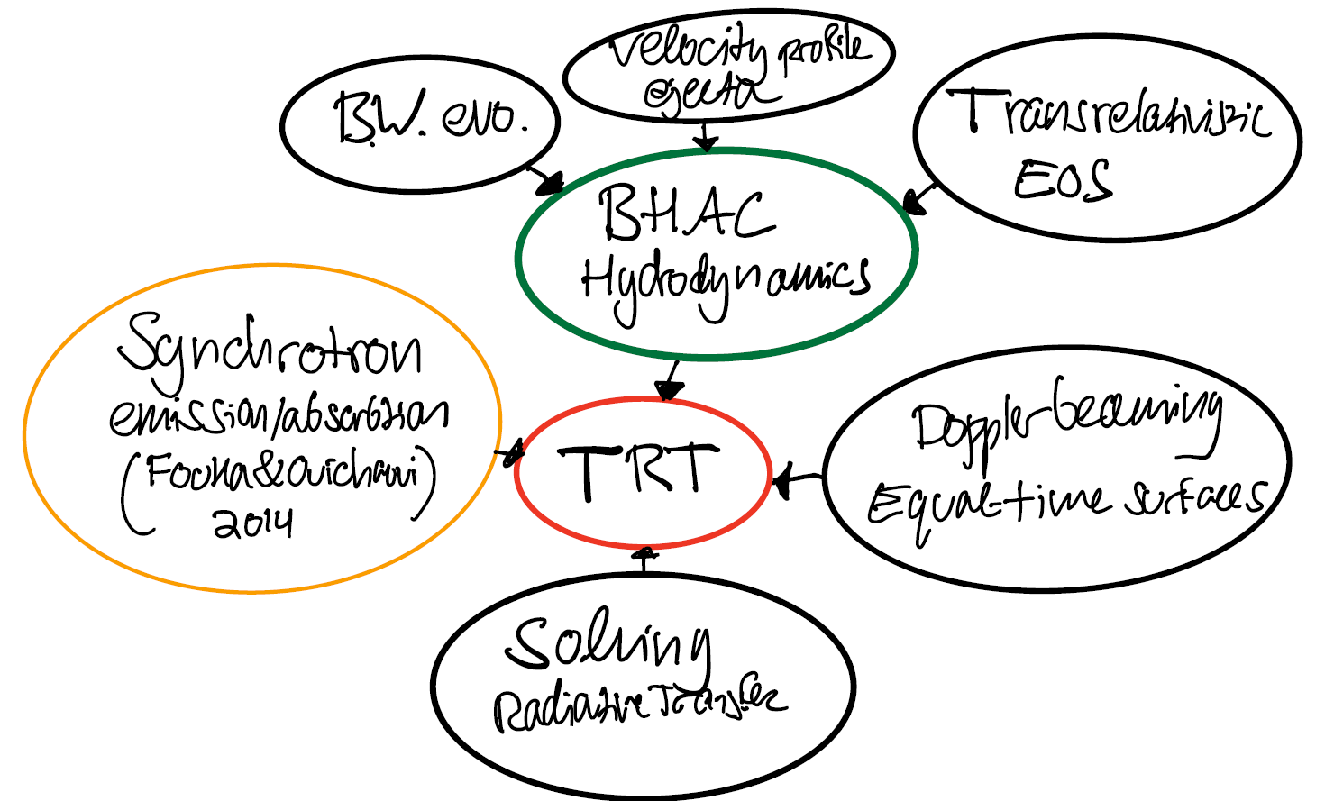
TRT - Teiresias Radiative Transfer
Fouka, M. Ouichaoui, S. (2014), MNRAS.
Analytical fits for the synchrotron emission from a power-law particle distribution with a sharp cutoff .
Porth, O., Olivares, H., Mizuno, Y., Younsi, Z., Rezzolla, L., Moscibrodzka, M., Falcke, H., Kramer, M. (2017).
The Black Hole Accretion Code. (1611.09720)
Notes:
BHAC – 1D hydrodynamic simulations w/ variable eos – takes couple minutes at most
Scale invariance means ISM can be varied with single hydro simulation
Standard synchrotron microphysics with f, p, e_b, e_e (cooling added later) (Fouka)
Observer time & doppler beaming
Gives specific intensity at each impact parameter.
Can give ~few time points / s. -> simulation takes ~1 min

Slide 11
Single-velocity outflow: E_{kin}= 3∙10 ⁵⁰ erg, M=3.5∙10⁻³ M☉ , n_{ISM}= 1 cm⁻³.

Slide 12
Single-velocity outflow: n_{ISM}= 1 cm⁻³, ε_{B}=1, ε_{e}=1, p=3, d=100Mpc.
v = 100 MHz < v_{m ,}v_{a}; v_{m}, < v = 1 GHz < v_{a} ; v_{m}, v_{a} < v = 10 GHz

Slide 13
GW170817 KN afterglow E_{kin}= 2.5∙10 ⁵⁰ erg, M=3.5∙10⁻³ M☉ , n_{ISM}= 0.001 cm⁻³
SFHo_M135135_LK: +Radice, Perego, Hotokezaka et al. 2018 (ApJ)

Slide 14
GW170817 KN afterglow E_{kin}= 2.5∙10 ⁵⁰ erg, M=3.5∙10⁻³ M☉ , n_{ISM}= 0.001 cm⁻³
SFHo_M135135_LK: +Radice, Perego, Hotokezaka et al. 2018 (ApJ)

Slide 15
GW170817 KN Afterglow n_{ISM}= 0.001 cm⁻³, ε_{B}=0.01, ε_{e}=0.1, p=2.16, d=40.3 Mpc.
SFHo_M135135_LK: +Radice, Perego, Hotokezaka et al. 2018 (ApJ)

Slide 16
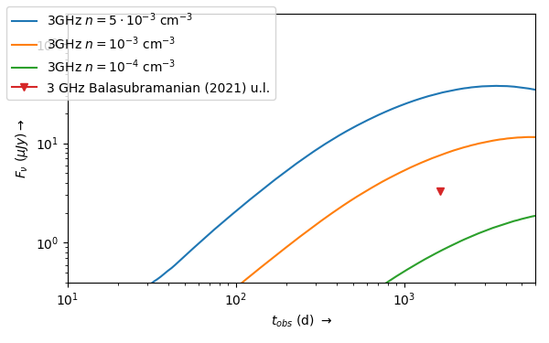
GW170817 KN afterglow
SFHo_M135135_LK: +Radice, Perego, Hotokezaka et al. 2018 (ApJ)

Slide 17
Plausible Higher Density BNS Scenario: n_{ISM}= 1 cm⁻³, ε_{B}=0.01, ε_{e}=0.1, p=2.16, d=100 Mpc.
SFHo_M135135_LK: +Radice, Perego, Hotokezaka et al. 2018 (ApJ)

Slide 18
Summary
Teiresias Radiative Transfer is a trans-relativistic afterglow code.
Uses 1D hydrodynamic simulations from the Black Hole Accretion Code.
Works in both optically thick and thin regimes, both above and below the synchrotron frequency, from radio to x-rays.
Can be used to model synchrotron radiation from, among others, kilonova, and supernova afterglows.
Public, Open Source: github.com/Edekje/trt
Suggestions, comments, questions welcome: ethan.van.woerkom@student.uva.nl

