Slide 1
ASTRA Test

Slide 2
Infinite Long Solenoid 2 T Field, L=7 m Step H_max=0.001
Initial Beam
Particles taken into account N = 500
total charge Q = -1.000 nC
horizontal beam position x = 2.9830E-04 mm
vertical beam position y = 1.6413E-04 mm
longitudinal beam position z = 1.1359E-07 m
horizontal beam size sig x = 0.7499 mm
vertical beam size sig y = 0.7499 mm
longitudinal beam size sig z = 0.8794 mm
average kinetic energy E = 7.500 MeV
energy spread dE = 1.467 keV
average momentum P = 7.995 MeV/c
transverse beam emittance eps x = 344.7 pi mrad mm
correlated divergence cor x = -0.3491 mrad
transverse beam emittance eps y = 346.5 pi mrad mm
correlated divergence cor y = 0.3496 mrad
longitudinal beam emittance eps z = 1.290 pi keV mm
correlated energy spread cor z = -1.6047E-02 keV
emittance ratio eps y/eps x = 0.9947
Output
Particles taken into account N = 500
total charge Q = -1.000 nC
horizontal beam position x = 4.7392E-04 mm
vertical beam position y = 2.2443E-04 mm
longitudinal beam position z = 7.000 m
horizontal beam size sig x = 0.7530 mm
vertical beam size sig y = 0.7525 mm
longitudinal beam size sig z = 0.9971 mm
average kinetic energy E = 7.500 MeV
energy spread dE = 1.467 keV
average momentum P = 7.995 MeV/c
transverse beam emittance eps x = 344.7 pi mrad mm
correlated divergence cor x = -1.044 mrad
transverse beam emittance eps y = 346.4 pi mrad mm
correlated divergence cor y = -0.3559 mrad
longitudinal beam emittance eps z = 1.463 pi keV mm
correlated energy spread cor z = -1.4118E-02 keV
emittance ratio eps y/eps x = 0.9950

Slide 3
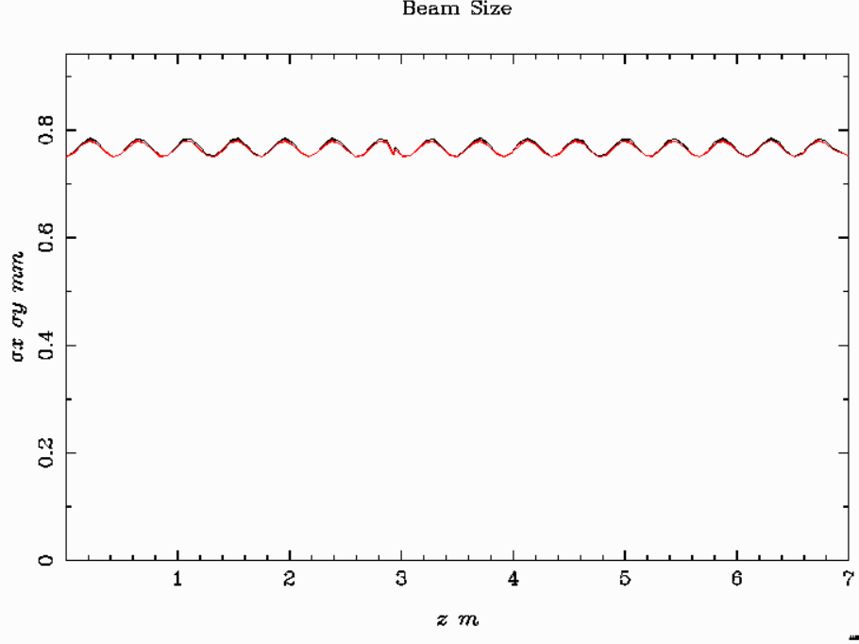
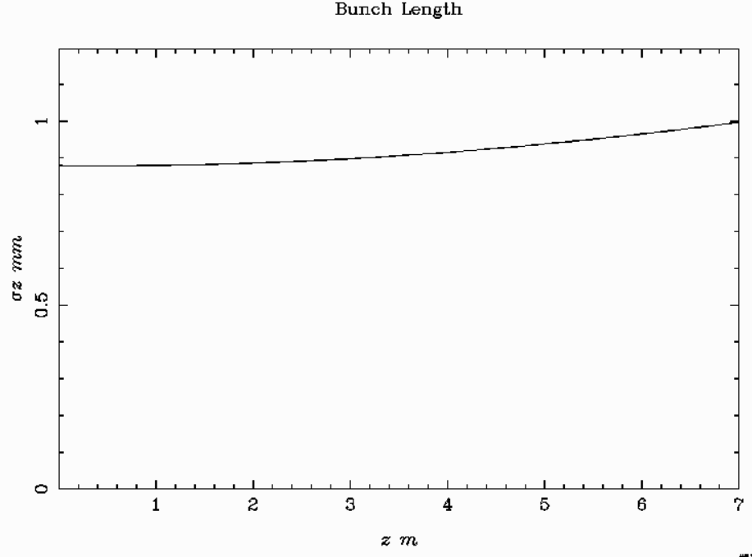
Infinite Long Solenoid 2 T Field, L=7 m Step H_max=0.001

Slide 4
Infinite Long Solenoid 0.5 T Field, L=7 m Step H_max=0.001
Initial Beam
Particles taken into account N = 500
total charge Q = -1.000 nC
horizontal beam position x = 2.9830E-04 mm
vertical beam position y = 1.6413E-04 mm
longitudinal beam position z = 1.1359E-07 m
horizontal beam size sig x = 0.7499 mm
vertical beam size sig y = 0.7499 mm
longitudinal beam size sig z = 0.8794 mm
average kinetic energy E = 7.500 MeV
energy spread dE = 1.467 keV
average momentum P = 7.995 MeV/c
transverse beam emittance eps x = 128.9 pi mrad mm
correlated divergence cor x = -8.7167E-02 mrad
transverse beam emittance eps y = 130.1 pi mrad mm
correlated divergence cor y = 8.7691E-02 mrad
longitudinal beam emittance eps z = 1.290 pi keV mm
correlated energy spread cor z = -1.6047E-02 keV
emittance ratio eps y/eps x = 0.9906
Output
Particles taken into account N = 500
total charge Q = -1.000 nC
horizontal beam position x = 4.2271E-04 mm
vertical beam position y = 3.2172E-04 mm
longitudinal beam position z = 7.000 m
horizontal beam size sig x = 0.7530 mm
vertical beam size sig y = 0.7527 mm
longitudinal beam size sig z = 0.9971 mm
average kinetic energy E = 7.500 MeV
energy spread dE = 1.467 keV
average momentum P = 7.995 MeV/c
transverse beam emittance eps x = 128.8 pi mrad mm
correlated divergence cor x = -0.8405 mrad
transverse beam emittance eps y = 130.2 pi mrad mm
correlated divergence cor y = -0.6689 mrad
longitudinal beam emittance eps z = 1.463 pi keV mm
correlated energy spread cor z = -1.4118E-02 keV
emittance ratio eps y/eps x = 0.9890

Slide 5
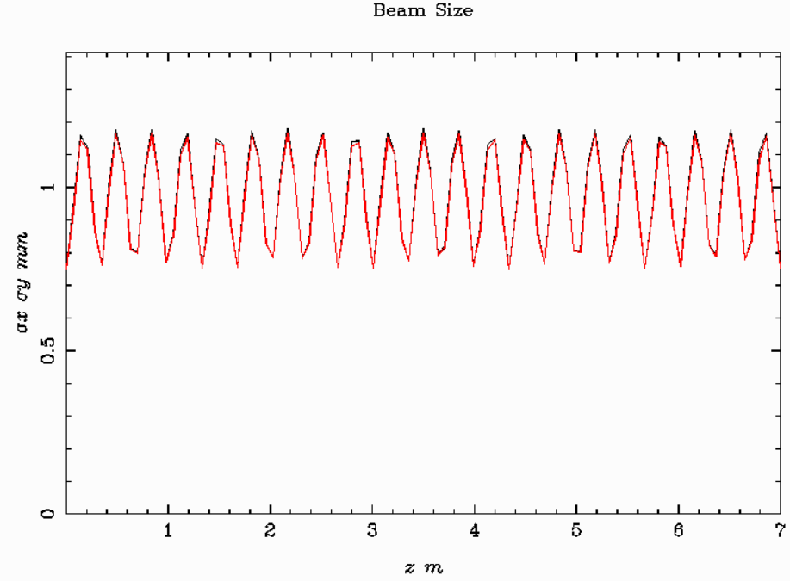
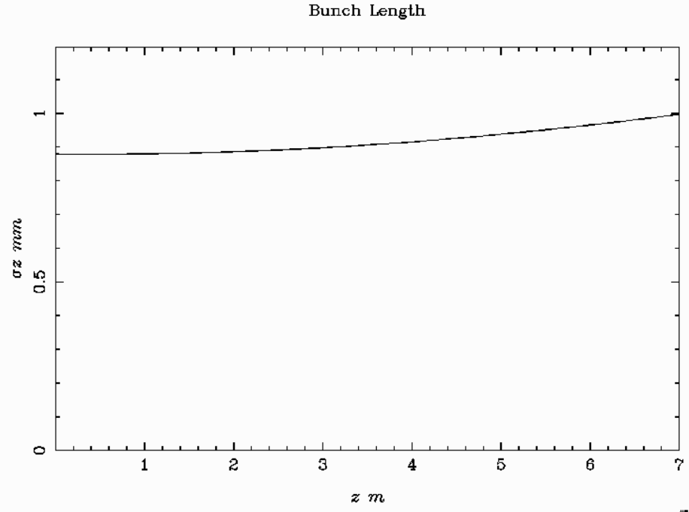
Infinite Long Solenoid 0.5 T Field, L=7 m Step H_max=0.001

Slide 6
AMD B₀ =15 T α=48.3 L=0.6 m σ_{x’}=0.1 rad
Initial beam parameters
Particles taken into account N = 500
total charge Q = 1.000 nC
horizontal beam position x = 2.9830E-04 mm
vertical beam position y = 1.6413E-04 mm
longitudinal beam position z = 1.1359E-07 m
horizontal beam size sig x = 0.7499 mm
vertical beam size sig y = 0.7499 mm
longitudinal beam size sig z = 0.8794 mm
average kinetic energy E = 15.50 MeV
energy spread dE = 5.746 keV
average momentum P = 16.01 MeV/c
transverse beam emittance eps x = 2202. pi mrad mm
correlated divergence cor x = 1.5063E-03 mrad
transverse beam emittance eps y = 2202. pi mrad mm
correlated divergence cor y = 4.4679E-03 mrad
longitudinal beam emittance eps z = 5.047 pi keV mm
correlated energy spread cor z = 0.2795 keV
emittance ratio eps y/eps x = 1.000
Beam parameters at the exit
Particles taken into account N = 500
total charge Q = 1.000 nC
horizontal beam position x = 2.1934E-02 mm
vertical beam position y = 1.2525E-02 mm
longitudinal beam position z = 0.6000 m
horizontal beam size sig x = 4.177 mm
vertical beam size sig y = 4.200 mm
longitudinal beam size sig z = 1.060 mm
average kinetic energy E = 15.50 MeV
energy spread dE = 5.752 keV
average momentum P = 16.01 MeV/c
transverse beam emittance eps x = 3392. pi mrad mm
correlated divergence cor x = 6.953 mrad
transverse beam emittance eps y = 3370. pi mrad mm
correlated divergence cor y = 6.689 mrad
longitudinal beam emittance eps z = 5.941 pi keV mm
correlated energy spread cor z = -1.298 keV
emittance ratio eps y/eps x = 1.007

Slide 7
AMD B₀ =15 T α=24.15 L=1.2 m σ_{x’}=0.1 rad
Initial beam parameters
Particles taken into account N = 500
total charge Q = 1.000 nC
horizontal beam position x = 2.9830E-04 mm
vertical beam position y = 1.6413E-04 mm
longitudinal beam position z = 1.1359E-07 m
horizontal beam size sig x = 0.7499 mm
vertical beam size sig y = 0.7499 mm
longitudinal beam size sig z = 0.8794 mm
average kinetic energy E = 15.50 MeV
energy spread dE = 5.746 keV
average momentum P = 16.01 MeV/c
transverse beam emittance eps x = 2202. pi mrad mm
correlated divergence cor x = 1.5063E-03 mrad
transverse beam emittance eps y = 2202. pi mrad mm
correlated divergence cor y = 4.4679E-03 mrad
longitudinal beam emittance eps z = 5.047 pi keV mm
correlated energy spread cor z = 0.2795 keV
emittance ratio eps y/eps x = 1.000
Beam parameters at the exit
Particles taken into account N = 500
total charge Q = 1.000 nC
horizontal beam position x = 2.1933E-02 mm
vertical beam position y = -2.3987E-02 mm
longitudinal beam position z = 1.200 m
horizontal beam size sig x = 4.987 mm
vertical beam size sig y = 5.056 mm
longitudinal beam size sig z = 1.496 mm
average kinetic energy E = 15.50 MeV
energy spread dE = 5.753 keV
average momentum P = 16.01 MeV/c
transverse beam emittance eps x = 2508. pi mrad mm
correlated divergence cor x = 8.370 mrad
transverse beam emittance eps y = 2485. pi mrad mm
correlated divergence cor y = 8.768 mrad
longitudinal beam emittance eps z = 7.927 pi keV mm
correlated energy spread cor z = -2.238 keV
emittance ratio eps y/eps x = 1.009

Slide 8
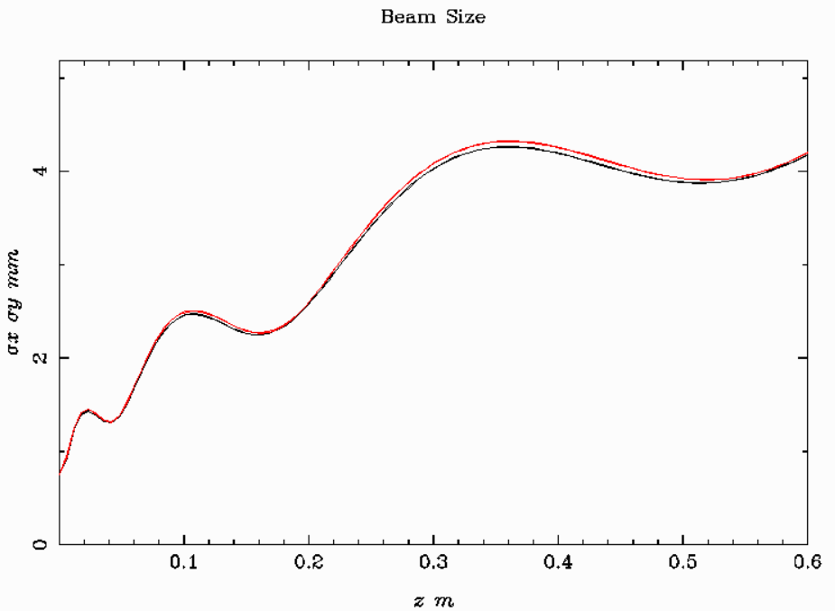
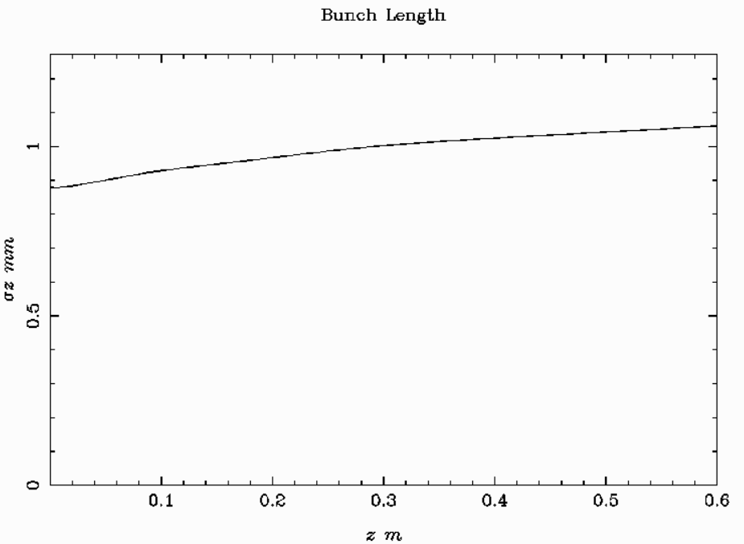
AMD B₀ =15 T α=48.3 L=0.6 m σ_{x’}=0.1 rad

Slide 9
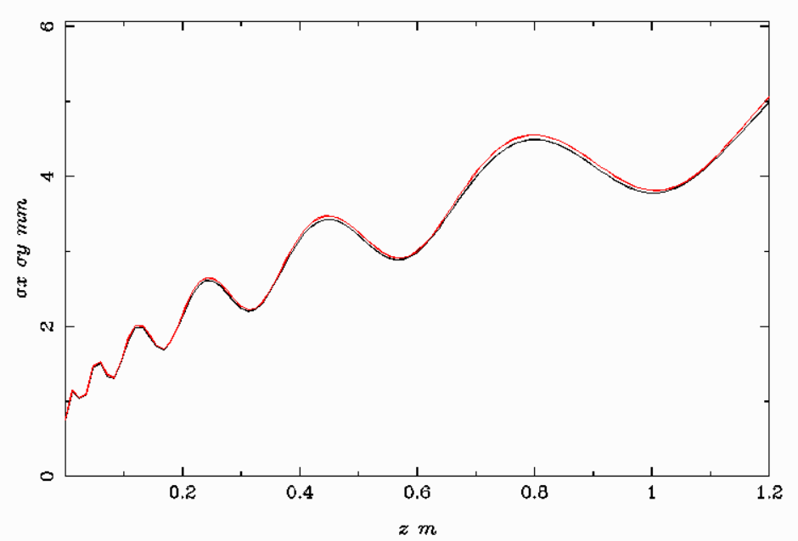
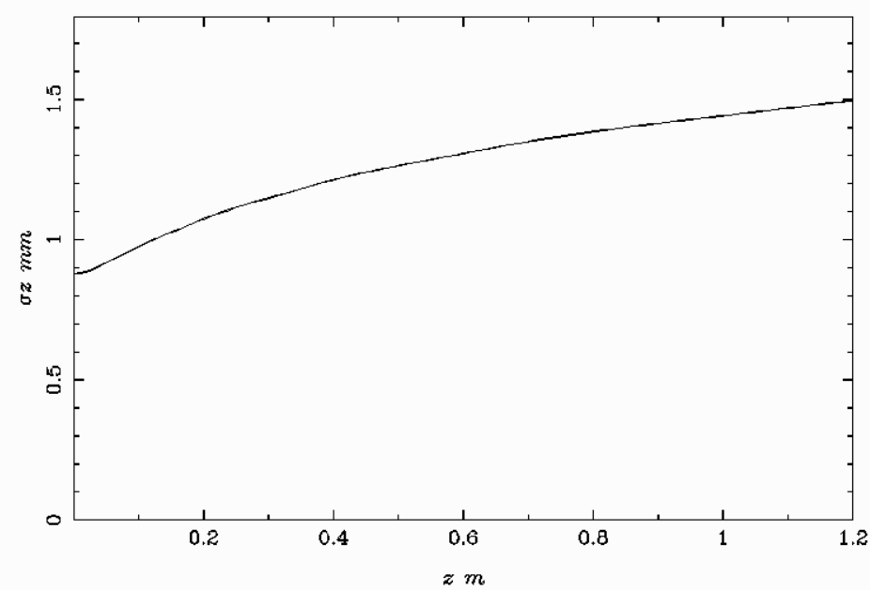
AMD B₀ =15 T α=24.15 L=1.2 m σ_{x’}=0.1 rad

Slide 10
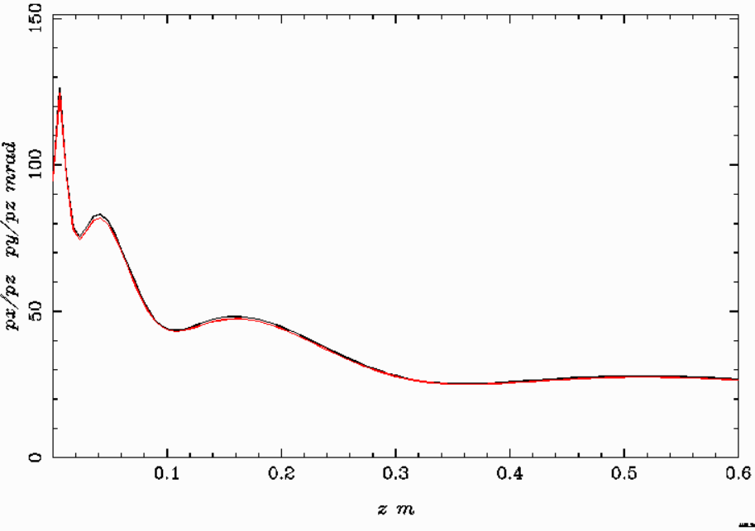
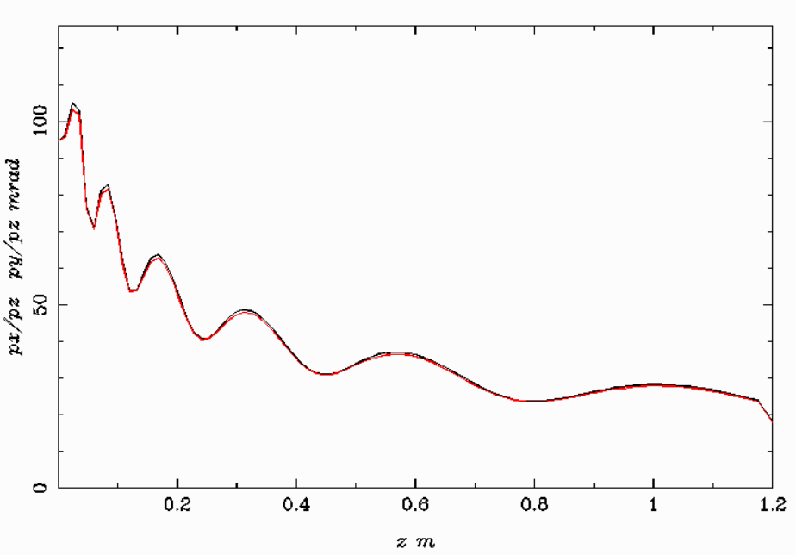
σ_{x’}=0.1 rad
α = 48.3
α = 24.15

Slide 11
AMD B₀ =15 T α=48.3 L=0.6 m σ_{x’}=0.2 rad
Initial beam parameters
Particles taken into account N = 500
total charge Q = 1.000 nC
horizontal beam position x = 2.9830E-04 mm
vertical beam position y = 1.6413E-04 mm
longitudinal beam position z = 1.1359E-07 m
horizontal beam size sig x = 0.7499 mm
vertical beam size sig y = 0.7499 mm
longitudinal beam size sig z = 0.8794 mm
average kinetic energy E = 15.51 MeV
energy spread dE = 22.19 keV
average momentum P = 16.02 MeV/c
transverse beam emittance eps x = 4403. pi mrad mm
correlated divergence cor x = 2.9685E-03 mrad
transverse beam emittance eps y = 4403. pi mrad mm
correlated divergence cor y = 9.1424E-03 mrad
longitudinal beam emittance eps z = 19.48 pi keV mm
correlated energy spread cor z = 1.169 keV
emittance ratio eps y/eps x = 1.000
Beam parameters at the exit
Particles taken into account N = 500
total charge Q = 1.000 nC
horizontal beam position x = 0.1221 mm
vertical beam position y = -3.4780E-02 mm
longitudinal beam position z = 0.6000 m
horizontal beam size sig x = 5.499 mm
vertical beam size sig y = 5.592 mm
longitudinal beam size sig z = 2.708 mm
average kinetic energy E = 15.51 MeV
energy spread dE = 22.21 keV
average momentum P = 16.02 MeV/c
transverse beam emittance eps x = 5252. pi mrad mm
correlated divergence cor x = 23.48 mrad
transverse beam emittance eps y = 5298. pi mrad mm
correlated divergence cor y = 23.50 mrad
longitudinal beam emittance eps z = 52.74 pi keV mm
correlated energy spread cor z = -10.67 keV
emittance ratio eps y/eps x = 0.9912

Slide 12
AMD B₀ =15 T α=24.15 L=1.2 m σ_{x’}=0.2 rad
Initial beam parameters
Particles taken into account N = 500
total charge Q = 1.000 nC
horizontal beam position x = 2.9830E-04 mm
vertical beam position y = 1.6413E-04 mm
longitudinal beam position z = 1.1359E-07 m
horizontal beam size sig x = 0.7499 mm
vertical beam size sig y = 0.7499 mm
longitudinal beam size sig z = 0.8794 mm
average kinetic energy E = 15.51 MeV
energy spread dE = 22.19 keV
average momentum P = 16.02 MeV/c
transverse beam emittance eps x = 4403. pi mrad mm
correlated divergence cor x = 2.9685E-03 mrad
transverse beam emittance eps y = 4403. pi mrad mm
correlated divergence cor y = 9.1424E-03 mrad
longitudinal beam emittance eps z = 19.48 pi keV mm
correlated energy spread cor z = 1.169 keV
emittance ratio eps y/eps x = 1.000
Beam parameters at the exit
Particles taken into account N = 500
total charge Q = 1.000 nC
horizontal beam position x = -6.4538E-02 mm
vertical beam position y = -0.2057 mm
longitudinal beam position z = 1.200 m
horizontal beam size sig x = 7.920 mm
vertical beam size sig y = 8.014 mm
longitudinal beam size sig z = 5.211 mm
average kinetic energy E = 15.51 MeV
energy spread dE = 22.21 keV
average momentum P = 16.02 MeV/c
transverse beam emittance eps x = 8107. pi mrad mm
correlated divergence cor x = 13.25 mrad
transverse beam emittance eps y = 8331. pi mrad mm
correlated divergence cor y = 12.06 mrad
longitudinal beam emittance eps z = 98.16 pi keV mm
correlated energy spread cor z = -11.77 keV
emittance ratio eps y/eps x = 0.9732

Slide 13
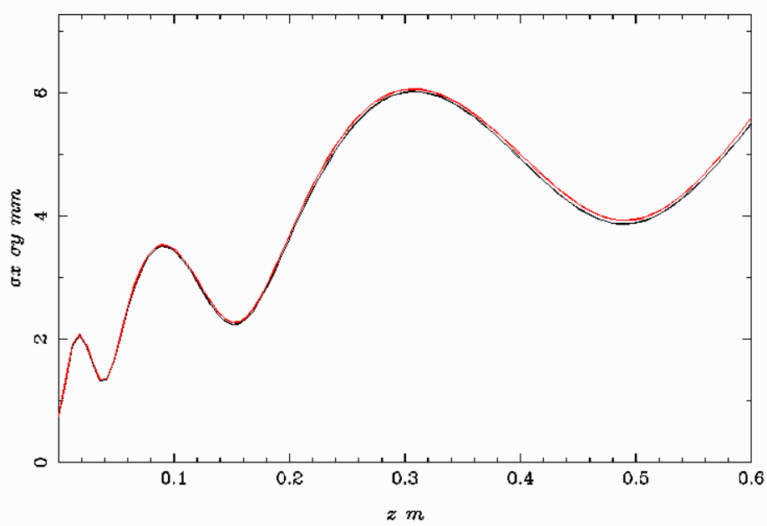
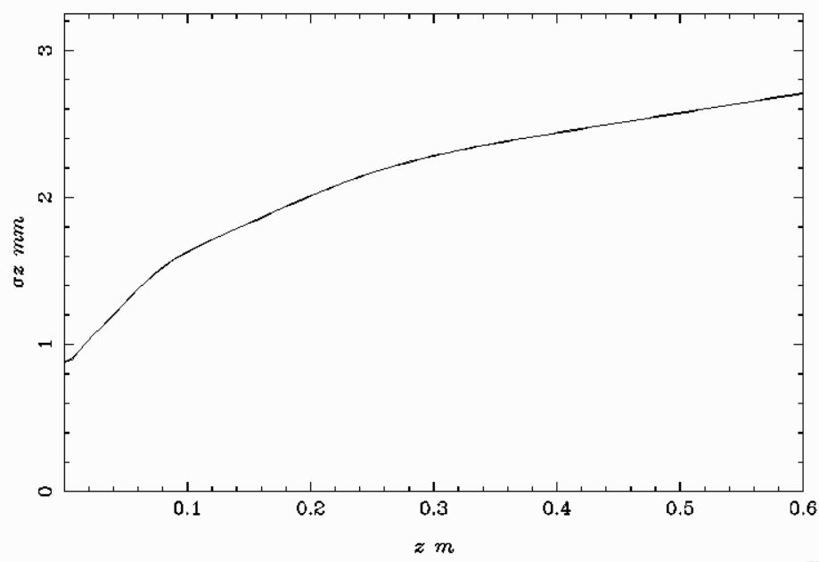
AMD B₀ =15 T α=48.3 L=0.6 m σ_{x’}=0.2 rad

Slide 14
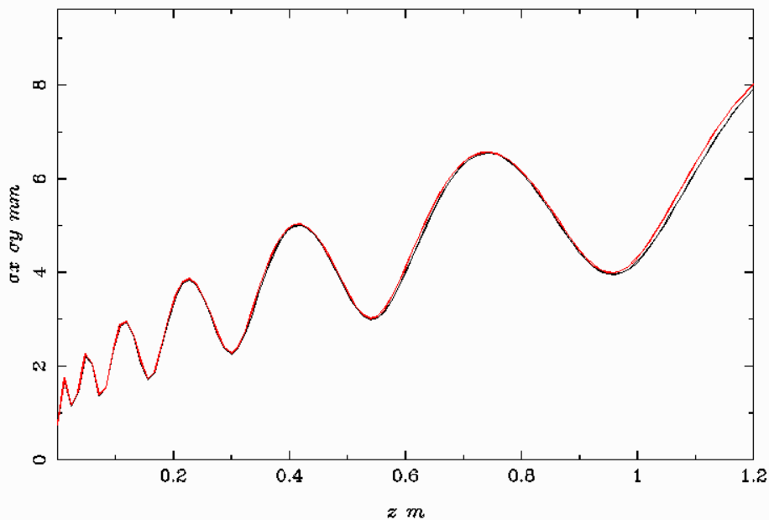
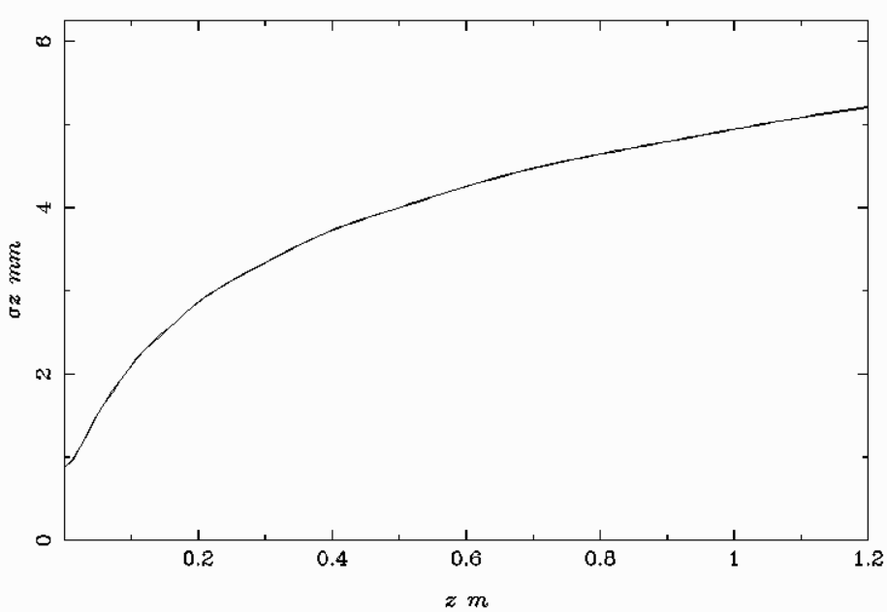
AMD B₀ =15 T α=24.15 L=1.2 m σ_{x’}=0.2 rad

Slide 15
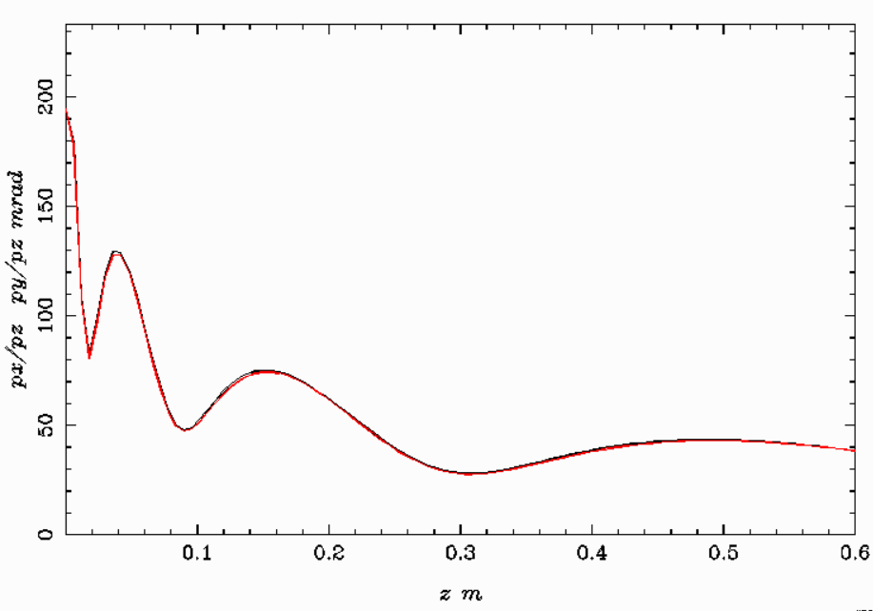
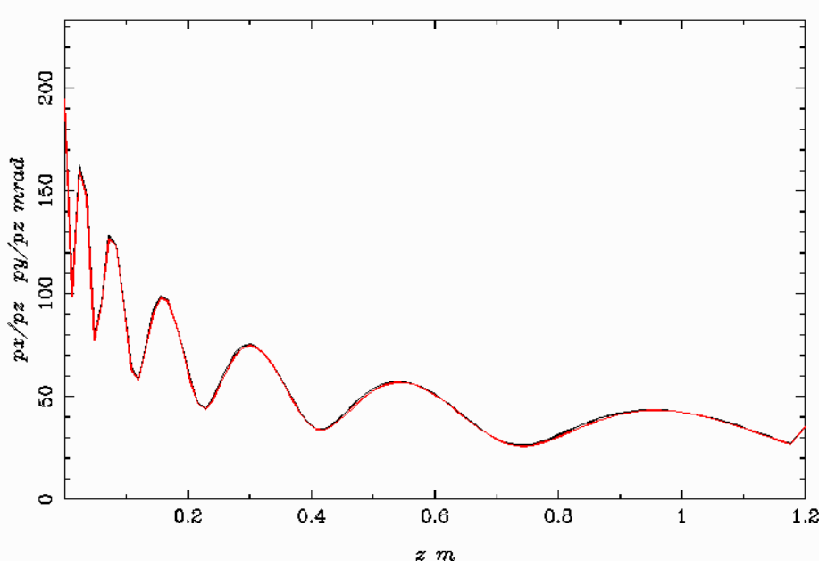
σ_{x’}=0.2 rad
α = 48.3
α = 24.15

