Slide 1
Introduction. The PERLE project at Orsay
and
the Motivation of the Workshop
09 /05/ 2022

Slide 2
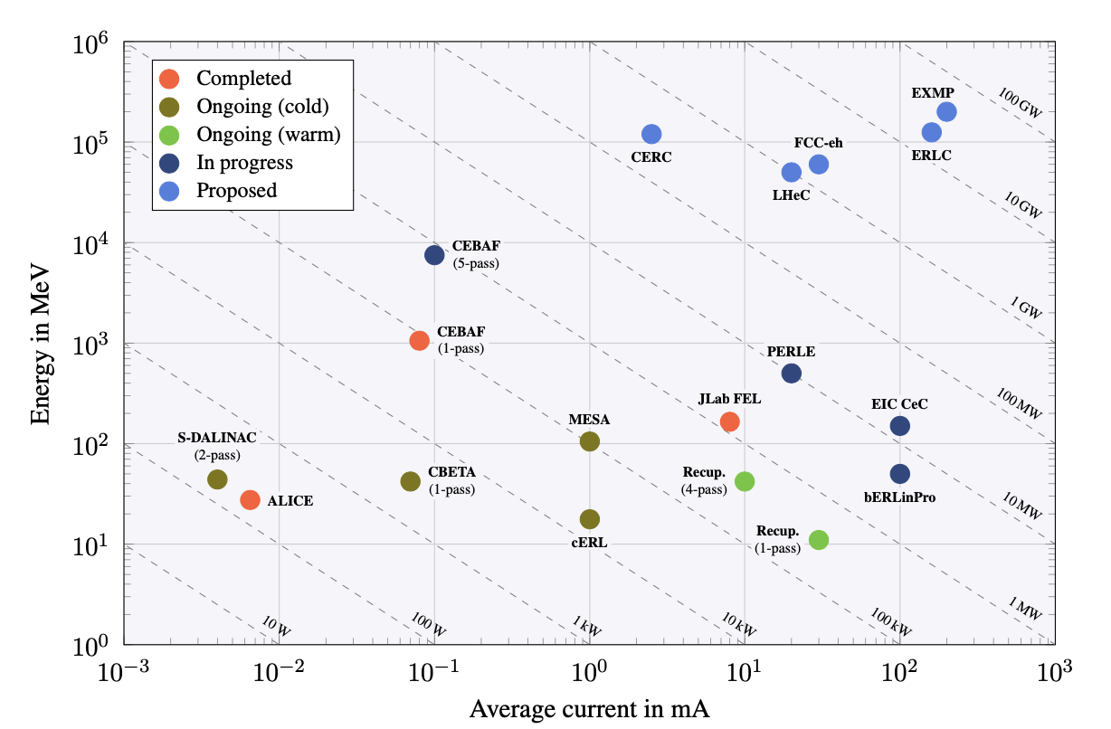
International Scientific Context: A brief history of the effort over the past 4 years
Jan 2020: ERLs Developments has been recognized as one of the five main pillars of accelerators R&D in support of the European Strategy for Particle Physics (ESPP).
Mid 2020: Following ESPP recommendations, the CERN Council mandated the Laboratory Directors Group (LDG) to define and maintain a roadmap for accelerators R&D.
Fall 2020: The LDG decided to create Expert Panels for each of the five selected priority areas for accelerators R&D.
Jan- Dec 2021: ERL Roadmap Panel, chaired by Max Klein and Andrew Hutton, has done a tremendous job with broad and active participation. The PERLE project was recognized as one of the "essential pillars of the ERL," with milestones to be achieved by the next ESPP in 2026. The other two priorities are : the Upgrade bERLinPRO toward the First ERL Facility to operate 100mA in single turn with FRT control and to develop Key Technology R&D Program for the next generation ERLs
Dec 2021: Accelerators roadmap presented and approved by the CERN Council and recently published (March 2022) as the CERN Yellow Report: https://doi.org/10.23731/CYRM-2022-001
The implementation of the roadmap will be followed by LDG (*)
Funding Limited
Technology Limited
^{(*)} "The Council invites ECFA and LDG to develop, in collaboration with SPC, funding agencies and relevant research organizations in Europe and beyond, detailed implementation plans defining milestones, priorities and funding sources, for consideration by the CERN Council at its spring 2022 session."
The proposal to follow the implementation of ERL Roadmap by a new panel, including the previous chairs. On going

Slide 3









National Scientific Context: PERLE Collaboration & PERLE- France
PERLE international collaboration
A collaboration agreement (CA) signed by all partners.
The bilateral ICRADA DOE- JLab with CNRS is still pending in DOE for signature.
Position of Budker Institute of Nuclear Physics → Participation suspended
New request of An-Najah University - Palestine to joint the collaboration: Agreed by the Collaboration Board → Formal inclusion soon.
PERLE in France. Important News.
  IN2P3/CNRS National Strategy (end of 2021): Perle@Orsay a priority for accelerators in line with the ESPP
  Project submitted to the recovery plan for 2022 (possibility of obtaining financial support for phase 1 of PERLE). Ministry response is asking us to resubmit in next phase (June 22) together with another project (SUpra2030). Work on going, timely followed by IN2P3 and led by Maud Baylac
  Infrastructure funding obtained: 2M€ available from 2022 for PERLE infrastructures (programming phase to be started soon)
  New Organization in France and significant increase of people involved

Slide 4
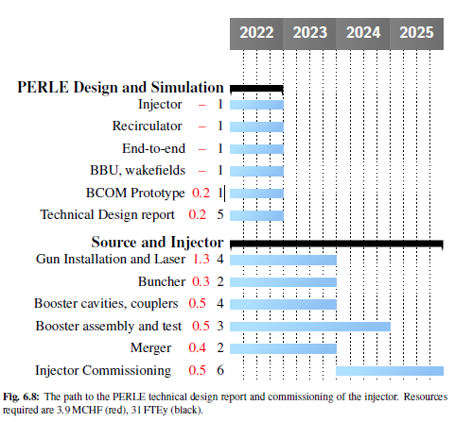
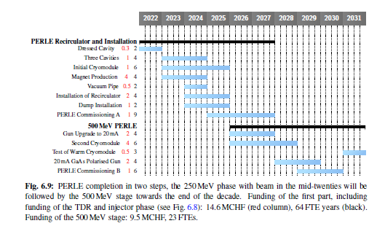
Some words on the global context.
Some preliminary planning : 6 years for PERLE 250 MeV*
It was shown as explicitely required in the Accelerator RoadMap at the CERN Council in December 2021
*Very tight schedule for the TDR. Today some discussion on redefining the scope of the TDR keeping the global planning

Slide 5
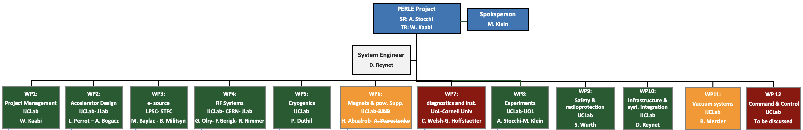
Project Organisation: PERLE Collaboration & PERLE- France
We have finalised an internal organisation in France led by two laboratories: IJCLab/LPSC.
PHD student (ending now) injection lines : Ben Hounsell (100% PERLE)
PHD student (2nd year) on RF/HOM/cavities : Carmelo Barbagallo (100% PERLE)
PHD student (1st year) on Beam Dynamics : Coline Guyot (50% in PERLE)
Postdoc (beam dynamics) Alex Fomin
5 months interns (Magnets/beam dynamics)→PHD thesis 2022:Rasha Abukeshek
From Jul 2022
  Postdoc (Injection line) Joshua Yoskowitz
From Oct. 2022
  Permanent CRNS position (beam dynamics) Julien Michaud
  PHD thesis Liverpool/AsTec/IJCLab (injections) Connor Monaghan
Denis Reynet System Engineers (IJCLab)
Luc Perrot Beam Dynamics (IJCLab)
Maud Baylac Gun Installation and Operation (LPSC)
Guillaume Olry RF System (IJCLab)
Patxi Duthil Cryogenic (IJCLab)
Hadil Abualrob Magnets (An-Najah / IJCLab)
Sébastien Wurth Security Issues (IJCLab)
Marc Langlet Infrastructures (IJCLab)
Bruno Mercier Vacuum System (IJCLab)
ALL in ALL many new join PERLE

Slide 6
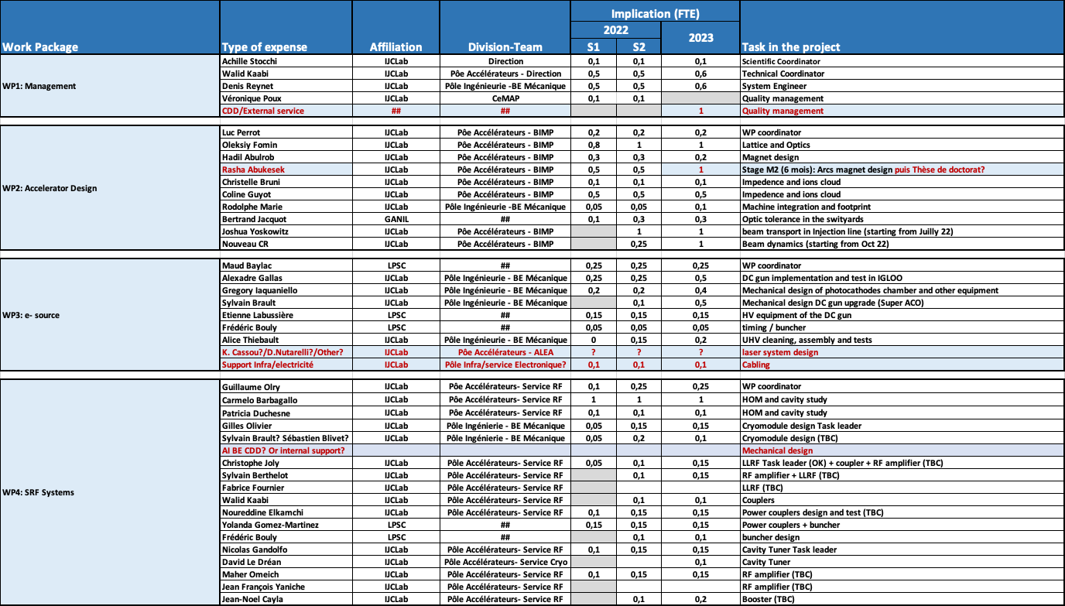
Manpower implicated and requested in 2022-2023 (1/2) - in France

Slide 7
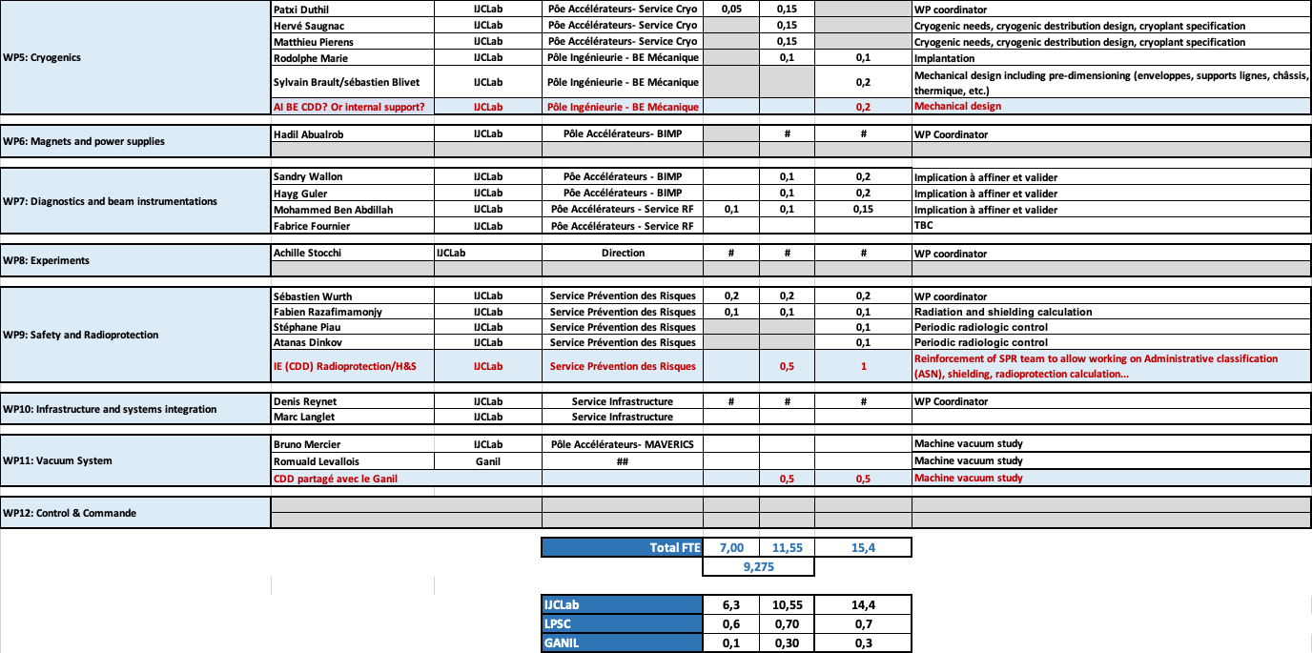
Manpower implicated and requested in 2022-2023 (2/2) – in France
In total: 49 persons currently implicated

Slide 8
WPs Progress, scope and timeline – together with the international partners
WP2: Accelerator Design
A first meeting was held last February with A. Bogacz and discuss the work plan.
New commers in this WP stating from this summer to re-enforce the team @ IJCLab.
S. Saitiniyazi, R. Apsimon (Lancaster) & P. Williams (Daresbury) are studying the optimisation of the bunch filling pattern of PERLE.
Scope for the TDR Phase: Consolidate the PERLE Lattice, studies of the collective effects, propose a lattice for 250 MeV version of PERLE.
WP4 (RF Systems): Monthly meeting between Frank Gerigk (CERN)- Bob Rimmer (JLab) and Guillame Olry (IJCLab). People identified to contribute by task:
Task 4.1 (Cavity and HOM design):
CERN: R. Calaga, J. Mitchell, E. Montesinos.
Jlab: H. Wang, G. Park, R. Rimmer
IJCLab: C. Barbagallo, P. Duschene and G. Olry.
Task 4.2 (Power Coupler):
CERN: E. Montesinos, J. Mitchell
JLab: J. Guo, H. Wang
lJCLab + LPSC : Y. Gomez-Martinez, W. Kaabi, Ch. Joly
Task 4.3 (SPL CM adaptation):
CERN: L. Dassa, V. Parma
Jlab: J. Henry, R. Rimmer
IJCLab: G. Olivier, H. Sognac
Task 4.4 (Tuning system & FRT):
CERN: A. Macpherson, N. Shipman, L. Dassa
JLab: T. Powers, C. Hovater, T. Plawski
IJCLab: N. Gandolfo, D. Le Dréan
Task 4.5 (LLRF):
IJCLab: C. Joly, S. Berthelot
JLab: C. Hovater, T. Plawski
Task 4.6 (RF power source):
IJCLab: C. Joly, S. Berthelot, F. Fournier
JLab: C. Hovater
Task 4.7 (Booster design):
JLab: H. Wang, R. Rimmer
IJCLab: TBD
Task 4.8 (Buncher design):
IJCLab+ LPSC: Y. Gomez Martinez + F. Bouly + …
WP3 e-source
Participants/contact persons from STFC
Rachael Buckley : radiation protection, site management
Ryan Cash : mechanics engineer, design of upgraded ALICE gun, prep chamber
Andy Goulden : operation manager, SF6 infrastructures, radiation safety
Lee Jones : photocathodes, drive laser, HV conditioning and commissioning
Keith Middleman : vacuum expert, excused for the meeting
Boris Militsyn : gun coordinator, primary contact
Rob Smith : HV engineer, operation of HV supply
Contact person from CNRS/IN2P3
IJCLab-Orsay
Gallas : mechanical engineer
W. Kaabi : PERLE project leader
D. Reynet : PERLE syste engineer
S. Wurth : IJCLab safety engineer
LPSC-Grenoble
M. Baylac : gun assembly coordinator
E. Labussière : HV power supply
Scope for the TDR phase: re-install and operate the DC-gun with the Alice parameters and first studies of the DC gun upgrade
Scope for the TDR phase:
HOM study, optimisation of dumping solution, fabrication and test on cavity of HOM coupler
Completion and test of the JLab prototype cavity
Design of fundamental power coupler for PERLE
Study of tuning system solution
Decision on the use of SPL cryomodule (and design completion)
Buncher design
Decision on JLab Booster solution and define of needed further design studies

Slide 9
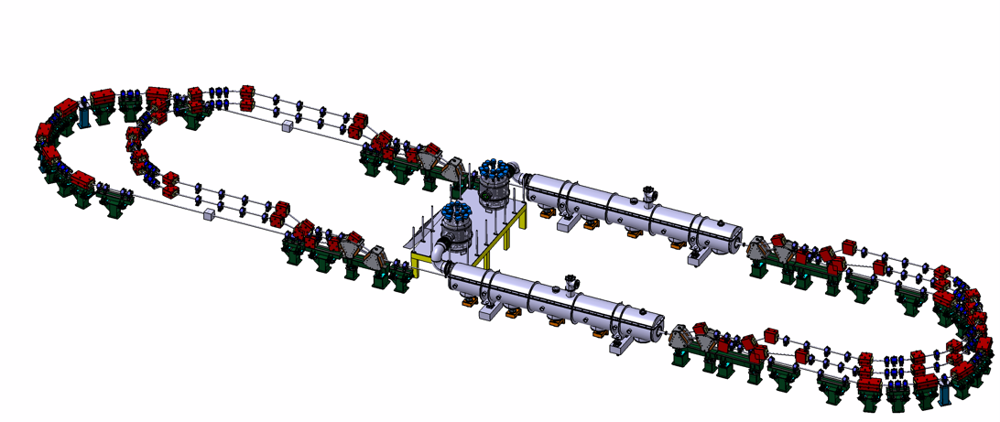
PERLE : Some nice acheivements
PERLE: first multi-turn ERL, based in SRF technology, designed to operate at 10MW power regime
2 Linacs (Four 5-Cell 801.58 MHz SC cavities)
3 turns (164 MeV/turn)
Max. beam energy 500 MeV
Preliminary Lattice design and footprint
ΔC = λ_{RF}/2
Injector
Target Parameter | Unit | Value
Injection energy | MeV | 7
Electron beam energy | MeV | 500
Normalised Emittance γε_{x,y} | mm mrad | 6
Average beam current | mA | 20
Bunch charge | pC | 500
Bunch length | mm | 3
Bunch spacing | ns | 25
RF frequency | MHz | 801.58
Duty factor |  | CW
7 MeV
ΔE = 82.2 MeV
Arcs 2:4:6
Arcs 1:3:5
Dump
7 MeV
ΔE = 82.2 MeV
Footprint: 31.5 x 5.5 x 0.9
Beyond CDR : Lattice design optimisation of
switchyards and circulating arcs

Slide 10
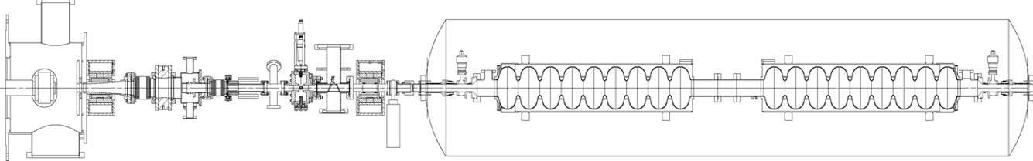
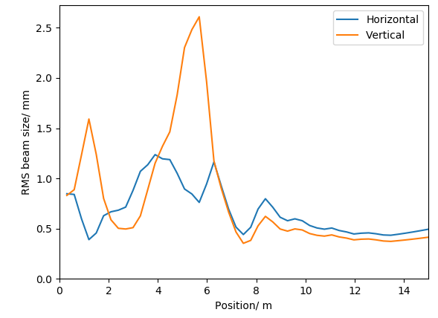
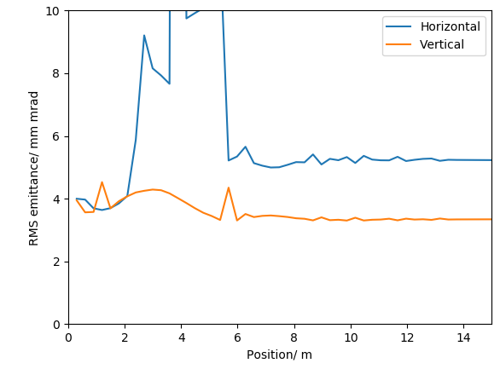
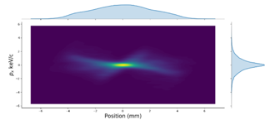
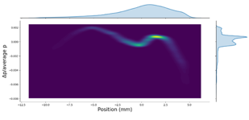
PERLE : Some nice acheivements
Energy spread
Photocathode gun
Buncher
SRF booster
Light box
PERLE Injection Line
The ALICE electron gun electrode geometry has been re-optimised for PERLE’s new requirements.
An optimisation with a 4 cavity booster linac, from the cathode to the booster exit, was done and meets the specification.
Focusing solenoids
Ben Hounsell (IJCLab/Liverpool) PHD
Electron source to booster exit optimisation:
Transverse beam size and emittance
 | Achieved values | Specification
Horizontal emittance | 5.23 mm mrad | < 6 mm mrad
Vertical emittance | 3.34 mm mrad | < 6 mm mrad
Bunch length | 3.22 | 3 mm
Kinetic energy | 86.1 MeV | 88.6 MeV
Horizontal beta function | 7.89 (mismatch 8.3 %) | 8.6
Horizontal alpha function | -0.74 (mismatch 11.6 %) | -0.66
Vertical beta function | 8.76 (mismatch 1.8 %) | 8.6
Vertical alpha function | -0.67 (mismatch 1.5 %) | -0.66

Slide 11
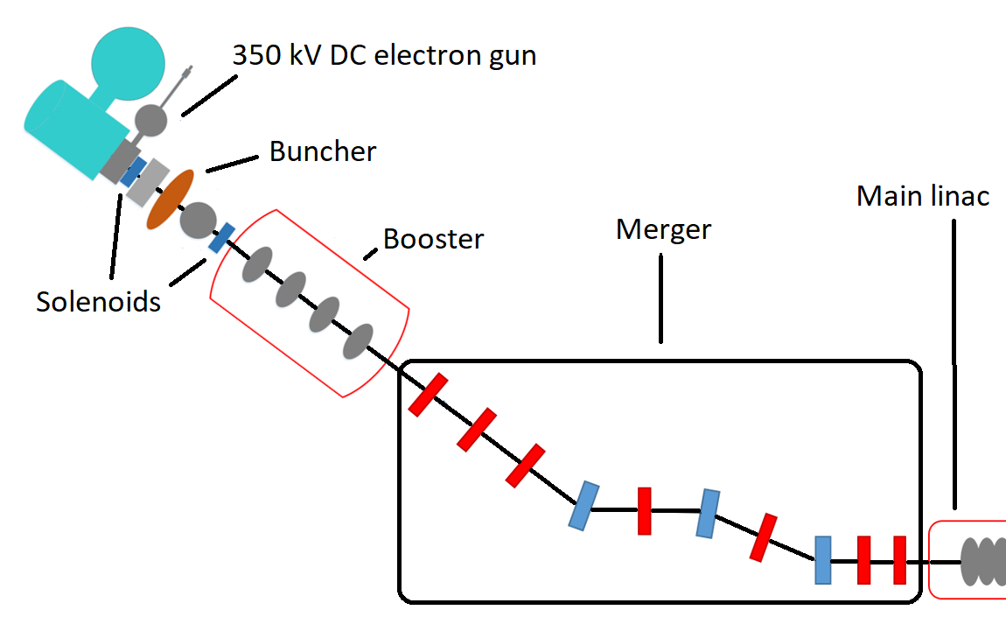
PERLE : Some nice acheivements
PERLE Injection Line
The PERLE Merger design:
The merger is the beamline which transports the beam into the main ERL loop.
The merger presents significant opportunity for emittance growth:
  Longitudinal space charge force induced shift in the dispersion
  Potentially asymmetric emittance compensation.
There are a wide range of possible designs and several were studied.
Generally shorter and smaller bending angles is better
4 dipole schemes were investigated as they have the potential to mitigate the effects of space charge on the dispersion and the consequent emittance growth.
Merger schemes investigated:

Slide 12
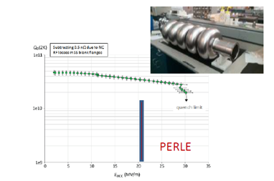
PERLE : Some nice acheivements
HOM-damping studies : Objective:extract the energy of the dangerous HOMs from the cavity
Adapting the SPL Module (IJCLab/CERN)
Carmelo Barbagallo (IJCLab) PHD
The first Nb 801.58MHz 5-cell elliptical cavity fabricated at JLab.
Preliminary results:
2Hook+2Probe couplers configuration seems to provide better damping than the DQW couplers configurations. However,couplers have still to be optimized!
Beam-stability impedance thresholds needed to determine the maximum allowed impedance.

Slide 13
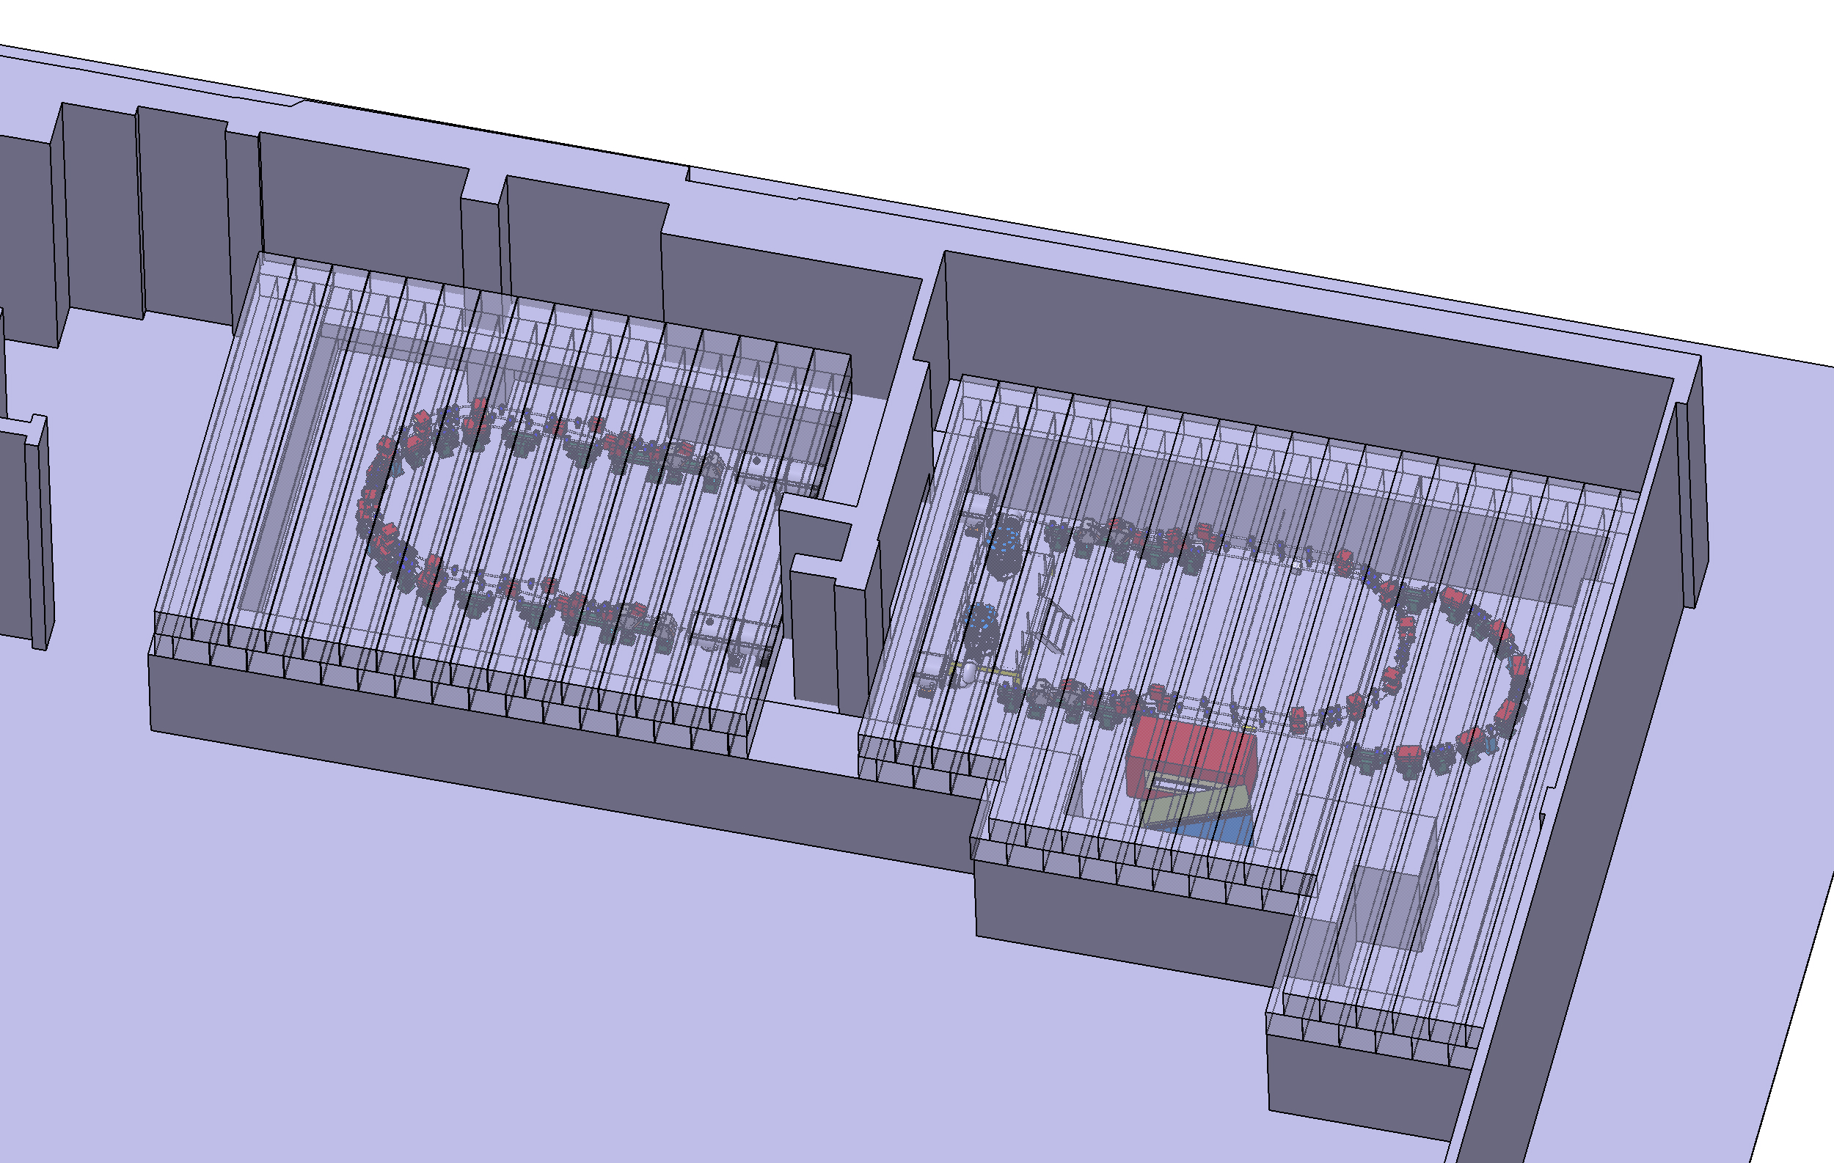
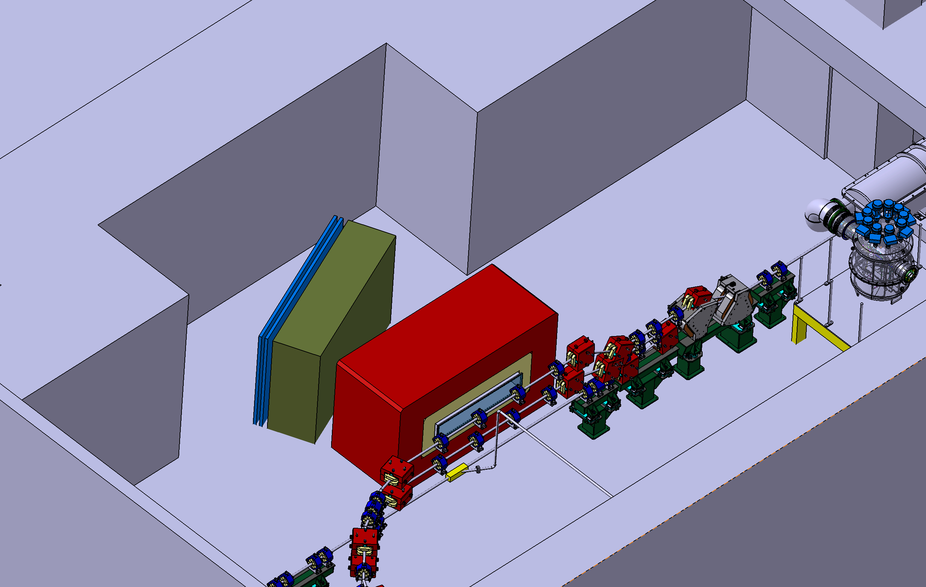
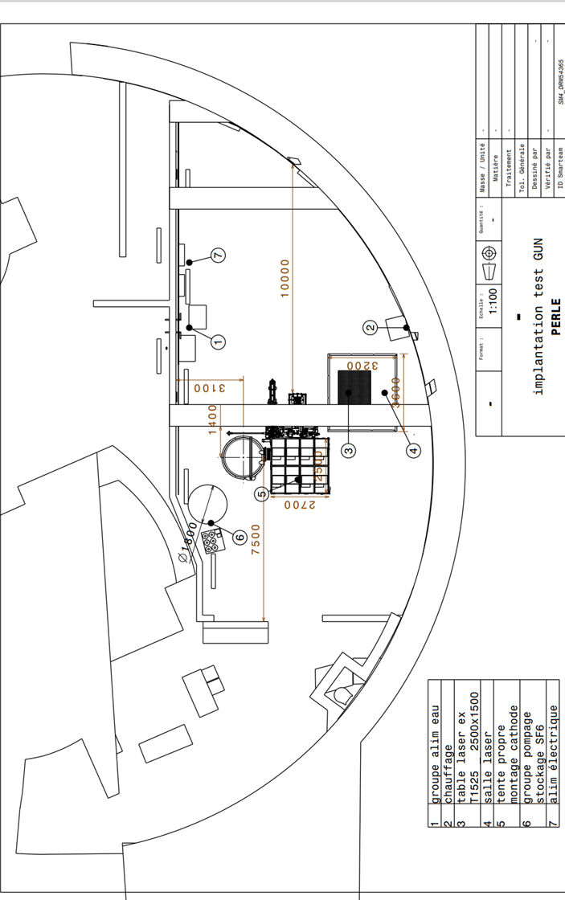
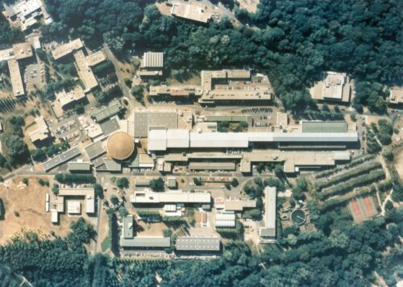
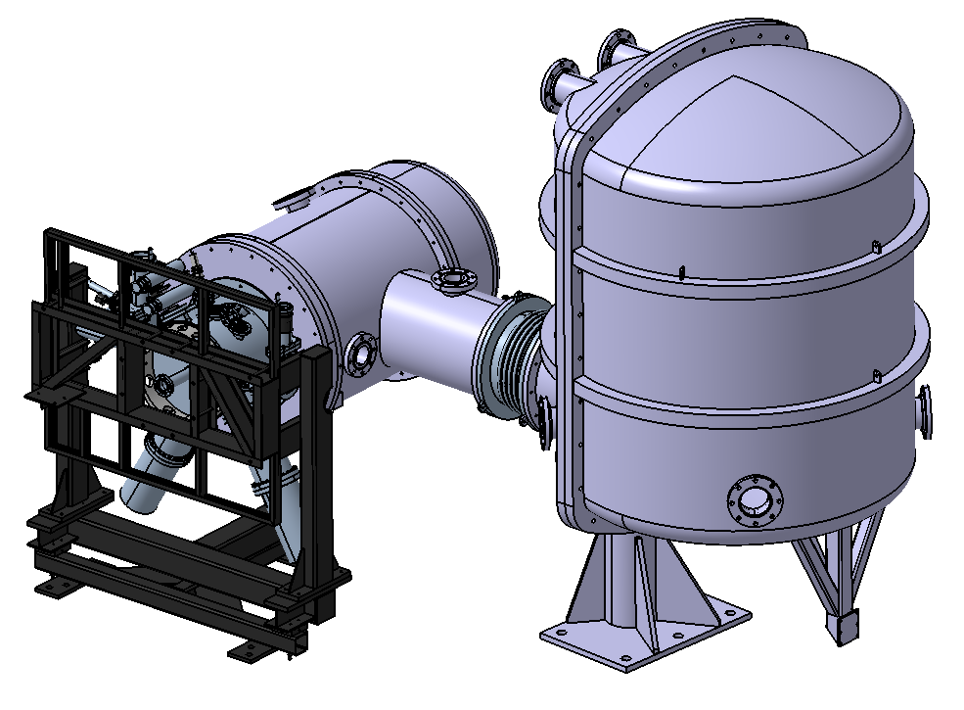
Proposed implantation @ IJCLab-Orsay. Infrastructure study work started
The possible footprint fo the nuclear eN experiment.
Discussion at this workshop
Start of the installation of the DC gun – see next slide

Slide 14
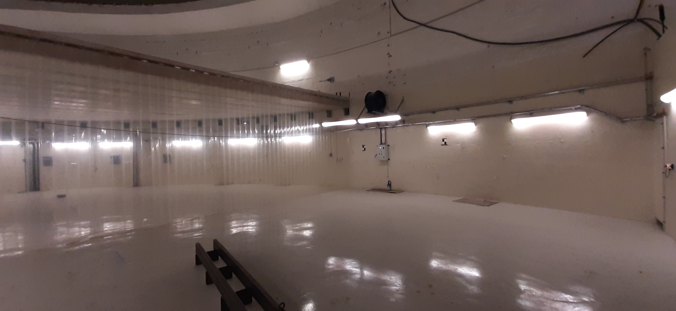
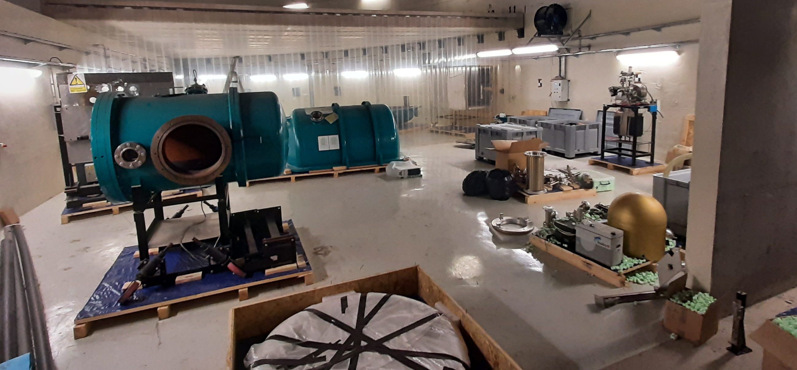
Daresbury DC-Gun for PERLE in the IGLOO Area : work started !
DC GUN in the IGLOO AREA – March/april 2022

Slide 15
The workshop “Physics with PERLE”
Workshop the 9th May at 15:00
DESTIN (DEep STructure Investigation of exotic Nuclei) PERLE@Orsay
  Starts to be structured in Orsay and involving national and international communities. Coupled to the future of GANIL reflexions. A priority for Nuclear Physics Perspectives at national level.
Photonics with Inverse Compton Scattering (ICS)
  Important community working in Orsay with large experience in past (Japan, USA) and present ICS experiments (ThomX) and in innovative R&D.
ep Physics.
  Important international community with large interest in proton radius, electroweak measurements, dark photons…
Applications
Accelerator R&D
a) the scientific motivation for this to be interesting and competitive in 5-10 years, and
b) the instrumental consequences on PERLE footprint, including apparatus sketches in interaction region and nearby. The operation demands (Required beam parameters, the duration of an experiment, other particular experimental requirements…).

Slide 16
Program of the workshop
INTODUCTION. PERLE Project. Motivation of the Workshop Max Klein 30’
Accelerator R&D Program with PERLE Oliver Bruening 15’+15’
Spectroscopy of Radioactive Ions: e-RI Scattering David Verney 20’+20’
Inverse Compton Scaterring gamma source for nuclear photonics applications
Aurélien Marteens 10’+10’
Layout of Experiments at MESA Kurt Aulenbacher 10’+10’
Future unpolarised ep experiments, motivation and constraints (especially on p radius and dark photons) Jan Bernauer 10’+10’
Remarks on a Future polarised ep experiment with PERLE (Physics and Layout)
Maarten Boonekamp 10’+10’
PERLE for Applications Peter Williams 15’+15’

