Slide 1
Accelerator R&D Program for PERLE
Many thanks to feedback and input from:
Alex Bogacz, Georg Hoffstaetter, Walid Kaabi and Peter Williams

Slide 2
ERL Validation Needs and Experience
Operational experience up to 1MW virtual beam power:
Proposed Collider Projects [e.g. LHeC and FCC-eh] extrapolate demonstrated virtual beam power from 1MW in single turn to several 100MW in multi-turn operation!!!
ERL Test Facilities
ERL Collider Projects
JLab pioneering
eRHIC [6]
LHeC [3] /
FCC-eh
CBETA [4]
EUV KEK [1]
IR-ERL JLab [1]
bERLpro [1]
PERLE [3]
cERL @KEK [1]
MESA [2]
ERL demo [1]
ARIEL TRIUMF [1]
Demonstration of multi-turn, multi MW ERL
Operation is the key goal for PERLE!!!
CBAF-ER [1]
ERL@CBAF [5]
CeC@RHIC [1]
1.5MW Highest
demonstrated
Virtual beam
power
Test ERL@BNL [1]
ALICE [1]
sDALINAC [2]
Future Test Facilities & ERL Applications
What are the main challenges and concerns for the multi-turn, multi MW ERL operation?
Operational ERLs with SRF operate with << 1MW beam power!!!
C-Beta and PERLE are the only multi-turn ERLs build or under construction with 10MW capability

Slide 3
What are the Key Challenges for Multi-Turn, Multi MW ERL operation? ➔ Key Open ERL Questions / Concerns
Conceptual Questions: ERL Concept
Efficiency and operability of ERL with multi-turn configuration
➔ energy consumption, machine downtime
Efficiency and operability of ERL with high current configuration
➔ beam losses, emittance growth and halo formation ➔ RF-trips, beam aborts
Minimum acceptable injection and beam dump energies
➔ related to dump channel acceptance and ERL efficiency
Energy Recovery efficiency as function of operation parameters [energy, intensity, # of re-circulations..]
➔ design iteration for LHeC and FCC-eh and refined performance projections

Slide 4
What are the Key Challenges for Multi-Turn, Multi MW ERL operation? ➔ Key Open ERL Questions / Concerns
Conceptual: Beam Dynamics
Space Charge effect on emittance, halo and losses
Beam Breakup Instability thresholds and mitigation measures ➔ Multi-turn BBU instability thresholds!
Microbunching
Halo formation
➔ Intensity dependent ➔ performance projections, identifications of limitations and estimate of losses!
Coherent Synchrotron radiation ➔ simulation benchmarking!
➔ performance limitation and mitigations
Lattice configurations and dispersion correction
Wake-Fields: Beam stability and dynamics for different bunch patterns
Beam Losses [halo and 3D bunch shapes], locations and intensity, along the ERL
➔ diagnostics and definition of protection systems and identification of operation flexibility

Slide 5
What are the Key Challenges for Multi-Turn, Multi MW ERL operation? ➔ Key Open ERL Questions / Concerns
Technical:
HOM damper design and heating / cooling estimates
➔ validation of designs for new operation concept
Source design and performance at high current
➔ cathode lifetime & exchangeability; emittance versus intensity etc…
RF transients and SRF operation with different bunch patterns
➔ Validation of Low-Level RF designs for ERLs with multi-turn operation
Alignment requirements and correctability
➔ injection stability and intervals required for re-tuning / re-alignment
Magnet design and stray field tolerances for multi-turn lattices
➔ magnetic field shielding and coupling in switch yard and return arcs

Slide 6
ALICE Experience:
Single turn operation
Low beam current
➔ Operation tools, procedures and Beam Diagnostics

Slide 7
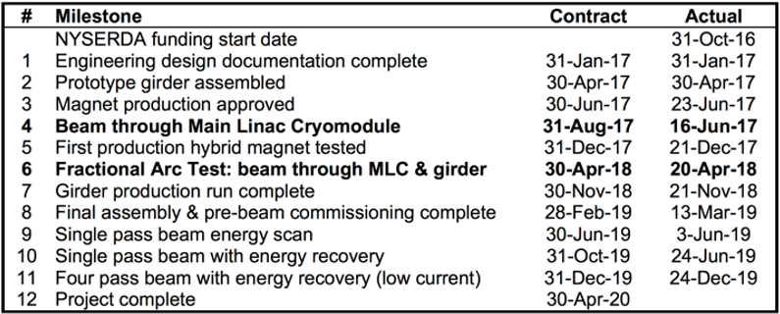
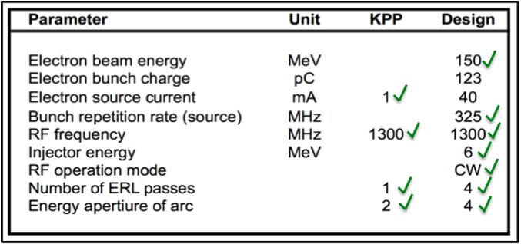
CBETA Experience:
Key Performance Parameters checked and achieved!
But Many questions could not be addressed:
High Current operation ➔ limited by losses along the machine and radiation from back scattered γs
form the beam dump; injector achieved 4mA versus the 20mA design value
High Current operation multi-turn ERL➔ limited by losses along the machine:
CSR induced energy spread, orbit & dispersion correction [FFAG!], beam distributions along the ERL

Slide 8
Example of CBETA issues that still require more understanding:
Beam Optics Matching and correction
➔ multiple beams passing through same BPMs with different energy [FFAG?]
Stray fields and PC stability
Beam distributions
Beam losses

Slide 9
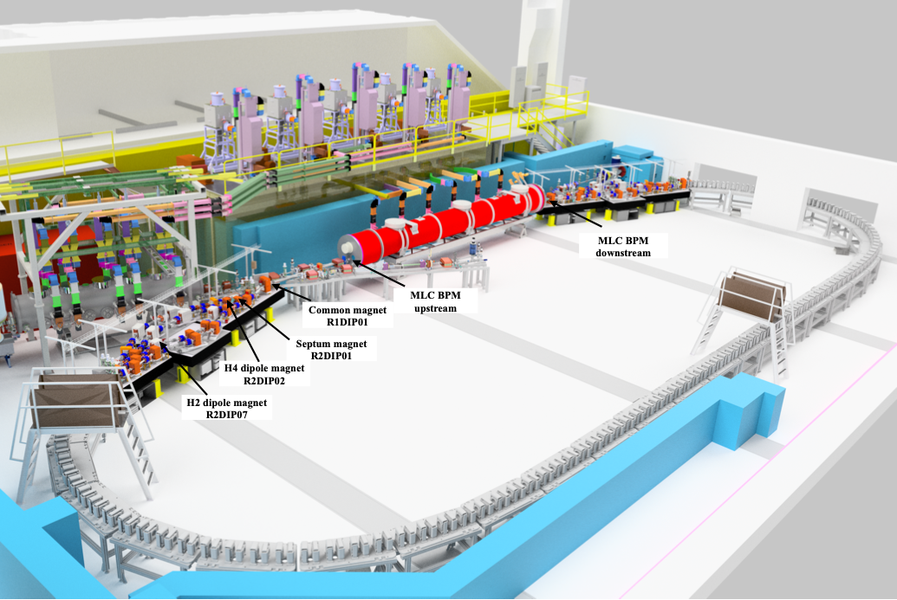
CBETA:
Layout and
R2 Diagnostic
Elements

Slide 10
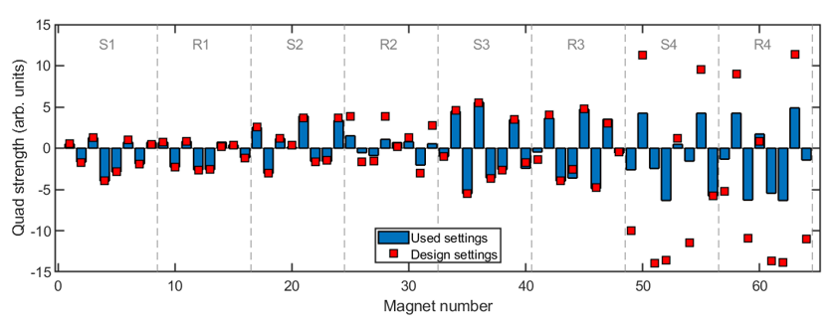
Beam Optics Matching
Primarily in R2, we had optics problems.
Could not reach design quadrupole setpoints, without losing beam
R2: could not reach design
S4,R4: No real attempt to reach design

Slide 11
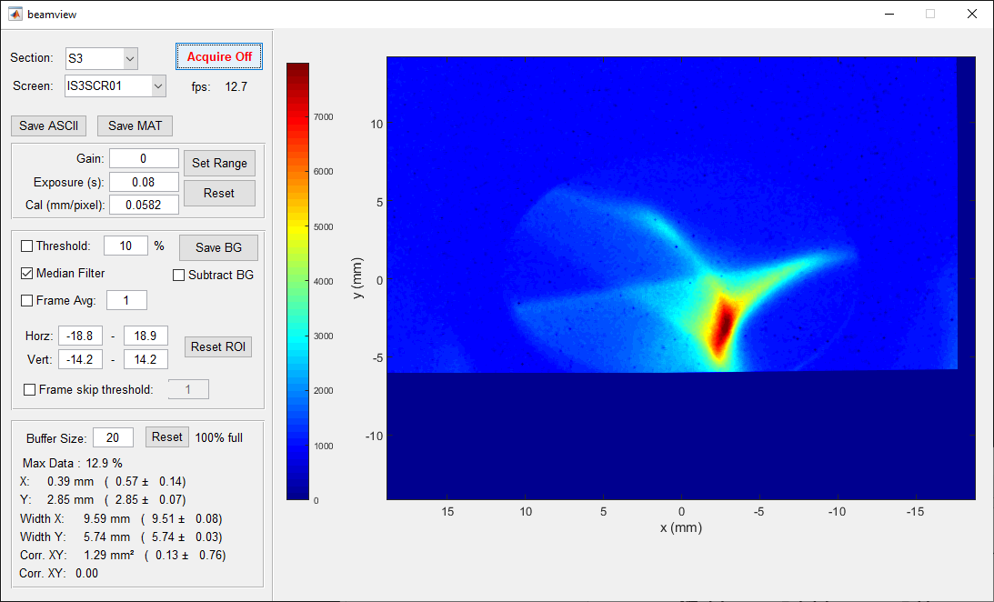

Peacock

Slide 12
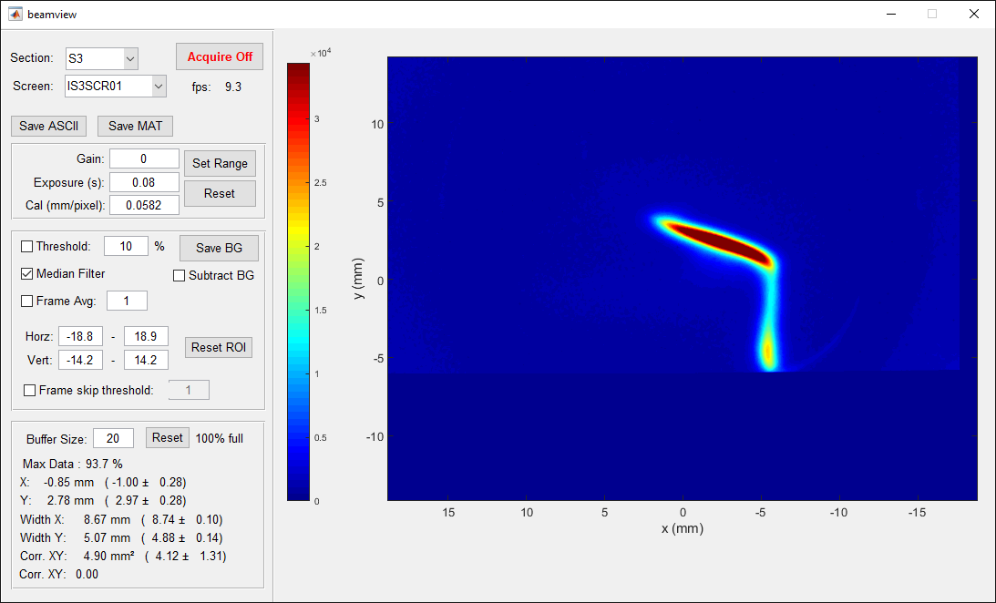
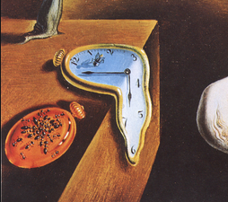
Salvador Dali Painting

Slide 13
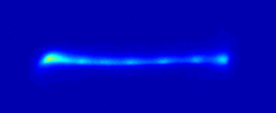
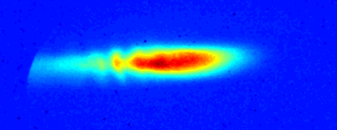
Microbunching Instability?
Occasionally, we would see a charge-dependent structure on the beam profile
As early as the beginning of the second pass
Charge dependent
Single bunch effect
Optics dependent
  causing the instability or just accidentally letting us see it?

Slide 14
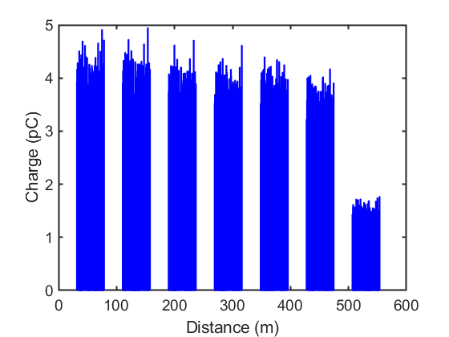
Transmission
MLC-1
MLC-2
MLC-3
MLC-4
MLC-5
MLC-6
MLC-7
10% loss
60% loss
Gradual 10% loss
Additional 60% loss after 2nd pass through R2
Percentages improve with lower initial charge (not shown)

Slide 15
MLC Slow Energy Drift
MLC energy drifts ∼0.5-1% over first ∼30 minutes
  Begins high, drifts lower
  Drift occurs in fast, discontinuous jumps
Manual “fix” button added which finds orbit deviations in S1 along direction of dispersion, predicts energy change
  Reproducible to few kV level, but not foolproof
Origin of problem never understood, remained occasional source of confusion throughout run

Slide 16
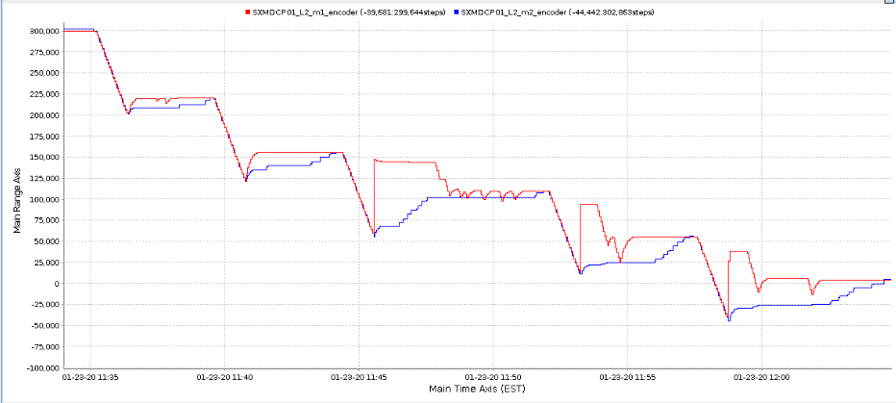
Path length adjustment
Some bellows would not reliably change their path length
Vibrations during bellows movement sometimes cause MLC to quench
  Must turn off MLC to adjust path length, then wait for MLC to stabilize.
  Very time-consuming!
No work-around. We tried to adjust phase as few times as possible.
25 minute duration

Slide 17
Summary of beam dynamics issues
Page Headline
Injector + Linac space charge optimization
Complete 4-pass start-to-end lattice
Fieldmap tracking in FFAG cell (many codes)
Start-to-end tracking with no collective effects
CSR 1-pass tracking
Resistive wall and roughness wakefields
Orbit and optics correction
Tolerance & stability analysis
BBU
RGS
Touschek scattering
Longitudinal Tails
Dark current tracking & collimation
Ion trapping
Realistic Splitter magnet design
CSR 4-pass tracking, with longitudinal phasing/shaping
Halo from cathode
microbunching
Well under control
Straightforward
Difficult

Slide 18
Conclusions
Path towards higher current
Path to higher current in 1-pass is straightforward, achievable
  Challenges from 1-pass ER are now routine
Significant challenges remain for improved 4-pass ER
  Clear paths exist to explore
New accelerator insights from CBETA operation
Hardware and software for multi-beam orbit correction
Sensitivity to magnet errors in compact accelerators
Mitigation of crosstalk between adjacent beam lines
Time of flight dependence on orbit
Methods of energy measurement
Beam dynamics effects that allow future efforts

Slide 19
PERLE Lattice design criteria
Demonstrate the minimum emittance dilution lattice choices for the LHeC and FCC-eh
Demonstrate the beam optics correctability and RF phase control
Operation tools, Beam Diagnostics and fill patterns and operation lexibility
Study intensity related effects [halo, distributions, CSR, losses etc.]
Study the nominal source setup and performance
Validation of key technical choices [e.g. HOM dampers, alignment and stabilization systems..]

Slide 20
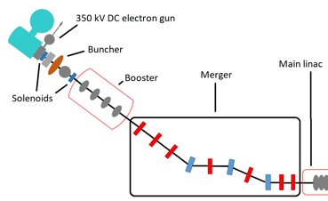
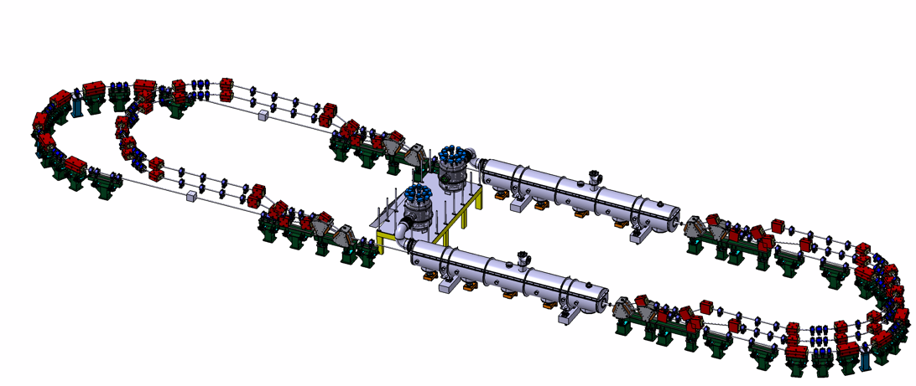
PERLE Configuration and parameters
1+1 Linacs (Four 5-Cell 801.58 MHz SC cavities)
3 turns (164 MeV/turn)
Max. beam energy 500 MeV
Target Parameter | Unit | Value
Injection energy | MeV | 7
Electron beam energy | MeV | 500
Normalised Emittance γε_{x,y} | mm mrad | 6
Average beam current | mA | 20
Bunch charge | pC | 500
Bunch length | mm | 3
Bunch spacing | ns | 25
RF frequency | MHz | 801.58
Duty factor |  | CW
DC = l_{RF}/2
Injector
7 MeV
DE = 82.2 MeV
Arcs 2:4:6
Arcs 1:3:5
Dump
7 MeV
DE = 82.2 MeV
Footprint: 31.5 x 5.5 x 0.9

Slide 21
PERLE Commissioning Wishlist
Beam Instrumentation and Diagnostics!
➔ 3D bunch shape measurements along the re-circulation!
➔ timing measurements along the ERL [RF-Phase adjustments / optimization ➔ D correction!
Beam loss measurements along the whole machine and turn-by-turn!
Simulation tools for start-end simulations to interpret measurements
Clear strategy from single turn ER to multi-turn ER [switch yard optimization]!
Clear strategy for intensity ramp-up!
Energy and beam power limit exploration ➔ only after multi-turn and intensity ramp-up!
➔ minimum required injection and dump energy!

Slide 23
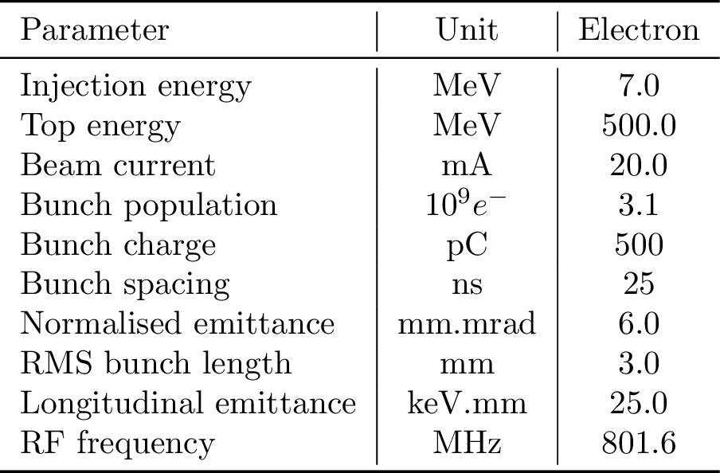
PERLE (500 MeV) − Baseline Layout
Footprint: 29 m × 5.5 m × 0.9 m
7 MeV
2 : 4 : 6
1 : 3 : 5
ΔE = 82.2 MeV
5.5 m
Top view
29 m
ΔE = 82.2 MeV
10 m
7 MeV
10 m
9 m
45 cm
Side view
45 cm
ΔS = λ_{RF}/2
IP
Value

Slide 24
PERLE (500 MeV) − Baseline Layout
Footprint: 29 m × 5.5 m × 0.9 m
7 MeV
2 : 4 : 6
1 : 3 : 5
ΔE = 82.2 MeV
5.5 m
Top view
29 m
ΔE = 82.2 MeV
10 m
7 MeV
10 m
9 m
45 cm
Side view
45 cm
ΔS = λ_{RF}/2
IP
Value

Slide 25
Outline
PERLE − Baseline Design (500 MeV): Layout, Optics, Lattices
  Multi-pass linac Optics in ER mode (3 passes ‘up’ + 3 passes ‘down’)
    Configured with the SPL style cryomodules
    Quad doublet after the merger − ‘splitting’ initial Twiss functions in both planes
  Switchyard Configuration
    Compact ’two step’ Spr/Rec with two B-com magnets
  Experimental Areas – Low-β inserts in both matching straights of Arc 6
    Tunable 2.7 meter long IR configured with a triplet − doublet pair
  Arc Optics Architecture
    ‘Six bend’ arc configuration – better balanced M₅₆ across the arc (vs ‘Four bend’ arc)
    Arc pathlengths compatible with 25 nsec injection – uniform bunch ‘filling pattern’
  Initial Beam Dynamics Studies
Summary and Outlook

