Slide 1
(potential) Nuclear Physics with PERLE
David Verney – IJCLab Orsay

Slide 2
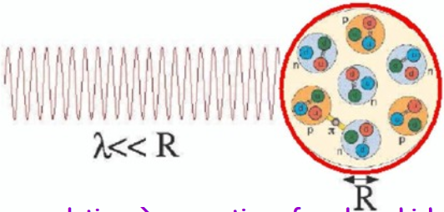
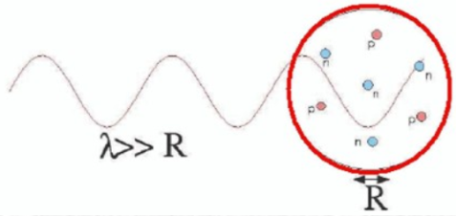
Introduction : the electromagnetic probes in nuclear physics
current precision tool of choice
• ion manipulation with em fields: mass measurements
• interaction with the hyperfine field : laser spectroscopy, nuclear orientation
→ I^{(π)},μ, Q_{s}, δ<r²_{c}>
intensively used at currently operated RIB facilities
these measurements have reached an extraordinary degree of refinement
• γ-spectroscopy : lifetimes, B(Eλ), B(Mλ)
but give access to (static or dynamical) integrated (global) quantities
• e- scattering
nuclear physics:
internal structure of the nucleus
E_{e}= 500 MeV → ≈0.5 fm scale
hadron physics:
structure of the nucleon
The interior of the nucleus becomes accessible
contrary to hadron probe, the only unknown in the reaction is the nuclear part

Slide 3
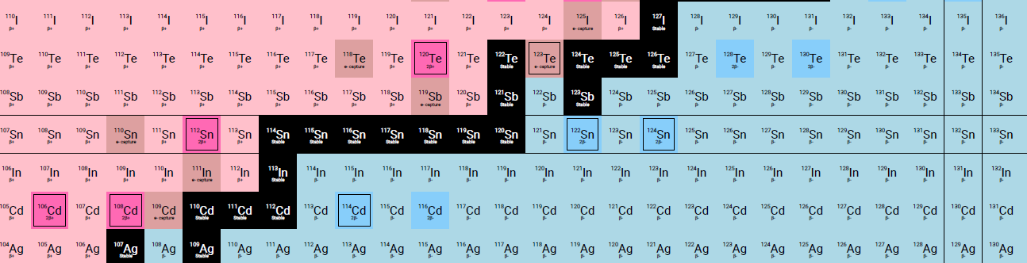
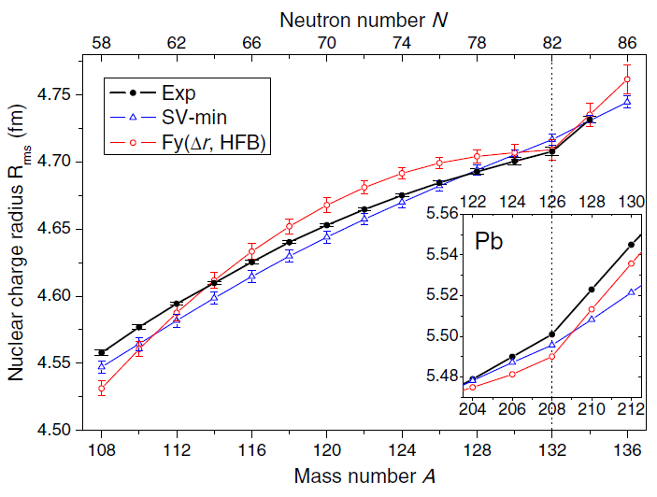
Introduction : the electromagnetic probes in nuclear physics
• one example: laser spectroscopy → δ<r²_{c}> : propagate mean square radius change from isotopic shifts
doubly magic ¹³²Sn
T_{1/2}=39.7 s
one the most fundamental properties of nuclei : saturation properties
doubly magic ¹³²Sn
T_{1/2}=39.7 s
Fayans functional involving gradient terms in surface and pairing energies
stable
Skyrme family
even more annoying : ab intio calculations face great difficulties in getting at the same time size and binding energy
C. Georges et al. PRL 122, 192502 (2019)

Slide 4
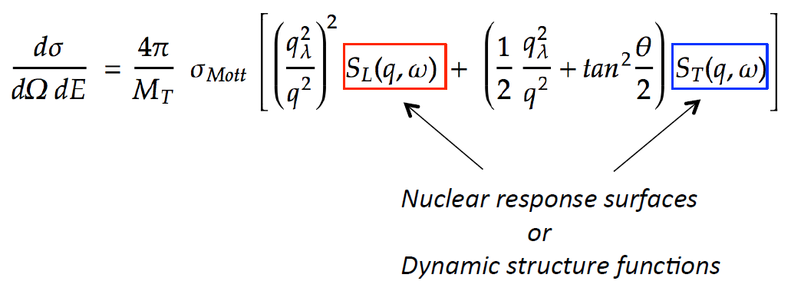
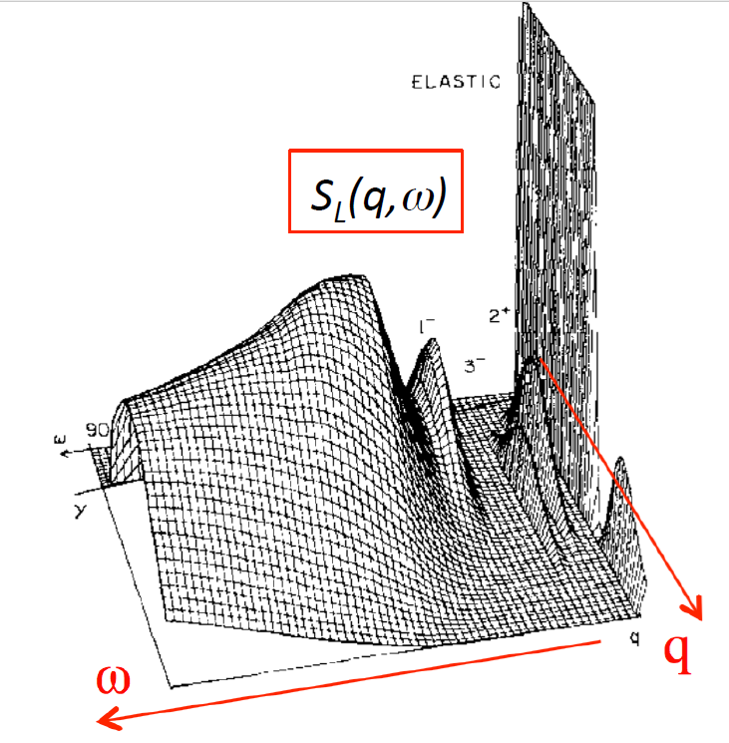
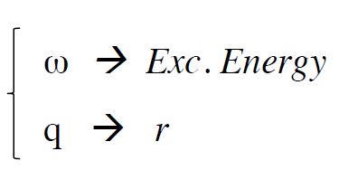
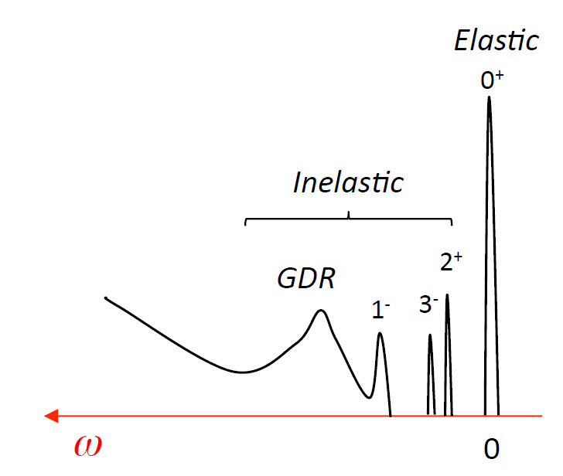
Electron scattering off nuclei
hadron physics:
structure of the nucleon
nuclear physics:
internal structure of the nucleus
E_{e}= 500 MeV → ≈0.5 fm scale
e- scattering opens up a new dimension

Slide 5
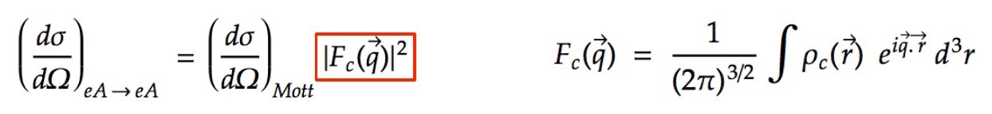
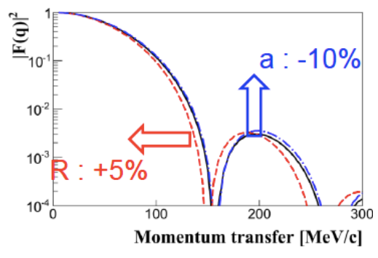
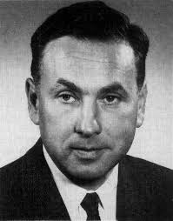
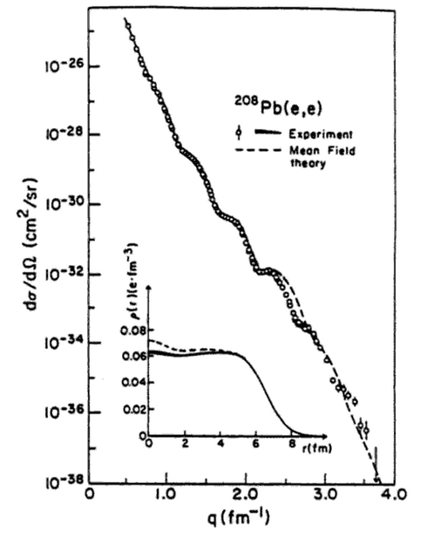
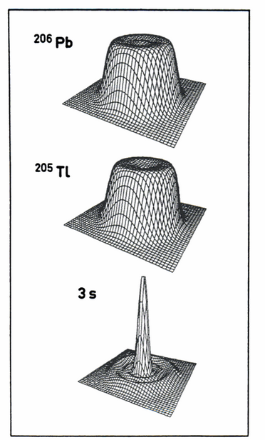
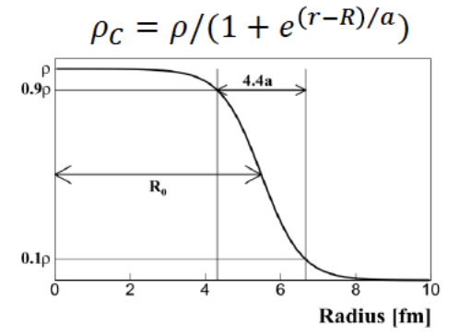
Simple example : elastic scattering
(for ω=0 and J^{π}=0⁺ states)
From the pioneering work of R. Hofstadter [1953 : e on Au ; Stanford] to the start of JLab
through MIT Bates Laboratory, SLAC, Saclay…
this type of measurements has reached an extraordinary level of refinement and achievements
Nobel price 1961
B. Frois and Papanicolas
Ann. Rev. Nucl. Part. Sci 37 (1987)
Dechargé and Gogny
PRC 81 (1980)
Cavedon, Frois, Goutte et al.
PRL 49 (1982)
etc…
12 orders of magnitude !
B. Frois et al
in Modern Topics in Electron Scattering
(World Scientific 1991)

Slide 6
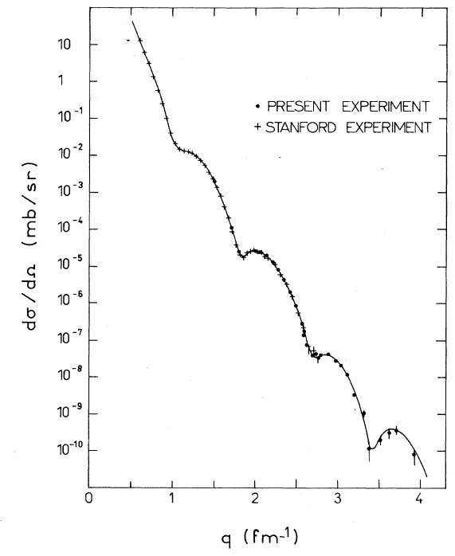
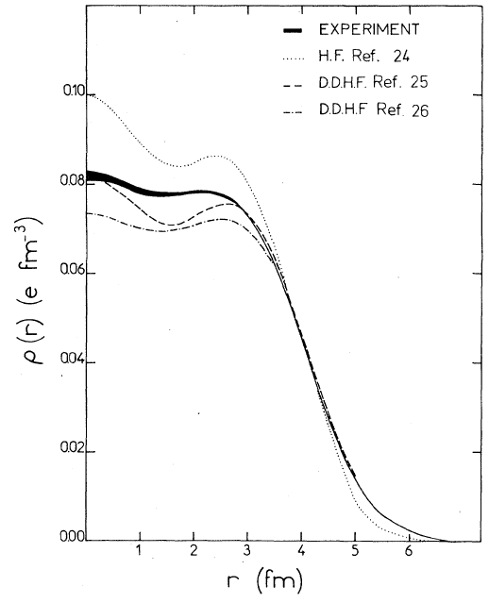
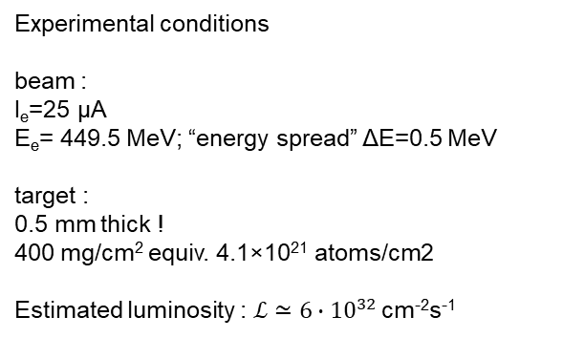
Concrete state-of-the-art example from the past
Sick et al. PRL 35 910 (1975) – experiment at Saclay Linear Accelerator (ALS)
objective : very-high momentum-transfer (q=780 MeV/c), elastic electron-scattering experiment on ⁵⁸Ni
Experimental conditions
beam :
I_{e}=25 µA
E_{e}= 449.5 MeV; “energy spread” ΔE=0.5 MeV
target :
0.5 mm thick !
400 mg/cm² equiv. 4.1×10²¹ atoms/cm2
Estimated luminosity : $ℒ≃{6∙10}^{32 }$cm⁻²s⁻¹
this momentum transfer amounts to a cross section of 8×10⁻³⁸ cm²
→ one event every 6 hours for I_{e}=25 µA

Slide 7
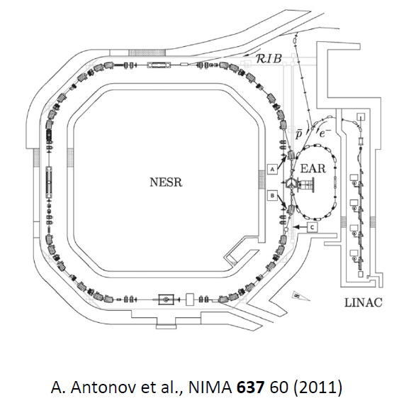
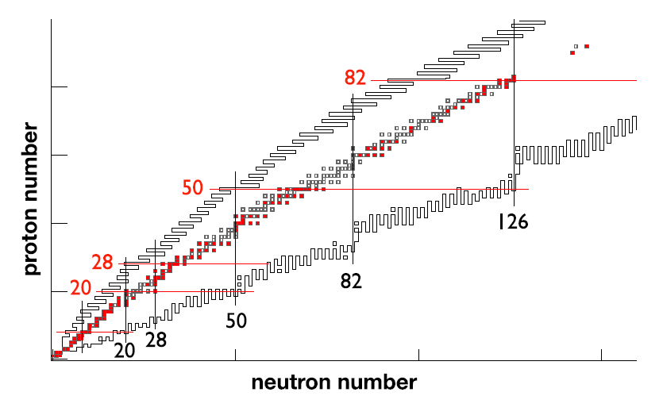
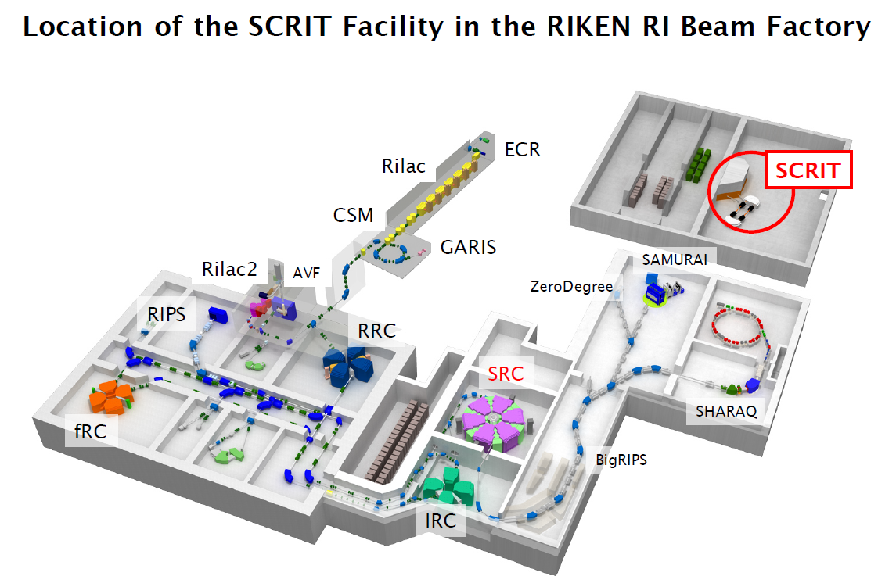
Elastic scattering off radioactive nuclei
perspectives for the form factors of exotic nuclei
→ double-ring collider : ELISE project at FAIR
NESR (0.74 GeV/nucleon) + EAR (0.5 GeV)
→ Targeted luminosity ~10²⁸ cm⁻²s⁻¹
(excluded from funded part of FAIR)
stable targets already used
→ fixed target strategy
Self-Confining RI Target : SCRIT
pioneering proof of concept, existing device at RIKEN
[Suda et al, PRL102, 102501 (2009)]
Achieved luminosity is ~3x10²⁷ cm⁻²s^{-­1} with stable Xe
ETIC@GANIL proposal 2015
(Obertelli, Corsi CEA Saclay)
Targeted luminosity is ~10²⁹ cm⁻²s^{-­1}
very ambitious (and expensive) proposal
technical feasibility not clear
not retained
T. Suda, H. Simon [Progress in Particle and Nuclear Physics 96 (2017) 1]
(Ie= 100-200 mA; Ntrap=10⁶ ions; σxσy=10⁻¹⁰ m²)

Slide 8
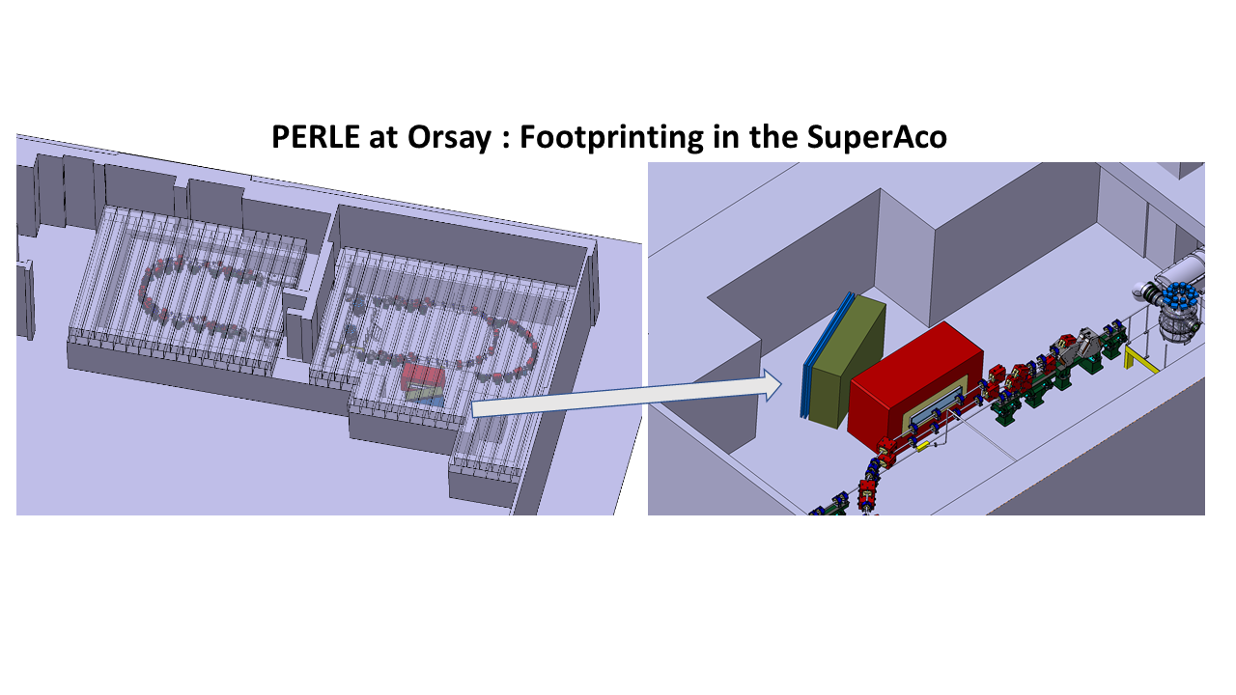
Elastic scattering off radioactive nuclei
perspectives for the form factors of exotic nuclei with PERLE
→ fixed target strategy : more compact, less resource demanding
→ a physics project at PERLE requires 3 major ingredients :
1
a Radioactive Ion Beam (RIB) factory
2
a Radioactive target preparation device
3
an electron spectrometer

Slide 9
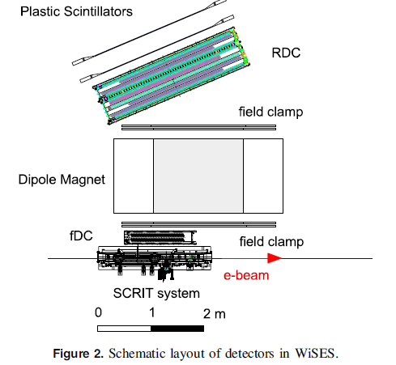
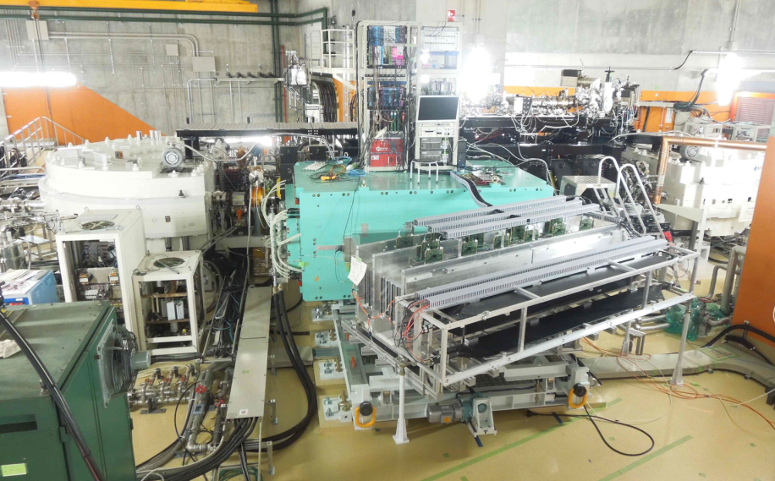
Elastic scattering off radioactive nuclei
perspectives for the form factors of exotic nuclei with PERLE
→ fixed target strategy : more compact, less resource demanding
Rear drift chamber
→ a physics project at PERLE requires 3 major ingredients :
1
a Radioactive Ion Beam (RIB) factory
0.4 T for 150 MeV
2
a Radioactive target preparation device
Front drift chamber
(inspired by the pioneering SCRIT example)
3
an electron spectrometer
no technological challenge
T Ohnishi et al Phys. Scr. T166 (2015) 014071

Slide 10
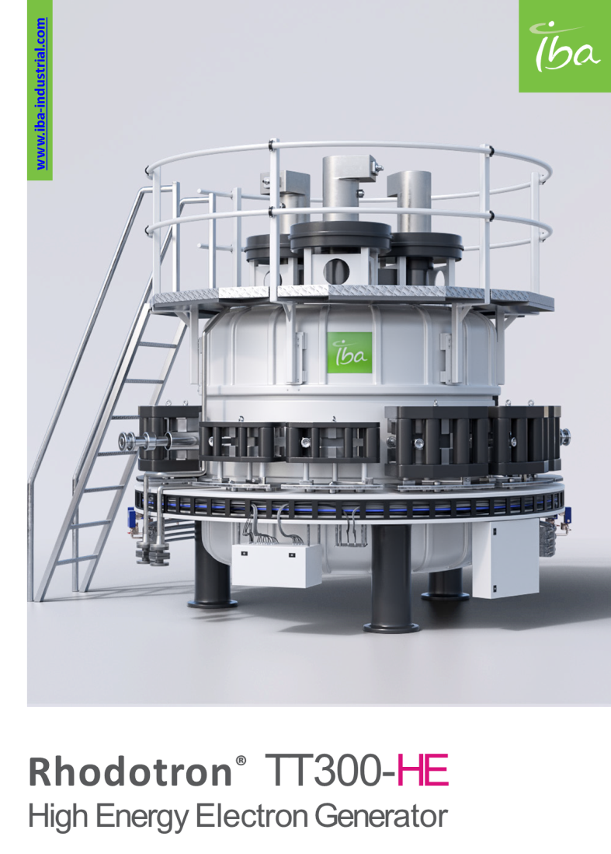
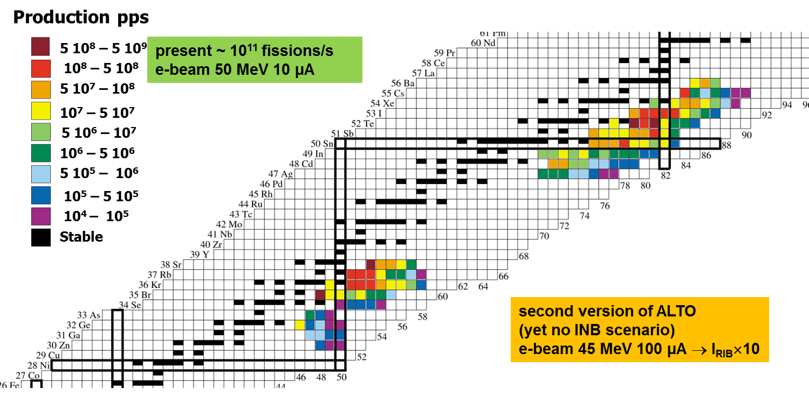
Elastic scattering off radioactive nuclei
perspectives for the form factors of exotic nuclei with PERLE
→ fixed target strategy : more compact, less resource demanding
→ a physics project at PERLE requires 3 major ingredients :
a Radioactive Ion Beam (RIB) factory
1
(inspired by the ALTO example)
2
a Radioactive target preparation device
3
an electron spectrometer
no technological challenge
RIB factory
^{ISOL technique}
^{Photofission based}
^{in “chapeau de gendarme”}

Slide 11
Elastic scattering off radioactive nuclei
perspectives for the form factors of exotic nuclei with PERLE
→ fixed target strategy : more compact, less resource demanding
→ a physics project at PERLE requires 3 major ingredients :
1
a Radioactive Ion Beam (RIB) factory
2
a Radioactive target preparation device
3
an electron spectrometer
where the technological challenge really lies

Slide 12
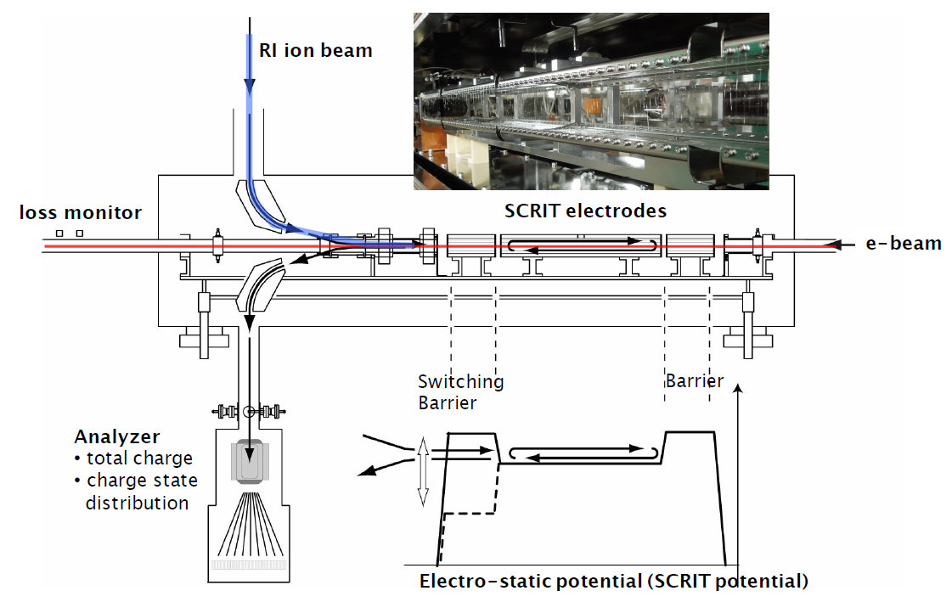
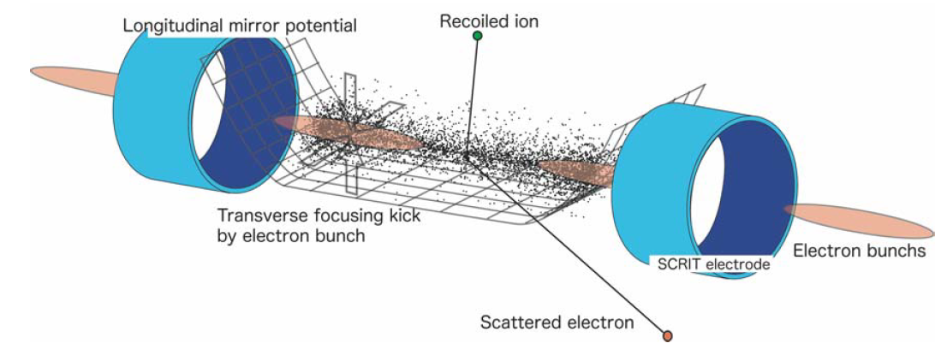
Elastic scattering off radioactive nuclei
perspectives for the form factors of exotic nuclei with PERLE
→ fixed target strategy : more compact, less resource demanding
yes but… all the complexity is concentrated in the target formation,
target characteristics will define the achievable luminosities
the radioactive target is a cloud of radioactive ions captured by the electrostatic potential created by the electron beam + auxiliary electrodes
adapted from : M. Wakasugi Workshop on e-Ion collision at CEA Saclay (25-27 Apr. 2016)

Slide 13
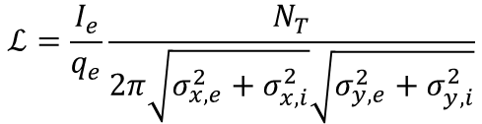
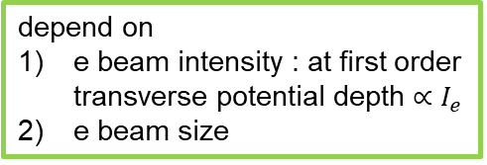


Elastic scattering off radioactive nuclei
perspectives for the form factors of exotic nuclei with PERLE
→ fixed target strategy : more compact, less resource demanding
yes but… all the complexity is concentrated in the target formation,
target characteristics will define the achievable luminosities
$$ℒ=\frac{I_{e}}{q_{e}}\frac{N_{T}}{2π\sqrt{σ_{x,e}^{2}+σ_{x,i}^{2}}\sqrt{σ_{y,e}^{2}+σ_{y,i}^{2}}}$$
$$ℒ=\frac{I_{e}}{q_{e}}\frac{N_{T}}{2π\left(σ_{e}^{2}+σ_{i}^{2}\right)}$$
N_{inj}
N_{T}
I_{e}
depend on
e beam intensity : at first order transverse potential depth $∝I_{e}$
e beam size
$$N_{T}=ϵ_{trap}ϵ_{overlap}N_{inj}$$

Slide 14
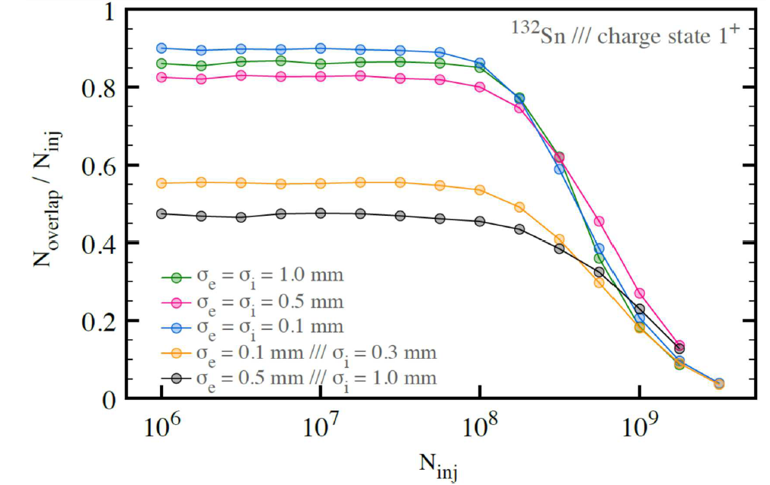
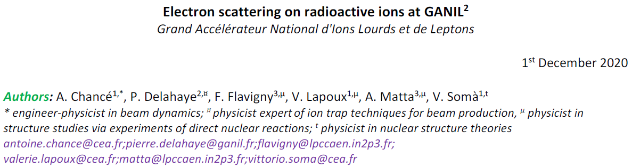
Elastic scattering off radioactive nuclei
Luminosity considerations
from preliminary study within GANIL long-range prospective
using WARP software (available online)
I_{e}=200 mA
trap length
=10 cm
N_{inj}
N_{T}
I_{e}
depend on
e beam intensity : at first order transverse potential depth $∝I_{e}$
e beam size
$$N_{T}=ϵ_{trap}ϵ_{overlap}N_{inj}$$

Slide 15
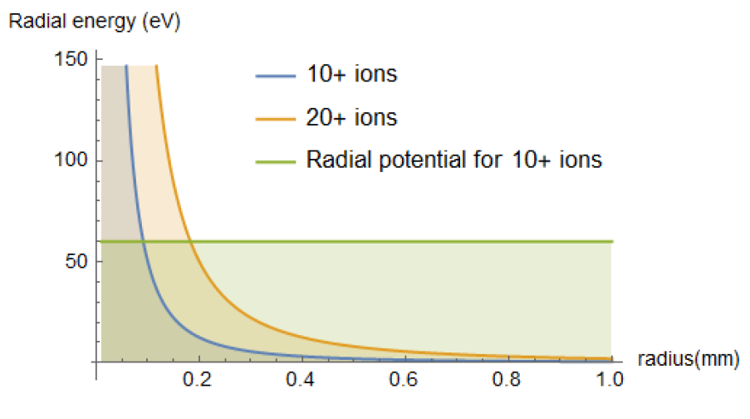

Elastic scattering off radioactive nuclei
Luminosity considerations
from preliminary study within GANIL long-range prospective
ion heating due to the interaction with the e beam
$$\frac{dE_{trans}}{dt}∝j_{e}×\frac{Q^{2}}{A}$$
charge state
N_{inj}
mass number
I_{e}=200 mA
electron density (A/cm²)
I_{e}=20 mA
e beam
N_{T}
I_{e}
depend on
e beam intensity : at first order transverse potential depth $∝I_{e}$
e beam size
$$N_{T}=ϵ_{trap}ϵ_{overlap}N_{inj}$$

Slide 16
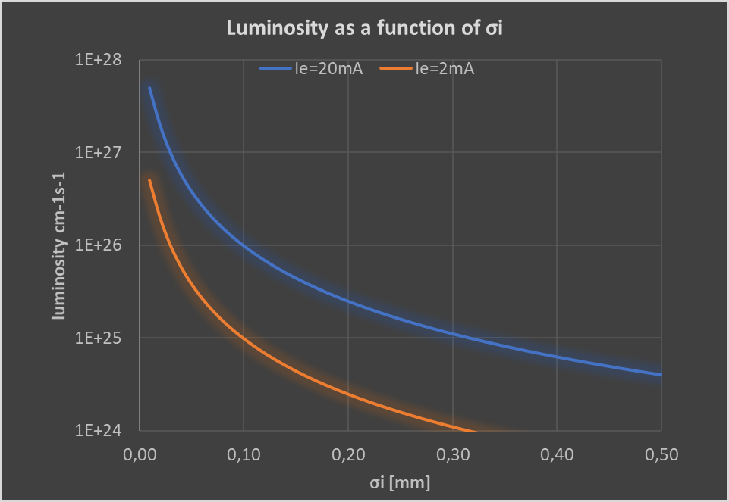





Elastic scattering off radioactive nuclei
Luminosity considerations
Sick et al. PRL 35 910 (1975)
experiment at Saclay Linear Accelerator (ALS) on ⁵⁸Ni
$ℒ$ cm⁻²s⁻¹
FAIR/ELISE targeted luminosity
assuming
$N_{T}=5×{10}^{7}$ions (1+)
σ_{e}=100 µm
SCRIT luminosity with stable nuclei
$${6∙10}^{24 }$$
$${6∙10}^{28 }$$
1953 Hofstadter’s luminosity
$${6∙10}^{32 }$$
absolute radius
2-parameters charge distributions
at reach

Slide 17
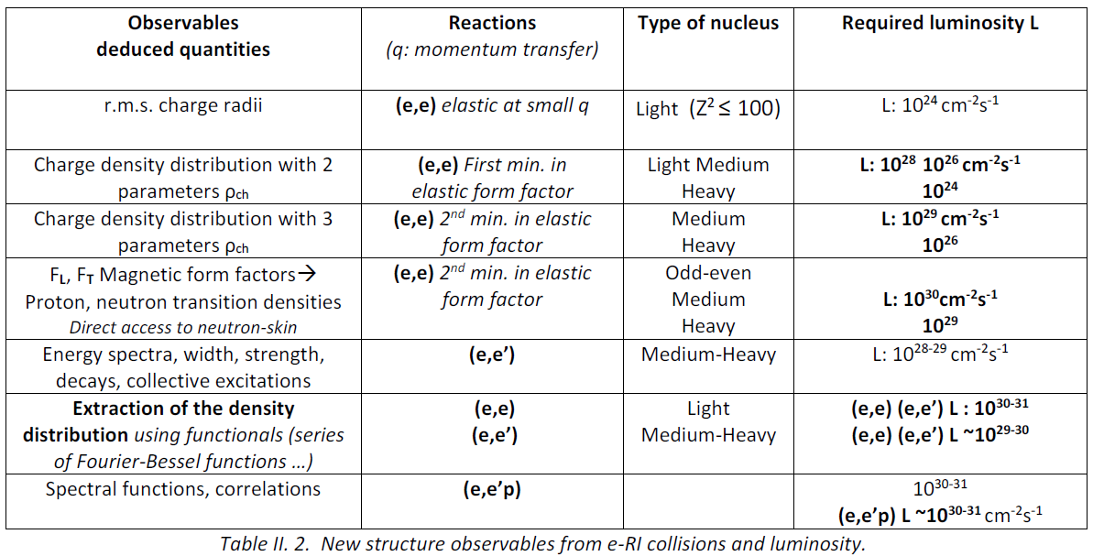
Elastic scattering off radioactive nuclei
Luminosity considerations

Slide 18
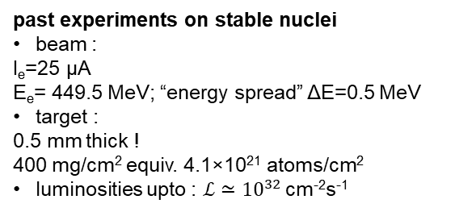
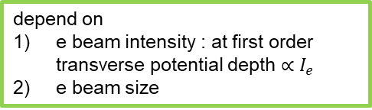

Conclusion
past experiments on stable nuclei
beam :
I_{e}=25 µA
E_{e}= 449.5 MeV; “energy spread” ΔE=0.5 MeV
target :
0.5 mm thick !
400 mg/cm² equiv. 4.1×10²¹ atoms/cm²
luminosities upto : $ℒ≃{10}^{32 }$cm⁻²s⁻¹
future fixed-target RI experiments
beam :
I_{e}=20 mA (PERLE nominal)
target :
a cloud of ions !
exact amount ? 10¹⁰⁻¹¹ atoms/cm2
3 orders of magnitude more
10 to 11 orders of magnitude less
luminosity difficult to evaluate exactly
(the size of the e beam is far from being the only driving parameter ! )
N_{inj}
the ball is also in the court of nuclear physics : design and optimization of the “target”, need to invent new trapping strategies
a serious evaluation of the achievable luminosities can only be obtained thanks to more elaborate simulations:
(eg charge state evolutions)
but even without any fancy concept absolute radius and 2-parameters charge distributions seam reasonably at reach
N_{T}
I_{e}
$$ℒ=\frac{I_{e}}{q_{e}}\frac{N_{T}}{2π\left(σ_{e}^{2}+σ_{i}^{2}\right)}$$
depend on
e beam intensity : at first order transverse potential depth $∝I_{e}$
e beam size
$$N_{T}=ϵ_{trap}ϵ_{overlap}N_{inj}$$

