Slide 1
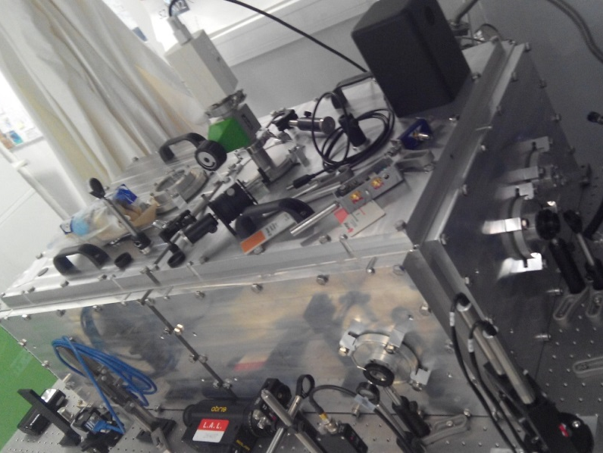
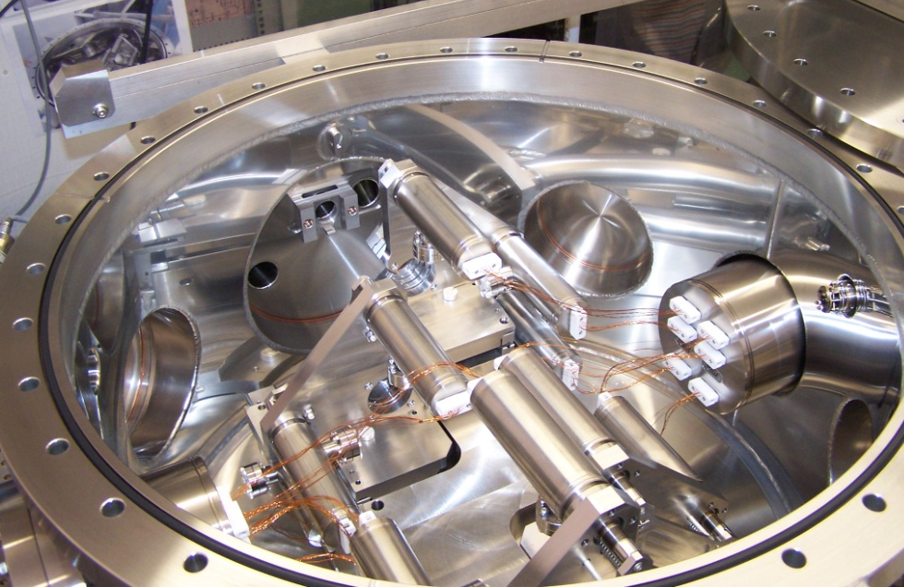
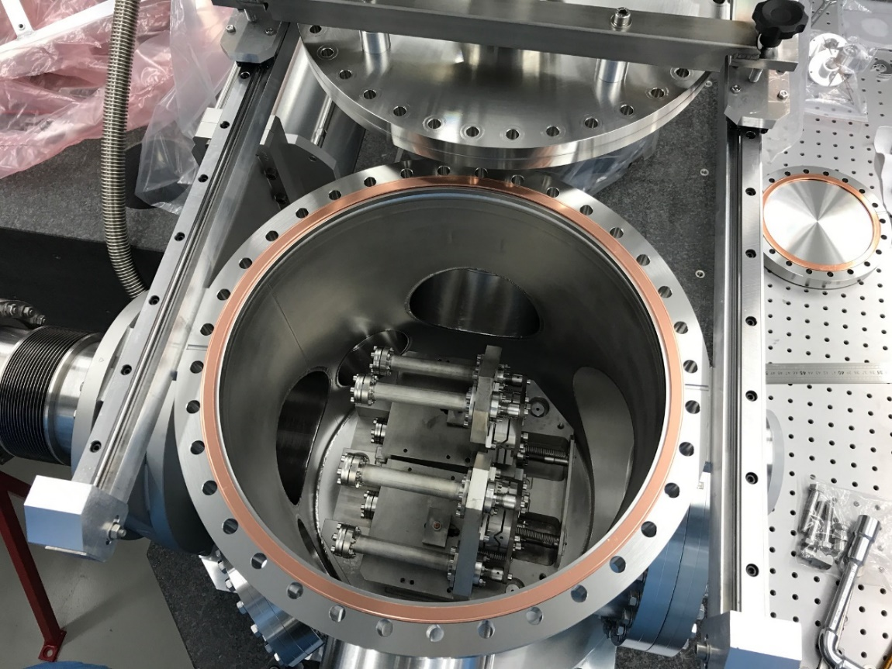
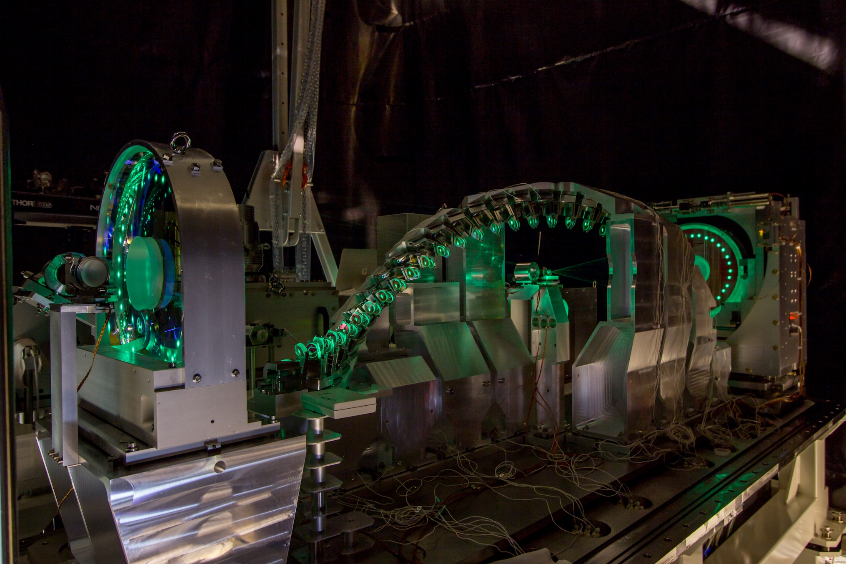
Inverse Compton Scattering 𝛾 source for nuclear photonics applications

Slide 2
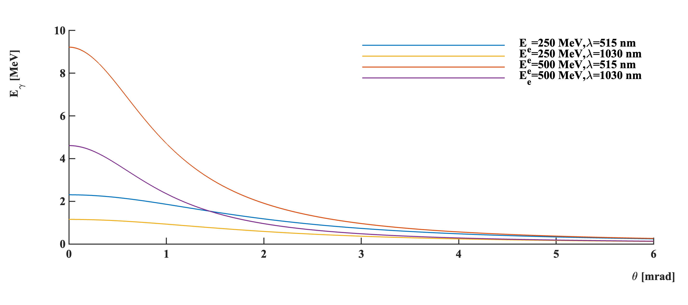
Energy-angle relation
Compton x-section
~0.66b (Ee<1GeV)
laser (E_{λ}=hc/𝜆=1.2eV)
Compton photon:
$E_{X/γ}≃{\frac{4γ^{2}\left(1−\frac{α^{2}}{4}\right)}{1+γ^{2}θ^{2}}E}_{λ}≈4.5 MeV$
α
θ
e⁻ beam
$$Ee=500 MeV$$
Klein O. and Nishina Y., Z. Phys. 52(1929) 853; Ginzburg I. et al., Nucl. Instr. Methods in Phys. Research 219 (1984) 5, V. B. Berestetskii, E. M. Lifshitz, L. P. Pitaevskii (1982). Quantum Electrodynamics. Vol. 4 (2nd ed.)

Slide 3
Energy-angle relation
Compton x-section
~0.66b (Ee<1GeV)
laser (E_{λ}=hc/𝜆=1.2eV)
Compton photon:
$E_{X/γ}≃{\frac{4γ^{2}\left(1−\frac{α^{2}}{4}\right)}{1+γ^{2}θ^{2}}E}_{λ}≈4.5 MeV$
α
θ
e⁻ beam
$$Ee=500 MeV$$
Advantage:
Quasi monochromaticity obtained by use of collimator
Price to pay → Flux reduction

Slide 4
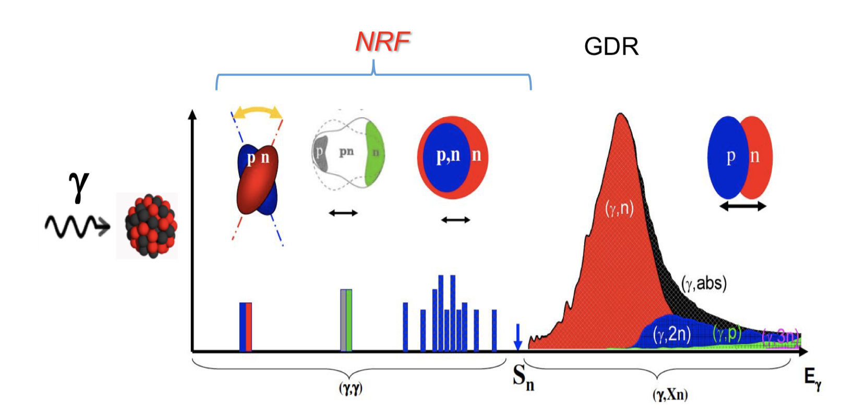
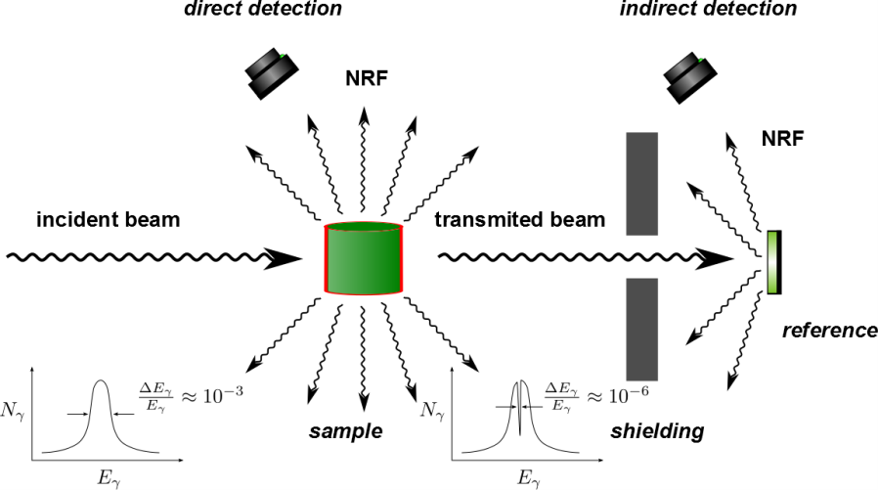
Gamma-ray applications
$E_{X/γ}≃$few MeV at most
Photo-nuclear reactions:
Nuclear Resonance Fluorescence (NRF)
Fine splitting of Pygmee DR
Giant Dipole Resonance (DR)
8MeV
Linearly polarized beams are of interest
S. Galès, PoS (INPC2016) 355, R. Hajima et al., Eur. Phys. J. Special Topics 223, 1229–1236 (2014)
NRF:
Narrow bandwidth (<1%) required
Backgrounds

Slide 5
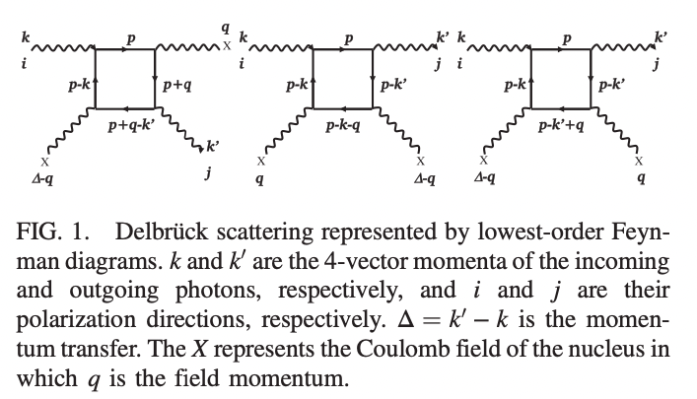
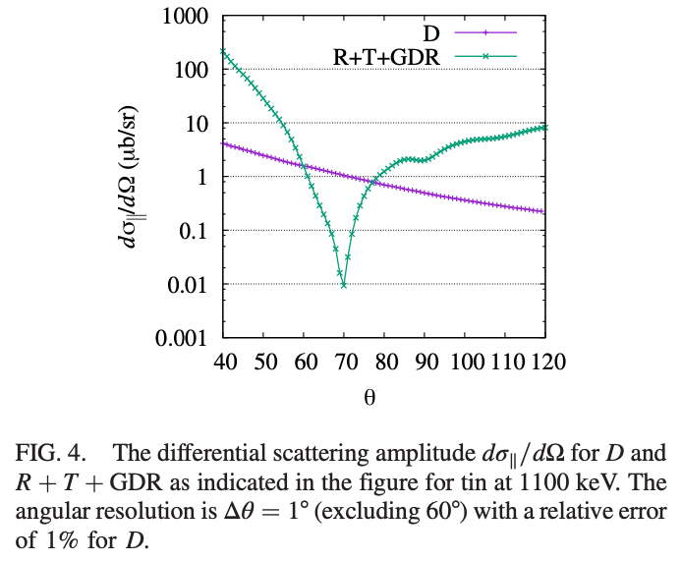
QED opportunity ?
Existing measurements:
Few % precision with very large O(1) pollution from Rayleigh, Thomson + nuclear resonances tails
J.K. Koga and T. Hayakawa, PRL 118, 204801 (2017)
Exploit polarization:
Only Delbrück contributes to some restricted angular range when p-polarisation is considered → 1% precision in 2days with PERLE ?
Some caveats:
- Some strong assumptions on resonance modelling
- only lowest order Delbrück scattering

Slide 6
Some key parameters
$ℰ:$Laser-beam single pulse energy
$I:$Electron beam intensity
$σ_{x,y}:$RMS average of transverse beam sizes
$ℱ:$Geometrical overlap form factor (Piwinski contribution typically)
$f:$ effective beam-crossing rate
$$n=σ_{C}f\frac{ℰ}{E_{λ}}\frac{I}{q}\frac{ℱ}{4π{σ_{y}σ}_{x}}$$
Photon rate

Slide 7
Some key parameters
$ℰ:$Laser-beam single pulse energy
$I:$Electron beam intensity
$σ_{x,y}:$RMS average of transverse beam sizes
$ℱ:$Geometrical overlap form factor (Piwinski contribution typically)
$f:$ effective beam-crossing rate
$$n=σ_{C}f\frac{ℰ}{E_{λ}}\frac{I}{q}\frac{ℱ}{4π{σ_{y}σ}_{x}}$$
Photon rate
Spectral purity
$\frac{σ_{E_{X}}^{2}}{E_{X}^{2}}≅{\left(γθ_{rms}\right)}^{4}+\frac{ε_{n}^{4}}{σ_{x}^{4}}+4\frac{σ_{E_{e}}^{2}}{E_{e}^{2}}$ $+\frac{σ_{E_{λ}}^{2}}{E_{λ}^{2}}+{\left(\frac{M^{2}λ}{2πw_{0}}\right)}^{4}+{BW}_{NL}^{2}$
Collimator opening
Beam emittance
Energy spread
Laser bandwidth
Diffraction spread
Strong field electron rest mass shift
On-axis harmonics
Usually limiting contribution

Slide 8
Combined figure of merit
$$n=σ_{C}f\frac{ℰ}{E_{λ}}\frac{I}{q}\frac{ℱ}{4π{σ_{y}σ}_{x}}$$
Photon rate
$$\frac{nE_{X}}{σ_{E_{X}}}$$
Spectral density
Spectral purity
$\frac{σ_{E_{X}}^{2}}{E_{X}^{2}}≅{\left(γθ_{rms}\right)}^{4}+\frac{ε_{n}^{4}}{σ_{x}^{4}}+4\frac{σ_{E_{e}}^{2}}{E_{e}^{2}}$ $+\frac{σ_{E_{λ}}^{2}}{E_{λ}^{2}}+{\left(\frac{M^{2}λ}{2πw_{0}}\right)}^{4}+{BW}_{NL}^{2}$
Collimator opening
Beam emittance
Energy spread
Laser bandwidth
Diffraction spread
Strong field electron rest mass shift
On-axis harmonics
Usually limiting contribution

Slide 9
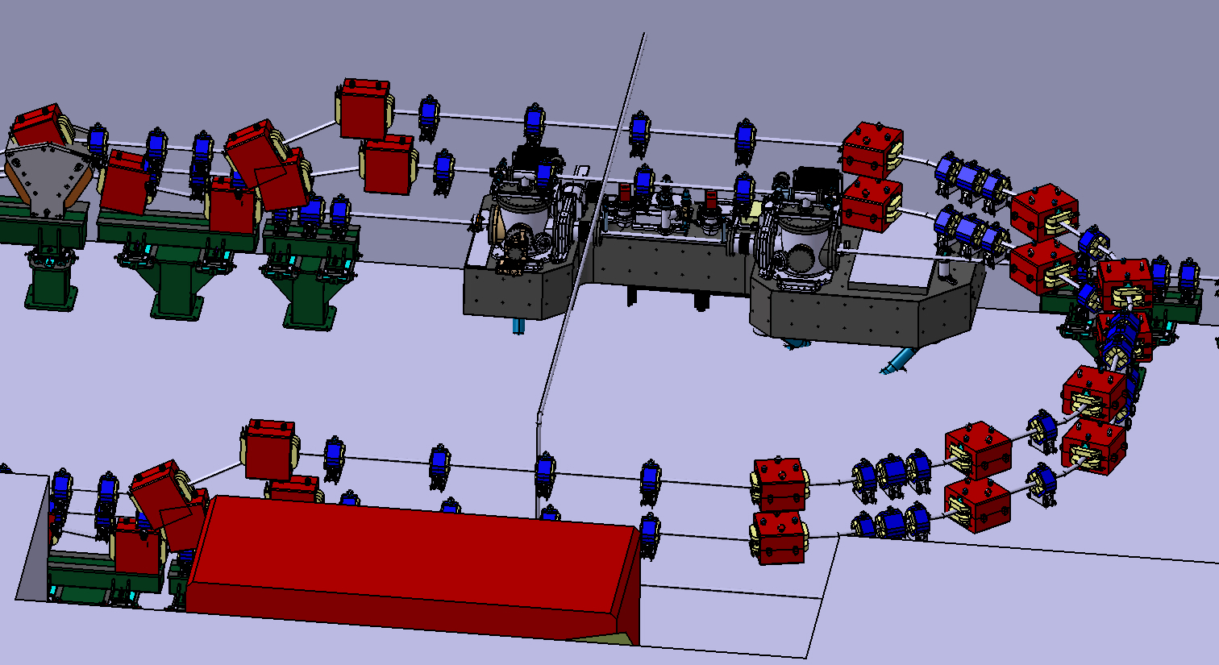
PERLE implementation
Gamma beam:
Opening angle ~ 2mrad
Detector:
Calorimetry
High-res calorimetry ? (HPGe)
Delbrück, ideally 4pi calorimetry, may be simplified to fit in available space
Cost ~ 500kE of hardware

Slide 10
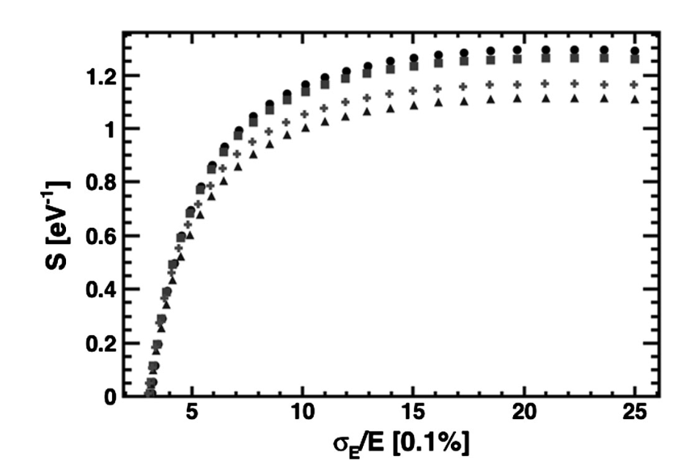
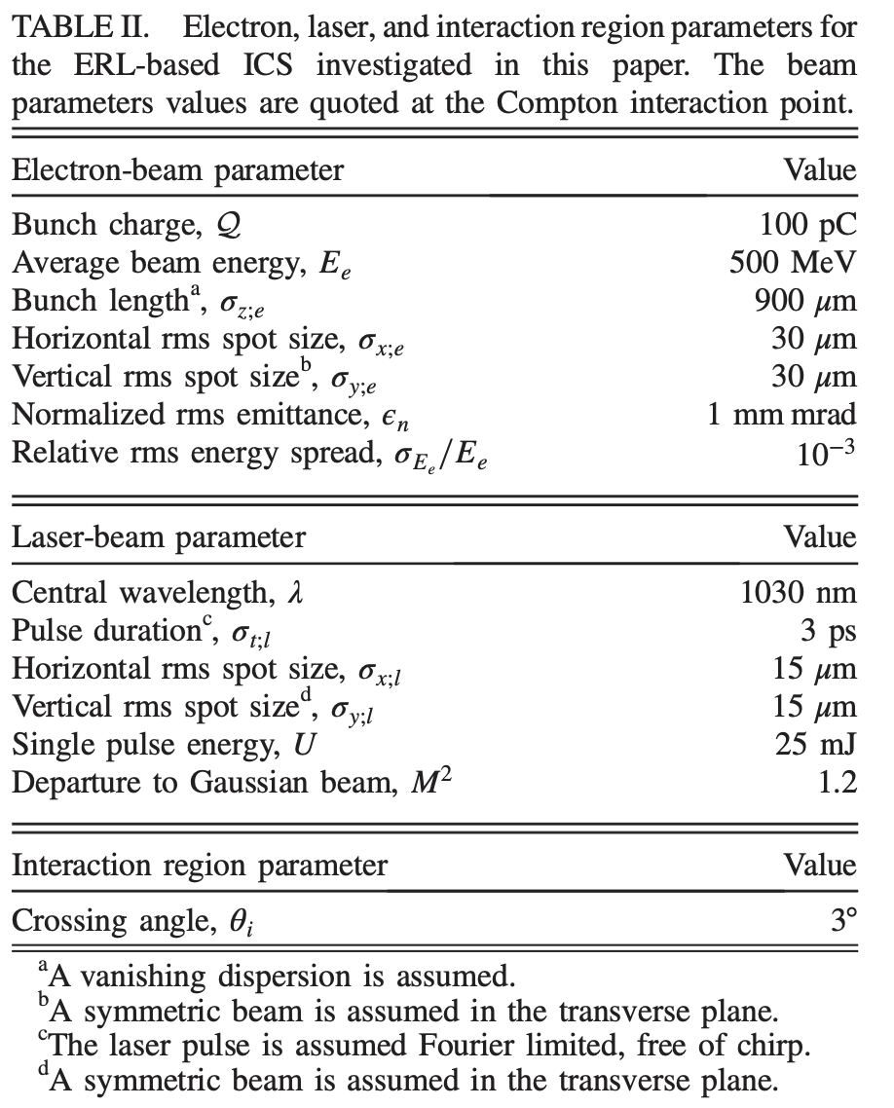
PERLE: Fast simulation
A. Martens et al., Phys. Rev. Accel. Beams 24, 091601
With 1MW 40MHz laser :
40 (20)x10⁶ photons/(s.eV) within <0.8 (0.5)% BW
NB: ELI-NP 4 x10⁴ photons/(s.eV) for 0.5% BW
Low (→0.1%) bandwidth:
Never demonstrated
Of interest for NRF applications (background)
@PERLE depending of charge vs momentum space spread trade-off.
→ Approximate relation for Q(ϵ,𝜎E) needed.

Slide 11
Conclusion: PERLE could be…
A high rate low energy gamma-ray source at 1.1MeV:
~>100x ELI-NP
more at 500MeV e-beam energies, or with halved wavelength laser
A very nice driver for R&D on optical cavities :
Very high average laser power in green (new AFAIK)
A place to demonstrate <0.1% bandwidth gamma source:
NRF backgrounds…
A place to perform QED physics…
Background free Delbrück scattering measurement in few days
but also more conventional NRF research

Slide 12
Backup

Slide 13
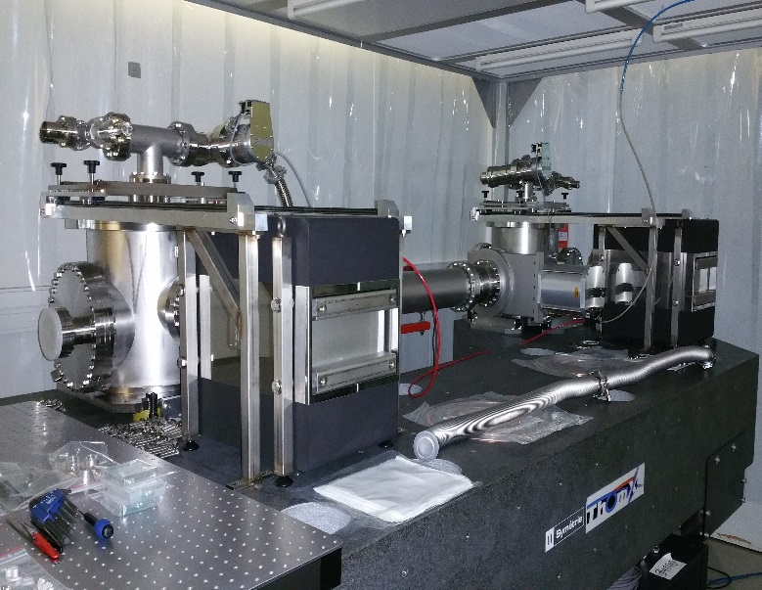
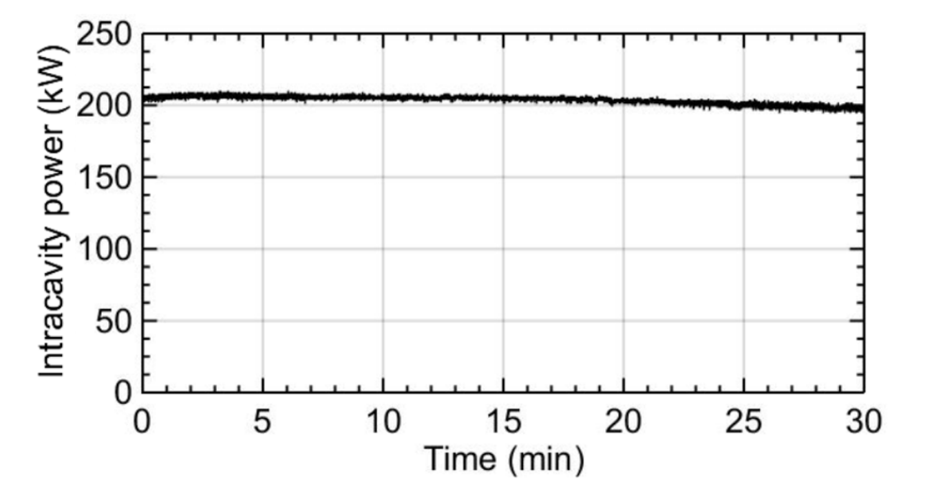
Typical elements and performance
Amoudry L. & H. Wang, PhD theses; Amoudry L. et al., Applied Optics 59(2020)116
Cost ~ 500kE of hardware

Slide 14
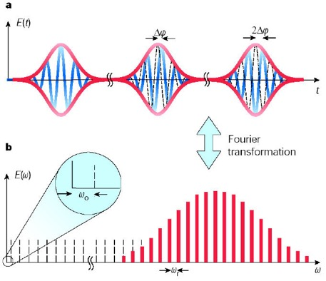
Laser phase noise
$$\text{Df}\text{c}\text{e}=2π\frac{F_{CEO}}{F_{REP}}$$
T=1/frep=2π/ω_{r}
2Δφ_{ce}
T. Udem et al. Nature 416 (2002) 233

Slide 15
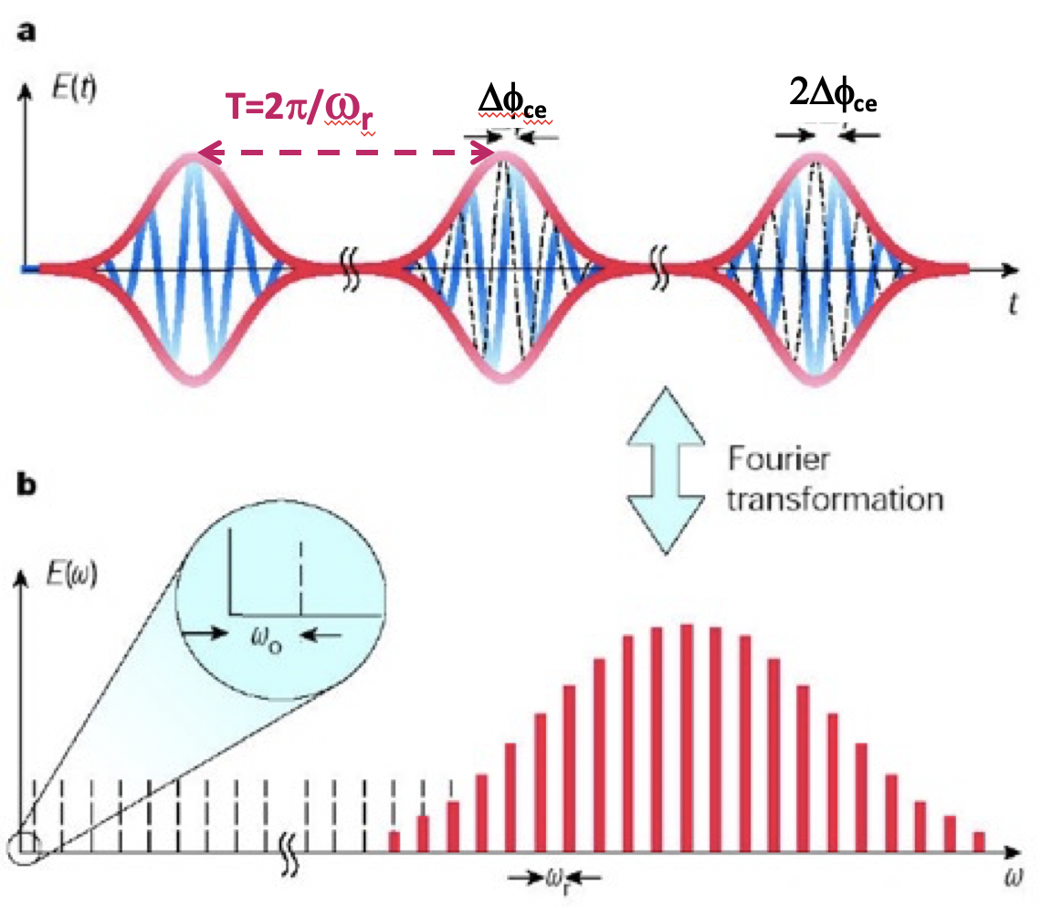
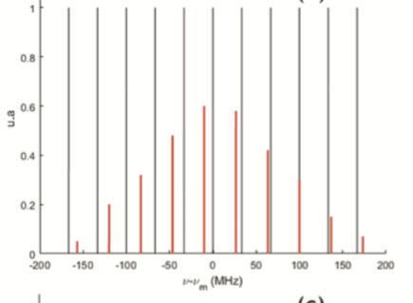
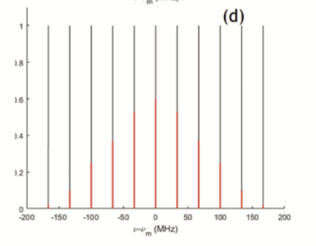
Ultra narrow linewidth
The whole comb must be locked:
dilatation (F_{REP})
translation (F_{CEO})
Not locked
Filtering lines of the optical cavity
Laser spectrum
$$F= \frac{FSR}{∆ν}=15000$$
$$FSR=33MHz$$
$$∆ν=2.2kHz$$
locked
NB: Compare with central frequency of $ν_{0}=290THz$
$$\frac{∆ν}{ν_{0}}<{10}^{−11}$$
Metrology-level requirement !
Unique laser provider ?

Slide 16
Fabry-Perot resonator
T_{rep}=1/F_{rep}
L
Input laser beam:
Few ps pulse duration
Input laser beam must be matched to the cavity:
Temporal superposition
Transverse mode matching
2L/c=F_{rep}
Resonant at different cavity lengths*
*for a non-degenerate cavity

Slide 17
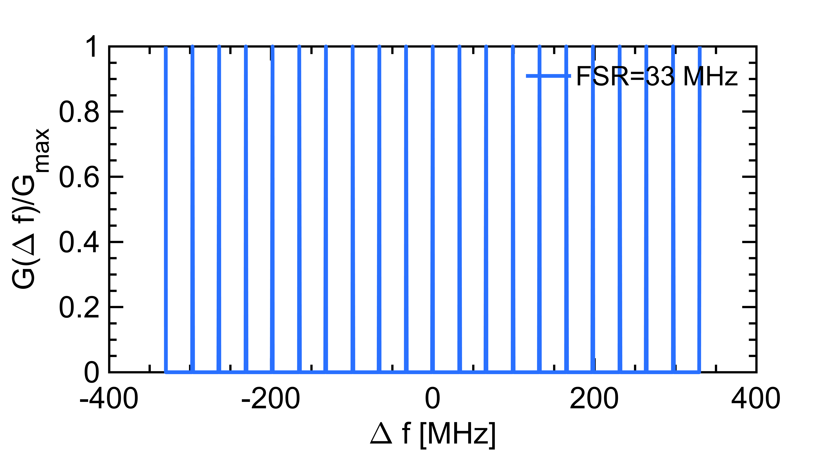
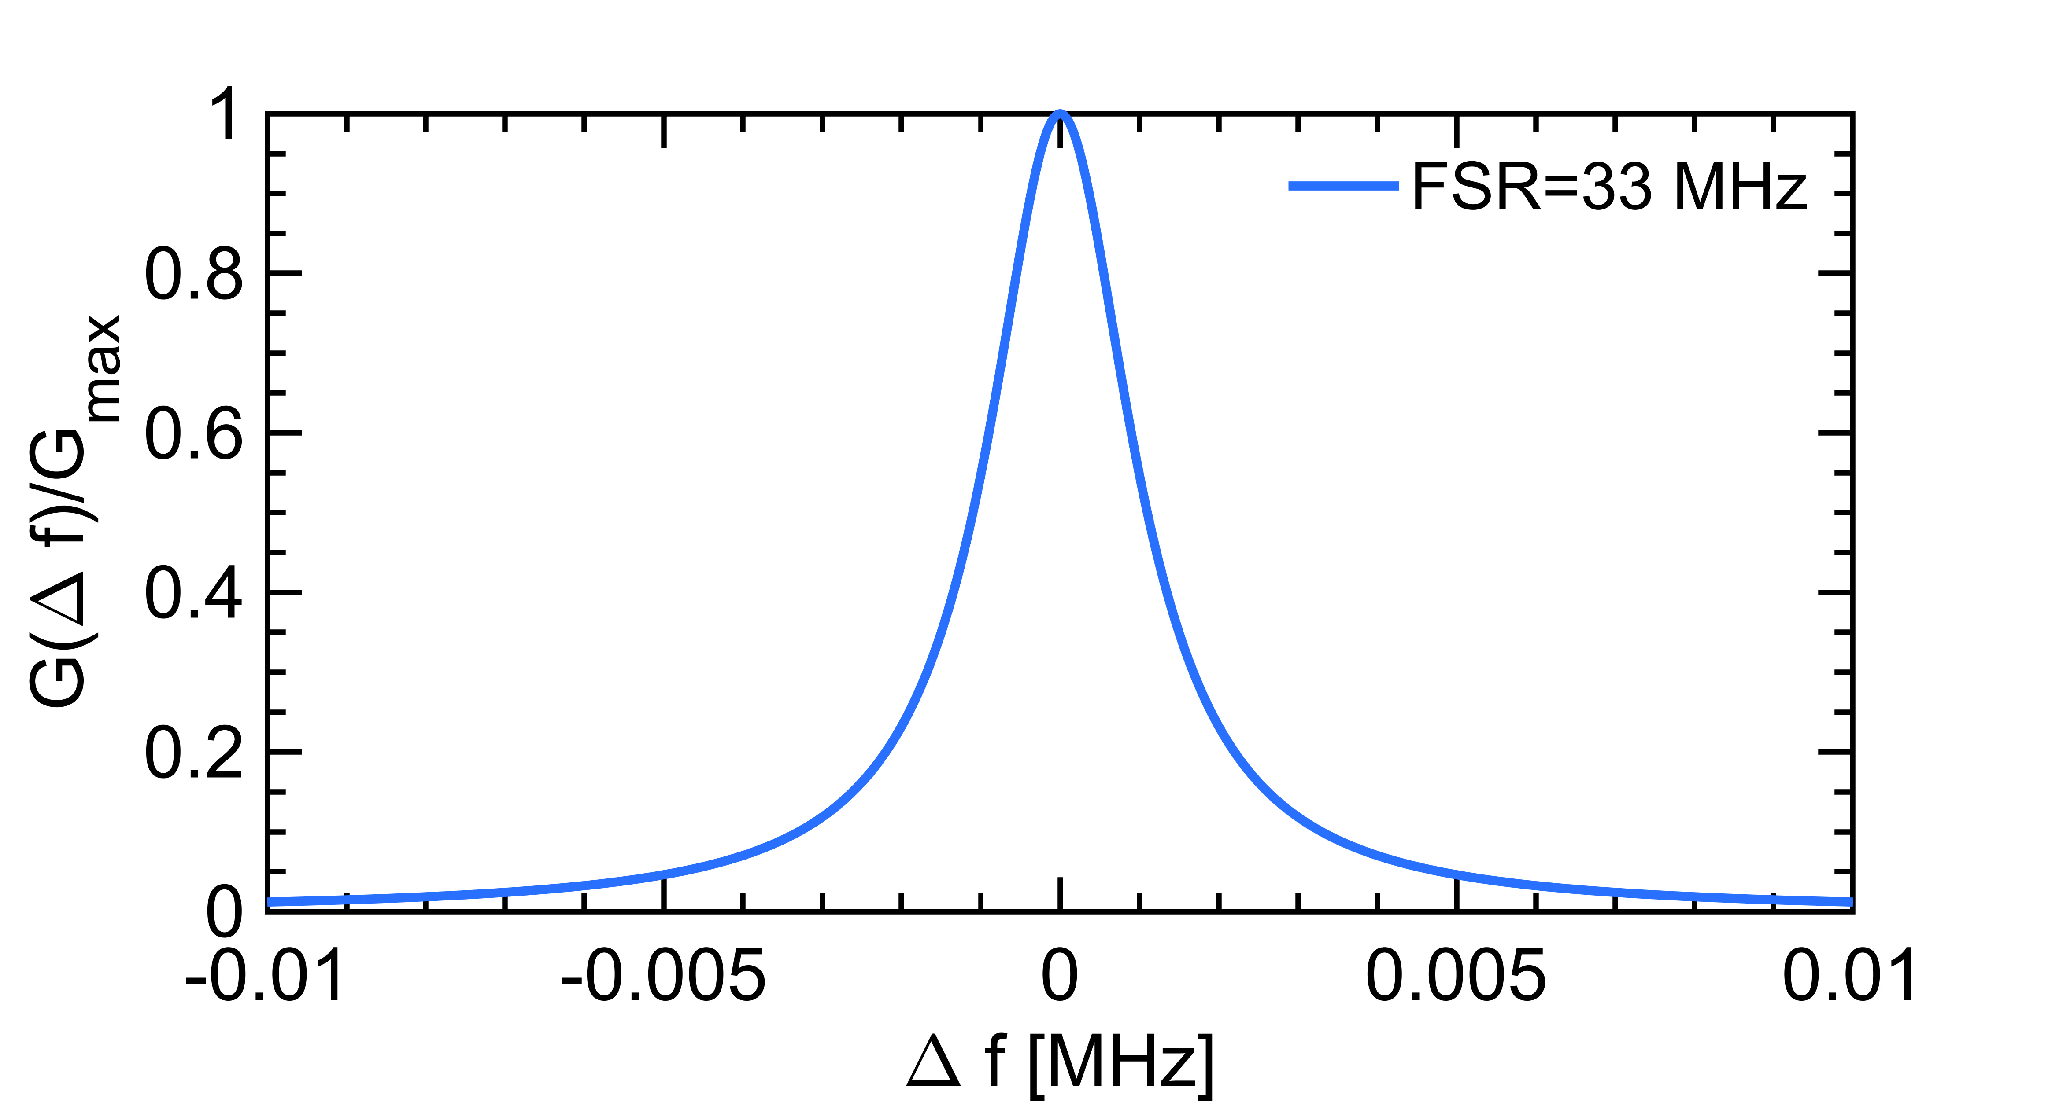
Fabry-Perot interferometric filter
Laser frequency must be precisely tuned
And remain stable !
$$F= \frac{FSR}{∆ν}=15000$$
$$∆ν=2.2kHz$$
NB: Compare with central frequency of $ν_{0}=290THz$
$$\frac{∆ν}{ν_{0}}<{10}^{−11}$$
Metrology-level requirement !
→unique provider but stopped production !!!

