Slide 1

Layout of Experiments at MESA
Physics with PERLE at Orsay
2022, May 9

Slide 2
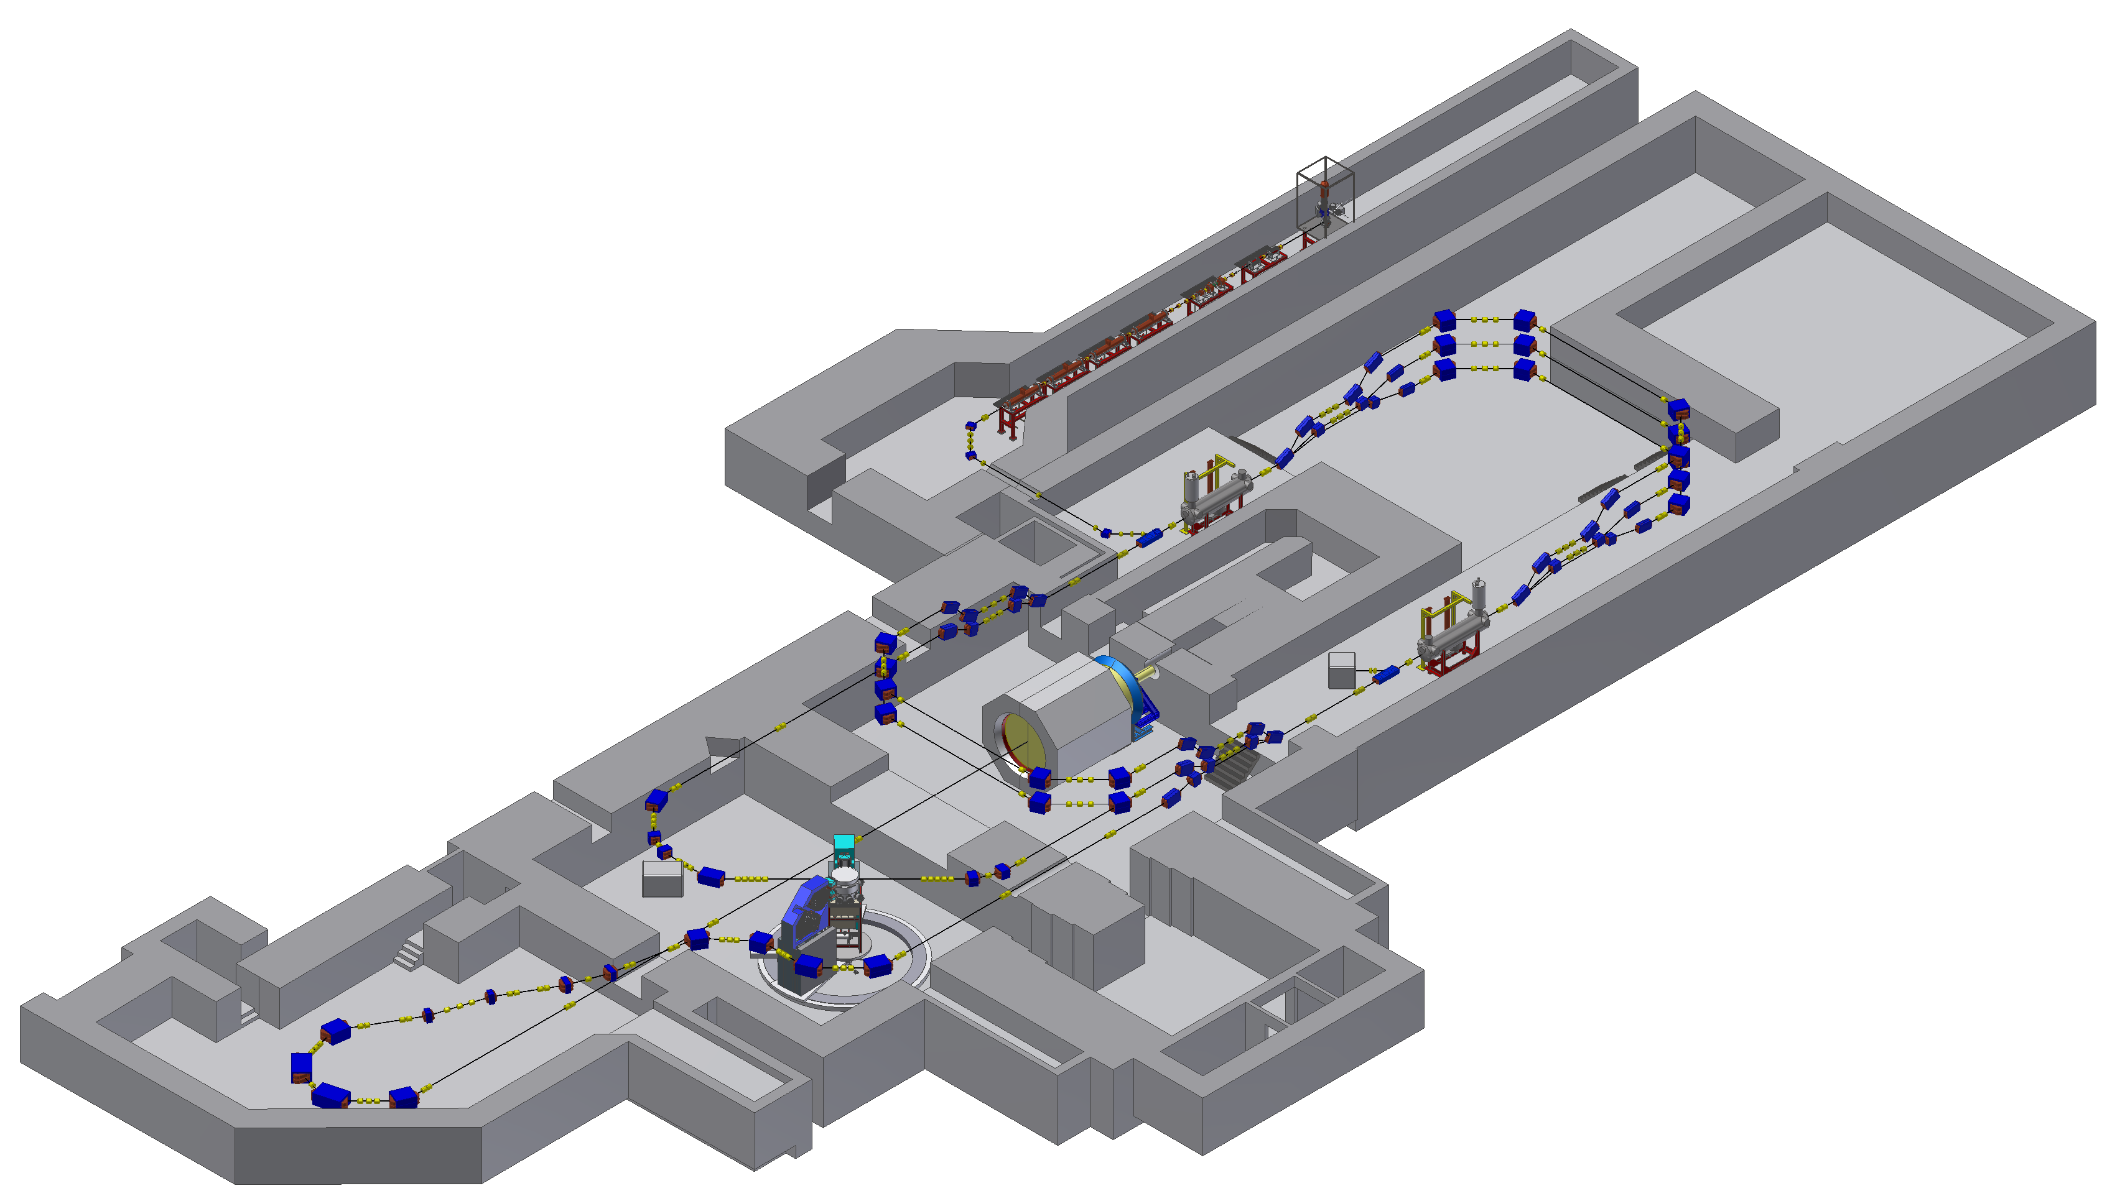
MESA Status
5 MeV Injector is currently being build (old part of building)
Cryomodules tested and within specs
Completion of building end 2022
Experiments begin in 2025
New building

Slide 3
MESA Operational modes
Op-mode | Target | Current/ Energy | Experiment Beam polarisation | Beam power@target
Ext. Beam (EB) | Solid/ Liquid | 0-1mA/ 55-105 MeV | P2, unpol (2025) | 0-25kW
Energy recovery(ERL) | Gas-jet | 1-10mA/ 55-105MeV | MAGIX (2026) Unpol. | 0.1-1MW
Fast cycling Storage(FCS) | Pol. Gas Laser | 10-100mA/ 105-200MeV | MAGIX+(?) Pol. | 1-10MW
New project,
under discussion

Slide 4
MESA- fixed target experiments
P2 experiment:
High target density, 0.15mA
External beam mode (EB)
Luminosity >10³⁹ cm⁻²s⁻¹
MAGIX experiment:
low target density, 1mA
Energy recovery mode (ERL)
Luminosity >10³⁵ cm⁻²s⁻¹
Under discussion:
ultra low density polarized target
>10 mA
Fast Cycling Storage Mode (FCS)
Luminosity >10³² cm⁻²s⁻¹
H.Merkel Talk at DPG Springmeeting 2022

Slide 5
EB-Experiment P2
D. Becker et al. Eur. Phys. J. A 54 (2018) 11, 208
DOI: 10.1140/epja/i2018-12611-6 &166,
A weak charge measurement of the proton with accuracy 1.4%
yields an accuracy Δsin²(θ_{W})/sin²(θ_{W}) =0.16%.....

Slide 6
P2-Challenges
H.Merkel Talk at DPG Springmeeting 2022

Slide 7
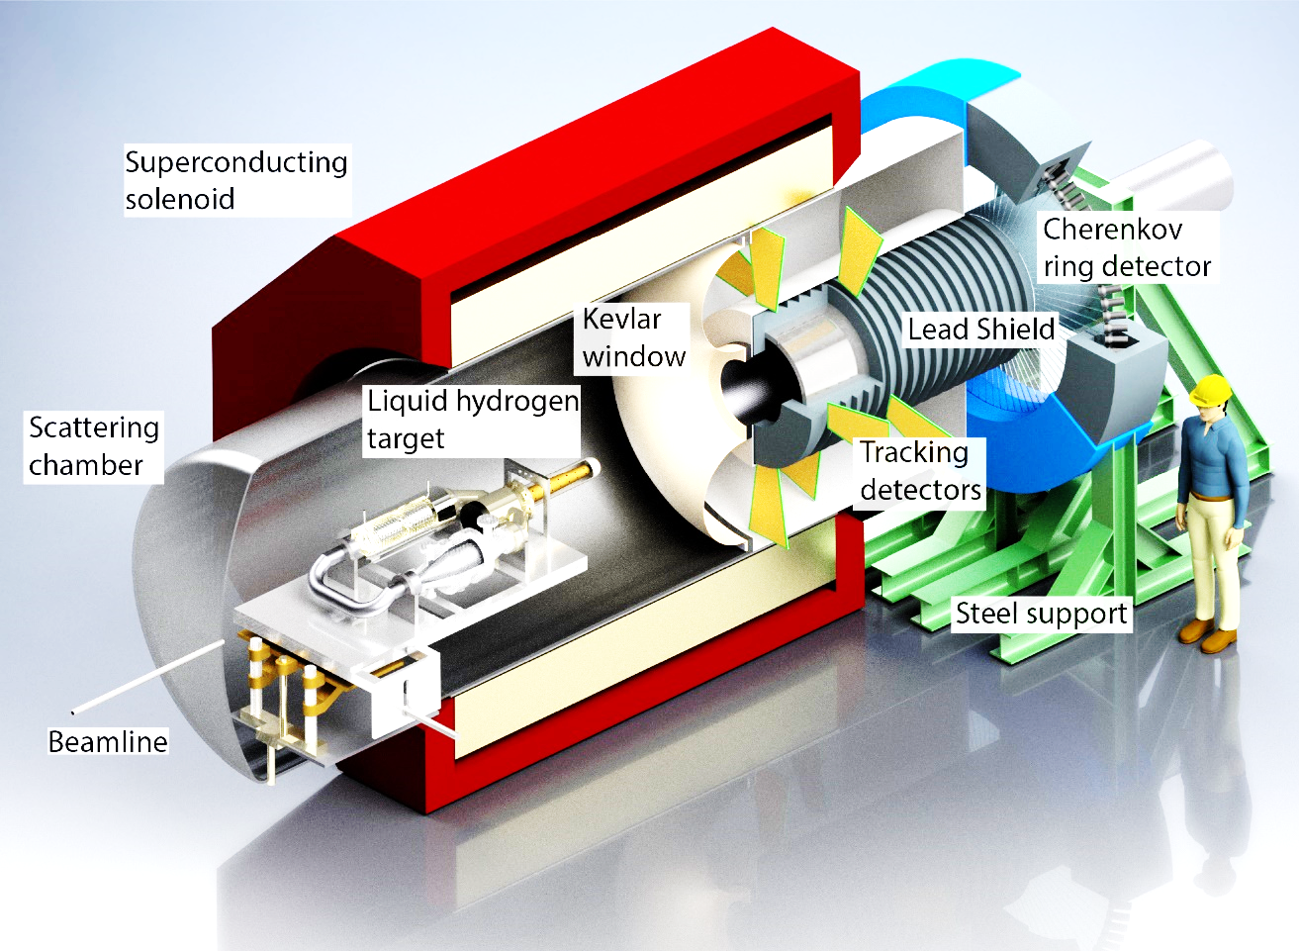
P2 procurement
Large bore solenoid ordered in June 2020, final design report accepted, delivery in December 2022
Assembly of Yoke in summer 22
90 Integrating quartz glass bars (high purity, laser grade polish): first 30 pieces delivered
PMT’s HV-channels ordered
More: D. Becker et al. Eur. Phys. J. A 54 (2018) 11, 208 DOI: 10.1140/epja/i2018-12611-6 &166

Slide 8
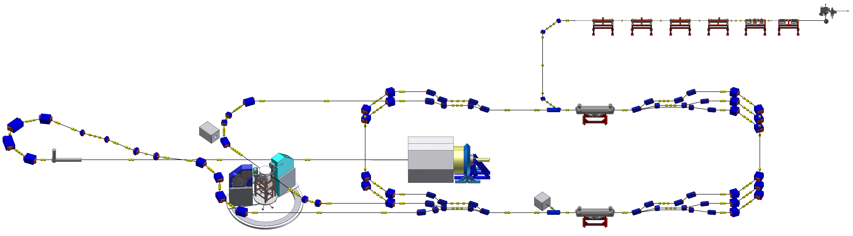
Energy Recovery Mode – MAGIX
Deceleration
Acceleration

Slide 9
MAGIX spectrometers
Spectrometes are ordered, expected delivery
March 23
H.Merkel Talk at DPG Springmeeting 2022

Slide 10
Gas Jet target at MAMI A1 /MAGIX
Gas jet target in operation at MAMI
H.Merkel Talk at DPG Springmeeting 2022

Slide 11
Experimental program at MAGIX
H.Merkel Talk at DPG Springmeeting 2022

Slide 12
Gas Jet target at MAMI A1 /MAGIX
H.Merkel Talk at DPG Springmeeting 2022

Slide 13
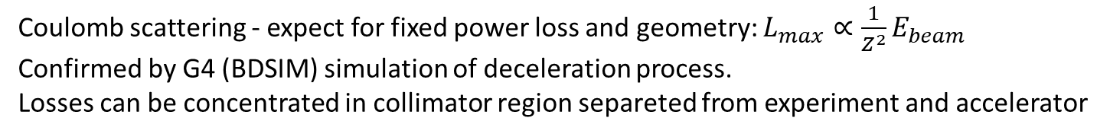
Luminosity limitation ERL gas jet target
Coulomb scattering - expect for fixed power loss and geometry: $L_{max}∝\frac{1}{Z^{2}}E_{beam}$
Confirmed by G4 (BDSIM) simulation of deceleration process.
Losses can be concentrated in collimator region separeted from experiment and accelerator
Results for „two collimator“ system
Total loss <100 Watt, loss in accelerator <0.05 W.
Ben LeDroit, PhD thesis Mainz 2021
Calculation for realistic MAGIX geometry
http://doi.org/10.25358/openscience-5808

Slide 14
Polarized targets – ultra low target density
Beam line Losses are limited, typical ~100 Watt.
1mA -10mA is then well adapted to Hydrogen gas jet target with 10¹⁸-10¹⁹ cm⁻² at MESA
Polarized targets a la HERMES or Hydro-Möller have 3-4 orders of magnitude lower density.
Higher CW current (to compesate for luminosity redeuction )requires huge investments (e.g. new cryomodules)
Can (in principle) be circumvented by the Fast Cycling Storage method - MESA as full energy injector in storage ring
Study funded by PRISMA research funds: Christian P. Stoll∗, Ben Ledroit1, Atoosa Meseck: A storage ring for Mesa: accelconf.web.cern.ch/ipac2021/papers/mopab217.pdf
Cross section of Hydro-Möller polarized gas target planned for MESA/P2 , areal density 10¹⁵cm² -10¹⁶cm² ,
V. Tyukin and K. Aulenbacher Polarized Atomic Hydrogen Target at MESA,
The 18th International Workshop on Polarized Sources, Targets, and Polarimetry, PSTP2019, 23-27 September, 2019 Knoxville, Tennessee PoS(PSTP2019)005

Slide 15
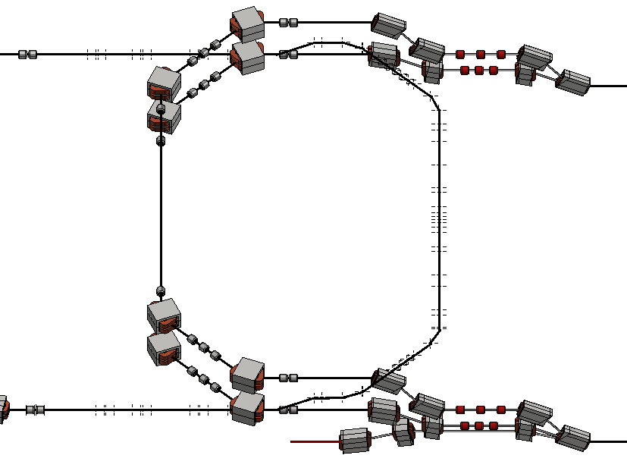

Fast Cycling Mode
~30m/100ns
In the fast cycling mode, the duty factor in the accelerator is reduced to ~1/1000 (1kHz repetiton rate with 100ns long bunch trains with 8-80pC bunch charge, i.e 10-100μA average current).
The experiment is operated like an internal target in a storage ring and sees CW current of 10-100mA
- at luminosities ~10³², losses in the ring are <1Watt
- after ~1000 turns the remaining beam is dumped on the beam dump

Slide 16
Conclusion
MESA is currently being build at University Mainz
Construction and commisioning until 2025
Rich portfolio of experiments at the experimetnal stations P2, MAGIX, and DarkMESA
Options for extensions after starting the experiment exist.

