Slide 1
Séminaire Inter-pôles:
PERLE@Orsay: A novel facility for ERL development and applications in multi-turn configuration and high-power regime
Orsay, 10 Juin 2022
Par Achille STOCCHI et Walid KAABI

Slide 2
Introduction- ERL concept:
The idea:
Provide RF power for acceleration
(1’)
(2’)…
(1)
New beam injected in ERL loop
Acceleration to the top energy
The benefits:
Reduce accelerator power consumption
Dumping the beam at injection power
Fresh beam in IP with the same characteristics
(2)
ERL Loop
(4)
Kinetic energy of used beam recycled to re-excite cavities
Beam used in IP
(3)
More advantages:
Linac-like beam quality with extremely flexible time structure
High operating efficiency
High average current carrying capability (no more RF power limit)
Multi-pass configuration: High average beam power in a compact machine

Slide 3
Introduction- Energy Recovery in RF Fields:
λ_{Rf}
E_{Out} = E_{Inj}
E = E_{inj} +ΔE
E = E_{inj} +2 ΔE
E_{Inj}
E = E_{inj} +ΔE
E = E_{inj} +ΔE
(β ~ 1)
L = n · λ + λ / 2
L = n · λ
Energy supply → acceleration
Deceleration = “loss free” energy storage (in the beam) → Energy recovery

Slide 4
Introduction- at the origin…
ERL concept was proposed first in 1965 by Maury Tigner ¹ (Cornell University) for colliders…
¹ M. Tigner: “A Possible Apparatus for Electron Clashing-Beam Experiments”, Il Nuovo Cimento Series 10, Vol. 37, issue 3, pp 1228-1231,1 Giugno 1965
The concept was experimented first in 1986 at SCA/FEL in Stanford, accelerating beams at rather low power.
The concept become really viable with recent advances in SRF technology in the last decades, quantified by reaching high cavity quality factors (Q₀ ≥ 10¹⁰) enabling high average current operation.

Slide 5
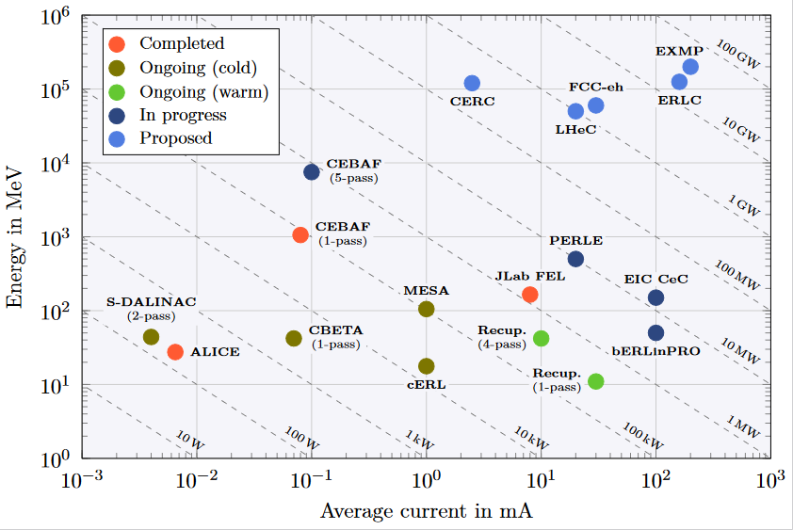
Introduction- The global landscape
NEW FRONTIER IS THE POWER AND MULTI TOURS !
Funding Limited
Technology Limited

Slide 6
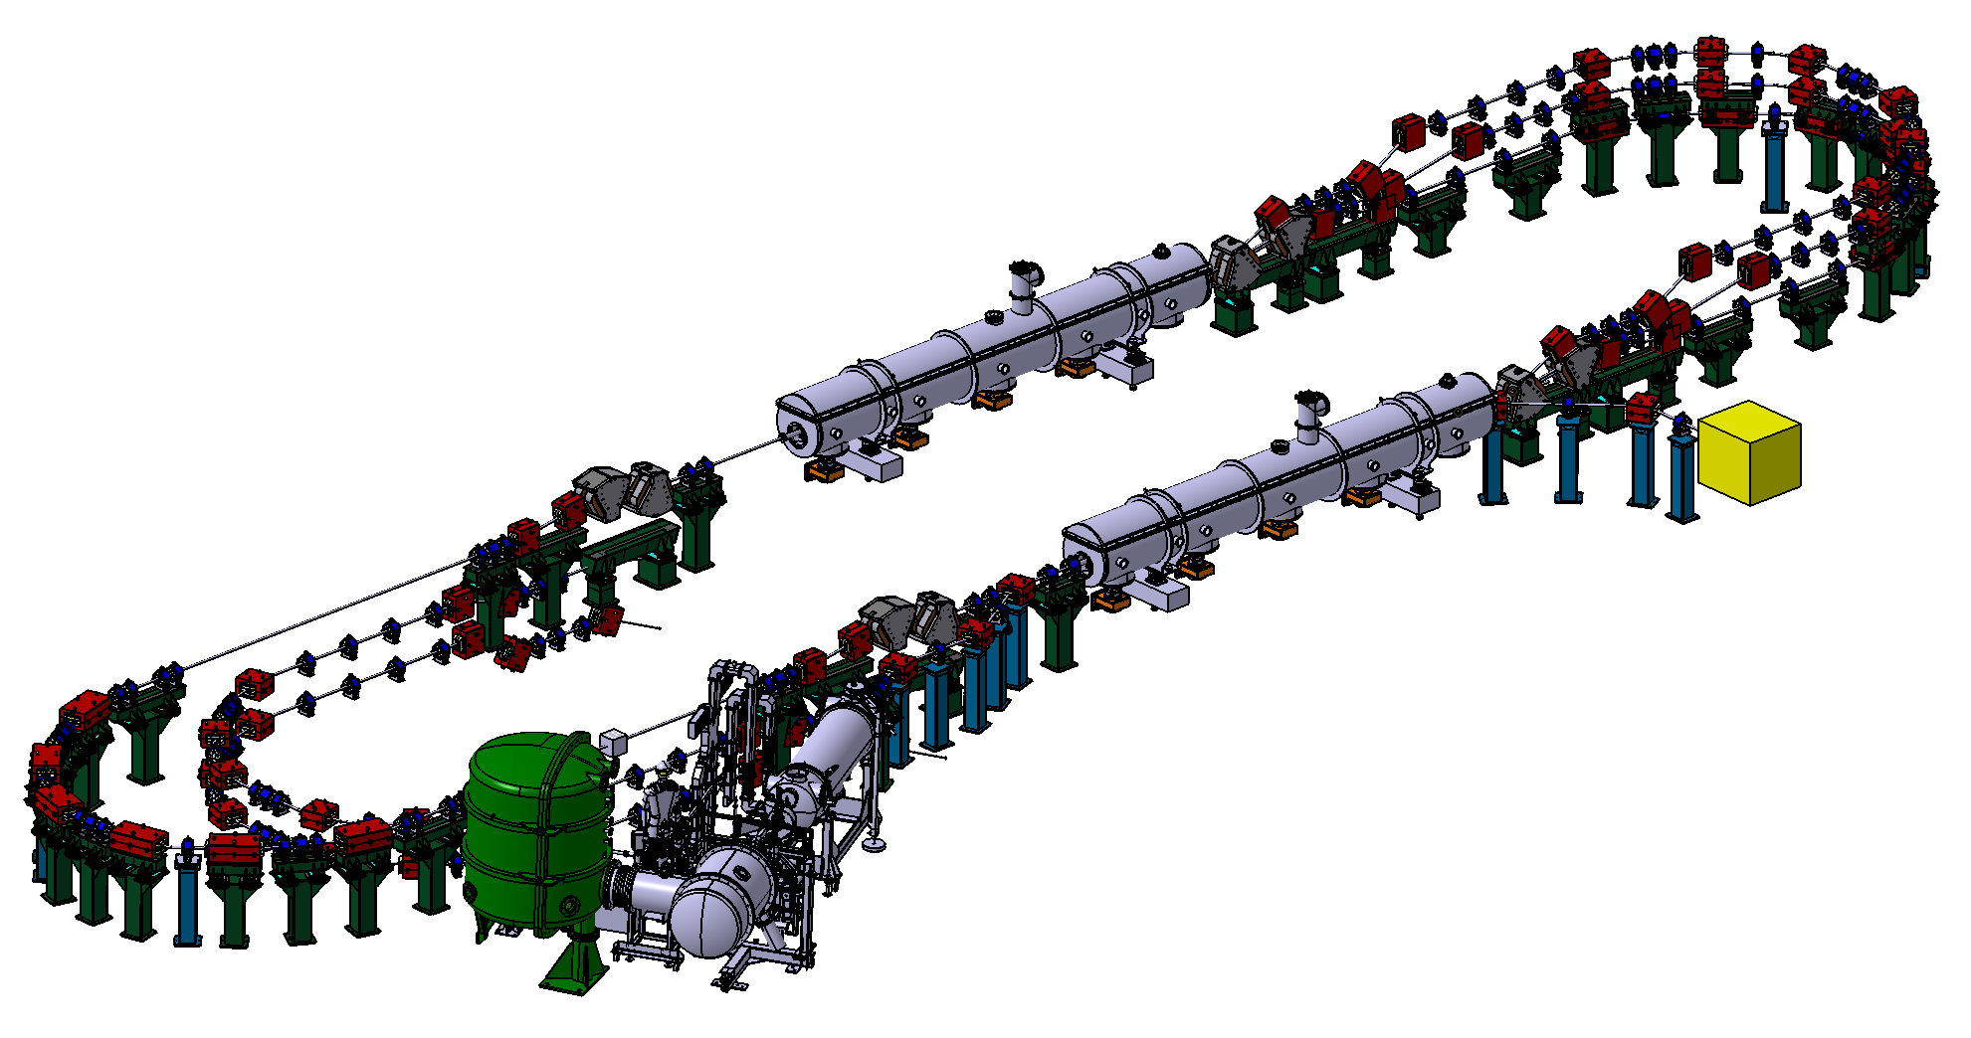
The short summary of the PERLE@Orsay Genesis
ep collisions at LHC. It appeared that the ideal machine combines the proton of LHC (from 7 TeV up to 13T eV) with an electron beam of 50-70 GeV and a target luminosity of 10³⁴cm⁻²s⁻¹.
→ the electron machine is an ERL, with in summary
current = 20mA, 3+3 passes (to reach 60 GeV)
Need of a demonstrator → Perle@Orsay
Target Parameter | Unit | Value
Injection energy | MeV | 7
Electron beam energy | MeV | 500
Normalised Emittance γε_{x,y} | mm mrad | 6
Average beam current | mA | 20
Bunch charge | pC | 500
Bunch length | mm | 3
Bunch spacing | ns | 25
RF frequency | MHz | 801.58
Duty factor |  | CW
2 Linacs (Four 5-Cell 801.58 MHz SC cavities)
3 turns (164 MeV/turn)
Max. beam energy 500 MeV
I = 20mA

Slide 7
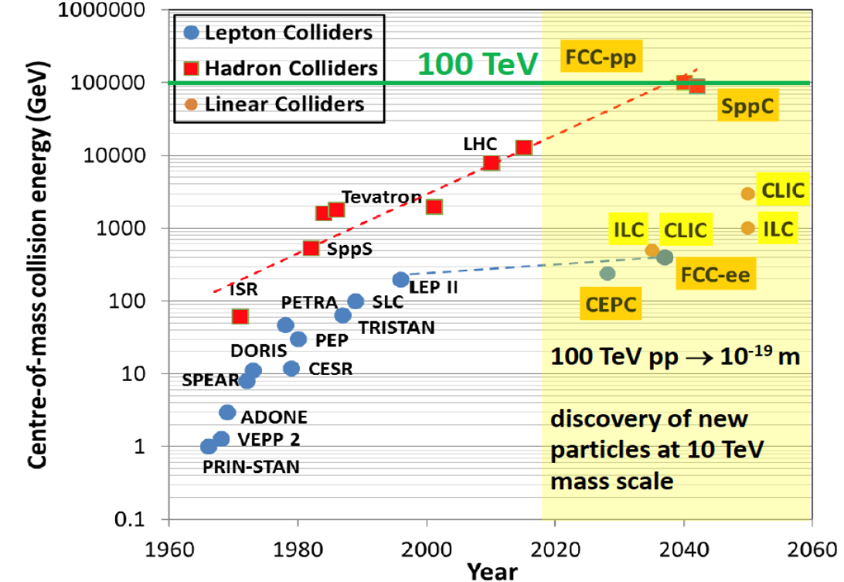
DIS (Deep Inelastic Scattering) ep Physics at High Energy in the next decades
FCC-pp
40 TeV
Hundred
Years of
HEP
Colliders
FCC-eh
LHeC
HERA
EIC

Slide 8
DIS (Deep Inelastic Scattering) ep Physics at High Energy in the next decades
Energy frontier DIS at HEP is necessary to explore SM and beyond
The LHeC Detector Design
d
LHeC and FCC-eh are partners of LHC and FCC.
Same parameters as the ones for PERLE@Orsay
No pile up, low radiation wrt pp; high precision through overconstrained kinematics: e-h; modular for rapid installation

Slide 9
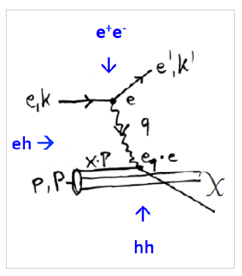
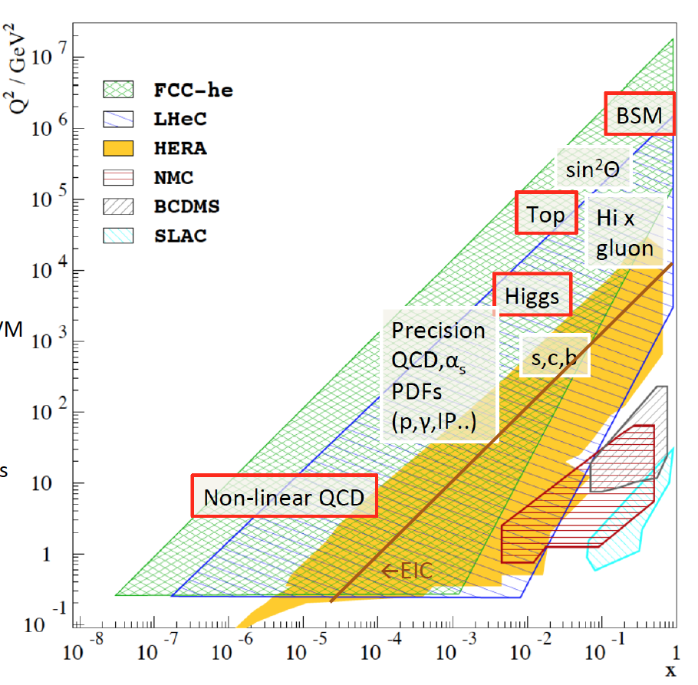
DIS (Deep Inelastic Scattering) ep Physics at High Energy in the next decades
Published in 2020
arXiv:2007:14491 (400 pages, 300 authors)
Raison(s) d’etre of ep/eA
at the energy frontier
Cleanest High Resolution
Microscope: QCD Discovery
Empowering the LHC/FCC
Search Programme
Transformation of LHC/FCChh into
high precision Higgs facility
Discovery (top, H, heavy ν’s..)
Beyond the Standard Model
A Unique
Nuclear Physics Facility

Slide 10
The short summary of the PERLE@Orsay Genesis
ep collisions at LHC. It appeared that the ideal machine combines the proton of LHC (from 7 TeV up to 13T eV) with an electron beam of 50-70 GeV and a target luminosity of 10³⁴cm⁻²s⁻¹.
→ the electron machine is an ERL, with in summary
current = 20mA, 3+3 passes (to reach 60 GeV)
Need of a demonstrator → Perle@Orsay
Target Parameter | Unit | Value
Injection energy | MeV | 7
Electron beam energy | MeV | 500
Normalised Emittance γε_{x,y} | mm mrad | 6
Average beam current | mA | 20
Bunch charge | pC | 500
Bunch length | mm | 3
Bunch spacing | ns | 25
RF frequency | MHz | 801.58
Duty factor |  | CW
2 Linacs (Four 5-Cell 801.58 MHz SC cavities)
3 turns (164 MeV/turn)
Max. beam energy 500 MeV
I = 20mA

Slide 11
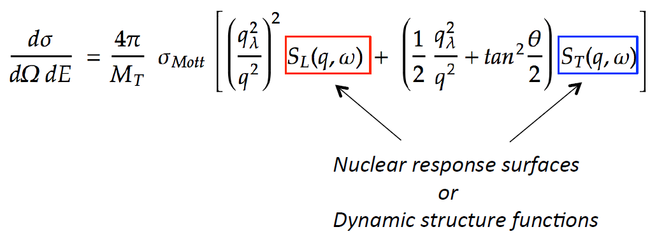
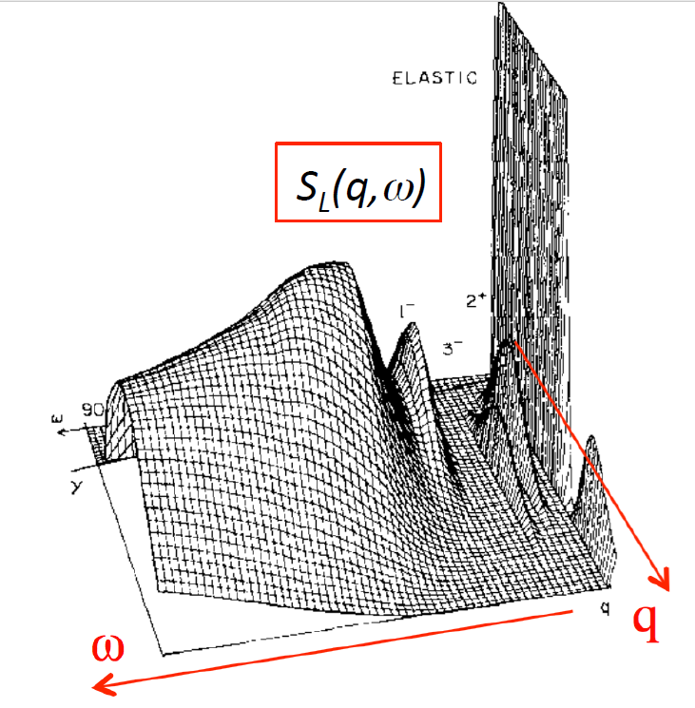
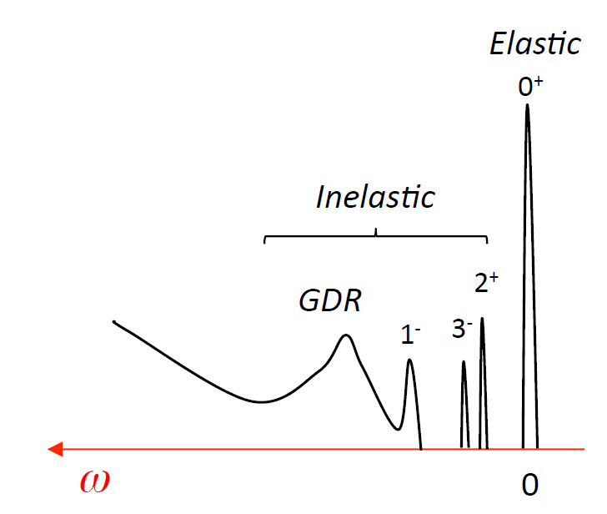
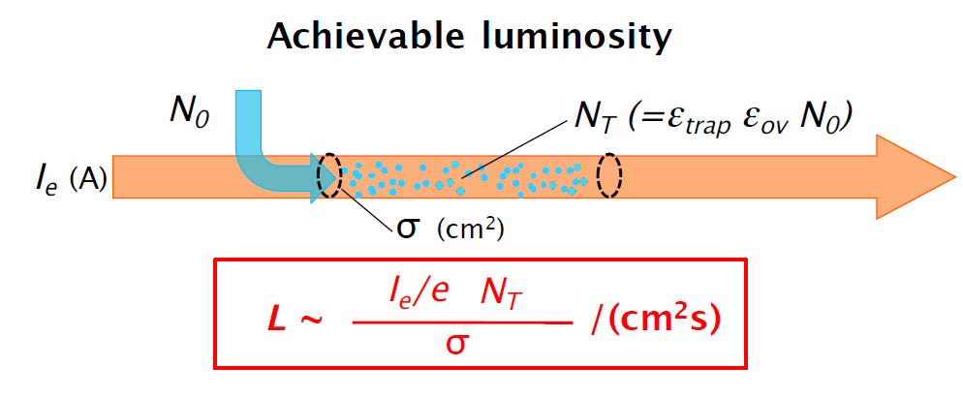
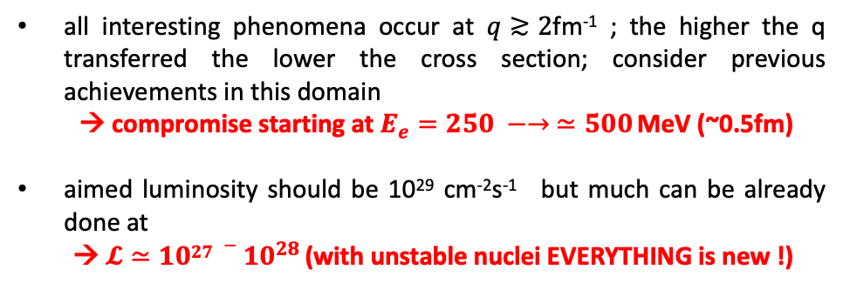
The New Frontier : e-RIB (Radioactive Nuclei Beam) scattering
A completely new horizon, explore the interior of exotic nuclei :
charge radius, shape… New properties are emerging (halo, pairing..) !
all interesting phenomena occur at $q≳2$fm⁻¹ ; the higher the q transferred the lower the cross section; consider previous achievements in this domain
→ compromise starting at $E_{e}=250 −→ ≃500$ MeV (~0.5fm)
aimed luminosity should be 10²⁹ cm⁻²s⁻¹ but much can be already done at
→ $𝓛≃{1027 −10}^{28 }$(with unstable nuclei EVERYTHING is new !)
Simple imaging
Full tomography
A long road ahead before reaching the full tomography of an exotic nucleus
The starting point is :
DESTIN [DEep STructure Investigation of (exotic) Nuclei]
Very chanellenging
The beam will confine RIB in longitudinal plane e- with positive ions), and traps have to confined RIB in transversal plane ( à la SCRIT at RIKEN)
Collection : from David Verney

Slide 12
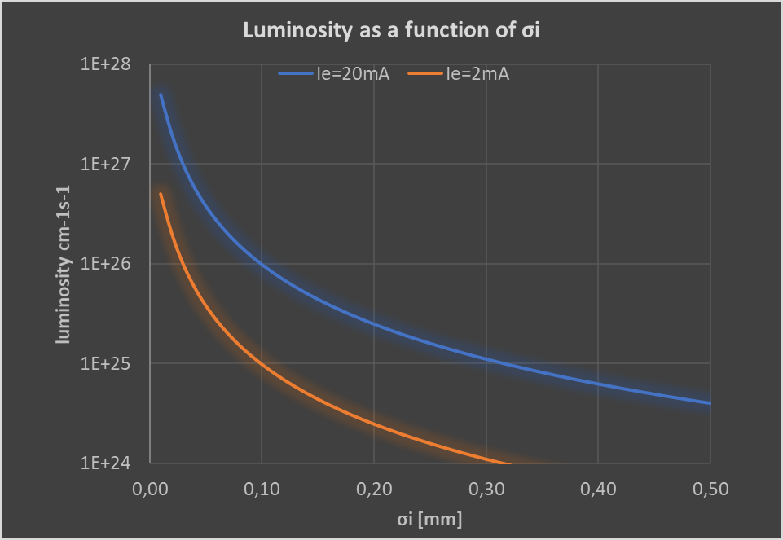
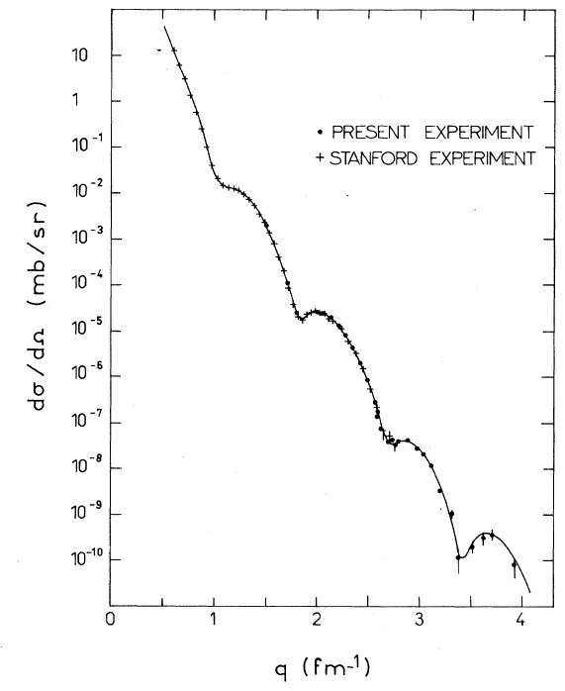




The New Frontier : e-RIB (Radioactive Nuclei Beam) scattering
Slides presented by David Verney at the recent Workshop
« Physics with PERLE@Orsay »
Sick et al. PRL 35 910 (1975)
experiment at Saclay Linear Accelerator (ALS) on ⁵⁸Ni
FAIR/ELISE targeted luminosity
$ℒ$ cm⁻²s⁻¹
SCRIT luminosity with stable nuclei
$${6∙10}^{24 }$$
$${6∙10}^{28 }$$
1953 Hofstadter’s luminosity
$${6∙10}^{32 }$$
Absolute radius and 2-parameters charge distributions seam reasonably at reach even with lower current.
To be evaluated at 250MeV instead of 500 MeV.

Slide 13
PERLE a key ERL project : HEP and Nuclear Physics communities
ERL machines open a new Frontier for the physics of “the electromagnetic probe”
At low energy e Nuclei (PERLE and Destin@Orsay) 250-500 MeV
(2) At Higher Energy e p (e A) (LHeC and/or FCC-eh) 60 GeV
You need high luminosity → High current
You need to increase the energy (remaining compact) → Multi turns
The (1) machine (PERLE@Orsay)
  will be the first ERL dedicated to Nuclear Physics for studying the eN interaction with radioactive nuclei
  It’s a necessary demonstrator for the (2) -HEP machine (LHeC / FCC-eh)- (same technological choices & beam parameters)
The key points : high power (current x energy) and complex machine in terms of beam dynamics (multi-turns)
+ PERLE@Orsay
is also a necessary demonstrator for other future machines and applications
Elastic ep Scattering at PERLE (p Radius, Dark Photons, PV)
Possibility of Nuclear Photonics (inverse Compton scattering y’s)

Slide 14
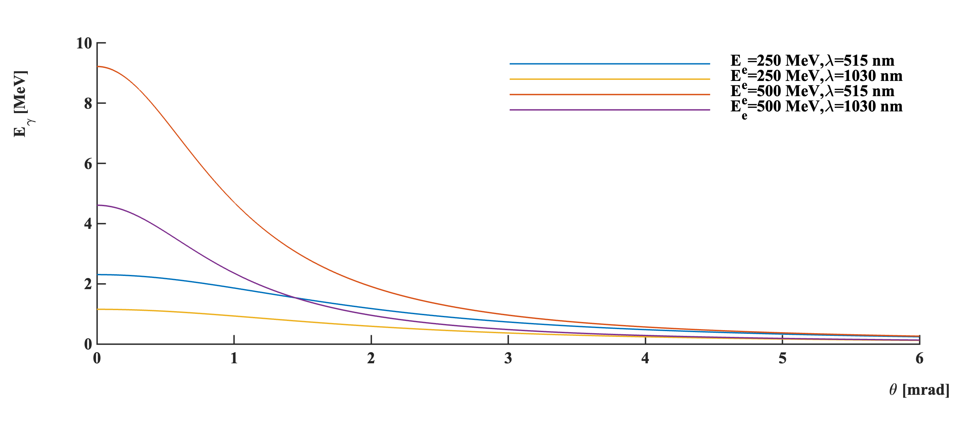
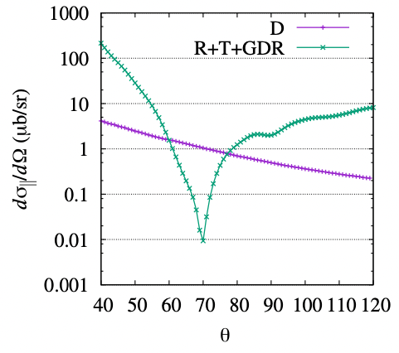


PERLE@Orsay as a Inverse Compton Scattering Machine
Compton photon:
$E_{X/γ}≃{\frac{4γ^{2}\left(1−\frac{α^{2}}{4}\right)}{1+γ^{2}θ^{2}}E}_{λ}≈4.5 MeV$
Slides presented by Aurélien Martens at the recent Workshop
« Physics with PERLE@Orsay »
laser (E_{λ}=hc/𝜆=1.2eV)
α
θ
A high rate low energy gamma-ray source at 1.1MeV:
~>100x ELI-NP
more at 500MeV e-beam energies, or with halved wavelength laser
e⁻ beam
$$Ee=500 MeV$$
A very nice driver for R&D on optical cavities :
Very high average laser power in green (new AFAIK)
A place to demonstrate <0.1% bandwidth gamma source:
NRF backgrounds…
A place to perform QED physics…
Background free Delbrück scattering measurement in few days
but also more conventional NRF research

Slide 15
  ESPP seen from ERL view point : Future ERL projects & the position of PERLE@Orsay
The development of ERLs has been recognized as one of the five main pillars of accelerators R&D in support of the European Strategy for Particle Physics (ESPP).
The ERL Roadmap Panel, chaired by Max Klein and Andrew Hutton, has done a tremendous job with broad and active participation. The PERLE project was recognized as one of the "essential pillars of the ERL," with milestones to be achieved by the next ESPP in 2026.
Two other important points :
  Upgrade bERLinPRO toward the First ERL Facility to operate 100mA in single turn with FRT control
  Key Technology R&D Program – next generation ERLs
ESPP R&D Accelerator RoadMap:
https://arxiv.org/ftp/arxiv/papers/2201/2201.07895.pdf
  AND NOW it is also coupled with the Nuclear Physics European Strategy
  DESTIN. Starts to be structured in Orsay and involving national and international communities. Coupled to the future of GANIL reflexions. A priority for Nuclear Physics Perspectives at national level

Slide 16
  … And some new ideas…

Slide 17
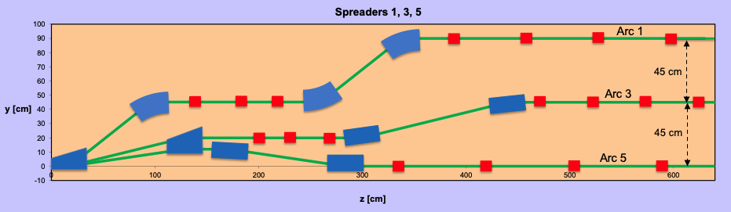
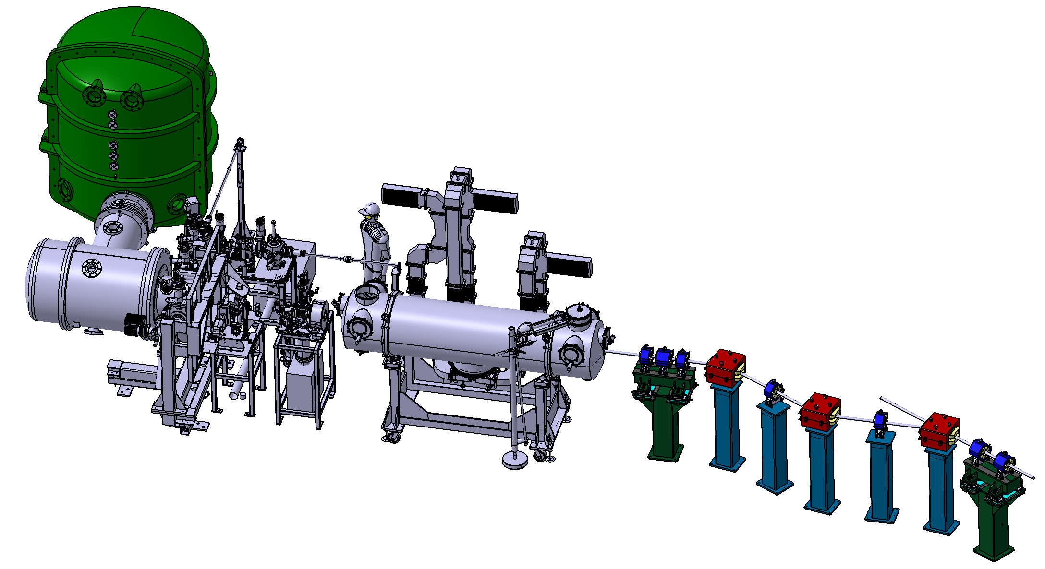
PERLE Configuration
PERLE: first multi-turn ERL, based in SRF technology, designed to operate at 10MW (20 mA, 500 MeV) power regime
Cryomodule with 4 five-Cell cavities
Total gradient 82 MeV
3 acc & 3 decc beams at different energies travelling in the CM.
Switchyard: vertical separation/recombination of beams at different energies
3 staked recirculation arcs for beams at different energies (Arcs 1, 3, 5).
Beam Dump
Interaction Points
Target Parameter | Unit | Value
Injection energy | MeV | 7
Electron beam energy | MeV | 500
Normalised Emittance γε_{x,y} | mm mrad | 6
Average beam current | mA | 20
Bunch charge | pC | 500
Bunch length | mm | 3
Bunch spacing | ns | 25
RF frequency | MHz | 801.58
Duty factor |  | CW
HV tank
Photocathodes loading chamber (Sb-based photocathodes)
Buncher
350-500 kV
DC gun
Merger
Injection line delivering 500pC bunches at 7 MeV.
Light box
Green laser 40 MHz
Booster: 5 single-cell cavities (802MHz) individually powered
3 staked (& inversed) recirculation arcs for beams at different energies (Arcs 2, 4, 6)

Slide 18
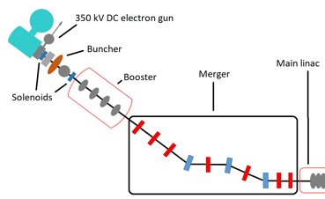
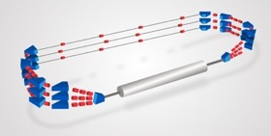
PERLE Timeline for TDR phase and beyond
2025
End Phase 0: Injection line
2030
End Phase 2: PERLE @ 500MeV
2023
PERLE TDR
2028
End Phase 1: PERLE @ 250MeV

Slide 19
Challenges imposed by PERLE design and parameters
Bunch Filling Pattern:
PERLE cavities are RF powered on CW mode. However, all the RF buckets are not filled with e- bunches.
Temporal structure of bunch generation is determined by laser pulse frequency illuminating the photocathode (40 MHz). Thus, in the injection line and in the ERL loop before the recirculation occurs: Bunches are injected every 25 ns (which correspond to a spacing inter-bunch of 20 λ_{RF}).
In these conditions, for 500 pC bunches, generated every 25 ns, the average current of PERLE beam is 500pC/25ns = 20 mA.
When recirculation occurs in the ERL Loop → bunches at different turns (and energies) in the linacs:
  Ovoid bunches in the same bucket
  Recombination pattern adjusted by tuning returned arcs length of the required integer of λ_{RF}
1
  Maximize the distance between the lowest energy bunches ( & ): ovoid reducing the BBU threshold current due to the influence of HOMs kicks
  Achieve a nearly constant bunch spacing: minimize collective effects
6
During ERL operation, The total current in the machine is 6 x 20mA = 120 mA.

Slide 20
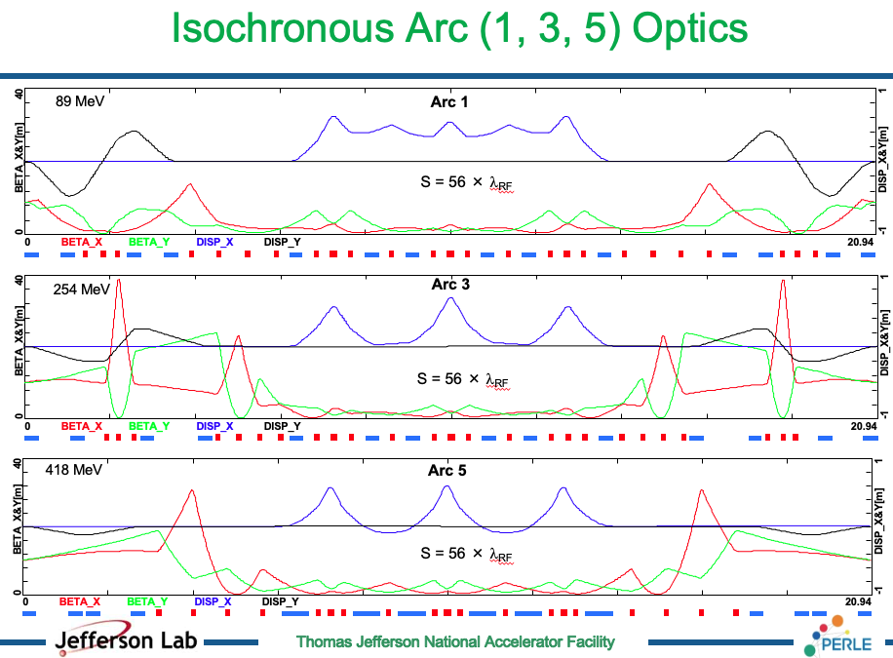
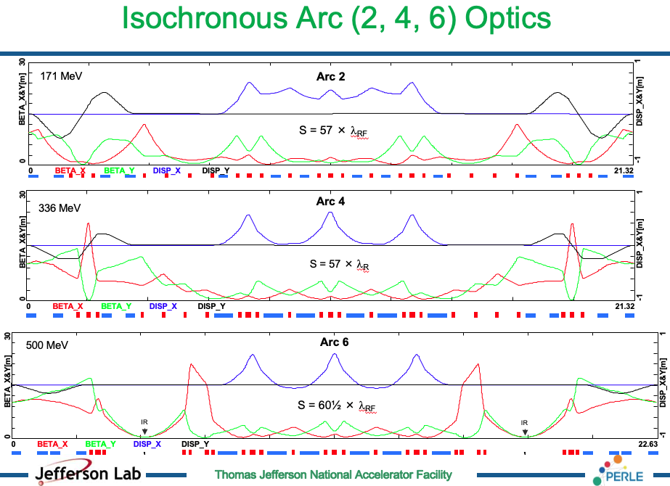
Challenges imposed by PERLE design and parameters
Lattice Design:
Courtesy to Alex Bogacz

Slide 21
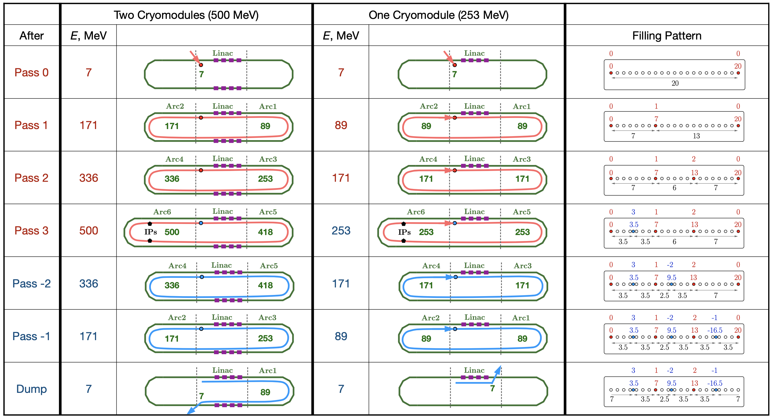
Challenges imposed by PERLE design and parameters
Lattice Design:
Courtesy to Alex Fomin

Slide 22
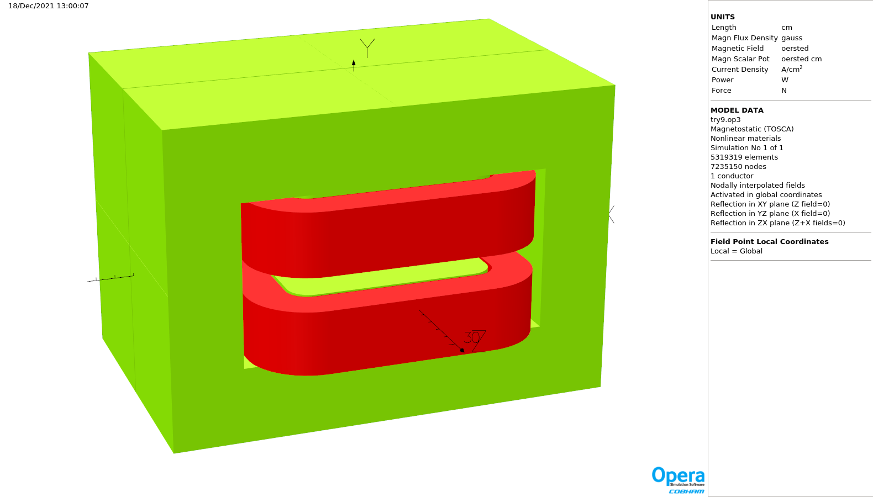
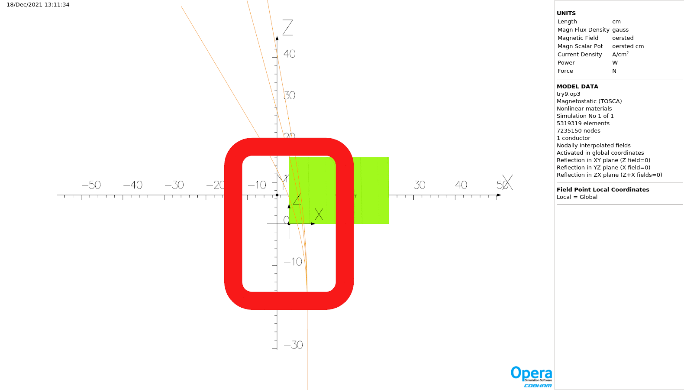
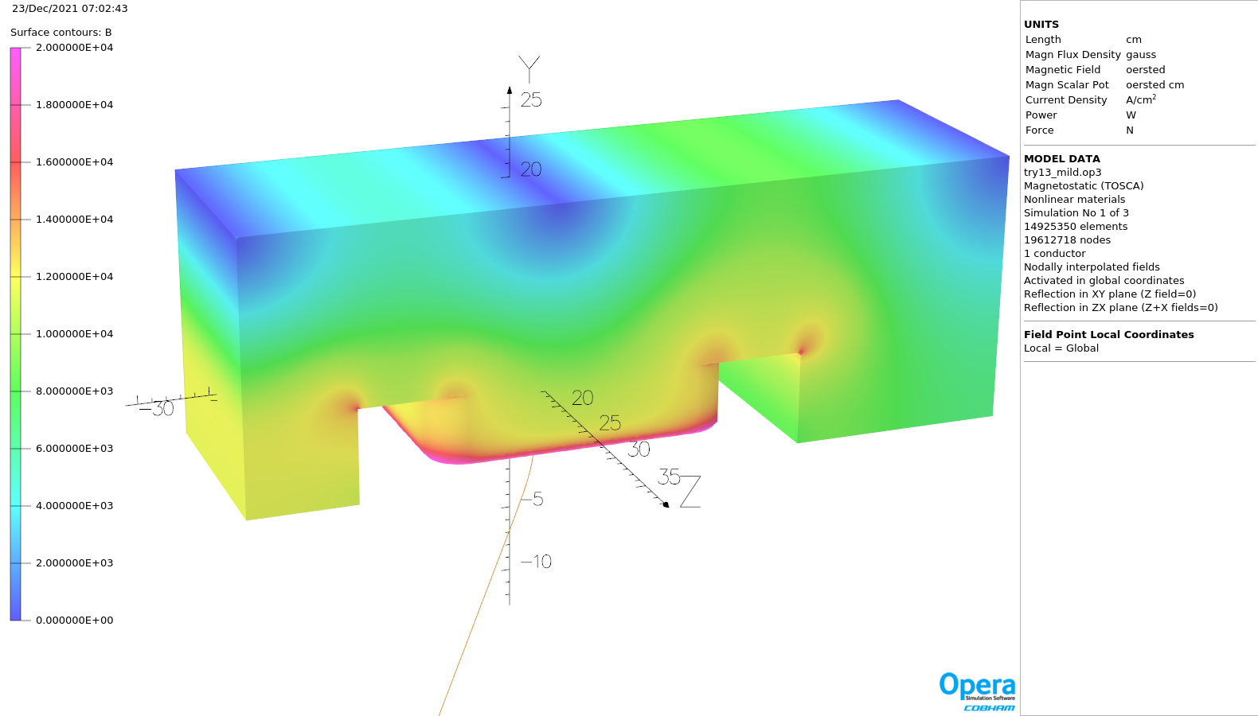
Challenges imposed by PERLE design and parameters
B-COM dipole:
Courtesy to J. Benesch
A design of a spreader dipole (B-COM dipole) was performed by Jay Benesch (JLab). The dipole is located at high energy arcs side (arc 2, 4, 6) to bend and separate three beams of 171.3, 335.6 and 500 MeV.
Homogeneity requirement 0.01% over an ellipse 2 cm high by 10 cm wide which follows the three beam paths
the magnet as a horizontal rather than a vertical bend.
Envelope as it will be installed in the spreader: width 340 mm, height 480 mm, steel length 320 mm, coil length 413 mm
Field on surface of 34 cm long model with mild steel BH curve, 397.4 A in coil. One fourth of model shown as symmetry was used to speed calculation. Orbit of 171.333 MeV electron shown.
Perspective view of horizontal dipole modelled.
Trajectories of the 171, 334 and 500 MeV beams through the model.
The conceptual design of the spreader dipole has been developed in sufficient detail to pass on to the final magnet designer. Field quality is an order of magnitude poorer than the specification but the quadrupole and perhaps the sextupole can be dealt with in the lattice.

Slide 23
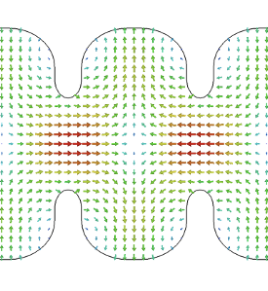
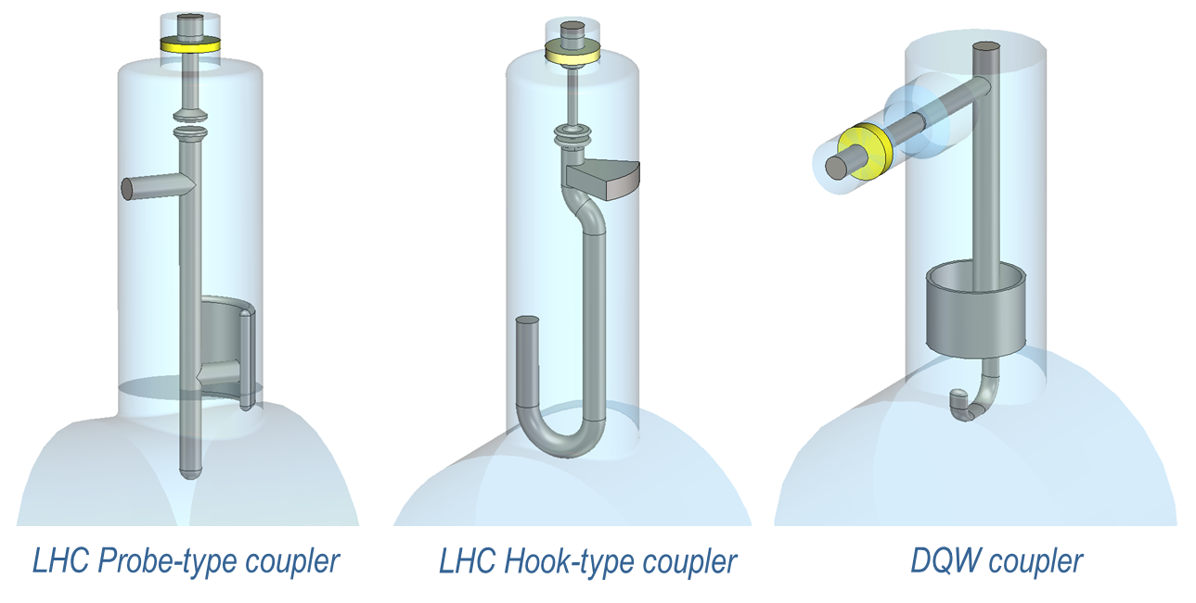
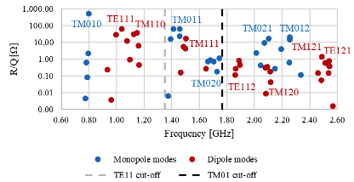
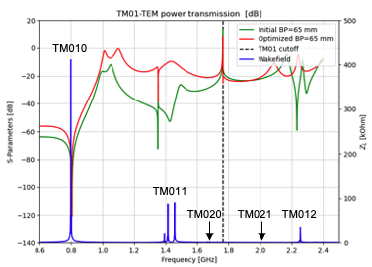
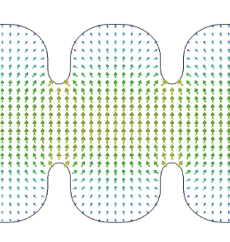
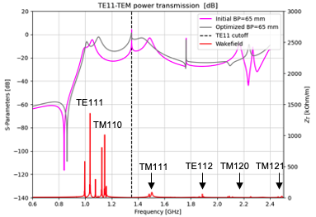
Challenges imposed by PERLE design and parameters
HOMs (High Order Modes): are parasitic excited modes in a resonant accelerating RF cavity, other than and with frequency greater than the operational mode (FM = Fundamental Mode).
Carmelo Barbagallo PhD work
TM011 mode
Identification of HOMs in PERLE cavity
Monopole HOMs:
Can lead to timing/phase errors and energy spread
Contribute to extra dynamic heat losses in cavity walls
TE111 mode
We consider as dangerous HOM all modes having high R/Q* (hypothesis R/Q >10 Ohm)
→ Need to be extracted from cavity & dumped by HOM couplers.
* R/Q represents the interaction between the beam & RF field inside the cavity. It depends only on cavity shape.
Dipole HOMs:
Can deflect the beam from its reference orbit: Unstable beam motion, transverse emittance growth, beam loss

Slide 24
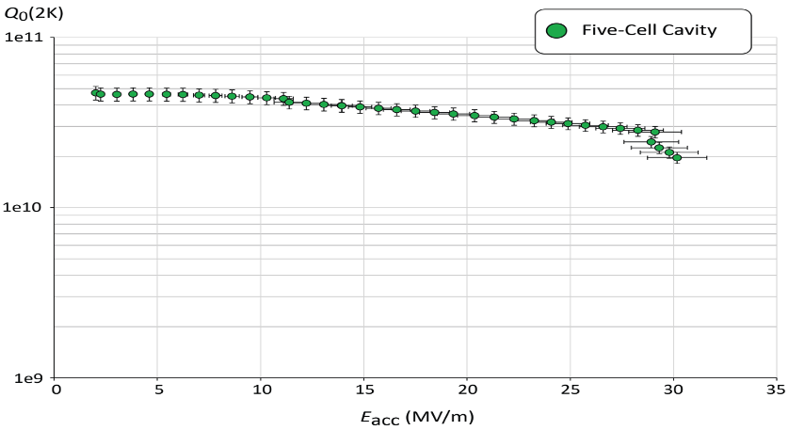
Challenges imposed by PERLE design and parameters
SRF Cavity:
Courtesy to F. Marhauser and R. Rimmer
PERLE Requirements | Impacts | Challenges | Possible Solutions
CW operation (RF) | High dynamic losses | The highest cavity Q₀ | Cavity post-treatment (Doping, infusion…)
High current operation | High HOMs excitation | Efficient HOMs extraction & damping | Act on cavity design: low frequency cavity choice (< 1GHz), larger cavity aperture, fewer cells for the a given gradient, optimisation of end-cell design.
Muti-bunches operation | Increase beam instabilities | The highest BBU threshold | Regular spacing of bunches: optimisation of the bunch filling pattern during Lattice design + BBU study after HOM optimisation (including collective effects).
Q₀ (2k) = 3 e10 @ ~27 MV/m
Quench @ E_{acc} ~ 30 MV/m
PERLE requirements
First Nb 802 MHz 5-Cell cavity fabricated at JLAB

Slide 25
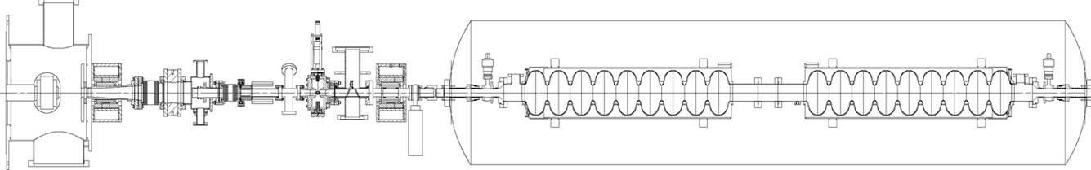

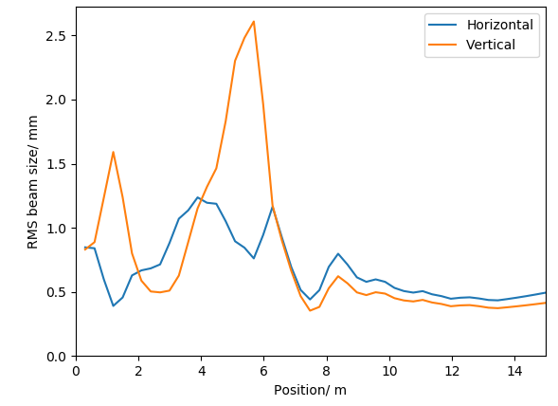
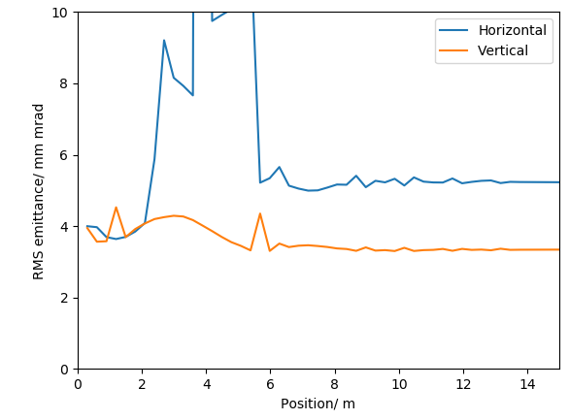
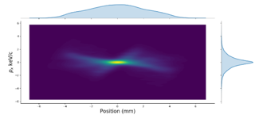
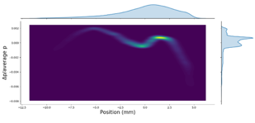
Challenges imposed by PERLE design and parameters
Injection line Optimisation:
Ben Hounsell (IJCLab/Liverpool) PHD
Energy spread
Electron source to booster exist optimisation:
The ALICE electron gun electrode geometry has been re-optimised for PERLE’s new requirements.
An optimisation with a 4 cavity booster linac, from the cathode to the booster exit, was done and meets the specification.
Photocathode gun
Light box
Buncher
SRF booster
Focusing solenoids
Transverse beam size and emittance
 | Achieved values | Specification
Horizontal emittance | 5.23 mm mrad | < 6 mm mrad
Vertical emittance | 3.34 mm mrad | < 6 mm mrad
Bunch length | 3.22 | 3 mm
Kinetic energy | 86.1 MeV | 88.6 MeV
Horizontal beta function | 7.89 (mismatch 8.3 %) | 8.6
Horizontal alpha function | -0.74 (mismatch 11.6 %) | -0.66
Vertical beta function | 8.76 (mismatch 1.8 %) | 8.6
Vertical alpha function | -0.67 (mismatch 1.5 %) | -0.66

Slide 26

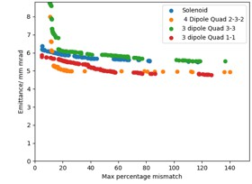
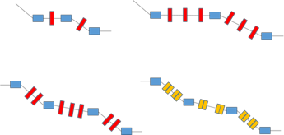
Challenges imposed by PERLE design and parameters
Injection line Optimisation:
Ben Hounsell (IJCLab/Liverpool) PHD
The PERLE Merger design:
The merger is the beamline which transports the beam into the main ERL loop.
The merger presents significant opportunity for emittance growth:
  Longitudinal space charge force induced shift in the dispersion
  Potentially asymmetric emittance compensation.
There are a wide range of possible designs and several were studied.
Generally shorter and smaller bending angles is better
4 dipole schemes were investigated as they have the potential to mitigate the effects of space charge on the dispersion and the consequent emittance growth.
Merger schemes investigated:

Slide 27
Challenges imposed by PERLE design and parameters
Diagnostics and beam instrumentation :
Beam in ERLs: combination of the very high average beam power (similar to synchrotrons) and non-equilibrium (non-Gaussian) nature of beams with small transverse and longitudinal emittances (similar to high-brightness linacs) → Need of routine beam profile measurements with a high dynamic range.
ERLs must operate with multiple beams of different energies transported in the same beam-lines (6 different beams at 3 different energies in case of PERLE) → Require specific monitoring systems capable to deal with multiple beams needs (BPMs, BAMs…).
Different beam modes have to be well defined for the following operation phases: the machine setup, average-current (power) ramp-up, and high-power operation. For ERLs, the difference in the average beam current between the tune-up mode and the high-power mode is typically of some orders of magnitude → Necessity of high dynamic range measurements.
For ERLs, local beam losses with an average power of about 1 W are an issue that cannot be ignored.
→ Comparing this level of beam loss with the average beam power (10 MW for PERLE) shows again the necessity of high dynamic range beam measurements (Typically of 10⁶).

Slide 28
Challenges imposed by PERLE design and parameters
Diagnostics and beam instrumentation :
Intercepting and Non-intercepting Measurements
Transverse beam profile
Twiss parameters
Transverse Emittance
Projected energy spread
Beam Halo
Longitudinal phase space
M₅₅ (based on BAM) non-intercepting but very invasive
Beam current / Bunch charge (feedback)
Bunch length measurements On-line (feedback)
BMP system (orbit, energy measurements / feedback)
Beam arrival time measurements
Beam Energy Measurements (BPM based)
Transverse beam profile (Synchrotron Radiation Monitors)
Projected energy spread (Synchrotron Radiation Monitors)
Beam Loss Monitor system (separate story)
- Critical parameters,
- High accuracy,
- Require intercepting techniques,
(cannot be done by non-intercepting methods without major developments)
- Required for feedbacks
- Non-intercepting
- Full power mode and
diagnostic mode
- Monitor critical parameters
during ramp up and operation
- Can be used for feedbacks
- Non-intercepting

Slide 29
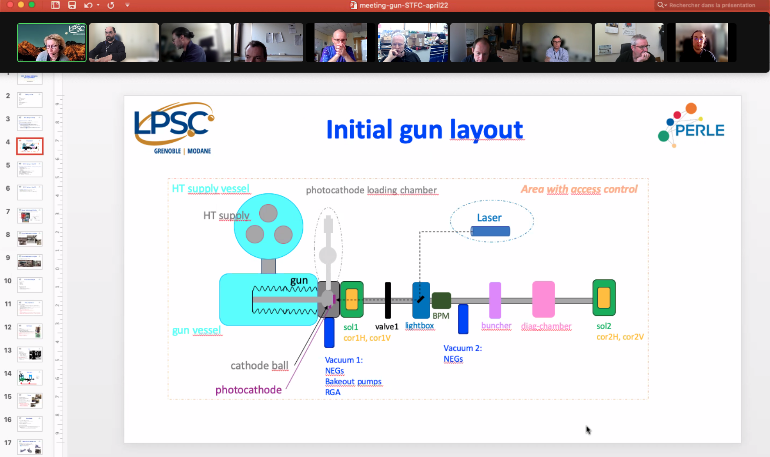
e- Source: Scope and progress
Scope for the TDR phase: re-install and operate the DC-gun with the Alice parameters and first studies of the DC gun upgrade
Participants/contact persons from STFC
Rachael Buckley : radiation protection, site management
Ryan Cash : mechanics engineer, design of upgraded ALICE gun, prep chamber
Andy Goulden : operation manager, SF6 infrastructures, radiation safety
Lee Jones : photocathodes, drive laser, HV conditioning and commissioning
Keith Middleman : vacuum expert, excused for the meeting
Boris Militsyn : gun coordinator, primary contact
Rob Smith : HV engineer, operation of HV supply
Contact person from CNRS/IN2P3
IJCLab-Orsay
  A. Gallas : mechanical engineer
  W. Kaabi : PERLE project leader
  D. Reynet : PERLE system engineer
  S. Wurth : IJCLab safety engineer
LPSC-Grenoble
  M. Baylac : gun assembly coordinator
  E. Labussière : HV power supply

Slide 30
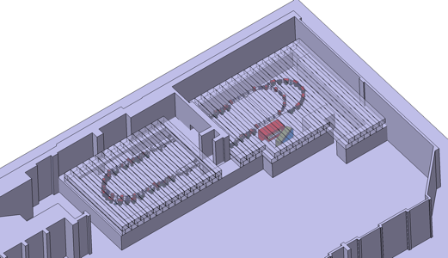
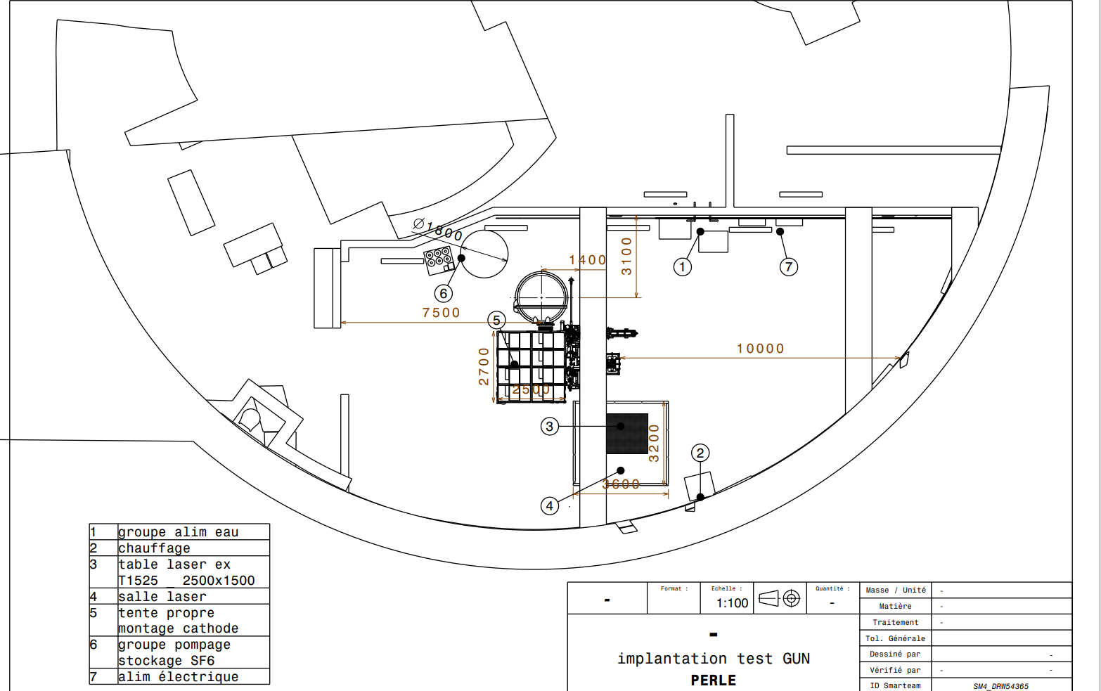
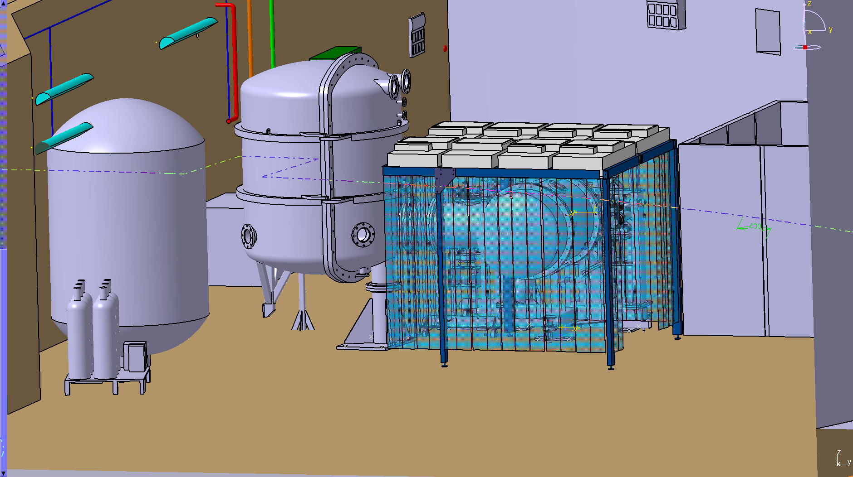
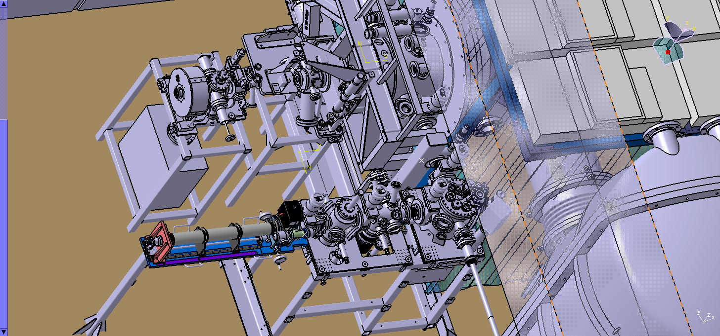
Infra. & Syst. Integration: Scope and progress
Scope for the TRD phase:
Implementation of the DC gun in IGLOO.
Preliminary studies of the site (Super ACO Hall): Geometrical report^{(*)} with the dimensions of the hall and underground, existing wall thickness and composition, ground load capacity, state of existent technical galleries around the hall…
Definition of infrastructure work needed.
Study of machine + experiments integration scenario
Study of ancillaries integration.
^{(*)} Service financially supported by « Service du patrimoine” of the university.

Slide 31
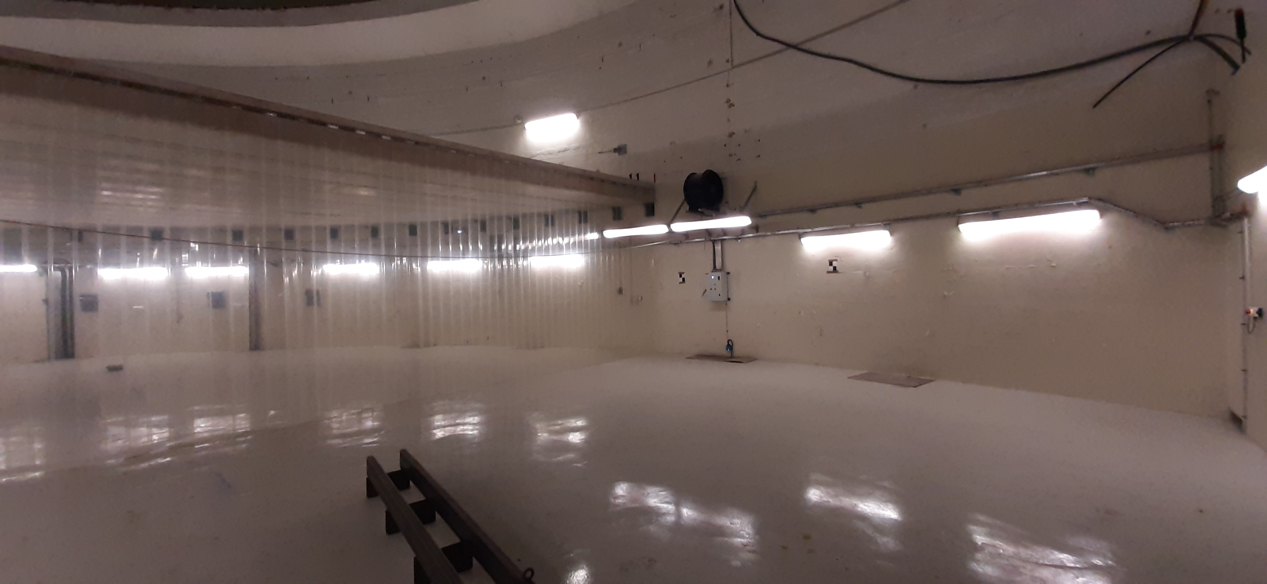
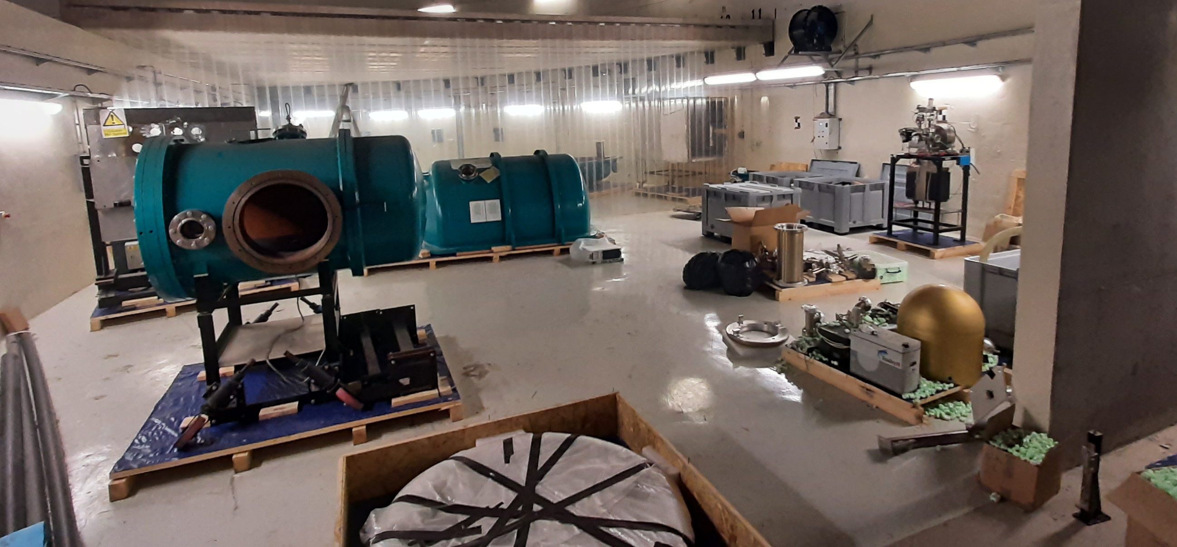
Infra. & Syst. Integration: Scope and progress
DC GUN in the IGLOO AREA – March 2022

Slide 32
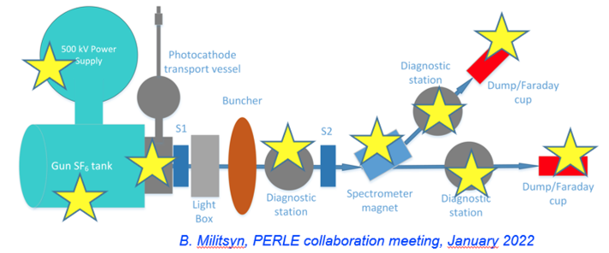
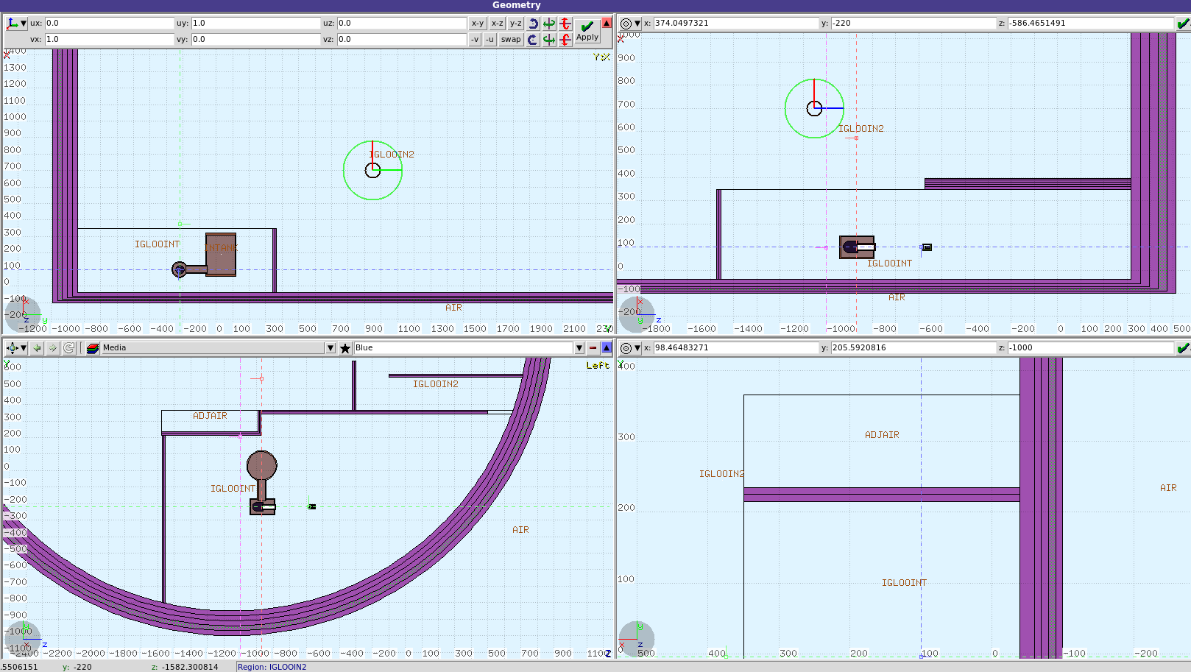
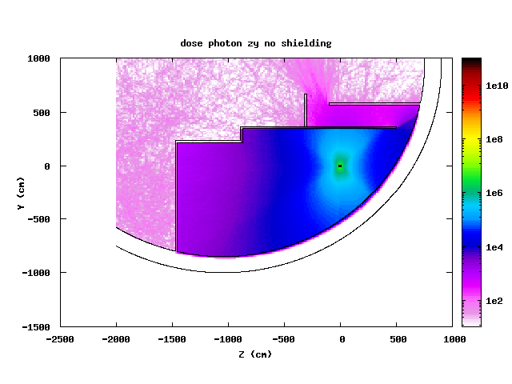

Safety & radioprotection: Scope and progress
Scope for the TRD phase:
ASN study to define the administrative regime of the PERLE Facility (Planning to be set up):
  Radioprotection calculations and shielding dimensioning.
  Study of the beam loss scenario and definition of mitigating solutions and required interlocks (preliminary study by IRSD available, to be refined)
Radioprotection study of the DC gun implementation in IGLOO (planning included in WP3-DC gun timeline):
  Bibliography and documentation gathering about the Daresbury DC gun.
  Definition of possible interaction points with beam to cover all the hypothesis of radiation leak
  Redaction of the authorisation request to ASN.
Arcing or total/partial beam loss to consider

Slide 33






Few words of organisation. PERLE Collaboration & PERLE- France
PERLE international collaboration
A collaboration agreement (CA) signed by all partners.
The bilateral ICRADA DOE- JLab with CNRS is still pending in DOE for signature.
Position of Budker Institute of Nuclear Physics → Participation suspended (Discussed in the last Collaboration Board Meeting: 28/04/22)
New request of An-Najah University - Palestine to joint the collaboration: Agreed by the Collaboration Board → Formal inclusion soon.
We are currently discussing with colleagues from Helmholtz Zentrum Berlin (HZB) and Darmstadt University to define a framework for a collaboration between PERLE and their ERL projects: bERLinPro and DICE.
PERLE in France. Important News
  IN2P3/CNRS National Strategy (end of 2021): Perle@Orsay a priority for accelerators in line with the ESPP
  Project submitted to the recovery plan for 2022 (financial support for phase 1 of PERLE). Ministry response is asking us to resubmit in next phase (June 22) together with SUpra2030 project. Work on going, timely followed by IN2P3 and led by Maud Baylac
  PERLE infrastructures will benefit of the CPER2 funding (2M€ available from 2022) (programming phase to be started soon)
  New Organization in France and significant increase of people involved

Slide 34
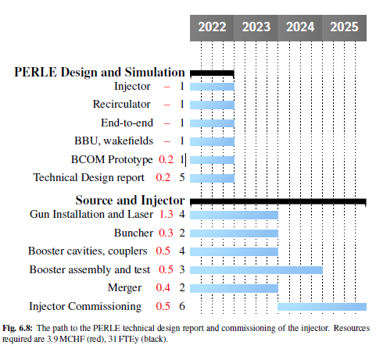
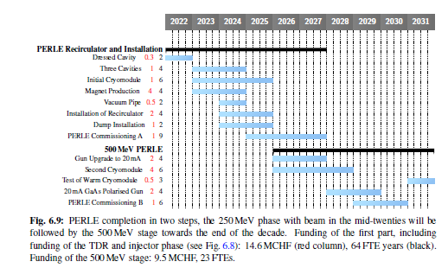
Some words on the global context.
Some preliminary planning : 6 years for PERLE 250 MeV
It was shown as explicitely required in the Accelerator RoadMap at the CERN Council in December 2021
We concentrate on TDR phase
*The international collaboration preferred for the time beign to keep this schedule for the TDR. Discussion done at the CB and on going.

Slide 35

Project Organisation: PERLE Collaboration & PERLE- France
PHD student (ending now) injection lines : Ben Hounsell (100% PERLE)
PHD student (2nd year) on RF/HOM/cavities : Carmelo Barbagallo (100% PERLE)
PHD student (1st year) on Beam Dynamics : Coline Guyot (50% in PERLE)
Postdoc (beam dynamics) Alex Fomin
5 months interns (Magnets/beam dynamics)→PHD thesis 2022:Rasha Abukeshek
From Jul 2022
  Postdoc (Injection line) Joshua Yoskowitz
From Oct. 2022
  Permanent CRNS position (beam dynamics) Julien Michaud
  PHD thesis Liverpool/AsTec/IJCLab (injections) Connor Monaghan
Denis Reynet System Engineers (IJCLab)
Luc Perrot Beam Dynamics (IJCLab)
Maud Baylac Gun Installation and Operation (LPSC)
Guillaume Olry RF System (IJCLab)
Patxi Duthil Cryogenic (IJCLab)
Hadil Abualrob Magnets (An-Najah / IJCLab)
Sébastien Wurth Security Issues (IJCLab)
Marc Langlet Infrastructures (IJCLab)
Bruno Mercier Vacuum System (IJCLab)
ALL in ALL many new join PERLE
We have finalised an internal organisation in France led by two laboratories: IJCLab/LPSC.

Slide 36



Ressources needed for TDR
We are actively entered in the TDR phase. ~50 people involved.
The Manpower (~10FTE (2022) →~15FTE (2023) summarised here has been discussed with the Services/Departements (IJCLab, LPSC). Compatibility with the other activites has to be still precisely evaluated.
Financial Support Requets for the TDR phase. Including the mounting of the DC gun
Financial support (~800k€) requested is summarised here.. « External » sources
  CDD/PHD (IN2P3, EU, ED)
  For equipment (IN2P3, CERN, Cremlin+ EURIZON)

Slide 37
Project Organisation: Meetings & reporting
PERLE Meetings
Weekly Wed-meeting of PERLE-France Management Board (PF-MB) : with RS,RT,IS,WP leaders
PERLE-France Collaboration Meeting (PF-CM) initiated. First held in April. Frequency every 3 months
We restart soon (frequency every 6-7 weeks) the PERLE- International Management Board (PI-MB) same as PF-MB including also the international WP leaders
2 to 3 annual PERLE- International Collaboration Meeting (PI-CM). One already held in Jan. 2022, the second is foreseen for October 2022.
2-3 annual PERLE Collaboration Board Meeting (CB): With representative of each collaboration members.
Meetings between PERLE and tutelles
COPIL created at IJCLab to follow the project progress and for the decisions taken by the IJCLab direction (without Achille)- including Fadi Ibrahim, Sébastien Descotes-Genon (president), Nathalie Arlaud, Valérie Chambert, Sébastien Bousson, David Verney, Jean-François Le Du, Tomas Junquera : (ACS), Frédéric Chautard. 1st PERLE COPIL Meeting (02 June)
Master Project PERLE exists at IN2P3 and periodic discussions are held to report on the project progress, further steps and resources allocated and still needed.
CODEC : IJClab revue for 2022 and 2023 founding and RH requests (11 Mai).
Project PERLE (IN2P3) for 2022 and 2023 founding and RH requests (24 Mai)
NEXT TO COME :
Scientific Council IJCLab (fall 2022), also at Scientific and Strategical Council (CSS)

Slide 38
Conclusions
ERL machines open a new frontier for the physics of “the electromagnetic probe” (ep, eA, eN). PERLE@Orsay is a key ERL project for HEP and Nuclear Physics communities
PERLE@Orsay has been recognised (together with BerlinPRO) an essential pillars of the ERL ESPP strategy. It combines high current and multi-passes (high luminosity / higher energy)
PERLE@Orsay is a very challenging machine : RF CW operation, specific SFR systems, multi-bunches operation, high power machine, complex Lattice design, broad range diagnostics, beam dynamics...
The International collaboration is formed and still opened to new comers.
Important boost in the last 9 months in France (IJCLab and LPSC) and we are actively entered in the TDR phase.

Slide 39
Thank you for your attention!
MESA ERL simulation©

