Slide 1

Laser electron interaction
in accelerators
Manar Amer
IJCLab - University Paris-Saclay
An Najah National University

Slide 2
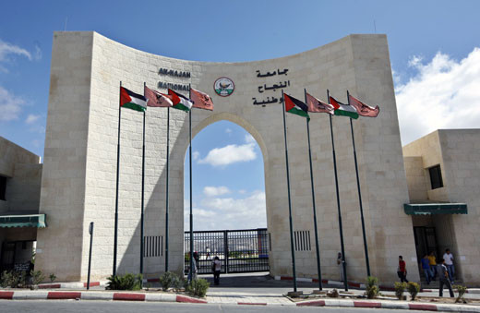

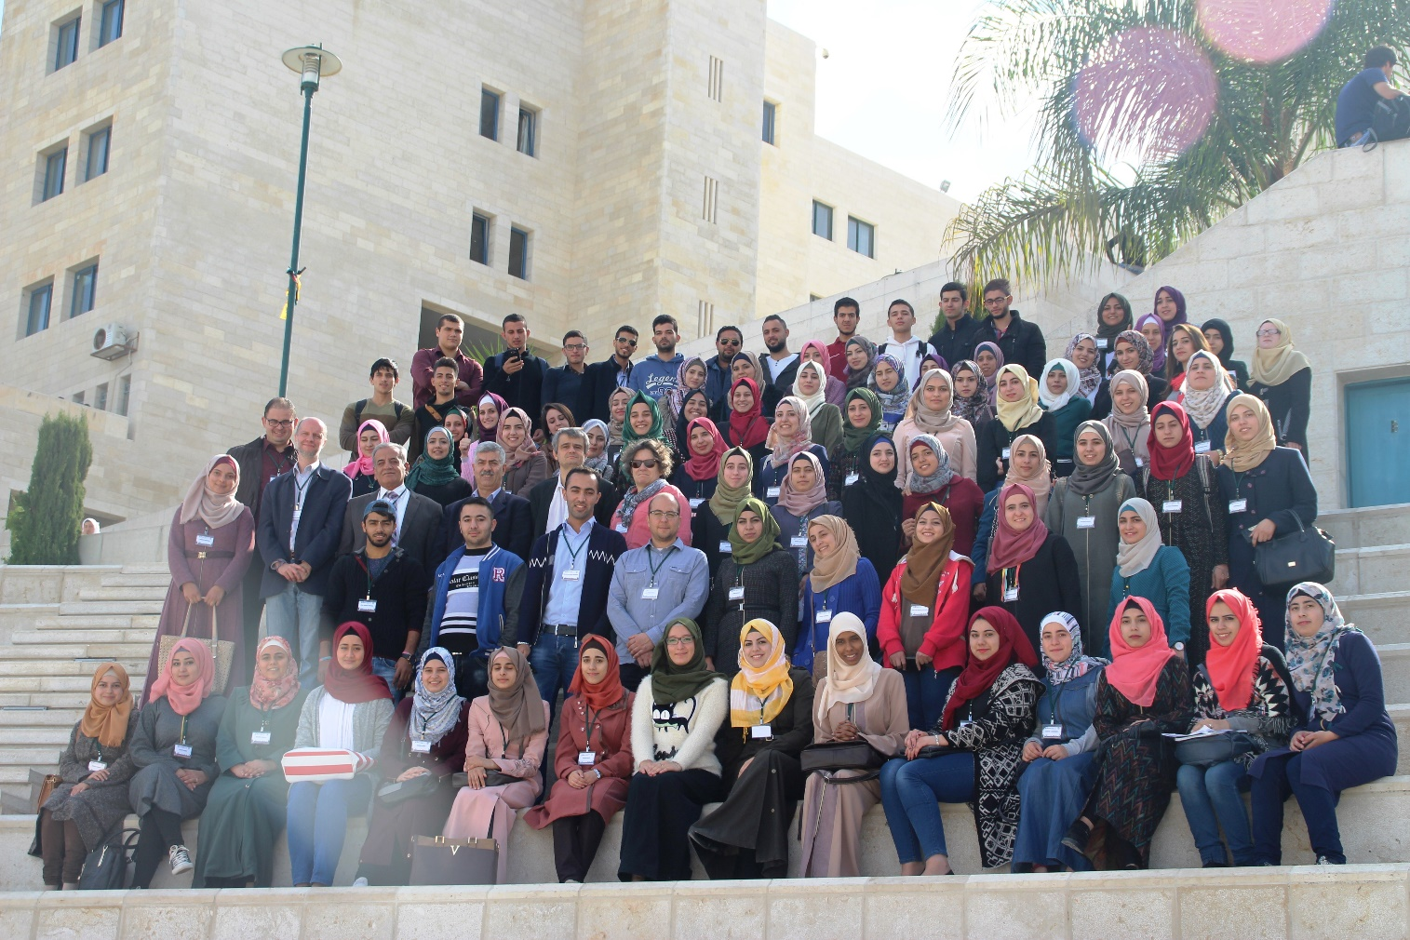
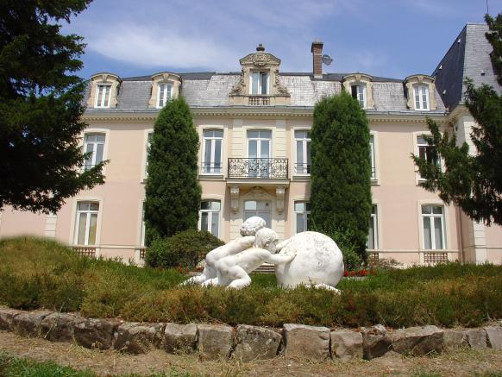
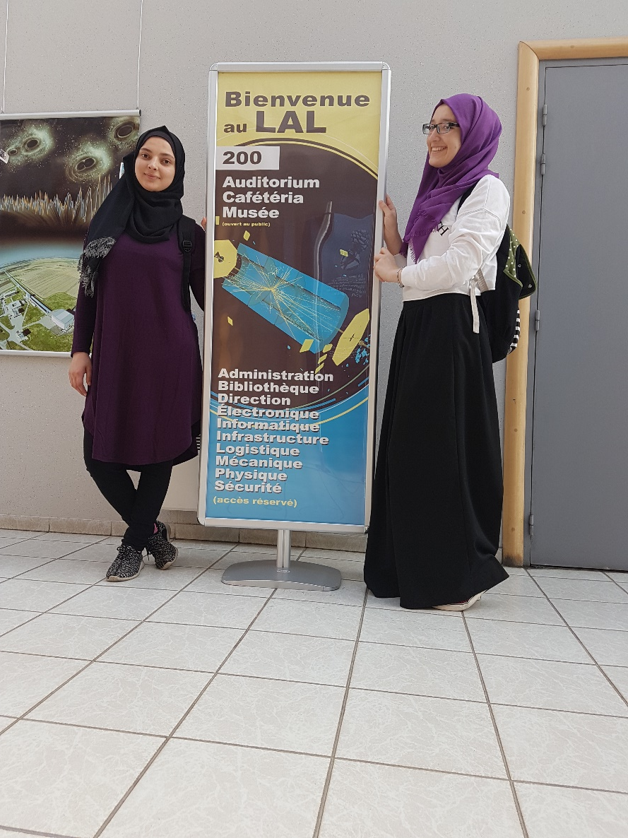

Timeline
An Najah University
An Najah University
Graduated 3 top of class
Worked as Teaching Assistant for a year
Start of Joint PhD supervision
Prof. Hadil ABUALROB
Worked as lecturer for a year
2016
2017
2018-2019
2020
2021 - Now
WISHEPP I
13 – 17 November
Paris Saclay University
Paris Scaly University
Master NPAC
Preparing Thesis @ IJCLab
Prof. Fabian Zomer
& Daniele Nutarielli
Last year of Bachelor
Intrnship @ IJCLab – LAL
First Fruits of WISHEPP

Slide 3
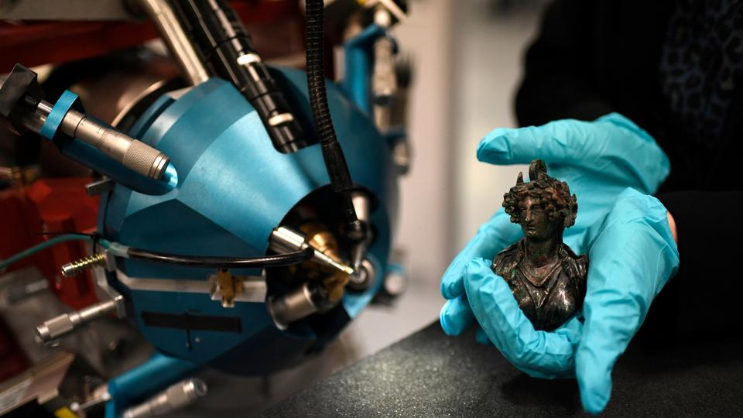
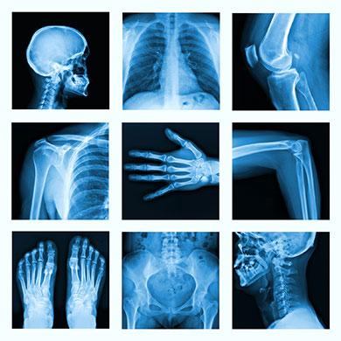
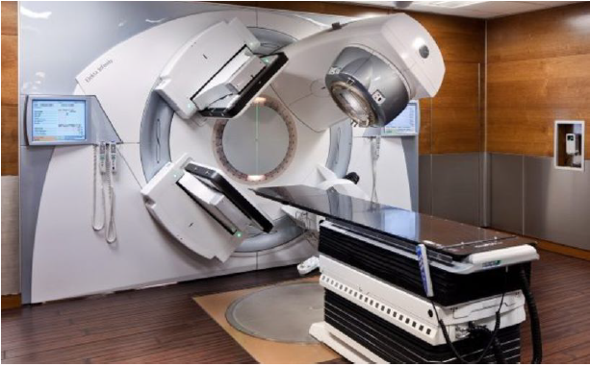
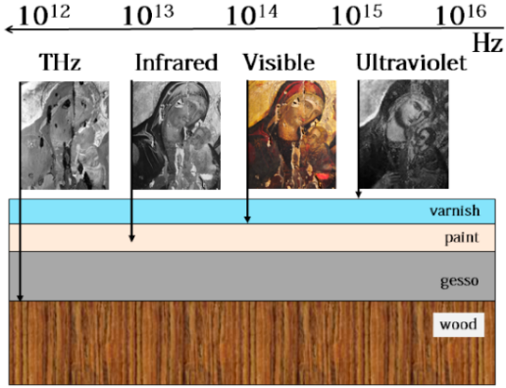
Motivation ( X-ray )
Hospitals
Medical Imaging and targeted cancer therapy
Accélérateur Grand Louvre d'analyse élémentaire (AGLAE)
Museums
Imaging cultural heritage
Louvre museum

Slide 4
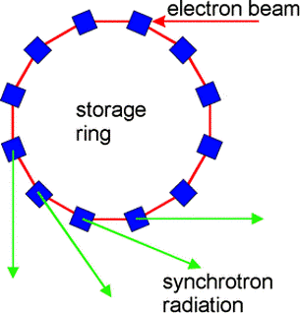
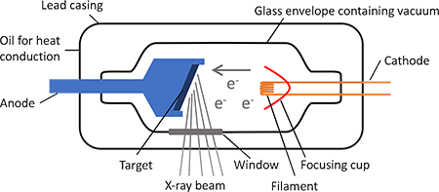
X-ray Production
ThomX as X-ray source
Inverse Compton scattering light source
Synchrotrons
A storage ring for high relativistic electrons
X-ray tube
a vacuum tube that converts electrical input power into X-rays
small in size to place in hospitals
Low cost ~ 100 K euros
Good enough for general imaging
Very Huge facilities
High cost > 300 M euros
Higher energy and brilliance
Wider range of research
Compact 300 m^2
Medium cost ~ 10 M
High brilliance

Slide 5
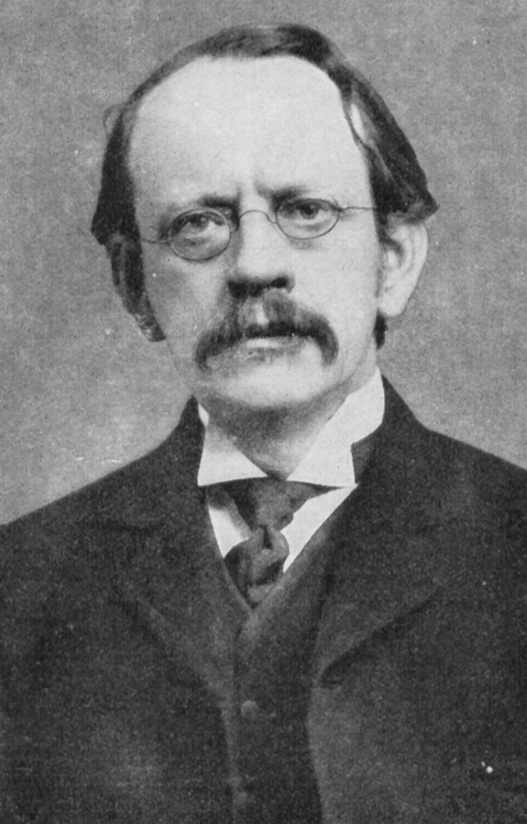
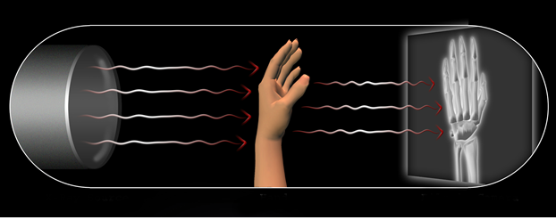
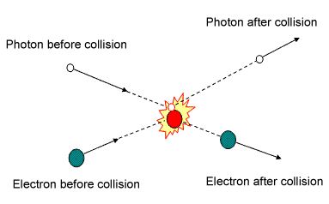
Introducing ThomX accelerator
ThomX accelerator
speeds particles
Joseph John Thomson
X-ray waves
    High penetration → imaging objects
    higher energy → targeted therapy
    Scientific Research
Thomson Scattering
Laser – electron Interaction

Slide 6
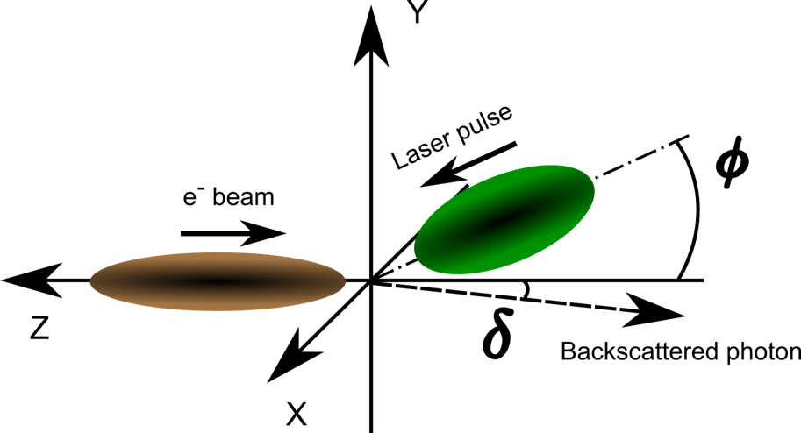
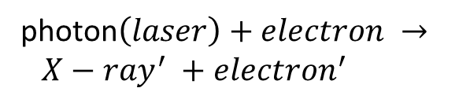
X-ray Production @ ThomX
X-ray s
photon$\left(laser\right)+electron → {X−ray}^{′} +{electron}^{′}$
My work in here

Slide 7
Injecting photon into optical cavity
Oscillator

Slide 8

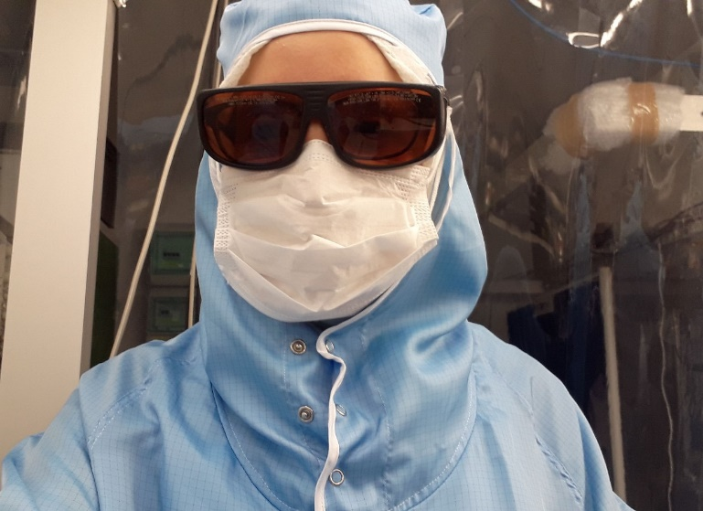
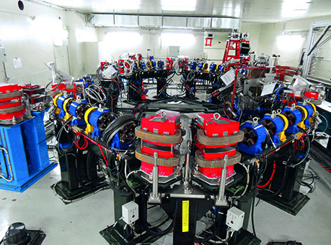
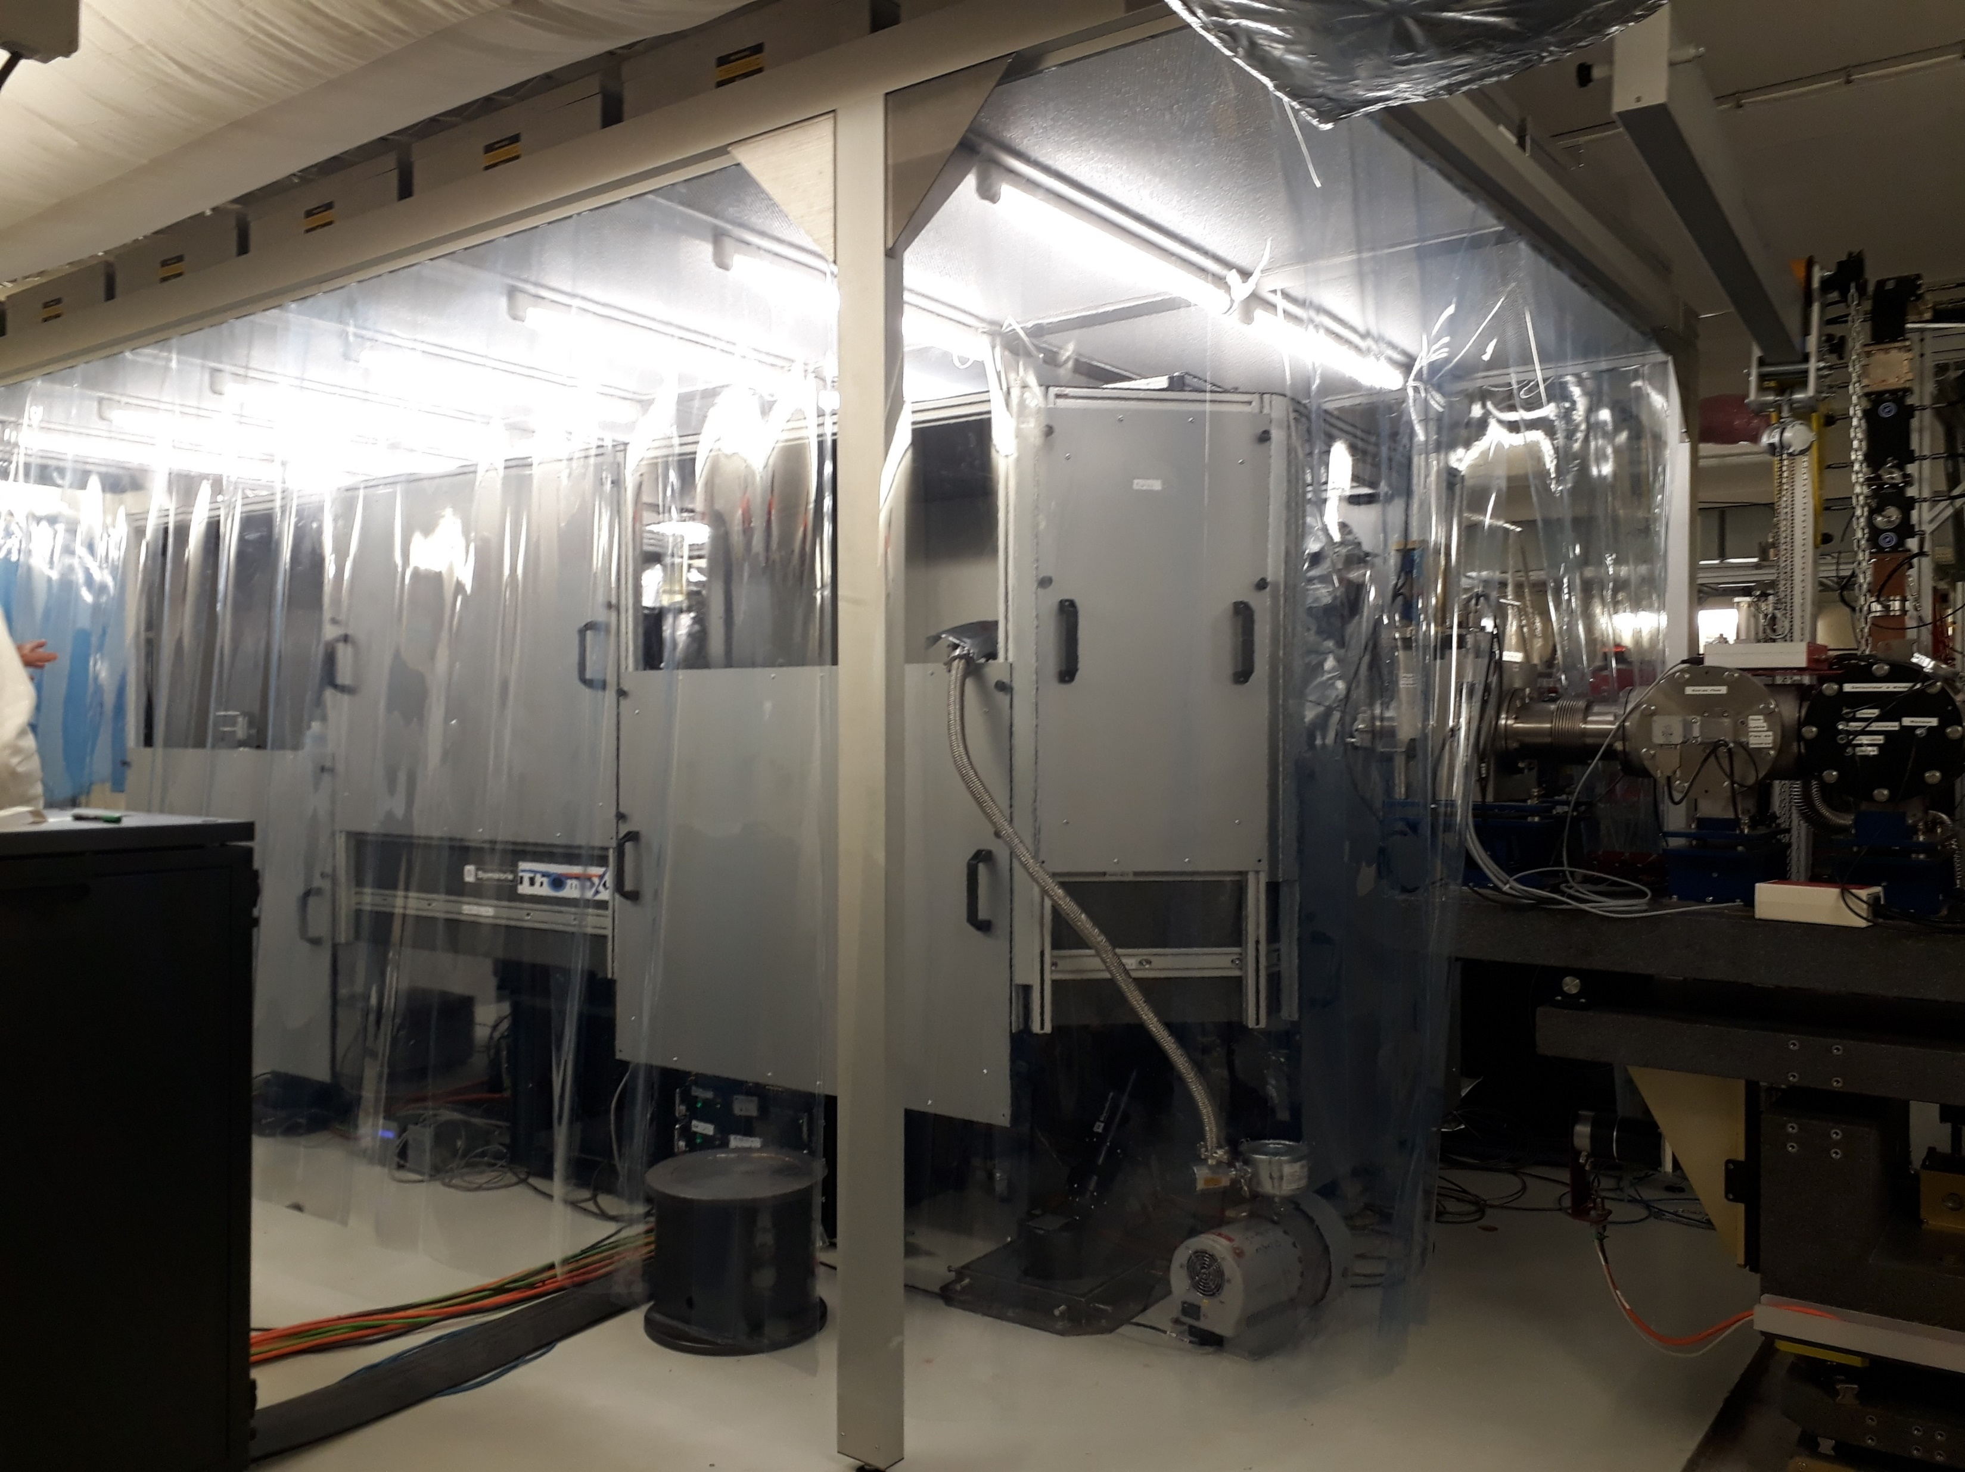
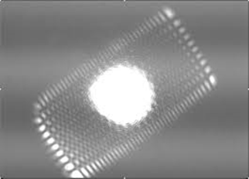
PhD Work – Preparing Photon

Slide 9
Thank you
for your attention

Slide 10
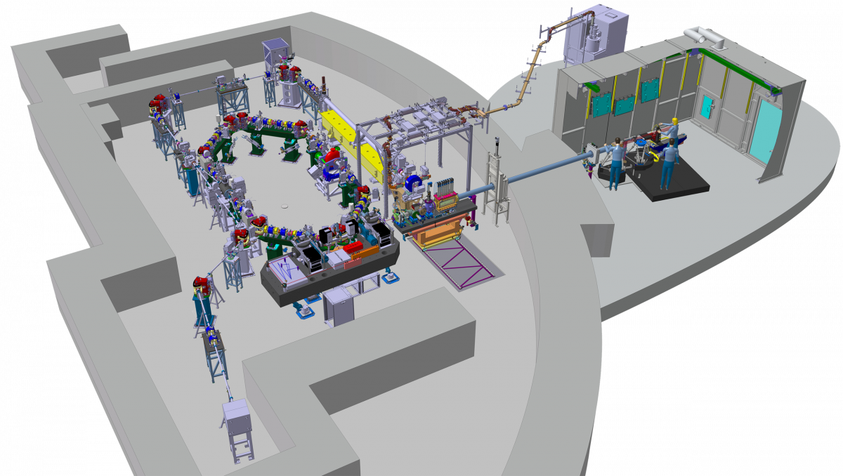

ThomX Bunker
Compact 300 m^2
Medium cost
High brilliance

