Slide 1
Design of the FCC_ee positron source with the proof-of-principle experiment at SwissFEL facility at PSI
Fahad A. ALHARTHI
IJCLab
01/02/2022 – 31/01/2025
Supervised by :Iryna Chaikovska, PhD
IJCLab

Slide 2
General context of the PhD
Studies on the high intensity positron sources for HEP
Physics design of the positron source of the Future Circular Collider (FCC-ee)
  Benchmarking our simulation tool with SuperKEKB
Start-to-end simulation and optimization studies for the FCC-ee positron injector.
Participation in different beam-tests at (MAMI, KEK, SwissFEL)

Slide 3
FCC-ee injector complex
Electron-Positron collider
~91 km
Pre-injector: e-/e+ linacs up to 6 (20) GeV, 1.54 GeV Damping Ring
Pre-Booster Ring (SPS or new ring) (6 - 20GeV)
Booster Ring (20 → 45 GeV)
The main 6 GeV linac feeds the positron source. The positrons are produced with 6 GeV e- beam
Booster ring
electrons
positrons
Pre-Injector
0.5 - 1 km
SPS, ~ 7 km
Notes:
FCC injector complex is composed of the so-called pre-injector, PBR and BR. The pre-injector consists of the e-/e+ linacs and DR. There are 2 options. The first one is based on the 6 GeV linac. Then the e- or e+ beam is injected to the pre-booster ring, where it is accelerated to 20 GeV and later it is injected to the main booster.
Another option implies the use of 20 GeV linac to provide the direct injection to the main booster.
Taking the baseline option, the main 6 GeV linac feeds the positron source. The positrons are produced with 6 GeV e- beam.
For the 20 GeV option, it is currently assumed that the e+ are generated at 6 GeV but certainly the higher drive beam energy is possible in this configuration

Slide 4
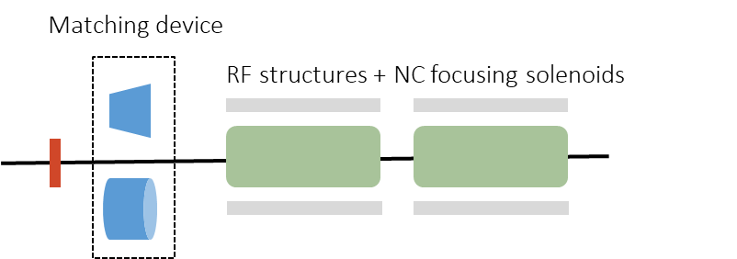
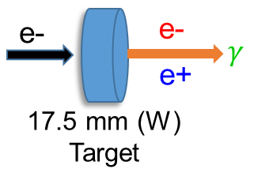
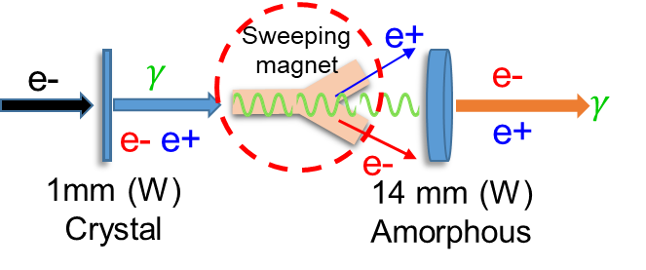
FCC-ee pre-injector layout
Positron source
Capture system
Conventional
Hybrid
Bremsstrahlung radiation Pair production.
Coherent radiation emission Pair production.

Slide 5
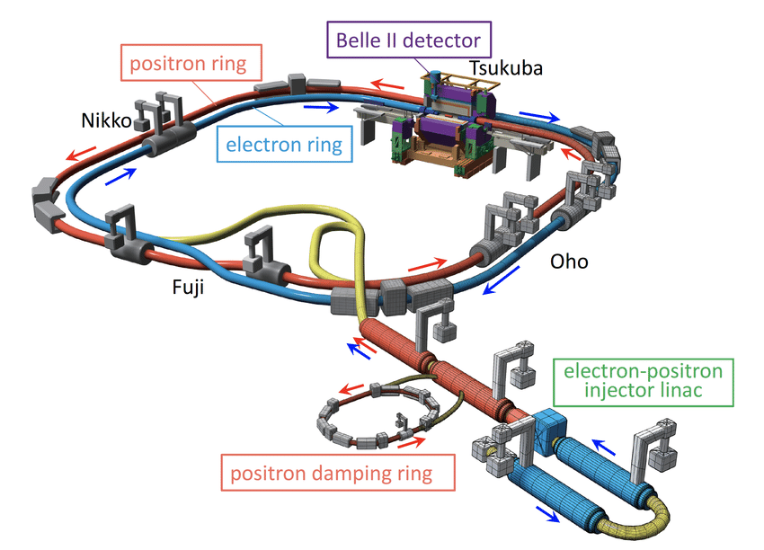
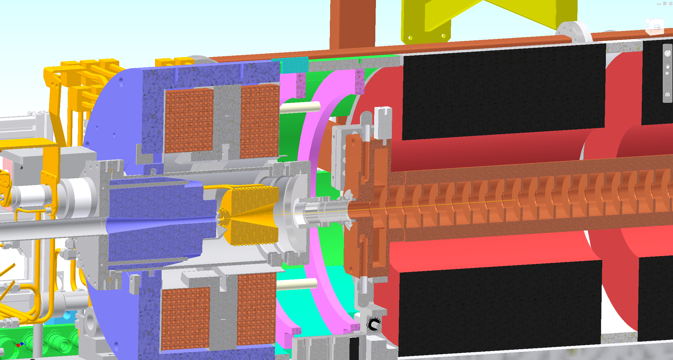
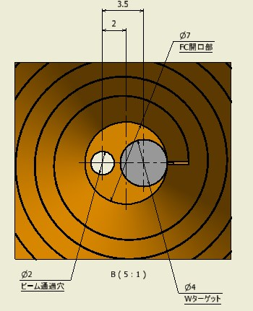
SuperKEKB positron source (currently in operation)
e- drive beam: 3.5 GeV, 2 bunches/pulse, 10 nC, 50 (25) Hz
The highest intensity positron source
BC (bridge coil)
LAS (large aperture S-band)
W target
FC (flux concentrator) head
solenoid
Positron source
1.1 GeV
Target material : W
Target size : Φ4 x 14
Inserted in the Cu block
hole
W
looking from downstream side

Slide 6
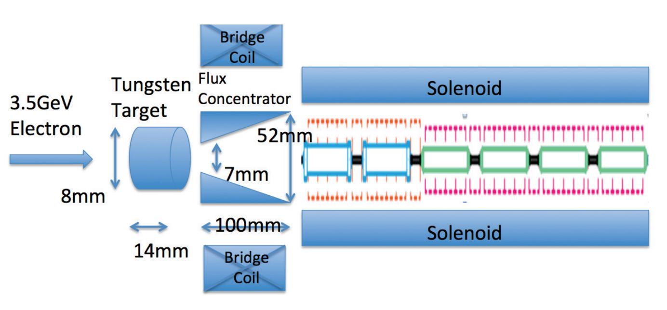
Benchmark of the FCC-ee code with SuperKEKB positron source
Initial particles GEANT4
Magnetic field
(FC,BC,DCSs) CST(provided*)
Tracking
RF-Track
Accelerating structure Superfish (provided*)
*Field maps are provided by SuperKEKB

Slide 7
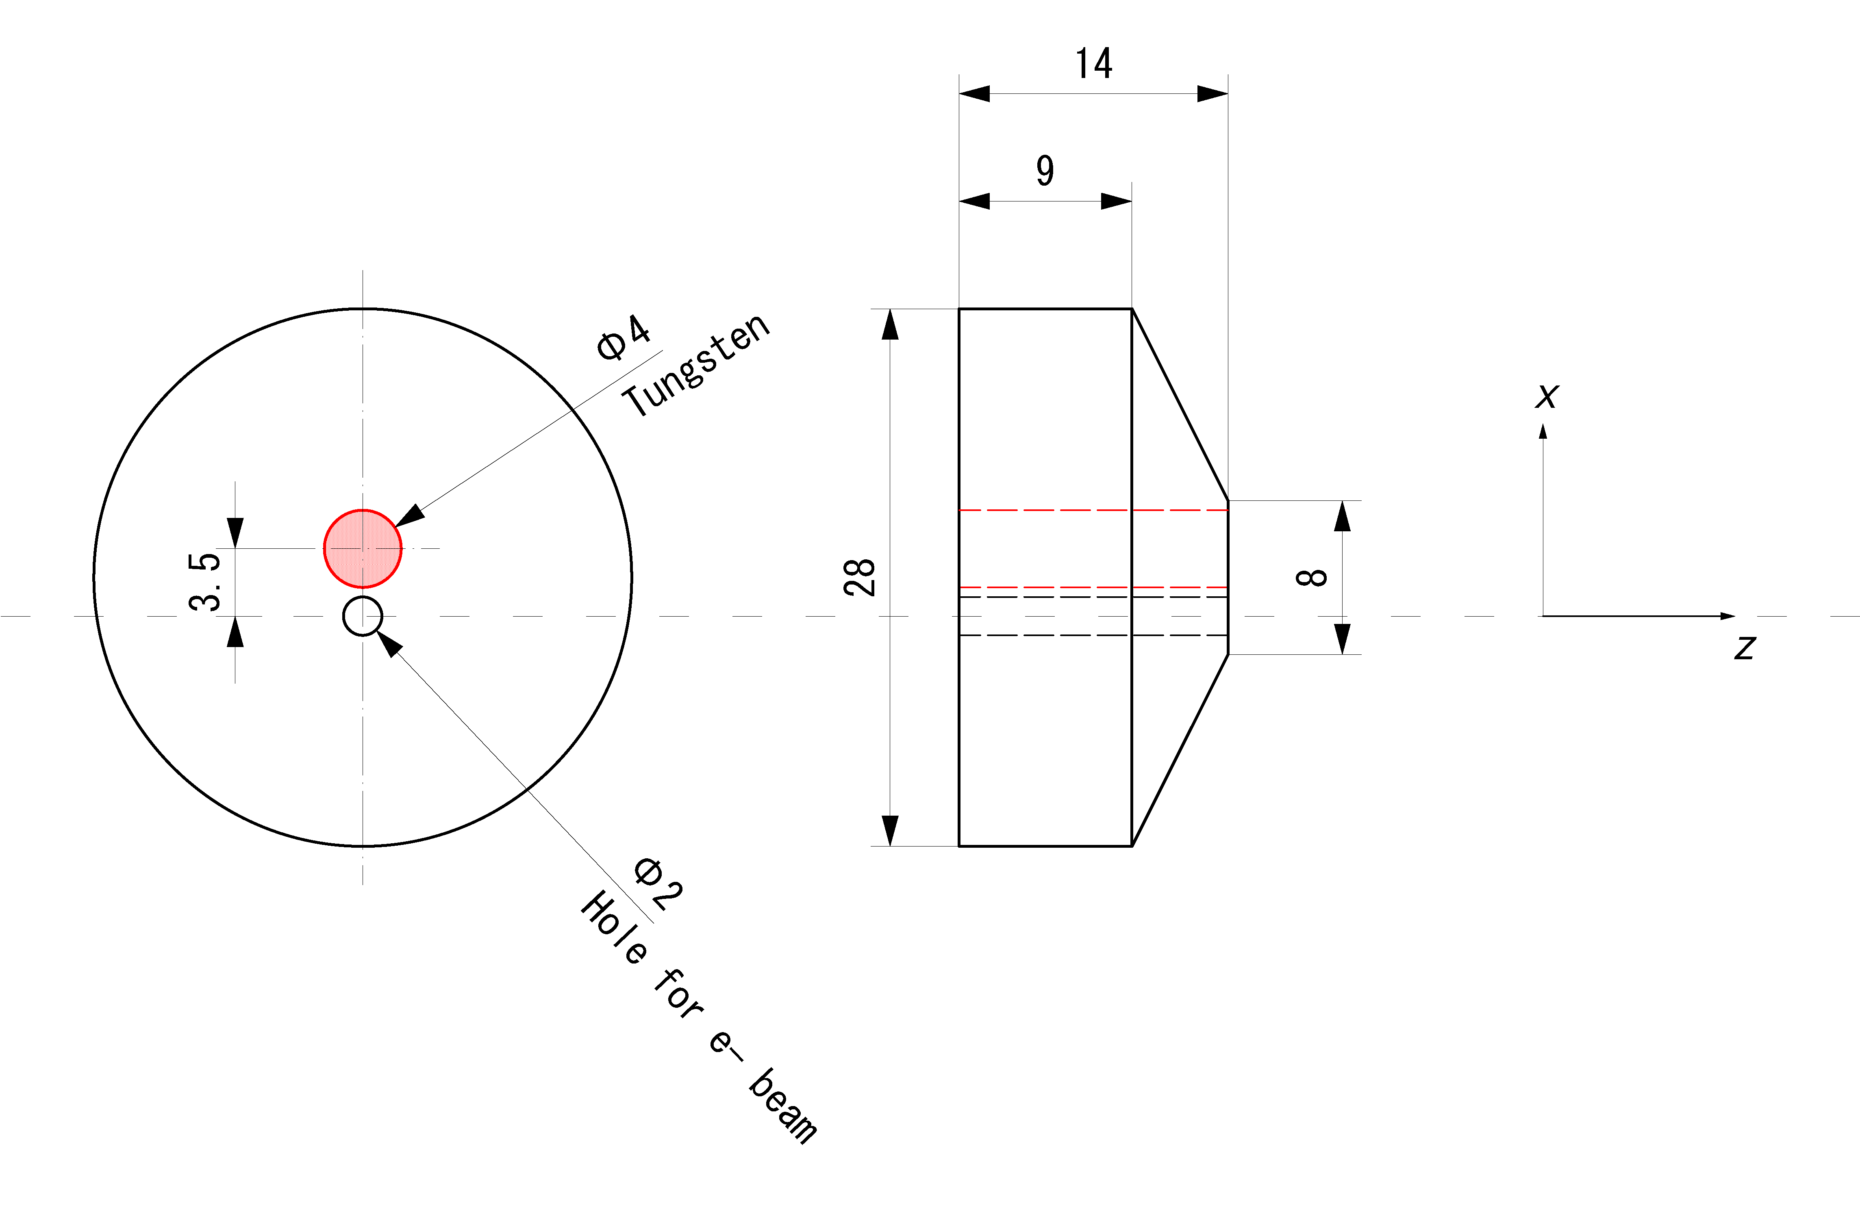
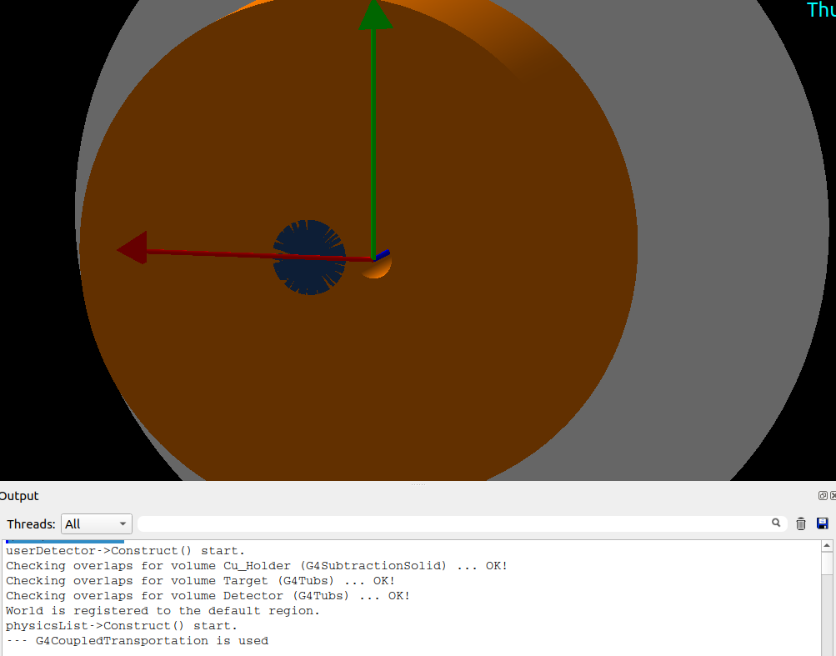
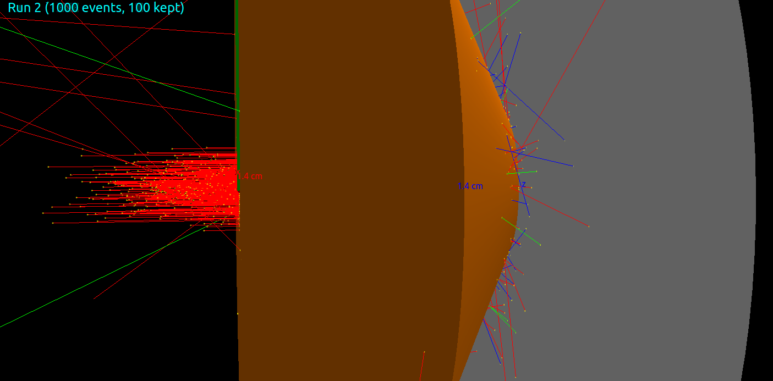
Benchmarking with SuperKEKB: target implementation in Geant4
Target geometry :
Detector
Cu_Holder
W_Target
e-_Hole
Overlap checking

Slide 8
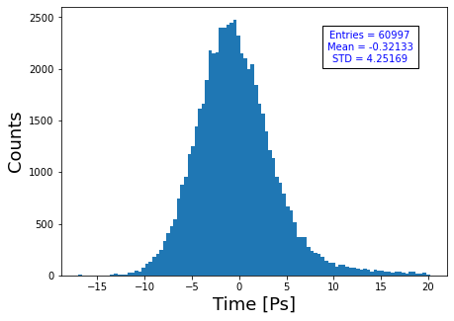
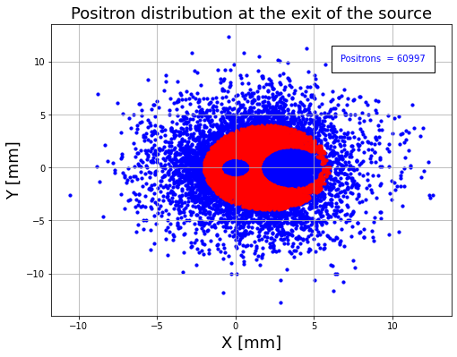
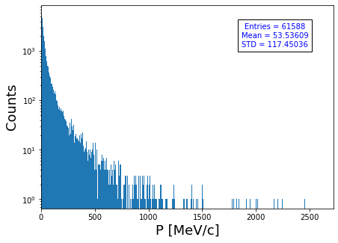
Positron beam production (after the target )
Positron beam :
W => 61%
Cu => 39%
Positrons :
N(e+)/N(e-) =~6.1
Beam size (s_{x}, s_{y}) = (1.35, 1.42) [mm]
Bunch length (s_{z}) = (4.25) [ps]
SuperKEKB N(e+)/N(e-) =~6.3

Slide 9
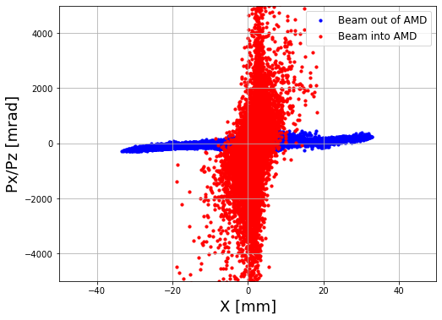
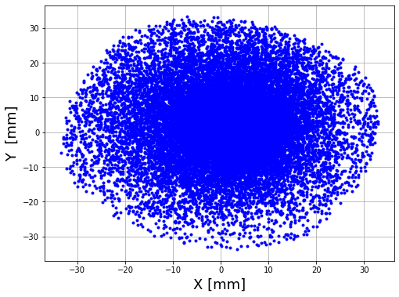
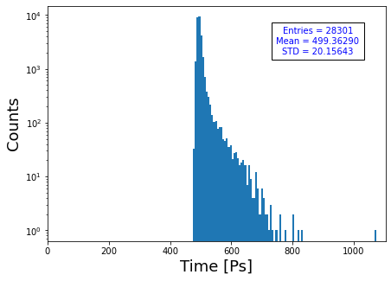
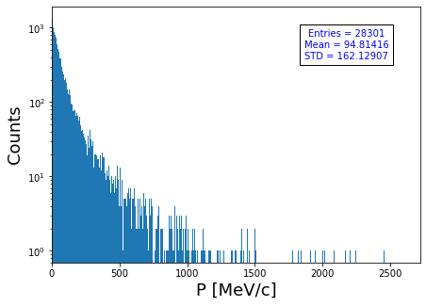
Positron tracking in the matching devise (RF-Track)
Tracking is performed with the actual 3D magnetic field map in volume
SuperKEKB N(e+)/N(e-) =~3.1
Positrons :
N(e+)/N(e-) =~2.8
Beam size (s_{x}, s_{y}) = (9.98, 9.95) [mm]
Bunch length (s_{z}) = (20) [ps]

Slide 10
Summary
Positron yield is the main optimization parameter as for now (emittance , bunch length , energy spread ).
Parameters | SKEKB (after Target) | G4 (no cut) | G4 (with cut) | SKEKB(AMD) | At matching devise
Positron Yield | ~ 6.3 | ~6.2 | ~6.1 | ~3.1 | ~2.8
In general we have good agreement with SuperKEKB, further analysis is needed.
Next step : perform the tracking of positron beam through the accelerating structure.
  Perform comparison at the end of the capture section (~150 MeV), also with the real experimental data!
By using the developed and validated simulation tools, start/continue the FCC-ee positron source design.
…

Slide 11
Thank you !

Slide 12
Backup

Slide 13
FCC-ee operational modes
Operation Type | Final Energy [GeV] | Beam Current [mA] | Bunches/Beam | Bunch Population
Z | 45 | 1280 | 10000 | 2. 43 x 10¹¹
W | 80 | 135 | 880 | 2.91 x 10¹¹
H | 120 | 26.7 | 248 | 2.04 x 10¹¹
ttbar | 182.5 | 5 | 40 | 2.37 x 10¹¹
Z-operation is where the highest current of 1.3 A is stored in the collider. For this reason, we take Z-mode which is the most challenging case as reference for the injector.
Injector for Z-mode, 200 Hz linac with 2 bunches per RF pulse separated by a few tens of ns.
Bunch charge from pre-injector ~3.5E10 particles during the first fill of the collider.

Slide 14
Injector parameters for the Z-mode
 | Baseline | HE Linac | Unit
Ring for injection | SPS/PBR | BR
Injection energy | 6 | 20 | GeV
Bunch population both species | 3.47 (5.55) | 3.12 (5.0) | 1E10 (nC)
Repetition rate | 200 | 200 | Hz
Number of bunches | 2 | 2
Bunch spacing | 17.5-50 | 17.5-50 | ns
Normalized emittance (x, y) (rms) | 50, 50 | 50, 50 | mm.mrad
Bunch length (rms) | ~1 | ~1 | mm
Energy spread (rms) | <0.1 | <0.1 | %
Electron source: an injector based on a photocathode RF gun can provide electrons for both ring injection and positron production and the laser system can provide the bunch-to-bunch intensity modulation and stability required
Position source: target-converter + capture system + 1.54 GeV linac + DR

Slide 15
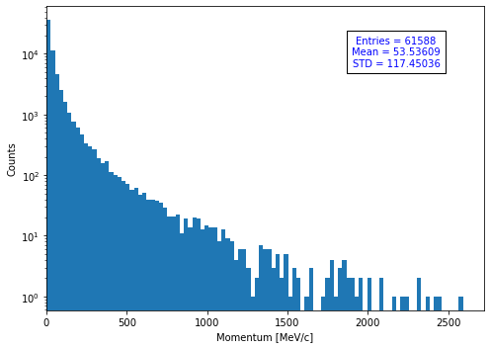
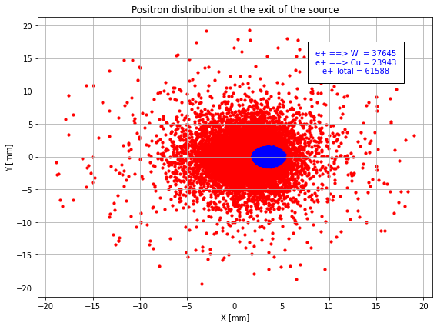
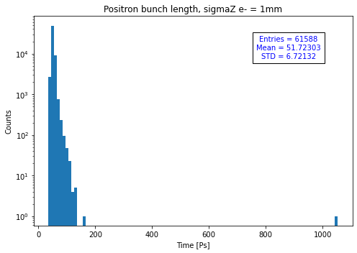
Positron beam immediately after the target
Positron beam:
W => 61%
Cu => 39%
Positrons :
N(e+)/N(e-) =~6.2
Beam size (s_{x}, s_{y}) = (1.591, 1.63) [mm]
Bunch length (s_{z}) = (6.72) [ps]
As you can see there is a long tail in the time distribution which will affect the bunch length.

Slide 16
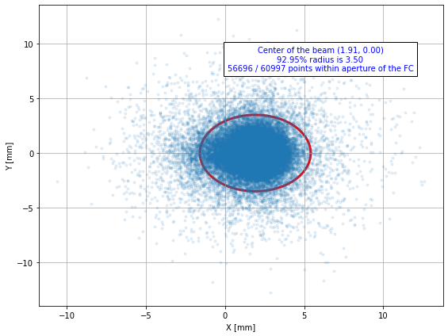
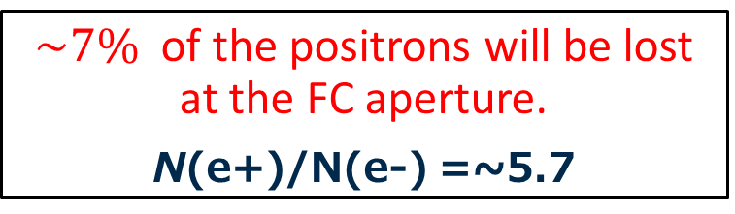
Positron lose due to the gematrical acceptance of the FC
$\sim 7\%$ of the positrons will be lost at the FC aperture.
N(e+)/N(e-) =~5.7

Slide 17
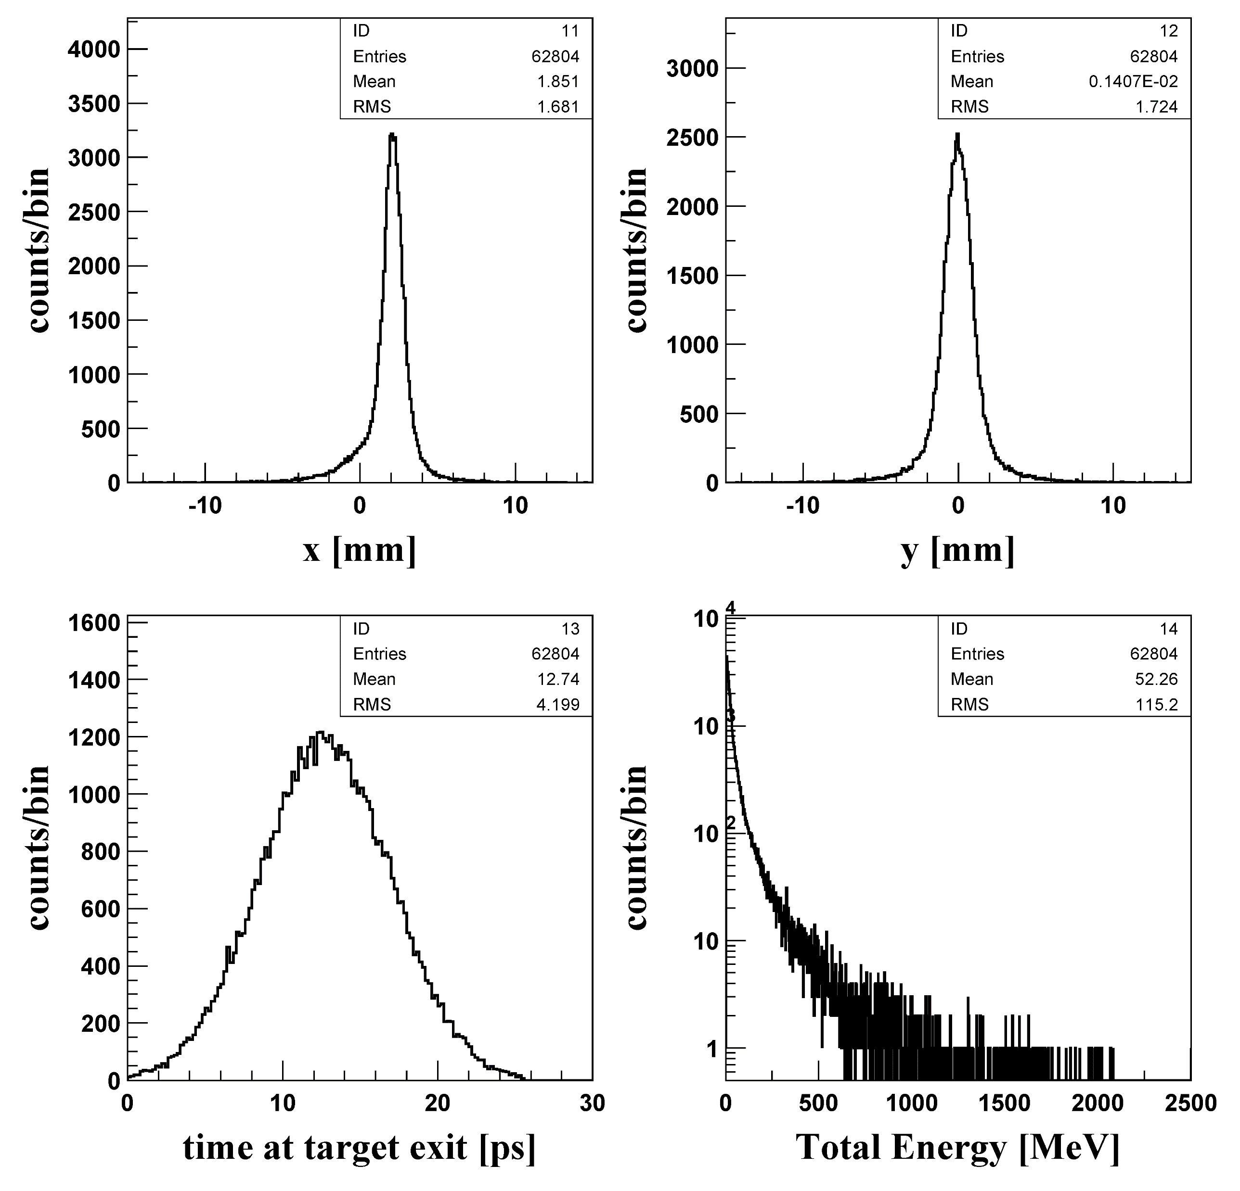
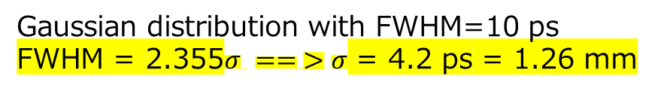
SuperKEKB primary electron parameters and positron beam distribution
EGS5 : Electromagnetic reaction in the targe
1) Incident electrons (x, y, p_{x,} p_{y}, E)
N = 20000 ( ⬅ Num. of loops )
E_{kinetic} = 2900 MeV (3.5 GeV was initial design)
(p_{x},p_{y})=(0,0)
x and y position are given by gaussian distribution
Beam center: (x, y)=(0.2, 0) [cm]
Beam size (s_{x}, s_{y}) = (0.05, 0.08) [cm]
(sqrt(x²+y²) < 1.0)
z = -1.5 [cm]
e+ and e- data at target exit (z=0)
Positrons :
N(e+)/N(e-) =~6.3
Beam size (s_{x}, s_{y}) = (1.681, 1.724) [mm]
Bunch length (s_{z}) = (4.2) [ps]
Gaussian distribution of the beam 6 sigmas (0 - 26) ps
2) Time distribution at z=0
Script
Gaussian distribution with FWHM=10 ps
FWHM = 2.355$σ == >σ$ = 4.2 ps = 1.26 mm

Slide 18
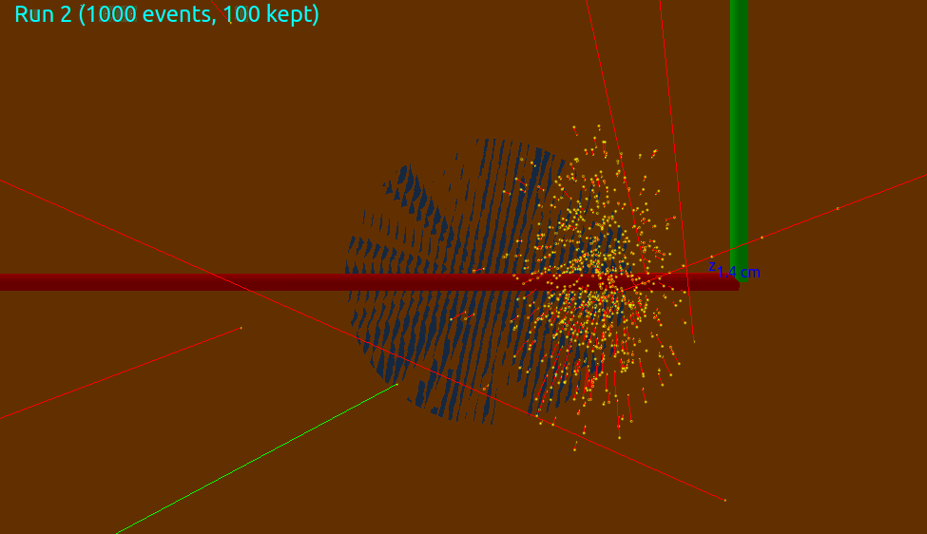
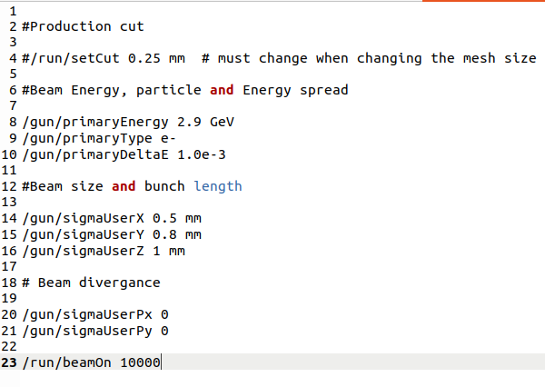
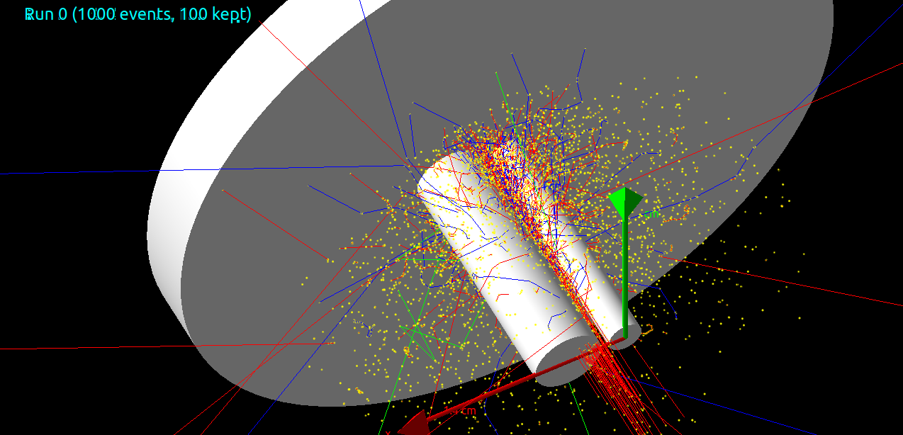
My simulation in Geant4 for SuperKEKB II
Primary electron beam :
As expected part of the beam will hit the Cu_holder .
No energy spread in my simulation !

Slide 19
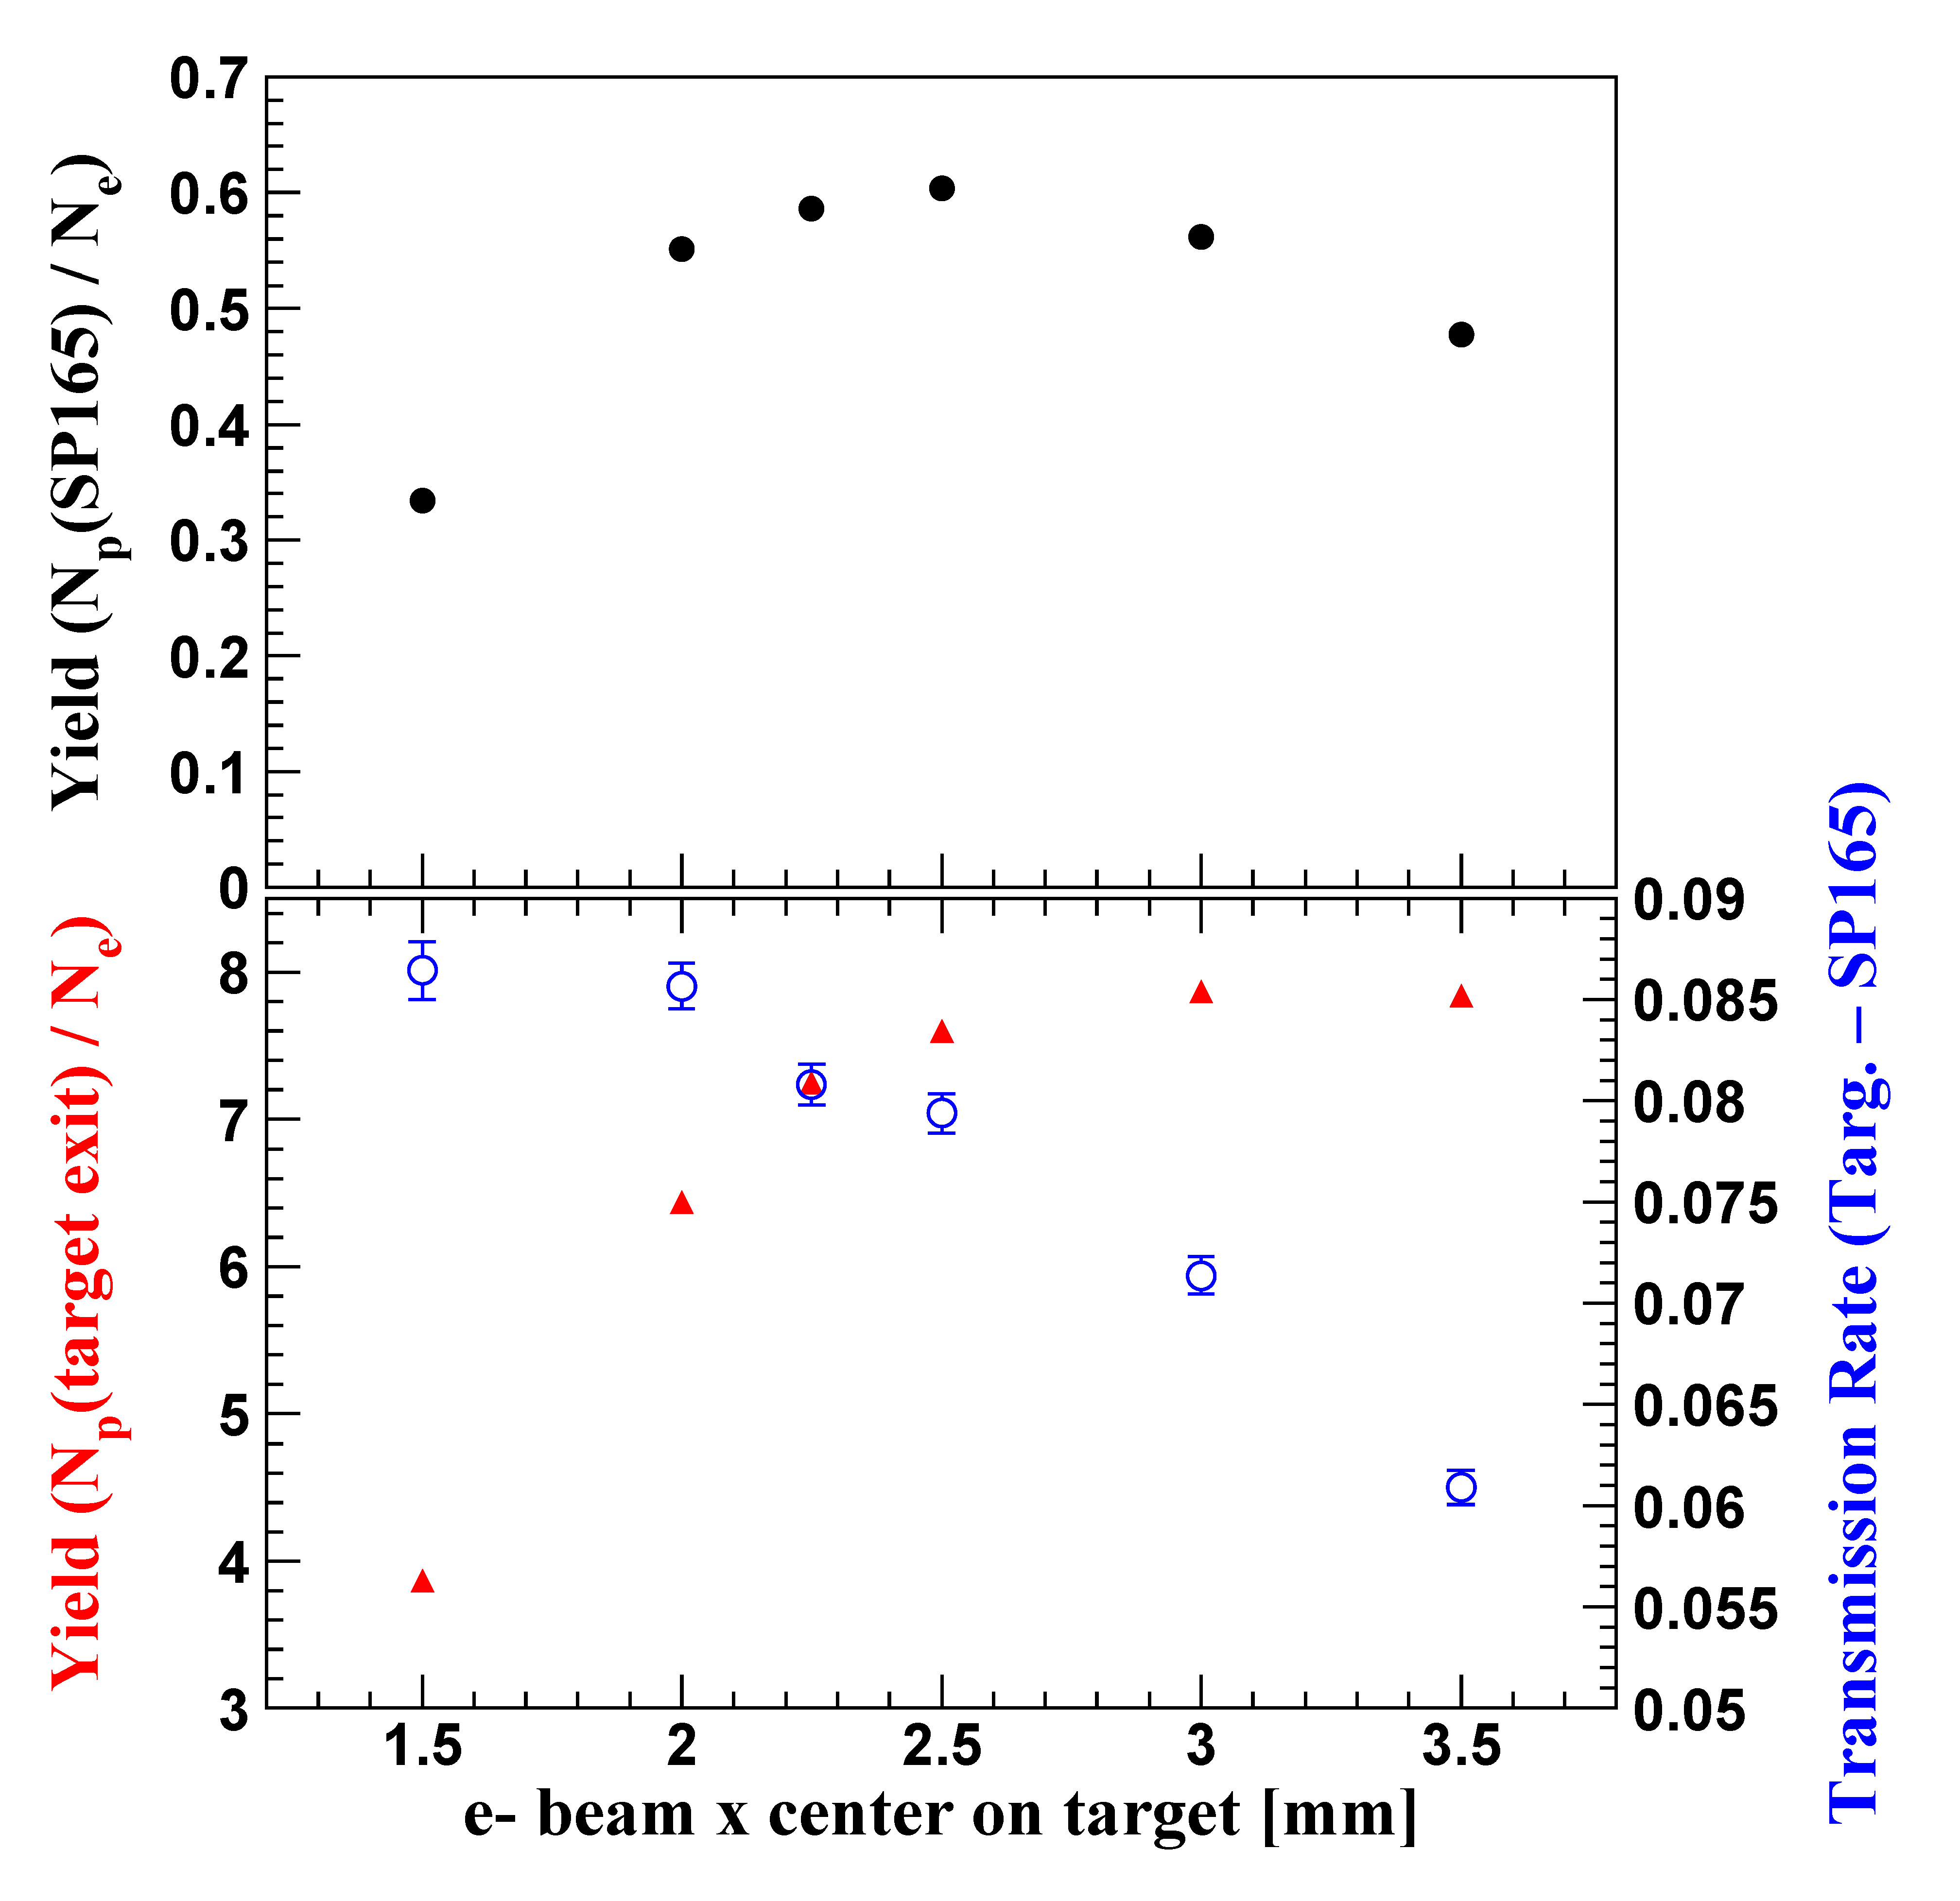
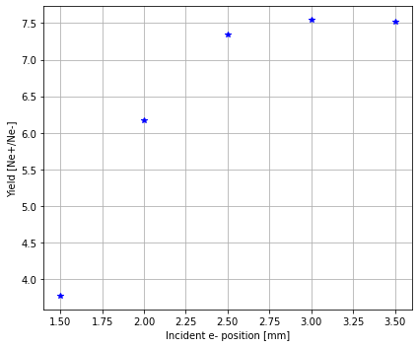
Incident position of the electrons and the positrons yield
Bunch length = 0
Ne- = 10k
Target center
SuperKEKB results
FC center

Slide 20
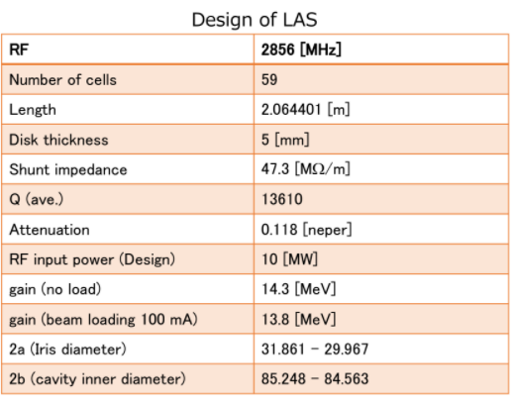
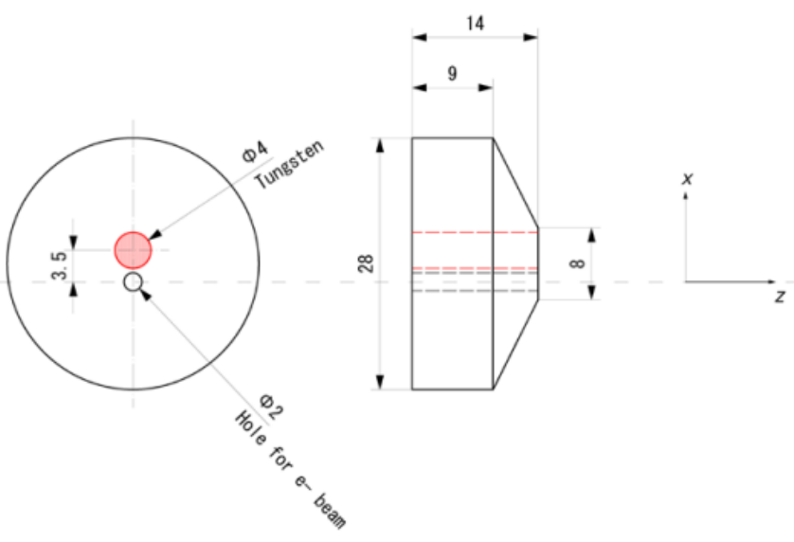
SuperKEKB positron source :
Primary beam:
Ne-=10000
E = 2.9 GeV
Px,Py = 0
Sx=0.5mm ,Sy = 0.8mm
Beam center =(2 ,0,-15)mm
Gaussian Time distribution at z=0 with FWHM =10 ps
Magnetic Fields:
FC =3.5T ,BC = 1.25T, DCS = 0.4T
Front gap = 2mm End gap = 40mm
AC_15_1, AC_15_2 : 12.56MV/m
Results after the target:
Ne+/Ne- = 6.3
PEDD 27.5 J/g (3.5GeV)
Results after AMD:
Ne+/Ne- = 3.1
AC_16 _1 - AC_16_4 : 14.292MV/m

Slide 21
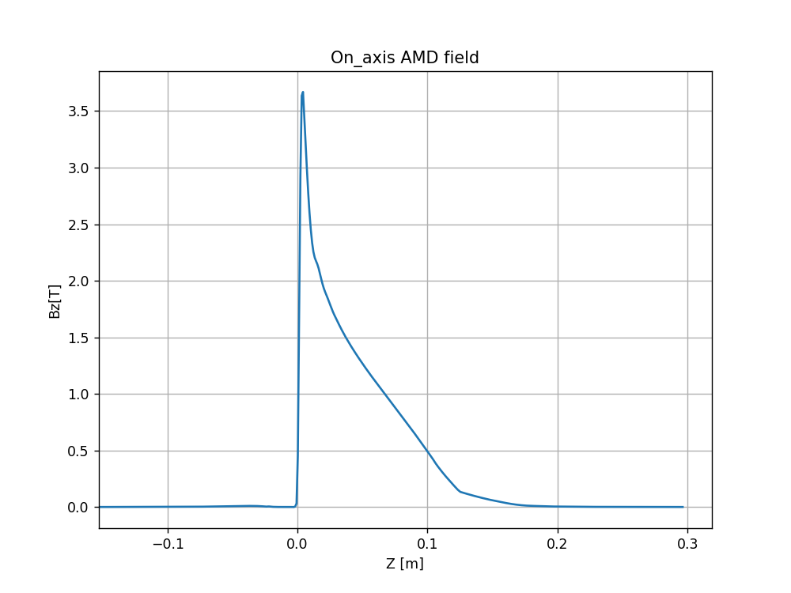
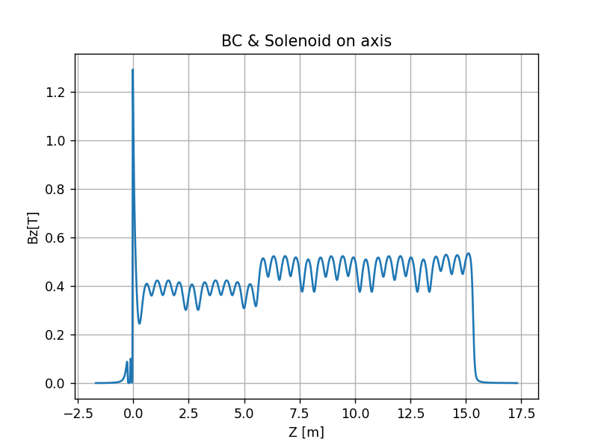
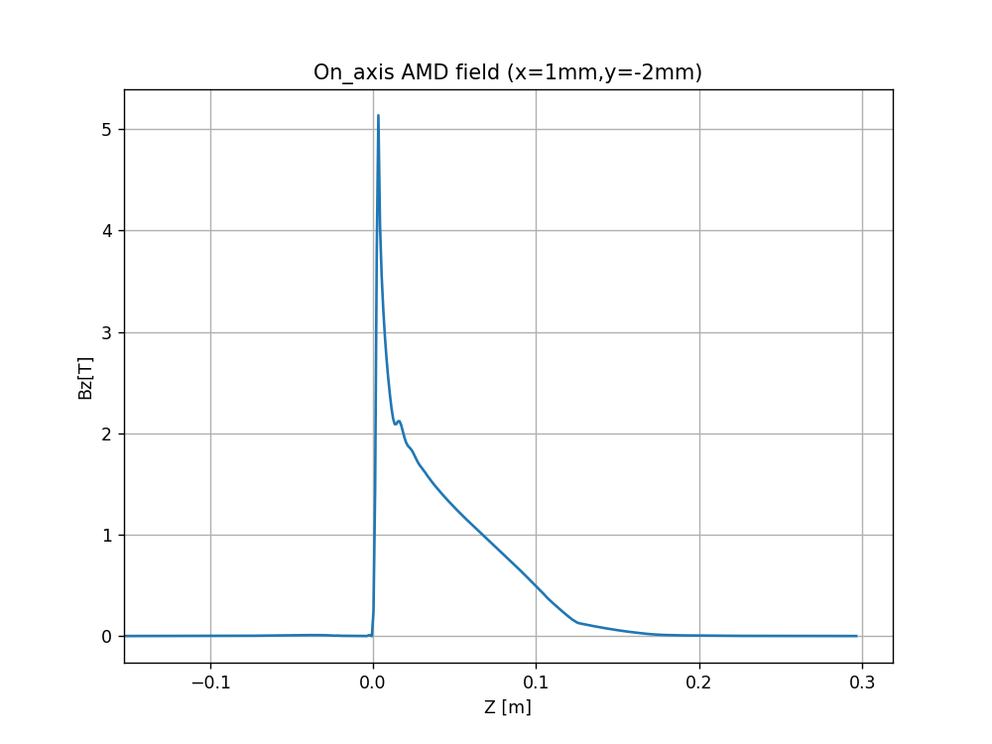
SuperKEKB AMD + BC & Solenoid

Slide 22
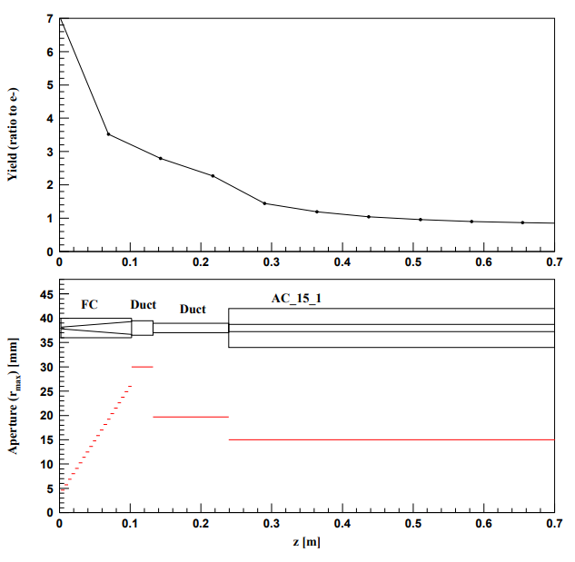
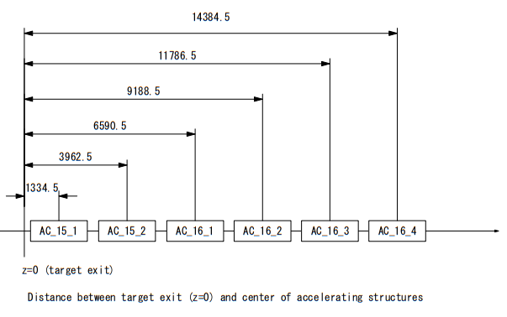
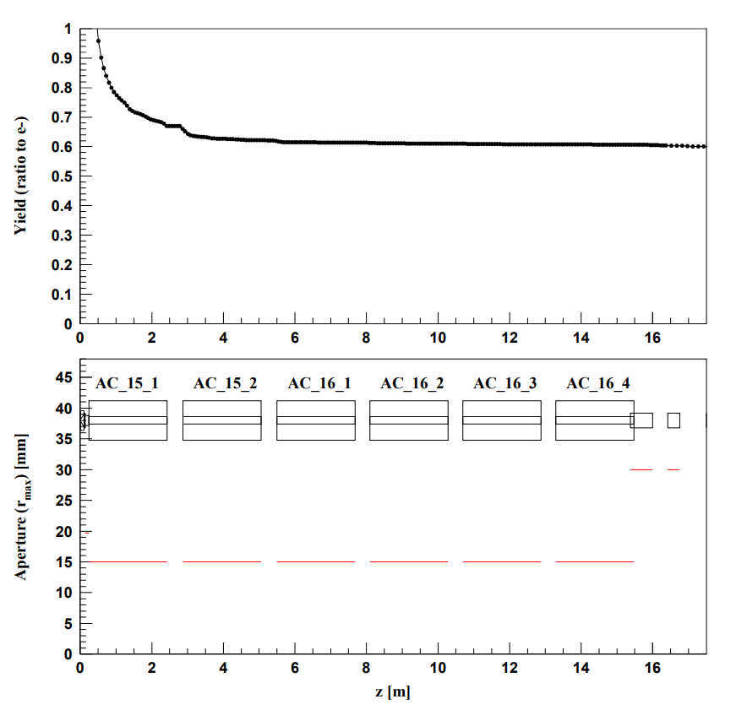
SuperKEKB Accelerating structure

