Slide 1
Testing an Alternative to the Standard Model with the LHeC
Philip Yock
University of Auckland
Auckland, New Zealand
LHeC Workshop, Orsay
26-28 October 2022

Slide 2
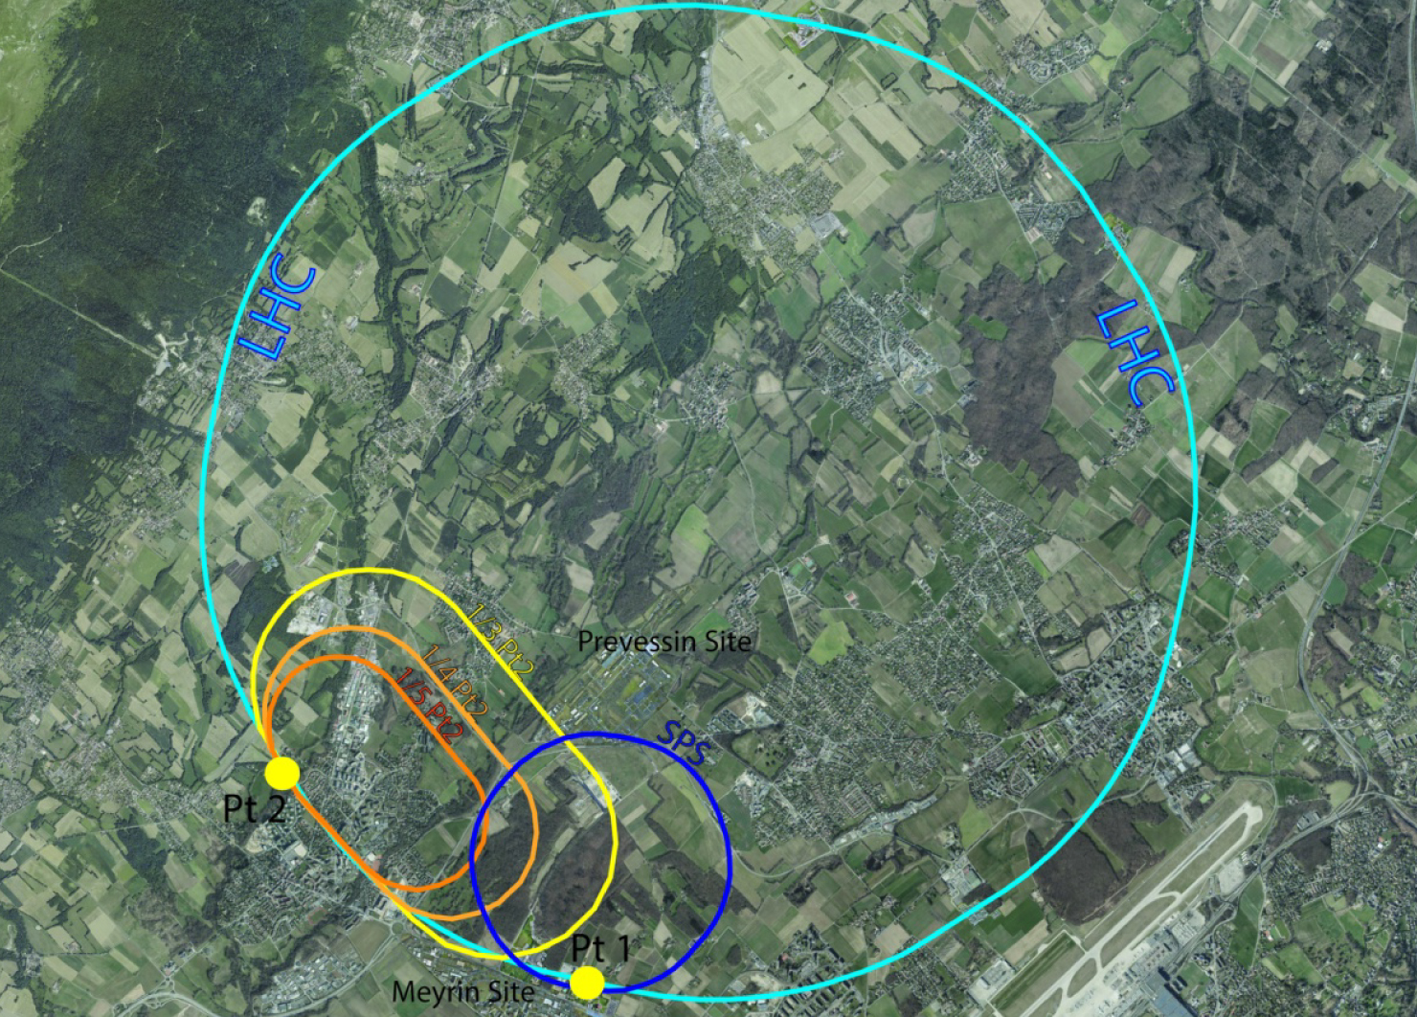
Thanks
Many thanks for the invitation to present a paper at this workshop on the Large Hadron Electron Collider.
Coming from down under in New Zealand, I wish all members of the LHeC team the very best of luck with the collider.

Slide 3
Goal today
Today I hope to point out that the LHeC could be a good instrument for testing an alternative to the Standard Model.
The alternative to the SM arose from work carried out on renormalization at MIT in the 1960s – some time ago!

Slide 4
The renormalization process in quantum field theory
Renormalization has a long history in quantum field theory, with the first successful calculation done by Bethe in 1947 (PR 72, 339, 1947).
This highlighted its two main features, its numerical success versus its uncertain foundation.
I introduced myself to the subject in the 1960s in New Zealand, and subsequently continued the learning process at MIT and other nearby universities.
This led to the formulation in 1969 of an alternative to what was to become today’s Standard Model of Particle Physics.
My hope today is to interest members of the LHeC team in carrying out a test of the alternative model using the LHeC collider.

Slide 5
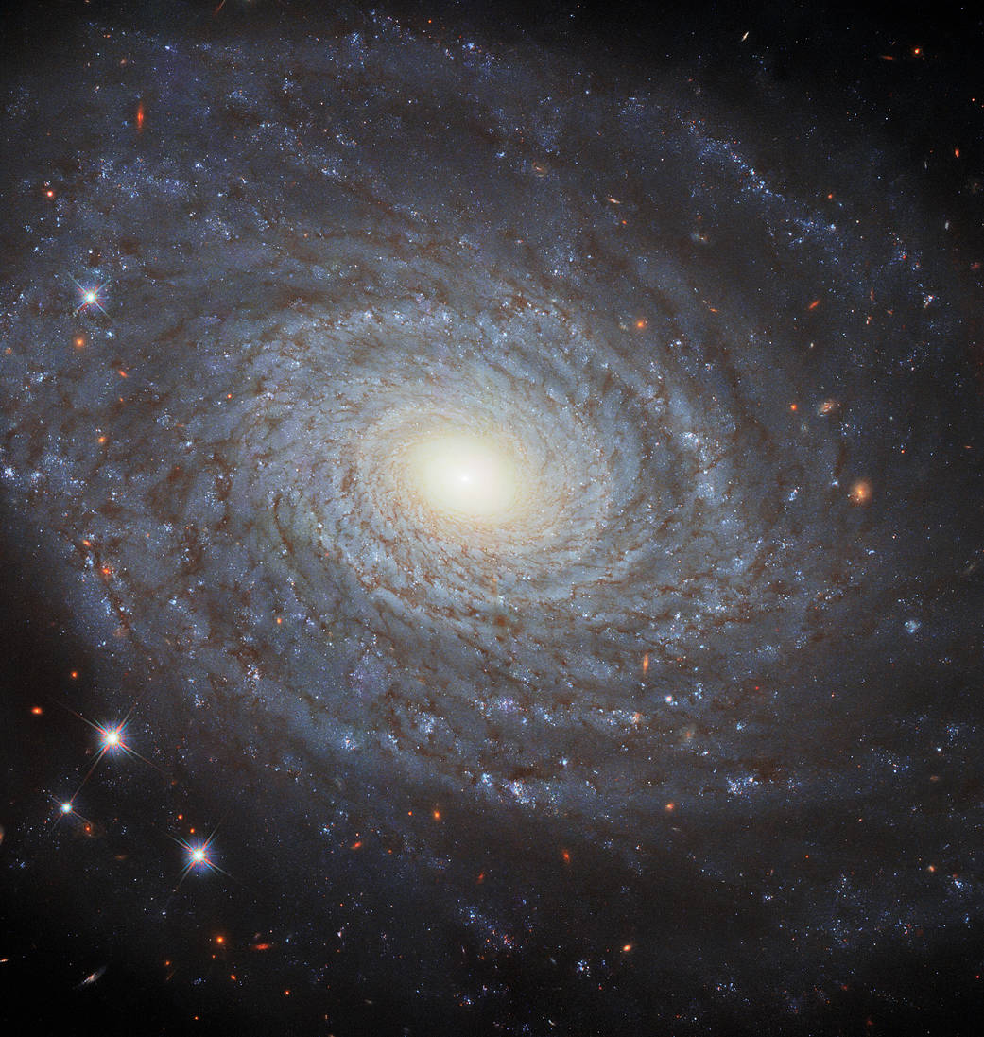
Dark Matter
Recently I gave a presentation on dark matter at the 25th annual conference on gravitational microlensing. This was held a few weeks ago at the Institute for Astrophysics in Paris.
That talk was based on a recent paper by Alan Sipols and Alex Pavlovich (Galaxies 8, 36, 2020), and it argued that dark matter, as commonly conceived, simply does not exist.
A test of the result was given by gravitational microlensing. This was an easy task, as the argument by Sipols and Pavlovich appeared to be conclusive.

Slide 6
The test of the alternative to the SM by the LHeC
The test to be described here today rests on a plausibility argument only, so the task of describing it is difficult.
The plausibility rests on two early papers by Johnson, Baker and Willy (PR 163, 1699, 1967) and Rosner (PRL 17, 1190, 1966).
These papers report eigenvalue equations to be satisfied by the electron charge to evade the infinite renormalization of vacuum polarization.
The plausibility arises as the eigenvalue equations apply to unrenormalized charges, not to renormalized or observed charges.
We conjecture here that renormalized charges are similar in magnitude to their unrenormalized charges, a major assumption.

Slide 7
The Paper by Johnson, Baker & Willey

Slide 8
The Paper by Johnson, Baker & Willey
The paper discusses the possibility of obtaining a finite version of QED if the bare charge of the electron satisfies an eigenvalue equation.

Slide 9
The Paper by Rosner

Slide 10
The Paper by Rosner
The eigenvalue equation for α₀, the unrenormalized coupling constant, is obtained to sixth order by setting the expression in square brackets = 0.
A self-consistent solution would require α₀ << 1, but this is not possible. We
therefore assume the bare coupling constant is of order unity, or greater, for an extra particle that is coupled to the photon, and that its renormalized coupling
constant is also of order unity, or greater.

Slide 11
The Paper by Rosner
The eigenvalue equation for α₀, the unrenormalized coupling constant, is obtained to sixth order by setting the expression in square brackets = 0.
A self-consistent solution would require α₀ << 1, but this is not possible. We
therefore assume the bare coupling constant is of order unity, or greater, for an extra particle that is coupled to the photon, and that its renormalized coupling
constant is also of order unity, or greater.

Slide 12
Highly charged subnucleons
The upshot of the above was the conjectured existence of a highly charged partner to the electron with a high electric charge, and a strong coupling to the electromagnetic field.
Such a particle has not as yet been seen. Lets us call it a “subnucleon” to distinguish it from the quark.
A simplified model was proposed in 1969 using the electron and two subnucleons, as follows. This was published at IJTP 2, 247, 1969.

Slide 13
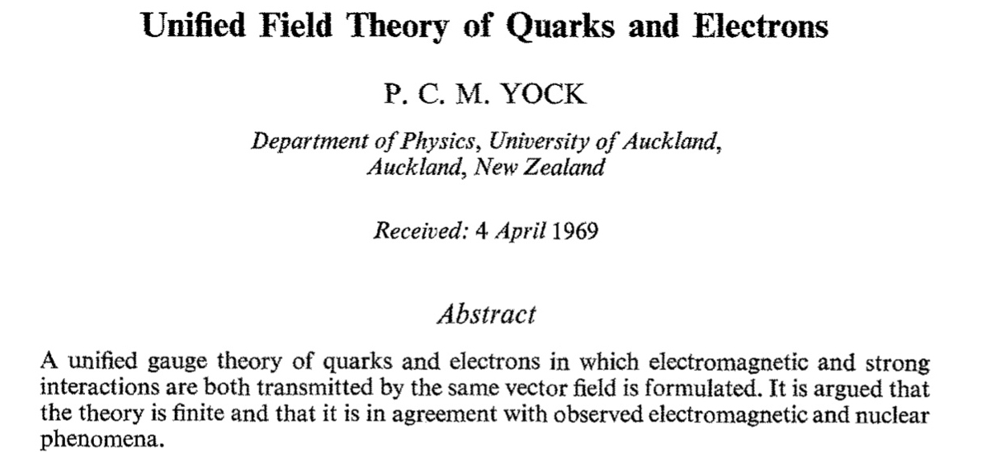
Highly charged subnucleons

Slide 14
Highly charged subnucleons
A theory of electro-strong interactions

Slide 15
Highly charged subnucleons

Slide 16
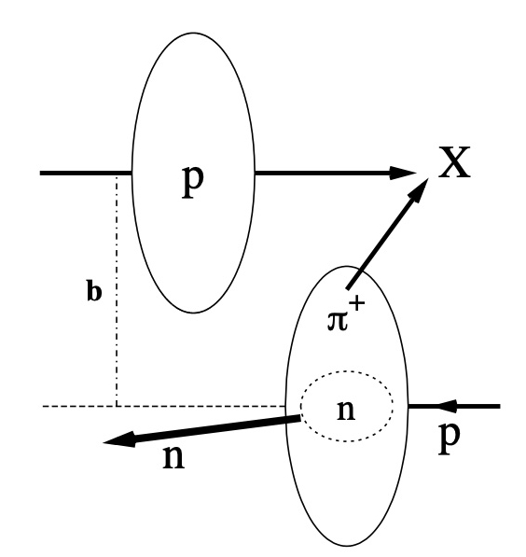
Highly charged subnucleons
The final model included four generations of subnucleons and leptons that are not carbon copies of one another.
It also included two scales of lengths for strong interactions, the familiar scale of ~ 10⁻¹⁵ m for normal Yukawa-type strong interactions, and a smaller scale of ~ 10⁻¹⁸ m or less for subnucleonic interactions. See Int. J. Theor. Phys. 41, 1591, 2002.
See U. D’Alesio and H.J. Pirner, EPJ 7, 109, 2000 for a related model shown here.

Slide 17
Why consider an alternative to the SM?
In 1969 the SM did not exist, so there was every reason to consider extensions of the existing theories that were available then.
In addition to the above, the Standard Model raises other questions. Why, for example, are there three generations of particles? Why are fractional charges present? Why does confinement occur? Why are so many adjustable parameters included? Why, for example, do the strange particles decay in 10⁻¹⁰ sec? Why do rapidity gaps events occur?
These are legitimate questions, which the Standard Model does not fully answer.

Slide 18
Comparison with Schwinger’s dyons and QCD
Dirac, and subsequently Schwinger, attempted to supply an answer to such questions through charge quantisation, but, monopoles have remained unseen over the years despite many searches.
Likewise the fractional charges of the Standard Model have remained unseen, and confinement has been assumed via QCD, without mathematical proof.
In the following we consider p-p collisions as observed with the MoEDAL detector at the LHC, and e-p collisions at HERA and the LHeC.

Slide 19
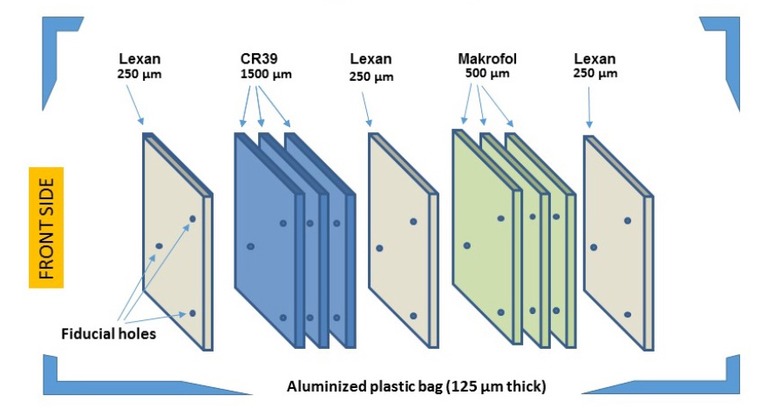
MoEDAL experiment
The MoEDAL detector (EPJ C82, 694, 2022) is presently being used to hunt for highly electrically or magnetically charged particles produced at the LHC with masses up to 1 TeV/c² using plastic detectors. No detections as yet.

Slide 20
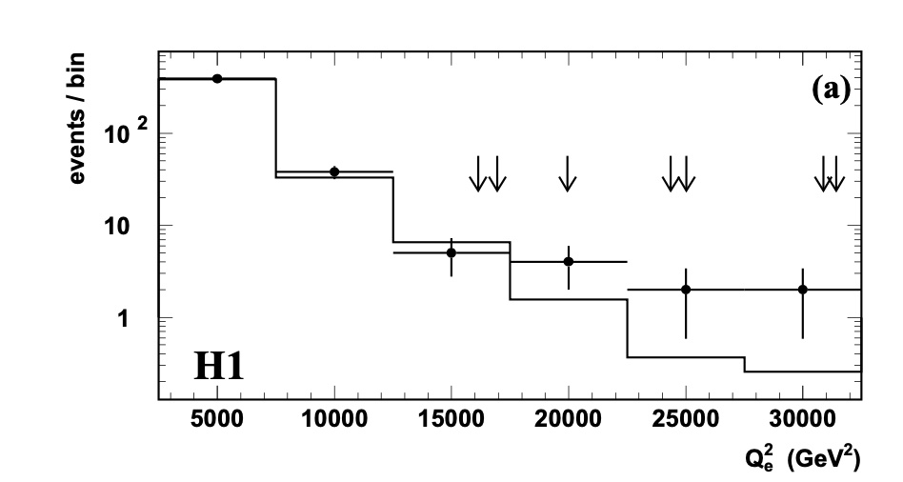
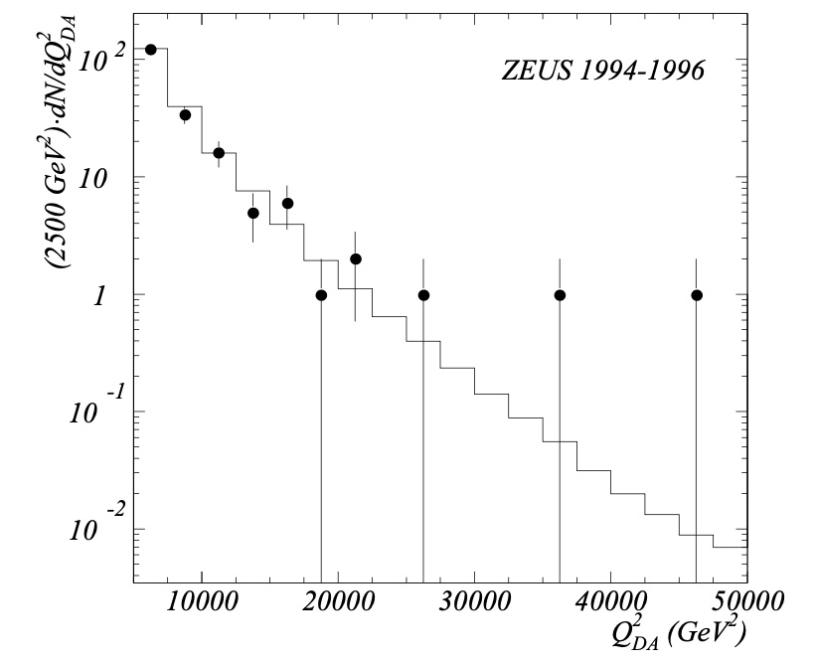
HERA Experiment
Early papers by both H1 and ZEUS reported large and growing excesses over expectation for e-p interactions producing high transverse momenta.
But these data were not confirmed.

Slide 21
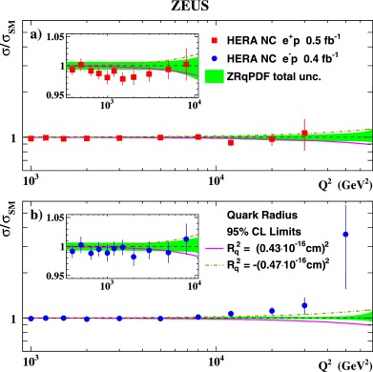
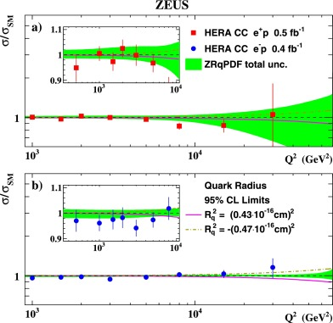
ZEUS (PLB 757, 168, 2016)
The recent data

Slide 22
ZEUS (PLB 757, 168, 2016)
The recent data show deficits, possible (growing) excesses and an absence of structure larger than 4 x 10⁻¹⁹ m in size.

Slide 23
Comparison with MoEDAL
Interestingly, such effects with constituent spacings of order 10⁻¹⁹ m could be expected to occur with constituent masses of order 1 TeV/c² assuming charges of order unity in natural units.
Such masses are within range of those presently being explored by the MoEDAL detector.
LHeC and MoEDAL are therefore complementary.
LHeC detects bound particles. MoEDAL detects free particles.

Slide 24
Suggestions
We suggest therefore that further efforts be made to understand the data.
In particular, we suggest that models with sub-structure with high charges, either positive and negative, or north and south, be considered at sizes ~ 10⁻¹⁹ m to be consistent with observations.
In addition, we suggest that the LHeC be built, and studies of electron-proton collisions made at higher energy and higher luminosity than were possible with HERA.
And the driving motivation for the above? The hunt for a quantum field theory free of divergent renormalization.

Slide 25
Concluding remarks
In 1985 Feynman wrote (QED, Princeton, 1985) the following words. “The shell game we play is technically called ‘renormalization’. But no matter how clever the word, it is what I call a dippy process! Having to resort to such hocus-pocus has prevented us from proving that the theory of QED is mathematically self-consistent. It’s surprising that the theory still hasn’t been proved self-consistent one way or the other by now. I suspect that renormalisation is not mathematically legitimate.”
In addition to the above, we have noted that the Standard Model raises other basic questions. Why, for example, are there three generations of particles? Why are fractional charges present? How does confinement occur? Why are so many adjustable parameters included? How do the strange particles decay in 10⁻¹⁰ sec? How do rapidity gaps events occur? Did HERA uncover new physics in the proton? Could the LHeC assist?
Finally we note that everything said here is highly speculative. Nevertheless, the author hopes that the LHeC is built, and that a search for the effects described above is made.
More information on the above is available in recent papers by the author at J. Roy. Soc. NZ 51, 538, 2021, Physics Essays 33, 149, 2020 and jointly with Agostini et al (J. Phys. G 48, 11, 2021).

