Slide 1
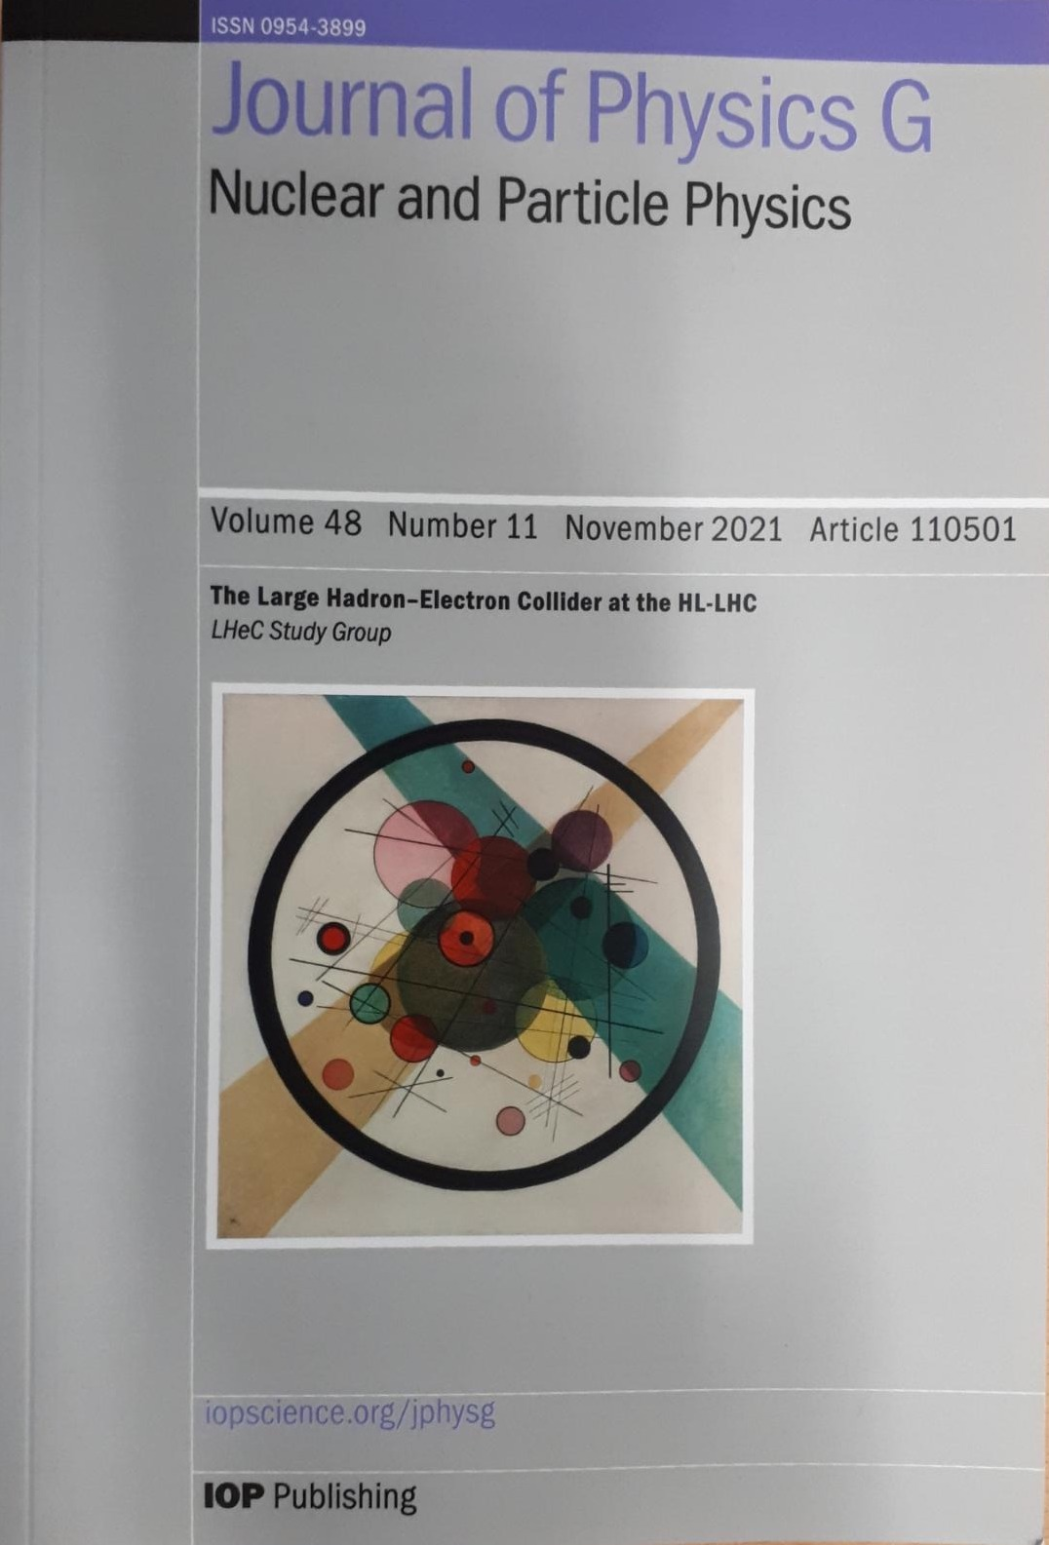
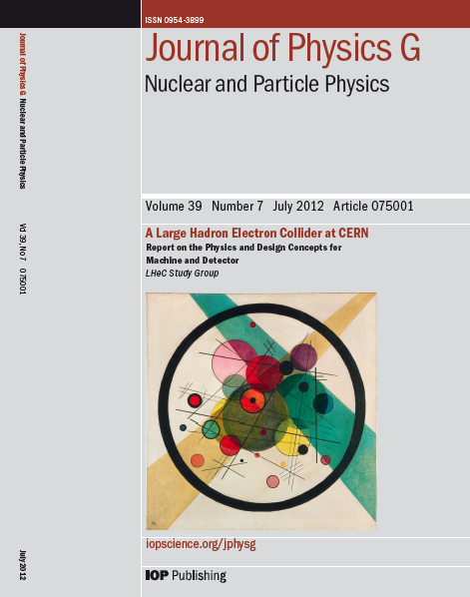
Technical Challenges of the LHeC design
CDR Study assumptions:
-Assume parallel operation to HL-LHC / FCC-hh
-TeV Scale collision energy
➔ 50-150 GeV Beam Energy
-Limit power consumption to 100 MW
➔ (beam & SR power < 70 MW)
➔ 60 GeV beam energy
-Int. Luminosity > 1000 * HERA
-Peak Luminosity > 10³³ cm⁻²s⁻¹
Higgs @ 125GeV
➔ 150MW
➔ 50GeV
➔ > 10³⁴ cm⁻²s⁻¹ & Cost Study

Slide 2

Technical Challenges of the LHeC design
Technology:
-Source: maximum current, cathode lifetime, halo production, polarization
-SRF: Microphonics and beam stability at high gradient SRF operation
-SRF: Cryostat design and HOM integration, HOM power losses
-Interaction Region design with detector, proton and electron beams and SR
-IR Magnet design
Operation:
-Halo generation and beam losses along the ERL – beam diagnostics
-Emittance dilution along the ERL and beam dump acceptance - diagnostics
-Overall ERL efficiency with multi-turn high beam power operation
-Timeline of the HL-LHC Schedule
I report here of the work by others
Many thanks to the many replies and the input I received for the preparation of the transparencies!

Slide 3
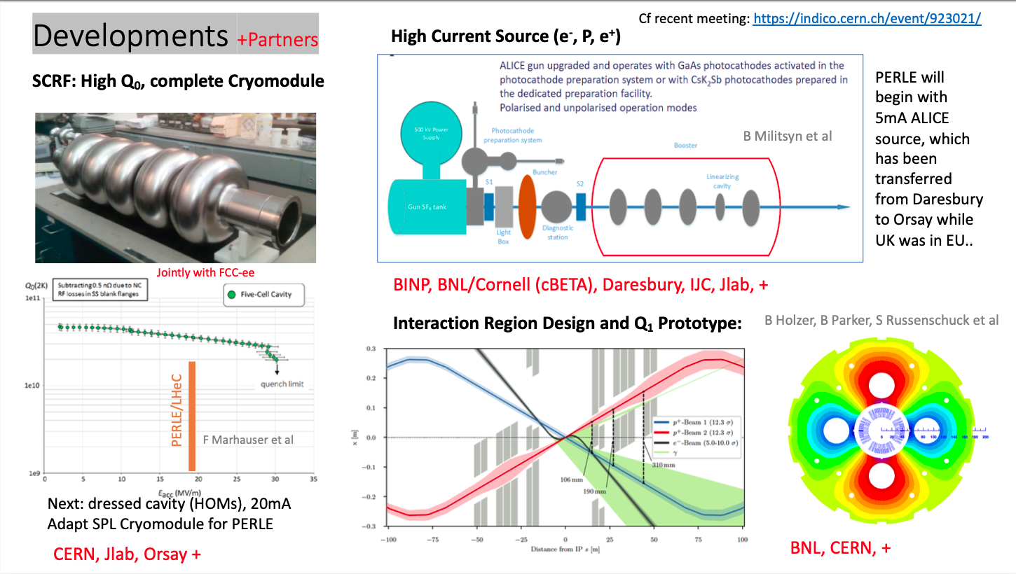
Max Klein @ FCC Workshop 2020

Slide 4
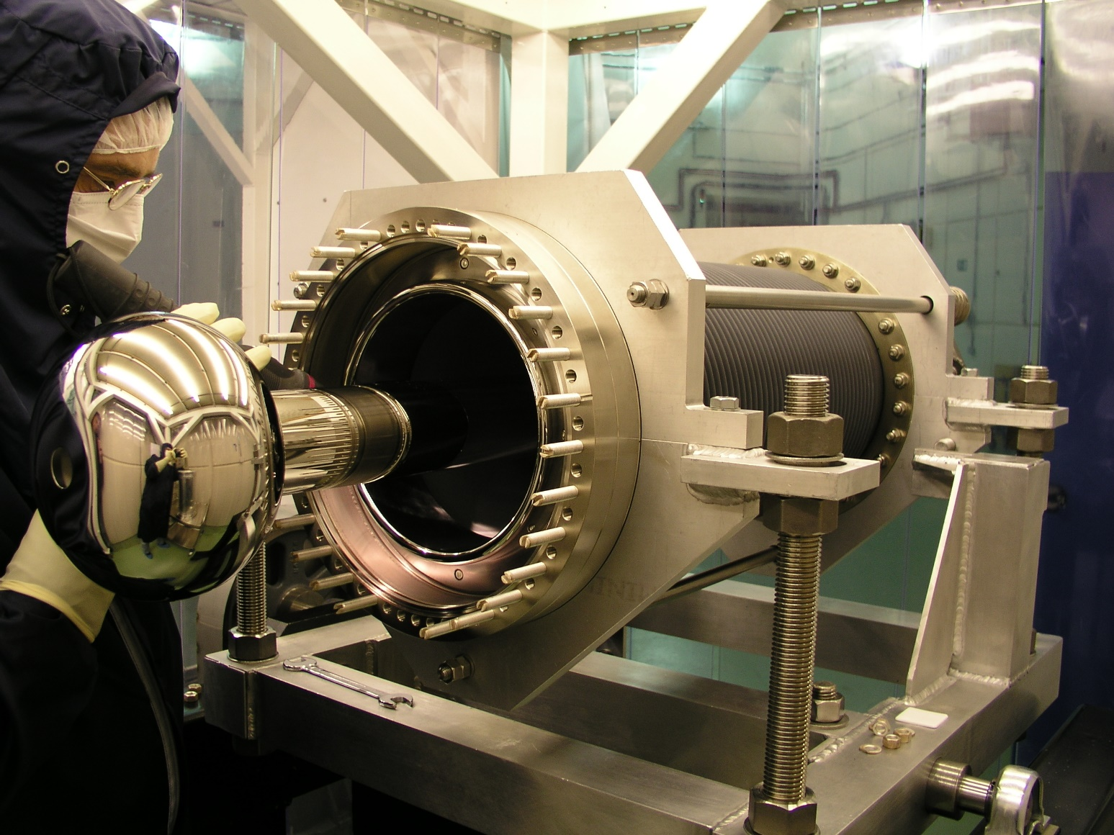
PERLE photogun
PERLE injector based on DC photogun at 350 kV (unpolarized beam)
  Q _{bunch} = 500 pC
  Frequency : 40 MHz
  Multi-alkali antimonide photocathode (CsKSb)
  Green laser (532 nm)
Staged approach
  Stage 1 : ALICE photogun
    Vent-bake gun (photocathode loading = full bake of the gun)
    Not the final version of the gun for PERLE
    Useful to gain experience and practice operation
  Stage 2 : upgraded gun
    Load-lock version (insertion chamber)
    High bunch charge optimization
➔ Factor 3 increase wrt ALICE operation!
ALICE photogun
Requires upgrade!
Laser, HV Power Supply
Vacuum, cathode lifetime
Maud Baylac @ ERL’2022
M. Baylac, B. Militsyn, ERL workshop, Cornell, October 3-6, 2022

Slide 5
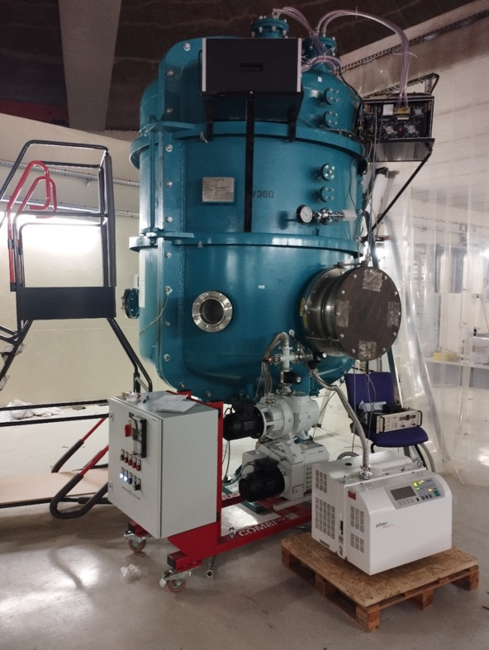
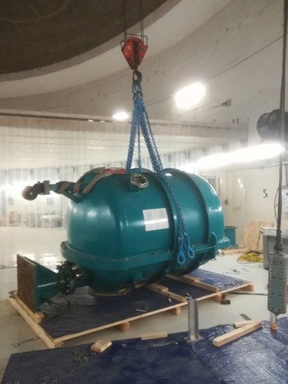
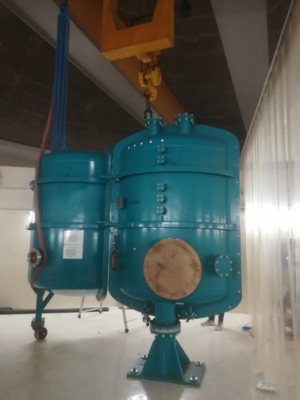
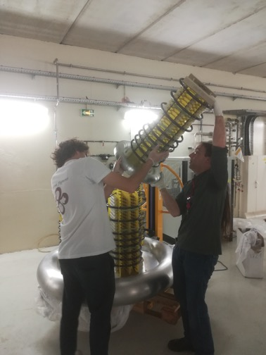
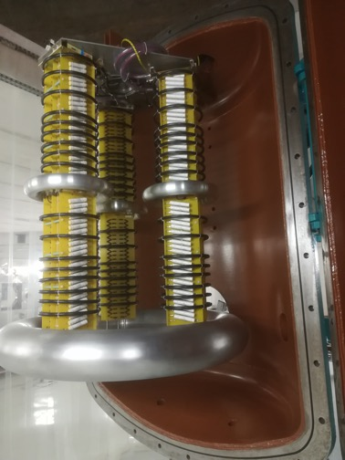
PERLE e- Source
HV vessel installation
(June 22)
HV power supply assembly
(July 22)
Checking the HV vessel tightness
(September 22)
Walid Kaabi @ ERL’2022

Slide 6
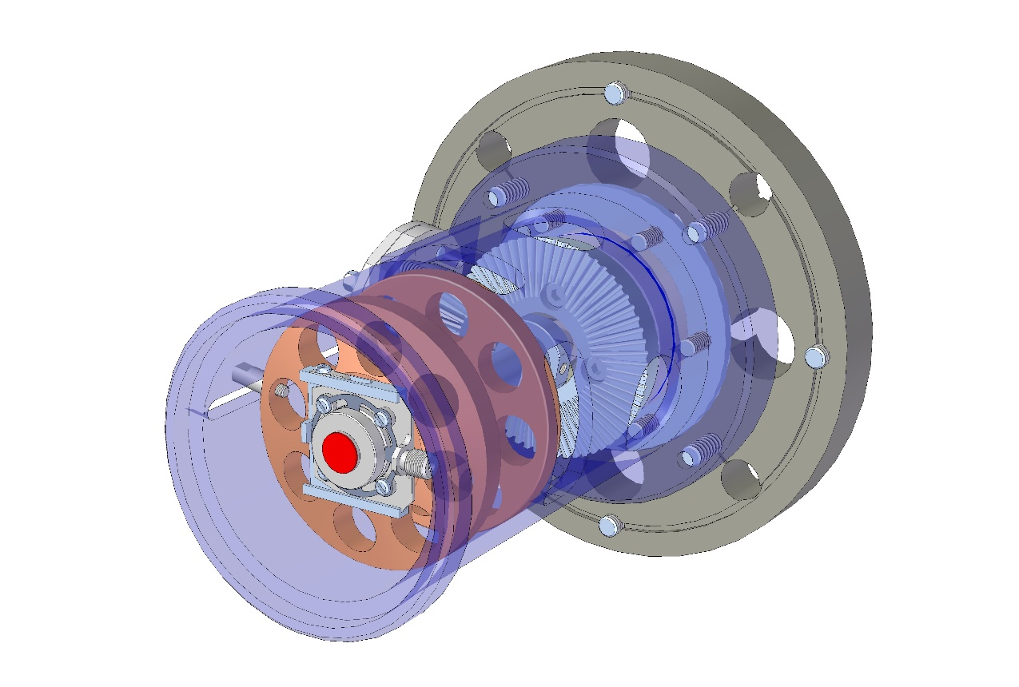
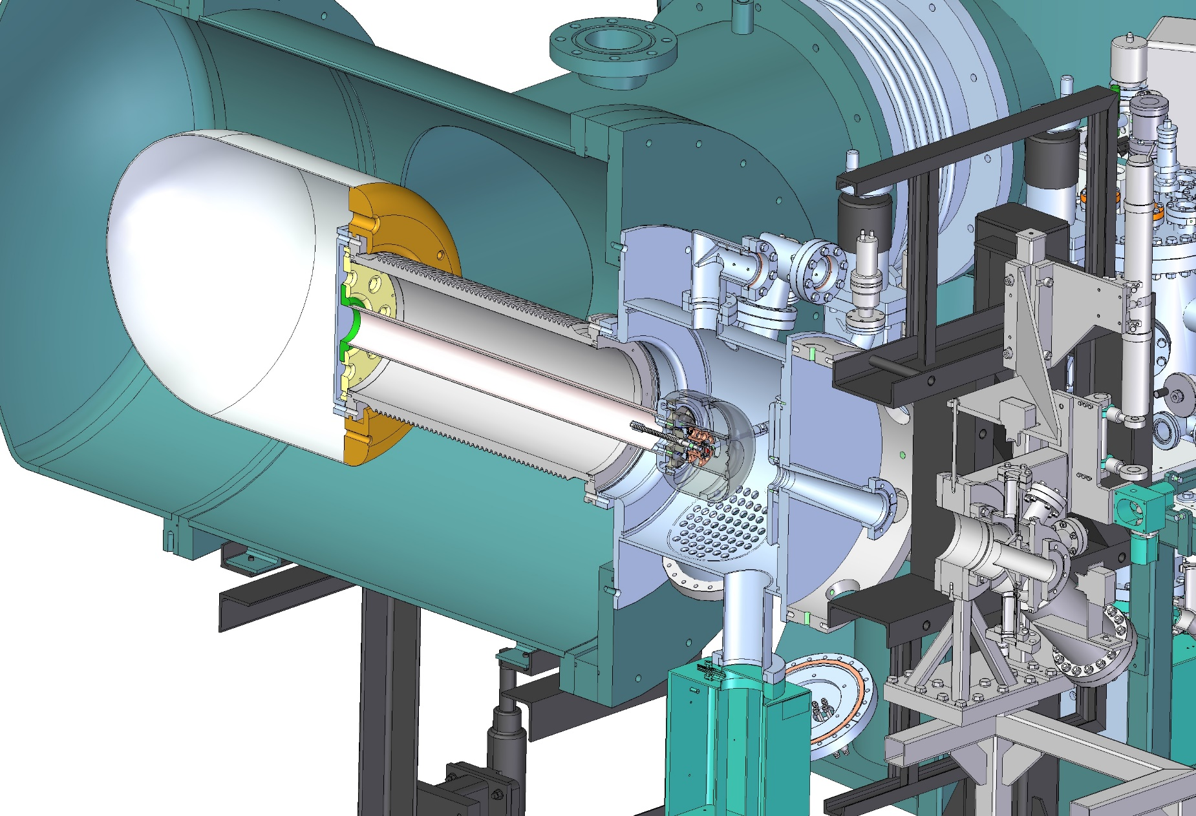
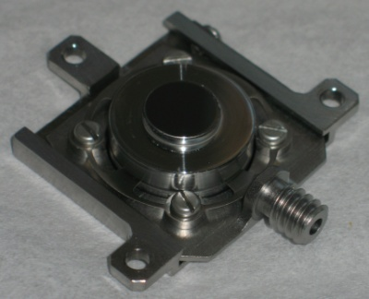
Gun upgrade – 1/2
Design by STFC of a gun upgrade
Implementation of a load-lock system
  Photocathodes can be interchanged without gun venting
  Photocathodes of different types can be installed in the load-lock gun
Maud Baylac @ ERL’2022
Photocathode layer
Kovar cathode holder
Inconel
spring
Titanium
base plate
B.L. Militsyn et al, DESIGN OF AN UPGRADE TO THE ALICE PHOTOCATHODE ELECTRON GUN - MOPC073 Proceedings of EPAC08, Genoa, Italy, 2008
Molybdenum plug
M. Baylac, B. Militsyn, ERL workshop, Cornell, October 3-6, 2022

Slide 7
Laser
Multi-alkali antimonide photocathodes require green laser light
  5 W on photocathode
  ➔ 10 to 20 W laser
  IR laser (1030 nm) with frequency doubling
  Pulse duration : 35 ps (3,5 ps rise/fall time)
  Operation 10-40 MHz
    Reduced rep rate due to power limit of HVPS
  Procurement underway
  Identified potential vendor
  Aim for a 10 W laser for initial tests
    upgradable to 20 W
  Call for tender expected before end of 2022
Maude Baylac @ ERL’2022
Key Challenges [Boris Militsyn]:
Cathode vacuum: 10⁻¹¹mbar for Cs to 10⁻¹² for GaAs
Cathode lifetime: infrastructure for in-situ cathode replacement
Beam halo for operation with higher power laser
Well underway in Orsay
Expect first functional tests by Spring 2024
Laser specs for 20 mA Sb-based photocathodes
Lase wavelength, nm | 500-550
Laser pulse repetition rate, MHz | 10-40
Energy in the single pulse at photocathode Qe=1%, µJ | 0.12
Average laser power at photocathode Qe=1%, W | 4.7
Laser pulse duration, ps FWHM | 35
Laser pulse rise time, ps | 3.5
Laser pulse fall time, ps | 3.5
Spot diameter on the photocathode surface, mm | 3 mm
Laser spot shape on the photocathode surface | Flat top
Laser operation mode | CW/Train-pulsed
Train length, µs | 100/TBC
Train repetition rate, Hz | 10/TBC
M. Baylac, B. Militsyn, ERL workshop, Cornell, October 3-6, 2022

Slide 8
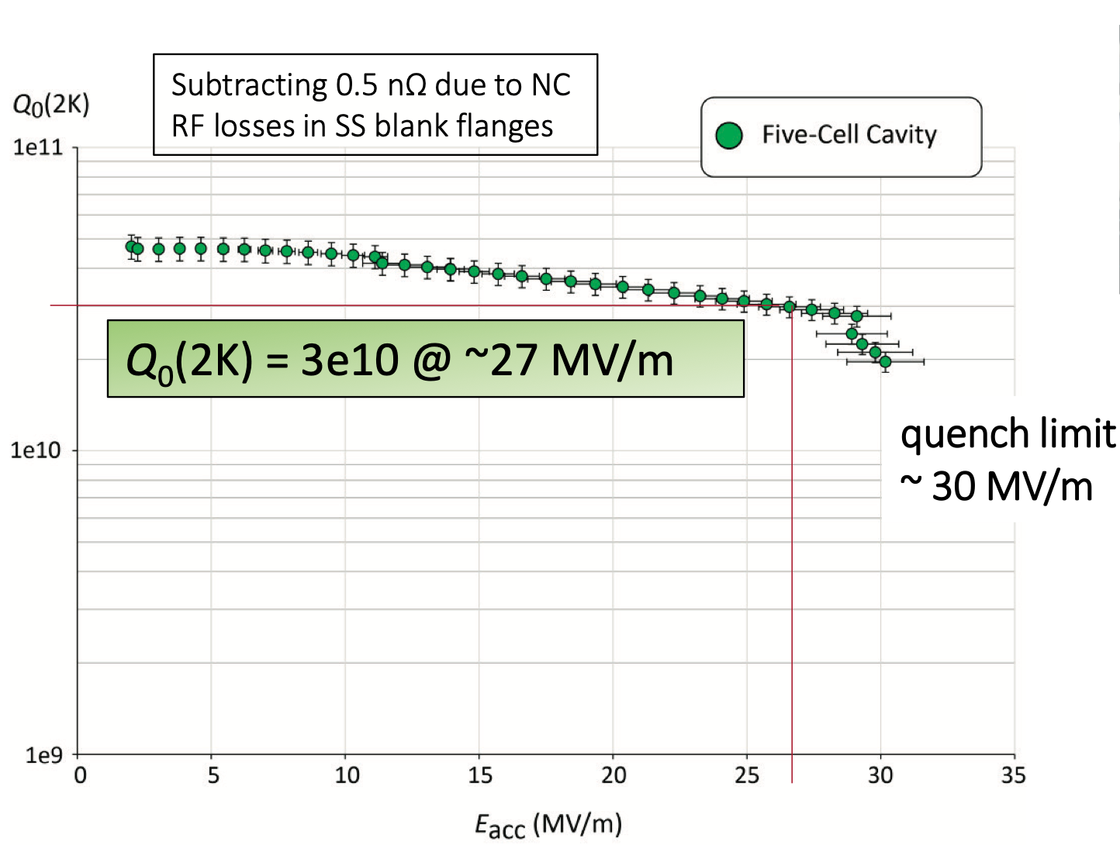
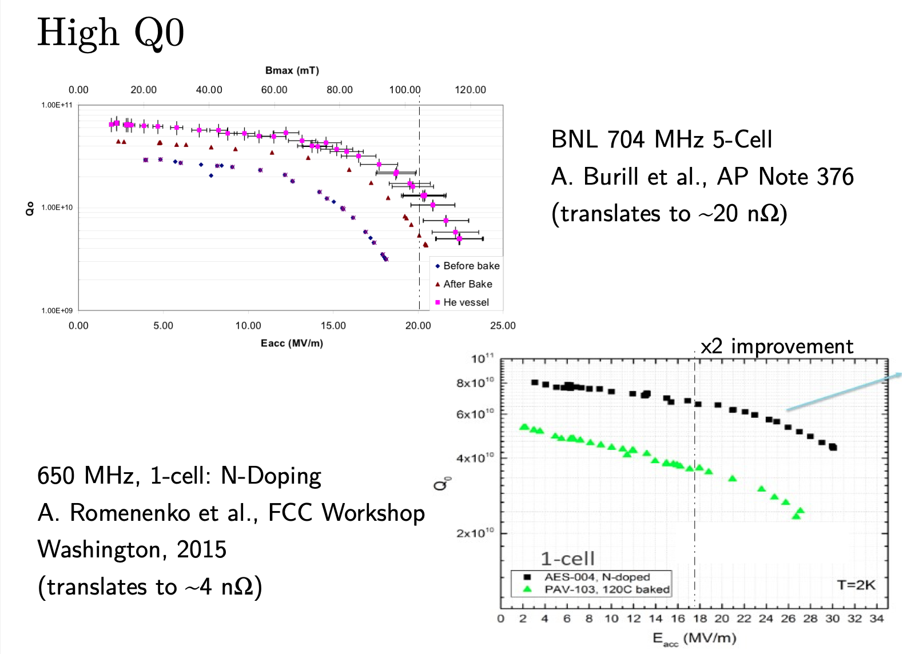
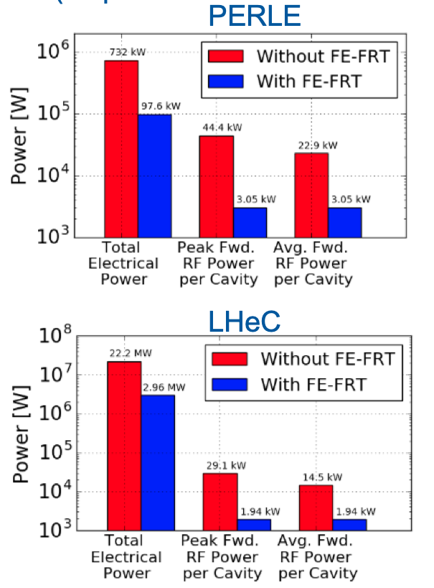
Technical Challenges of the LHeC design: SRF R&D
Nitrogen doping and Q₀ versus gradient
SRF Cavity design: High Q₀ at high gradient
Microphonics: FerroElectrical Fast Reactive Tuner
Ongoing R&D
Do we need / want N-Doping?
➔ Timescale compatible with PERLE planning?
Nicholas Shipman @
PERLE Meeting Orsay 2020
Frank Marhauser @FCC Week Amsterdam 2018
and @ PERLE Meeting Orsay 2020

Slide 9
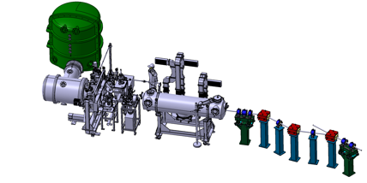
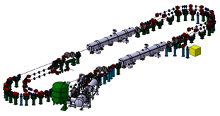
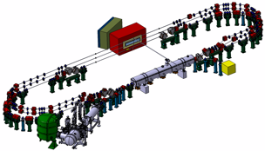
PERLE main Milestones (TDR phase and beyond)
2025
End Phase 0: Injection line
2030
End Phase 2: PERLE @ 500MeV
2023
PERLE TDR
2028
End Phase 1: PERLE @ 250MeV
Walid Kaabi @ ERL’2022

Slide 10
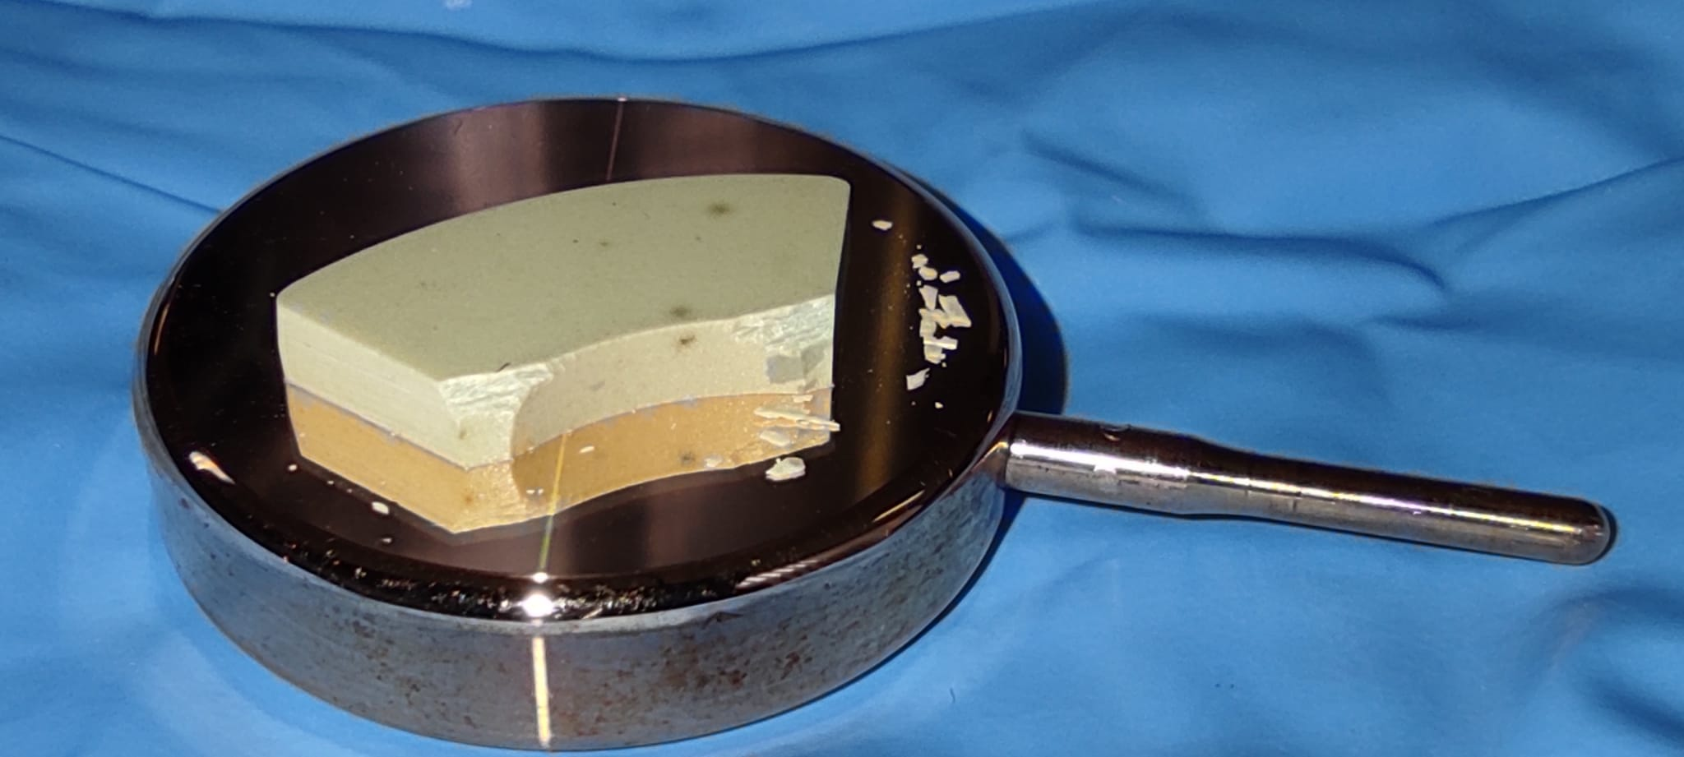
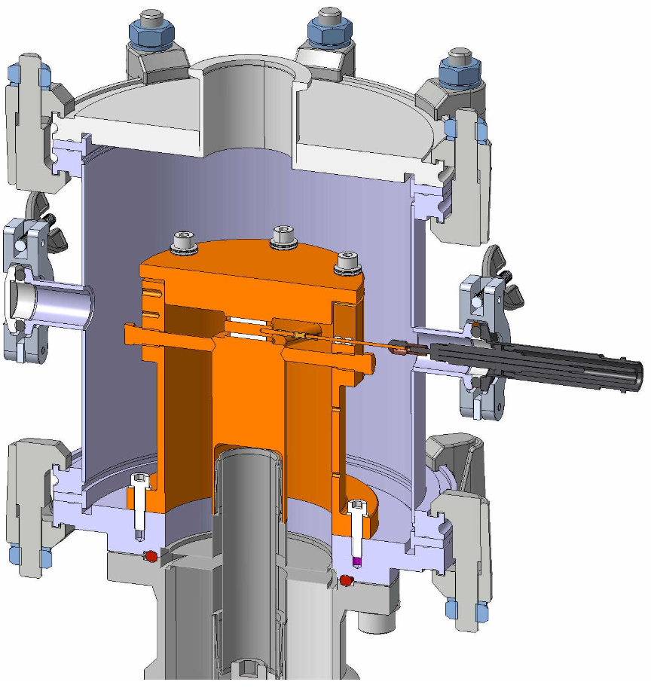
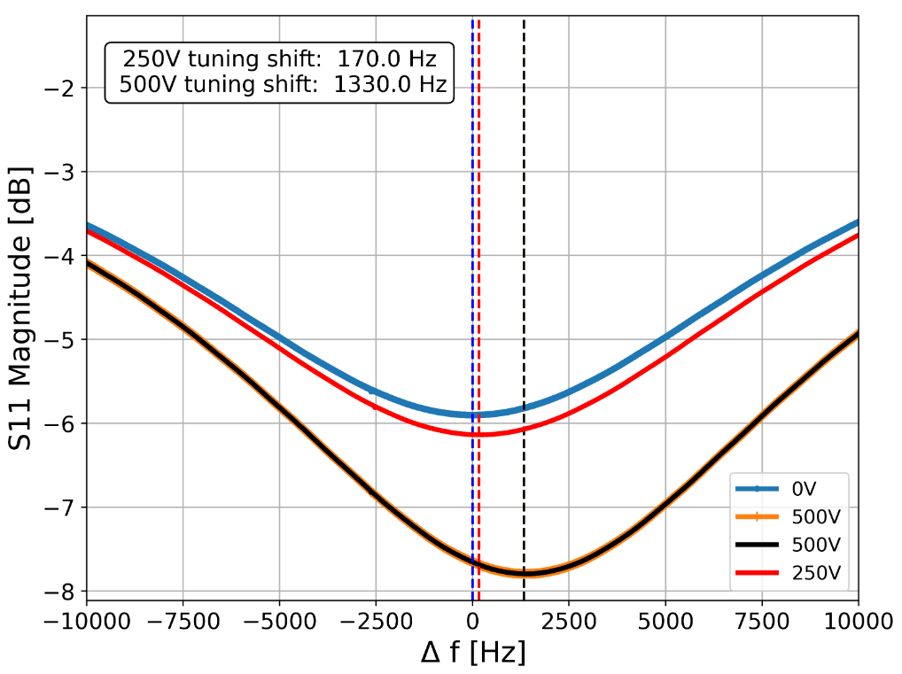
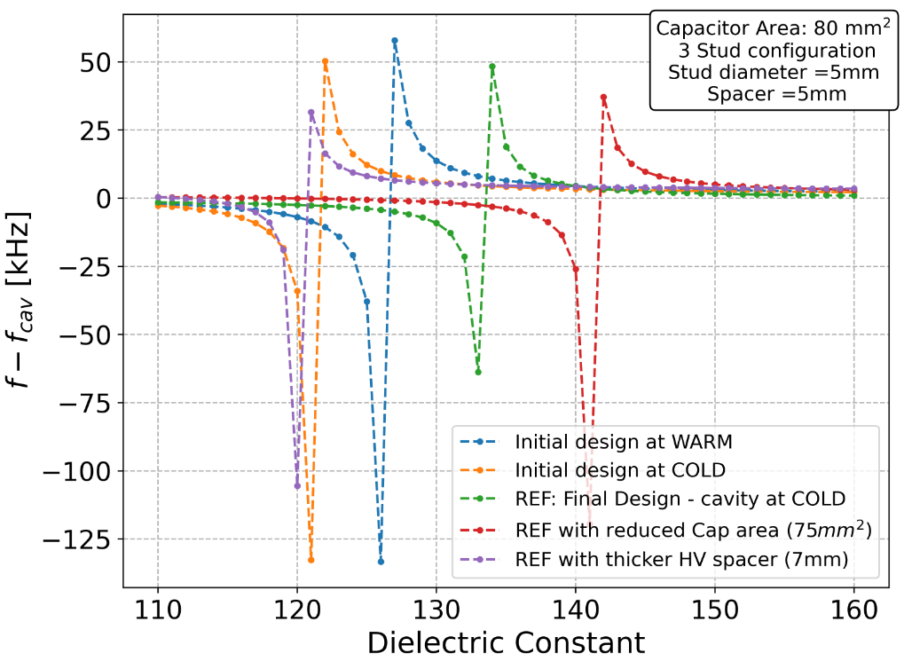
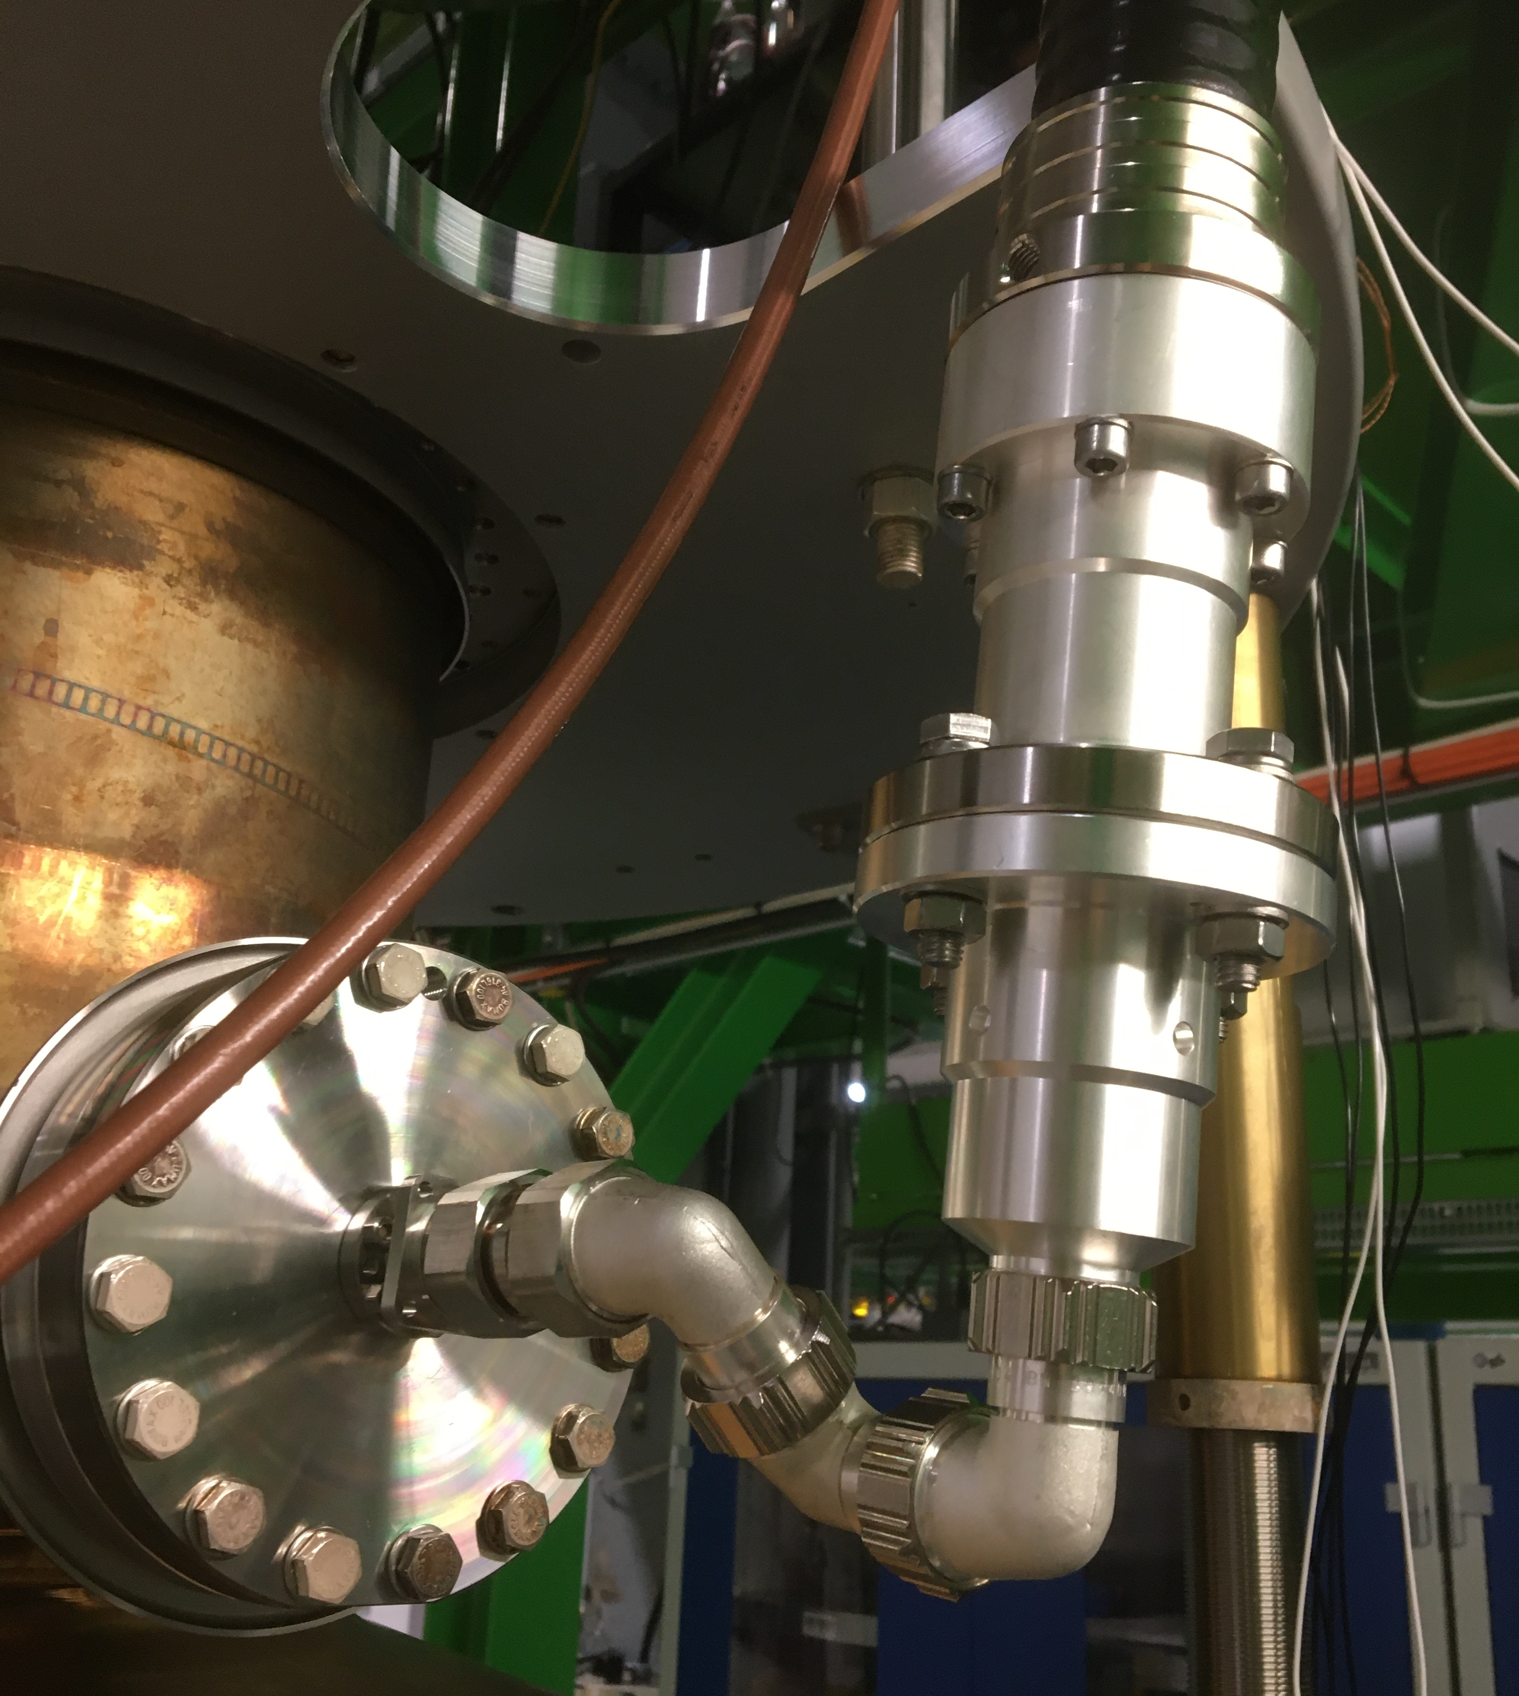
Transient Detuning Project: TDD0
Nik Shipman @ ERL’2022
RF designs of FRT focused on coupled mode scheme
  FRT resonance jumped across cavity resonance
  Greater phase shift and larger tuning range with smaller antenna
  Discontinuous tuning range – not suitable microphonics suppression
Brazeless (compression fit) thin wafers of ferro-electric in vacuum
  Aim: reduced losses + higher biasing electric fields
  + greater change in permittivity at reduced voltage
First prototype TDD0 (Transient Detuning Demonstrator) built and tested on cold LHC cavity
Result: 1.3kHz tuning shift observed with 500V
  Test cut short due to cavity vacuum leak
  TDD0 designed for 10-16kV, voltage limited due to vacuum leak on TDD0
Lessons learned:
  FerrElectric stack sensitive to air gap/compression force
  Care must be taken to apply compression evenly
  Implementation of rigid line in cryostat susceptible to mechanical stress and losses
    Place FRT inside cryostat for next test.
Top: uneven compression force cracked ceramic.
Left: Large diam. rigid line caused vacuum leak.
Right: Breakdown through ceramic near cracks?

Slide 11
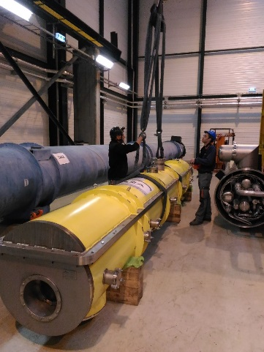
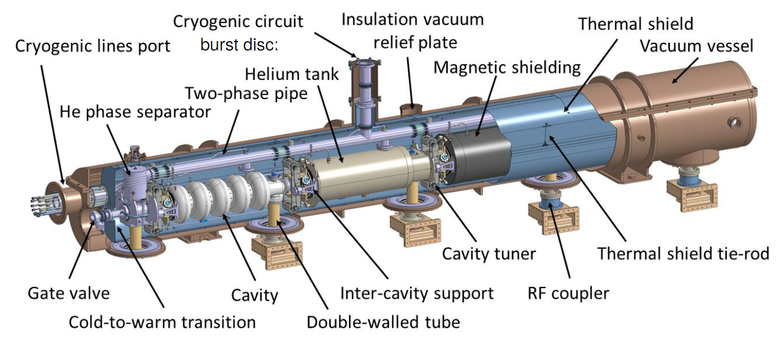
Potential REUSE of the SPL/HG CRYOMODULE DESIGN and components
CERN proposed to re-use the existing SPL short cryomodule prototype either as it is or replacing the 704 MHz cavities by the perle referenced 802 MHz cavities
Gilles Olivier @
PERLE Meeting Orsay 2020
For more details about SPL (HG) cryomodule design and status:
see presentation of Luca DASSA. PERLE workshop, Daresbury on January 15th , 2018.
Design of the cryomodule performed by IPNO and updated by CERN.
Vacuum vessel and most of cryogenic lines delivered.
CAN THIS DESIGN AND THESE COMPONENTS BE REUSED FOR PERLE @ ORSAY ?

Slide 12
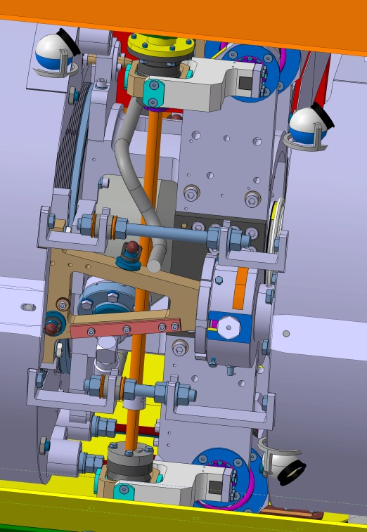
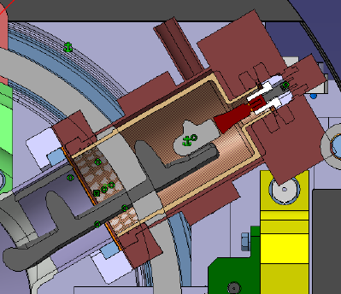
HOM EXTRACTION
How many extraction ports (interferences with CTS)?
Location and position of these ports?
Which power per HOM (W/tens of W, potentially much more if resonant excitation)?
What kind of damper (waveguide, loop coupling)?
What kind of RF line to the external load (cable sufficient, which kind of connector)?
Intermediate thermalization only? Risky.
Active helium cooling?
External cooled RF loads.
HOM signal for diagnostic purpose.
Gilles Olivier @
PERLE Meeting Orsay 2020
Key Challenges:
HOM Design finished – need 4HOM coupler / cavity
Lack of space in Cryostat is a major problem
Integration of FE-FRT and couplers?
Q₀ for fully dressed and cryostated cavity?
➔ exploring option of using ESS-type cryomodule
Not really a technology problem but time critical
POTENTIALLY THE MAIN ISSUE DUE TO THE LACK OF SPACE
Volume between 2 cavities is quite crowded
Waveguide HOM coupler. Courtesy of Brookhaven NL
Loop coupling with active cooling. Courtesy of CERN

Slide 13
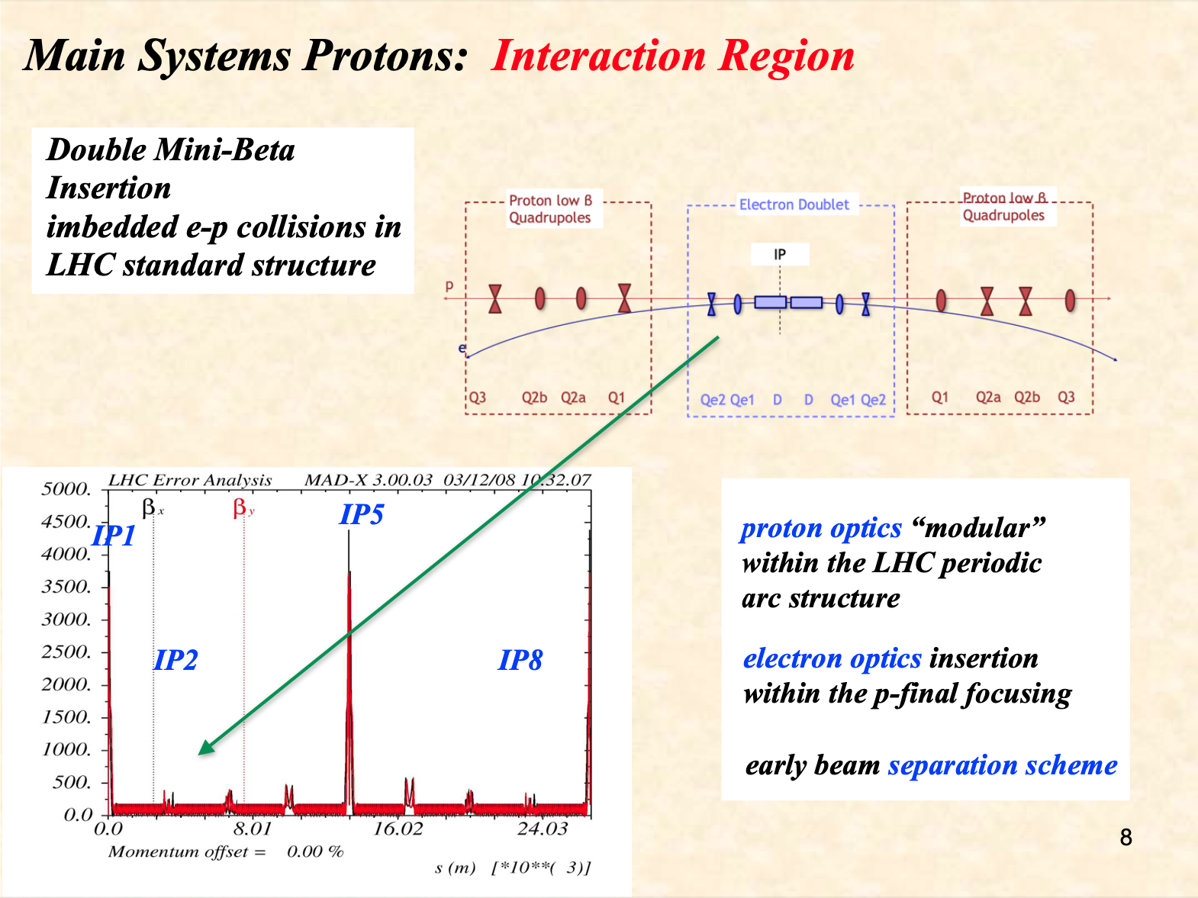
Bernhard Holzer @ ICHEP 2022
See presentation from Kevin on Thursday
Combine a detector dipole field
With an early focusing scheme,
Off center quadrupoles and
very compact proton quadrupole
design

Slide 14
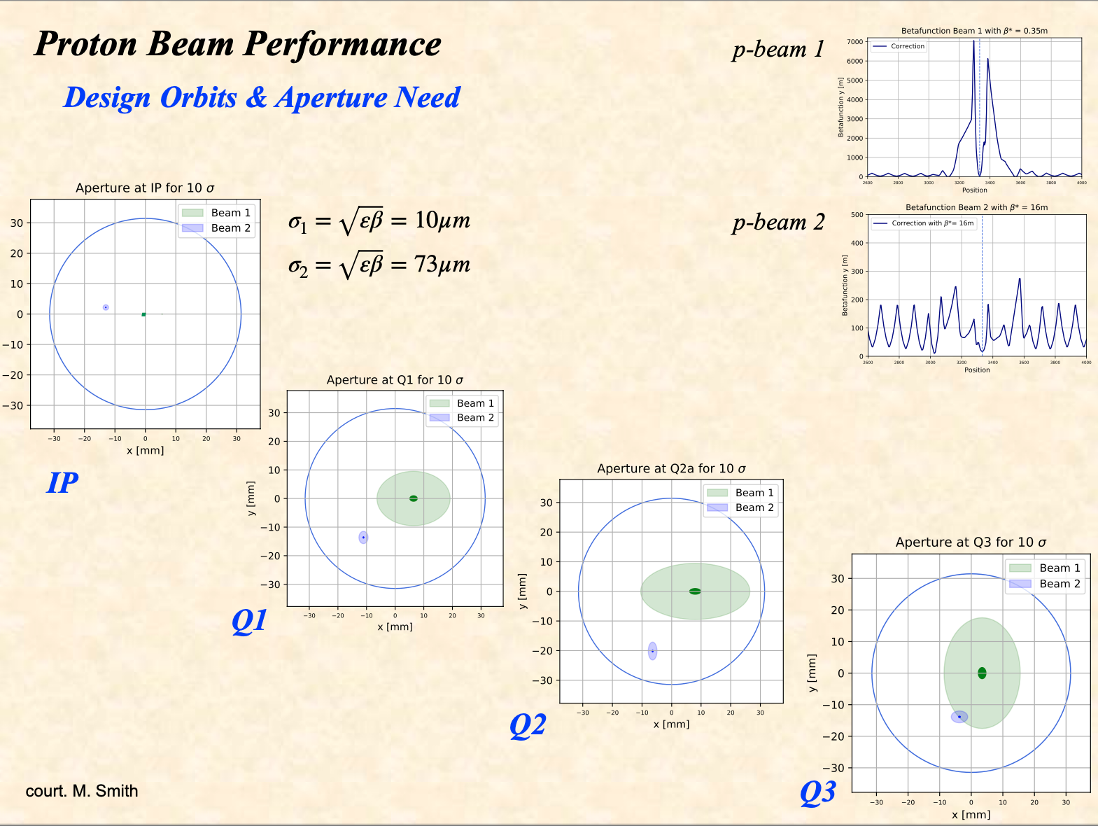
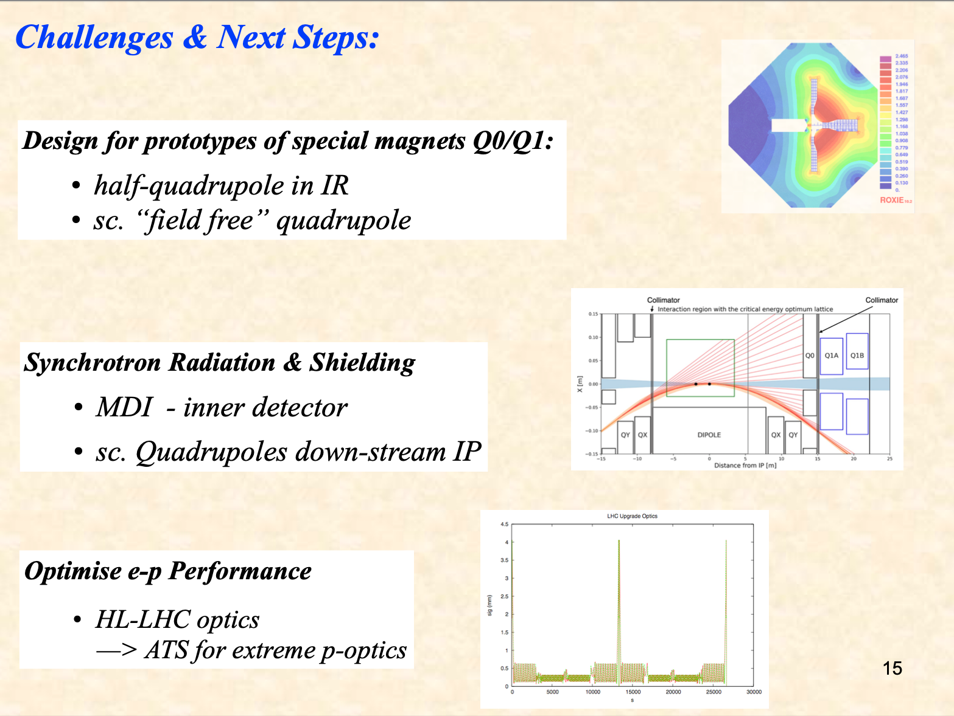
Bernhard Holzer @ ICHEP 2022

Slide 15
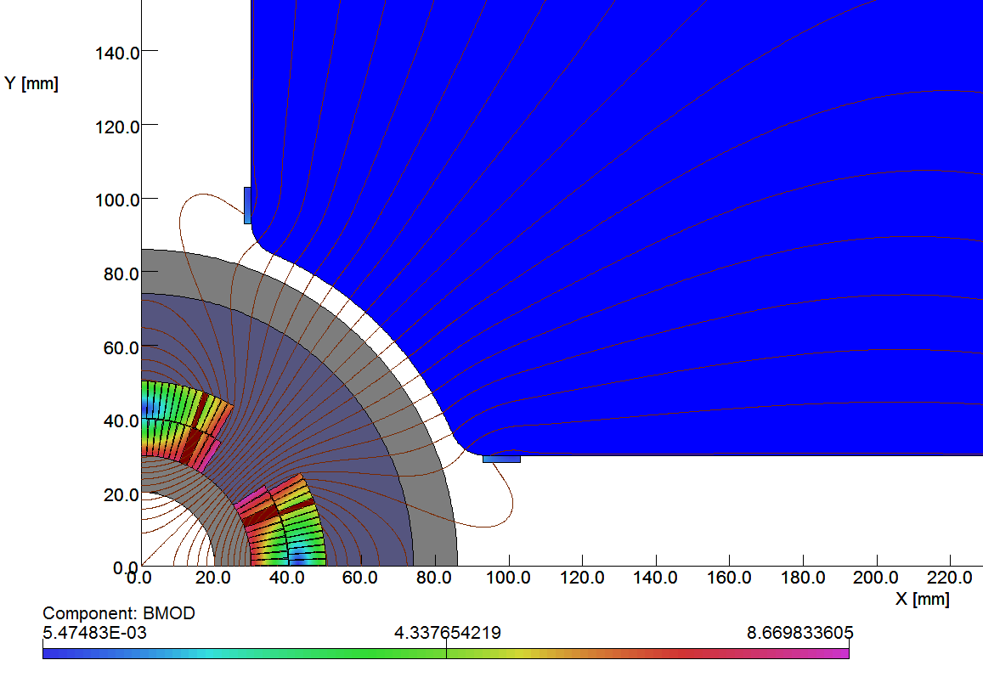
Self-Contained Coil Plus Quad Yoke.
First magnet, Q1A, has 40 mm diameter clear aperture and provides 252 T/m gradient.
Rref = 15 mm
n Bn
1 0.00
2 10000.00
3 0.00
4 0.00
5 0.00
6 -0.57
7 0.00
8 0.00
9 0.00
10 0.03
Brett Parker @
Electrons for the LHC
Workshop, Orsay 2018
Max. |B| in Coil = 8.7 T

Slide 16
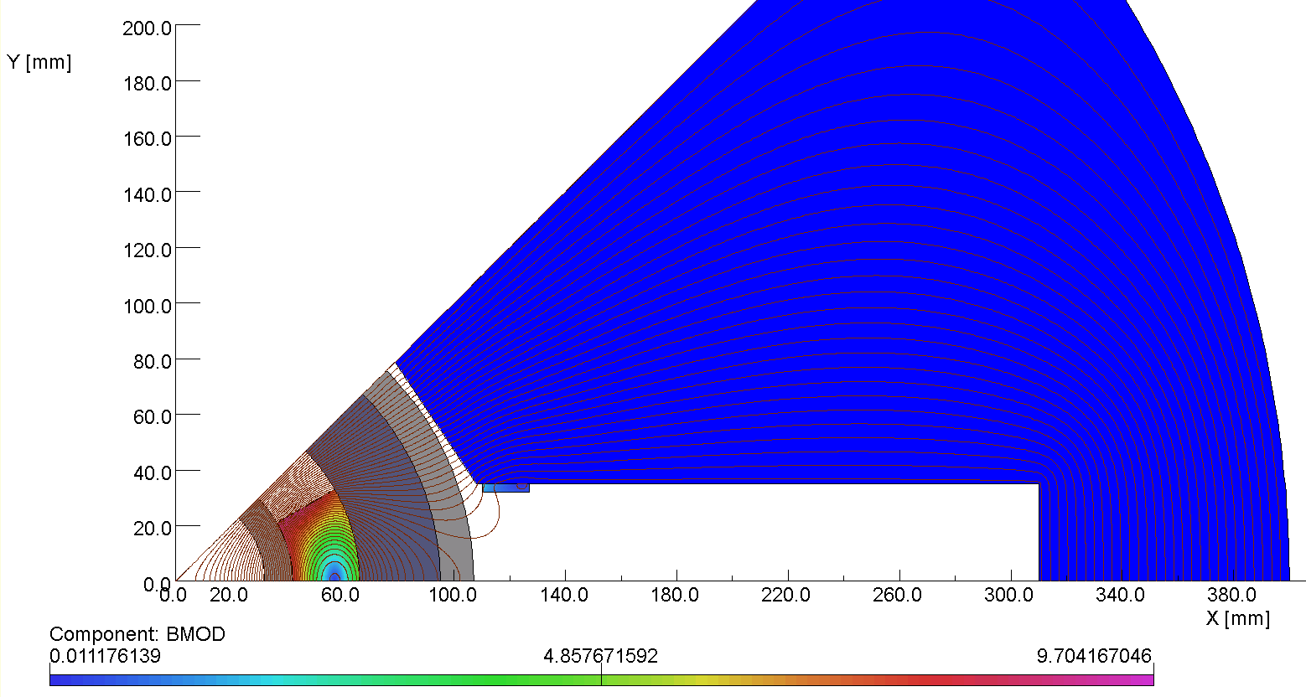
Proposed Q1B Quadrupole Parameters*.
R_apt = 32 mm
t_inner = 10 mm
R_coil = 42 mm
t_coil = 24 mm
t_collar = 29 mm
t_outer = 12 mm
d_outer = 107 mm
Brett Parker @
Electrons for the LHC
Workshop, Orsay 2018
This time the yoke is more highly saturated. So we will need to take more care in optimizing the shape of the pole tip.
Q1B
R_{apt} = 32 mm
G = 200 T/m
Coil used for fine tuning
Slot extends to 310 mm
*Concept discussed at May 2018 CERN meeting.

Slide 17
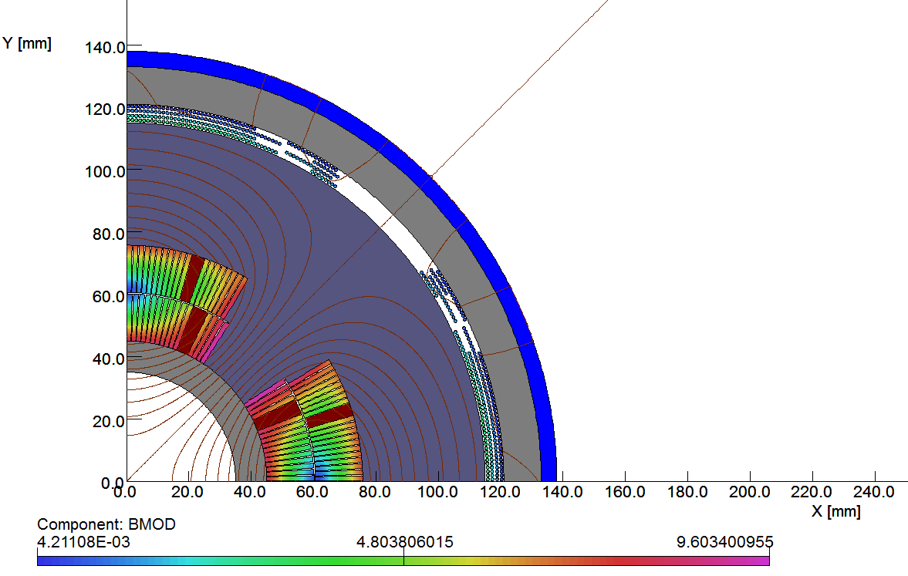
70 mm Bore, Q2 Actively Shielded Quad*.
G_{Bare} = 200 T/m, G_{Net} = 186 T/m
Eff = 100*[186/200] = 93.% Checks
Brett Parker @
Electrons for the LHC
Workshop, Orsay 2018
d_{min} could be 11 mm smaller without shield. This corresponds to a 9% d_{min} size increase.
Rref = 22 mm
n Bn
1 0.0
2 10000.0
3 0.0
4 0.0
5 0.0
6 0.9
7 0.0
8 0.0
9 0.0
10 0.0
Max. |B| in Coil = 9.6 T

Slide 18
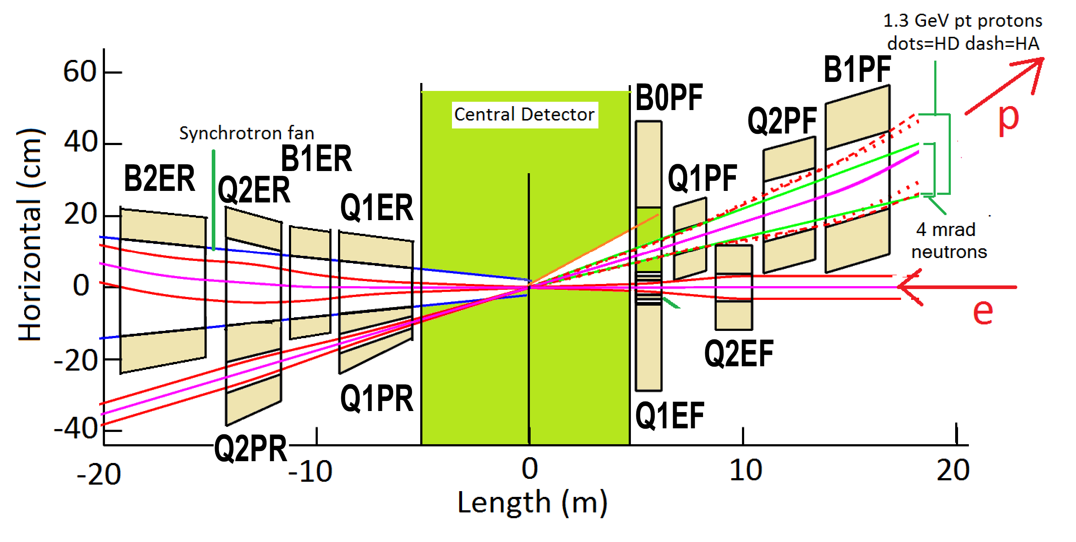
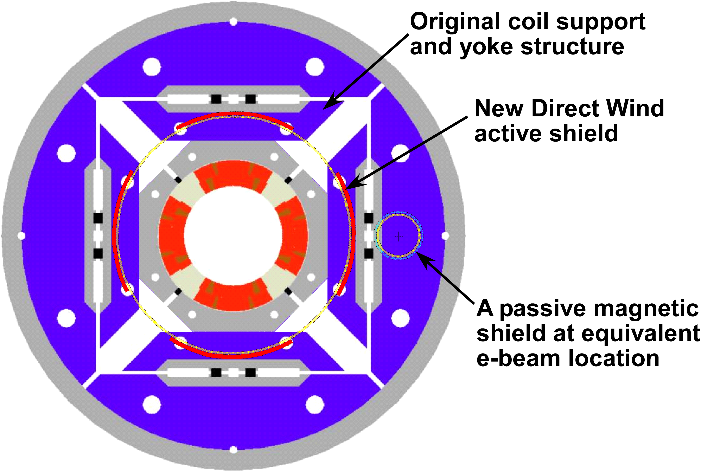
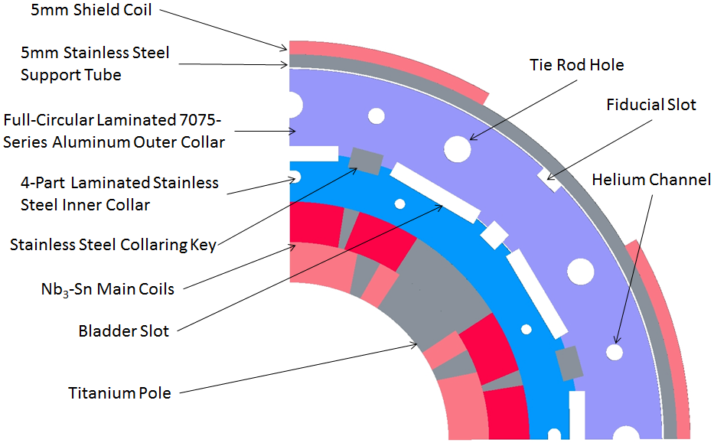
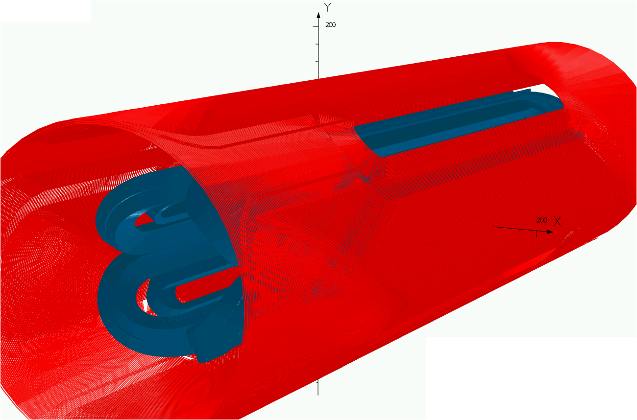
Fast Track R&D
Rear Side
Key Challenges:
Do we really need Nb₃Sn technology?
Forces will be substantial independent of conductor choice
Need a short model for the asymmetric magnet design
with field free region for electrons!
HL-LHC Nb₃Sn magnets required over 20 years R&D!
New NbTi magnets not that much less [ca. 10 years]
Additional challenges from integration with ALICE III!
HL-LHC magnet production [after R&D]: 5 years for one IR!!!
Forward Side
Brett Parker @
Electrons for the LHC
Workshop, Orsay 2018
Use existing Nb₃Sn coils (from LARP work) with a new active shield to prove out Q1PF concept.
Main challenge is limited space for mechanical structure.
NbTi active shield coil around an Nb₃Sn inner coil
New proposed compact mechanical structure
LARP mechanical structure comparison

Slide 19
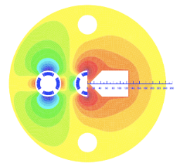
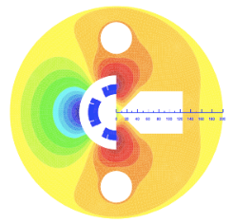
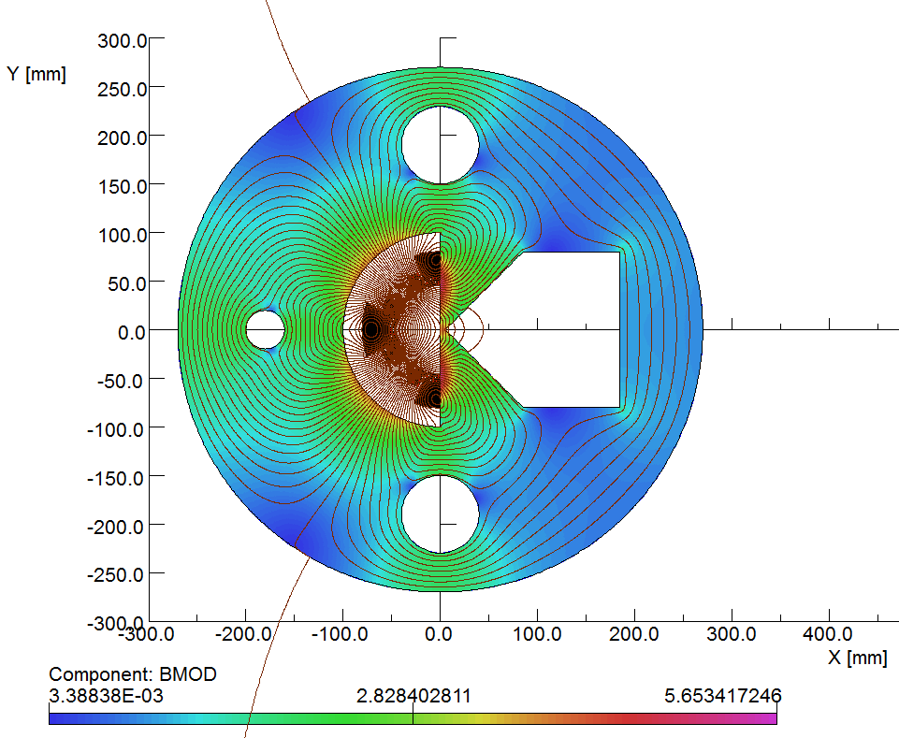
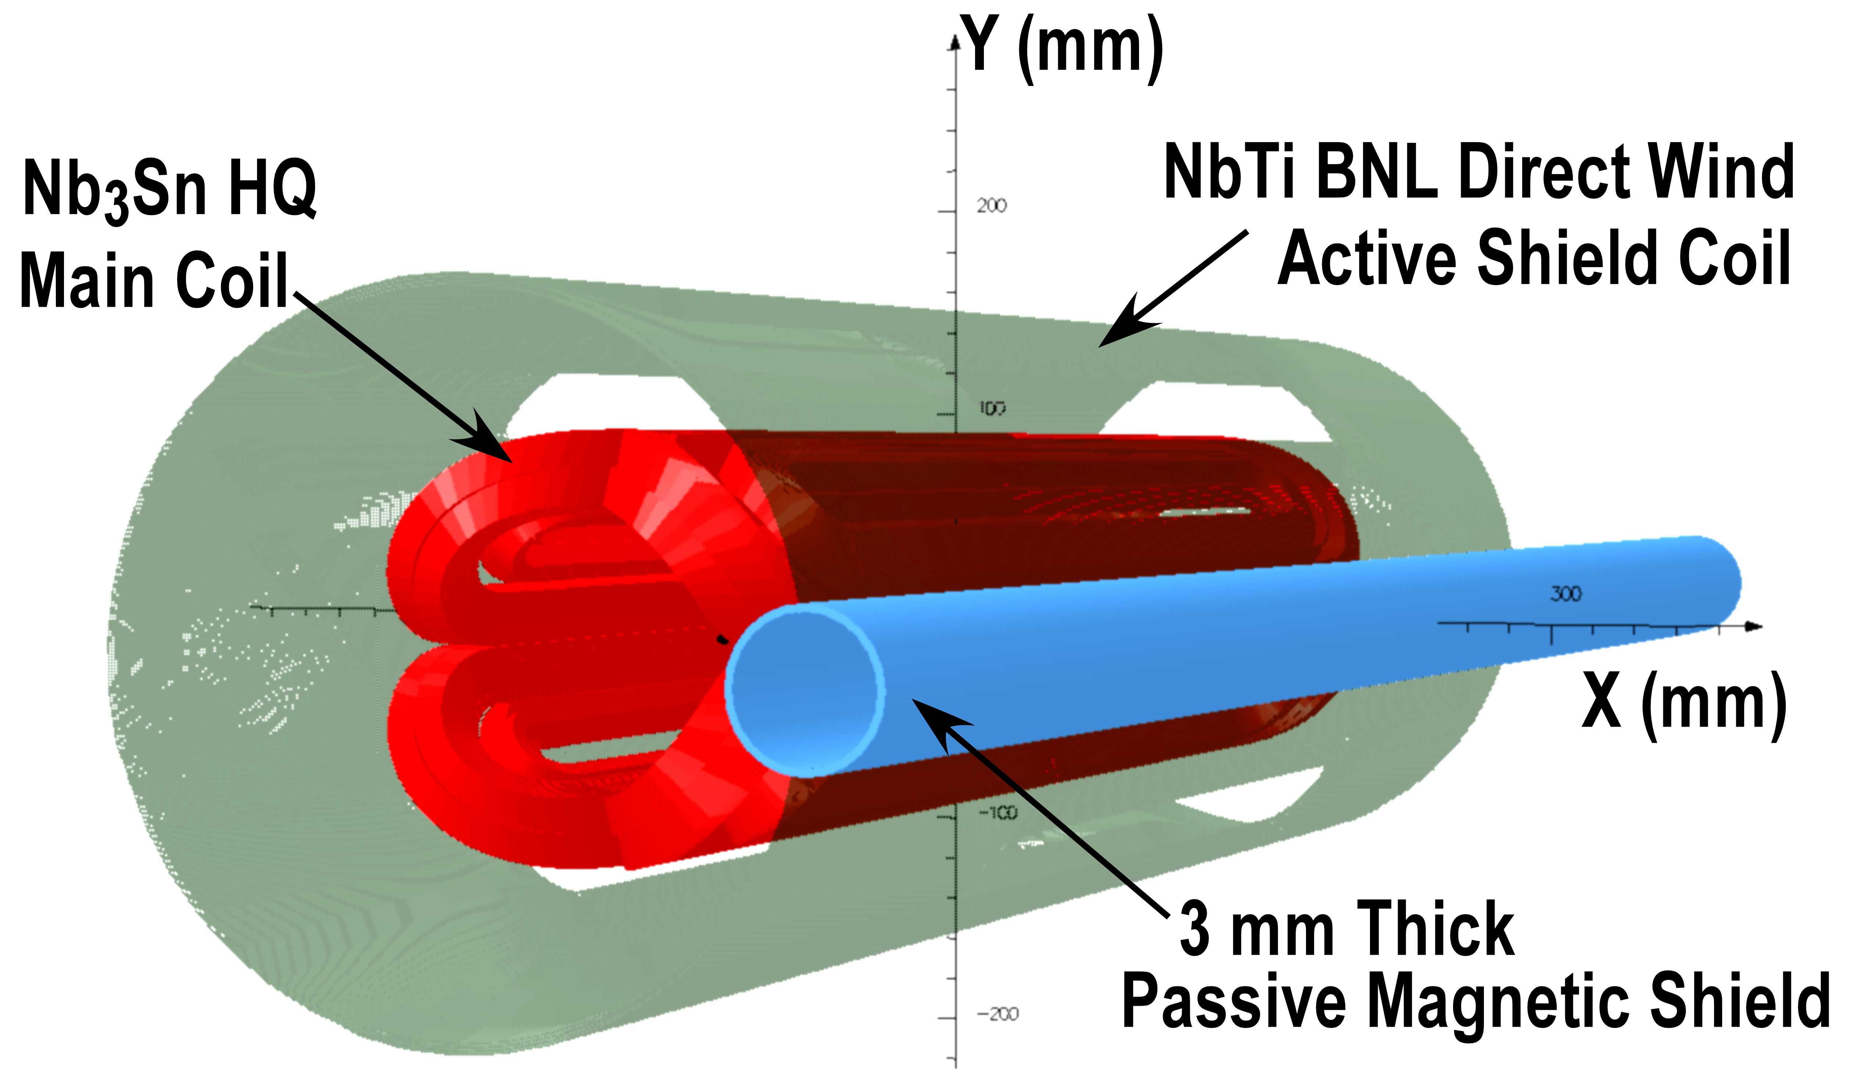
Asymmetric IR Design: Challenge Triplet Magnets & SR
S. Russenschuck in CDR 2012
CDR parameter: R = 23mm; 250T/m SA [6-7T] &
R = 46mm; 145 T/m HQ [6-7T]
IR magnet design is clearly challenging and
requires novel SC magnet design features
➔ Need to start R&D now to be ready by 2033!
B. Parker @ LHeC 2017
Workshop and IPAC2016:
R = 30mm; 151T/m [4.5T]
With an active coil for field
Compensation ➔ ‘sweetspot’

Slide 20
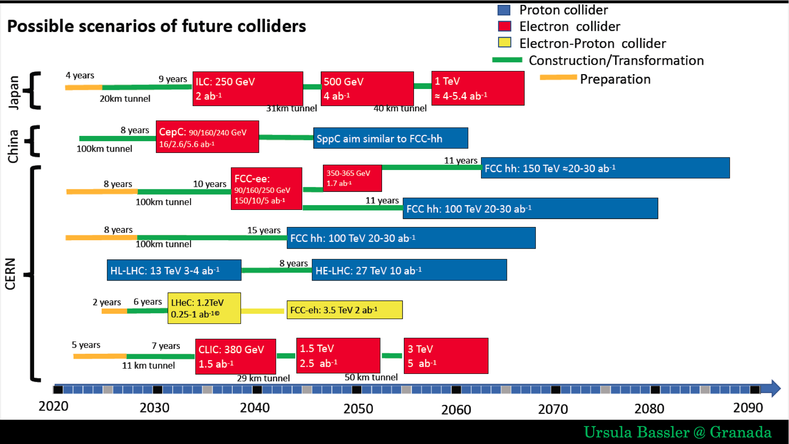
Start now ‘29

Slide 21
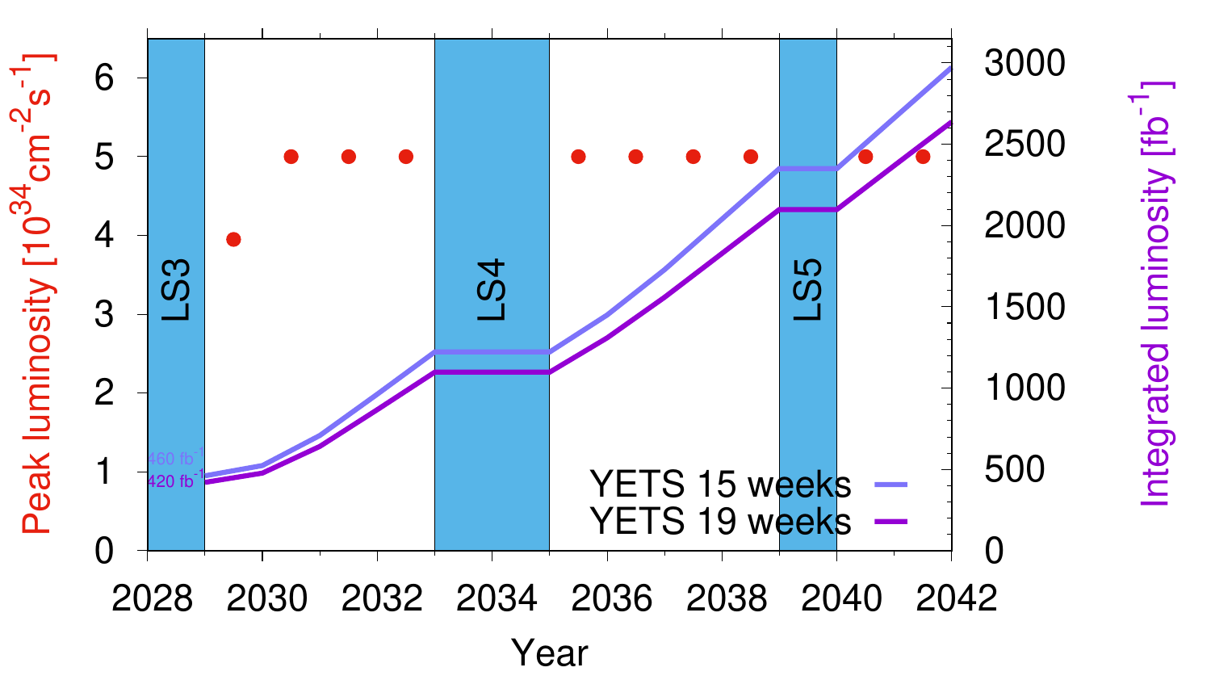
HL-LHC Schedule Planning
Current Concerns:
Energy Prices and operation cost!
Rogelio Tomas @ HL-LHC Coordination Group 18.10.2022

Slide 22
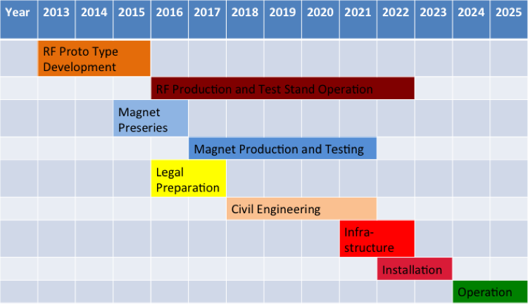
LHeC Tentative Time Schedule
2023
2033 LS4 start
2030 – End Phase II Perle
LS3 --- HL LHC

Slide 23
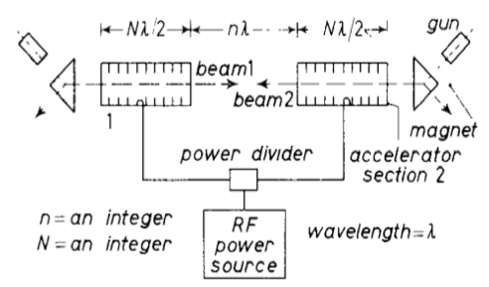
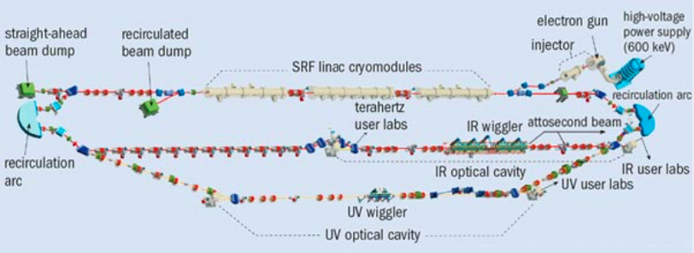
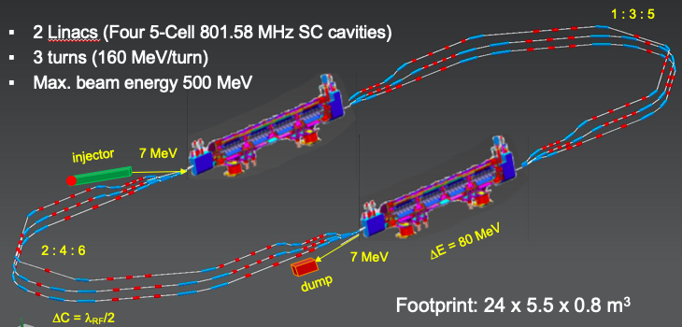
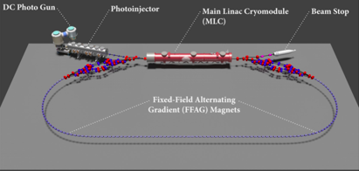
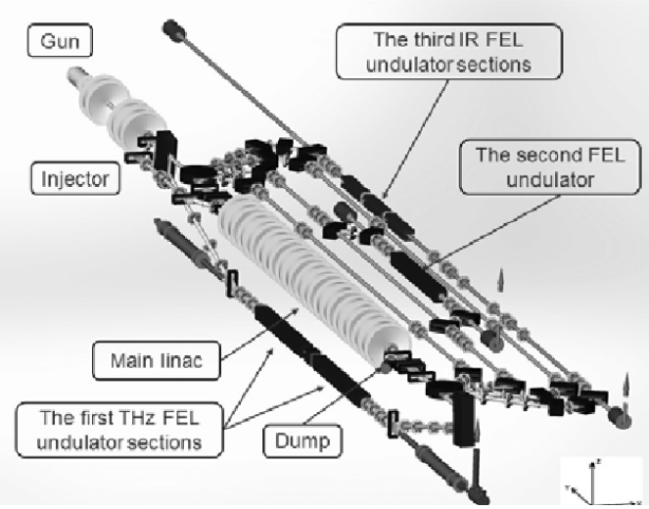

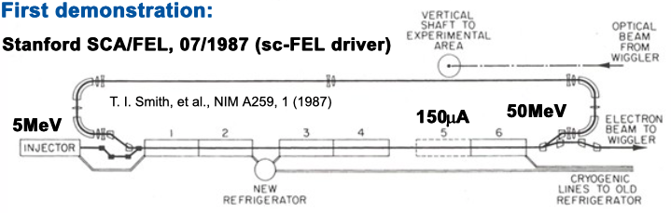
ERL Evolution:
First Idea:
M. Tigner 1965
JLab First MW beam power operation
FEL Demo [1999] & Upgrade [2000]
Multi-turn SRF
C-Beta 2019-2020
Multi-turn SRF, multi-MW
PERLE@Orsay 2025
We missed two important major milestones ahead of PERLE!
No demonstration of >> 1MW beam power
Missing demonstration of high beam current multi-turn operation
➔ Increased urgency to demonstrate these aspects asap!
ALICE
JEARI ERL
1960
1970
1980
1990
2000
2010
2020
2030
2040
First Demonstration
SLAC SCA / FEL 1987
Multi-turn Operation
BINP FEL 2004 [NC]
Multi-MW Operation
bERLin-Pro 2020
HEP / NP ERL application
LHeC; FCC-hh; ep and eI;

Slide 24
Summary of Key Challanges
Source Concept:
Need to demonstrate high current operation with good lifetime ➔ underway in Orsay
SRF challenges:
-HOM couplers integration and FE FRT systems ➔ need cryomodule finalization
-N doping and higher Q₀ ➔ would need R&D now
Magnet challenges:
Interaction Region design and Synchrotron Radiation
Asymmetric magnet designs with high peak field in coils ➔ need magnet R&D now!
Integration of LHeC optics into ALICE III layout ➔ further optics and layout studies
Energy Recovery Linac Concept:
Need to demonstrate feasibility / scalability to multi-turn multi-MW beam power

Slide 25
End

Slide 26







ERL Cost Items scaling with Energy: 802 MHz 5-Cell SRF
JLAB / CERN
collaboration
1st Cavity Prototype for PERLE/LHeC and FCC-ee/eh
F. Marhauser Feb 2018
Q₀ (2k) = 3 e10 @ ~27 MV/m
And these results are without Nitrogen doping or Infusion!!!
➔ There is still headroom!!!
✔
?
Parameter | Unit | CRN5
E_{acc} at quench | MV/m | 30.1
E_{pk} at quench | MV/m | 68.1
B_{pk} at quench | mT | 126.3
FE onset field | MV/m | ~25
FE-induced radiation(max) | mR/hr. | 0.06
Max. Q₀-value | /1e10 | 4.72
Q₀-value at 25 MV/m | /1e10 | 3.12
Lorentz Force Detuning | Hz/(MV/m)² | -1.5
Quench @ E_{acc} ~ 30 MV/m
✔
?
LHeC requirements
✔
?
✔ = done, ? = option

Slide 27

ERL
Facilities
Overview:
ERL2017 workshop
@ CERN
CBETA

Slide 28
ERL Validation Needs and Experience
Operational experience up to 1MW virtual beam power:
Proposed Collider Projects [e.g. LHeC and FCC-eh] and electron cooler designs for the eI collider extrapolate demonstrated virtual beam power far beyond the achieved 1.5MW operation!!!
ERL Test Facilities
ERL Collider Projects
JLab pioneering
eRHIC [6]
LHeC [3]
C-Beta [4]
EUV KEK [1]
IR-ERL JLab [1]
bERLpro [1]
PERLE [3]
cERL @KEK [1]
MESA [2]
Demonstration of multi-turn, multi MW ERL
Operation is on its way!!!
PERLE
ERL demo [1]
ARIEL TRIUMF [1]
CBAF-ER [1]
ERL@CBAF [5]
CeC@RHIC [1]
1.5MW Highest
demonstrated
Virtual beam
power
Test ERL@BNL [1]
ALICE [1]
sDALINAC [2]
ERL Applications

