Slide 1
Quantum Simulation of Hamiltonian Using Variational Approach Involving Linear Combination of Unitary Operators
Ashutosh Singh
Indian Institute of Technology Roorkee
Supervisor: Prof. P Arumugam
(In close collaboration with Pooja Siwach and Abhishek)

Slide 2
Outline
Introduction
Motivation
Solving nuclear physics problems
Algorithms
Modified algorithm

Slide 3
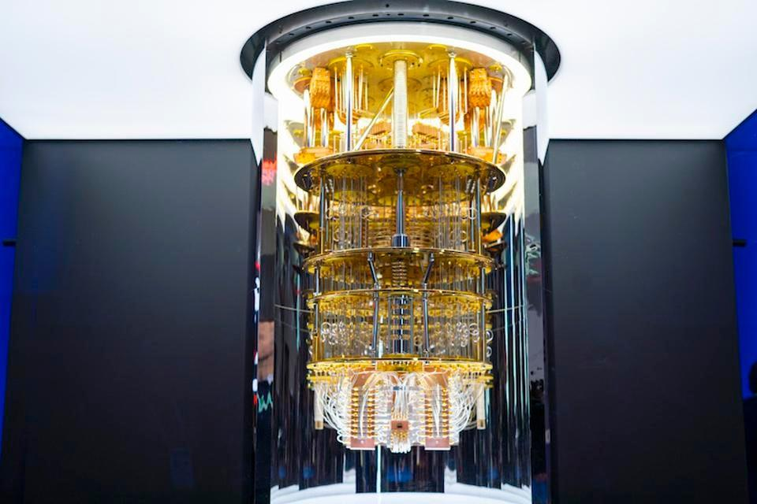
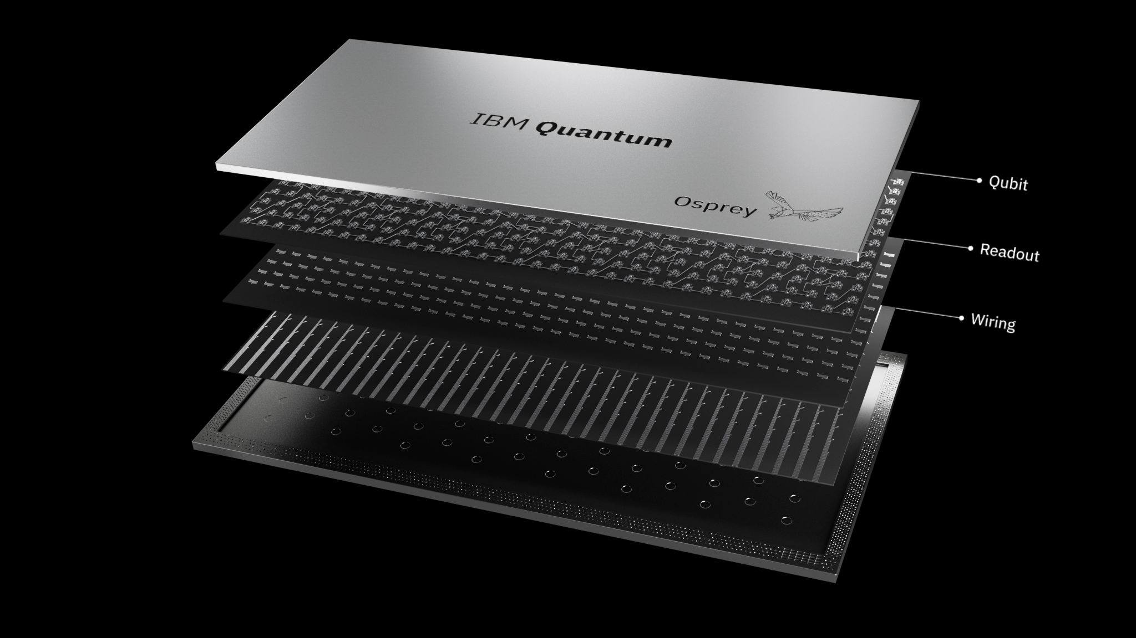
Introduction
Why Quantum simulations?
Certain problems can be solved in polynomial time on the quantum computer, which cannot be solved in polynomial time on a classical computer.
Classical simulations face difficulty in simulating any quantum system due to exponential growth in resource requirements.
Similar complexities occur in nuclear many-body problems.
We are trying to solve the smaller problem on the quantum computer of the present NISQ era.
Also, trying to give proof of concept that problems can be solved on the quantum computer once they are a practical reality in the near future.
P.C.: IBM Quantum

Slide 4
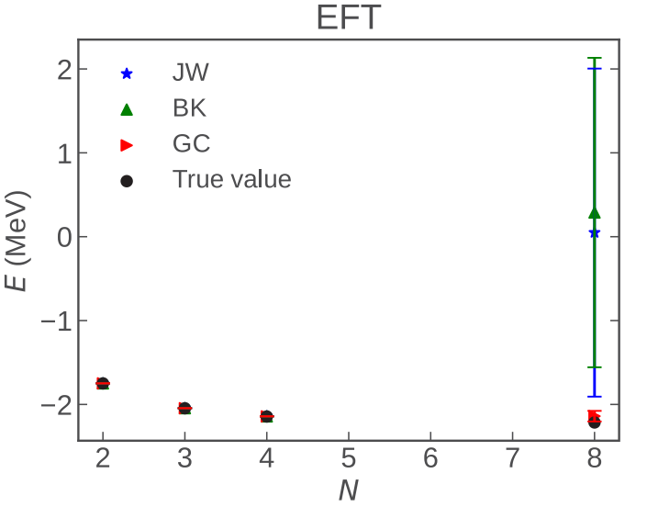
Motivation for current work..
In the last decade, quantum computers have been used to simulate various molecules, and a wide variety of chemistry problems are being simulated.
In recent years researchers have drawn their attention to nuclear physics problems which can be solved on a quantum computer.
E. Dumitrescu et al. PRL 120 (2018) 210501.
PS and PA, PRC 104 (2021 ) 235501.
A. Roggero et al. PRC 100 (2019) 034610.
Fig. 1: Deuteron binding energy as function of number of basis states.

Slide 5
Continue…
In Childs et al. QIC 12 (2012), 901-924 , a new approach for simulating Hamiltonian dynamics based on implementing linear combinations of unitary (LCU) operations is proposed.
LCU method is used in PS and PA, PRC 105 (2022) 064318, to calculate the expectation value of operators.
In TB and SK, JCP 154 (2021) 194107 , proposed a technique to simulate molecular resonances.
In A. Roggero et al. PRC 102 (2020) 064624, used LCU for creation of excited states.
Motivated by these, we are trying to modify the variational algorithm and implement it for complex energy calculations.

Slide 6
Encodings and quantum algorithms
We transform the nuclear problem in such a way that it can be solved on a quantum computer.
Where,
We map many-body basis states and operators to qubit basis states and operations respectively.
This mapping is done via various encodings, among which we will primarily use Jordan-Wigner transformation (JWT) and Gray code encoding (GC).
After mapping, the second quantized hamiltonian transforms to Pauli strings which can be applied to quantum circuits.
We have various algorithms like VQE, Quantum phase estimation (QPE) and LCU etc., which can be used to simulate the problem.

Slide 7
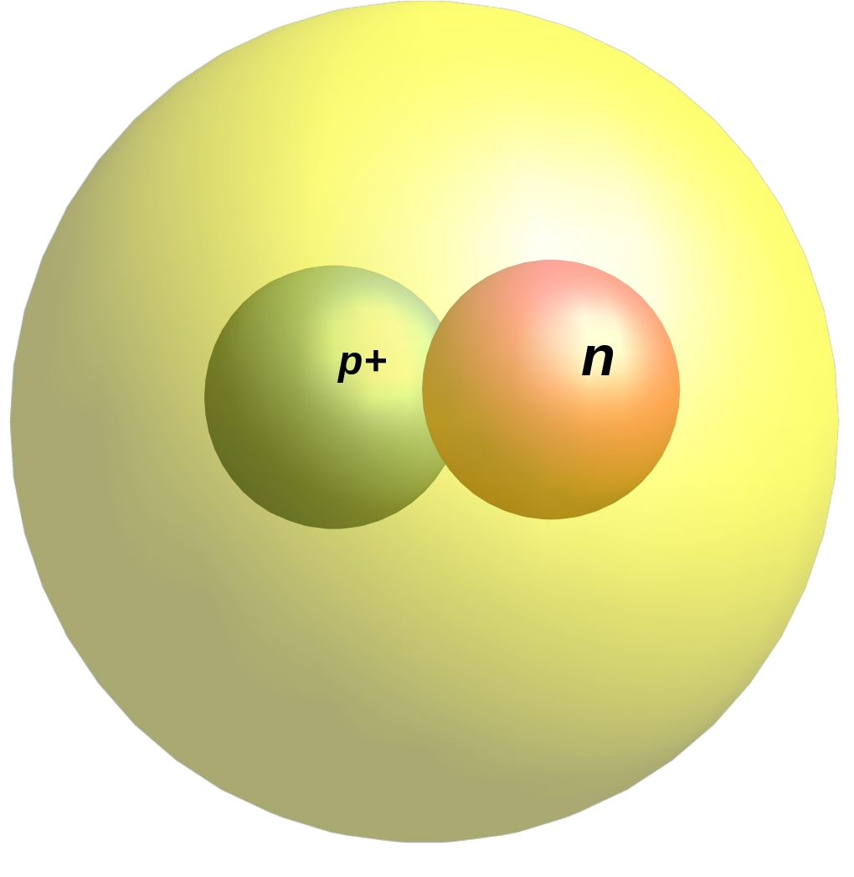
BE of Deuteron
For simplicity, we choose the problem of deuteron BE calculation.
Hamiltonian for N=2 , N=3 and N= 4 are:
O. D. Matteo et al. PRA 103 (2021), 042405.
PS and PA, PRC 104 (2021 ) 235501.

Slide 8
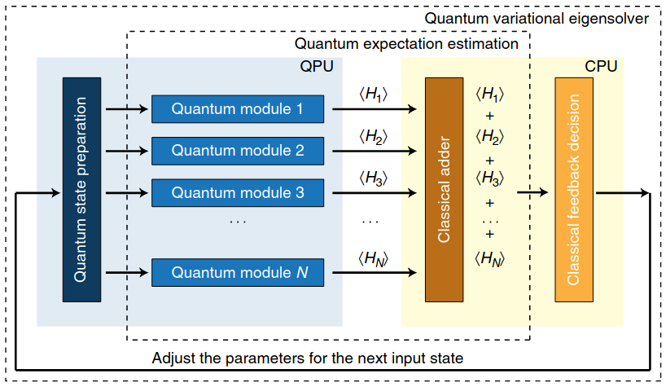
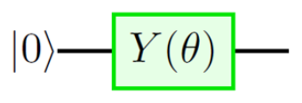
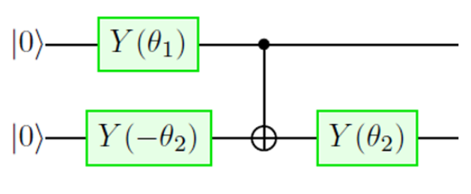
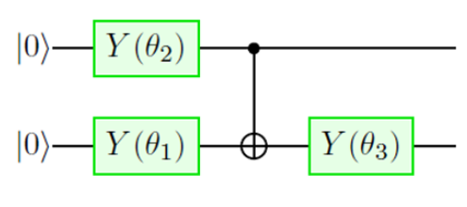
Variational Quantum Eigensolver (VQE)
(a)
(b)
(c)
Fig. 3: Parameterized ansatz for N=2, 3 and 4 for GC encoding.
Fig. 2: Architecture of the variational-quantum eigensolver.
A. Peruzzo and J. McClean et al. Nature Communications 5, 4213 (2014)
PS and PA, PRC 104 (2021 ) 235501

Slide 9
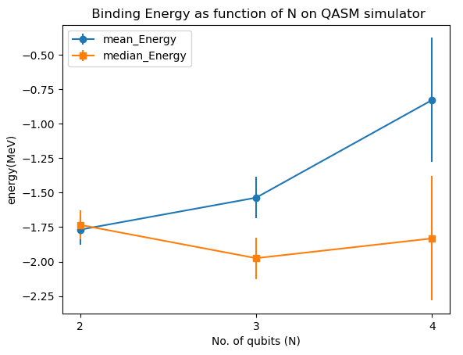
Results for binding energy through VQE
Basis size (N) | True Value | VQE (Results)
2 | -1.74916 | -1.7335918 ± 0.107
3 | -2.04567 | -1.9751983 ± 0.150
4 | -2.145 | -1.8317920 ± 0.451
Fig. 4: Energy as a function of number of states for EFT potential for GC encoding
Table 1: Energy calculated with QASM simulator for EFT potential

Slide 10
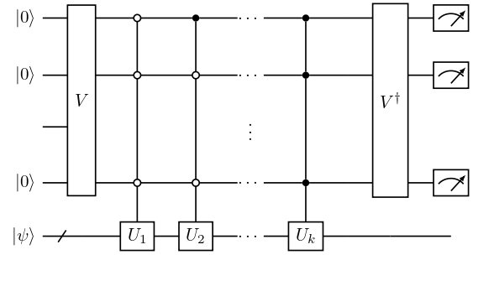
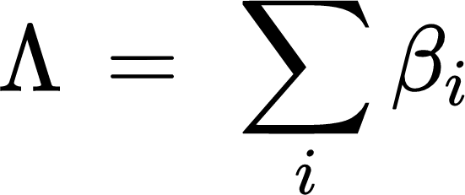
Expectation value through LCU
The method for calculating expectation value based on LCU is discussed in PS and PA, PRC 105 (2022) 064318 and A. Roggero et al. PRC 102 (2020) 064624.
Where,
and
Fig. 5: General circuit for LCU

Slide 11
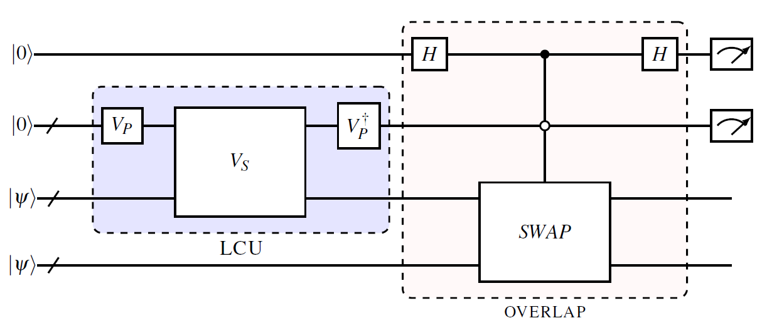
Continue …
Once we get the we can calculate expectation value of operator by taking its overlap with
Fig. 6: Expectation Value Calculator
J.C. Garcia-Escartin et al. PRA 87 (2013), 052330.
PS and PA, PRC 105 (2022), 064318

Slide 12
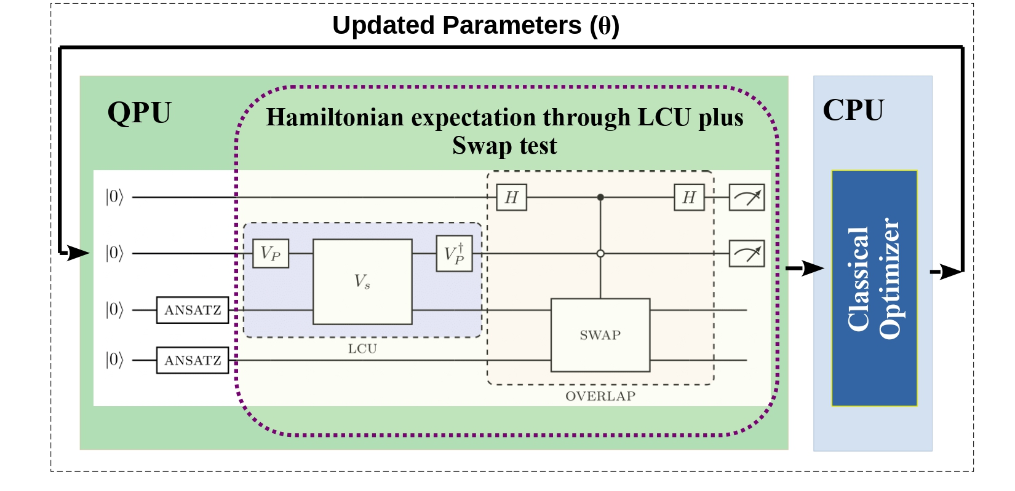
Modified algorithm
Fig. 7: Modified variational algorithm for expectation value calculation

Slide 13
Results and discussion
We have applied this algorithm for binding energy of deuteron under EFT potential, and Hamiltonian is encoded via Gray Code encoding.
Classical optimizer used for our calculation is SPSA optimizer.
Executed the algorithm for 100000 shots and 100 independent runs.
For error bar we used MAD.
Basis size (N) | True Value | Modified variational algorithm
2 | -1.74916 | -1.7459993 ± 0.025
3 | -2.04567 | -2.0464696 ± 0.044
4 | -2.145 | -2.0992413 ± 0.078
Table 2: Energy calculated with QASM simulator for EFT potential through modified algorithm

Slide 14
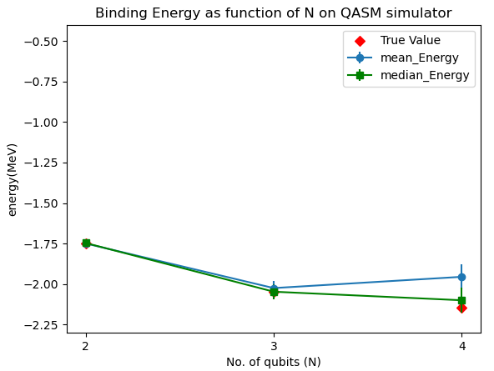
Results
Fig. 8: Energy as function of number of states for EFT potential for GC encoding using modified variational algorithm using LCU.

Slide 15
Conclusions
We modified the variational algorithm such that it can be applied to system having non hermitian Hamiltonian.
We calculated the BE of deuteron with our method and results are in agreement with the published VQE results.
Even though this method is more prone to error due to larger gate depth, this method can be applied to the non-hermitian matrix, which occurs in the case of resonances.
This shows a validity of method and further it can be extended for the Hamiltonian having complex energies.

Slide 16
Thank you

