Slide 1
Efficient encodings for simulating nuclear many-body problem
Nov. 22-24, 2022
Pooja Siwach

Slide 2
Outline
Introduction
Nuclear Hamiltonian
Encodings
Transformations
Simulations results
Results with noise and noise mitigation

Slide 3
Introduction
What makes the nuclear many-body problem different from others?
Form of interaction is unknown.
Strong and short-range
Several unique symmetries
Adding one more nucleon can change the properties substantially
Problem with conventional computers
Ab-initio approach cannot be followed for heavy nuclei even with the best supercomputer and with employing muliple CPUs and GPUs.
Higher order interaction terms make computations more complex

Slide 4
Nuclear Hamiltonian simulation
Matrix element for kinetic term (tri-diagonal)

Slide 5
Encodings
Mapping quantum many-body states on qubits
OH
BK
Binary
GC
GC utilizes complete Hilbert space of basis,
No. of qubits is the same in OH and BK but reduced in GC.
|3>
0
1
11
10
|2>
0
0
10
11
|1>
1
1
01
01
|0>
0
0
00
00
|0100>
|1100>
|0010>
|1010>
|01>
|11>
|10>
|01>
Jordan & Wigner, ZP 147 (1928)
Seeley et al., JCP 137 (2012)
Sawaya et al., npj QI 6 (2020)

Slide 6
Transformations for OH and BK
JW
J&W, ZP 147 (1928)
BK
Compared in JCTC 2018, 14, 5617−5630
and BK is found to reduce the gate count substantially.
update
parity
remainder
Seeley et al., JCP 137 (2012)

Slide 7
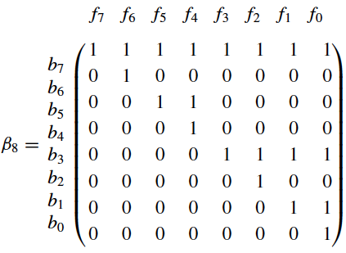
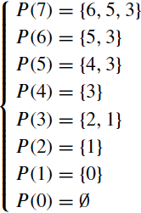
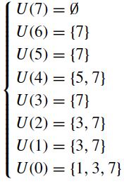
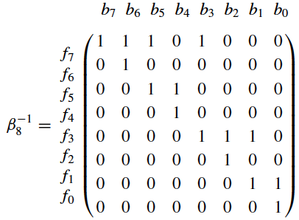
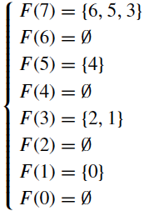
Sets in BK
Seeley et al., JCP 137 (2012)

Slide 8
Transformation for GC
Matching qubits
Mismatching qubits
Sawaya et al., npj QI 6 (2020)
PS and P. Arumugam, PRC 104 (2021)

Slide 9
Hamiltonians and ansatz
EFT
Central
GC
JW
BK
Dumitrescu et al., PRL 120 (2018)
Matteo et al., PRA 103 (2021)

Slide 10
Transformed Hamiltonian
JW
BK
EFT
GC
JW
No. of terms is the same, but length of Pauli strings differ
Central
BK
GC

Slide 11
Deuteron BE

Slide 12
Results with noise mitigation

Slide 13
Zero-noise extrapolation
$$r=2M+1$$
PS and P. Arumugam, PRC 104 (2021)

Slide 14
Summary
Different encodings are explored for the nuclear Hamiltonian simulations
We analyze the encodings under noise and noise mitigation techniques
Gray code encoding is found to be the most efficient one for present case
Thank you

