Slide 1
S001 AGATA capsule scan trapping study vs temperature
G. Duchêne, F. Didierjean, M. Filliger, M. Moukaddam, M-H. Sigward

Slide 2
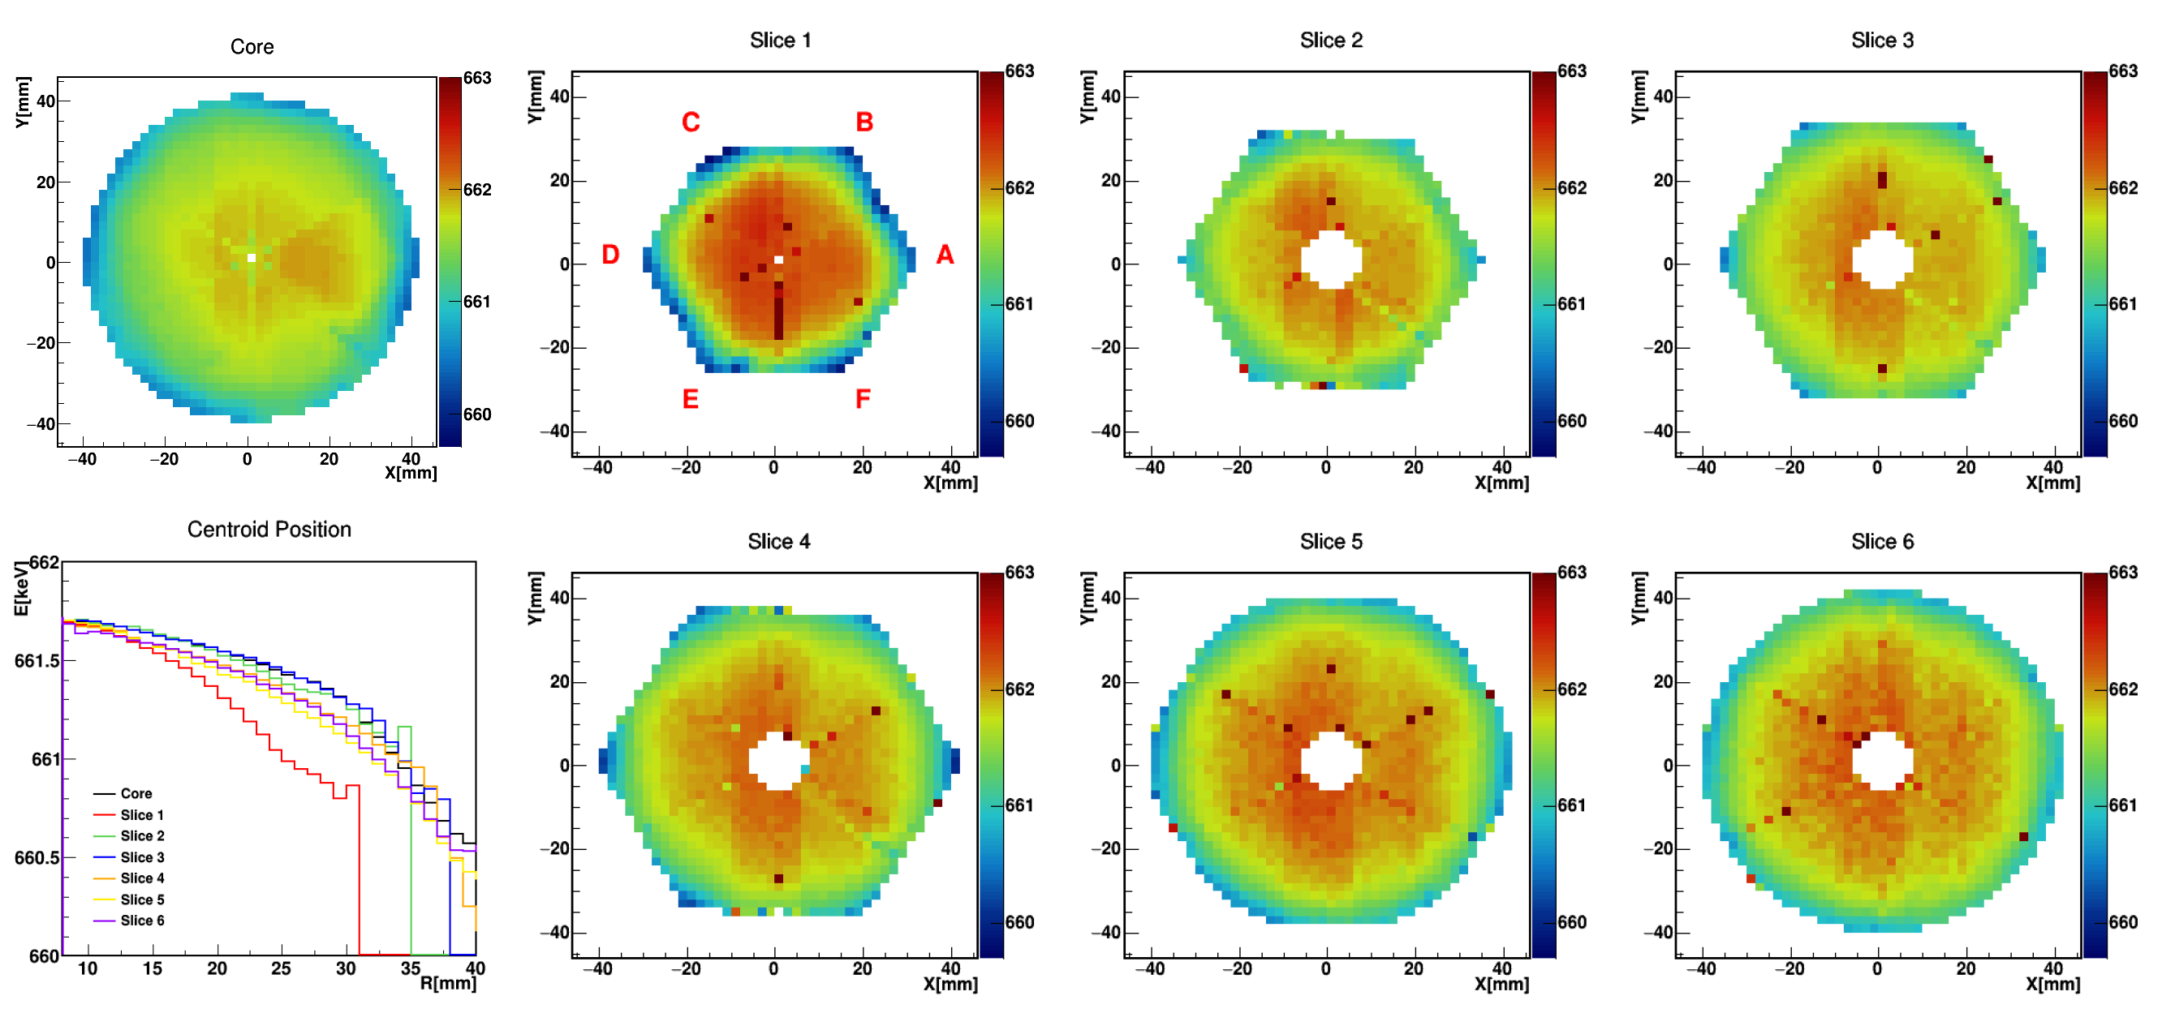
Electron trapping in n-type Ge detectors
Energy peak shifts (Mohamad’s talk)
Detector scanned in vertical position with a ¹³⁷Cs source (662 keV)
Gamma-ray spectrum collected at each XY position
Peak shift plotted vs XY/segment slice
Anomaly observed in slices 2, 3 and 4 (red arrows)
B. De Canditiis, PhD Univ. Strasbourg, 2020

Slide 3
Electron trapping in n-type Ge detectors
Normal electron
trapping
Abnormal electron
trapping
B. De Canditiis, PhD
Univ. Strasbourg, 2020

Slide 4
Electron trapping versus temperature
Trapping versus temperature
Trap depth = ΔE = E_{C} – E_{T}
Heat generates vibrations (phonons) which may excite the trapped electrons
Bolzmann law ~ C*e ^{–(ΔE/2kT)}
Explore in temperature and search temperature at which tail disappears
ΔE determination
E_{C}
ΔE
E_{T}
E_{V}

Slide 5
Values for Ge(Li) detectors
Trapping > 5 µs for
ΔE > 0.08 eV
D. Guthknecht, PhD,
Univ. Strasbourg, 1971

Slide 6
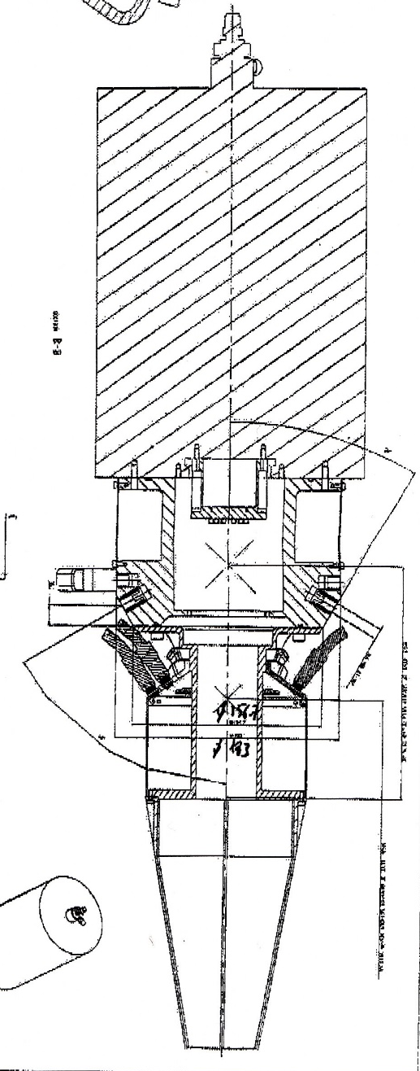
Electron trapping versus temperature
How to do that?
Screw heat resistances on the cold finger
Place a PT100 for temperature regulation/temperature monitoring close to the heat resistances
PT100
Dewar
heat
resistances
PT100
cold finger
PT100
crystal

Slide 7
Electron trapping versus temperature
How to do that?
Screw heat resistances on the cold finger
Place a PT100 for temperature regulation/temperature monitoring close to the heat resistances
PT100
Dewar
heat
resistances
PT100
cold finger
PT100
crystal

Slide 8
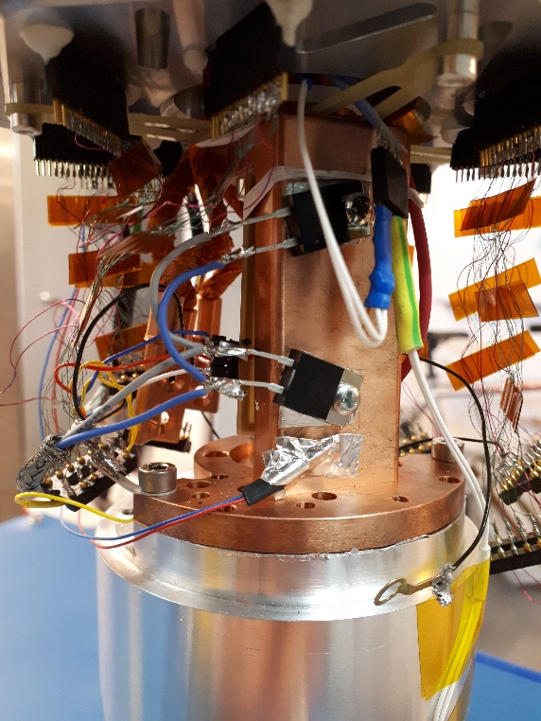
Electron trapping versus temperature
How to do that?
Screw heat resistances on the cold finger
Place a PT100 for temperature regulation/temperature monitoring close to the heat resistances
heat
resistances
PT100
cold finger

Slide 9
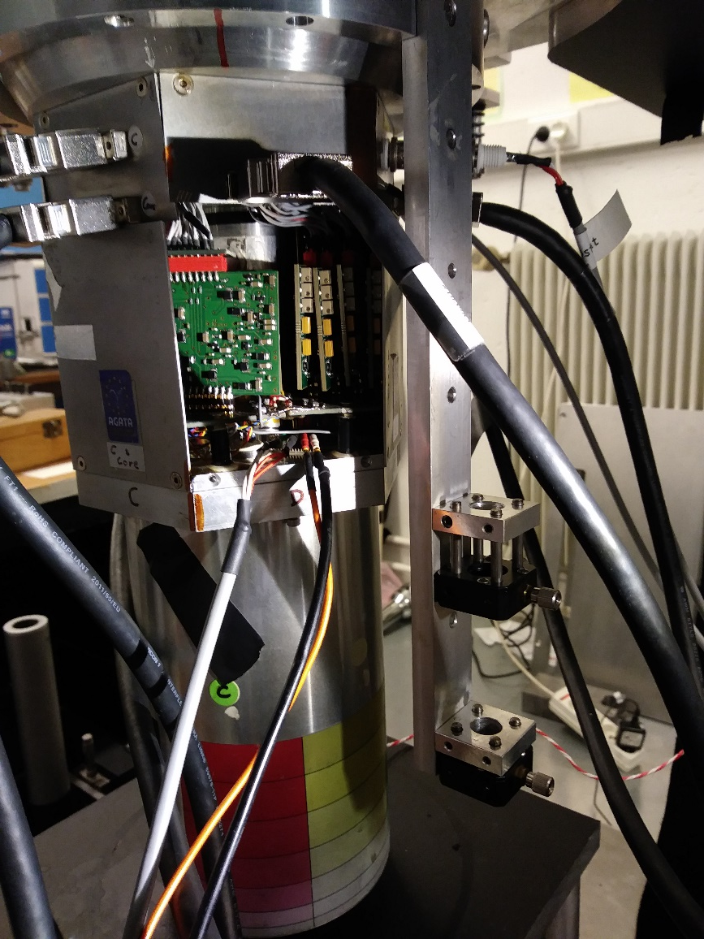
Electron trapping versus temperature
How to do that?
Screw heat resistances on the cold finger
Place a PT100 for temperature regulation/temperature monitoring close to the heat resistances
Open the preamp chamber
Connect wires to the resistances and the PT100
Cold finger
PT100
wiring
heat-
resistance
power wires

Slide 10
Electron trapping versus temperature
How to do that?
Add heat resistances in the cold finger
Place a PT100 for temperature regulation/temperature monitoring close to the heat resistances
Open the preamp chamber
Connect wires to the resistance and the PT100
Use the NKR-200 MIRION module for regulated T or a standalone power supply not regulated
Install a PT100 on the end-cap
Monitor all temperatures (Michel’s talk)

Slide 11
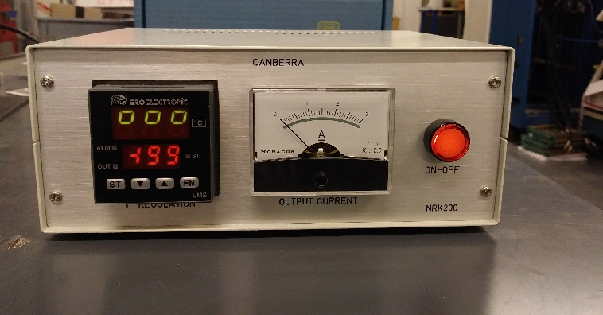
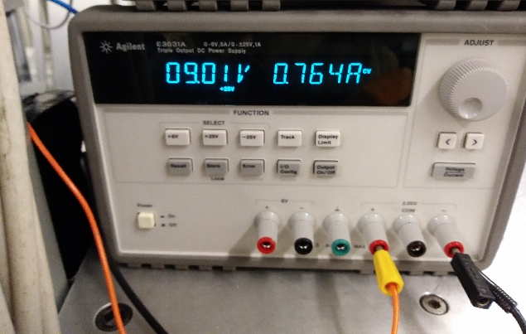
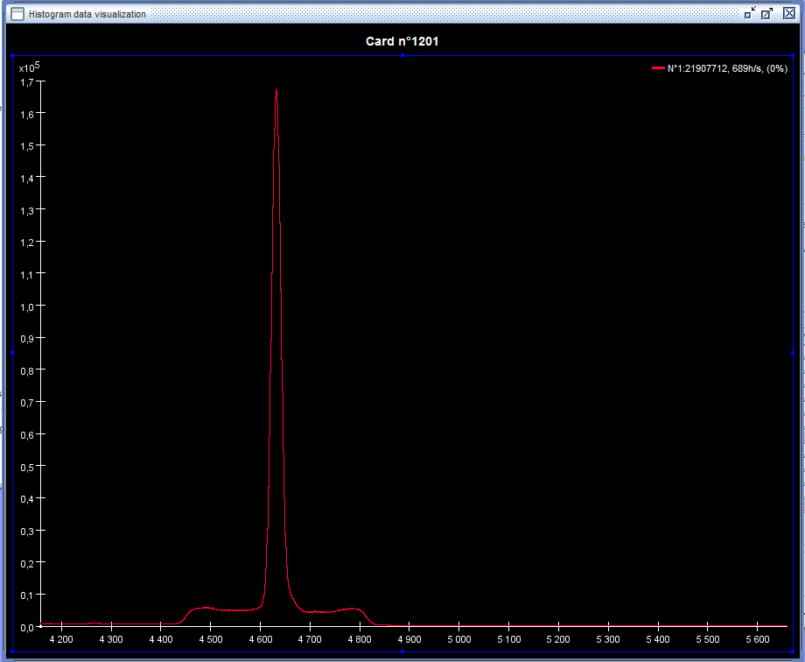
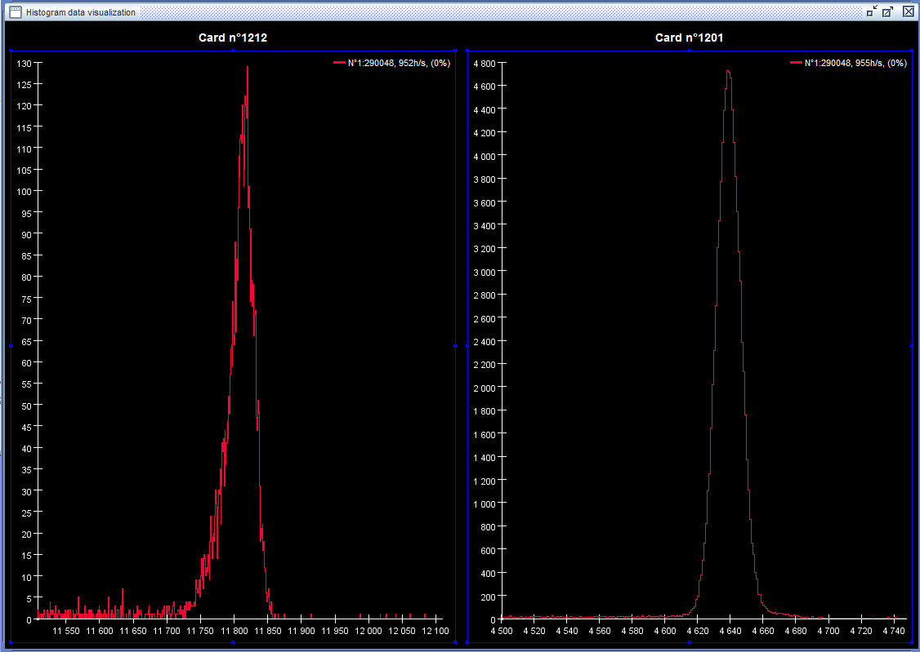
Electron trapping versus temperature
MIRION NRK-200 module
Standalone power supply

Slide 12
Electron trapping versus temperature
MIRION NRK-200 module
Standalone power supply

Slide 13
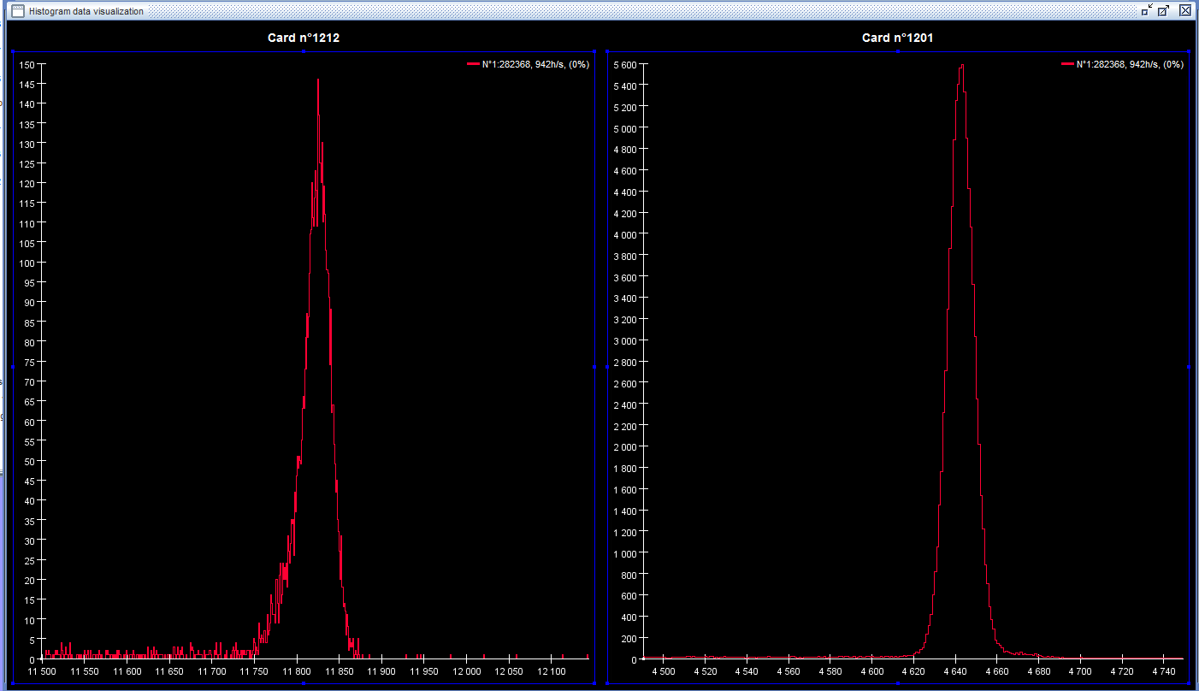
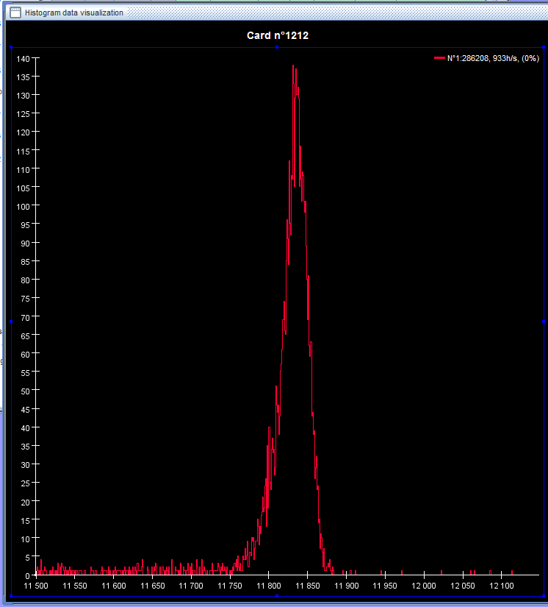
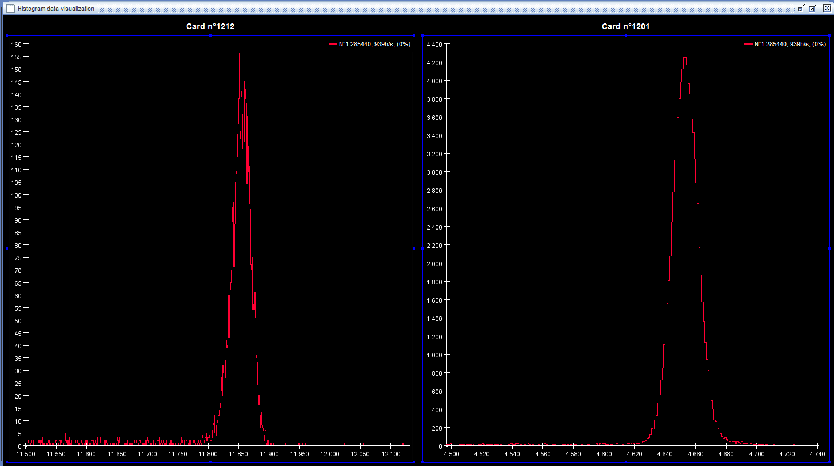
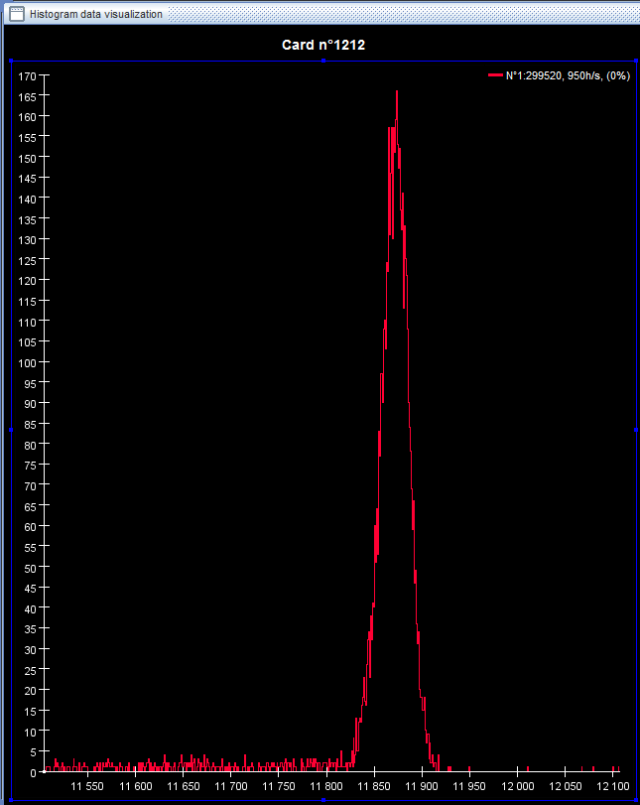
Electron trapping versus temperature
Fixed position with default
at different temperatures
Acquisition 300 sec
T° dét -177,97
T° dét -174,3°
T° dét -171,3°
T° dét -164,5°
T° dét -158,1°

Slide 14
Electron trapping versus temperature
Fixed position with default
at different temperatures
Acquisition 300 sec
T° dét -177,97
T° dét -174,3°
T° dét -171,3°
T° dét -164,5°
T° dét -158,1°

Slide 15
Electron trapping versus temperature
Trap occupation at T = 0 K
Occ = N₀
F_{FD} = electron distribution function
g(E) = electron state density in metals
F_{FD}
g(E)
In semi-conductors E is replaced by
E_{C} – E_{V}
In our case E is replaced by ΔE = E_{C} – E_{T}
F_{FD} *g(E)
E_{C}
E_{T}
E_{V}
E_{V}

Slide 16
Electron trapping versus temperature
Density of trapped electrons excited to the conduction bande
F_{FD} *g(E) = C(T)* e ^{–[ΔE/2kT]}
Integrating over all energies in the conduction band we get the number of electrons excited to the conduction band
ΔE
-ΔE/2kT

Slide 17
Electron trapping versus temperature
Density of trapped electrons excited to the conduction bande
F_{FD} *g(E) = C(T)* e ^{–[ΔE/2kT]}
Integrating over all energies in the conduction band we get the number of electrons excited to the conduction band
Trap with increasing T
Occ(T) = N₀*(1- N_{e}(T))
T at N₀ /2 (T_{1/2})
ΔE = 2kT_{1/2}*ln[4(2π/h²*m_{e}kT_{1/2})^{3/2}]
Extracted ΔE at T= -164°C
ΔE = 0.131 eV ~ 130 meV
Very preliminary
To be confirmed
N₀
N₀/2
ΔE
-ΔE/2kT

Slide 18
Electron trapping versus temperature
Density of trapped electrons excited to the conduction bande
ρ = C(T)* e ^{–[ΔE/2kT]}
Integrating over all energies in the conduction band we get the number of electrons excited to the conduction band
Trap with increasing T
Occ(T) = N₀ *(1- N_{e}(T))
T at mid height (T_{1/2})
ΔE = 2kT_{1/2}*ln[4(2π/h²*m_{e}kT_{1/2})^{3/2}]
Extracted ΔE at T = -164°C
ΔE = 0.131 eV ~ 130 meV
Very preliminary
To be confirmed
ΔE
ΔE (meV) | Τ (µs)
< 50 | < 0.1
~80 | > 5
160 (gold) | ~10⁶
-ΔE/2kT
D. Guthknecht, PhD,
Univ. Strasbourg, 1971

Slide 19
Perspectives
Similar study in any point of the scanned zone (same ΔE value everywhere along the default line?)
Check the evolution of normal electron trapping and extraction of the corresponding ΔE value
Compare with existing ΔE values for lattice defaults

Slide 20
Thank you for attention Thanks to IKP for S001 lending

