Slide 1


Emmanuel Clément (GANIL)
submitted to NIM A

Slide 2
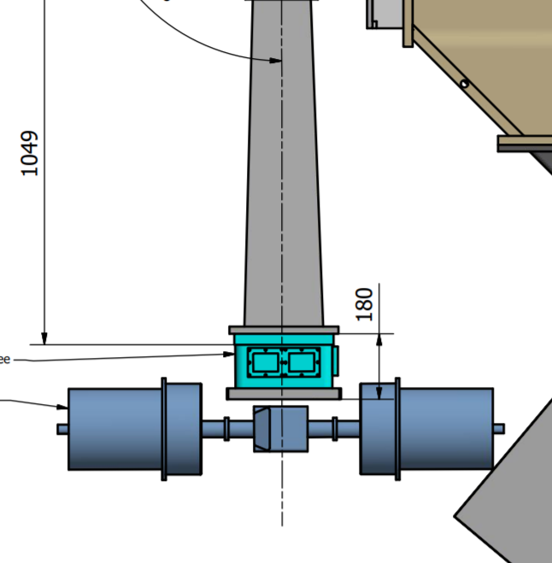
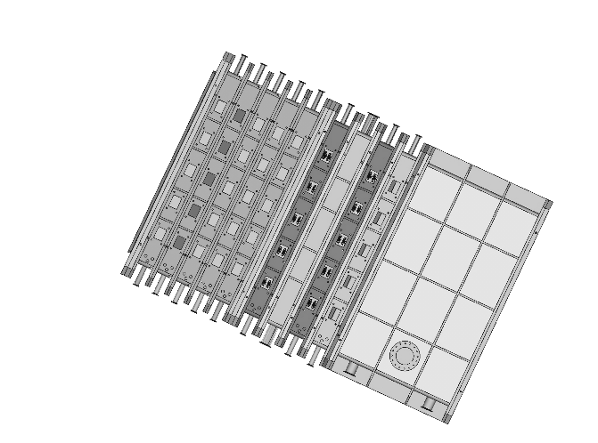
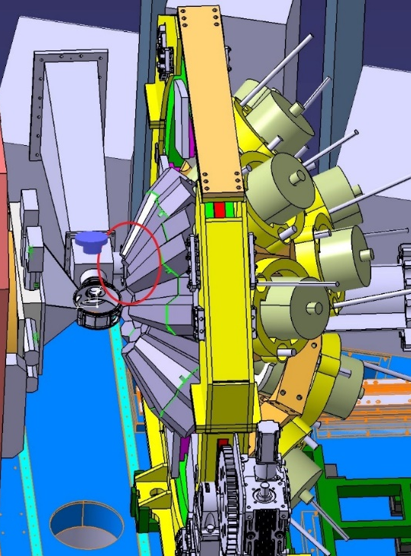
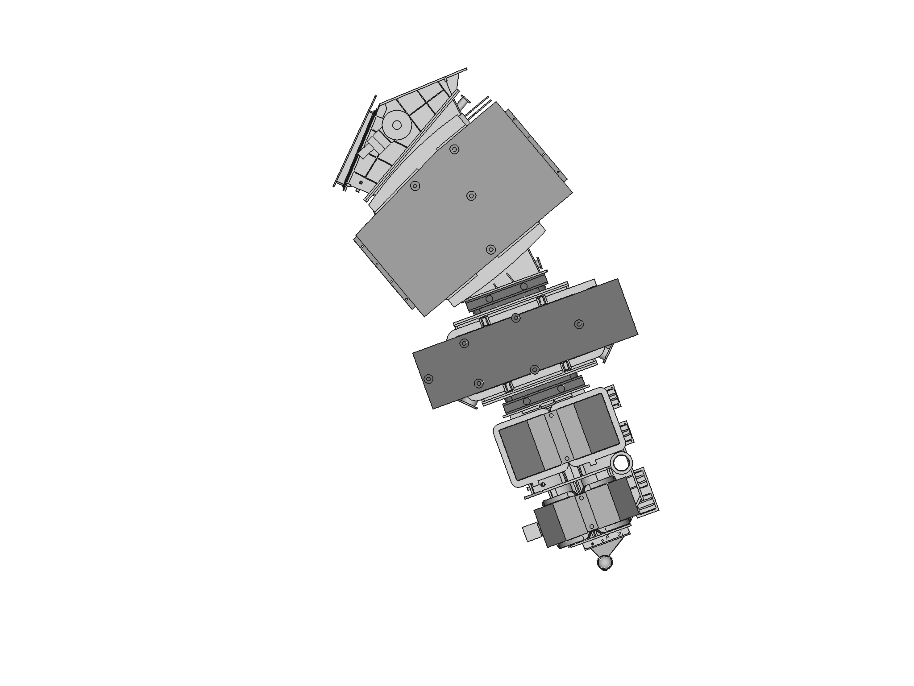
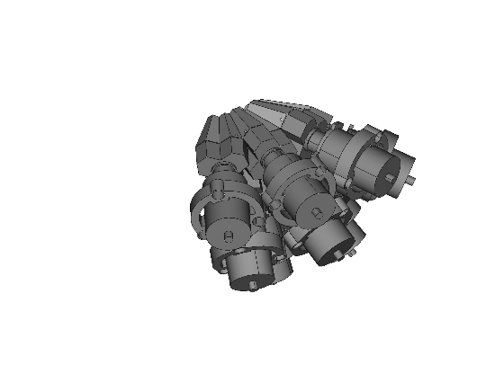
AGATA + VAMOS 2021 – Heavy Ions
Motivations :
2nd arm + EXOGAM ➔ TLF tagging
μs Isomer
A, E* measurement
Detection setup
TLF
55°
¹⁹⁸Pt
¹³⁶Xe / ²³⁸U
40°
PLF
Scaled X0.5
AGATA 39 crystal
As Compact configuration as possible
Full PID
Of PLF
Acquisition system
E810 : Production of Neutron rich nuclei using MNT ²³⁸U+²³⁸U.
D. Ackermann et al.
Detection of U-like in VAMOS
X-ray detection AGATA + LEPS
Focal plane
AGATA response function < 100 keV
E806 : Spectroscopy in the vicinity of N=126 from MNT ¹³⁶Xe+¹⁹⁸Pt
Second Arm Detection
Delayed γ-ray spectroscopy
Emmanuel Clément (GANIL)

Slide 3
PHYSICAL REVIEW C 92, 024619 (2015)
Light and heavy transfer products in ¹³⁶Xe + ²³⁸U multinucleon transfer reactions
A. Vogt et al.,
Emmanuel Clément (GANIL)

Slide 4
PHYSICAL REVIEW C 92, 024619 (2015)
Light and heavy transfer products in ¹³⁶Xe + ²³⁸U multinucleon transfer reactions
A. Vogt et al.,
?
?
Emmanuel Clément (GANIL)

Slide 5
Goal of the study :
The γ-rays with E< 100keV mainly interact with a single photo-electric effect in the first layer of the detector where the electric fields are the most complex
The mean free path of 100 keV photons in Ge is μm, well below the first AGS step
PSA answer will be wrong.
Tracking will not do miracle
How bad are we ?
Can we correct easily ?
→ Scan in energy from 15 keV to 1.4 MeV
Emmanuel Clément (GANIL)

Slide 6
November 2020 source measurement:
24 AGATA crystals
In nominal
7 days data taking
All data on GRID
+ all usual lines
+ 145 keV
Mono energetic sources
+ 279 keV
+ 391 keV
Emmanuel Clément (GANIL)

Slide 7
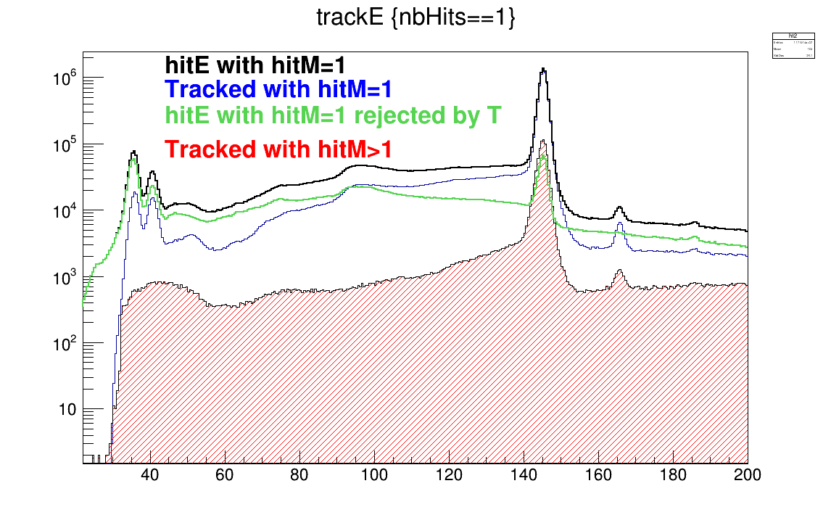
Present statement
¹⁴¹Ce
Emmanuel Clément (GANIL)

Slide 8
Data
Geant4
Accepted events are in the first ADL step
PSA returns a flat « random » Z distribution
Clustering on the sides
Emmanuel Clément (GANIL)

Slide 9
121 keV
In slice 1, there is no slice « 0 »
1408 keV
From B. de Canditiis et al, EPJA 57, 223 (2021)
Emmanuel Clément (GANIL)

Slide 10
All « core » Normalized
hitE/coreE0
Emmanuel Clément (GANIL)

Slide 11
All « core » Normalized
Core AddB / core
Emmanuel Clément (GANIL)

Slide 12
All « core » Normalized
OFT/core
OFT_{smearing} / core
Emmanuel Clément (GANIL)

Slide 13
All « core » Normalized
Acting on Post-PSA
(if MulSeg==1 && E < 100 keV,
&& Z < 10 mm)
Force all to 1 mm
Emmanuel Clément (GANIL)

Slide 14
All « core » Normalized
Acting on Post-PSA
(if MulSeg==1 && E < 100 keV,
&& Z < 10 mm)
Force all to 1 mm
Force all to 0.5 mm ▲
+ Force < 40 keV to 0.1mm ■
+ Force < 40 keV to 0.01 mm ○
Emmanuel Clément (GANIL)

Slide 15
¹⁴¹Ce
The low efficiency of AGATA at very low energies is not a tracking problem
It is a PSA problem
No slice 0 (but it is life)
More noisy signal after normalization
A fix in the post-psa was tested
Can Neural Network and auto-encoder reduce the noise ?
Emmanuel Clément (GANIL)

