Slide 1
WP4 RF Systems
WP leaders: Frank Gerigk (CERN), Guillaume Olry (IJCLAB) and Robert Rimmer (JLAB)
8 tasks
Task 4.1:
Cavity & HOM design & prototyping
IJCLab: P. Duchesne, C. Barbagallo, G. Olry, S. Roset
Jlab: H. Wang, G. Park, R. Rimmer
CERN: R. Calaga, J. Mitchell, E. Montesinos, S. Clément, R. Gérard, P. Maurin, S. Barriere
Task 4.5:
LLRF
IJCLab: C. Joly, JF. Yaniche, S. Berthelot
Jlab: C. Hovater, T. Plawski
CERN:
IJCLab: W. Kaabi, N. El Kamchi, C. Joly, S. Berthelot
LPSC: Y. Gomez-Martinez
Jlab: J. Guo, H. Wang
CERN: E. Montesinos
Task 4.6:
RF power sources
IJCLab: M. Omeich, C. Joly, JF. Yaniche, S. Berthelot, F. Fournier
Jlab: C. Hovater
CERN:
Task 4.2:
Power coupler design & prototyping
Task 4.7:
Booster design
IJCLab: G. Olry, D. Reynet
Jlab: S. Wang, R. Rimmer
CERN:
(+Fay Hannon?)
Task 4.3:
Cryomodule
IJCLab: G. Olivier, S. Brault, H. Saugnac
Jlab: R. Rimmer, J. Henry
CERN: L. Dassa, V. Parma
Task 4.4:
Tuning system & Fast reactive tuner design & prototyping
Task 4.8:
Buncher design
IJCLab: G. Olry
LPSC: Y. Gomez-Martinez? + F. Bouly?
Jlab:
CERN:
IJCLab: N. Gandolfo, D. Le Dréan
Jlab: T. Powers, C. Hovater, T. Plawski
CERN: A. Macpherson, N. Shipman, L. Dassa
Main objectives of the last 6 months on:
  HOM couplers design and fabrication
  Prototyping of Copper cavities for first HOM measurements
  Cryomodule design
  (more recently) Booster study
Task X.X:
xxx
Task not yet started

Slide 2
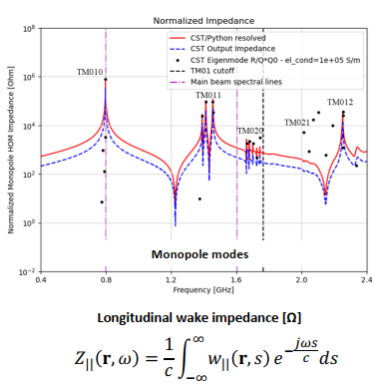
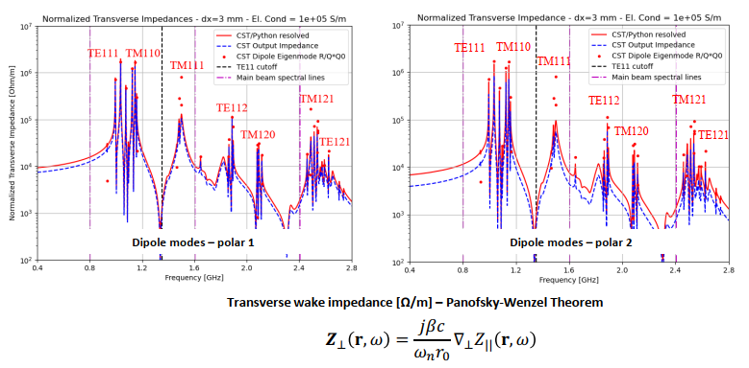
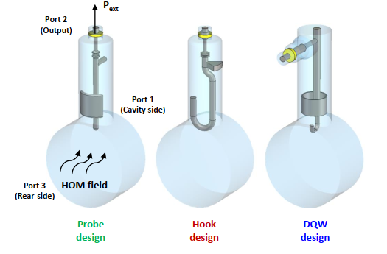
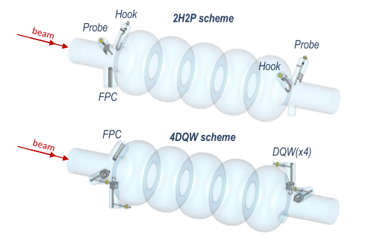
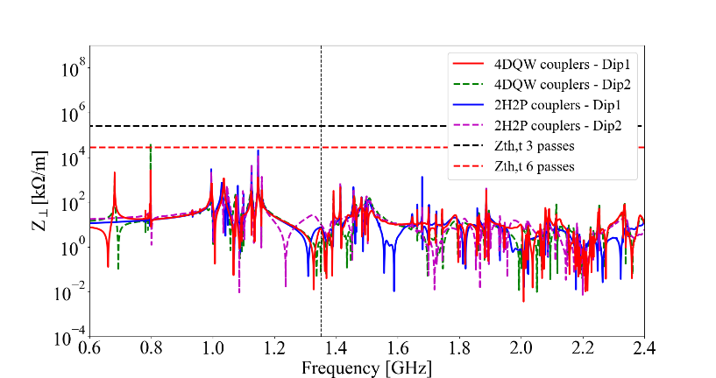
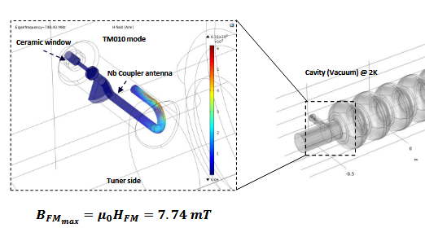
WP4 RF Systems
Task 4.1:
Cavity & HOM design & prototyping
HOM couplers design = main subject of the thesis of Carmelo Barbagallo
Wakefield simulations (with CST Studio)
HOM coupler optimization of 3 different designs
Study of 2 damping schemes with 4 HOM couplers (needed especially for dipole HOM extraction)
First thermal simulations (with COSMOL)

Slide 3
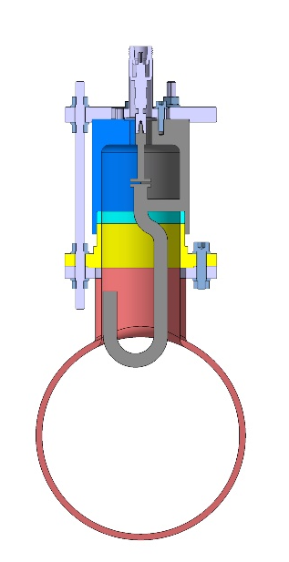
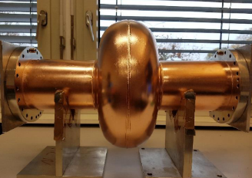
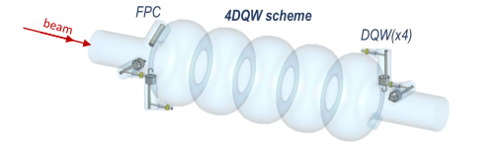
WP4 RF Systems
Task 4.1:
Cavity & HOM design & prototyping
Prototyping of HOM couplers based on Carmelo’s design
Hook HOM coupler
Goal: build one DQW, one hook and one probe HOM coupler. Fabrication by CERN by 3D printing (polymer + Cu coating).
3D printing of the Hook type HOM coupler: Step file sent on last Monday. First prototype planned within 2 weeks. Will be used on the monocell Cu cavity for the first measurements.
Next prototype with the probe HOM coupler.
Manufacturing process of the hook coupler
Start point: Specification drawing with clear interfaces with the cavity and outside world (PERLE)
Design study: Cutting into subcomponent and Manufacturing drawing (CERN EN-MME)
Green light from the project on the proposal from MME (PERLE)
Manufacturing of the components in ACCURA25 (CERN Polymer Lab)
Metrology with high precision 3D Scan (CERN EN-MME)
Copper coating (CERN TE-VSC)
Metrology (facultative, EN-MME)
Assembly (either conductive glue or mechanically (CERN EN-MME and Polymer lab)
Final Metrology (EN-MME)
3D metal printing for the DQW coupler: to be studied in October. Planned to be used with the 5-cell Cu cavity in Feb/March next year.
Prototyping of Cu cavities for HOM measurements
Monocell at CERN
Goal: build two 801 MHz Cu cavities (1 monocell and 1 5-cell cav) to perform HOM measurements with prototypes HOM couplers. Fabrication/modifications done by JLAB.
Monocell cavity: parts provided by CERN (1/2 cells and beam tubes). Modification needed of one beam tube to host the HOM port. ½ cells will be clamped. Goal: cavity ready for mid-October ‘22 (Carmelo’s visit @ JLAB.)
5-cell cavity: 14 Cu plates ordered and sent to JLAB this week. Build a prototype identical to the Nb 5-cell already produced and tested. Study of the fabrication wil start soon (deep drawing & welding of the cell, HOM ports and fundamental power coupler location...). Goal: cavity ready for Feb/March ‘23 (2nd Carmelo’s visit palnned @ JLAB.)
5-cell with HOM and FPC ports

Slide 4
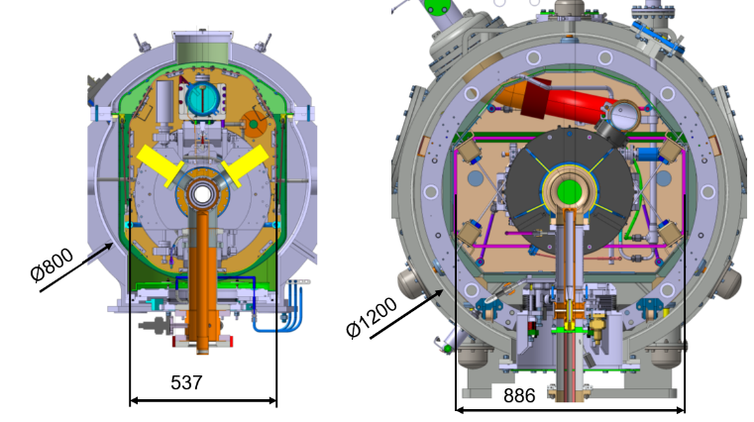
WP4 RF Systems
Task 4.3:
Cryomodule
Study of the SPL cryomodule compatibility for PERLE
Goal: can we reuse all components (or part of) already produced within the framework of the former SPL project?
Meeting in June to make a status on available and reusable or not reusable components + missing components.
About components
Reusable parts are: vacuum vessel (with modifications) and part of the cryogenic lines, power couplers (with modifications)
Missing components: tuning systems, all bellows, gate valves, thermal shield, magnetic shields, burst disks and safety systems
Main issues (mostly due to the lack of space):
Implementation of additional gate valves needed
Additional cooling circuit for the HOM couplers
Implementation of the cold tuning systems (→ clash with the supporting system and HOM couplers of the cavities)
Implementation of the HOM couplers (→ clash with the thermal shield, the supporting system of the cavities and tuning system)
Study of a backup is needed based on an “ESS-like” cryomodule.
Bigger advantage : more space inside (+400mm in diameter)
More transversal space between cavities
No supporting system between cavities
Easy access to the Tuning System (openings on the vacuum vessel)
Blocking system for transportation
Design validated (prototypes and some series cryomodules already
tested at CEA and ESS)
SPL tuning system and HOM couplers (yellow parts) interference
Interferences of the HOM couplers inside the cryomodule
SPL
ESS

Slide 5
WP4 RF Systems
Task 4.7:
Booster
Study of the « AES « booster compatibility for PERLE
Goal: can we reuse the module and its valve box (cavity packages must be changed because of the frequency)?
First meeting with JLAB yesterday. Need to do a little of “archaeology” to dig out the last CAD model... JLAB will send the CAD model and all useful documentation to IJLAB.
A lot of questions on: Cryo capacity...Alignment...Cost of refurbishing (including disassembly/reassembly, transportation, modifications on the vacuum vessel...)
Need to schedule another meeting with AES people and Fay Hannon (if they are available)
Need to know who is doing beam dynamics calculations...

Slide 6
Thank you for your attention

