Slide 1
WP3 - DC GUN
Task leader : M. Baylac, CNRS – LPSC, Grenoble - France - B. Militsyn, STFC, Daresbury – UK
D. Reynet, W. Kaabi , A. Gallas, G. Iaquaniello, R. Marie, D. Nutarelli, K. Cassou, A. Martens, V. Soskov
CNRS – IJCLab, Orsay - France
E. Labussière, CNRS – LPSC, Grenoble - France
B. Fell, L. Jones, K. Middleman, T. Noakes, R. Smith STFC, Daresbury – UK
B. Hounsell, M. Klein, University of Liverpool (UK)

Slide 2
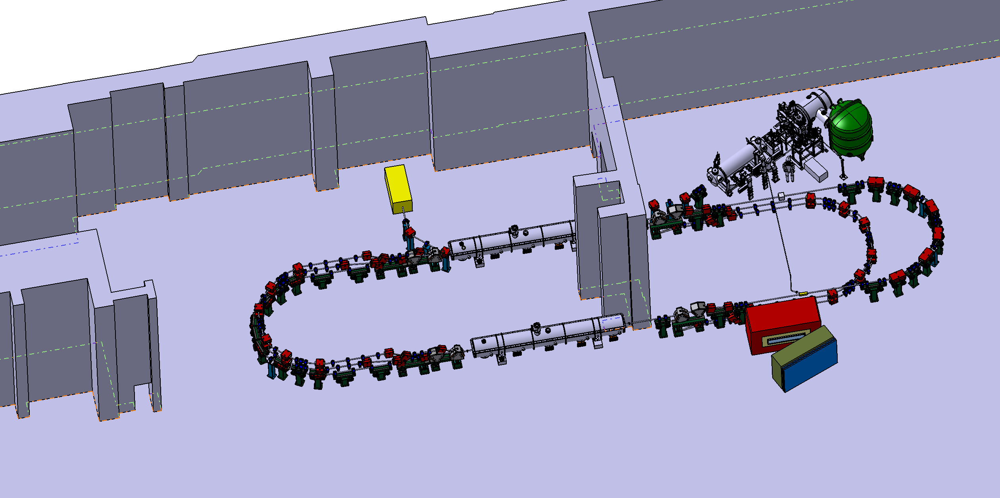
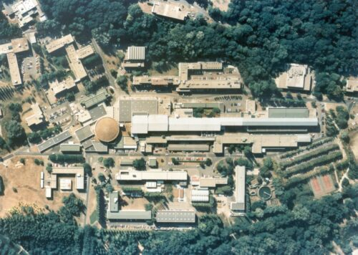
Perle installation at IJClab-Orsay
The installation of PERLE under study in Super ACO building
PERLE
(superAco)
Perle Footprint in super ACO
Identification of main constraints :
Square meters for auxiliary components (magnet power supply, RF amplifiers, cryoplant…)
Mass of components and mass of concrete shielding to compare to the strength of the concrete slab
and needs :
Infrastructure for the machine (electrical, cooling water, pressurized air, optical fiber…).

Slide 3
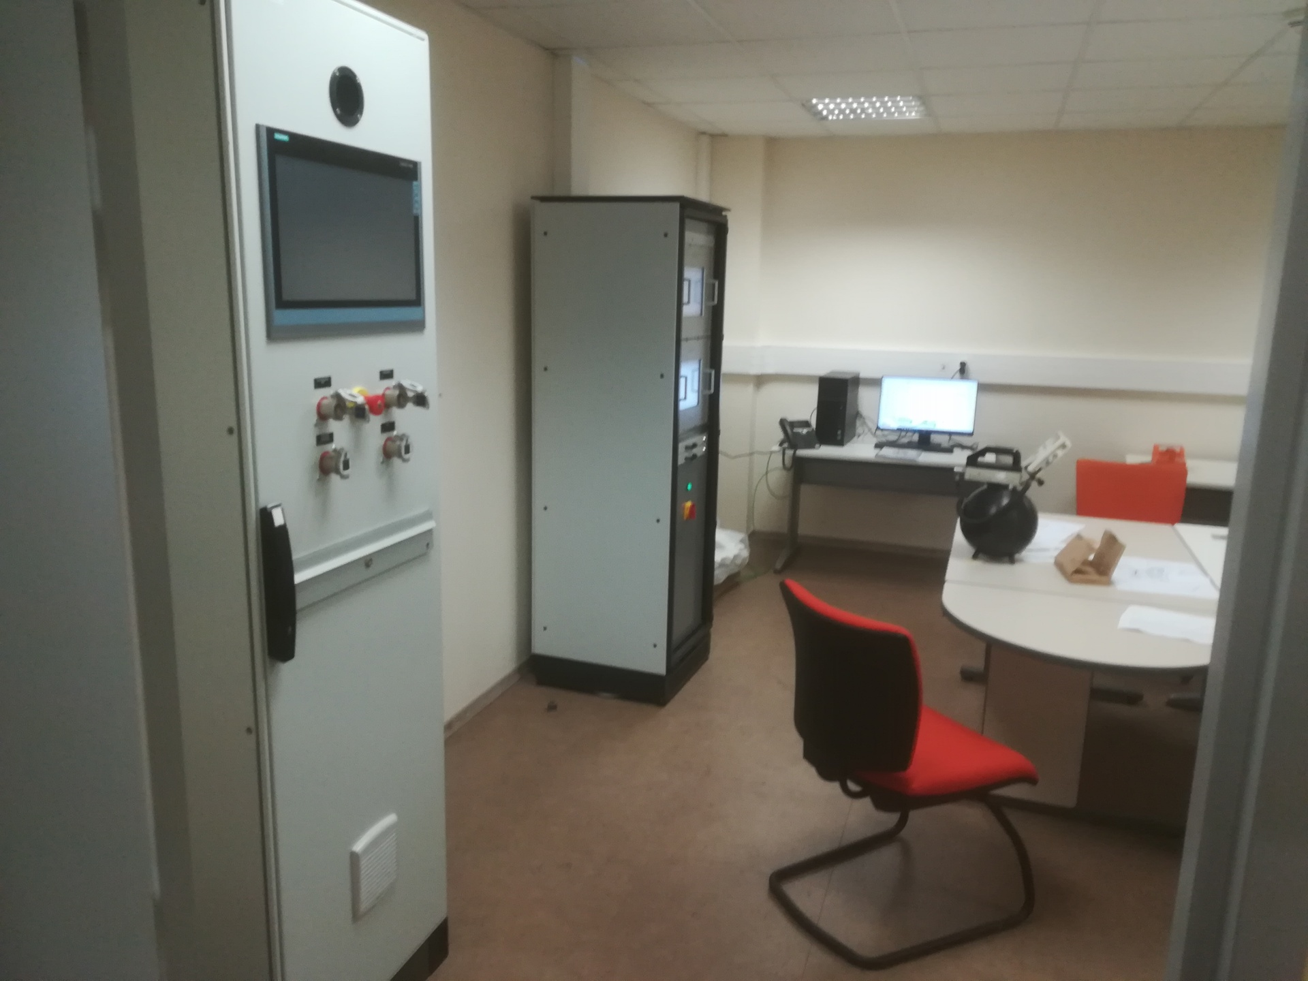
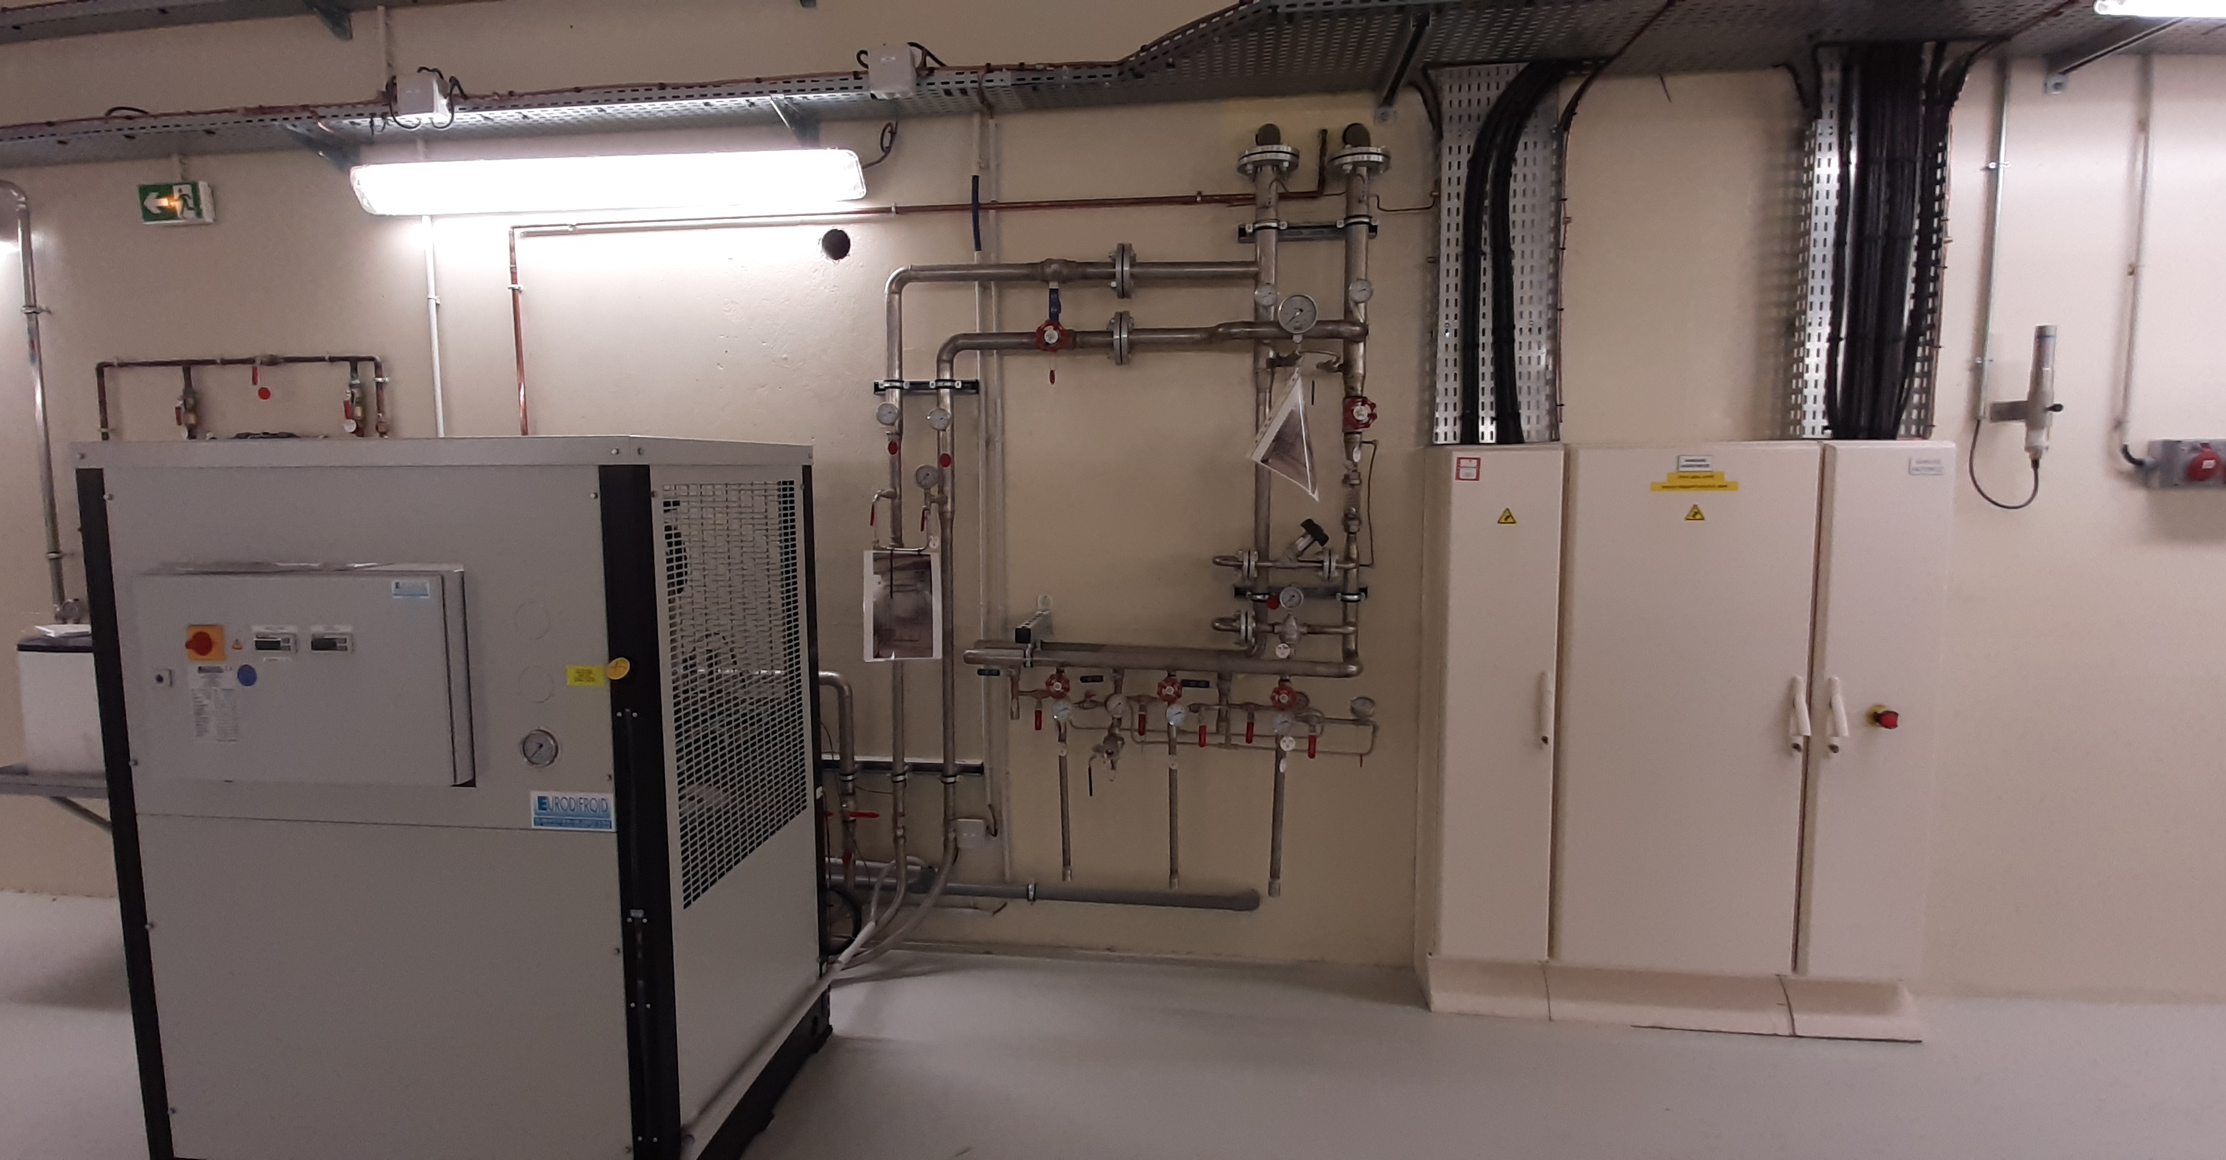
Gun installation at IJClab - Orsay
the implementation of the DC-GUN began in another building: the igloo
The installation of gun began in another building : the Igloo : gun could be tested independently
The igloo is a fully equiped bunker (radioprotection, crane, electrical power, compressed air …)
Dedicated control room…
PERLE
(superAco)
Photogun (Igloo)

Slide 4
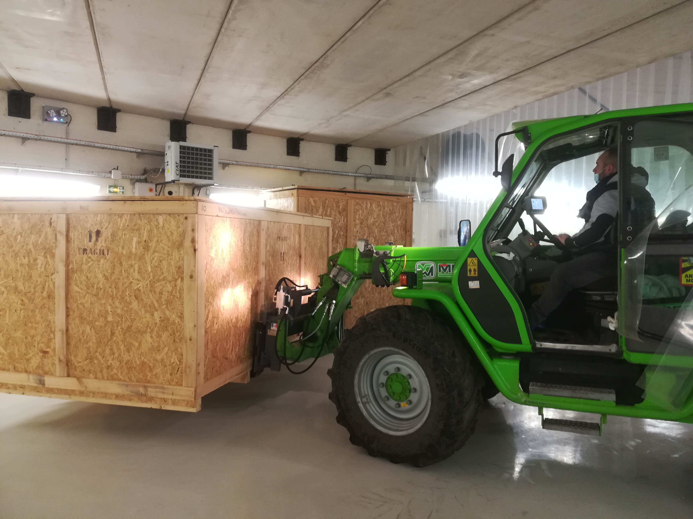
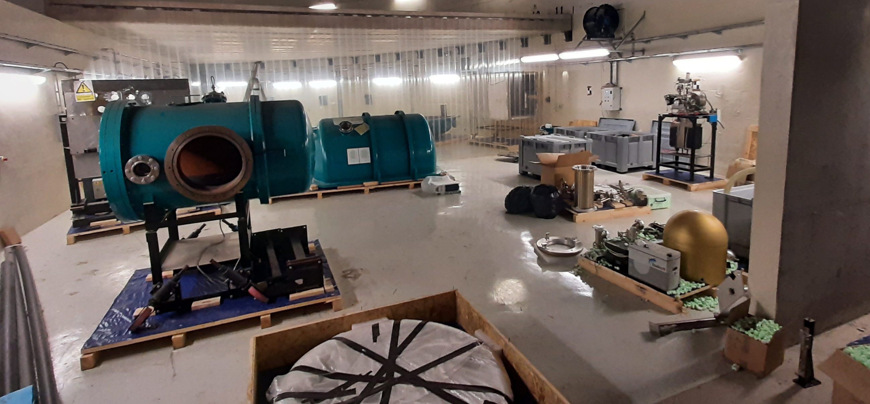
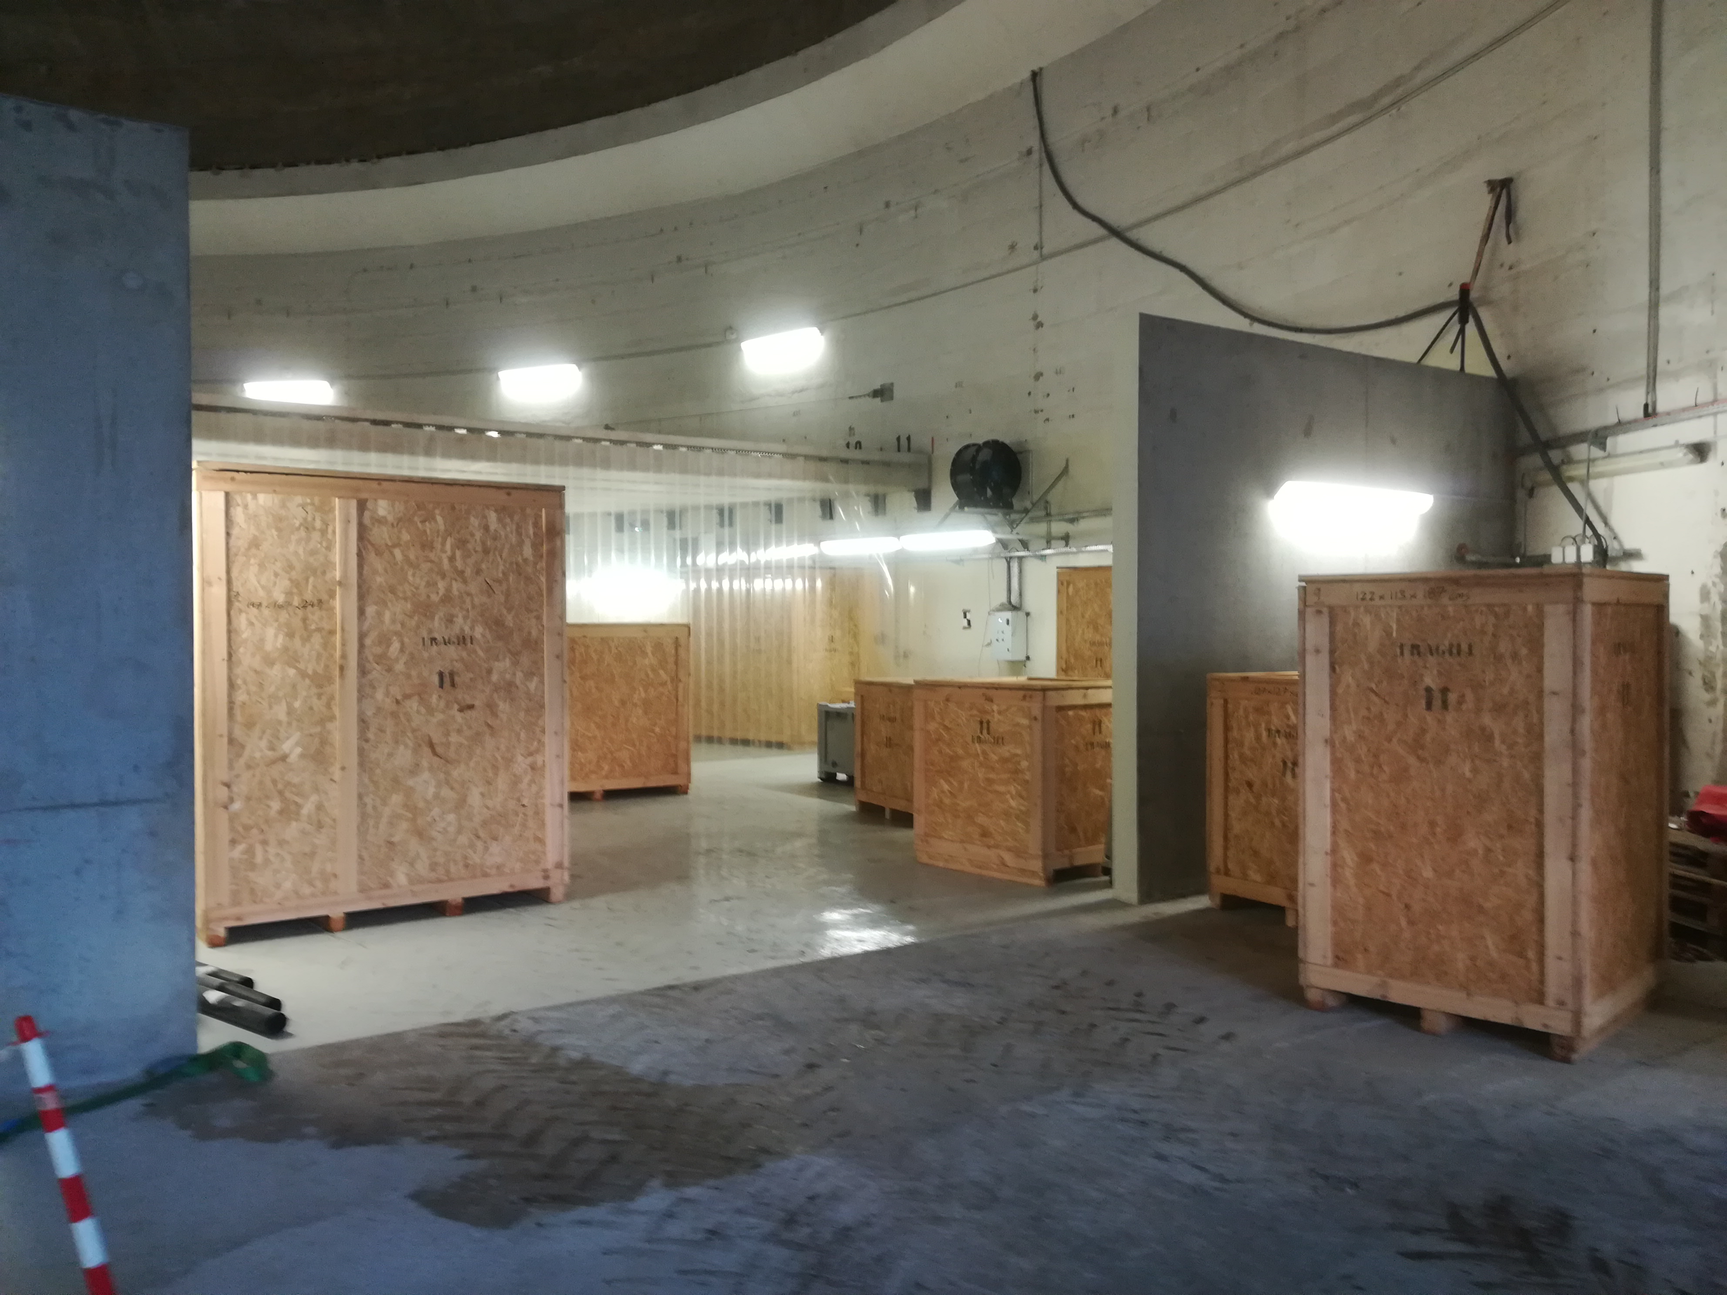
Summary of 7 months of work on the gun : Equipment transferred to the igloo
March 2022

Slide 5
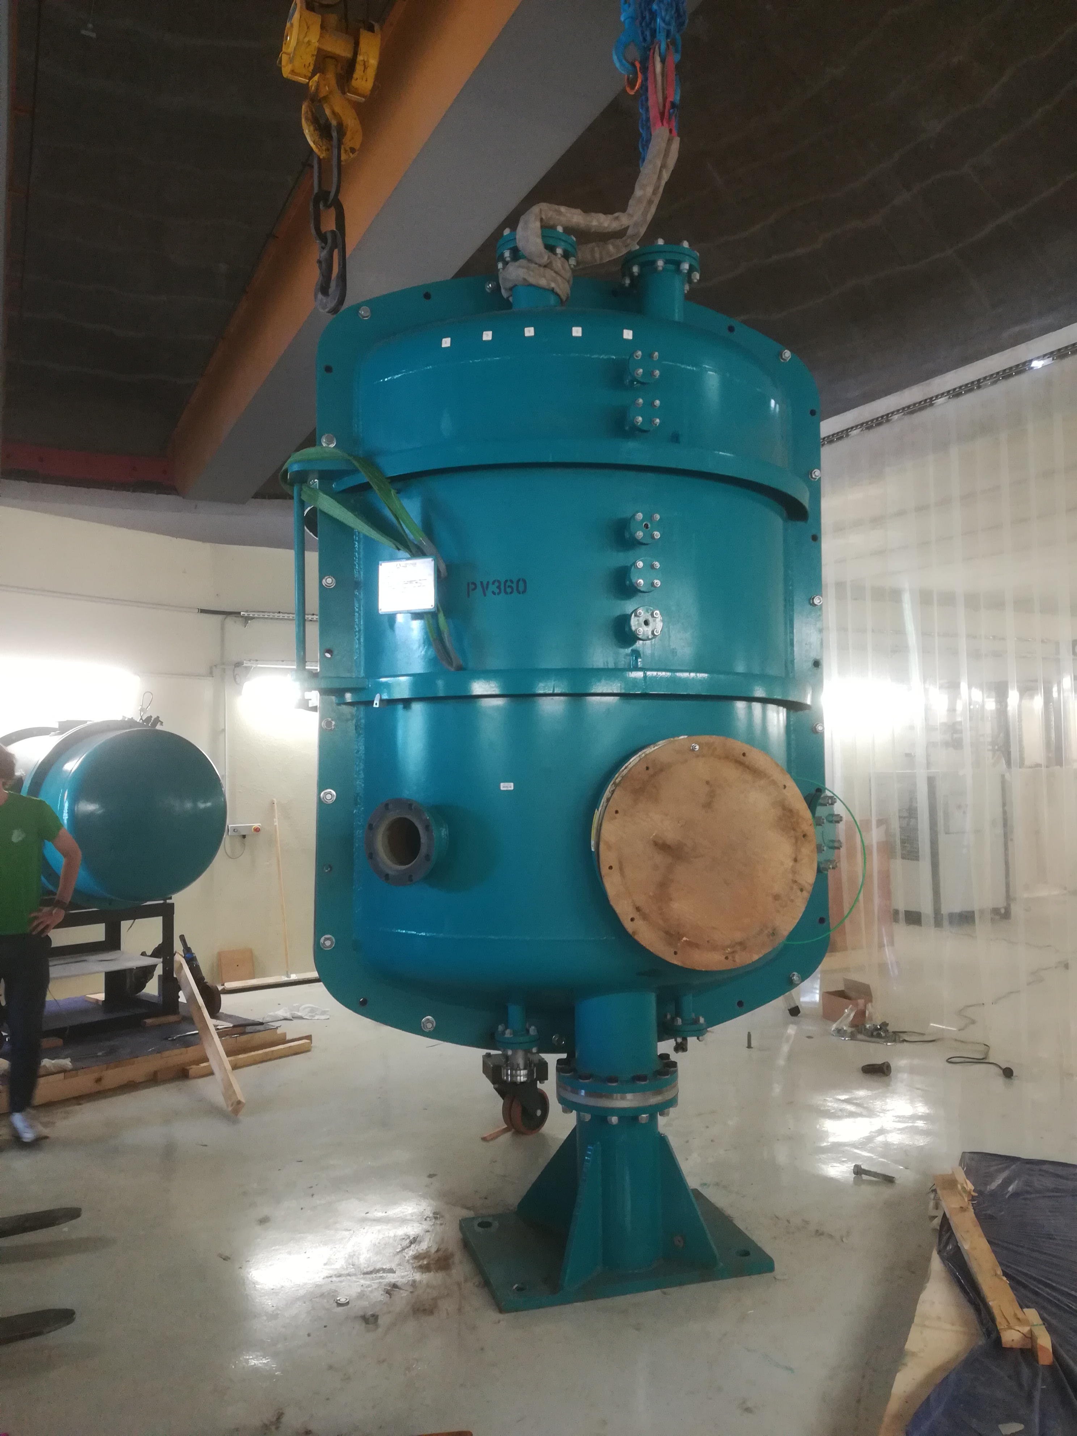
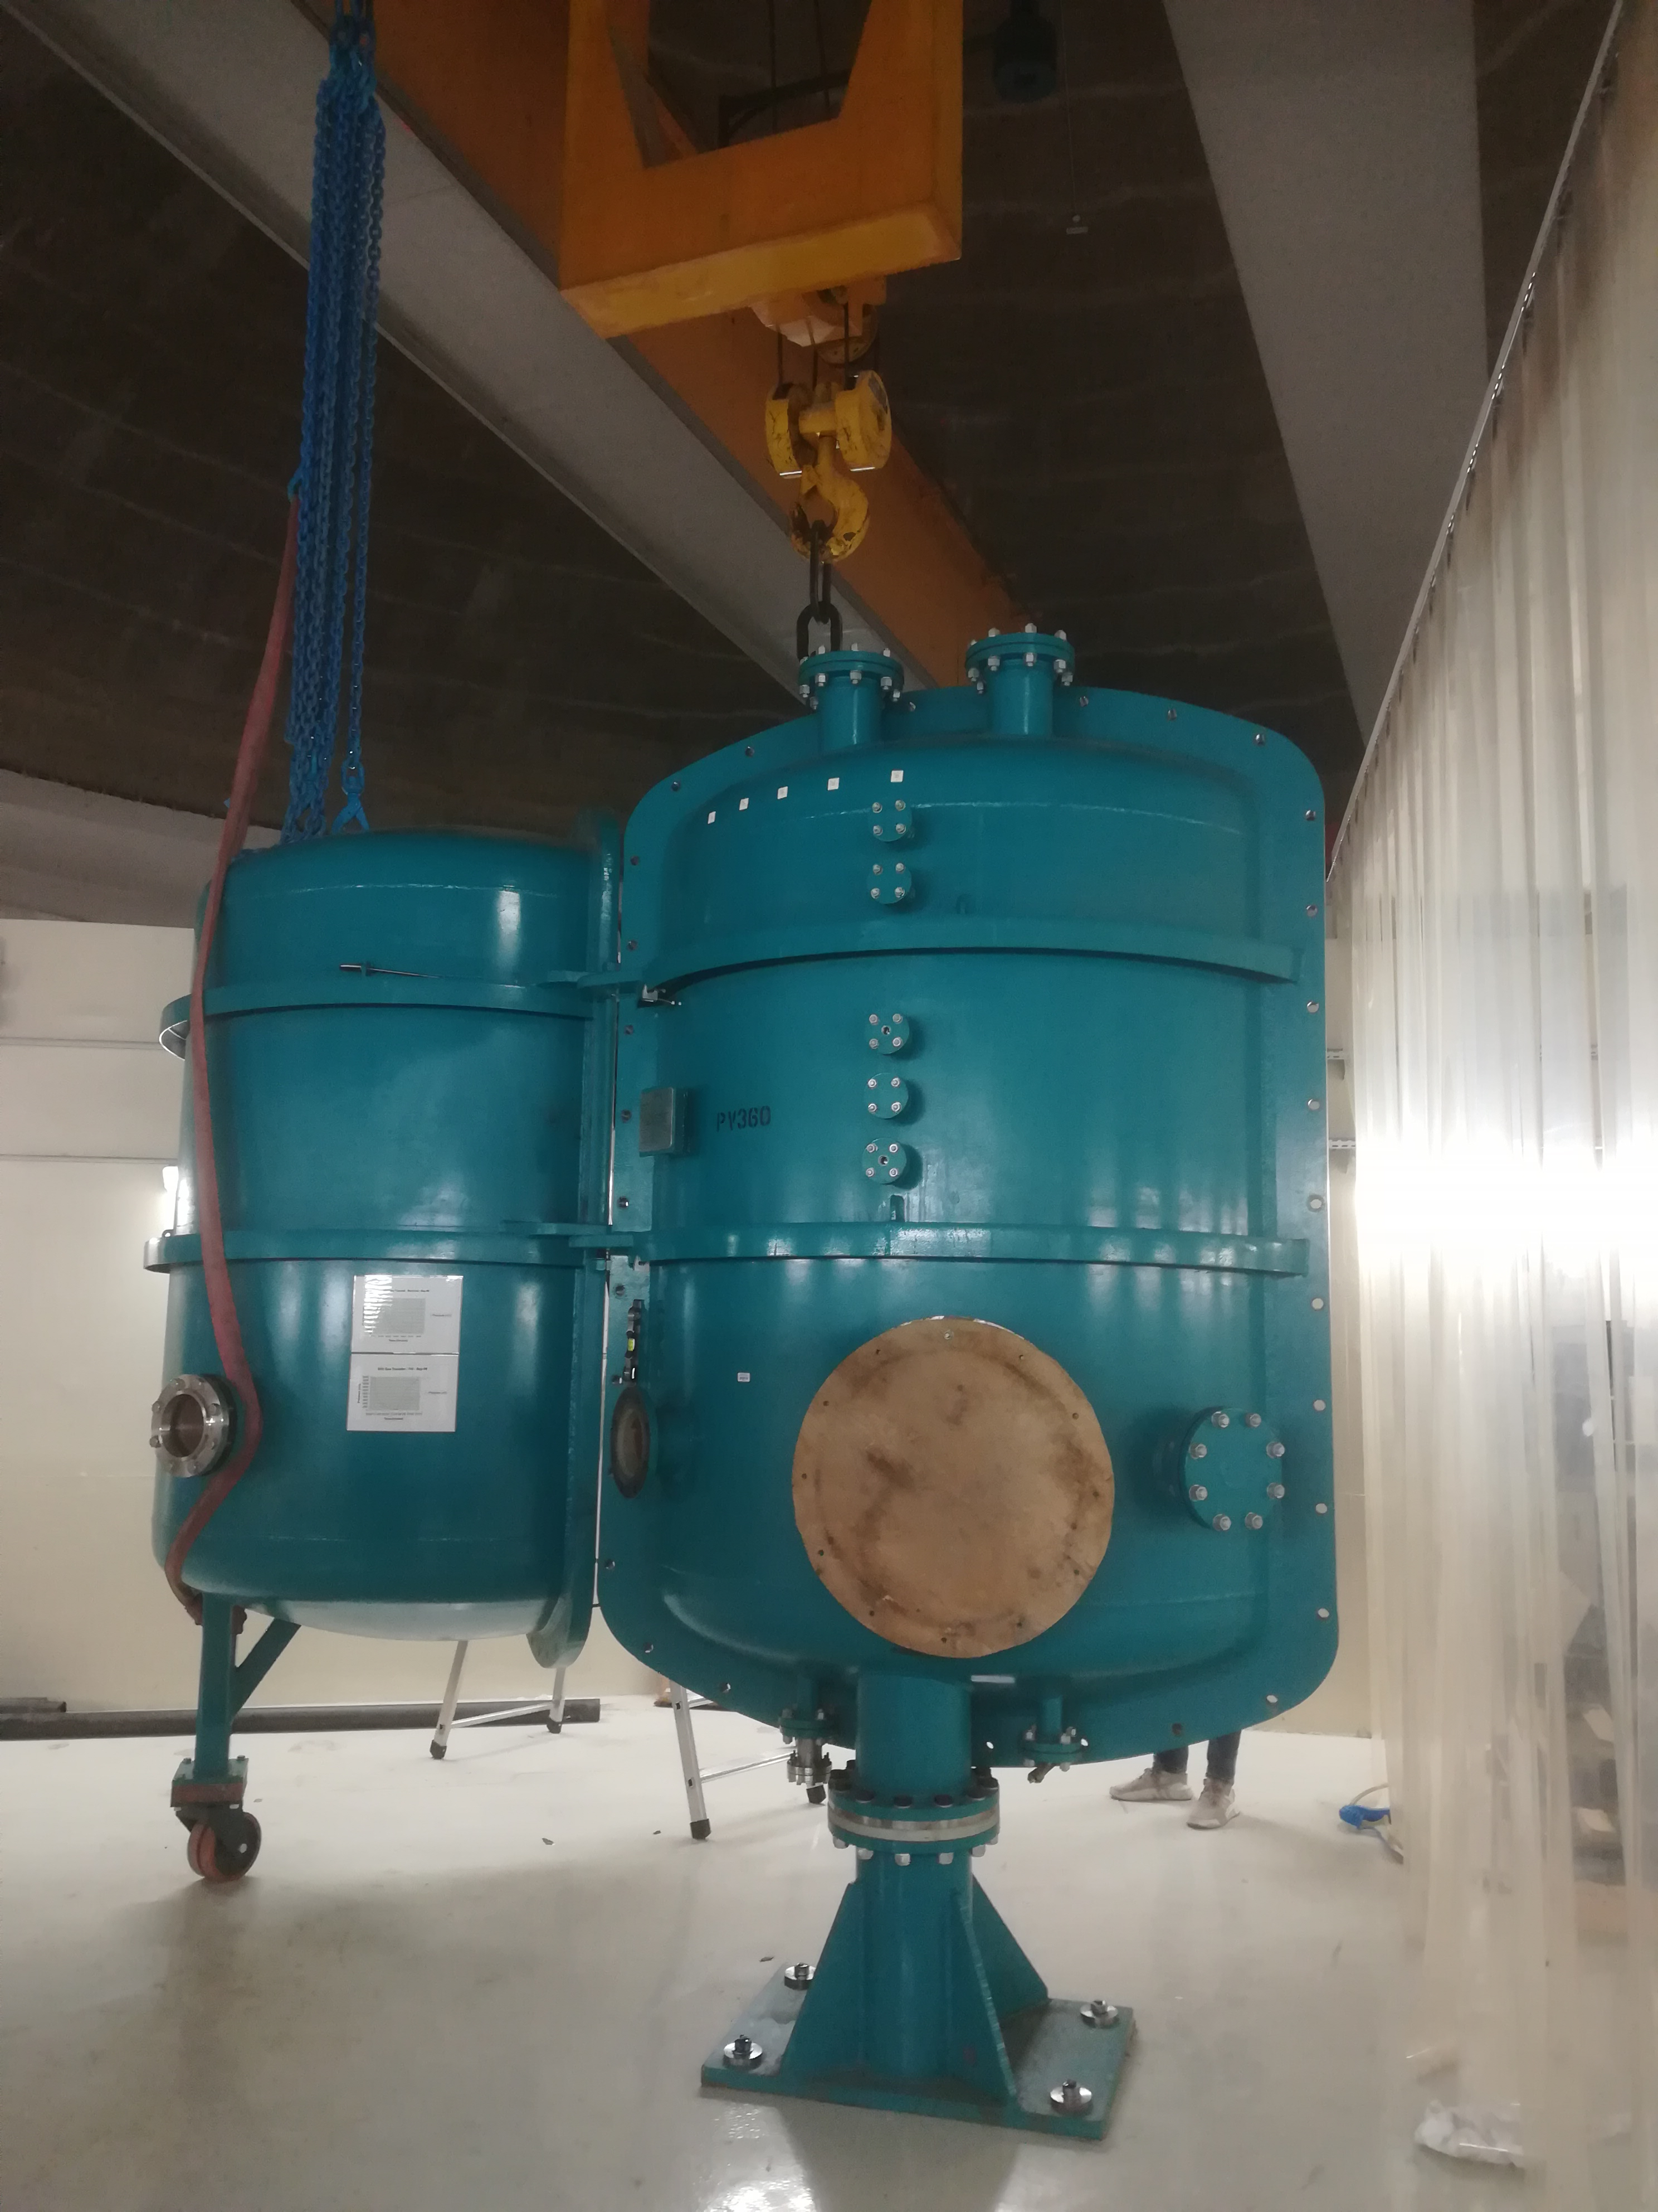
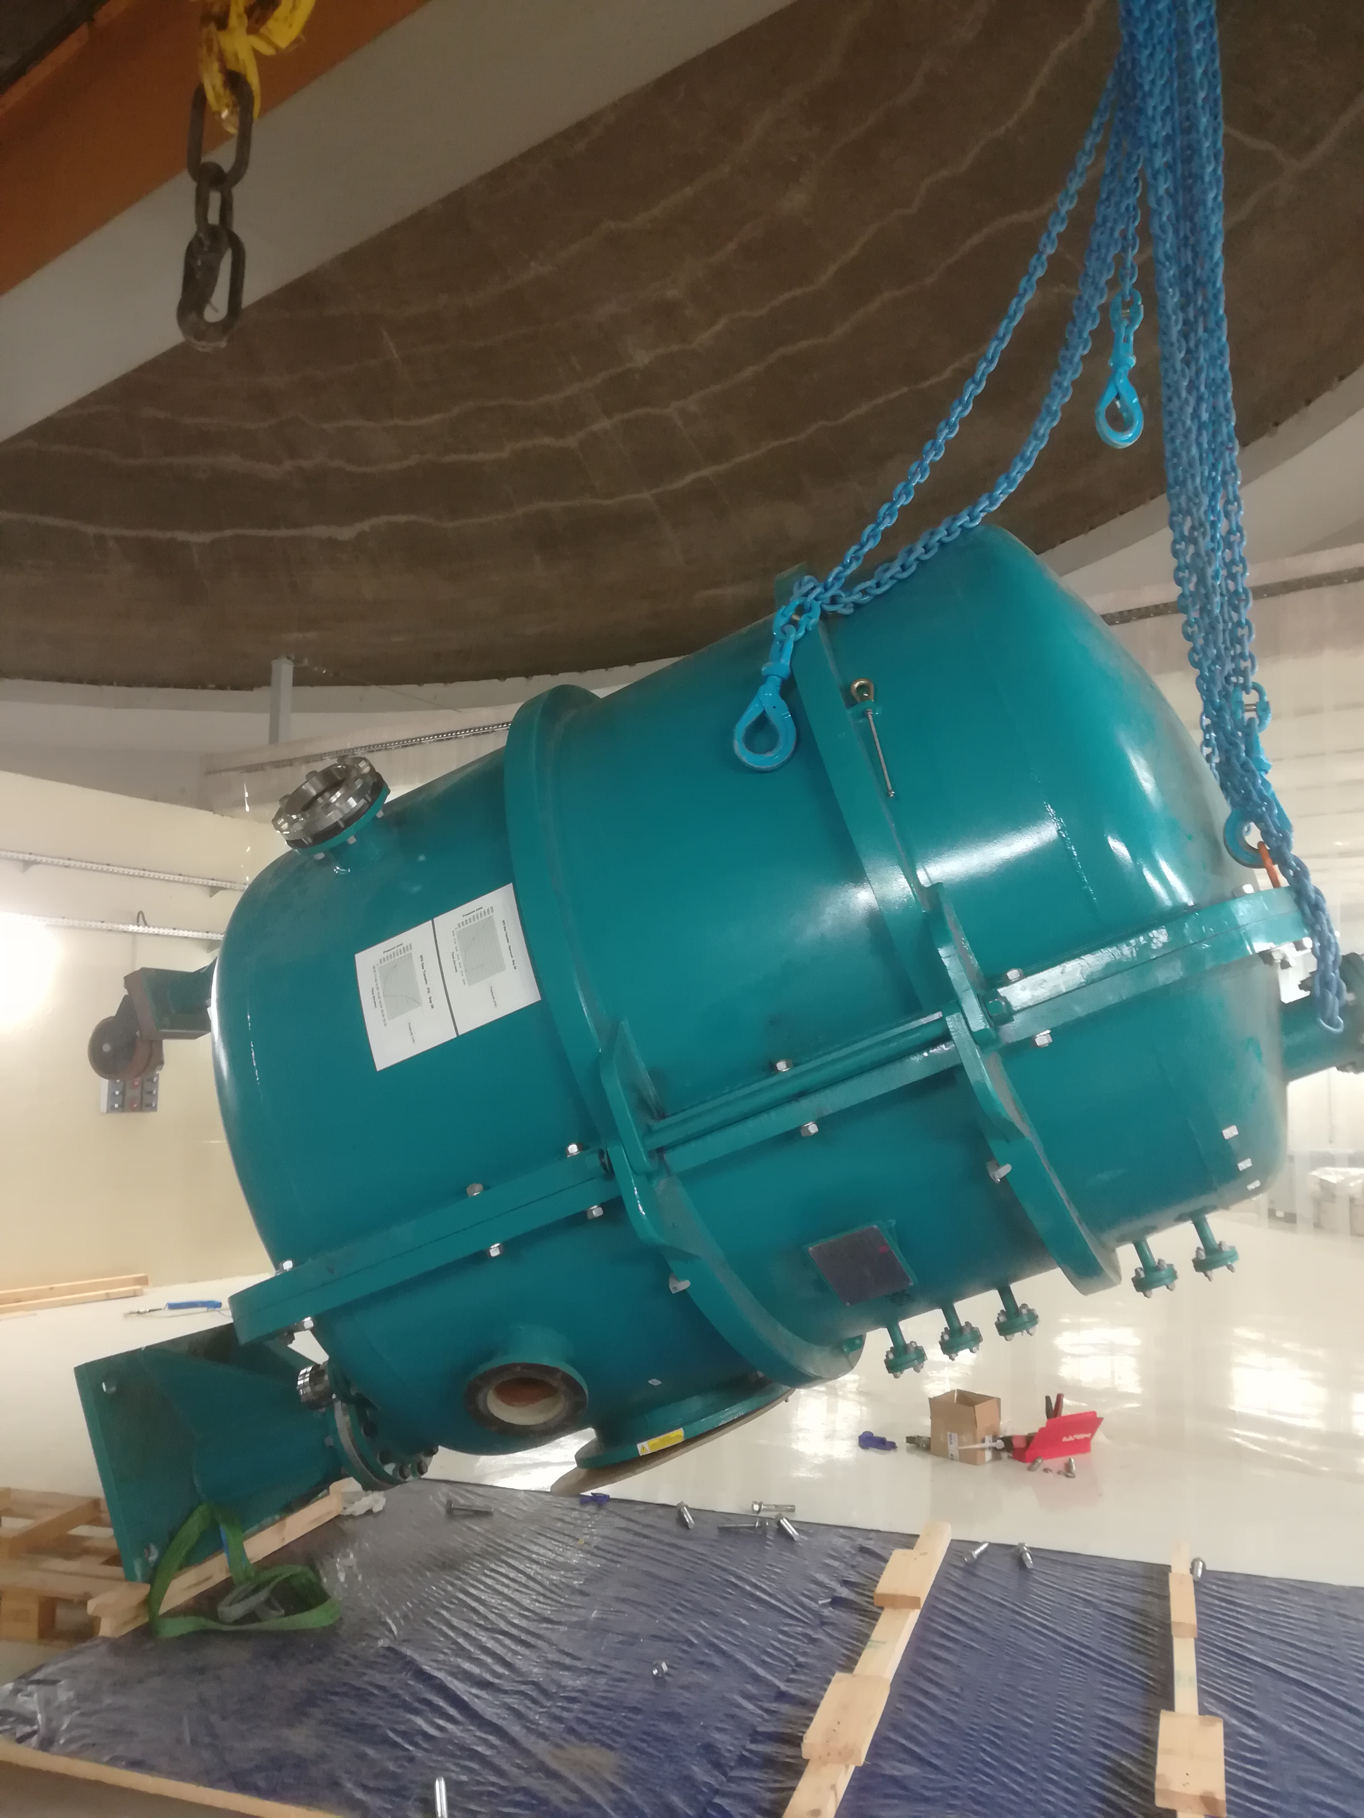
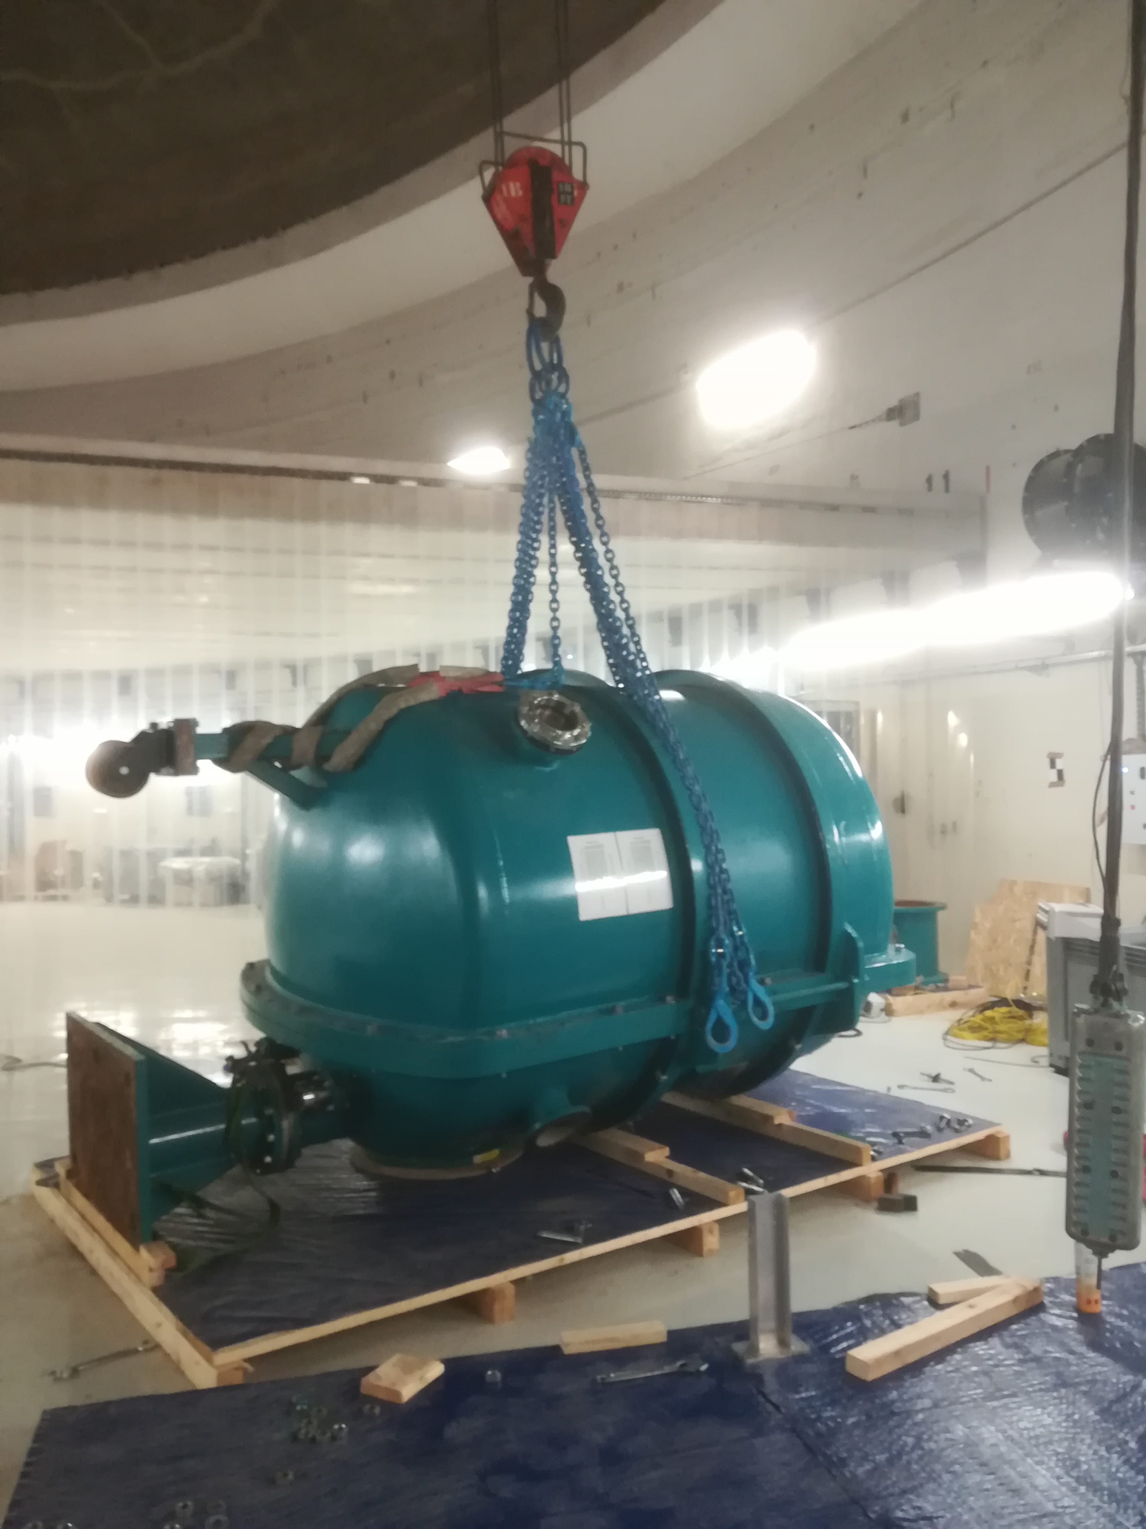
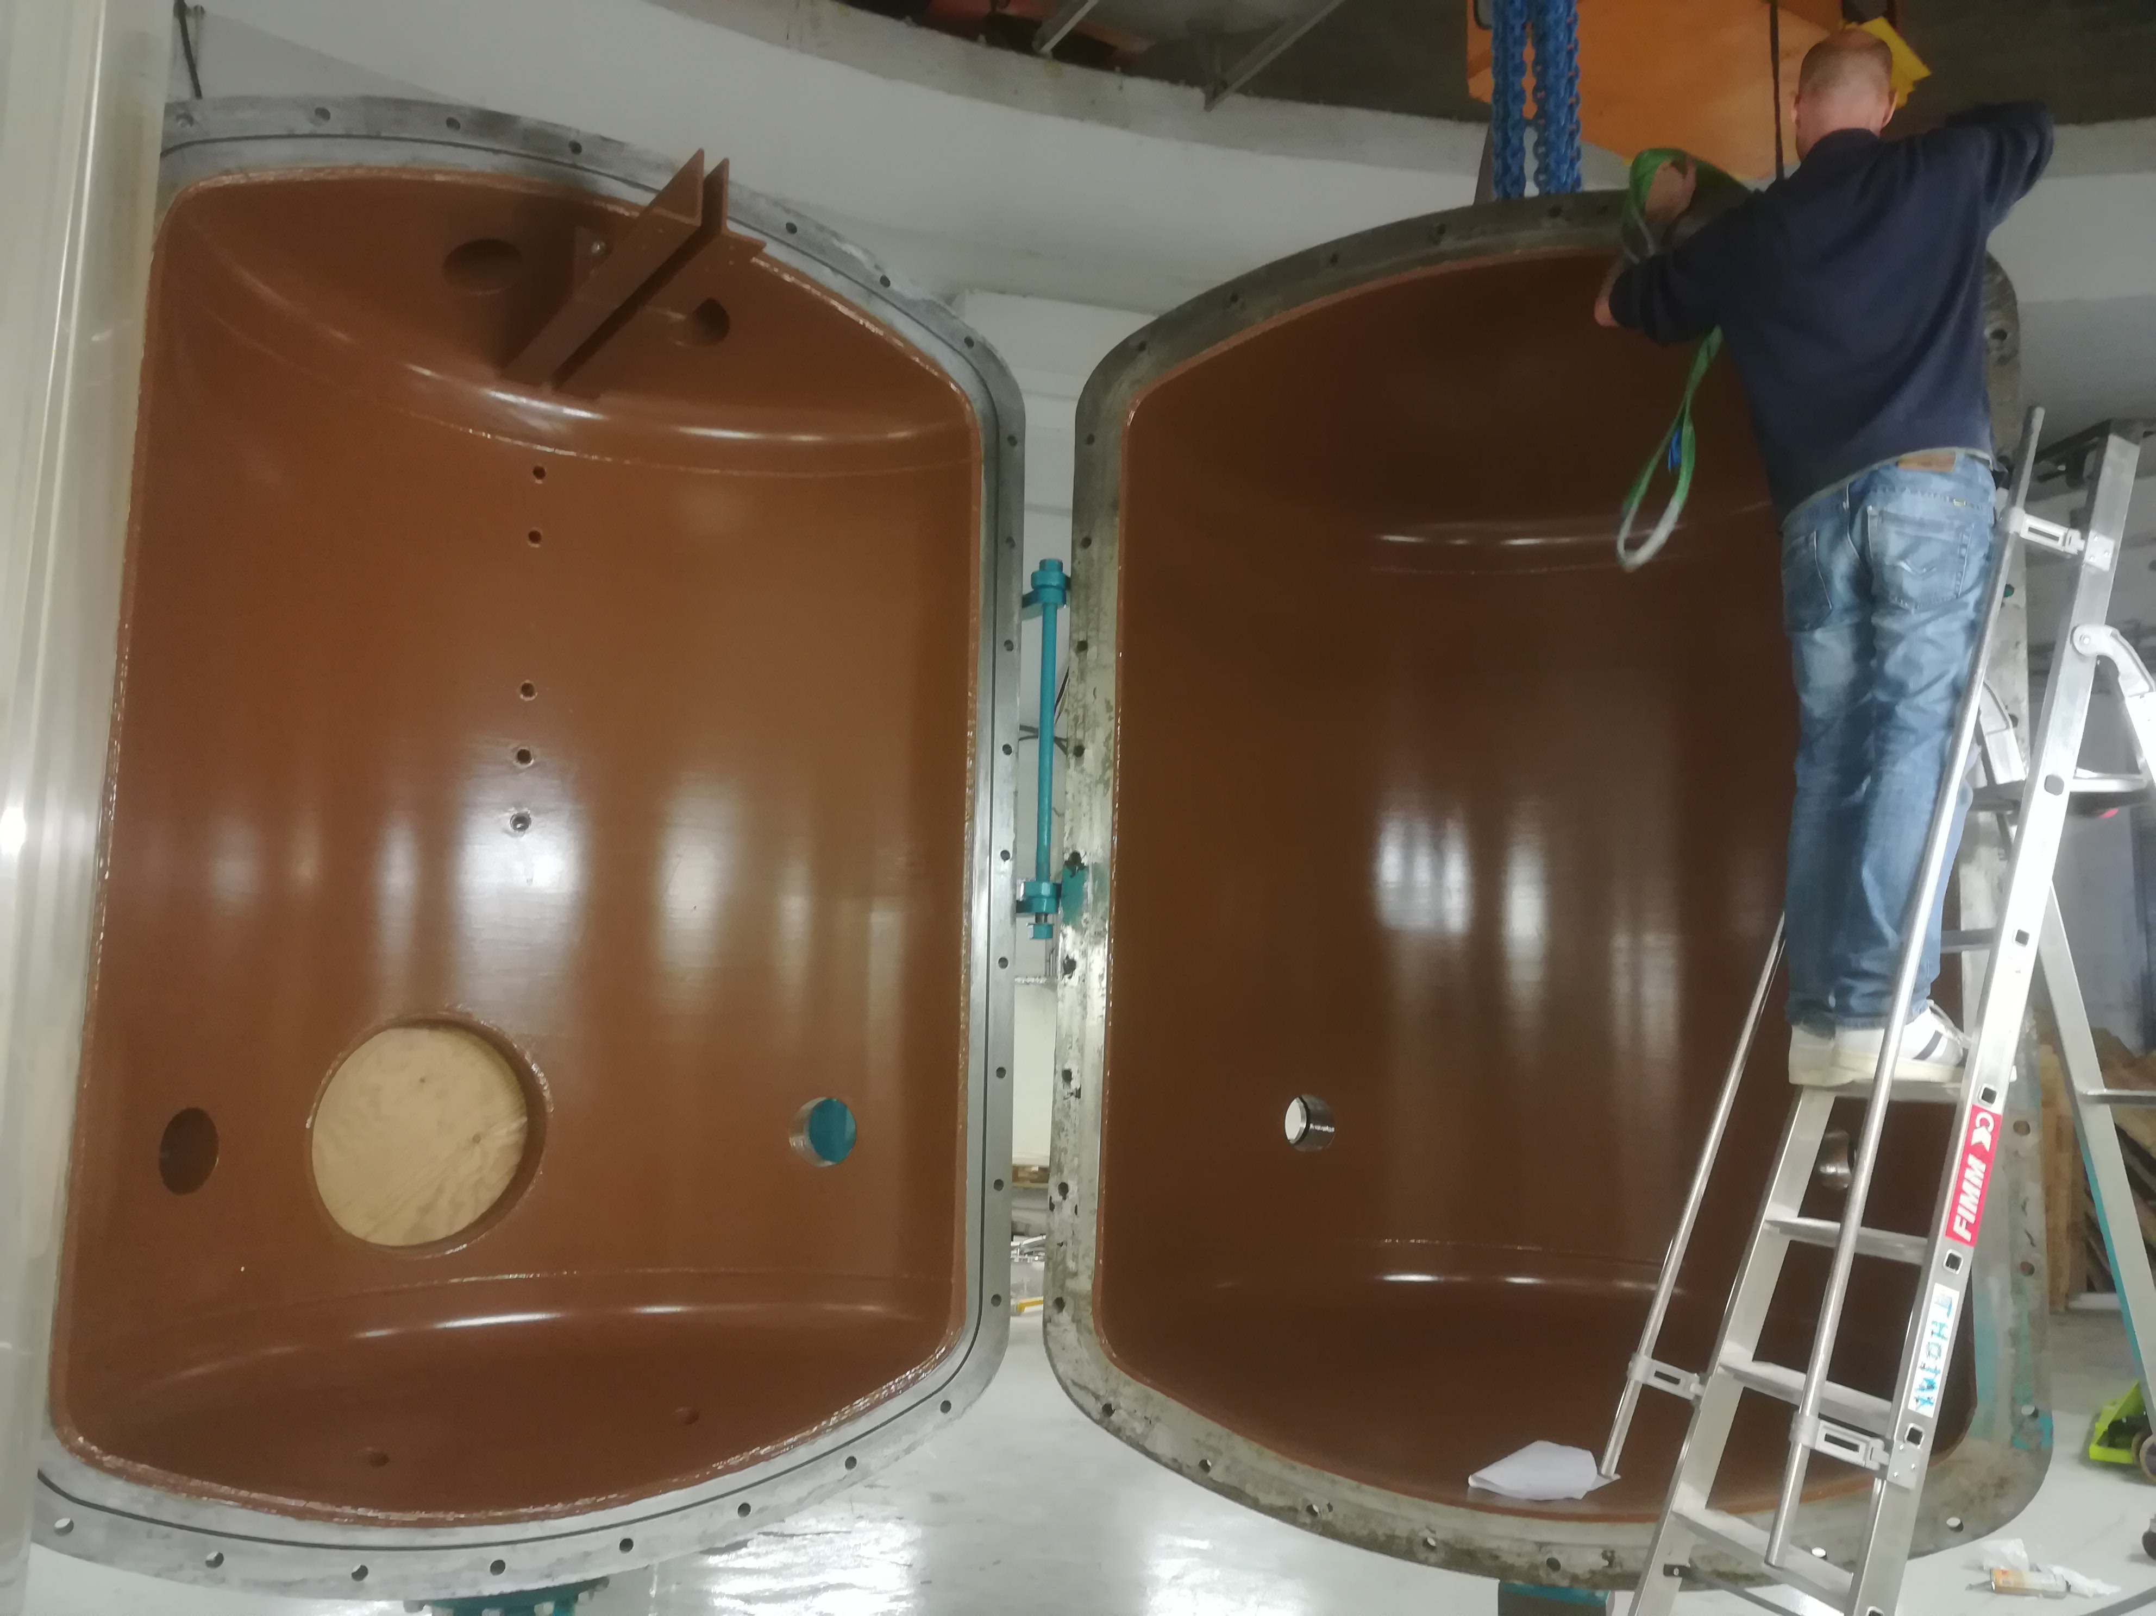
High Voltage vessel installation
Lift up
Opening and cleaning
June 2022

Slide 6
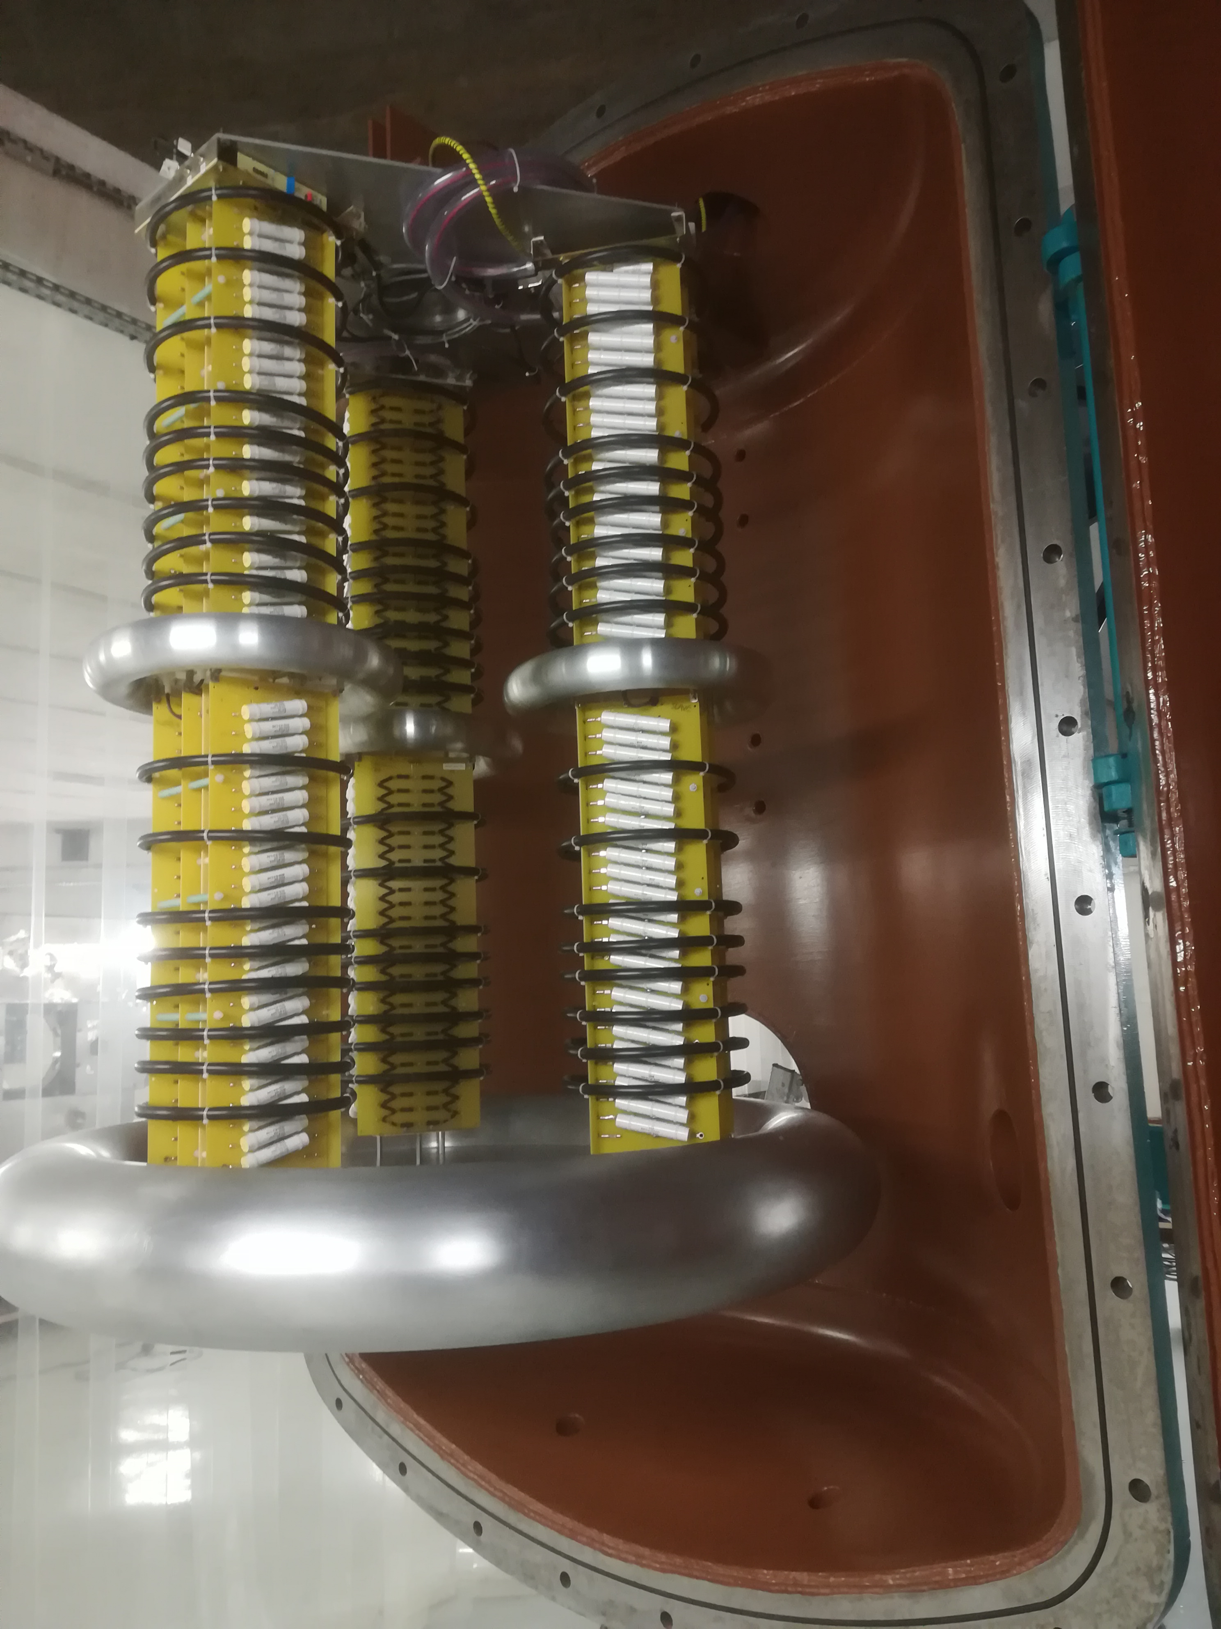
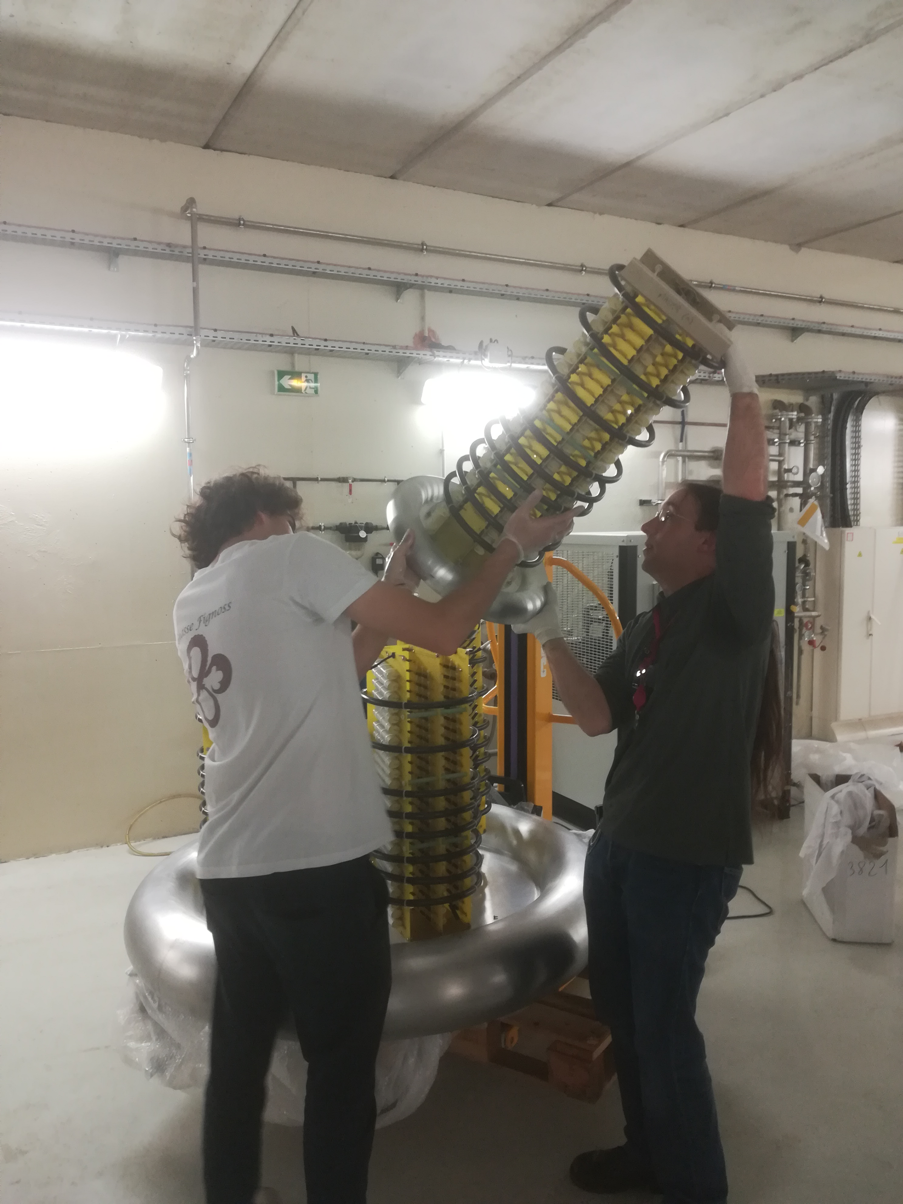
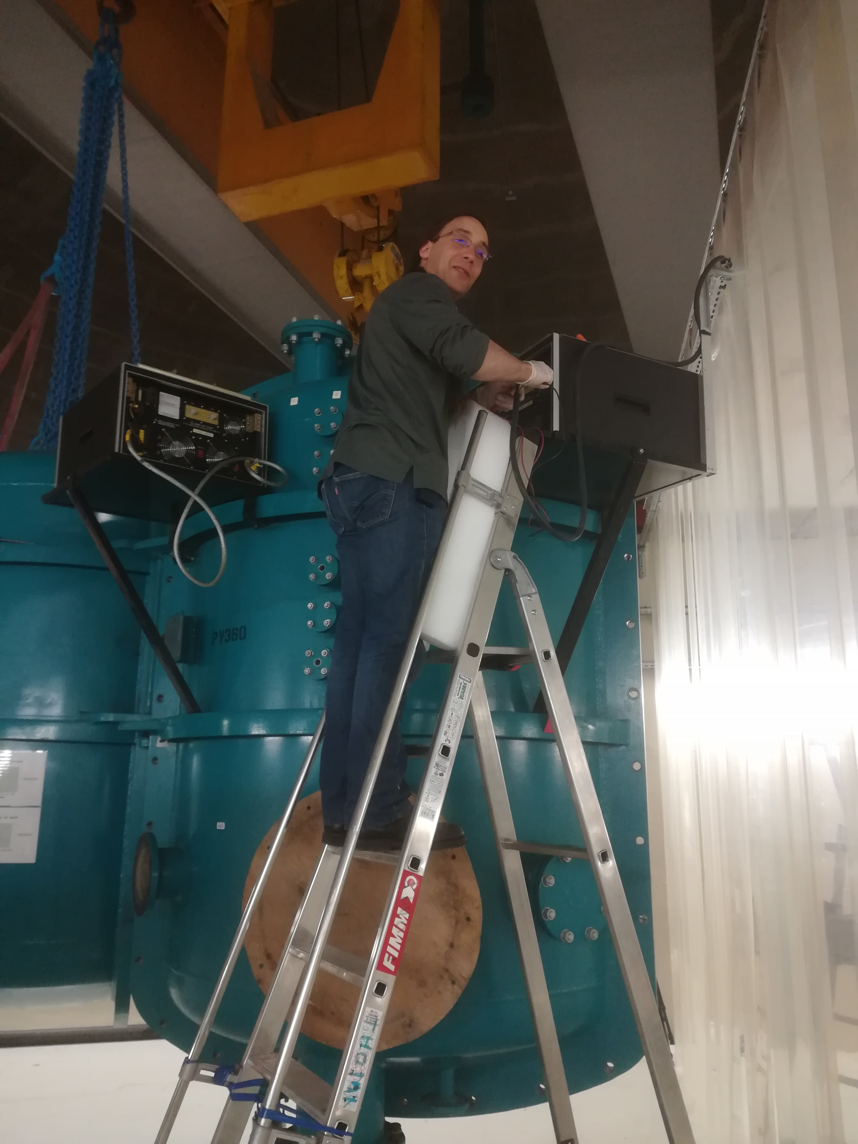
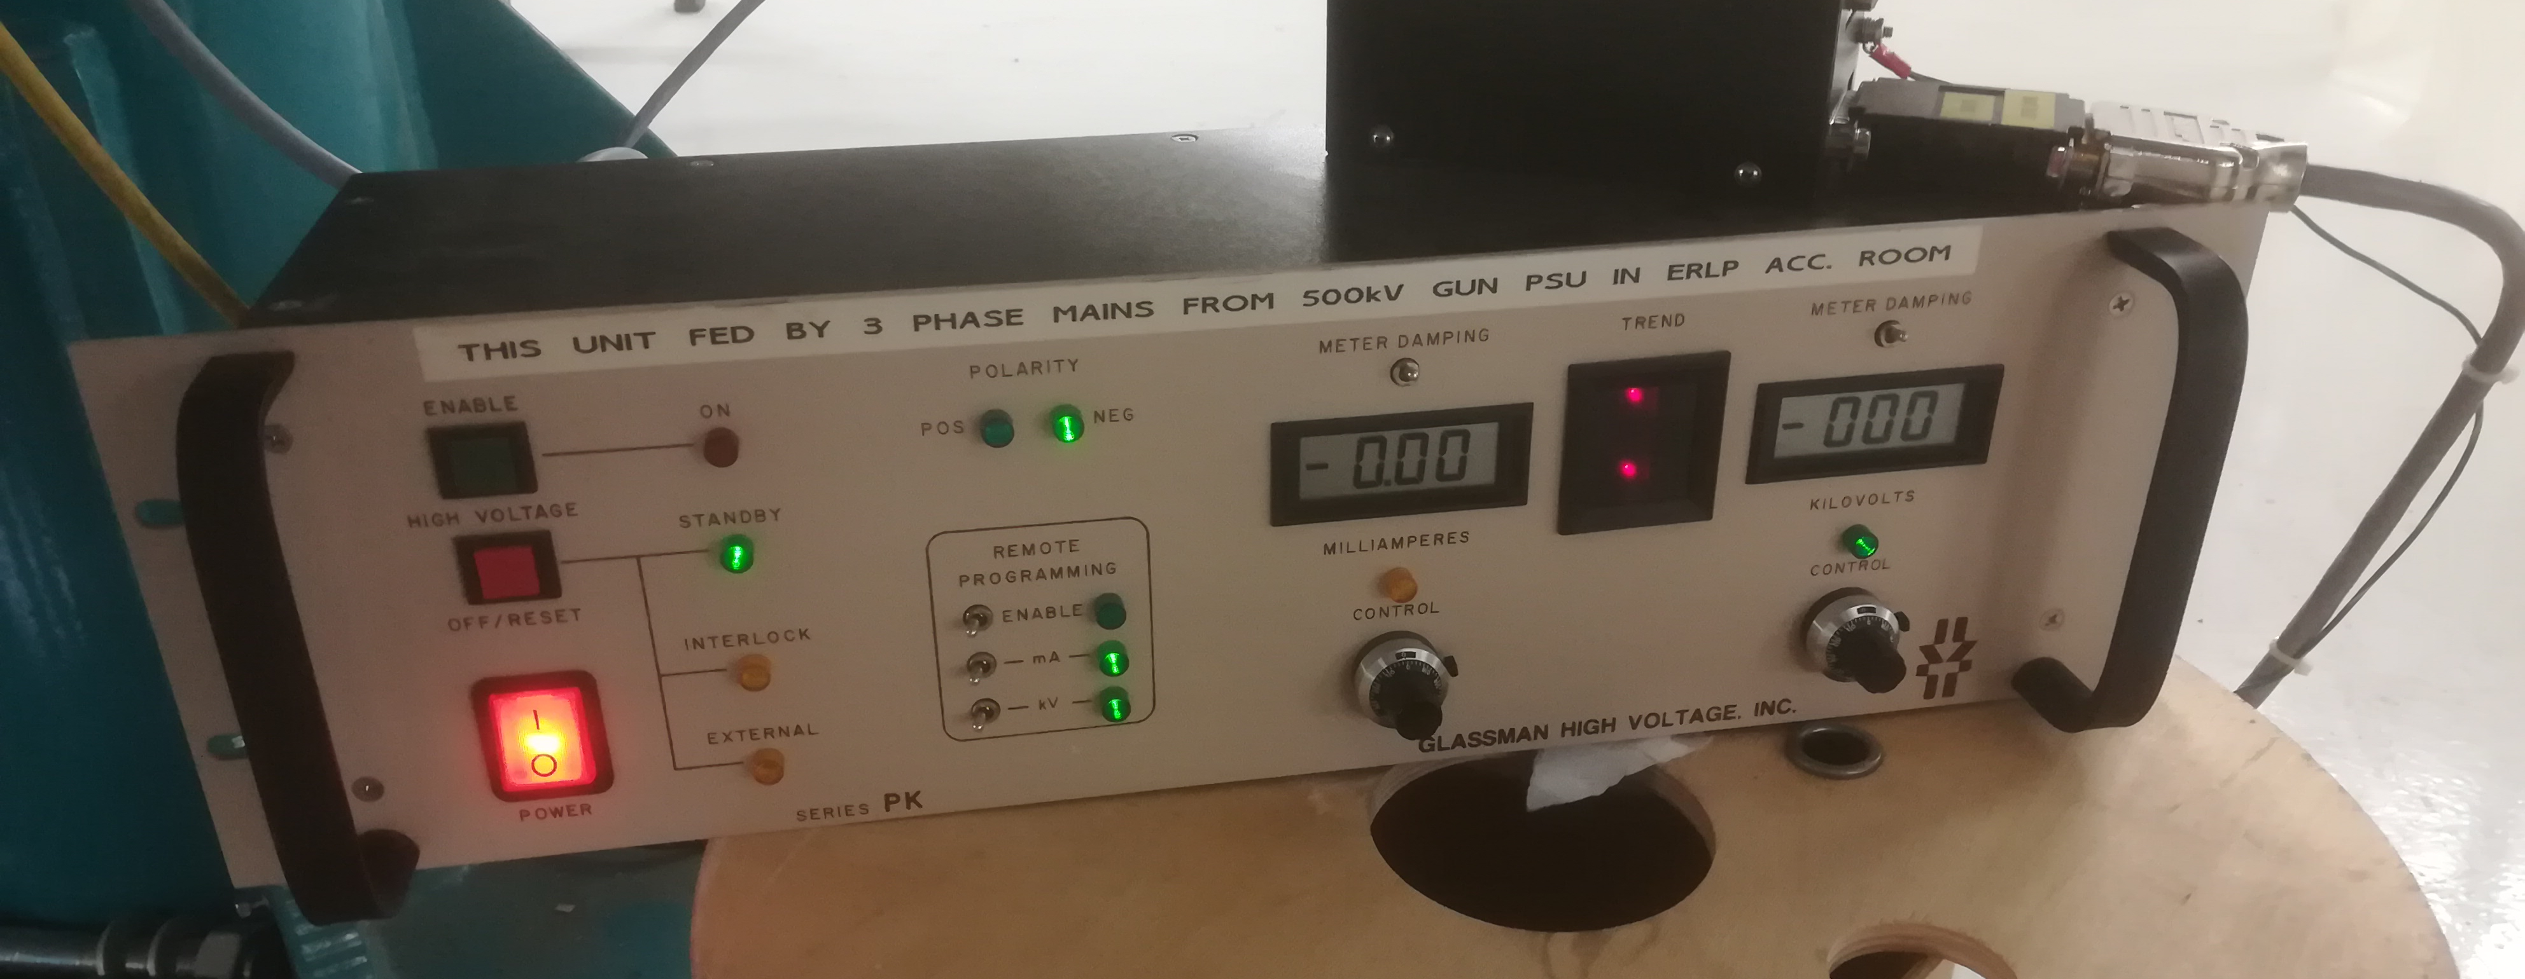
High Voltage Power Supply assembly
July 2022
Mechanical assembly : OK
Electrical test : OK

Slide 7
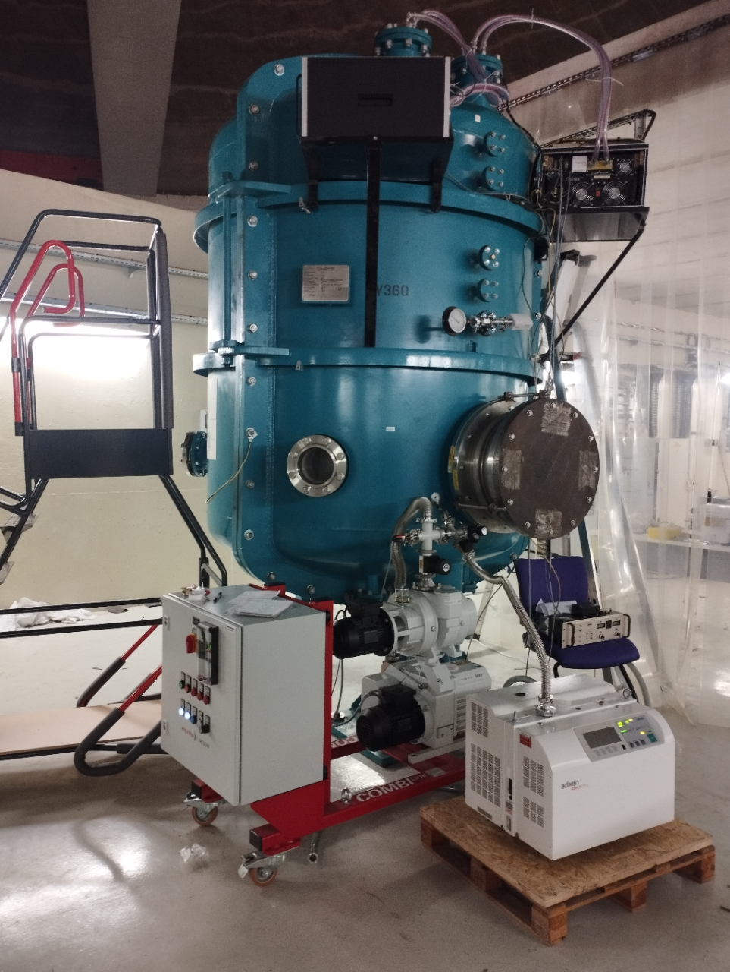
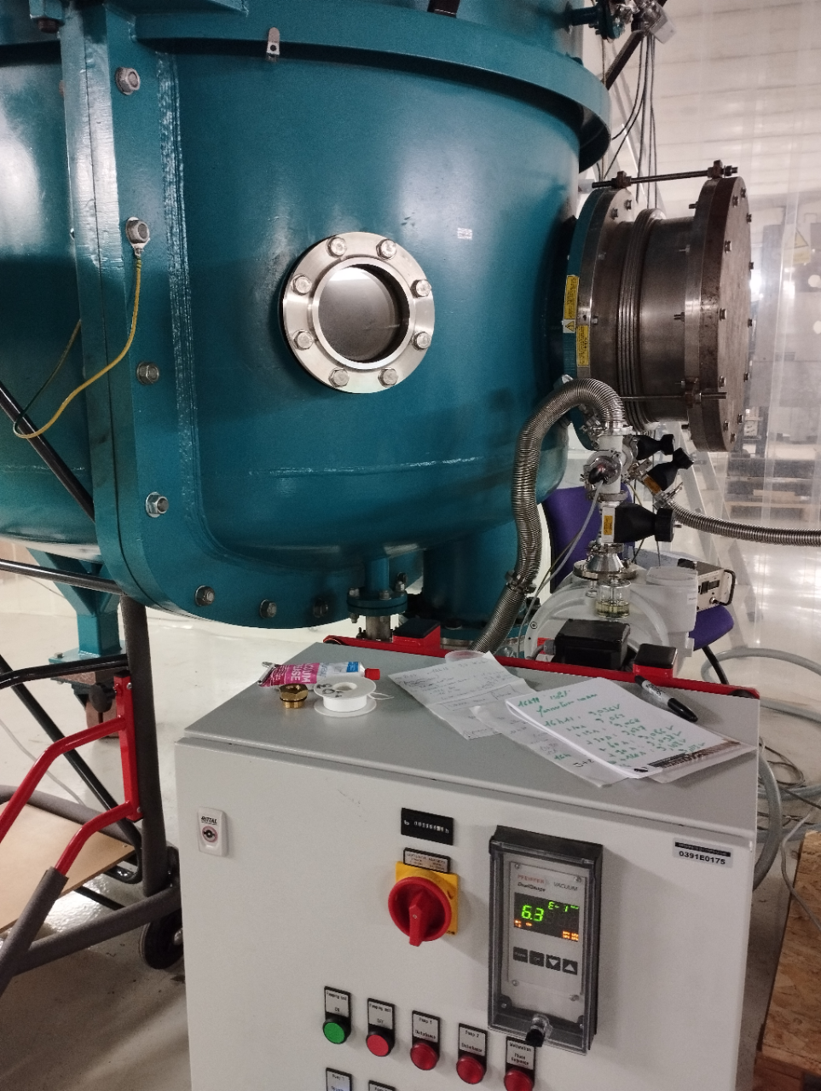
Check of HV vessel tightness
It takes time to lower the pressure (degassing of the columns)
Difficulty in starting leak detection
But no “big leak”
Admissible pressure to transfer SF6 into the tank
September 2022

Slide 8
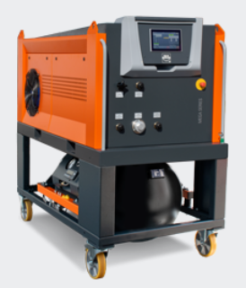
High Voltage conditionning
SF6 system
Discussions underway with vendor
Call for tender expected end 2022
Next steps
Preliminary tests (limited at low voltage (up to 30 kV) by french regulations) in November
Permit from Nuclear Safety Authorization (ASN) required for operation at high voltage
Nuclear safety file being prepared
Permit expected by mid 2023 ➔ HV conditioning to follow
Laser
Writing the specifications for the laser
Discussions underway with vendor
Call for tender expected end 2022

Slide 9
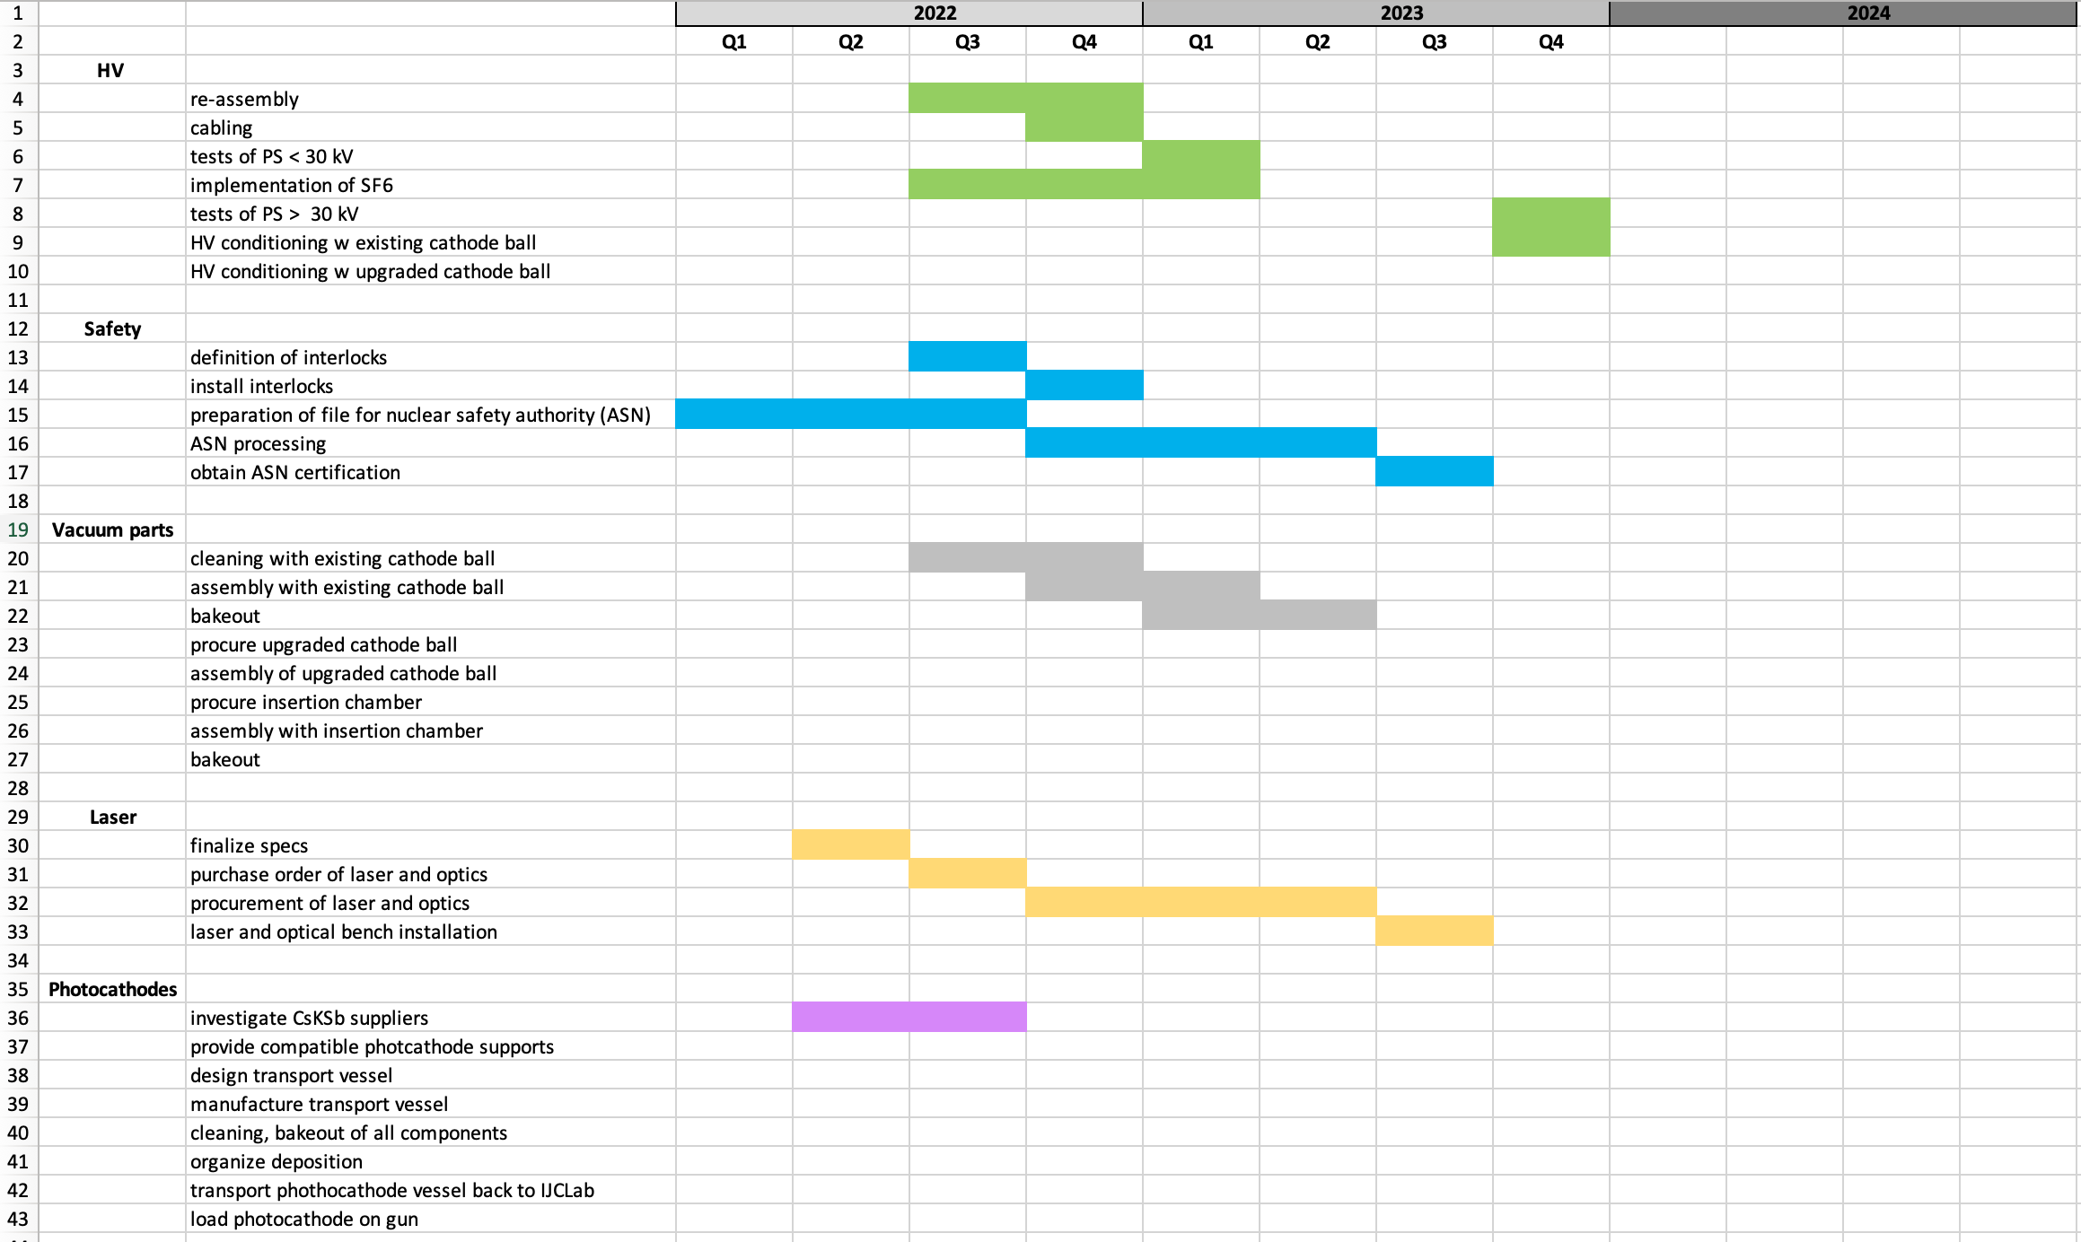
Gun commissioning
Main steps & schedule
Gun fully assembled, under vacuum and operational
procurement of the SF6 system
procurement and installation of the Laser and the optical system
Obtain permit from the French nuclear safety authority (ASN)
HV conditoning for operation at 350 kV
Initial functional tests with a robust photocathode (vent-bake gun)
➔ Goal : first functional test (electrons on a viewer) by early 2024

