Slide 1
Work Package 2 : Accelerator Design
WP2: Accelerator Design
Task 2.1:
Lattice and optics
Task 2.2:
Beam Dynamics
Task 2.3:
PERLE Footprint
Task leader : IJCLab : Luc Perrot / Jlab : Alex Bogacz
IJCLab members on WP2
Alex Fomin, IN2P3 Post-doc, since February 2022, 100%
Rasha Abukeshek, UPSay-IJCLab PhD, WP2 & WP6, 100%
Julien Michaud, CNRS researcher, from November 2022, 100%
Coline Guyot, UPSay-IJCLab PhD, 50% (Christelle Bruni, CNRS)
Partners to WP2
Bertrand Jacquot, CNRS GANIL-SPIRAL2, 30% for WP2
Hadil Abualrob, prof. An-Najah National Univ. (Palestine), WP6 lead.
Rodolphe Marie, IJCLab workshop, mechanic
Connor Monaghan, PhD at Liverpool University, October 2022
Robert Apsimon, Cockcroft Institute (UK)
Peter Williams, STFC Daresbury (UK)
Sub-systems
Injection line
Source
booster
buncher
Connection section
Main ERL
LINAC
Arcs
Extraction lines
Extraction section
Junction line to users
Junction line to dump
Full design
Optics / beam dynamic
Footprint

Slide 2
Work Package 2 : Accelerator Design
    From last collaboration meeting
  Full knowledge of the 500 MeV ERL design
  250 MeV ERL studies
  First longitudinal studies on the way to mitigation of collective effects
  Feeling pattern solutions studies
  Interaction points possibilities
  Longitudinal beam dynamic from 7MeV to 82MeV with field-map & calculation tool
  Coline Guyot work
  From 250 MeV to 500 MeV stage
  Alex Fomin work (see talk + ERL2022 poster)
  Is it 2 different machines specially from integration & costing ?
  We decide to flip the machine : simpler for IP regions (valid for 250 & 500 MeV)
  250 MeV is it fine for beam physics with 6 passes ?
  250 MeV seems fine for applications/users (ex. DESTIN project)
  Only One feeling Pattern will be choose

Slide 3
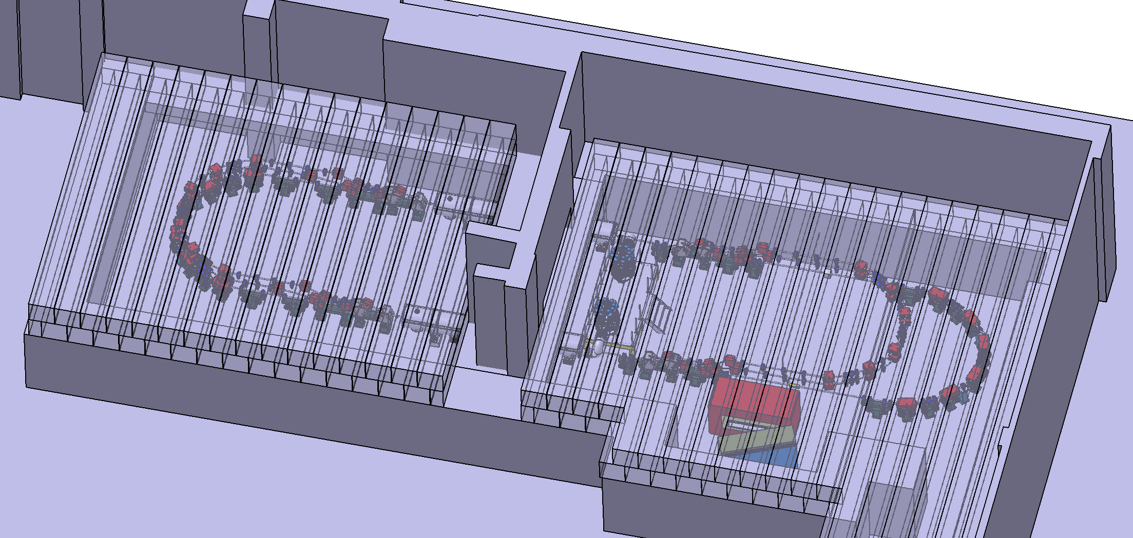
Work Package 2 : Accelerator Design
TDR objectives : full accelerator design and crucial topics
  Fix the optimal filling pattern
  Injection line and merger final design
  Diagnostics types, location and specification
  Interaction point specifications
  Nonlinear aberrations corrections with multipole magnets
  Momentum acceptance and longitudinal match
  Start-to-End simulation with CSR & micro-bunching
  Beam Break-up Instability studies
  Space-charge studies from injection to ERL
  Multi-particle tracking studies, error effects and halo formation
  Impedance analysis and wakefield effect mitigation
  Particle cloud
  We have now human resources to reach the TDR objectives

Slide 4
WP2 – accelerator Design

