Slide 1
Work Package 6: Magnets and power supplies
Hadil Abualrob
September 28th 2022

Slide 2
WP6: magnets and power supplies
Members
Hadil Abualrob: WP leader (since May 22)
Rasha Abukeshek: PhD student (intern since April 2022)
Saleh Abuali: Mechatronics engineering (since July 2022)
Tasks
Task 1: magnetic design and optimization (in progress)
Task 2: prototyping and measurements (hands on the magnetic measurement bench)
Task 3: power supplies (Ned HR)
Interlinks
IJCLab:
WP2:
Luc Perrot: WP leader
Alex Fomin: Post doc
For the magnetic measurement:
Jean Noel Cayla: Technician
Alexandre Gonnin: Mechanical Engineer
JLab:
Jay Benecsh

Slide 3
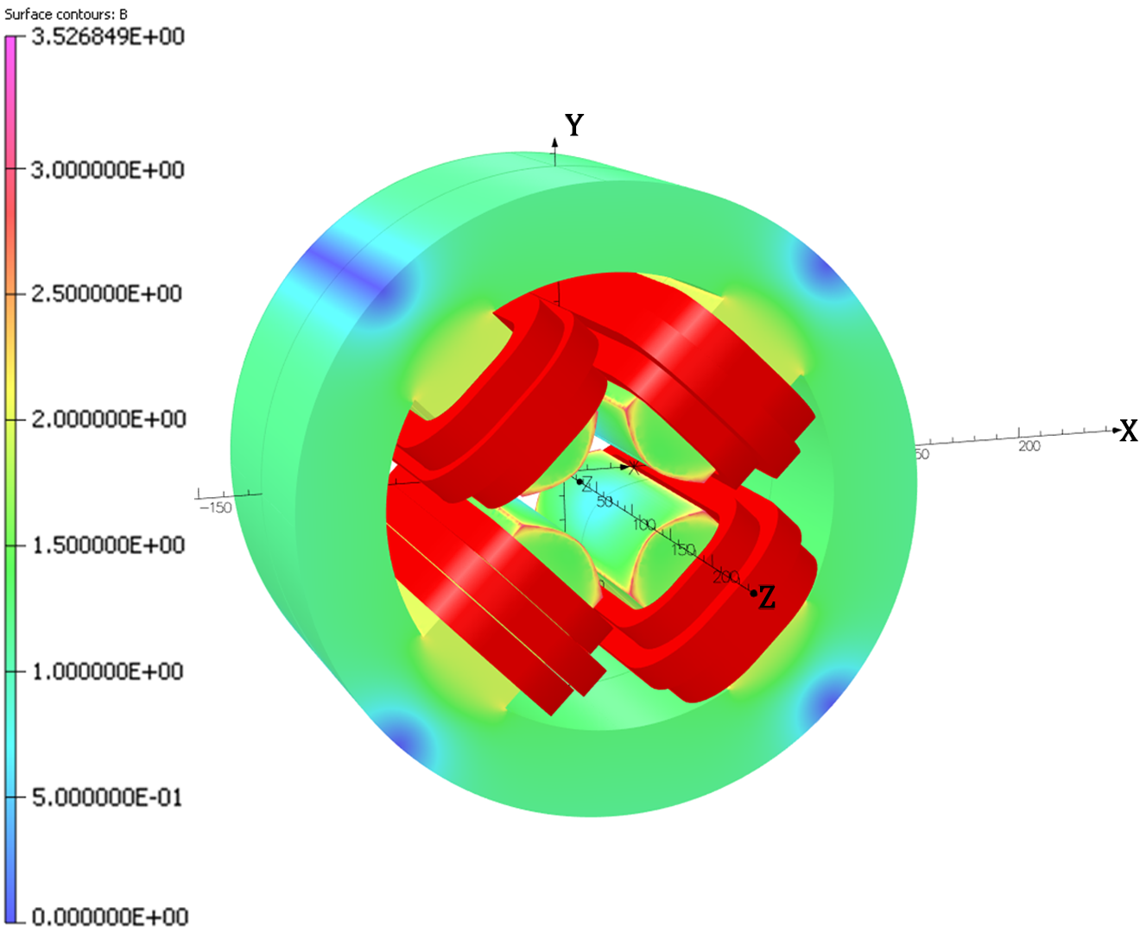
Task 1: magnetic design and optimization
Parameters | Value
Number of turns/coil | 20 (2$×$10)
No. of coils | 3 (series connection)
Coil cross section | $$20.25{ mm}^{2}$$
Current density J | 2.882 A/${mm}^{2}$
Pole tip field | 0.685 T
Parameter | Value
Width | 40 cm
Height | 60 cm
Length | 34 cm
Aperture | 4 cm
Pole width | 25 cm
Pole height | 5.25 cm
Pole blend radius | 0.8 cm
Work by R. Abukeshek for the 500 MeV machine
M2 GI intern (April-September 2022)

Slide 4
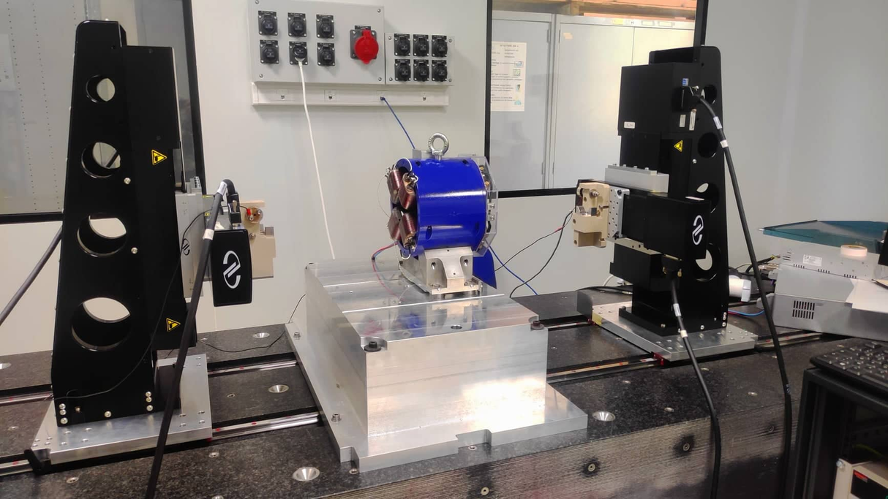
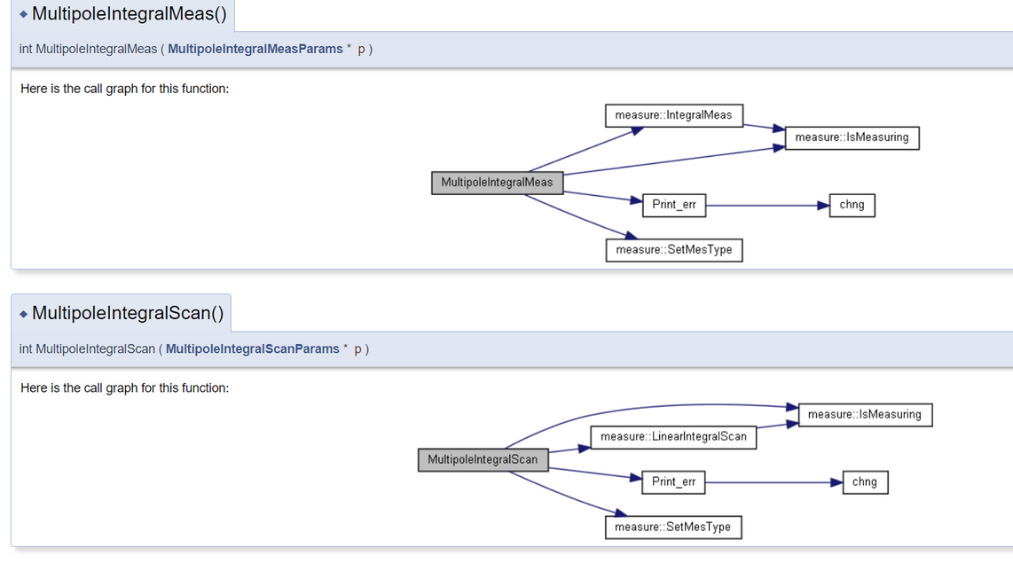
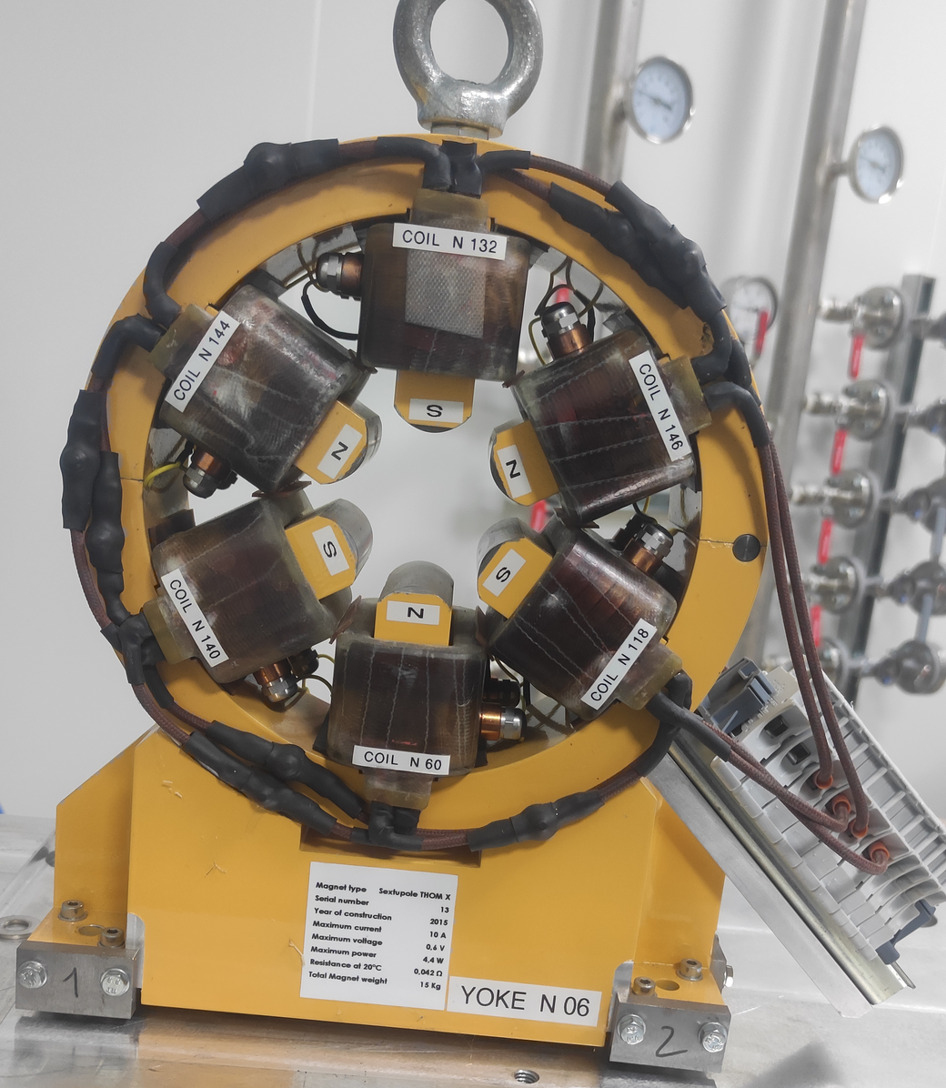
Task 2: prototyping and measurement
Functionality analysis
Measurement of the spare magnets of Thom-X
Operational stretched wire bench is available at the IJCLab
Strong connection with Synchrotron SOLEIL

Slide 5
Tentative plan
Plan for TDR
What is needed
Magnets optimization
B-com
Qudrupoles
Sextuples
Need for other magnets (multipoles, steerers)?
Mechanical pieces design
Power supplies (HR?)
Adaptability for the 500 MeV and the 250 MeV machines? Or consider a total upgrade?
Include prototyping and measurement?
Time scale/task
Human resources/task
Budget plan:
B-com magnets in priority
Agree on an industrial provider
On-site visits for potential providers
Quotation
depends on the HR

