Slide 1
Study of the Magnet Design of Dipoles and Quadrupoles for PERLE Accelerator
Presented by
Rasha ABUKESHEK
Supervisors
Hadil ABUALROB & Walid KAABI
September 28th , 2022
rasha.abukeshek@ijclab.in2p3.fr

Slide 2
Outline
PERLE @ Orsay.
Magnet System of PERLE.
Design of dipoles and quadrupoles for PERLE.
B-com magnet.
Geometry and field calculations.
Harmonic content.
Quadrupole magnet.
Geometry and field gradient calculation.
Field saturation.
Conclusion & Outlook.

Slide 3
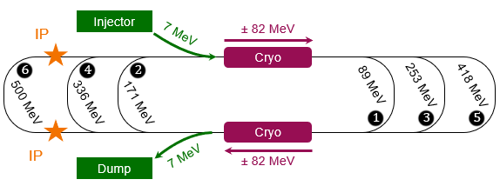
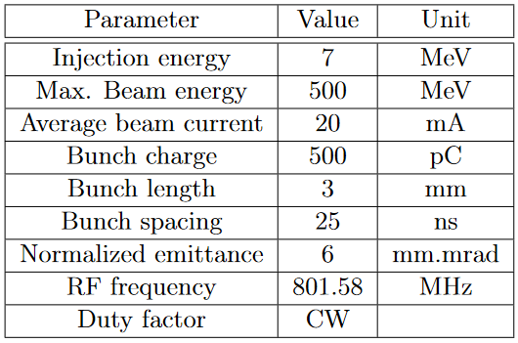
PERLE @ Orsay
PERLE is the first multi-turn, high current ERL based on SRF technology to operate at 10 MW power.
Cryomodule with 82 MV accelerating gradient.
3 acceleration passes → maximum energy 500 MeV
Dump energy: 7 MeV.
Same technological choices of LHeC → PERLE will be a demonstrator for the multi-turn ERL for the LHeC.
PERLE will also be a facility platform for nuclear applications (DESTIN).

Slide 4
PERLE Lattice
Racetrack footprint: 29 m × 5.5 m × 0.9 m
7 MeV
2 : 4 : 6
1 : 3 : 5
ΔE = 82.2 MeV
5.5 m
Top view
Dipole
Quadrupole
29 m
RF cavity
ΔE = 82.2 MeV
10 m
7 MeV
10 m
9 m
Three sections:
LINAC
Two cryomodules with four 5-cell SRF cavities.
Arcs
6 arcs for three-turn configuration.
Spreader/combiner
Connect LINAC to arcs section.
One common dipole magnet for the three arcs at each side called the B-com magnet.
My work: the design study of the quadrupoles and commutational magnet.

Slide 5
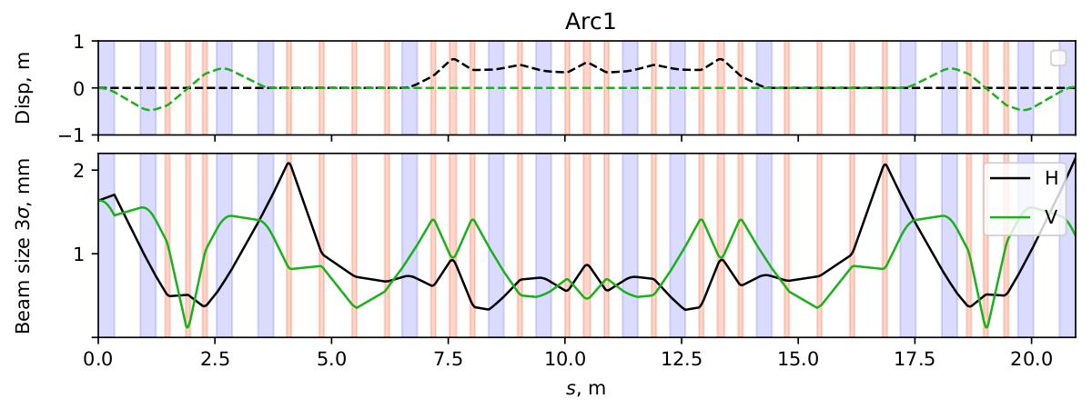
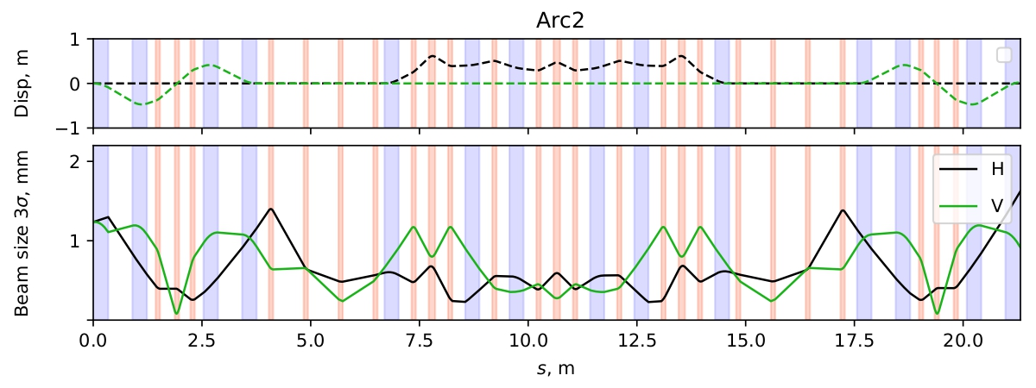
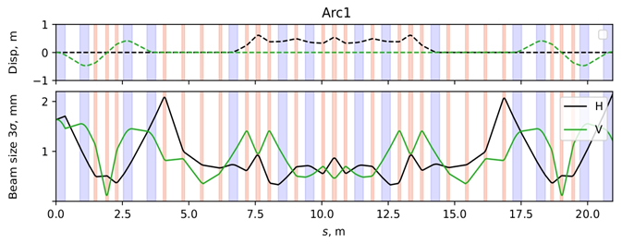
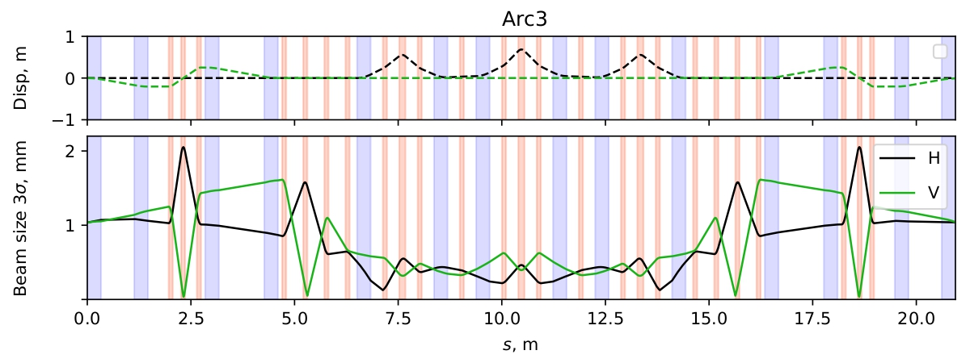
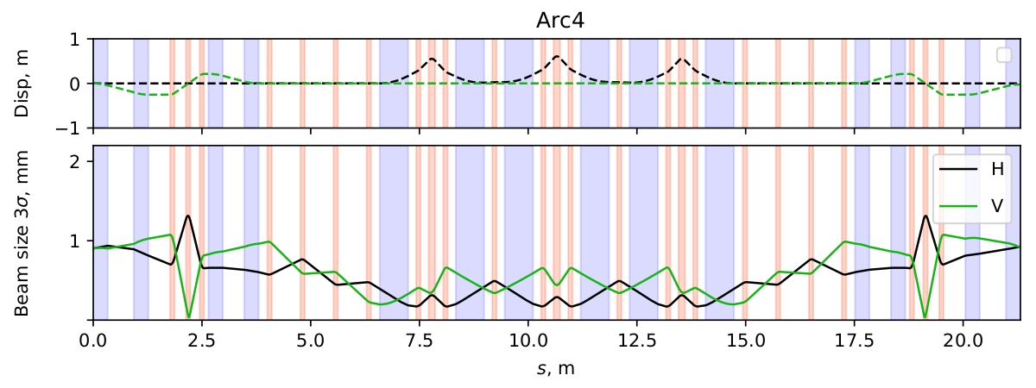
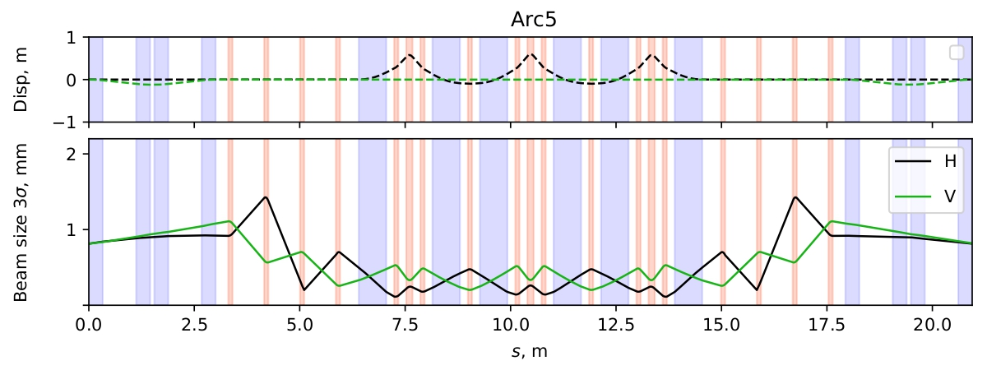
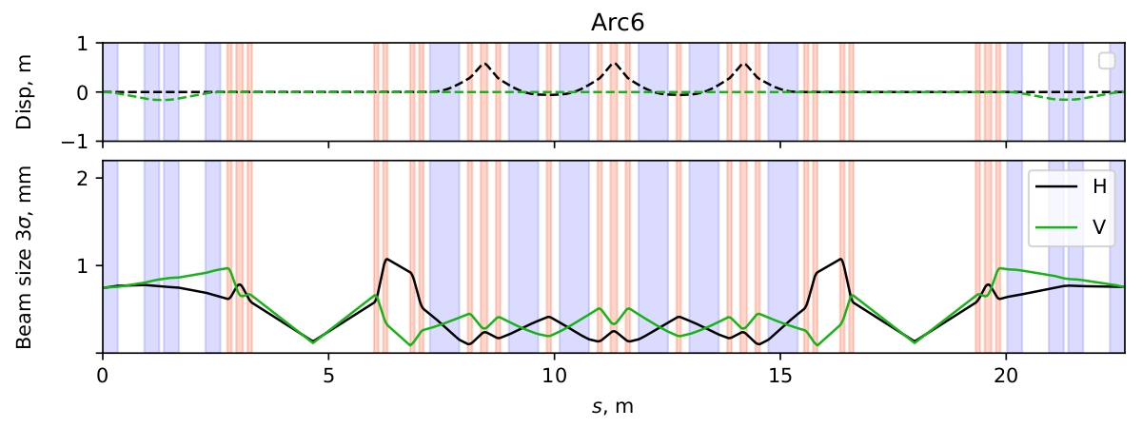
PERLE Lattice
Pure symmetry optics design.
First order lattice (dipoles and quadrupoles only).
The beam size does not exceed 2 mm.
Electron beam envelope and dispersion function in the arcs section. Blue bars represent dipole magnets and red bars represent quadrupole magnets. The beam size is in mm corresponding to 3 σ.
Magnets requirements are defined by the beam dynamics.
Electron beam envelope and dispersion function in the arcs section. Blue bars represent dipole magnets and red bars represent quadrupole magnets. The beam size is in mm corresponding to 3 σ.
Courtesy to Alex Fomin.

Slide 6
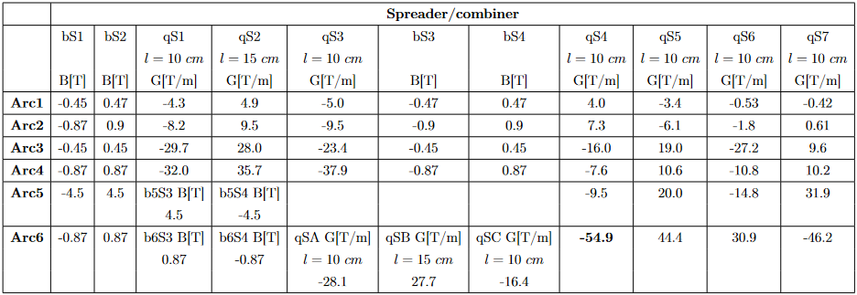
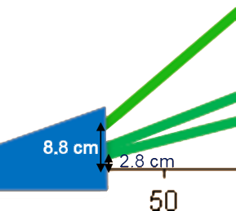
Magnet System Specifications
Spreader/combiner sections
B-com magnet
Common between three arcs.
Vertical beam split at three different energies.
30° bending angle (8.8 cm exit point).

Slide 7
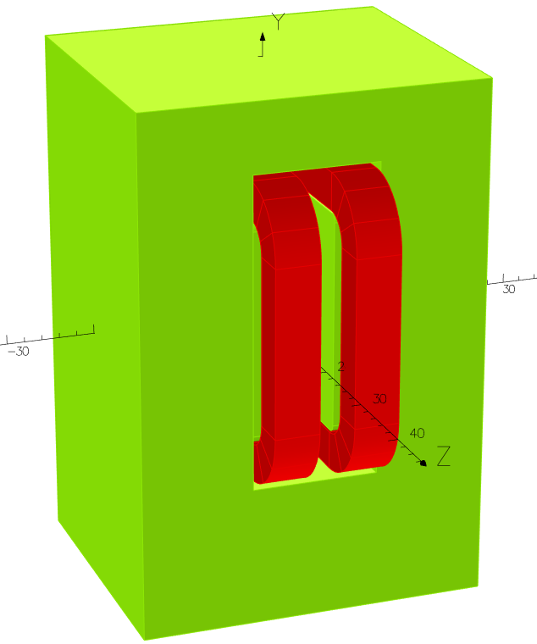
B-com Magnet
Design parameters
Optimized aperture of 4 cm.
Pole blend radius modified for lower harmonic content.
Magnet geometry | *Old design | New design
Width | 40 cm | 40 cm
Height | 57 cm | 60 cm
Length | 34 cm | 34 cm
Aperture | 3.6 cm | 4 cm
Pole width | 22 cm | 25 cm
Pole height | 5.25 cm | 5.25 cm
Pole blend radius | 2.4 cm | 0.8 cm
Coil
Yoke
90° clock-wise rotation around z-axis.
Yoke material: standard steel (C content < 0.1%)
* Courtesy to Jay Benesch.
This work is in collaboration with Jay Benesch from JLab.
Tool: Opera 3D

Slide 8
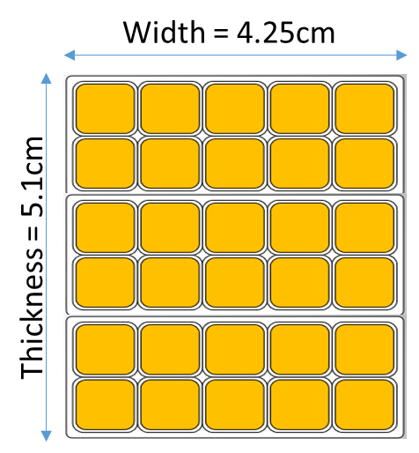
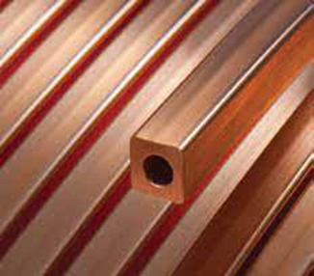
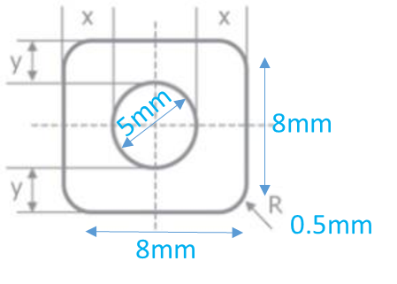
B-com Magnet
Design parameters
Coil Parameters | Value
Excitation current NI | 11520.2625 A.turn
Number of turns/coil | 5$×$6 = 30
Current | 384 A
Coil cross section | $$72.25{ mm}^{2}$$
Current density J | 5.315 A/${mm}^{2}$
Material | Copper
Excitation current calculated for B = 0.87 T
Hollow copper conductor from Luvata company https://www.luvata.com/products/hollow-conductors .

Slide 9
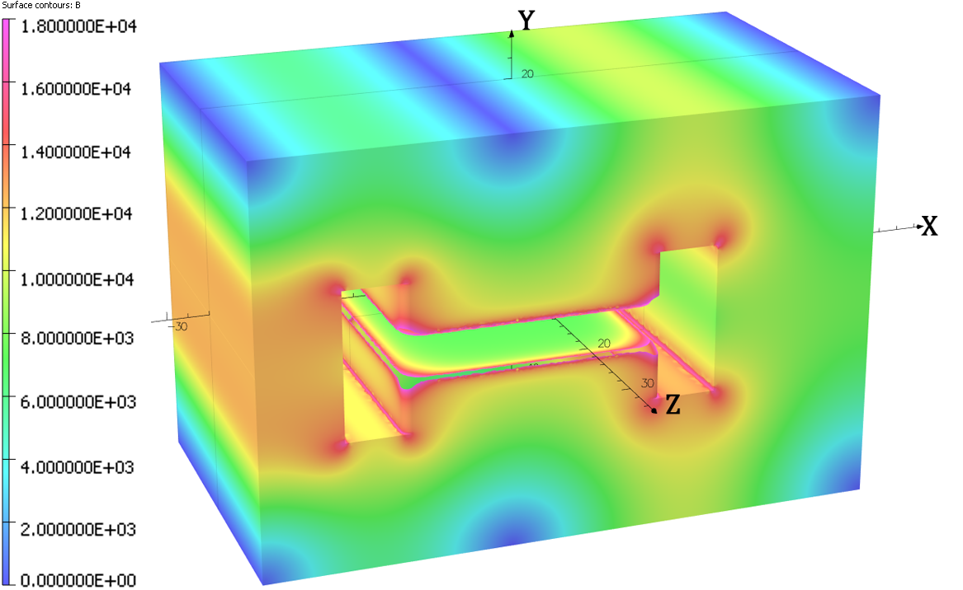
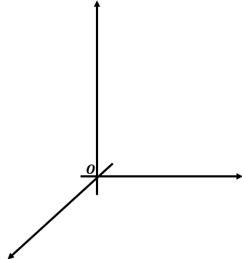
B-com Magnet
Field calculations
Edges with field larger than 1.8 T are not displayed.
No chamfer or shim is added to the pole. Only a blend radius of 8 mm.
Y
$$\vec{B}$$
x
e-
z

Slide 10
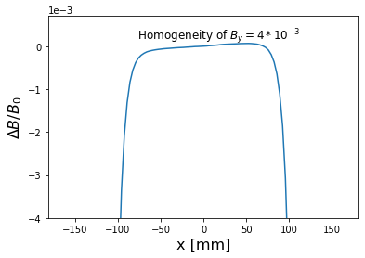
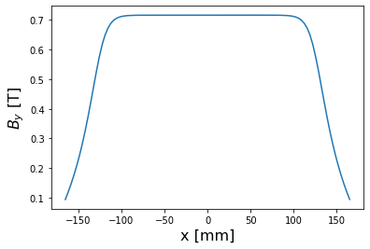
B-com Magnet
Field calculations
$$By (0, 0, 0) = 0.716382 T$$
$$\frac{ΔB}{B_{0}}=\frac{B\left(x\right)−B_{0}}{B_{0}}$$
$\int{B.dl}=0.3 T.m$along the magnet length
for 0.34 m yoke length → B = 0.88 T

Slide 11
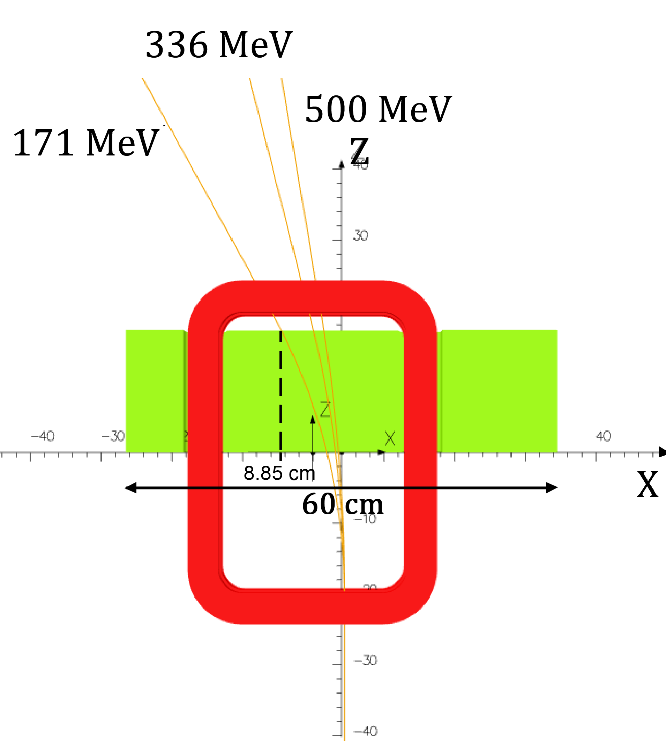
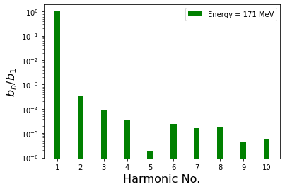
B-com Magnet
Harmonic content
Harmonics calculated along the trajectory of the beam.
0.036% field homogeneity along the beam path.
Quadrupole and sextupole components can be dealt with in the lattice.
Initial design: 0.1% field quality
Improvement by one order of magnitude.

Slide 12
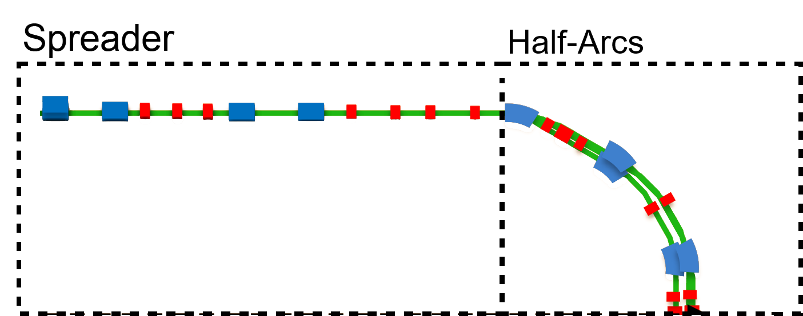
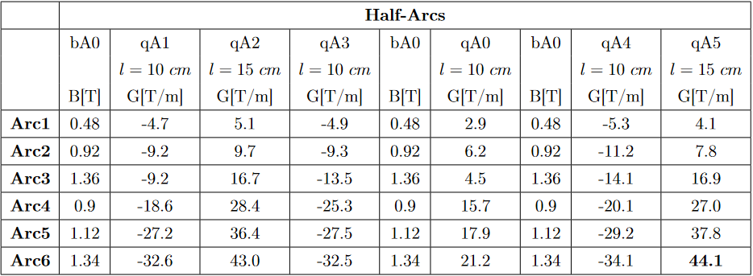
Magnet System Specifications
Arcs section
Two series of quadrupole magnets.
Quadrupole with magnetic length $l=$ 15 cm.
focusing magnet.

Slide 13
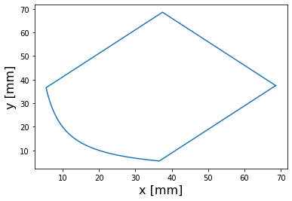
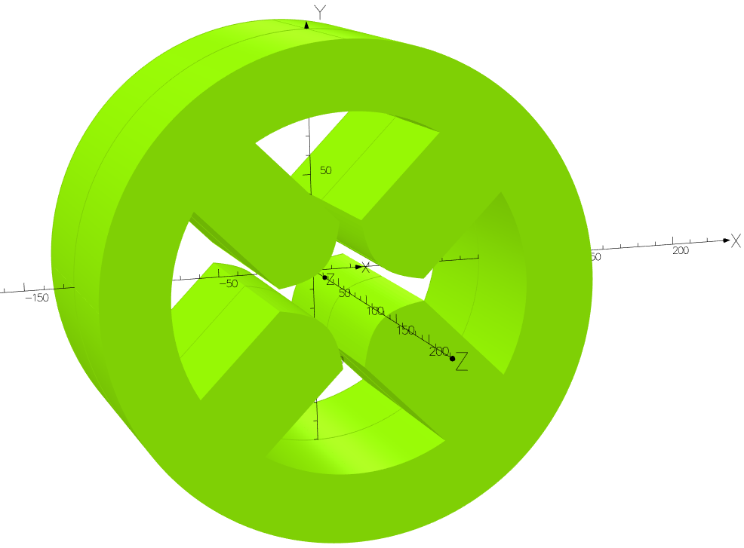
Quadrupole Magnet
Design parameters
Quadrupole height based on available space between the arcs (45 cm).
Parameters | Value
Height | 250 mm
Yoke thickness | 35 mm
Length | 150 mm
Aperture radius | 20 mm
Pole width | 44 mm
Max. gradient | 44.1 T/m
NI per coil | 1750.7 A.turn
Quadrupole pole profile equation $xy= ±\frac{r^{2}}{2}$
Pole with parallel sides.
No chamfering is introduced.
Standard steel for the yoke.

Slide 14
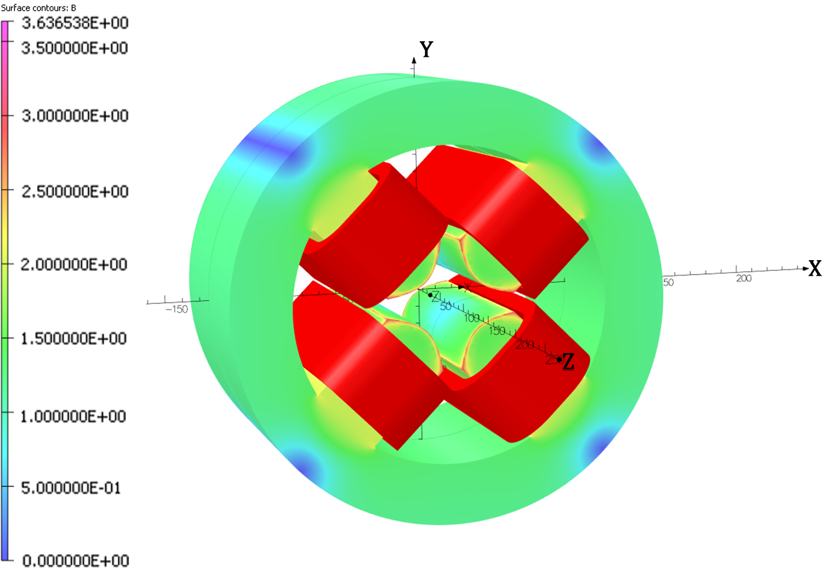
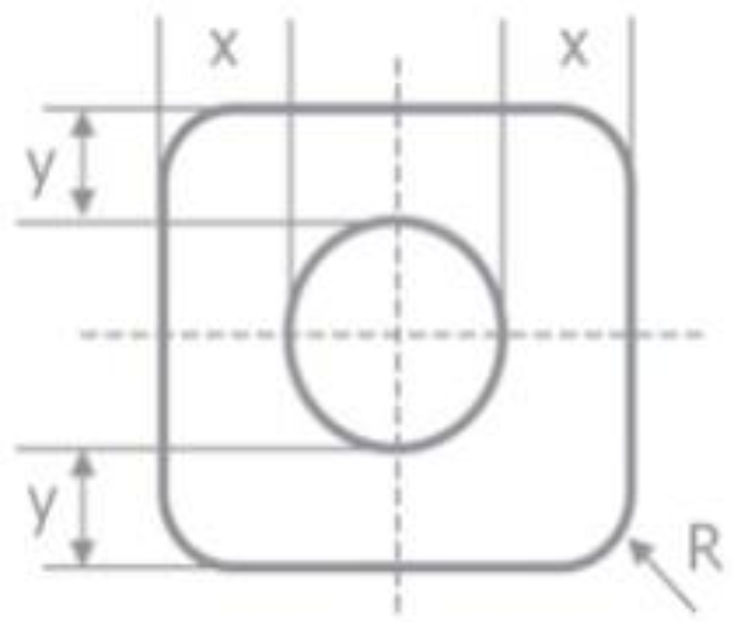
Quadrupole Magnet
One coil design
Parameters | Value
Number of turns/coil | 20 (2$×$10)
Current | 87.535 A
Coil cross section | $$20.25{ mm}^{2}$$
Current density J | 4.323 A/${mm}^{2}$
Pole tip field | 0.725 T
2 mm
4 mm
0.5mm
4 mm

Slide 15
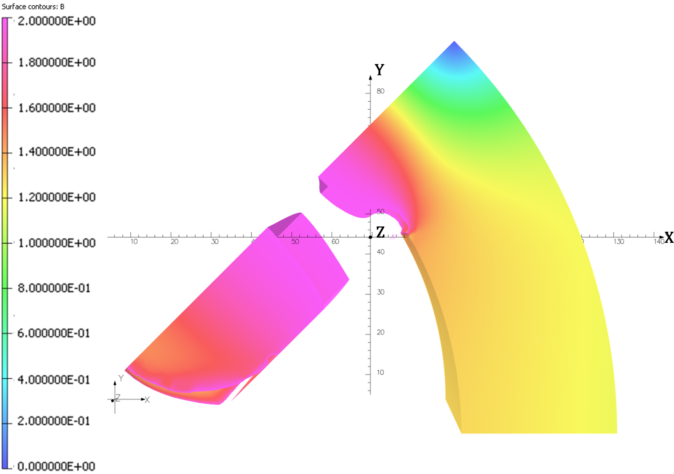
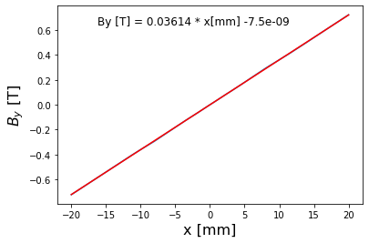
Quadrupole Magnet
One coil design
Saturation!
Areas with B > 2 T are not displayed.
The pole base is highly saturated.
G = 36.14 T/m

Slide 16
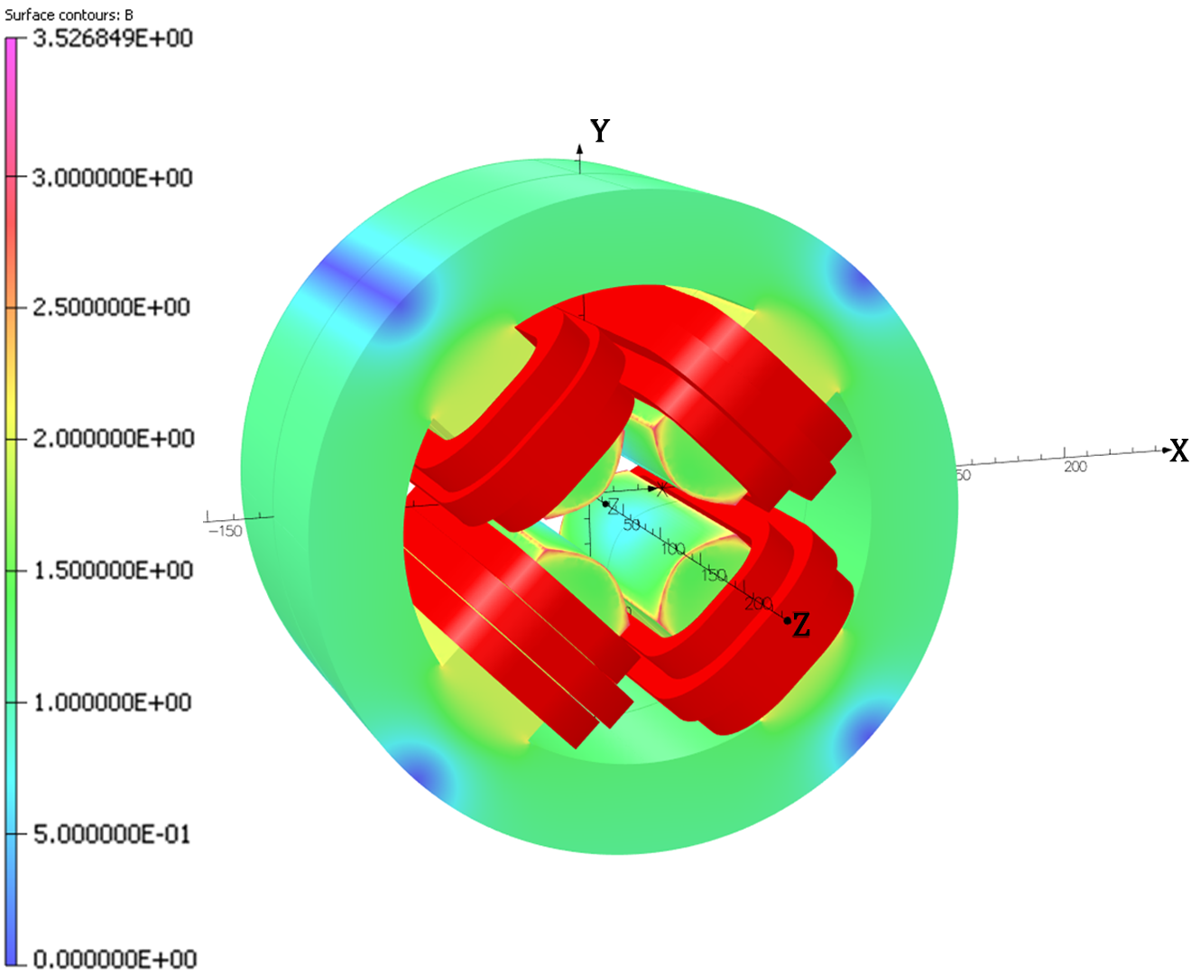
Quadrupole Magnet
Multi-coil design
My suggestion to overcome saturation is to investigate multi-coil configuration.
Parameters | Value
Number of turns/coil | 20 (2$×$10)
No. of coils | 3 (series connection)
Coil cross section | $$20.25{ mm}^{2}$$
Current density J | 2.882 A/${mm}^{2}$
Pole tip field | 0.685 T

Slide 17
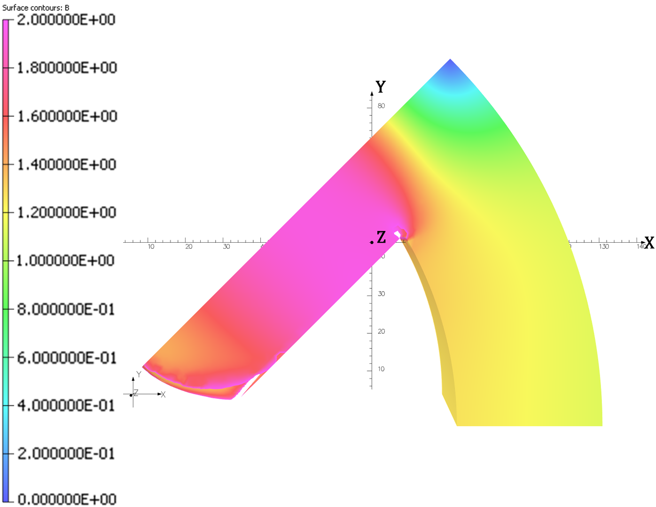
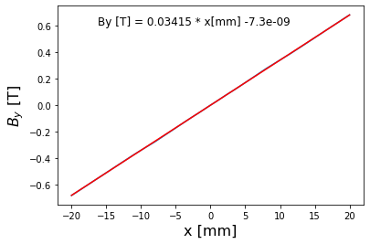
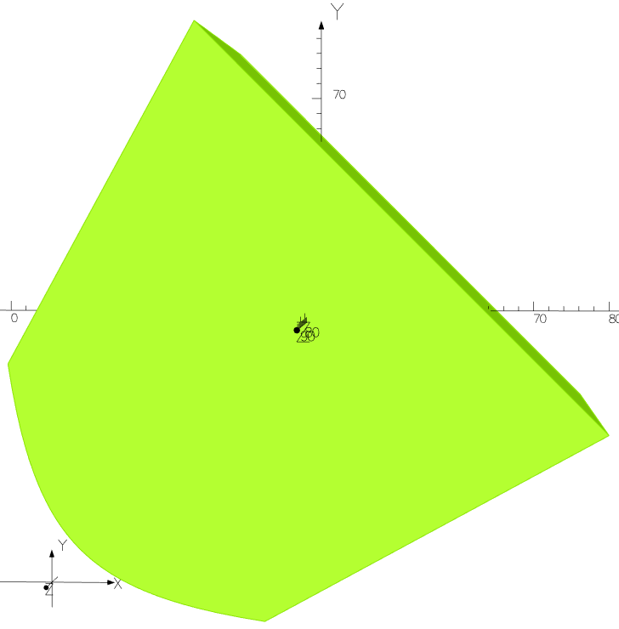
Quadrupole Magnet
Multi-coil design
G = 34.15 T/m
15 cm quadrupole: design is ready up to the 4th arc.
arcs 5 and 6: design saturation.
Improvements
Less saturation (by 0.1 T).
Less current density to drive the field.
Gradient value almost comparable.
Suggested solution: pole tapering

Slide 18
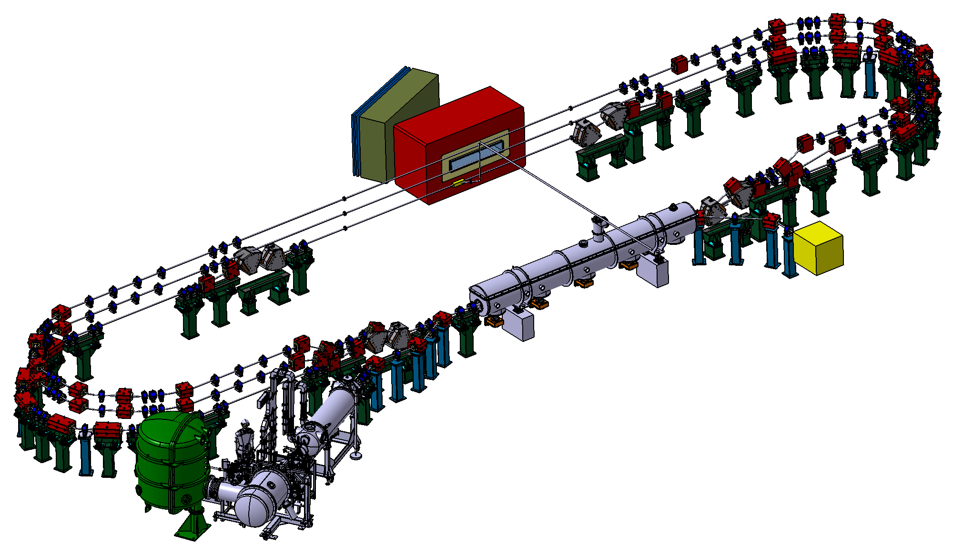
Conclusion and Outlook
The B-com magnet is designed to generate vertical field of 0.7 T and field integral of 0.88 T along the magnet length with harmonic content in the order of ${10}^{−4}$ meeting the accepted tolerances of the beam dynamics.
One-coil design for the quadrupole was studied but showed saturation for the pole base.
Multi-coil design is proposed which gave a gradient of 34.15 T/m.
Further improvement to overcome saturation beyond 36 T/m is foreseen during PhD (pole tapering).
Perspective
Beam dynamics study and optimization of the new lattice for PERLE 250 MeV machine.
Design of magnetic element for the new lattice.
Magnetic measurement of the B-com prototype.

Slide 19
Thank You!

Slide 20
Backup slides

Slide 21
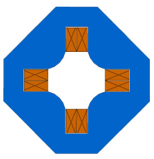
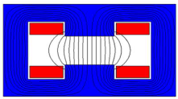
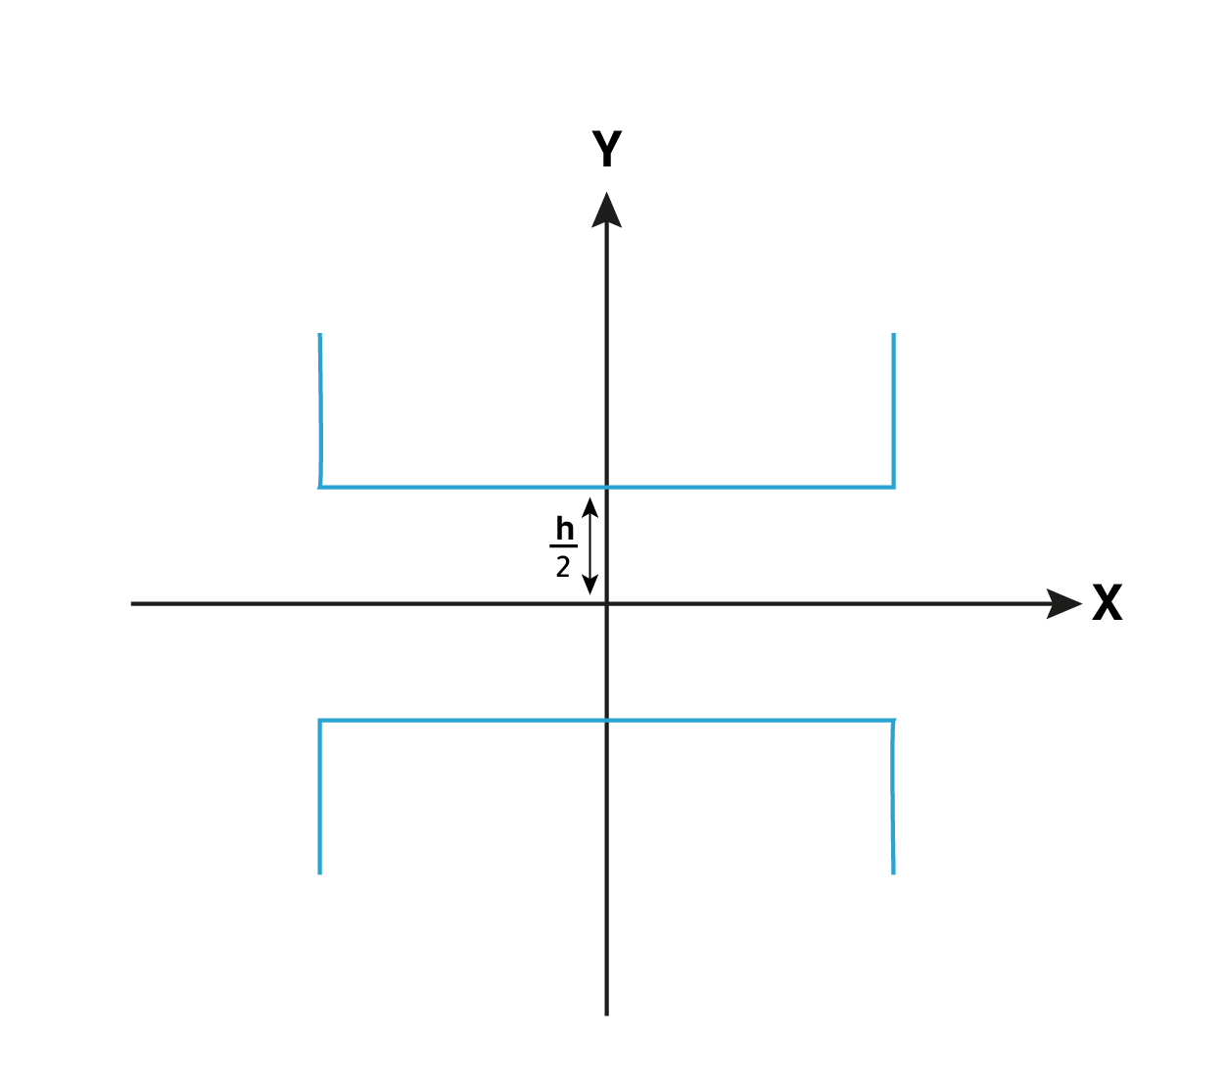
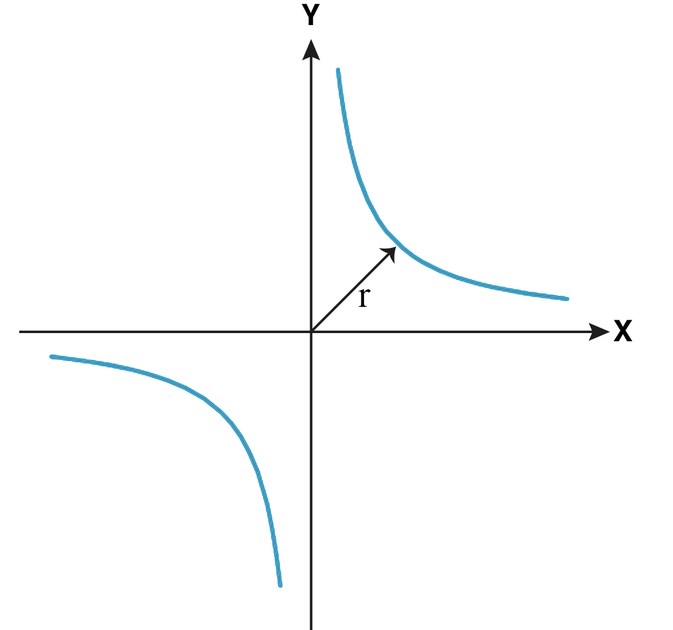
Magnets for accelerators
Dipole magnet (n = 1)
$B_{y}=C_{1}$ and $B_{x}=0$
$$y= ±\frac{h}{2}$$
$$NI_{dipole}=\frac{Bh}{μ_{0}}$$
Quadrupole magnet (n = 2)
$B_{y}=C_{2}x$ and $B_{x}=C_{2}y$
$$xy= ±\frac{r^{2}}{2}$$
$$NI_{quadrupole}=\frac{Gr^{2}}{2μ_{0}}$$
$$J=\frac{NI}{A_{coil}}$$
$$G=B^{′}=Bρk$$

Slide 22
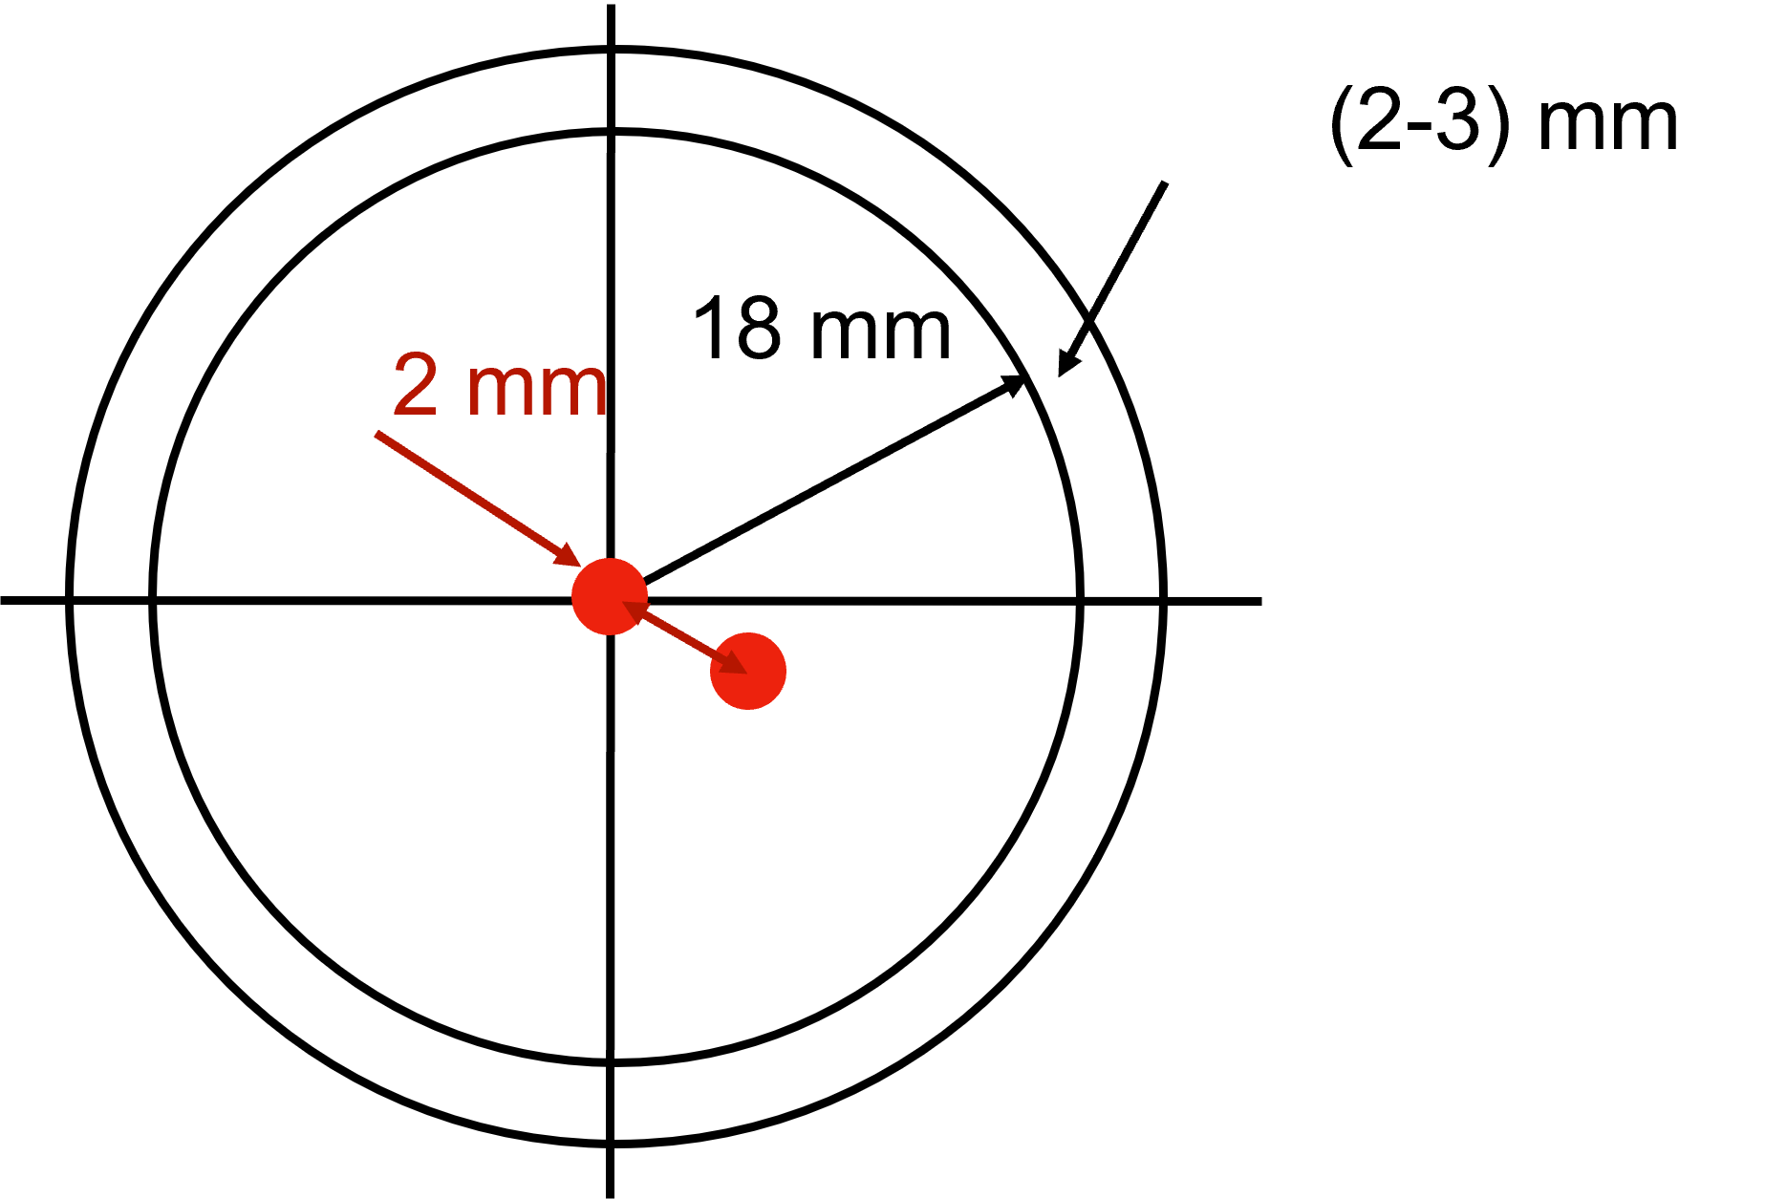
Aperture choice
The beam size in the arcs does not exceed 2 mm at 3σ.
Higher order effects are taken into account.
Standard vacuum pipes are stated.
Flange selection guide https://www.lesker.com/selection-guide/flange

Slide 23
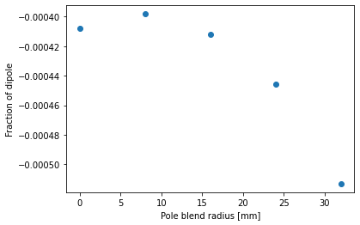
B-com blend radius
Pole blend (mm) | Energy (MeV) | $$\frac{\sqrt{\sum_{n=1}^{5}{b_{n}^{2}}}}{b_{1}}$$
32 | 171 | -5.13E-04
 | 336 | -1.76E-04
 | 500 | -2.44E-04
24 | 171 | -4.45E-04
 | 336 | -1.41E-04
 | 500 | -1.95E-04
16 | 171 | -4.12E-04
 | 336 | -1.10E-04
 | 500 | -1.57E-04
8 | 171 | -3.98E-04
 | 336 | -8.66E-05
 | 500 | -1.18E-04

Slide 24
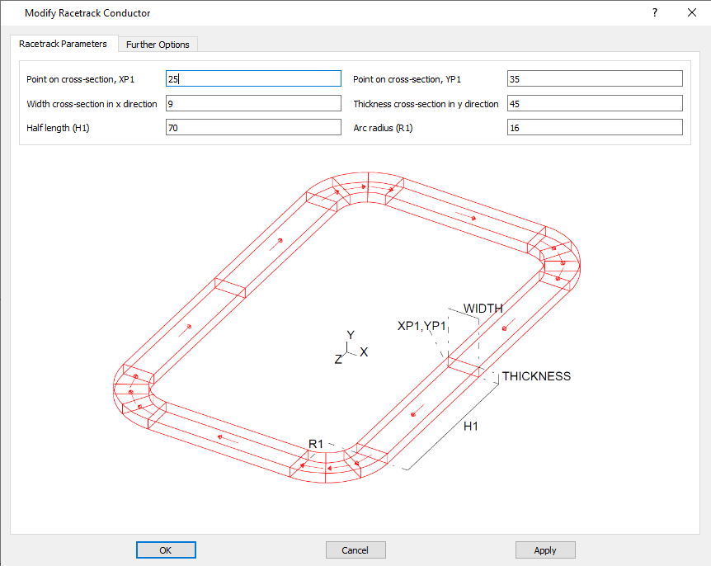
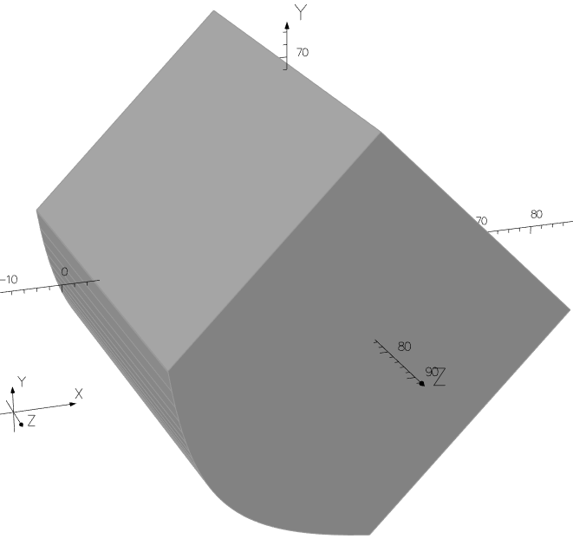
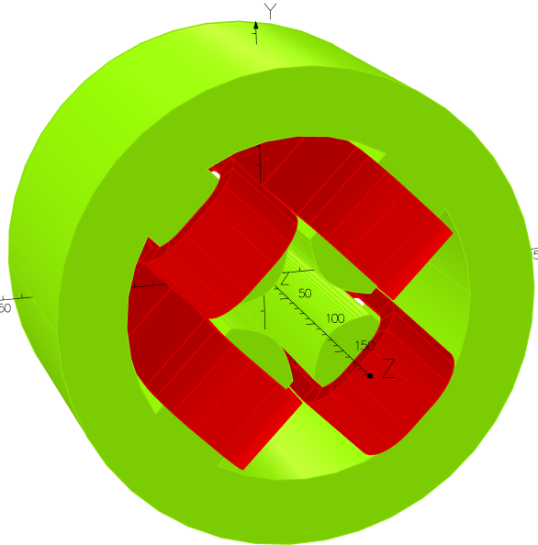
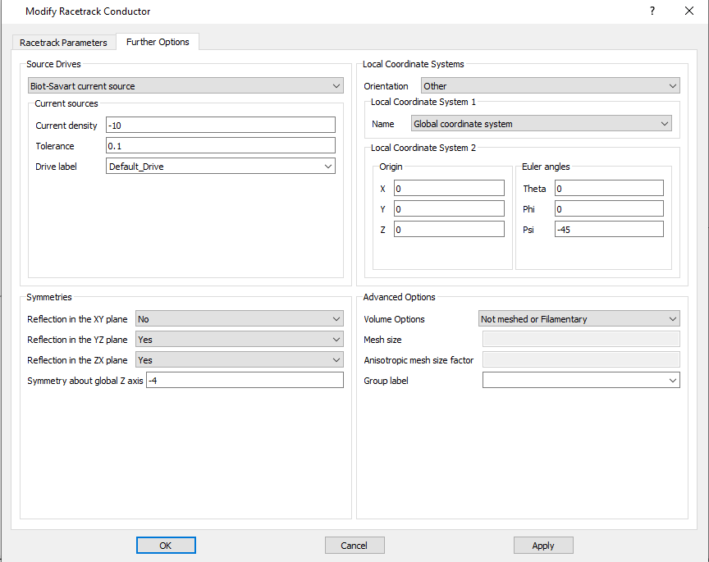
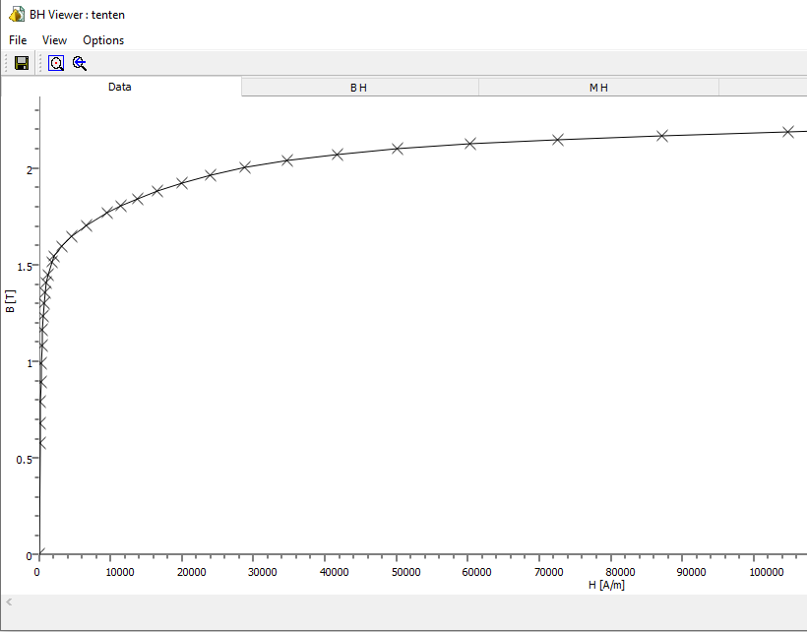
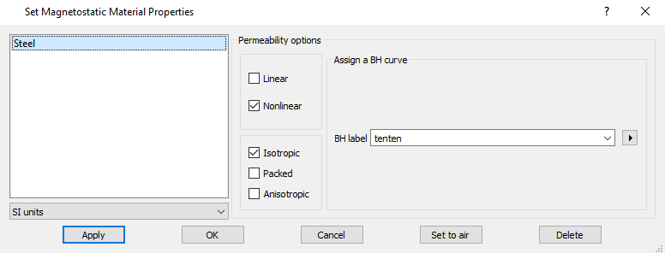
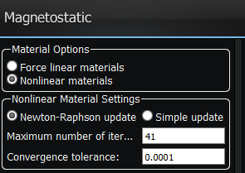
Magnet design using Opera 3D

Slide 25
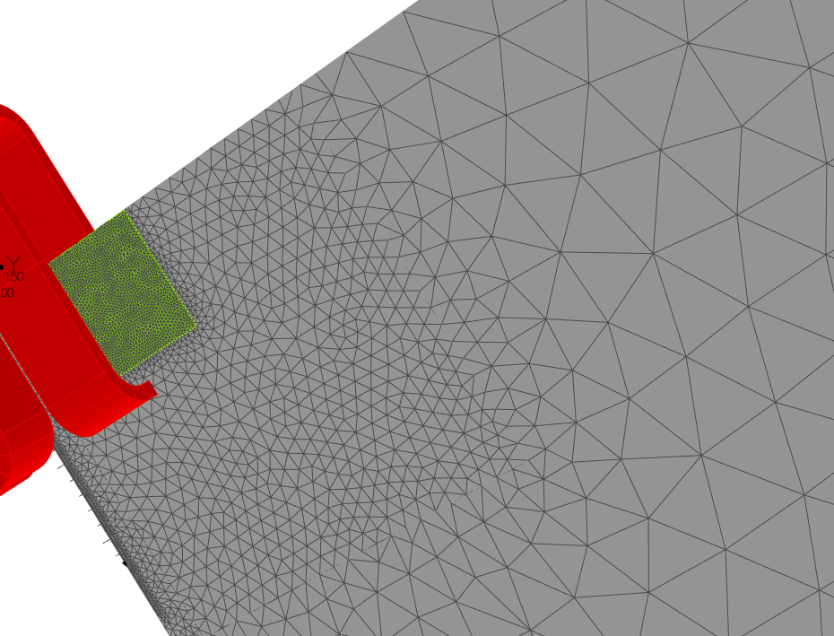
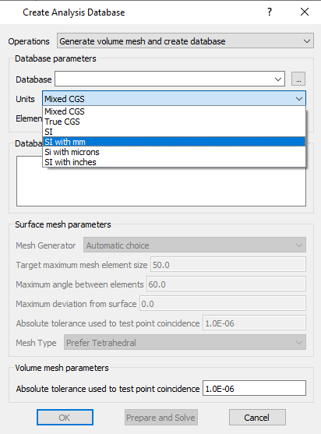
Magnet design using Opera 3D
Mesh size for each element

Slide 26
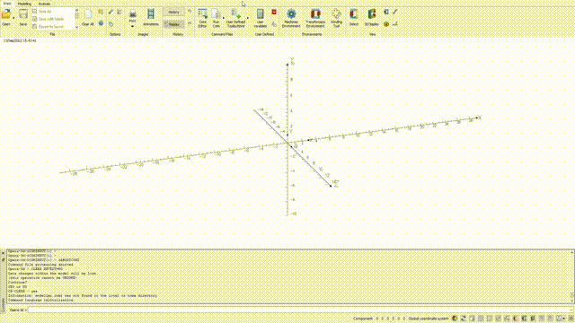
Magnet design using Opera 3D

Slide 27
Harmonic content using Opera 3D

Slide 28
Maxwell’s equations for magnets
Maxwell’s equations for magnetostatics in vacuum:
$\vec{∇}.\vec{B}=0$ and $\vec{∇}×\vec{B}=0$
Magnetic field satisfying Maxwell’s equations for magnetostatics can be expressed in terms of harmonics:
$B_{y}+iB_{x}=\sum_{n=1}^{∞}{C_{n}{\left(x+iy\right)}^{n−1}}$ n: multipole order.
Magnet of order n is composed of 2n poles.
Real accelerator magnet produces magnetic field of superposition of multipole terms.
$$m=n \left(2p+1\right) , p=1, 2, 3, …$$
finite permeability and geometry → Allowed harmonics.
Fabrication or alignment errors → Forbidden harmonics.

Slide 29
Harmonic content using Opera 3D
PERLE phase I: 250 MeV
PERLE phase II: 500 MeV

Slide 30
Quadrupole gradient
Three-coils with current density of 4.323 A/mm^2
G = 39.9 T/m
Maximum field in the yoke B = 3.78 T
Max. B in the pole base is 2.2 T

