Slide 1
PERLE-Executive Board
Introduction and general news (Achille Stocchi , Walid Kaabi et Denis Reynet)
Presentations and Advancements of some WPs where some decisions should be taken soon (Luc Perrot, Guillaume Olry, Maud Baylac,)
Conclusions
28 September 2022

Slide 2
NEWS - Collaborations / PERLE@Orsay in the international context
Recent News/and next to come. Collaborations :
ICRADA with JLab signed in Mai 2022.
An-Najah National University (Nablus-Palestine) join PERLE@Orsay , 1st July 2022. PI : Hadil Abualrob
Visits and contacts with HZB. Collaboration PERLE@Orsay-bERLinPro starting and will be formalised by an MoU
Promising discussios on going with ESS-Bilbao to concretise the interest to join PERLE (meeting 10th-11th october 2022)
Creation of the PERLE@Orsay Executive Board, with all the WP leaders. First meeting, 28th Sept. 2022.
PERLE recognized as a central multi turn facility selected for the realization of the European ERL roadmap. It has been endorsed by CERN Council, published as arXiv:2201.07895 and CERN Yellow Rep.Monogr. 1 (2022) 185-227
Baseline detailed ERL paper (arXiv:2207.02095) accepted for publication by JINST
ERL Panel for the European Strategy of Particle Physics launched. The Chair person is Jorgen D’Hondt (see next page)
Some discussions on going with : Italy/Frascati and Milano, Darmstadt/sDalinac, HZRD…

Slide 3
NEWS - ERL and PERLE@Orsay in ESPP
ERL panel meets very 3-4 weeks
Initial report given to Council this week
Next: more comprehensive plan for Council in December
First actions
  setup of WGs
  contact to RF panel
  Contact with FAs and labs : STFC, Rossendorf, Darmstadt…
connecting the ERL R&D community with the HEP steering and funding bodies
leverage on ongoing ERL R&D towards implementations in HEP applications
strengthen collaboration across the field to reach the HEP-related R&D objectives
incl. representative of ongoing & upcoming ERL facilities
3

Slide 4
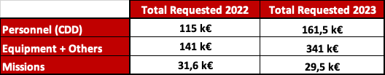

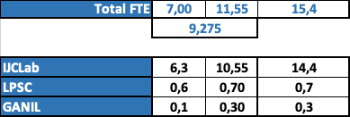
NEWS – Finances and HR
Recent News/and next to come: Finances.
TDR Phase 2022-2023, Consolidation with IJCLab/IN2P3.
2M€ from CPER for infrastructure, maybe not sufficient for the full infrastructure works. Search for extra funding.
PEPR for the PERLE Phase I under construction; Deposit of the project with CNRS (INP, IN2P3) and CEA on going.
Contributions from other countries so far only in kind (source, booster, SPL to be discussed). Finances to be discussed, within PERLE and through the newly formed ERL coordination group
Financial support (~800k€)
  CDD/PHD (IN2P3, EU, ED)
  For equipment (IN2P3, CERN, Cremlin+ EURIZON)
Recent News and next to come : HR
Strong increasing in 2022 of the manpower at IN2P3 (IJCLab-Orsay and LPSC-Grenoble)
Collaboration agreement foresees/demands bilateral MoUs of IJCLab/IN2P3 with PERLE partner institutes about resource loaded (financial, material) contributions ICRADA now signed and a base for such an agreement with JLab
Manpower (~10FTE (2022) →~15FTE (2023)
~50 people involved

Slide 5
Work in Progress – All Work Packages started
Scientific News and Progresses/Results : SOME REPORTS TODAY.
Several Work Packages have some important results to be reported :
  WP2 Accelerator design, WP3 e-Source , WP4 RF System, WP7 Physics, work since several months with international partners. Presentations also at Executive Board.
  WP6 Magnets & Power supply restarted with month ago with international partners;
  WP5 : Cryogenics, WP9 Safety & Protections, WP10 Infrastructure & syst. Integration work since several months with only IJCLab members.
Some Work Packages just started:
  WP7 Diagnostic and Instrumentation no yet any international partners;
  WP11 Vacuum Systems, some collaboration with GANIL at level of discussions;
  WP 12 Command and Control Just reflexions yet only internal at IJCLab.

Slide 6
PERLE Configurations and Plans
Mission of PERLE in 3 lines:
Demonstration of high current (20mA) multi (3) turn ERL operation and low energy nuclear/particle physis
CDR in 2017 (J.Phys.G 45 (2018) 6, 065003 and arXiv:1705.08783) current Composition of PERLE Collaboration:
IJCLab (host), AsTEC, BINP (on hold), CERN, Cockcroft, U Cornell, Grenoble, Jlab, U Liverpool, U Nablus, open to further partners
Major Phases of Realisation and Operation
TDR by next year, based on current studies and Prepare to Build (P2B) work/plans (as source installation) → clarity on configuration
There follow four major steps:
1. 250 MeV at high currents [requires time for acc R&D: step wise increase of currents, safe, controlled operation]
2. Initial experiments [two IRs, when machine is reliably understood]
3. 500 MeV phase [possibly with advanced technology reducing power load, 4K? FRT]
4. Second phase for experiments: at higher energy and likely increased intensity
6

Slide 7
NEWS - MEETINGS
Meetings to come:
CERN Council, 29th September 2022.
ERL Conference at Cornell, with large participation and presentations from PERLE Coll.
ESS-Bilbao IN2P3/PERLE visits on 10th - 11th October 2022
Presentations of PERLE@Orsay at IJCLab-Strategical and Scientific Council 16-17 October, and then detailed at the Scientific Council of IJCLab on 16 December 2022.
LHeC / PERLE Workshop the 25th -27th October 2022 at Orsay
HZB visiting Orsay on 6th December.
+ PERLE presentation requested at several seminars and conferences

Slide 8
WP7 (Experiments): “Physics with PERLE”
DONE : Physics Workshop the 9th May
DESTIN (DEep STructure Investigation of exotic Nuclei) PERLE@Orsay
  Starts to be structured in Orsay and involving national and international communities. Coupled to the future of GANIL reflexions. A priority for Nuclear Physics Perspectives at national level.
Photonics with Inverse Compton Scattering (ICS)
  Important community working in Orsay with large experience in past (Japan, USA) and present ICS experiments (ThomX) and in innovative R&D.
ep Physics.
  Important international community with large interest in proton radius, electroweak measurements, dark photons…
COMING : Workshop LHeC 25th/27th October

Slide 9
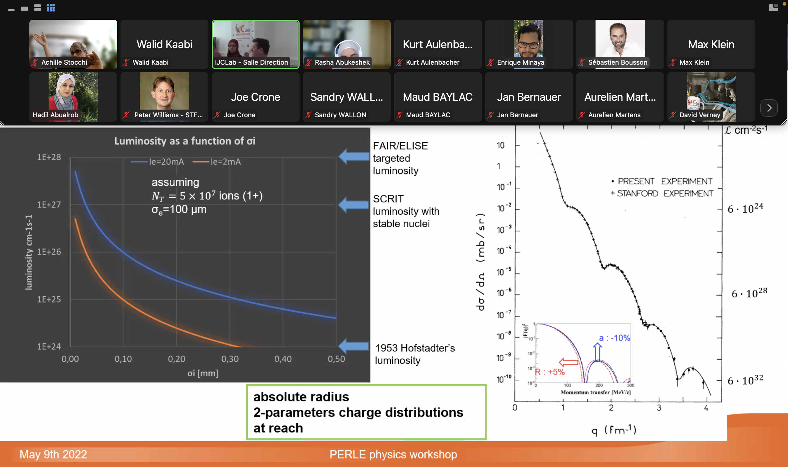
SOME IMPORTANT OUTCOME ALREADY ON PHYSICS APPLICATIONS - I
The New Frontier : e-RIB (Radioactive Nuclei Beam)scattering !
A completely new horizon, explore the interior of exotic nuclei :
charge radius, shape… New properties are emerging (halo, pairing..) !
Talk: D. Verney

Slide 10
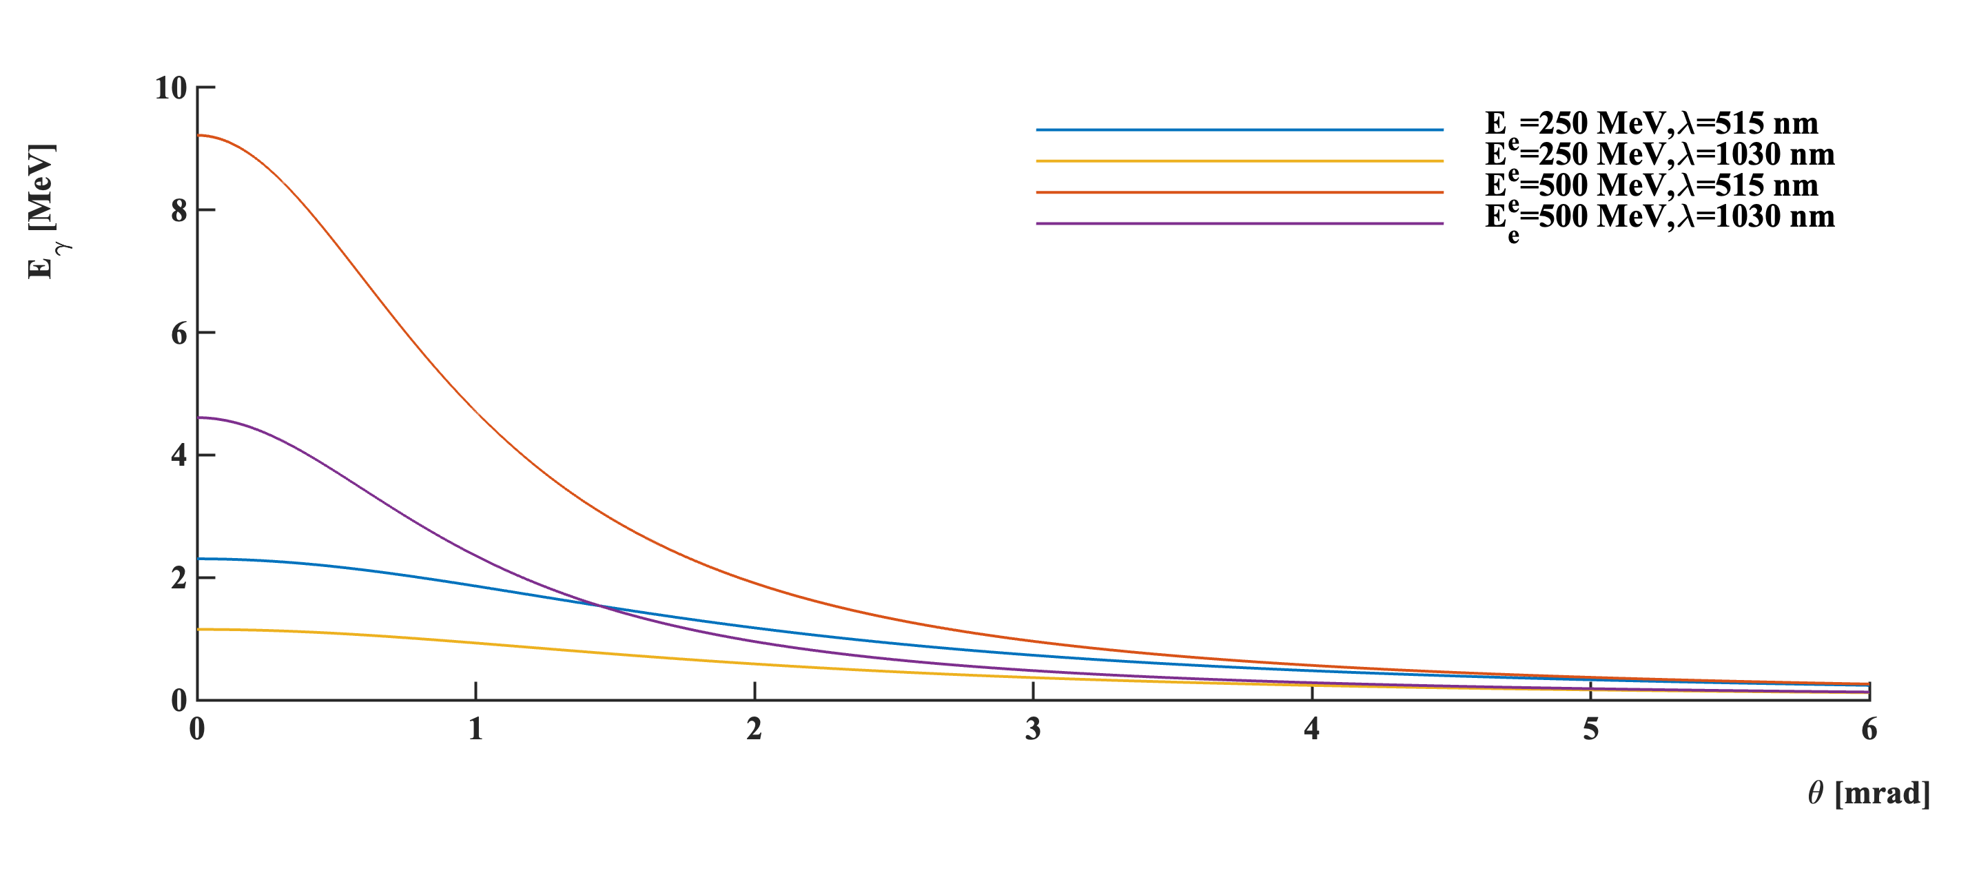
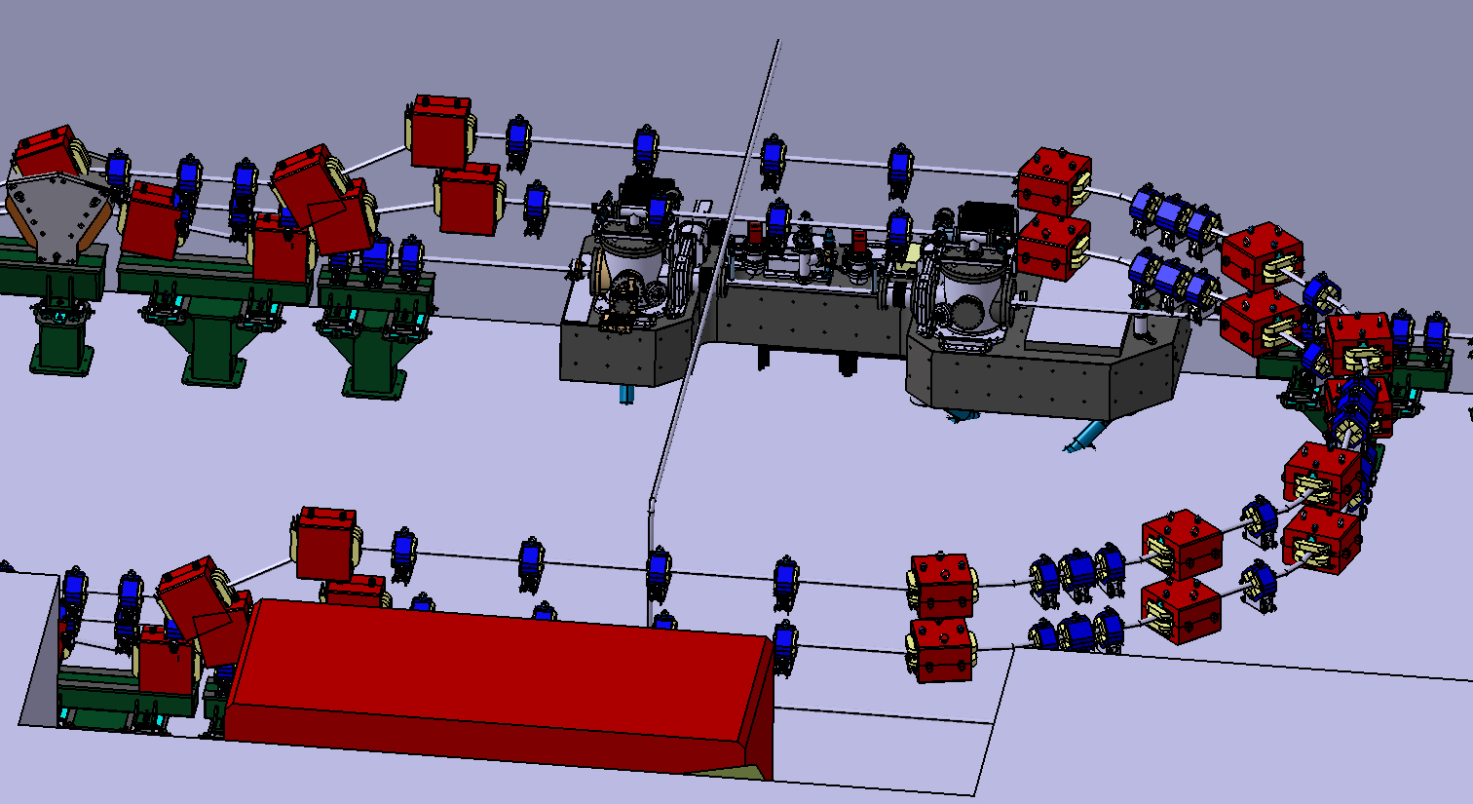
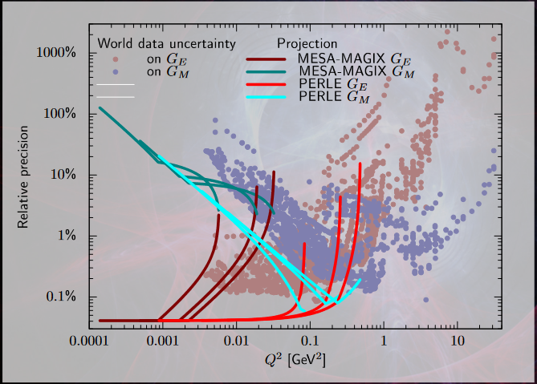
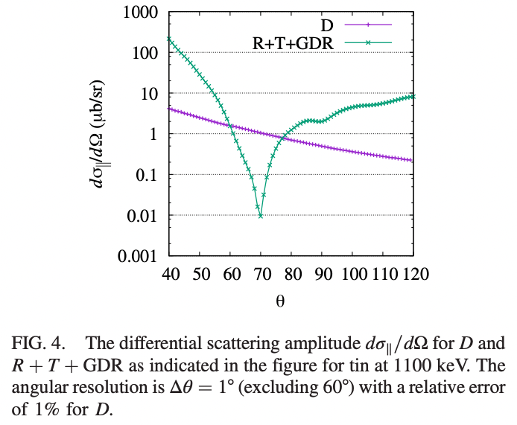
SOME IMPORTANT OUTCOME ALREADY ON PHYSICS APPLICATIONS - II
ICS (Inverse Compton Scattering) Aurelien M.
A high rate low energy gamma-ray source at 1.1MeV:
~>100x ELI-NP
more at 500MeV e-beam energies, or with halved wavelength laser
Jan Bernauer – ep physics
A very nice driver for R&D on optical cavities :
Very high average laser power in green (new AFAIK)
A place to demonstrate <0.1% bandwidth gamma source:
NRF backgrounds…
A place to perform QED physics…
Background free Delbrück scattering measurement in few days
but also more conventional NRF research

