Slide 1
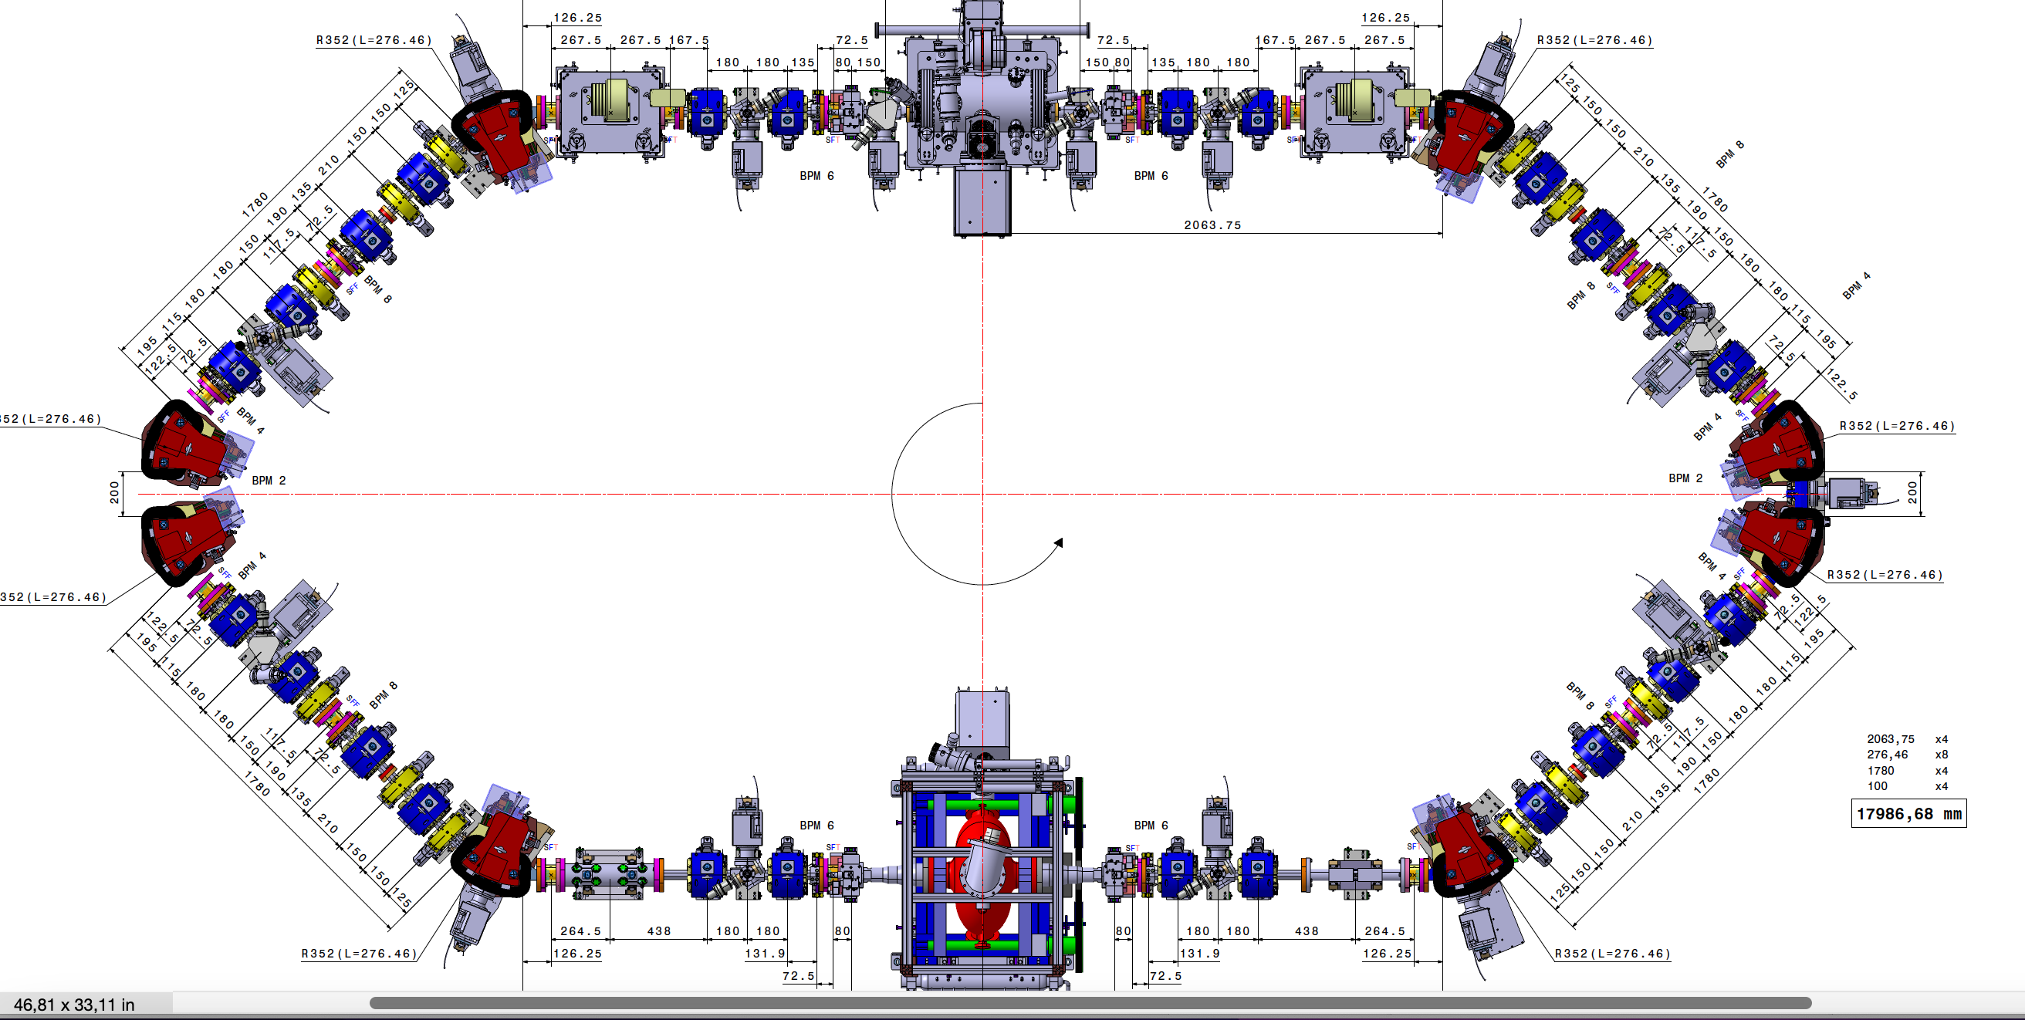
MML
BPM 1
BPM 12
Tango: BPM2
BPM 2
BPM 11
BPM 3
BPM 10
BPM 4
BPM 9
BPM 5
BPM 8
BPM 6
BPM 7

Slide 2
19 September 2022
16-21h
Fist time full turn obtained

Slide 3
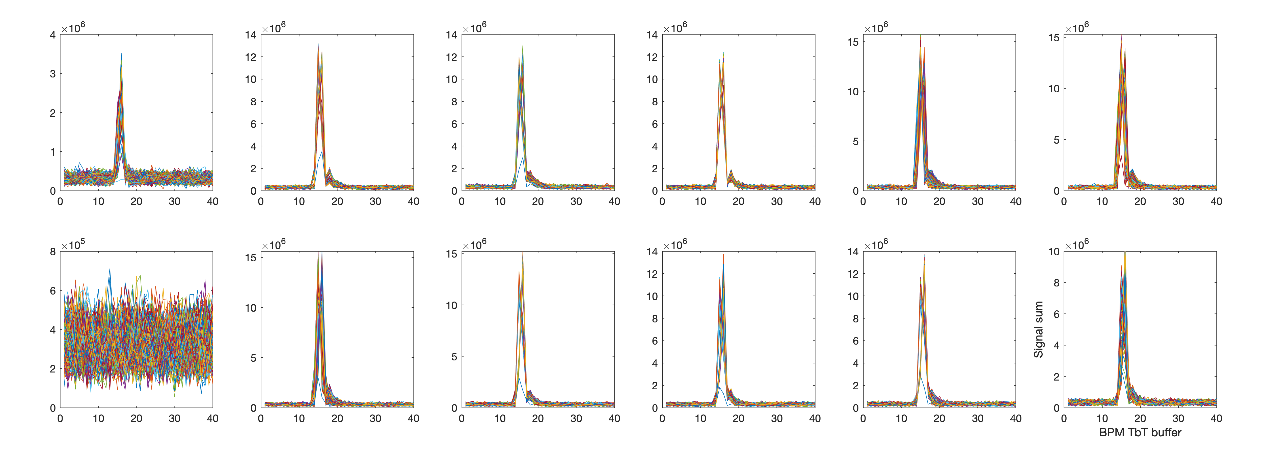
BPM signal sum
(the 1st BPM after injection)
BPM OFF

Slide 4
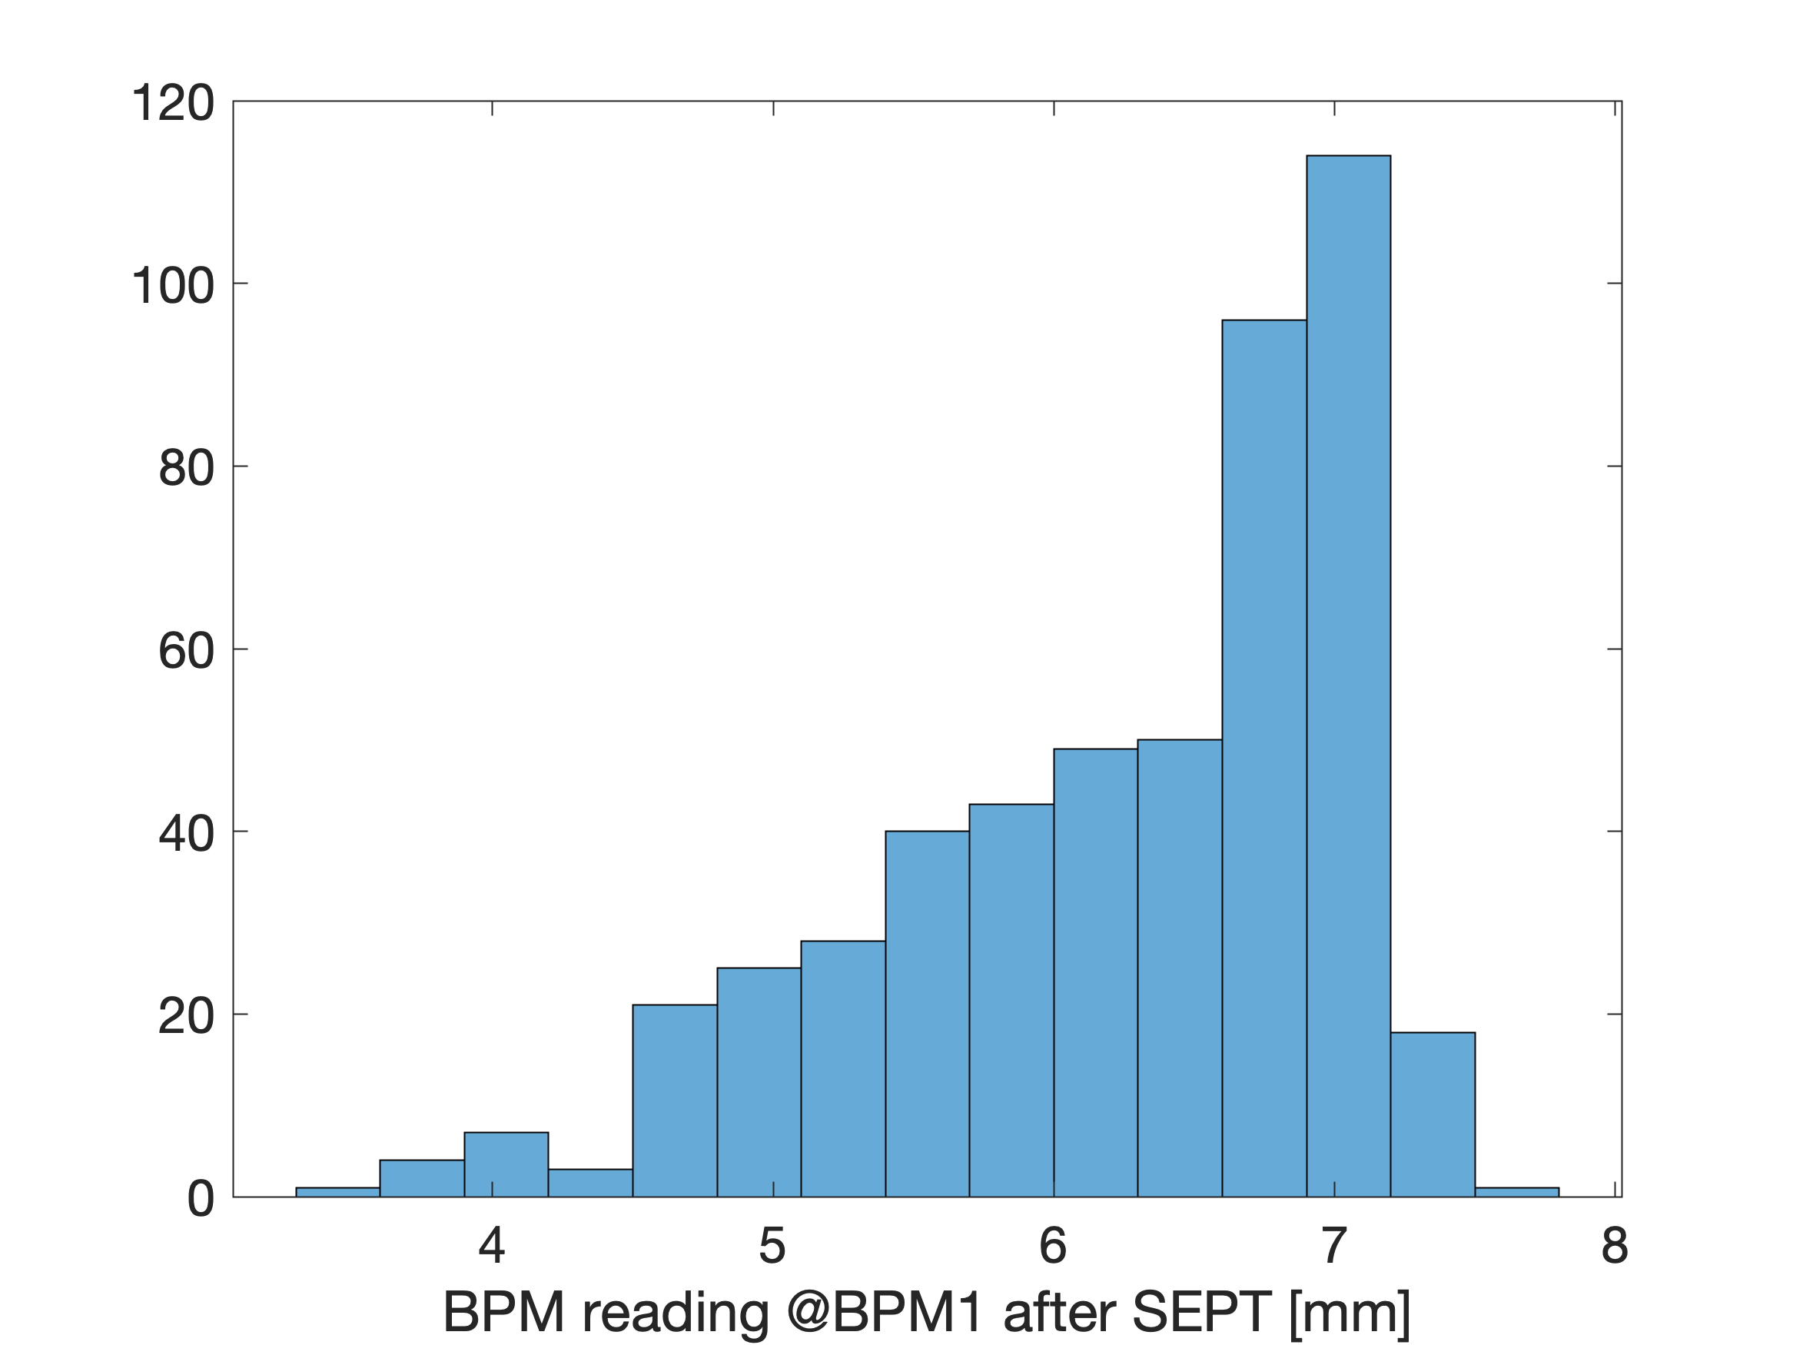
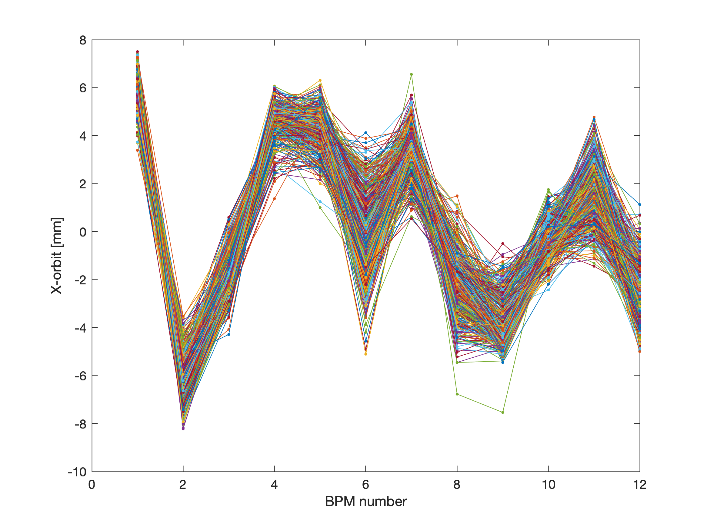
x orbit for 500 injections

Slide 5
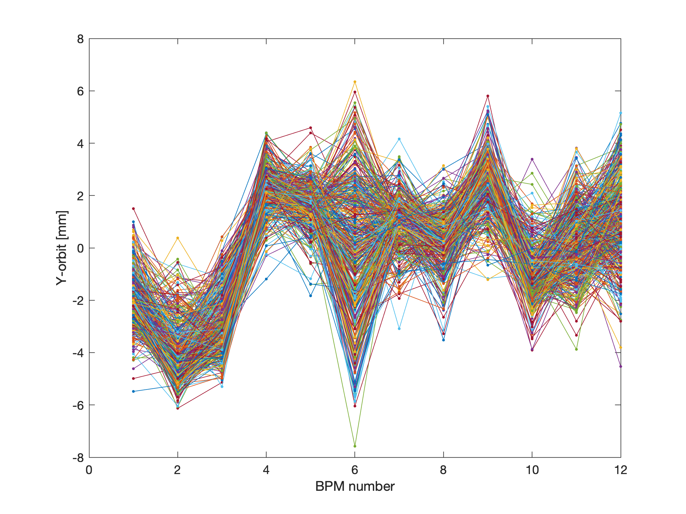
y orbit for 500 injections

Slide 6
21 September 2022
16-18h
Beam from injector was very unstable, energy jitter?
QUAD power supply replaced

Slide 7
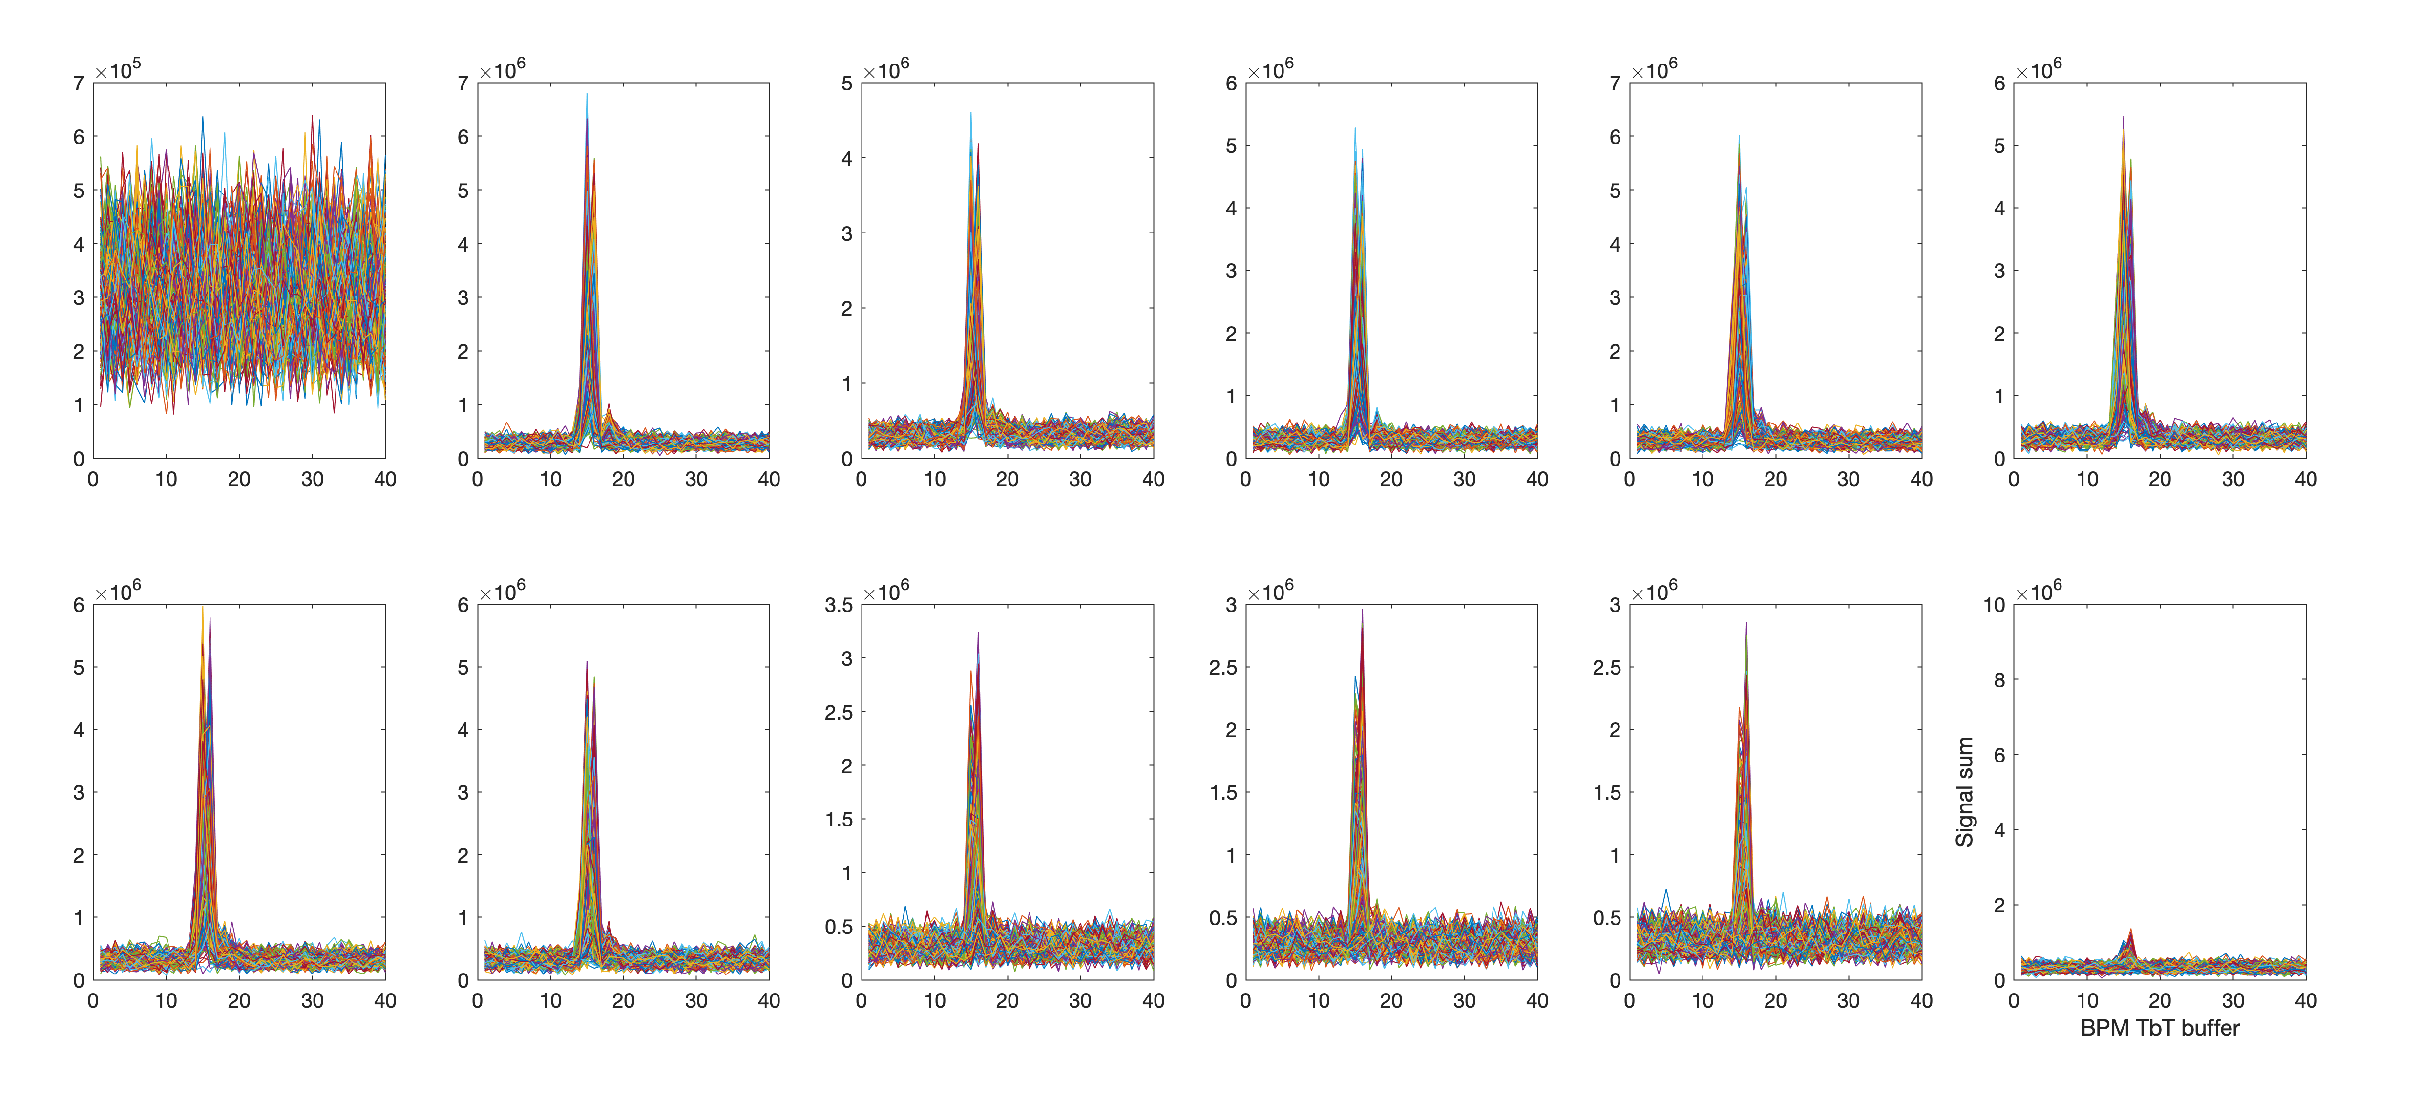
BPM signal sum
(the 1st BPM after injection)

Slide 8
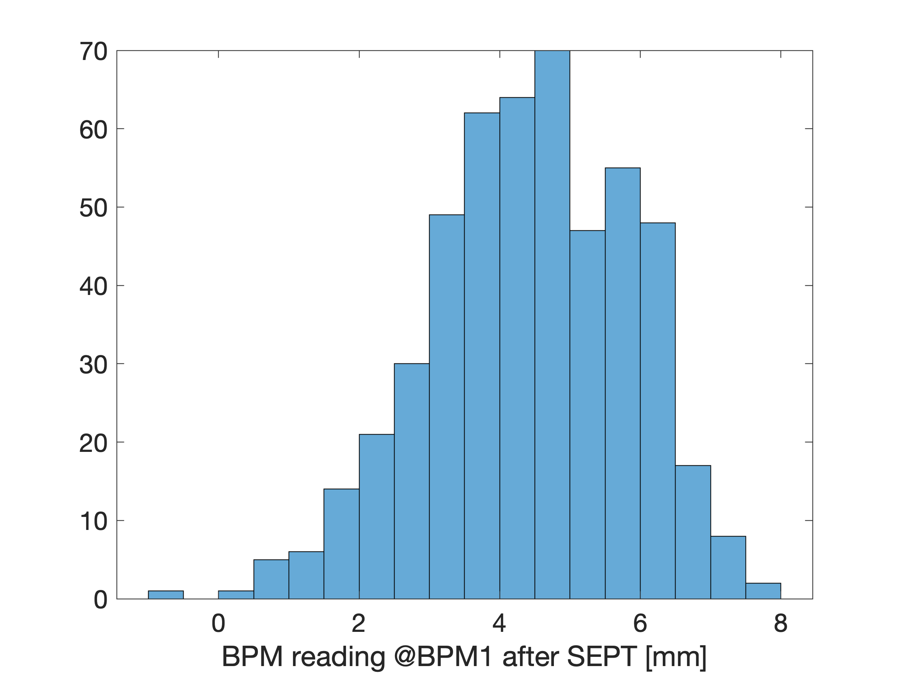
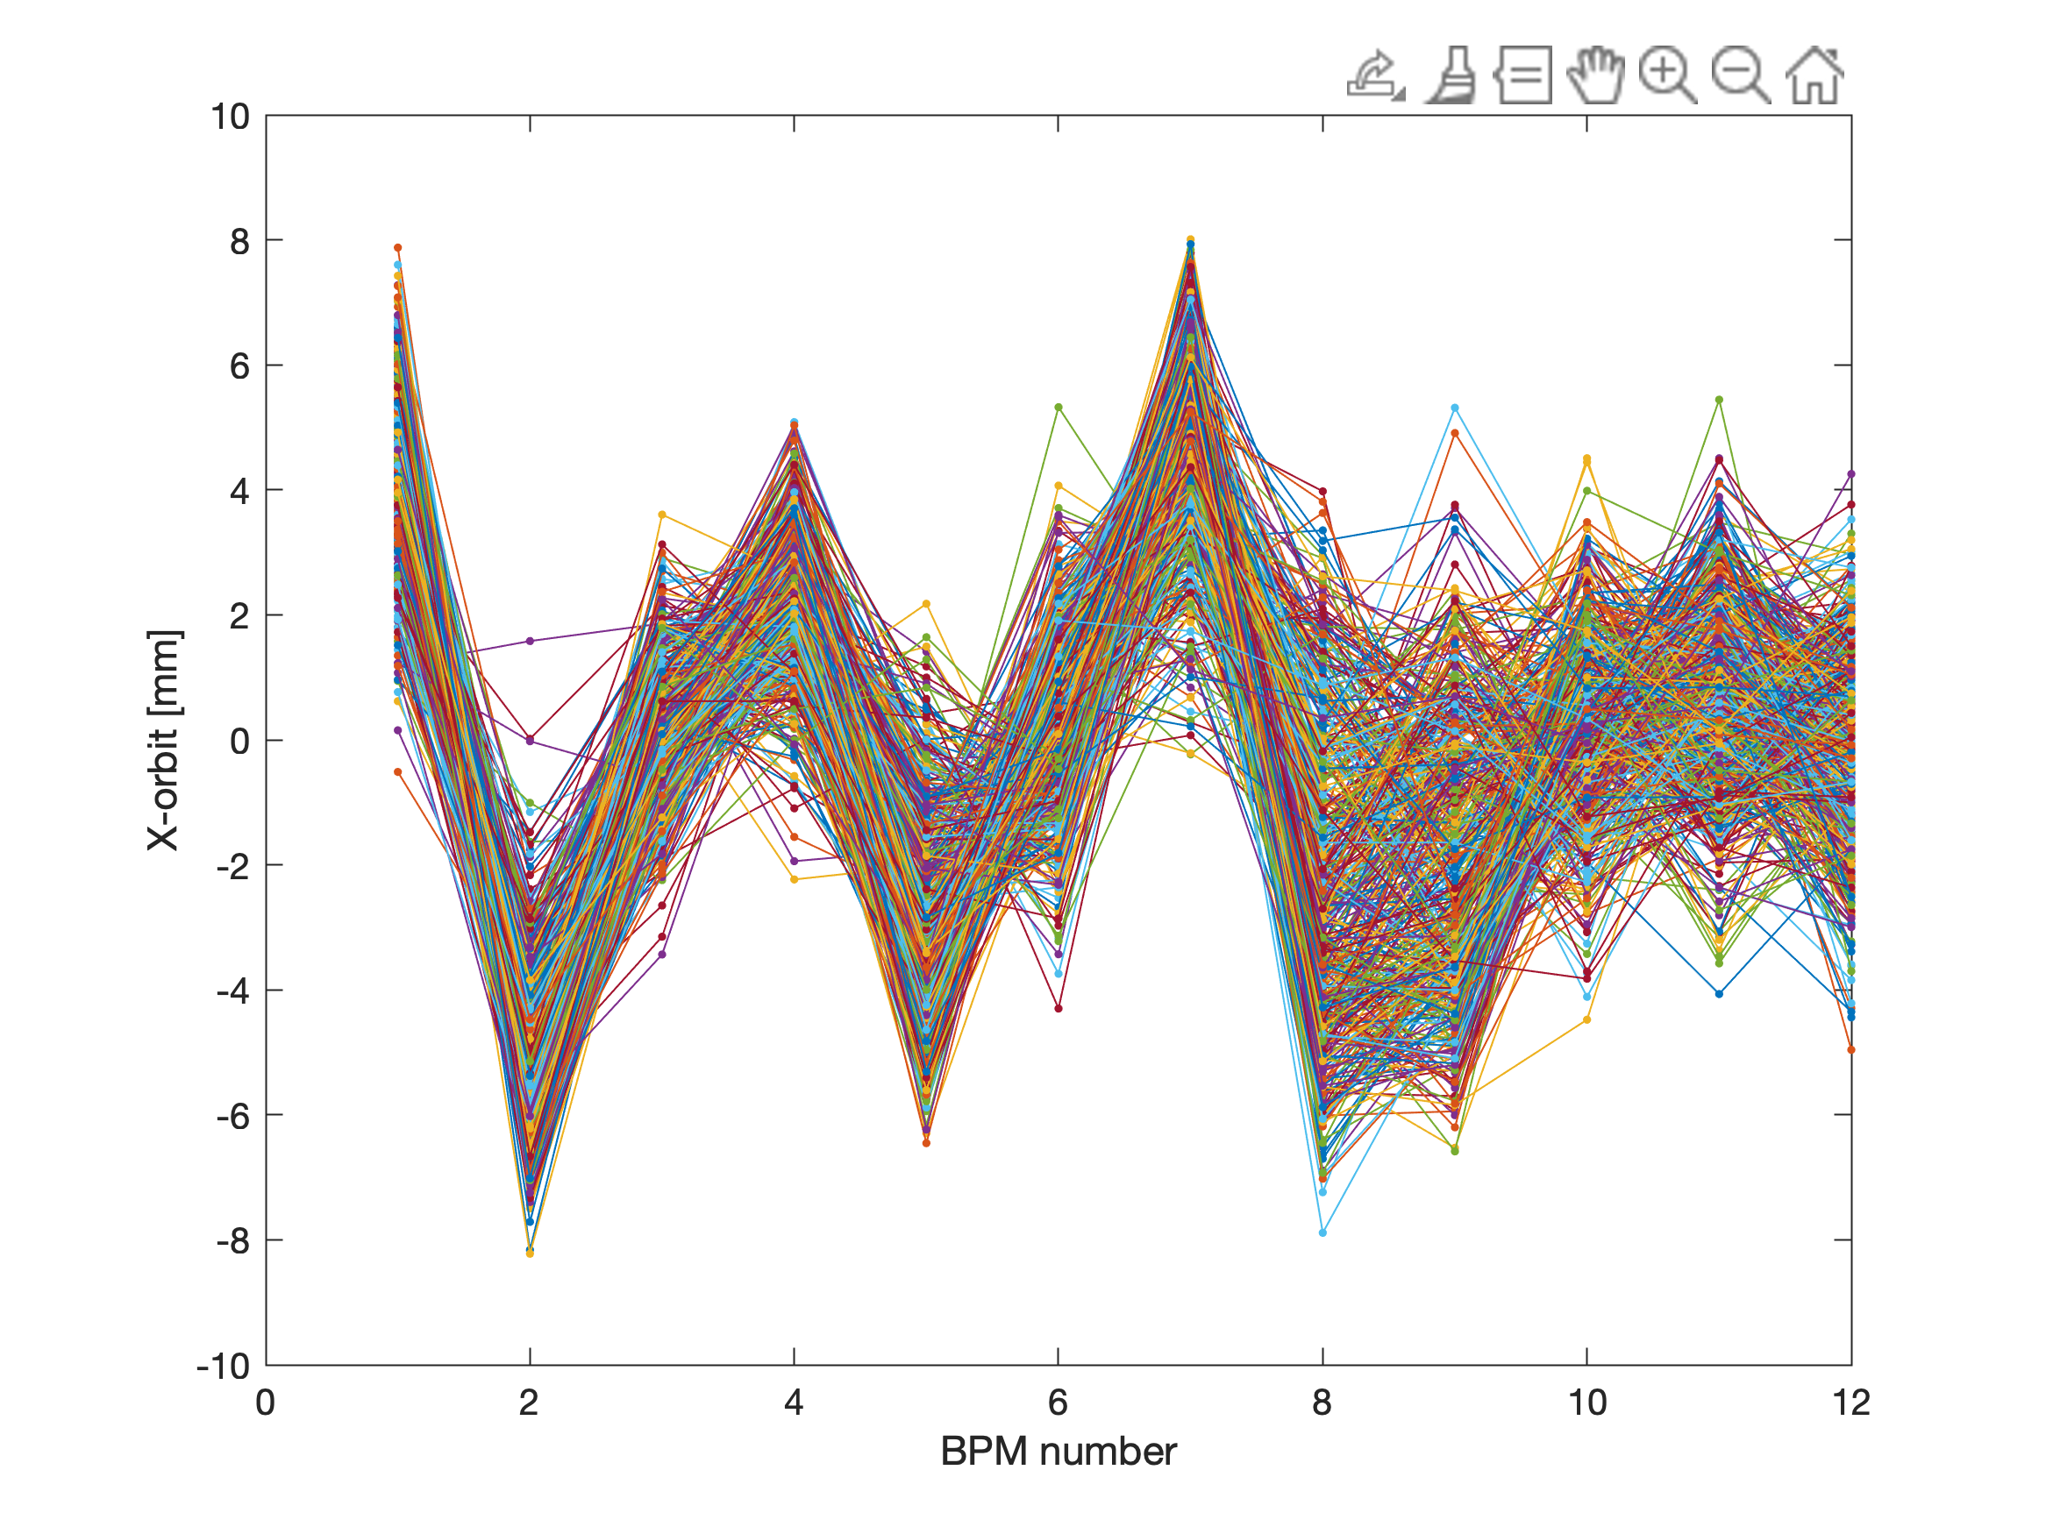
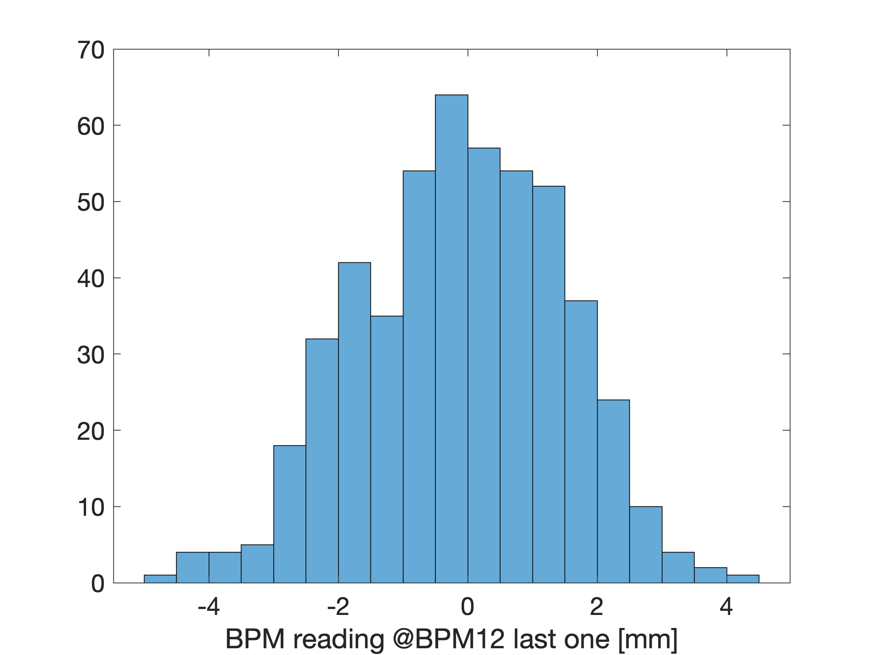
x orbit for 500 injections

Slide 9
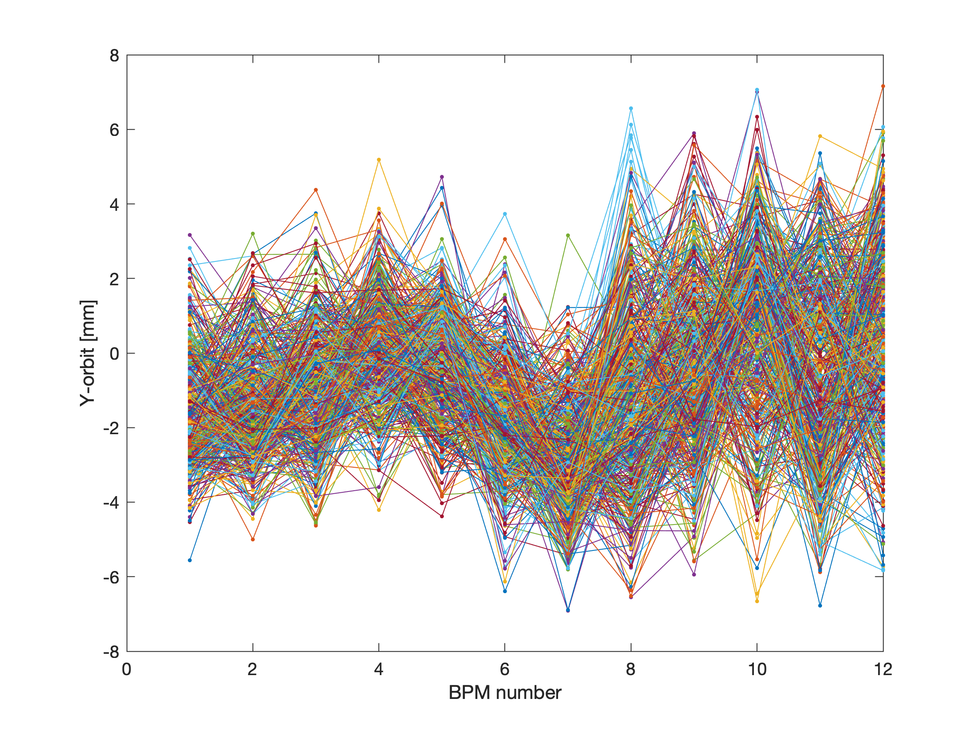
y orbit for 500 injections

