Slide 1
The P³ experiment: a Positron Source Demonstrator for FCC-ee
Nicolas Vallis (PSI / EPFL) on behalf of FCC-ee Injector WP6
eeFACT Workshop - Frascati, 15 September 2022

Slide 2
The P³ project
PSI Positron Production
Introduction
    FCC-ee and P³
    e+ production at SwissFEL
Key Technology and Beam Dynamics
    AMD
    RF Cavities
    Solenoid around RF Cavities
    The P³ beam
Beam Diagnostics
Project Status and Conclusion

Slide 3




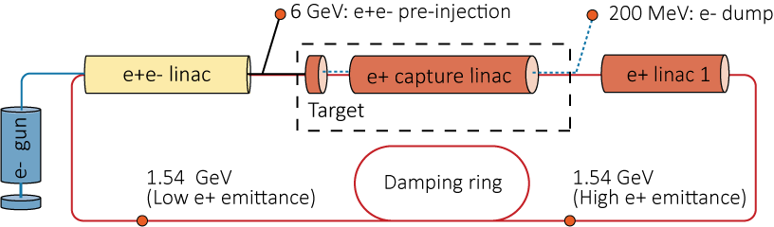
FCC-ee Injector Study
Work package in FCC collaboration.
Two deliverables included in FCC feasibility study:
    Design proposal for FCC-ee Injector.
    Proof-of-principle experiment for novel positron source (P³).
Due to FCC-ee high current requirements
    Only target-based e+ production schemes considered.
    Vast production of e+, poor transport efficiency to DR
    Use of HTS solenoids for the AMD proposed for higher efficiency.
Schematic of FCC-ee Injecor Complex
Target
Adiabatic Matching Device
10 RF Cavities surrounded by solenoids

Slide 4
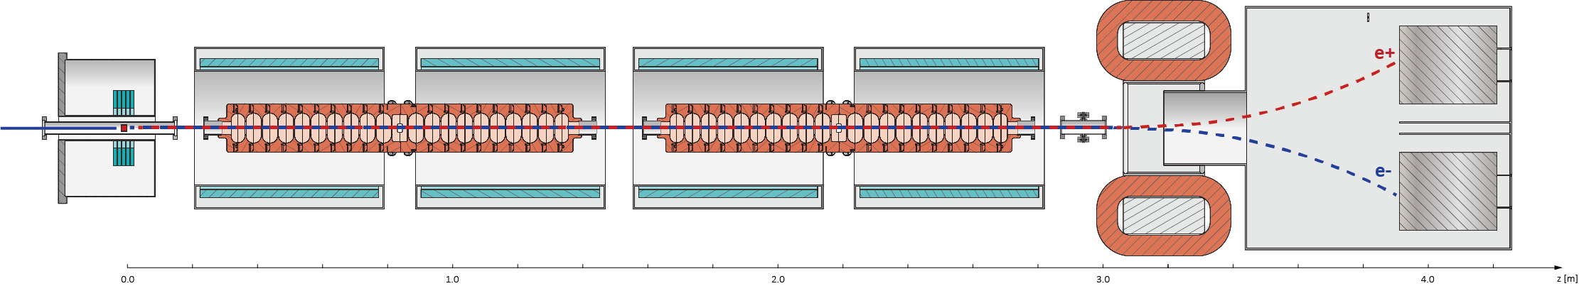
The PSI Positron Production (P³) Experiment
6 GeV beam from SwissFEL linac
Solenoids
Beam diagnostics
Concept design of P³
Target and HTS Adiabatic Matching Device
2 RF Cavities

Slide 5
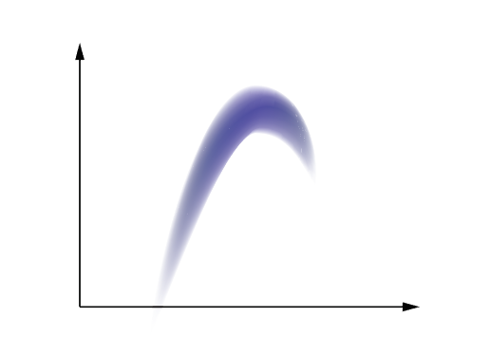

Goals of P³
References for yield value:
Main goal is to provide first experimental validation of such a yield.
But a compact positron source at PSI can:
    Host further experiments/tests
    Contribute to other future positron machines
SuperKEKB Factory (State of the art, 3 GeV) [1] | 0.5
FCC-ee requirements [2] | 1 (plus safety factor 2)
P³ simulations | 8
$$Yield=\frac{Ne^{+}accepted by DR}{Ne^{−}primary beam}$$
E
DR Acceptance window
[1] K. Akai, K. Furukawa, and H. Koiso, "Superkekb collider", 2018.
[2] I. Chaikovska et al., "Positron source for FCC-ee", 2019.
1.54 GeV
t
Impression of the a e+ beam at entrance of DR
and DR acceptance window

Slide 6
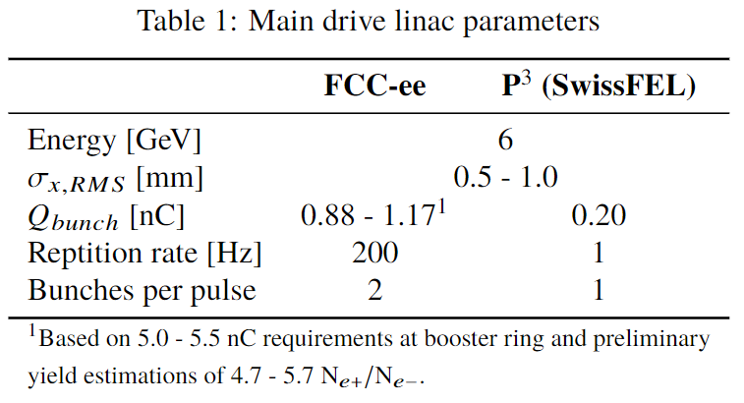
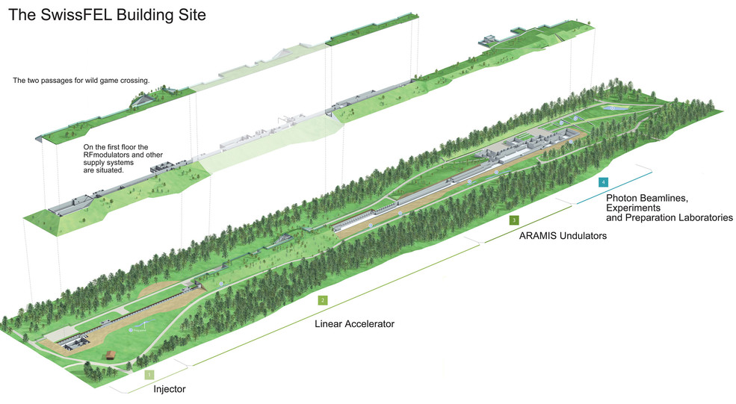
e+ Source at SwissFEL
SwissFEL linac can provide high quality 6 GeV electron beam.
Strict radiation limits do not allow for high bunch charges and rep. rates.
    beam dynamics insensitive of electron charge and time structure.
    thermomechanical study of the target excluded from P³.
SwissFEL facility

Slide 7
II. Key Technology and Beam Dynamics
High temperature superconductor-based AMD
(12.7 T peak on-axis)
NC or SC solenoids
(0.4 to 1.5 T peak on-axis)
SW, S-band Cavities with large iris aperture 40 mm

Slide 8
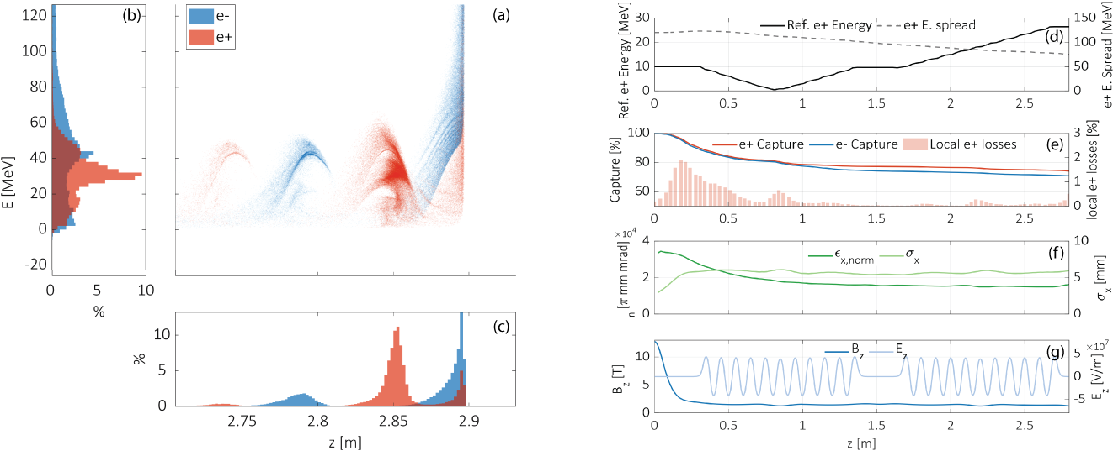
Solenoids: Beam Matching and Confinement
Baseline:
    High temperature SC based Adiabatic Matching Device (12.7 T)
    SC solenoids around cavities (1.5 T) or
    NC solenoids around cavities (0.4 T).
AMD matches the e+ beam into capture system. Part of the beam is lost and norm. transverse emittance decreases over first RF cells.
SC solenoids contain the matched beam. Capture efficiency and emittance stabilize.
12.7 T
1.5 T

Slide 9
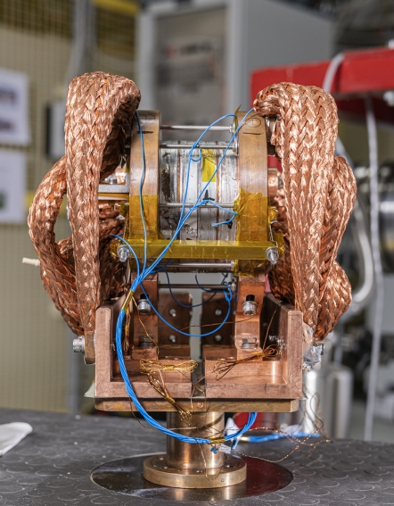
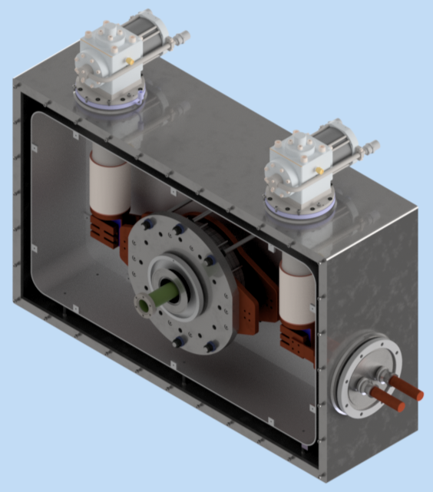
HTS Adiabatic Matching Device
HTS demonstrator built at PSI:
    4 ReBCO tape coils at 2kA
    Operation at 18.2 T, on-axis peak
    Temperature 20 – 30 K, no need of He cooling
    No insulation, quench self-protected
Simulation study at CERN found no critical machine protection issues [1]
Technical design of cryostat in development at PSI
HTS demonstrator at PSI (M. Duda et al.)
Preliminary model of the AMD,
including cryostat (H. Garcia Rodrigues)
[1] B. Humann et al., Radiation Load Studies for the FCC-ee Positron Source with a Superconducting Matching Device, 2022.

Slide 10
Solenoids Around RF Cavities (I)
Solenoids must create strong and flat magnetic channel.
Mechanical constraints exist, separation must be provided for waveguides and installation
Assembly
Waveguides

Slide 11
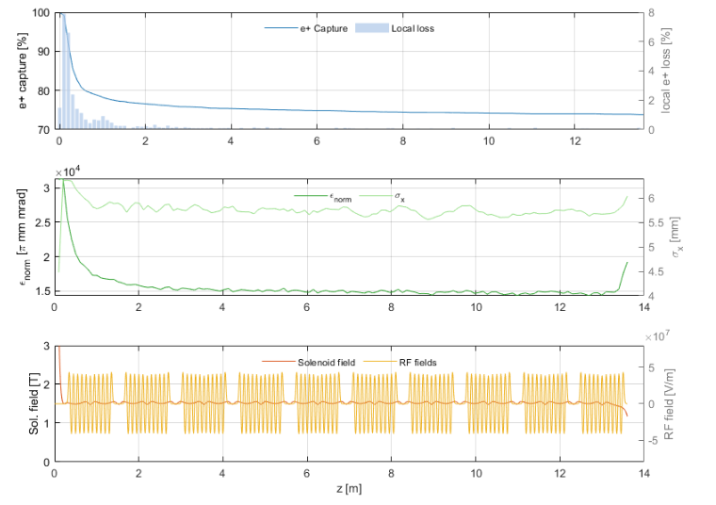
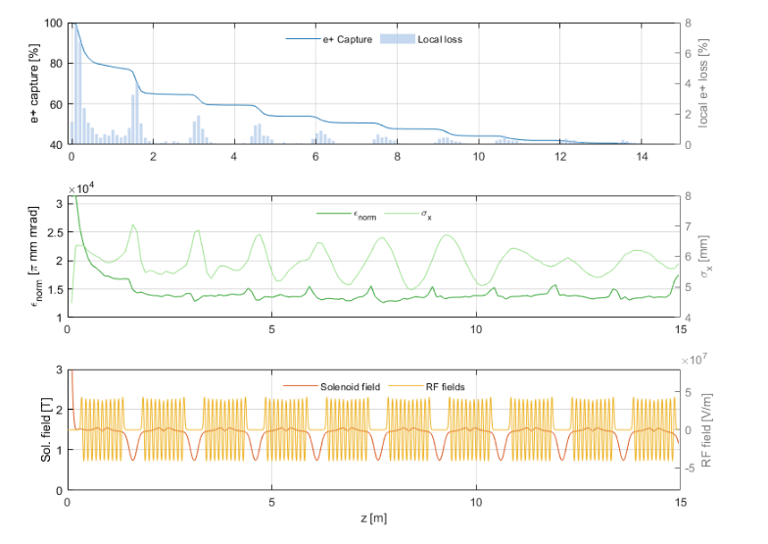
Solenoids Around RF Cavities (II)
75 %
41 %
Extended simulations over 10 RF Cavities with optimized (left) and breached (right) magnetic channels.

Slide 12
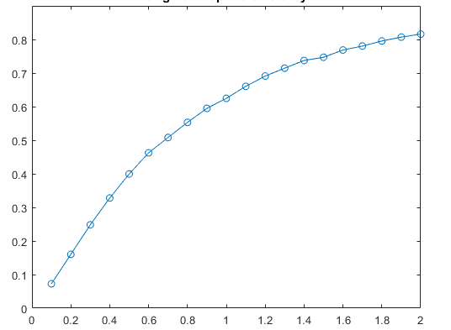
Solenoids Around RF Cavities (III)
0.3 T as NC
reference point
1.5 T as SC
reference point
Two baseline options for P-cubed:
    Superconducting
        NbTi
        1.5 T on axis
    Normal Conducting
        Copper
        0.4 T on axis
72%
Capture efficiency after at 200 MeV
25%
Solenoid strength around cavities [ T ]

Slide 13
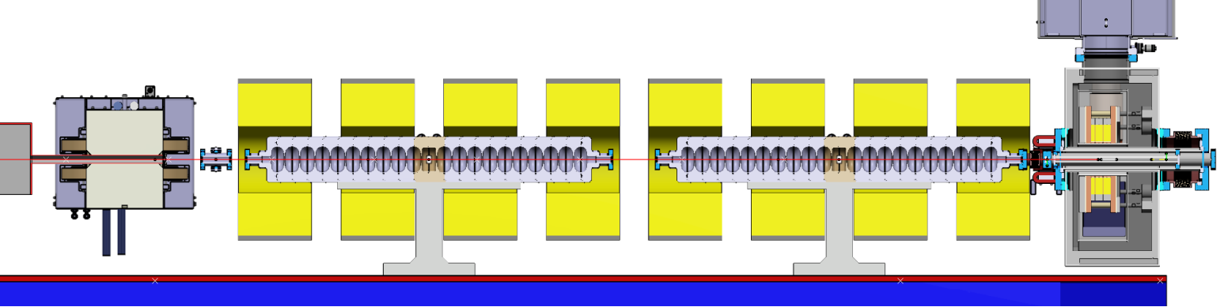
Solenoids Around RF Cavities (IV)
Superconducting (NbTi, 1.5 T)
Normal Conducting (Copper, 0.4 T)
Superconducting:
    Extremely high yield provided (8.0)
    Lower power consumption
    High cost (above tender call limit
    230 kCHF)
Normal conducting:
    Lower yield (3.1), sufficient for FCC-ee requirements
    Extremely high power consumption (>100 kW), large amount of copper required
    Lower cost, conventional technology

Slide 14
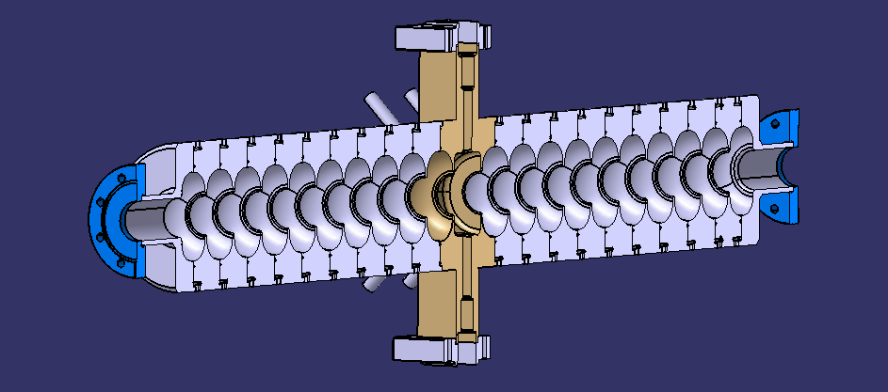
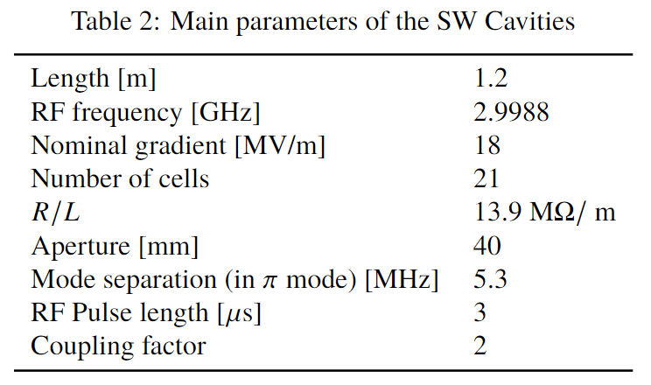
RF Cavities
Impression of the a e+ beam at entrance of DR
and DR acceptance window
E
1.54 GeV
+/- 3.8 %
λ
Mechanical model of RF Cavities (R. Zennaro)
z
Ideally:
    High capture efficiency
    Low energy spread
    Positrons in one bucket

Slide 15
Estimation of the Yield at DR
e- discarded
P³
8 extra cavities
200 MeV
e+
Φ₁
Φ₂
On-crest
E
Analytical transformation
in longitudinal plane.
Transverse losses neglected
1.54 GeV
+/- 3.8 %
200 MeV
λ

Slide 16
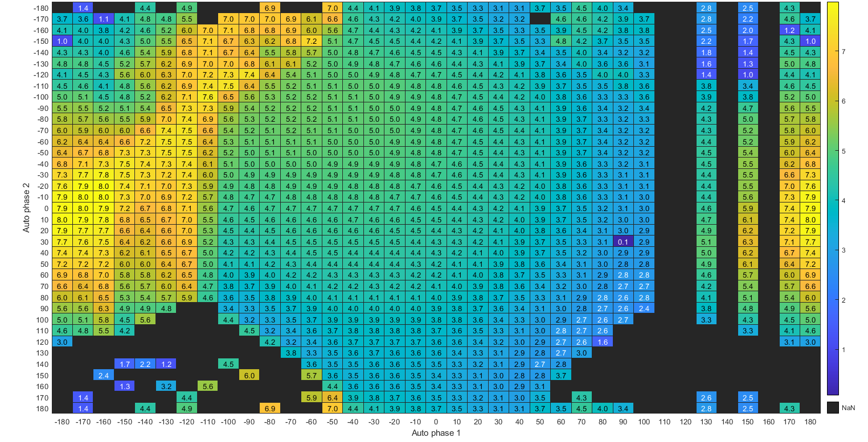
RF Working Points
Working point for Max. Yield at DR = 8.0 @ (Phi1 = -170, Phi2 = 0)
Phase cavity 1
Phase cavity 2

Slide 17
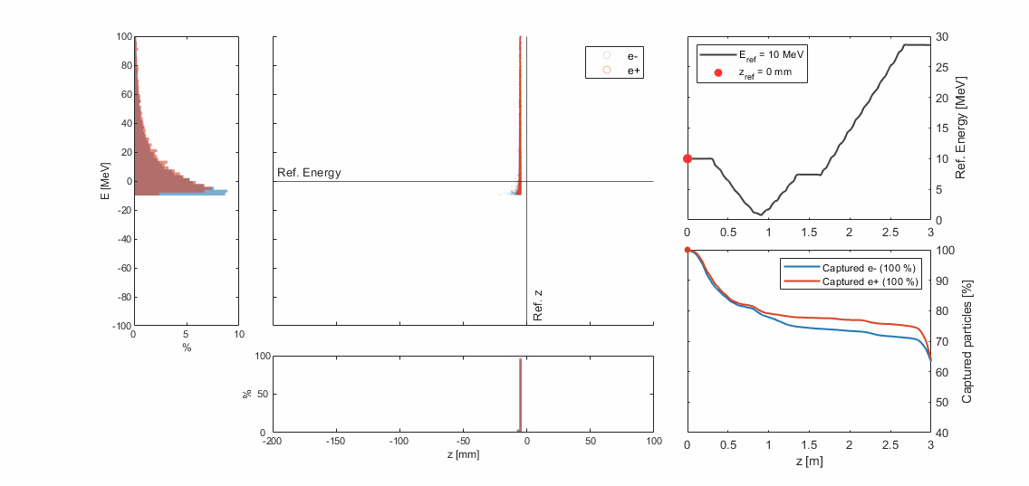
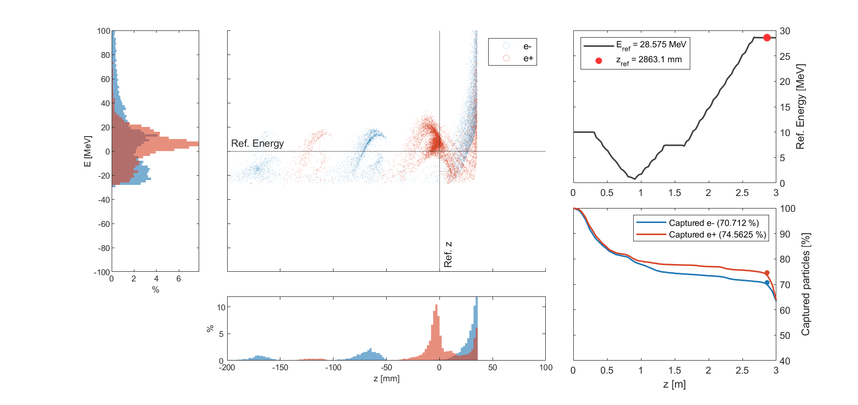
RF Working Points (II)
Second bucket:
Lower energy spread
e+ concentrated in main bunch
Deceleration over first RF cells

Slide 18
RF Working Points
Yield at DR = 5.1 @ (Phi1 = -40, Phi2 = -100)
Phase cavity 1
Points in this region provide high capture efficiency (>75%) but lower yield!
Phase cavity 2

Slide 19
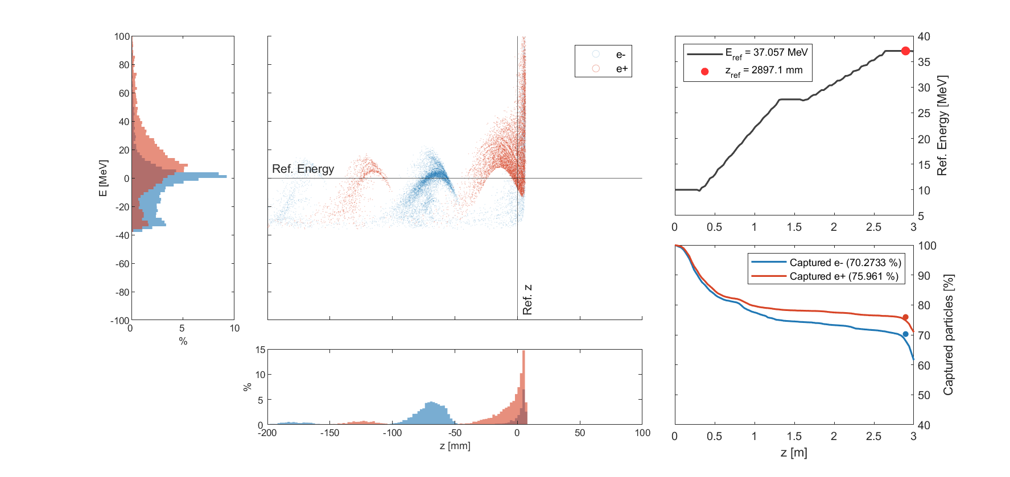
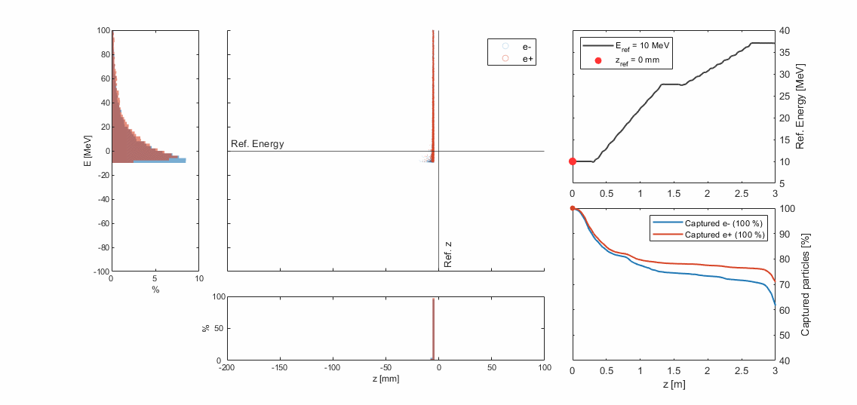
RF Working Points (III)
First bucket:
High energy spread
Many electrons in first bucket

Slide 20
The p3 beam (I)
AMD max. | 12.7 | T
Solenoids max. | 1.5 | T
e+ capture efficiency | 74 | %
Energy Spread | 92 | MeV
Norm. emittance | 15157 | pi mm mrad

Slide 21
The P3 Beam (II)
Longitudinal profile of e+ beam at DR entrance
 | Yield at DR | 8.0
 | AMD max. | 12.7 | T
 | Solenoids max. | 1.5 | T
@ 200 MeV | Capture efficiency | 72 | %
 | Energy Spread | 66 | MeV
 | Norm. emittance | 14667 | pi mm mrad

Slide 22
II. Beam Diagnostics
Charge detector
Broadband Pick-Ups
Spectrometer
Faraday Cups

Slide 23
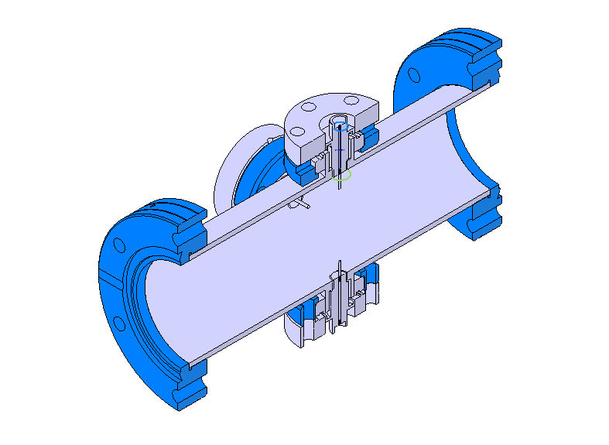
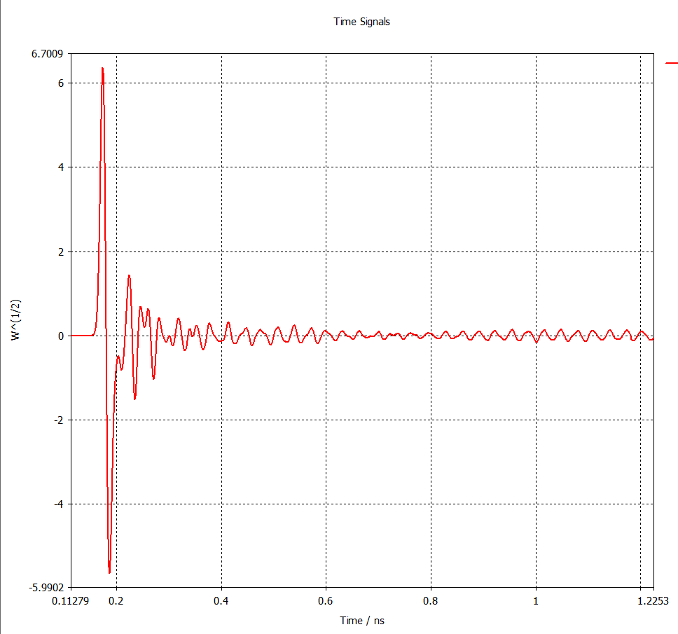
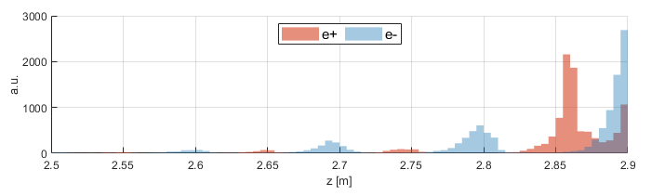
Broadband Pick-Ups
4 Pick-Ups
e+
BBPs measure time structure of the beam after second cavity.
Broadband operation and high sampling frequency (40 GHz) required to differentiate e+ and e- bunches.
Based on SuperKEKB factory diagnostic [1].
e-
[1] T. Suwada et al., "First simultaneous detection of electron and positron bunches at the positron capture section of the SuperKEKB factory", Sci. Rep., vol. 11, 2011.
Simulated signal at BBPs (E. Ismaili)

Slide 24
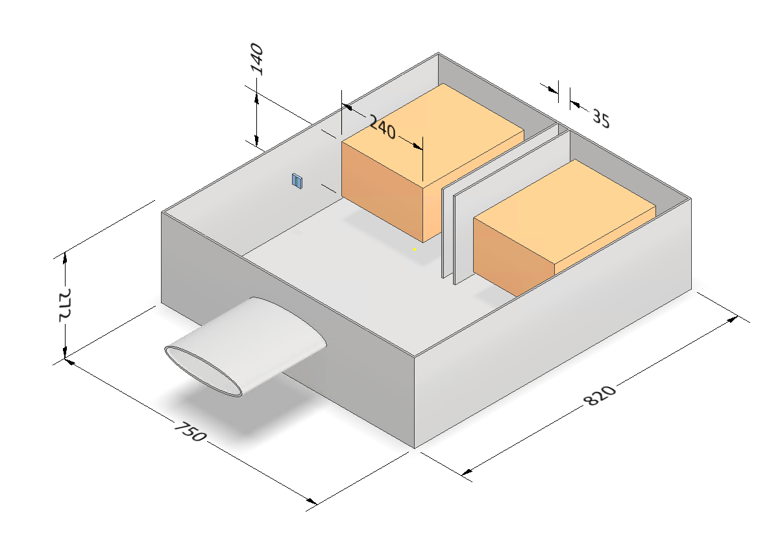
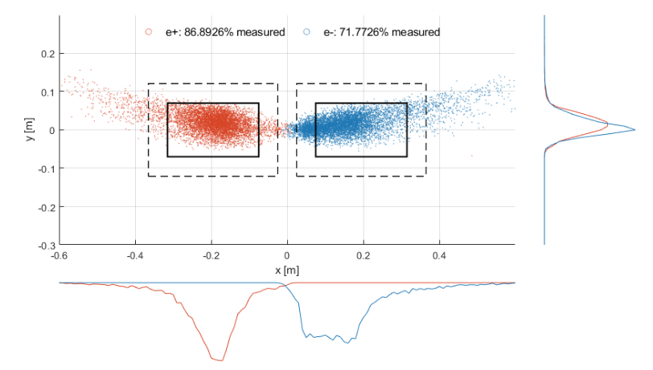
Faraday Cups
Measurement of e+ and e- charge separately.
Alluminum FCs at 25 Ohm. Matching to 50 Ohm through 2 parallel coax cables
Negligible electron backscattering
e+
e-
B
● e+ ● e-
Optimized dimensions of diagnostics chamber.
e+e- beam at faraday cups

Slide 25
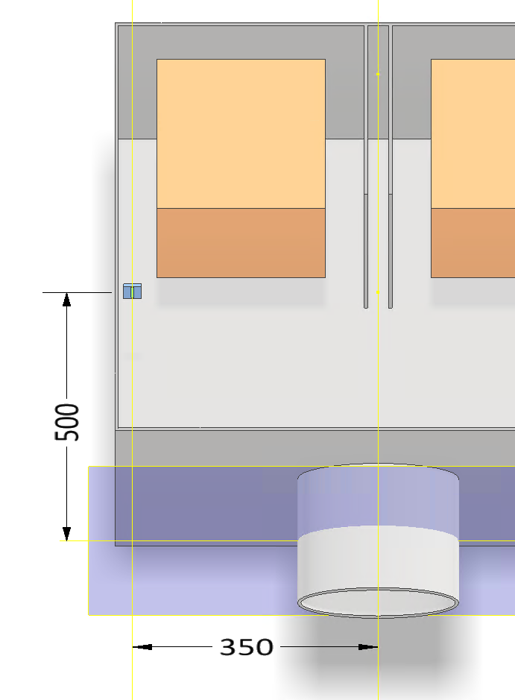
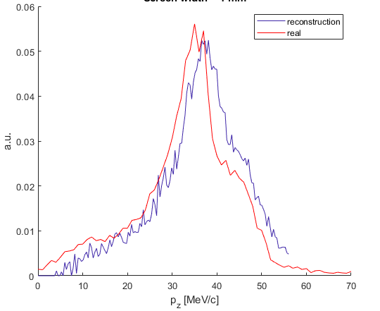
Spectrometer and Charge Detector
Schematic of energy spectrum measurement
Dipole strength scanned to measure e+ energy profile
e+ at different p_{z} detected by narrow screen
Technology of the detector t.b.d.!
e+
B
Pz spectrum reconstruction

Slide 26
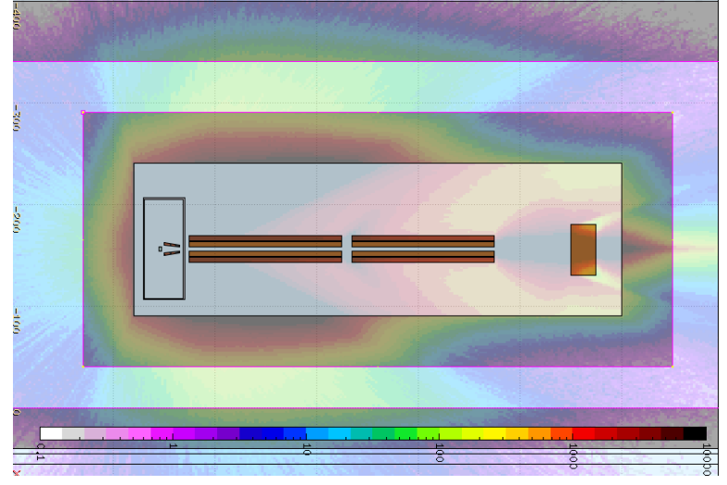
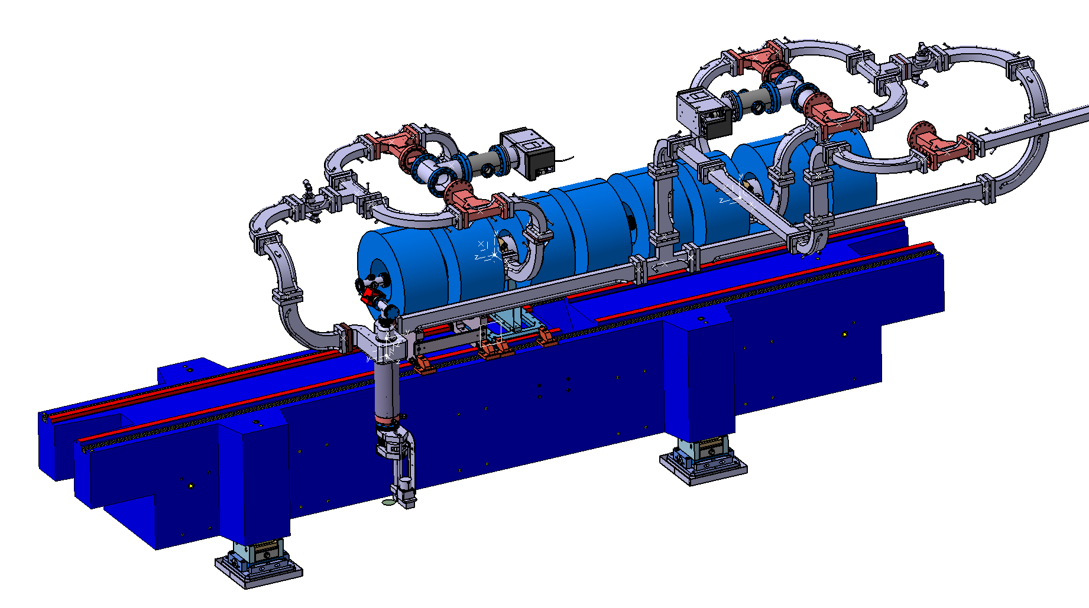
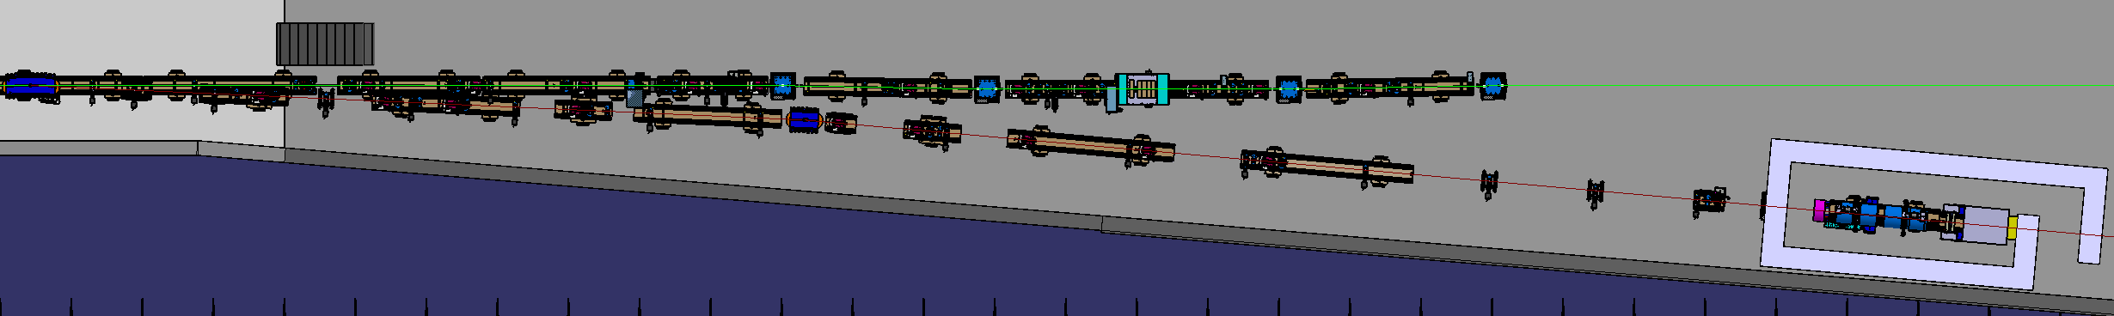
IV. Project Status
Mechanical design of P³ and RF network (A. Magazinik)
Radioprotection studies (I. Besana)
Design of the extraction line and P3 bunker at SwissFEL (D. Hauenstein and M. Schaer)

Slide 27
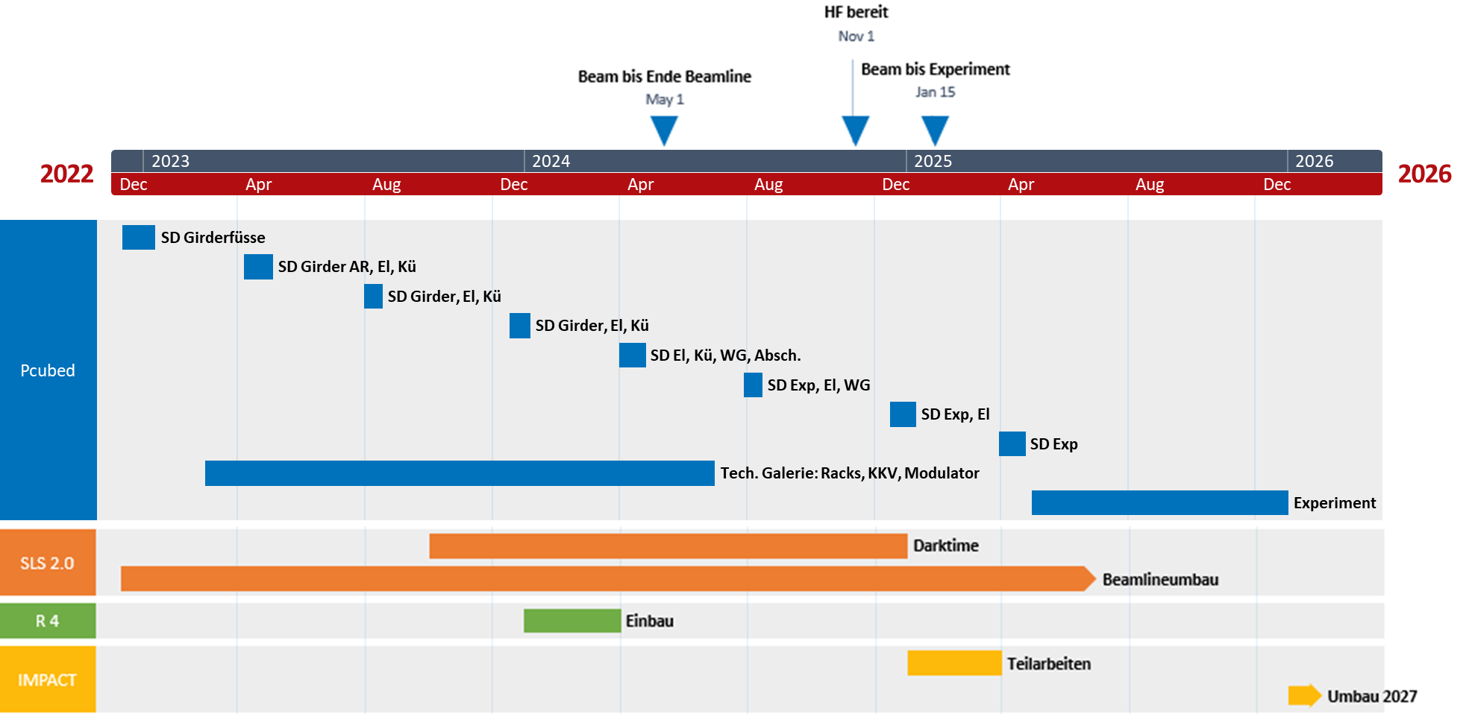
Timeline
Preliminary timeline of the P3 experiment
(M. Schaer and D. Hauenstein)
SwissFEL Shutdowns

Slide 28
Status of Experiment Design
 | Target | Concept design defined.
 | RF Structures | Ready for copper purchase.
Magnets | AMD | HTS tape to be purchased shortly. Design of cryostat almost complete.
 | Solenoids around RF structures | NC and SC options presented.
Beam diagnostics | Faraday Cups and diagnostics chamber | Dimensions optimized. Backscattering simulations performed.
 | Broadband pick-ups | Feedthroughs to be purchased and tested shortly. Optimization of pickups in progress.
 | Spectrometer | Baseline design complete. Mechanical modification of existing dipole in progress.
 | Charge detector | Technology under discussion.
Purchase phase
In progress
Concept design

Slide 29
Final Remaks
P³ is at advanced design stage and on-schedule. Final design expected for 2023 Q1.
Experiment to take place in 2025. Eventual delays might occur due to installation and integration issues.
Make the most of our compact positron source at PSI:
    A demonstrator for all future e+e- colliders and positron machines.
    Possible host to further experiments and tests.
Open to new ideas and collaborators!

Slide 30


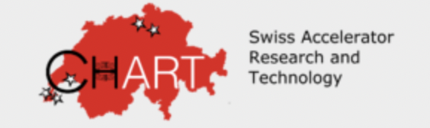
Acknowledgements
Mike Seidel (thesis advisor)
Paolo Craievich
Riccardo Zennaro
Mattia Schaer
Anastasiya Magazinik
Fabio Marcellini
Erisa Ismaili
Michal Duda
Jaap Kosse
Henrique Garcia Rodrigues
This work was done under the auspices of CHART (Swiss Accelerator Research and Technology) Collaboration, https://chart.ch

