Slide 1
Astra simulation of a 2 GHz, 9/10π section
Viktor Mytrochenko

Slide 2
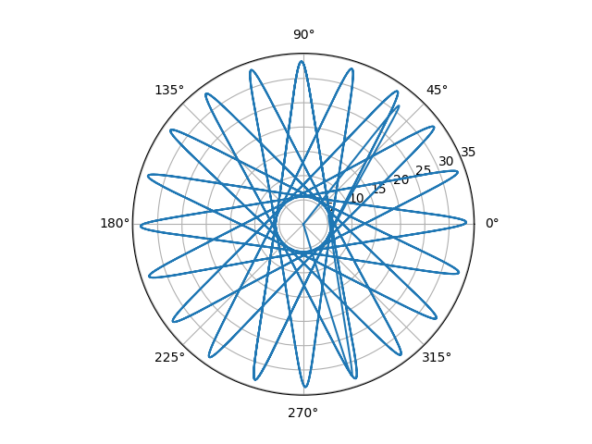
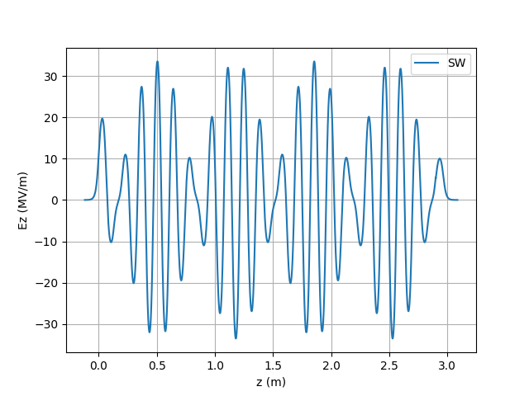
Wavelength is 149.8962 mm
Real part of on axis electric field of a traveling wave corresponds to standing wave field
20 cells

Slide 3
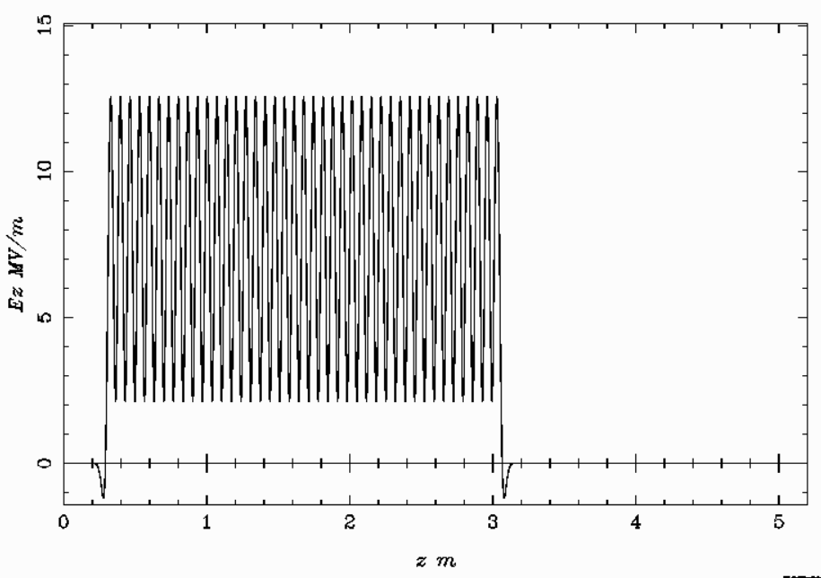
Traveling wave field reconstructed by ASTRA from 1D field map.
D=67.45330305 mm, Phase advance is 162° (9/10 π) per a cell, aperture is 30 mm.
The first row of the field map file for ASTRA
Z1 Z2 n m
0 1.34906606 9 20
For ASTRA simulation length of a traveling wave section will be multiple of 20 cells or 1.349 m.

Slide 4
Layout of the linac entrance
It seems that 33 cm is reasonable distance from the target to the AS
0.33 m
R= 36 mm
R_{coil} = 0.15 m
Input waveguide
Accelerating Section
Cryostat
0.37 m
Solenoid Coil

Slide 6

Accelerating Sections
Cryostat
Solenoids

Slide 7
On axis magnetic field. Superposition of the superconducting coil field and normal conducting solenoid field.

Slide 8
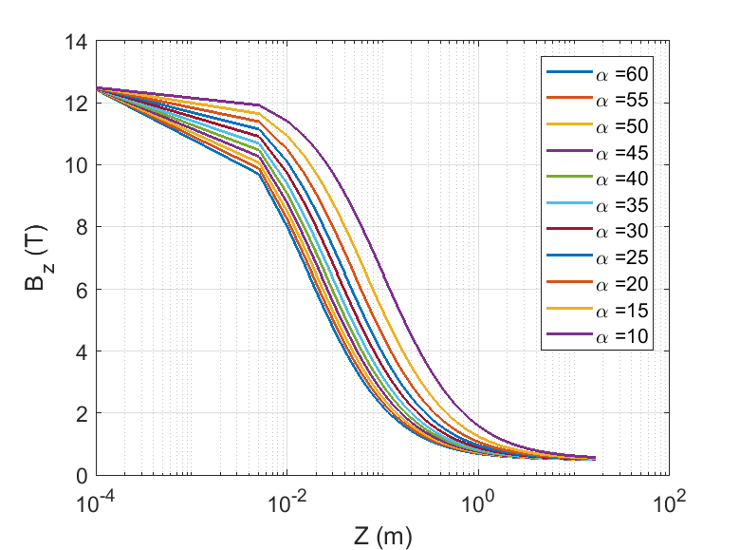
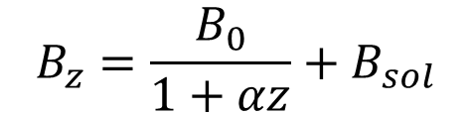
AMD field variation
$$B_{z}=\frac{B_{0}}{1+αz}+B_{sol}$$
B₀ = 12 T
B_{sol} = 0.5 T

Slide 9
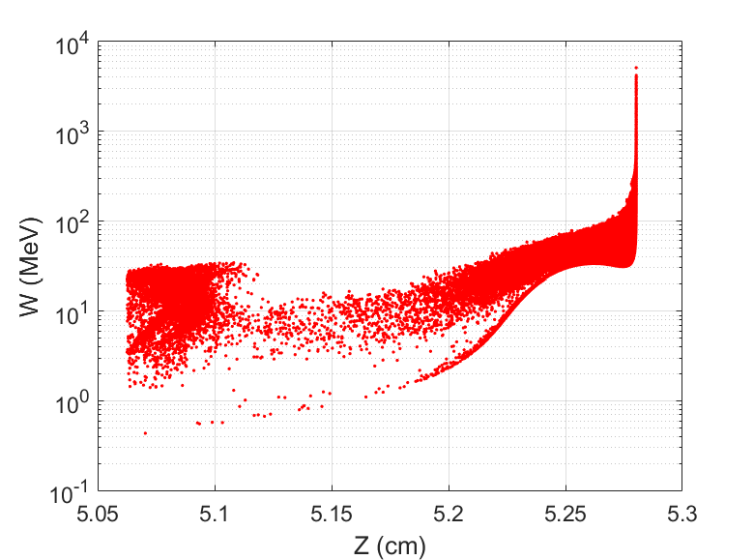
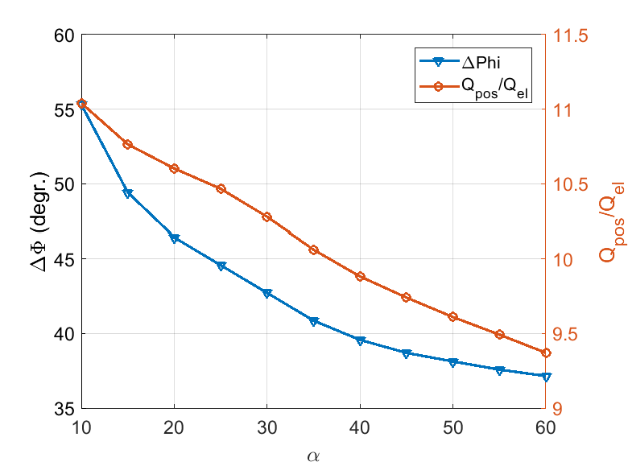
AMD field variation results
Accelerating section with 60 cells
Energy gain 30 MeV (Maximal energy gain, AUTO_PHASE=T)
Z_{limit} = 0.2 m
α=60

Slide 10
The first bucket contains the vast majority of particles

Slide 11
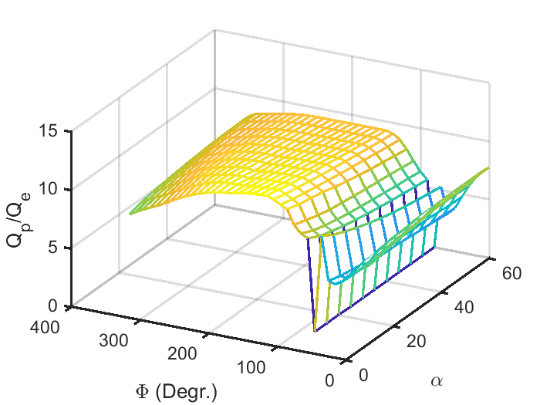
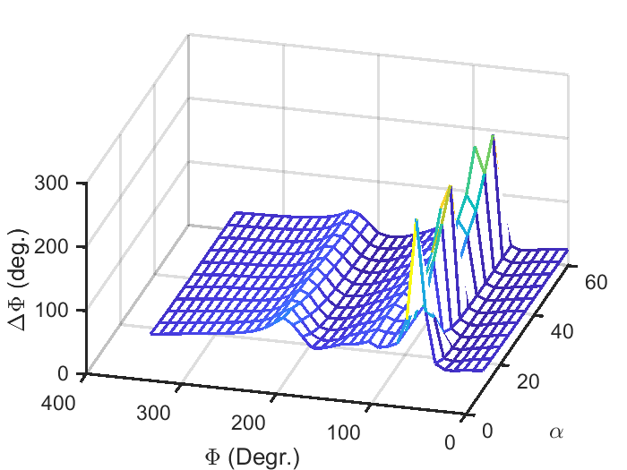
2D scanning: α =10 through 60, Φ=0° through 350° One accelerating section, 60 cells, 9/10π phase advance
Beam cutting: Z_{limit} =0.1 m, ∆W=±50 MeV from W_{peak}
∆Φ, ∆W/W contain 70% of beam particles

Slide 12
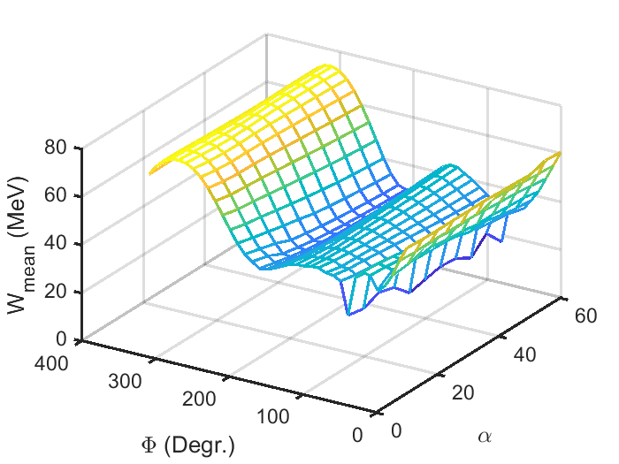
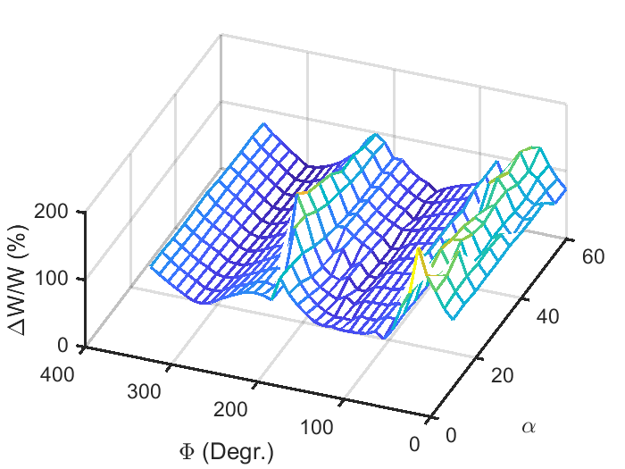
2D scanning: α =10 through 60, Φ=0° through 350° One accelerating section, 60 cells, 9/10π phase advance

Slide 13
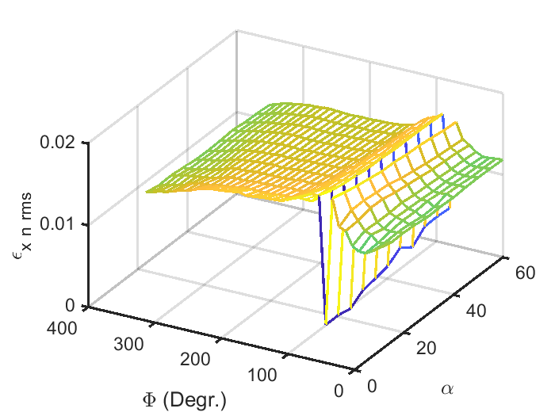
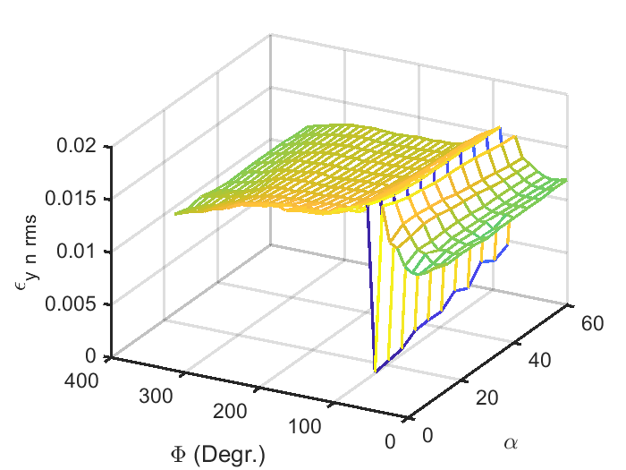
2D scanning: α =10 through 60, Φ=0° through 350° One accelerating section, 60 cells, 9/10π phase advance

Slide 14
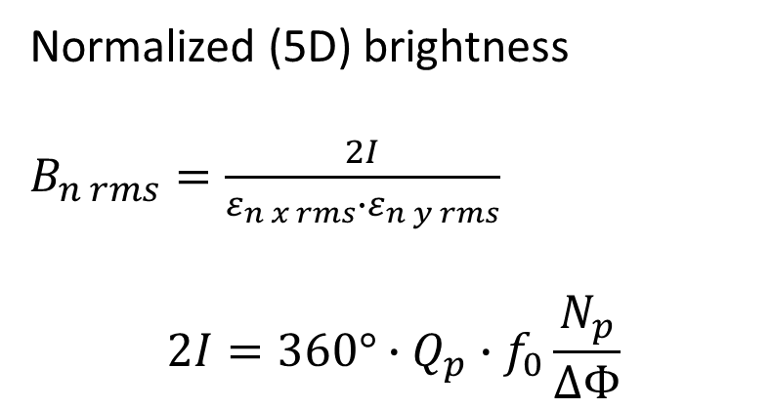
2D scanning: α =10 through 60, Φ=0° through 350° One accelerating section, 60 cells, 9/10π phase advance
Normalized (5D) brightness
$B_{n rms}=\frac{2I}{ε_{n x rms}{∙ε}_{n y rms}}$
$$2I=360°∙Q_{p}∙f_{0}\frac{N_{p}}{∆Φ}$$

Slide 15
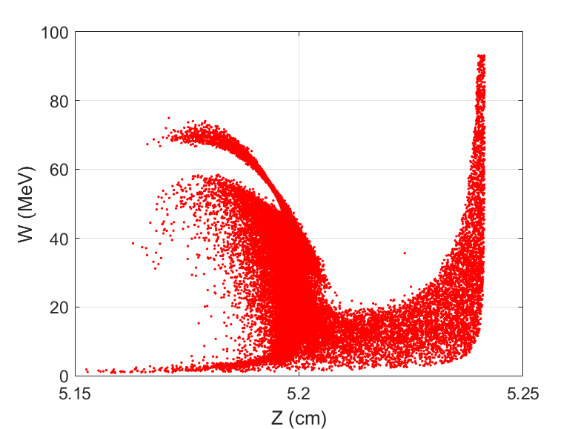
α = 60, Φ = 190°

Slide 16
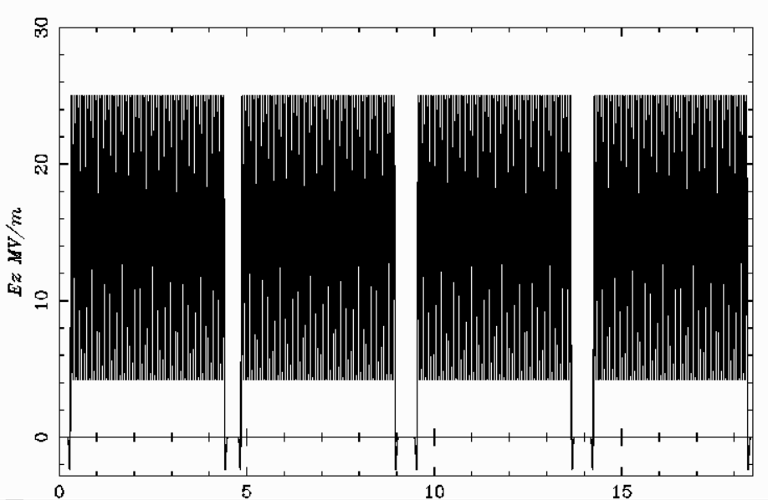
Four accelerating sections, reference particle moved to bunch center. Distance between accelerating section is 35 cm.

Slide 17
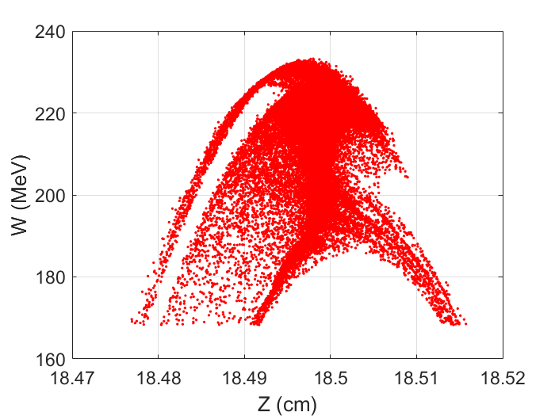
Four accelerating sections, reference particle moved to bunch center. Distance between accelerating section is 35 cm.
Q_{p}/Q_{e} = 8.3
∆Φ = 11.3° (70% of particles),
that corresponds to ∆Z = 4.7 mm
∆W/W = 8.0% (70% of particles)

Slide 18
Four accelerating sections, reference particle moved to bunch center.

Slide 19
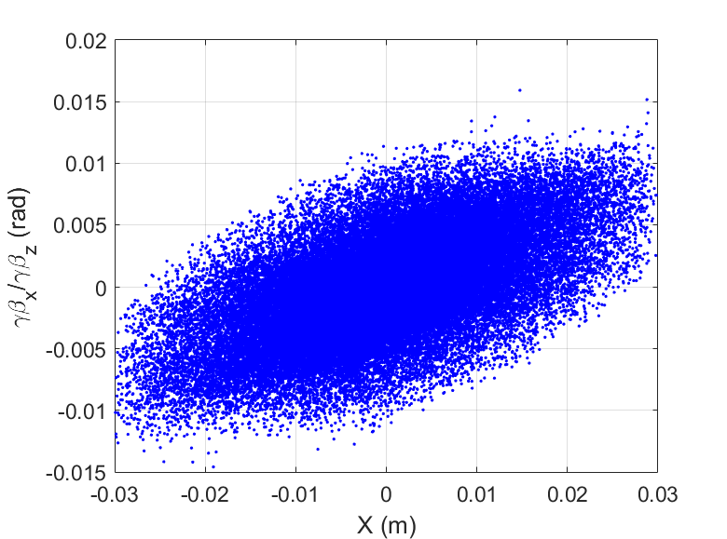
Four accelerating sections, reference particle moved to bunch center.
Average beam energy is 215 MeV
Normalized emittance ε_{x,y n rms} = 11⋅10³ mm⋅mrad
Therefore, geometrical emittance is about 25 mm⋅mrad
At 1.54 GeV it is expected to be
about 4 mm⋅mrad

Slide 20
Length of the solenoid is just 17 m.

Slide 21
2D scanning: α =10 through 60, Φ=0° through 350° at different B₀ from 6 T through 16 T or 20 T One accelerating section, 60 cells, 9/10π phase advance α =60 is the optimal value
B₀ | B* | Φ | ∆Φ | N | ε_{x n rms} m⋅rad | ε_{y n rms} m⋅rad | dx rms mm | dy rms mm
6 | 2.40e7 | 180 | 13.6 | 70891 | 0.0148 | 0.0148 | 8.75 | 8.72
8 | 3.35e7 | 190 | 12.1 | 79976 | 0.0140 | 0.0140 | 8.58 | 8.57
10 | 3.33e7 | 190 | 14.3 | 87013 | 0.0135 | 0.0134 | 8.52 | 8.43
12 | 3.34e7 | 190 | 16.1 | 92649 | 0.0131 | 0.0131 | 8.42 | 8.43
14 | 3.33e7 | 190 | 18.0 | 97338 | 0.0127 | 0.0127 | 8.37 | 8.33
16 | 3.34e7 | 180 | 19.4 | 101130 | 0.0125 | 0.0124 | 8.35 | 8.31

Slide 22
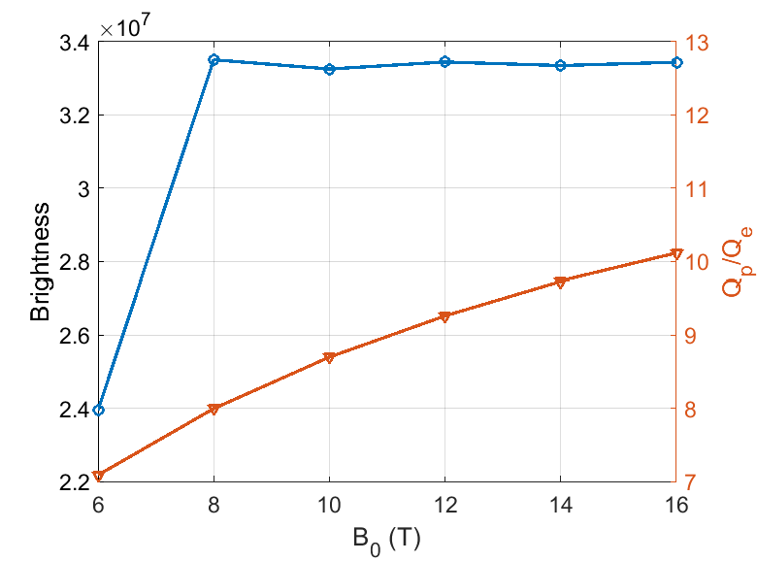
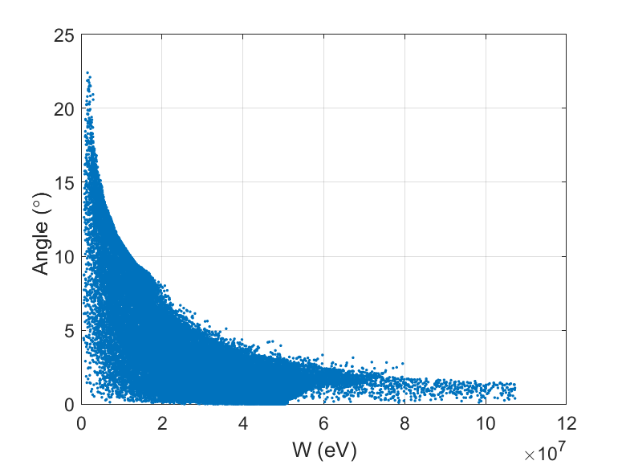
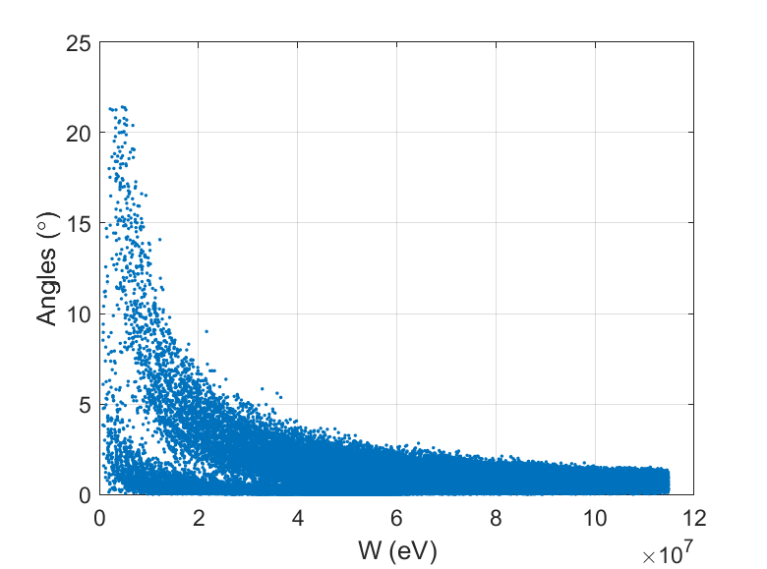
One accelerating section, 60 cells, 9/10π phase advance α =60 is the optimal value
Φ=190°
Φ=190°
Φ=0°

Slide 23
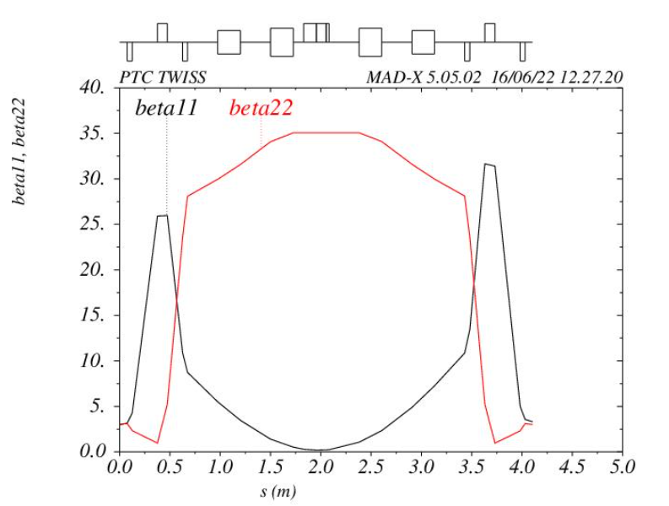
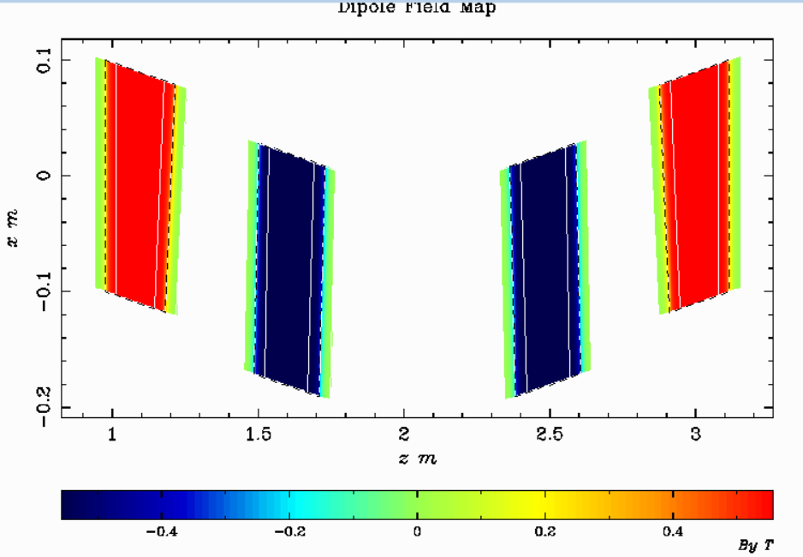
The question is, how can particles be cut in reality? By chicane?

Slide 24
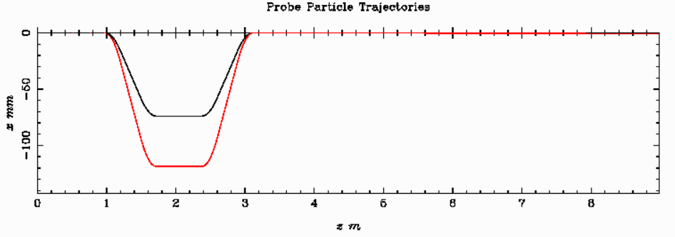
Chicane
Probe particles with energy deviation ±50 MeV
Simulation is in progress. Results are not yet satisfactory. Horizontal emittance at the output is four time higher.

Slide 25
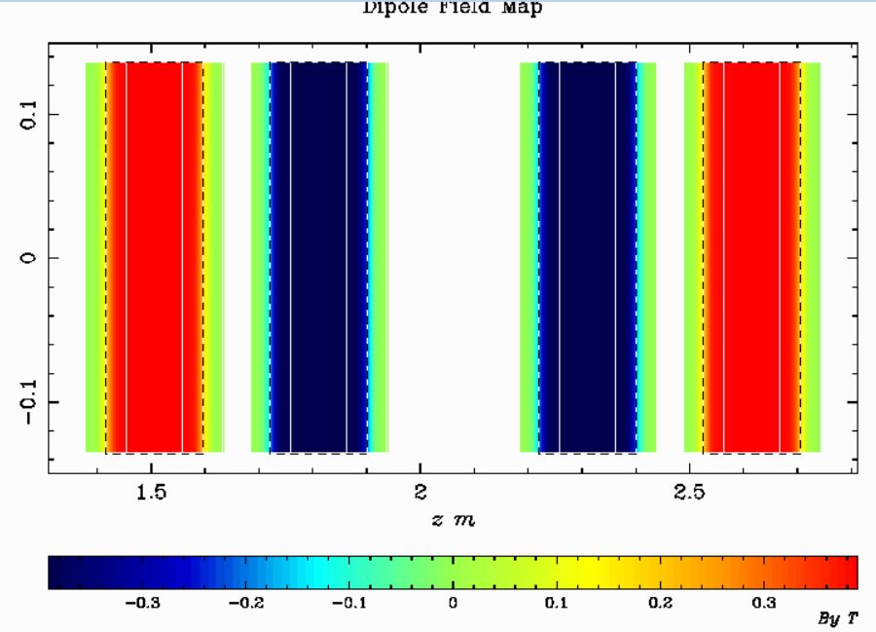
SKEKB Chicane

Slide 26
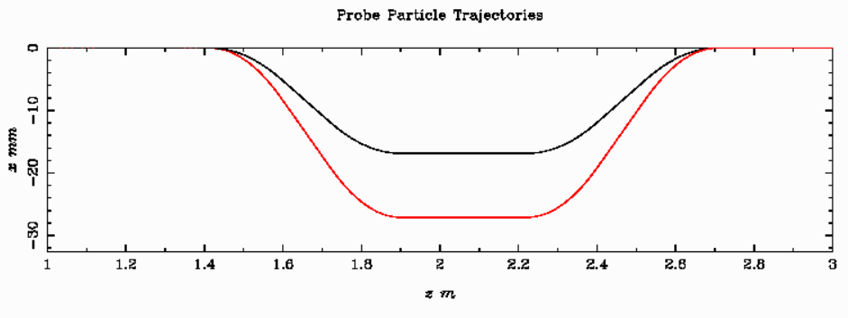
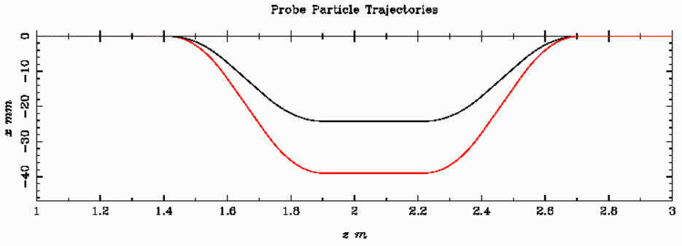
SKEKB Chicane
B=0.272 T
B=0.3899 T

