Slide 1
Positron beam measurements @SuperKEKB
19-21 December 2022
Y. Enomoto, T. Kamitani, F. Miyahara, M. Satoh, T. Suwada (KEK)
F. Alharthi, I. Chaikovska, V. Kubytskyi (IJCLab)

Slide 2
Outline
Electron source
Positron source
Flux Concentrator
Positron measurements at SuperKEKB:
Phase scans (1D & 2D).
Scan of primary e- beam positron on the target.
Scan of the FC.
Future plan
Conclusion and discussion.

Slide 3
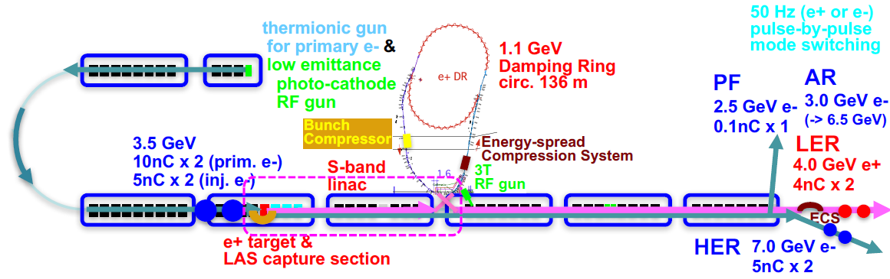
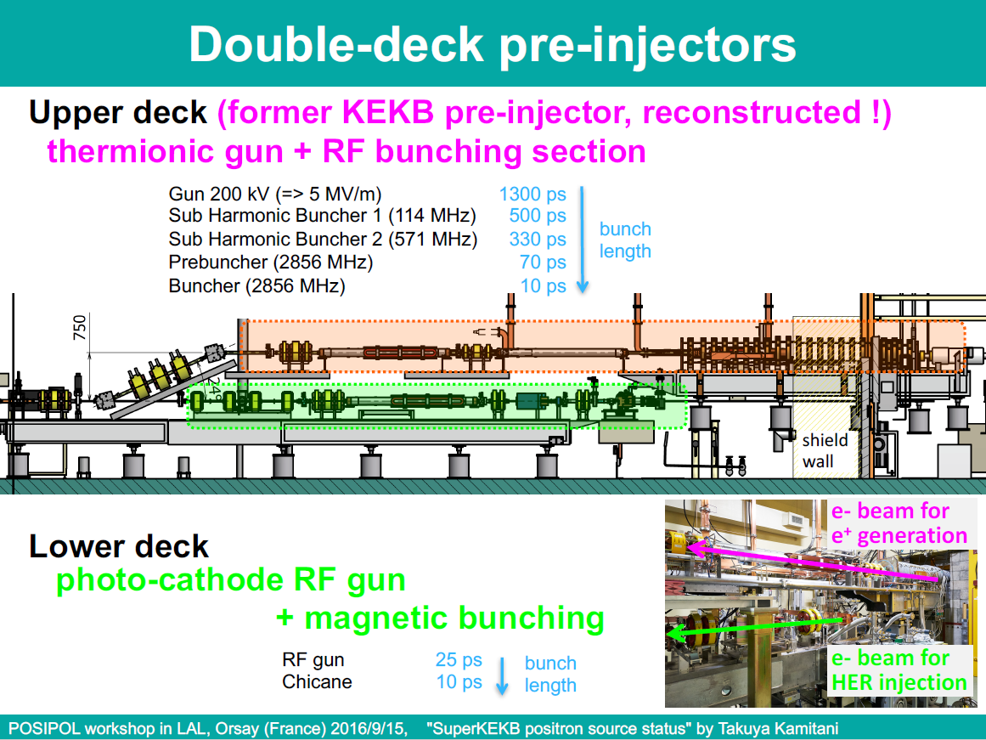
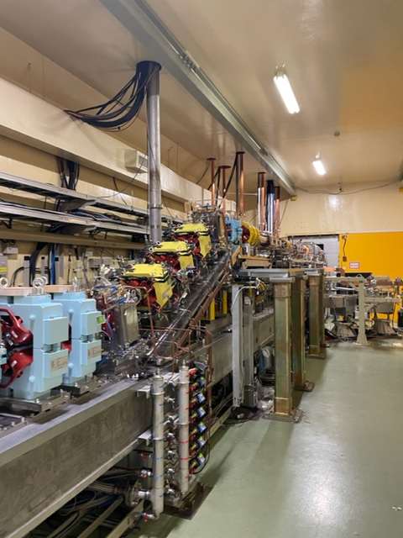
Electron source
Reference : POSIPOL-2016 workshop in LAL, Orsay (France), 2016.09.15

Slide 4
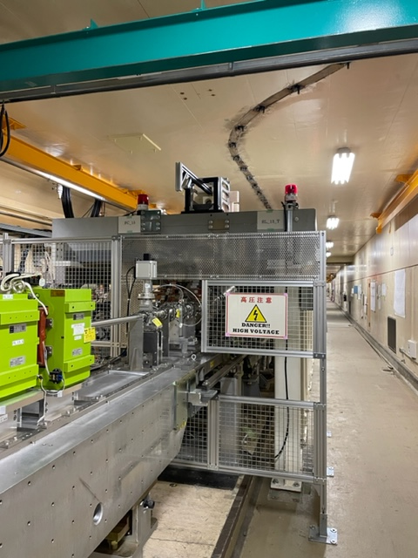
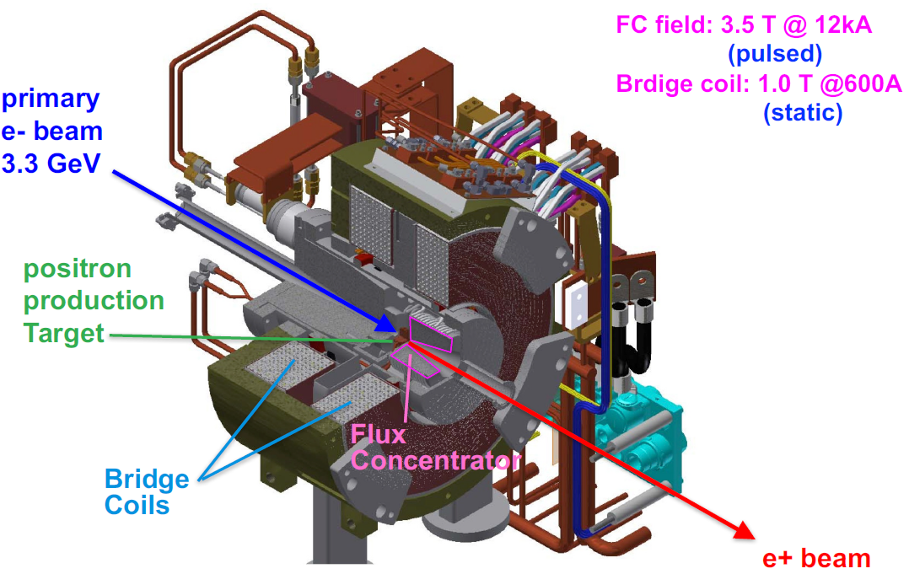
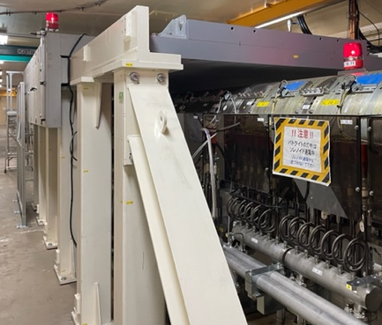
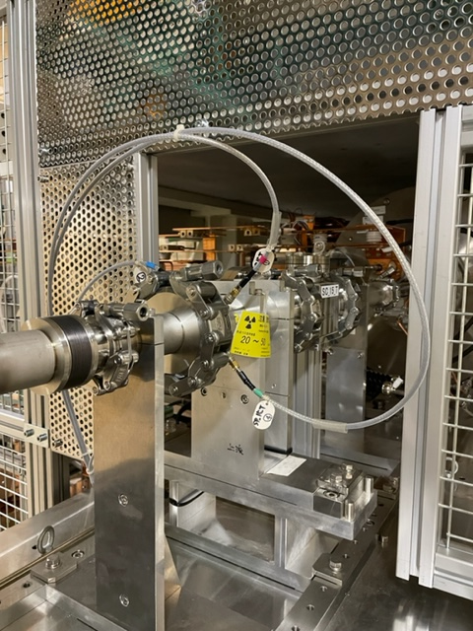
Positron source
Reference : POSIPOL-2016 workshop in LAL, Orsay (France), 2016.09.15
e+
e-

Slide 5
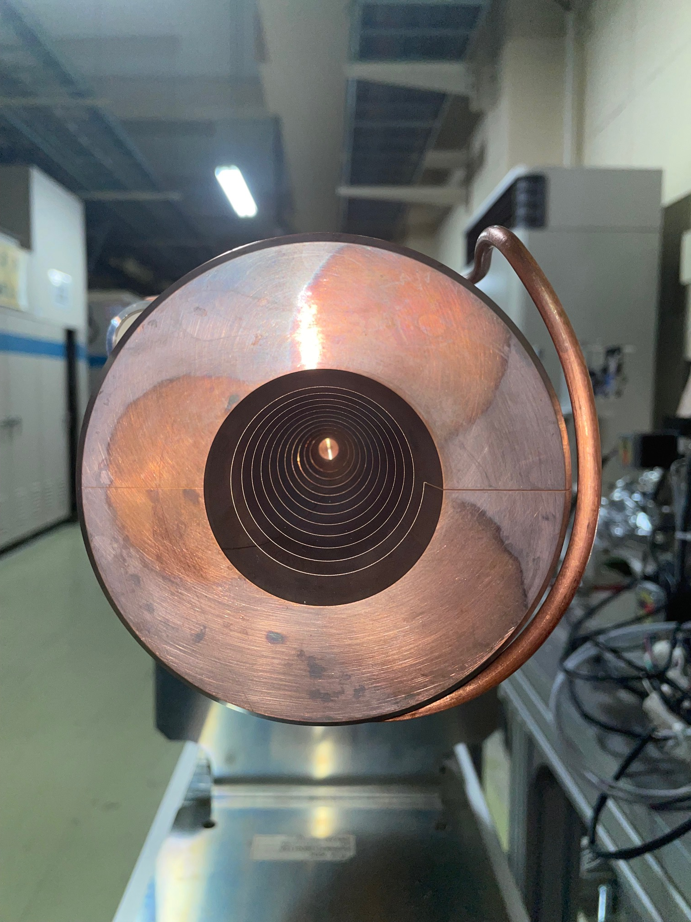
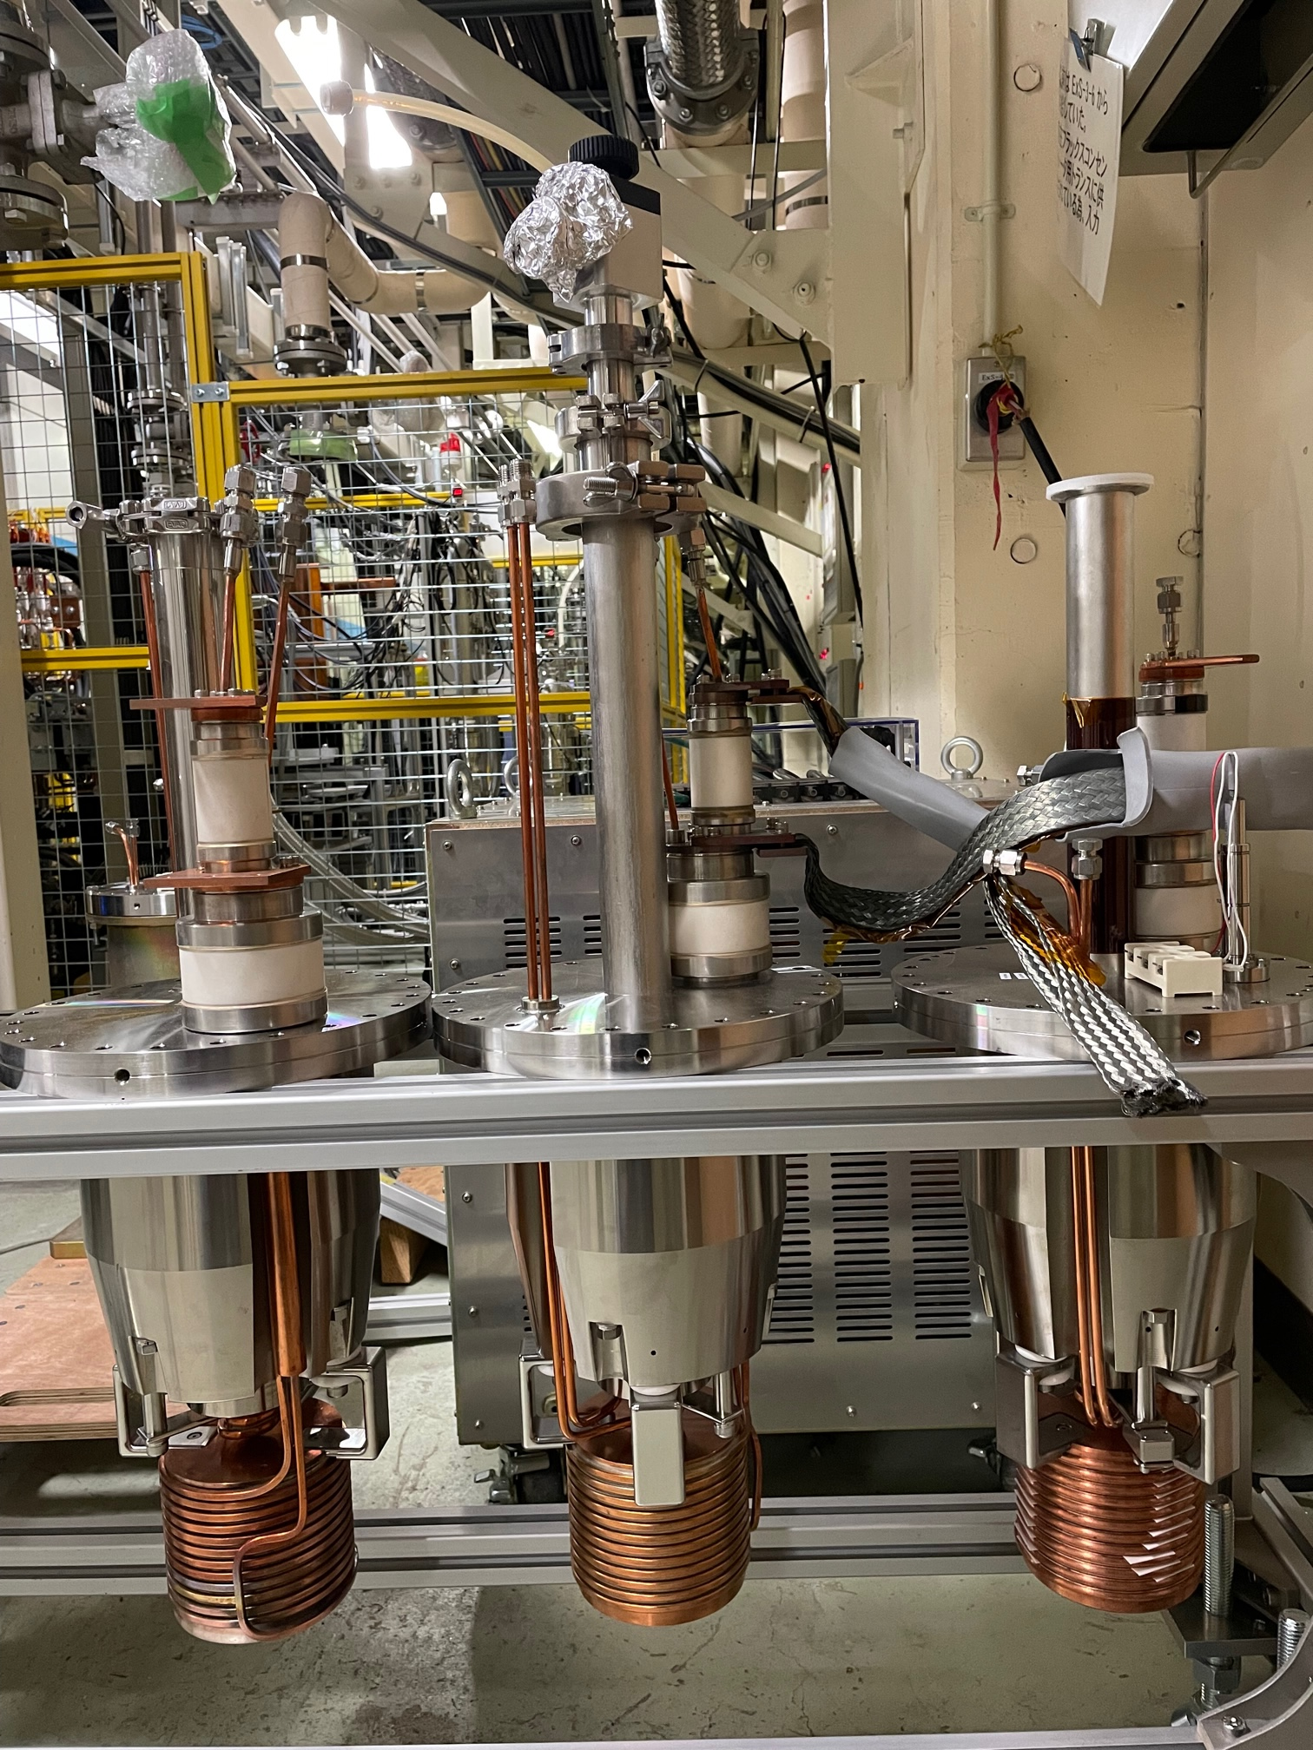
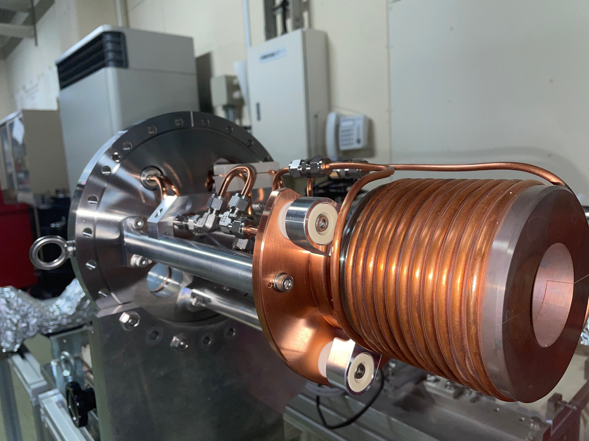
Flux concentrator
FC field : 3.5T at 12.5kA (pulsed)

Slide 6
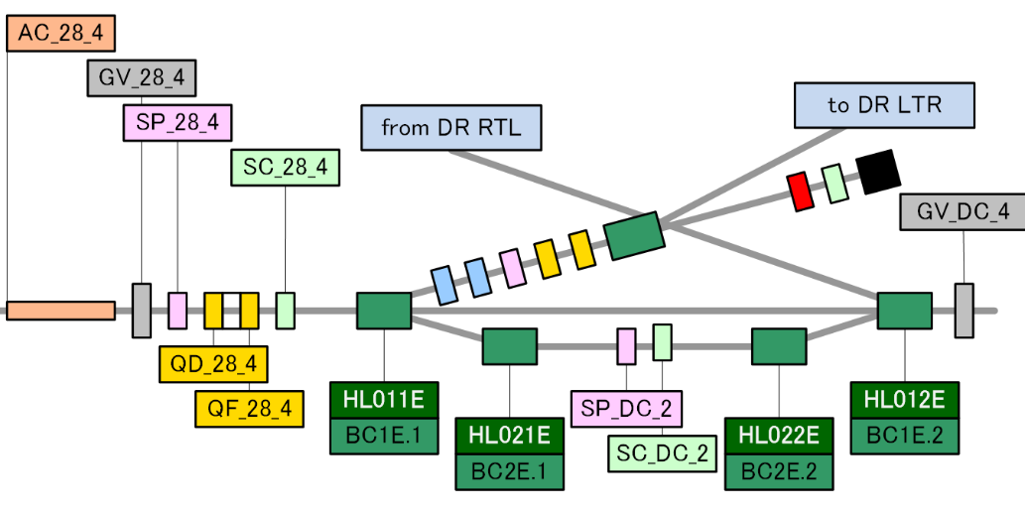
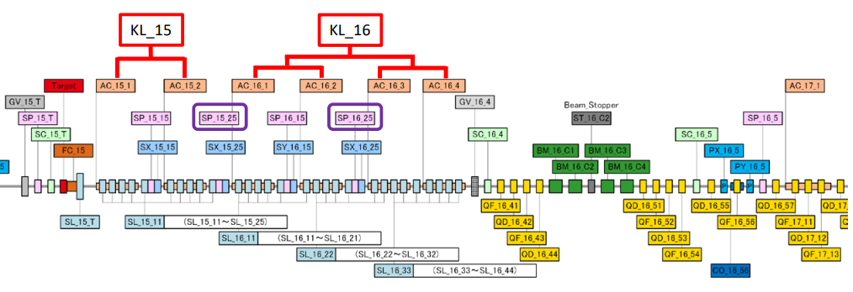
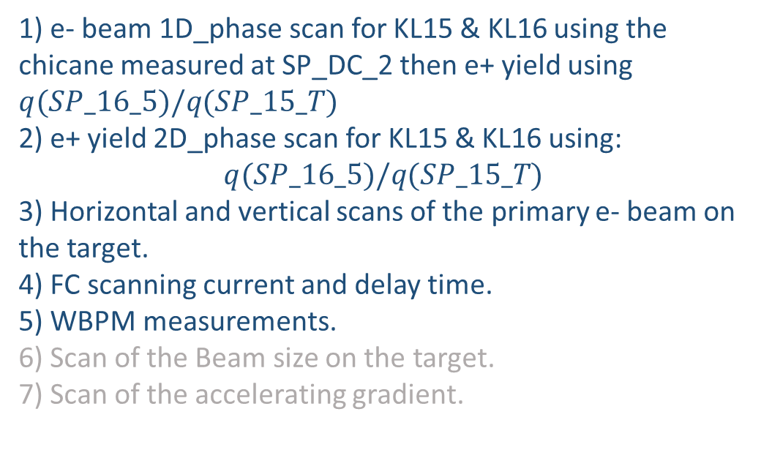
Positron beam measurements for benchmarking
1) e- beam 1D_phase scan for KL15 & KL16 using the chicane measured at SP_DC_2 then e+ yield using $q(SP_16_5)/q(SP_15_T)$
2) e+ yield 2D_phase scan for KL15 & KL16 using:
$$q(SP_16_5)/q(SP_15_T)$$
3) Horizontal and vertical scans of the primary e- beam on the target.
4) FC scanning current and delay time.
5) WBPM measurements.
6) Scan of the Beam size on the target.
7) Scan of the accelerating gradient.

Slide 7
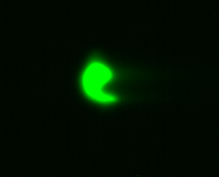
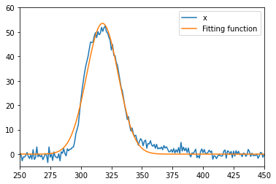
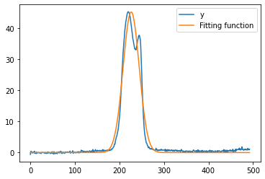
Electron beam parameters
Screen Before the Target.
Parameter | Typical value | Operational value
Beam energy | 2.9 [GeV] | 2.9 [GeV]
Beam sizes (σx, σy) | (0.5, 0.8) [mm]
Beam emittance
Bunch charge | 10 [nc] | ~ 10[nC]
Rep rate | 25 Hz | 5 – 12.5 [Hz]
Bunch length | ~4 [ps] RMS
Parameter | X | Y
Fitting parameter | 12.94933496 | 18.1240013
Calibration Factor | 0.0506 | 0.0509
Beam size [mm] | 0.655 | 0.922

Slide 8
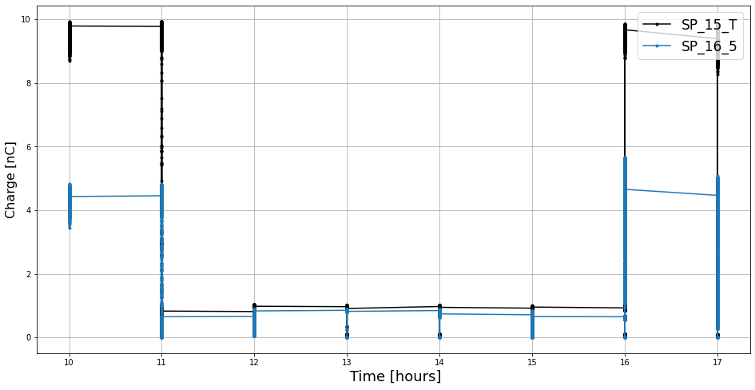
Electron beam parameters
Beam charge distribution measured by the BPMs for the first day of the experiment 19/12/2022 , 10:00 - 17:00

Slide 9
Capture section parameters
Parameter | Typical Value | Operational value
(FC , Bc, Sol) Filed strength | (3.5, 1,~0.5) [T]
FC current conversion factor to Filed strength
AC151 ~ AC152, gradient | ~12.56 [MV/m]
AC151 ~ AC152, power , Conversion factor
AC151 , phase
AC161 ~ AC164, gradient | ~ 14.3 [MV/m]
AC161 ~ AC164, power,
AC161 , phase
Chicane : BM_16_C1 ~ BM_16_C4 | 0.1936 [T]
Quads ~ (11)

Slide 10
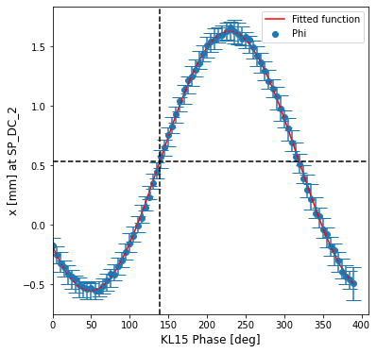
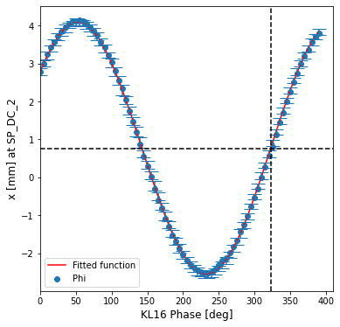
Primary e- beam 1D phase scan and relative phase scanning for positrons
139.06
322.55
Primary e- beams passes through target hole
50 points per condition.
Phase scan at 5 deg step for [0, 390] deg.
Positions are measured at SP_DC_2 in the middle of the chicane.

Slide 11
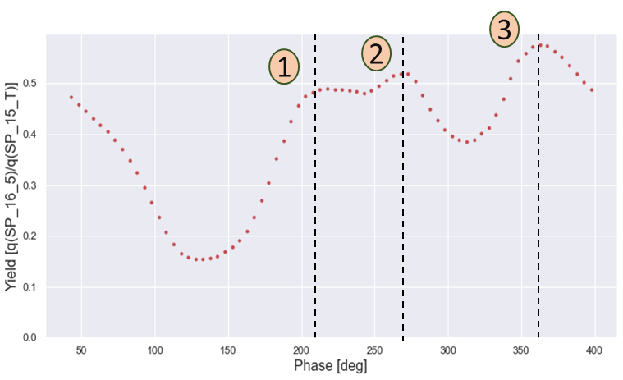
Primary e- beam 1D phase scan and relative phase scanning for positrons
Scanning both phases and evaluate the positron yield at the end of capture section
Yield vs KL15, KL16 phase measurement KL15 : [139.2-180, 139.2+180] KL16 : [322.7-180, 322.7+180]
Last BPM before the target
First BPM after the capture section
 | Phi 16 | Phi15
1 | ~210 | ~29
2 | ~270 | ~90
3 | ~360 | ~180

Slide 12
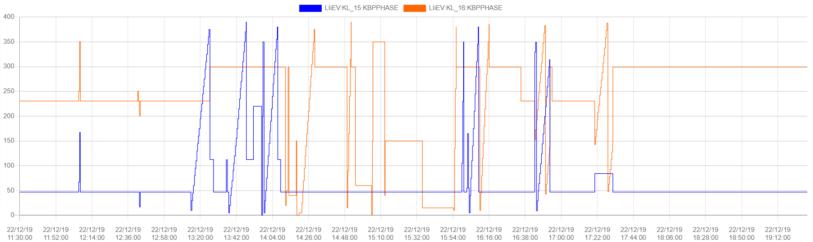
Operational phases and first day 1D scan
Primary electron scan
Positron yield scan

Slide 13
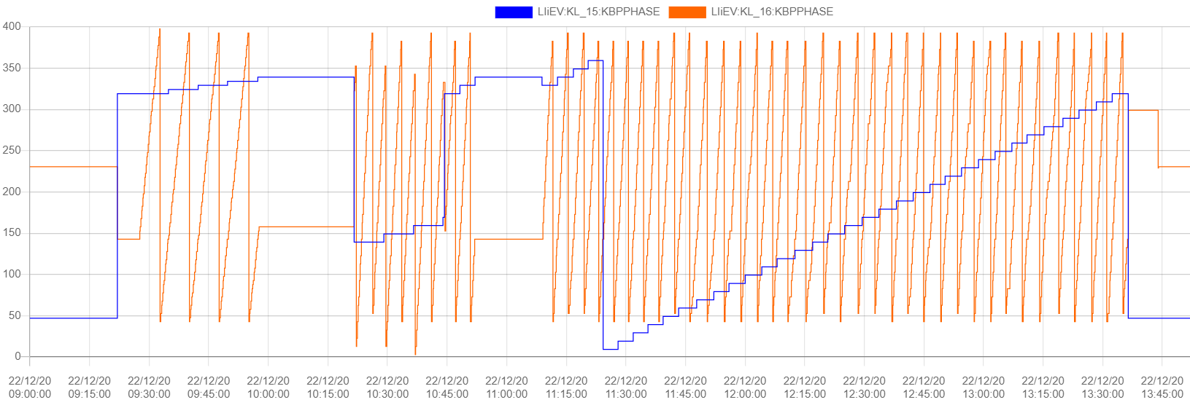
2D phase scan

Slide 14
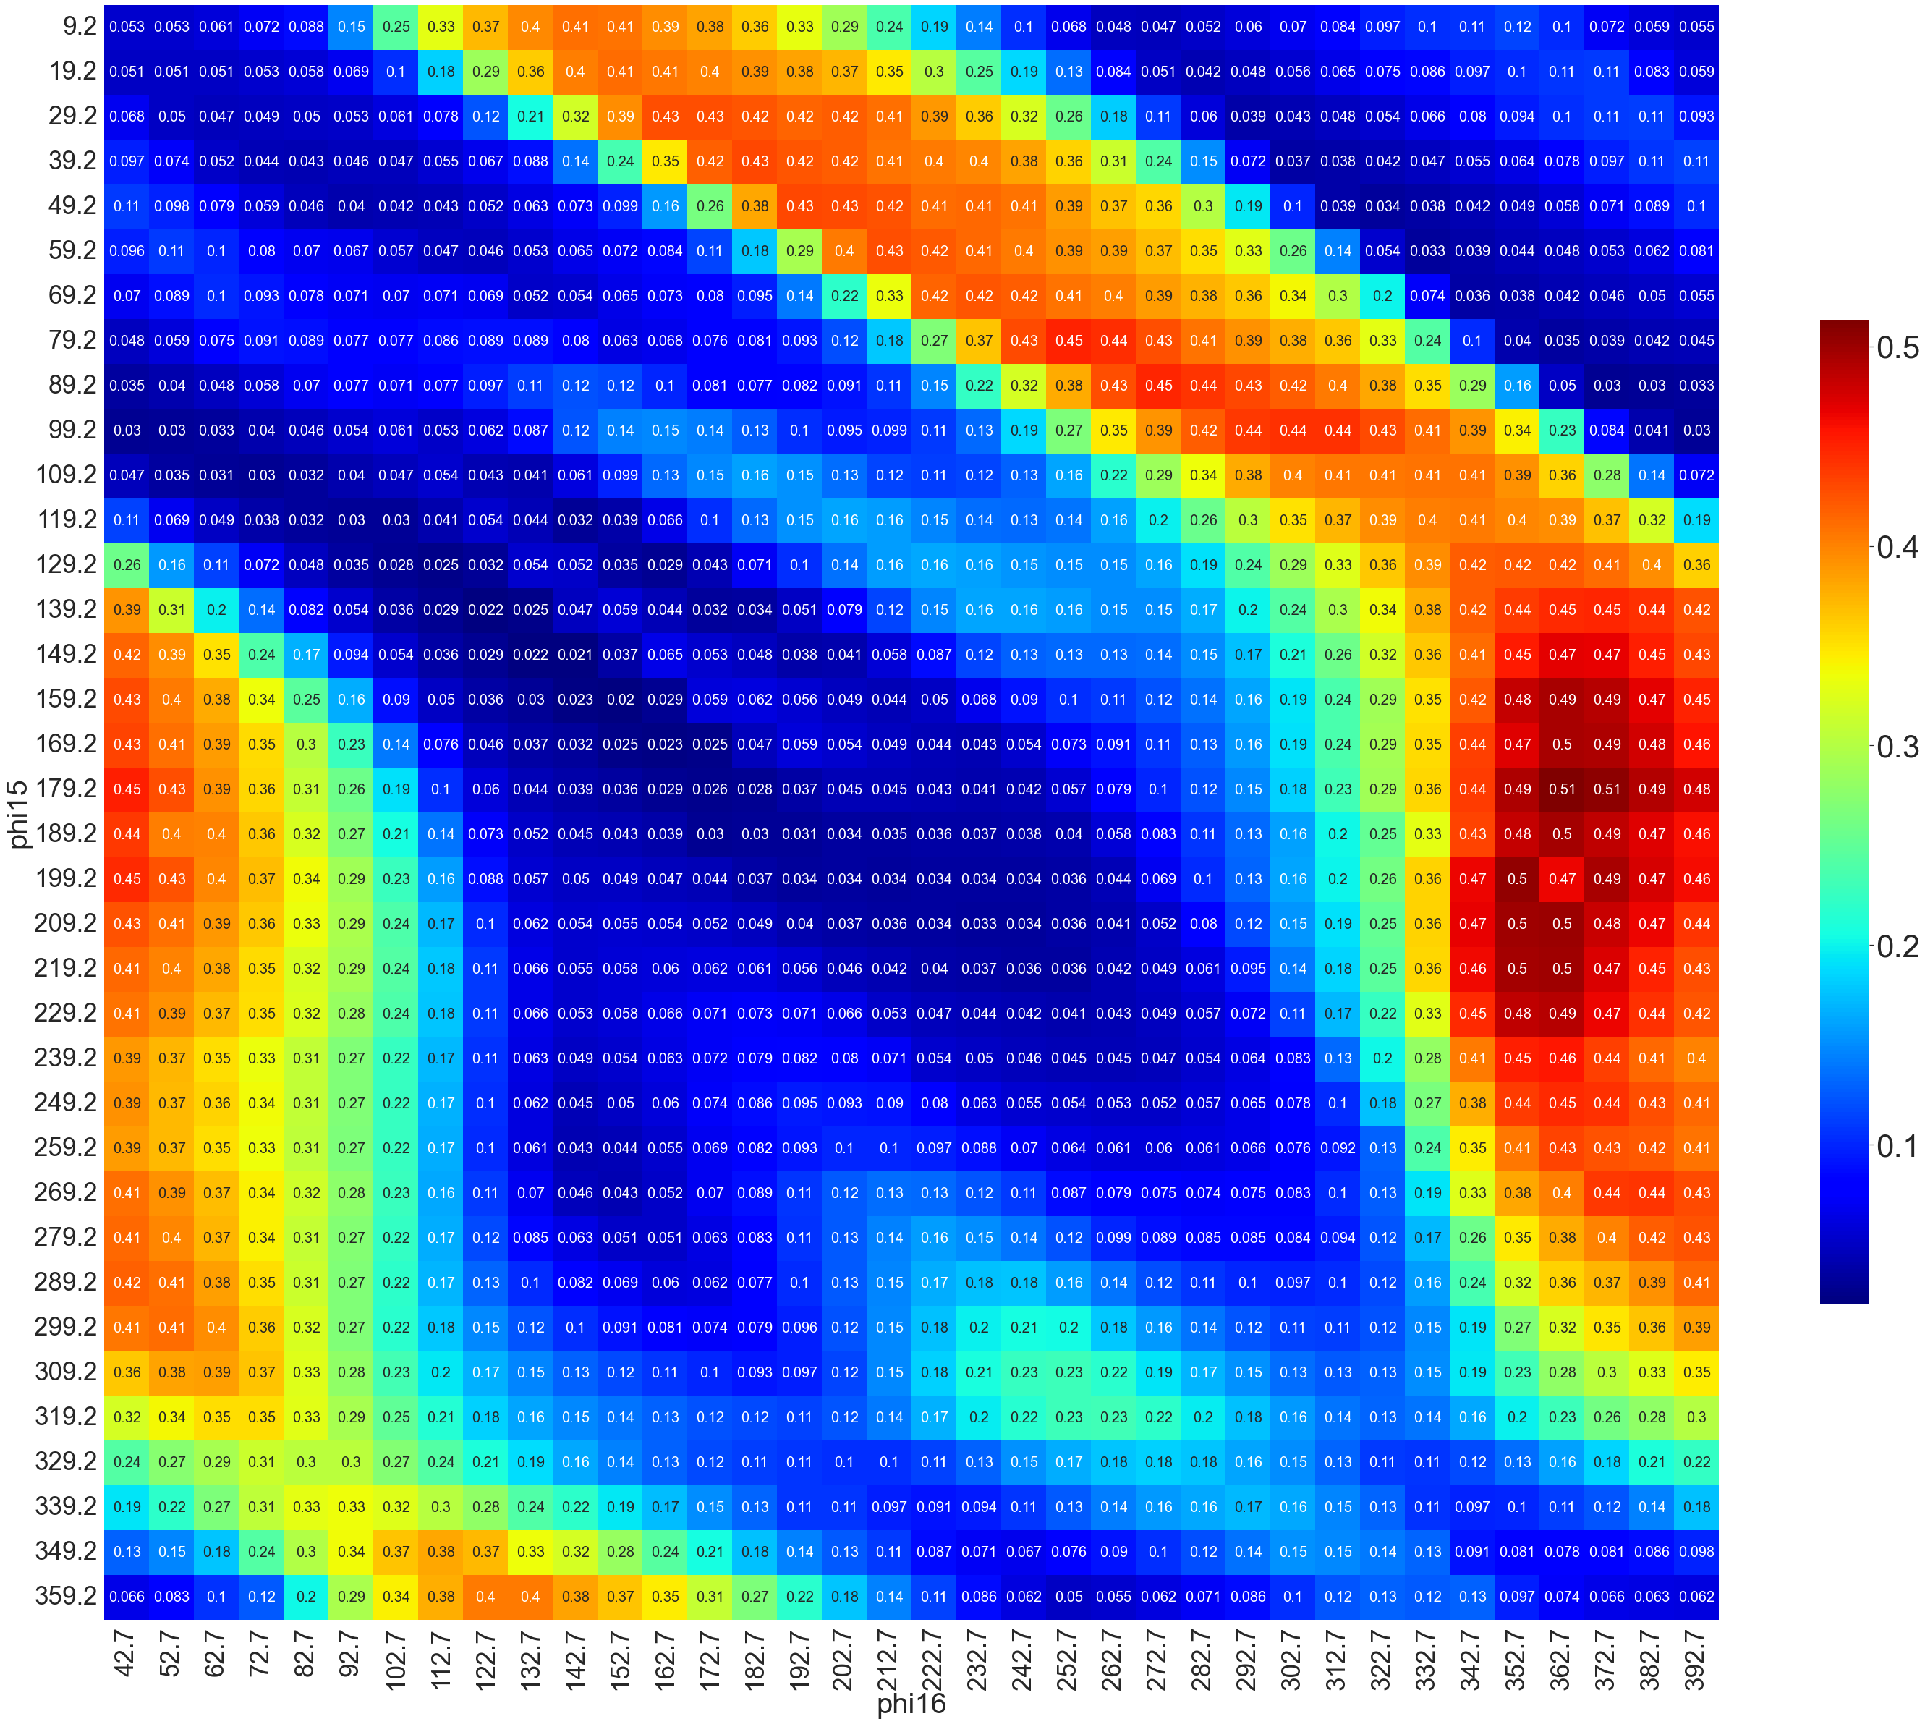
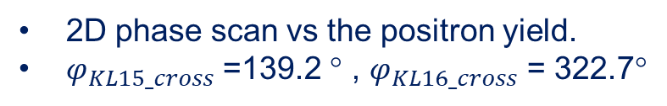
2D phase scan
1
2D phase scan vs the positron yield.
$φ_{KL15_cross}$ =139.2 ° , $φ_{KL16_cross}$ = 322.7°
4
2
 | Phi 16 | Phi15 | Yield
1 | ~210 | ~29 | 0.41
2 | ~270 | ~90 | 0.45
3 | ~360 | ~180 | 0.51
4 | ~230 | ~50 | 0.41
159.2
169.2
179.2
189.2
199.2
209.2
219.2
229.2
3
Phi15 [deg]
Scanning duration ~2H
At 12.5Hz
342.7
352.7
362.7
372.7
382.7
392.7
Phi16 [deg]

Slide 15
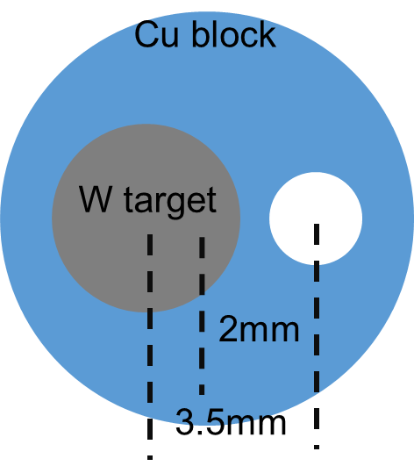
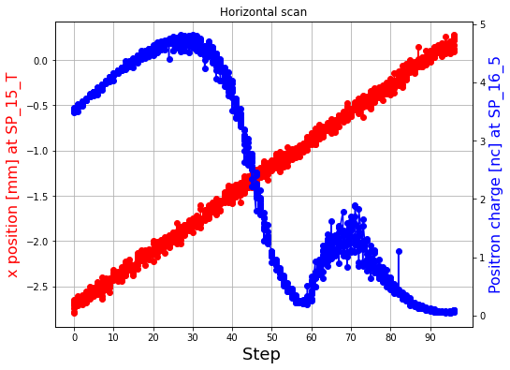
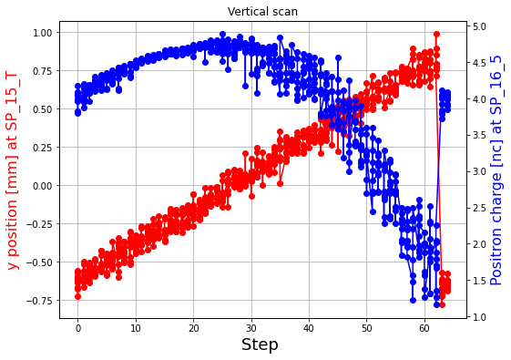
Scan of primary electron position on the target
Scan by changing the current of PX_13_5 steering magnet
1
Max positron charge at ~ x = 2mm offset from the beam axis.
Δz ~ -0.9368 [m]
2
Second charge peak correspond to the e- beam passing through the hole or Cu holder?
3
Max positron charge at ~y = 0 offset from the beam axis.
1
2
3
?

Slide 16
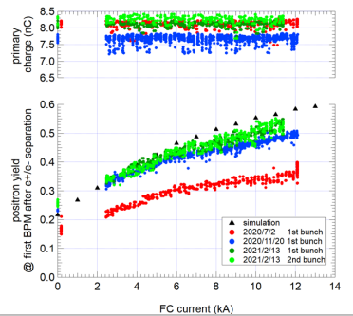
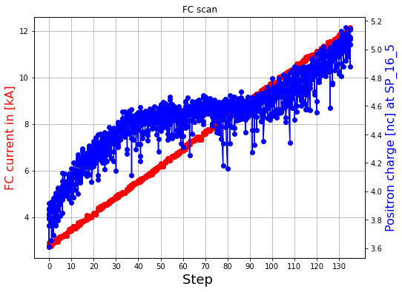
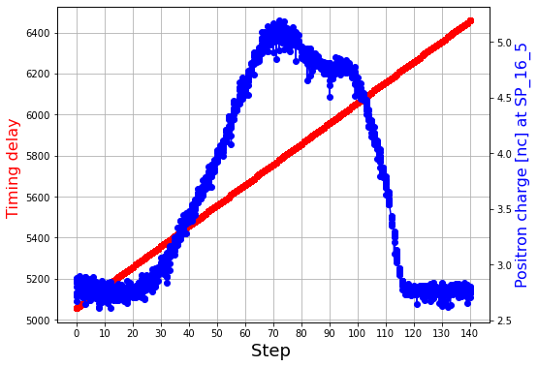
Flux concentrator - scanning vs the positron charge
FC field scanning performed with two different ways :
Delaying the pulse timing of the FC current.
Scanning the FC current [4 : 12.5 kA]
Max positron charge is at the center of the pules which is correspond to the max current of FC.
Positron charge behavior in this measurement is not as expected, more positrons could be captured and the shape of the scan. Potential reasons ?

Slide 17
WBPM measurement
During the 2D scan measurement we used the two Wideband Beam monitors (SP_15_25) and (SP_16_25).
Both :
Raw waveform data
Position and charge (Calibration is not accurate)
Data size ~45 GB!
The analysis is not done yet but soon it will start.

Slide 18
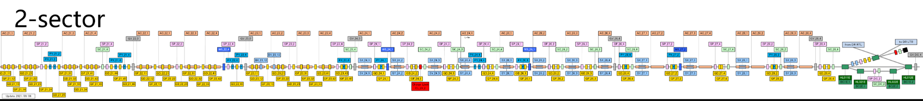
Future plans
Finalize the simulation model in RF-Track.
Benchmark the simulation model with the experimental data.
Discuss the possibility of implementing the linac until the damping ring : SAD , MADX..

Slide 19
Conclusion
Successfully achieved the objective of this trip:
Meeting many experts in the field.
Many Insightful discussions with all of you.
Visiting different facilities inside or outside KEK.
Amazed by the work flow and the origination in the Accelerator control room (my first time!)
Beam measurements.

Slide 20
Thank you !

Slide 21
I think the reason is that the beam size is larger than the hole, so the number of particles hitting the copper when it comes to the center of the hole is larger. F.Miyahara-san

