Slide 1
Section length variation
V. Mytrochenko

Slide 2
Comparison of TRW field representation by the default method and by real and imaginary field map
Phase scan for the section of 60 cells long (including couplers for Real&Imag case)
Field maps start at different positions.
For the default field representation field starts on 31 mm (37°) closer to the target.
Problem:
Discrepancy was found between results with different way of traveling wave section representation

Slide 3
Beam brightness versus phase and section length
Numbers in the legends are the section length in cells
Field amplitude 1.0
Field amplitude 1.5
Field amplitude 2.0

Slide 4
Mean beam energy versus phase and section length
Numbers in the legends are the section length in cells
Field amplitude 1.0
Field amplitude 1.5
Field amplitude 2.0

Slide 5
Total positron yield versus phase and section length
Numbers in the legends are the section length in cells
Field amplitude 1.0
Field amplitude 1.5
Field amplitude 2.0

Slide 6
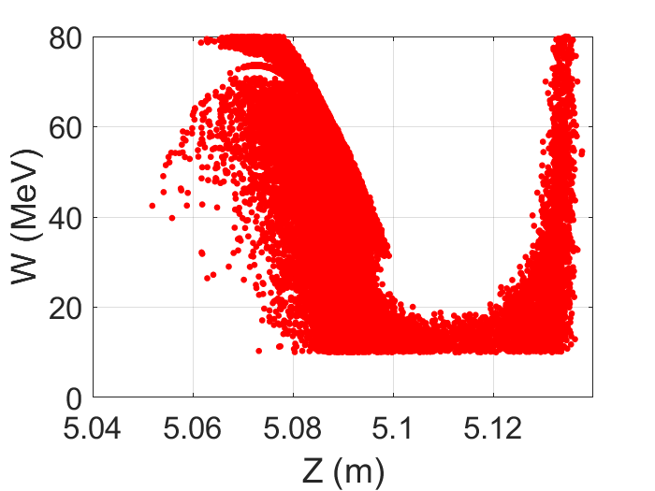
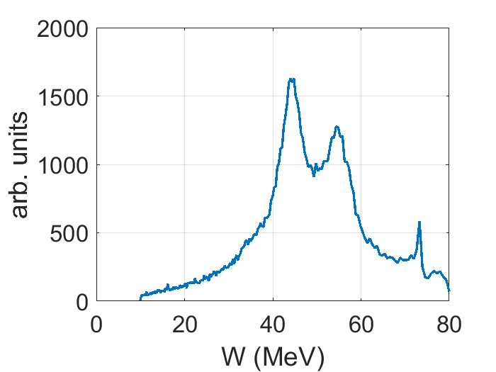
68 cells, Energy gain 15.95 MeV/m (Ampl. 2.0)
dW/W (1σ) = 31.4%, dZ (1σ) = 8.0 mm

