Slide 1
SuperKEKB Chicane
Fahad A. ALHARTHI
fahad.alharthi@ijclab.in2p3.fr
Laboratoire de Physique des 2 Infinis Irène Joliot-Curie (IJCLab)
CNRS, Université Paris-Saclay

Slide 2
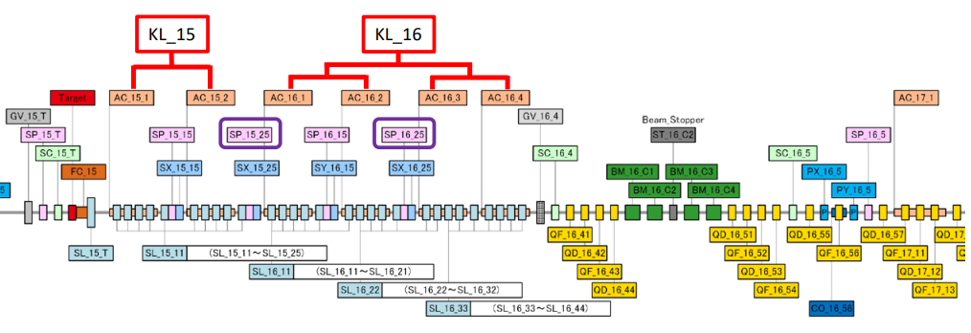
Capture section
Two Klystrons (KL_15 & KL_16) feeding 6 accelerating structures.
It is necessary to do the phase scans for AC151 & AC161 only.
 | KL_15 | KL_16
Gradient [MV/m] | 12.65 | 14.929
Work is in progress !
Done !

Slide 3
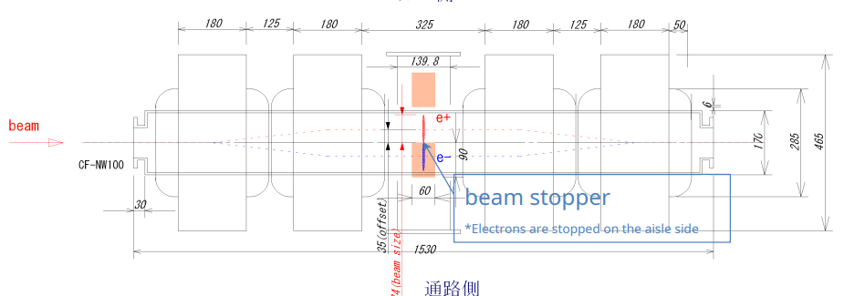
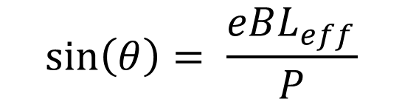
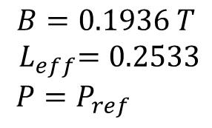
$$\sin\left(θ\right)= \frac{eBL_{eff}}{P}$$
$$B=0.1936 T$$
$${ L}_{eff}=0.2533$$
$P=P_{ref}$

Slide 4
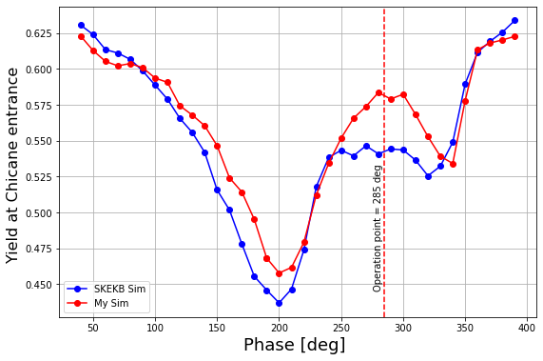
Before the Chicane (simulation only)
The phases here are actual Klystron phases.
Same phase applied to both klystrons (15, 16)

Slide 5
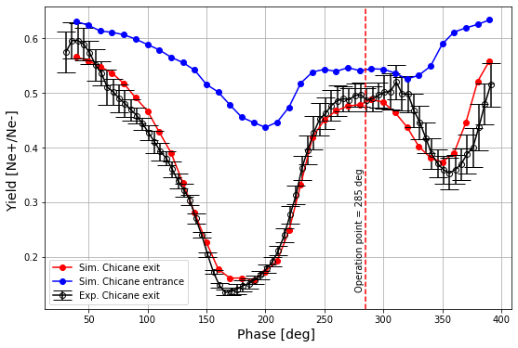
SuperKEKEB (GPT and measurement in July 2022 )

Slide 6
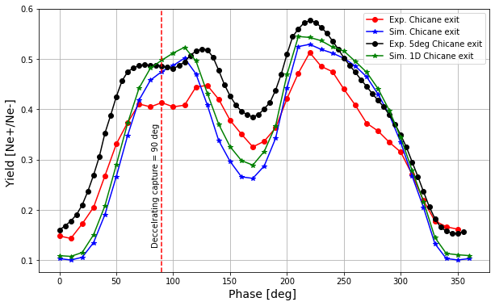
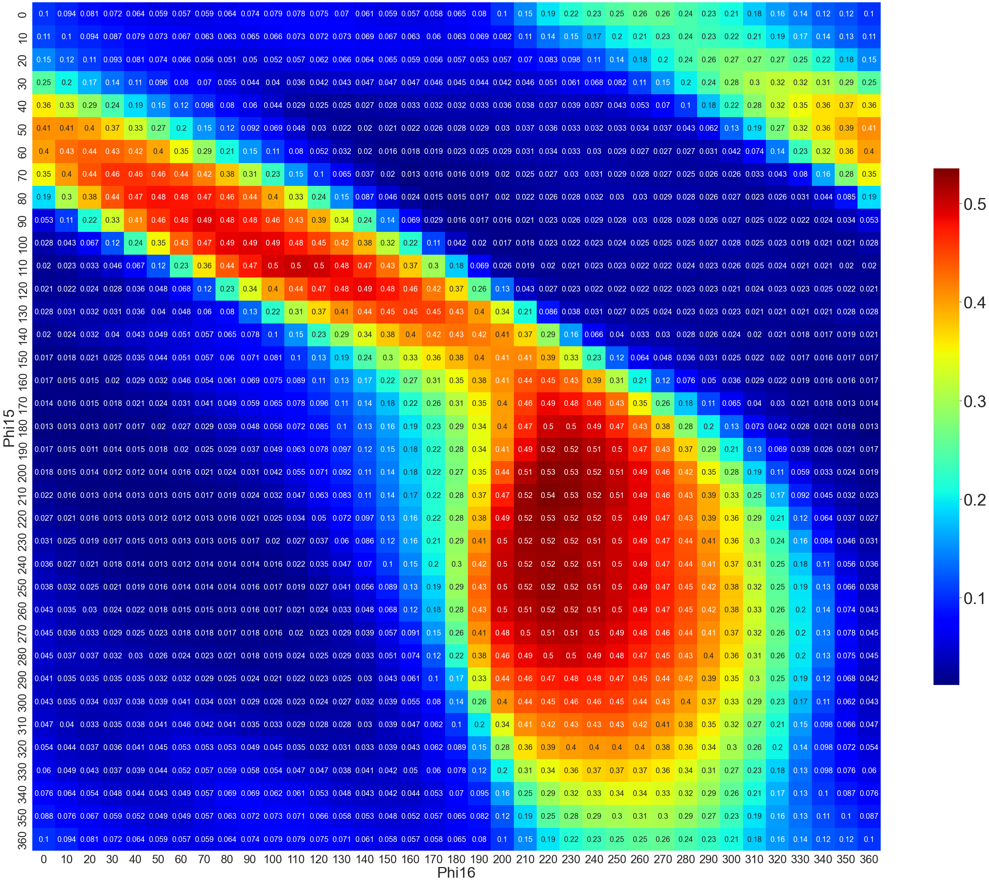
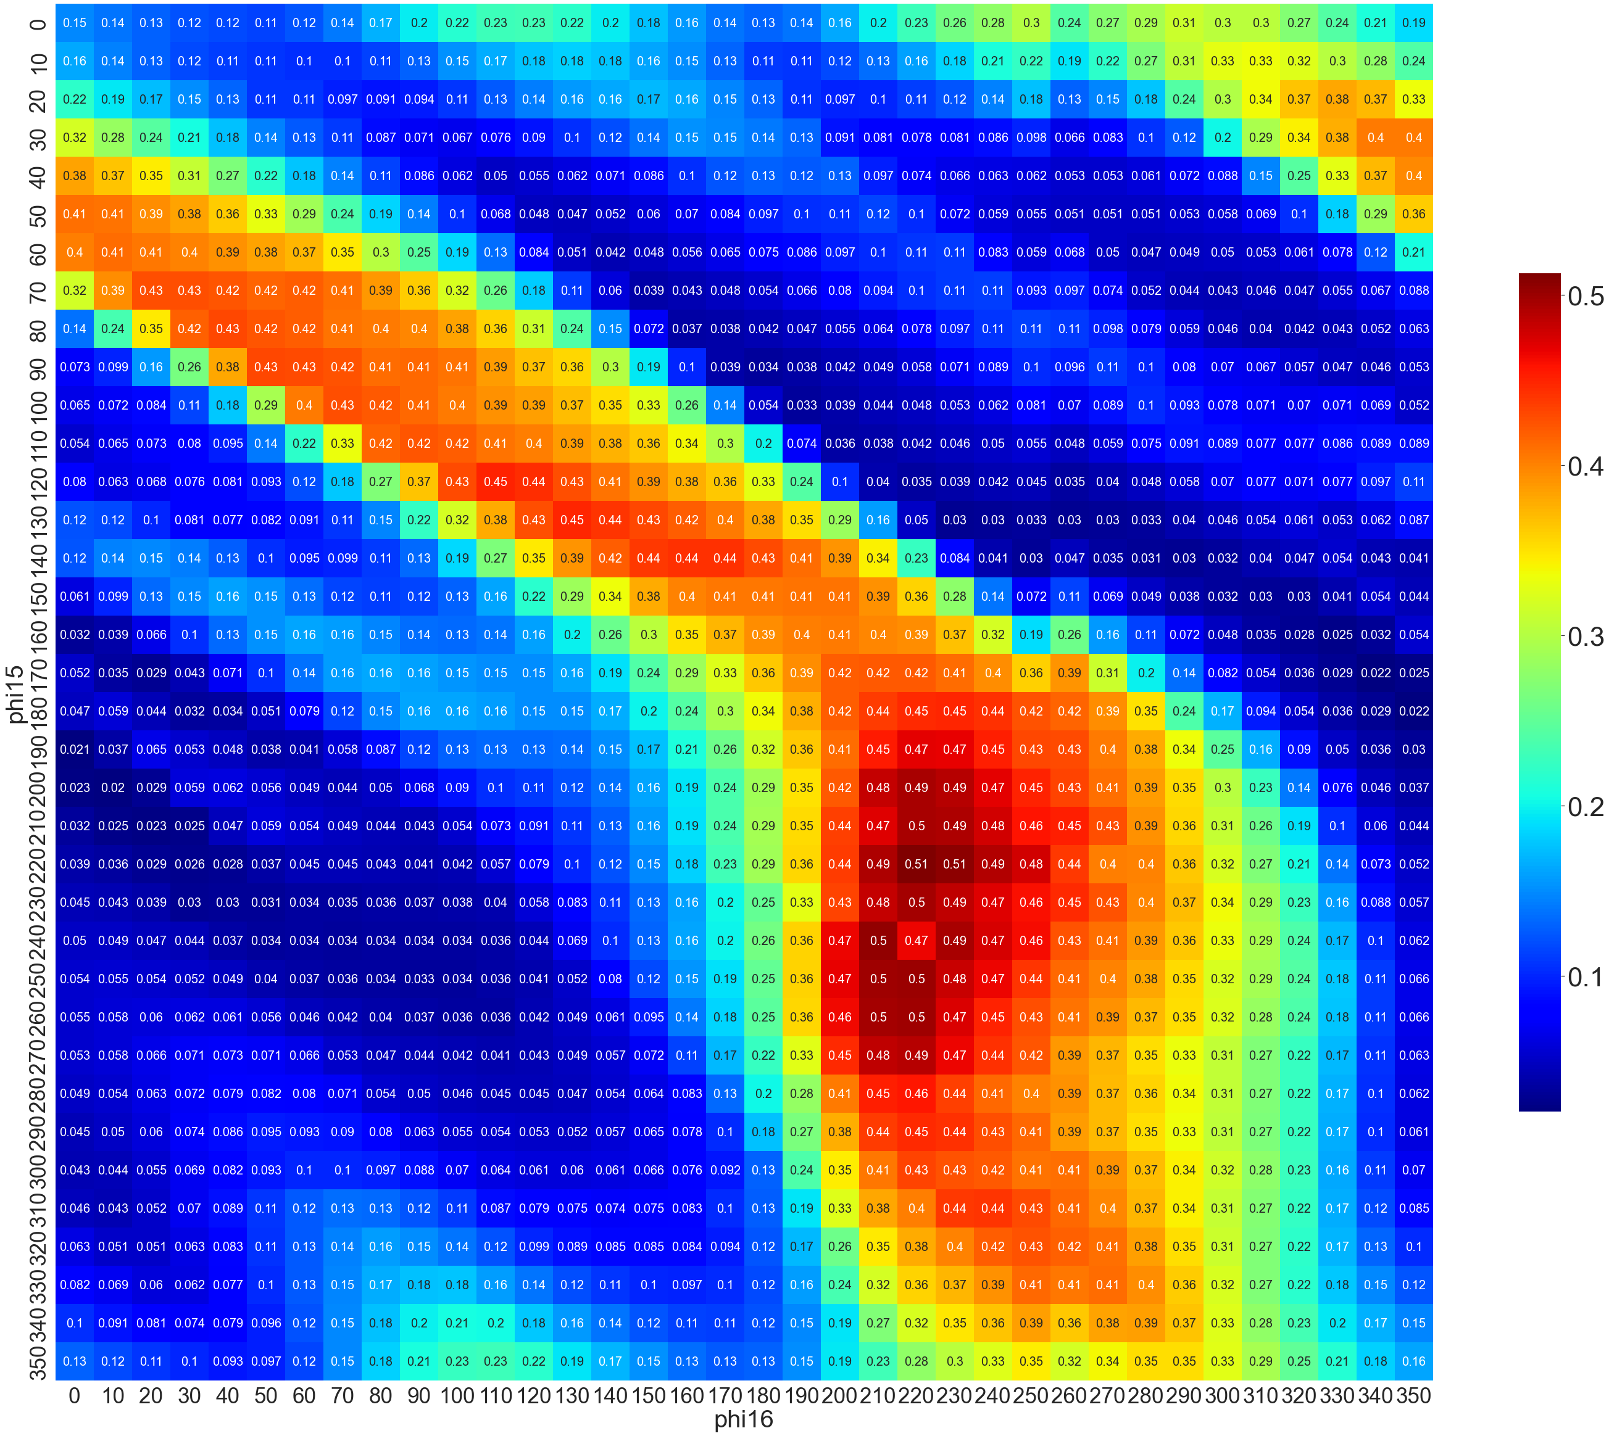
2D phase scan after the Chicane ( simulation Vs. measurement at SKEKB Dec.2022 )
Simulation
Measurement at SKEKB
KL15 Zcross = 151.5°
KL16 Zcross = 124°
KL15 Zcross = 139.2°
KL16 Zcross = 322.7°

Slide 7
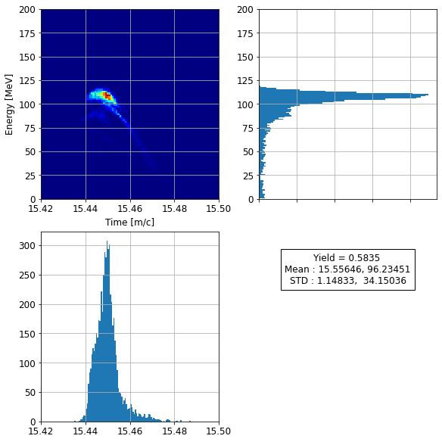
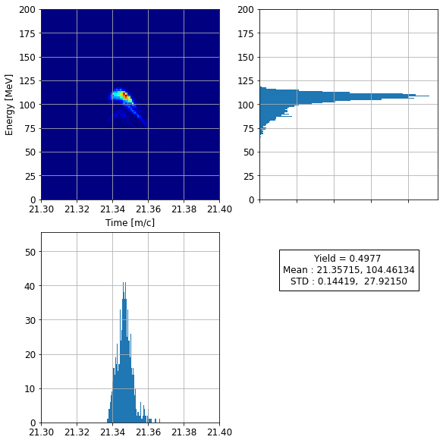
Longitudinal phase space (90 degree , deceleration mode)
After chicane
Before chicane
~15% drop in the yield

Slide 8
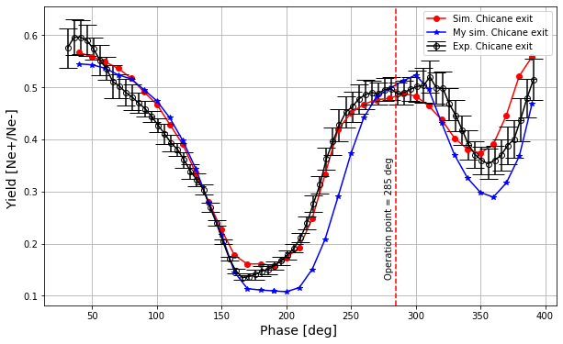
Comparison between my simulation and SKEKB simulation and measurement (July 2022)

