Slide 1

The Doctoral School PHENIICS
welcome address at the IJCLab fresher’s day
David VERNEY
Directeur adjoint de l’ED PHENIICS
ED PHENIICS deputy director

Slide 2
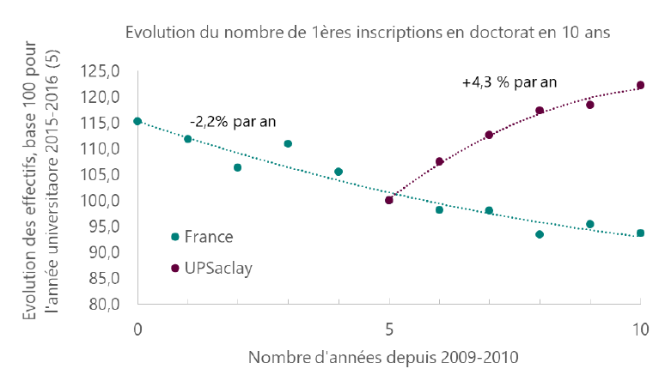
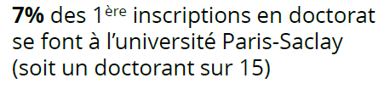
ED portrait
Université Paris Saclay
~4100 PhD students – 20 doctoral schools
Graduate School of Physics
4 Doctoral Schools
~200 PhD students
15 labs : 445 supervisors (309 HDR)

Slide 3
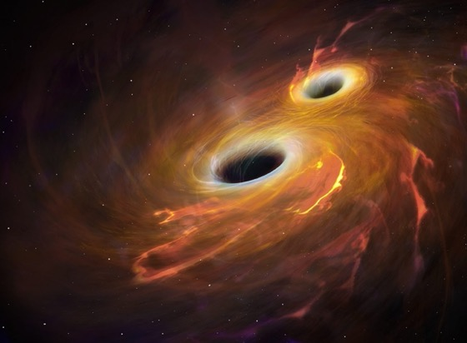
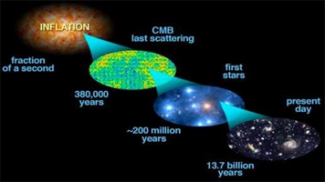
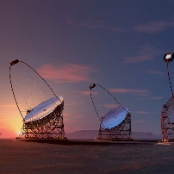
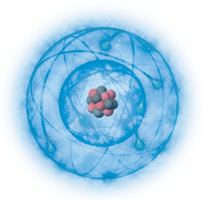
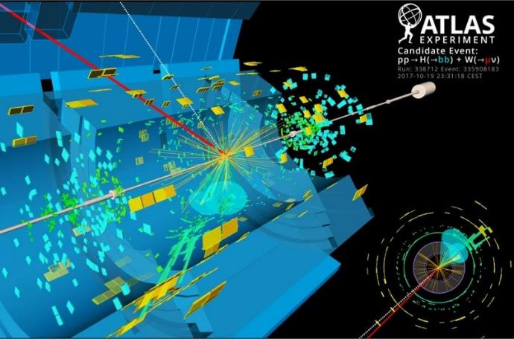
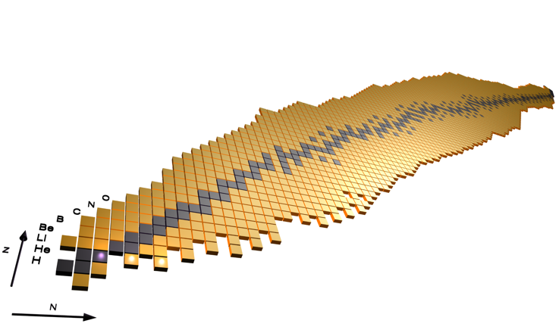
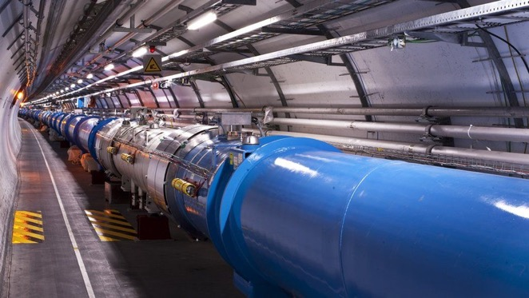
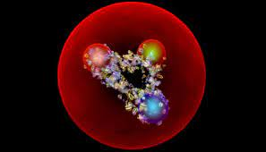
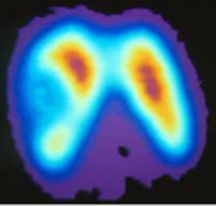
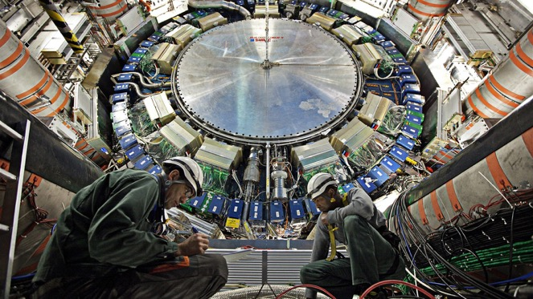
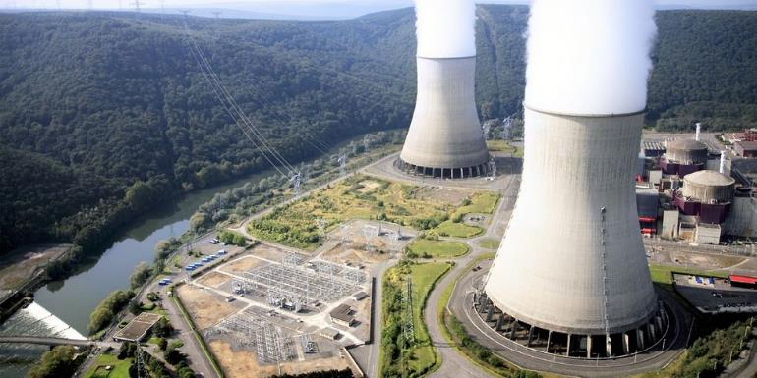
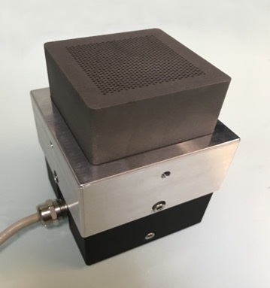
ED portrait scientific perimeter
centered around subatomic physics
Nuclear astrophysics, nucleo-synthesis ; Cosmology, dark matter and energy
Particle (high energy) Physics, astroparticules ;
Nuclear & Hadron Physics
Extreme in spin
Extreme in mass
Accelerator physics
Extreme in isospin
Detectors
nuclear energy
Back-end nuclear cycle, radiation protection and radiochemistry
radio and hadron therapy
material science
medical imaging and radioactivity

Slide 4
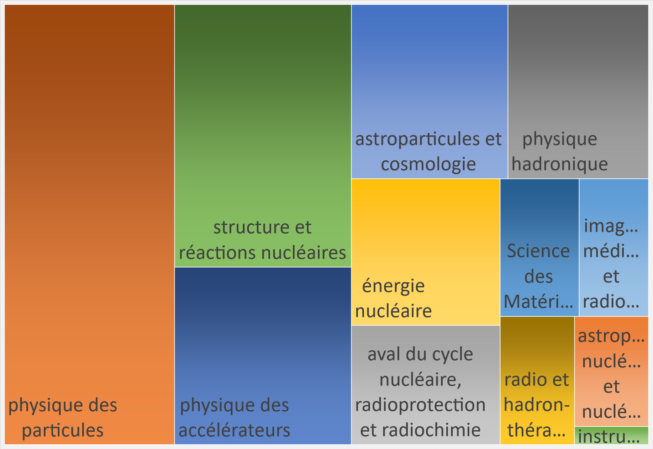
ED portrait scientific perimeter
distribution of PhD students by specialty in 2021-2022
(total 208)
12 « specialties »
astroparticules et cosmologie
astrophysique nucléaire et nucléosynthèse
aval du cycle nucléaire, radioprotection et radiochimie
énergie nucléaire
imagerie médicale et radioactivité
instrumentation spatiale
physique des accélérateurs
physique des particules
physique hadronique
radio et hadron-thérapies
Science des Matériaux
structure et réactions nucléaires

Slide 5










ED portrait institutional and academic perimeters
15 labs* :
445 supervisors (309 HDR)
*20 if one counts each IRFU dpt as a lab
CPhT
DAM,DEN,DRT
Irfu
CEA Cadarache
CEA Marcoule
Fresher’s Day 2021

Slide 6


3 major actors around the PhD student
employer
(CNRS, CEA, IRSN…)
laboratory
individual follow up committee
doctoral school
CAT
(tutorship)
lab director
research team
ED director
PhD supervisor

Slide 7
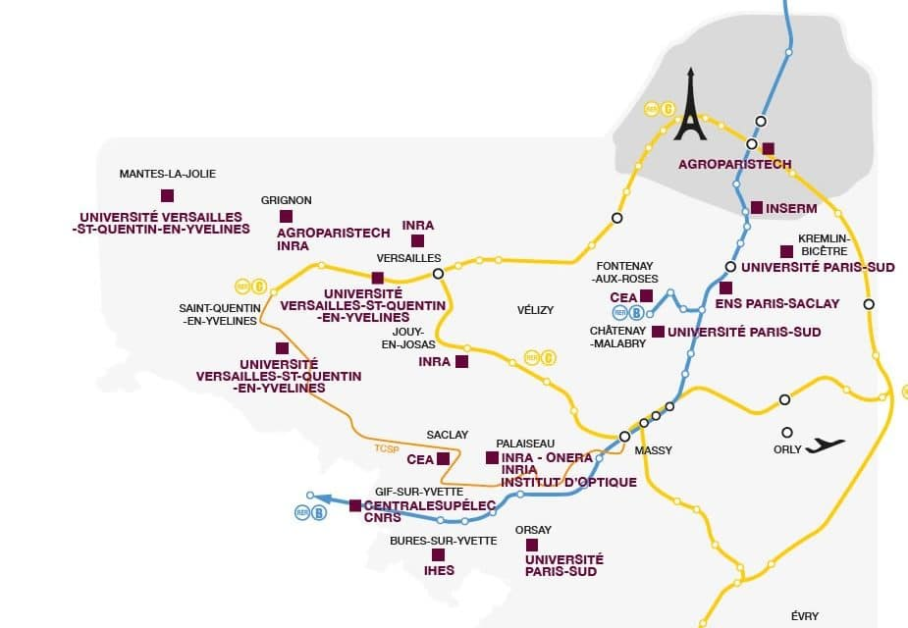
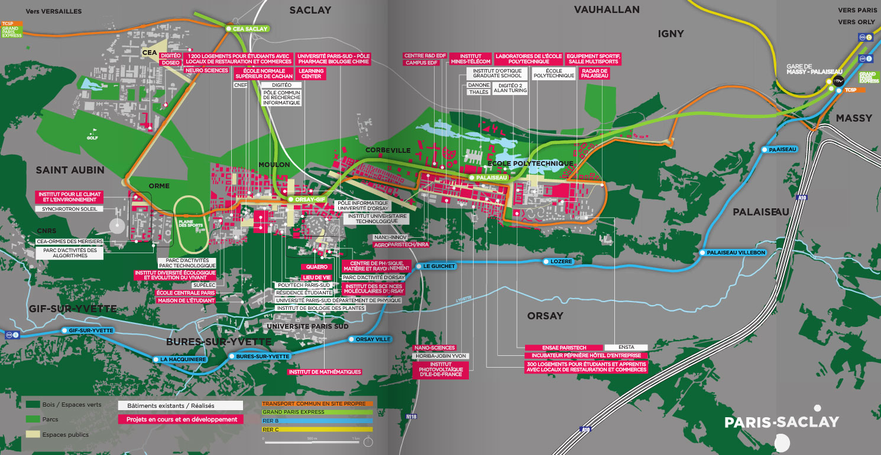
ED PHENIICS organization geographical and thematic
Head of the doctoral School (the «directorate»)
Patrice HELLO IJCLab Director (located at IJCLab building 100)
Didier FRANCK IRSN Deputy-Director
Guillaume MENTION Irfu/DPhP Deputy-Director
David VERNEY IJCLab Deputy-Director
Sophie GARUS Administrative Assistant (located at IJCLab building 200)

Slide 8
ED PHENIICS organization geographical and thematic
Répartition par année
Année
1ère année | 62
2ème année | 72
3ème année | 53
4ème année | 16
5ème année | 1
Total | 204
8 ont soutenu
a soutenu
pedagogical follow-up « portfolio » at IJCLab
Patrice : PHE, astro cosmo, accélérateurs
David : Nucléaire, théorie, énergie & environnement, physique santé
ingénierie ?
Répartition par nationalité
58% étrangers – 42% français
(37 nationalités !)

Slide 9
The Doctoral School Council
doctoral School concil
de Saint Jean Cyril CEA DAM
de Carlan Loic CEA DES
Couprie Marie-Emmanuelle Soleil
Drouart Antoine Irfu/DPhN
Proust Eric CEA DES
Garus Sophie Assistante ED
Bourge Catherine IJCLab
Charron Eric UPSay
Fouchet Thierry Obs. Paris (A&A)
Terras Véronique LPTMS (ED PIF)
Ridel Melissa LPNHE Paris
Lemoine Thierry Thalès
Abada Asmaa IJCLab
Hello Patrice IJCLab
Mention Guillaume Irfu/DPhP
Franck Didier IRSN
Arleo Francois LLR
Garrido Frederico IJCLab
Verney David IJCLab
Prezado Yolanda Curie
yearly elections
please volunteer !
and vote !
PhD student representatives
elected in march 2022 - Voting participation rate: 33% (66 votes cast)
Baptiste LEFEVRE (CEA/Irfu)
Yahya KHWAIRA (IJC Lab)
Afnan SHATAT (IJC Lab)
Ioannis PLAKIAS (IJC Lab)

Slide 10
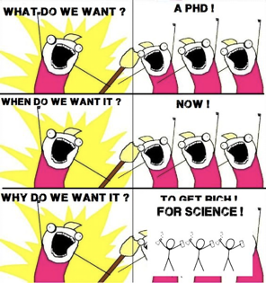
welcome !

