Slide 1
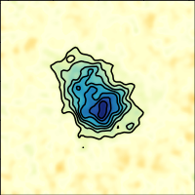
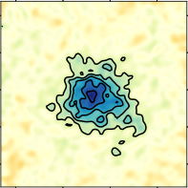
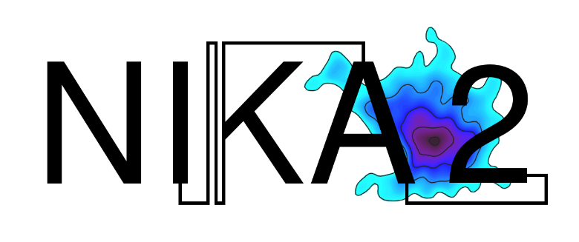
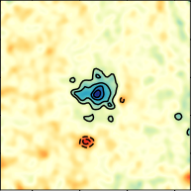

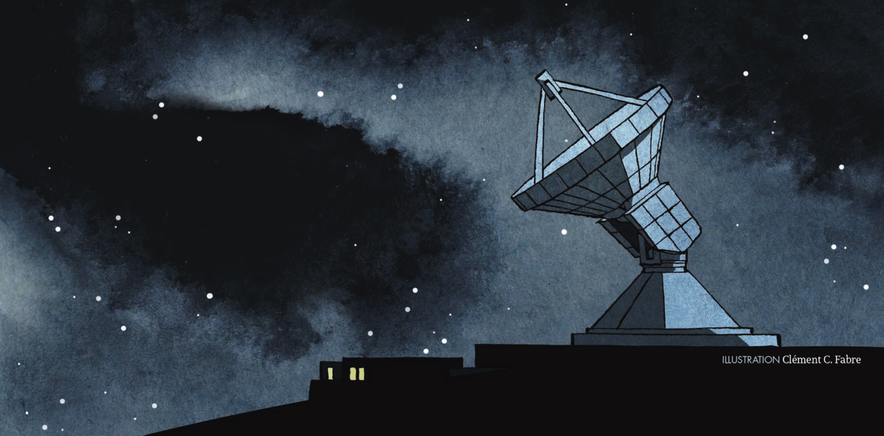
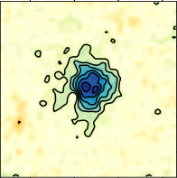
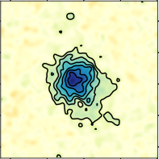
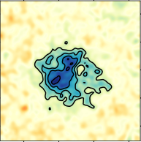
Accurate Galaxy Cluster Cosmology with NIKA2 Sunyaev-Zel’dovich Large Program
Laurence Perotto on behalf of the NIKA2 collaboration
Kick-off meeting of the GDR Cosmological Physics | 17-20 January 2023 | LPNHE

Slide 2
Outlines
The NIKA2 Sunyaev-Zel’dovich Large Program and its implication for Cluster-based Cosmology
Implication of resolved Sunyaev-Zel’dovich observation on Cluster Cosmology
NIKA2 Sunyaev-Zel’dovich Large Program
Status, recent results and perspectives
1

Slide 3
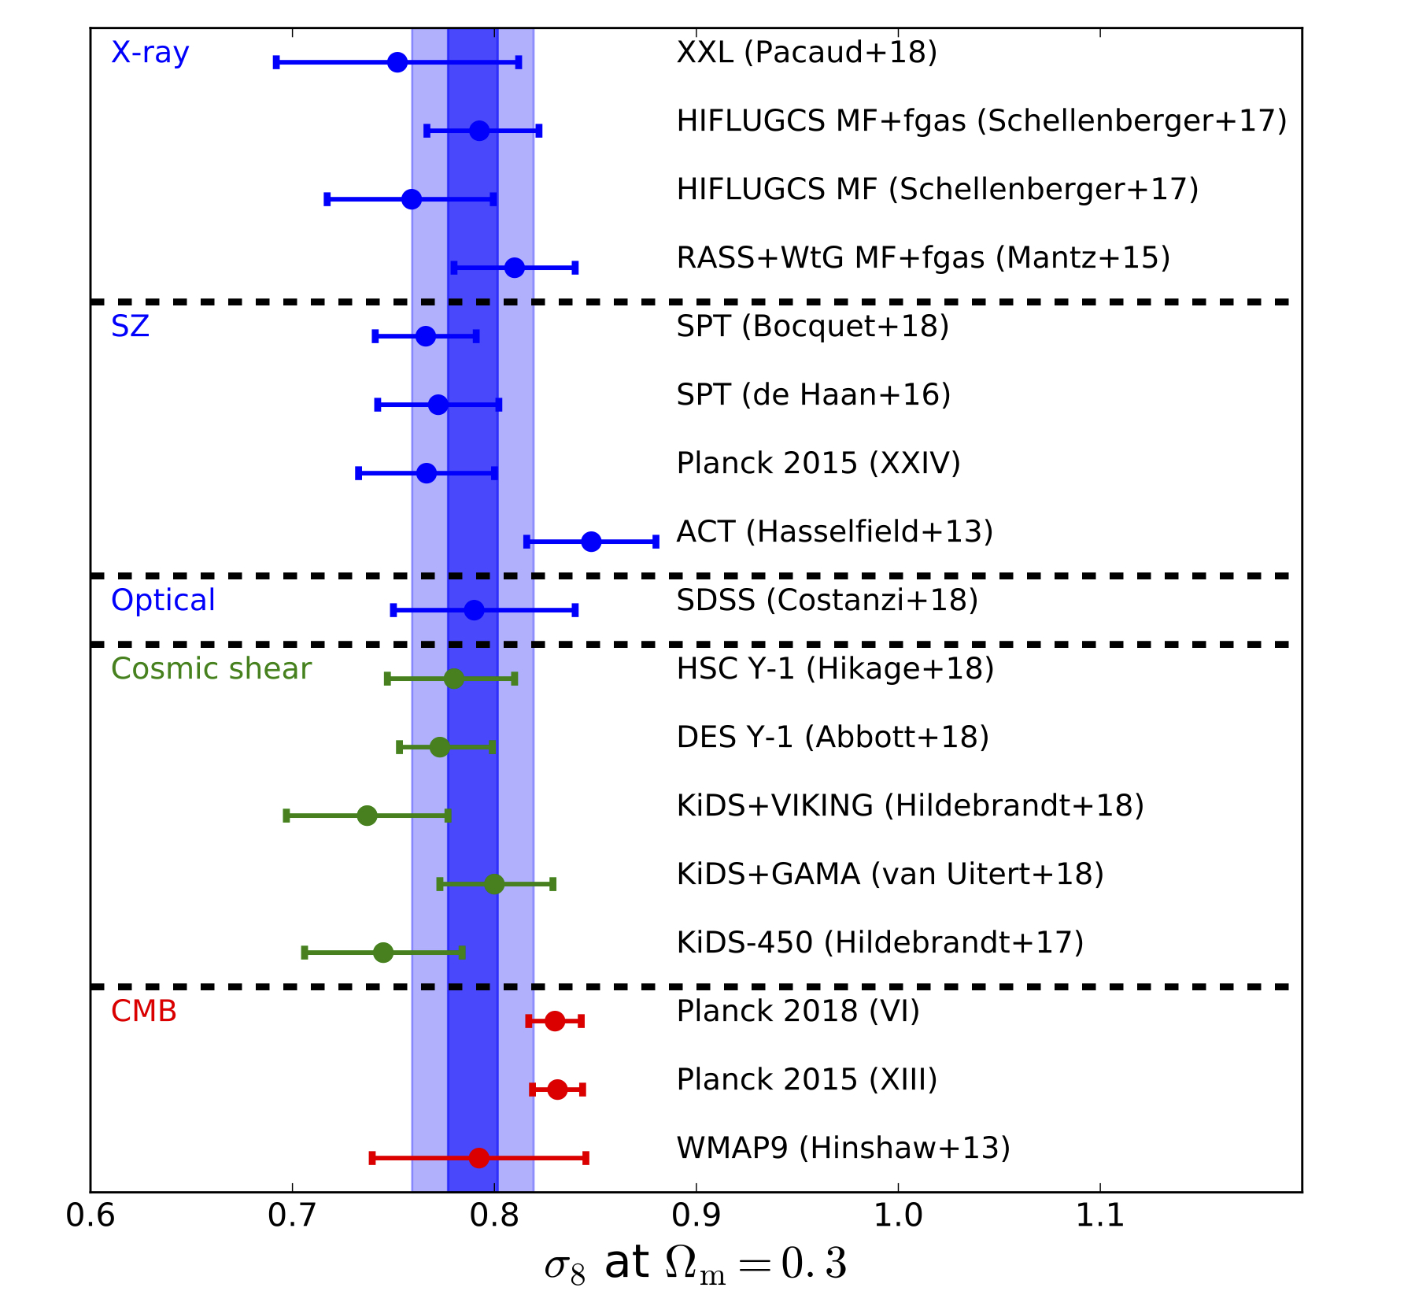
Galaxy cluster Cosmology & the « S8 tension »
Galaxy clusters are tracers of the matter density field over cosmic evolution
Cluster number counts:
Numerical density of clusters in bins of mass and redshift
Widely used cluster-based probe for cosmology
Sensitive to Ω_{m} and σ₈ (and extensions to the base 𝚲CDM model)
Pratt et al. ISSI review (2019)
Predicts lower σ₈ than the CMB cosmology
Mass needs to be related to an observable of clusters
The accuracy on the calibration of the mass-observable scaling relations is the main limitation
2

Slide 4

Observables of Galaxy clusters
Multi-wavelength objects
Detected using the clustering of galaxies (optical/NIR) or using observables of the hot gas (Intra-Cluster-Medium, 12%)
The X-ray emission
The Sunyaev-Zel’dovich thermal effect
Sunyaev&Zel’dovich+1970
XMM-Newton
Inverse Compton diffusion of CMB photons by electrons of the ICM
Spectral distorsion: independent of the redshift
Effet x1000
The Compton parameter:
Photometry
Bremsstrahlung of the electrons
143 GHz
217 GHz
353 GHz
The SZ observable:
Spectroscopy
Line emission of the metals
A2319 observed with Planck
3

Slide 5
Mass-Observable scaling relations & hydrostatic masses
Galaxy clusters are scale invariant (dominated by gravitational processes)
Mass-Observable scaling relations can be calibrated on a small representative cluster sample
A precise method: measuring the mass under the HydroStatic Equilibrium (HSE) hypothesis
For a spherical cluster:
X-ray M_HSE
The SZ/X-ray synergy
Photometry
Resolved SZ observation
Spectroscopy
The challenging X-ray spectroscopy is bypassed
SZ observations at a similar angular resolution to current X-ray observatories are needed
4

Slide 6
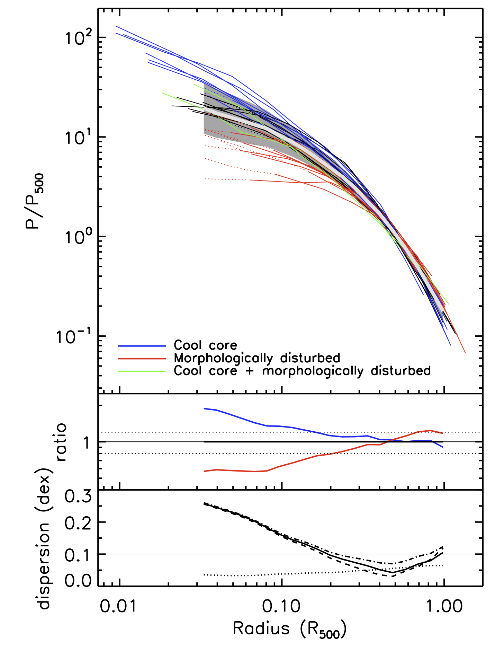
Mean pressure profile
Useful for cluster detection based on matched filters
Key tool to draw cosmological constraints from the y map
Pratt+2010
33 clusters at z<0.2
Widely-used universal pressure profile estimates are calibrated using nearby clusters observed in X-ray
Arnaud et al 2010 universal pressure profile calibrated using the REXCESS sample of 33 clusters at z<0.2 observed in X-ray
Pratt+2010, Arnaud+2010
Planck pressure profile calibrated using 62 clusters ≲ 0.3 observed in SZ and X-ray
Planck Collaboration (2013), A&A 550, A131
for distant clusters requires prohibitive high-quality spectroscopic data
depends on the dynamical state
Resolved SZ observation of high-redshift clusters can improve our knowledge of the mean pressure profile
5

Slide 7
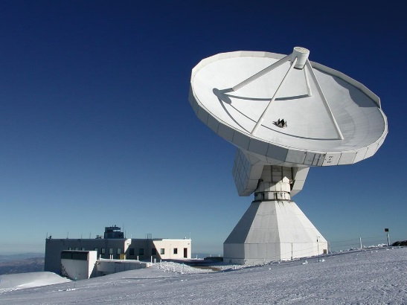
NIKA2
A millimetric continuum camera of 2 900 Kinetic Inductance Detectors (KID), operating at 150 and 260 GHz, in polarisation at 260 GHz and installed at the IRAM 30-meter telescope since 2017
Adam et al. (2018) A&A 609, A115 arXiv:1707.00908
NIKA2 collaboration
NIKA2 consortium + the Institut de Radio-Astronomie Millimétrique (IRAM)
150 members, about 30 institutes in a dozen countries
France: 12 labs @ INSU, IN2P3, CEA, INP
Structure
  Principal Investigator : Alessandro Monfardini
  Project Scientist : Juan Macias-Pérez
  Editorial Board : chair L. Perotto
  Core Team : 40 members
1300 hours of Guaranteed Time at the IRAM 30-m telescope distributed in 5 Large Programs
6

Slide 8
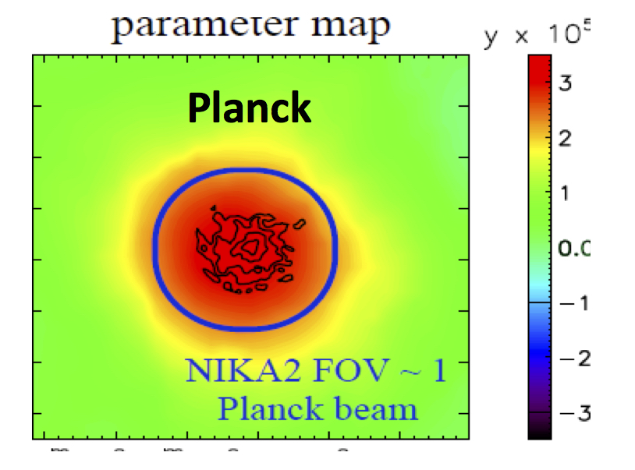
Performance well-suited for SZ resolved mapping
 | 150 GHz | 260 GHz
FOV diameter | 6.5‘ | 6.5’
Angular resolution: FWHM | 17.6’’ ± 0.1’’ | 11.1’’ ± 0.2’’
RMS calibration uncertainties | 3% | 6%
Mapping speed arcmin² /mJy² / hours | 1388 ± 174 | 111 ± 11
Two frequency bands to observe the SZ decrement and a slight positive signal
© F. Kéruzoré
Perotto et al. (2020) A&A 637, A71 arXiv:1910.02038
Resolved mapping of clusters from the core to the characteristic radius
Stability and high sensitivity
at 150 GHz to map clusters including low-mass ones
at 260 GHz to detect and remove point sources
7

Slide 9
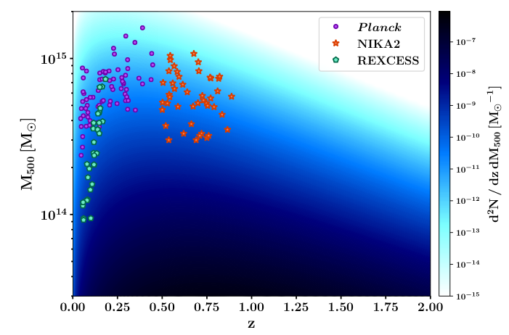
The Sunyaev-Zeldovich Large Programme
Florian Ruppin
High angular resolution thermal SZ mapping of a representative sample of galaxy clusters for Cosmology
300 hours of Guaranteed Time at the IRAM 30-m telescope
45 sources at 0.5 < z < 0.9
Follow-up of Planck and ACT (Atacama Cosmology Telescope)
Representative: selected in mass and redshift in the Planck and ACT catalogues
X-ray observation available (XMM-Newton and Chandra)
Main goals
Average thermodynamical properties of the Intra-cluster medium
Relation between the tSZ observable and the mass
Probe the low-mass and high-redshift clusters
Provide the community with tools to improve the Cosmology with galaxy clusters
8

Slide 10
The LP-SZ Dataset & Team
Dataset for each cluster
PSZ2 G144@ Planck NIKA2 XMM-Newton
Ruppin+2018
Deep integration-time spectroscopy
The LP-SZ team
30 members in 13 instituts
specialists of all key domains for Galaxy clusters studies
  Observation in SZ, X-rays, Optical, radio
  Simulation
9

Slide 11
Status of the LP-SZ observations
The LPSZ is 85% completed : about 50 hours left out of 300 & 33 observed clusters out of 45
High M
Observation complete in 2023
High SNR map for most of the observed clusters
Diversity
PRELIMINARY
Individual studies give enthusiasming results
Low M
z = 0.5
z = 0.9
10

Slide 12
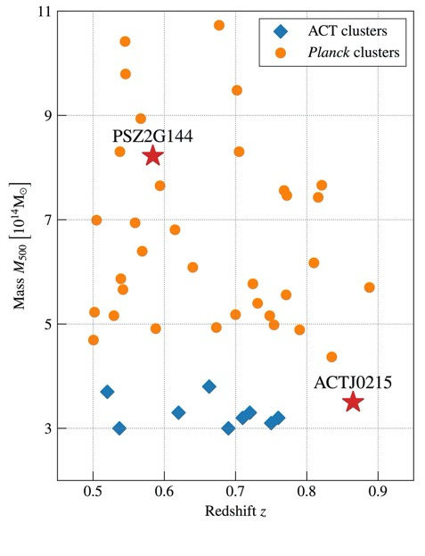
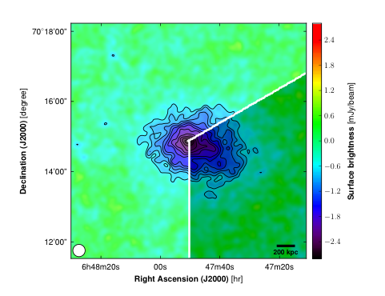
NIKA2 LP-SZ first results
The challenging
The demonstrator
  PSZ2-G0144.83+25.11
  ACT-Cl J0215
Science verification, April 2017
Observed in January 2018
Ruppin et al. (2018) A&A 615 A112
Kéruzoré et al. (2020) A&A 644 A93
New method to jointly constrain the point source contamination and the SZ signal
SZ/X-ray hydrostatic mass
Precision improvement wrt
  ACT
  XMM-Newton measurements
Evidence of an overpressure region
Accurate M_HSE when the overpressure is masked out
Illustration of the resolved SZ mapping capabilities
Hasselfield+2013
Bartalucci+2018
11

Slide 13

NIKA2 insight on the hydrostatic mass bias
Muñoz-Echeverría et al. (2023) accepted in A&A [arXiv:2209.07460]
Enclose the deviation from the hydrostatic equilibrium
The b-value to reconcile Planck CMB & SZ cosmology is smaller than predicted by hydrodynamical simulations
Test case: CL J1226.9+3332 (aka PSZ2-G160.83+81.66)
The most distant cluster of the LPSZ, z = 0.89
CLASH Zitrin+2015, APJ, 801:44
NIKA2 150GHz
SZ/X-rays
X-rays only
convergence map
Fit of a M_{lens} ( < r ) profile
M_{lens}
NIKA2+XMM-Newton M_{HSE}
Ferragamo et al. (2022)
(1-b_{HSE/lens}) ~ 0.9 ± 0.2
new perspectives to the measure of the hydrostatic mass bias
12

Slide 14
Towards the first LPSZ cosmological tools release
C. Hanser @ CMB-France Nov. 2022
https://indico.in2p3.fr/event/28120
Main goals of the LPSZ: new measurements of the M_{HSE} - Y_{SZ} scaling relation and the mean pressure profile
Selection of a sub-sample
Data quality criteria
Extreme systems are excluded
≥ 3 clusters per mass bin => 20 clusters
High M
PRELIMINARY
Standard analysis
Calibration, noise decorrelation and mapmaking
  Perotto et al. (2020) A&A 637, A71
Point source fluxes as nuisance parameters
  Kéruzoré et al. (2020) A&A 644 A93
Low M
z = 0.5
13

Slide 15
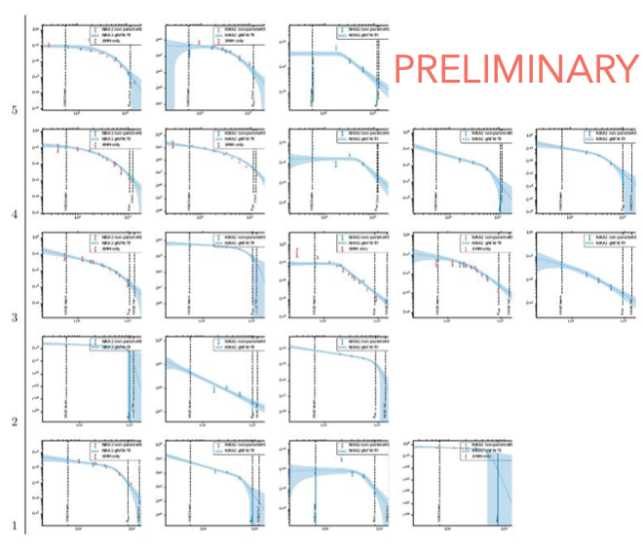
Towards the first LPSZ cosmological tools release
C. Hanser @ CMB-France Nov. 2022
https://indico.in2p3.fr/event/28120
On-going analysis using a sub-sample of 20 clusters
Forward modeling to deproject a pressure profile
Using PANCO2
Public release in Kéruzoré et al. (2023) Arxiv:2212.01439
Two different models of the pressure profile
gNFW (Nagai+2007) widely-used in litterature
« More flexible » radially binned profile = power laws in spherical shells
Perspectives:
First LPSZ mean pressure profile [C. Hanser PhD thesis]
and Y-M scaling relation [A. Moyer PhD thesis]
14

Slide 16
Summary
The NIKA2 LP-SZ [PI Mayet&Perotto] a 300-hour guaranteed-time program for the resolved SZ imaging of a representative (SZ-selected) sample of 45 clusters at 0.5 < z < 0.9
Status: 33 out of 45 clusters observed with the expected sensitivity → LPSZ observation will be complete in 2023
First single-cluster analyses open new perspectives
[Artis+2023] Physics of extreme clusters to give feedback to hydrodynamical simulations
[Muñoz-Echeverría+2023] new insight on the hydrostatic mass bias at high-z using SZ/X-ray synergy and lensing
On-going first analysis on a sub-sample of 20 clusters to produce the LPSZ v1 cosmological tools
At the end of the program, we will deliver
Maps, pressure profiles, integrated quantities (Y₅₀₀, M₅₀₀, …) for each cluster
Mean pressure profile
Y-M scaling relation
Improving the accuracy of cluster-based cosmology
15

Slide 17

International conference: « Observing the Universe at millimeter wavelengths »
26-30 June 2023 | LPSC Grenoble
https://lpsc-indico.in2p3.fr/event/2859/abstracts/
Web site & registration

Slide 18
LP-SZ extreme systems
Artis et al. (2022) EPJ WoC, 257, id.3
Artis et al. (2023) in prep.
The major merger PSZ2 G091.83+26.11
A massive cluster at z = 0.822
XMM-Newton
NIKA2 150GHz
PRELIMINARY
Integrated square density
∝ integrated pressure
Bartalucci et al. (2018), A&A, 617, A64
Bourdin & Mazzotta (2008) A&A, 479, A2
Inaccessible with X-ray data only
Equatorial over-heated region consistent with a major merger
The SZ/X-ray temperature map:
Valuable feedback to the hydrodynamical simulation
Adam et al. (2017), A&A, 606, A64
11

Slide 19
The hydrostatic lensing mass bias
Muñoz-Echeverría et al. (2023) accepted in A&A [arXiv:2209.07460]
M_{HSE} using X-ray data only (spectroscopy)
Two different models of the pressure profile
used to calculate M_{HSE} (< r )
Robustness tests against instrumental systematic effects:
large scale filtering
Low-frequency noise residuals
Robust measure of b_{HSE/lens} for the highest-z cluster of the LPSZ : (1-b_{HSE/lens}) ~ 0.9 ± 0.2
Different value using X-ray only
The LPSZ sample combined with lensing data offers new perspectives to the measure of the hydrostatic mass bias
Muñoz-Echeverría et al. (2022) EPJ Web. Conf. 257, 33
13

Slide 20
Mean pressure profile
Useful for cluster detection based on matched filters
Key tool to draw cosmological constraints from the y map
Planck Collaboration (2013), A&A 550, A131
Widely-used universal pressure profile estimates are calibrated using nearby clusters observed in X-ray
Arnaud et al 2010 universal pressure profile calibrated using the REXCESS sample of 33 clusters at z<0.2 observed in X-ray
Pratt+2010, Arnaud+2010
Planck pressure profile calibrated using 62 clusters ≲ 0.3 observed in SZ and X-ray
Planck Collaboration (2013), A&A 550, A131
for distant clusters requires prohibitive high-quality spectroscopic data
depends on the dynamical state
Resolved observation of high-redshift clusters can improve our knowledge of the mean pressure profile
5

