Slide 1
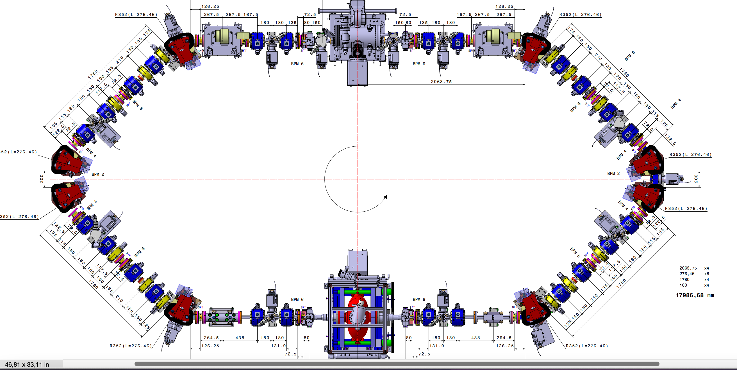
MML
[1 4]
[1 3]
[1 2]
[1 1]
QP2
-QP1
-QP1
QP2
[1 1]
[2 6]
HCOR
HCOR
[1 2]
[2 5]
HCOR
HCOR
[1 3]
-QP31
-QP31
[2 4]
HCOR
[1 5]
BPM 1
BPM 12
[2 12]
HCOR
QP41
[1 1]
QP41
[1 6]
[1 12]
QP4
BPM 2
BPM 11
QP4
[1 7]
[1 11]
-QP3
[1 2]
RI-C1
-QP3
[1 8]
BPM 3
BPM 10
BPM 4
RI-C2
BPM 9
-QP3
-QP3
QP4
BPM 5
BPM 8
QP4
QP41
BPM 6
BPM 7
QP41
HCOR
[1 12]
-QP31
HCOR
[1 4]
-QP31
[2 1]
[2 2]
[2 3]
[2 4]
[2 3]
HCOR
QP2
-QP1
-QP1
QP2
HCOR
[1 5]
[2 2]
HCOR
HCOR
[2 1]
[1 6]

Slide 2
Tango
QP.04
QP.03
QP.02
QP.01
STR.01-H.01
STR.01-V.01
STR.06-H.01
STR.06-V.01
STR.02-H.01
STR.02-V.01
STR.05-H.01
STR.05-V.01
STR.03-H.01
STR.03-V.01
QP.05
QP.12
BPM.02-LIB.03
BPM.01-LIB.03
STR.04-H.01
STR.04-V.01
QP.06
QP.11
QP.07
BPM.03-LIB.03
BPM.06-LIB.05
QP.10
QP.08
RI-C1
QP.09
BPM.04-LIB.03
BPM.05-LIB.05
BPM.05-LIB.04
RI-C2
BPM.04-LIB.05
QP.09
QP.08
QP.10
BPM.06-LIB.04
BPM.03-LIB.05
QP.07
STR.04-H.01
STR.04-V.01
QP.11
BPM.01-LIB.04
BPM.02-LIB.04
QP.06
STR.03-H.01
STR.03-V.01
STR.05-H.01
STR.05-V.01
QP.12
QP.05
QP.01
QP.02
QP.03
QP.04
STR.02-H.01
STR.02-V.01
STR.06-H.01
STR.06-V.01
STR.01-H.01
STR.01-V.01

Slide 3
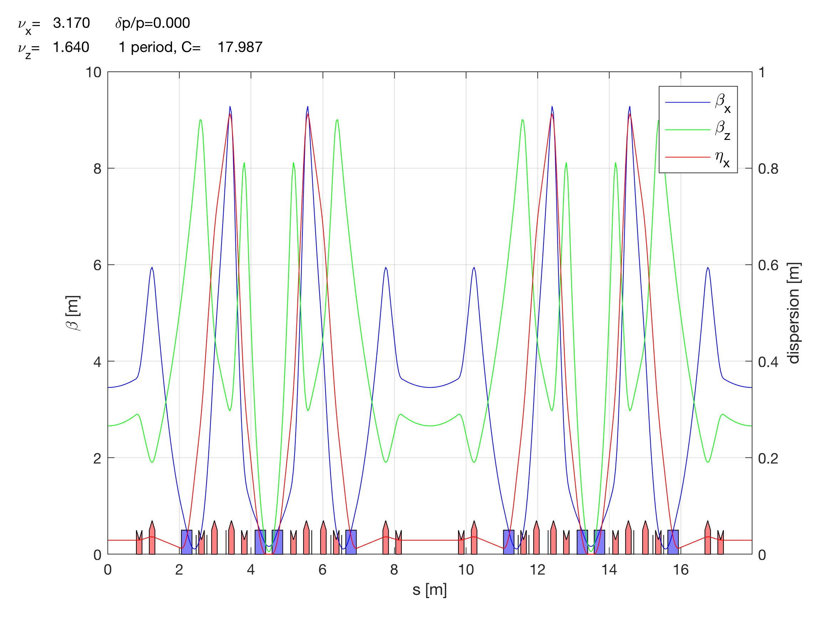

Slide 4
19 September 2022
16-21h
Fist time full turn obtained

Slide 5
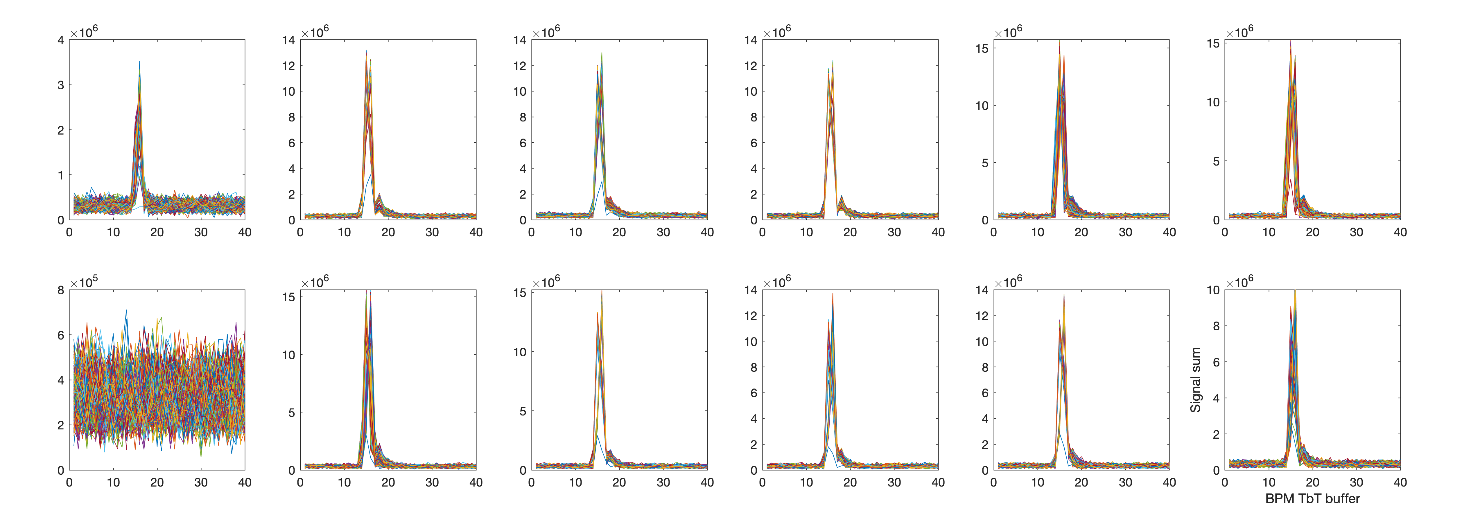
BPM signal sum
(the 1st BPM after injection)
BPM OFF

Slide 6
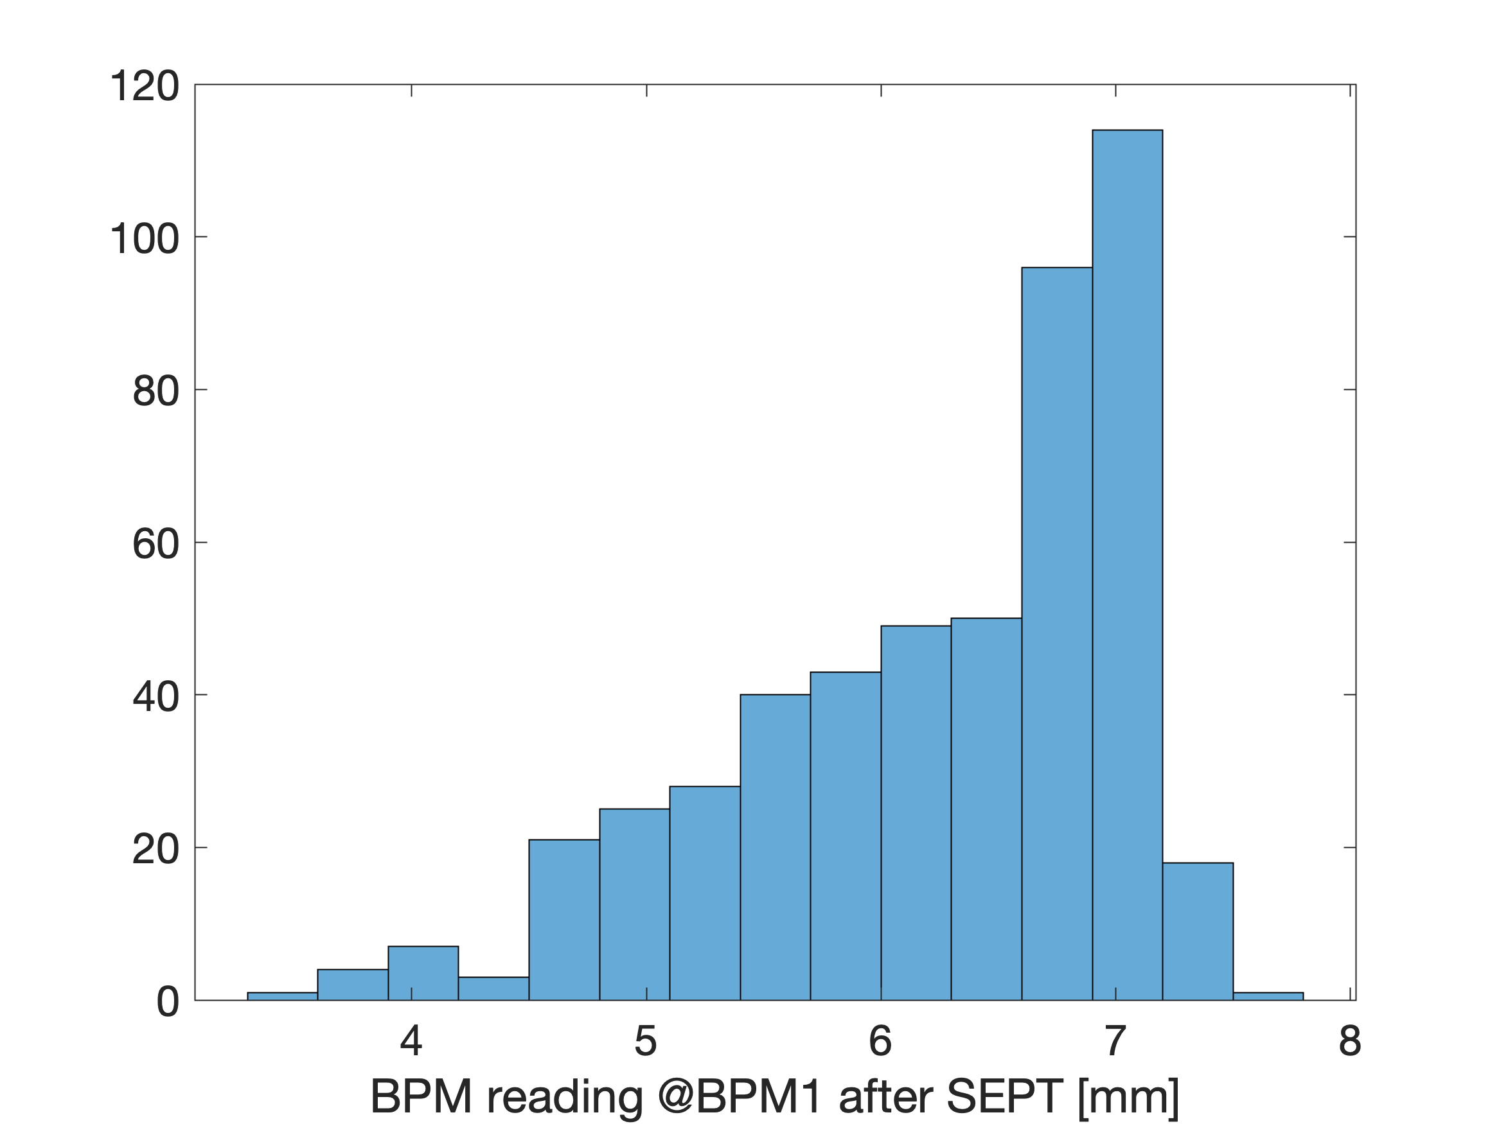
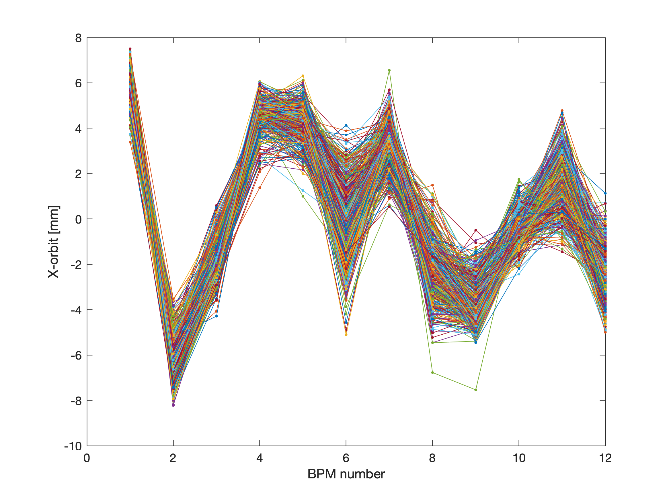
x orbit for 500 injections

Slide 7
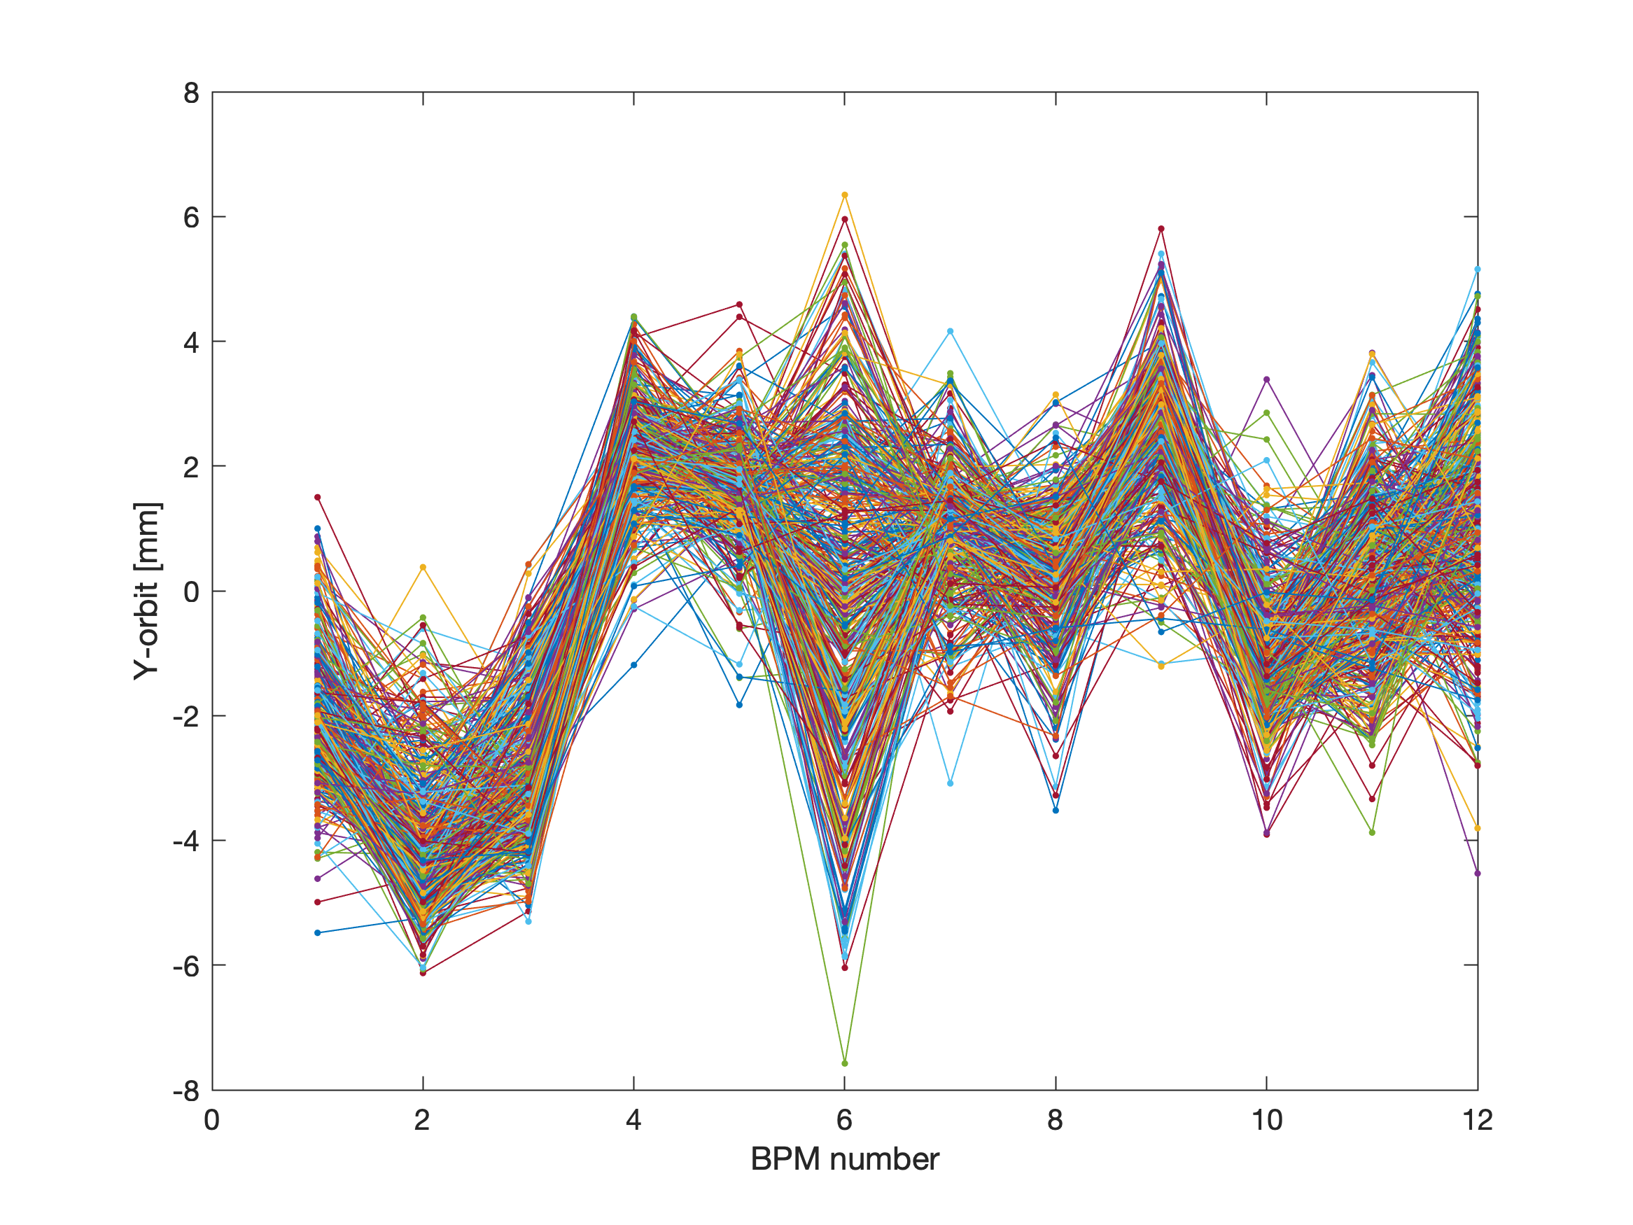
y orbit for 500 injections

Slide 8
21 September 2022
16-18h
Beam from injector was very unstable, energy jitter?
QUAD power supply replaced

Slide 9
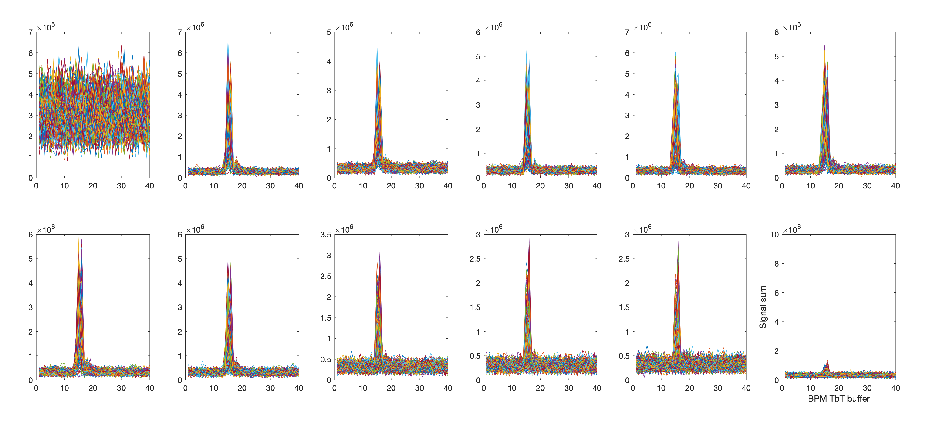
BPM signal sum
(the 1st BPM after injection)

Slide 10
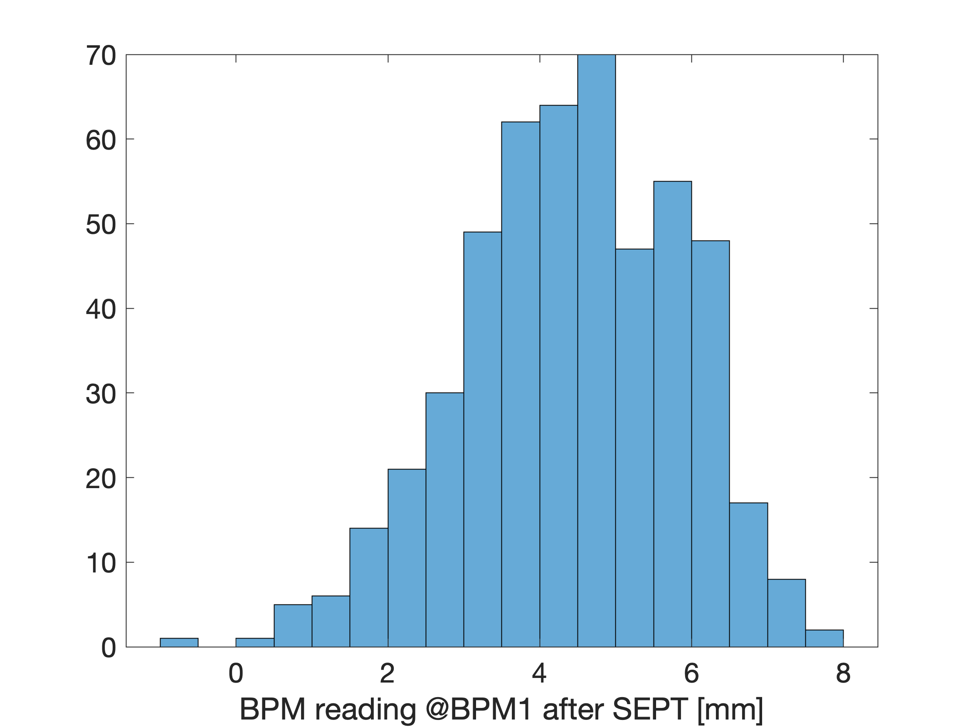
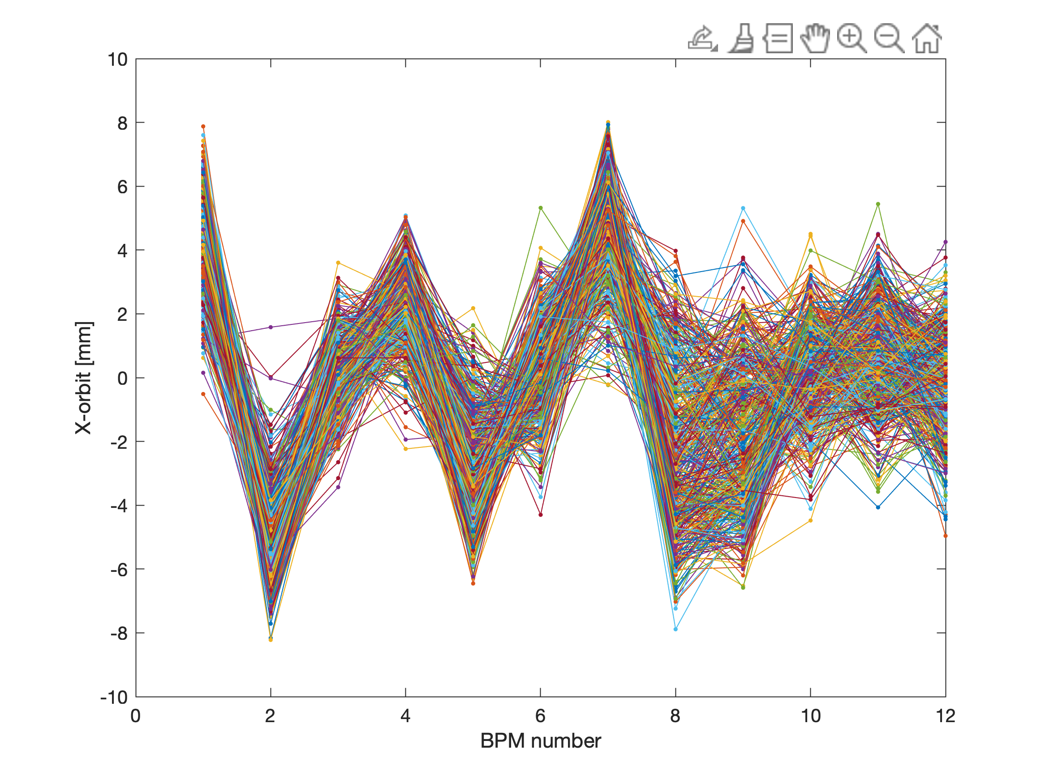
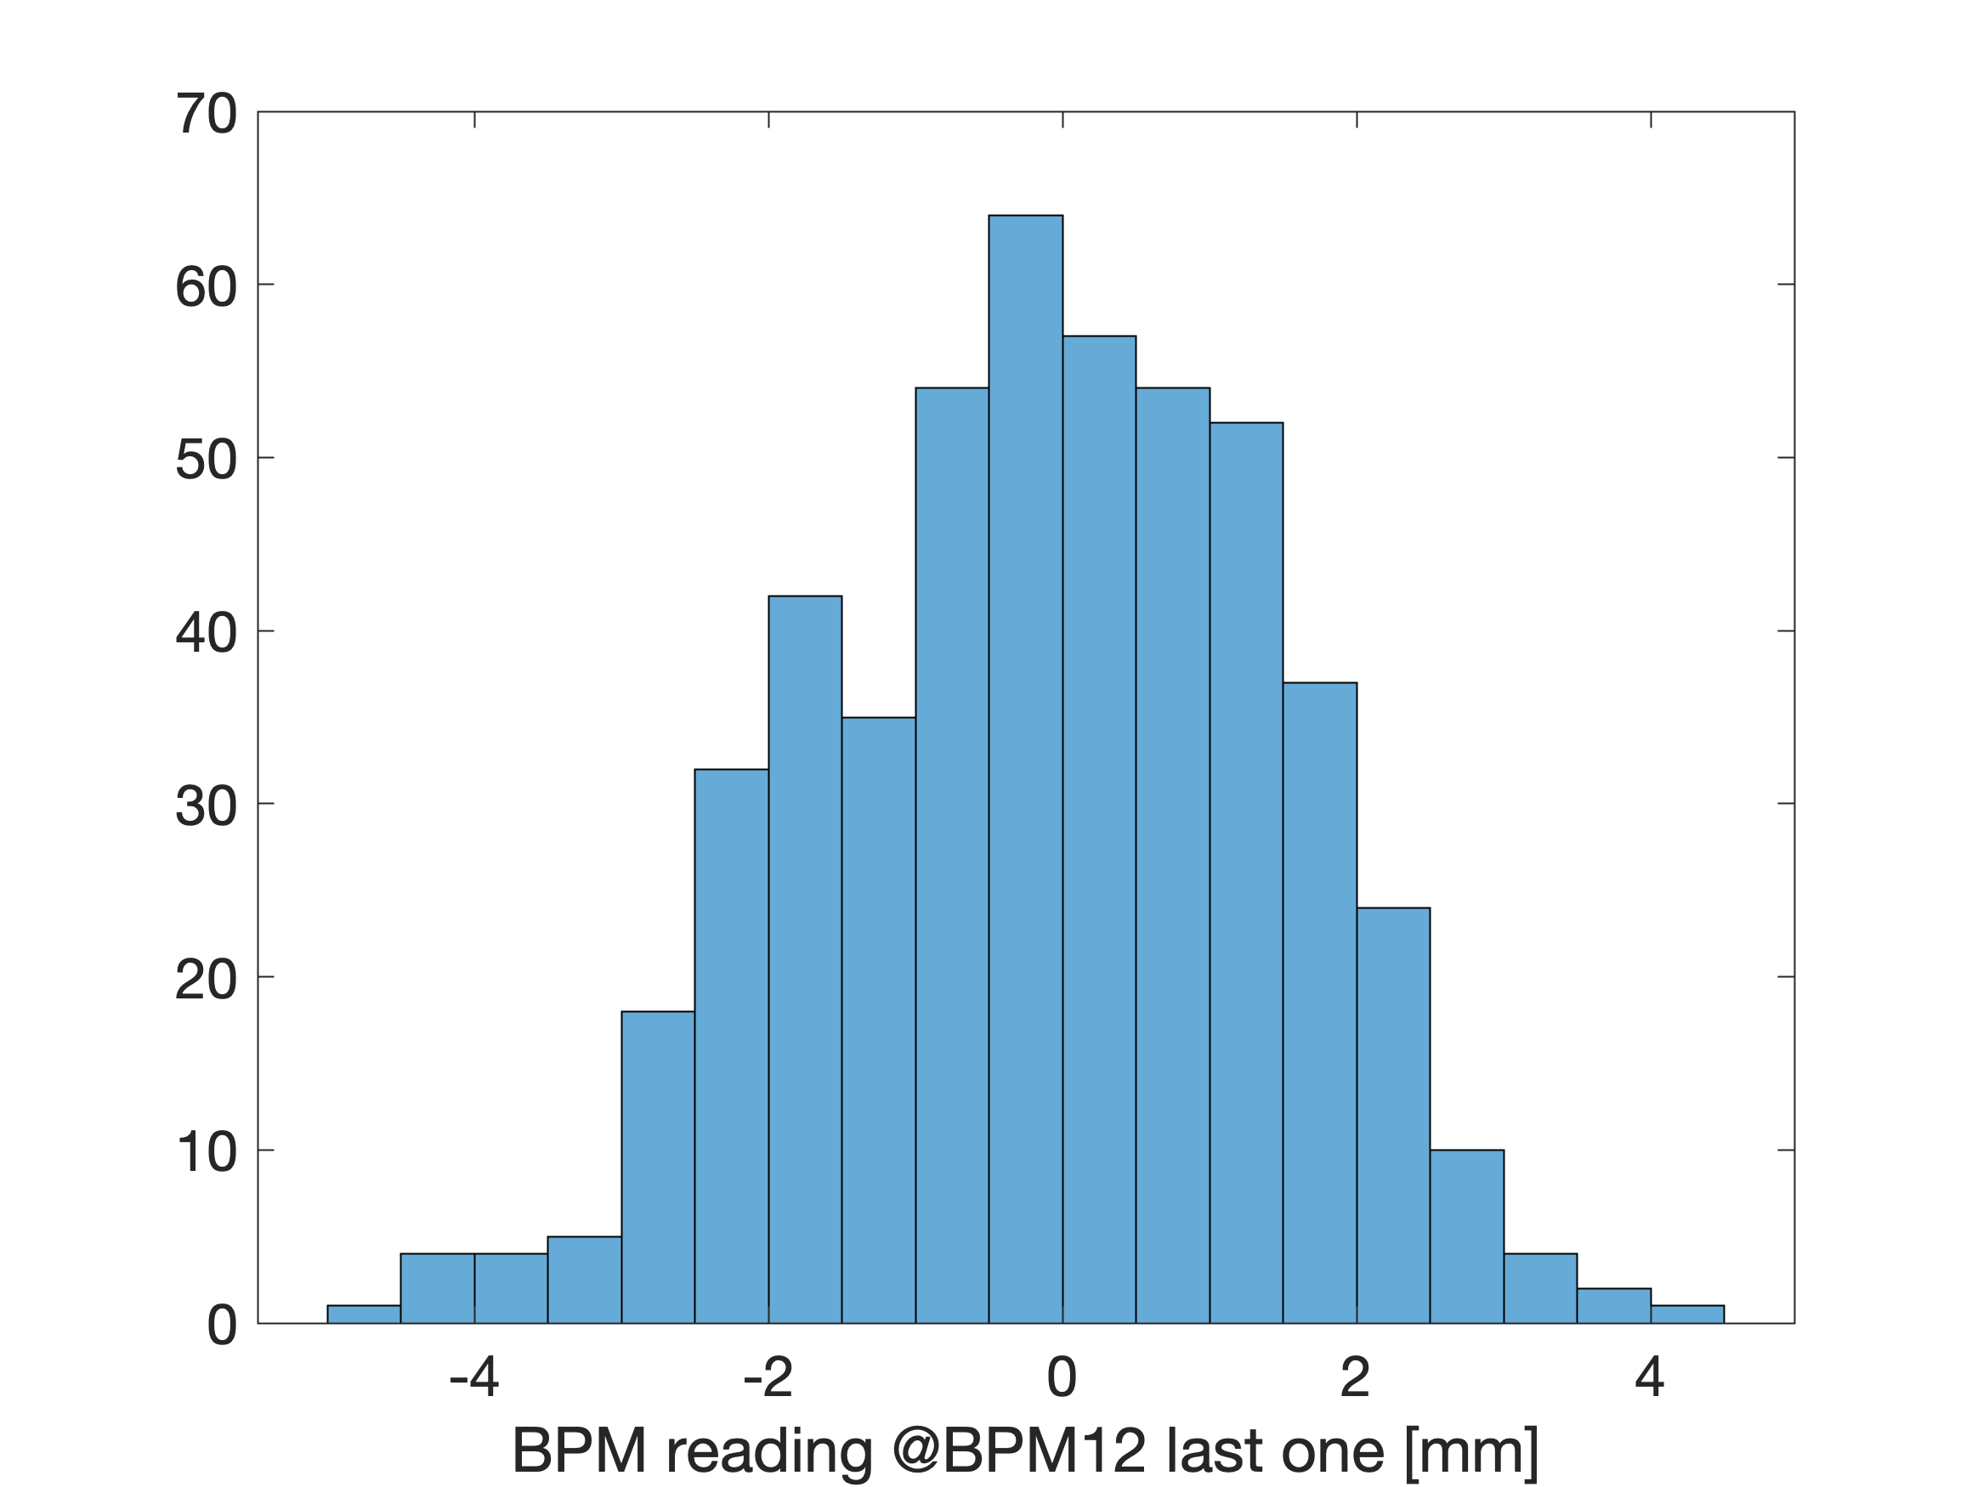
x orbit for 500 injections

Slide 11
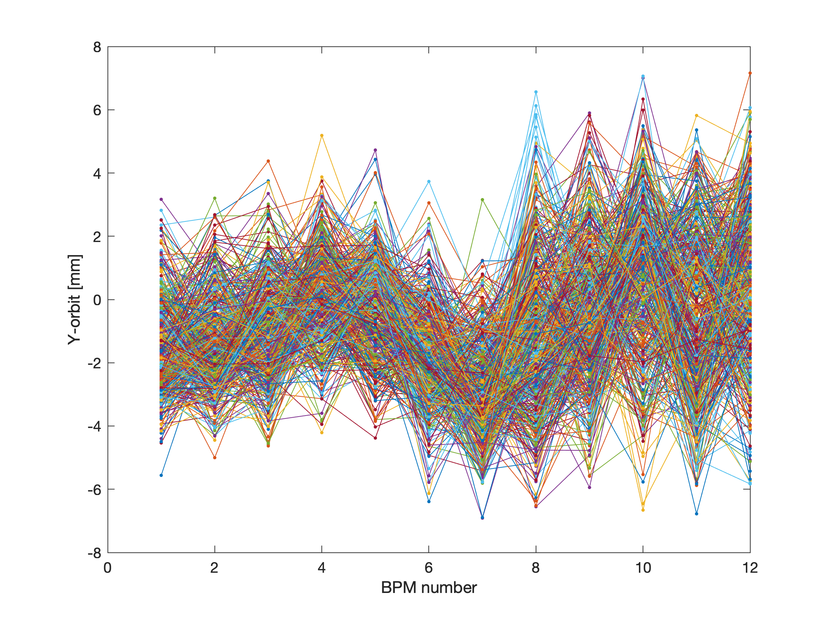
y orbit for 500 injections

Slide 12
23 September 2022
16-22h
QUAD power supply replaced
Beam from injector was very unstable, energy jitter?
At the end of the day we found more stable conditions
Signal at two last BPM drops significantly (by 3-4 times) => no evidence of second turn with the BPMs
We have done SVD trajectory corrections => up to now, no significant improvements in terms of 2nd turn
The scintillator installed near the septum at some conditions showed the signal spaced by 60 ns. Probably the
lost particles at the end of the 1st turn?

Slide 13
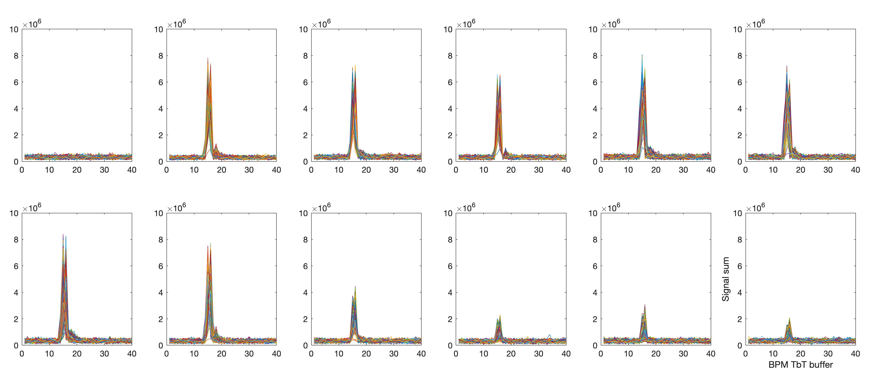
BPM signal sum
(the 1st BPM after injection)

Slide 14
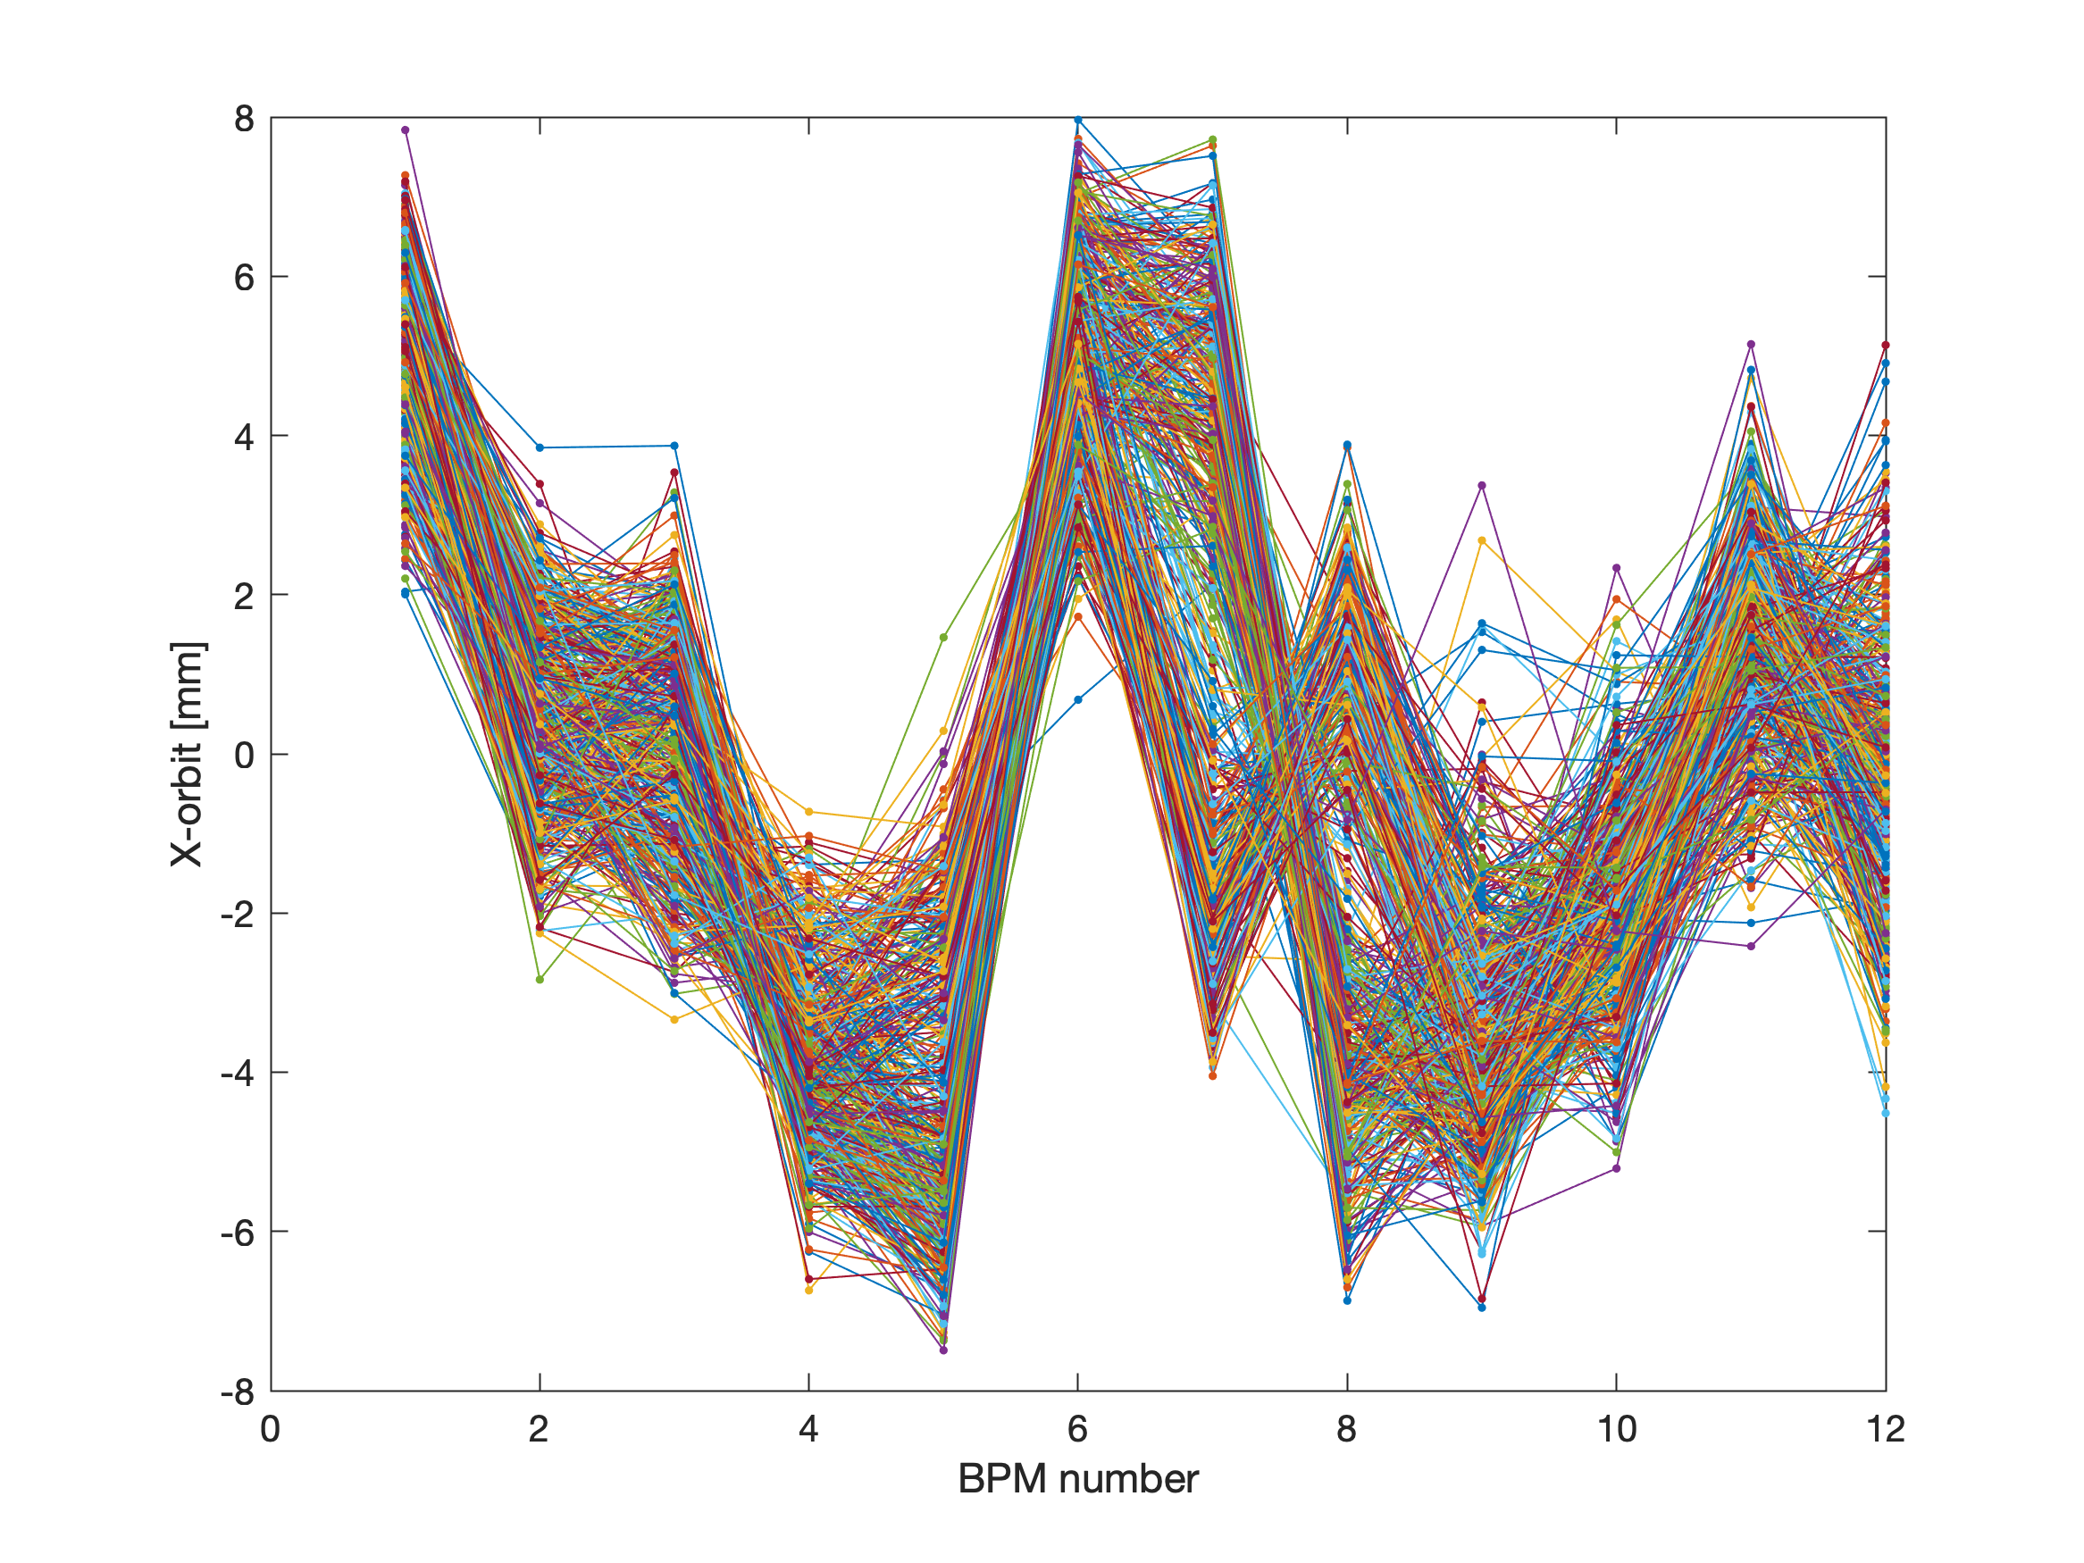
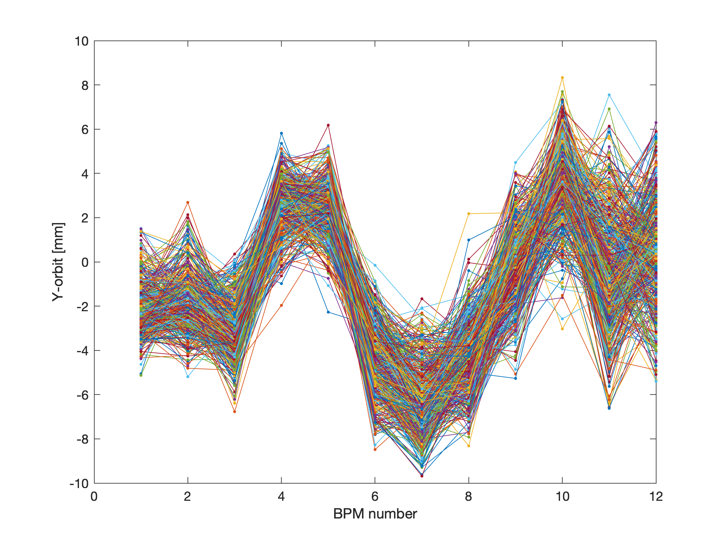
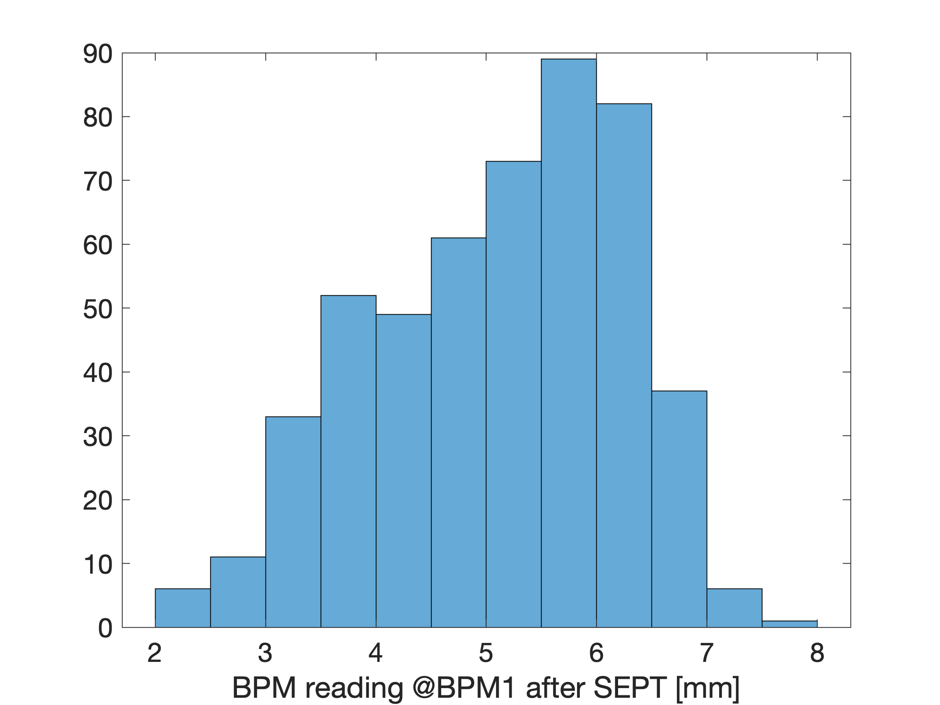
x/y orbit for 500 injections
(the 1st BPM after injection)

Slide 15
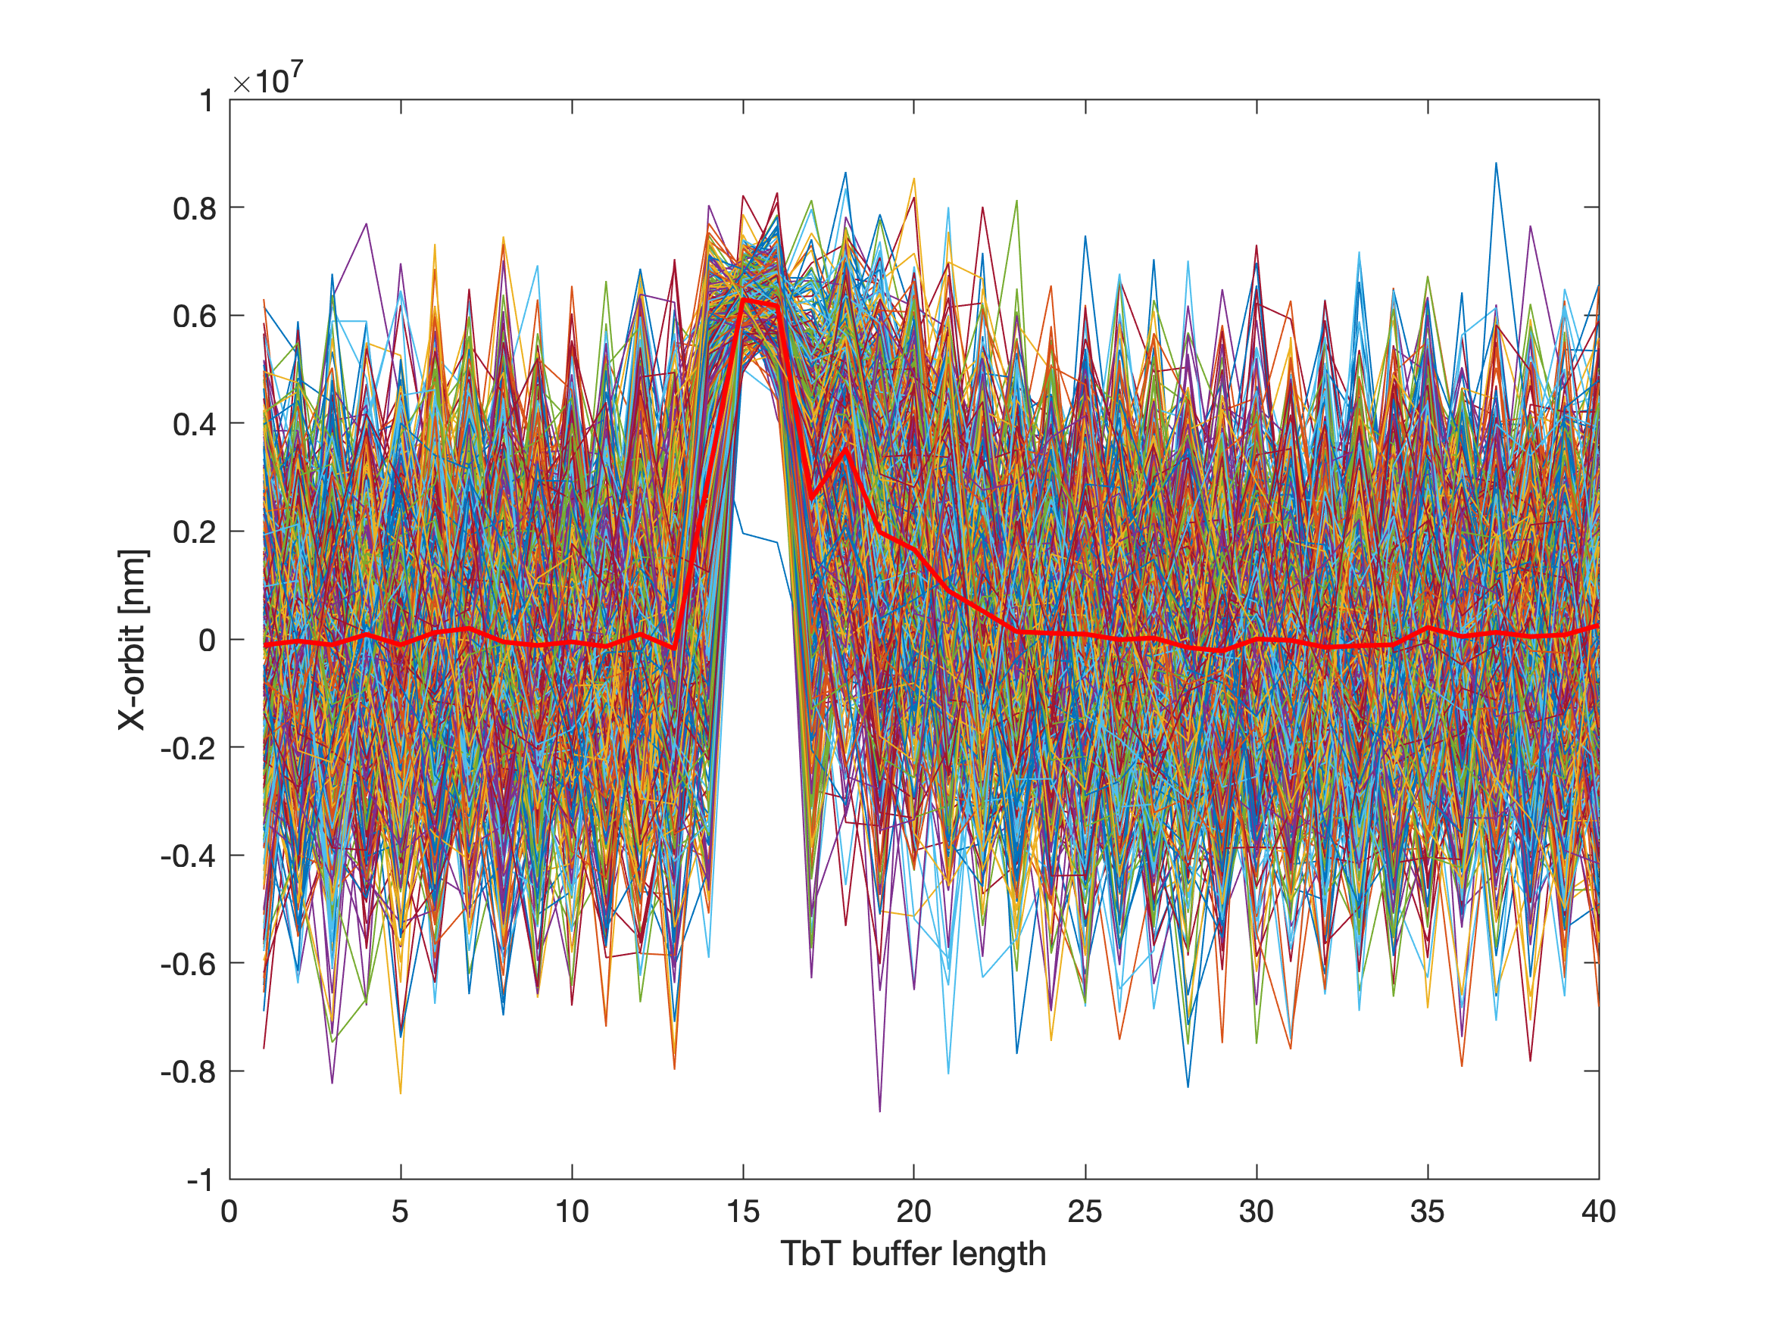
x orbit buffer (TbtLength = 40)

Slide 16
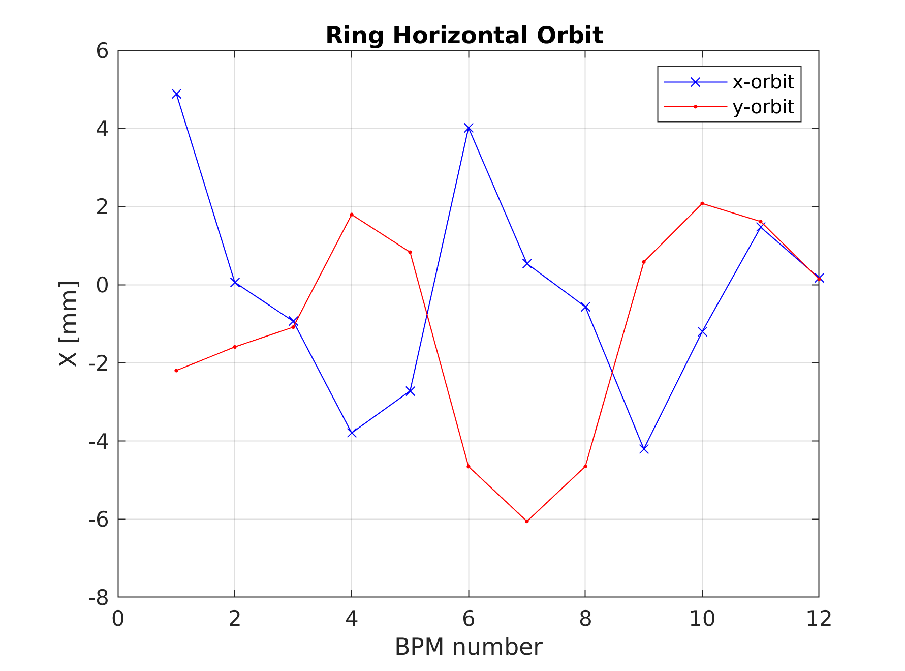
x/y orbit at the end of the shift
(the 1st BPM after injection)
No signal @BPM12

Slide 17
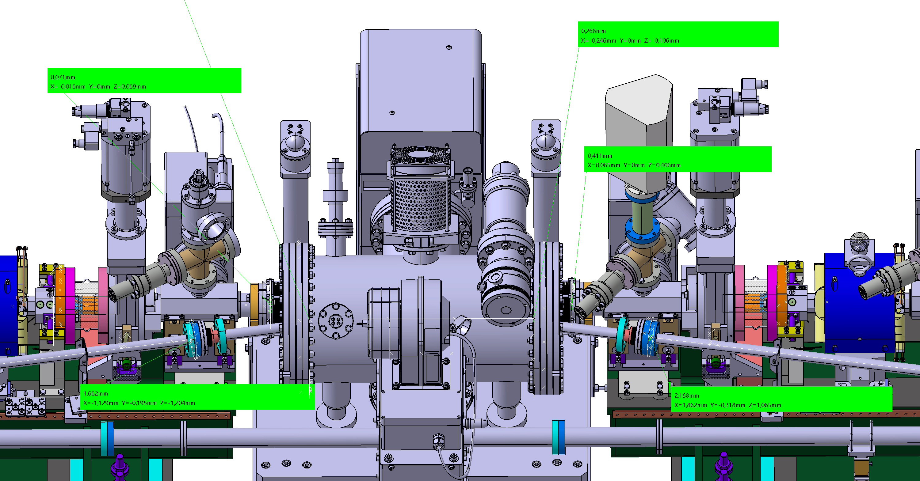
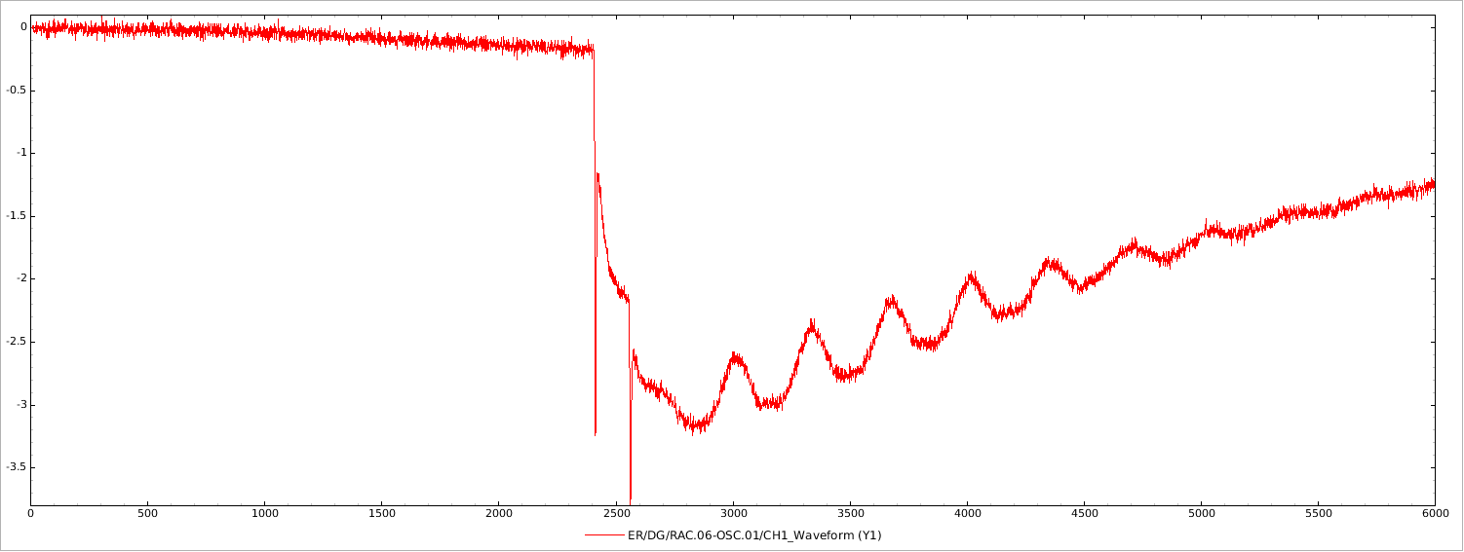
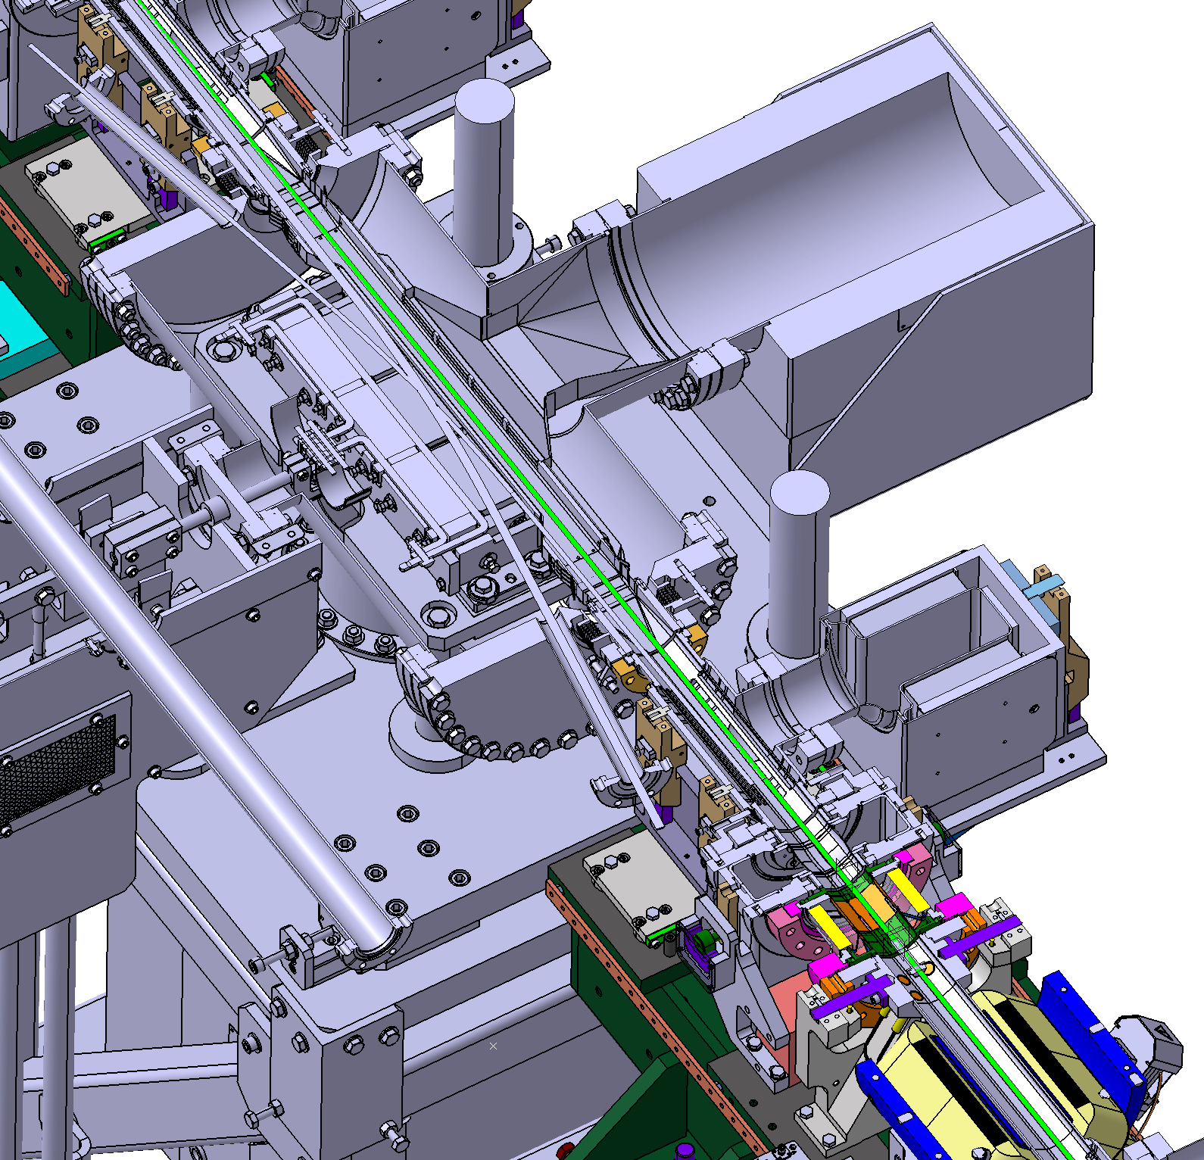
Signal from scintillator detector near SEPTUM
Scintillator + PMT
60 ns = 2nd turn ?

Slide 18
30 September 2022
11-21h
We found the same configuration as it was at previous shifts. Attempts to correct the trajectory and improve
the transport efficiency.
It seemed that there is a problem with QUADs in the end of the turn. At the end we found that with QUAD #09 #10 #12 OFF
We can do the full 2 turns. To be investigated. Today (03/10/2022 we confirmed that the QUAD #10 family QP4 was with
wrong polarity). This was corrected today (03/10/2022).
With the scintillator and FBLM signal we also saw the evidence of the 2 full turns.
We took the data in diffirent configurations (QUAD OFF, with/wo COR…)

Slide 19
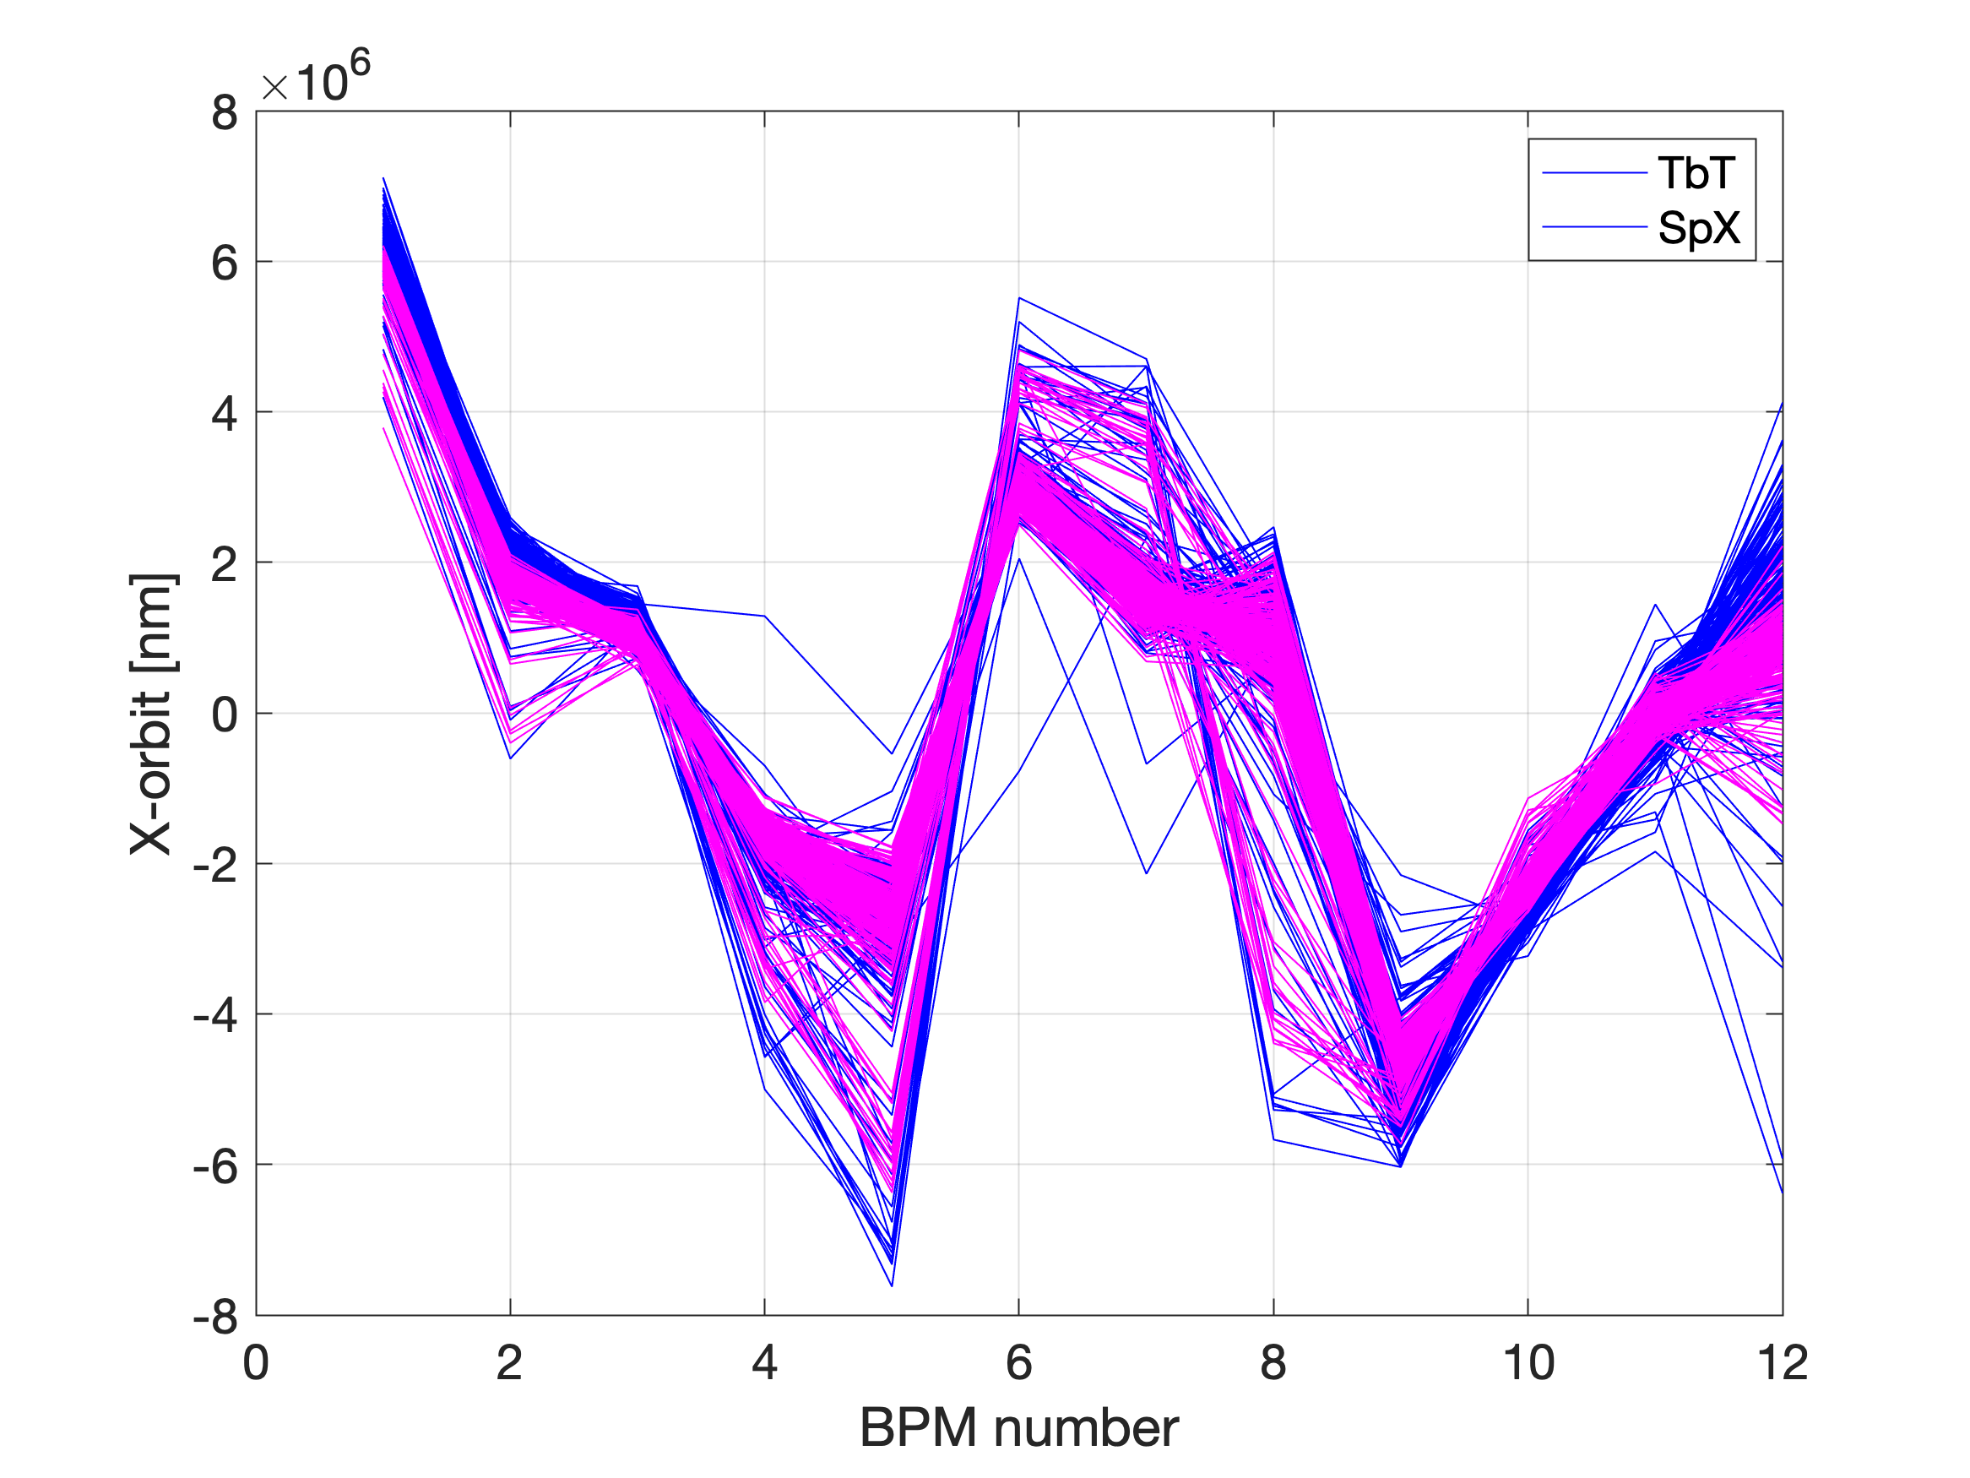
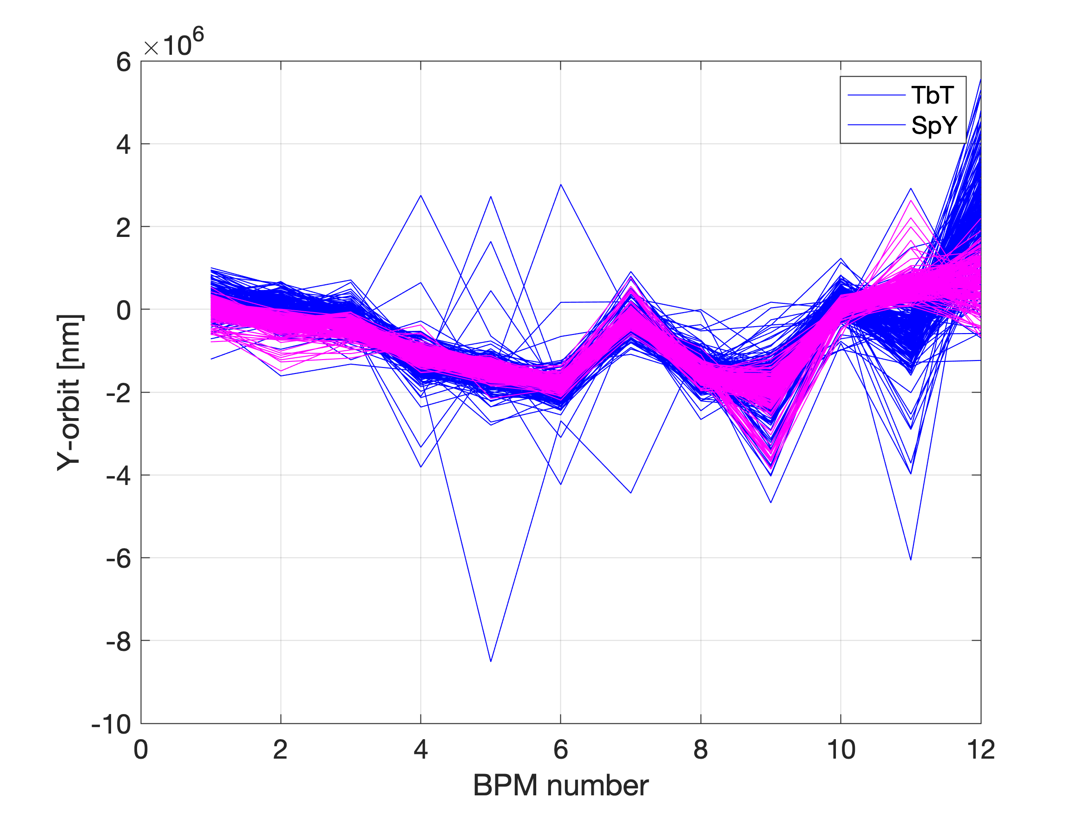
Comparison SpX vs. TbT
Typical configuration (all QUAD ON with HCOR/VCOR ON)
Magenta: SpX

Slide 20
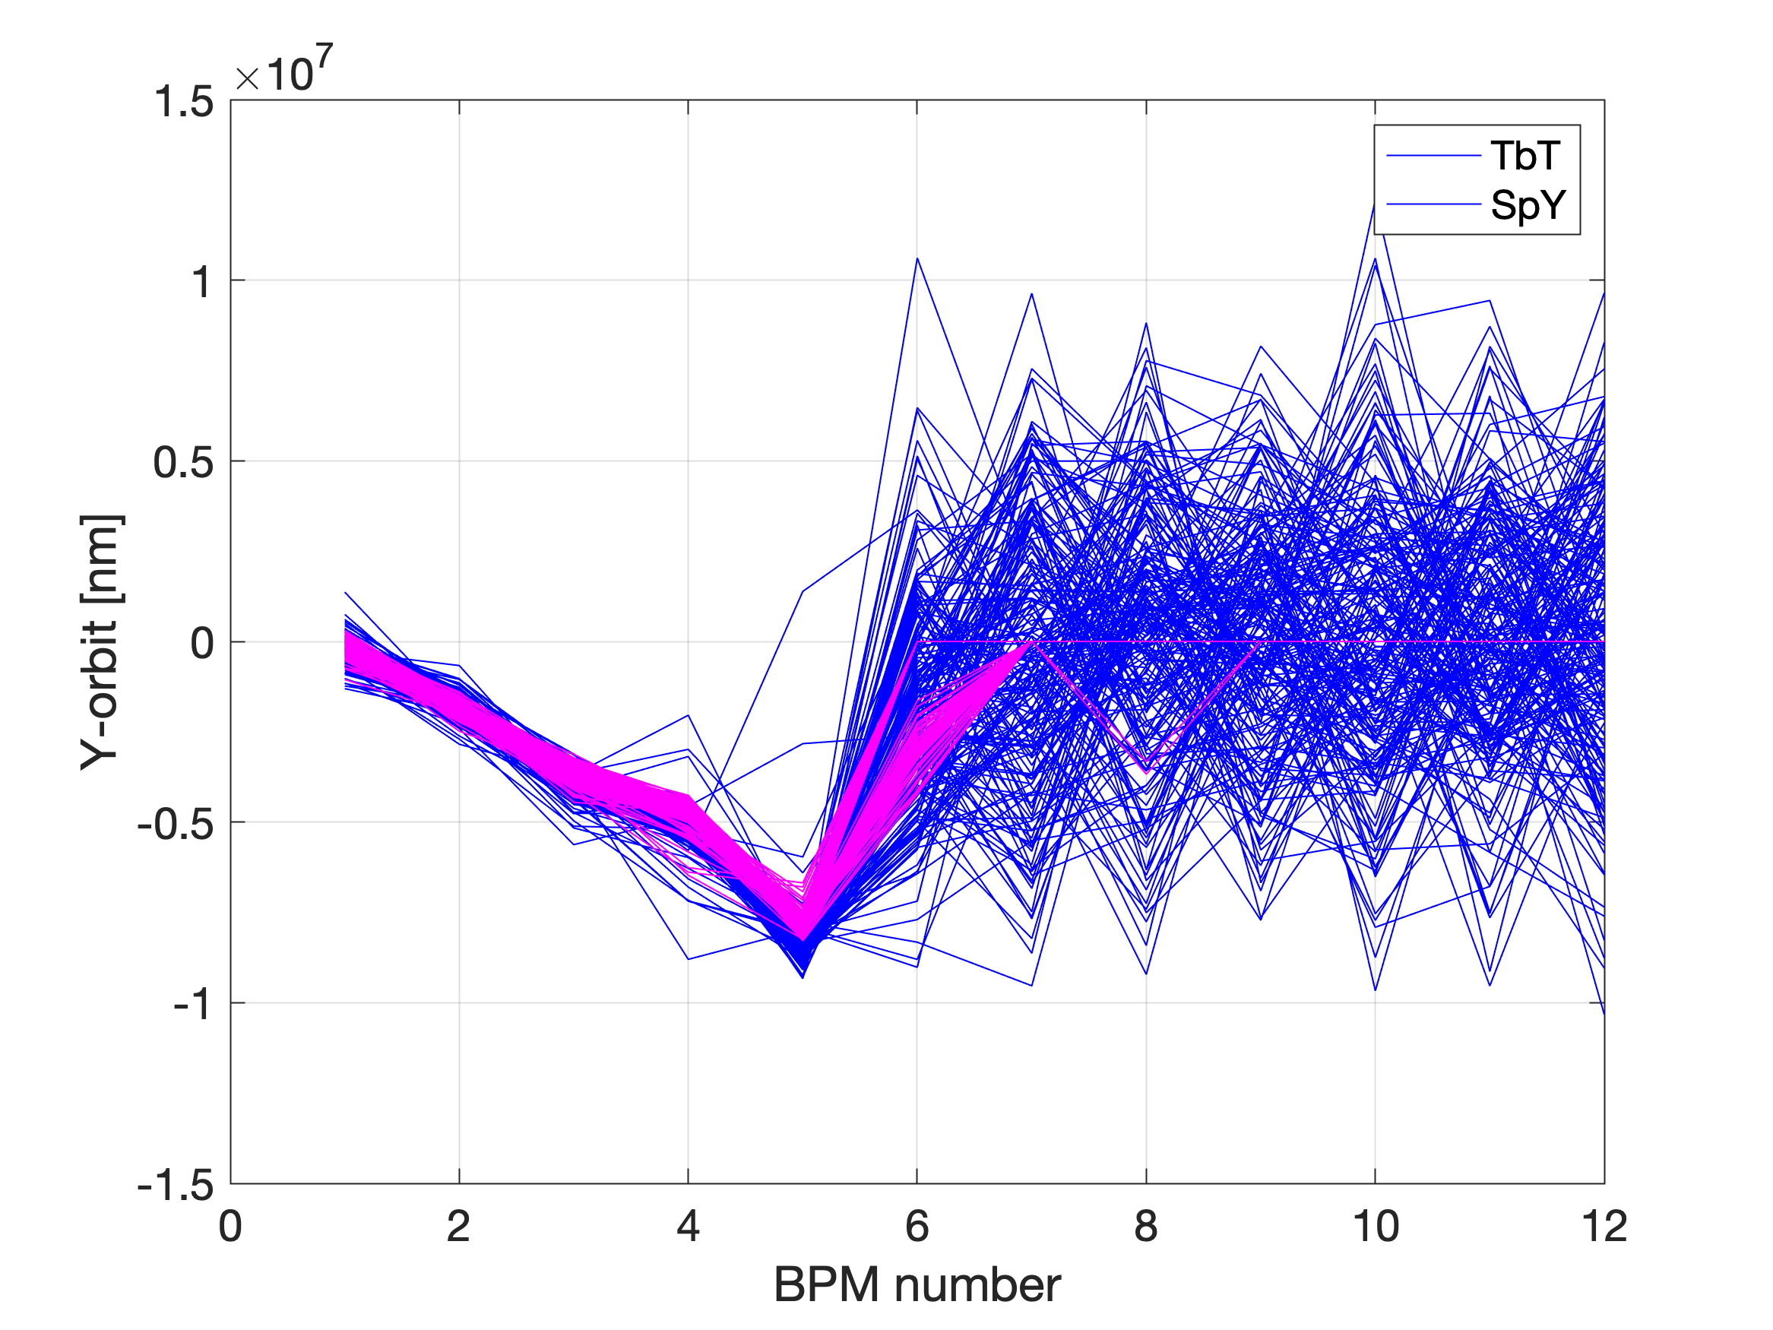
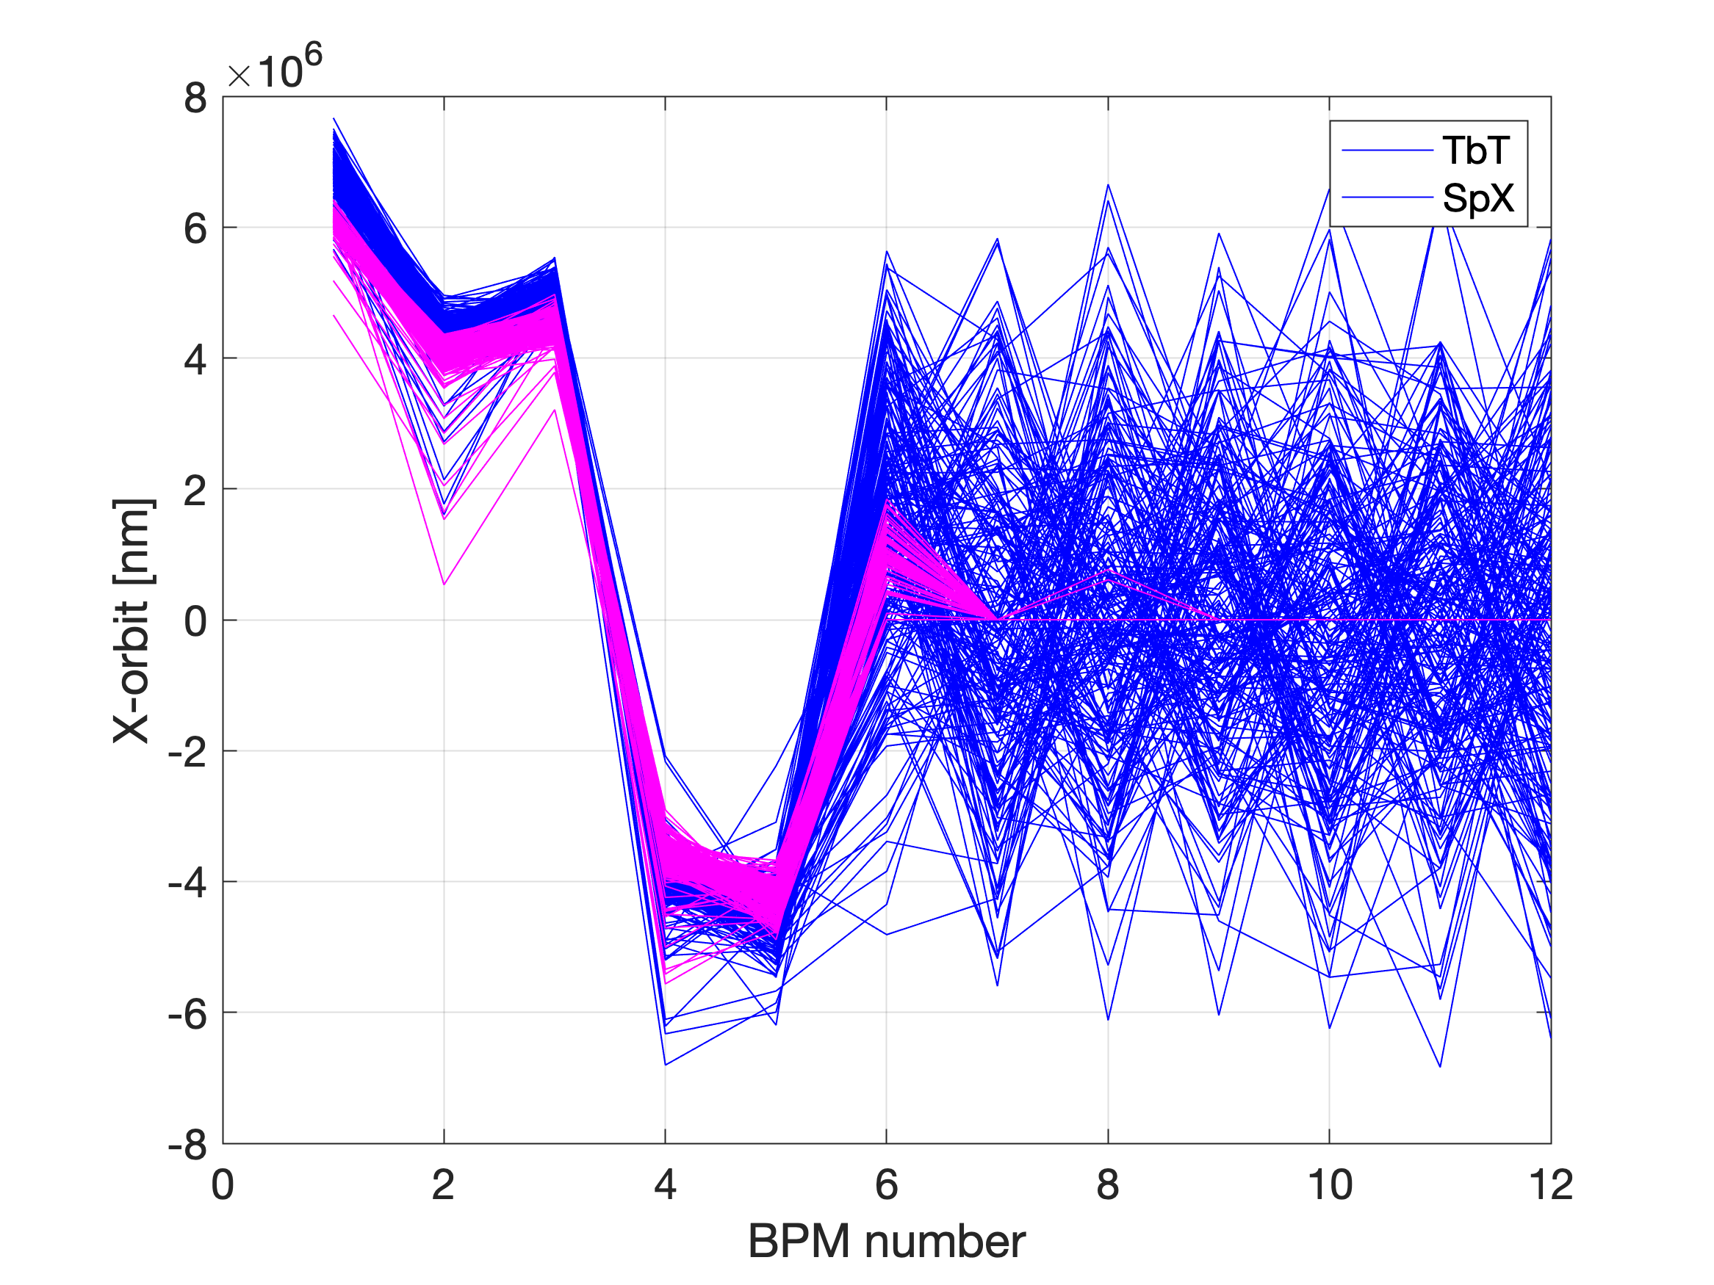
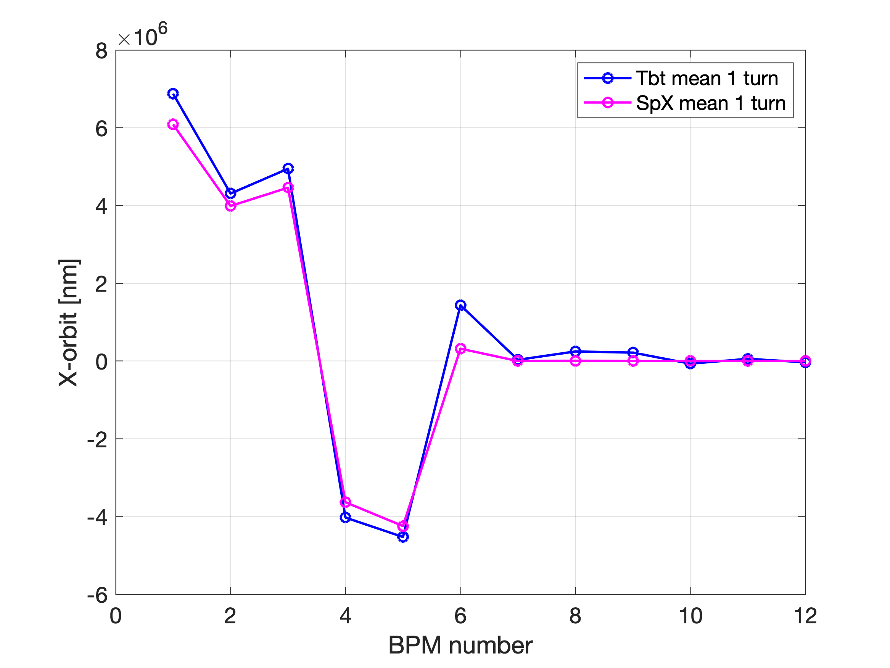
Configuration all QUAD OFF (SpX and Tbt)

Slide 21
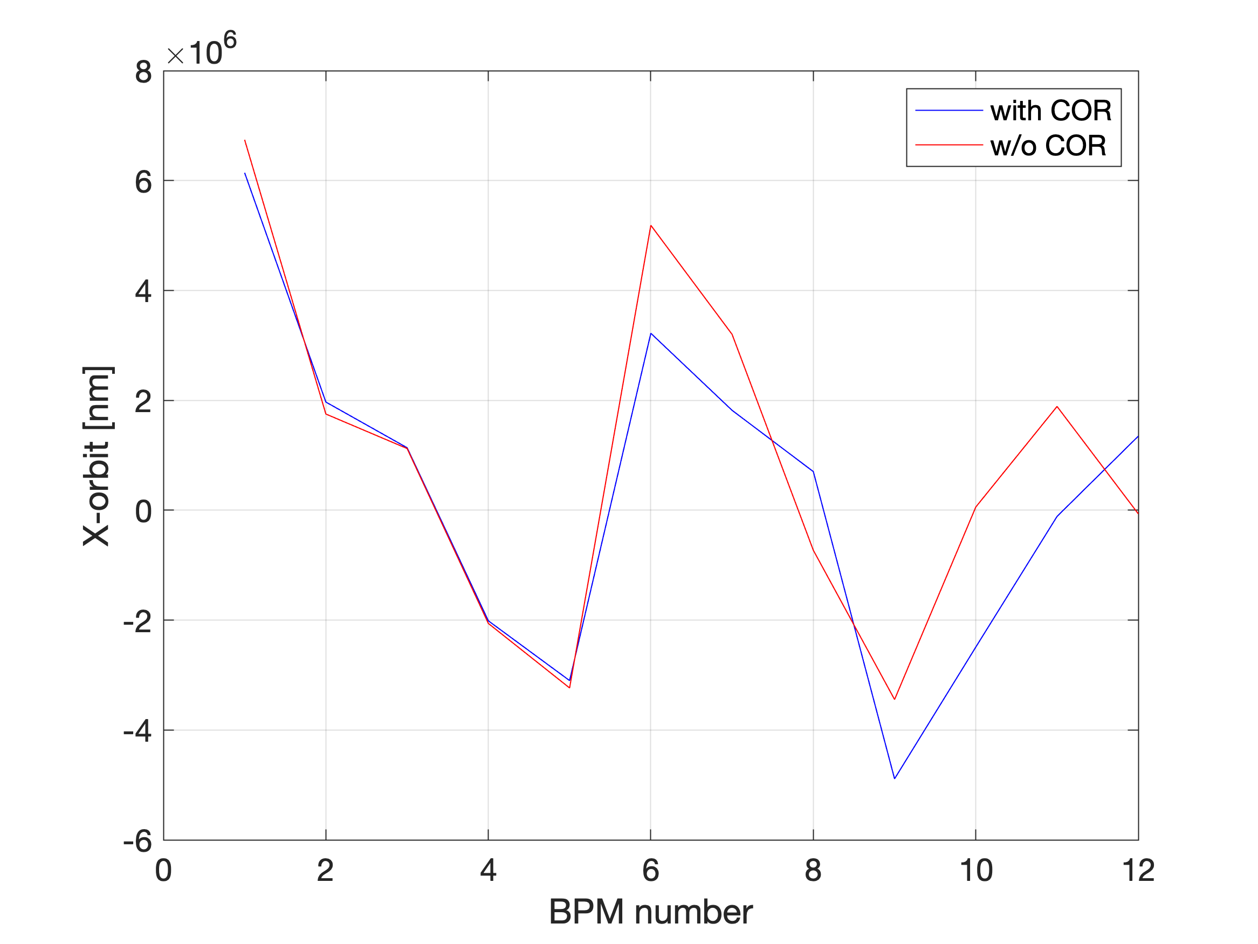
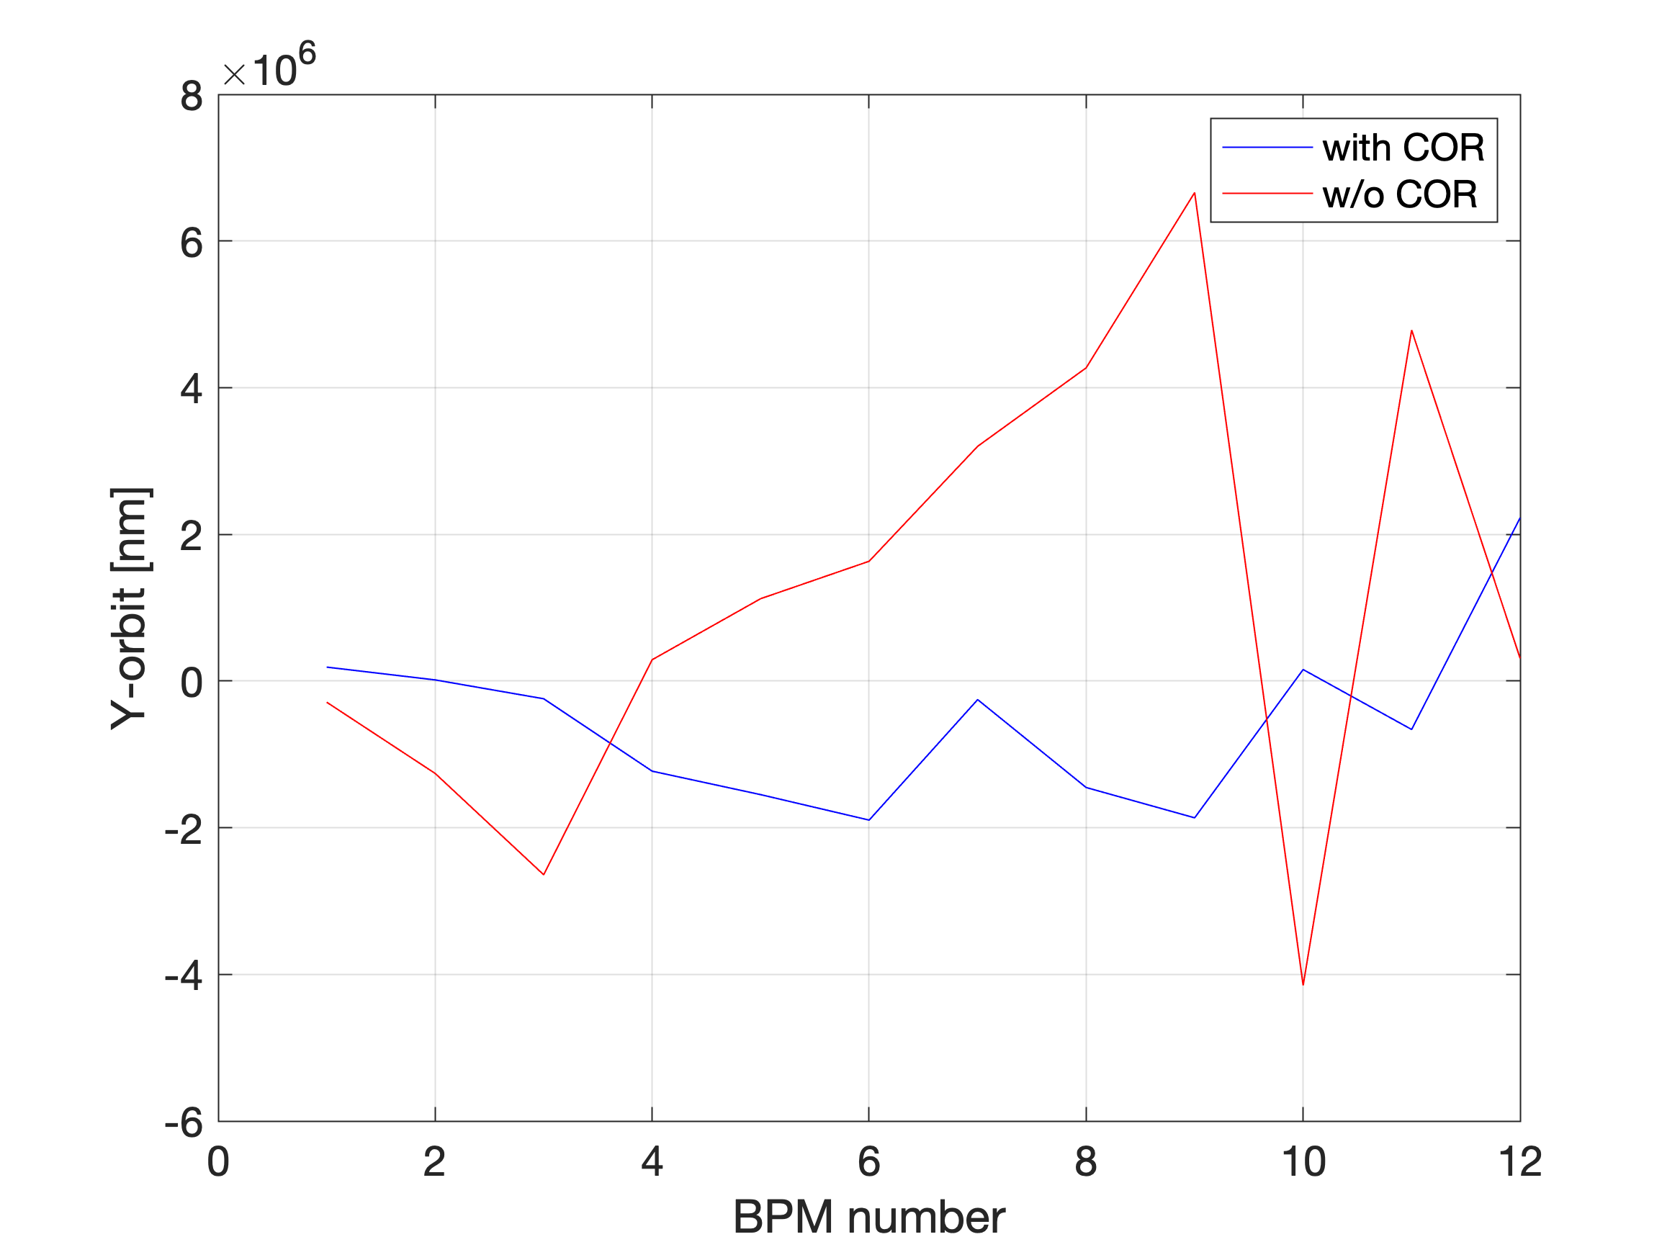
Configuration with and w/o correctors

Slide 22
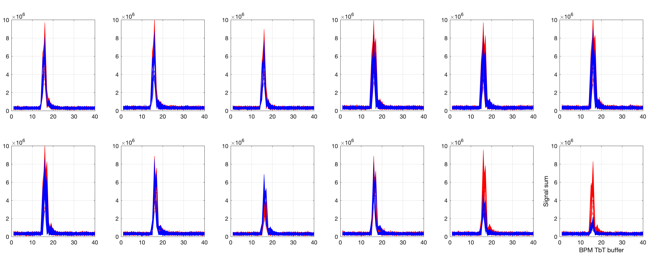
BPM signal sum (1 and 2 turns configurations)
(the 1st BPM after injection)
Blue: 1 turn (All QUAD ON)
Red: 2 turns (QUAD #9 #10 #12 are OFF)

Slide 23
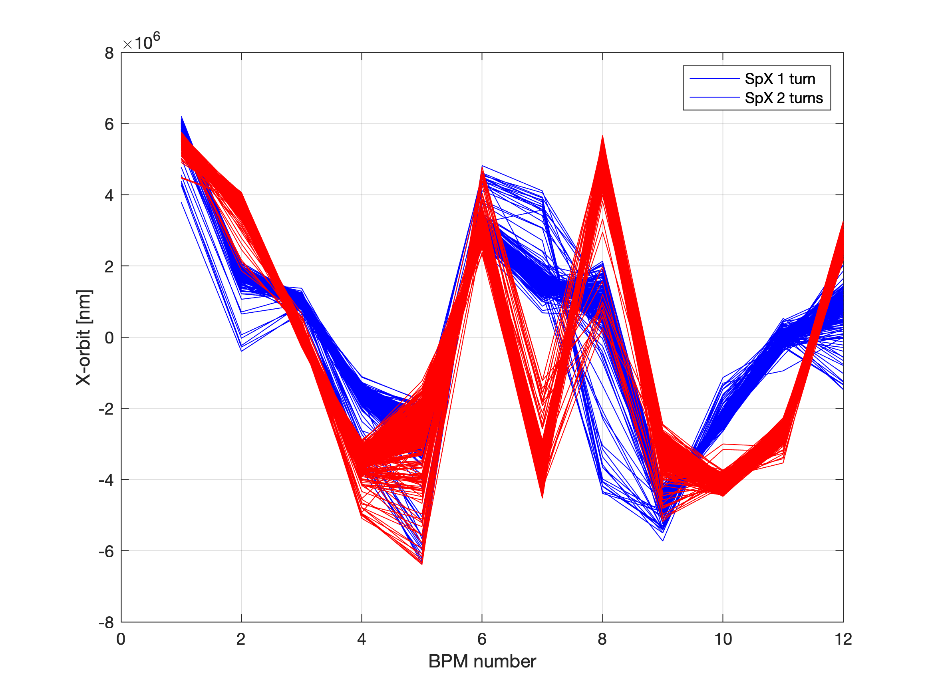
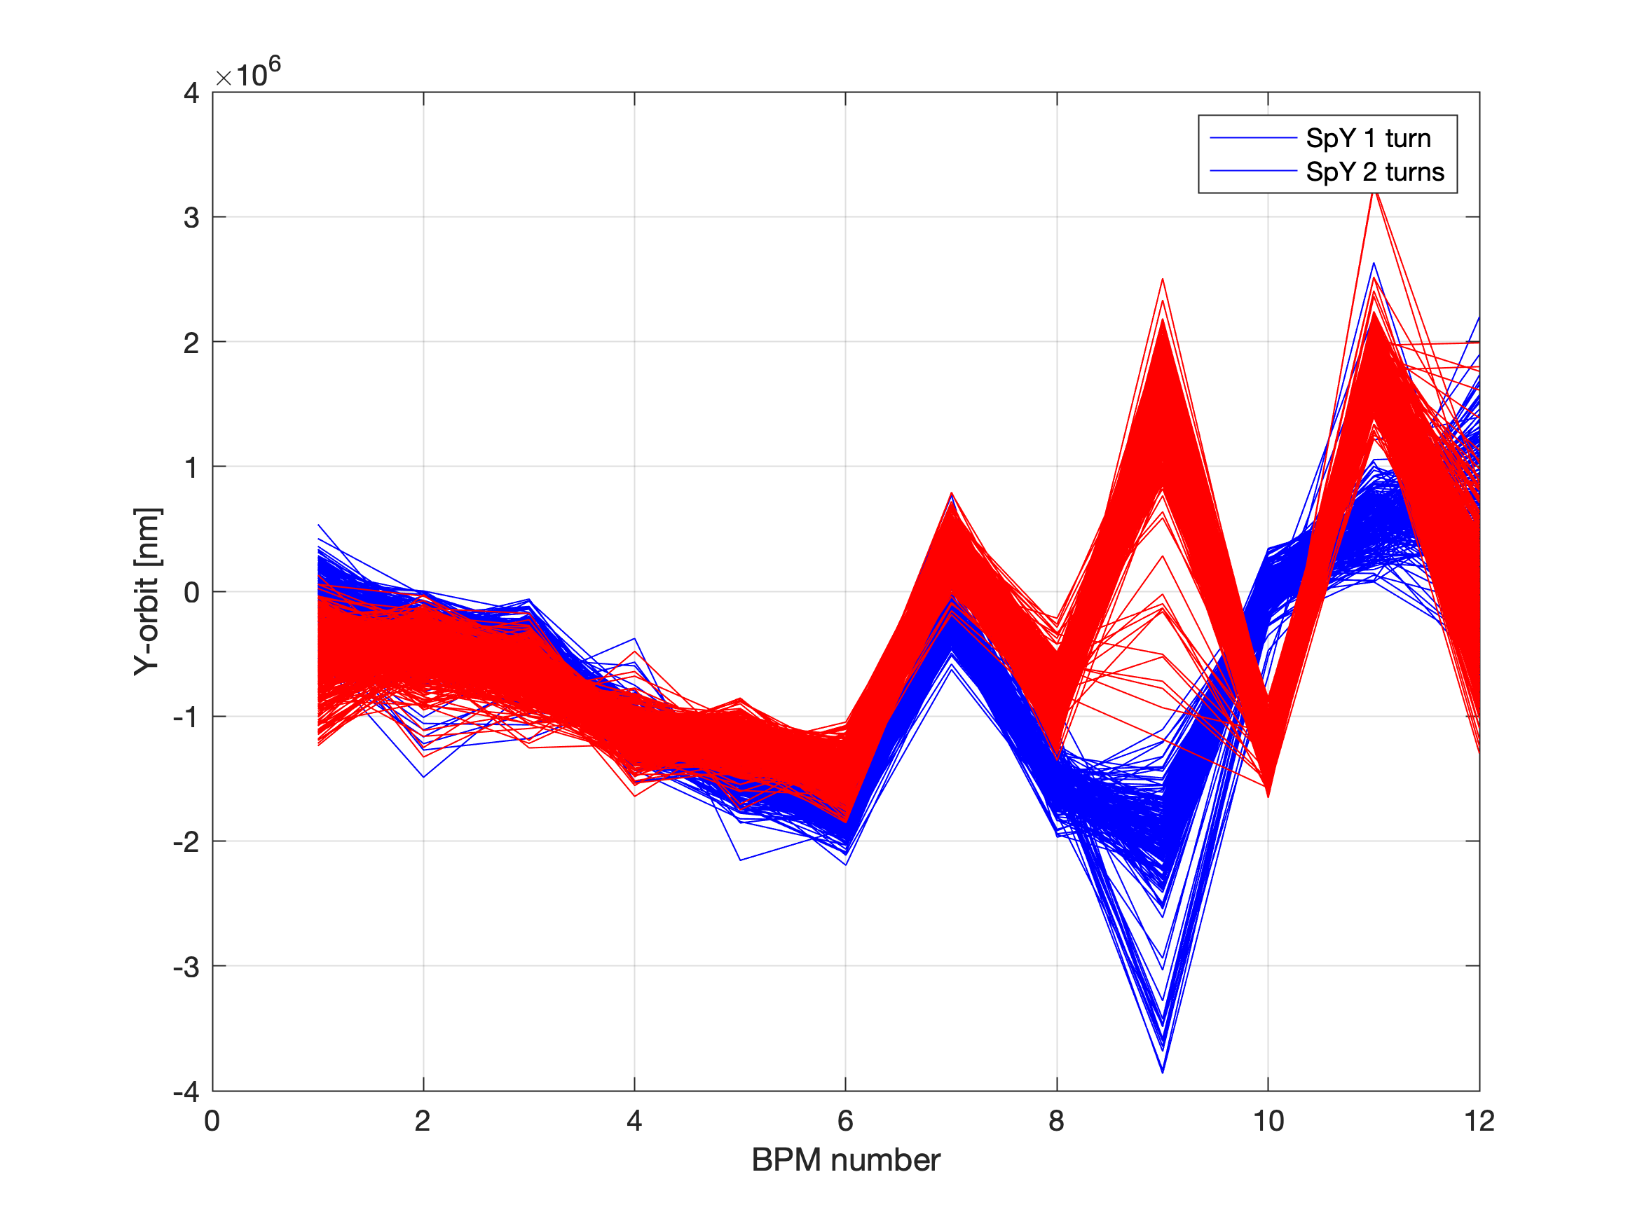
Orbit: configuration 1 and 2 turns
Blue: 1 turn (All QUAD ON)
Red: 2 turns (QUAD #9 #10 #12 are OFF)

Slide 24
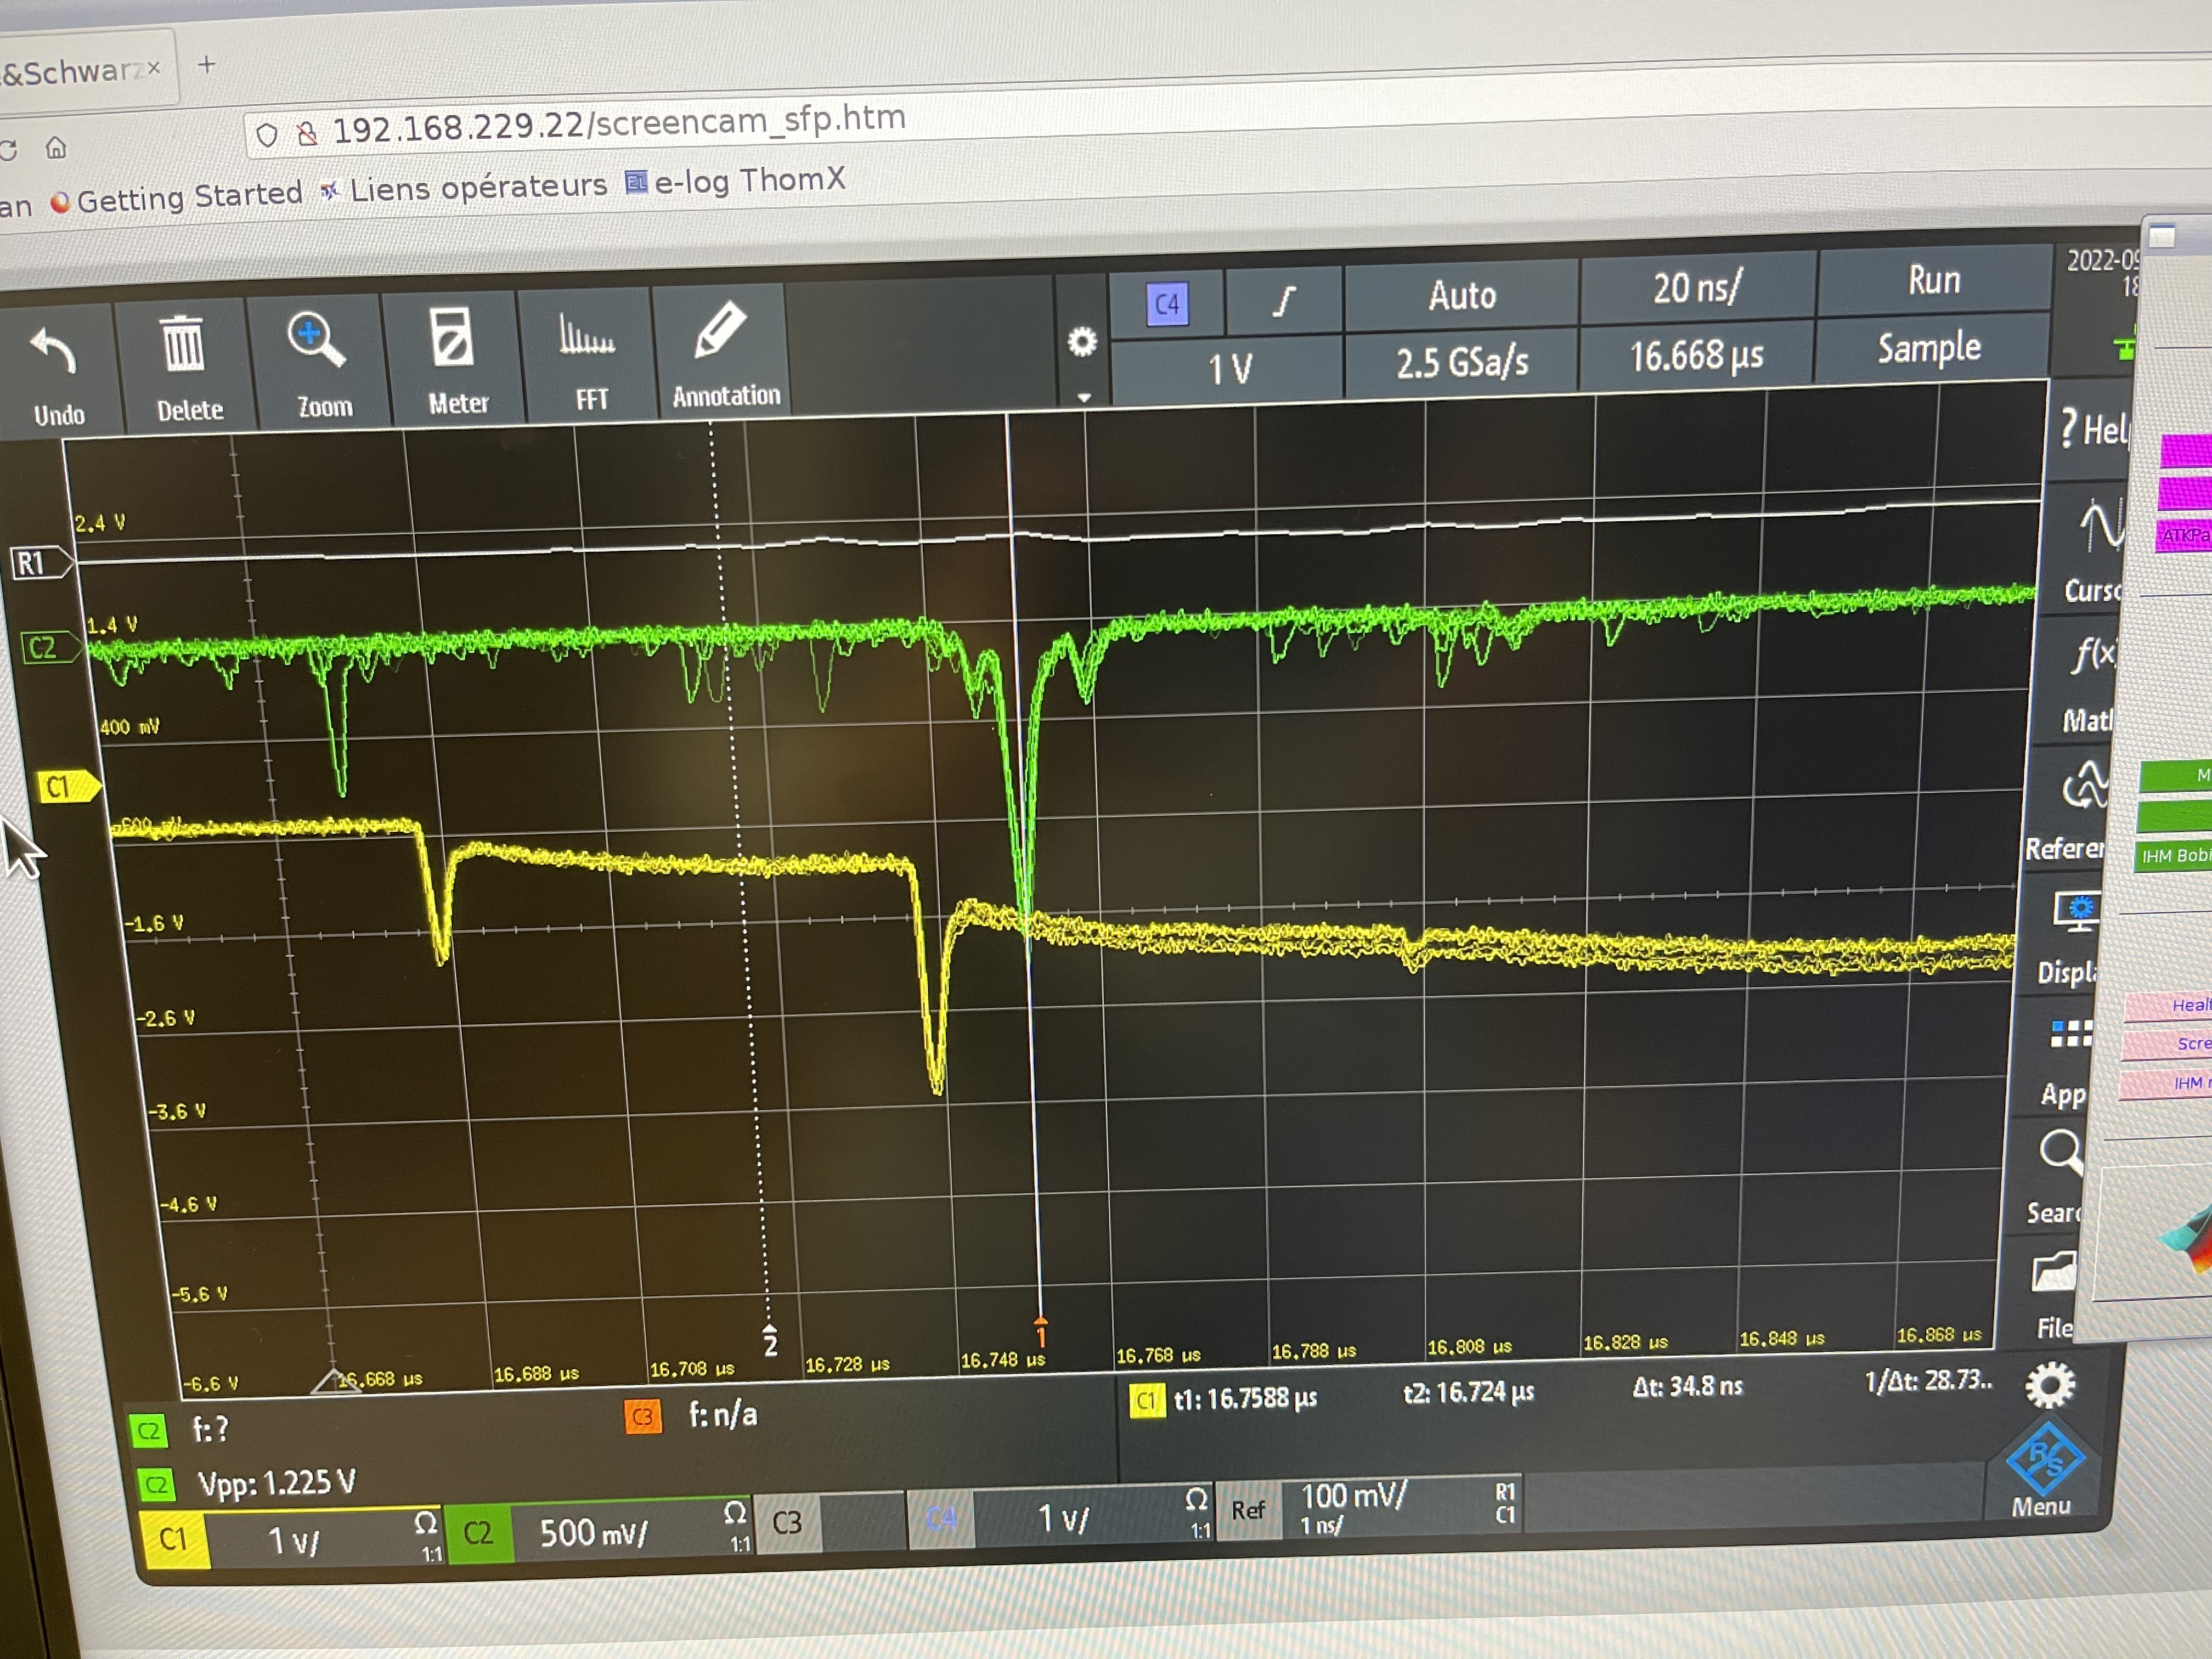
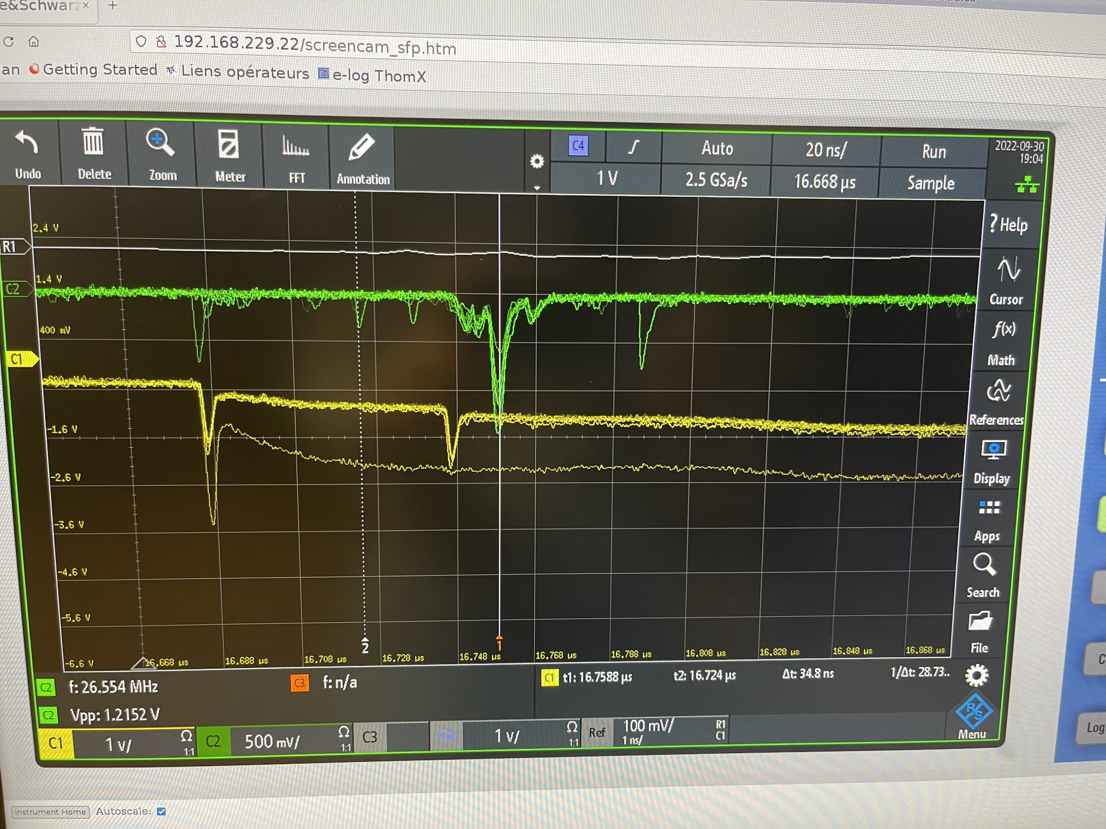
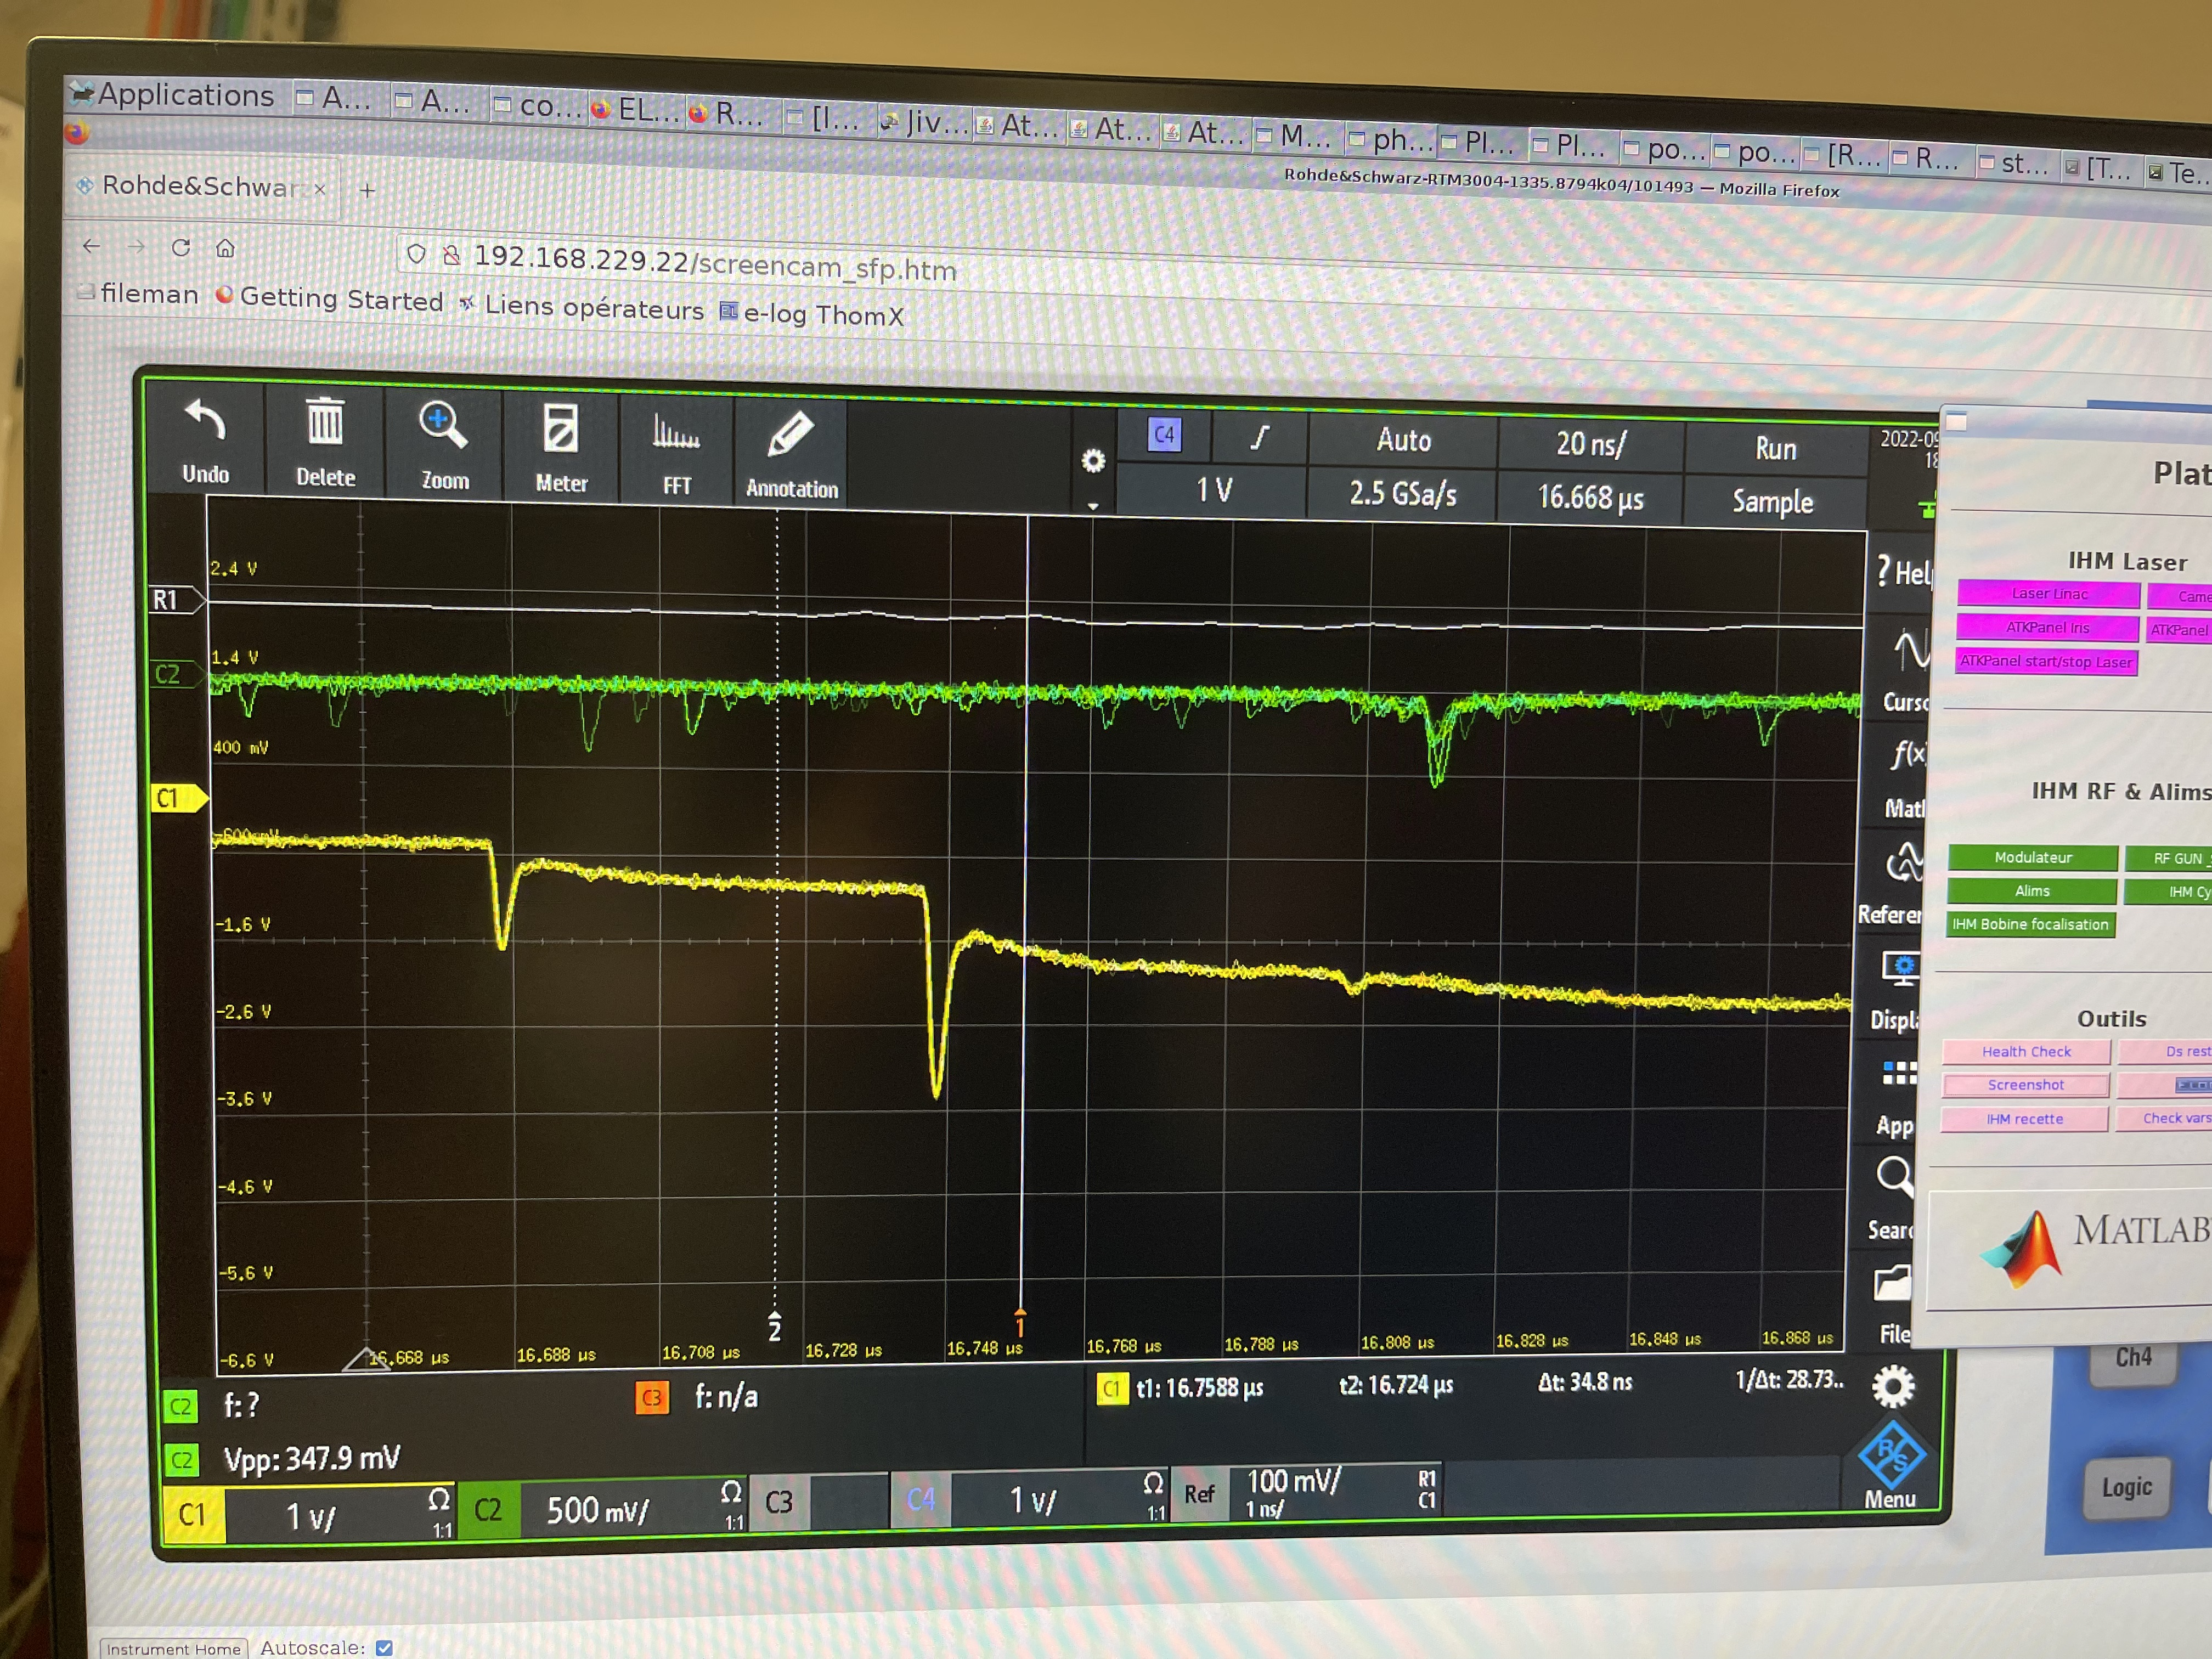
Signal from scintillator detector and FBLM
1 full turns
2 full turns with losses
FBLM
Scint.
Scint.
2 full turns
Fiber

Slide 25
3 October 2022
18h-21h30
As we corrected the polarity of the QUAD #10, we check now the trajectory with beam
First storage ~300 turns

Slide 26
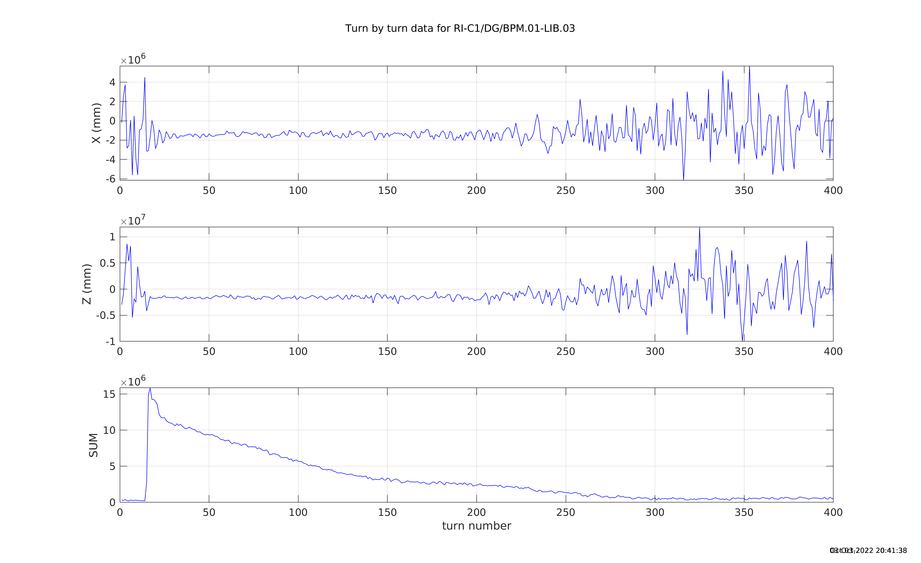
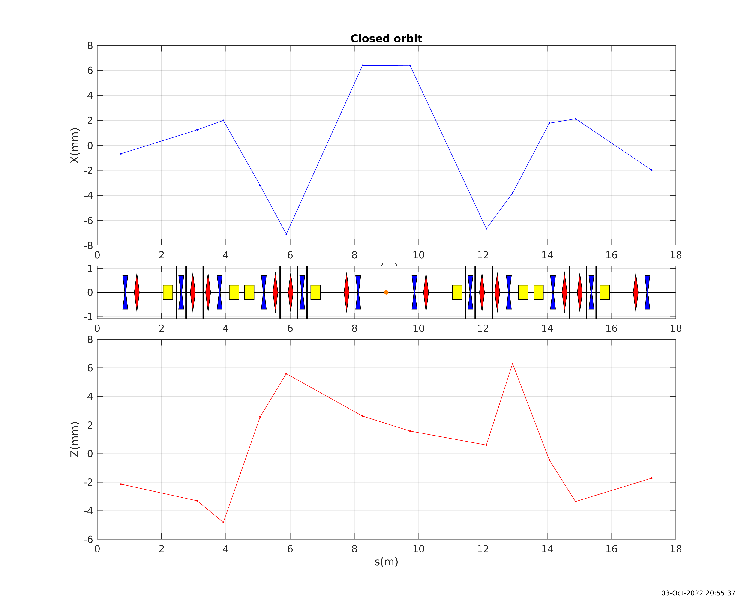
First beam storage

Slide 27
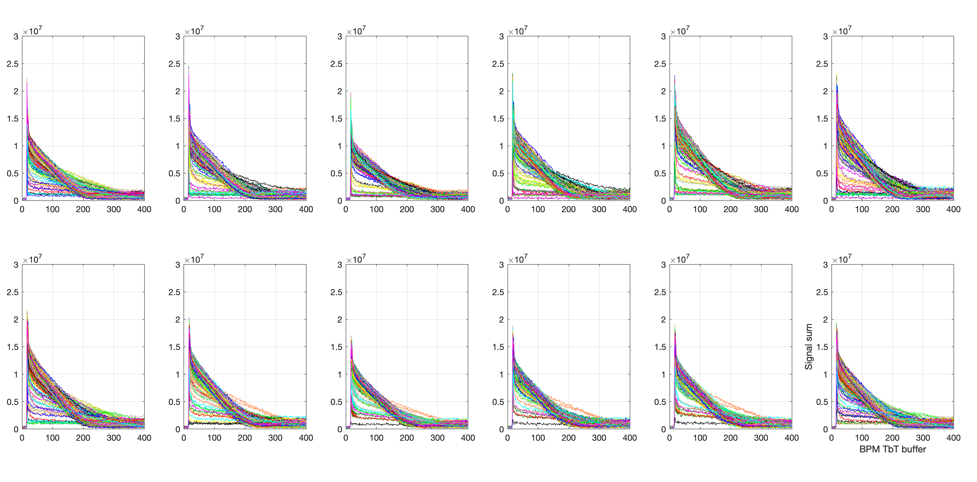
BPM signal sum
(the 1st BPM after injection)
Trig 1:500

Slide 28
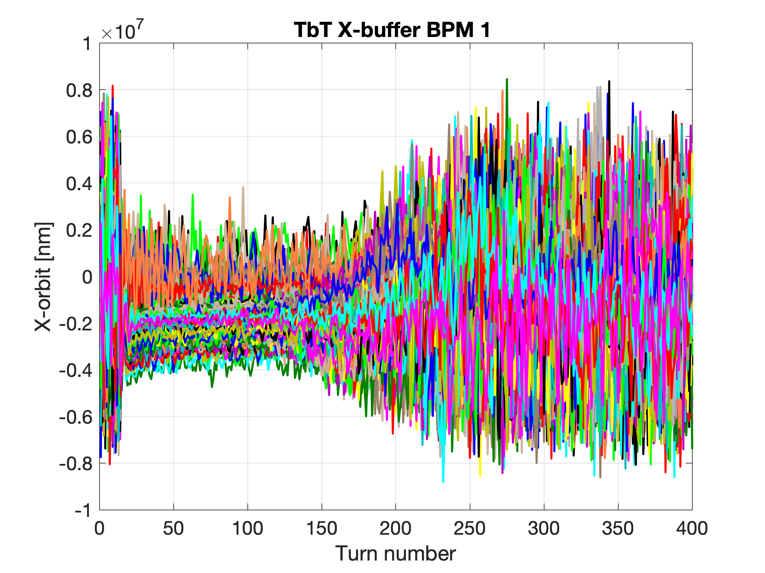
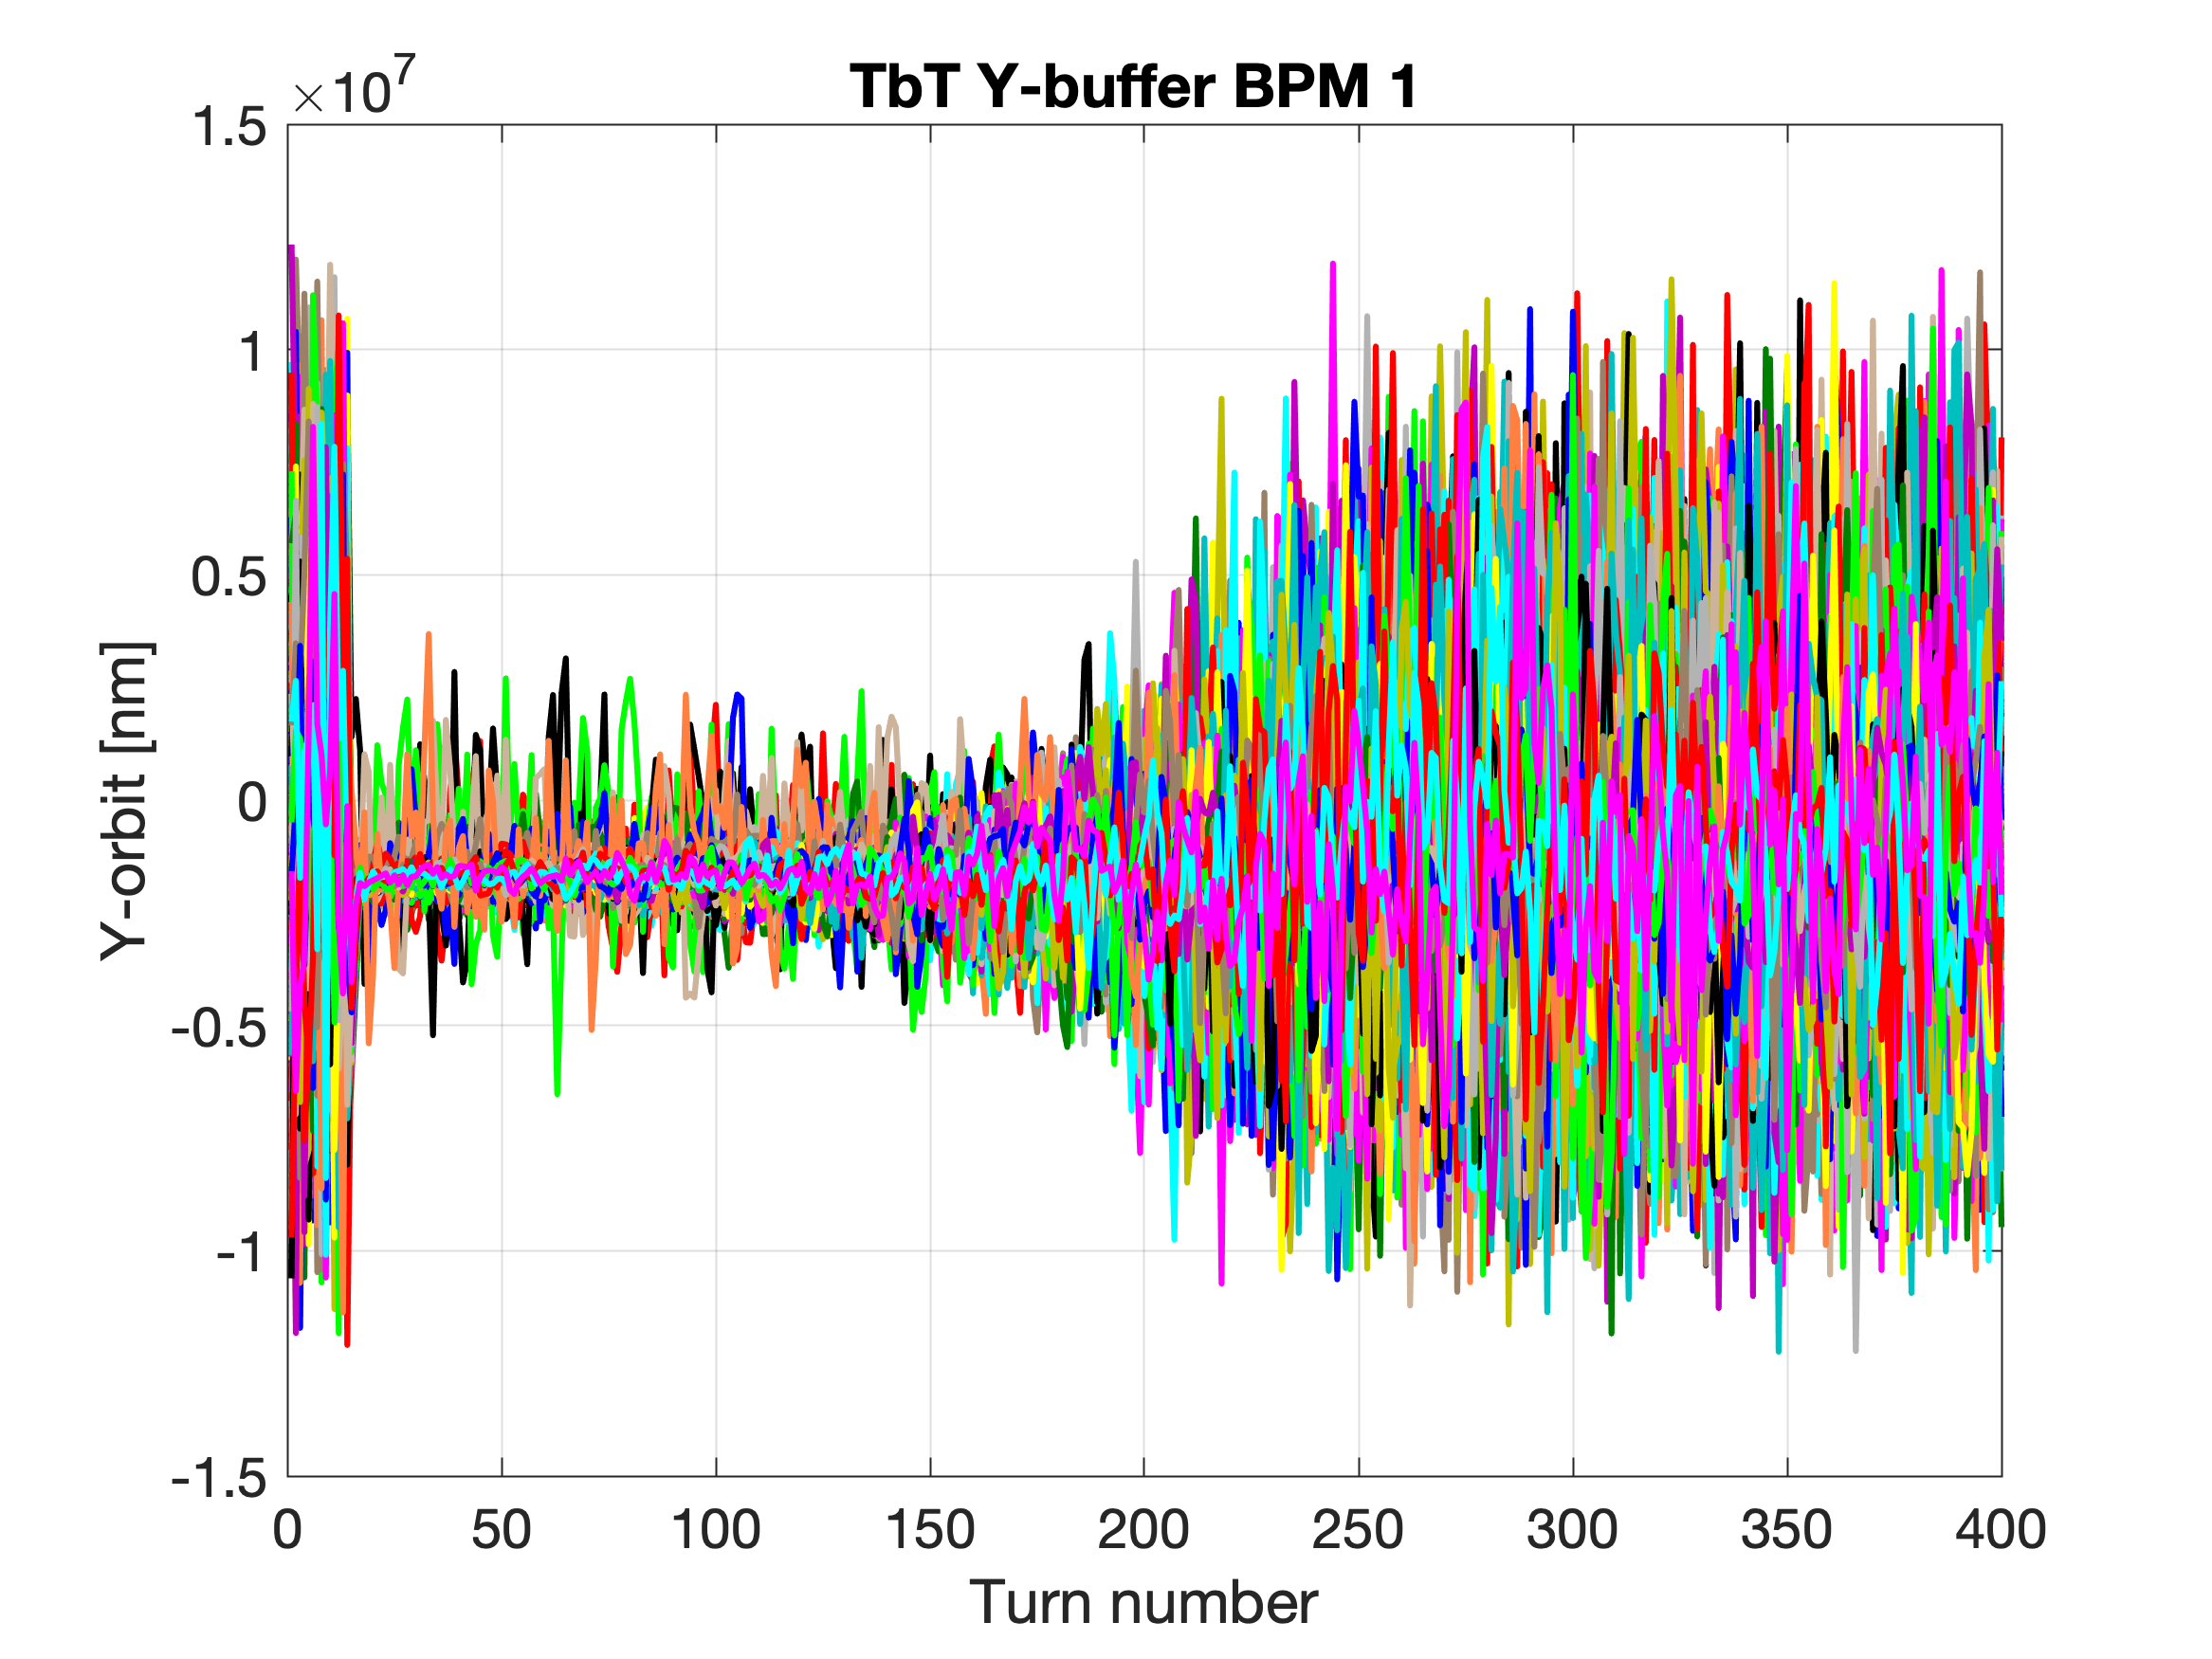
X-/Y- TbT buffer
Trig 1:500

Slide 29
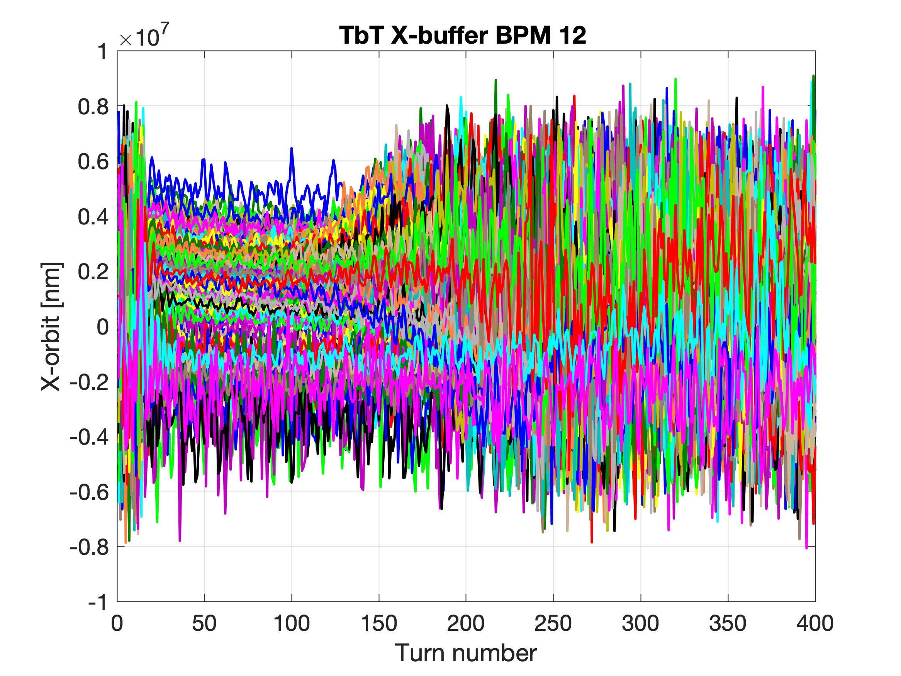
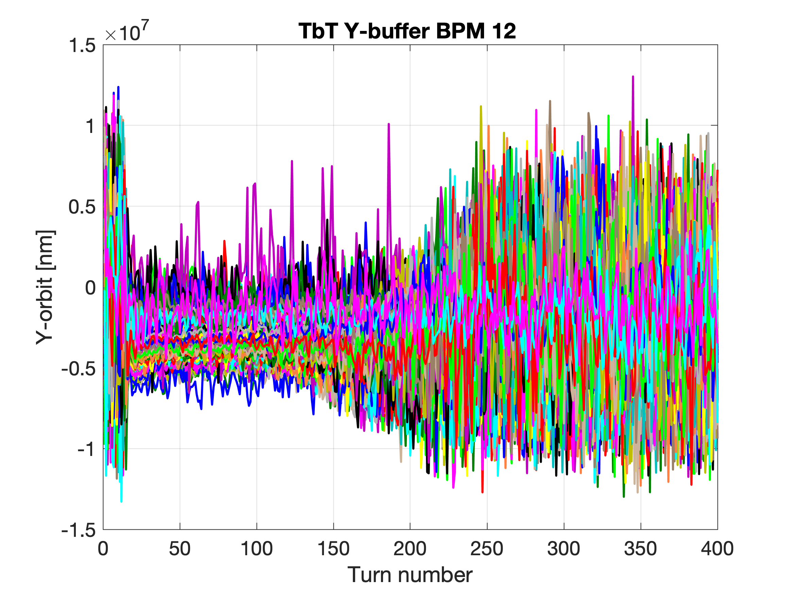
X/Y- TbT buffer
Trig 1:500

Slide 30
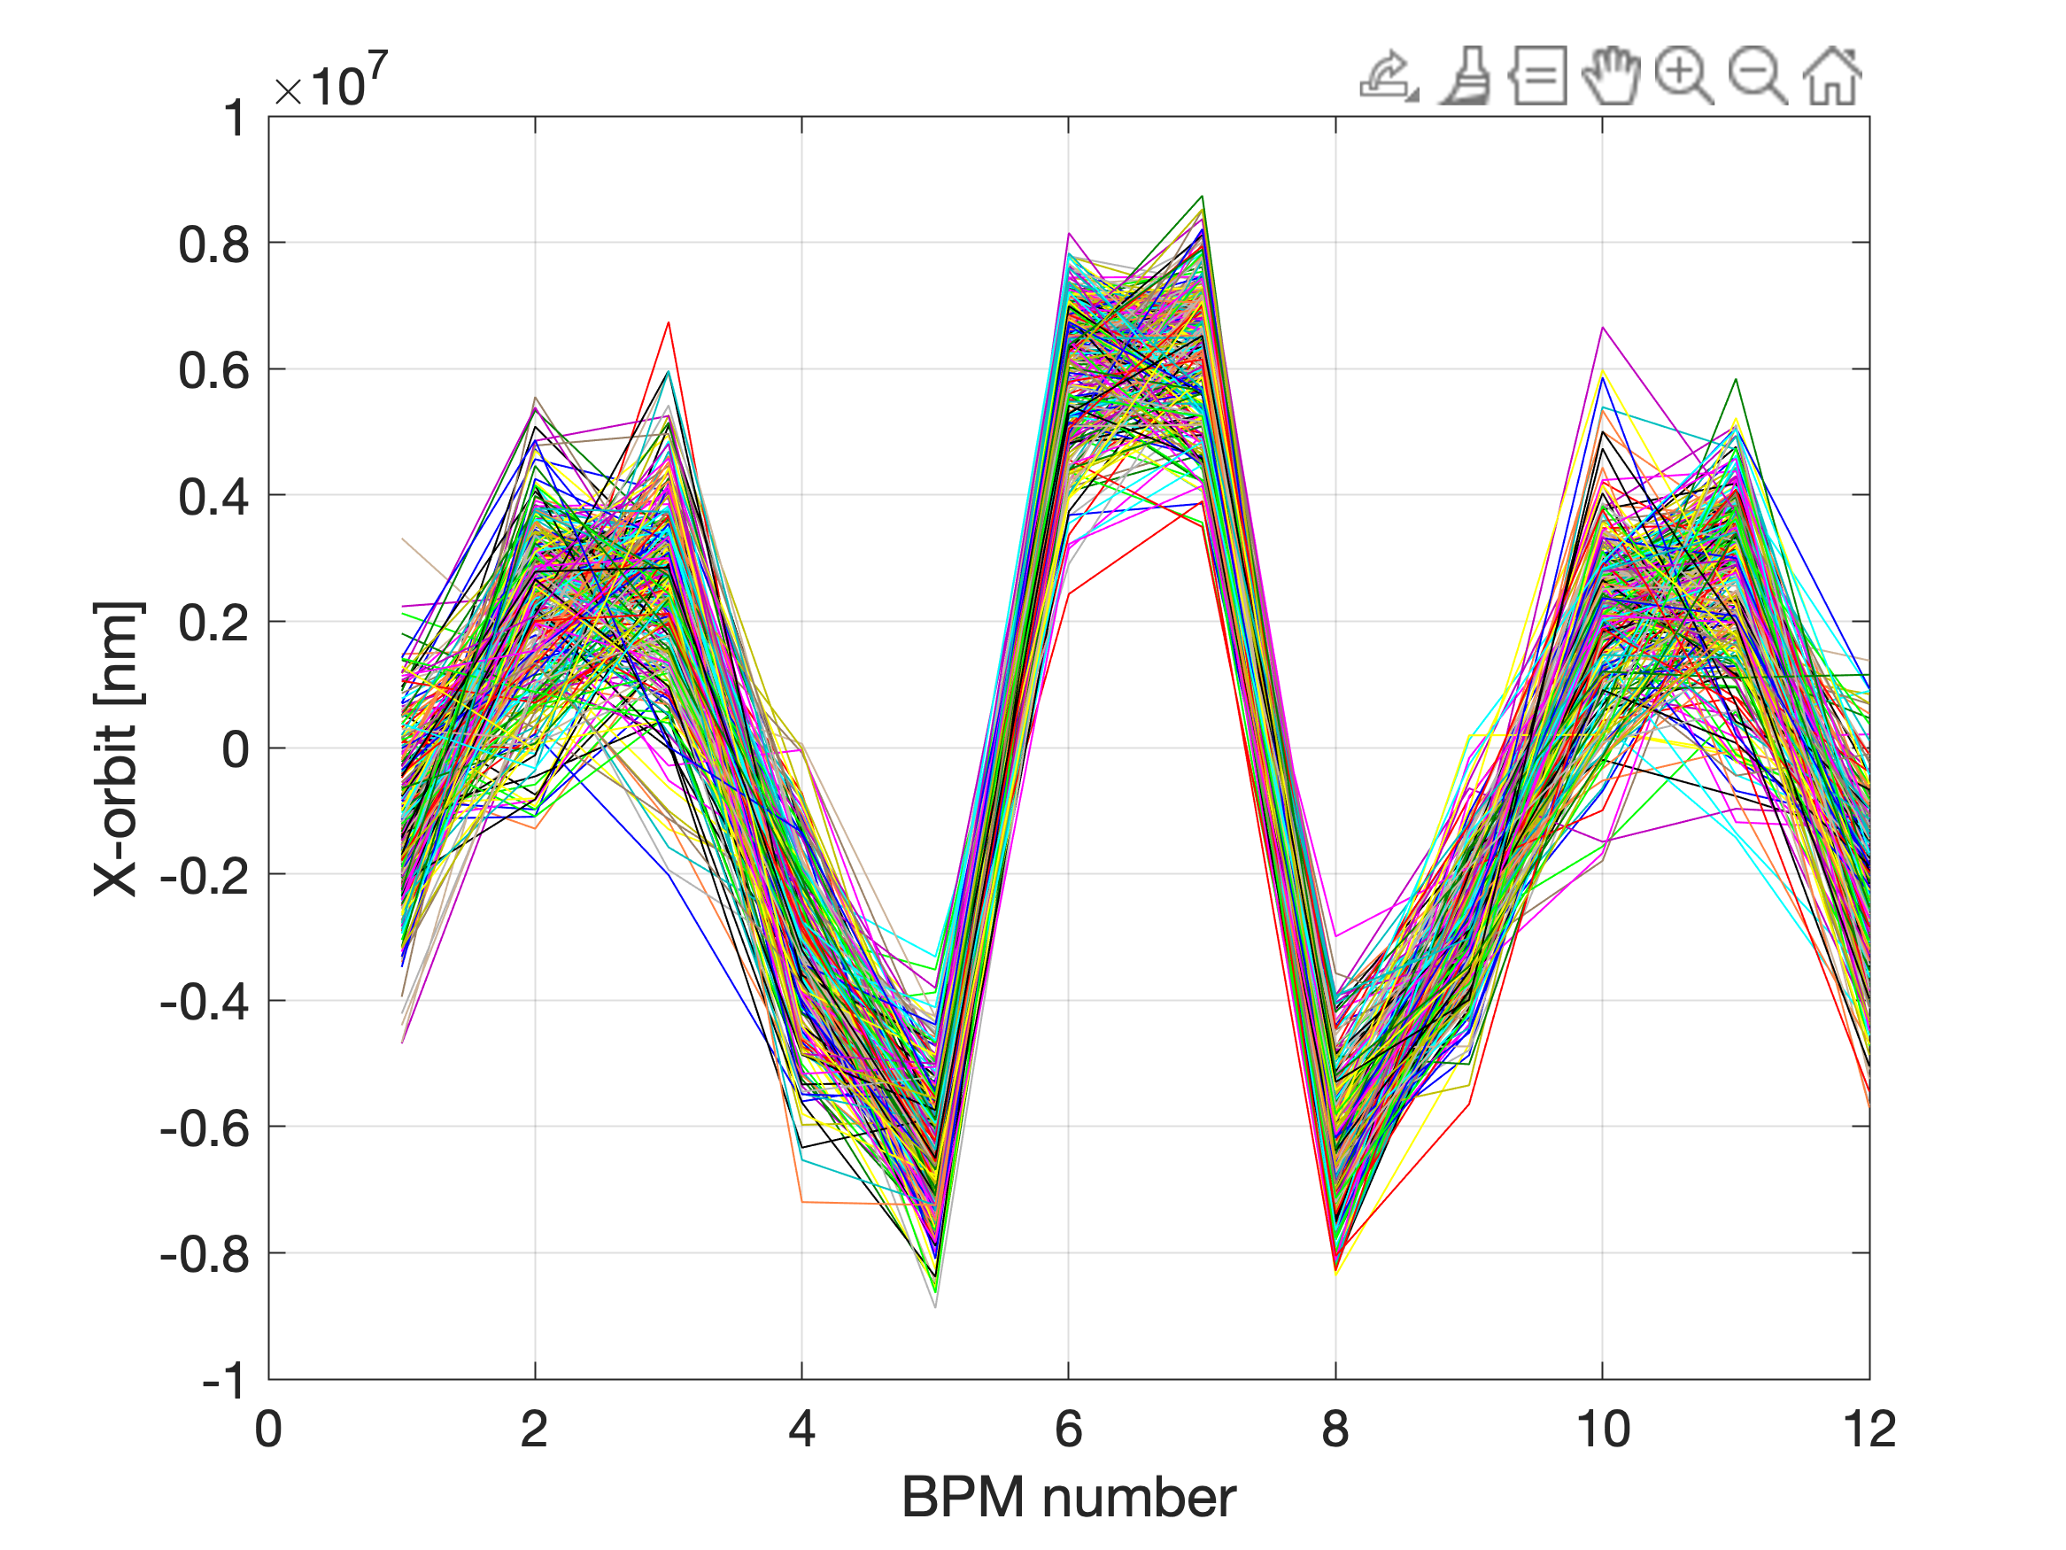
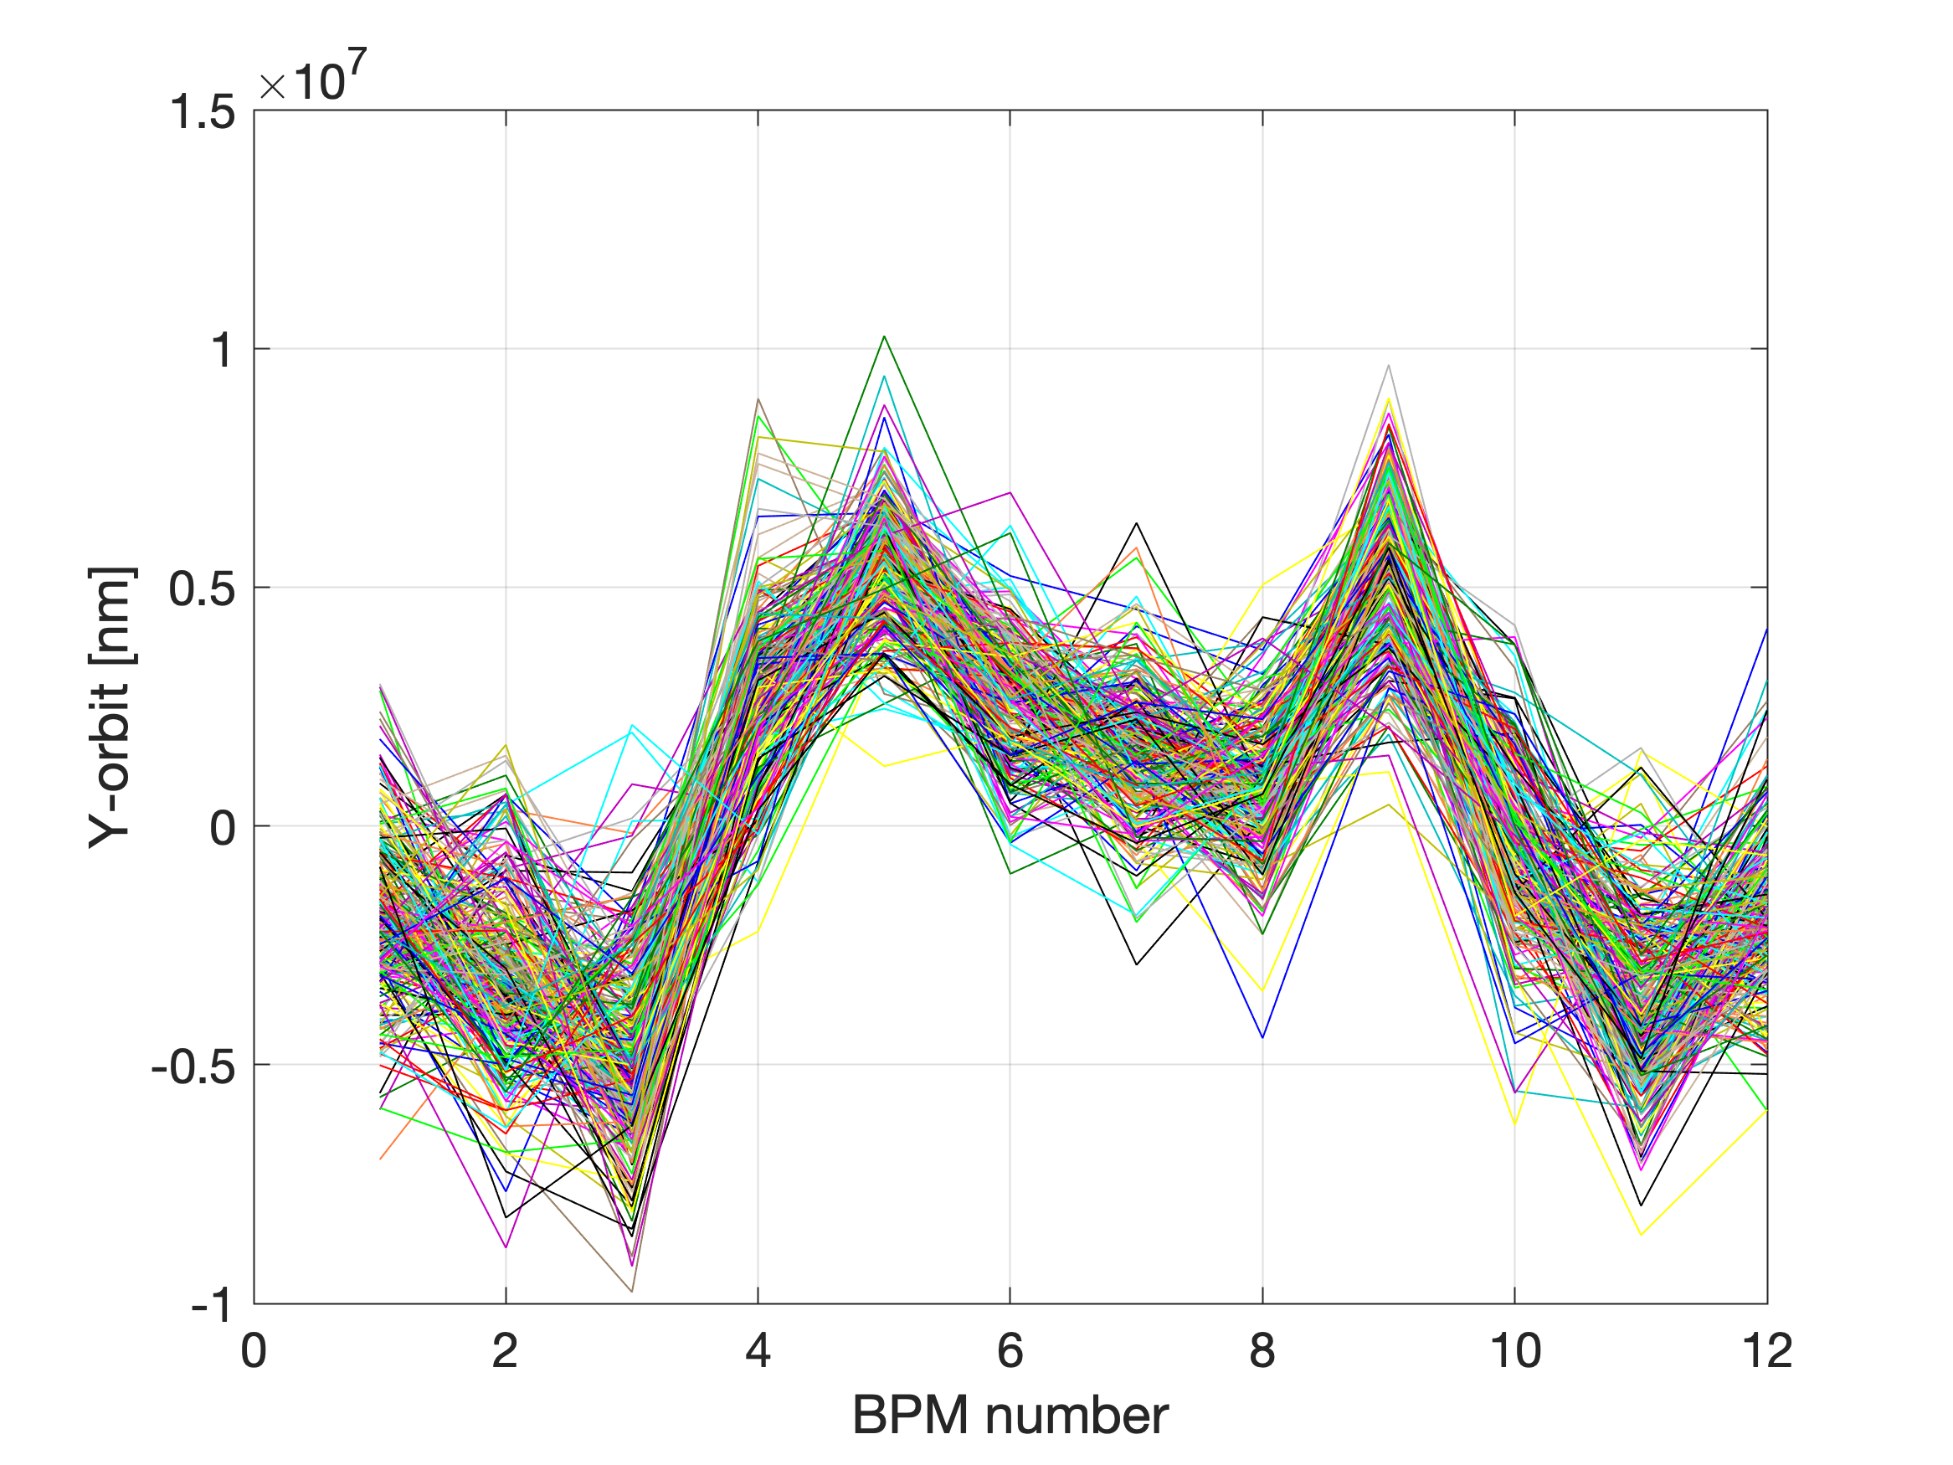
X-/Y- orbit turn-by-turn
Trig #5
Turns: 16: end

Slide 31
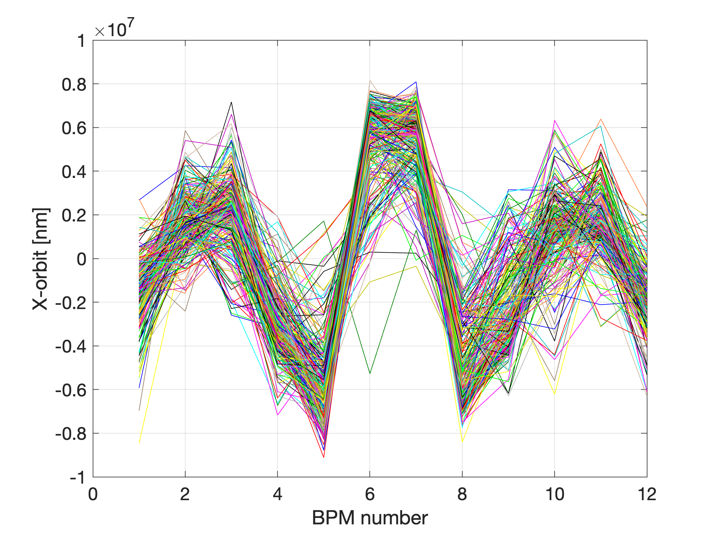
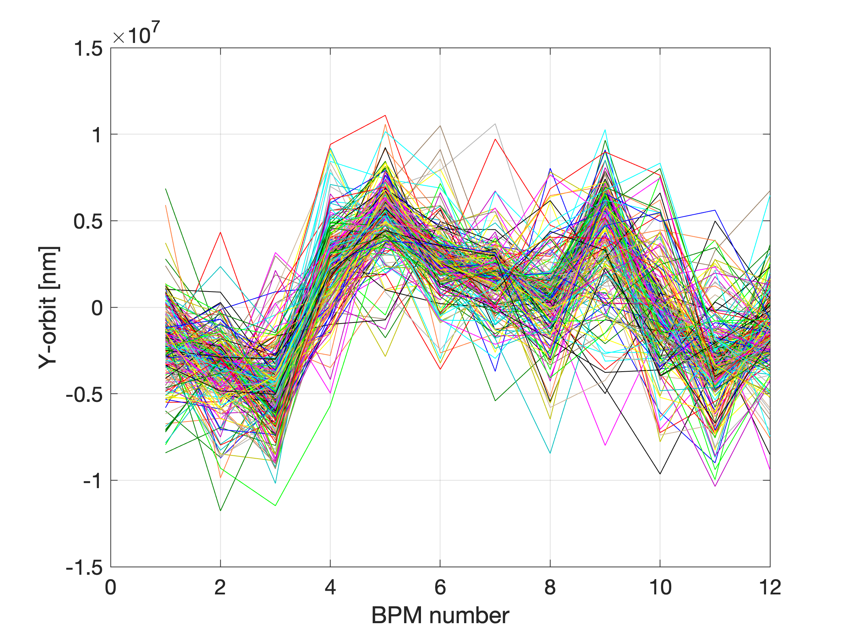
X-/Y- orbit turn-by-turn
Trig #200
Turns: 16: end

Slide 32
7 October 2022
15h -20h
Another settings of the TL (dispersion closed and beam in the centre for 2 last QUAD ?)
No losses at the SEPTUM it the first injection
Kicker timing was wrong in the beginning of the shift.

Slide 33
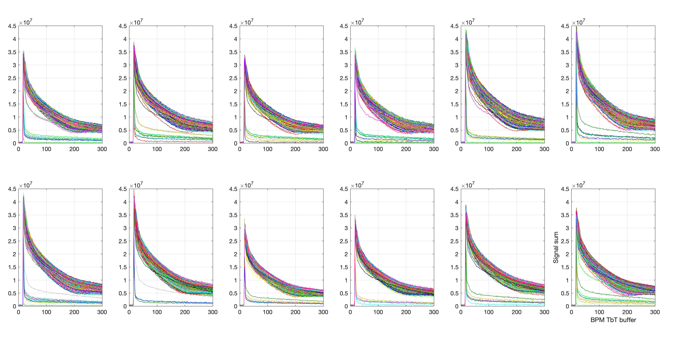
BPM signal sum
(the 1st BPM after injection)
Trig 1:500

Slide 34
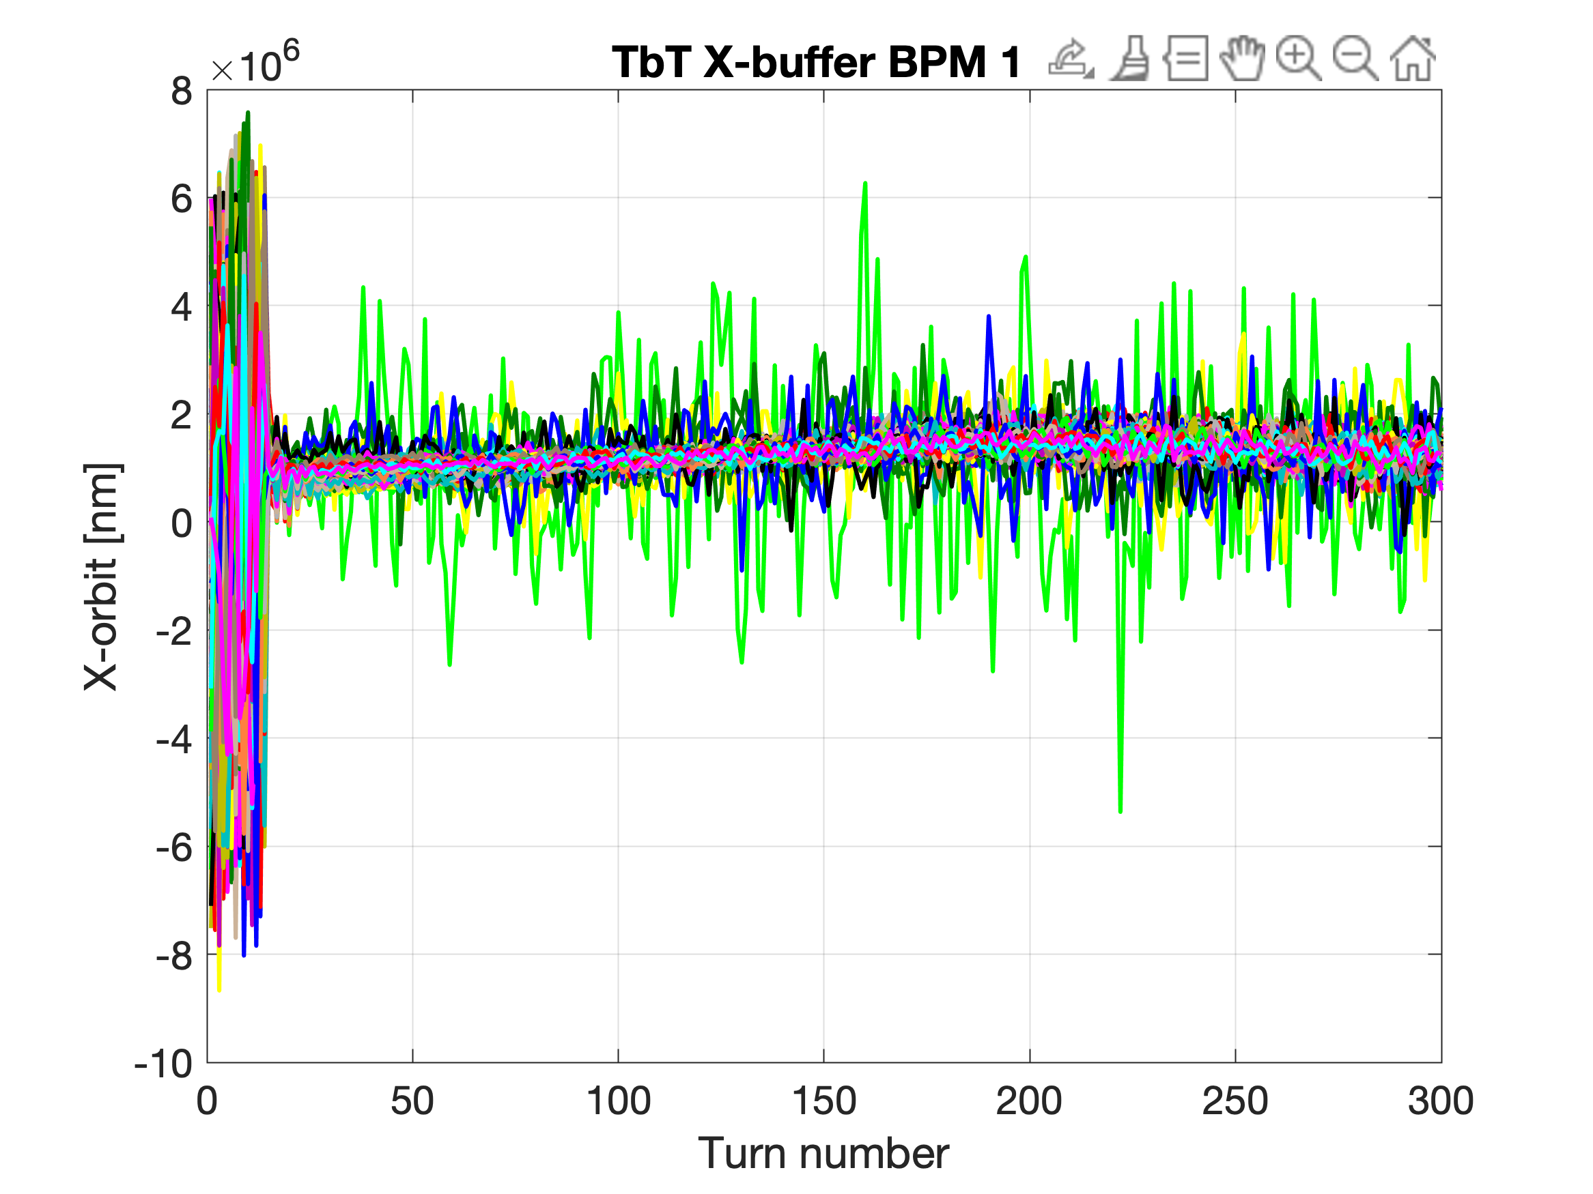
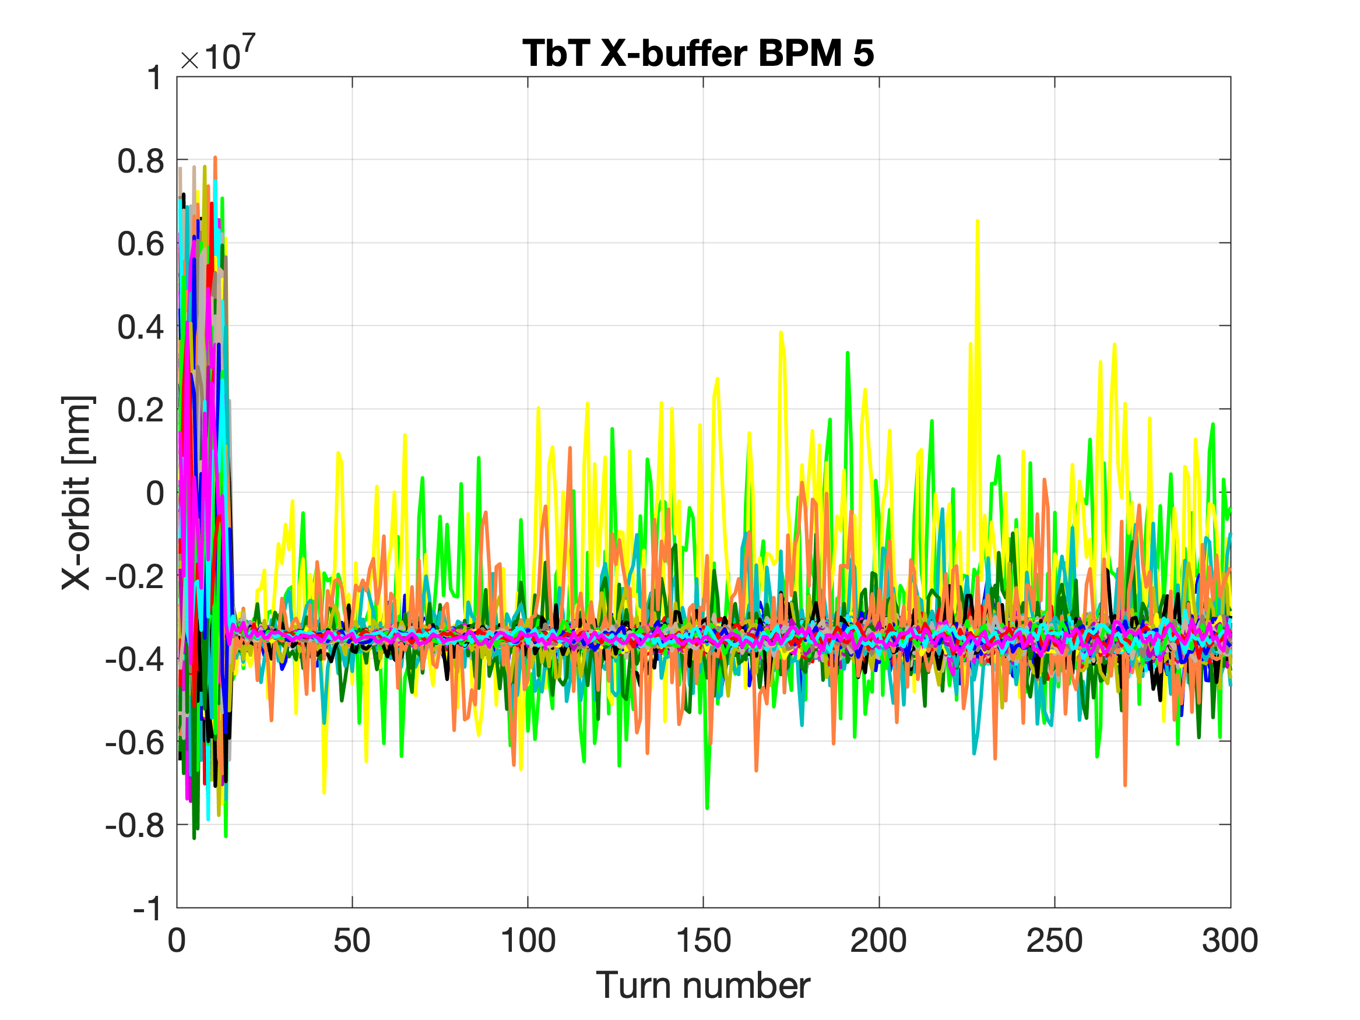
X- TbT buffer
Trig 1:500

Slide 35
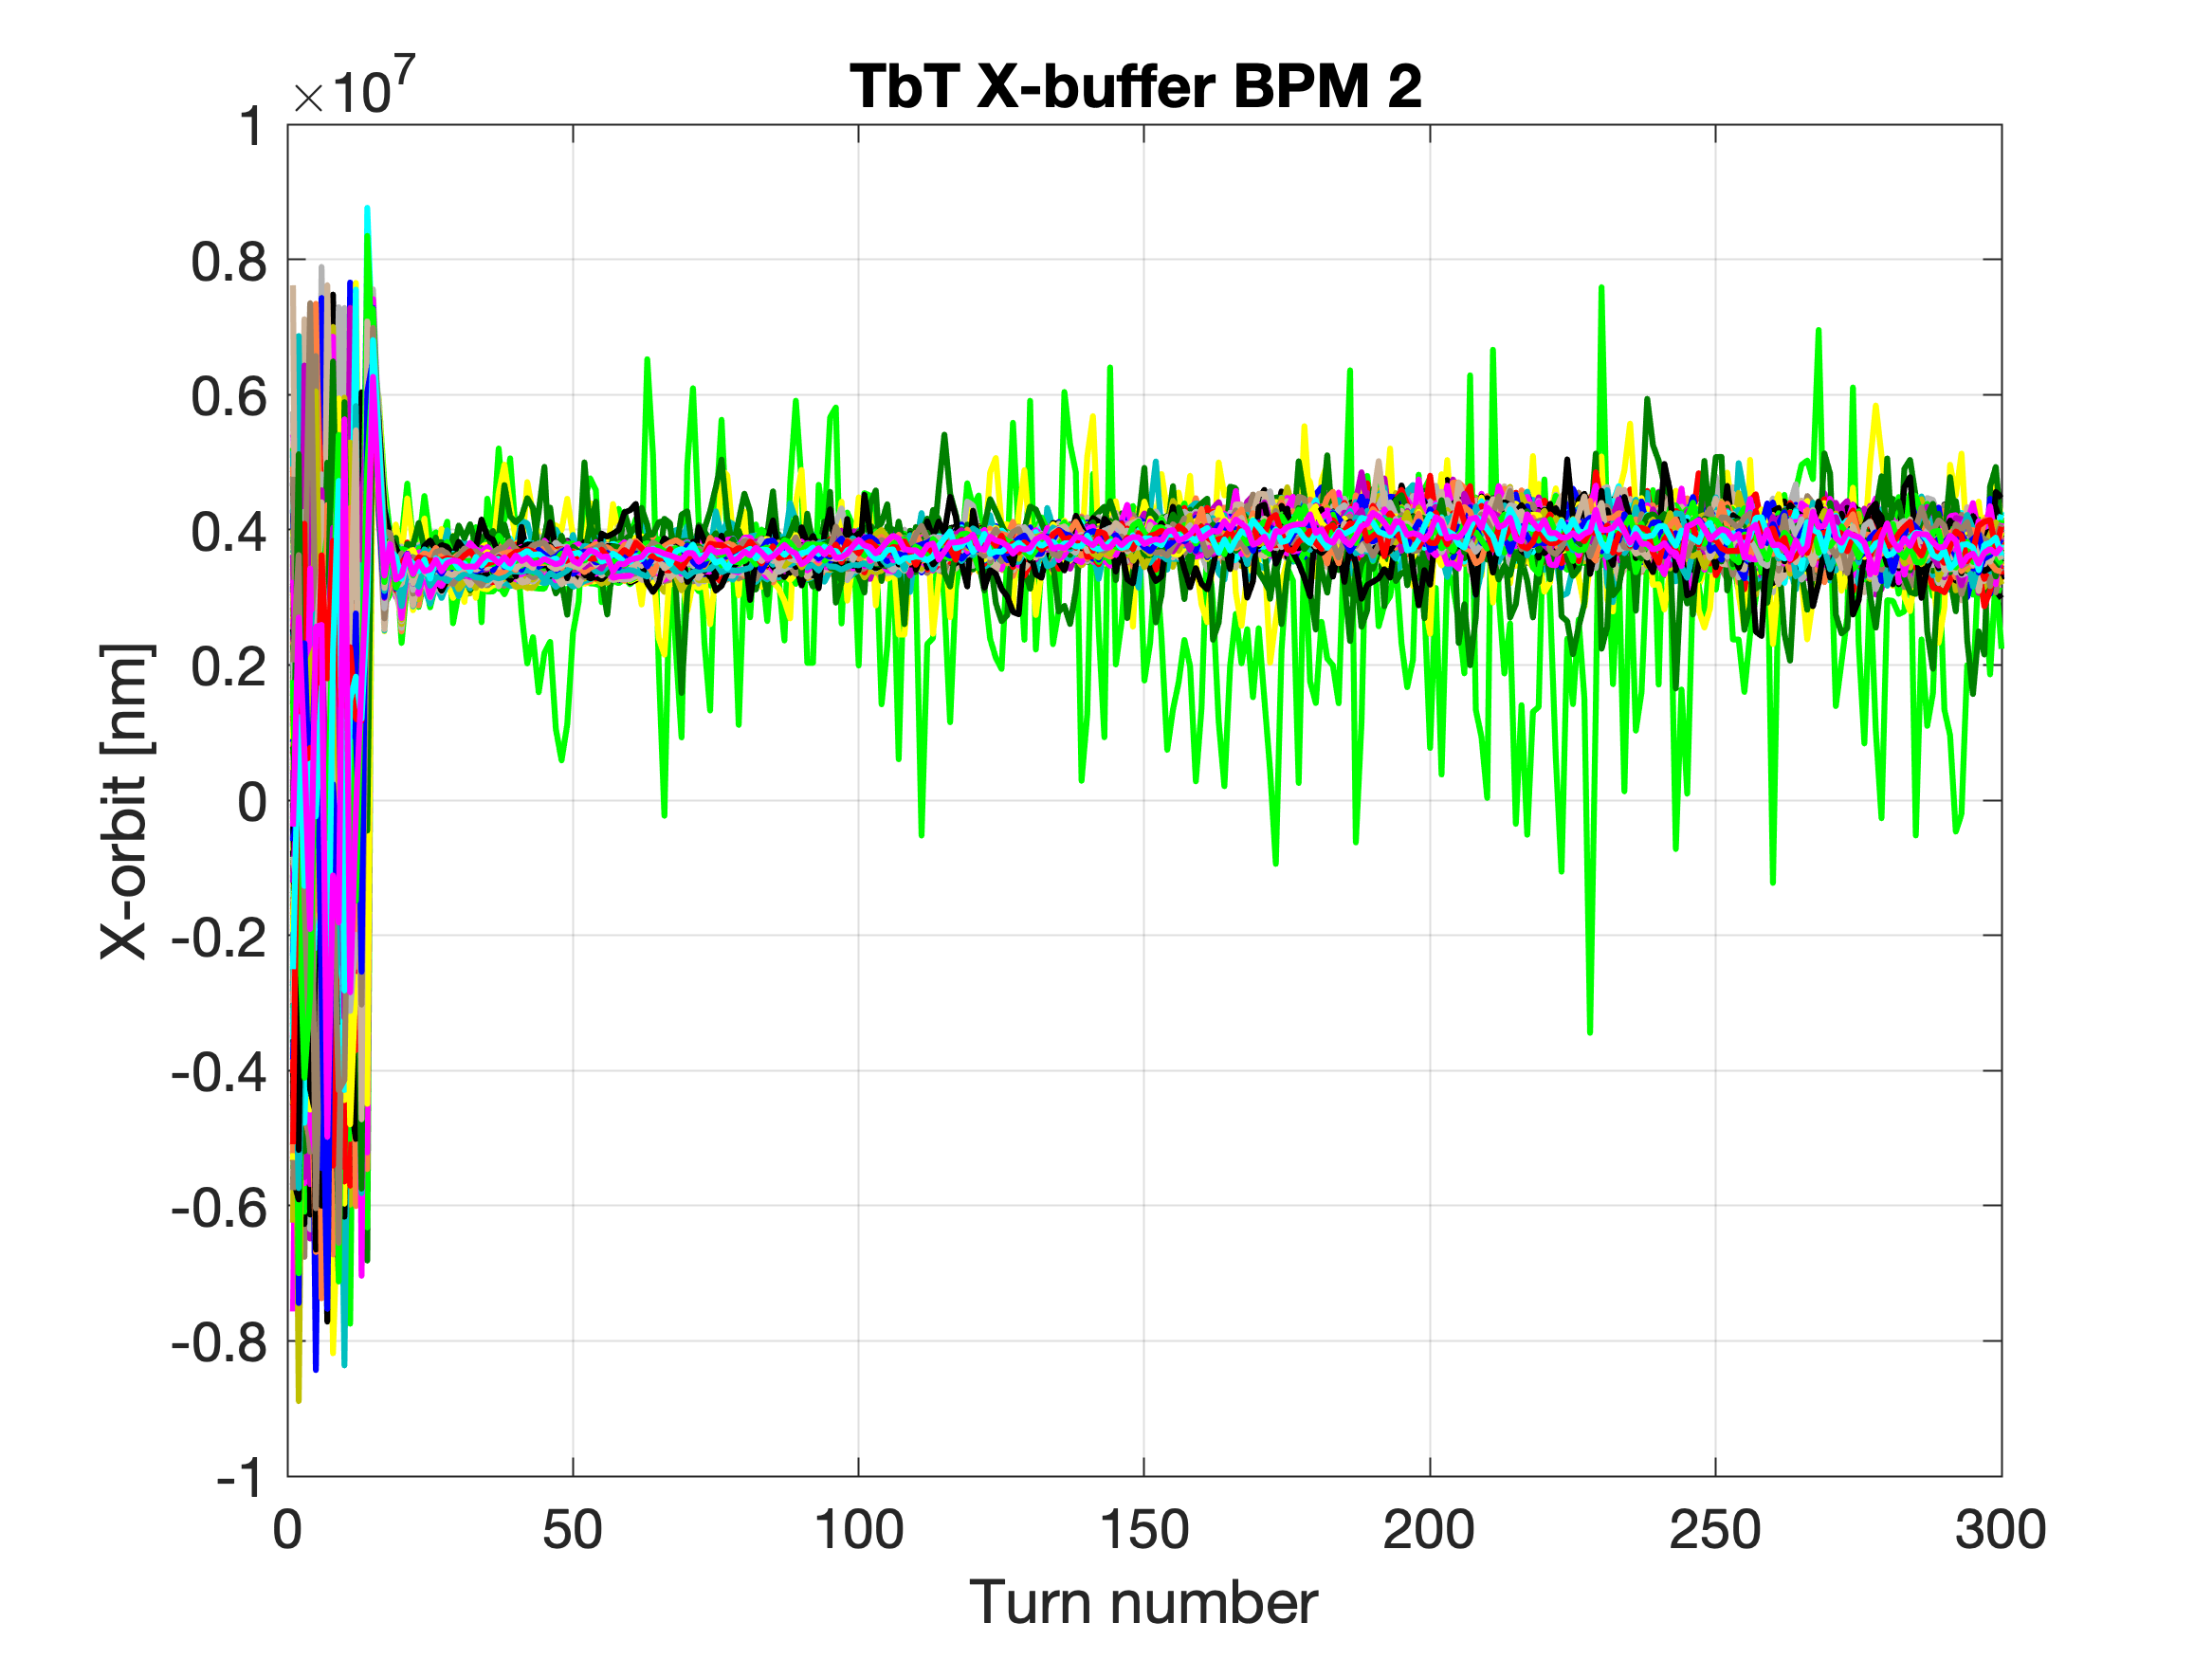
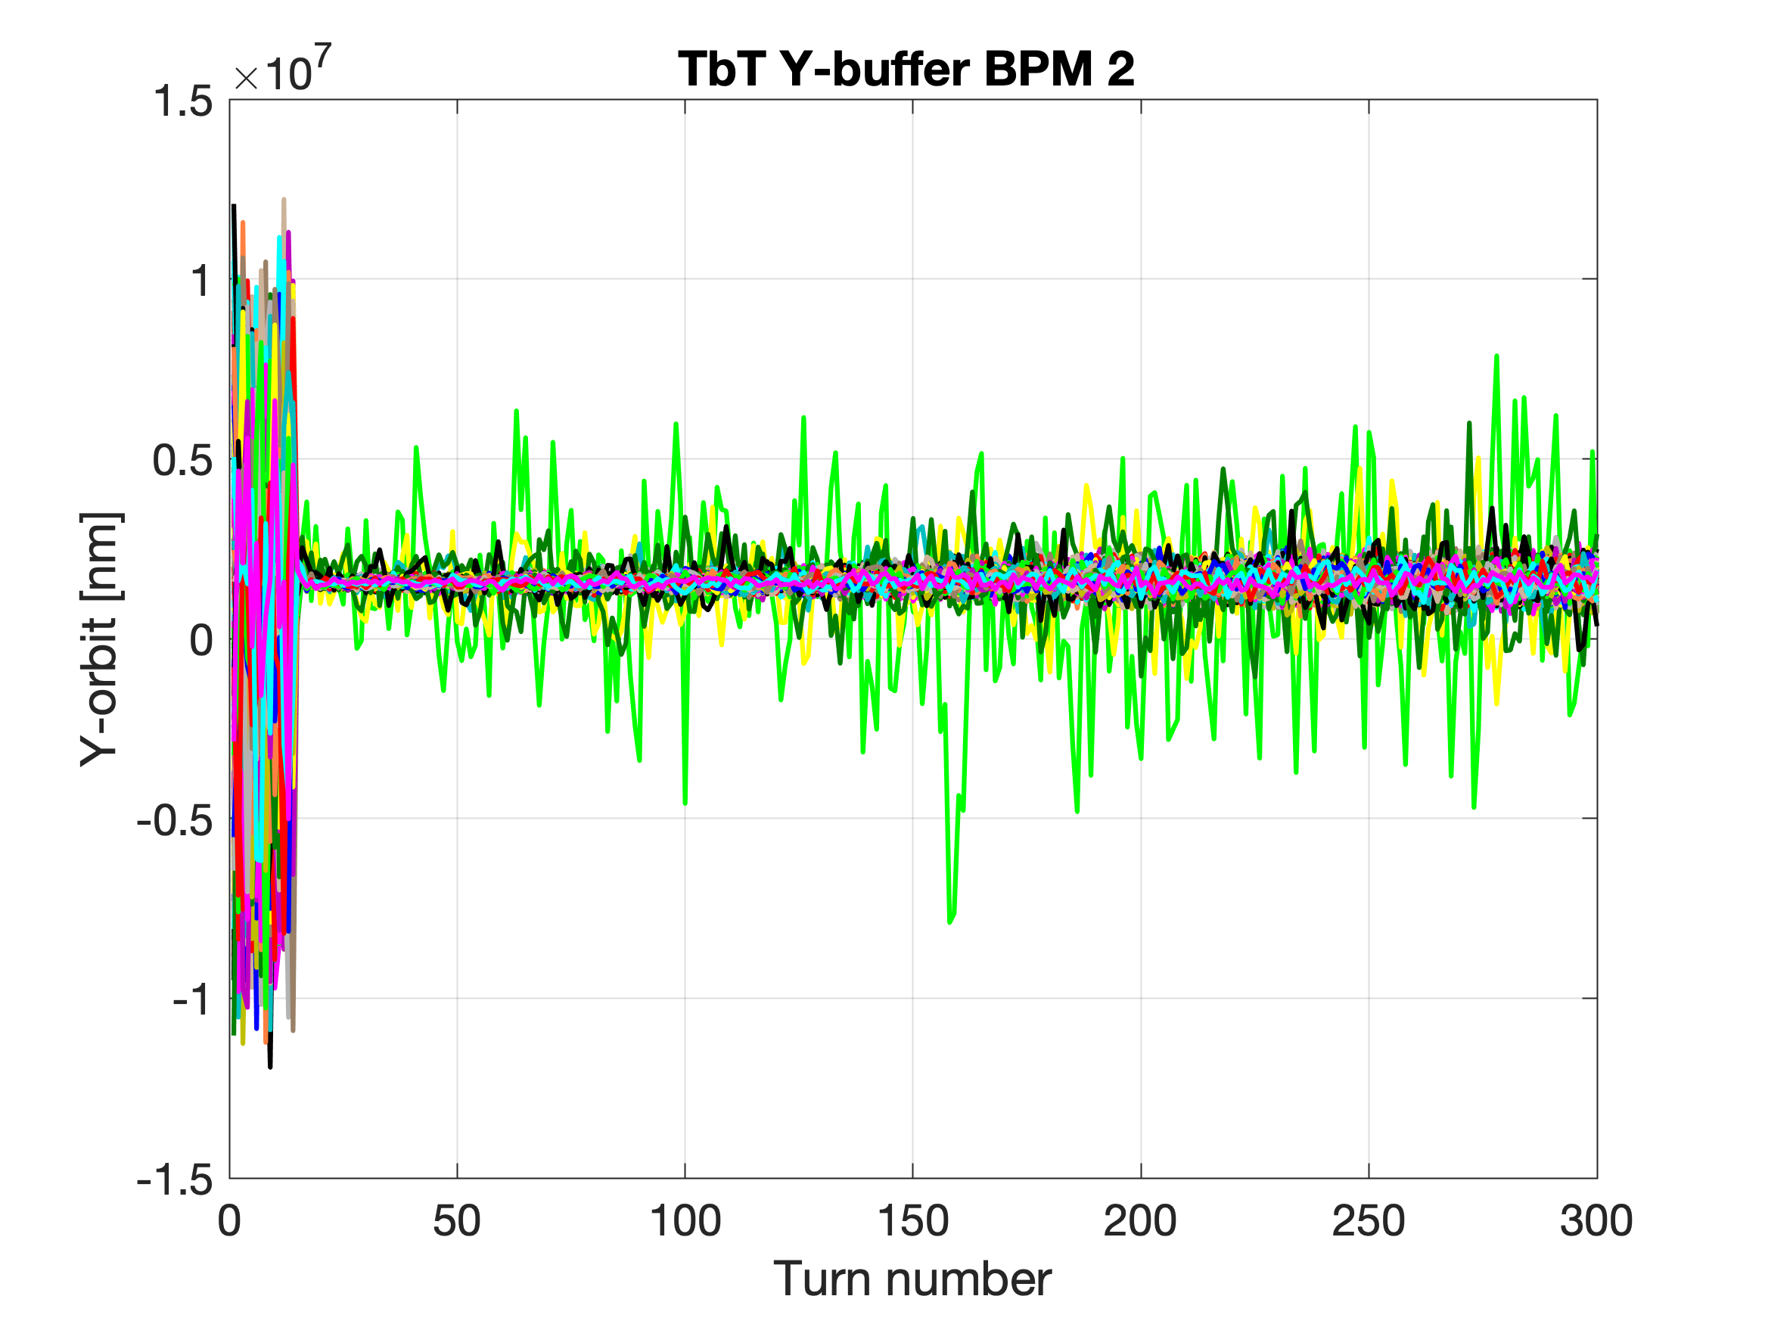
X-/Y- TbT buffer
Trig 1:500

Slide 36
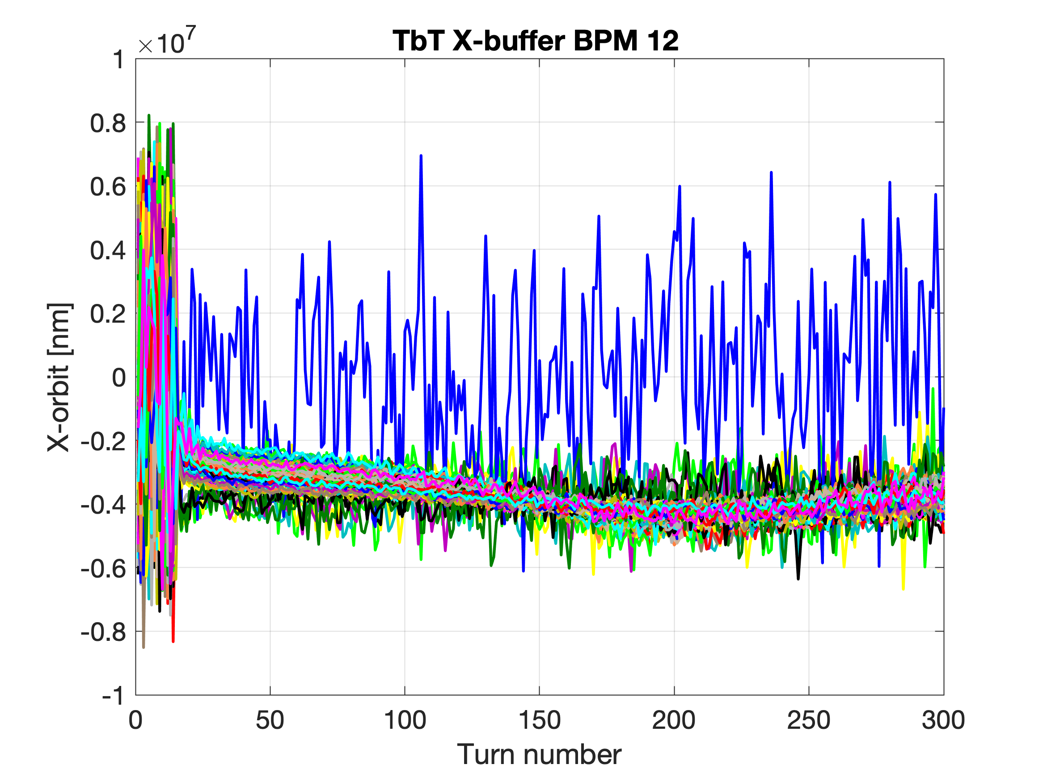

X-/Y- TbT buffer
Trig 1:500

Slide 37


X-/Y- orbit turn-by-turn
Trig #100
Turns: 16: end

Slide 38


X-/Y- orbit turn-by-turn
Trig #5
Turns: 16: end

Slide 39


X-/Y- orbit turn-by-turn
Trig #500
Turns: 16: end

Slide 40


X-/Y- orbit turn-by-turn 03/10 vs. 07/10
03/10/2022
07/10/2022
One injection
Turns: 16: end

Slide 41
14 October 2022
10h -20h
Orbit correction

Slide 42

Beam storage

Slide 43

Beam orbit (corrected)

Slide 44



Problem with BPM and Magnets

Slide 45

First trial for tune estimation

