Slide 1

Overall Status and Parameters Optimization
Paolo Craievich (PSI) on behalf of the CHART/FCCee Injector design collaboration
FCCee Injector Studies Mini-Workshop, IJCLab Orsay, 24 and 25 November 2022

Slide 2
Outline
Information from the FCC accelerator pillar meetings
Status of the parameters
Open questions
Notes:
Here the outline of my talk

Slide 3
Action Items from FCC Accelerator Pillar meetings
  Provide a design specification with the lifetime and the emittances
  Clarify the requirements for the injector chain shielding: topic of the positron source requirements - required number of electrons and the time spent in each beam operating mode. Effectively, the integrated power on the positron target as a function of the beam operating mode. This is required to define the injector shielding requirements
  Requirements for the bunker (underground)
  Clarify the costing process for the injectors
  Establish processes for costing exercise including input from external collaborators
  Develop milestones and deliverables for the mid-term cost review (second half 2023)

Slide 4
Option for the FCCee Injector complex
Electron-Positron collider
~91 km
Booster ring
electrons
positrons
Pre-Injector
0.8 – 1.5 km
SPS, ~ 7 km
Mid-term cost review: we have to provide a cost estimate for the Injector complex at 6 GeV including DR AND a cost estimate for the HE linac

Slide 5
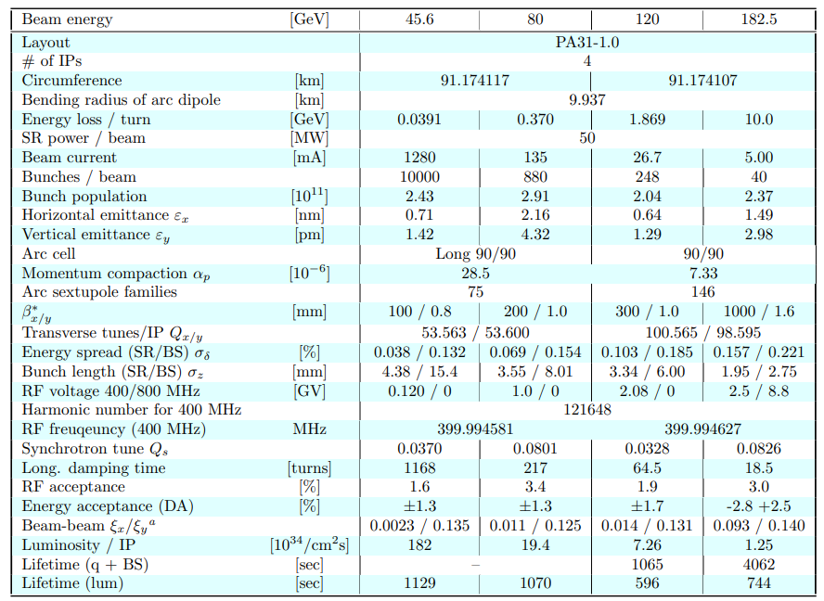
FCCee “latest” parameters

Slide 6
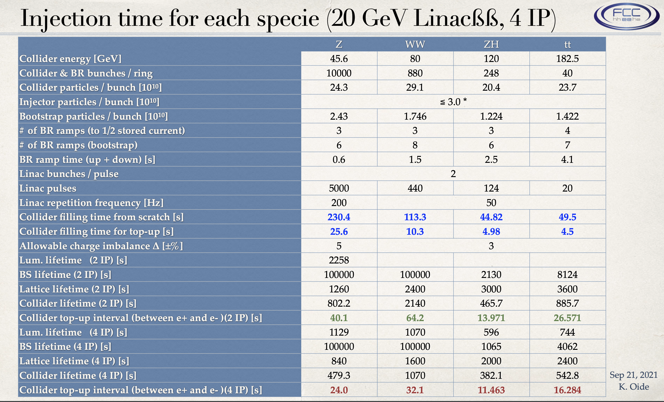
Injection time for each specie (20 GeV, 4IP)

Slide 7
Injector parameters (Z-mode)
FCC Accelerator Pillar meeting #07, 01.11.22
 | CDR0 | HE Linac | Unit
Ring for injection | SPS/PBR | BR
Injection energy | 6 | 20 | GeV
Bunch charge (max) | 4 (5) |  | nC
Repetition rate | 200 |  | Hz
Number of bunches | 2
Bunch spacing | 25 |  | ns
Normalized emittance (x, y) (rms) | 10, 10 |  | mm.mrad
Energy spread (rms) | <0.1 |  | %
Bunch length (rms) | ~1 |  | mm
ΔQ/Q | <3 |  | %
Energy spread (rms) | <0.1 |  | %
Bunches/beam | ~10000
Other important requests:
The bunch by bunch intensity will randomly vary 10% (?) to 100%, depending on the intensity balance between the collider rings

Slide 8
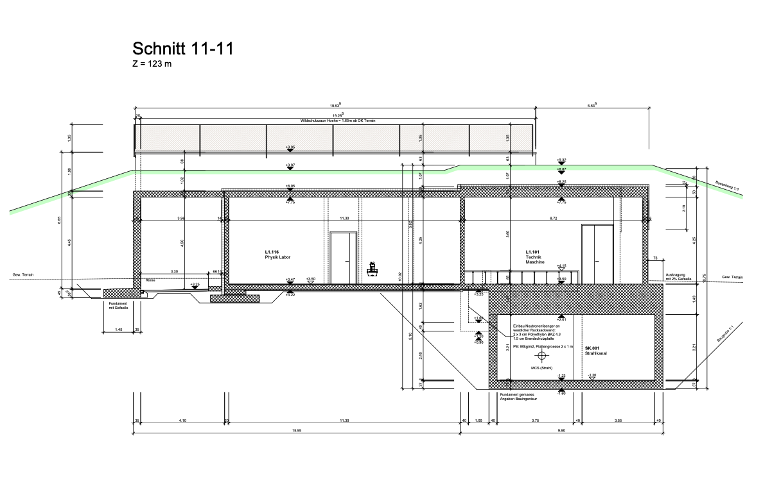
Beam Power Levels (max)
Location | Beam parameters | Beam power
Injector/e-linac/e+linac | 200 Hz, 5 nC, 1.54 GeV | 2 x 1.54 kW = 3.08 kW
Common linac | 200 Hz, 5nC, 6 GeV | 4 x 12 kW = 24 kW
Positron source | 200 Hz, 5nC, 6 GeV | 2 x 6 kW = 12 kW
Positron linac | 200 Hz, 5nC, 1.54 GeV | 2 x 7.7 kW = 15.4 kW
HE linac/trasfer lines | 200 Hz, 5 nC, 20 GeV | 2 x 20 kW = 40 kW
SwissFEL tunnel section

Slide 9
Filling pattern for the Z-mode (an attempt)
Oide’s talk with more details
In this phase changing bunches/train can meet the specifications
Total filling time from scratchg for the Z-mode 245.7 s for each species
Collider filling time for top-up 27.3 s
Luminosity lifetime 479 s (4 IP)
Collider top-up interval (between e+ and e- )(4 IP) 24 s

Slide 10
Specification for the bunch length
(and beam loading compensation)
Antoine’s talk for details about bunch length and energy spread for the BR
Trasfer line with bunch decompression/EC
BR
σ_{z}>1mm
σ_{δ}<1%
R₅₆
σ~1mm
Energy chirp for decompression
Energy spread at the injection <0.1% (rms) – key parameter → limitation on the bunch length at the linac end
Need a bunch decompression and an energy compression
More flexibility for the linac but more complex transfer line (additional X-band(?) short linac)

Slide 11
FCCee Pre-Injector complex (up to 6 GeV)
Injector is split in WPs:
  WP1: Electron source, e-linac (2.8 GHz, 200 Hz), common linac (2.8 GHz, 400 Hz), e+Linac (2.0 GHz, 200 Hz), High Energy Linac (2.8 or 5.6 GHz, 200 Hz)
  WP3: Positron generation and capture (2-bunches, 25 ns, 200 Hz)
  WP4: DR and transfer lines (Energy Compressor, DR, Transfer line, Bunch Compressor)
Outstanding question for the layout: is the DR also necessary for electron bunches?

Slide 12
Electron source
Zdenek’s talk with more information
Electron source: an injector based on a photocathode RF gun can provide electrons for both ring injection and positron production
First conceptual design of a photo-injector exists, very good emittance can be achieved even at higher charge
  DR for electron bunches can be avoided
Electron source, preliminary: shorter bunch length is possible 1.3 mm → 0.65mm
The 100% amplitude modulation of the electron and positron charge required for injection into the collider ring could be provided from an optical modulator in the laser systems, 1 laser or 2 lasers? – under investigation

Slide 13
Electron (for now) linacs
We are converging to a layout for the electron linacs (Simona’s talk)
E-linac and common linac
  Frequency is fixed (2.8 GHz)
  RF Design for S-band structures ready?
HE linac: frequency still an open point
Next step: moving a possible cost model (Jean-Yves) and length of the building

Slide 14
Repetion Rate for the Common Linac
2+2 pulses in the same rf bucket
Baseline: Common linac at 400 Hz, 200 Hz (electrons) + 200 Hz (positrons) when positron are generated
  Challenging for the RF systems (HV mods and klystrons). Klystron at 400 Hz from CETD could be feasible. HV modulators under development for other projects.
  DR has to provide a delay of 2.5 ms (more complicate timing) to allocate the positron bunches on the on the right rf bucket

Slide 15
Positron source and linac
Tomorrow we have a dedicated session on the positron source
Target design: required number of electrons and the time spent in each beam operating mode (integrated charge), it is important to establish target operating conditions beyond Z mode (beam power, how many years per mode) to get more precise DPA estimates
Outstanding question: acceptance in the damping ring is still an open question, simulation showed a positron yield up to 7 but considering an ideal window for energy and time acceptance.
  Mattia and Antonio’s talks will provide more details and will hopefully trigger a discussion
  Already enough information presented in the last coordination meeting: https://indico.cern.ch/event/1188665/contributions/4995541/attachments/2514388/4322465/20220922_coordMeet_WP4_CM.pdf
Commitment for the mid-term cost review: we have to provide a comparison between the two options, FC and SC solenoid
  FC solutions: SuperKEKB, CLIC, Pavel’s proposal

Slide 16
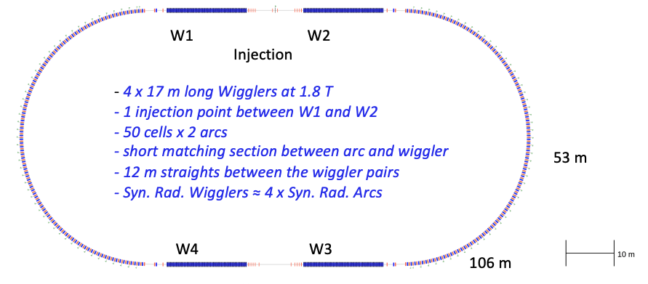
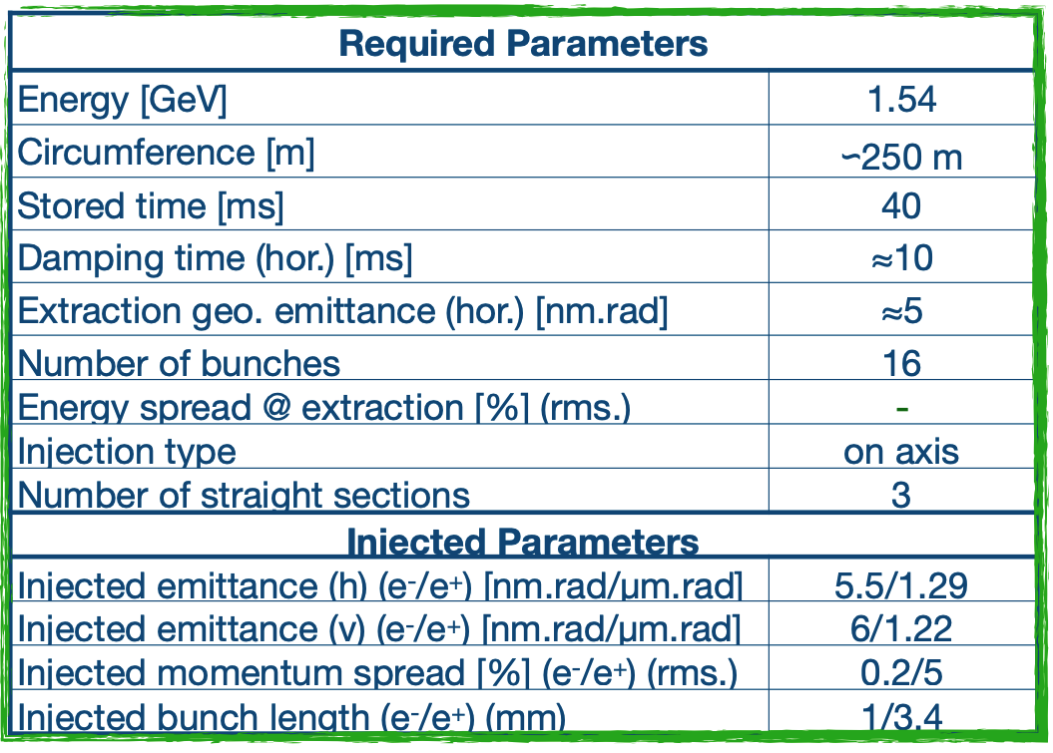
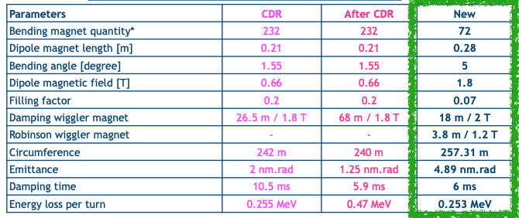
Damping ring
Parameters from the WP4 - Damping ring and transfer lines meeting on 11.11.22
~5 ms
~1.7 nm.rad
more
The concepts for the DR and the return transfer line are on-going → we have to converge!
RF systems to be decided (most likely 400 MHz)
More complicate with new specification for emittance and damping time
DR acceptance has to be optimized
C. Milardi, A, De Santis, O. Etisken

Slide 17
Injector layout with DR at higher energy
The high positron yield would allow positrons to be generated at a lower electron beam energy 2.42, 2.86 or 3.30 GeV
The large increasing of the yield (comparison to KEK) is largely due to larger aperture of the RF cavities and larger magnetic field provided by the AMD. Basically we “simply” increased the acceptance of the injector/linac system and moved the problem downstream to the damping ring
Increasing the energy of the damping (lower geometrical emittance) ring and reducing the energy of the drive beam (lower yield at the linac) creates a better balanced system
Rep rate up to 400 Hz with 2-bunch for RF pulse (as rep rate in common linac) → linac cycle 12.5 s for 2x5000 rf pulses
Dedicated linac for electron and positron up to 2.42, 2.86, or 3.30 GeV.
No return arc for positron/electron beams → it is easier to preserve emittance (no trivial issue)
DR for both electrons and positrons. In principle a higher charge with higher emittance from the photo-injector is possible because can be dumped in DR
Easier operation of the common linac, seconds instead of milliseconds between e+ and e- operations
Drawback: DR at higher energy?
  SLS-2: 2.7 GeV, circumference 288 m, magnetic peak field 1.3 T, angle 3.5 deg

Slide 18
Injector Layout & Diagnostic locations
https://indico.cern.ch/event/1209598/timetable/
Transfer Line (TL)
Emittance, Charge
Matching
Electron dump and positron TL
Energy & spread
Matching
BPMs
BPMs
BPMs
Transfer Line (TL)
Emittance
Charge
Matching
Positron source
Charge
Separation e-/e+
DR: next slide
Photo-injector
Charge
Spectrometer
Bunch compressor
Energy & Spread
Emittance
Compression
Arrival time
Matching
Dump and TL
Charge
Energy & spread
Matching
Arrival time
Energy Compressor (Bunch de-compressor)
Energy & Spread
Emittance
Compression
Arrival time
Matching

Slide 19
Concluding remarks
For now I wish you an fruitful workshop
I will prepare my concluding remarks for tomorrow

Slide 20
Backup slides

Slide 21
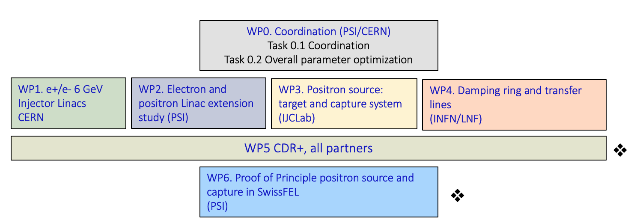
FCC-ee injector study (Project in CHART)
Collaboration between PSI and CERN with external partners:
CNRS-IJCLab (Orsay), INFN-LNF (Frascati), SuperKEKB as observer (also interested in the P³ project), INFN-Ferrara – radiation from crystal
CDR+ and cost estimate
P³ project

Slide 22

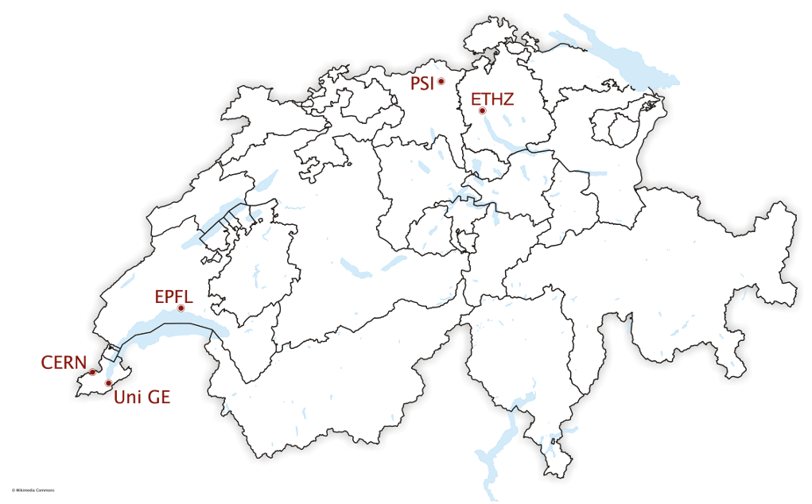
What is CHART?
CHART (Swiss Accelerator Research and Technology): umbrella collaboration for accelerator research and technology activities in Switzerland
The mission is to support the future oriented accelerator project FCC at CERN and development of accelerator concepts beyond the existing technology
The activities are focused on the support of the FCC project. I.e. High-field magnet R&D complemented by beam dynamics studies for FCC-ee, FCC-hh and FCC-ee Injector and positron production test facility
→ CHART is contributing to the FCC Feasibility Study to be delivered in 2025
Reference: https://chart.ch/

Slide 23
Concluding remarks
The pre-injector is still in the design phase and there are still some outstanding questions to be addressed
Some specifications of the pre-injector were frozen in view of the next year mid-term cost review (second half 2023)
As deliverable for the review, we must provide a cost estimate for the injector. So, after the design phase we must start with a cost model for the different part of the injector (including diagnostics)!
The type and technology for diagnostics fairly defined based on the experiences of SwissFEL (2-bunches, smaller charge), BUT the number of components and their specifications still to be defined
PSI Positron production (P³) project
  Some key diagnostics for the positron source will be tested, broadband pickups, energy spread and charge measurements

