Slide 1
WP1 parameters and layout status and plans
Alexej Grudiev
24/03/2022

Slide 2
Outline
WP1 status: brief overview
Latest update of parameters from Acc. Pillar on Nov. 15th 2022
Baseline layout and parameters at BR injection
Discussion and possible scenarios towards final baseline design of linacs
Discussion: What parameters are missing to complete baseline design ?

Slide 3
HE Linac
Baseline layout
Common Linac
2.8 – 5.6 GHz
200 Hz
Electron source
2.8 GHz
200 Hz
2.8 GHz
2 x 200 Hz
SPS (PBR)
20 GeV
eLinac
6 GeV
BR
1.54 GeV
pLinac
1.54 GeV
EC
DR
2.0 GHz
200 Hz
BC
Positron source
200 Hz
positron
Common linac at 400 Hz
200Hz + 200 Hz
200 Hz electron
V_{rf}
5
10
t [ms]
40
0

Slide 4
Electron source

Slide 5
Several options proposed we have to chose
Simona
Bettoni

Slide 6
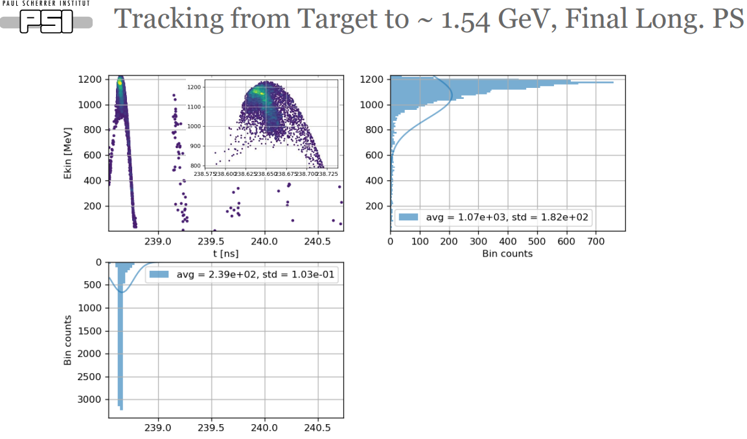
pLinac
Mattia Schaer

Slide 7
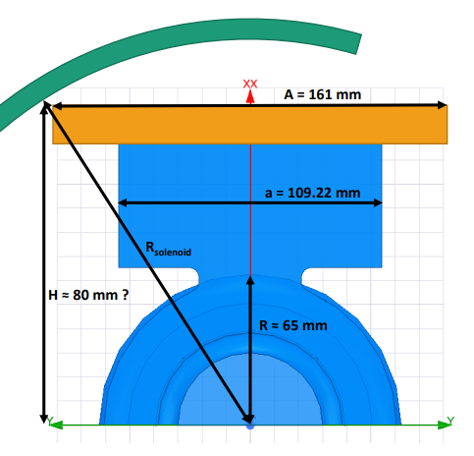
RF structures for pLinac 2 GHz

Slide 8
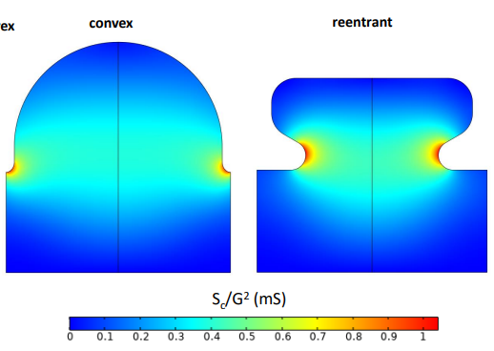
RF structures for eLinac and common linac 2.8 GHz

Slide 10
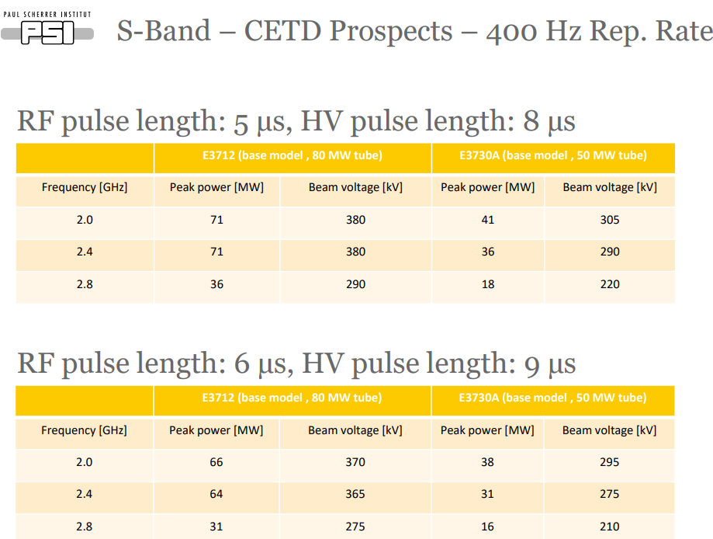
RF power sources at 2 and 2.8 GHz
Jean-Yves Raguin

Slide 11
Latest update of parameters at BR injection
parameter | Baseline | Alternative | Comments
Ring for injection | BR | SPS or PBR | Destination
Injection energy [GeV] | 20 | 6 | Fixed
Bunch population [1e10] | 2.5 |  | 4 nC, A. Chance, 15/11/2022
Number of bunches | 2 | 2
Repetition rate [Hz] | 200 | 200
Bunch spacing [ns] | From 15 to 60 |  | Sub-harmonics of 200 MHz, 2.5ns
Normalized transverse emittances (RMS): γε_x,y [um] | <10, <10 |  | A. Chance, 15/11/2022
Energy spread (RMS) [%] | <0.1 |  | A. Chance, 15/11/2022
Bunch length (RMS) [mm] | <7 |  | A. Chance, 15/11/2022
Stability at injection in BR for bunch length ~ 1 mm will be studied by BR team.
If longer bunches are required, TL will be adapted to stretch them.

Slide 12
Possible scenario for beam evolution for electron chain, nominal beam
parameter | e-source | eLinac | Common | HE linac | comments
Injection energy [GeV] |  | ~0.2 | 1.54 | 6
Energy gain [GeV] | ~0.2 | ~1.52 | 4.46 | 14
Extraction Bunch population, (charge) [1e10, (nC)] | 4.13, (5.0) | 3.0, (4.8) | 2.88, (4.6) | 2.75, (4.4) | 5% margin on each step. 10% for TL+BR
Extraction Normalized transverse emittances (RMS): γε_x,y [um] | <4.0 | <5.1 | <6.4 | <8 | 20% margin on each step. 20% for TL+BR
Energy spread (RMS) [%] |  |  |  | <0.1
Bunch length (RMS) [mm] |  |  |  | <7
Bunch length and energy spread specification are given at 20 GeV.
At lower energy stages they can be different depending on what is better for linacs or e-source.

Slide 13
Positron production scenarios
Electron beam for positron production shell have the same parameters as the nominal beam
This minimizes work and number of designs
This can be refined later when we have more consolidated design of nominal electron beam and positron production
pLinac: takes the beam 6D phase space after positron source (WP3) and transport and accelerate it to DR injection (WP4). Some iterations probably to happen

Slide 14
Top-up scenarios
200 Hz, 2 bunches per pulse must be provided also during top-up
Intensity of 2 bunches must be adjustable independently
Range of intensity from 0 to 100%. To be confirmed and better defined by Accelerator Pillar
Bunches with different intensities must have the other parameters to be “not very different” at BR. To be better defined by Accelerator Pillar
Thus, linac operation at different bunch intensities must be “transparent”, no changes in magnets and, if possible, in RF settings.

Slide 15
What do we need to deliver: short term plan
Mid 2023: baseline design of ALL linacs
RF structure: RF frequency, aperture, gradient, RF unit layout
Quadrupoles: aperture, gradient
Overall layout including linacs to linacs transfer and matching => required space
Next week Acc. Pillar meeting: What information we still missing to do the baseline design in the next 6 months
Top-up requirements: intensity, timing, accuracy
…

