Slide 1
Electron sources and pre-injector
Zdenek Vostrel
FCC-ee Injector Studies Mini-Workshop
14 November 2022

Slide 2
Overview
Summary of previous work
Study of initial Gaussian distribution
Top-up injection studies

Slide 3
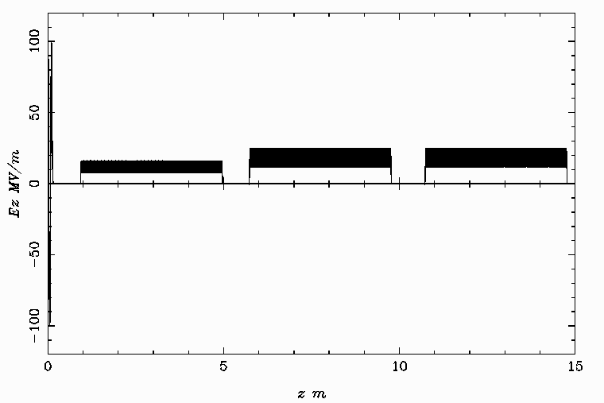
The electron gun
Overview
What do we optimise?
MaxE = 100 MV/m
MaxE = 16.2 MV/m
MaxE = 25 MV/m
MaxE = 25 MV/m
Electron emission:
Initial distribution
Emission time
0.7 m
5.7 m
10.7 m
Phi(1)
MaxB(1)
Phi(2)
Phi(3)
Phi(4)
Bunch energy at the end: ∼ 200 MeV

Slide 4
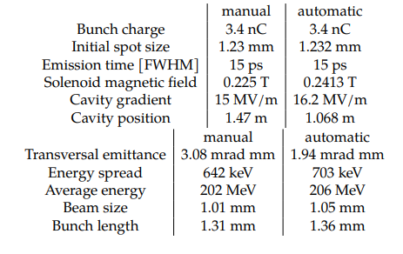
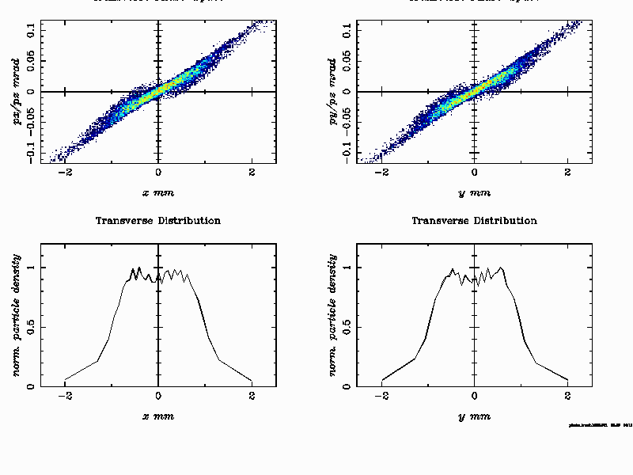
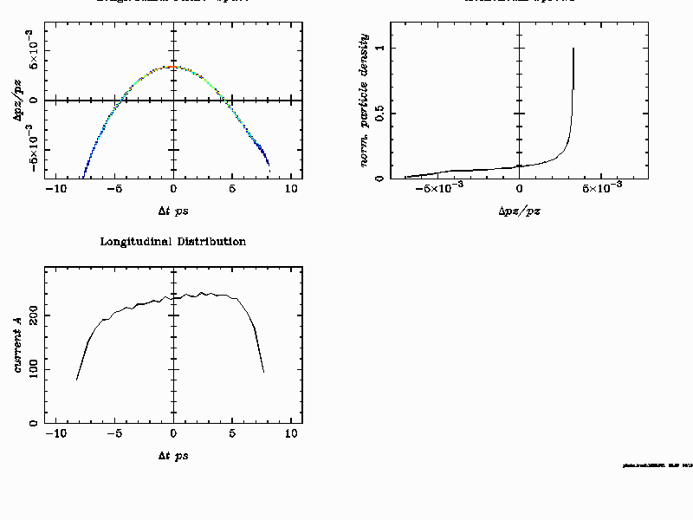
Previous work
Tomas Brezina – Technical Student before me
Focused on optimalisation of 3.4 nC charge
Results were used as an input for Simona

Slide 5
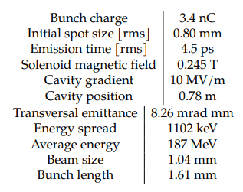
Previous work
Tomas: Uniform, 5 nC
Initial spot size | 1.5 mm
Laser pulse length (FWHM) | 15 ps
Gun solenoid | 0.2413 T
TW Acc. Gradient | 16.2 MV/m
First acc. Section at | 1.068 m
Tomas Brezina – Technical Student before me
Brief study of Gaussian distribution
Large increase in emittance → work for me
Study of 5 nC bunch with uniform distribution
Emittance RMS | 3.1 mm
Energy Spread RMS | 0.4 %
Energy | 206 MeV
Beam size RMS | ~ 0.7 mm
Bunch length RMS | 1.4 mm
Uniform
Gaussian

Slide 6
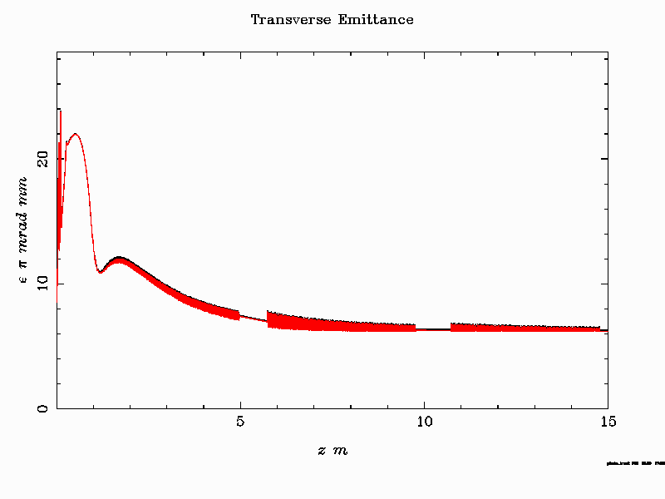
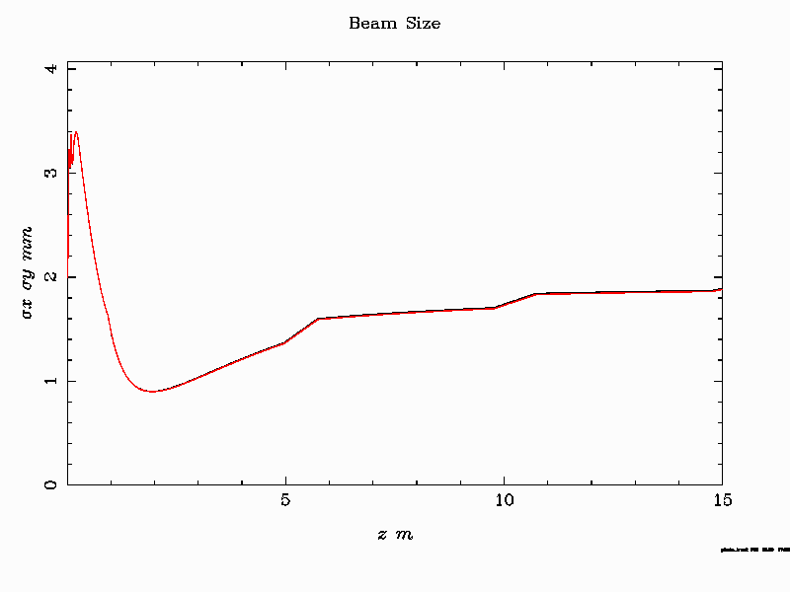
Previous work
Tomas: Uniform, 5 nC
Initial spot size | 1.5 mm
Laser pulse length (FWHM) | 15 ps
Gun solenoid | 0.2413 T
TW Acc. Gradient | 16.2 MV/m
First acc. Section at | 1.068 m
Steffen – Simona´s request for shorter bunches
Shortened bunch by decreasing bunch length & increase spot size
Bunch can be shorten at the expense of the emittance
Emittance RMS | 3.1 mm
Energy Spread RMS | 0.4 %
Energy | 206 MeV
Beam size RMS | ~ 0.7 mm
Bunch length RMS | 1.4 mm
Uniform distribution, 5.0 nC, spot size: 2.0 mm, Bsol:0.243 T, Accdist:0.9 m, pulse length 4 ps
Emittance: 6.1 um, beam size: 1.9 mm , bunch length: 0.65 mm, deltaE= 0.24 %
Steffen: Uniform, 5 nC

Slide 7
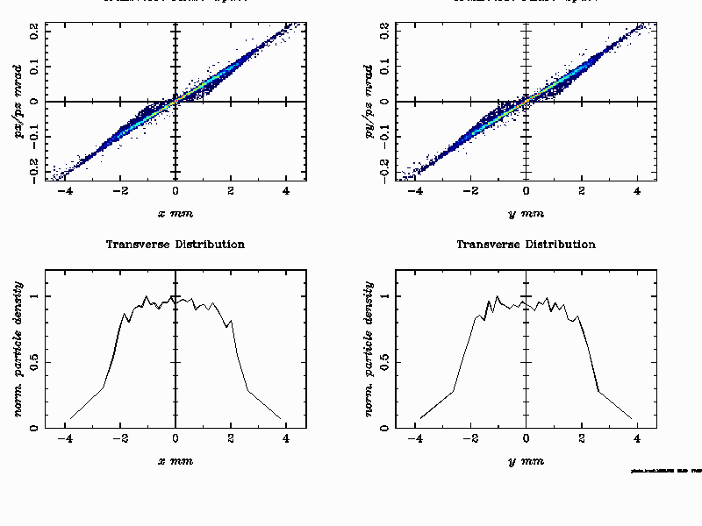
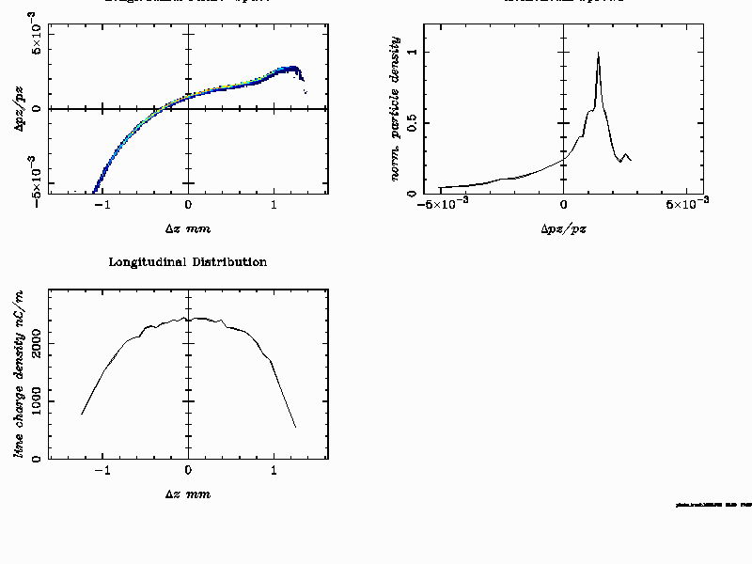
Previous work
Comparison of phase spaces
Steffen:
Uniform, 5 nC
Emission time: 4 ps
Aim: shorter bunches
Tomas:
Uniform, 5 nC
Emission time: 15 ps
Aim: best emittance

Slide 8
Gaussian transversal distribution
Tomas
Uniform
Gaussian
Optimalised for Gaussian distribution
Difference between Gaussian and Uniform initial distribution is not that large
Beam parametres after the aparature (15 m)
Bunch parameter | Gaussian Initial Distribution | Uniform Initial Distribution
Transversal emittance | 6.2 mm mrad | 4.9 mm mrad
Beam size RMS | 1.4 mm | 1.6 mm
Longitudial emittance | 400 keV mrad | 281 keV mrad
Bunch length RMS | 1.03 mm | 0.9 mm
Energy spread RMS | 576.5 keV | 350 keV
Average energy | 205.7 MeV | 204.1 MeV
Total charge | 5.5 nC | 5.5 nC

Slide 9
Top-up injection
1. Optimise for each charge
Complicated to change at high frequency
3. Keep charge density constant
Optimise only for one given charge (which would be mostly used)
Change spot size so the charge density remains contant → similar space charge effects
2. Keep gun and spot size constant
Increase only charge (→ intensity of inducing laser) realistic?

Slide 10
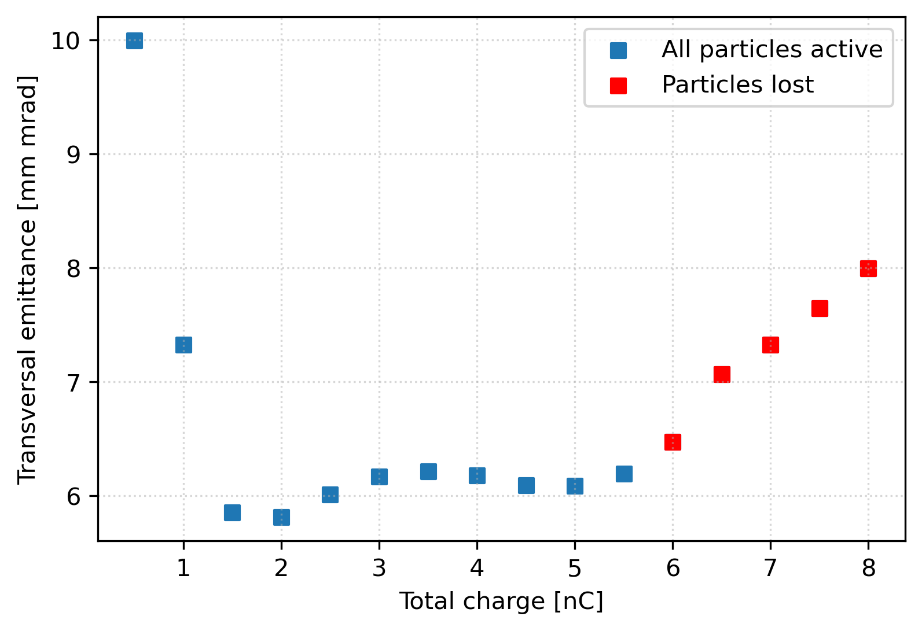
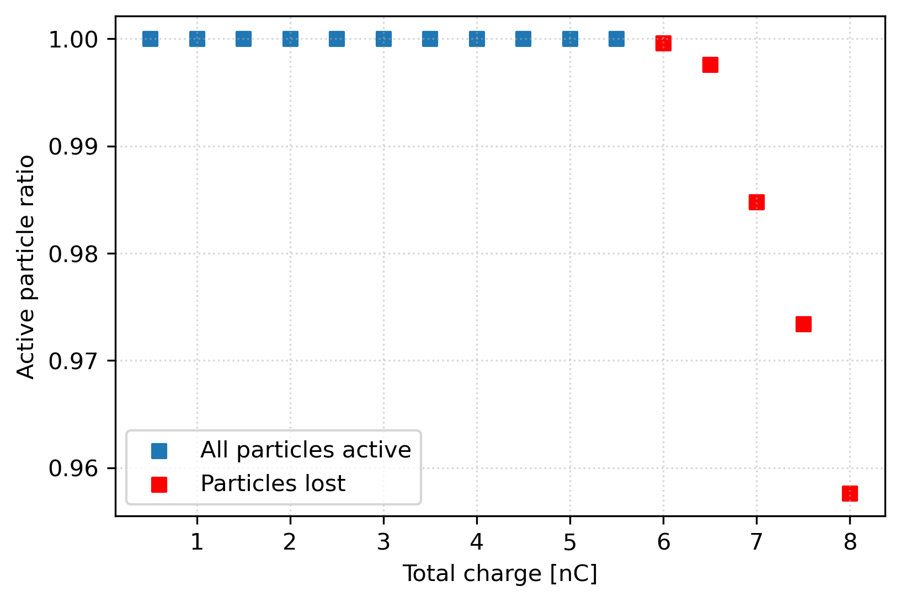
Charge variation at constant gun parameters
I kept the optimised parameters used to obtain results for Gaussian distribtion
Total charge scan
Can be compensated by magnetic field
How conservative do we want to be?
Particles lost at the gun

Slide 11
Charge variation at constant gun parameters
The particles are lost in the gun itself
Gun parameters
Change charge density
Adjust the phase of the gun (didn´t work well)
Transversal size (sig_x, sig_y of the initial Gaussian distributions)
Longitudinal size (emission time Lt)

Slide 12
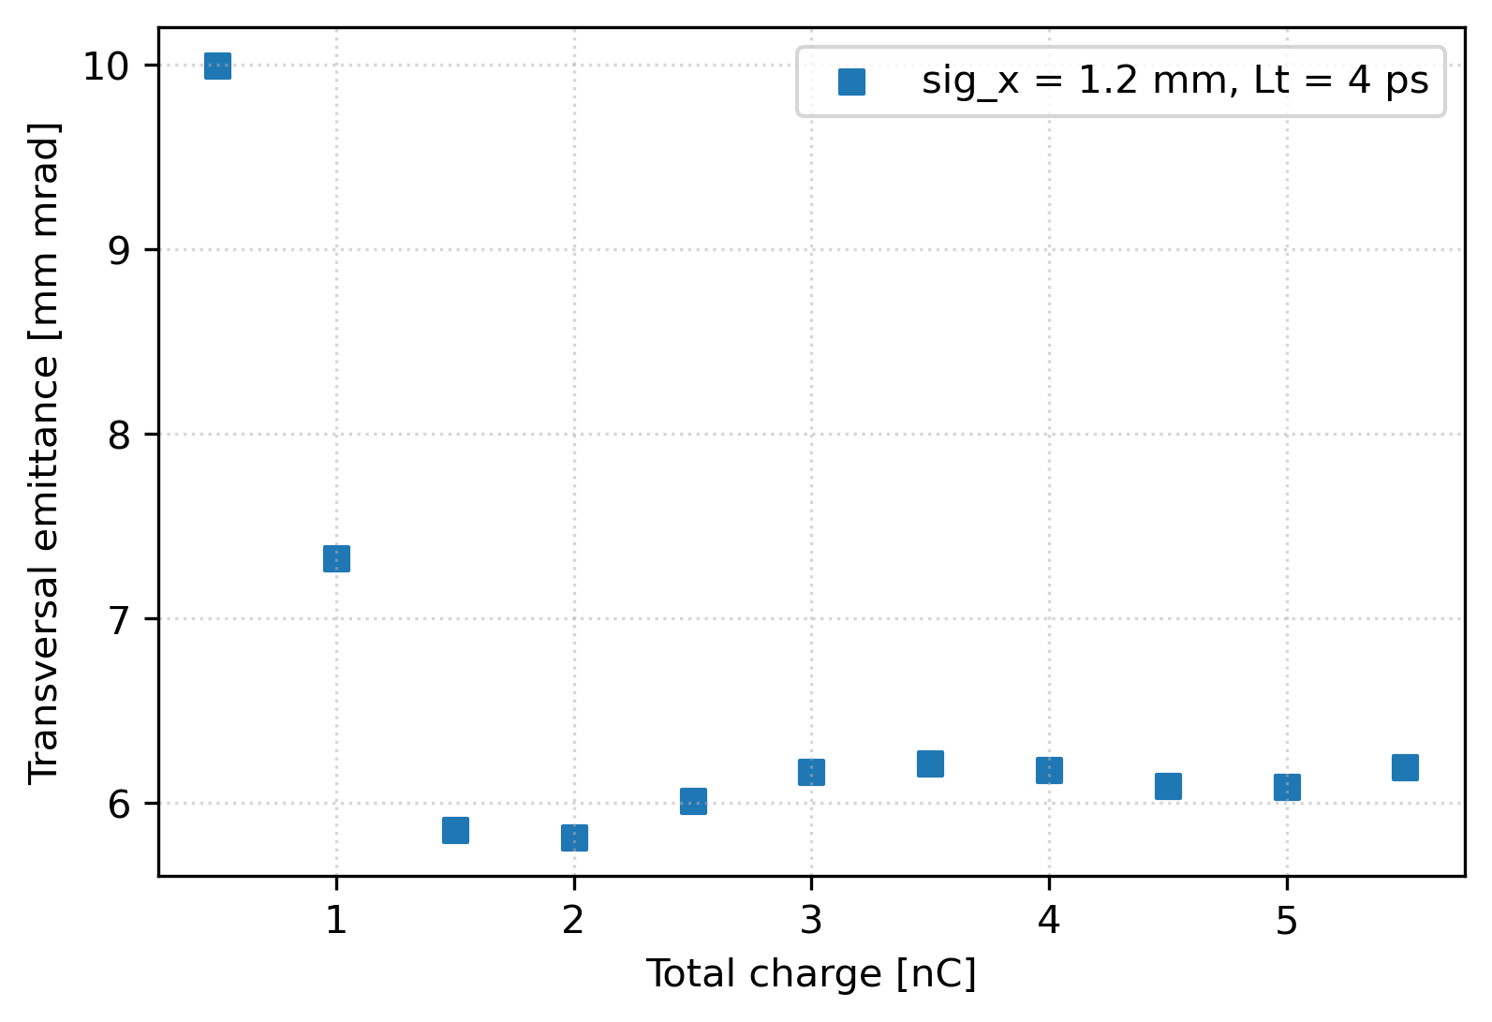
Increase initial bunch size
Change charge density
Transversal size (sig_x, sig_y of the initial Gaussian distributions)
Longitudinal size (emission time Lt)

Slide 13
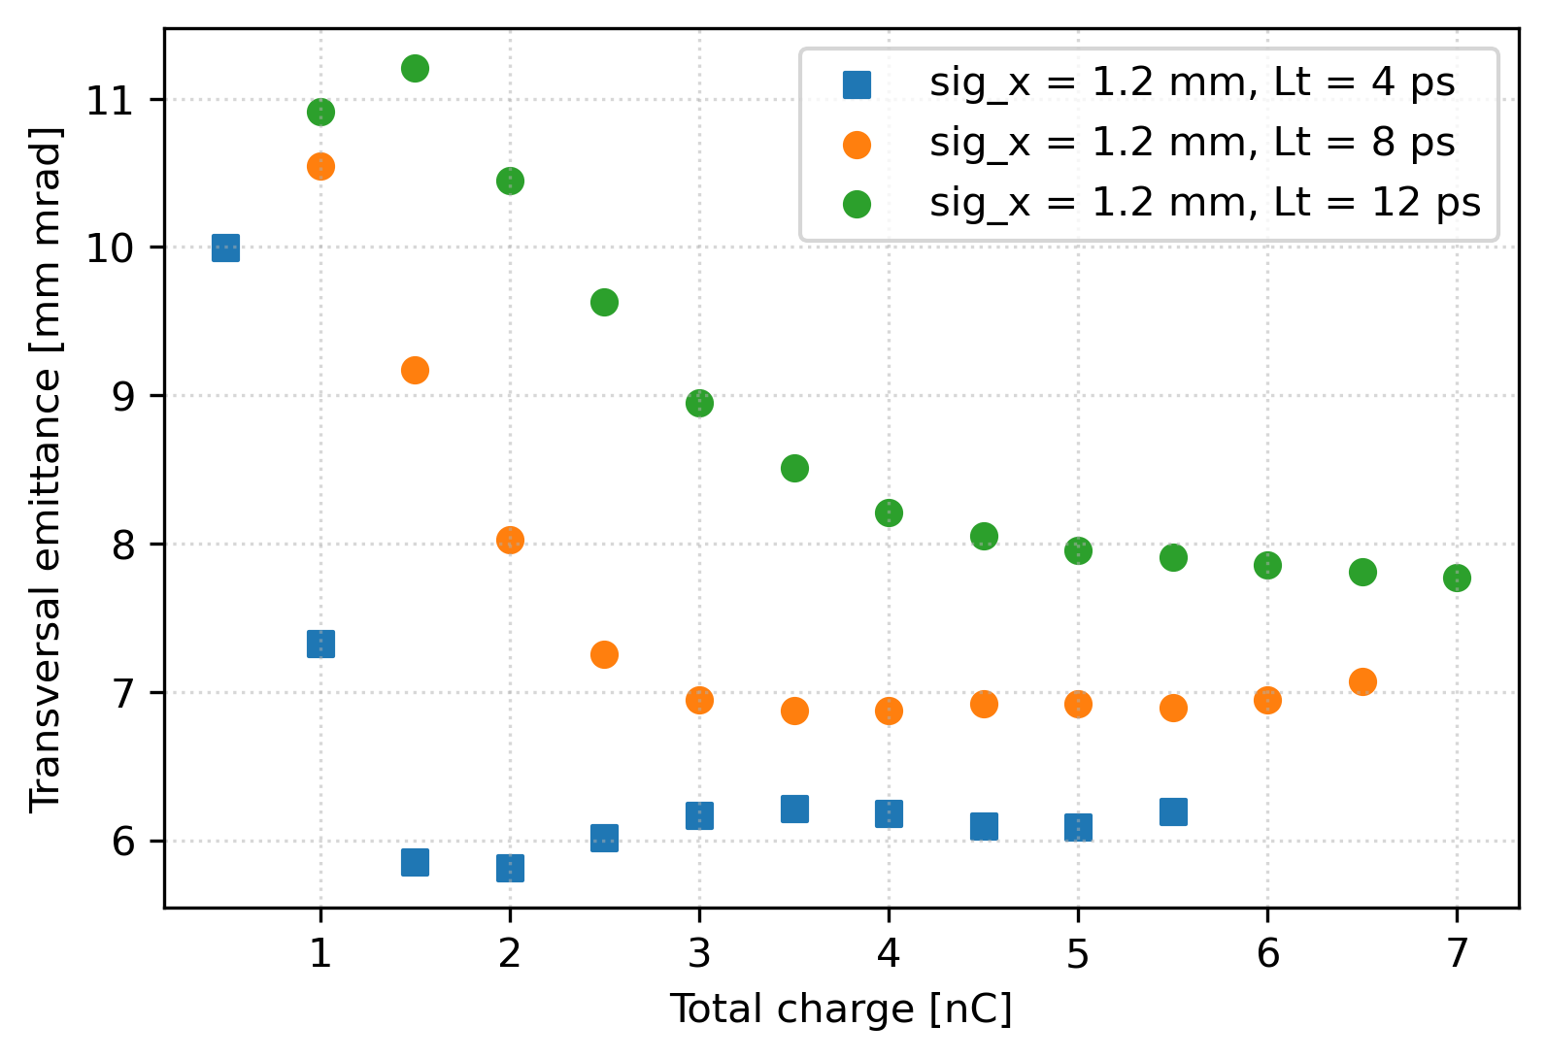
Increase initial bunch size
Change charge density
Transversal size (sig_x, sig_y of the initial Gaussian distributions)
Longitudinal size (emission time Lt)

Slide 14
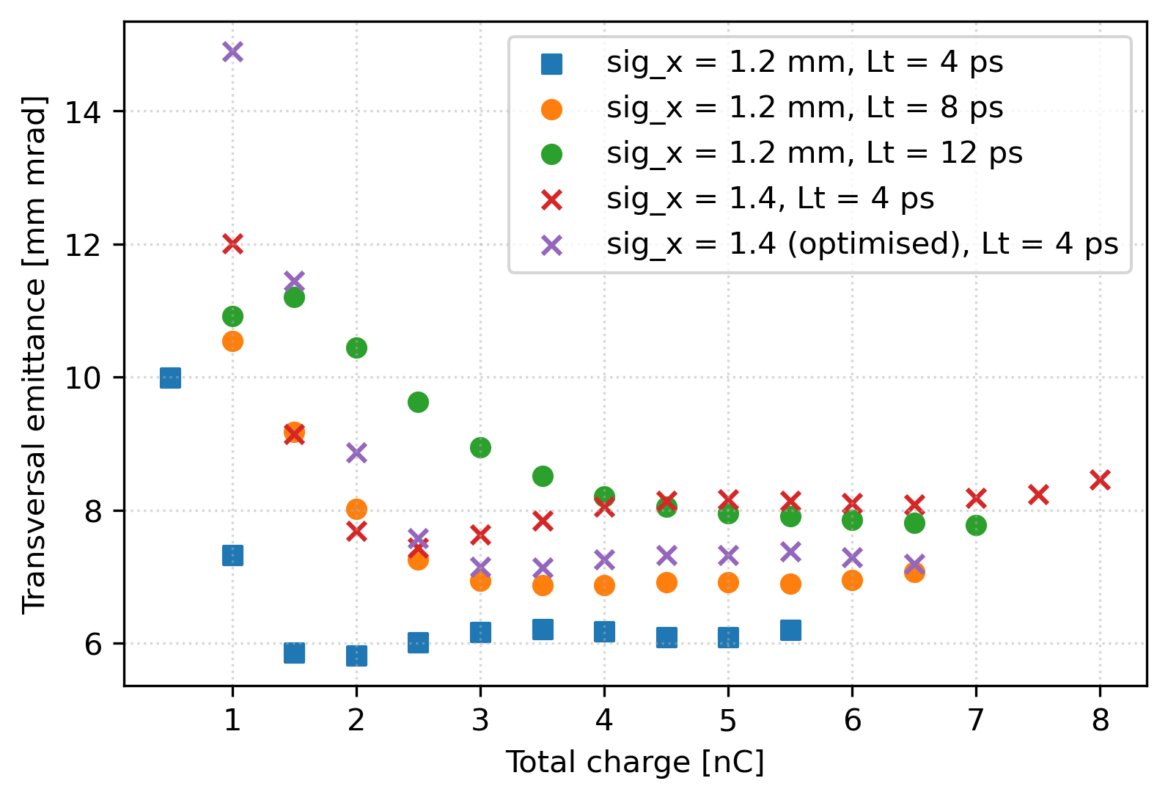
Increase initial bunch size
Change charge density
Transversal size (sig_x, sig_y of the initial Gaussian distributions)
Longitudinal size (emission time Lt)
3-6 nC → emittance ∼ constant
Emission surface increase ∼ emission time increase
Large increase of emittance for lower charge (can be optimised by the solenoid B field)
How conservative do we want to be? (large margin → worse emittance)

Slide 15
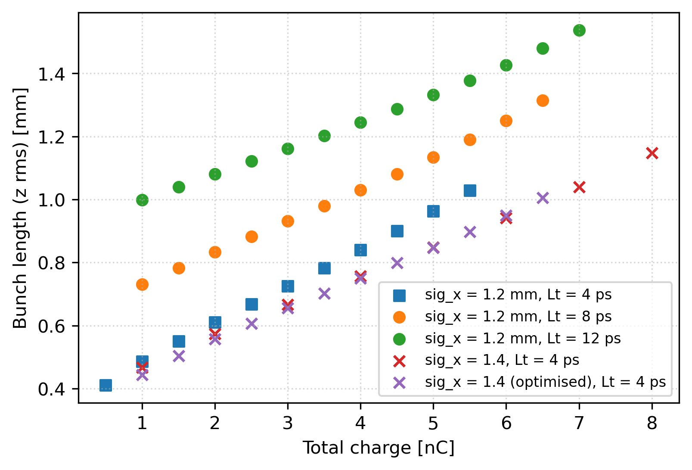
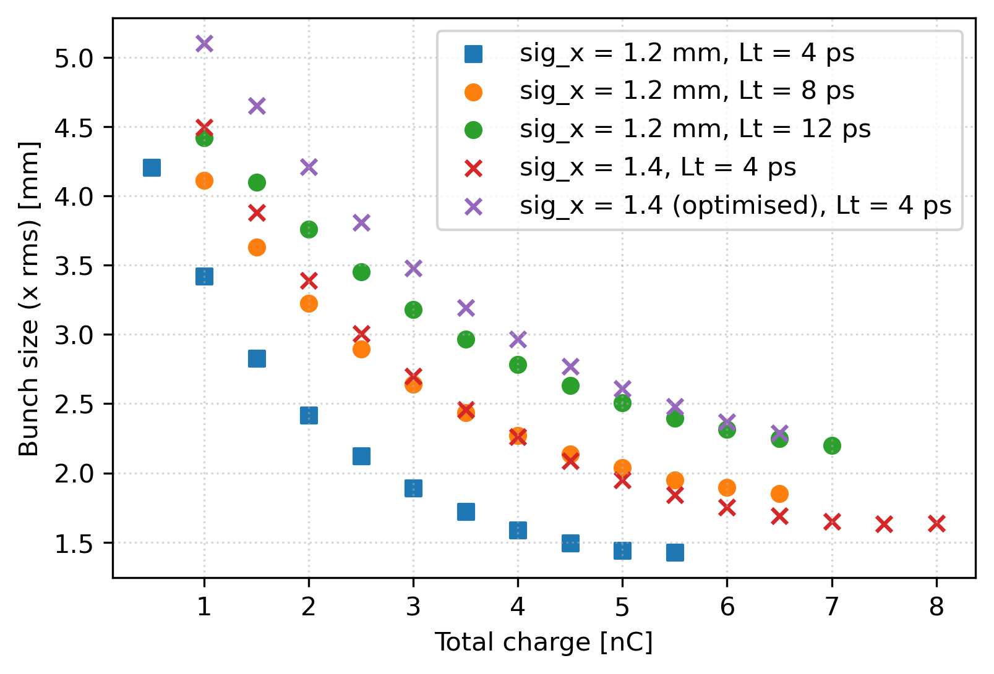
Increase initial bunch size
Better to increase transversal beam size → better bunch length
Large variation of bunch length and size for charge variation with constant gun parametres

Slide 16
Top-up injection
1. Optimise for each charge
Complicated to change at high frequency
3. Keep charge density constant
Optimise only for one given charge (which would be mostly used)
Change spot size so the charge density remains contant → similar space charge effects
2. Keep gun and spot size constant
Increase only charge (→ intensity of inducing laser) realistic?

Slide 17
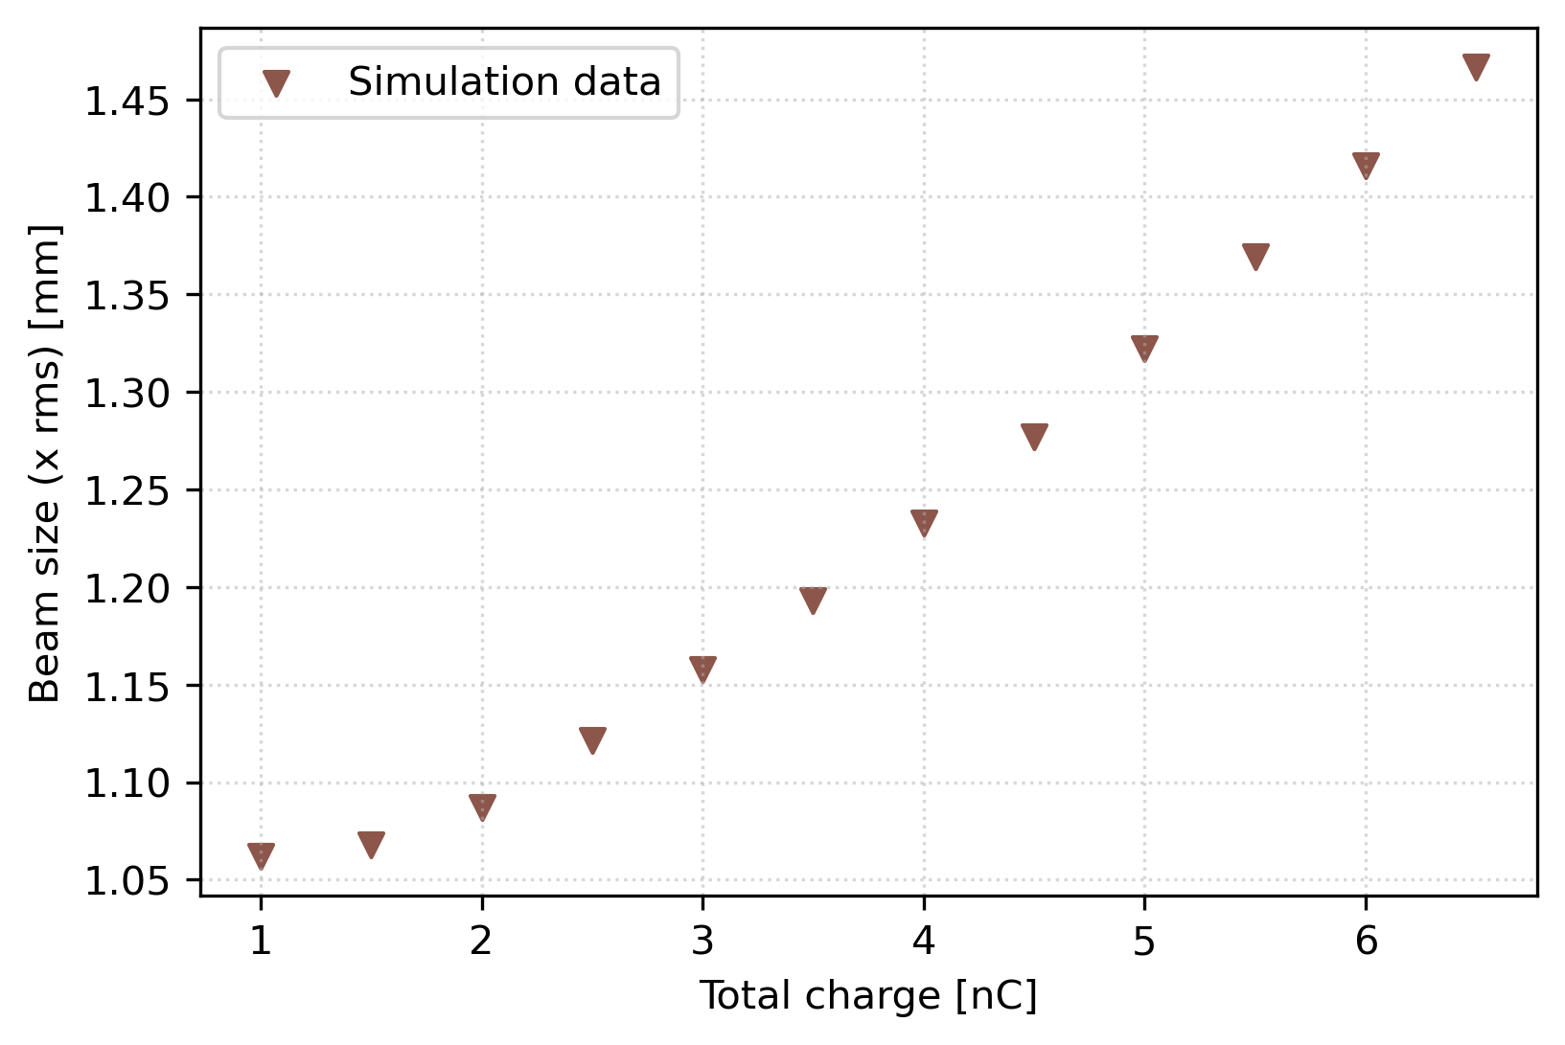
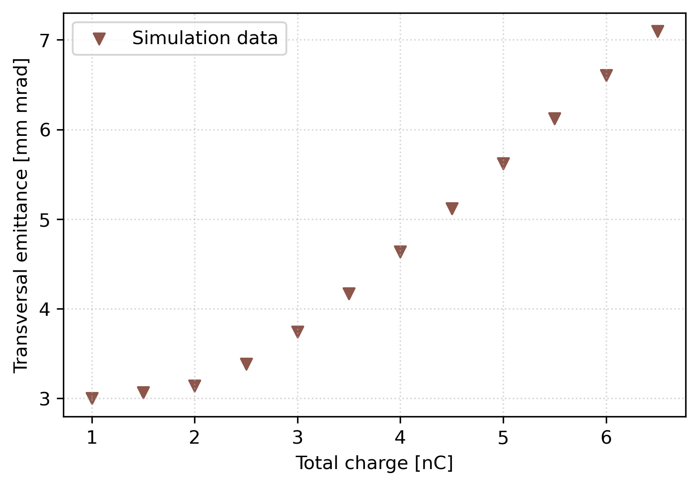
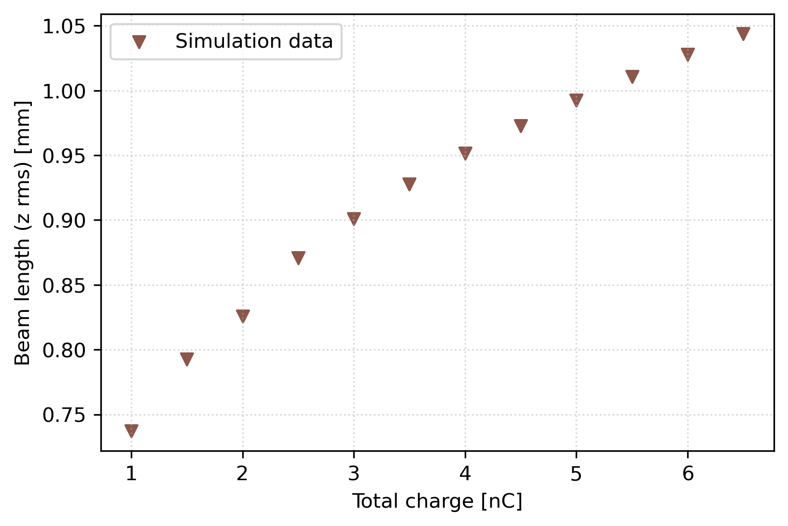
Compensate bunch size to keep Q density constant
Same charge density → similar space charge effects
Changing emittance
More stable beam size (compared to fixed parameters)
Optimised gun parameters for Sig_x = 1.2 mm, Lt = 4 ps
Last simulated charge = 6.5 nC (higher charge not tested)

Slide 18
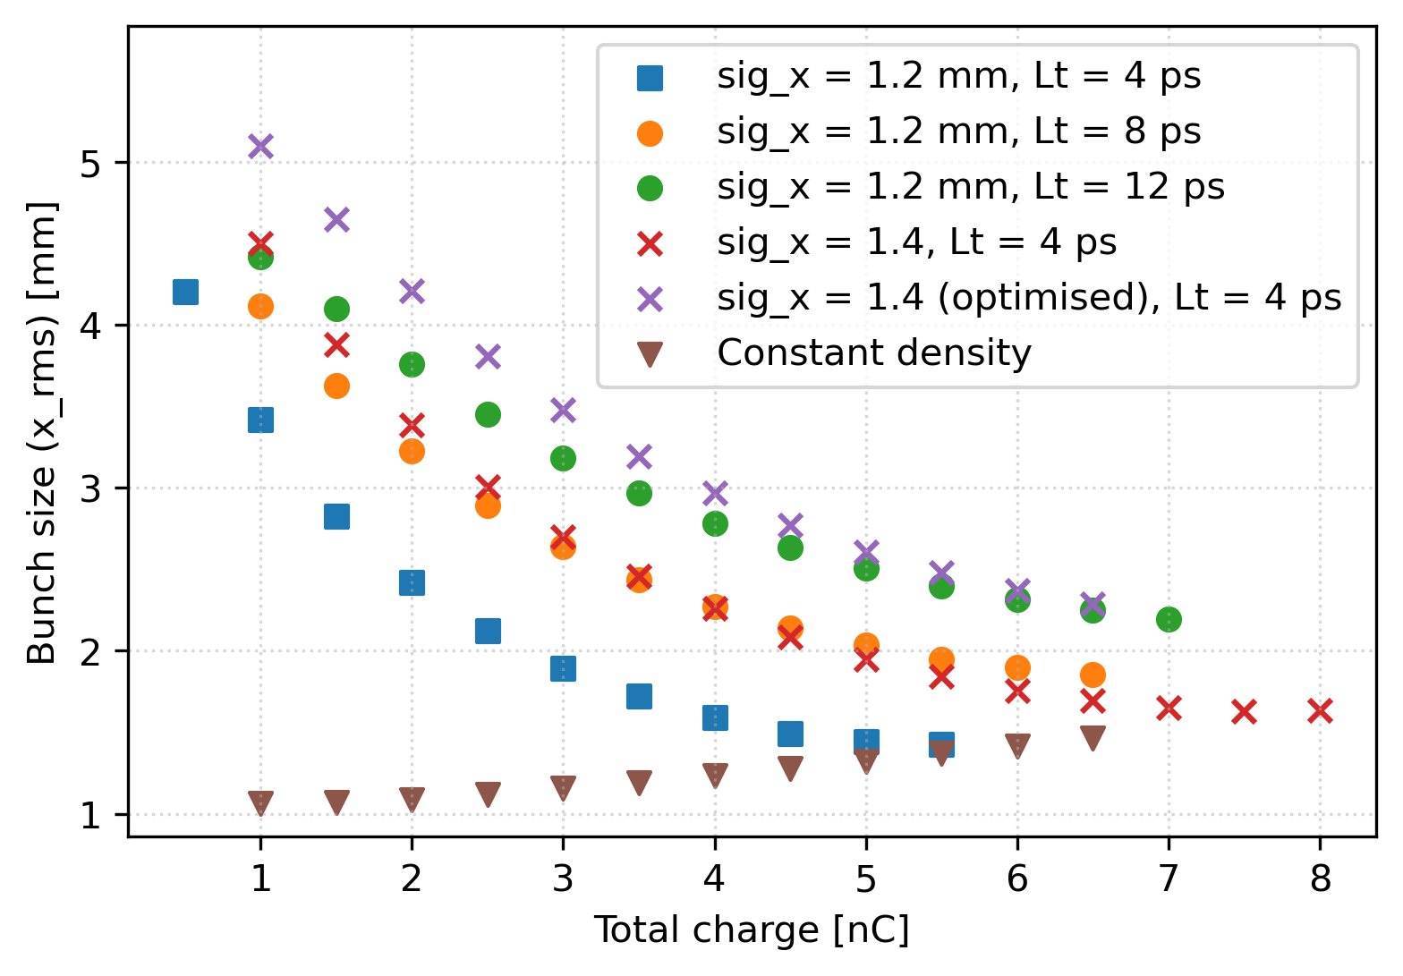
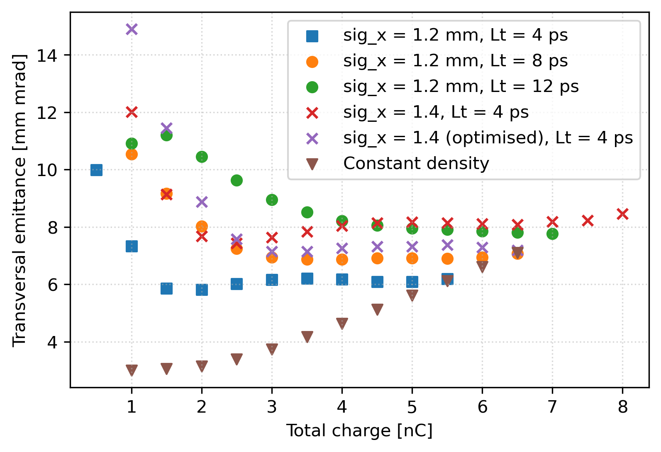
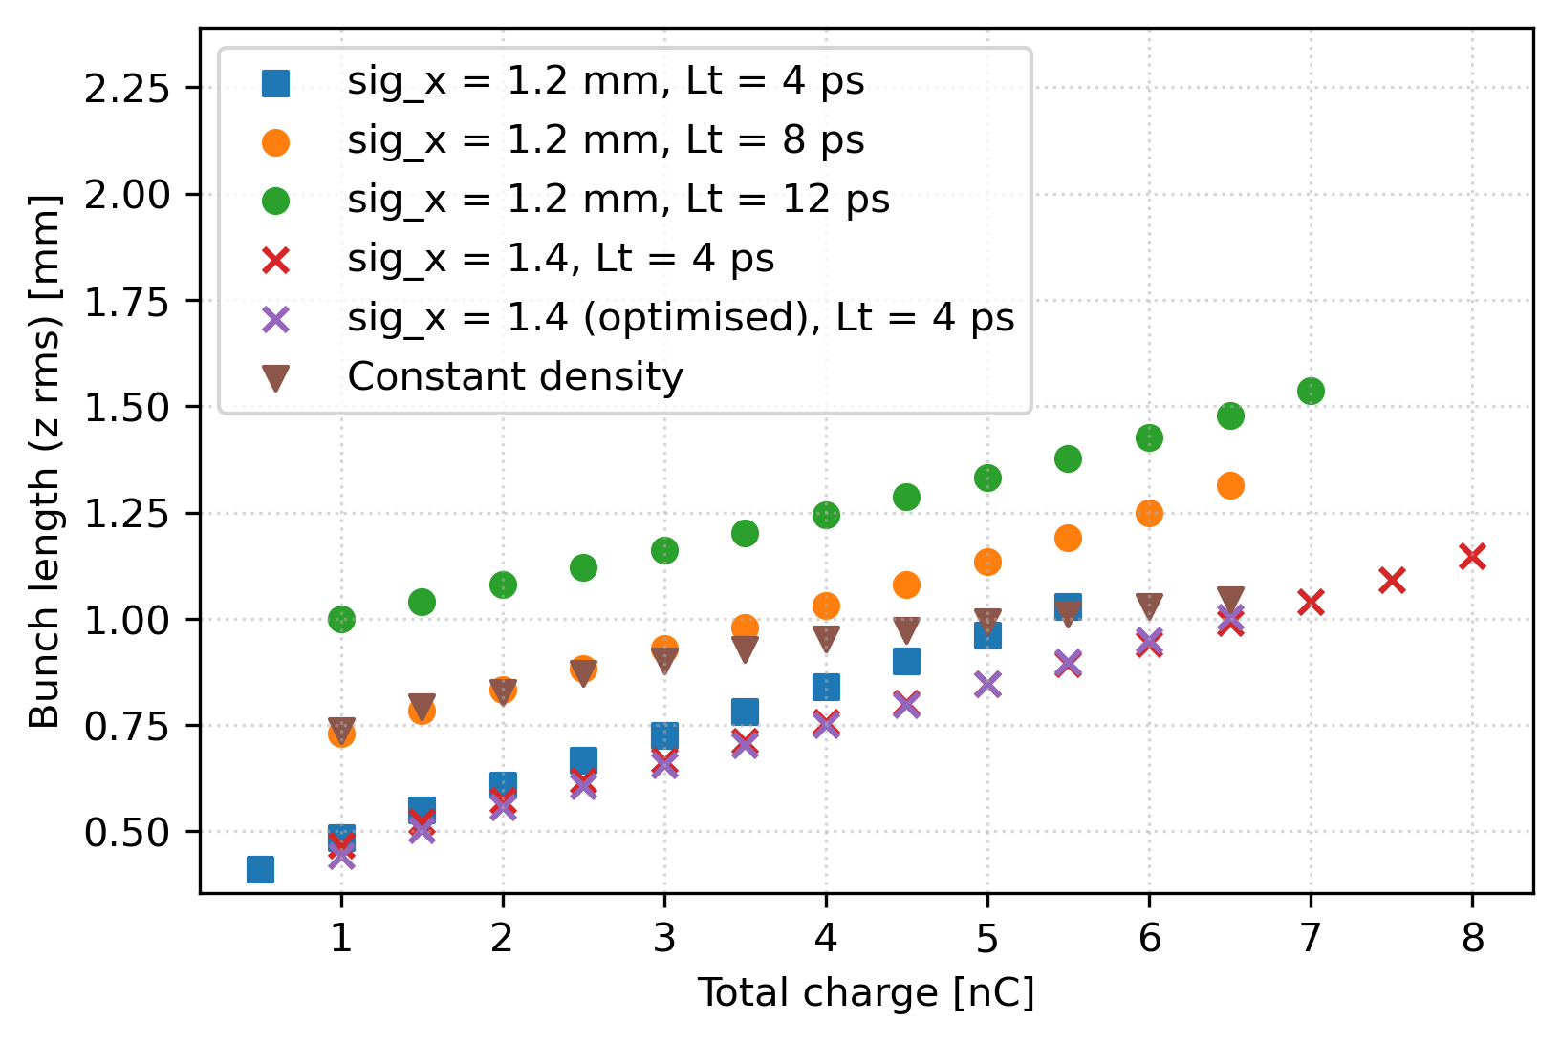
Compensate bunch size to keep Q density constant
Same charge density → similar space charge effects
Changing emittance
More stable beam size (compared to fixed parameters)
Optimised gun parameters for Sig_x = 1.2 mm, Lt = 4 ps

Slide 19
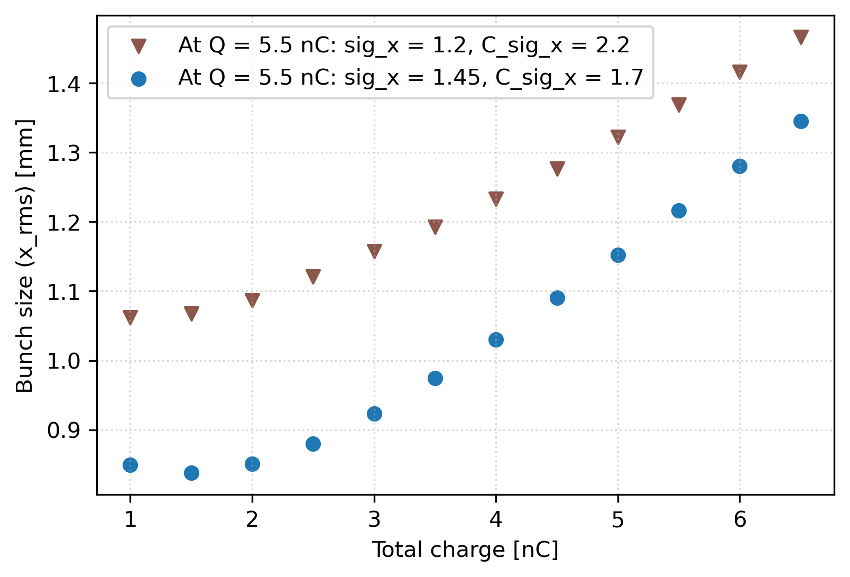
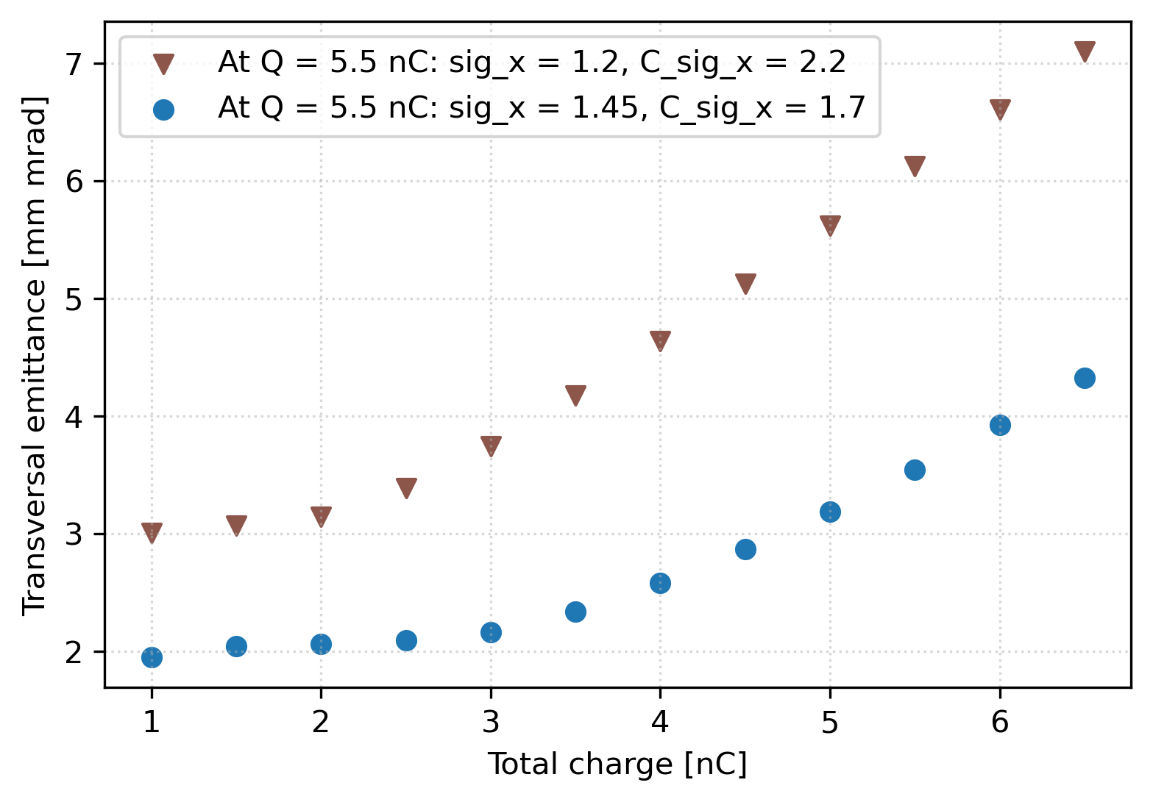
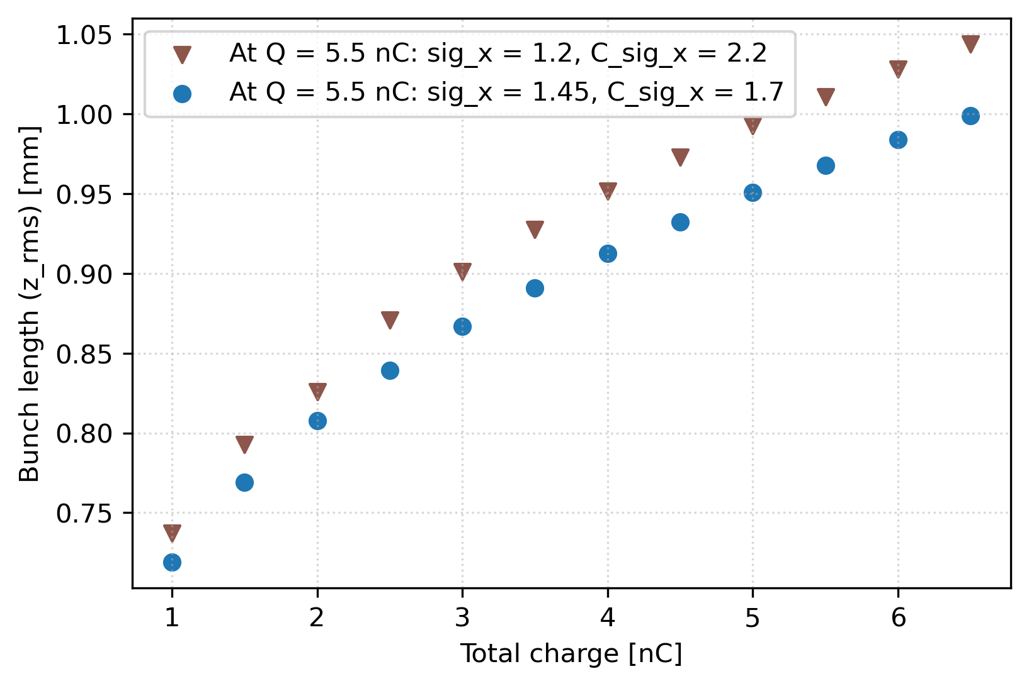
Improve the charge density compensation method
Motivated by Simona → finding optimal value of C_sig_x (which I kept constant previously)
Optimalised for Q = 5.5 nC →sig_x = 1.45 mm, C_sig_x = 1.7
Compensating charge by changing only sig_x
Gun parameters constant in all simulations

Slide 20
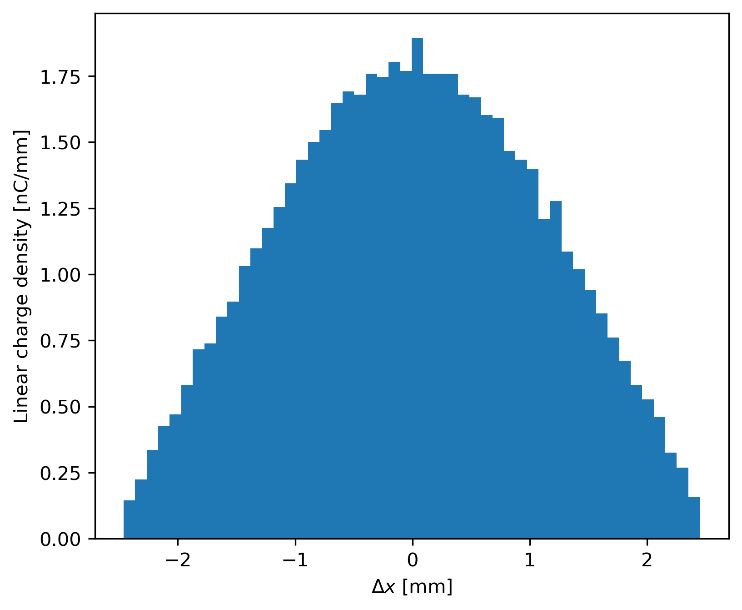
Sanity check!
Tomas: Uniform, 5 nC
Initial spot size | 1.5 mm
Laser pulse length (FWHM) | 15 ps
Gun solenoid | 0.2413 T
TW Acc. Gradient | 16.2 MV/m
First acc. Section at | 1.068 m
Huge improvement of emittance
Tomas got similar results for the normal distribution → the low emittance makes sense
I still have Gaussian distribution
Emittance RMS | 3.1 mm
Energy Spread RMS | 0.4 %
Energy | 206 MeV
Beam size RMS | ~ 0.7 mm
Bunch length RMS | 1.4 mm

Slide 21
Summary
Tomas → emittance estimate for uniform initial distribution
Steffen → we can shorten the bunch (by decreasing emission time) at the expense of emittance
Currently optimising mainly for 5.5 nC
Gaussian initial distribution does not significantly worsen the bunch properties
Investigating options for top-up injection
Charge density compensation seems promising
Changing sig_x or cut of sig_x in Gaussian distribution? → TODO
Probably need to talk to laser people

Slide 23
Produced beam
Parameter | Gaussian Initial Distribution | Uniform Initial Distribution
Charge | 5.5 nC | 5.5 nC
Z distribution | Plateau | Plateau
Emission time | 0.004 | 0.004
Accelerating field gradients | 100 & 16.2 & 25 & 25 MV/m | 100 & 16.2 & 25 & 25 MV/m
Sig x | 1.2 mm | 1.15 mm
Cutt off | 2.2 sigma | -
MaxB(1) | 0.257 T | 0.256 T
Phi(1) | 0 deg | -15 deg
Phi(2) | -10 deg | -19 deg
Phi(3)&Phi(4) | 0 deg | 0 deg
Beam parametres after the aparature (15 m)
Parameter | Gaussian Initial Distribution | Uniform Initial Distribution
Transversal emittance | 6.2 π mm mrad | 4.9 π mm mrad
Beam size | 1.4 mm | 1.6 mm
Longitudial emittance | 400 π keV mrad | 281 π keV mrad
Bunch length | 1.03 mm | 0.9 mm
Energy spread | 576.5 keV | 350 keV
Average energy | 205.7 MeV | 204.1 MeV

Slide 24
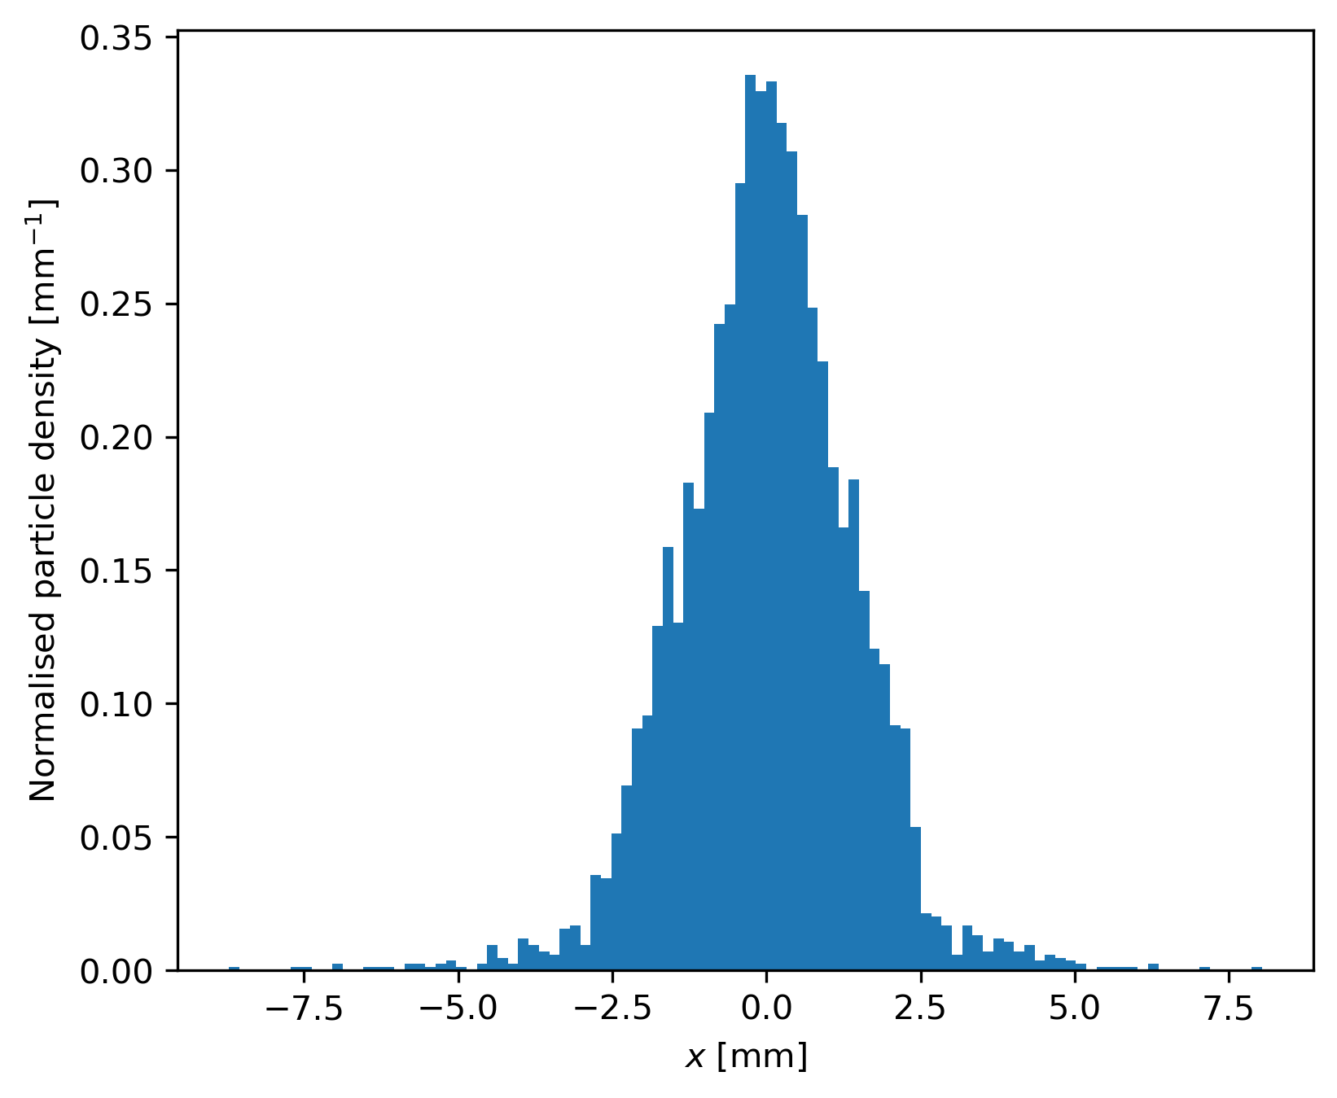
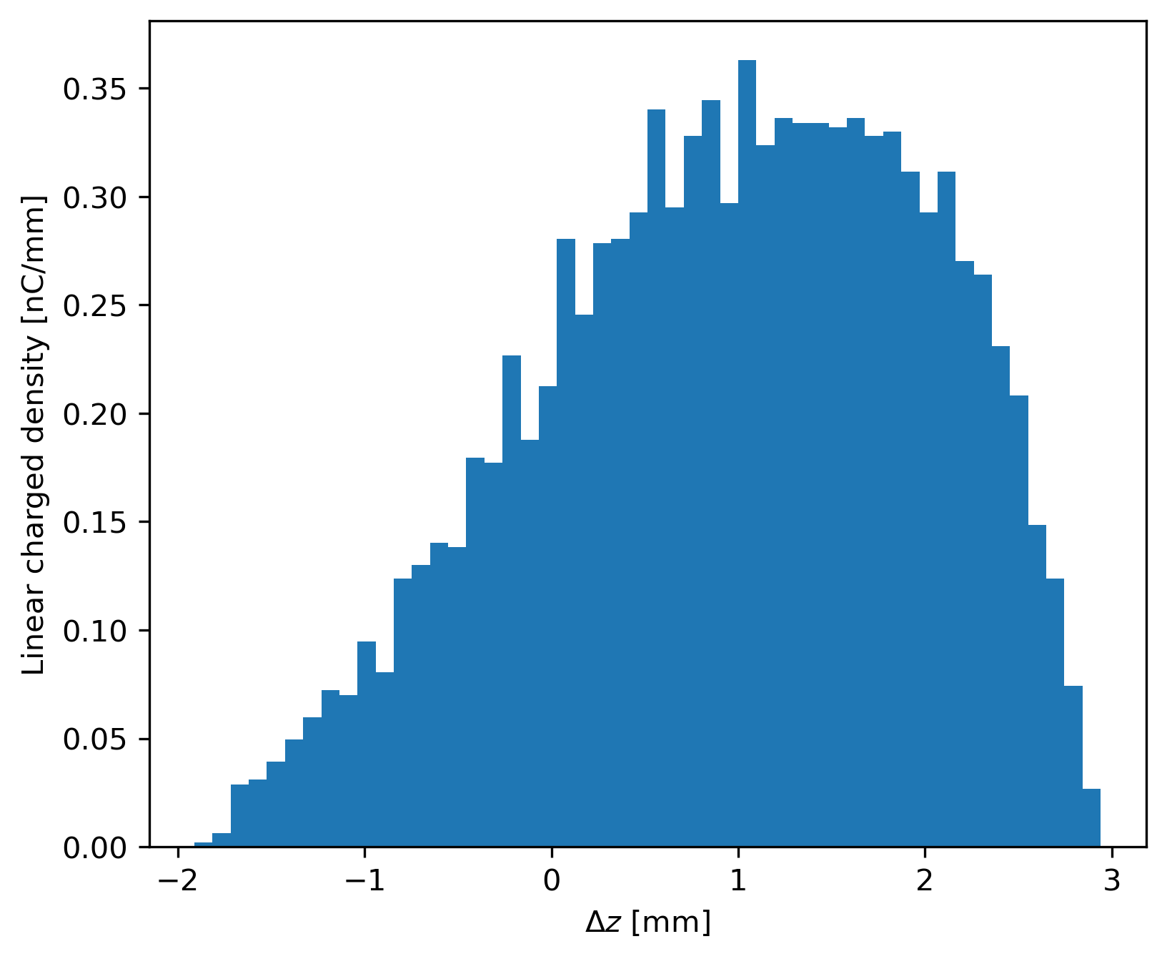
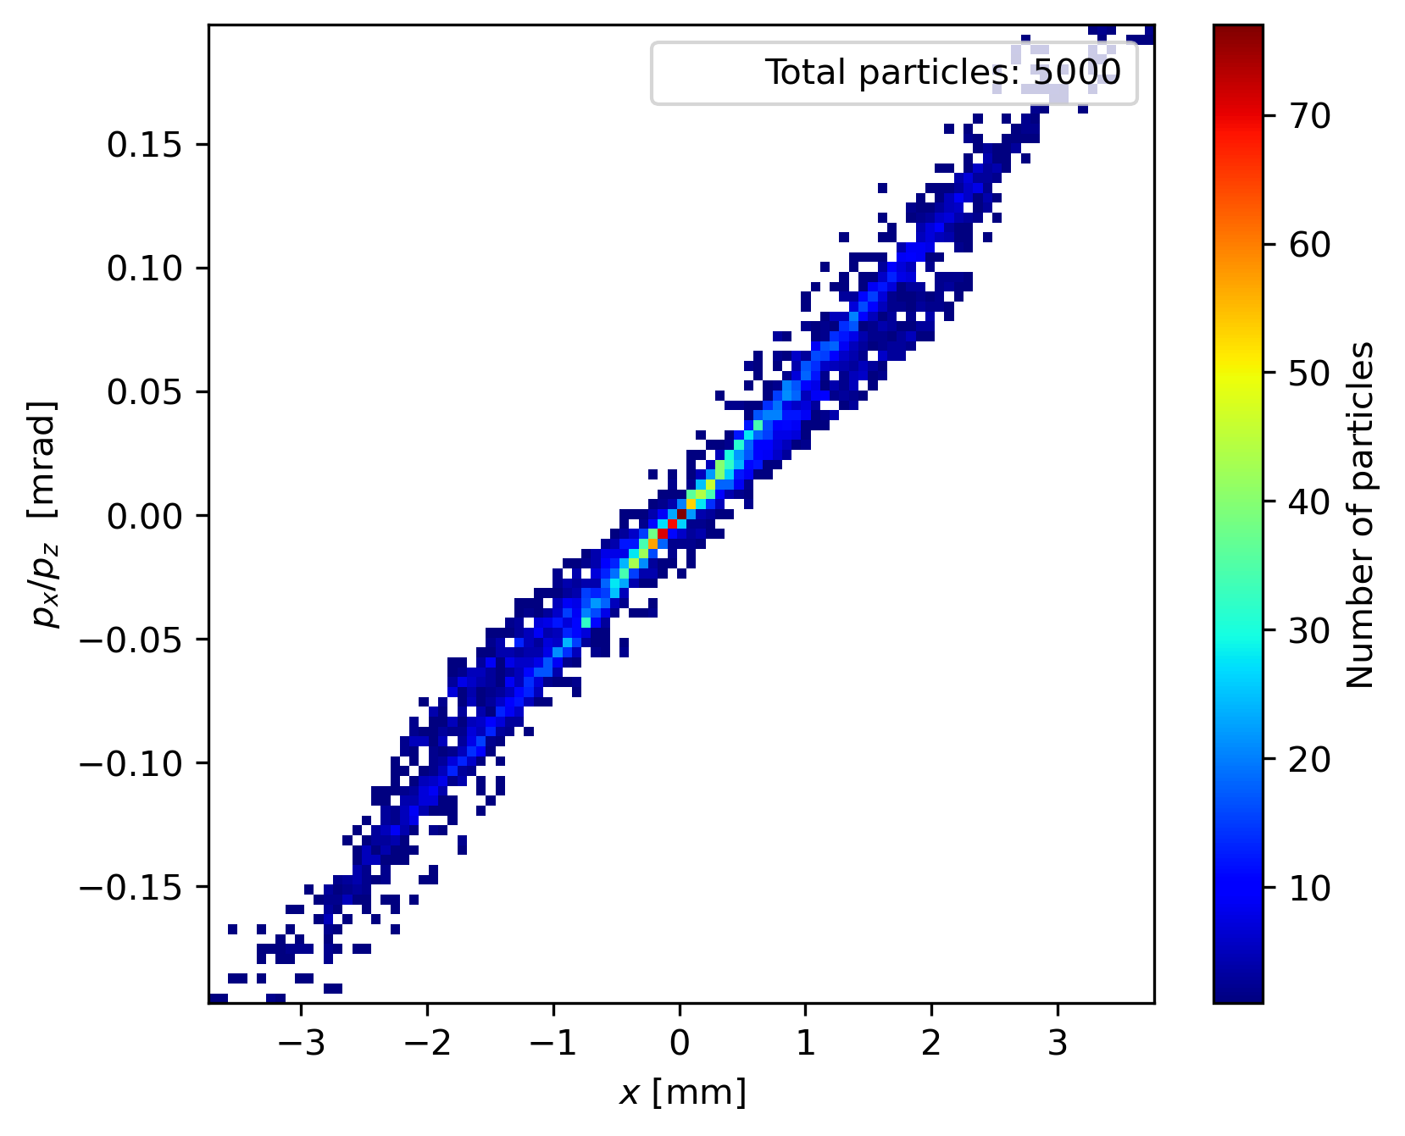
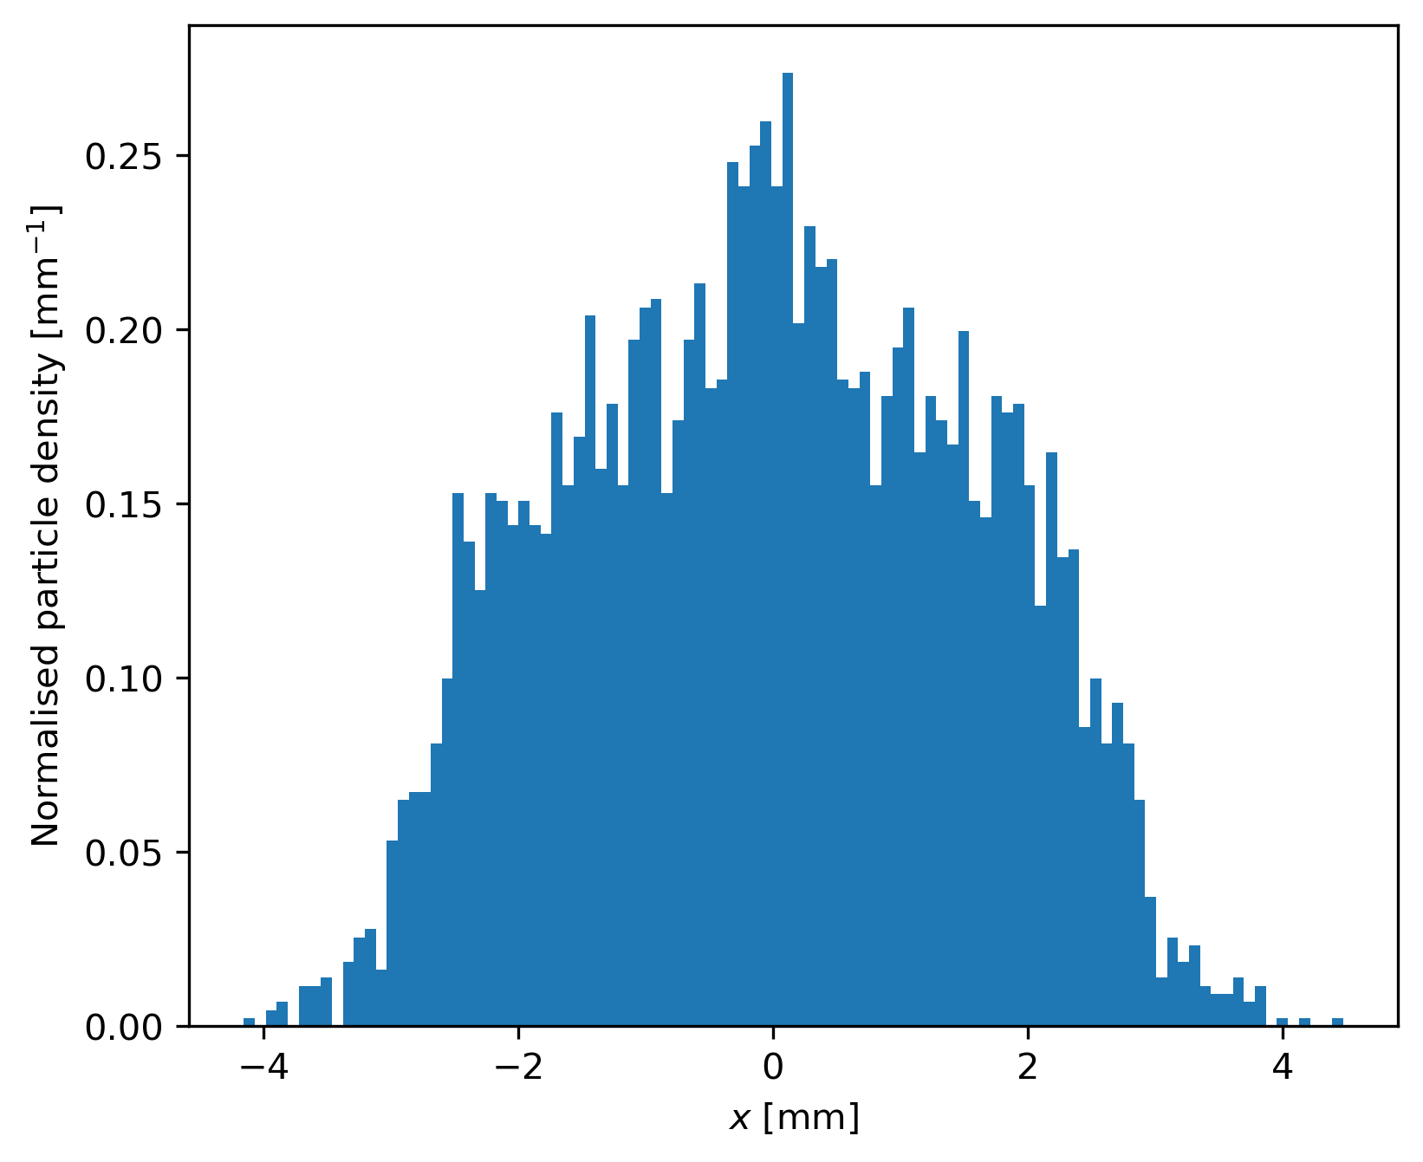
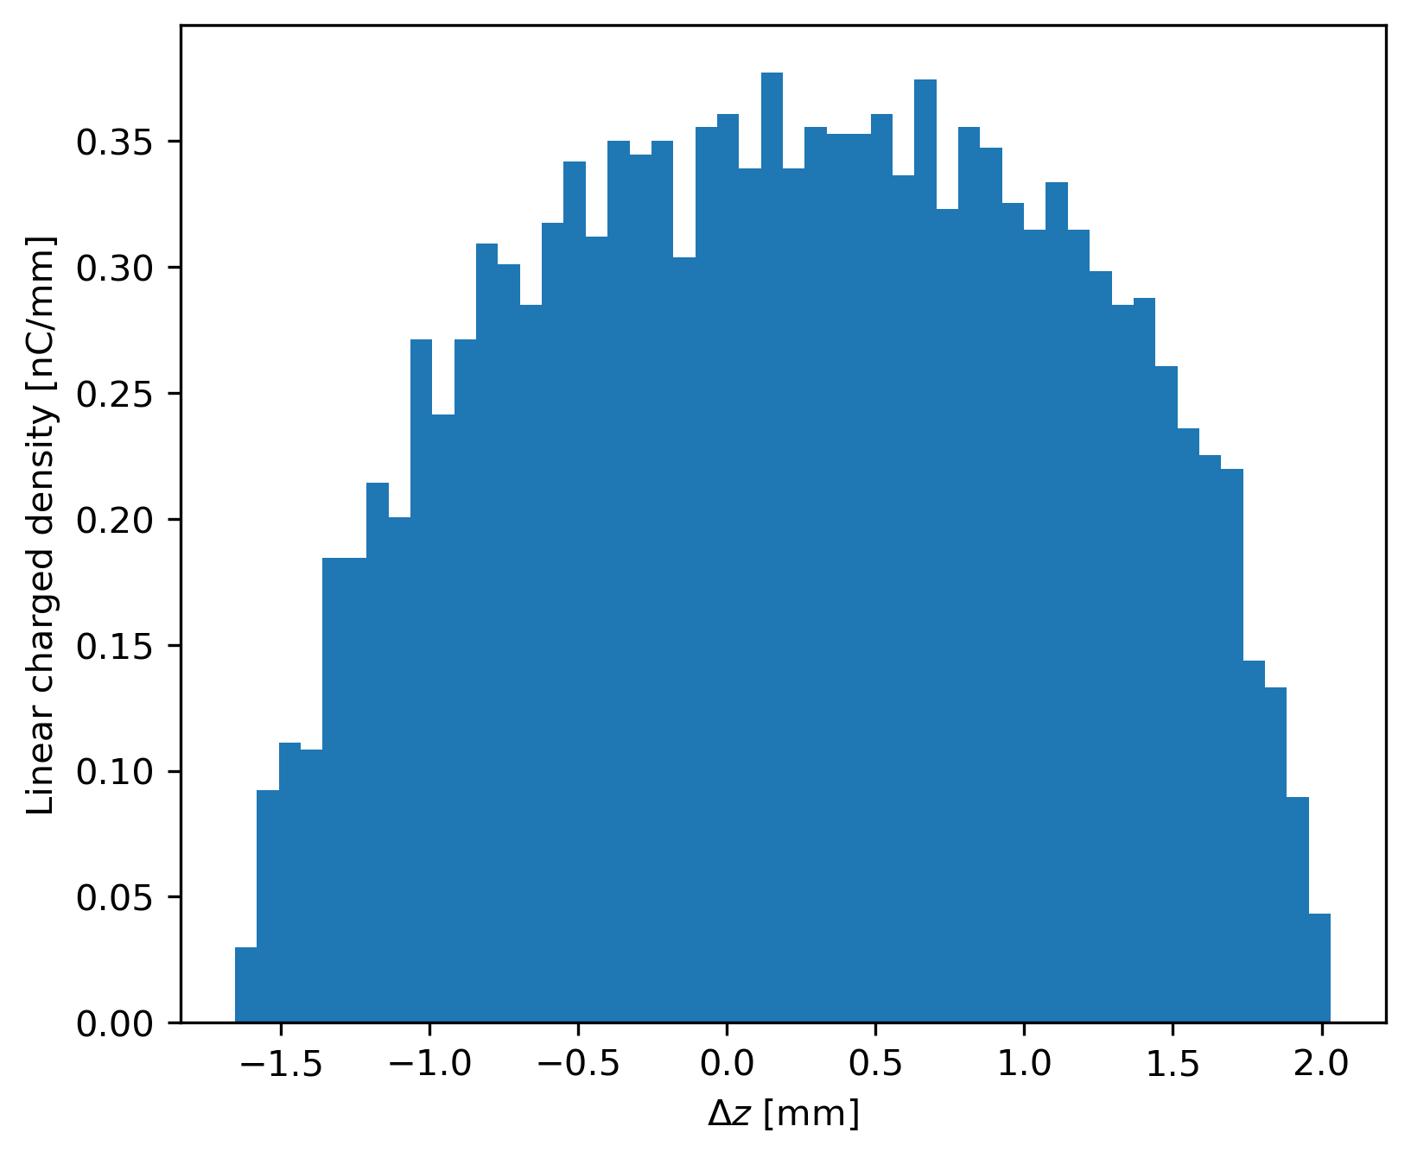
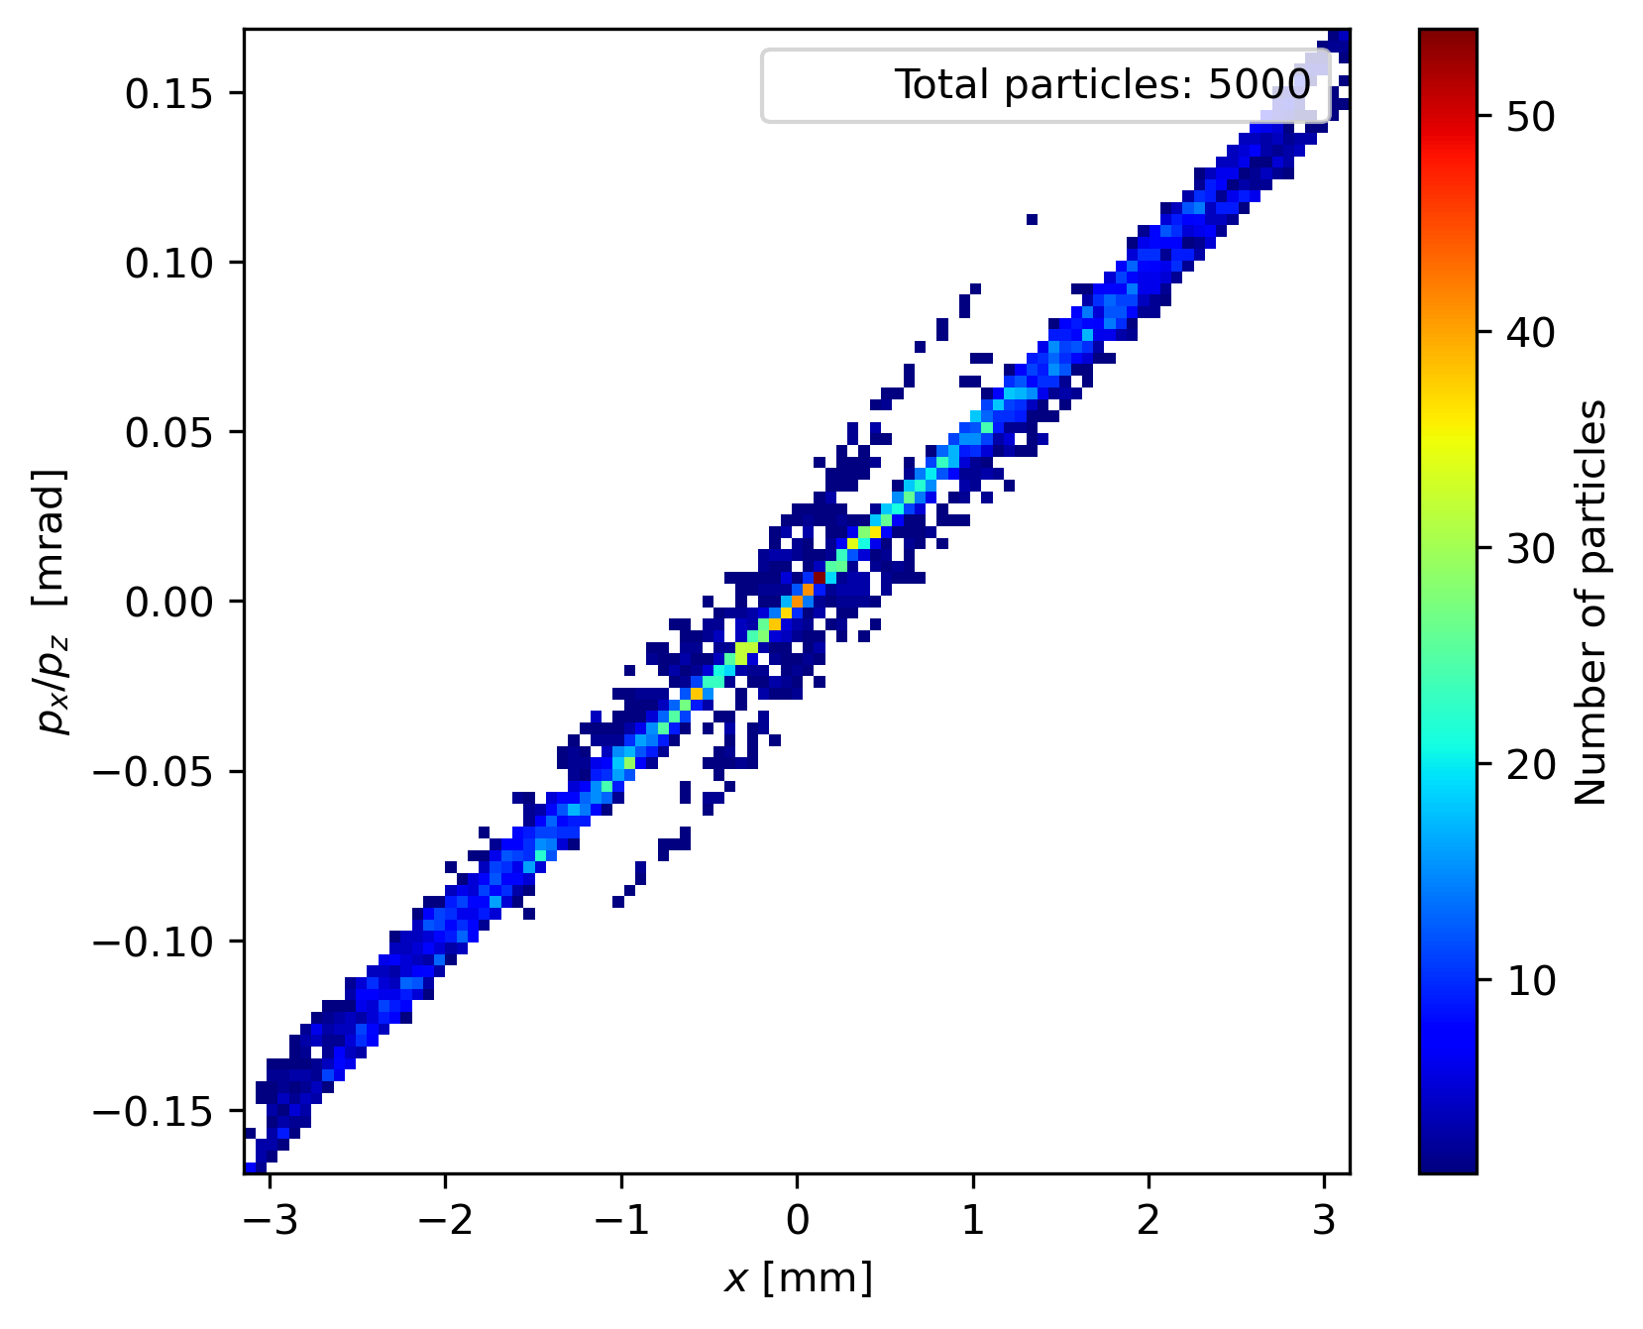
Phase space comparison
Gaussian
Uniform

Slide 25
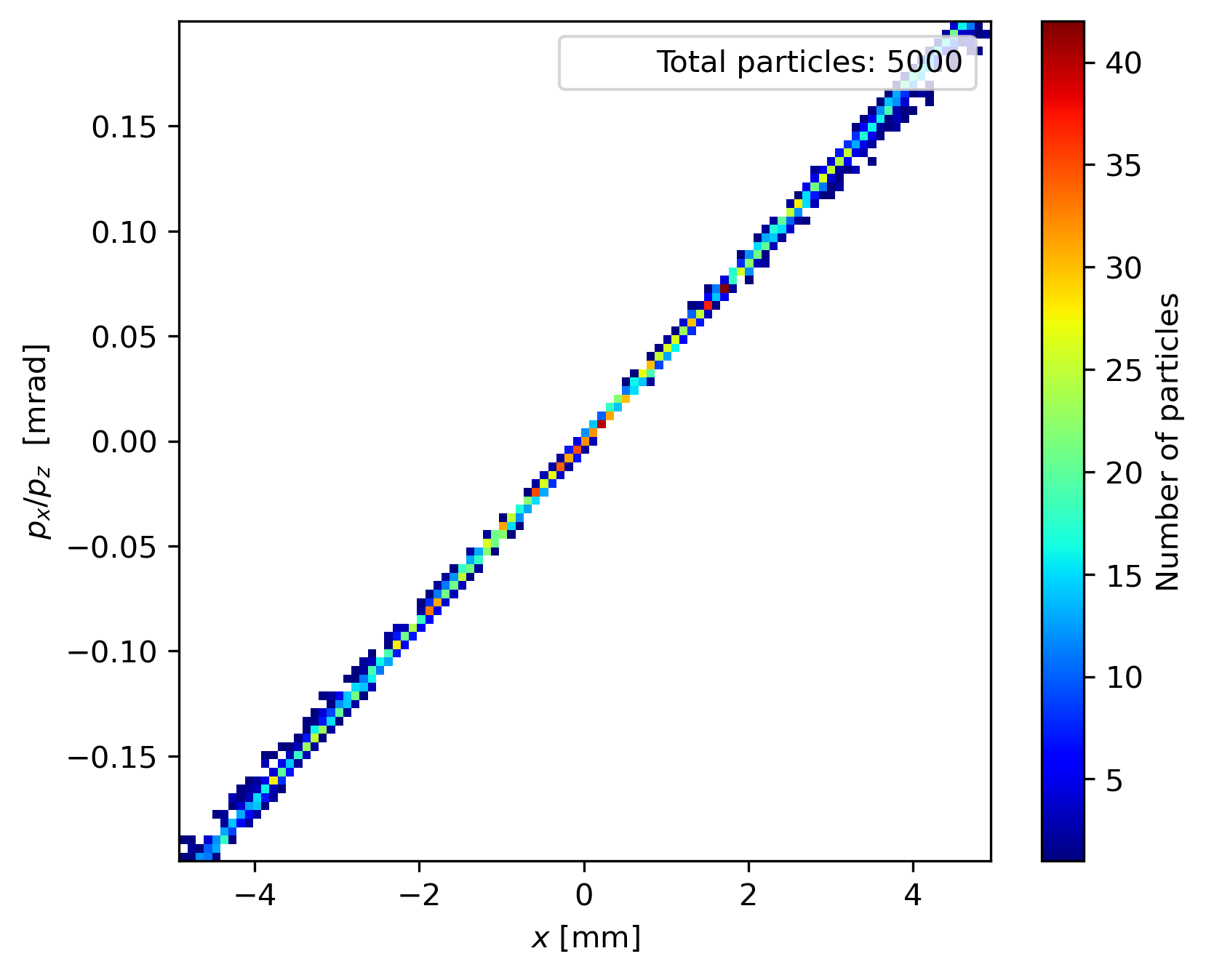
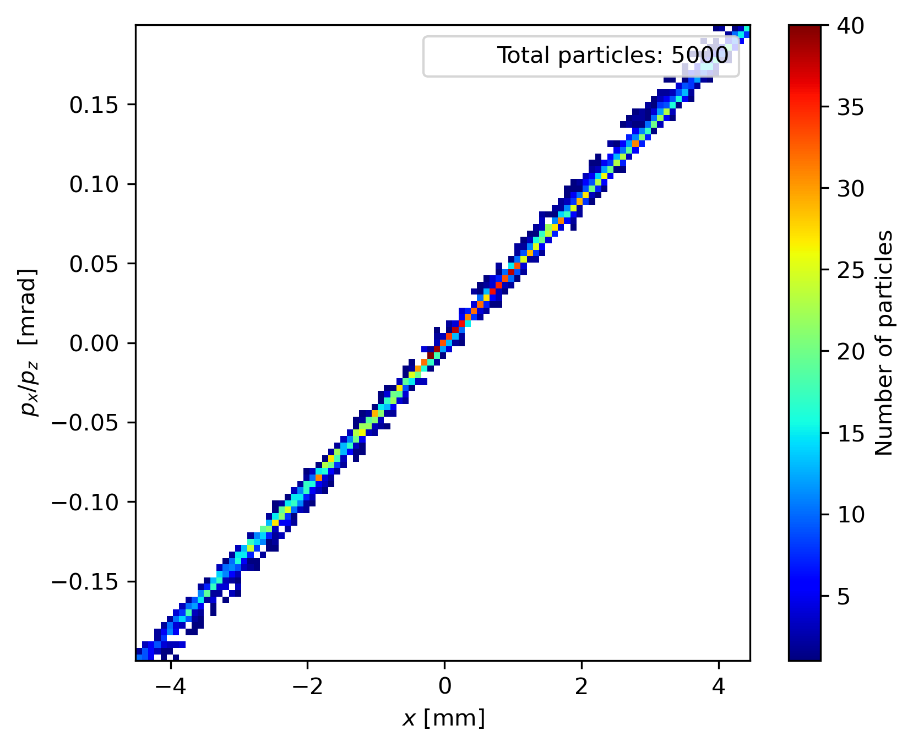
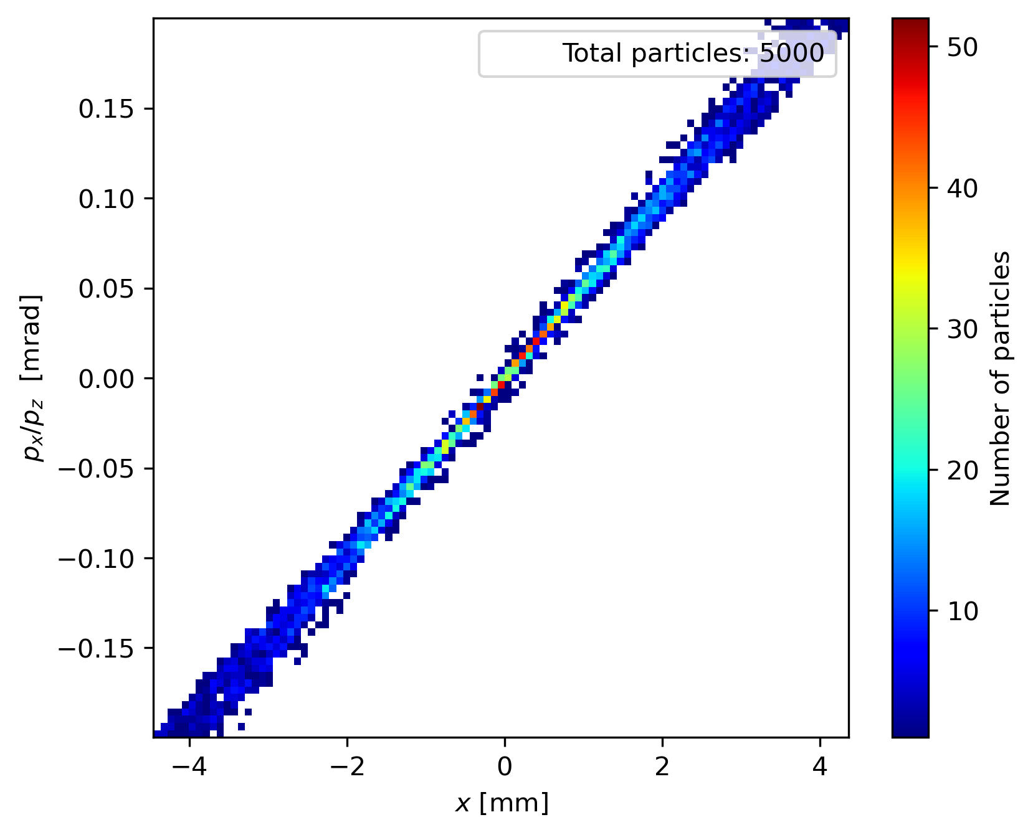
Phase space orientation for charge variation with constant gun parametres
1 nC
3 nC
6 nC
Gun parametres kept constant

Slide 26
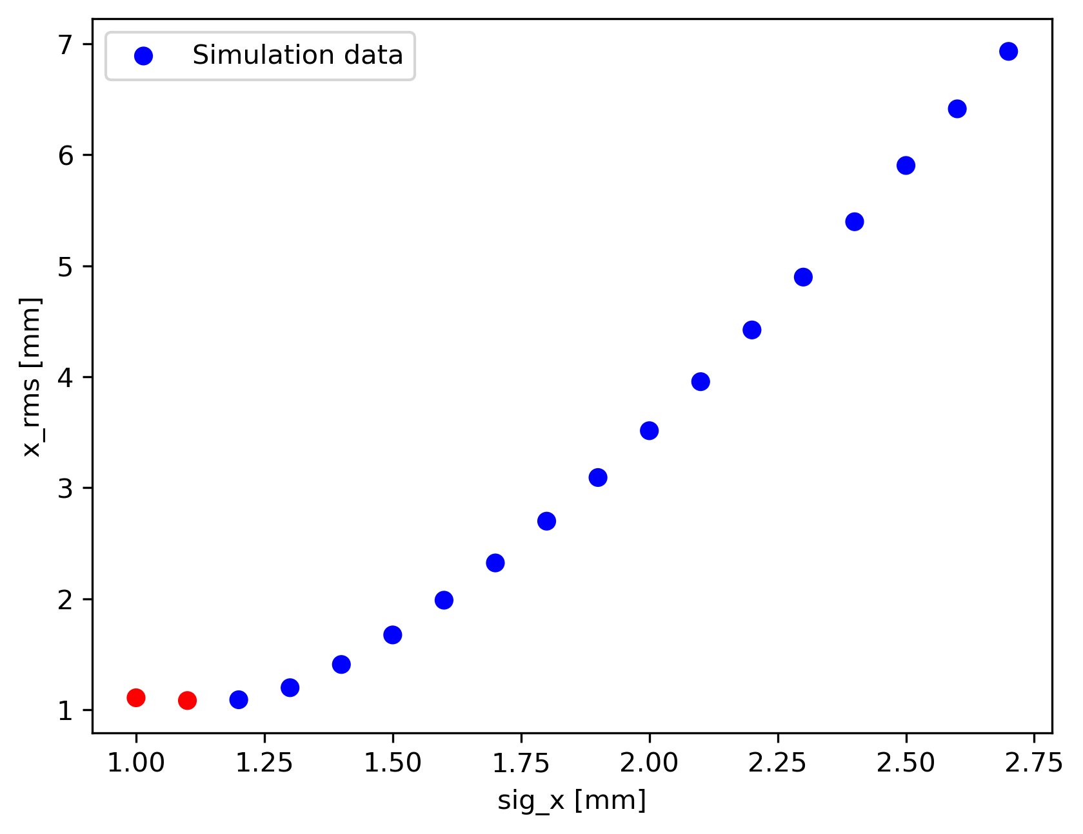
Why sig_x = 1.2 mm
Parameter | Gaussian Initial Distribution | Uniform Initial Distribution
Charge | 5.5 nC | 5.5 nC
Z distribution | Plateau | Plateau
Emission time | 0.004 | 0.004
Accelerating field gradients | 100 & 16.2 & 25 & 25 MV/m | 100 & 16.2 & 25 & 25 MV/m
Sig x | 1.2 mm | 1.15 mm
Cutt off | 2.2 sigma | -
MaxB(1) | 0.257 T | 0.256 T
Phi(1) | 0 deg | -15 deg
Phi(2) | -10 deg | -19 deg
Phi(3)&Phi(4) | 0 deg | 0 deg

Slide 27
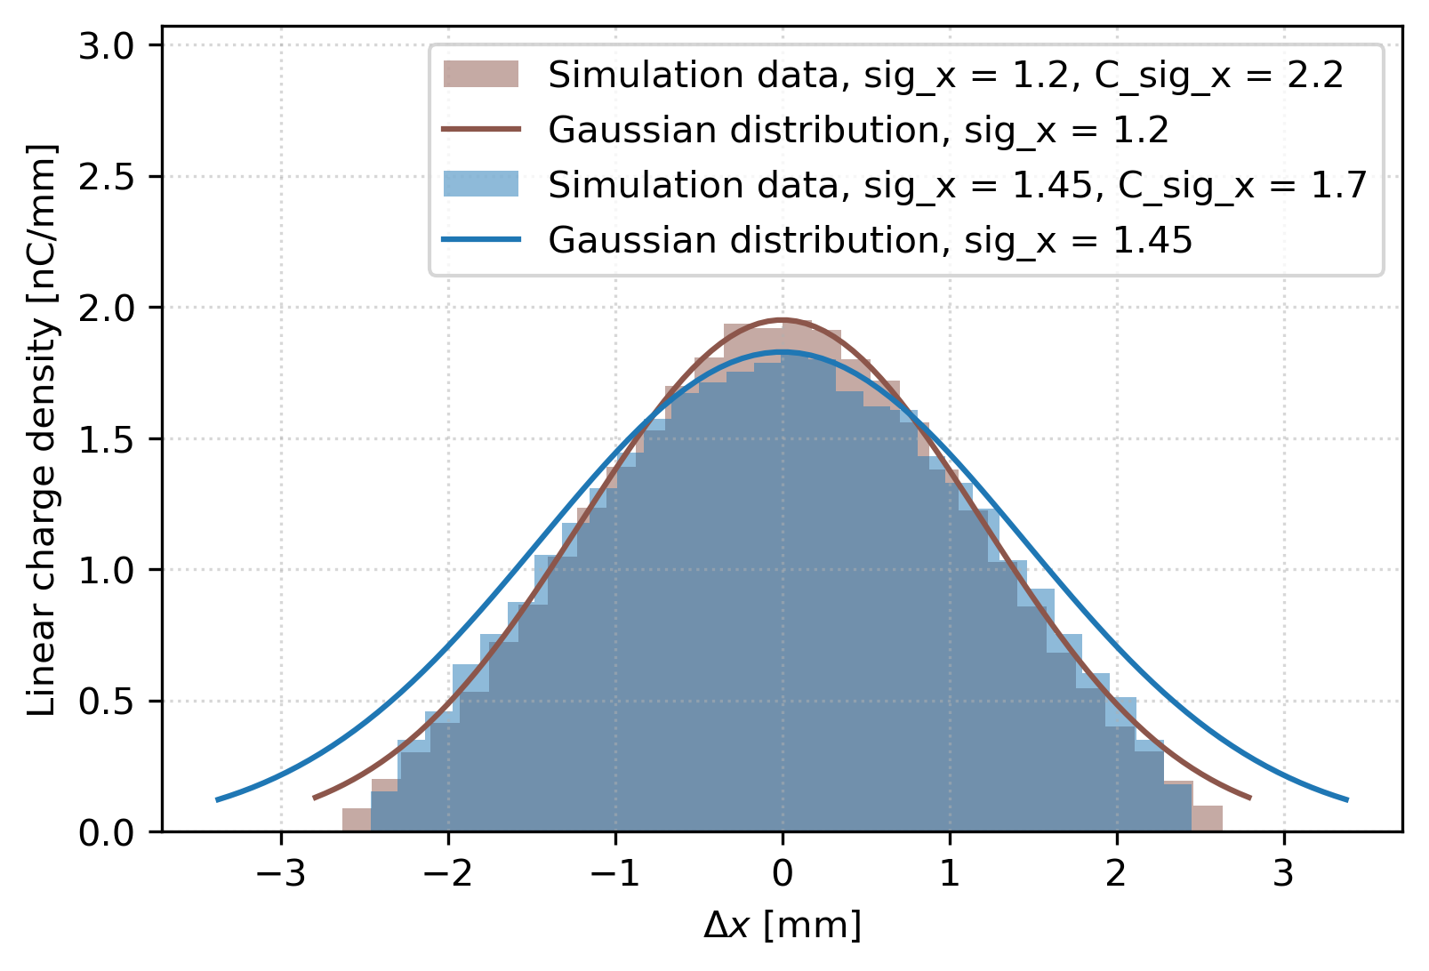
Initial distribution comparison

