Slide 1

FCCee: from 200 MeV to 6 (20) GeV linac-ee
Simona Bettoni¹, Andrea Latina²
A. Grudiev², P. Craievich¹, S. Doebert², H. W. Pommerenke⁽²⁾, J.-Y. Raguin¹, M. Schaer¹, Y. Zhao², R. Zennaro¹
(WP1 FCCee Injector Study Group)
¹ Paul Scherrer Institut, Villigen (Switzerland)
² CERN, Meyrin (Switzerland)
FCC-ee Injector Studies Mini-Workshop
24th Nov-25th November 2022
Orsay (France)

Slide 2
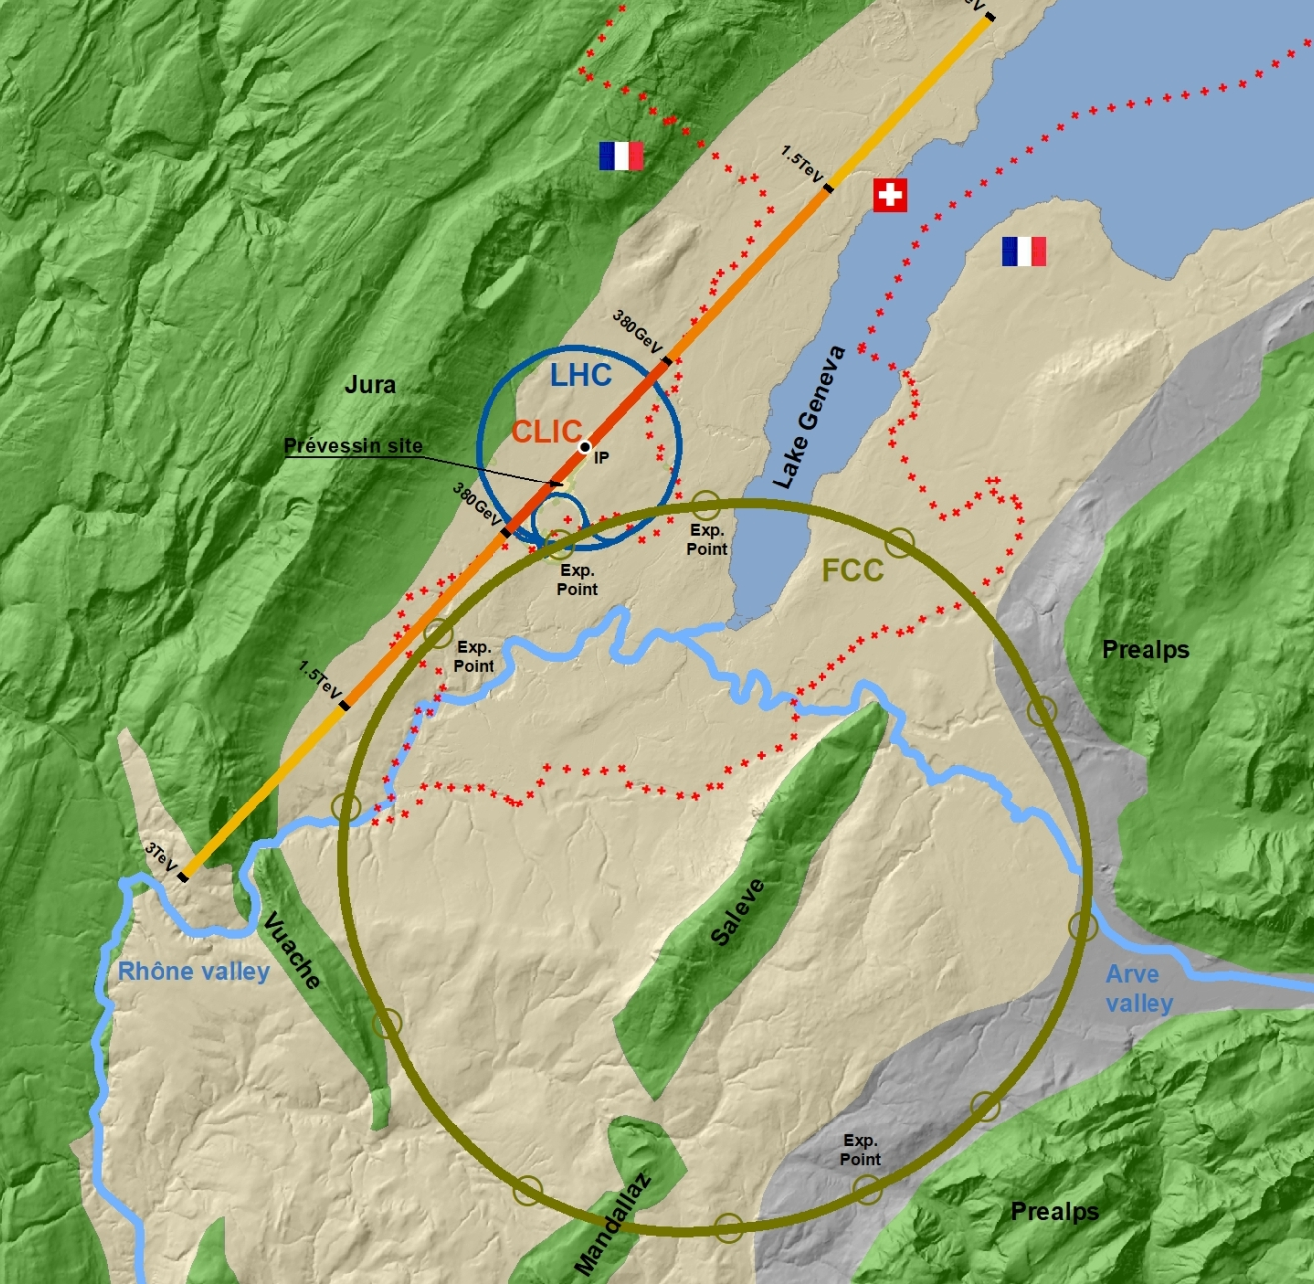
Outlook
Machine layout, inputs, and acceptance
Recall to the previously presented results
Baseline design:
  Transverse: static misalignments and orbit jitter (single and multi bunch)
  Longitudinal: energy spread and bunch length optimizations
How to react to large machine setup changes
Summary
Questions for the discussion

Slide 3
Layout, inputs, and acceptance
6 GeV→20 GeV
Final
200 MeV→1.54 GeV
1.54 GeV→6 GeV
~300 m
Initial*
*Optimizations by T. Brezina before, Z. Vostrel now, and S. Doebert

Slide 4
Layout, inputs, and acceptance
200 MeV→1.54 GeV
1.54 GeV→6 GeV
Parameter | Baseline |  | Alternative | Comments
Ring for injection | SPS (PBR) |  | HE Linac
Initial energy (MeV) | 200
Final energy (GeV) | 6 | 20
Charge (nC) | 5.0 | 5.5 |  | Changed from 4 nC to 5.5 nC during the linac optimization
Initial charge distribution | Gaussian/From tracking
Number of bunches | 2
Bunch spacing (ns) | 17.5 (15-100) |  |  | From BD Linac point of view used to define LRW
Initial transverse rms emittance (um) | 3.3*, 6.1** |  |  | *at 4 nC-σ_{z} = 1.3 mm, **at 5 nC-σ_{z} = 0.65 mm
Final maximum transverse rms emittance (um) | 50
Initial rms bunch length (mm) | 1.3 (when starting the optimization) |  |  | Coming from the linac(s) optimization or booster requests
Final rms bunch length (mm) | 1-1.5
Final rms relative energy spread | 0.1-0.15%

Slide 5
Linacs’ modeling
Lattice modeling:
    FODO lattice with 90 degs phase advance/cell
    One quadrupole/RF structure. Option with half of the quadrupoles investigated
    RF structures’ wakefield: Bane model (a is the iris radius)
    90 degrees of the RF cavity corresponds to on-crest operation
Simulation codes:
    MAD-X for the optics matching
    Elegant for the single bunch tracking simulations
    RF Track for the single and multi-bunch tracking simulations
RF STRUCTURES | eLinac | Common Linac
Length (m) | 3 | 3
Frequency (GHz) | 2.0/2.8 | 2.0/2.8/5.6
Gradient (MV/m) | 25/40 | 25/40
Number of cavities (no energy loss)-25 cavities | 18 | 60
Radius (a) over lambda | 0.1…0.2
RF structure shape and frequency
RF shape, aperture, and operation phase
How much do we loose when we lower the frequency (better for RF curvature)?
How much is convenient to go to larger aperture RF structure to stay closer to on-crest operation?
RF design by H. Pommerenke

Slide 6
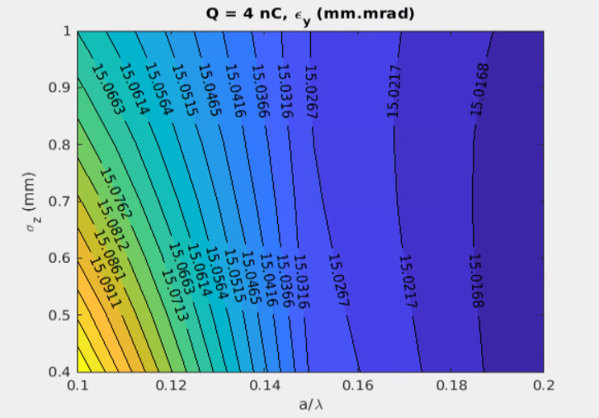
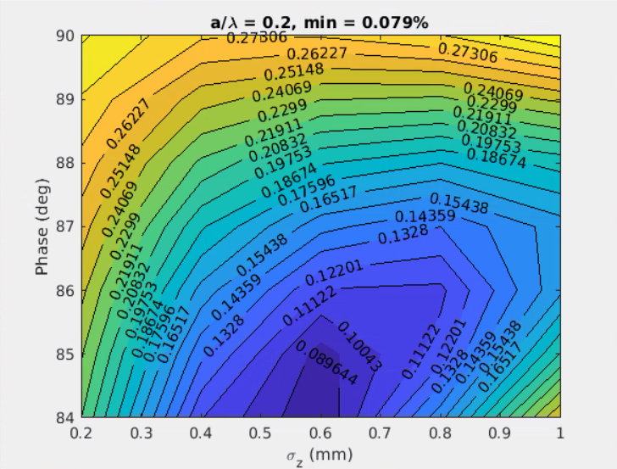
Single bunch effects
More reported at the 2022 FCC Week and ICFA at Frascati
Single-bunch effects are dominated by short-range wakefield, elements misalignment, RF curvature, and incoming jitter
Emittance growth
Sources: off-axis orbit and/or random misalignments of several elements (RF structures and quadrupoles)
Possible cures: lattice optimization, trajectory correction, optimization of the RF structures design
Projected energy spread
Sources: RF curvature and longitudinal wakefield vs bunch length
Possible cures: compensation of the RF curvature effect with the longitudinal wake potential
2D scans to determine the optimal working point
Transverse: emittance
Longitudinal: energy spread
Scan of the rms bunch length (σ_{z}) and the aperture of the RF structures (a/λ)
Scan of the bunch length (σ_{z}) and the RF phase (90 deg corresponds to on-crest phase)

Slide 7
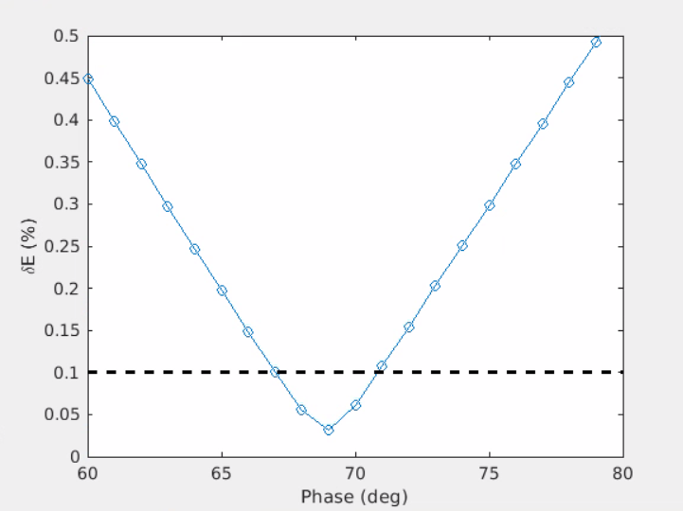
Energy spread optimization
Goal: bring the projected energy spread below 0.1%* equal to 0.1-0.15% at the end of the linac
Considered scenarios:
Short bunch from the gun
  Possible large emittance at the exit of the gun section
  Possible large longitudinal space charge effect
  Minimal hardware request
  No bunch length variation due to arrival time and RF jitter
  No CSR
Bunch compressor at the exit of e- Linac
  More hardware necessary: linearizing cavities and bunch compressor
  Possible emittance degradation due to CSR
  Solution depends on the arrival time and RF jitter
  Very small values of energy spread achievable
Shorter bunch from the gun and linearization
  Same advantages and disadvantages as 1., but a smaller value of energy spread (or equivalently longer bunch lengths) achievable
Considered parameters:
Phase extent: phase range where the final energy spread fulfils is inside the acceptance → stability
Minimum Target energy spread
Bunch length range → machine layout and beam specifications

Slide 8
Possible scenarios
More reported at the 2022 FCC Week and ICFA at Frascati
 | a/λ = 0.10 | a/λ = 0.15 | a/λ = 0.20
Phase range (deg) | 73…74 | <75…81 | <80…85
Min δE/E | 1e-3 | 5e-4 | 4e-4
Rms bunch length (mm) | 0.8 | 0.4…0.65 | <0.4…0.7
Shorter from the gun
1.
These values represent the minimum achievable energy spread. This may be increased changing the RF operation phase
These values represent the bunch length corresponding to the minimum energy spread
Scenario 1 gives a worse emittance at the exit of the gun (<10 mm.mrad), but still well below the maximum tolerated at the end of the linac (50 mm.mrad). Scenarios 2 and 3 require more detailed studies to evaluate emittance degradation mechanisms (using codes like CSRTrack for example)
 | a/λ = 0.10 | a/λ = 0.15 | a/λ = 0.20
Phase range (deg) | <70…75 | 86…>90 | <80…85
Min δE/E | 1e-4 | 1e-4 | 1e-4
Rms bunch length (mm) | 0.457
Bunch compression
2.
 | a/λ = 0.10 | a/λ = 0.15 | a/λ = 0.20
Phase range (deg) | 66…70 | 77…81 | 81…85
Min δE/E | 2e-4 | 3e-4 | 3e-4
Rms bunch length (mm) | 0.650
linearization
3.

Slide 9
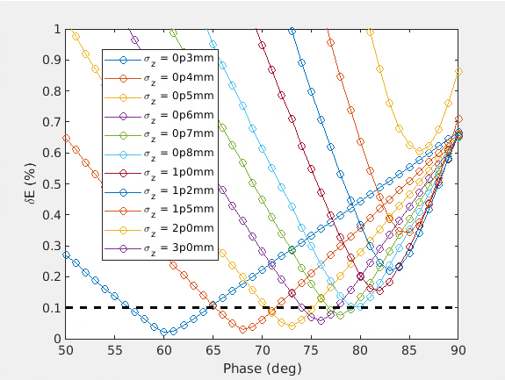
Extrapolation to the different layouts: modular design
For each case the maximum bunch length and the corresponding phase giving the target energy spread are selected
f (GHz) | G (MV/m) | a/λ | a (mm) | Maximum σ_{z} (mm) |  | Maximum phase (deg)
 |  |  |  | δ_{E} = 0.1 % | δ_{E} = 0.15 % | δ_{E} = 0.1 % | δ_{E} = 0.15 %
2.8** | 25 | 0.1 | 10.7 | 0.8 | 1.2 | 69 | 89
2.8** | 25 | 0.15 | 16.1 | 0.8 | 1 | 79 | 82
2.8** | 25 | 0.2 | 21.4 | 0.7 | 0.8 | 82 | 82
2.8** | 40 | 0.1 | 10.7 | 0.8 | 0.8 | 77 | 85
2.8** | 40 | 0.15 | 16.1 | 0.7 | 1 | 82 | 79
2.8** | 40 | 0.2 | 21.4 | 0.7 | 0.8 | 85 | 84
5.6** | 25 | 0.1 | 5.4 | No solution | No solution | No solution | No solution
5.6** | 25 | 0.15 | 8.0 | 0.5 | 0.6 | 61 | 66
5.6** | 25 | 0.2 | 10.7 | 0.5 | 0.6 | 74 | 66
5.6** | 40 | 0.1 | 5.4 | 0.4 | 0.5 | 81 | 73
5.6** | 40 | 0.15 | 8.0 | 0.5 | 0.5 | 71 | 72
5.6** | 40 | 0.2 | 10.7 | 0.4 | 0.5 | 67 | 72
2.0* | 25 | 0.1 | 15 | 1 | 1.2 | 78 | 81
2.0* | 25 | 0.15 | 22.5 | 1 | 1.2 | 85 | 85
2.0* | 25 | 0.2 | 30 | 1 | 1.2 | 84 | 86
2.0* | 40 | 0.1 | 15 | 1 | 1.2 | 87 | 88
2.0* | 40 | 0.15 | 22.5 | 1 | 1.2 | 86 | 84
2.0* | 40 | 0.2 | 30 | 1 | 1.2 | 88 | 87
Possible to compose the linac(s) assuming different RF and bunch parameters
** Electron linac at 2.8 GHz
* Electron linac at 2 GHz

Slide 10
Possible designs to 6 GeV or 20 GeV
Option 1:
Target bunch length and energy spread obtained
Good for emittance: long pulse from the gun
Option 2:
Longer bunch length achievable, target energy spread obtained (harmonic cavityª, passive, or “energy compressor”)
Even better for emittance
Option 3/3b:
Target energy spread obtained, bunch length tunable
To be investigated possible emittance degradation mechanisms
Option 4:
Maximum flexibility on the bunch length, target energy spread obtained
To be investigated possible emittance degradation effects
Option 5 (under discussion with R. Zennaro):
Target bunch length and energy spread obtained
To be investigated possible emittance degradation mechanisms (more in the following)
σ_{z0} ~ 1-1.2 mm
e- linac
Common linac
σ_{z0}
f1 = 2.8 GHz
f1 = 2.8 GHz
σ_{z0} = 1.7-3 mm
e- linac
Common linac
σ_{z0}
f1 = 2-2.8 GHz
f1 = 2-2.8 GHz
6-4*f1ª
σ_{z0} ~ 1-1.2 mm
-R₅₆
σ_{z0} = 1.7-3 mm
e- linac
Common linac
Common linac
σ_{z1}
f1 = 2-2.8 GHz
f1 = 2-2.8 GHz
6-4*f1ª
σ_{z0} = 1.7-3 mm
-R₅₆
σ_{z1} = 0.5 mm
σ_{z2}
σ_{z1} < 1 mm
f1 = 2.8 GHz
M*f1^{b}
R₅₆
f2 = 2.8-5.6 GHz
f2 = 2.8-5.6 GHz
-R₅₆
σ_{z0}
e- linac
Common linac
σ_{z1}
f1 (2.8 GHz)
f1 (2.8 GHz)
f2 (11.2 GHz),
0 crossing
ª For the 20 GeV layout SuperKEKB “energy compressor” scheme, passive linearizer or others to be considered
^{b} Smaller than the other cases voltage required

Slide 11
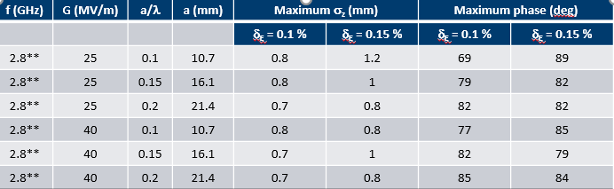
Baseline for the common linac design
Higher is the RF gradient better the performance are
Assumed a conservative 25 MV/m gradient in the simulations
The final energy, and therefore the number of structures, are computed including the beam energy loss along the linac
f (GHz) | G (MV/m) | a/λ | a (mm) | σ_{z} (mm) | N struct | Final E (GeV) | phase (deg) | Final δ_{E}/E ( %)
2.8 | 25 | 0.1 | 10.7 | 1.0 | 63 | 5.94354 | 74 | 0.14145
2.8 | 25 | 0.15 | 16.1 | 1.0 | 62 | 6.07784 | 82 | 0.15331
2.8 | 40 | 0.1 | 10.7 | 1.0 | 38 | 5.94451 | 80 | 0.15482
2.8 | 40 | 0.15 | 16.1 | 1.0 | 38 | 6. 03897 | 85 | 0. 16159

Slide 12
Way to quantify the “robustness” of the machine to misalignments
Analysis of the simulation results:
    Each seed corresponds to a simulation
    Each simulation gives final x and y emittance
    Shown the histogram of the emittance, its mean and std over the full set of simulations
    Sum of the normalized histogram from the smallest or the largest emittance computed
This quantifies the percentage of bad (above the threshold) or good seeds (below the threshold) relatively to the total number of seeds
Parameters for the simulations:
Typical values are 500-1000 seeds
The assumed initial emittance is 5 mm.mrad at 5.5 nC with 1 mm rms laser pulse length (from the new optimizations about 6 mm.mrad is expected)

Slide 13
a/λ = 0.15 (a = 16.1 mm, f = 2.8 GHz)
Quadrupoles
Offset x, y = 50 um rms
RF cavities
Offset x, y = 100 um rms
Gaussian distribution
No orbit correction
Quadrupoles
Offset x, y = 50 um rms
RF cavities
Offset x, y = 100 um rms
BPM
Offset x, y = 30 um rms
Gaussian distribution
Orbit correction
Elegant results
Quadrupoles misalignments dominate the possible emittance increase
Emittance increase by maximum a factor 2 for less than 10% of the seeds
Orbit correction brings back the emittance to low values

Slide 14
Modeling studies
RFTrack (code developed by A. Latina): on-crest, 1000 seeds
Elegant: 82 deg, 500 seeds
RFTrack on crest, Elegant off-crest (by 8 degrees)
Both RFTrack and Elegant off-crest (by 8 degrees)
a/λ = 0.1
a/λ = 0.15
If the RF structures are operated on-crest Elegant and RFTrack give similar results, whereas if the RF structures are operated off-crest the two codes disagree
For RF apertures corresponding to a/λ = 0.15 at 2.8 GHz 0% of the seeds reaches 50 mm.mrad in Elegant and RFTrack (this used for the multi-bunch, and the outcome is the maximum a/λ = 0.1)
More in the next slide
More on codes comparison (Placet vs others) inPAC'07 and analytical vs Elegant: FEL '05

Slide 15
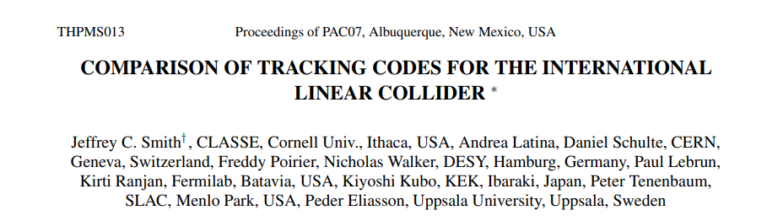
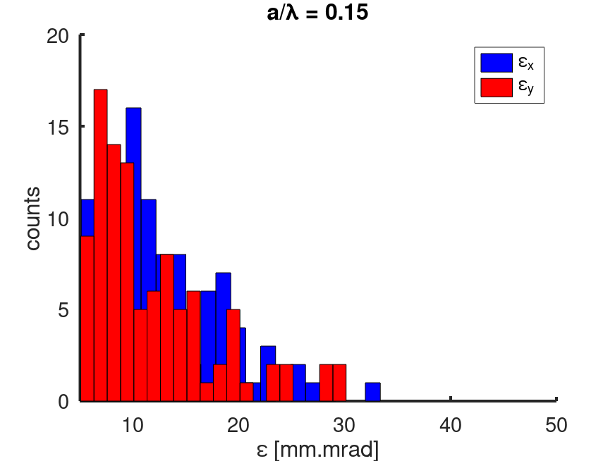
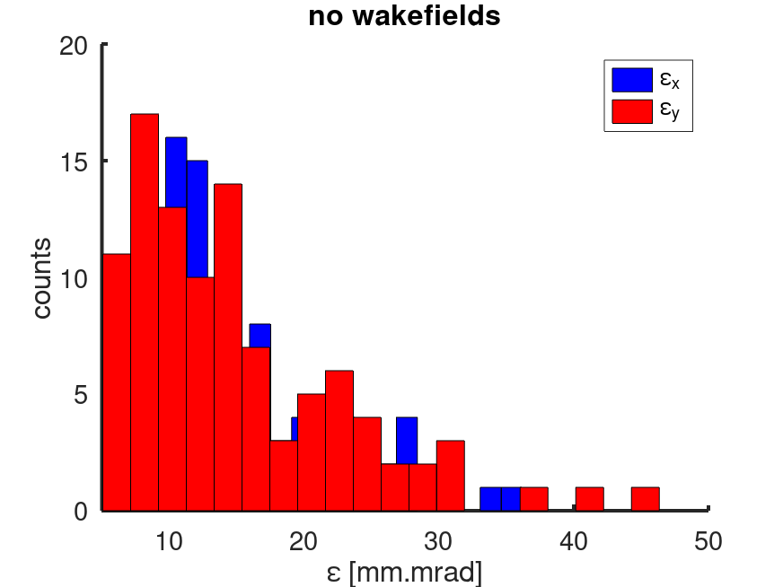
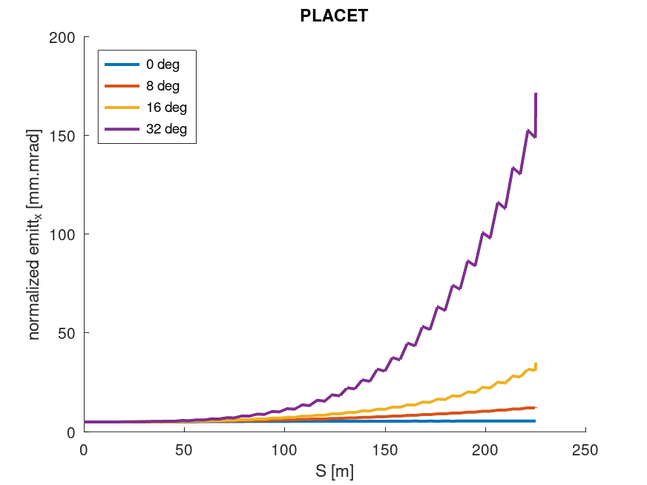
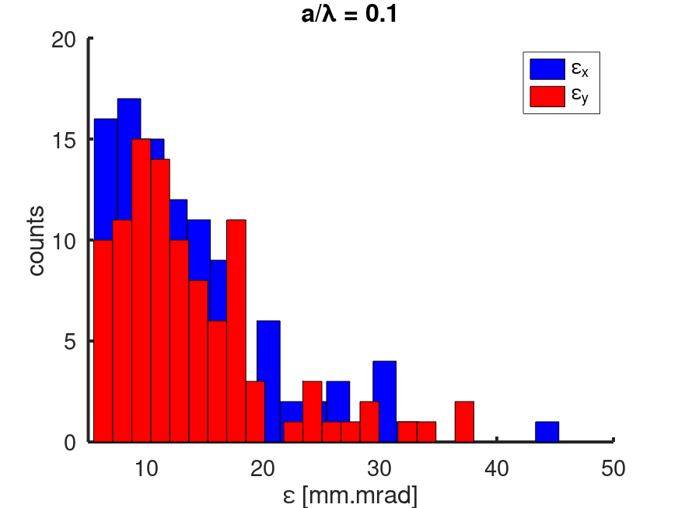
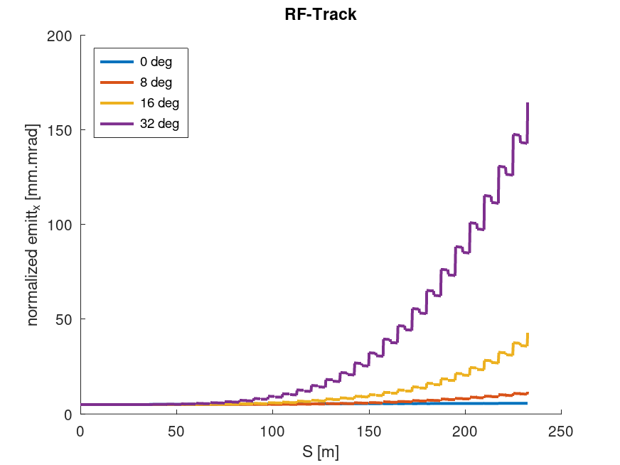
RFTrack (A. Latina)
https://inspirehep.net/literature/772336
Expectations using RFTrack on FCC common linac
Results of codes comparisons
No orbit correction
Quadrupoles
Offset x, y = 50 um rms
RF cavities
Offset x, y = 100 um rms
Gaussian distribution
8 deg off-crest

Slide 16
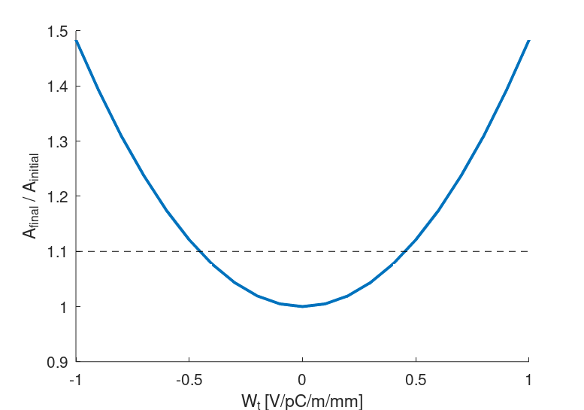
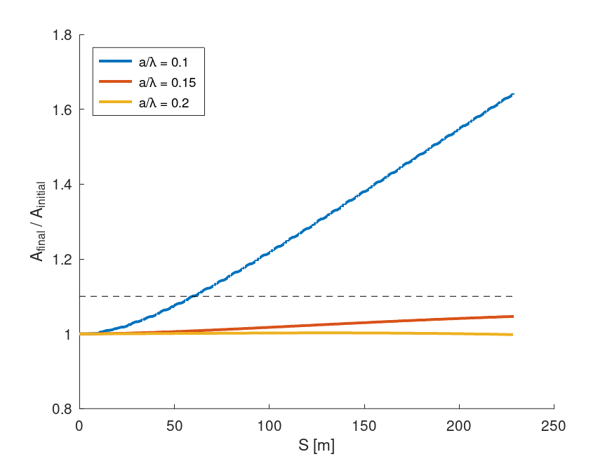
Orbit jitter
Action* increase
Measurement of the incoming jitter amplification along the lattice due to orbit jitter
Bunch 1 (multi bunch)
Bunch 2 (single bunch)
0.45 V/pC/m/mm at 4 nC
(0.33 V/pC/m/mm at 5.5 nC)
RF design by H. W. Pommerenke:
RF structures optimized to produce a maximum kick~0.2 V/pC/m/mm at 17.5 ns time separation
Done for 2.8 GHz, but no problems foreseen at 5.6 GHz
If 10% amplification tolerated, the minimum a/λ = 0.15 at
2.8 GHz (a = 16.1 mm)

Slide 17

How to deal with large charge variation?
The final energy spread depends on the bunch charge (beam loading)
Charge scan
(applied to a previous design)
Jitter
δE/E changes by 0.008% (0.092% and 0.108% instead of 0.1%) for 2% charge jitter
The optimal phase changes by about 2.5 deg/nC
Is it this jitter related energy spread increase tolerable?
How to react to a change of the charge of bunch2 (single bunch)?
How to react to a change of the charge of bunch1 (single and multi-bunch)?

Slide 18
Considering the present design
Acting on the laser
Change the arrival time of the laser on the cathode
This changes the phase seen by the bunch when entering in the RF structures
How much is the velocity of this process? Use two lasers?
Acting on the RF
Manipulate the RF in such a way that the bunch(es) see different phases
Implemented at SwissFEL for the two bunch operation (distance 28 ns)
Which is the limit of this method?
Phase and amplitude steps introduced along the single RF pulse to independently control bunch 1 and bunch 2
Developed by Z. Geng for SwissFEL (PSI)
 | Amplitude (%) | Phase (deg)
Gun (S-band) | -1.8 ~ 0.9 | ±1.3
S-band structures | -1.7 ~ 0.0 | ±0.8
X-band structures | -21.6 ~ 0 | ±11.5
C-band structures | -4.8 ~ -2.9 | ±0.9
Change in phase

Slide 19

Acting on the design (brainstorming with R. Zennaro)
Method:
Chicane: energy difference (induced by the different charge) → arrival time difference → phase difference
Compensate the energy difference by applying the appropriate voltage downstream of the chicane (cavities at f2)
2.8GHz
2.8GHz
213 MV (~8 m) @ 11.2 GHz
0.4 m
$${Voltage}_{2}=\frac{λ_{2}E}{2qπR_{56}}$$
Advantages:
  Possible to compensate different energy due to change in charge
  Possible to use the same chicane to tune the bunch length and after partially compensate for the residual chirp
To be evaluated/kept in mind:
  It works for short (~R₅₆*ΔE/E) bunches
  Feasibility of the chicane with the desired R56 at high energy. Possible to use the arc? Available R₅₆?
  Possible mechanisms of emittance increase, also if at such a high energy and for moderate compression not serious issues expected
  Possible difference in final bunch lengths

Slide 20
Conclusions
A possible baseline design studied:
    Target energy spread and bunch length requests fulfilled
    The relatively long laser length allows for the initial emittance very well
    optimized to <<50 mm.mrad (by S. Doebert et al.)
    No emittance degradation mechanisms due to bunch
    compression/decompression in the lattice in the baseline design
    (more critical at low energy)
    The emittance increase due to static misalignments of quadrupoles, RF structures (and BPMs) has been computed for the considered geometry. More effect than previously expected (RFTrack-Placet compared with Elegant), but still the final emittance is smaller than 50 mm.mrad without orbit correction
    Impact of orbit jitter on the lattice determines a constraint on the RF structure geometry
    Modular design: several frequencies, gradients, geometries already simulated: we may “compose” a different design
How to deal with the machine parameters changes:
    Acting on the laser: velocity of the process or use of two lasers
    Acting on the RF: amount of the effect
    Acting on the design: under evaluation

Slide 21

Acknowledgments
To the entire WP1, A. Aksoi, A. Chance,
B. Dalena, Z. Geng, M. Migliorati, …
…CHART* and you for your attention
*This work was done under the auspices of CHART (Swiss Accelerator Research and Technology Collaboration, https://chart.ch
FCCIS: 'This project has received funding from the European Union's Horizon 2020 research and innovation programme under the European Union's Horizon 2020 research and innovation programme under grant agreement No 951754.'

Slide 22
Discussions
Layout and parameters:
Are we speaking to inject to the SPS at 6 GeV or the booster at 20 GeV?
Any change on the target energy spread (0.1-0.15%), bunch length (1-1.5 mm), and emittance (<50 mm.mrad)?
Is it important the bunch longitudinal shape?
Is it important that the different bunches have the same length?
Possible corrections:
Can we think to vary the bunch length in the ring?
If different bunch lengths are a problem, can eventually the cavity in the ring compensate for it?
Can the injection system compensate for an orbit jittter, and in which time scale? Bunch 1 vs bunch 2, or intra-train?

Slide 23
SPARES

Slide 24
Modeling studies ongoing
RFTrack (code developed by A. Latina): 0 deg, 1000 seeds
Elegant: 82 deg, 500 seeds
If the RF structures are operated on-crest Elegant and RFTrack give similar results, whereas if the RF structures are operated off-crest the two codes disagree
Discrepancy is much smaller for smaller RF apertures
For RF apertures corresponding to a/λ = 0.15 at 2.8 GHz 0% of the seeds reaches 50 mm.mrad in Elegant and RFTrack (this used for the multi-bunch, and the outcome is the maximum a/λ = 0.1)
More on codes comparison (Placet vs others) inPAC'07 and analytical vs Elegant: FEL '05

Slide 25
a/λ = 0.15 (a = 16.1 mm, f = 2.8 GHz)
Quadrupoles
Offset x = 50 um rms
Offset y = 50 um rms
Gaussian distribution
Quadrupoles
Offset x, y = 50 um rms
RF cavities
Offset x, y = 100 um rms
Gaussian distribution
Quadrupoles misalignments dominate the possible emittance increase (negligible emittance increase misaligning only the RF structures by 100 um Gaussian rms noise)
Emittance increase by about a factor 2 for less than 10% of the seeds

Slide 26
a/λ = 0.15 (a = 16.1 mm, f = 2.8 GHz), with orbit correction
Quadrupoles
Offset x, y = 50 um rms
RF cavities
Offset x, y = 100 um rms
Gaussian distribution
Aligned BPM
ORBITA NO
ORBITA SI
Quadrupoles
Offset x, y = 50 um rms
RF cavities
Offset x, y = 100 um rms
BPM
Offset x, y = 30 um rms
Gaussian distribution
Misaligned BPM
Orbit correction cures the observed emittance increase
BPM alignment does not seem to be an issue (at least up to 30 um)

Slide 27
Smaller RF structure aperture: a/λ = 0.1 (a = 10.7 mm, f = 2.8 GHz)
SKIP
Quadrupoles
Offset x, y = 50 um rms
RF cavities
Offset x, y = 100 um rms
Gaussian distribution
No orbit correction
Quadrupoles
Offset x, y = 50 um rms
RF cavities
Offset x, y = 100 um rms
BPM
Offset x, y = 30 um rms
Gaussian distribution
Orbit correction

Slide 28
Elegant vs RFTrack comparison (off-crest by 8 degrees)
Elegant
RFTrack
a/λ = 0.1
Quadrupoles
Offset x, y = 50 um rms
RF cavities
Offset x, y = 100 um rms
Gaussian distribution
a/λ = 0.15

Slide 29
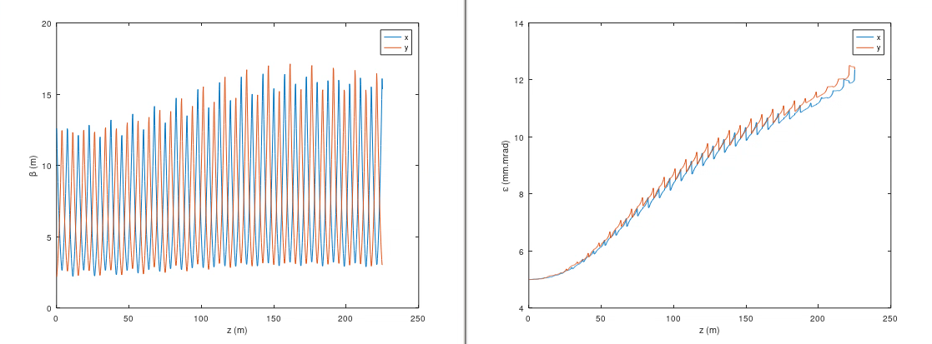
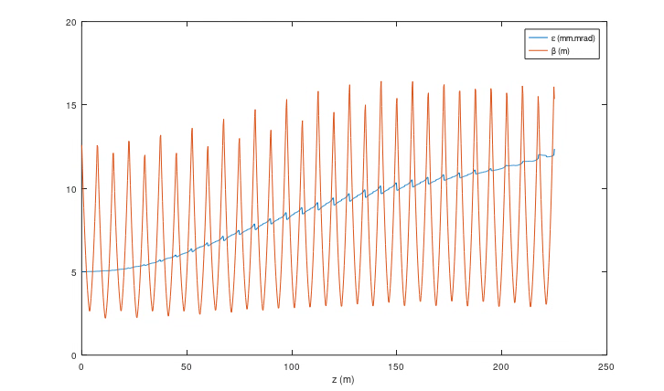
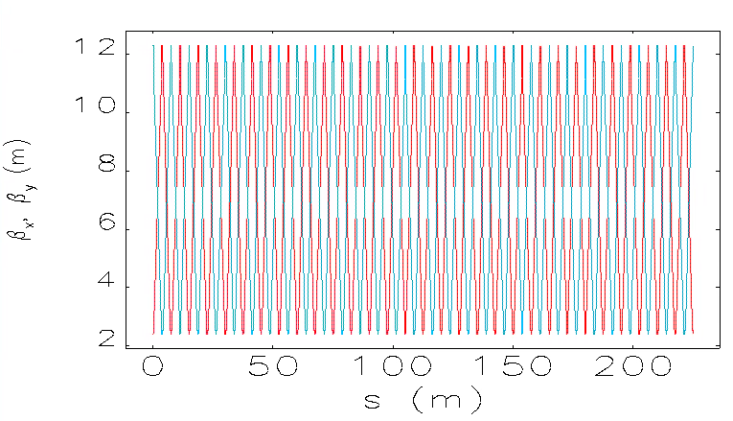
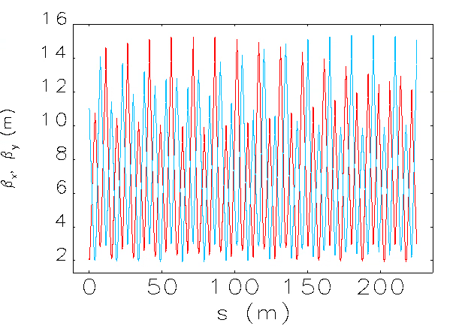
RFTrack
Elegant
Optics like it is
I mismatched a bit
Very similar results

Slide 30
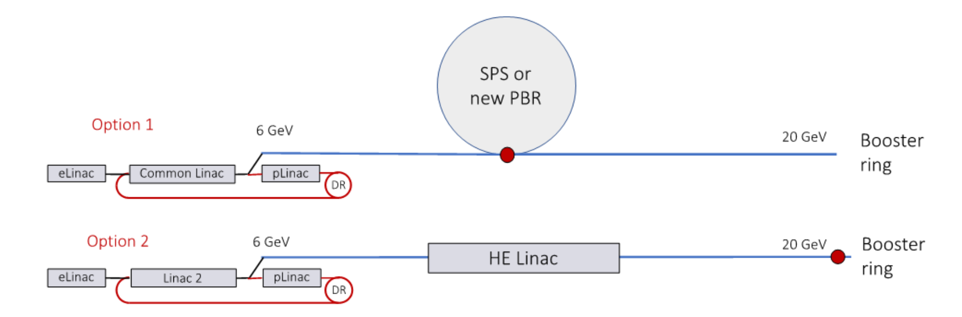
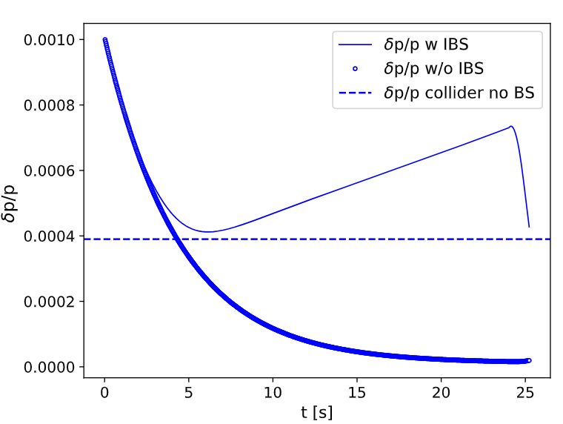
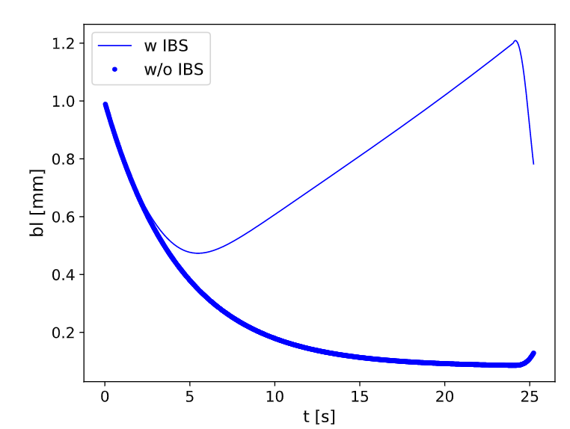
Why do we consider the 6 GeV with the booster requests?
Baseline
Alternative
Booster simulations and discussions
(thanks to B. Dalena, M. Migliorati, and A. Chance)
Impact on the linac(s) design
Assumed energy spread at the injection = 0.1%
5.6 GHz, 0.15, 40 MV/m
Low energy spread: better for dynamic aperture, worse for instabilities
Long bunch length: better for instabilities, but under investigation coupling transverse-longitudinal plane
Bunch length~>1-1.5 mm
Energy spread~0.1-0.15%
(ongoing optimization)
Marginal modification of the optimum working point (phase and bunch length) stopping the linac at 6 GeV or at 20 GeV
Strong impact on the linearizing cavity amplitude: alternative solutions must be considered

Slide 31
More parameters scans

Slide 32
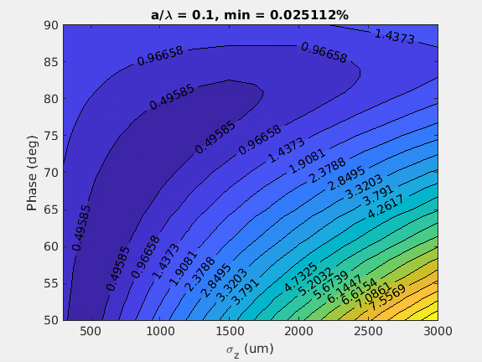
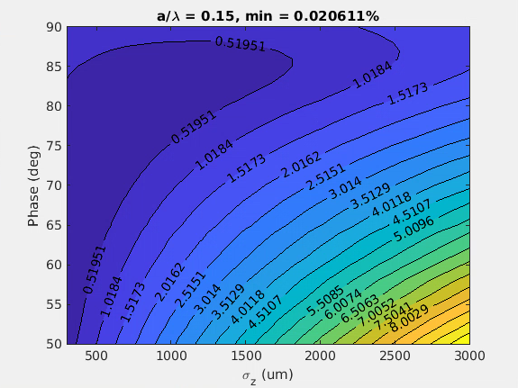
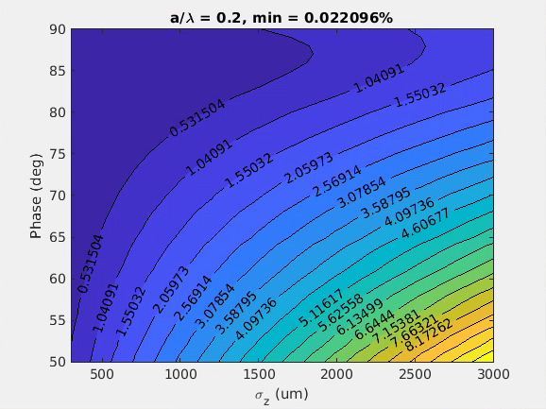
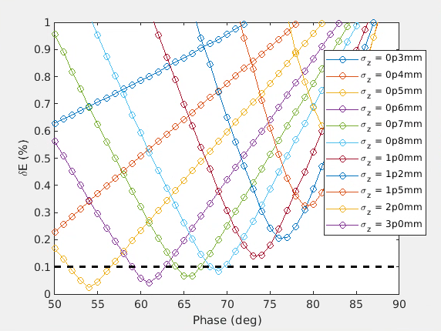
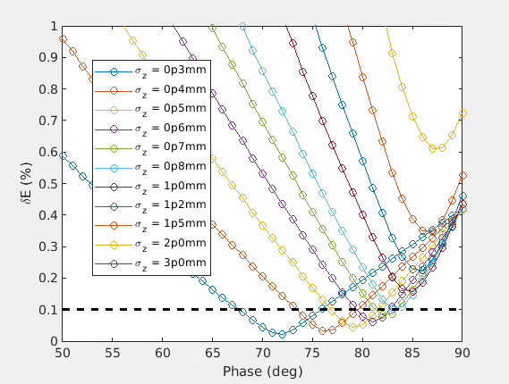
f = 2.8 GHz, G = 25 MV/m, no linearizer
Back
a/λ = 0.1 (a = 10.7 mm)
a/λ = 0.15 (a = 16.1 mm)
a/λ = 0.2 (a = 21.4 mm)

Slide 33
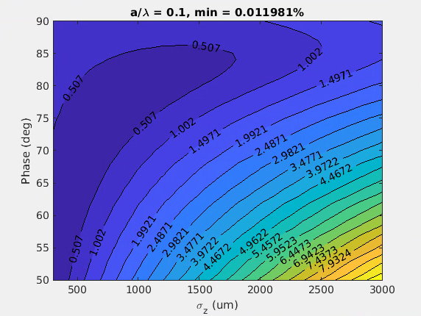
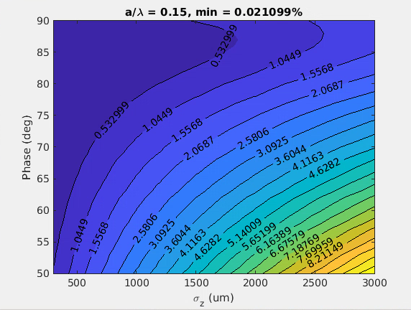
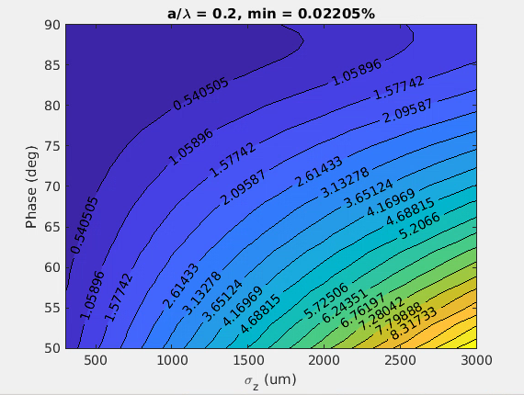
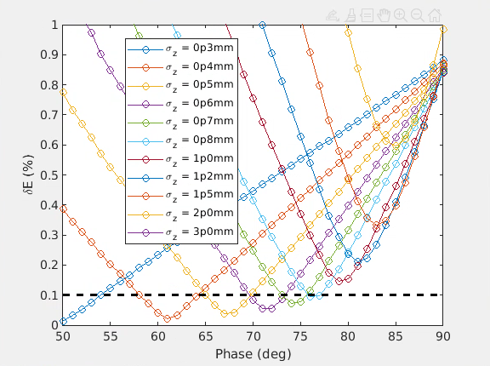
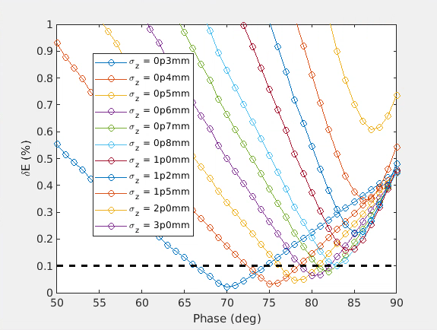
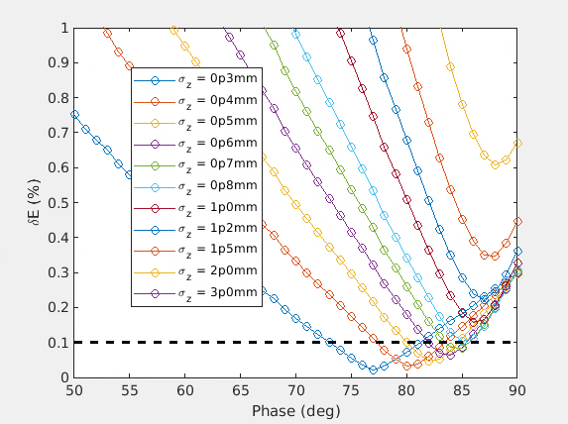
f = 2.8 GHz, G = 40 MV/m, no linearizer
Back
a/λ = 0.1 (a = 10.7 mm)
a/λ = 0.15 (a = 16.1 mm)
a/λ = 0.2 (a = 21.4 mm)

Slide 34
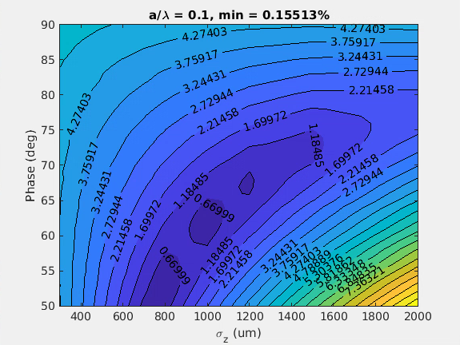
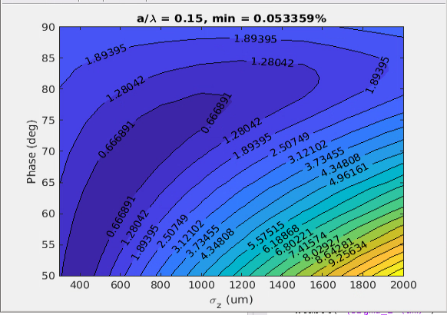
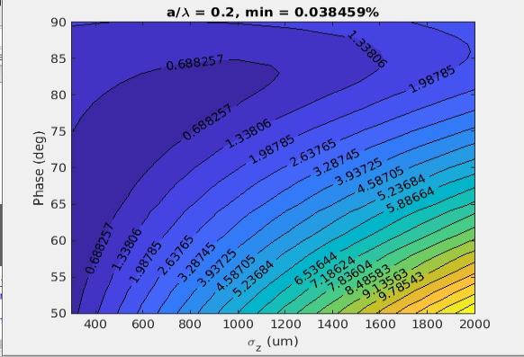
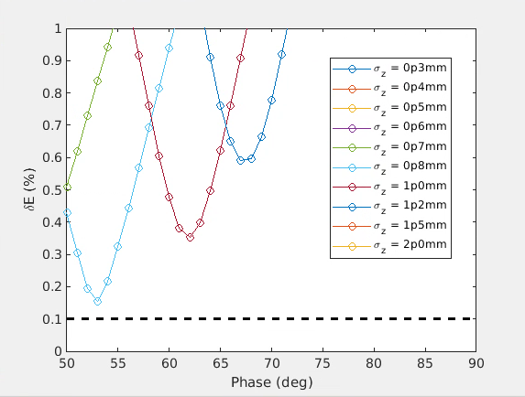
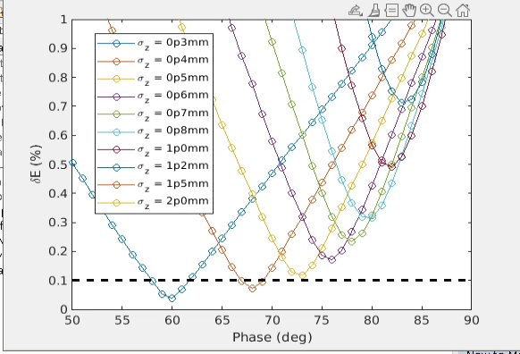
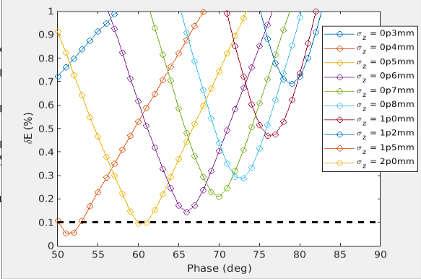
f = 5.6 GHz, G = 25 MV/m, no linearizer
/psi/home/bettoni_s/Matlab_works/Scan_FCC
Back
a/λ = 0.1 (a = 5.4 mm)
a/λ = 0.15 (a = 8 mm)
a/λ = 0.2 (a = 10.7 mm)
f_5p6GHz_G_25MVm_al_0p1.fig
f_5p6GHz_G_25MVm_al_0p15.fig
f_5p6GHz_G_25MVm_al_0p2.fig

Slide 35
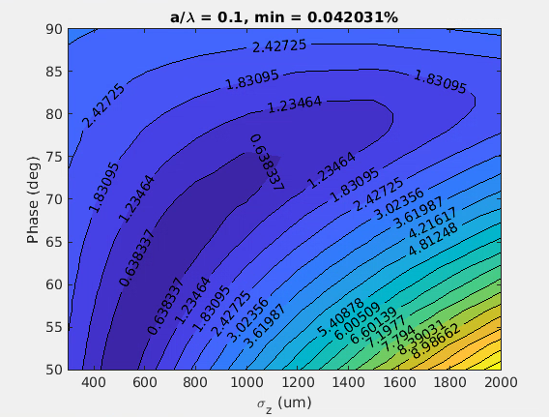

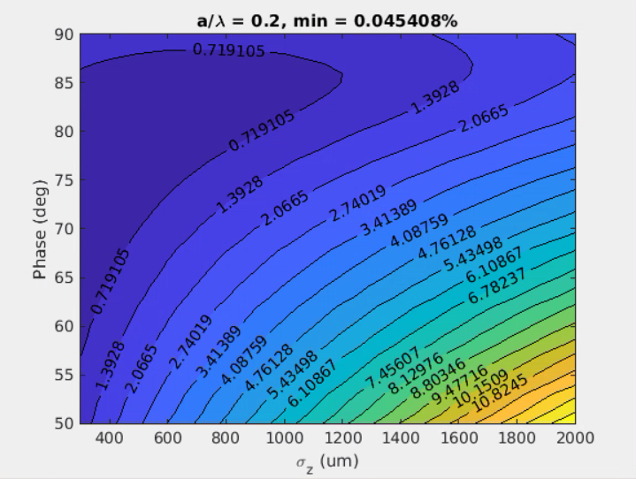
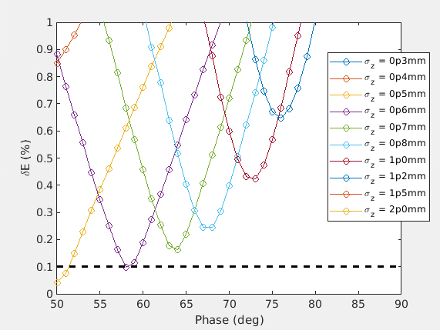
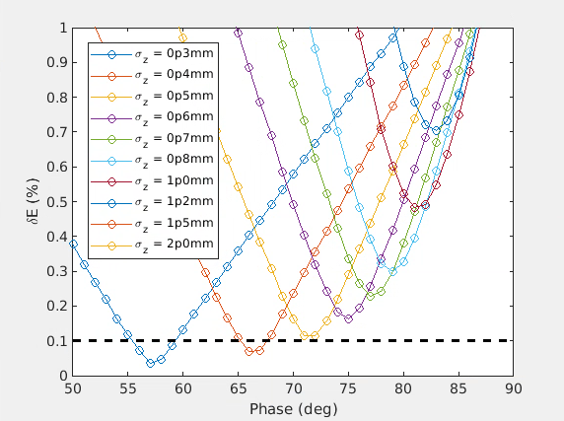
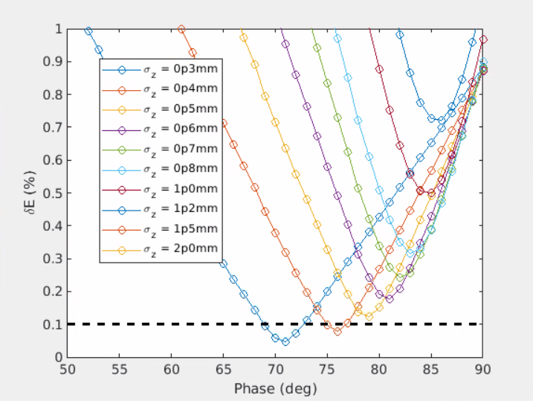
f = 5.6 GHz, G = 40 MV/m, no linearizer
Back
a/λ = 0.1 (a = 5.4 mm)
a/λ = 0.15 (a = 8 mm)
a/λ = 0.2 (a = 10.7 mm)

Slide 36
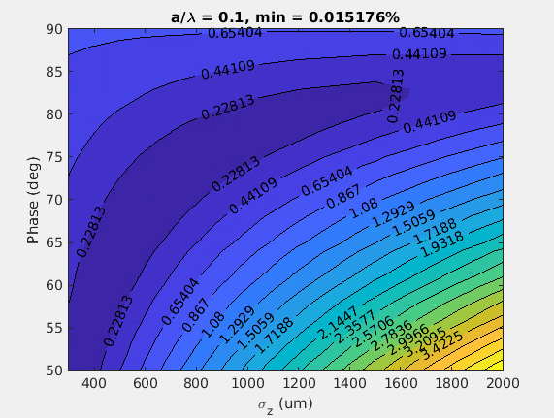

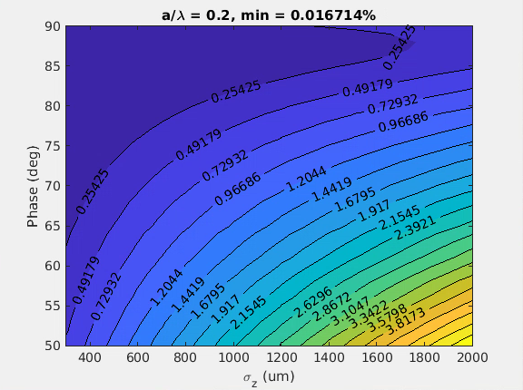
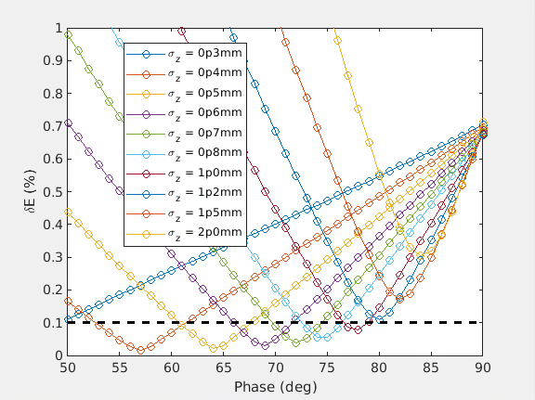
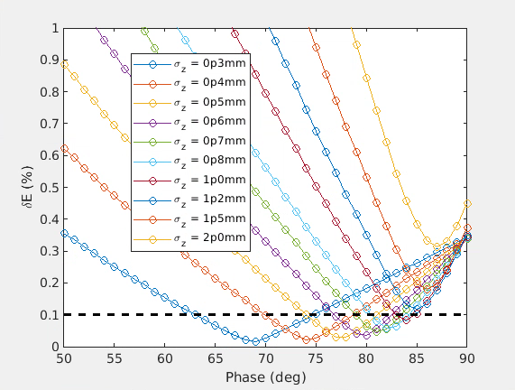
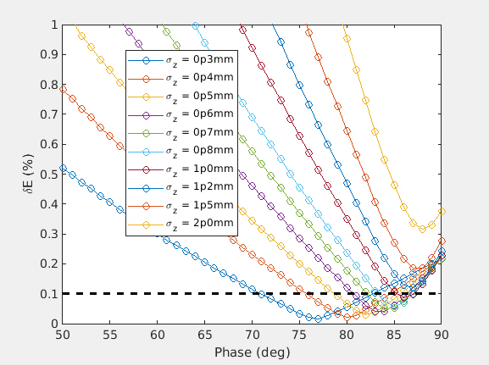
f = 2.0 GHz, G = 25 MV/m, no linearizer
Back
Electron linac run at 2 GHz. To be consistent with the previous a/λ = 0.2 (~3 deg difference expected)
a/λ = 0.1 (a = 15 mm)
a/λ = 0.15 (a = 22.5 mm)
a/λ = 0.2 (a = 30 mm)
f_2p0GHz_G_25MVm_al_0p1.fig
f_2p0GHz_G_25MVm_al_0p15.fig
f_2p0GHz_G_25MVm_al_0p2.fig

Slide 37
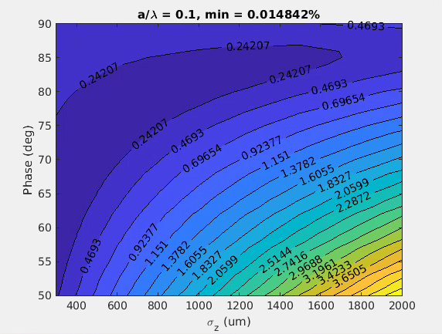
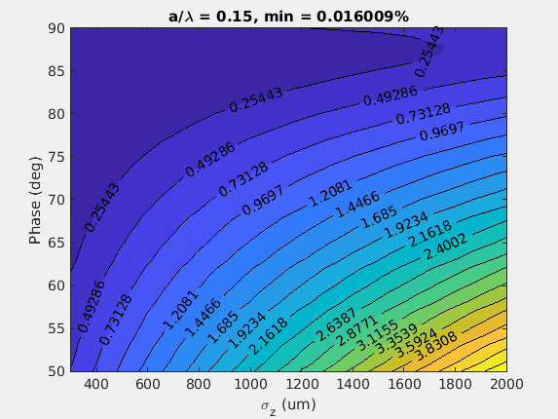




f = 2.0 GHz, G = 40 MV/m, no linearizer
Back
Electron linac run at 2 GHz. To be consistent with the previous a/λ = 0.2 (~3 deg difference expected)
a/λ = 0.1 (a = 15 mm)
a/λ = 0.15 (a = 22.5 mm)
a/λ = 0.2 (a = 30 mm)
RUNNING …
SAVE ALSO .FIG
f_2p0GHz_G_40MVm_al_0p1.fig
f_2p0GHz_G_40MVm_al_0p15.fig
f_2p0GHz_G_40MVm_al_0p2.fig

Slide 38
Charge and geometry dependence

Slide 39

Q = 5 nC-start2end
Newly optimized shorter distribution
The distribution is a bit shorter than expected, but fine tuning

Slide 40


To keep in mind
Start-to-end fits with expectations, also if the newly optimized initial distribution seems to be a bit shorter than 650 um
From 0.15 to 0.2 a/lambda in e-Linac moves the optimal phase by 2 degrees
From 4 to 5 nC moves the optimal phase by 3 degrees
All this at this bunch length
It can be partially recovered by elongating the bunch length, but the maximum bunch length to stay below 0.1% final energy spread is 800 um, as expected from previous simulations (otherwise RF curvature starts to make impossible to stay below 0.1% final energy spread)

Slide 41
RF structures design

Slide 42




RF structures gradient
7D Sweep range:
  rf phase advance ψ = 2π/3 … 9π/10
  frequency f = 2.0 GHz … 5.6 GHz
  aperture a_{entr} , a_{exit} = 0.08 λ … 0.34 λ
  iris thickness d_{entr} , d_{exit} = 0.02 λ … 0.19 λ
  structure length L = 0.5 m … 5.0 m
Courtesy of H. Pommerenke

Slide 43
Linearizing cavity(ies)

Slide 44

With the linearization
Without linearization
With linearization (using 12 GHz cavities)
f (GHz) | G (MV/m) | a/λ | a (mm) | Maximum σ_{z} (mm) | Maximum phase (deg)
 |  |  |  | δ_{E} = 0.1 %
2.0* | 40 | 0.1 | 15 | 3 | 89
Much longer bunch lengths possible
Less efficient for 5.6 GHz (2nd harmonic) except we compress and we can neglect the RF curvature downstream the compression

Slide 45
Low frequency design case: 2 GHz case
Without longitudinal phase space (LPS) linearization
Max σz = 1-1.2 mm
Max σz = 1-1.2 mm
e- linac
Common linac
2.0 GHz, a/λ = 0.1
2.0 GHz, a/λ = 0.1
With LPS linearization
Max σz = 3 mm
e- linac
Common linac
Max σz = 3 mm
2.0 GHz, a/λ = 0.1
2.0 GHz, a/λ = 0.1
12 GHz, a/λ
Max σz= 3 mm
e- linac
Common linac
σz tunable
2.0 GHz, a/λ = 0.1
2.0 GHz, a/λ = 0.1
12 GHz, a/λ
(RF structures off or slightly shorter bunch upstream and rest of the linac powered or dechirper)
  The beam quality is the best (longest bunch length) → transverse beam dynamics
  Operation phase close to 90 degrees
  Linearization quite efficient (6th harmonic)
  Possible to go toward small apertures and longer bunch lengths in case LPS is applied
  Linearization is more demanding higher the final beam energy is → “energy compressor” à la SuperEK-B attracting

Slide 46
Others

Slide 47

Time structure
From P. Craievich, FCC Week 2022

Slide 48
“Minimalistic” schematic layout: a closer look
e- Linac a
(Match)
(BC)
(Match)
e- Linac b
Match
Common Linac
e+ Linac
Match
DR
Match
Schematic layout must include:
  Matching sections to and after the compression chicanes (if present)
  Independent matching sections to the common Linac (swap of βx and βy for electrons and positrons)
  Independent launch orbit for electrons and positrons at the entrance of the common Linac
Bend

Slide 49

Some considerations (valid for all the layouts)
Bunch length tuning and operation point:
  We select R56 to run at 90 degrees to generate the desired chirp for the compression: maximize the RF efficiency
  The same argument is valid to elongate the beam swapping the sign of R56
R56>0
E
T
H
No chirp (off-crest)
Chirp (phase = 90 deg)
$$CF=\frac{1}{1−A∙R_{56}}$$
t
E
E
H
R56<0
H
T
E
H
T
T
t
t
t
Energy spread tuning:
  We may use not powered structures (not tunable) or dedicated structures, like a dechirper (tunable)
Longitudinal phase space linearization (alternative to the harmonic cavity), like in SuperKEKB:
  Accelerate the bunch using stations with frequency f
  Elongate the bunch by a factor N
  Decelerate the beam with stations at frequency f (equivalent to Nth harmonic with the short bunch)
  Compress the beam

