Slide 1
e+ Linac of the FCC-ee Injector,
Discussing Open Points Based on 2 Possible Layouts
Mattia Schaer :: Paul Scherrer Institute, Andrea Latina :: CERN
FCC-ee Injector Study Collaboration, Mini Workshop, Orsay, 24.11.2022

Slide 2
What We Have…
First start-to-end particle tracking (RF-Track) from the prod. target to the damping ring
→ Large transport efficiency
→ Yield 35 % smaller than expected from simulations of only the capture system
Two possible linac layouts
  Transport with solenoids up to 1.54 GeV
  Transport with solenoids up to 780 MeV + conventional FODO lattice up to 1.54 GeV
Transverse emittance as a function of the considered (core) bunch portion

Slide 3
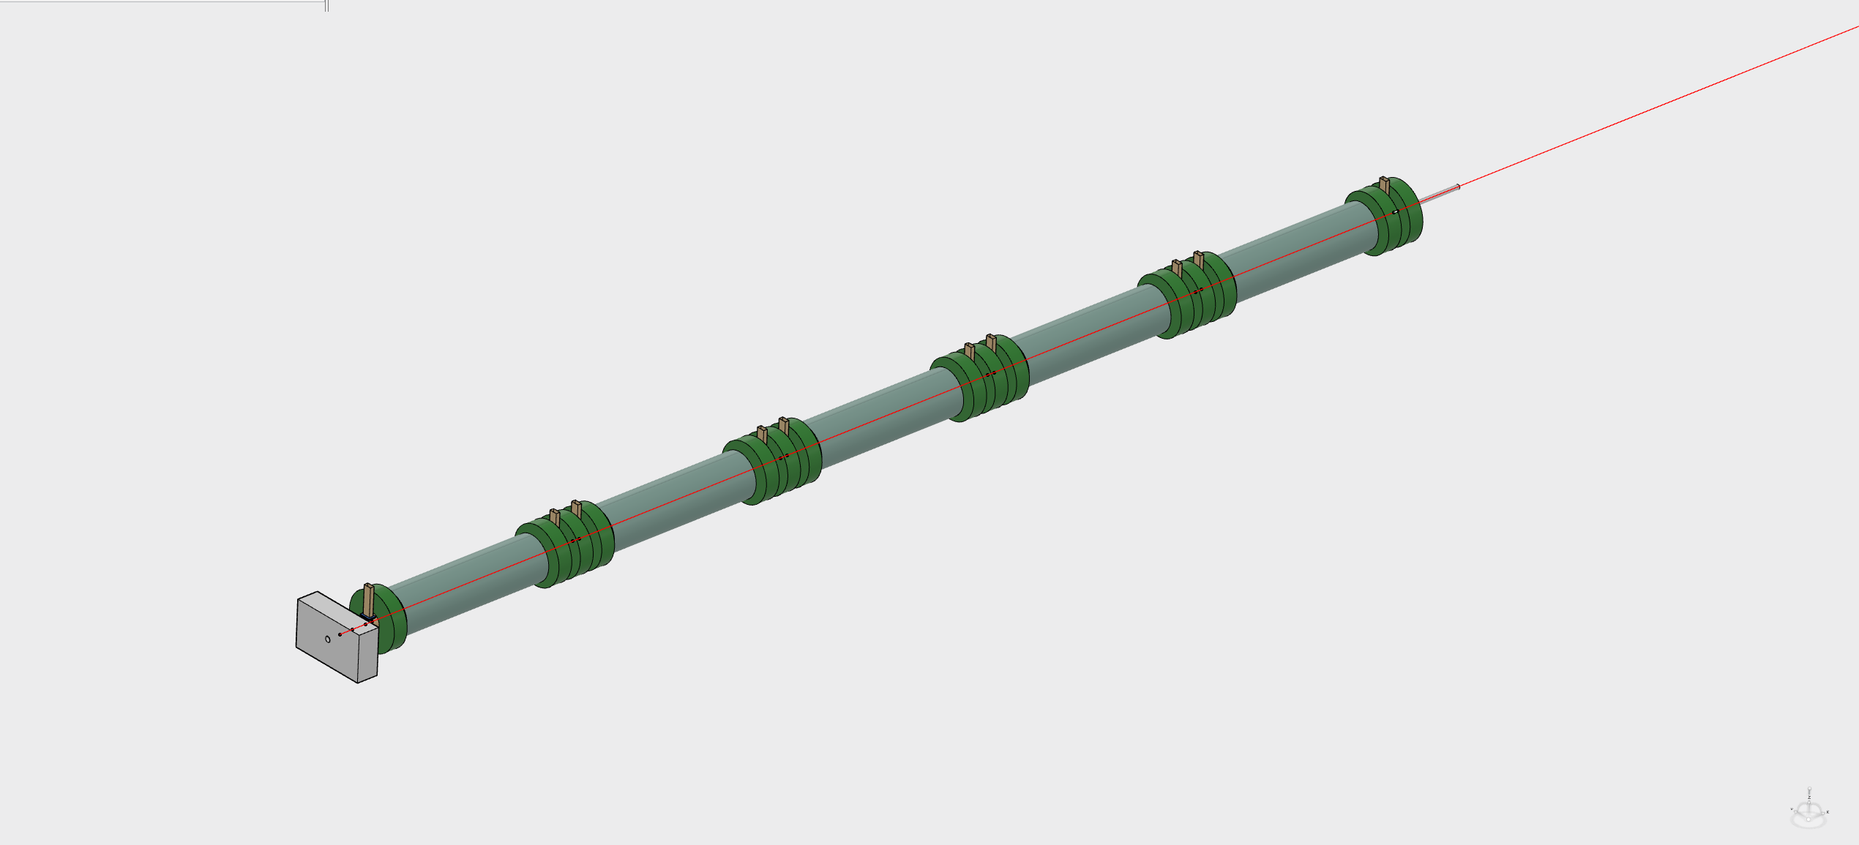
e⁺ Linac Layout 1
Up to 1.54 GeV
3D mechanical model fully consistent
with beam dynamics, RF and magnetic simulation setups

Slide 4
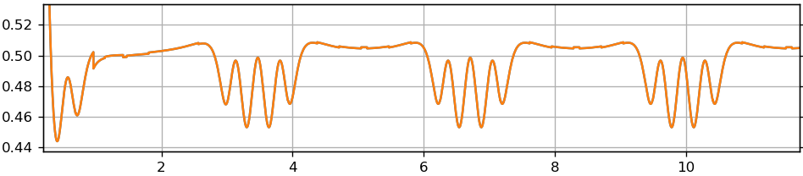
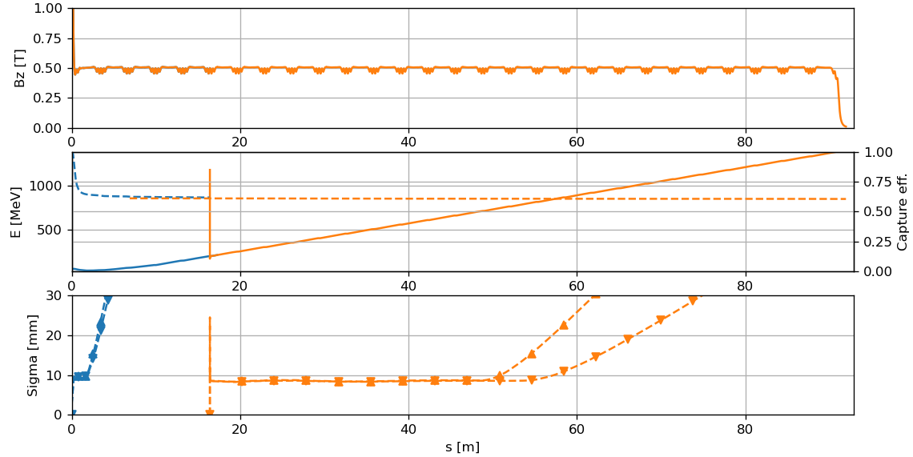
e⁺ Linac Layout 1, Transport
Start-to-end tracking with RF-Track
Artifacts
from particles with s < 0
Artifacts
from
particles
with s < 0

Slide 5
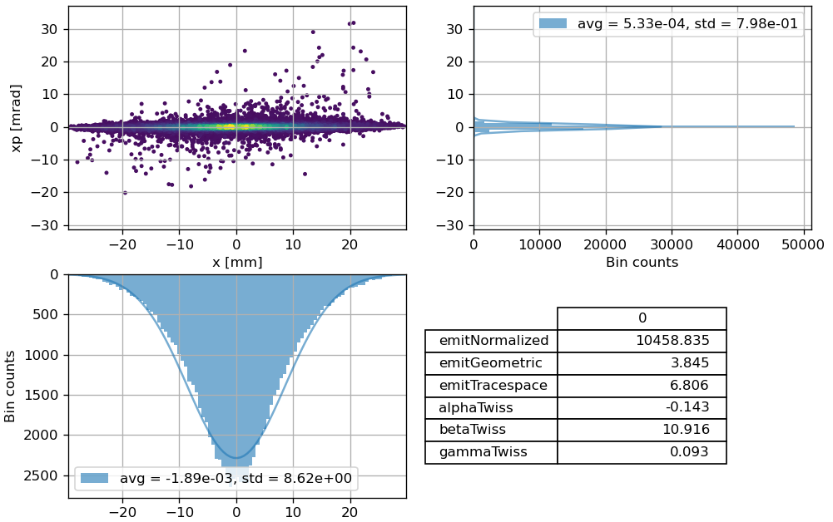
e⁺ Linac Layout 1, Final Transverse PS

Slide 6
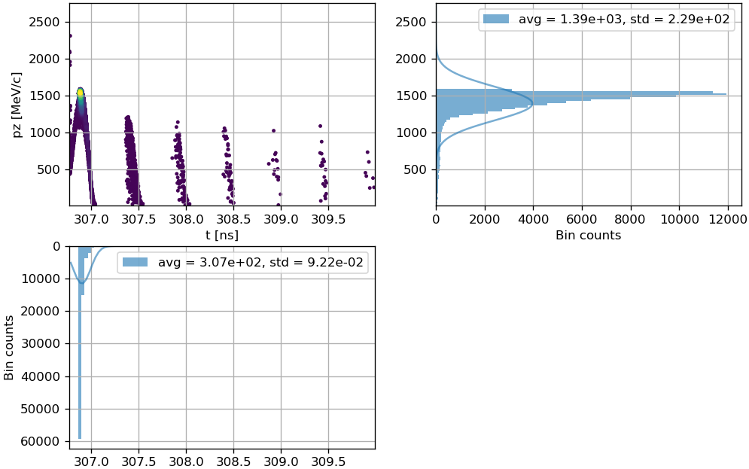
e⁺ Linac Layout 1, Final Longitudinal PS

Slide 7
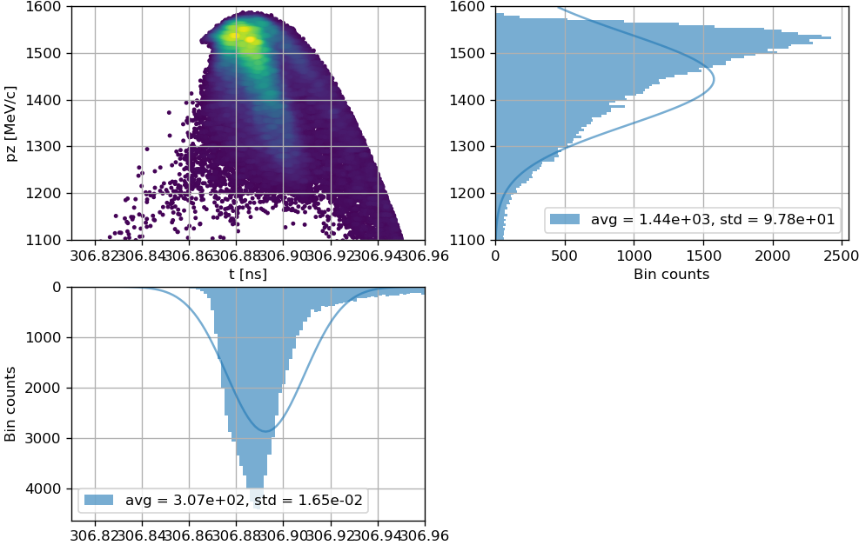
e⁺ Linac Layout 1, Final Main Bucket (Long. PS)

Slide 8
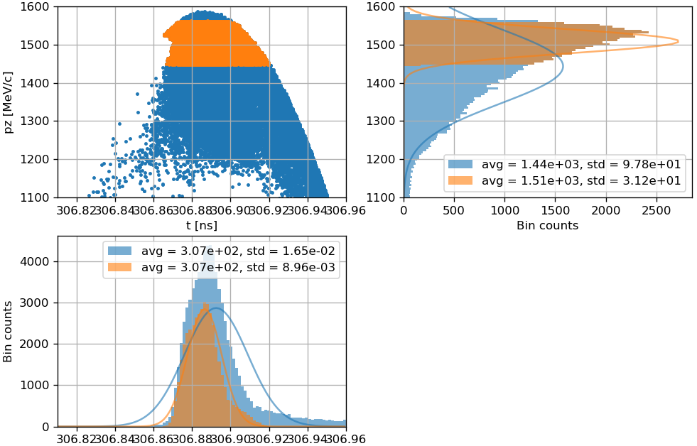
e⁺ Linac Layout 1, Yield at Damping Ring
Yield at DR = 4.2= 0.65 * expected
After application of +/- 3.8 % energy window

Slide 9
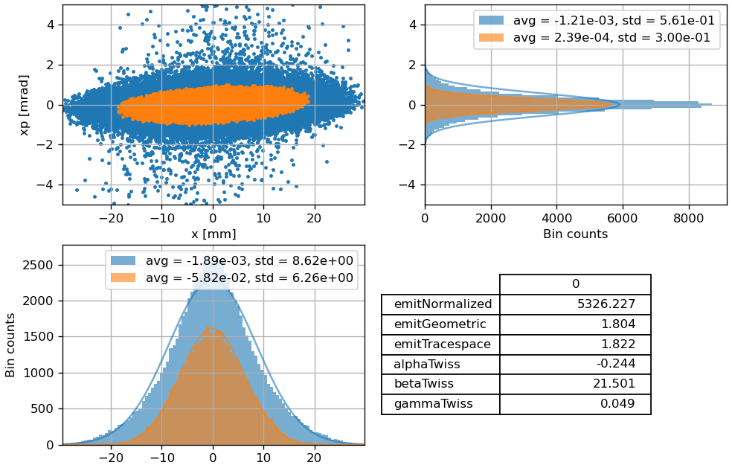
e⁺ Linac Layout 1, Emittance of Accepted Particles
vs.
10458 mm mrad
Reduction of a
factor 2!

Slide 10
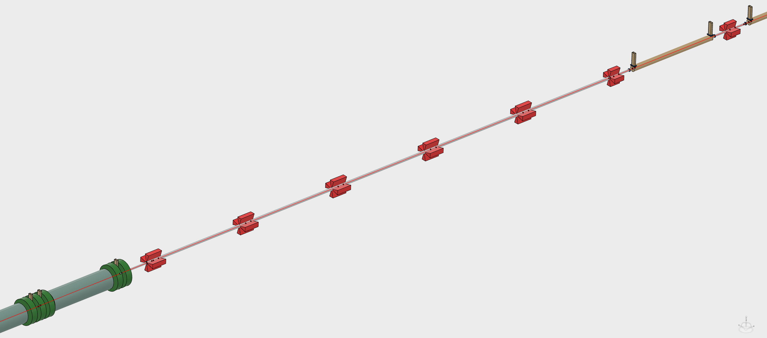
e⁺ Linac Layout 2
Up to 1.54 GeV
780 MeV
3D mechanical model fully consistent
with beam dynamics, RF and magnetic simulation setups

Slide 11
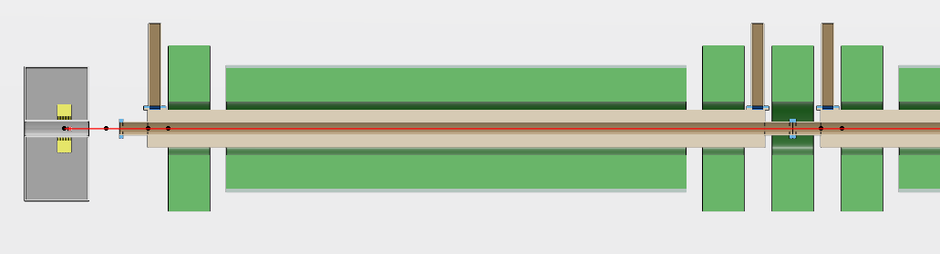
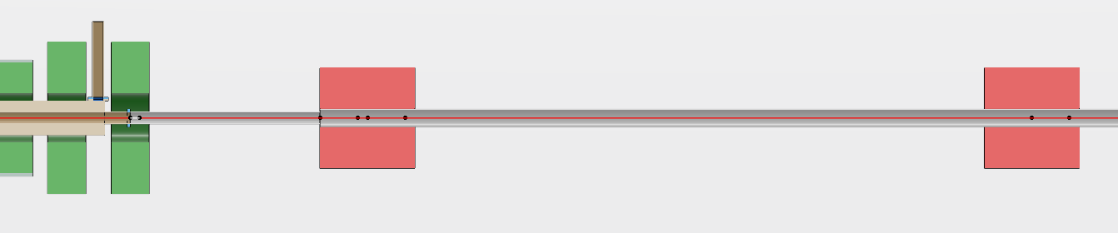
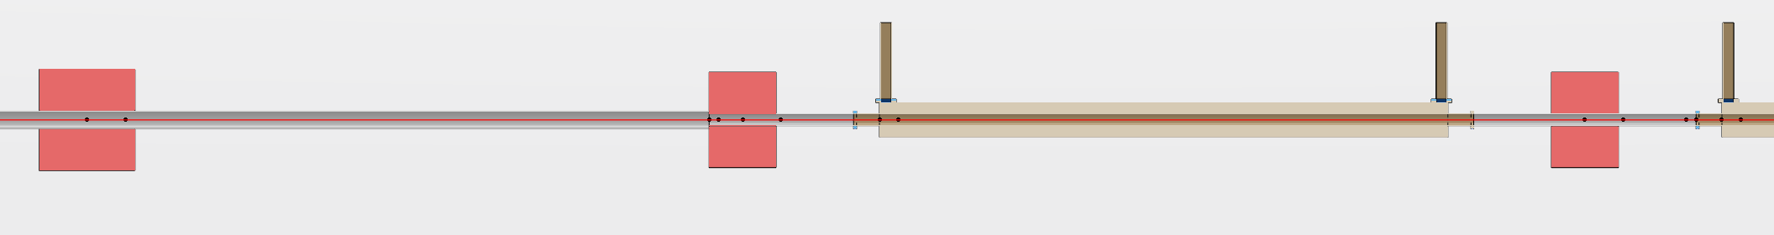
e⁺ Linac Layout 2, Different Sections

Slide 12
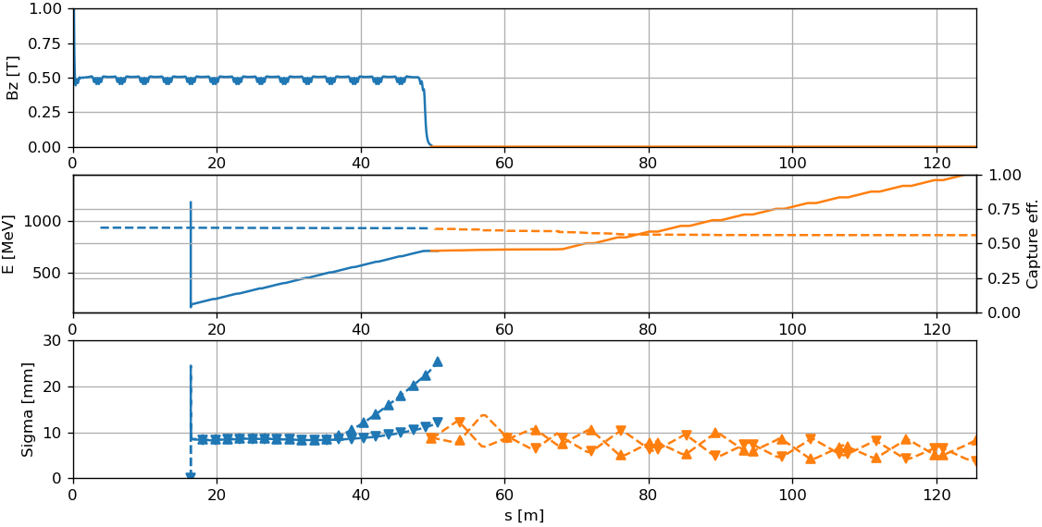
e⁺ Linac Layout 2, Transport
Start-to-end tracking with RF-Track
Dynamics up to 780 MeV identical to Layout 1
Matching section and FODO designed with Elegant
(without acceleration)

Slide 13
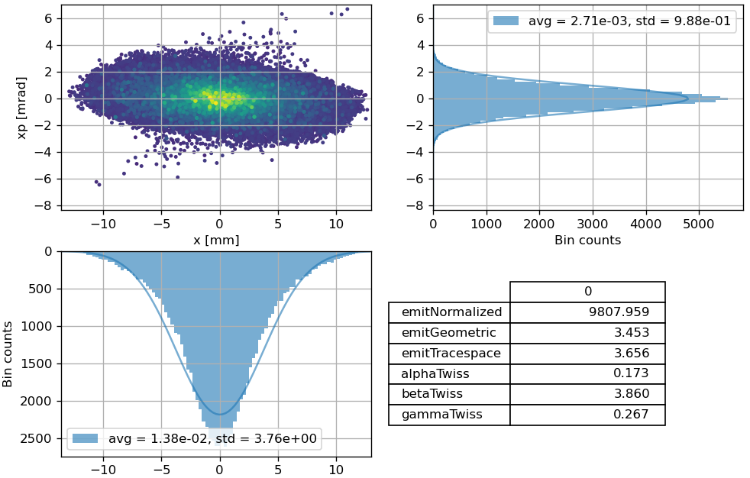
e⁺ Linac Layout 2, Final Horizontal (X) Transv. PS

Slide 14
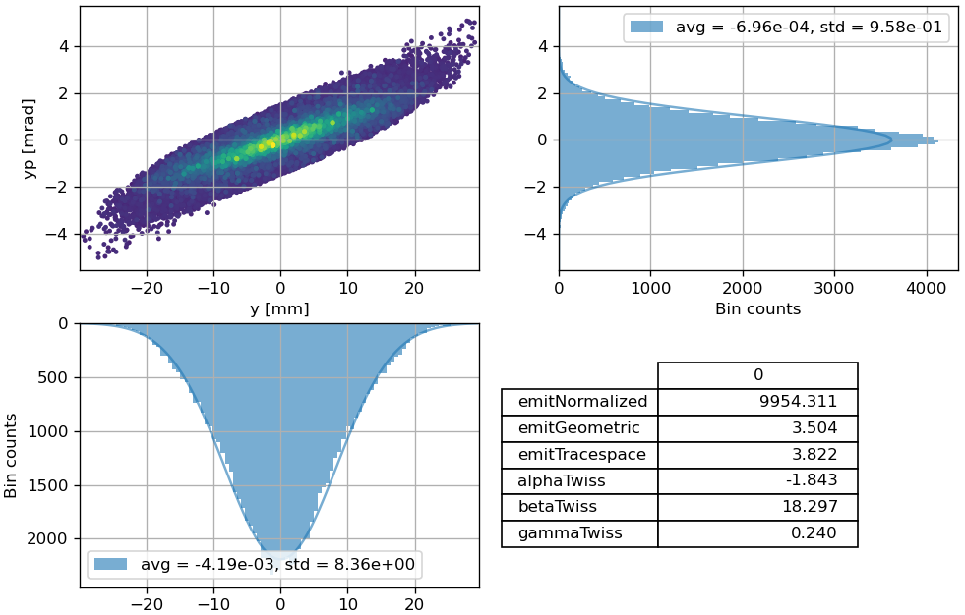
e⁺ Linac Layout 2, Final Vertical (Y) Transv. PS

Slide 15
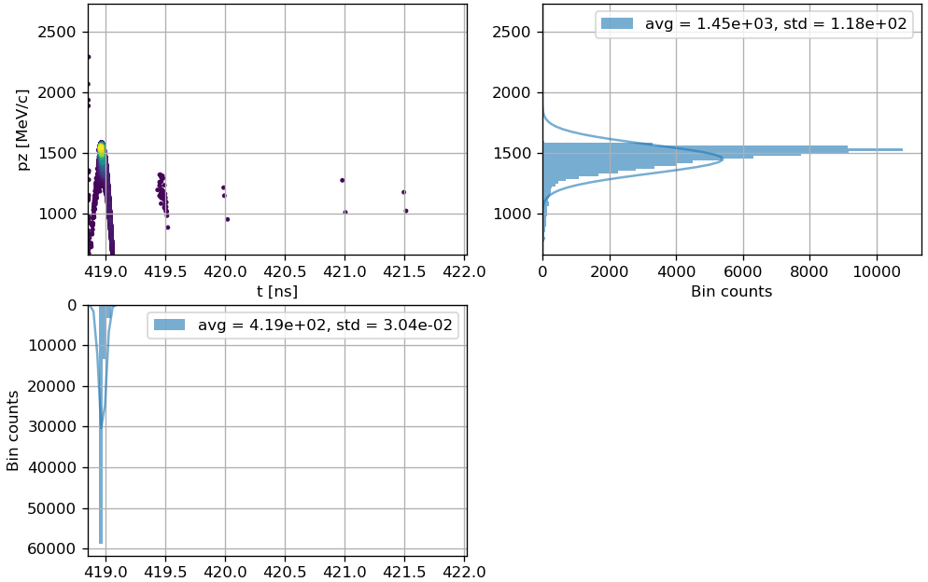
e⁺ Linac Layout 2, Final Longitudinal PS

Slide 16
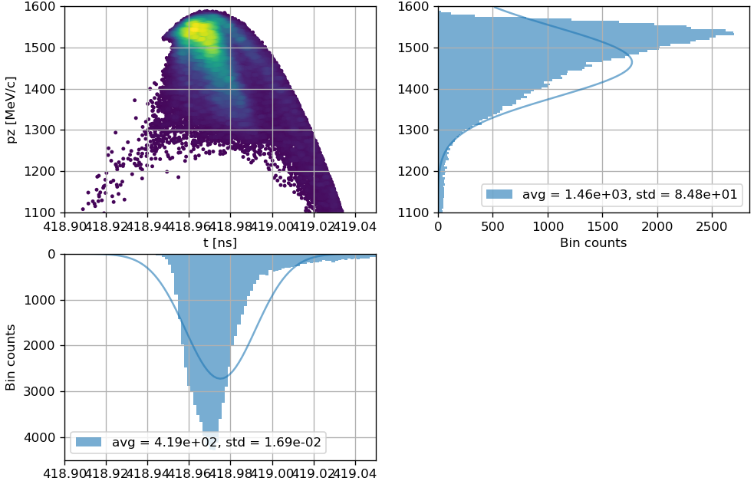
e⁺ Linac Layout 2, Final Main Bucket (Long. PS)

Slide 17
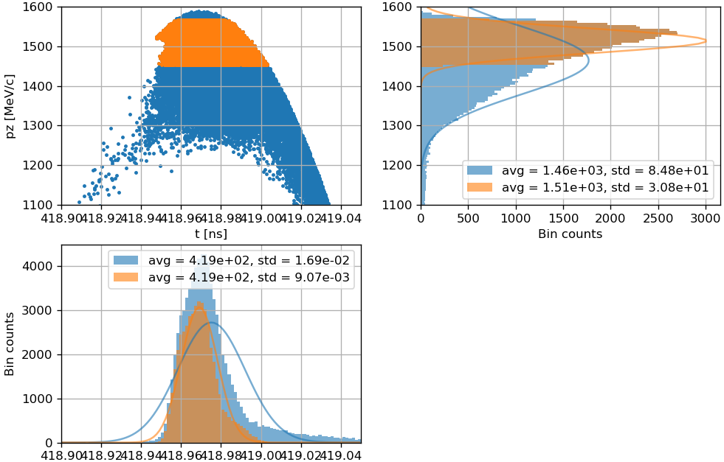
e⁺ Linac Layout 2, Yield at Damping Ring
Yield at DR = 4.6 = 0.70 * expected
After application of +/- 3.8 % energy window

Slide 18
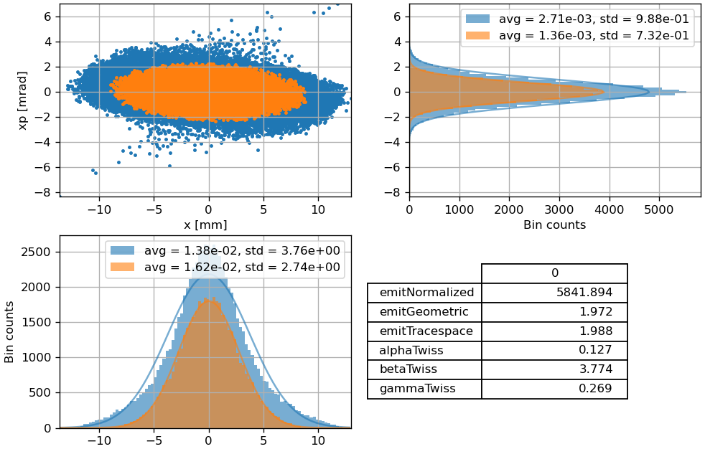
e⁺ Linac Layout 2, Emittance of Accepted Particles
vs.
9807 mm mrad
Reduction of a
factor 2!

Slide 19
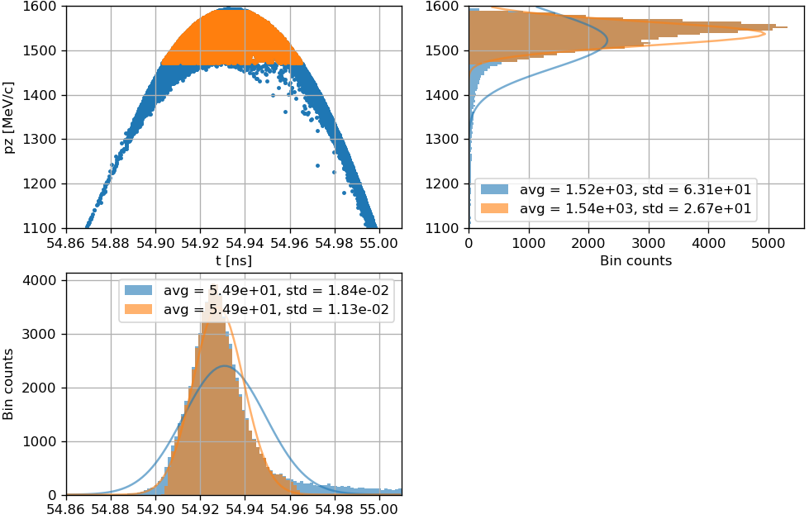
Smaller Yields Than Initial Estimations…
Energy distr.
much more peaked!
Yield estimation at DR = 6.54 (Yongke)
After analytical computation of long. dynamics
and application of +/- 3.8 % energy window

Slide 20
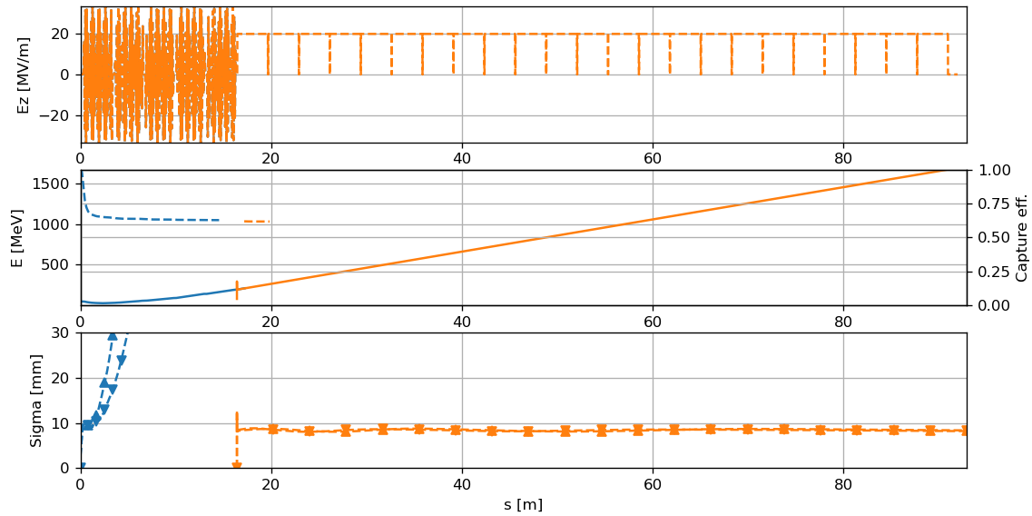
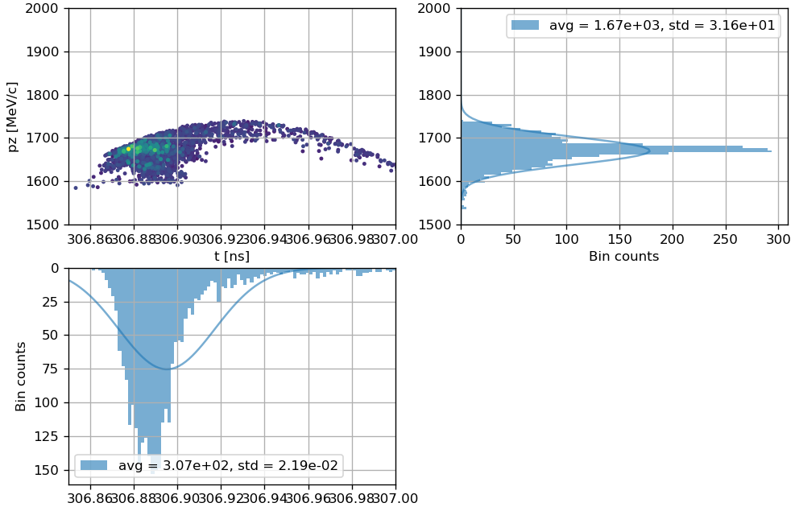
… Probably Due to E_{z}(r) ≠ const. and Large σ_{r}
Trial simulation accelerating with E_{z} = const.
(B_{z} identical to Layout 1)
Energy histogram much more similar
to the analytical tracking!
(Hypothesis to be further verified…)

Slide 21
… and What we Still Need
Apply 6D (?) damping ring acceptance, current energy window is a very rough assumption
→ Robust yield estimation
Verify feasibility of solenoids up to 780 MeV in detail
(misalignments, multipolar components, etc.)
Design chicane to separate e+ and e-, 1st trial will be in the matching section at 780 MeV
Design energy compressor, if e+ charge accepted in the damping ring is not enough
(depends on pt. 1)
Consider quadrupoles around RF structures at intermediate energies
(depends on pt. 2, costs and mechanical complexity)

Slide 22
Next Step 1: Apply 6D Damping Ring Acceptance
Dynamic aperture of damping ring
(C. Milardi, A. De Santis)
+/- 2 mm (full)

Slide 23
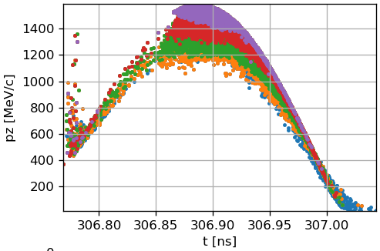
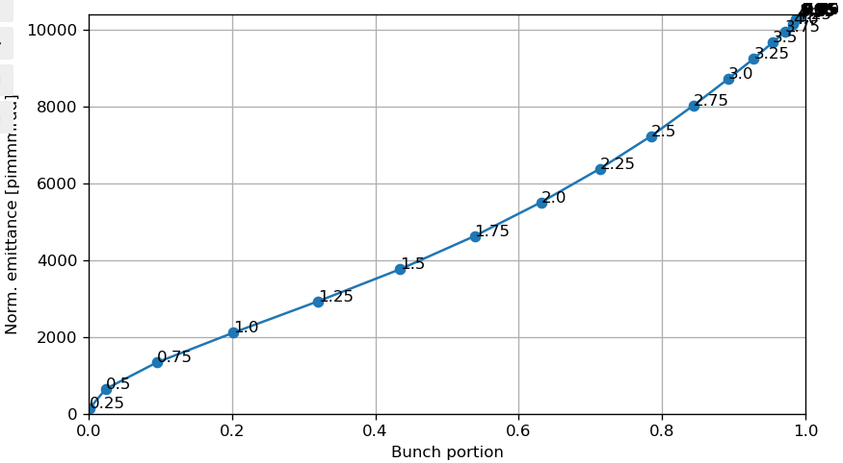
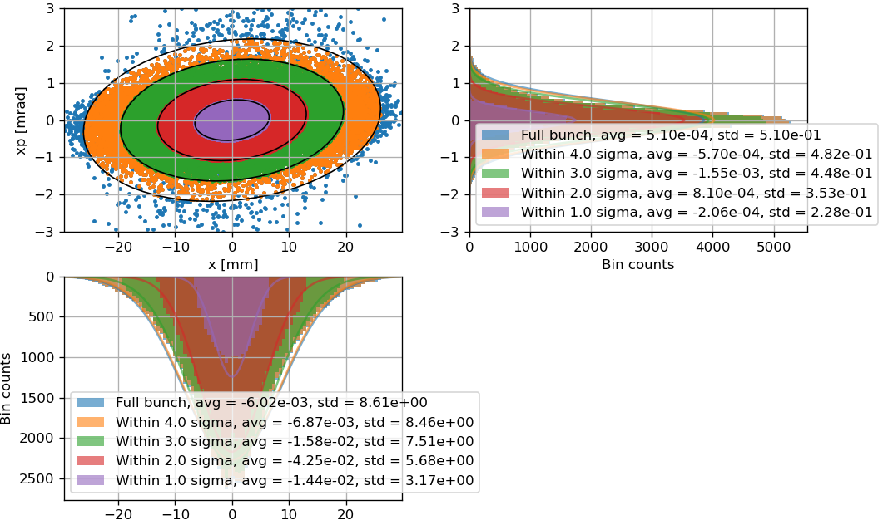
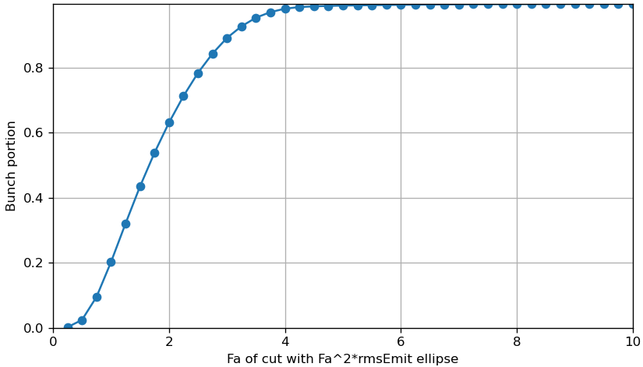
Emittance vs. Bunch Portion @ 1.54 GeV

Slide 24
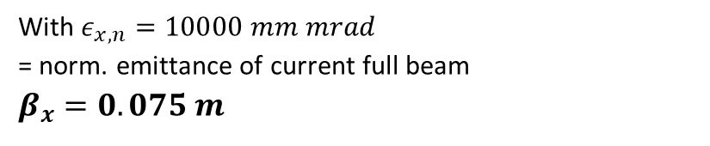
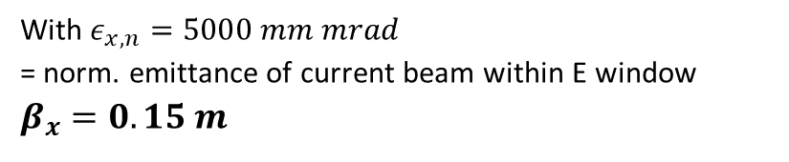



1st Estimation of Beta-Func. Required At Injection
$$β_{x}=σ_{x}^{2}\frac{βγ}{ε_{x,n}}$$
With $ε_{x,n}=5000 mm mrad$
= norm. emittance of current beam within E window
$$β_{x}=0.15 m$$
With $ε_{x,n}=10000 mm mrad$
= norm. emittance of current full beam
$$β_{x}=0.075 m$$
$F_{a}σ_{x}=2 mm$, $F_{a}=4$ → $σ_{x}=0.5 mm$
+/- 2 mm (full)
$$βγ=3014$$

Slide 25
About 2 Orders of Magnitude Difference
$$β_{x}=σ_{x}^{2}\frac{βγ}{ε_{x,n}}$$
Injection-extraction dog leg
(C. Milardi, A. De Santis)
With $ε_{x,n}=5000 mm mrad$
= norm. emittance of current beam within E window
$$β_{x}=0.15 m$$
With $ε_{x,n}=10000 mm mrad$
= norm. emittance of current full beam
$$β_{x}=0.075 m$$

Slide 26
Backup Slides

Slide 27
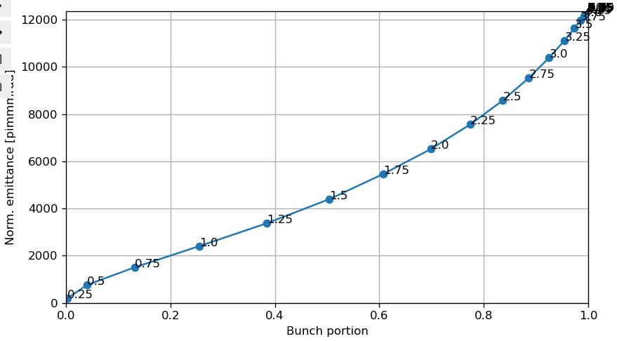
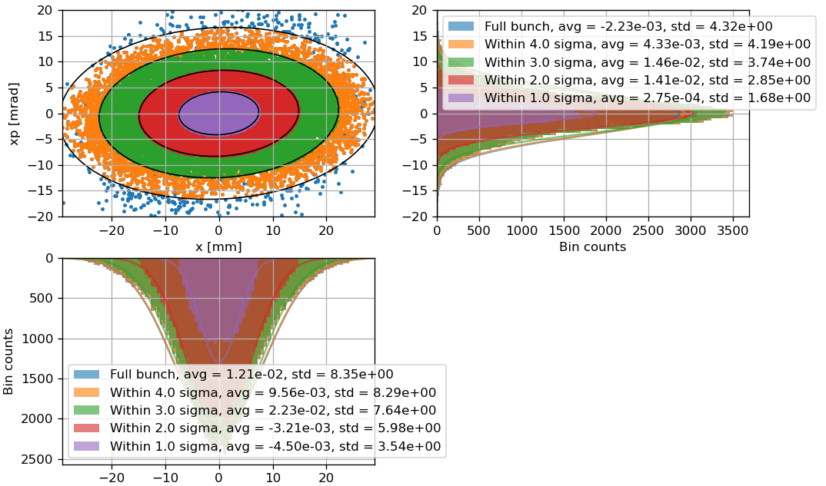
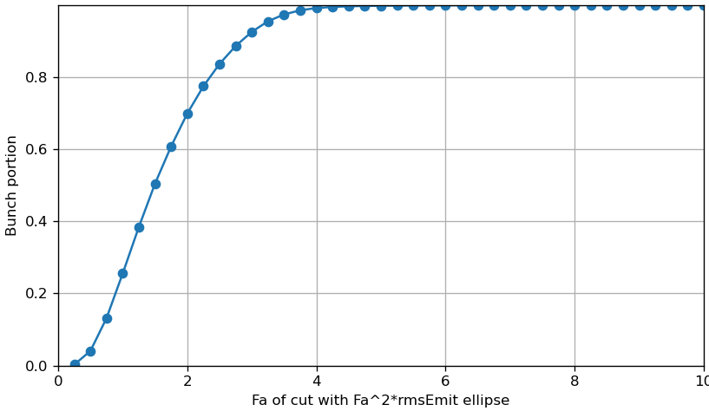
Emittance vs. Bunch Portion @ 200 MeV

Slide 28
