Slide 1

WP3 - Positron source: target and capture system
I. Chaikovska on behalf of the WP3 team

Slide 2
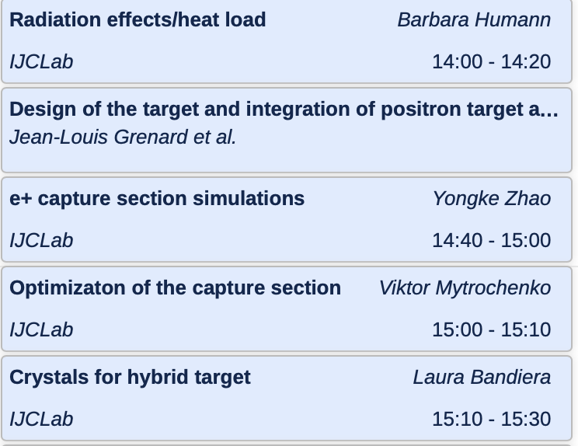
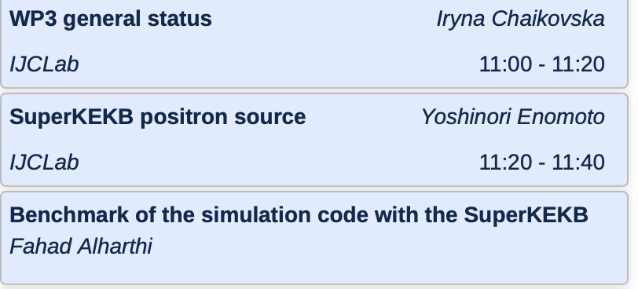
WP3 contributions

Slide 3

FCC-ee positron source: requirements
Accepted e⁺ yield is a function of primary beam characteristics + target + capture system + DR acceptance
The complete filling for Z running => Requirement ~2.4 ⨯ 10¹⁰ e⁺/bunch (4 nC)
N_{e-}/bunch ⨯ η^{e+}_{Accepted} ≥ 4 nC/bunch ⨯ 2
*A safety margin of 2 is currently applied for the whole studies.
All the studies are focused on the operation scheme: 6 GeV, 2 bunches/pulse, 200 Hz rep. rate, the max e- bunch charge is 4 nC ➜ ~ 9.6 ⨯ 10¹² e⁺/s

Slide 4
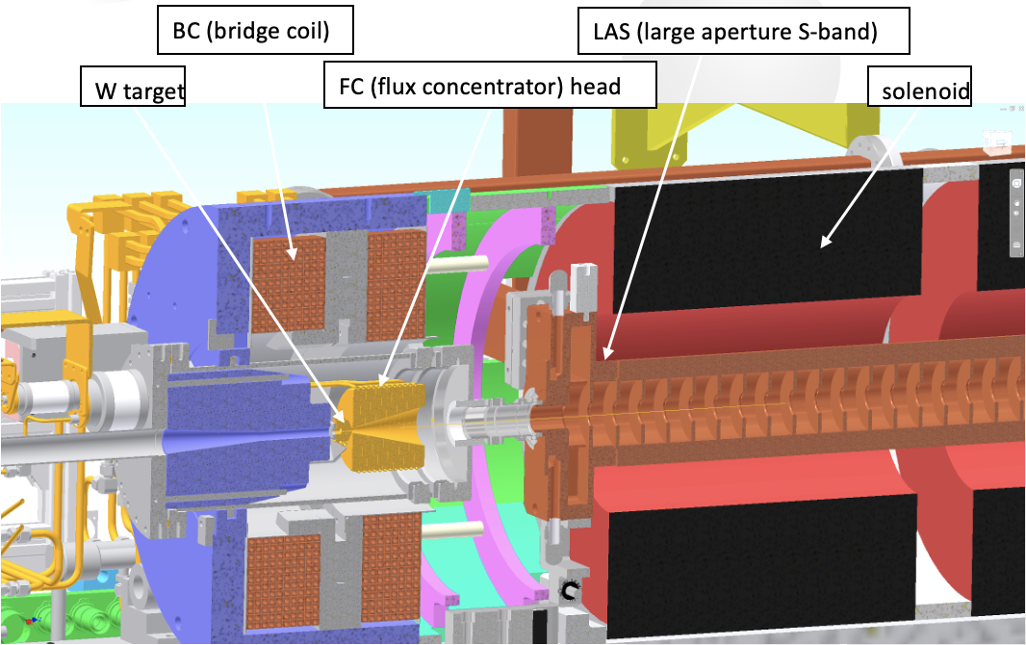
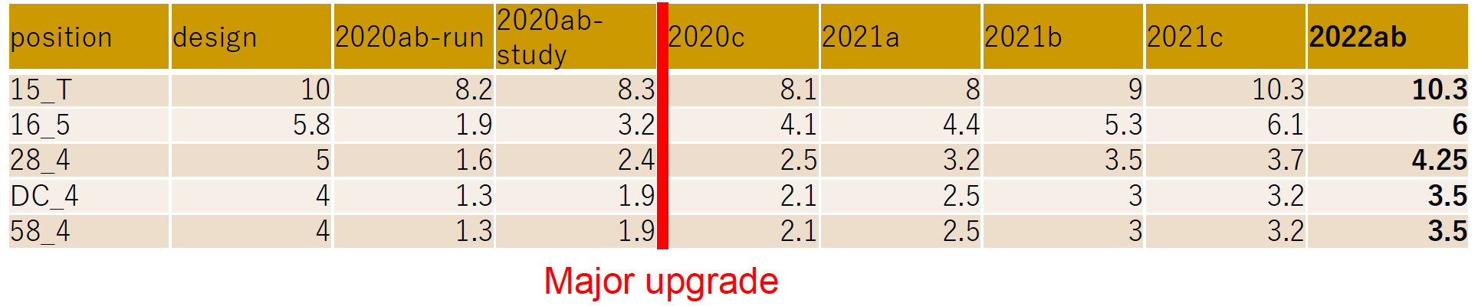
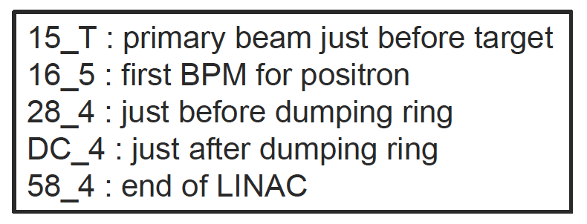
Benchmark with the SuperKEKB positron source
e- drive beam: 3.5 GeV, 2 bunches/pulse, 10 nC, 50 (25) Hz
F. Alharthi (IJCLab)
The positron source of SuperKEKB is the world’s highest intensity positron source currently in operation.
KEK has long operation experiences, test facility and the real positron source in operation (simulation results, experimental data) → ideal for a benchmark for the FCC-ee simulation software
Y. Enomoto (KEK)
0.3 e+/e-

Slide 5
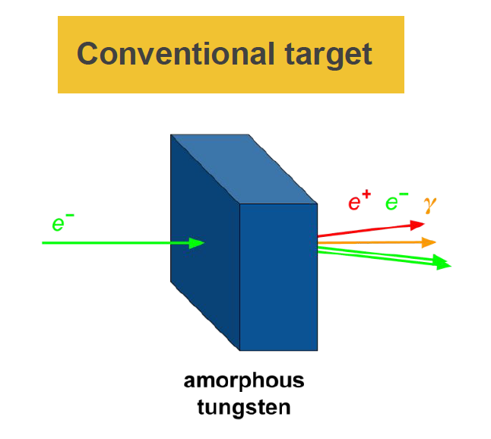
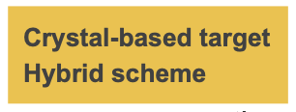
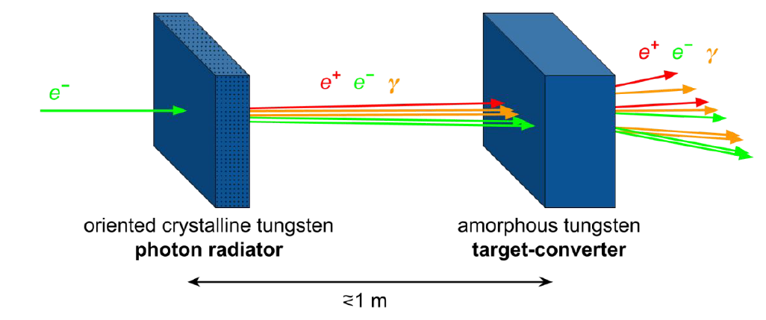
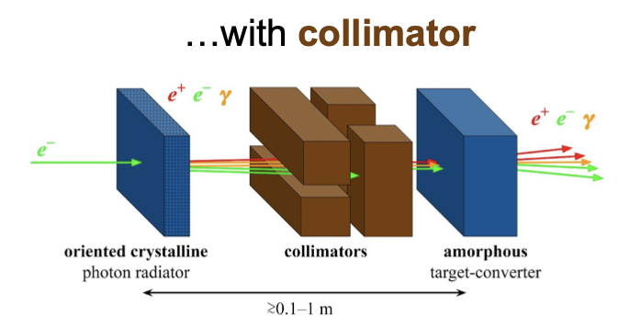
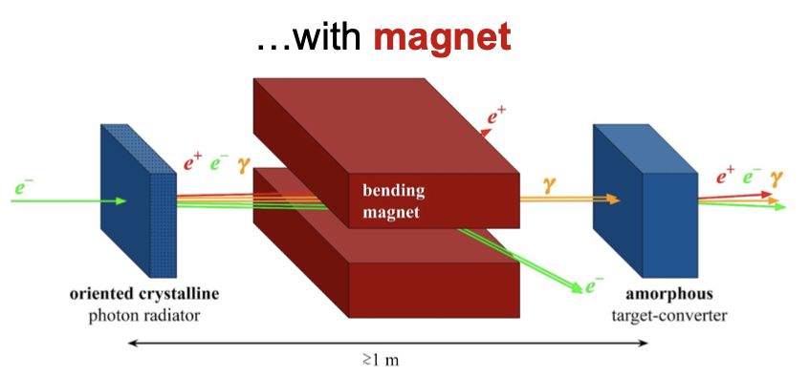
FCC-ee: positron production
Schemes under consideration now
Conventional scheme: bremsstrahlung and pair conversion (mainly studied until now)
Hybrid scheme (crystal-based positron source) use the intense radiation emitted by high energy (some GeV) electrons channeled along a crystal axis => channeling radiation.
L. Bandiera (INFN/Ferrara)

Slide 6
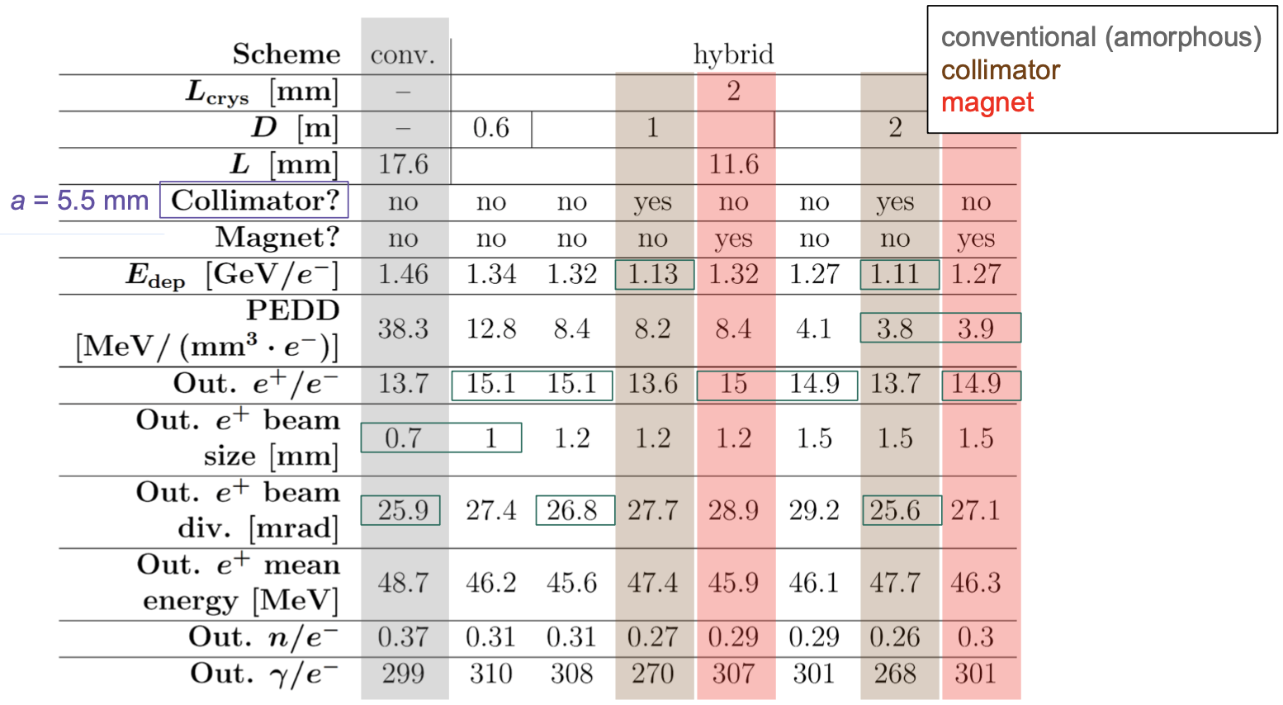
Hybrid source: preliminary positron production optimization
6
A 2 mm thick crystal has been selected to be used as a radiator for the hybrid positron source.
→ good photon yield, moderate values of photon divergence and energy deposition in the crystal.
M. Soldani (INFN/Ferrara)
→ Comparable e+ production rate but lower thermal load.
→ Next: capture simulations

Slide 7
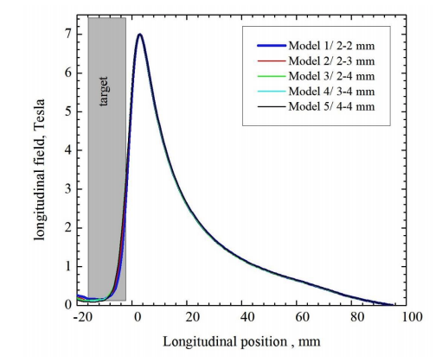
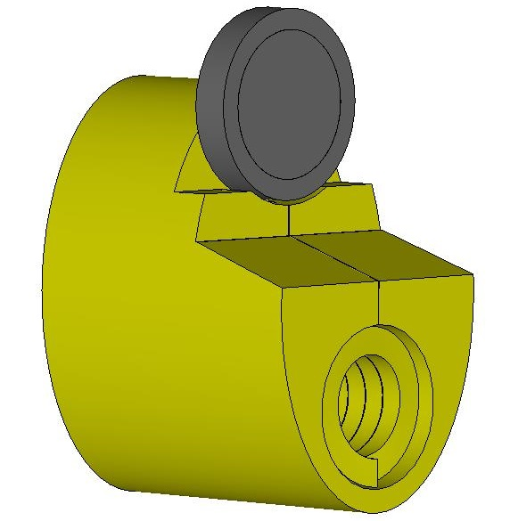
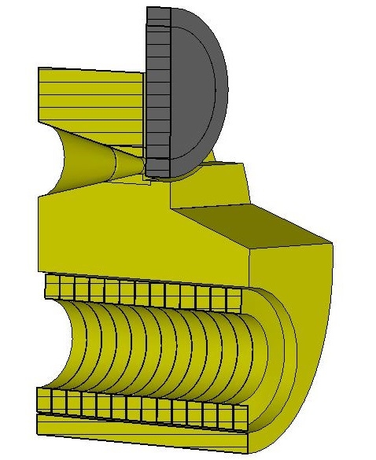
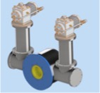
FCC-ee: positron capture system (matching device)
Flux Concentrator (FC)
High-Temperature Superconducting (HTS) solenoid
FC on-axis field, with fixed target position
HTS solenoid field, with optimised target position

Slide 8
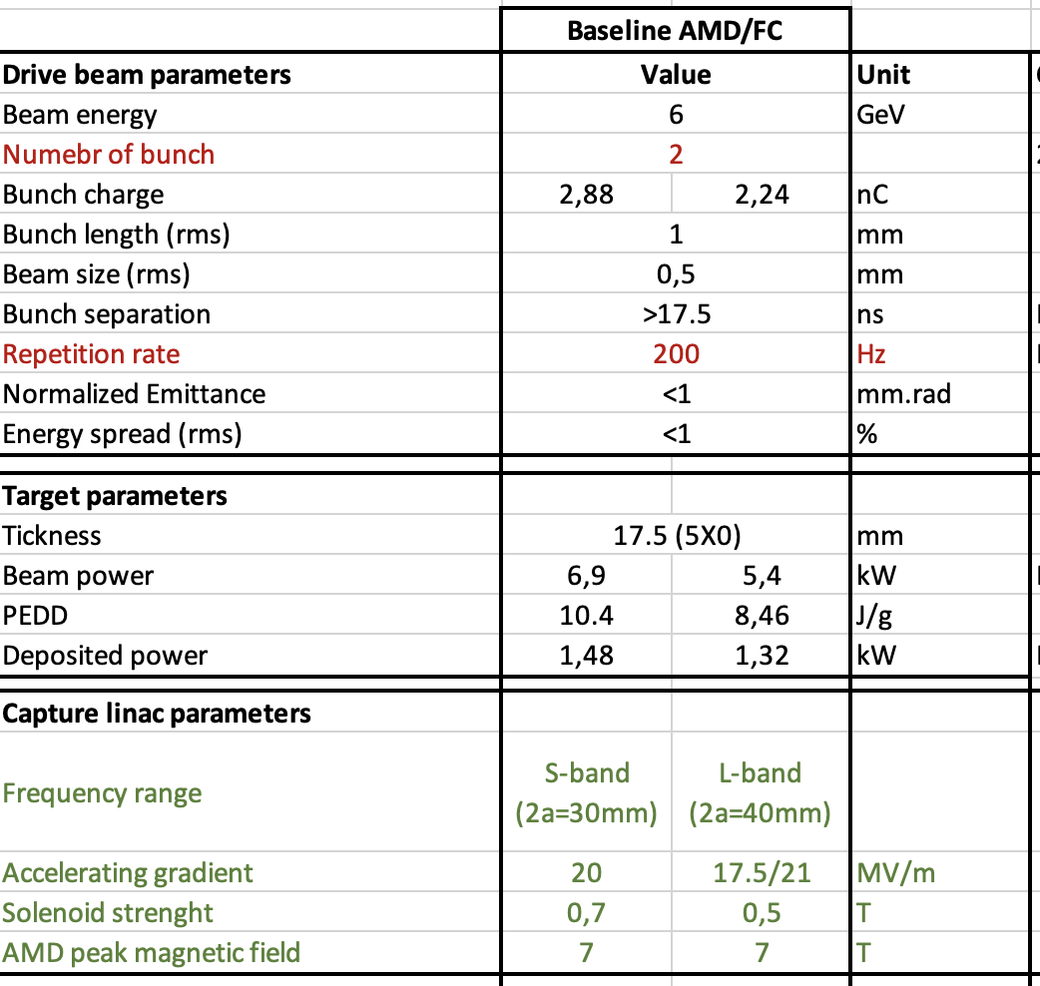
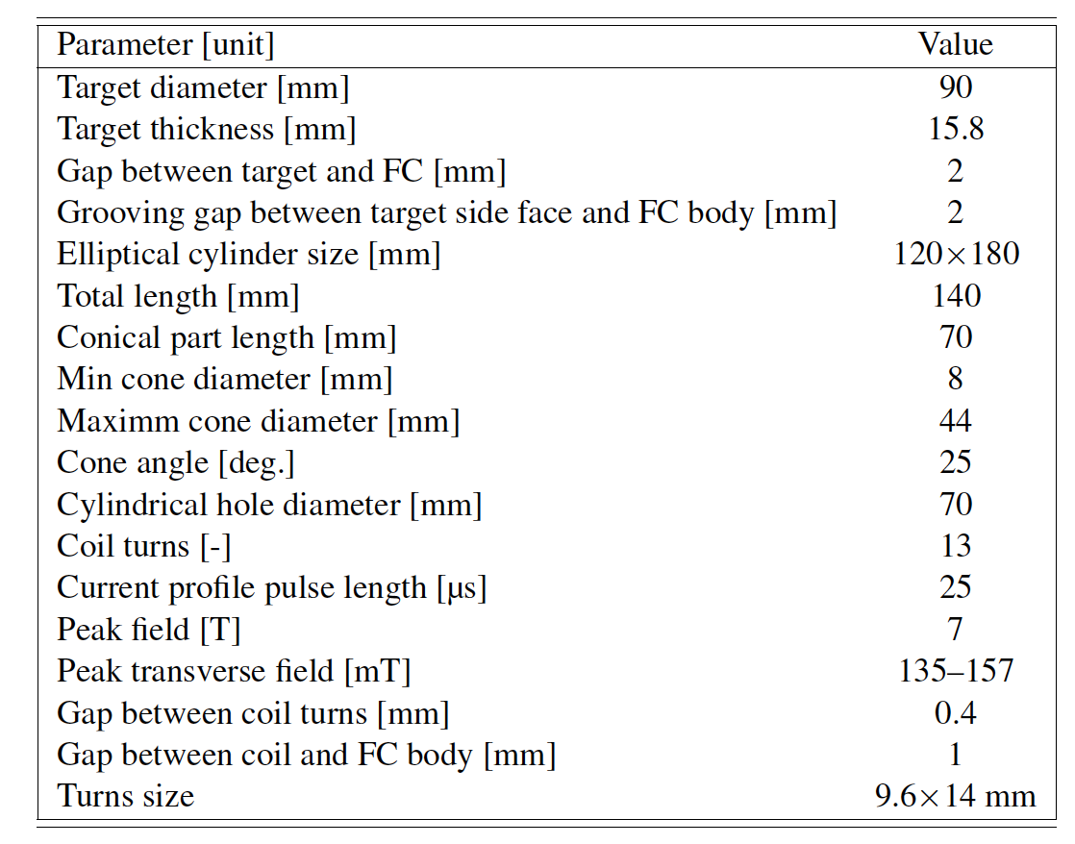
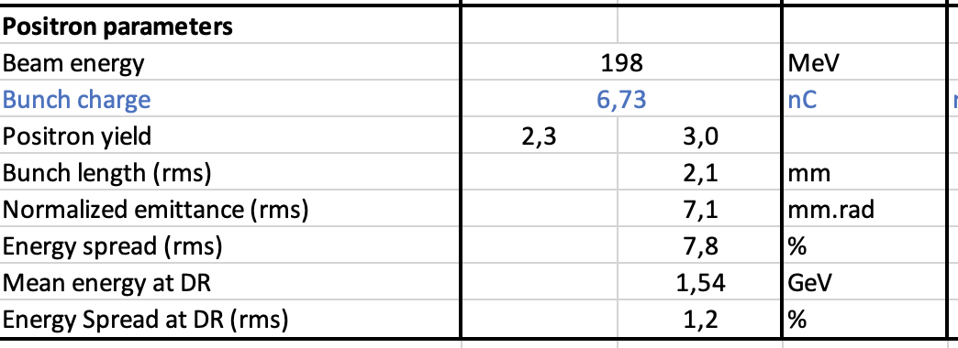
Flux Concentrator-based capture system (CDR baseline)
P. Martyshkin, Y. Zhao (CERN)
Perform radiation load studies, the first estimation for the target design. First mechanical integration.
Optimize the FC design if needed (rep. rate ?)

Slide 9
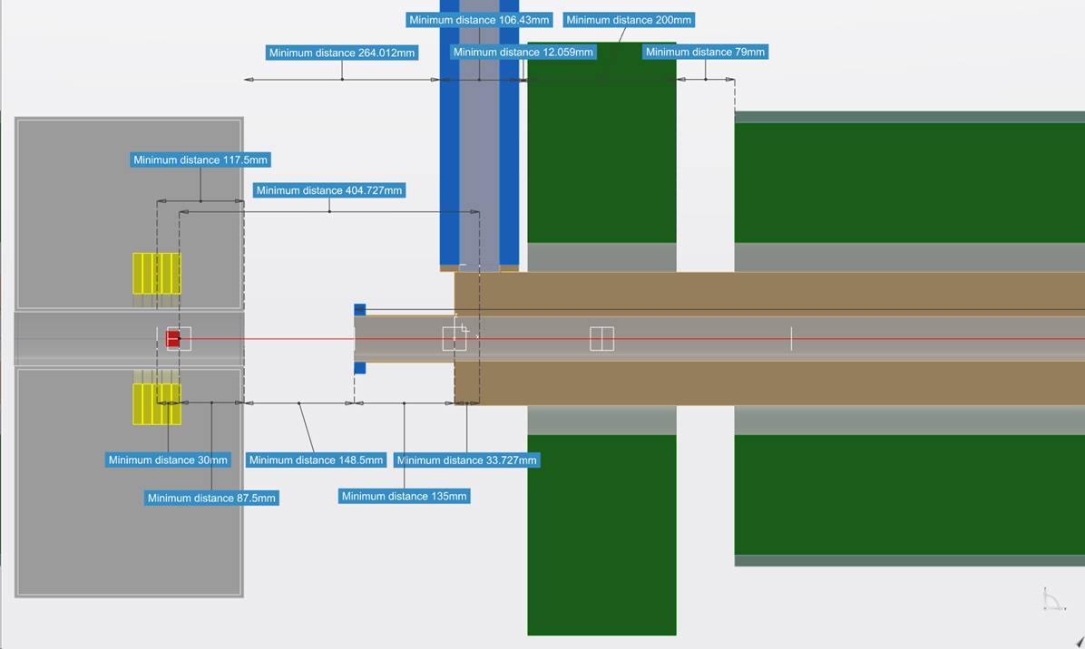
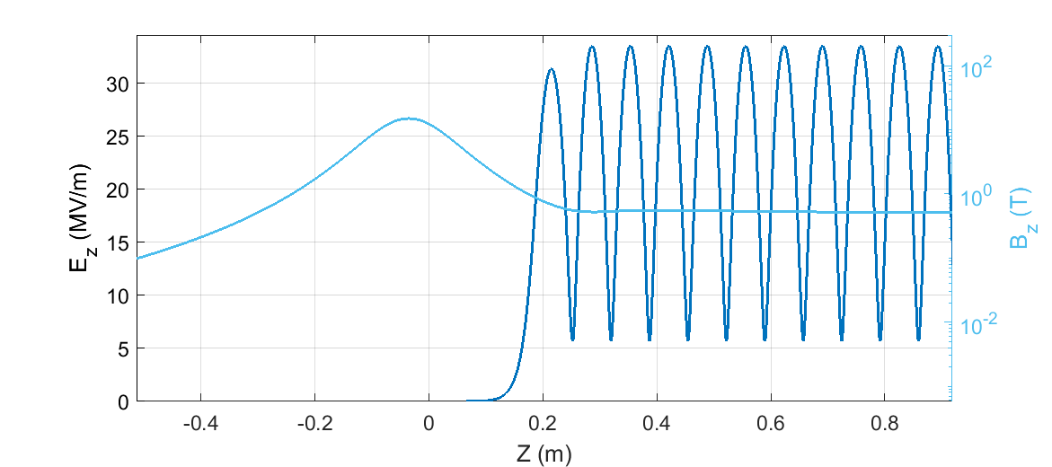
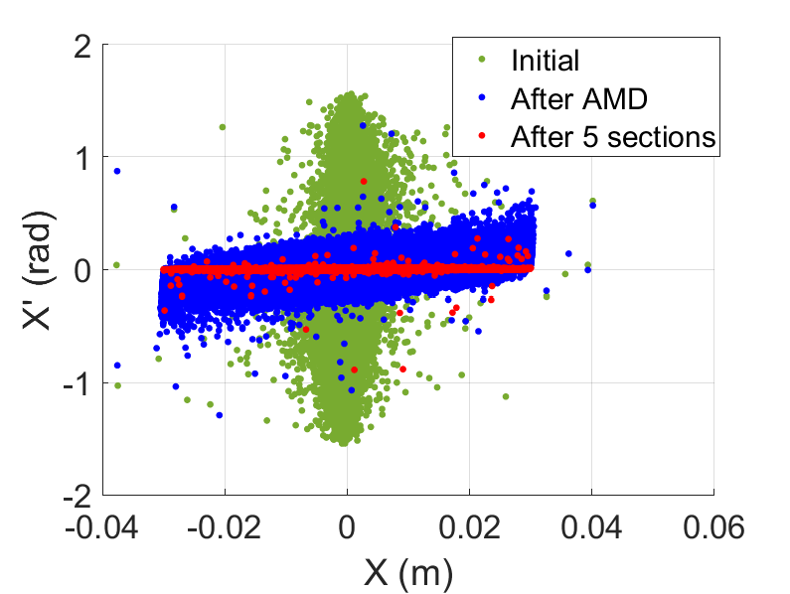
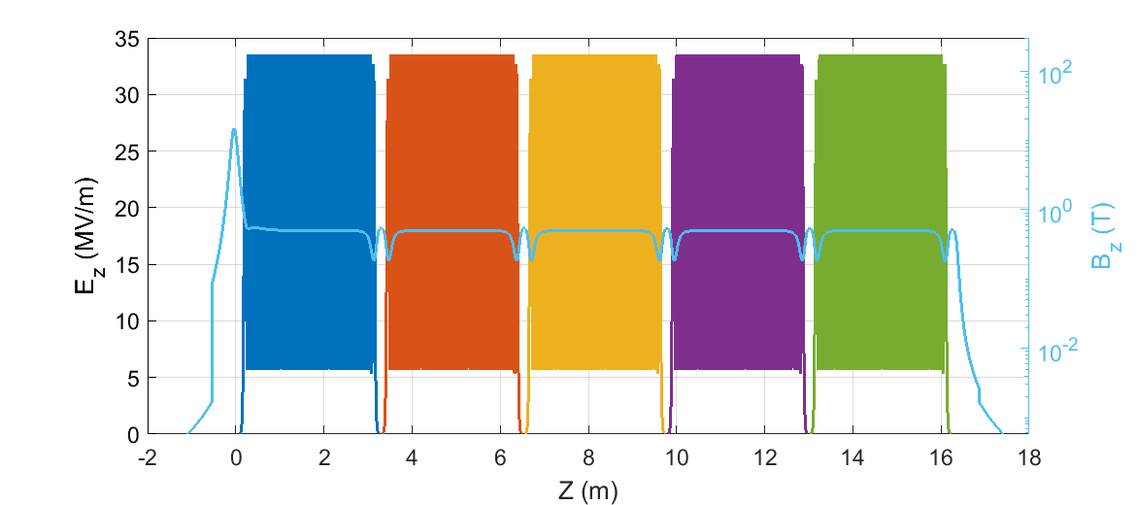
SC solenoid –based capture system for FCC-ee
V. Mytrochenko (IJCLab)
Y. Zhao (CERN)
Capture system “-version 0”
Positron production: conventional scheme
Matching Device is based on the SC solenoid (5 HTS coils, 72 mm bore including shielding)
Capture Linac is based on the L-band TW RF structures ( 2 GHz, 3-m long, Ф = 60 mm)
NC long solenoid B = 0.5 T (realistic design conf. 2)
Positron capture section –v0
The first results (preliminary)
Capture eff. @ 200 MeV: ~0.4
e+ yield : ~ 6 Ne+/Ne-
e+ norm. emittance: ~11 mm.rad

Slide 10
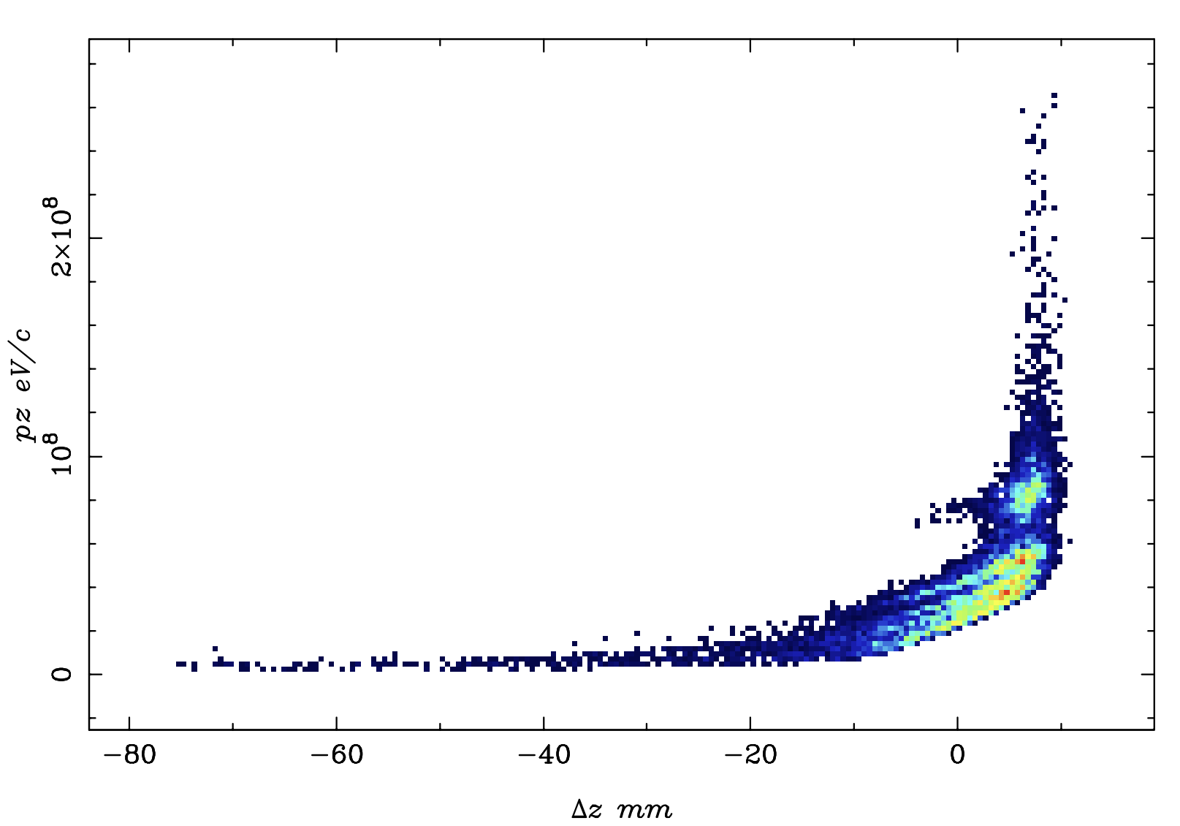
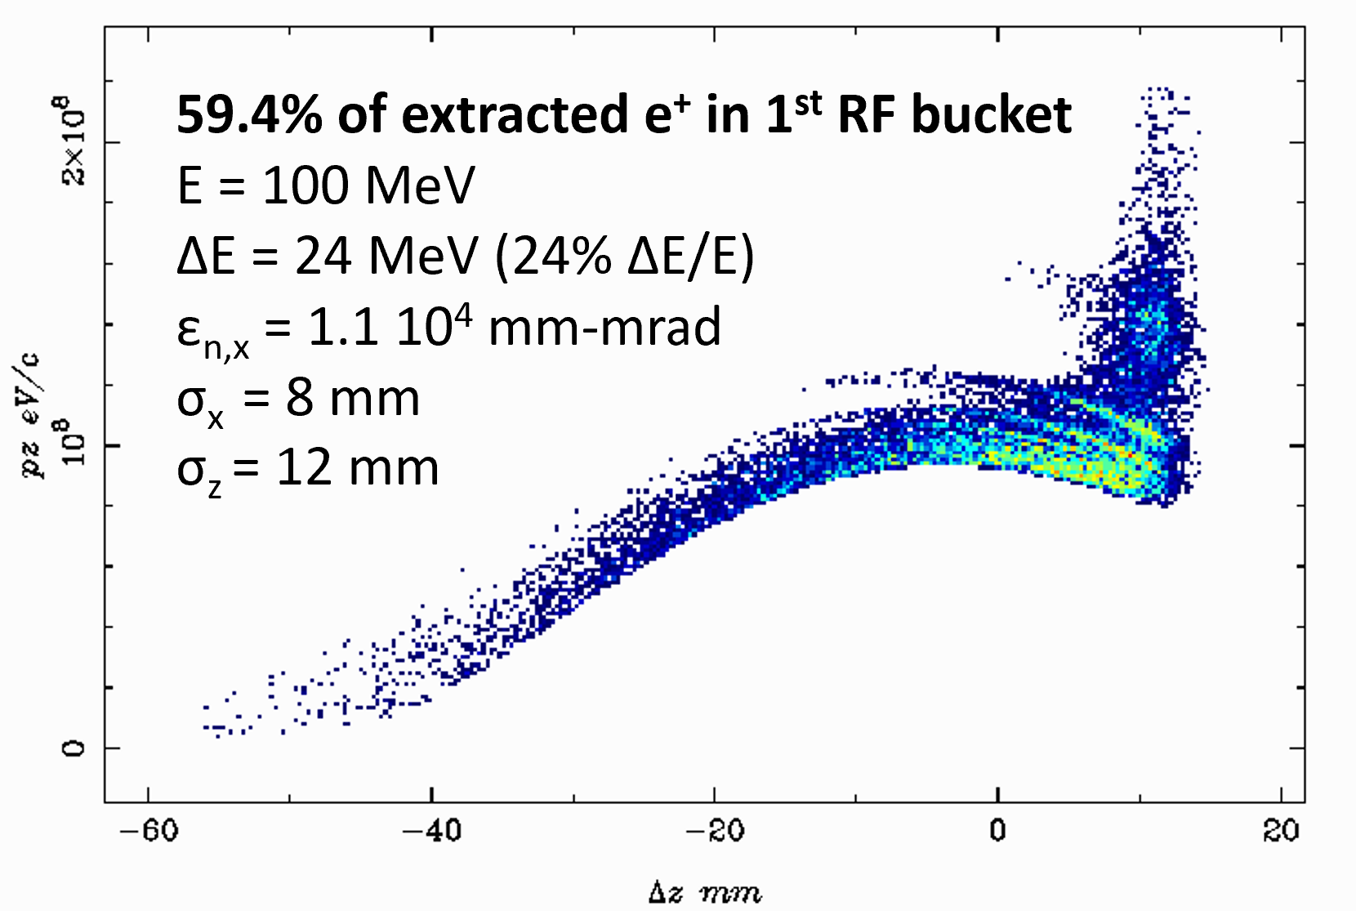
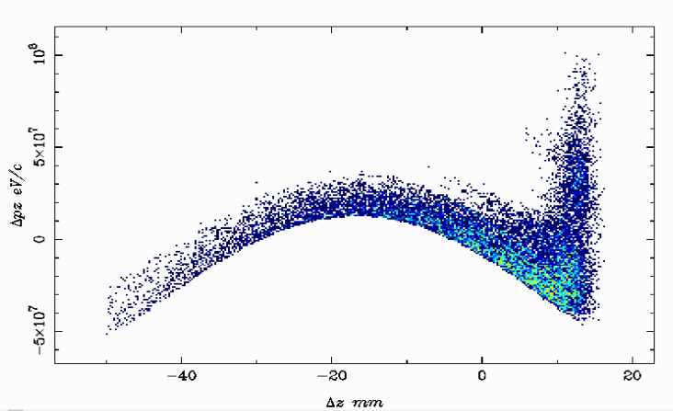
AI-driven performance boost (GIOTTO Application)
Bridge coils
A. Bacci and M. Rossetti-Conti (INFN/Milano)
HTS
Bridge coils
Helmholtz coils
Helmholtz coils
Target
L-band TW CERN Study
L-band TW CERN Study
0.
1
2
3
4
5
6
7
z [m]
Starting Point
First Ooptimized Working Point
Opt. with bridge coils
40.7% of extracted e⁺ in 1st RF bucket
E = 45 MeV
ΔE = 29 MeV (64% ΔE/E)
ε_{n,x} = 1.0 10⁴ mm-mrad
σ_{x} = 7.8 mm
σ_{z} = 9.7 mm
65.0% of extracted e⁺ in 1st RF bucket
E = 82.14 MeV
ΔE = 21.1 MeV (26% ΔE/E)
ε_{n,x} = 1.1 10⁴ mm-mrad
σ_{x} = 8.63 mm
σ_{z} = 14 mm

Slide 11
List of current open points
Mechanical design/target reliability. Moving target? Comparison of conventional vs. hybrid schemes.
  Positron source operating conditions for different modes (incident beam power, how many years per mode) ➜ radiation load studies.
Effect of high magnetic field on the positron production in target.
FC-based capture system? Simulations with large aperture acc. structures. FC design (SuperKEKB, CLIC)? Radiation load studies/mechanical integration ?
HTS design ( P3) ➜ shielding layout and impact on e+ capture efficiency. Field profile.
NC vs. SC solenoid for the capture section.
Electron and positron separation (where and how)
Mechanical layout (distances between the target/acc. structures) ➜ impact on acc. e+ yield
6D DR acceptance (how to apply at capture system)

Slide 12
Before mid 2023
Baseline design of the positron source + capture system
  Comparison of FC-based CS vs. HTS-based CS
  Comparison of the e+ production schemes ?
  Comparison of the NC vs. SC solenoid around the acc. structures ?
  …

