Slide 1
Benchmark of the simulation tools for the FCC-ee positron source with SuperKEKB
Fahad A. ALHARTHI
fahad.alharthi@ijclab.in2p3.fr
Laboratoire de Physique des 2 Infinis Irène Joliot-Curie (IJCLab)
CNRS, Université Paris-Saclay
Many thanks to: I. Chaikovska, R. Chehab, V. Mytrochenko (IJCLab), A. Latina, Y. Zhao (CERN), M. Schaer (PSI), Y. Enomoto, F. Miyahara (KEK).

Slide 2
Outline
SuperKEKB positron source.
Primary electron beam and Target design
Tracking with RF-Track
Positron beam and matching devise
Initial phase scans
Summary

Slide 3
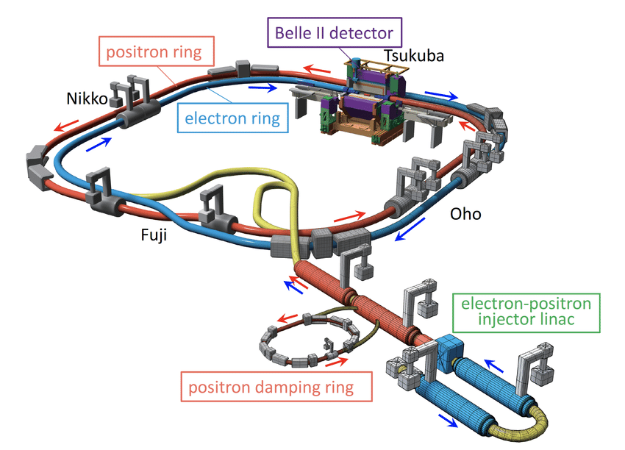
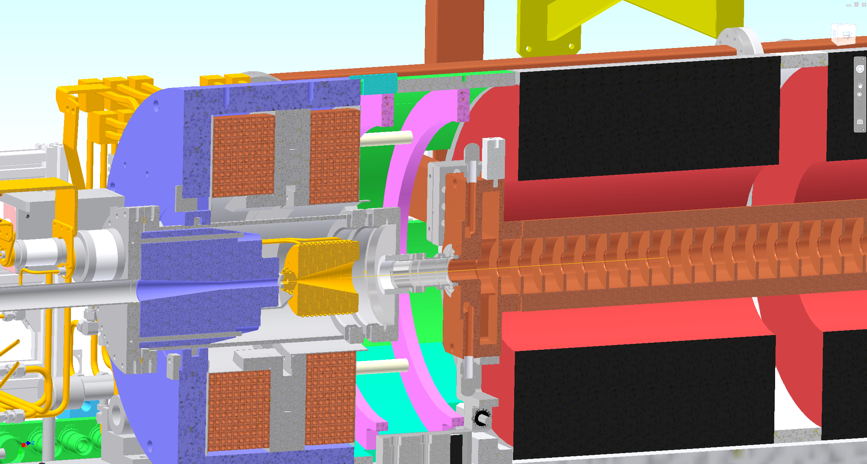
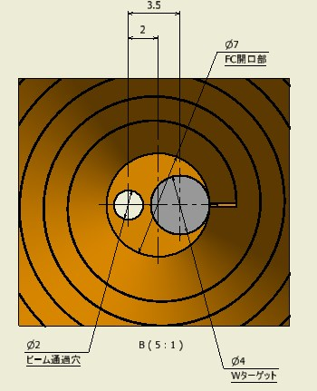
SuperKEKB positron source (currently in operation)
Electron drive beam: 3.5 GeV, 2 bunches/pulse, 10 nC, 50 (25) Hz
The highest intensity positron source
BC (bridge coil)
LAS (large aperture S-band)
W target
FC (flux concentrator) head
solenoid
Positron source
1.1 GeV
Target material : W
Target size : Φ4 x 14
Inserted in the Cu block
Courtesy of Y. Enomoto (KEK)
hole
W
looking from downstream side

Slide 4
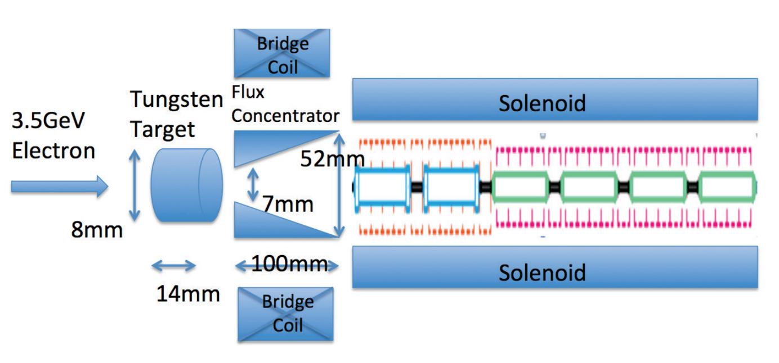
Benchmark of the FCC-ee code with SuperKEKB positron source
Initial particles GEANT4
Magnetic field
(FC,BC,DCSs) CST(provided*)
Tracking
RF-Track
Accelerating structure Superfish (provided*)
*Field maps are provided by SuperKEKB

Slide 5
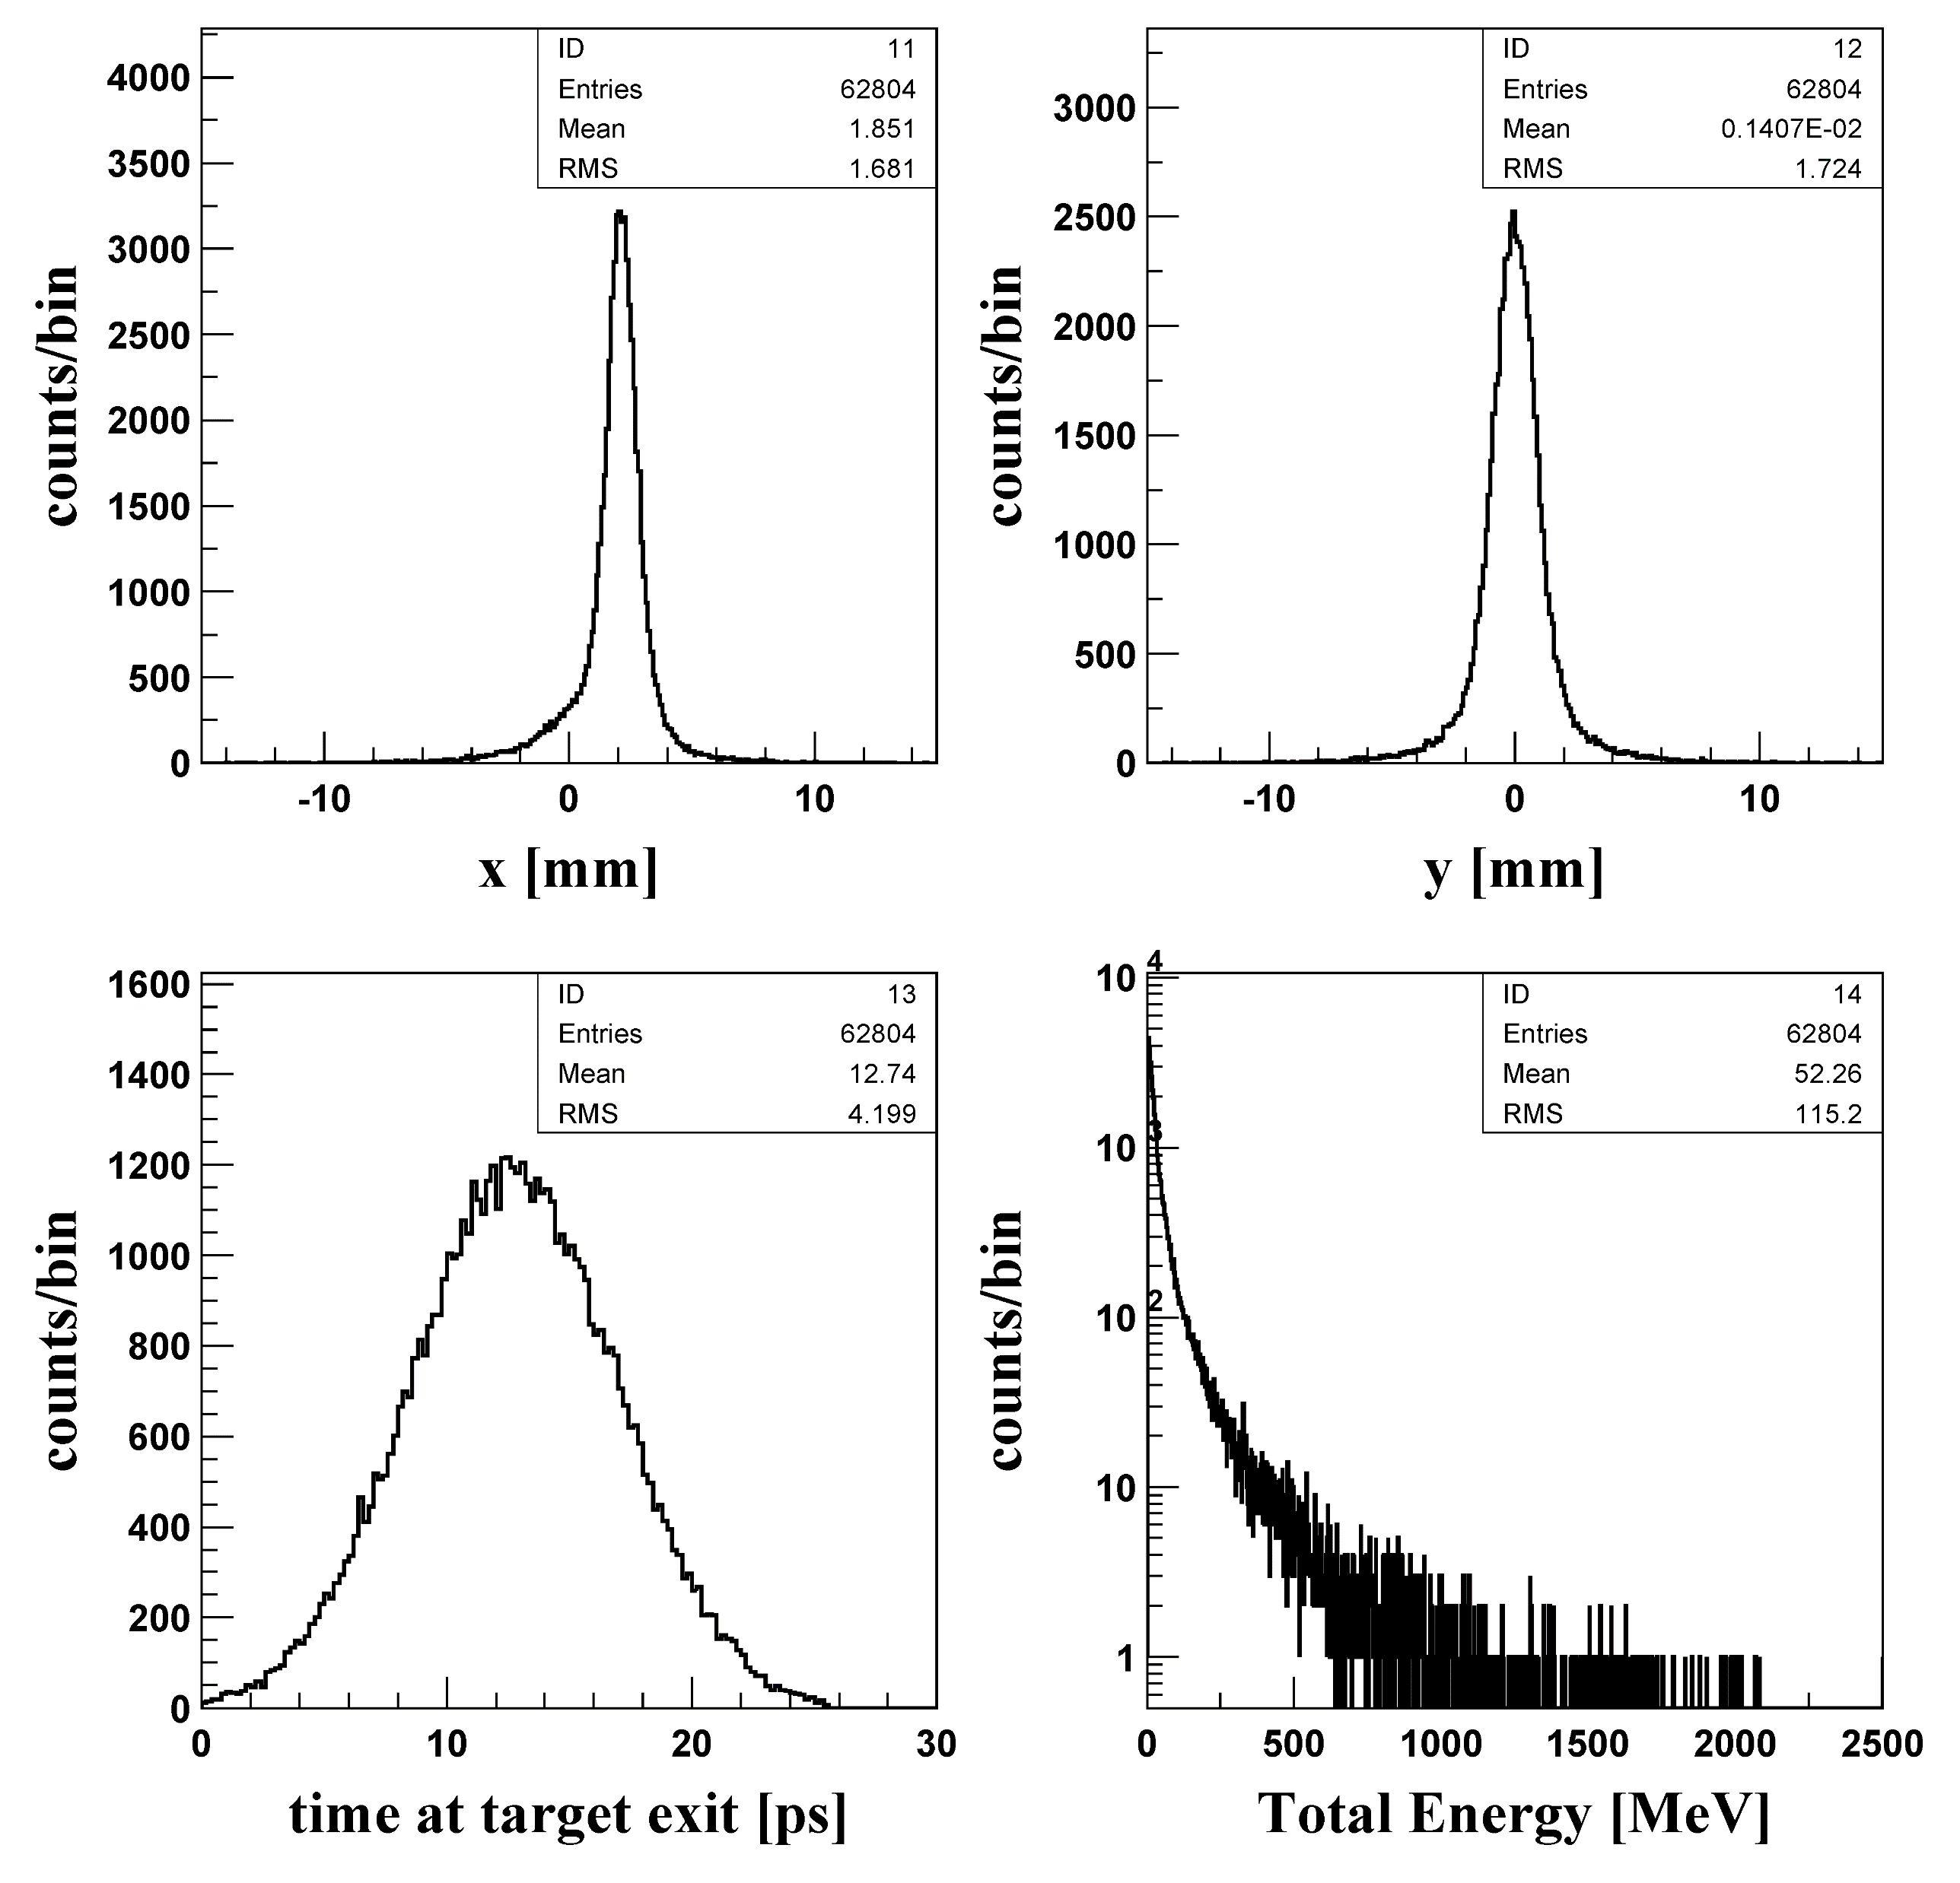
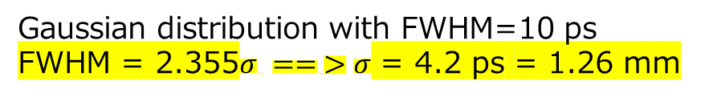
SuperKEKB primary electron parameters and positron beam distribution
F. Miyahara
EGS5 : Electromagnetic reaction in the targe
1) Incident electrons (x, y, p_{x,} p_{y}, E)
N = 20000 ( ⬅ Num. of loops )
E_{kinetic} = 2900 MeV (3.5 GeV was initial design)
(p_{x},p_{y})=(0,0)
x and y position are given by gaussian distribution
Beam center: (x, y)=(0.2, 0) [cm]
Beam size (s_{x}, s_{y}) = (0.05, 0.08) [cm]
(sqrt(x²+y²) < 1.0)
z = -1.5 [cm]
e+ and e- data at target exit (z=0)
2) Time distribution at z=0
Script
Positrons :
N(e+)/N(e-) =~6.3
Beam size (s_{x}, s_{y}) = (1.681, 1.724) [mm]
Bunch length (s_{z}) = (4.2) [ps]
Gaussian distribution of the beam 6 sigmas (0 - 26) ps
Gaussian distribution with FWHM=10 ps
FWHM = 2.355$σ == >σ$ = 4.2 ps = 1.26 mm

Slide 6
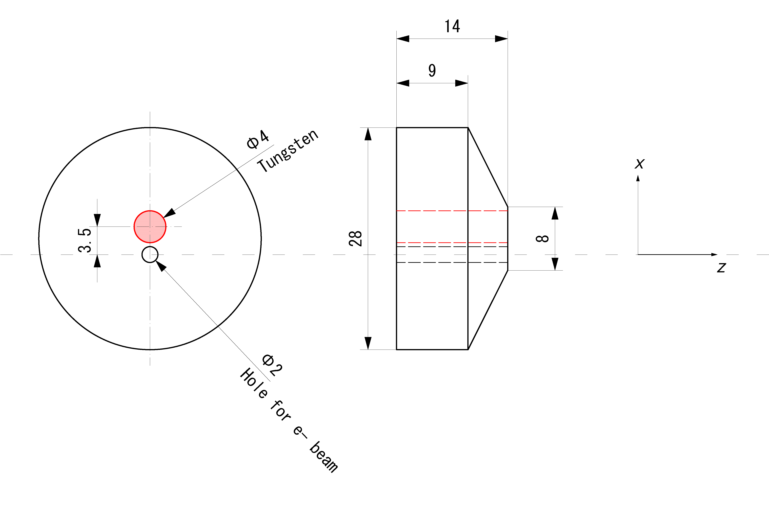
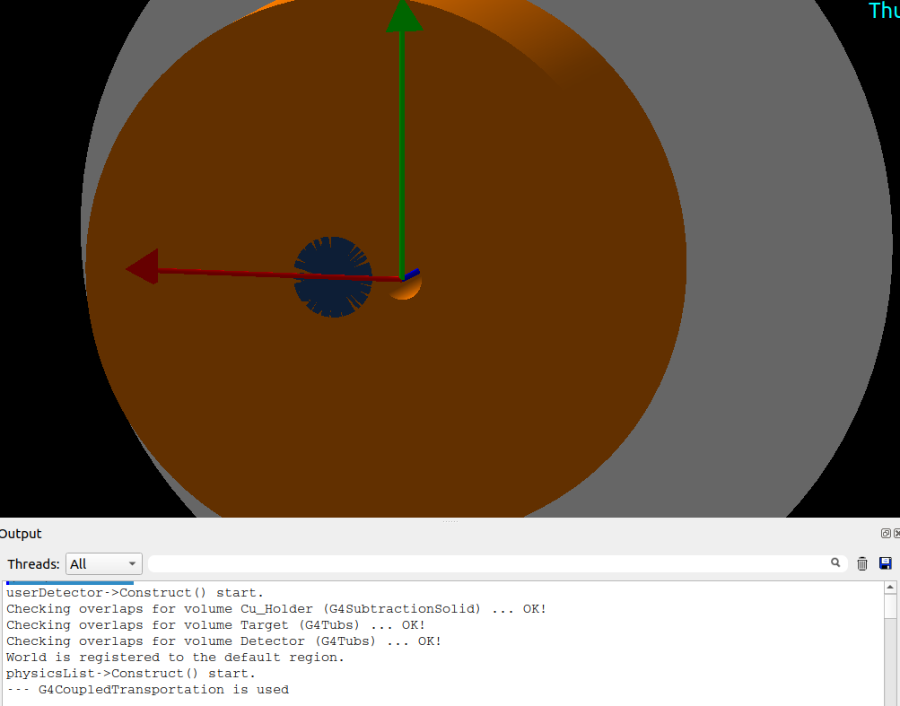
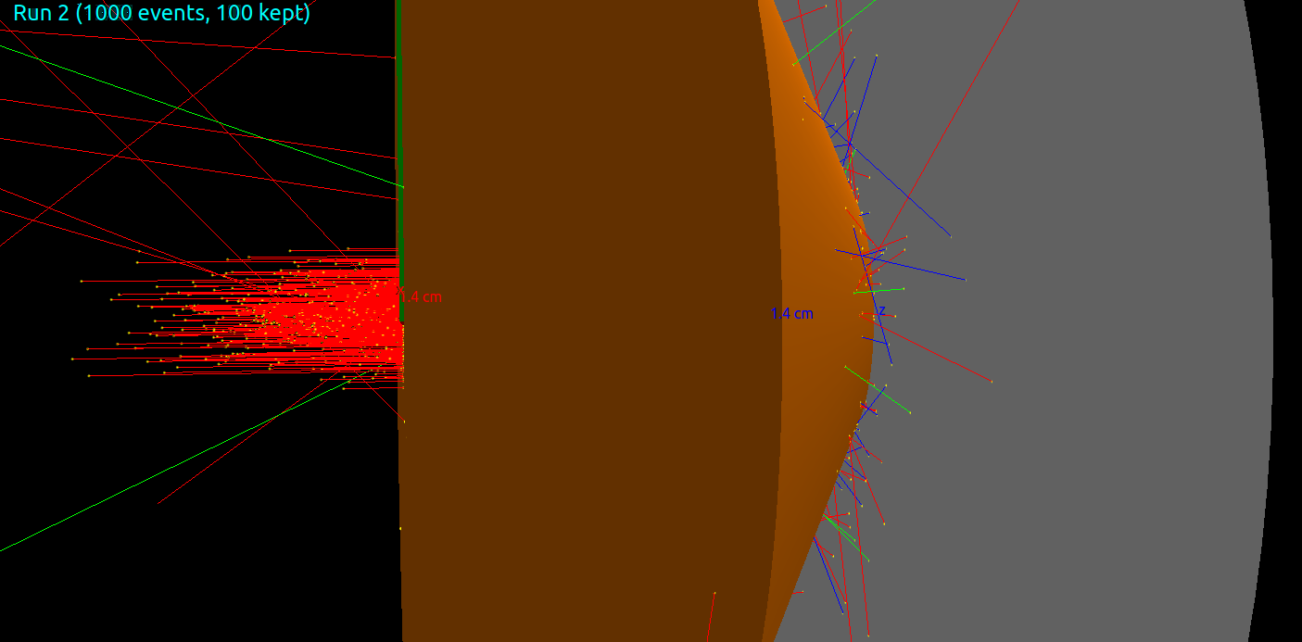
Geant4 simulation for SuperKEKB I
Target geometry :
Detector
Cu_Holder
W_Target
e-_Hole
Overlap checking

Slide 7
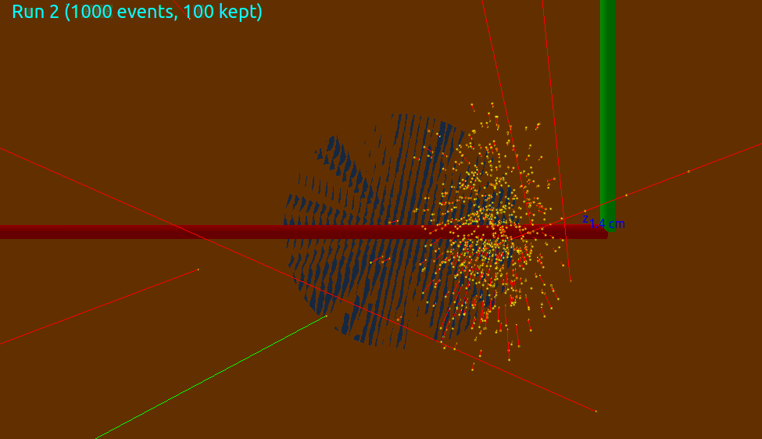
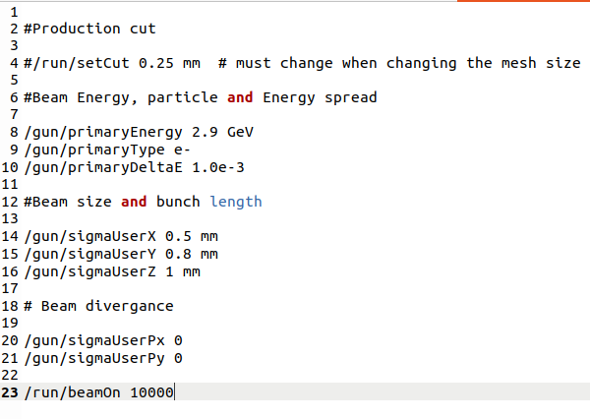
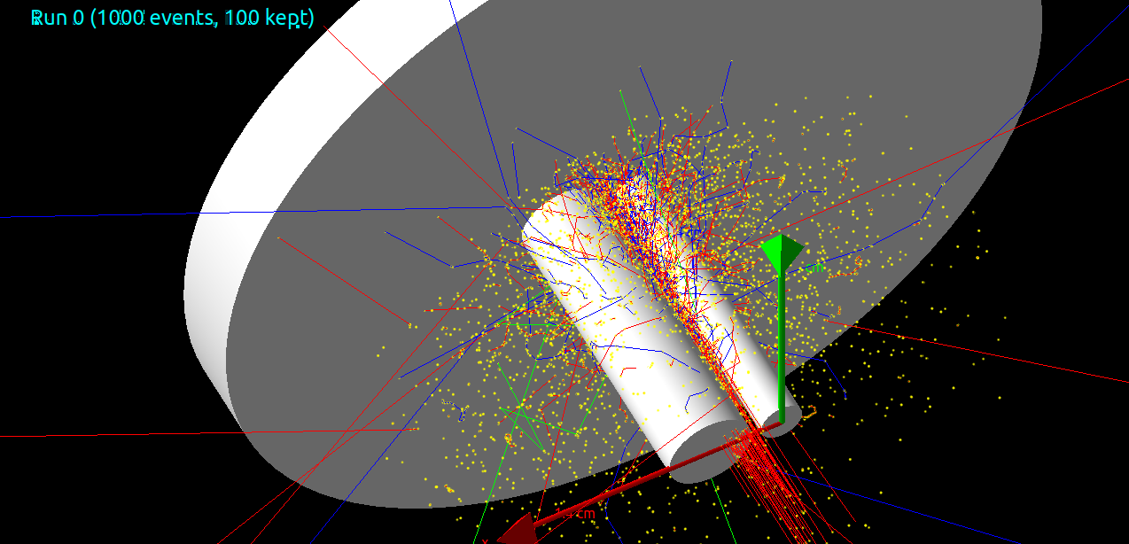
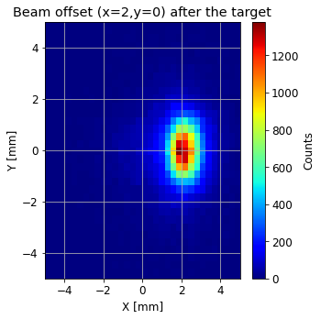
Geant4 simulation for SuperKEKB II
Primary electron beam :
As expected part of the beam will hit the Cu_holder .

Slide 8
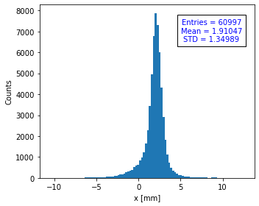
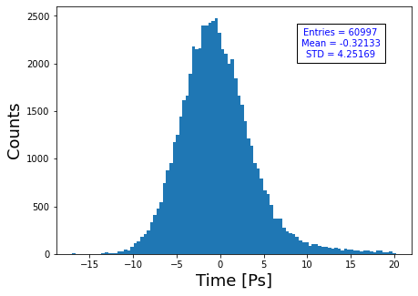
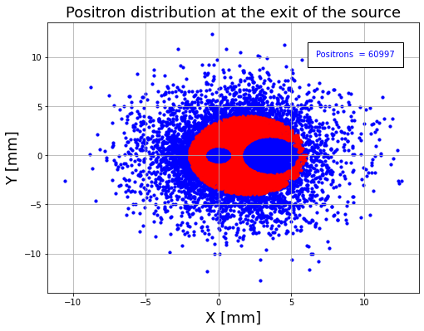
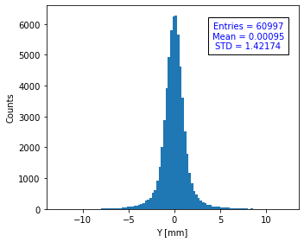
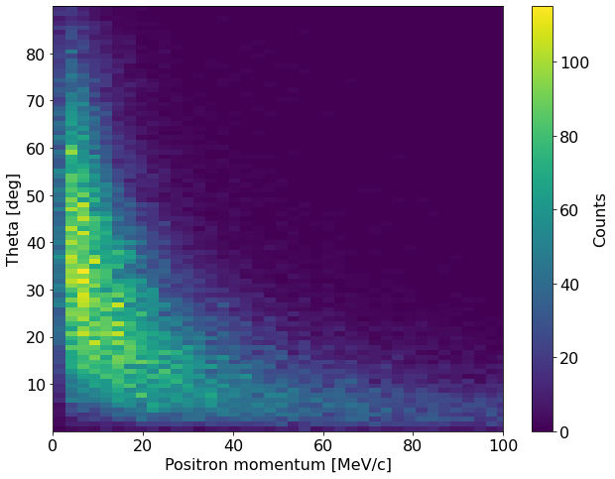
Positron beam production (after the target )
Positron beam :
W => 61%
Cu => 39%
e- hole
Target
Positrons :
N(e+)/N(e-) =~6.1
Beam size (s_{x}, s_{y}) = (1.35, 1.42) [mm]
Bunch length (s_{z}) = (4.25) [ps]
SuperKEKB N(e+)/N(e-) =~6.3

Slide 9
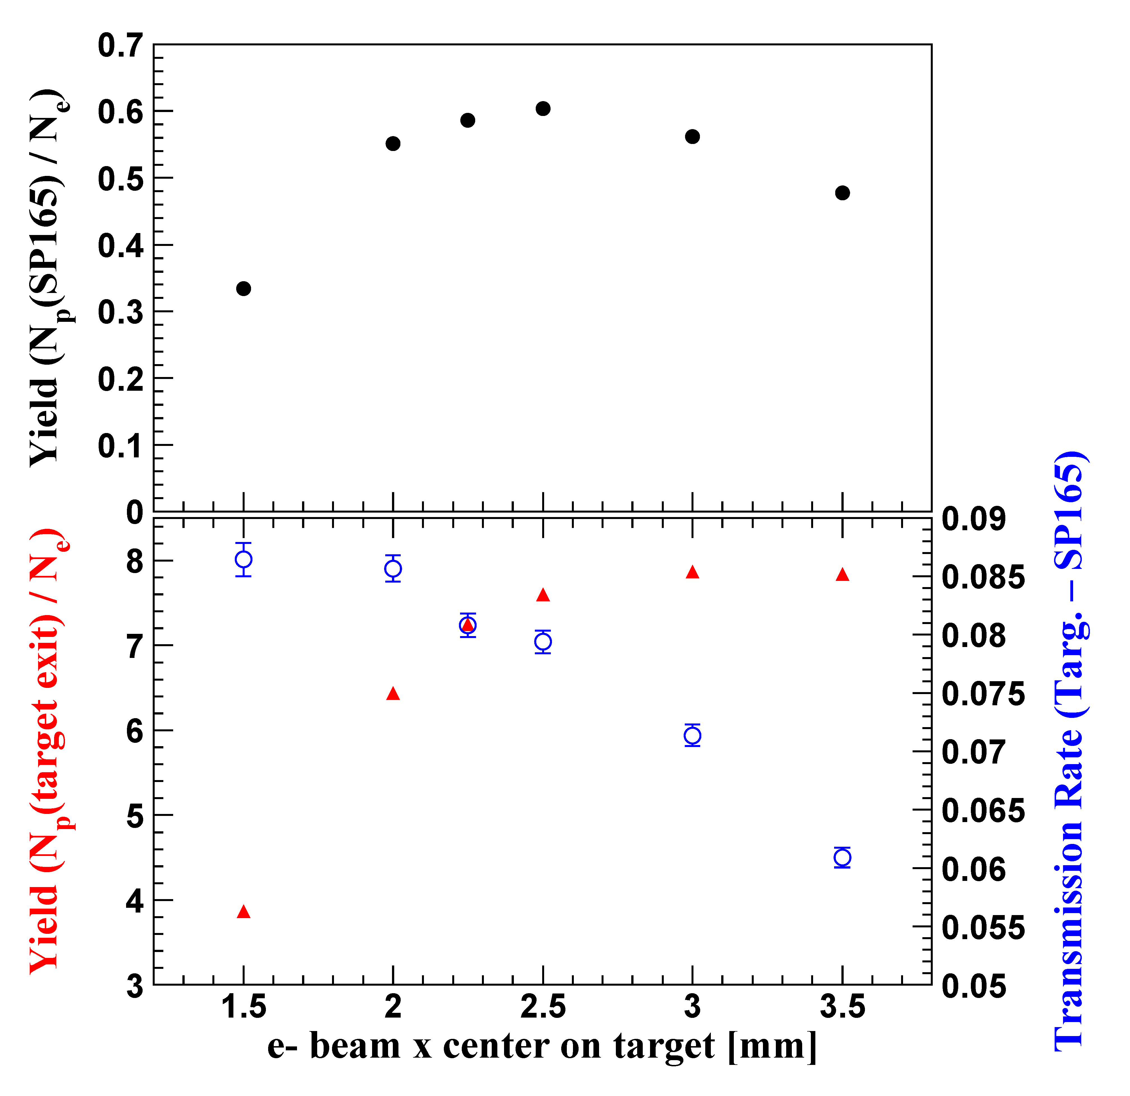
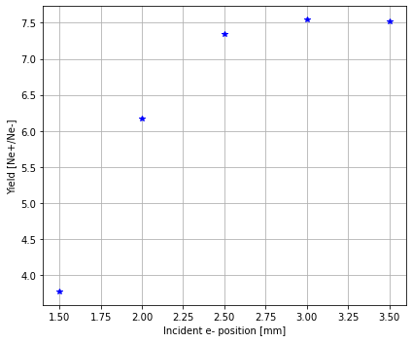
Incident position of primary electron beam and positron Yield
Bunch length = 0
Ne- = 10k
Target center
SuperKEKB results
FC center

Slide 10
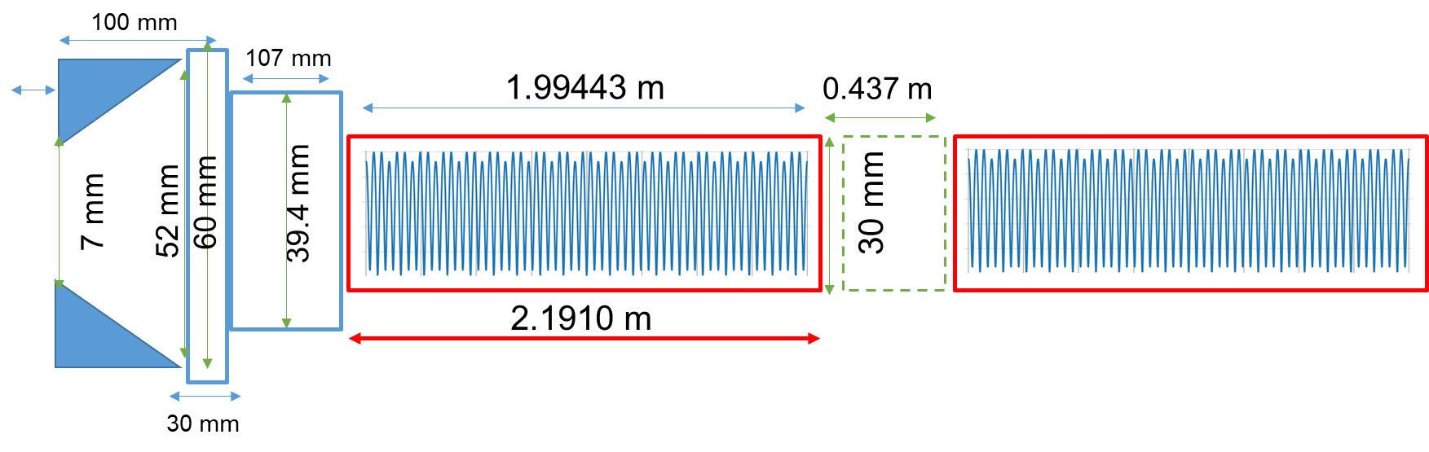
SuperKEKB tracking in RF-track
RF-Track is a new tracking code developed at CERN for the optimization of particle accelerators, which offers outstanding flexibility and rapid simulation speed.
2 mm
FC
AC_151
AC_152
Duct2
Target
*A. Latina, “RF-Track: Beam tracking in field maps including space-charge effects, features and benchmarks,” p. MOPRC016. 4 p, 2017. 28th Linear Accelerator Conference, East Lansing, Michigan, 25 - 30 Sep 2016.
Duct1

Slide 11
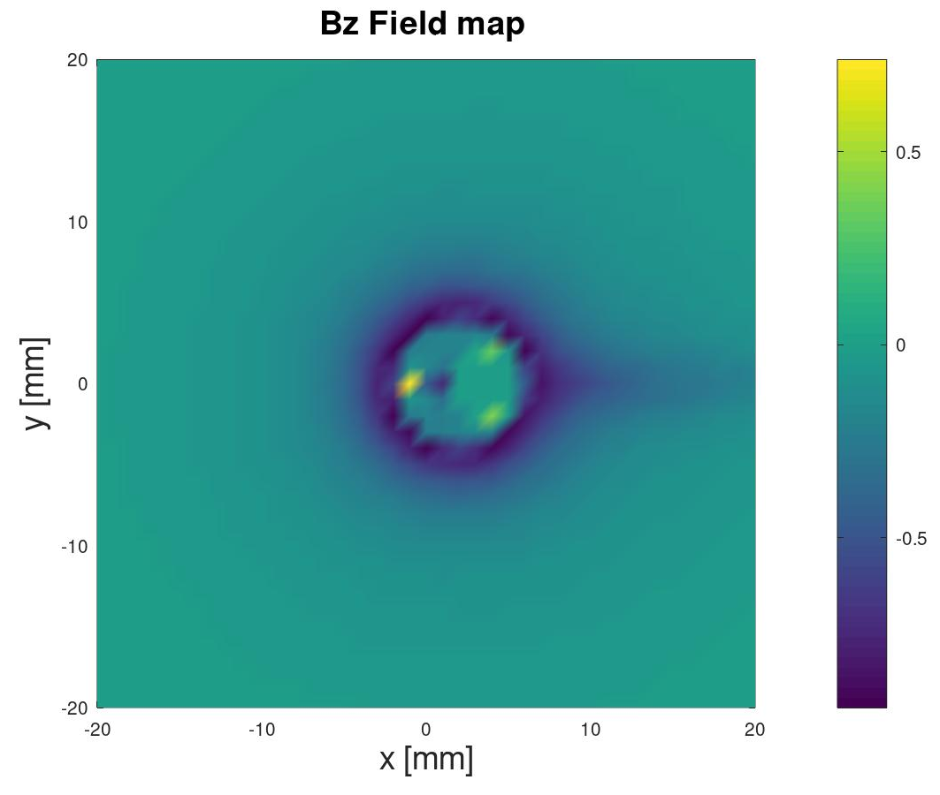
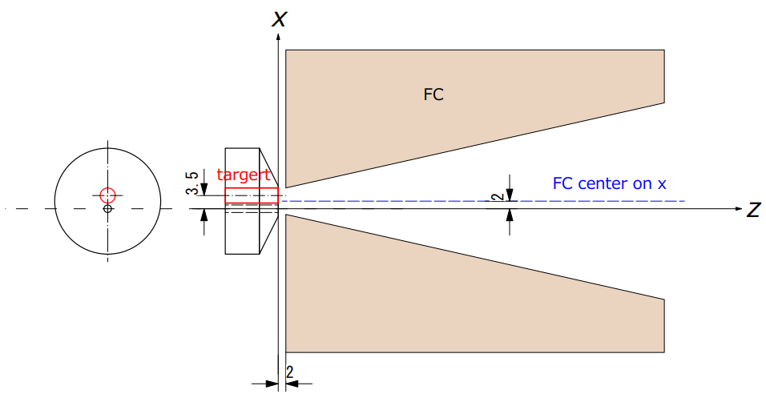
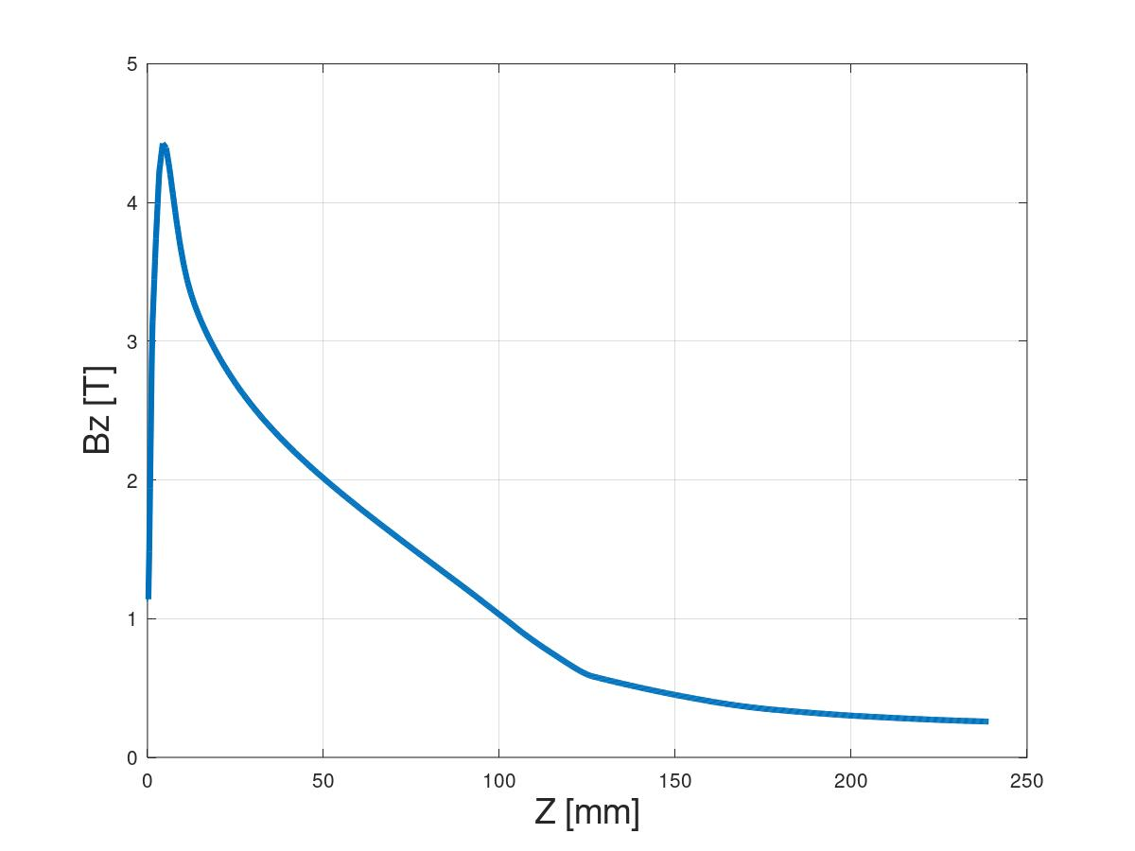
SuperKEKB Adiabatic Matching Devise (AMD)
AMD consists of : Flux concentrator (FC) + Bridge coil (Bc)
FC is placed with 2mm offset in the x-axis
e- hole
2mm gap between the target and the FC
Target

Slide 12
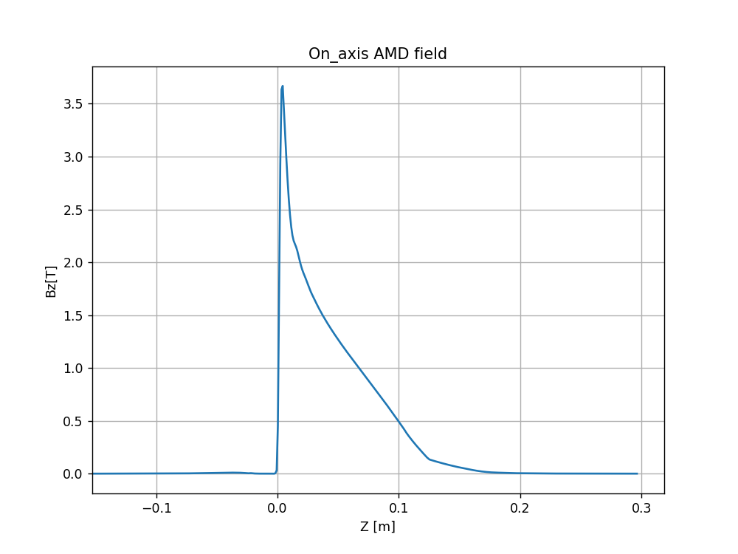
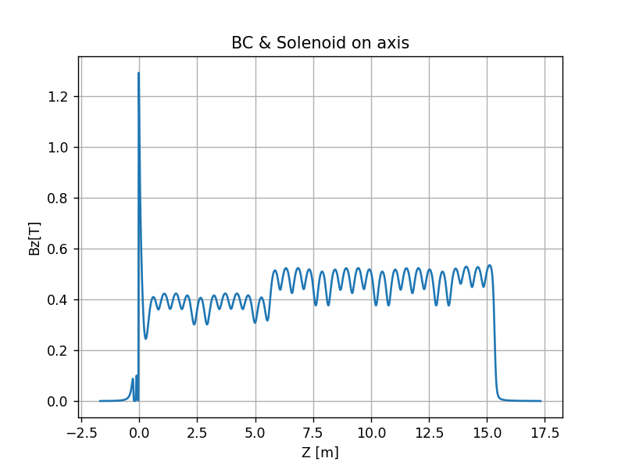
SuperKEKB AMD + BC & Solenoid

Slide 13
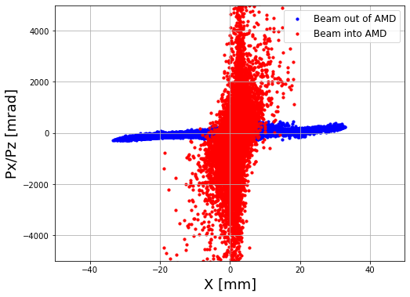
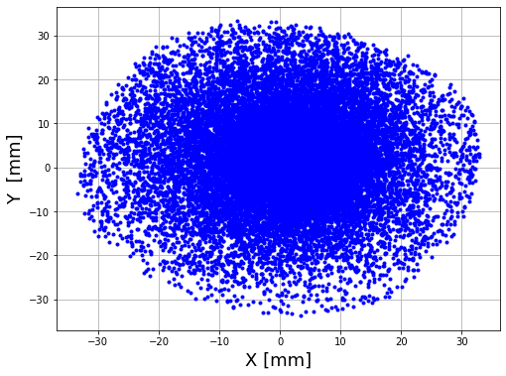
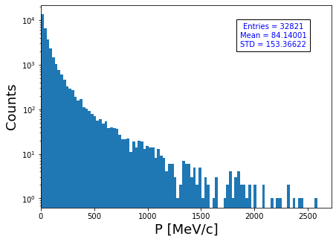
Positron tracking in the Adiabatic matching devise (RF-Track)
Tracking is performed with the actual 3D magnetic field map in volume
Positrons :
N(e+)/N(e-) ~3.2
Beam size (s_{x}, s_{y}) ~(9.98, 9.95) [mm]
Bunch length (s_{z}) ~ (20) [ps]
SuperKEKB N(e+)/N(e-) =~3.1

Slide 14
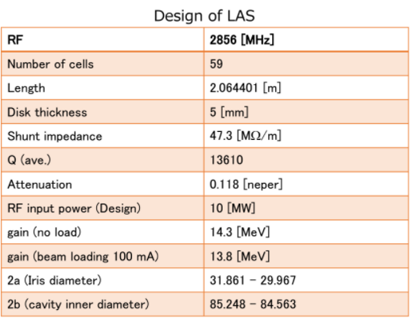
SuperKEKB tracking in RF-track
2 mm
AC_151
AC_152
FC
Target
Duct2
AC_15_1, AC_15_2 : 12.56MV/m
Duct1

Slide 15
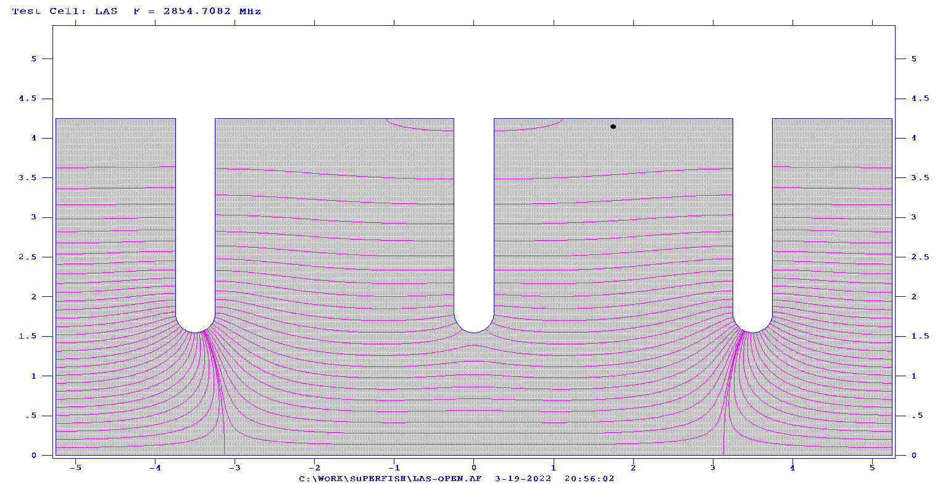
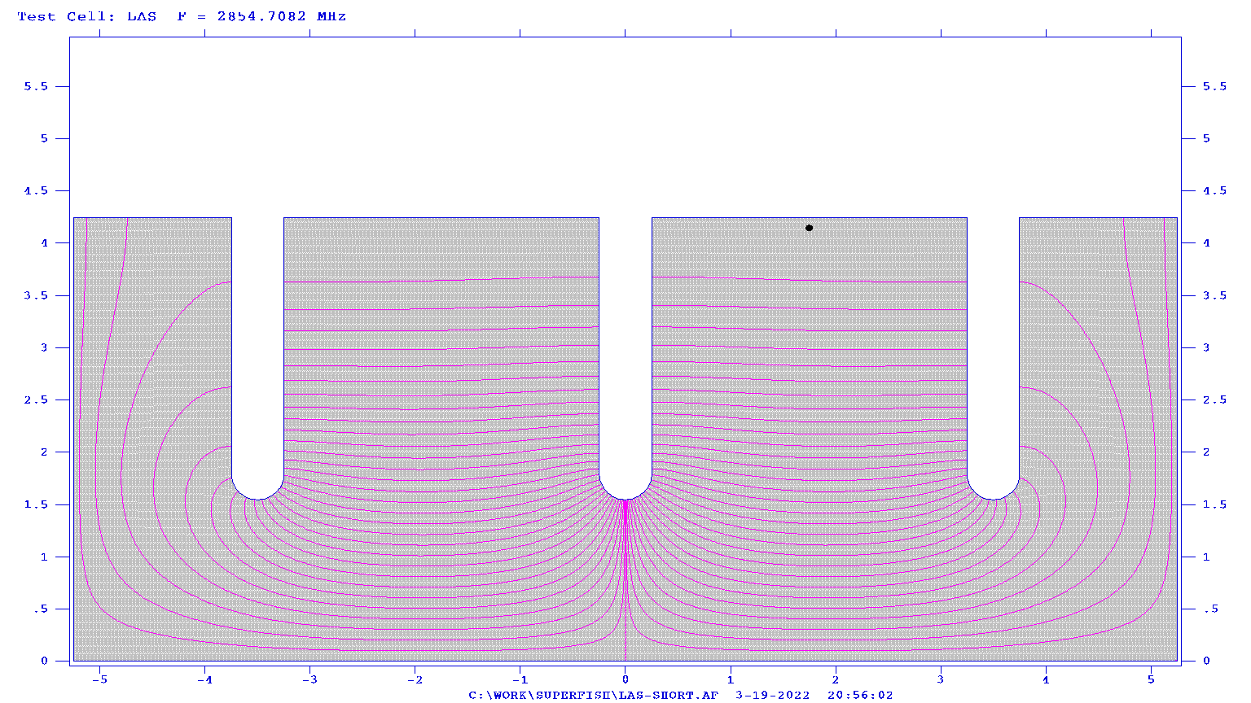
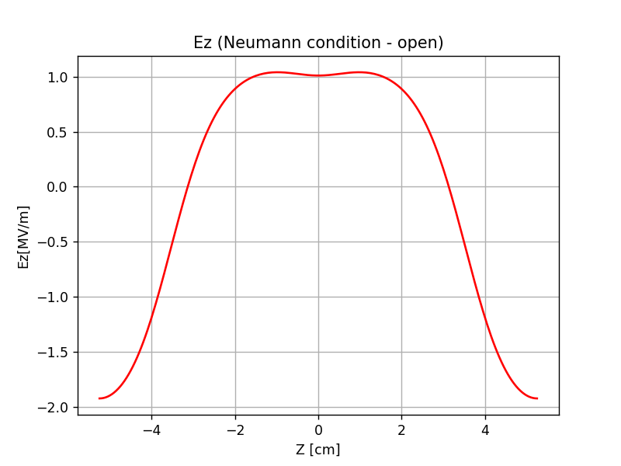
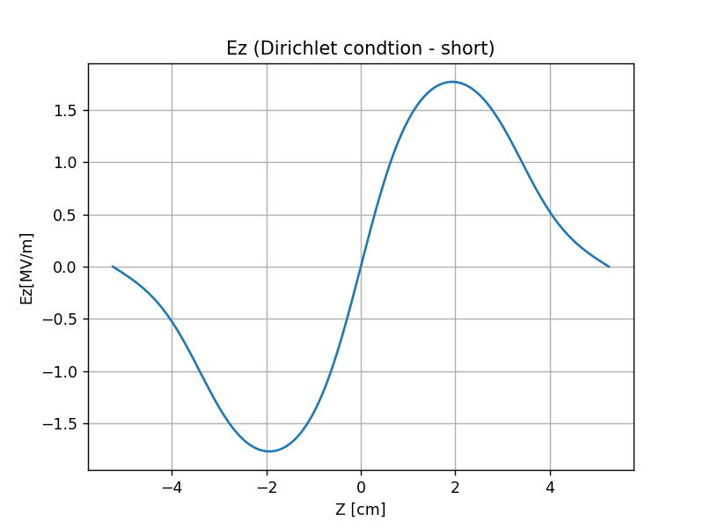
SuperKEKB Accelerating structure – Field map
Field maps:
Neumann condition
F. Miyahara
1) GPT – analytical field: (trwlinac or trwlinbm)
2) Superfish – cylindrical symmetric field :
3 cell cavity under Dirichlet and Neumann boundary condition.
Making 57 cells field map by arranging 19 of the 3-cell field map
2 cells as couplers, total cells/structure = 57+2 = 59
Two fields map provided : open & short :
Open = Neumann condition, Short = Dirichlet condition
Dirichlet condition
Neumann condition : Tangential electric field is zero (E_{T} = 0)
Dirichlet condition : Tangential magnetic field is zero (H_{T} = 0)

Slide 16
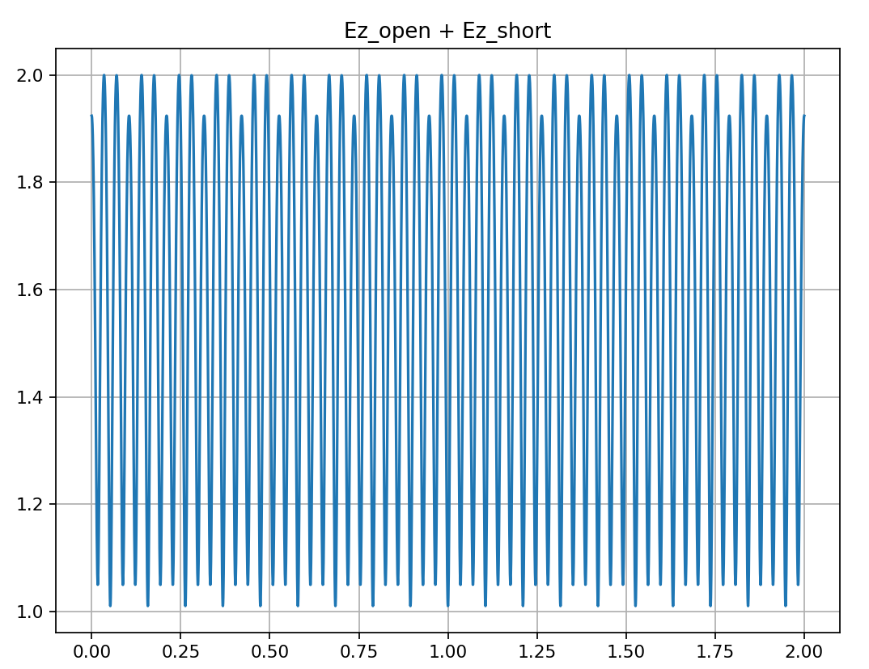
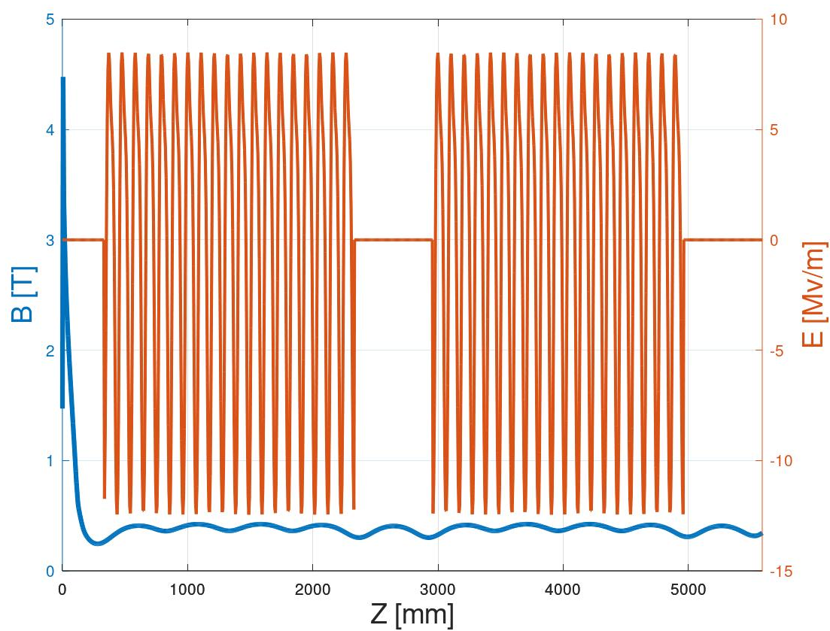
SuperKEKB Ez field along the structure
The two field map combined using this formula :
E = Ez_open - i*Ez_short

Slide 17
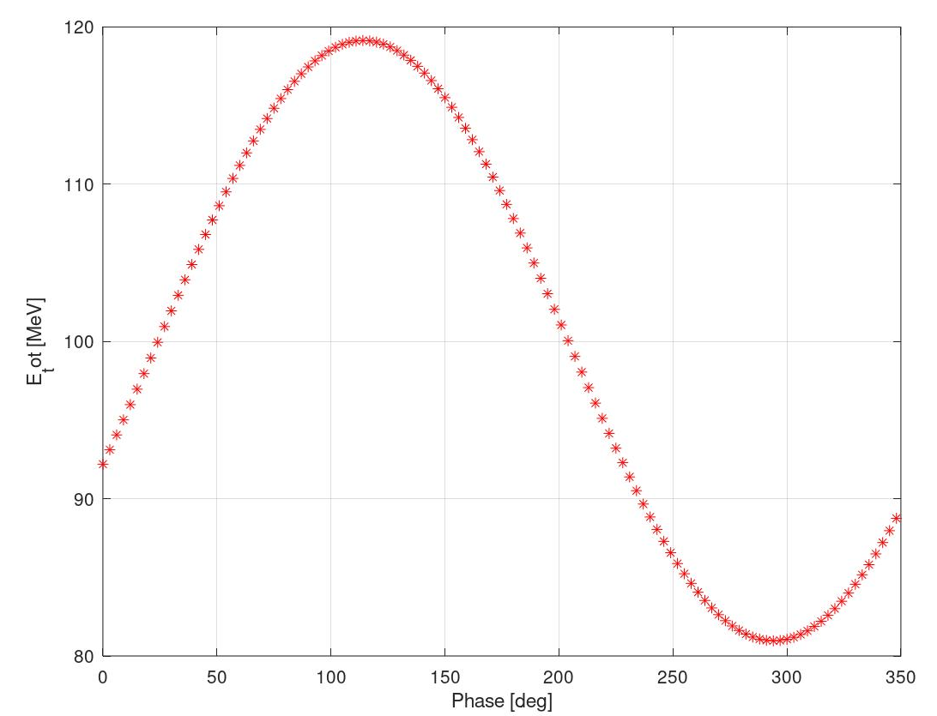
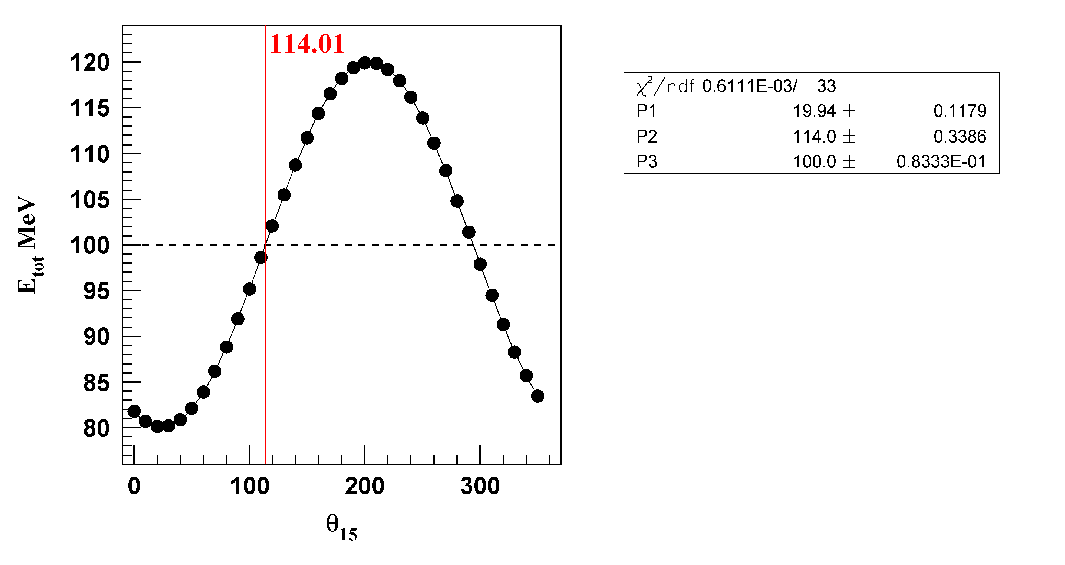
Initial phase scan
AC_15_1
Target exit
Send a single electron with energy 100 MeV at t=0 from the target. (px,py)=(0,0)
A = [0 0 0 0 0 100] => [x px y py s E]
24.21 deg
There is ~ 90 deg difference which could be due to the definition of the field map !
F. Miyahara

Slide 18
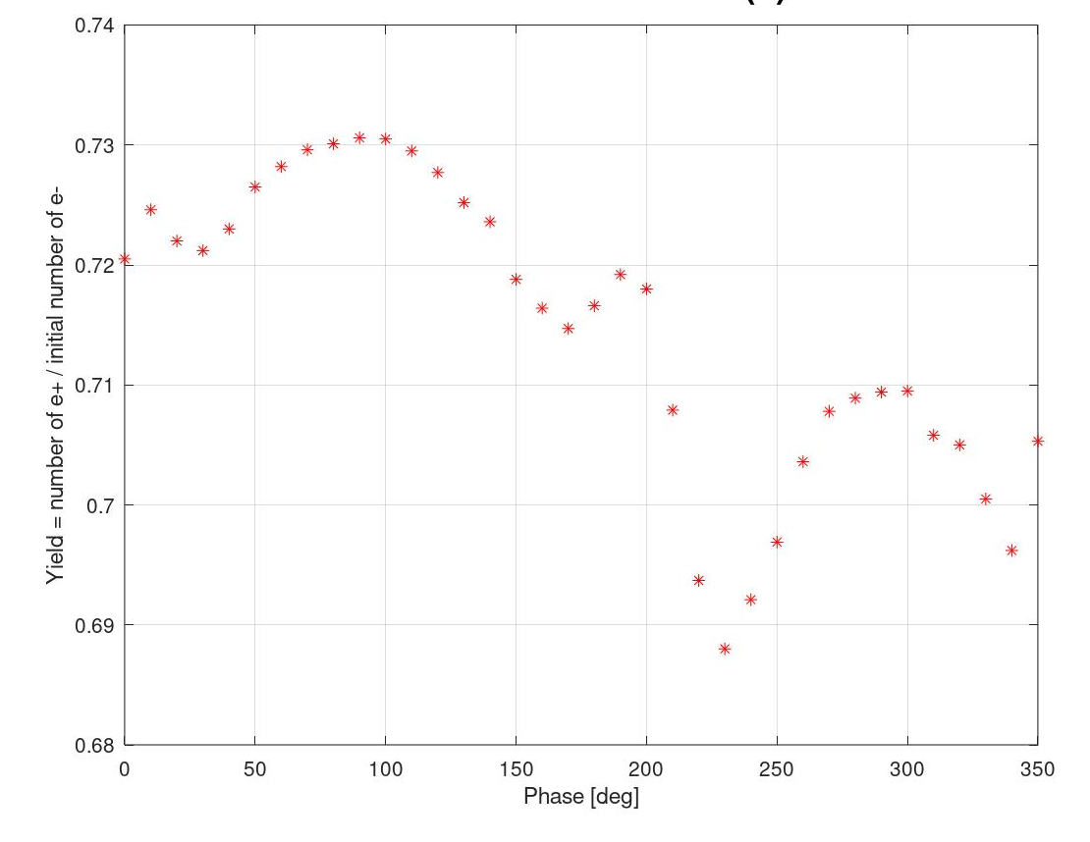
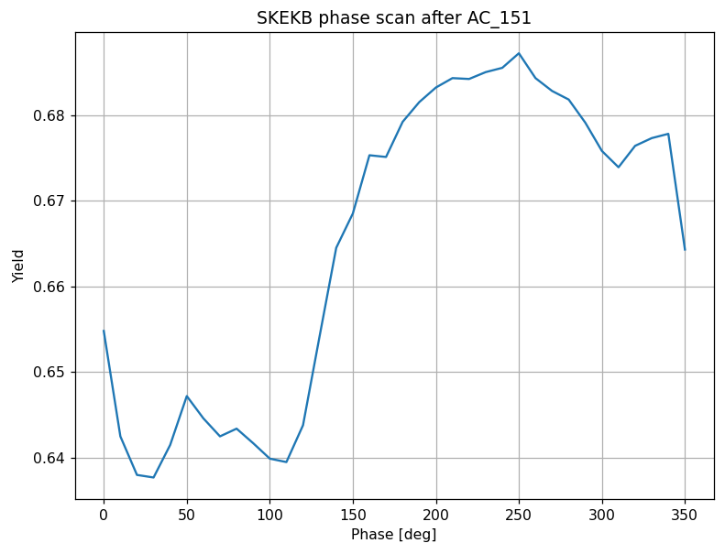
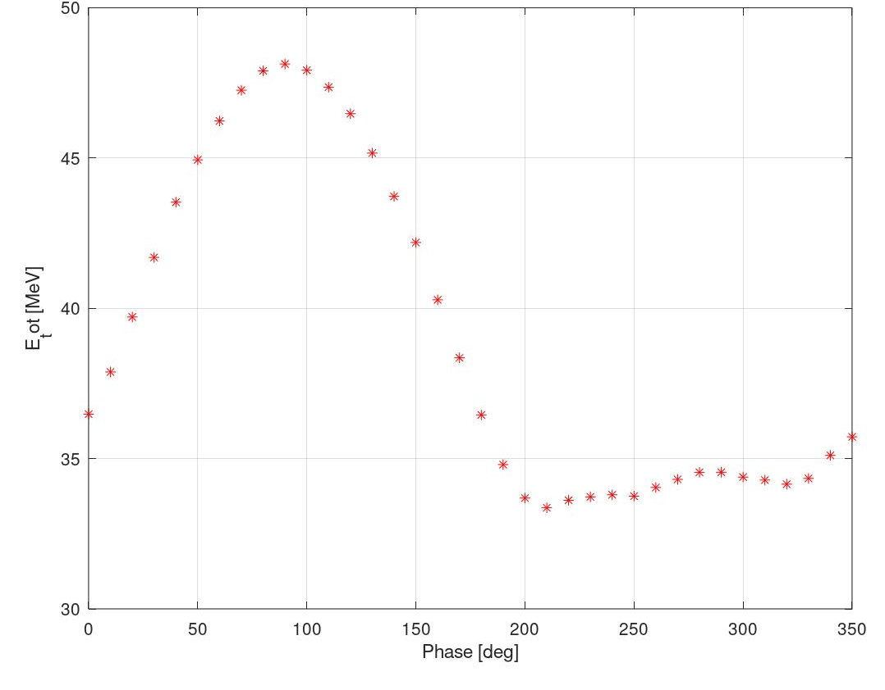
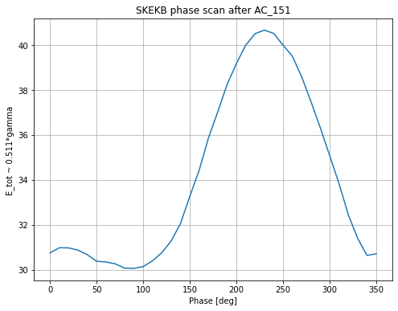
Preliminary Phase scans for the first Accelerating structure(AC_151)
Scan the phase [0:10:350]
Good agreement in terms of the yield (Ne-/Ne+) and energy gain.

Slide 19
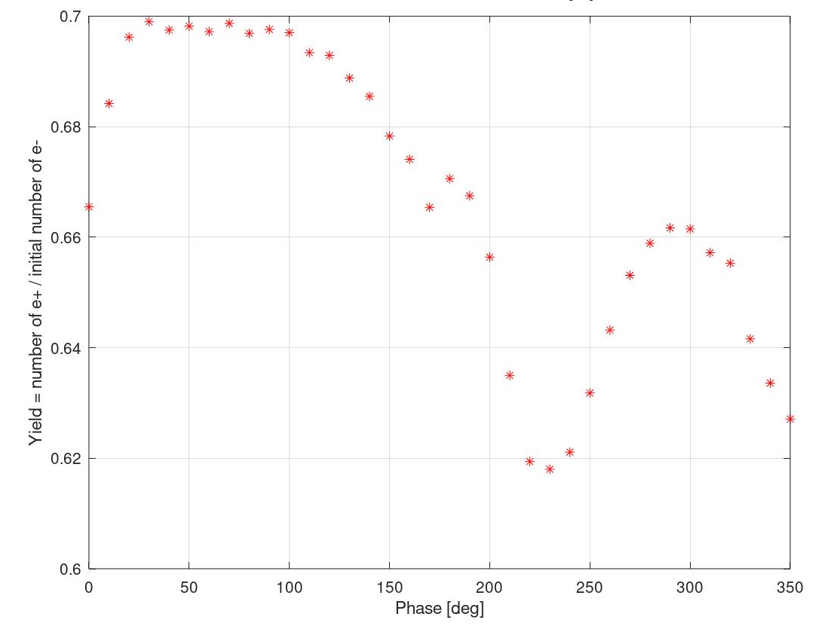
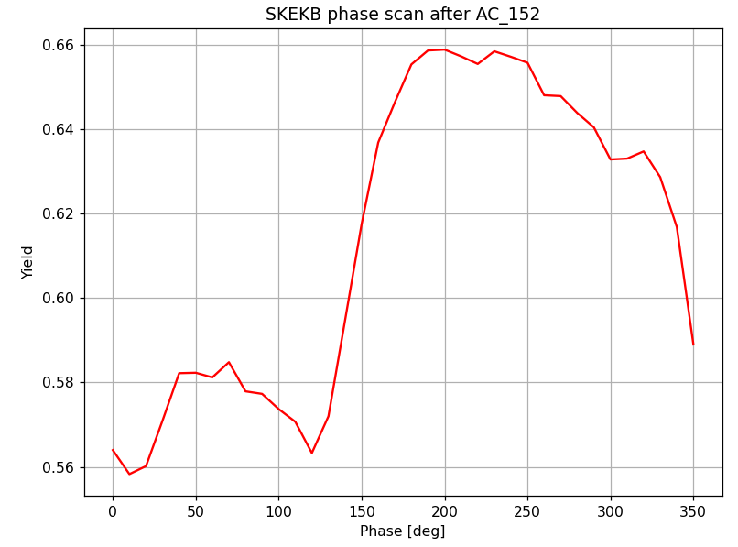
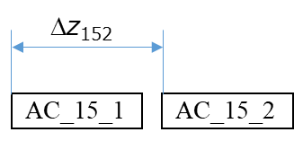
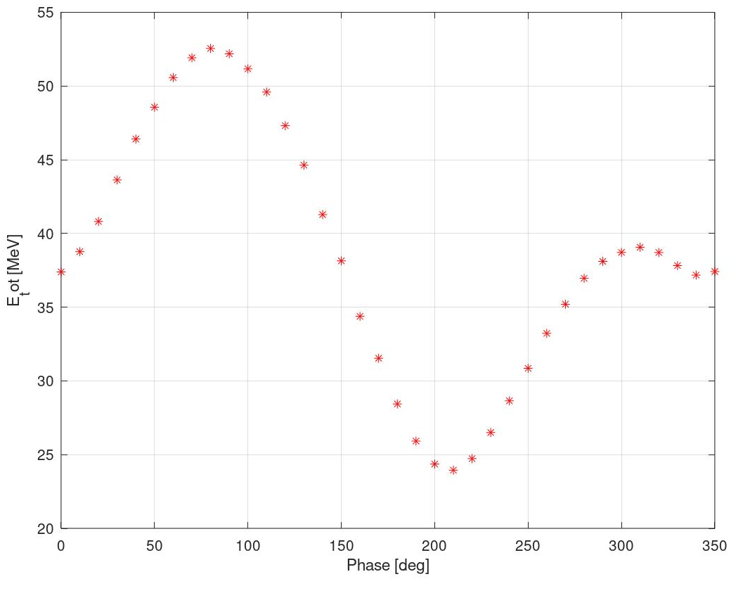
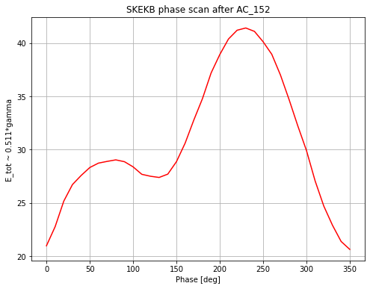
Preliminary Phase scans for the second Accelerating structure(AC_152)
Target exit
Since the particle is relativistic the phase of the second cavity is : φ_{AC152}=φ_{AC151}+ΔZ.
Good agreement in terms of the yield (Ne-/Ne+) and energy gain.

Slide 20
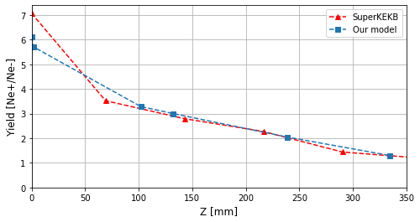
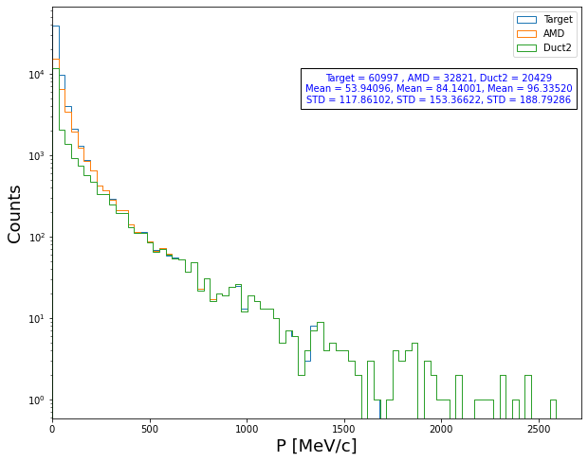
Summary
Positron yield is the main optimization parameter as for now (emittance , bunch length , energy spread ).
Flexible Geant4 model (source , target , particle distribution …)
Good agreement between our model and SuperKEKB
Next step : perform the tracking until the end of capture section (~150 MeV).
Benchmark with the real experimental data.
By using the developed and validated simulation tools, start/continue the FCC-ee positron source design.

Slide 21
Thank you !

Slide 22
Backup

Slide 23
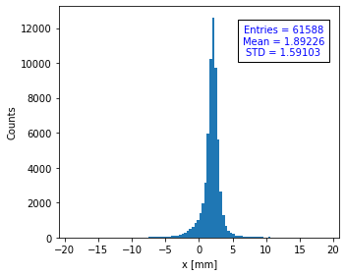




Geant4 model for SuperKEKB
Positron beam:
Positrons :
N(e+)/N(e-) =~6.2
Beam size (s_{x}, s_{y}) = (1.591, 1.63) [mm]
Bunch length (s_{z}) = (6.72) [ps]
As you can see there is a long tail in the time distribution which will affect the bunch length.

Slide 24

Positrons summary :
Parameters | SKEKB | G4 (no cut) | G4 (with cut)
Primary electrons bunch length | 0 | 1mm = 3.3 ps
Positron Yield | ~ 6.3 | ~6.2 | ~6.1
Beam size (s_{x}, s_{y}) [mm] | 1.681, 1.724 | 1.591, 1.63 | 1.35, 1.42
Bunch length (s_{z}) [ps] | 4.2 | 6.72 | 4.25
Bunch length (s_{z}) [mm] | 1.26 | 2.02 | 1.28
Main reason for the difference ?
They are using zero value for the production cut which will lead to generate more positrons with Very low energy and high scatter angle, in my case I am using the default (gamma = e- = e+ = 700um = 990eV) .

Slide 25

SuperKEKB positron source :
Primary beam:
Ne-=10000
E = 2.9 GeV
Px,Py = 0
Sx=0.5mm ,Sy = 0.8mm
Beam center =(2 ,0,-15)mm
Gaussian Time distribution at z=0 with FWHM =10 ps
Magnetic Fields:
FC =3.5T ,BC = 1.25T, DCS = 0.4T
Front gap = 2mm End gap = 40mm
AC_15_1, AC_15_2 : 12.56MV/m
Results after the target:
Ne+/Ne- = 6.3
PEDD 27.5 J/g (3.5GeV)
Results after AMD:
Ne+/Ne- = 3.1
AC_16 _1 - AC_16_4 : 14.292MV/m

