Slide 1
Radiation Load Studies for the FCC-ee Positron Source:
AMD and Positron Linac
Barbara Humann (SY-STI-BMI)
Supervisor: Anton Lechner
FCCee Injector Studies Mini-Workshop
(25/11/2022)
Acknowledgments to I. Chaikovska, P. Craievich, M. Schär, Y. Zhao,…

Slide 2
Agenda
Geometry
Beam Parameters
AMD
Positron Linac
Outlook & Conclusion

Slide 3
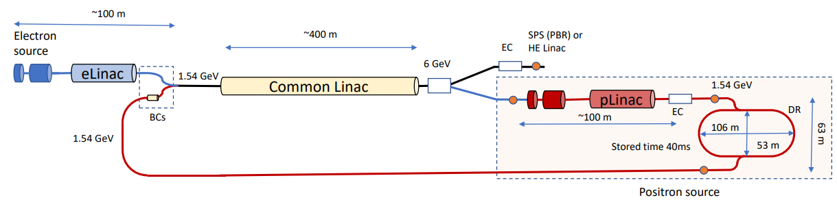
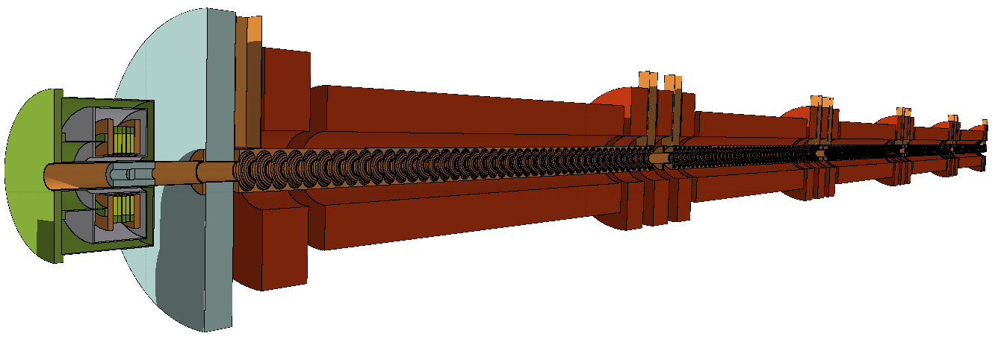
Geometry
https://indico.cern.ch/event/1133621/contributions/4756873/attachments/2418347/4139305/FCC%20injector%20schematic%20layout%2031032022.pdf
1) AMD
2) Positron Linac

Slide 4
Geometry – Adiabatic Matching Device (AMD)
Part | Material
Target | Tungsten
Coils | HTS (YBCO)
Cryostat | Stainless steel
Shielding | Tungsten
Support | Aluminum (grey)
Support | Copper (brown)
Radial Coil Position | 6.1cm
Shielding thickness | 1.9cm
Target radial size | 1.5cm
Target position in z | 1.75cm
AMD exit in z | 10cm
New:
Target and shielding are made from pure tungsten and in one piece
Thicker shielding → smallest aperture possible chosen
Facilitates cooling, better shielding effect
- Corrected magnetic field

Slide 5
Geometry – Positron Linac
Self designed shielding (tungsten) to protect RF structure
RF entrance: z=26.6cm
5 cells, 44 cells each, copper
324cm per cell including VC, 297cm cavities (6.75cm per cavity)
Constant magnetic field of 0.5T in cavities
Aperture: 3cm, up to r=7cm
Solenoids: 13cm aperture → what will be in-between cavities and solenoids?
Concept of one long solenoid, 3 shorter ones
Copper with density taking in account the water cooling channels

Slide 6

Parameters for the FCC-ee positron target
Electron drive beam | 6GeV
Beam size | 0.5mm RMS
Repetition rate | 200Hz
Bunches per pulse | 2
Bunch intensity (filling) | 3.47E10 (5.56nC)
Bunch intensity (top up) | 3.47E9
Beam Power | 13.34kW
Target length | 5X₀=17.5mm
Filling time of collider:
2.4% filling from scratch
97.6% at top-up with 10% bunch charge
Old
(FCC-Week 2022)
New
100% filling with full bunch charge
Current time scheme: needed for reliable dose and DPA values
(no difference between filling and top-up)
2bunches*200Hz*3600s*24h*185days*0.804(duty factor)*3.47E10e-/bunch*0.5
e- on target per year: 8.9E19e-/year

Slide 7
Measured quantities
Instantaneous effects
  Total deposited power (in W): Determines the heat load on the elements
  Power density (in mW/cm³): Quenching of SC if it is too high
Long term radiation effects
  Dose (in MGy): Deterioration of (organic) materials
  Displacement per atom (DPA): Structural damage of inorganic materials; Dimensionless number proportional to the number of Frenkel pairs
Frenkel Pair

Slide 8
Adiabatic Matching Device Target

Slide 9
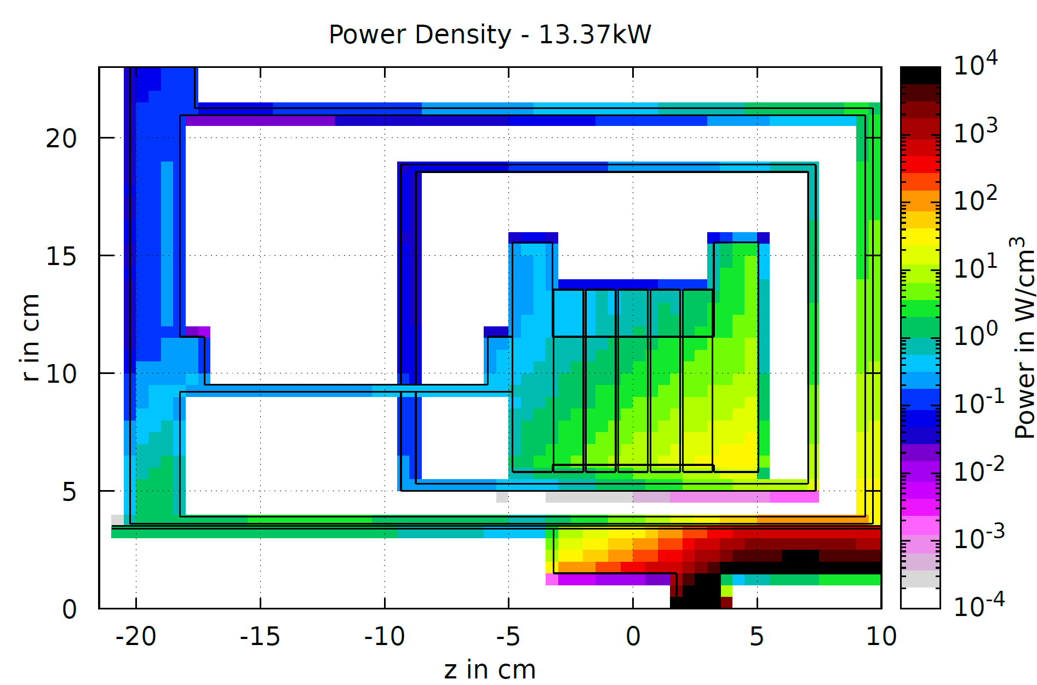
Power on different AMD elements
 | 13.34kW | 3.43kW
Target | 3100W | 869W
Shielding | 1040W | 209W
Coils (1-5) | 0.6-2.9W | 0.27-1.25W
x3.9
x3.5
4140W vs.1078W
x3.8
Power Density - 13.34kW Beam power
x4.9
Smaller target, less increase (x3.5)
bigger shielding, more increase (x4.9)
Sum increases proportional (x3.9) to beam power (x3.9)
→ Slightly different distribution but total power stays similar

Slide 10
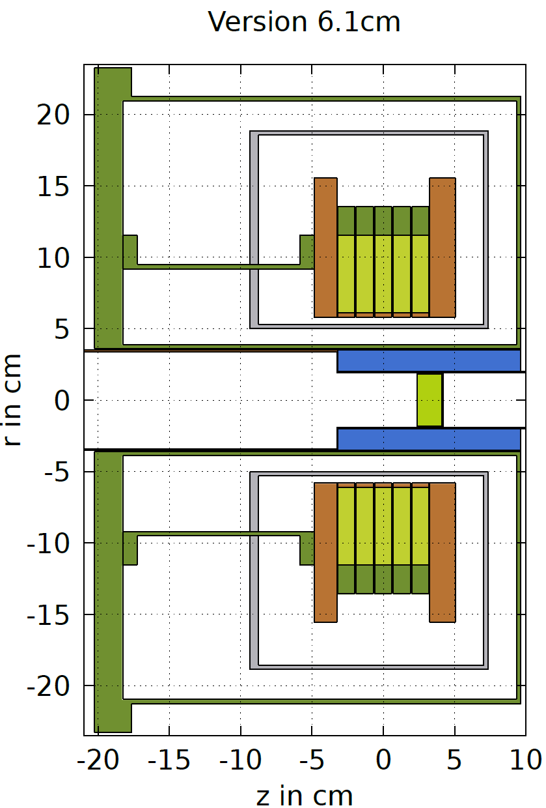
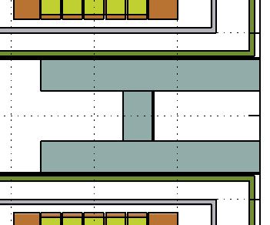
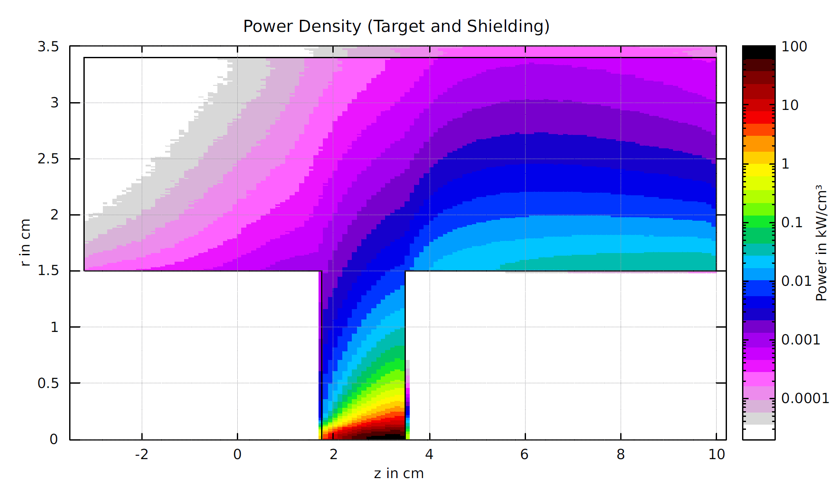
Close up on the target
Old
(FCC-Week 2022)
New
Shielding and target in one piece
Pure tungsten
Shielding: 1.5cm → 2cm
Aperture: 2cm →1.5cm
Shielding
80kW/cm3
8 DPA/year
Target

Slide 11
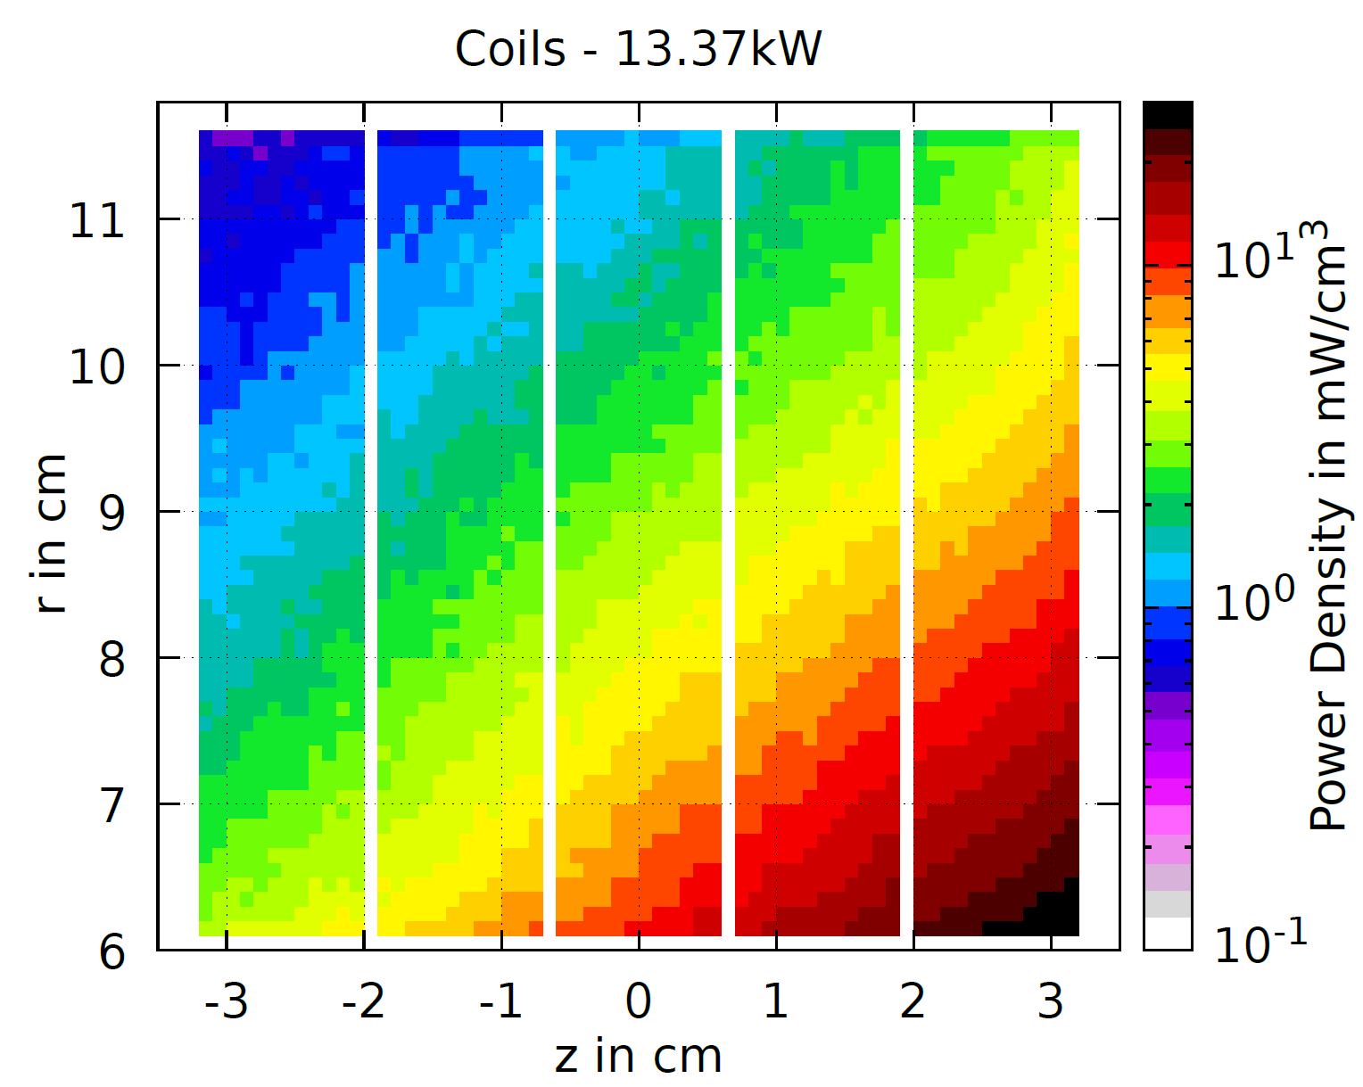
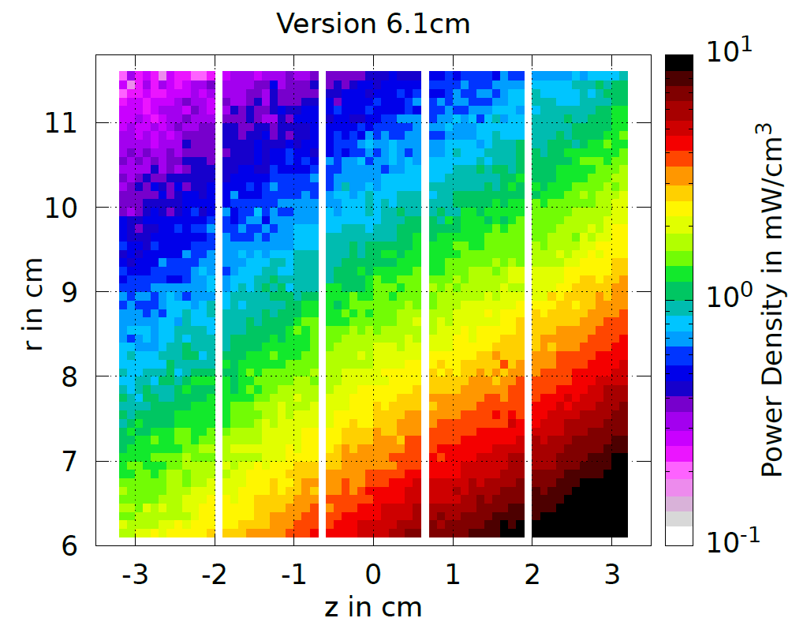
Power density on coils
Coils - 13.34kW Beam power
Coils
FCC Week 2022:
up to 10mW/cm3
30mW/cm³
Should be safe considering HTS coils + strong gradient is favourable as well
Values ~3x higher than in old design due to 4x higher beam power.
Power density does not scale directly, due to thicker shielding protecting the coils better and a target position further downstream.

Slide 12
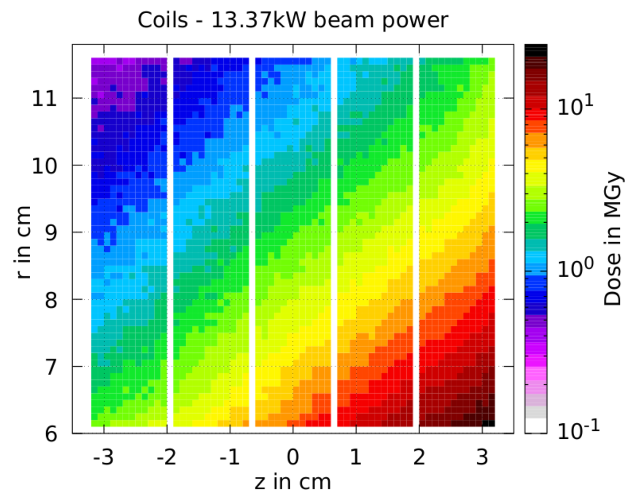
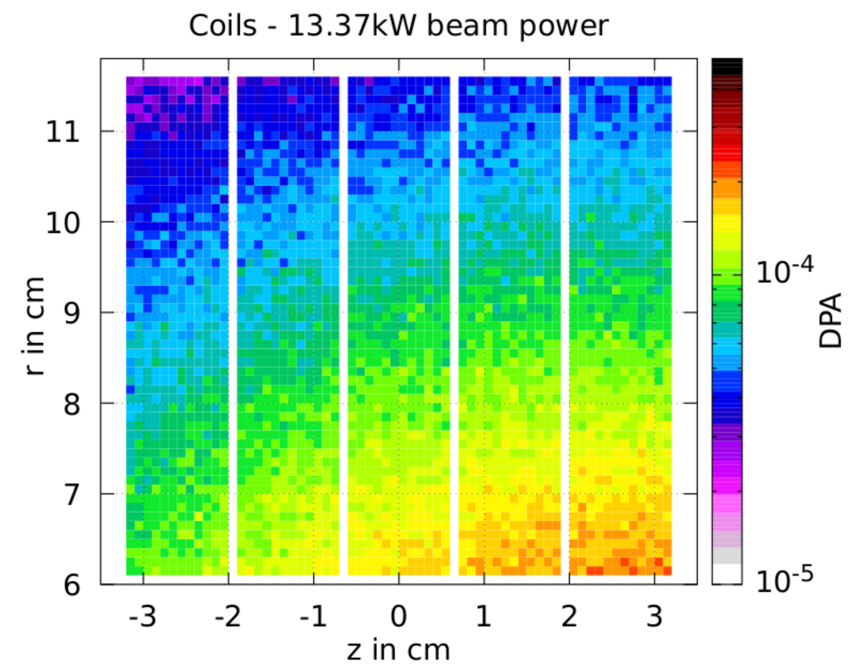
Long-term radiation effects per year of Z operation on coils
Dose and DPA values must be investigated if they can be considered as safe
Up to 22MGy/year
Up to 2E-4 DPA/year
Remarks:
long term radiation effects (dose, DPA) are given for one year of Z operation.
Conservative assumption is that values will be ~10x higher for operational time of FCC-ee.

Slide 13
Positron Linac

Slide 14
Geometry reminder
Waveguide
Solenoid connector
Solenoid short
AMD
Solenoid long
Cavities
Cell 1
RF Shielding (10.5cm)
5 cells with each 44 cavities (324cm per cell)

Slide 15
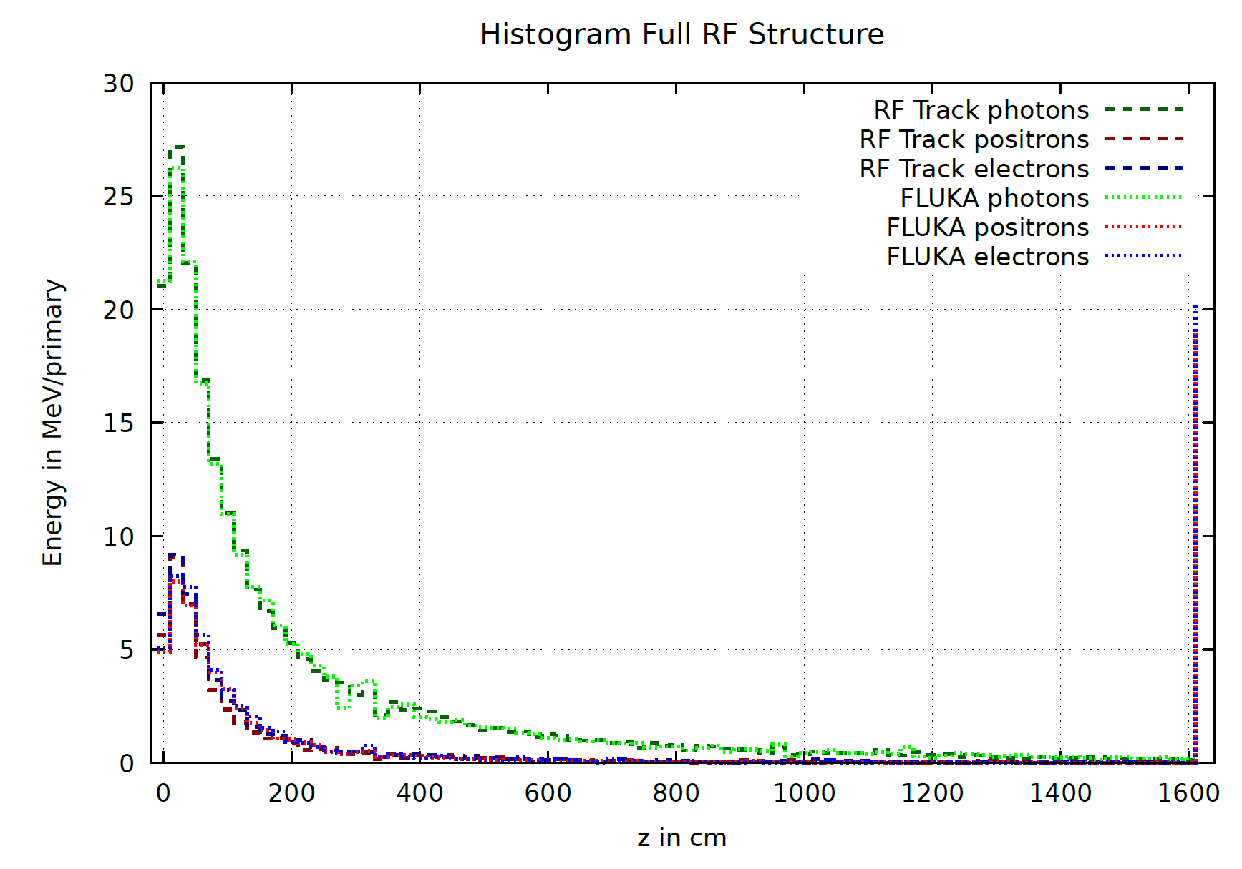
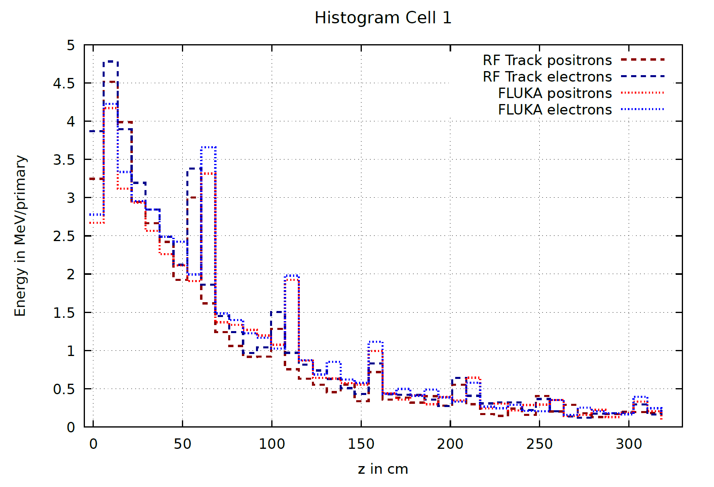
Power loss on aperture in positron linac
Thanks to Y. Zhao for the RF Track values
As soon as particle leaves vacuum and touches a cavity/VC it is dumped, and its properties are stored
Good agreement in data means that FLUKA simulations should be sufficient for energy deposition studies, even with only a constant magnetic field of 0.5T and no electrical field.

Slide 16
Power loss on aperture in positron linac
 | Electrons |  | Positrons |  | Photons |  | TOTAL
 | RF Track | Fluka | RF Track | Fluka | RF Track | Fluka | RF Track | Fluka
Total | 1154W | 1126W | 1037W | 1061W | 4830W | 4822W | 7021W | 7015W
Cell 1 | 1015W | 1026W | 913W | 967W | 3722W | 3721W | 5650W | 5721W
Cell 2 | 85W | 71W | 79.5W | 62.8W | 631W | 607W | 796W | 741W
Cell 3 | 24W | 16W | 23.5W | 19.7W | 265W | 261W | 313W | 297W
Cell 4 | 21.2W | 9.1W | 12.8W | 6.6W | 140W | 148W | 174W | 163W
Cell 5 | 8.8W | 3.4W | 7.9W | 4.1W | 71W | 83W | 88W | 90W
Values are generally in good agreement
Thanks to Y. Zhao for the RF Track values!
Impact on the aperture ≠ energy deposition

Slide 17
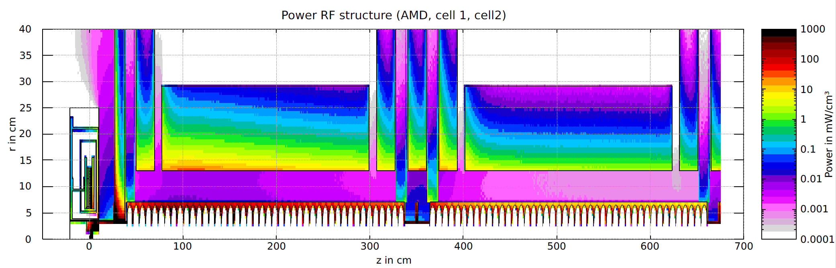
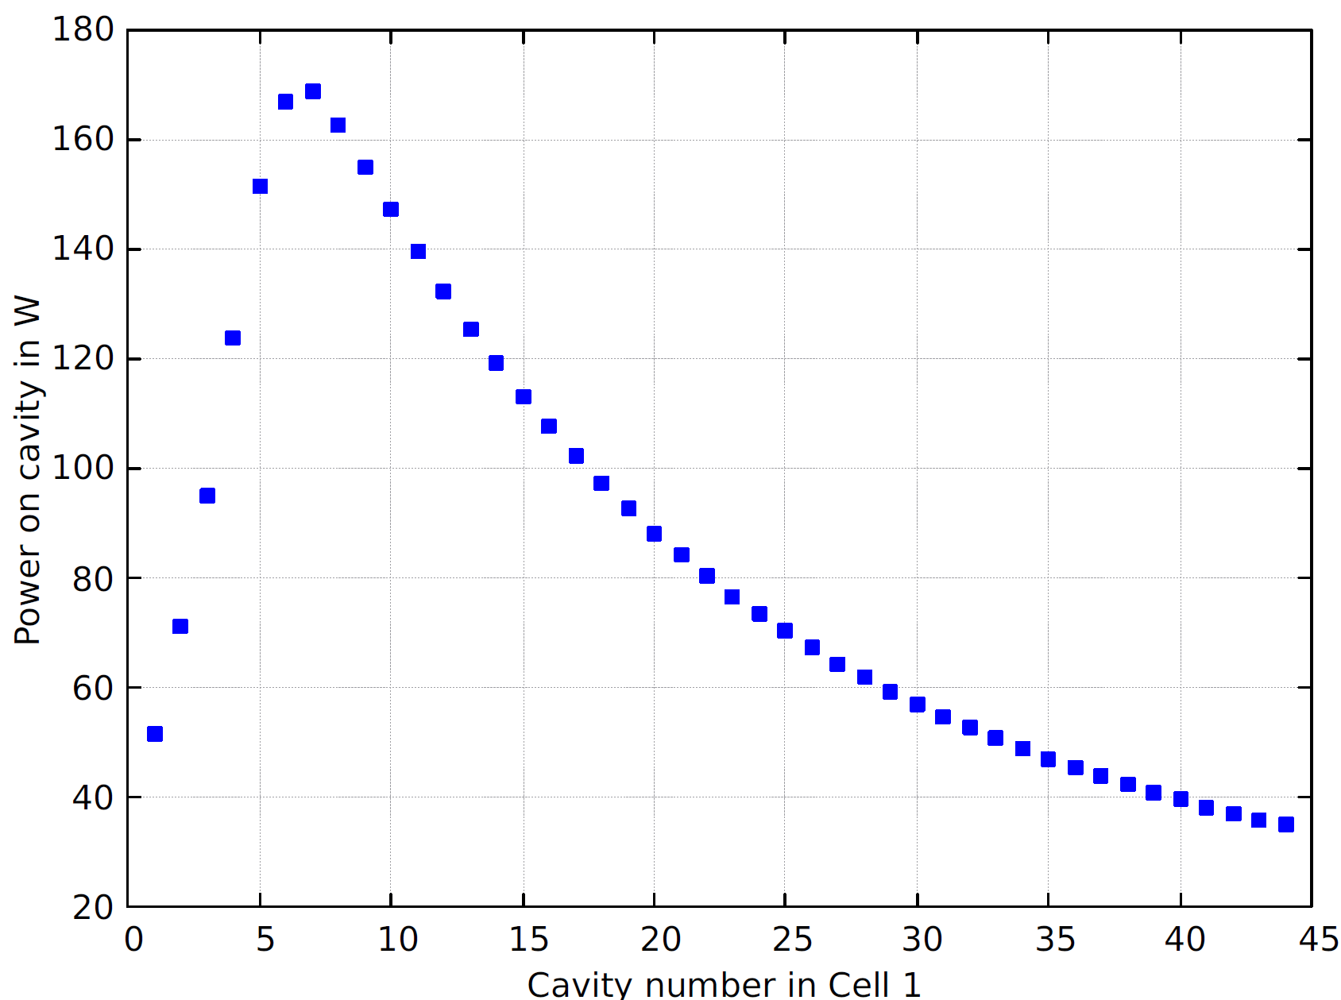
Power deposition on different elements of the positron linac
 | 13.34kW
Shield RF | 1049W
Flange AMD/RF | 132W
Flanges cells | 43W-3.6W
SOL short | 68W*-3.6W
SOL long | 607W-12.66W
SOL connect | 53W-4.3W
* Highest value in first short solenoid of cell 2
First cell most impacted: up to 170W(!) absorbed by cavity
Cell 2 up to 20W per cavity
Shielding protects positron linac solenoids, but not the cavities
If cavities need more protection, elaborate shielding scheme must be elaborated

Slide 18
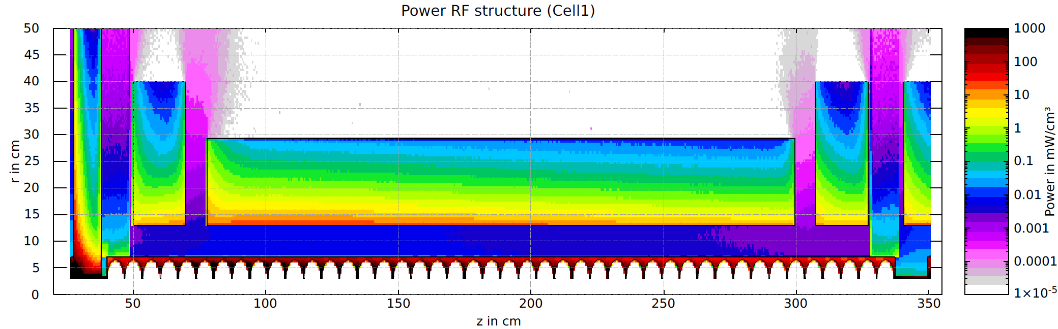
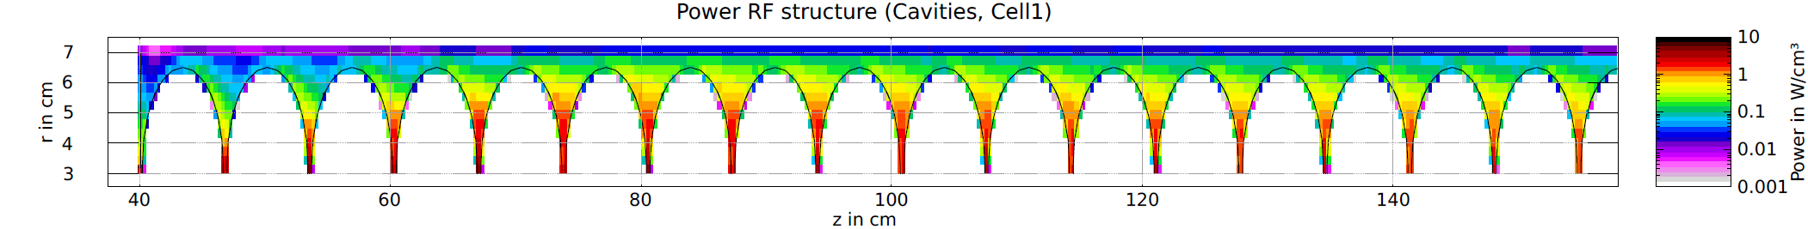
Close up to first cell
Solenoid: 65MGy/year – shielding?
Solenoid: 0.25W/cm³, 35MGy/year (z=100cm), ~3.5E-5 DPA/year
Organic materials in solenoid?
Flange:
3.8W/cm³, 2800MGy,
1E-3 DPA
Hottest spot: 5W/cm³, 3500MGy, 1.2E-3 DPA
Which numbers are acceptable?

Slide 19
Summary
AMD & Target:
  Coils: power density is below critical values, DPA and dose must be understood if they are acceptable
  Target: 13.34kW beam power leads to critically high heat load and DPA ➔ solution pending
Positron Linac:
  Power loss: FLUKA results align well with RFTrack
  Cavities: highly impacted by particles from the inside, so shielding is not possible.
  Solenoids: Protected by large tungsten shielding in front of positron linac. In case of organic material and/or SC solenoid, dose values are too high.
  What power deposition values and DPA levels can the cavities withstand?

Slide 20
Any questions?

