Slide 1
Design of the FCC-ee positron source target: current status & challenges
Mini workshop on the FCC-ee Injector Studies
Ramiro Mena Andrade, Antonio Perillo Marcone and Jean-Louis Grenard (SY-TCD-STI)
Date: 25th November 2022

Slide 2
Content
Target design: Recap
Target design: W-Cu model
Summary

Slide 3
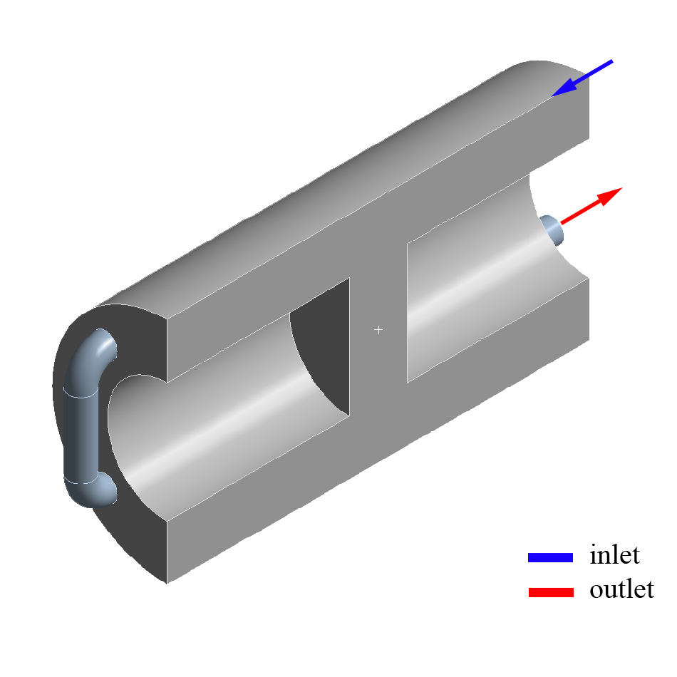
Target design: Recap
Goal:
To provide a mechanical design of the positron’s source target.
Previous results:
Target’s cooling through its shielding
Parametric analysis
geometry & working conditions
Recommended geometry:
C2x2 D7.5mm at 25 m/s and 12.5 bar
Fig. Design’s approach:
target and shielding are integrated on a single piece
Fig. Recommended geometry
C2x2 D7.5mm
New challenge: an increase in the energy density deposition by a factor of 4
Power to dissipate in the target:
Before: 0.9 kW [Aug-2022]
Current: 3.6 kW [Oct-2022]

Slide 4
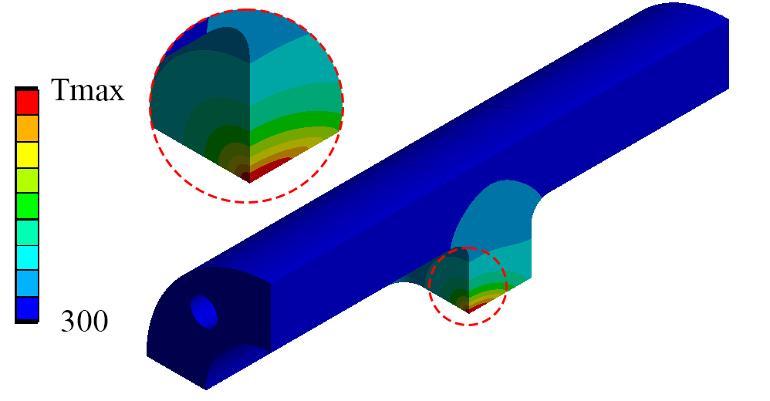
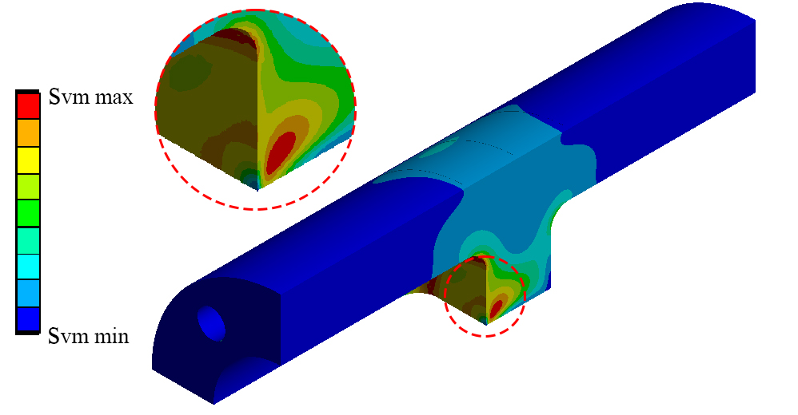
Target design: Updating the energy deposition
Question:
Can we still use the previous design?
Answer:
No. The new energy density deposition requires a new strategy for cooling.
Fig. Geometry (left). Maximum temperature Tmax (middle) and Maximum Von-Mises stress (right) as a function of the convection coefficient h

Slide 5
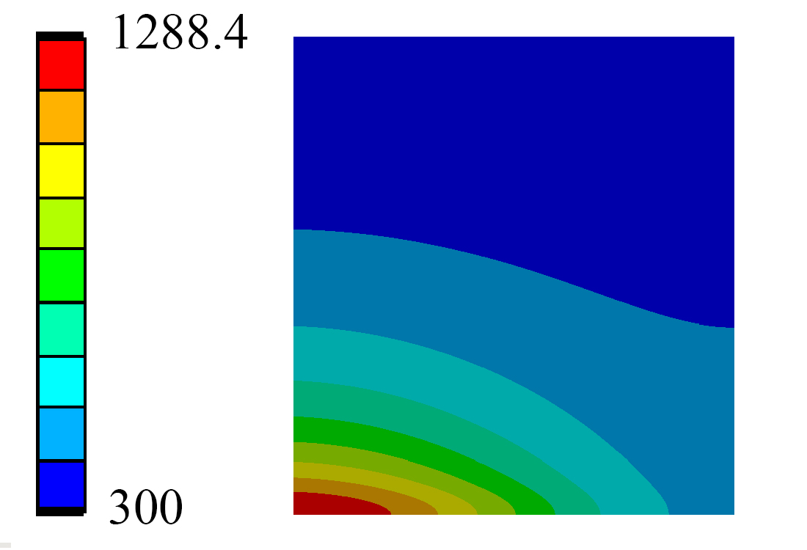
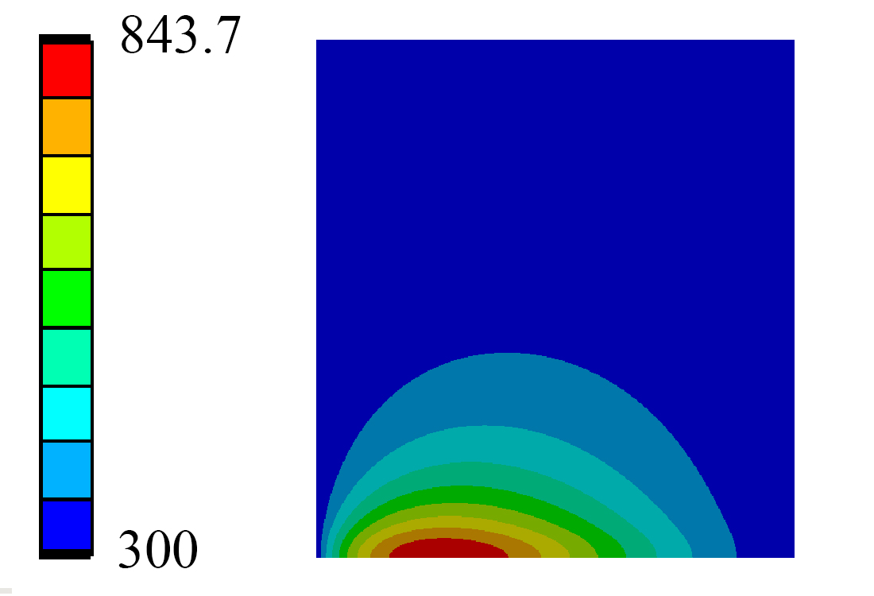
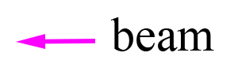
Target design: Understanding the “physical limits”
Hypothesis 1:
The whole shielding is perfectly cooled at T=300K
Hypothesis 2:
The external surface of the target is perfectly cooled at T=300K
Fig. Temperature distribution in the target for hypothesis 1
Fig. Temperature distribution in the target for hypothesis 2
Take away message: the maximum temperature in the target will be “bounded” between both values

Slide 6
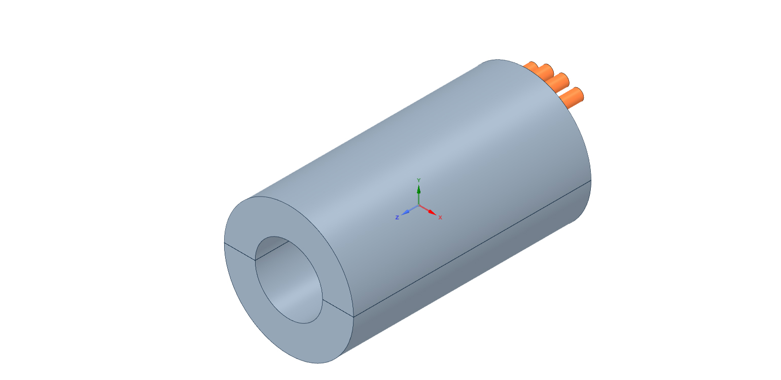
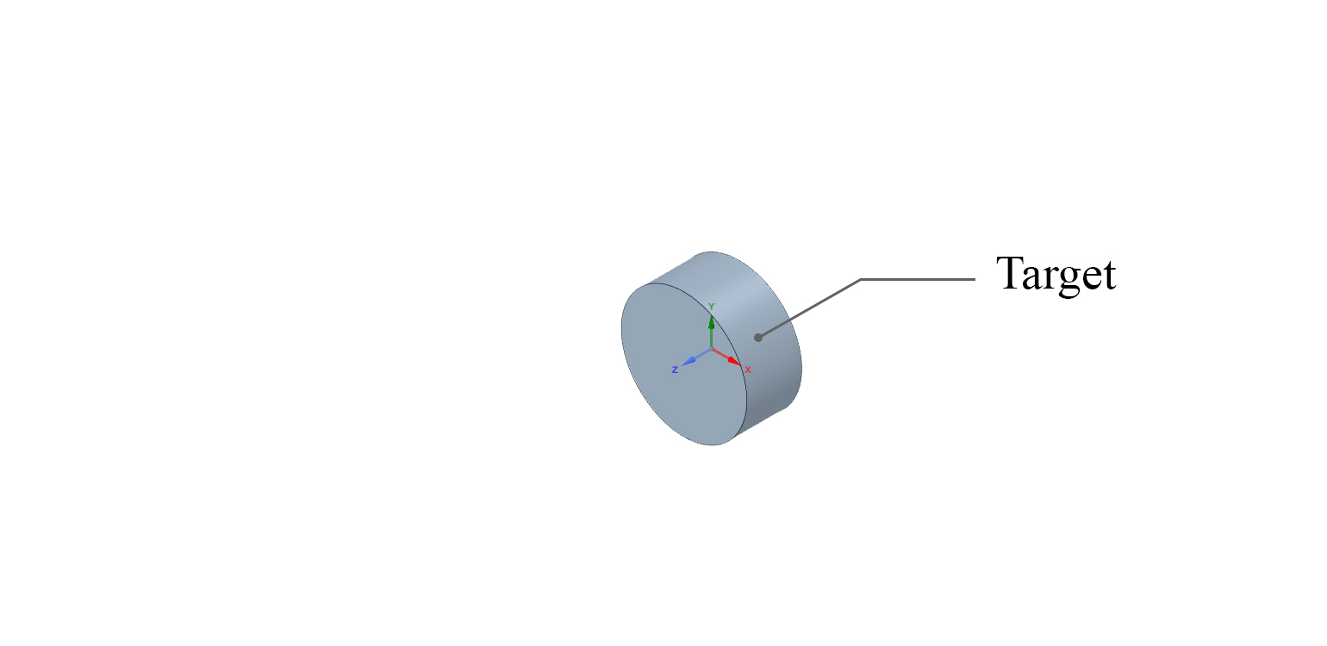
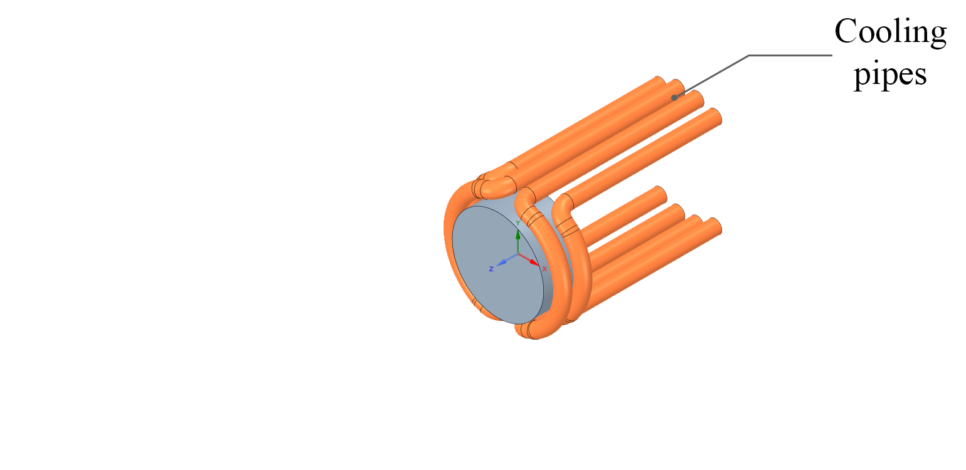
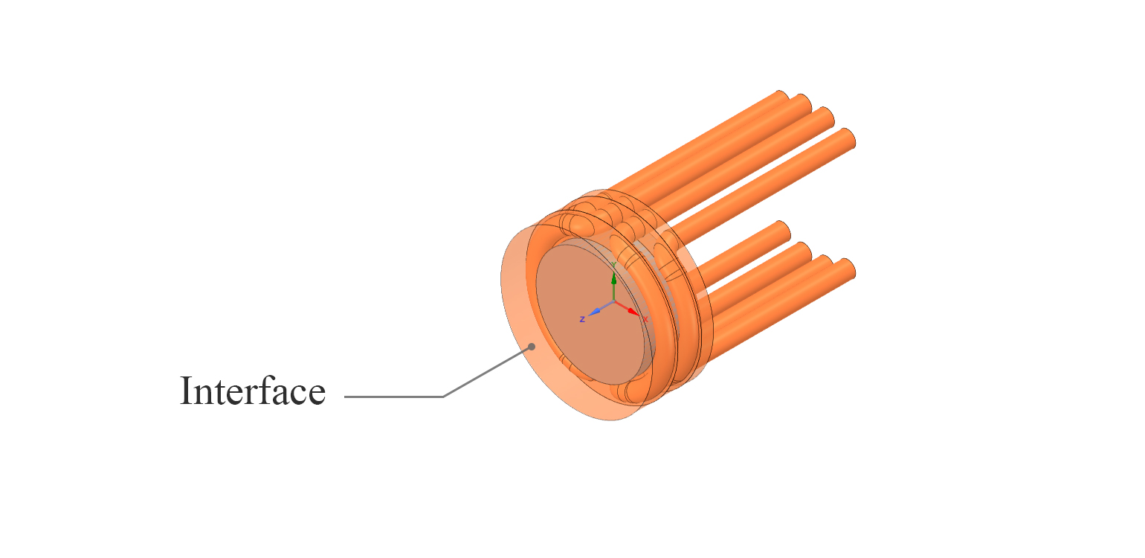
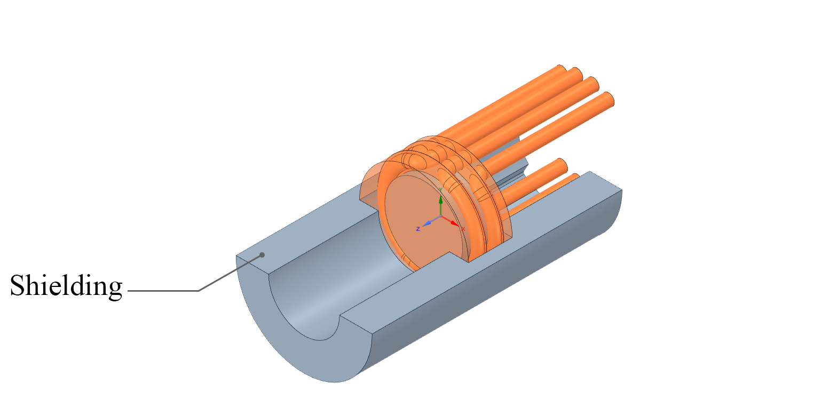
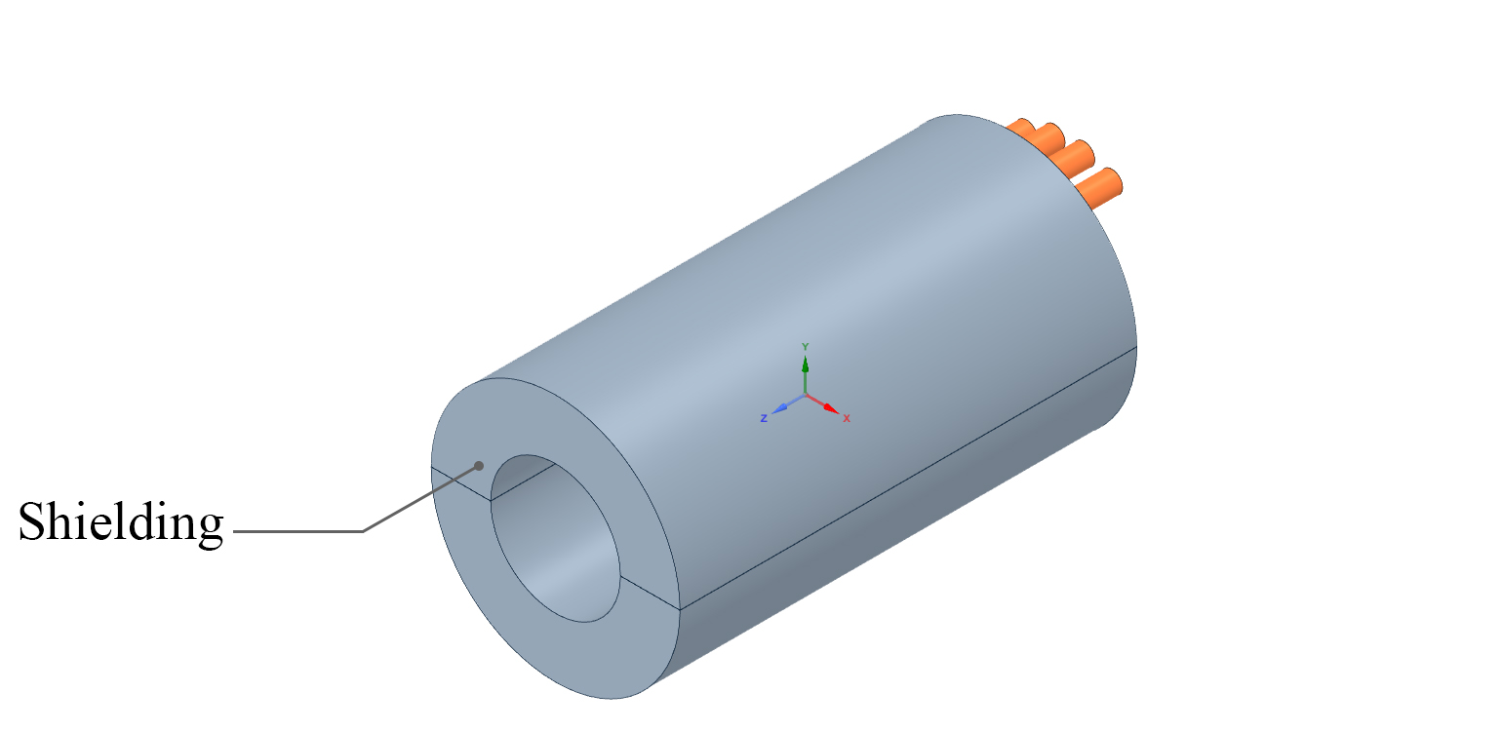
Target design: W-Cu model
Features:
Material selection based on ITER* and SuperKEKB**
Target embedded in a copper interface
4 loops for cooling
Shielding is divided in two parts
*T. Hirai and G. Pintsuk, Fusion Engineering and Design 82 (2007) 389–393
** T. Kamitani, M. Akemoto, D. Arakawa, Y. Arakida, A. Enomoto, S. Fukuda et al., SuperKEKB
positron source construction status, in Proceedings of the 5th International Particle Accelerator
Conference, Dresden, Germany, 15–20 June 2014, pp. 579–581.
Model:
Fig. W-Cu target model components

Slide 7
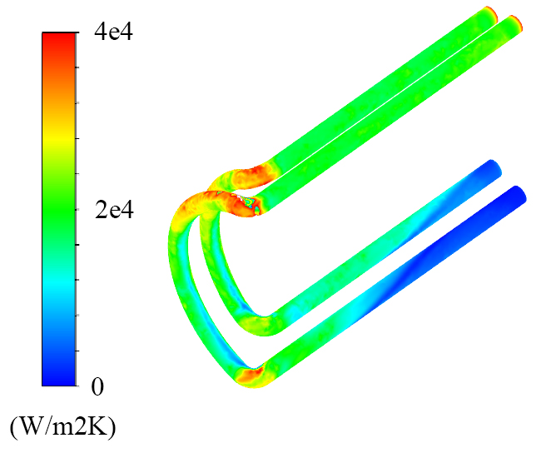
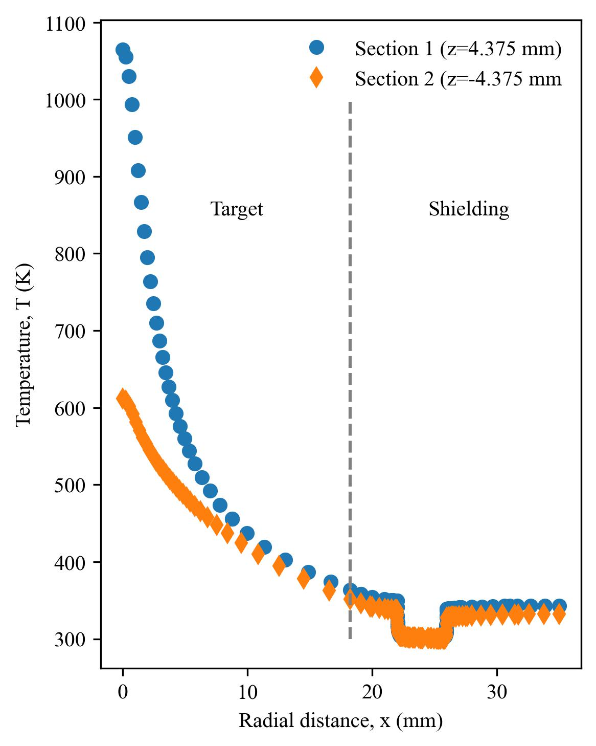
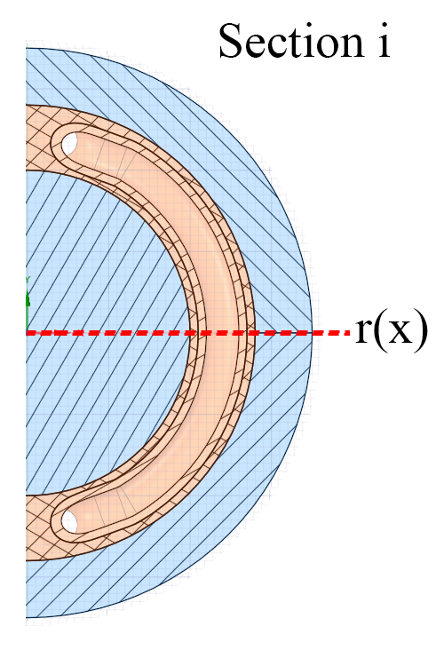
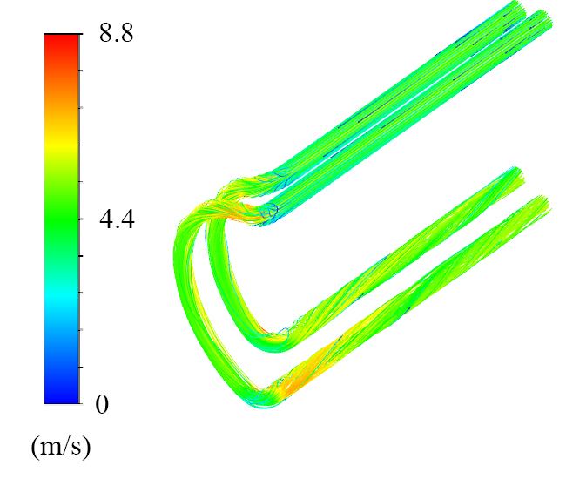
Target design: W-Cu model
CFD results
Cooling fluid: H2O
u= 5 m/s
p= 20 bar
h = 18297.918 W/m2K (average)
Fig. Convection coefficient h (W/m2K) distribution
Fig. Radial temperature distribution
Fig. Velocity streamlines (m/s)

Slide 8
Target design: W-Cu model
Thermo-mechanical results (1/2)
T limit = 500 C (773.15 K) *
σ limit = 273.15 MPa*
* Garoby et al 2018 Phys. Scr. 93 014001
Fig. Principal stress σ1 (MPa)
Fig. Temperature distribution in the target (K)
Fig. Principal stress σ2 (MPa)
Fig. Von-Mises equivalent stress (MPa)
Fig. Principal stress σ3 (MPa)

Slide 9
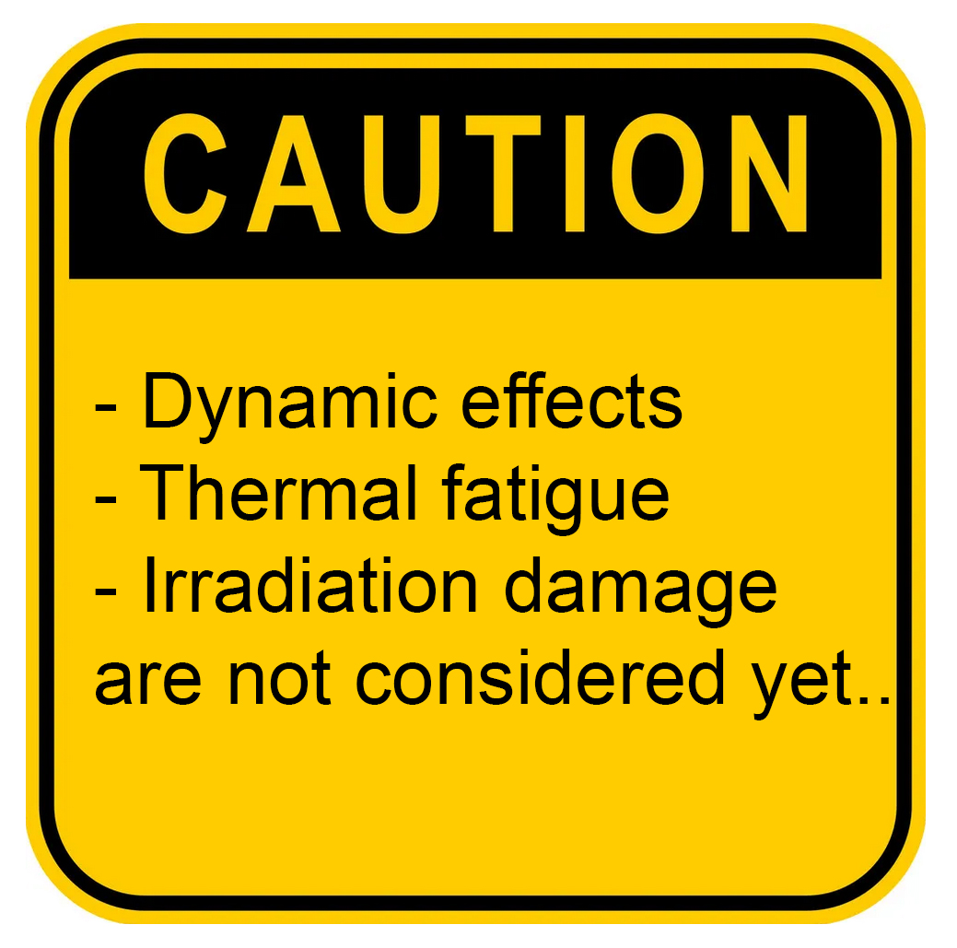
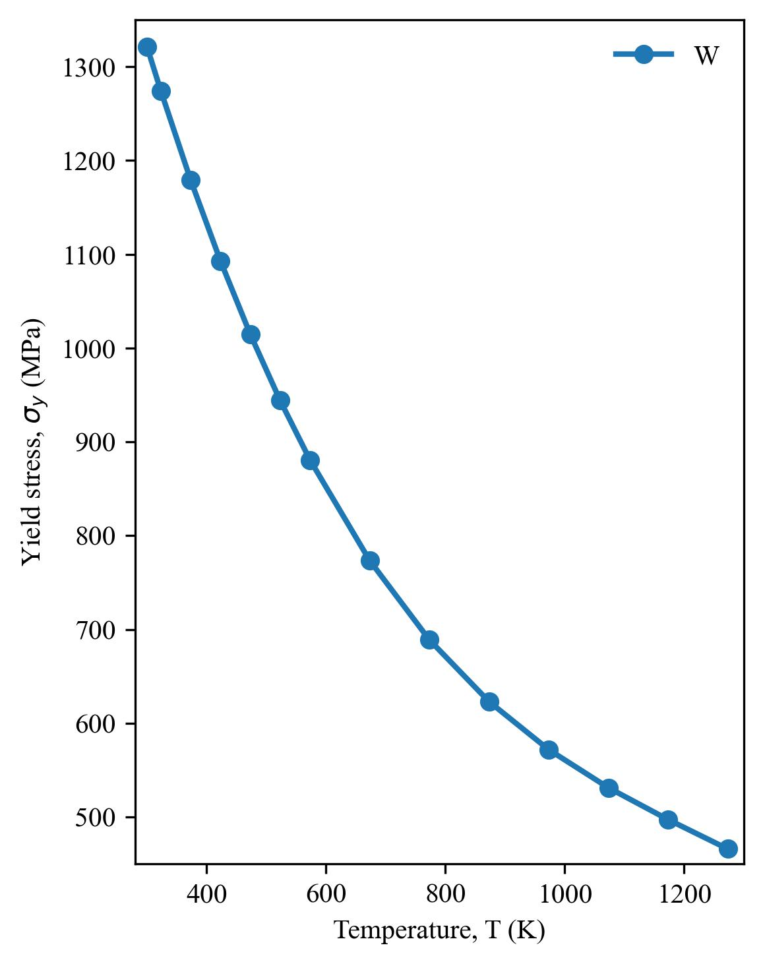
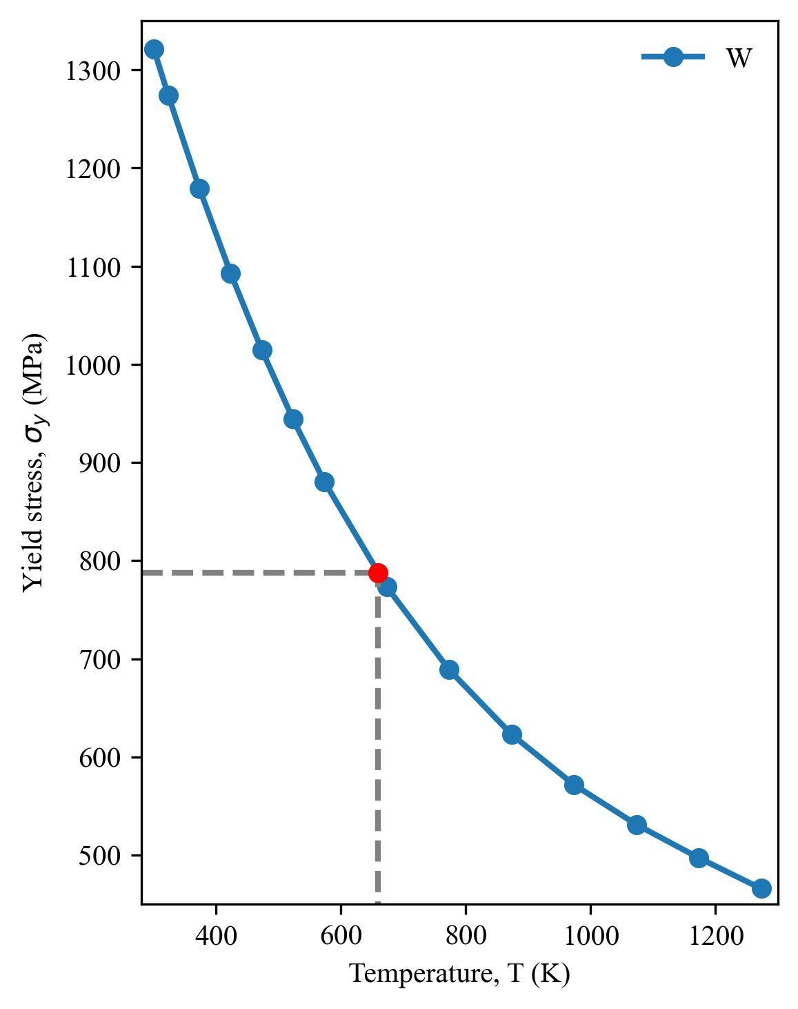
Target design: W-Cu model
Thermo-mechanical results (2/2)
The temperature at the location of maximum
Von-Mises stress (776.08 MPa) is 658.8 K (385.65 C)
787.36 MPa
Fig. Temperature distribution in the target (K)
Fig. Von-Mises equivalent stress (MPa)
Fig. Yield stress σy as a function of temperature [MPDB 2022]

Slide 10
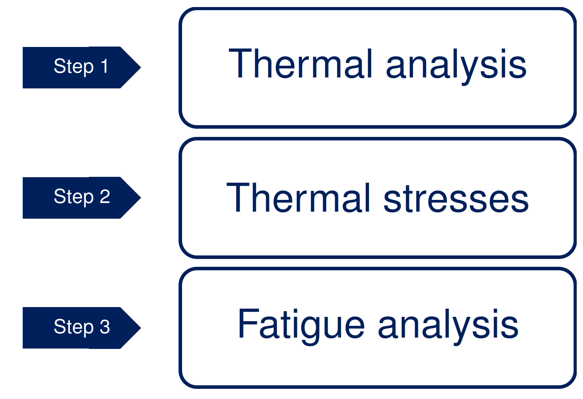
Target design: Discussion
Design workflow
Ideas to explore:
The increment in energy deposition (x4) causes an important rise of temperature in the target (x3).
As a consequence, the obtained thermal stresses are on the limit of the elastic range of tungsten.
Ideas to explore:
- Physics: beam configuration (size)
- Cooling: material selection and/or design optimization
- Geometry: target thickness
- Design: rotary target?

Slide 11
Summary
As a reference, the SuperKEKB target has a thickness of 14mm and dissipates a power of 0.5-3 kW. To deal with this power, it is embedded in a copper interface. On the other hand, the FCC-ee target has a thickness of 17.5mm and with the updated energy deposition mapping, it must dissipate 3.6 kW. Following this philosophy, a preliminary design was presented.
With the current specifications, the material is subjected to significant thermal gradients and thermal stresses. The presented results are considering a steady-state scenario only and the material is close to its yield limit. Therefore, it is important to discuss possible strategies to mitigate this potential issue.

