Slide 1
P³ status and beam dynamics updates
Nicolas Vallis & Riccardo Zennaro :: on behalf of the P³ Team :: Paul Scherrer Institute
Workshop on FCC-ee Injector Studies, IJCLab, 25.11.2022

Slide 2
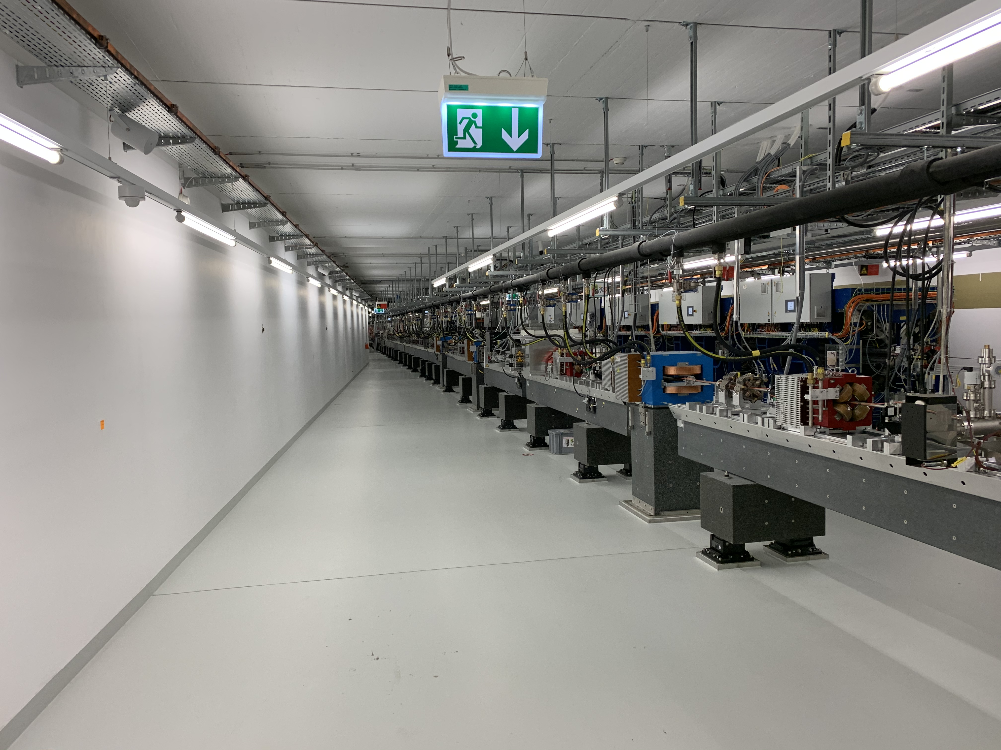
The 6 GeV Electron Beam of SwissFEL @ PSI
SwissFEL building has been designed to allocate a future beam line (Porthos)
Perfect location for P³
 | FCC-ee | SwissFEL |  | P³(*)
Beam energy | 6 GeV
RMS beam size | ~ 0.5 mm
Rep. rate | 200 Hz |  | 100 Hz | 1 Hz
Bunch charge | ~ 5 nC |  | 0.2 nC | 0.2 nC
Bunches/pulse | 2 |  | 2 | 1
(*) for radiation reasons we must limit the average beam current of P³

Slide 3
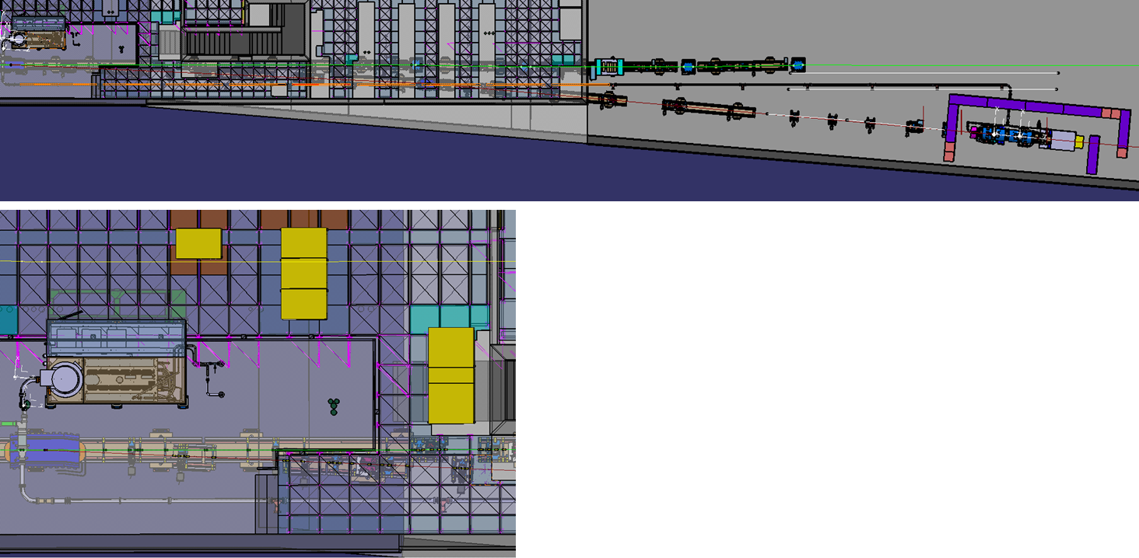
Running the P³ Experiment in SwissFEL
Porthos extraction line (Phase Planned)
P³ experiment
EMI22+
P3 experiment requires the realization of two PSI projects:
EMI22+ (Erneuerung Modulatoren Injektor):
Production of new HV klystron modulators for the SwissFEL injector based on the technology developed for the PSI HV modulator currently used in for PolariX (X-band deflector).
Porthos extraction line (Phase Planned):
Installation of the initial part of the Porthos extraction line. Most components will remain in place for Porthos Final Phase.

Slide 4
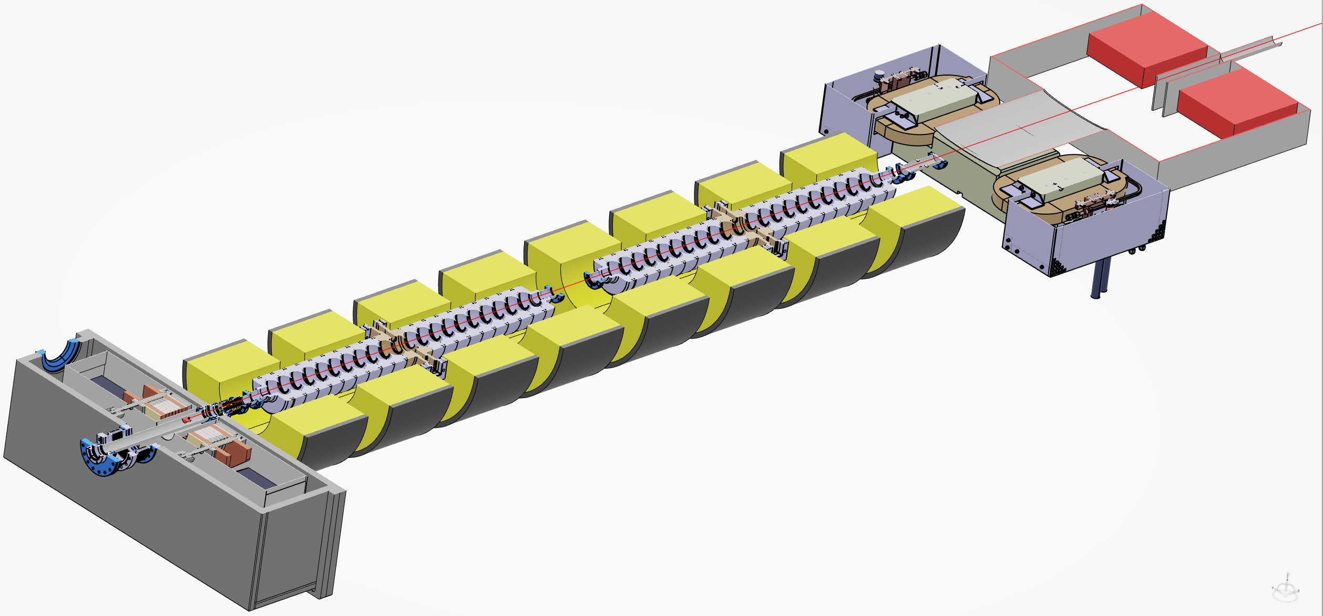
P³ Experiment
Spectrometer dipole
→ Separation of e+ and e-
RF SW S-band structures
→ Acceleration
W Target
→ e+ generation
Faraday cups
→ Charge measurement
Broadband pickups
→ Resolution of particle bunches in time
0.4 T 200 A NC Solenoids around RF accel. structures →
Confinement of beam in transverse direction
HTS solenoid (AMD)
→ Initial focusing of e+ beam

Slide 5
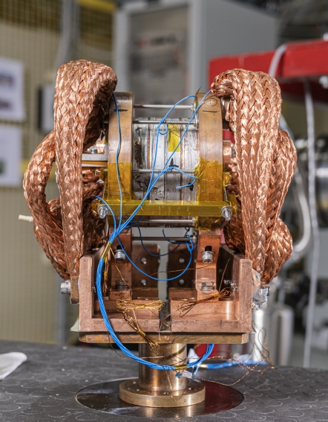
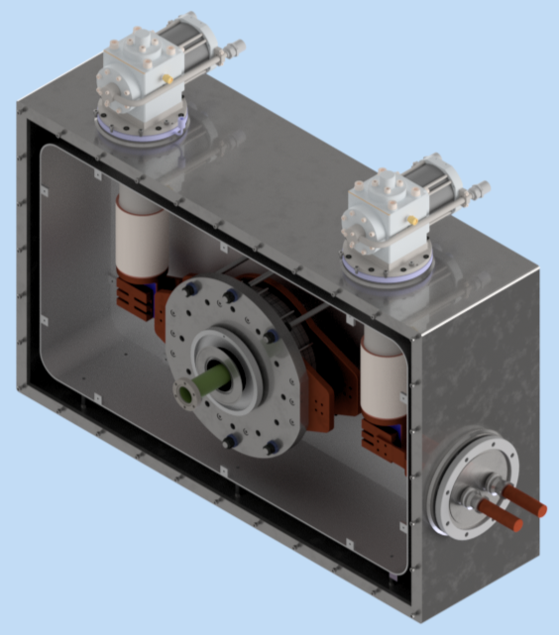
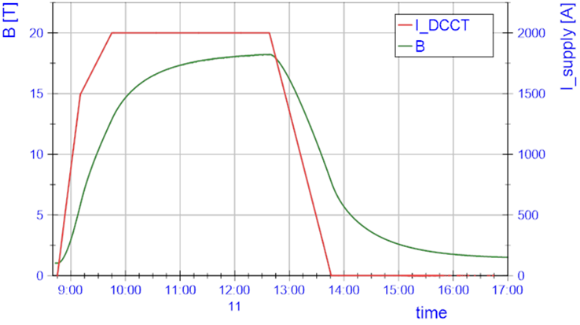
HTS Solenoid as Adiabatic Matching Device (AMD)
HTS demonstrator developed at PSI (left)
    4 ReBCO (Rare-earth barium copper oxide) tape coils at 2kA
    Operation at 18.2 T, on-axis peak
    Temperature 20 – 30 K, no need of He cooling
Technical design of cryostat for P³
in development at PSI (right)
CW operation, ramp-up time of magnetic field ~ 2 days
HTS demonstrator at PSI
(M. Duda et al.)
Preliminary model of the AMD for P³
(H. Garcia Rodrigues)

Slide 6
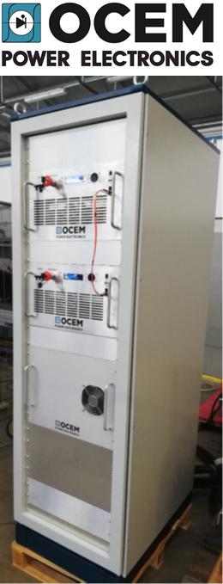
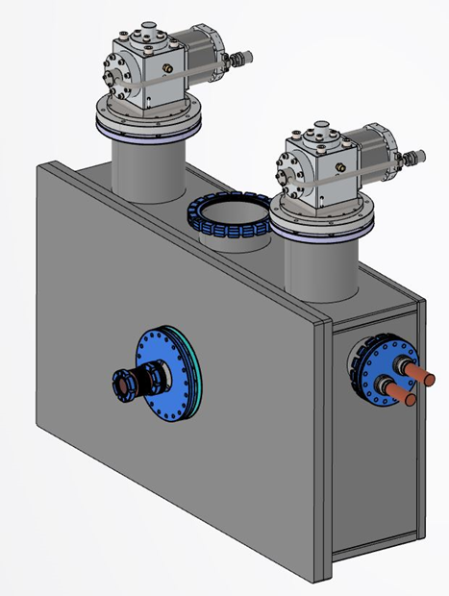
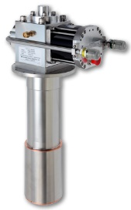

AMD design and procurements
2x cryocoolers RDK-500B 20K
ordered
2.8km HTS tape quotation received
ready to order
2kA power converter quotation received
ready to order
Cryostat thermal model ready
Mechanical design ready at end 2022

Slide 7
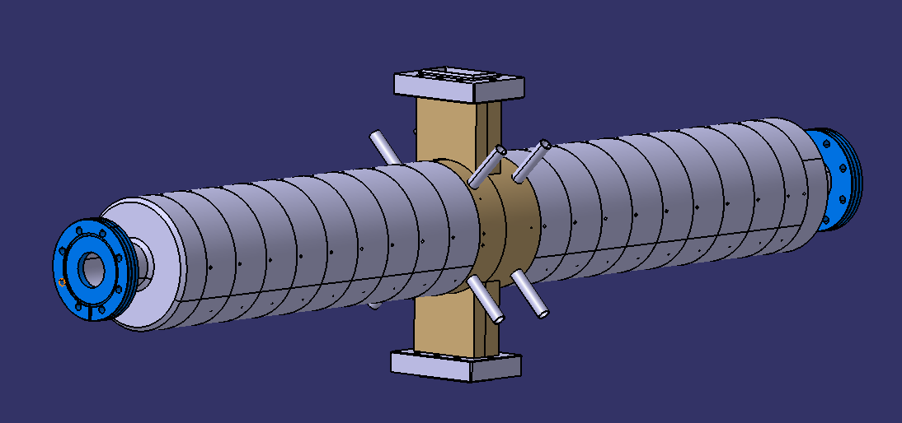
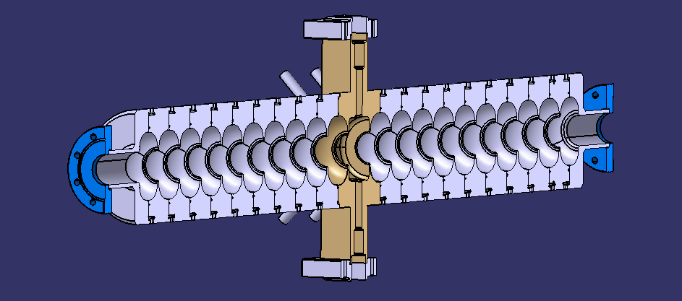
Acc./bunching with RF S-Band SW cavities
Length | 1.2 m
RF Frequency | 2.9988 GHz
Gradient | ~ 18 MV/m
N cells | 21
Q-factor | 21600
R/L | 13.9 MOhm/m
Aperture | 40 mm
Mode Separation | 5.3 MHz (π mode)
Coupling factor | 2
Status:
Cups under production at VDL delivery March/April 2023
Brazing at PSI in May/June 2023

Slide 8
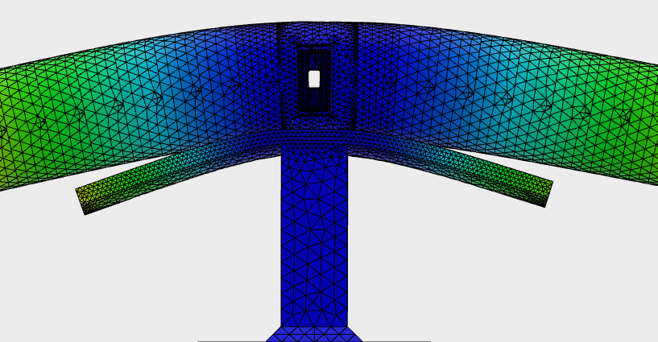
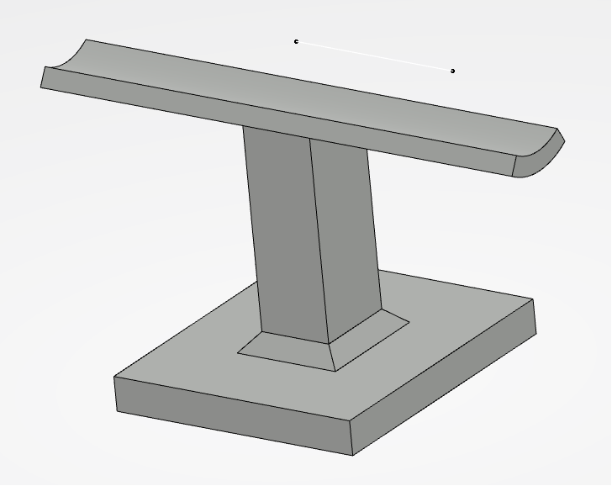
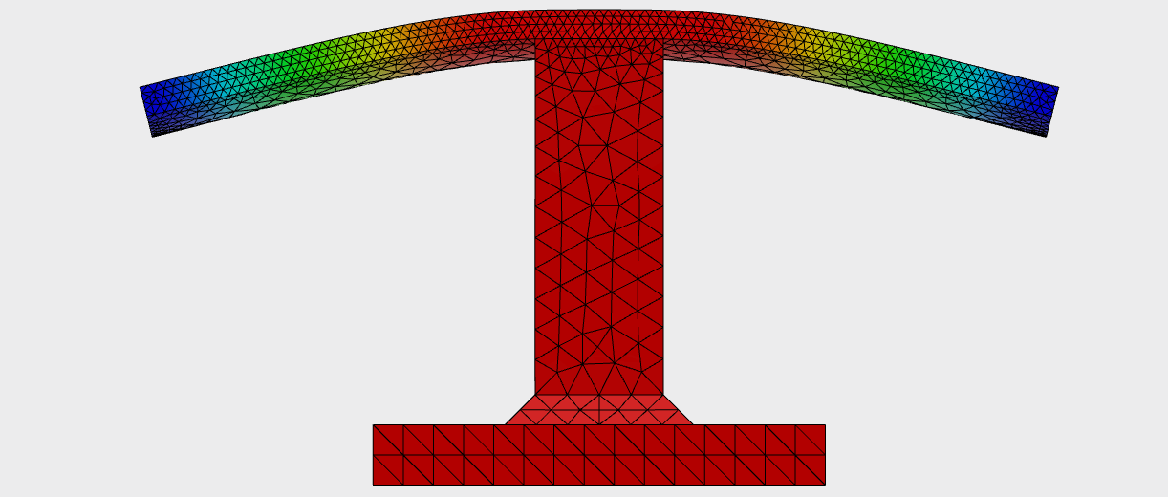
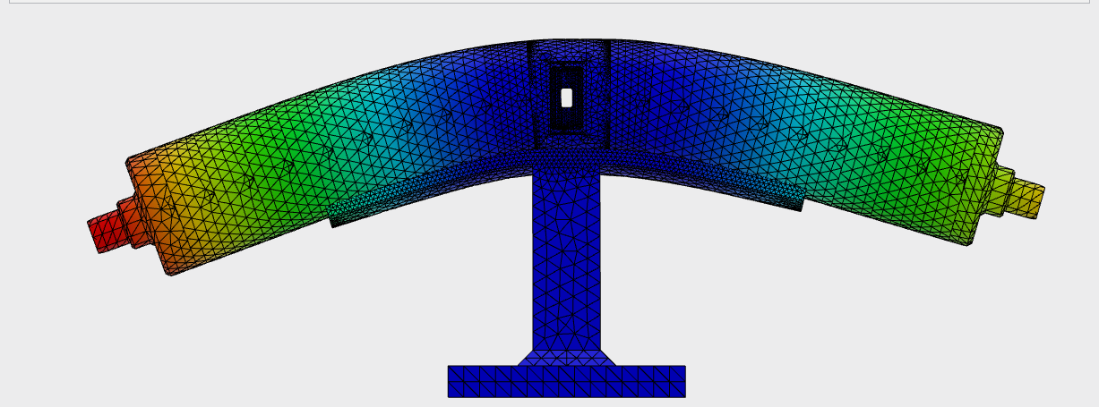
RF cavity support study
Compact design
easy insertion/extraction of NC solenoids with small radius
Uncertainty in the correct Young’s modulus for heat-treated (830 °C) copper
Young's modulus: 60 GPa
Max. deformation 8 μm
Support alone
Max. deformation 5 μm
Young's modulus: 10 GPa
Max. deformation 40 μm
Courtesy of Mattia Schär

Slide 9
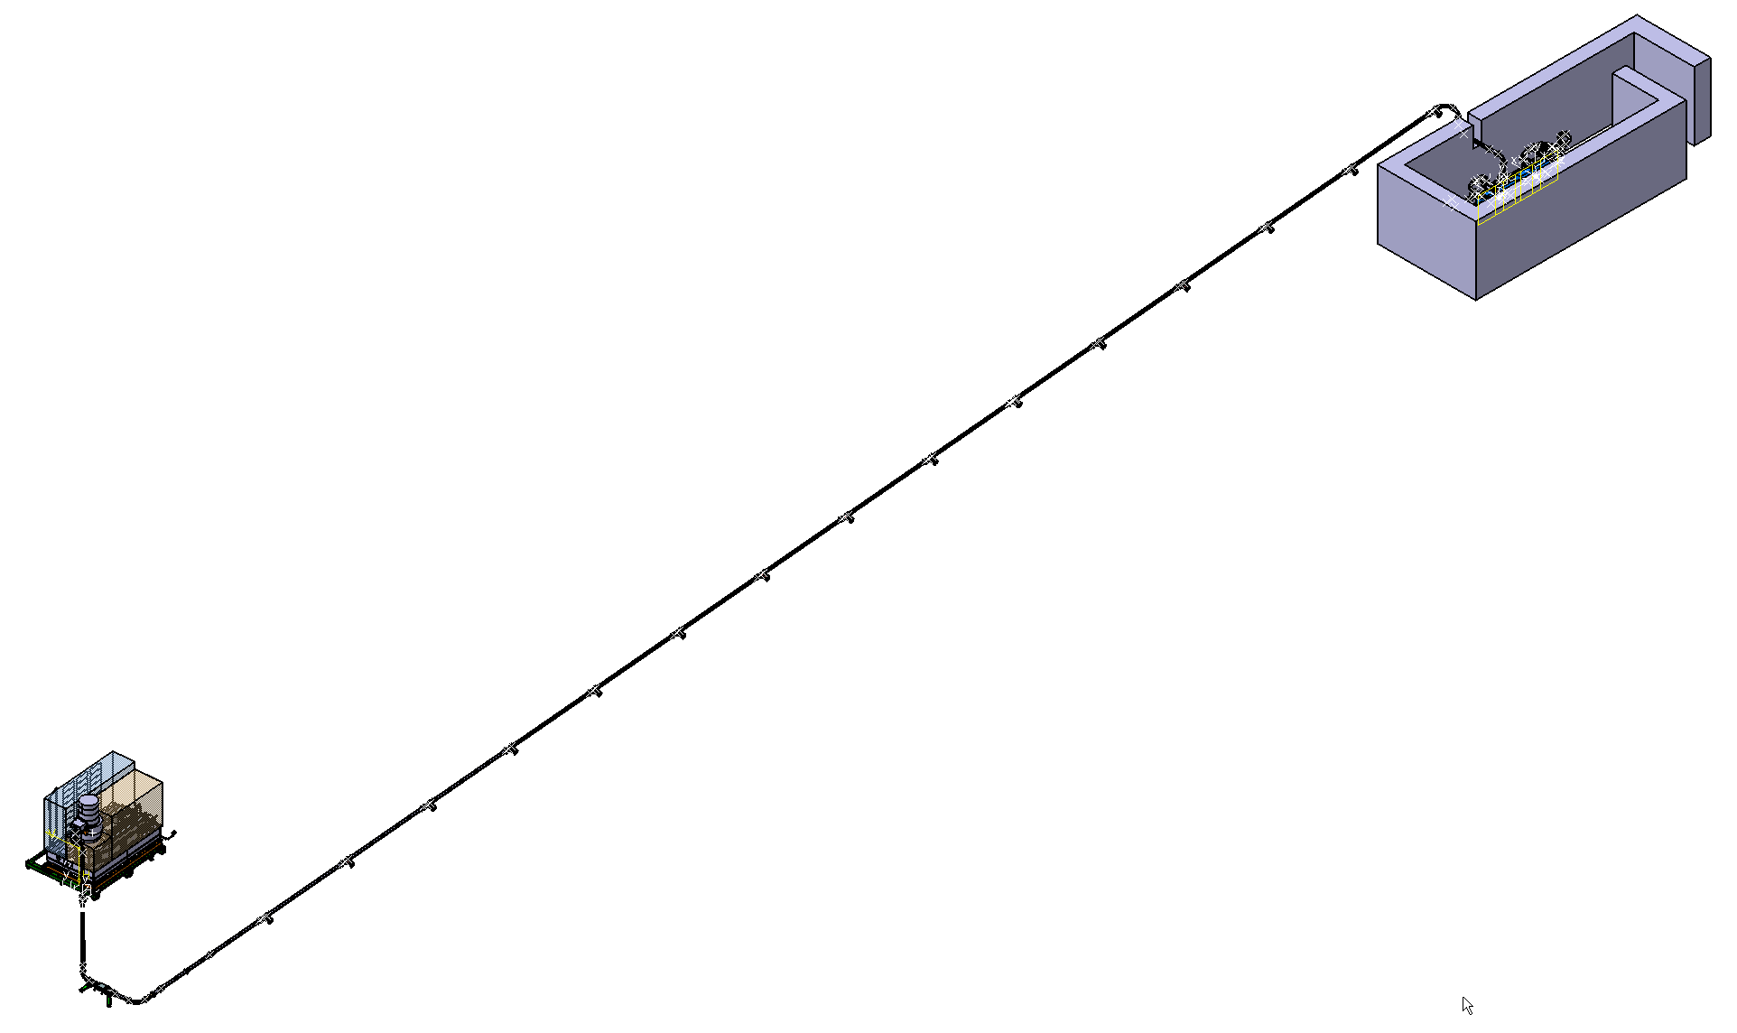
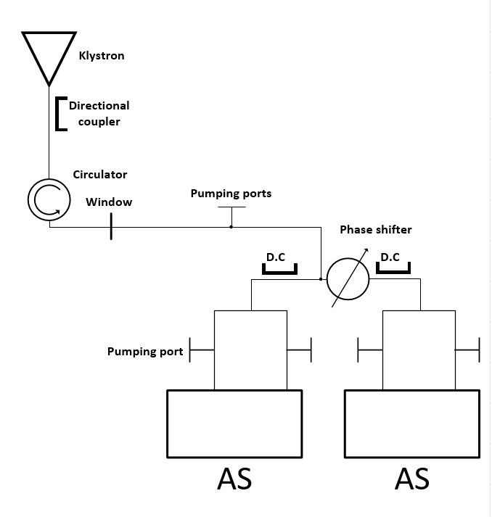
Overview S-Band RF System
Nr | S-band Components | Qty | Units
1 | Splitter | 3 | Pieces
2 | H-bend | 14 | Pieces
3 | E-bend | 11 | Pieces
4 | Directional coupler | 3 | Pieces
5 | Window | 1 | Pieces
6 | Circulator | 1 | Pieces
7 | Pumping port | 4* or 18** | Pieces
8 | Phase shifter | 1 | Pieces
9 | Waveguides | 58687 | Length (mm)
About 59 m waveguides needed,
will be borrowed from CERN
* SF6 vs. ** Vacuum solution

Slide 10
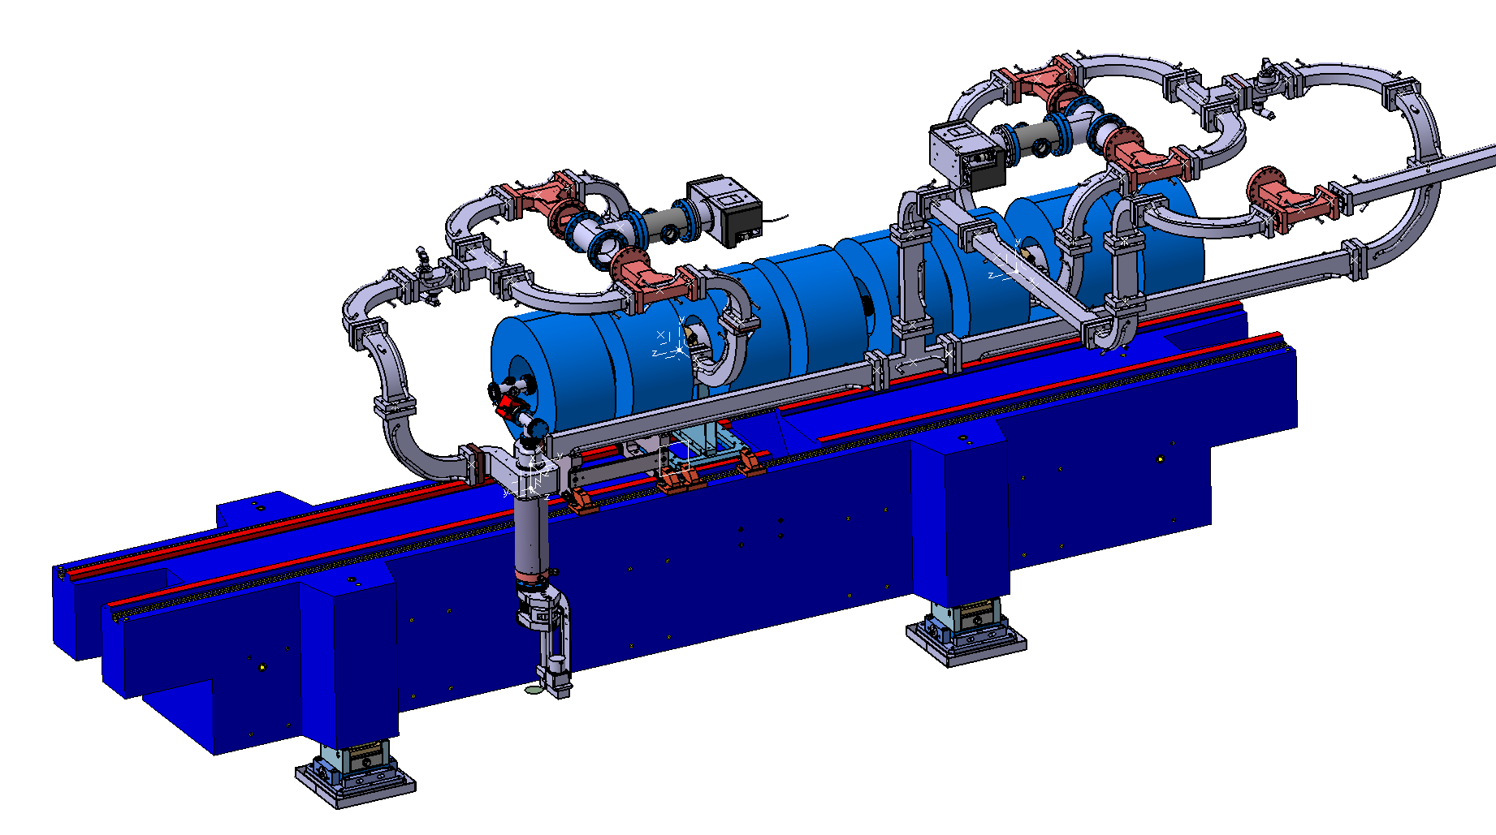
P³ Experiment, S-Band RF Network
Pumping port
Directional coupler
Accelerating structure
Phase shifter
Compact and low waveguide layout to provide the possibility to add shielding on top
The full experiment will be mounted on the girder outside the SwissFEL tunnel

Slide 11
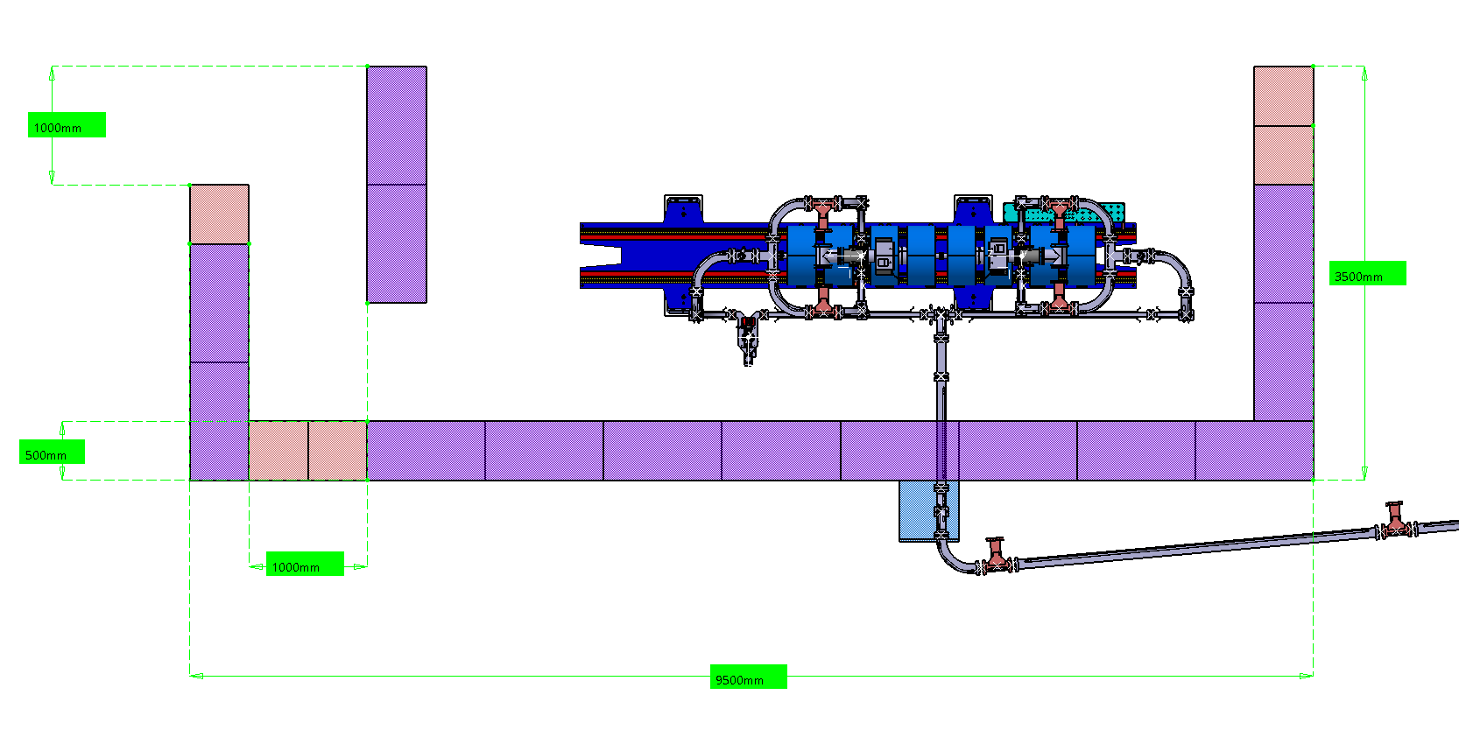
P³ Bunker
Side wall
Chicane will be mounted at the end, really needed?

Slide 12
Radiation and shielding study
Main critically: radiation above the roof
Next step:
Study of the possibility to install the fast scope and solenoid power supply in the tunnel next to the experiment
Probably no need of chicane
Values for 0.2 pC/bunch 1 Hz, 1 bunch/ pulse
Above the roof (including 0.4 m soil)
Neutrons
Limit 1 mSv/h (Tunnel)
Photons
Courtesy of I. Besana
Limit 0.5 μSv/h

Slide 13
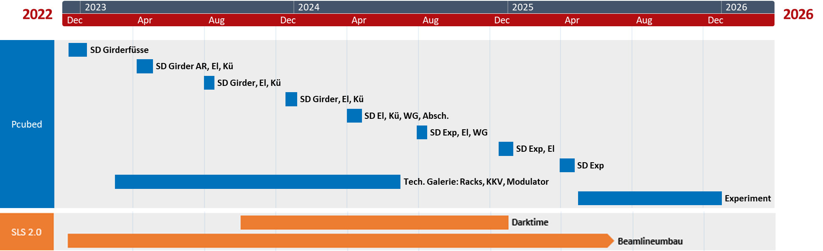
Time Schedule
Q1 2025 cooling water and electricity available to start:
klystron/modulator commissioning (technical gallery)
beam line commissioning (tunnel)
Q3 2025 Start of the experiment
Very limited resources from service groups
2023-2024 Aramis modification and Porthos installation, new girder under production, quadrupoles ordered, dipole yoke modification planned

Slide 14
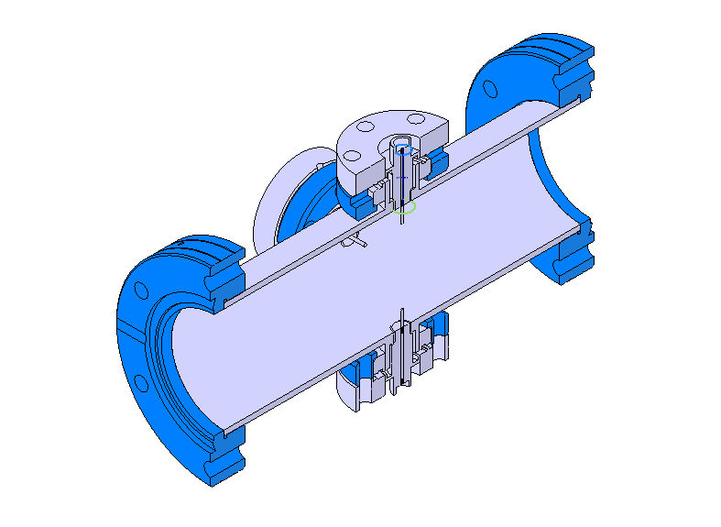
Broadband Pick-Ups
BBPs measure time structure of the beam after second cavity.
Very broad band required to differentiate e+ and e- bunches, separated ~167 ps.
Based on SuperKEKB factory diagnostics [1].
4 Pick-Ups
e+
e-
[1] T. Suwada et al., "First simultaneous detection of electron and positron bunches at the positron capture section of the SuperKEKB factory", Sci. Rep., vol. 11, 2011.

Slide 15
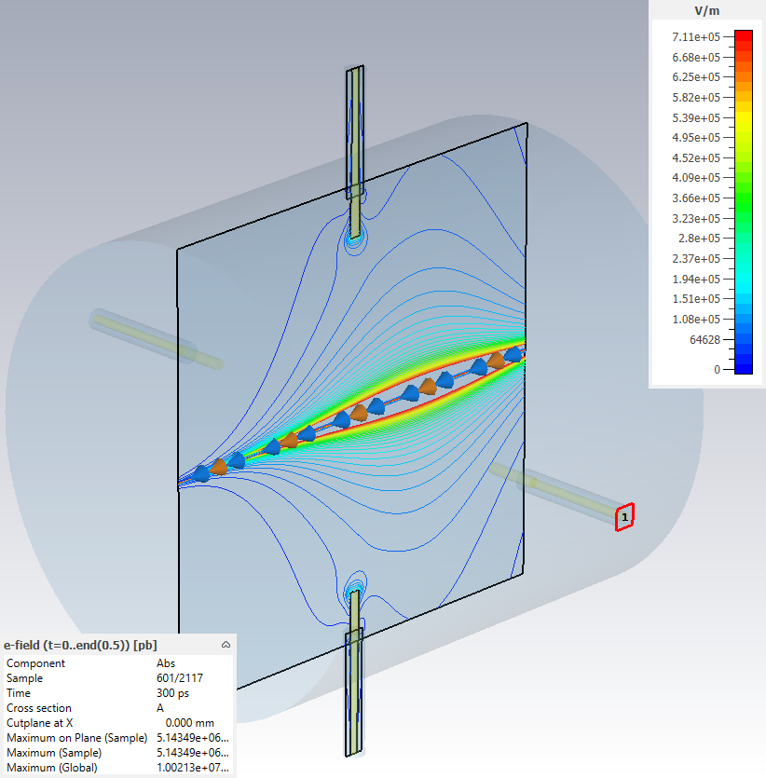
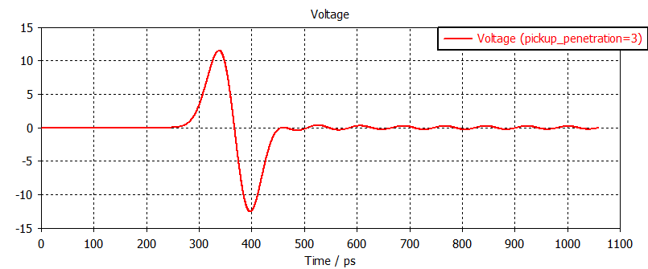
Broadband Pick-Ups 2
A gaussian approximation of the main e+ bunch is simulated with CST wakefield solver over vacuum chamber.
Pick-up geometry optimized:
    Maximum peak voltage
    Minimum signal tail

Slide 16
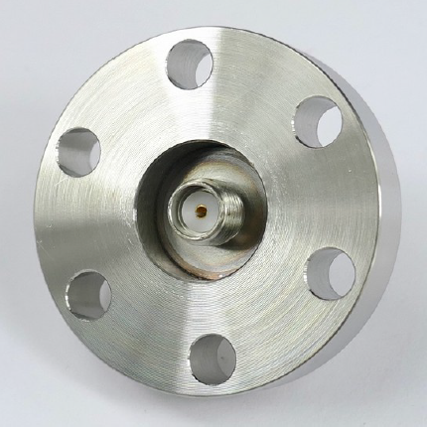
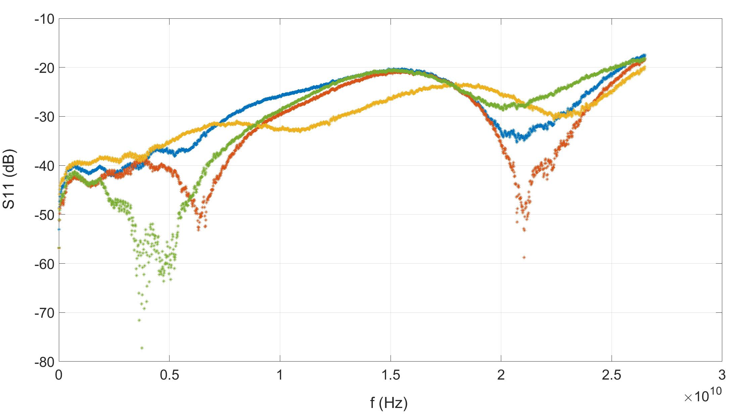
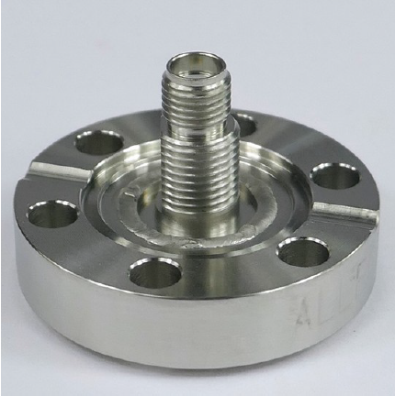
Broadband Pick-Ups 3
First hardware tested for P³
Large bandwidth
(S11<-20 dB 0-20 GHz)
Feedthrough from Allectra GmbH

Slide 17
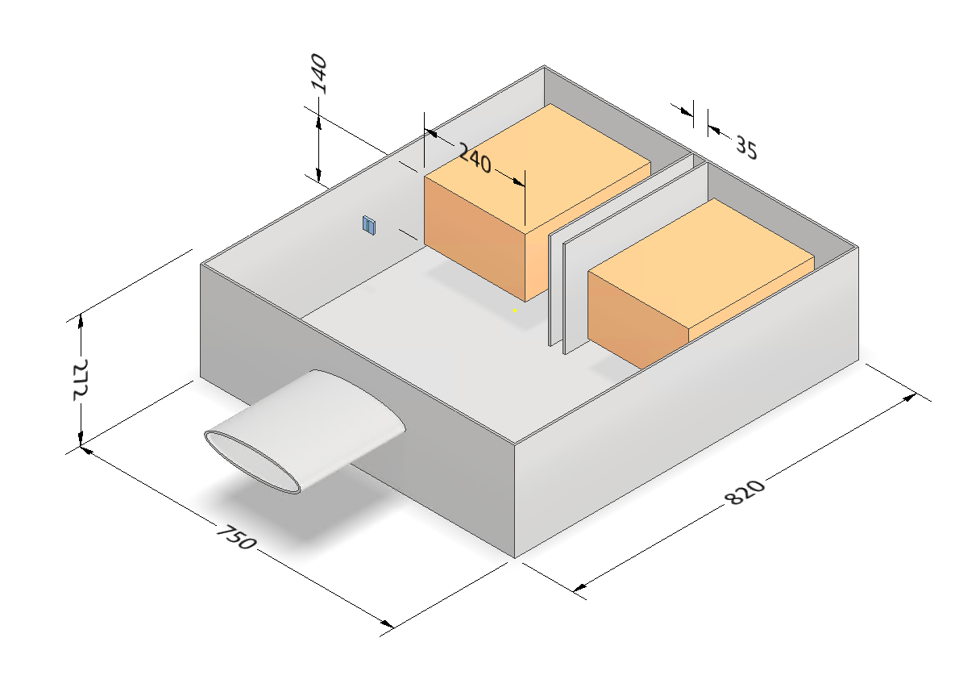
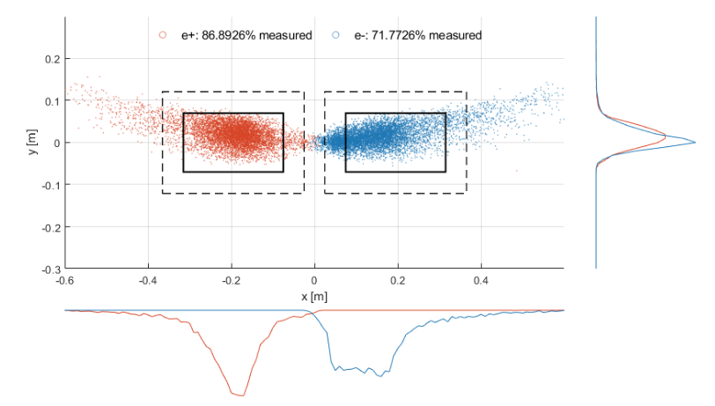
Faraday Cups
Measurement of e+ and e- charge separately.
Alluminum FCs at 25 Ohm. Matching to 50 Ohm through 2 parallel coax cables
Negligible electron backscattering
e+
e-
B
● e+ ● e-
Current dimensions of diagnostics chamber.
e+e- beam at faraday cups

Slide 18
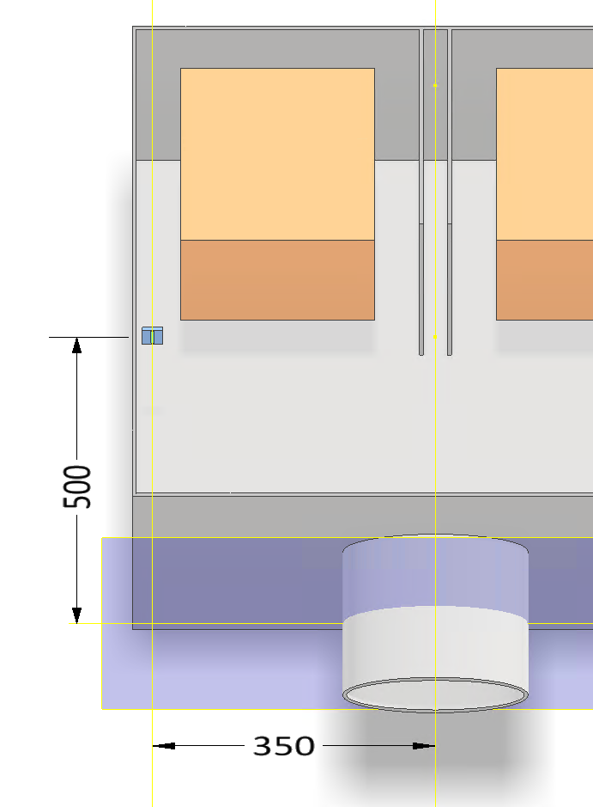
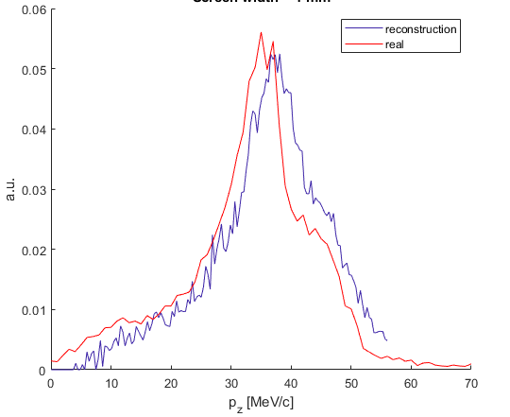
Spectrometer and energy spectrum
Schematic of energy spectrum measurement
Dipole strength scanned to measure e+ energy profile
e+ at different p_{z} detected by scintillating fiber
Test/calibration of the Fiber Q2 next year at the Swiss Federal Institute of metrology (METAS)
Scintillating fiber
e+
B
Pz spectrum reconstruction

Slide 19
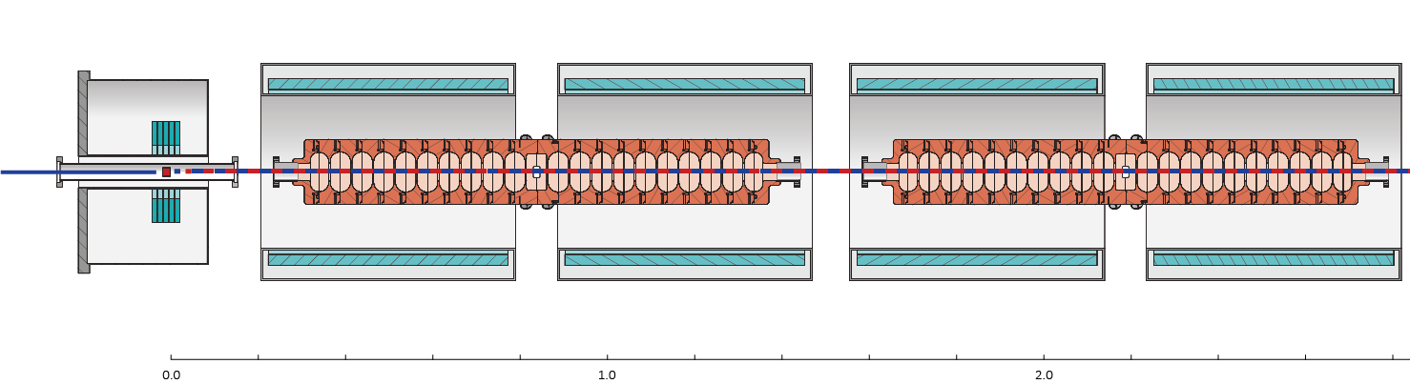
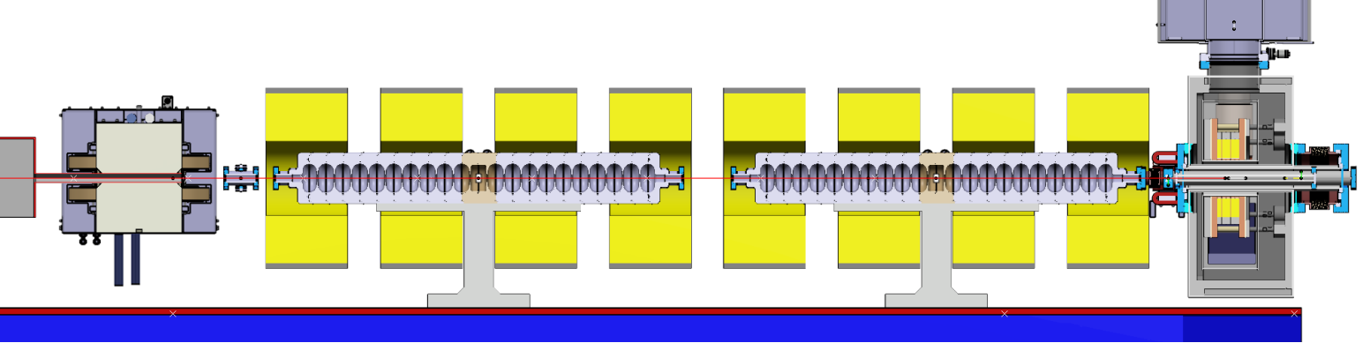
Implementation of NC Solenoids
Superconducting (NbTi, 1.5 T)
Normal Conducting (Copper, 0.4 T)
 | P³ (SC) | P³ (NC)
E_{e-} [GeV] | 6 | 6
Cavity aperture [mm] | 40 | 40
B₀ [T] | 12.7 | 12.7
B_{s} [T] | 1.5 | 0.4
Estimated Yield at DR | Up to 8.0 | Up to 3.69

Slide 20
Implementation of NC Solenoids 2
Implementation of NC solenoids is a turning point in the design:
    Yield at DR decrease
    Re-adjustment of most experiment parameters, particularly the beam diagnostics section (e.g. faraday cup & pick-up dimensions, dipole reference field, etc.)
New parameter optimization, work in progress:
    Geant4 simulations at target
    Transverse beam dynamics: Theoretical and simulation of the AMD
    Longitudinal beam dynamics: Study of RF phase working points

Slide 21
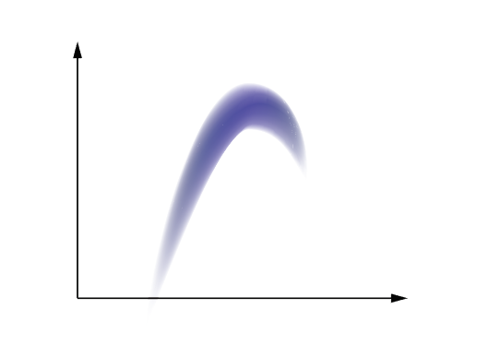
Estimation of Yield at DR
~0 – 200 MeV: ASTRA particle tracking over 10 RF Cavities.
    Phases of 2 first cavities are free parameters
    Rest of 8 cavities on crest
~200 MeV – 1.54 GeV:
    Electron removal at 200 MeV
    Analytical transformation of positron distribution up to 1.54 GeV.
1.54 GeV: DR acceptance window.
    +-3.8 % in energy
    One RF bucket length (+- 5 cm) in z
E
1.54 GeV
+/- 3.8 %
λ
Impression of the a e+ beam at entrance of DR
and DR acceptance window

Slide 22
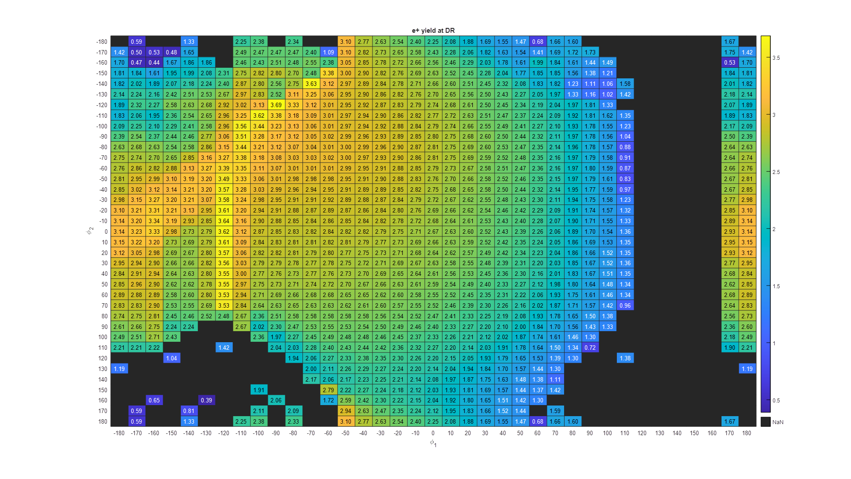
Yield at DR
(-90, -120)
(-160, 0)
(-160, 0): Preferred working point
(-90, -120): Max. Yield.

Slide 23
(-160, 0): Preferred
(-90, -120): Max. Yield
 | Yield at DR | 3.34 | 3.69
@ 200 MeV | Capture efficiency | 27.46 | 30.89 | %
 | Energy Spread | 36.93 | 40.73 | MeV
 | Norm. emittance | 5181 | 5133 | pi mm mrad

Slide 24
(-90, -120): Max. Yield at DR
Low energy
e+ and e- completely overlapped!

Slide 25
(-160, 0): Preferred working point
High center-of-bunch energy
Reasoably high capt. efficiency
Excellent bunching
But first bunch very close!

Slide 26
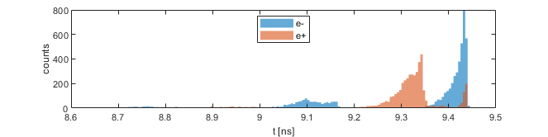
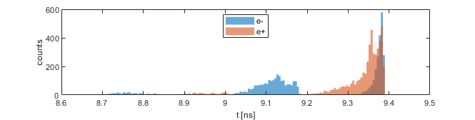
Recap
RF phase scan combined with BBP measurements can provide a direct observation of the positron capture.
Several issues to be considered in BBP design:
    First and second bunches can be very close to each other
    Overlapping of e+ and e- can happen.
(-160, 0): Preferred
(-90, -120): Max. Yield

