Slide 1
Overall Status and Parameters Optimization
Paolo Craievich (PSI) on behalf of the CHART/FCCee Injector design collaboration
FCCee Injector Studies Mini-Workshop, IJCLab Orsay, 24 and 25 November 2022

Slide 2
Concluding remarks 1/7
Overall status and parameters optimization (Booster and injection time)
Excel table with parameters on the CERN collaborative workspace
Main changes: normalized emittance at linac end 10x10 mm mrad
Charge to be injected into the collider: 4 nC
Transfer lines to and from SPS not in FCC pre-injector studies. How to use the SPS with electrons and positrons will be clarified by another working group.
The top-up operation needs to be clarified in order to define the lower limit in the charge variation, which currently ranges from 0 to 100%. This requirement comes from the different lifetimes of the individual bunch in the collider. However, the requirements for bunch intensity variation at the injector will have to come from the 'measurements' in the collider rings (24 s before the injection)
The question of the use of DR for electrons remains open. The location of the damping ring will be decided according to the performance of the transfer line for positrons.
A possible solution with a DR at a higher energy (~2.8 GeV) and without a positron/electron transfer line was proposed to overcome several open issues

Slide 3
Concluding remarks 2/7
WP1: Electron source and Linacs
Simulations to change the charge bunch-by-bunch have shown that it is possible, e.g., by changing the charge density at the cathode, but clearer specifications on the top-up are needed, e.g., what is the average charge of the bunch? Discussions with laser experts are needed to meet this requirement.
The specifications for injection into the booster ring (BR) can be met by considering an energy compressor in the transfer line between the injector and the BR. This solution should be studied at 20 GeV.
With this energy compressor, the design of the linac can converge to a solution without bunch compressor and decompression in the linac itself. Option 5 in Simona's slides could be the solution for both the common linac and the high-energy linac
Target energy spread 0.1% (rms). Higher or smaller can give issues in the BR.
Design chicane to separate positron and electron, first trial will be in the matching section at 780 MeV.

Slide 4
Concluding remarks 3/7
WP4: DR and transfer lines
The acceptance of DR is one of the main problems now. Mattia and Antonio showed that the acceptance of DR is very low and does not meet the specifications for FCCee. This problem has a big impact on both the positron source and the design of the DR.
Damping time 7.5 ms (clarify with Tor the motivation), normalized emittance 5 um at equilibrium, in the current specification presented by Ozgur it is 6.5 um.
A new 'simplified' layout is being worked on at 1.54 GeV.
Collective effects need to be reconsidered based on the new parameters.
Beam loading with non-uniform DR filling (impact on RF power?)
It is necessary to freeze a layout in order to begin more detailed studies.

Slide 5
Concluding remarks 4/7
WP3/WP6: Positron source and p-cubed experiment
New specification for positron target: 4nC/bunch x2 safety margin (due to experiences at SuperKEKB where they have up to 10 nC/bunch of electrons -> 3.5 nC at the linac end (yield 0.35)
Next step: include the magnetic field of the AMD in the simulations of the target.
Potentially less divergence of the initial positron distribution, to be verified!
P-cubed experiment: one of the main goal is the benchmark with simulations for FCCee. We must test as many working points as possible.
List of open points in Iryna's slide
For the mid-term review, we need to reconsider a solution with FC and compare it with the current one using an SC solenoid.

Slide 6
Concluding remarks 5/7
WP3/WP6: Positron source and p-cubed experiment (cont’d)
Radiation Load studies: beam power 13.34 kW (2x200Hzx6GeVx5.56nC)
AMD & Target:
Coils: power density is below critical values, DPA and dose must be understood if they are acceptable
Target: 13.34kW beam power leads to critically high heat load and DPA ➔ solution pending
ILC target: same problems with radiation load studies
SuperKEKB: shorter accelerating structures just after the target can help to avoid discharges
Integrated charge for each mode is necessary to estimate the correct DPI, 8 DPA is a large number.
First rf structure must dissipate up to 170W (mainly in the thin iris)

Slide 7
Concluding remarks 6/7
WP3/WP6: Positron source and p-cubed experiment (cont’d)
Target design and integration :
Power dissipated 3.6kW! (factor 4 more than previous spec ~0.9kW) → preliminary design BUT significant thermal gradients and thermal stresses
W-Cu model (SuperKEKB, ITER) can help with a right cooling channels
Ingredients for “sustainable” Target systems: guideline for the bunker around the positron source
An initial assessment of radiation levels must be carried out to define shielding.
Work must be done on the integration of the beamline equipment into its surroundings.
FCCee Positron capture:
maximum yield is not obtained accelerating on-crest after 200 MeV (using an analytical approximation for the longitudinal beam dynamics)

Slide 8
Concluding remarks 7/7
WP3/WP6: Positron source and p-cubed experiment (cont’d)
Optimization of the capture section:
Substantial emittance dilution after a chicane at 200 MeV for the separation of electron and positron
A working point with almost all positrons in one rf bucket, necessary a comparison with Yonke’s, Nicolas’ results.
shorter rf accelerating structures and “ideal” magnetic field profile can provide a higher yield (~8) if compare the present one (~6.5)
Hybrid scheme: a solution with a crystal could be extremely interesting if the deposited power on the target will be critical in the conventional scheme
As deliverable for the review, we must provide a cost estimate for the injector. So, after the design phase we must start with a cost model for the different part of the injector!

Slide 9
Additional information
Questions from Anton:
*) What is the acceptable power load to the RF cavities? In particular, is there a limit on the total power per cavity and, secondly, is there a limit concerning the local power density in the cavities?
*) What is the acceptable power load to NC solenoid around the e+ linac, both in terms of total power and power density?
*) Is there any organic material used in the NC solenoid (e.g insulation, spacers etc.) which could suffer from long-term radiation damage?
Answer from Alexej:
Concerning the transverse dimensions of the RF structure and the power load, please find presentation of Hermann where this has been discussed https://indico.cern.ch/event/1140849/
Although the geometry was Optimized for fitting into the aperture of the quadrupole, you can estimated the wall thickness of the structure with the integrated cooling channel to be about 35 to 55 mm.
Preliminary thermal simulation have been done for average power loss pers RF cell (that is what Barbara calls cavity in her talk) of 126 W. The heist power shown by Barbara is 170W is a bit higher than this but it is only fir a few RF cells. On the contrary the RF power loss will be similar in all cells. So I think it is fare to say that in the first RF structure (44 RF calls) the average power load from the RF and from the beam loss are comparable. It must certainly be studied in more detail and adequate cooling design must be implemented, but I do not think that there is any showstopper.

Slide 10
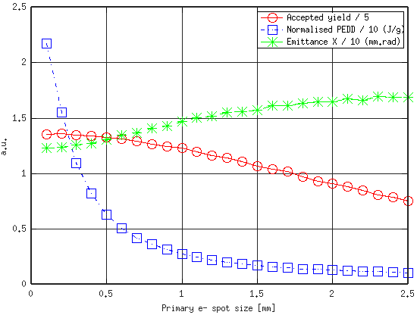
Additional information
Scan of beam size for FCC-ee, using HTS AMD + R30 L-band to 200 MeV + Constant 0.5 T Bz (by Yonke):

Slide 11
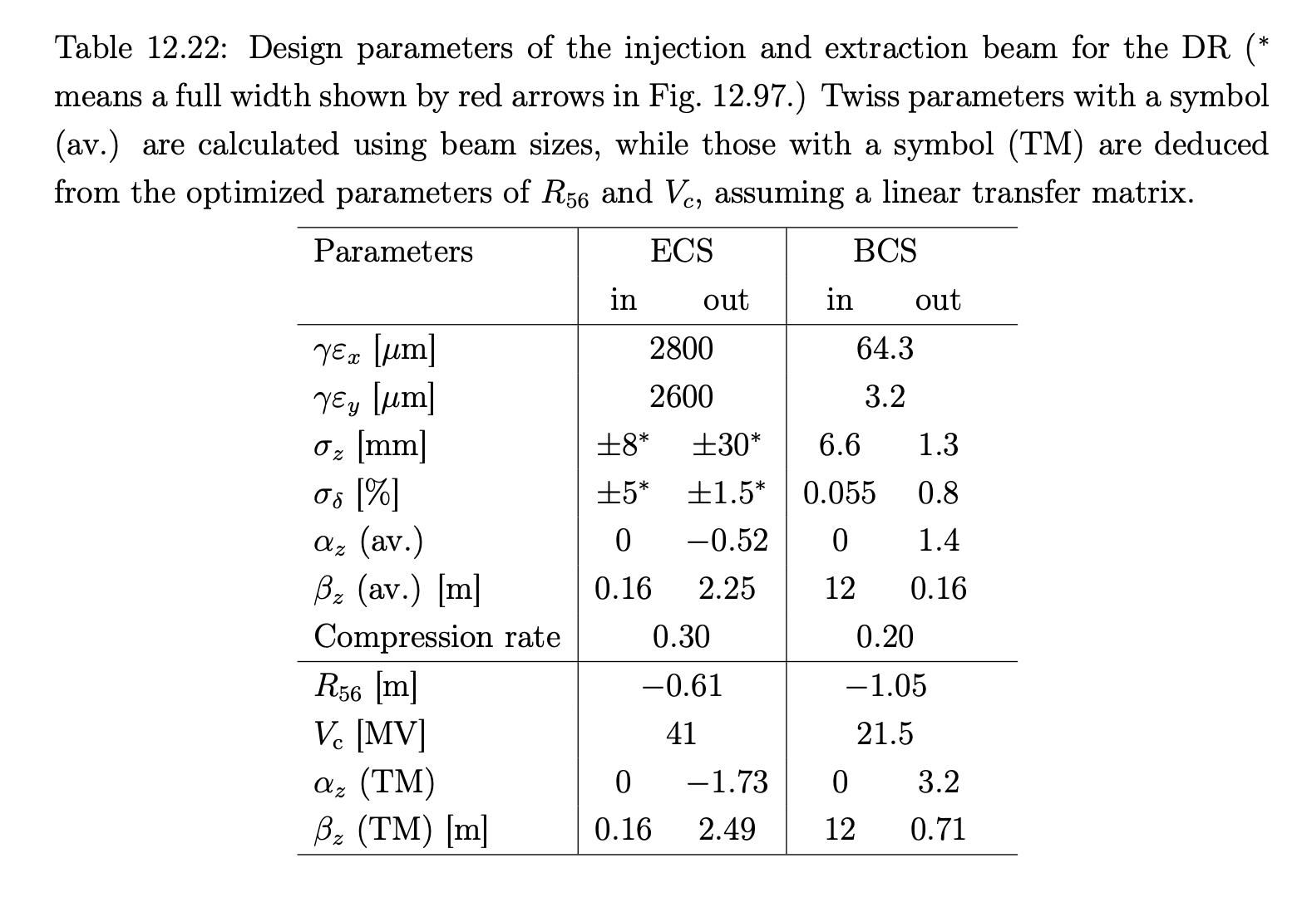
Additional information
SuperKEKB Design report: https://www-linac.kek.jp/linac-com/report/skb-tdr/12_DR_Reviced2020_10_20.pdf, thanks to Enomoto-san and Iida-san

