Slide 1
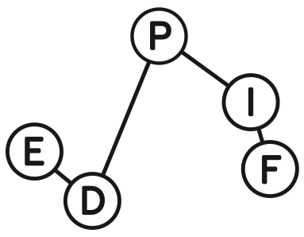
Doctoral School « Physique en Île-de-France » ED PIF
ED564 : PSL – SU – UP – UPSaclay
https://www.edpif.org

Slide 2
General presentation
The Doctoral School, or "École Doctorale Physique en Île-de-France", is formally hosted by
Université PSL,
and driven jointly with the universities:
Sorbonne Université (SU),
Université de Paris (UP),
Université Paris-Saclay (UPSaclay).
The broad scientific scope of the EDPIF includes many aspects of fundamental physics, theoretical and/or experimental: the physics of fundamental interactions, quantum physics of dilute or condensed matter, statistical physics, soft matter and biophysics, as well as fundamental topics in optics, acoustics and hydrodynamics.
The EDPIF hosts around 700 PhD candidates preparing their doctorate in more than 50 laboratories throughout the Paris region (both center and south area), with more than 800 researchers involved in thesis supervision.

Slide 3
How to apply ?
Thesis proposals can be found on the EDPIF website: https://www.edpif.org/en/recrutement/prop.php
The first thing to do is to contact personally the PhD advisor !
Once you agree with the PhD advisor, you should apply on his/her subject on the EDPIF website: https://www.edpif.org/en/recrutement/candid.php
Remark: in some particular cases, when the funding is requested directly to Paris-Saclay, you will need also to apply on ADUM. Your future supervisor should tell you if it is the case

Slide 4
Funding of the PhD
You must have sufficient funding for the 3 years of the PhD
➔ 2 possibilities:
The subject is already funded or you have your own funding ➔ no specific deadline
Otherwise, you should go through the EDPIF competition to get a doctoral contract
Remark: 46 doctoral contracts were given through the EDPIF competition in 2022 (9 in UPSaclay, 9 in PSL, 18 in SU, 10 in UPCité)
➔ most EDPIF PhD students are in case 1. (other types of funding)

Slide 5
The EDPIF competition
Submission of applications on the EDPIF website: https://www.edpif.org/en/recrutement/candid.php Deadline: May 10 2023
Selection of a shortlist of candidates for an interview Dates of the interviews: June 6-8 2023
After the interviews, the selection committee establishes a ranking consisting of a main and a supplementary list. This ranking should then be approved by the council of the ED on June 12 2023
Applicants are notified individually by email and by posting on the website of the ED

Slide 6
More about the Interview
Candidates have ten minutes to present themselves, with particular emphasis on their past research activities (internships). A maximum (indicative) of two slides must be devoted to the presentation of the thesis subject.
The selection committee questions the candidates for about five minutes.
It is not yet decided whether the interviews will be or not in videoconference this year. Anyway, applicants who cannot be present on the day of the interview can make their presentation by videoconference.
Candidates can speak in English or French, as they prefer.
The members of the selection committee are issued from all the scientific themes of the ED. Be pedagogical in your presentation !

Slide 7
To conclude
All the information can be found on the EDPIF website:
https://www.edpif.org/en/
Contact for Paris-Saclay:
Deputy-director: Véronique Terras
Assistant: Sabine Hoarau
Contact email: edpif.upsaclay@edpif.org

